Slide 1
The African Monsoon Recent Evolution and Current Status Include Week-1 and Week-2 Outlooks
Update prepared by
28 June 2021
For more information, visit:
http://www.cpc.ncep.noaa.gov/products/Global_Monsoons/African_Monsoons/precip_monitoring.shtml

Slide 2
Outline
Highlights
Recent Evolution and Current Conditions
NCEP GEFS Forecasts
Summary

Slide 3
Highlights: Last 7 Days
During the past 7 days, in East Africa, rainfall was above-average over southern Sudan, northern South Sudan, and parts of western Ethiopia and Uganda. Below-average rainfall was observed over pockets of central southern Sudan. In Central Africa, rainfall was below-average over parts of central and northern DRC, and pockets of CAR. Above-average rainfall was observed over parts of eastern DRC. In West Africa, above-average rainfall was observed over pockets of Guinea, Sierra Leone, central Guinea, southern Mali, Burkina Faso, northern Benin, and parts of Nigeria. Below-average rainfall was observed over Liberia, southern Cote d’Ivoire, Ghana, Togo and southern Benin.
Week-1 outlooks call for an increased chance for above-average rainfall over Guinea-Bissau, Guinea, Sierra Leone, Liberia, southern Cote d’Ivoire, southern Nigeria and Cameroon. In contrast, there is an increased chance for below-average rainfall over southern Burkina Faso and northern Ghana.
Week-2 outlooks call for an increased chance for below-average rainfall over southern Senegal, southern Mali, Burkina Faso, western Niger, and northern DRC. In contrast, there is an increased chance for above-average rainfall over Sierra Leone, Liberia, western Cote d’Ivoire, and western Ethiopia.

Slide 4
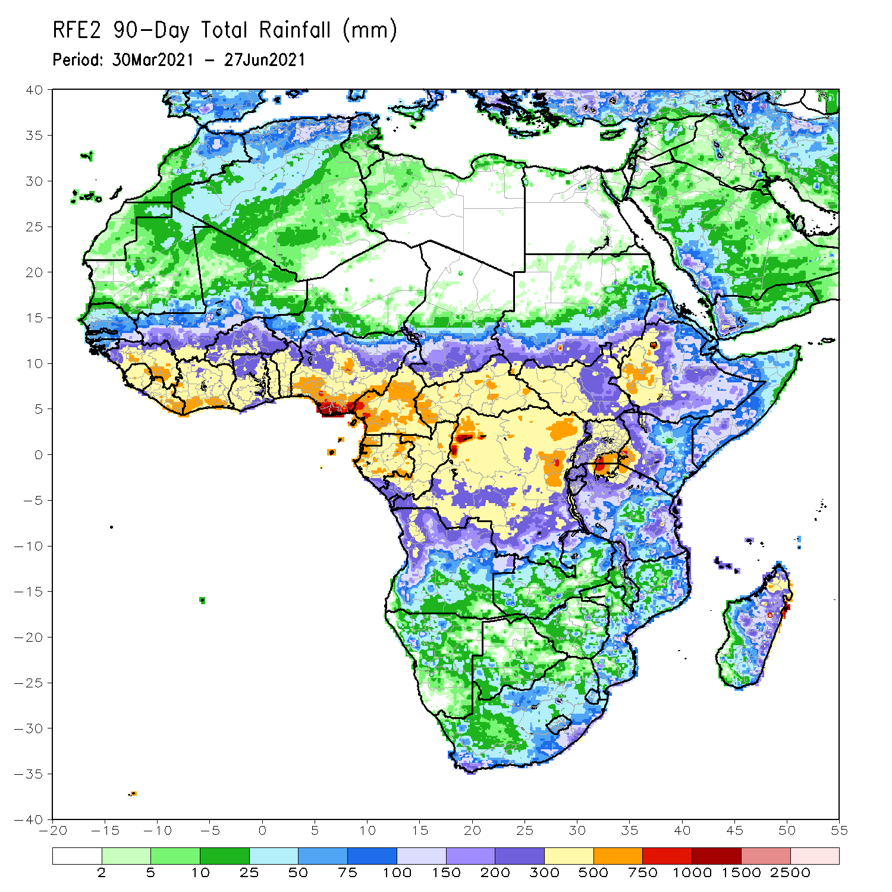
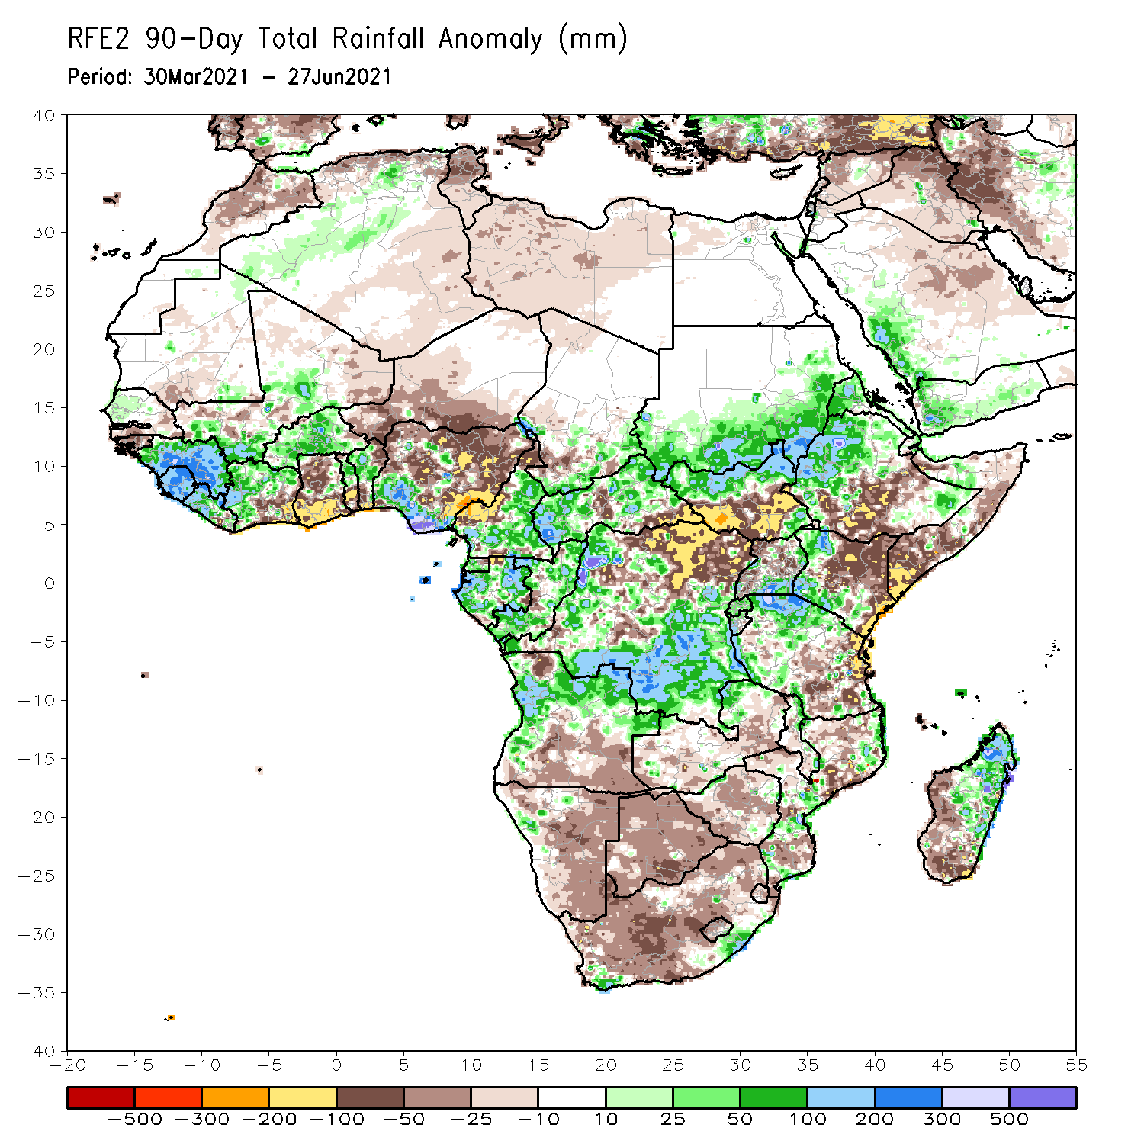
Rainfall Patterns: Last 90 Days
Over the past 90 days, in East Africa, above-average rainfall was observed over western Ethiopia, northern South Sudan, southern and eastern Sudan, Eritrea, southern Uganda, pockets of southeastern Ethiopia, western Kenya, and northern Tanzania. Rainfall was below-average over parts of southern Ethiopia, central and southern Somalia, and central and eastern Kenya. Rainfall was also below-average over southern South Sudan, northern Uganda and southern Tanzania. In southern Africa, above-average rainfall was observed over the far northern Southern Africa, while below-average rainfall was observed over the central and southern portions of Southern Africa. In Central Africa, rainfall was above-average over central and southern DRC, Equatorial Guinea, Gabon, Congo, and much of CAR. Rainfall was below-average over northeastern DRC, pockets of central CAR, and western Cameroon. In West Africa, rainfall was above-average over much of Guinea, Sierra Leone, much of Cote d’Ivoire, Burkina Faso, northern Benin, and southern Nigeria. Below-average rainfall was observed over eastern Liberia, southern Cote d’Ivoire, Ghana, southern Togo, southern Benin, Niger, and northern Nigeria.
Notes:
4

Slide 5
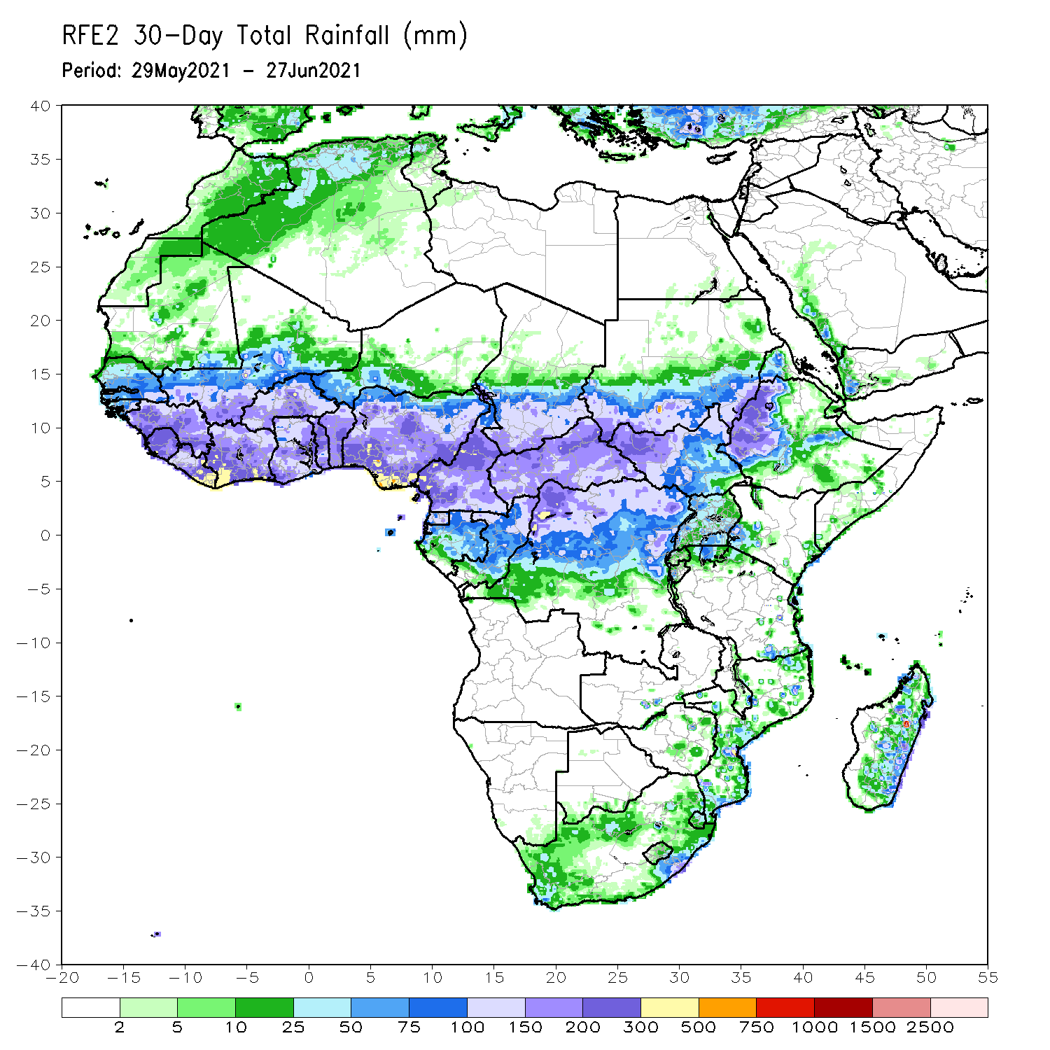
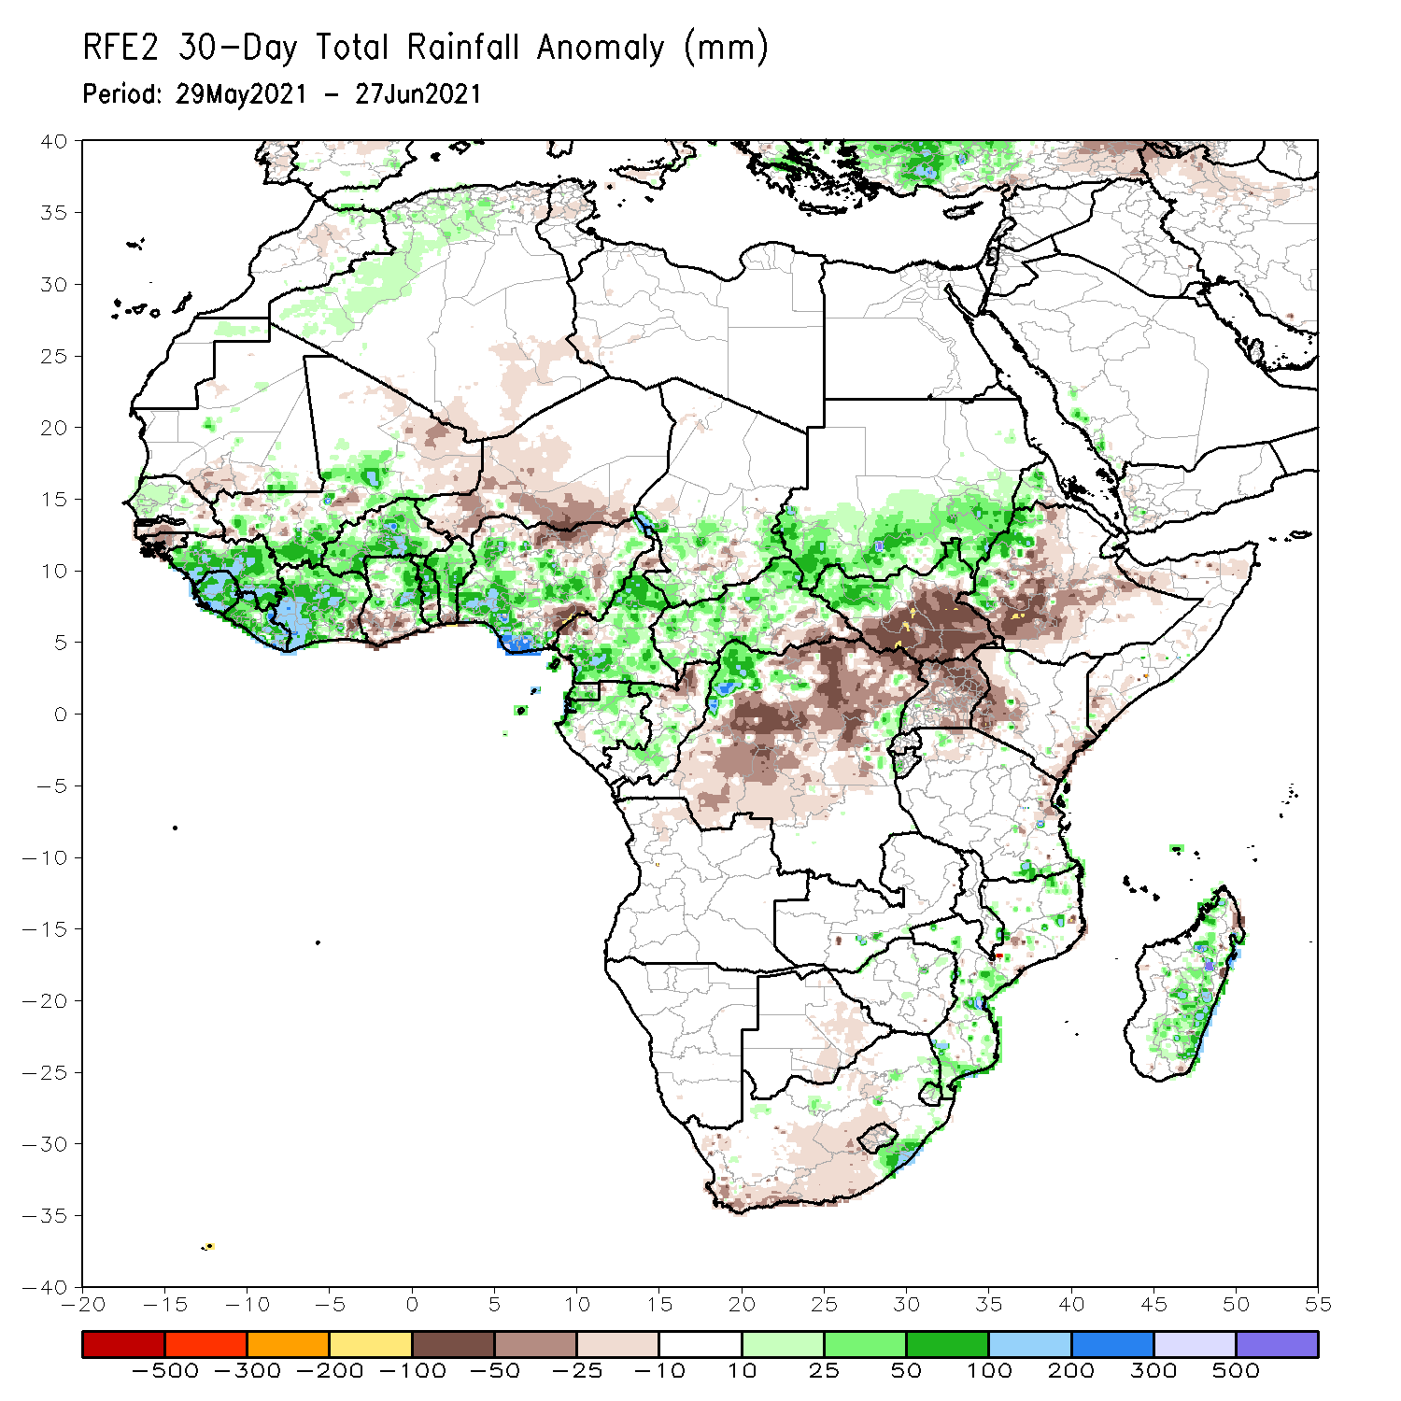
Rainfall Patterns: Last 30 Days
During the past 30 days, in East Africa, above-average rainfall was observed over the southern and eastern parts of Sudan and northern South Sudan Republic. Rainfall was below-average over southern South Sudan, many parts of Ethiopia, Uganda, Kenya and Somalia. In Central Africa, rainfall was below-average over parts of central and northeastern DRC. Rainfall was above-average over Equatorial Guinea, Gabon, Congo, much of CAR, and northwestern DRC. In West Africa, rainfall was above-average over parts of Senegal, Guinea, Sierra Leone, Cote d’Ivoire, Burkina Faso, much of Ghana, Togo, Benin, and many parts of Nigeria. Below-average rainfall was observed over Guinea-Bissau, southern Ghana and portions of Niger, and pockets of Nigeria.
Notes:
5

Slide 6
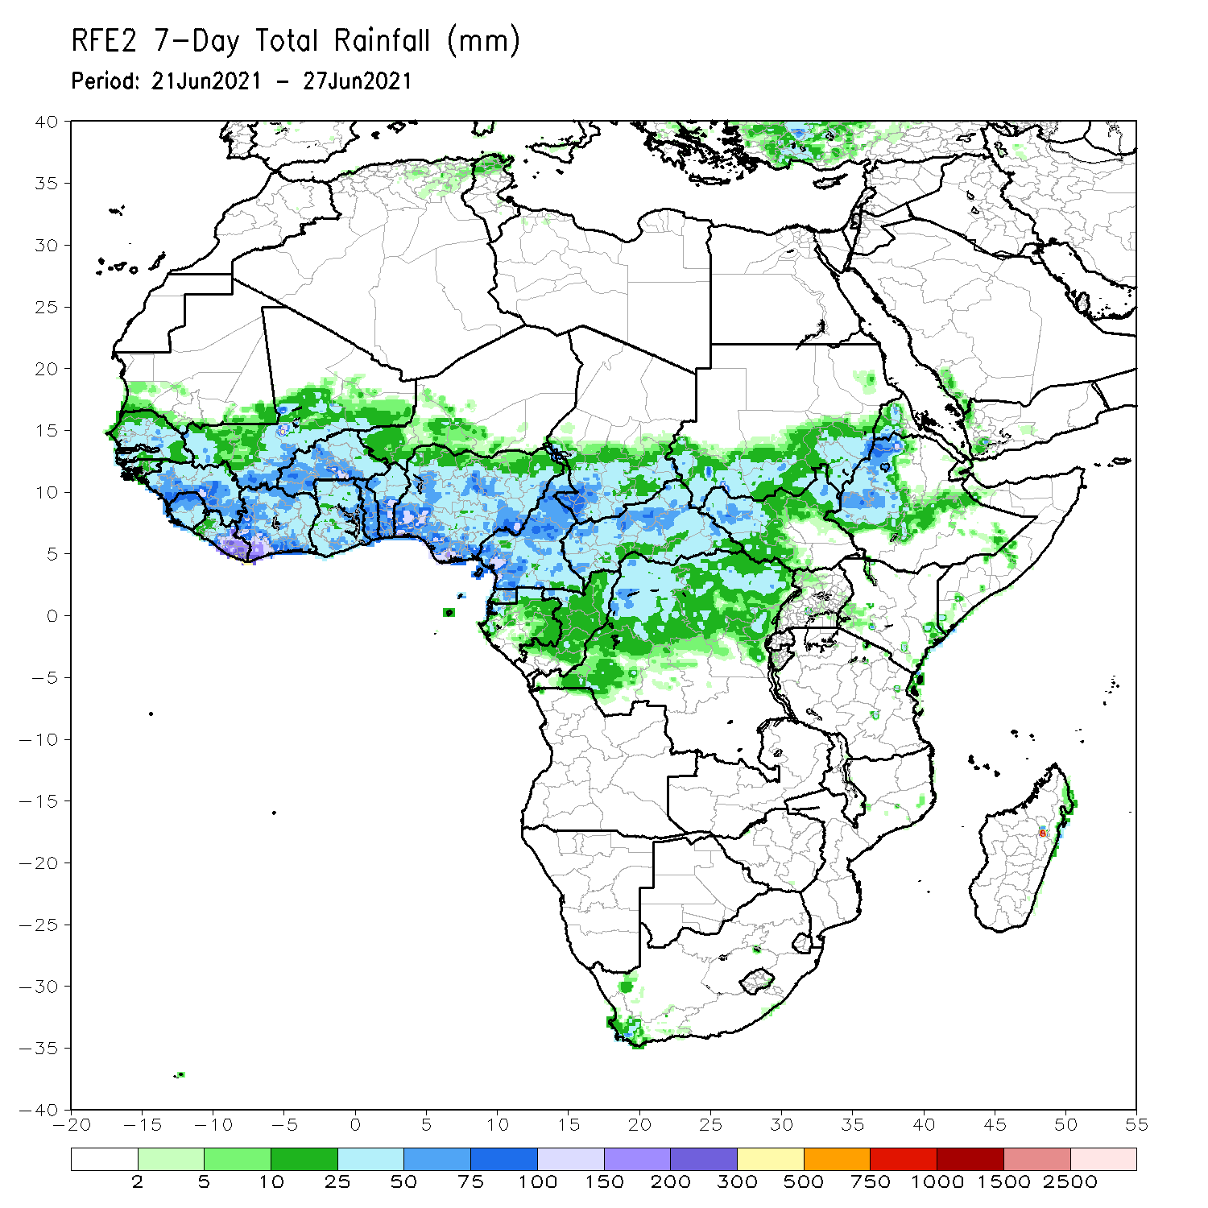
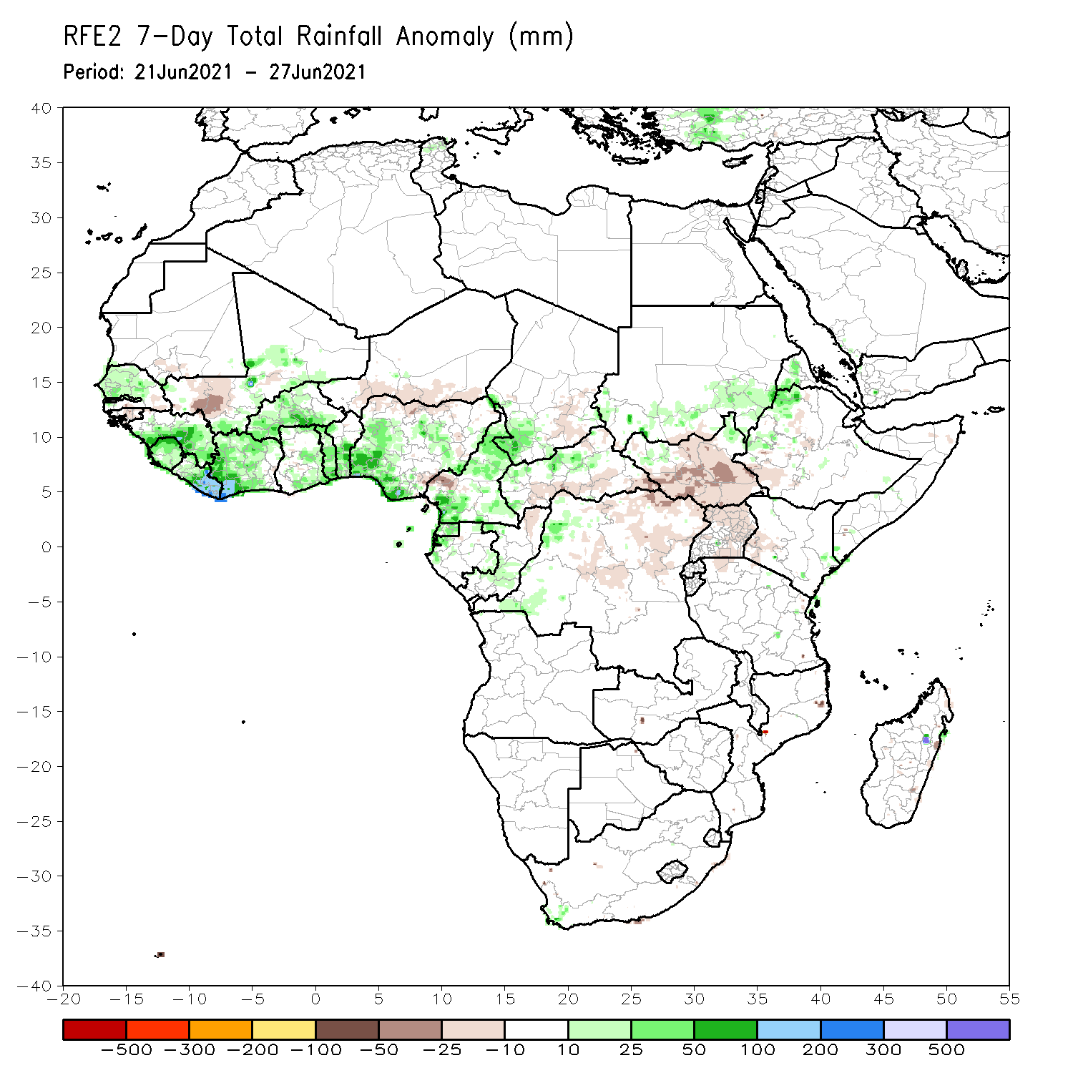
Rainfall Patterns: Last 7 Days
During the past 7 days, in East Africa, rainfall was above-average over parts of eastern Sudan and western Ethiopia. Below-average rainfall was observed over much of South Sudan and Uganda. In Central Africa, rainfall was below-average over parts of central and northern DRC, and pockets of CAR. Above-average rainfall was observed over southern Cameroon, Equatorial Guinea, northern CAR, and parts of Gabon and Congo. In West Africa, above-average rainfall was observed over much of the Gulf of Guinea countries and the neighboring areas of southern Sahel. Below-average rainfall was observed over pockets of Mali and Nigeria.

Slide 7
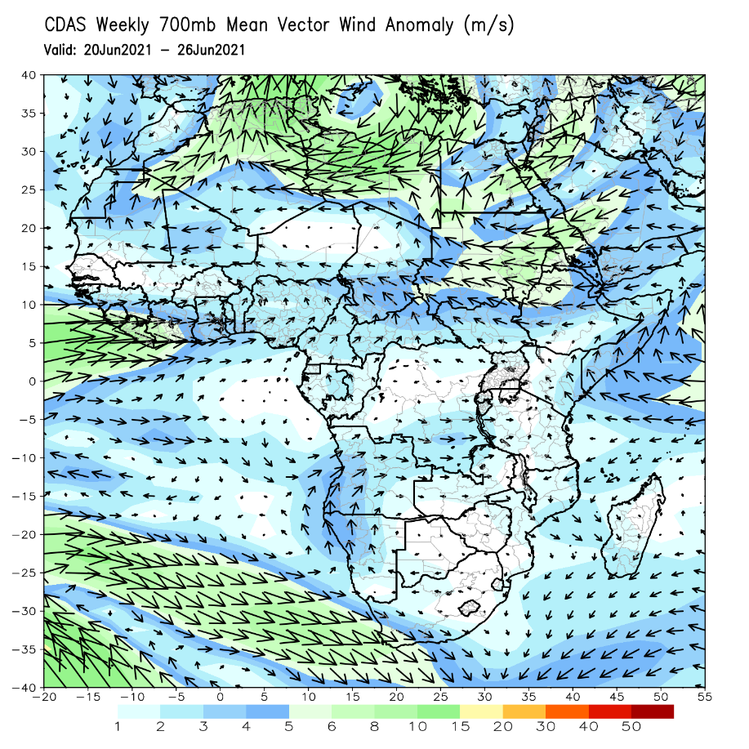
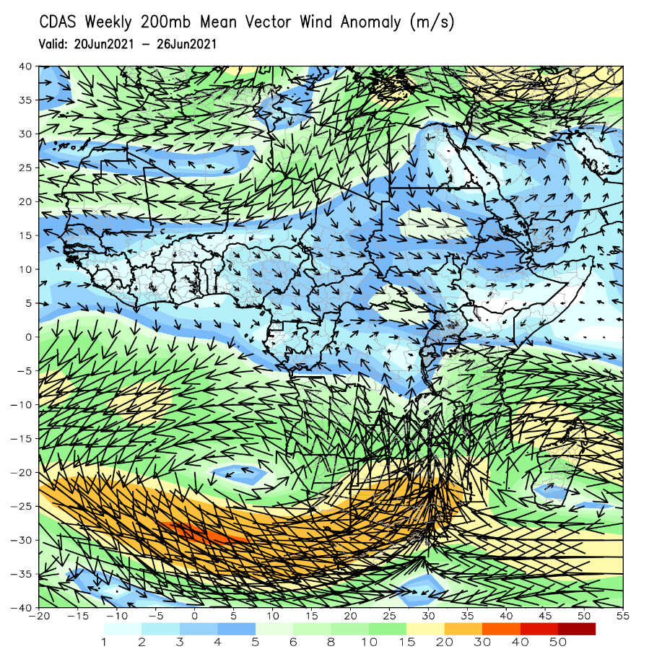
Atmospheric Circulation: Last 7 Days
At 700-hPa level (left panel), anomalous westerly to southwesterly flow with its associated cycloninc turning was observed across the Gulf of Guinea region.

Slide 8
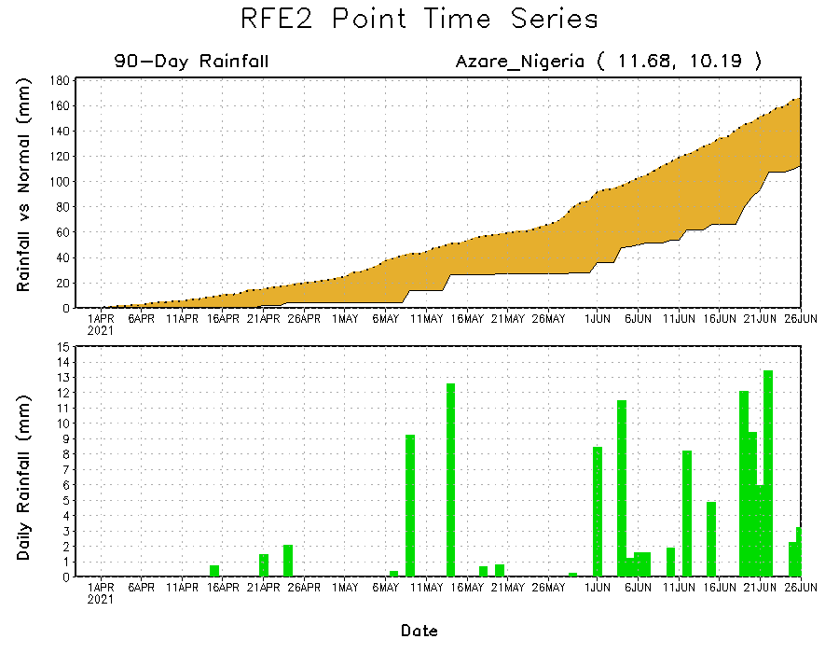
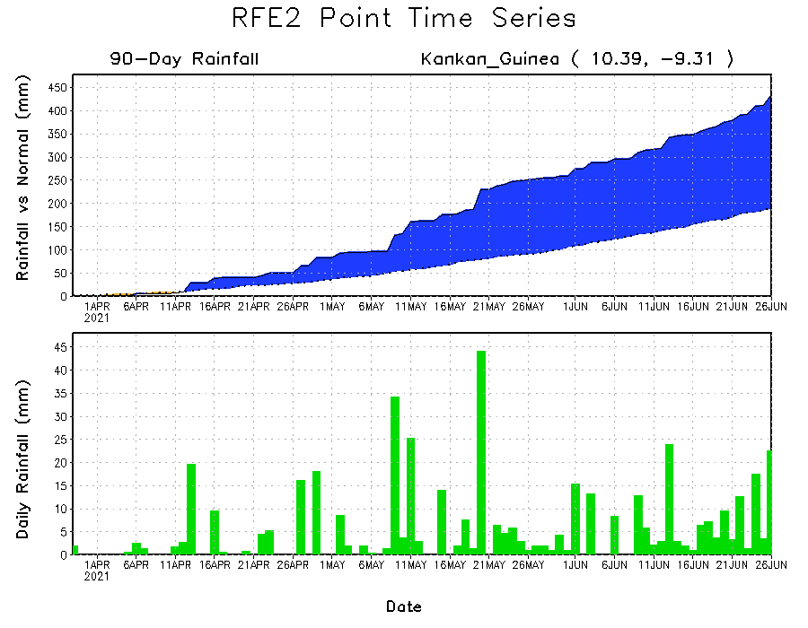
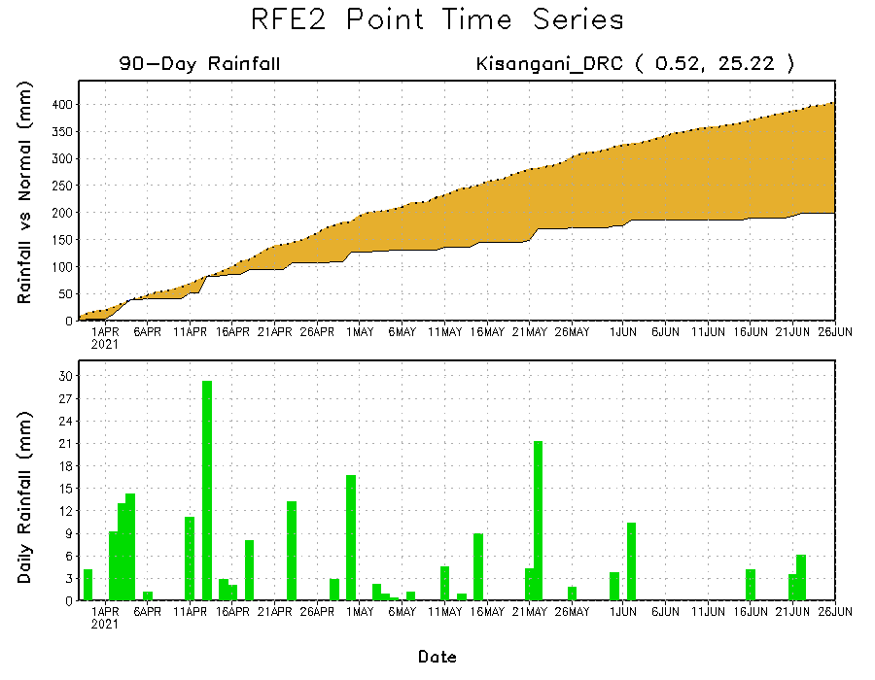
Rainfall Evolution
Daily evolution of rainfall over the last 90 days at selected locations shows moderate to heavy rainfall sustained moisture surpluses over parts of Guinea (bottom left). In contrast, seasonal total rainfall remained below-average over portions of northern Nigeria (top right) and northeastern DRC (bottom right).

Slide 9
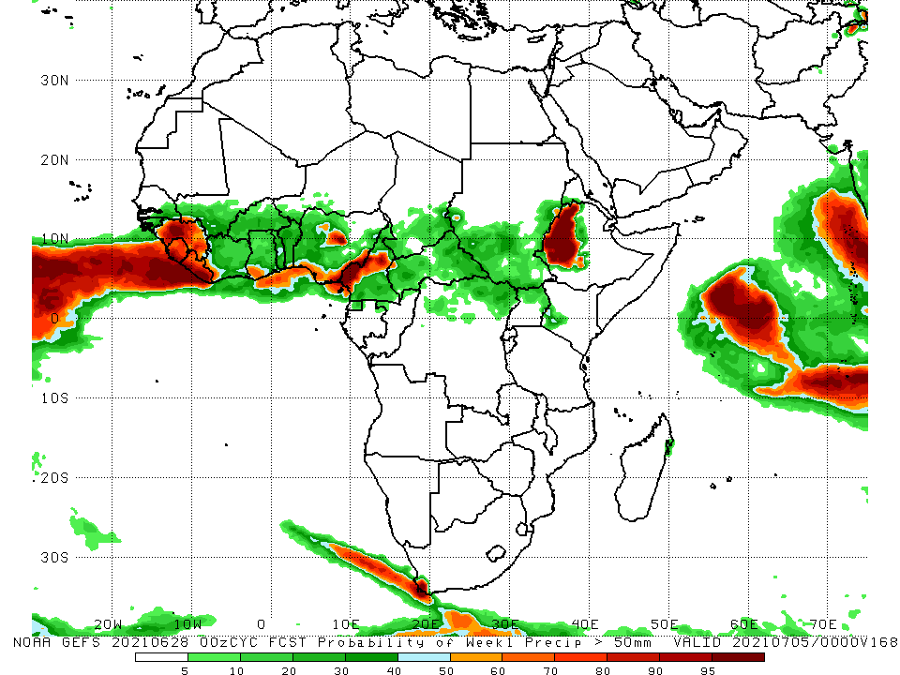
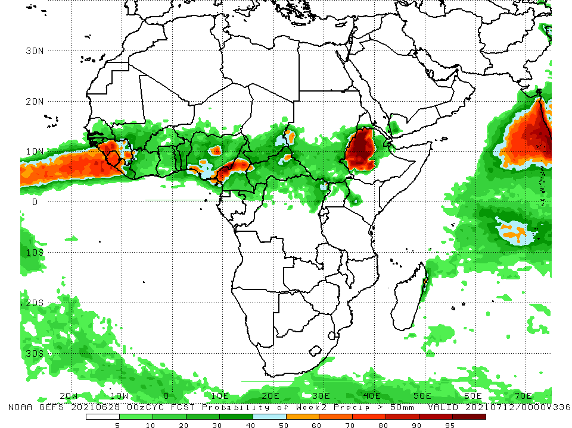
NCEP GEFS Model Forecasts Non-Bias Corrected Probability of precipitation exceedance
Week-1, Valid: 29 June – 05 July, 2021
Week-2, Valid: 06 – 12 July, 2021
For week-1 (left panel) and week-2 (right panel), the NCEP GEFS indicates a moderate to high chance (over 70%) for rainfall to exceed 50 mm portions of the Gulf of Guinea region, and western Ethiopia.
Notes:
9

Slide 10
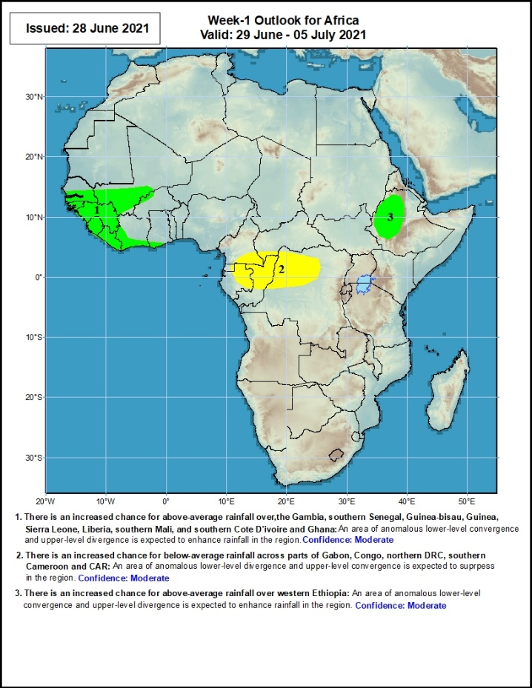
Week-1 Precipitation Outlooks
29 June – 05 July, 2021
There is an increased chance for above-average rainfall over southern Senegal, Guinea-Bissau, Guinea, Sierra Leone, Liberia, southwestern Mali, and coastal Cote d’Ivoire: An area of anomalous lower-level convergence and upper-level divergence is expected to enhance rainfall in the region. Confidence: Moderate
There is an increased chance for below-average rainfall over eastern Gabon, northern Congo and northwestern DRC: An area of anomalous lower-level divergence and upper-level convergence is expected to suppress rainfall in the region. Confidence: Moderate
There is an increased chance for above-average rainfall over western Ethiopia: An area of anomalous lower-level convergence and upper-level divergence is expected to enhance rainfall in the region. Confidence: Moderate
Notes:
10

Slide 11
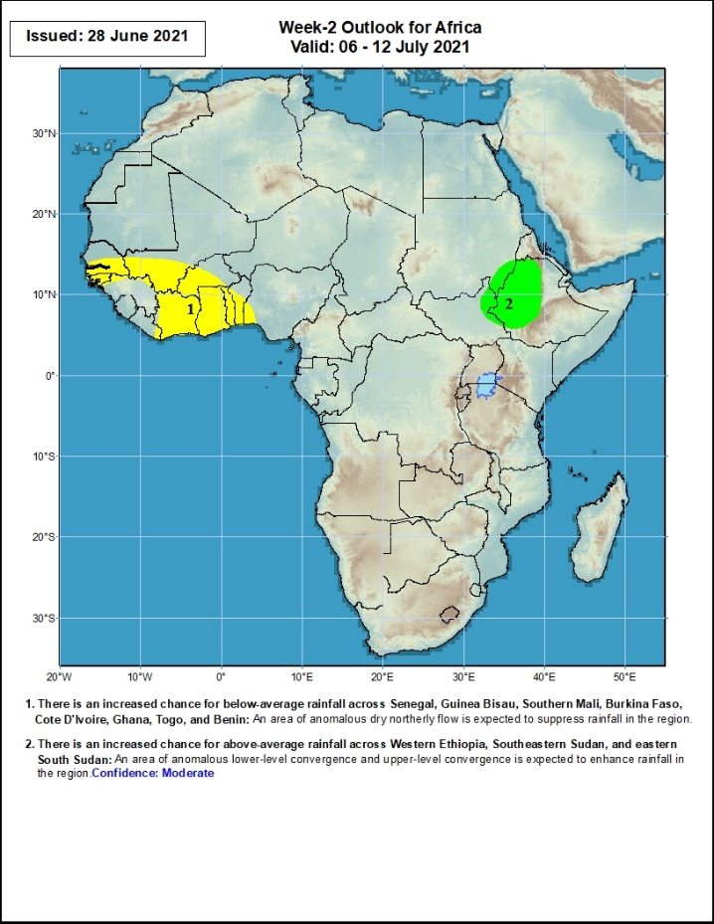
Week-2 Precipitation Outlooks
06 – 12 July, 2021
There is an increased chance for below-average rainfall across southern Senegal, Guinea-Bissau, southwestern Mali, Cote d’Ivoire, western Burkina Faso, Ghana, Togo, Benin, southwestern Nigeria: An area of anomalous lower-level divergence and upper-level convergence is expected to suppress rainfall in the region. Confidence: Moderate
There is an increased chance for above-average rainfall over the far eastern portions of Sudan and South Sudan, and western Ethiopia: An area of anomalous lower-level convergence and upper-level divergence is expected to enhance rainfall in the region. Confidence: Moderate
Notes:
11

Slide 12
Summary
During the past 30 to 90 days, in East Africa, above-average rainfall was observed over the southern and eastern parts of Sudan and northern South Sudan Republic. Rainfall was below-average over southern South Sudan, many parts of Ethiopia, Uganda, Kenya and Somalia. In Central Africa, rainfall was below-average over parts of central and northeastern DRC. Rainfall was above-average over Equatorial Guinea, Gabon, Congo, much of CAR, and northwestern DRC. In West Africa, rainfall was above-average over parts of Senegal, Guinea, Sierra Leone, Cote d’Ivoire, Burkina Faso, much of Ghana, Togo, Benin, and many parts of Nigeria. Below-average rainfall was observed over Guinea-Bissau, southern Ghana and portions of Niger, and pockets of Nigeria.
During the past 7 days, in East Africa, rainfall was above-average over parts of eastern Sudan and western Ethiopia. Below-average rainfall was observed over much of South Sudan and Uganda. In Central Africa, rainfall was below-average over parts of central and northern DRC, and pockets of CAR. Above-average rainfall was observed over southern Cameroon, Equatorial Guinea, northern CAR, and parts of Gabon and Congo. In West Africa, above-average rainfall was observed over much of the Gulf of Guinea countries and the neighboring areas of southern Sahel. Below-average rainfall was observed over pockets of Mali and Nigeria.
Week-1 outlooks call for an increased chance for above-average rainfall over southern Senegal, Guinea-Bissau, Guinea, Sierra Leone, Liberia, southwestern Mali, coastal Cote d’Ivoire, western Ethiopia. In contrast, there is an increased chance for below-average rainfall over eastern Gabon, northern Congo and northwestern DRC.
Week-2 outlooks call for an increased chance for below-average rainfall over southern Senegal, Guinea-Bissau, southwestern Mali, Cote d’Ivoire, western Burkina Faso, Ghana, Togo, Benin, southwestern Nigeria. In contrast, there is an increased chance for above-average rainfall over the far eastern portions of Sudan and South Sudan, and western Ethiopia.

