Slide 1
The African Monsoon Recent Evolution and Current Status Include Week-1 and Week-2 Outlooks
Update prepared by
07 June 2021
For more information, visit:
http://www.cpc.ncep.noaa.gov/products/Global_Monsoons/African_Monsoons/precip_monitoring.shtml

Slide 2
Outline
Highlights
Recent Evolution and Current Conditions
NCEP GEFS Forecasts
Summary

Slide 3
Highlights: Last 7 Days
During the past 7 days, in East Africa, rainfall was below average over eastern South Sudan, western and southern Ethiopia, and much of Uganda. Above-average rainfall was observed over pockets of South Sudan Republic and southern Sudan. In Central Africa, rainfall was below-average over Equatorial Guinea, Gabon, Congo and DRC. Above-average rainfall was observed over parts of Cameroon and CAR. In West Africa, above-average rainfall was observed over many places in the Gulf of Guinea region. Rainfall was below-average over pockets of northern Nigeria.
Week-1 and week-2 outlooks call for an increased chance for above-average rainfall along the Gulf of Guinea coast. In contrast the outlooks call for an increased chance for below-average rainfall over much of Central Africa, the Lake Victoria region, and southwestern Ethiopia.

Slide 4
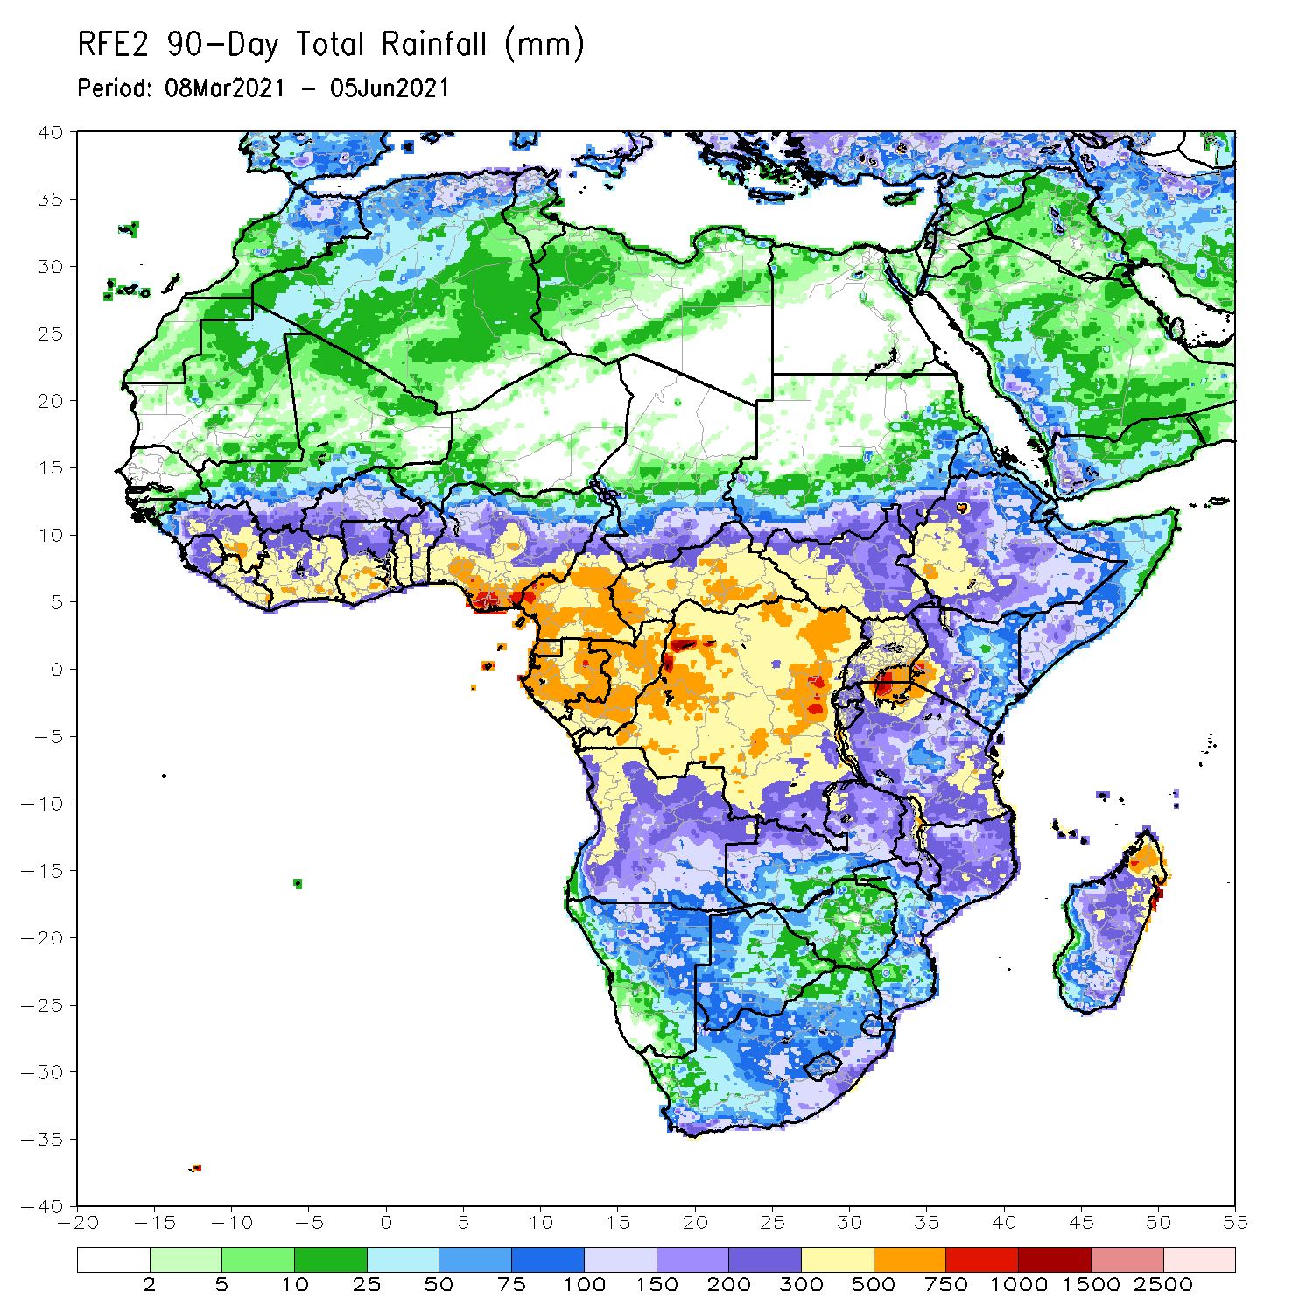
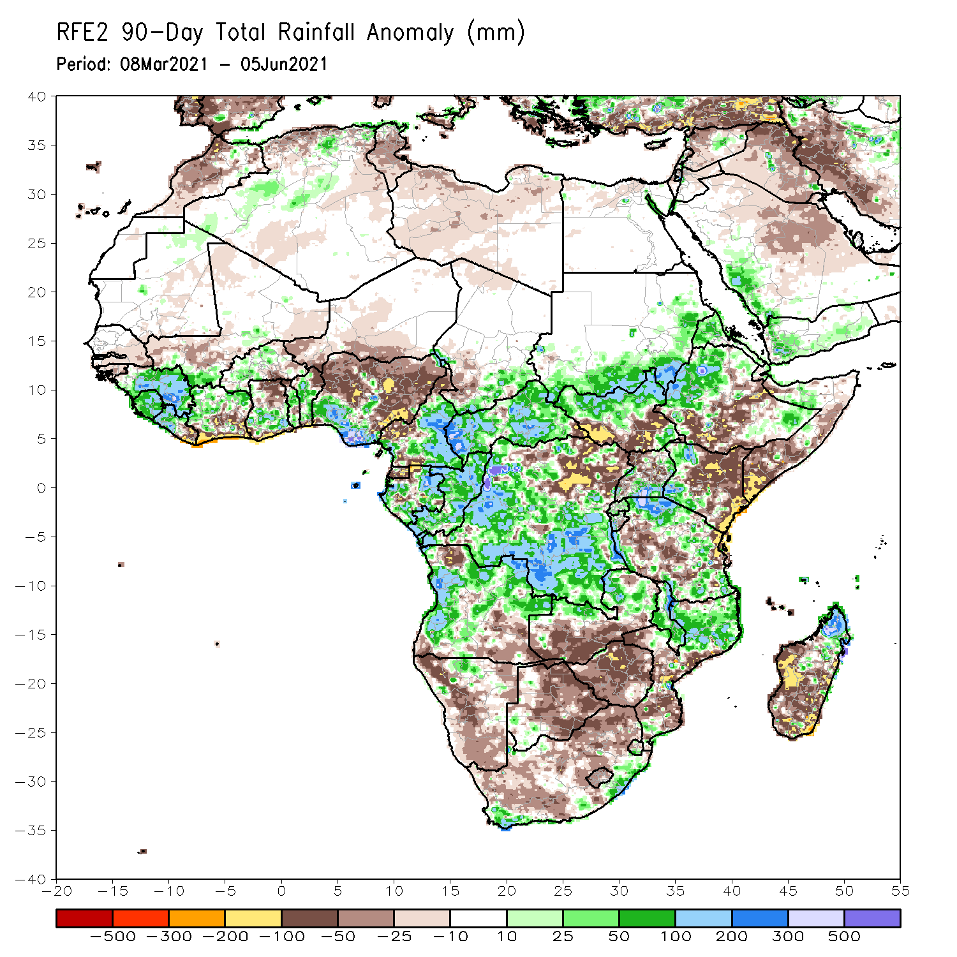
Rainfall Patterns: Last 90 Days
Over the past 90 days, in East Africa, above-average rainfall was observed over western Ethiopia, northern South Sudan, southern and eastern Sudan, Eritrea, southern Uganda, pockets of southeastern Ethiopia, western Kenya, and northern and eastern Tanzania. Rainfall was below-average over parts of central and southern Ethiopia, southern Somalia, and eastern Kenya. Rainfall was also below-average over southern South Sudan, northern Uganda and western Tanzania. In southern Africa, above-average rainfall was observed over the northern portions of Southern Africa, while below-average rainfall was observed over central and southern portions of Southern Africa. In Central Africa, rainfall was above-average over central and southern DRC, much of Gabon, Congo, and much of CAR. Rainfall was below-average over parts northern DRC. Below-average rains were also observed over Equatorial Guinea and western Cameroon. In West Africa, rainfall was above-average over many places in the Gulf of Guinea countries. Below-average rainfall was observed over pockets of Cote d’Ivoire, northern Ghana, and central and northern Nigeria.
Notes:
4

Slide 5
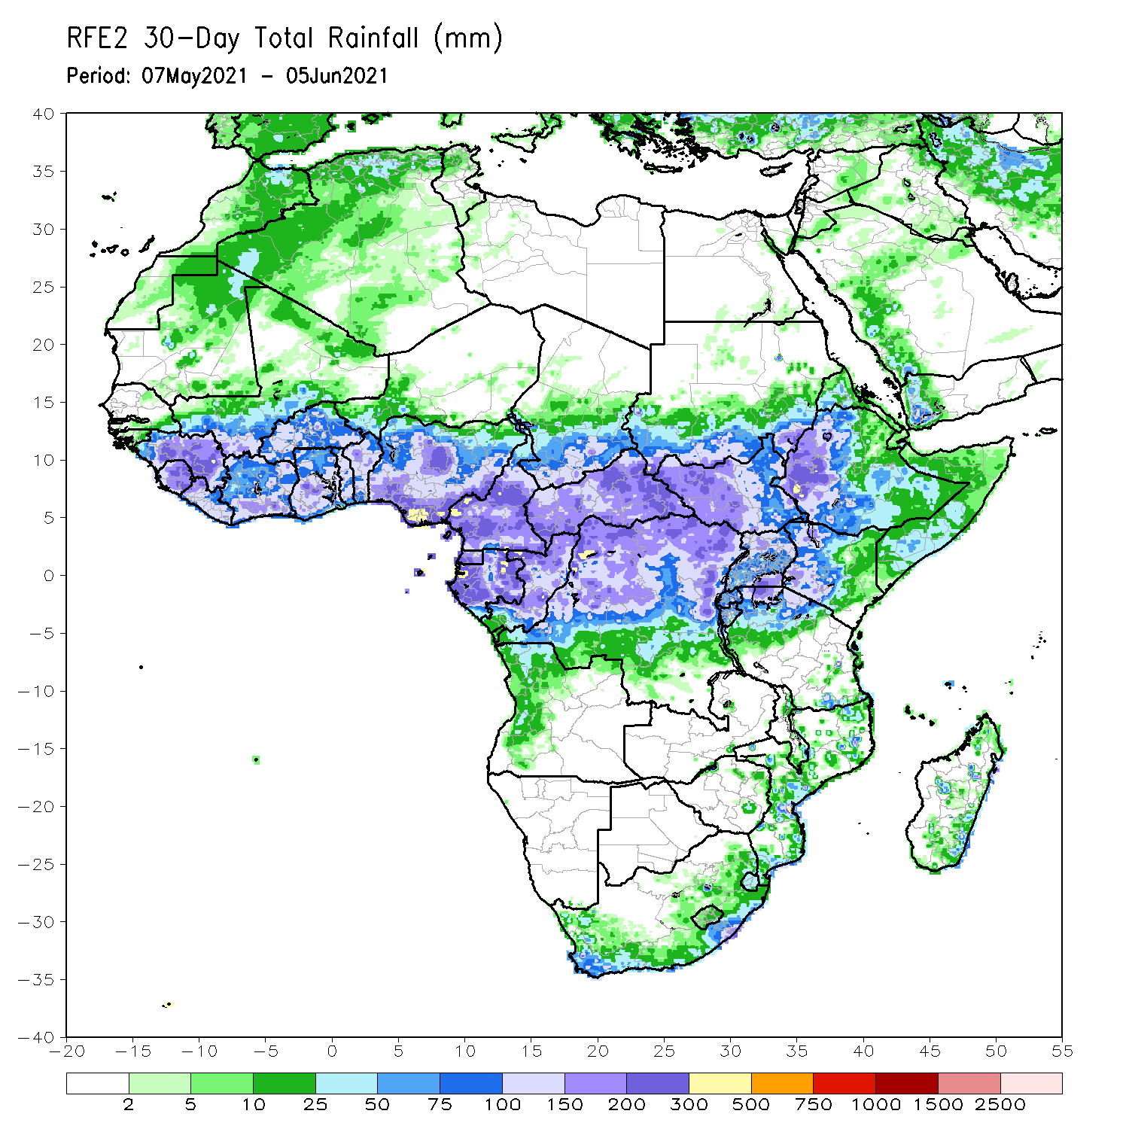
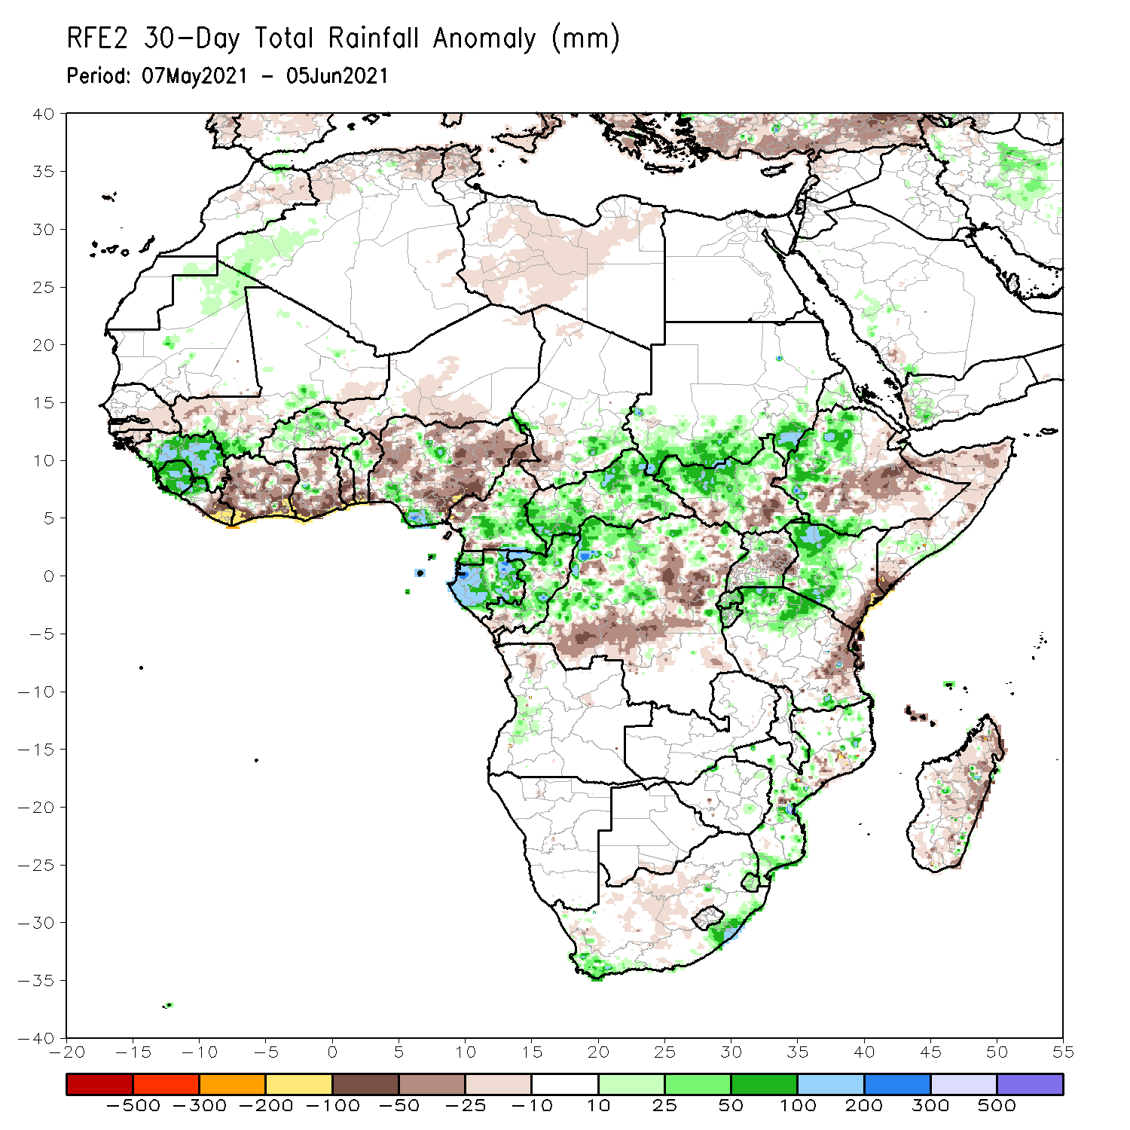
Rainfall Patterns: Last 30 Days
During the past 30 days, in East Africa, above-average rainfall was observed over western Ethiopia, parts of southern and eastern Sudan, much of South Sudan, and western Kenya. Rainfall was below-average over southern Ethiopia, the far eastern Kenya and pockets of southern South Sudan, and Somalia. In Central Africa, rainfall was below-average over parts of central and northeastern DRC. Rainfall was above-average over much of CAR, Congo, and northwestern and northern DRC. In West Africa, rainfall was above-average over Guinea, Sierra Leone, Burkina Faso and southern Nigeria. Below-average rainfall was observed over southern Senegal, Guinea-Bissau, southwestern Mali, eastern Liberia, much of Cote d’Ivoire, Ghana, Togo, southern Benin,, and central and northern Nigeria.
Notes:
5

Slide 6
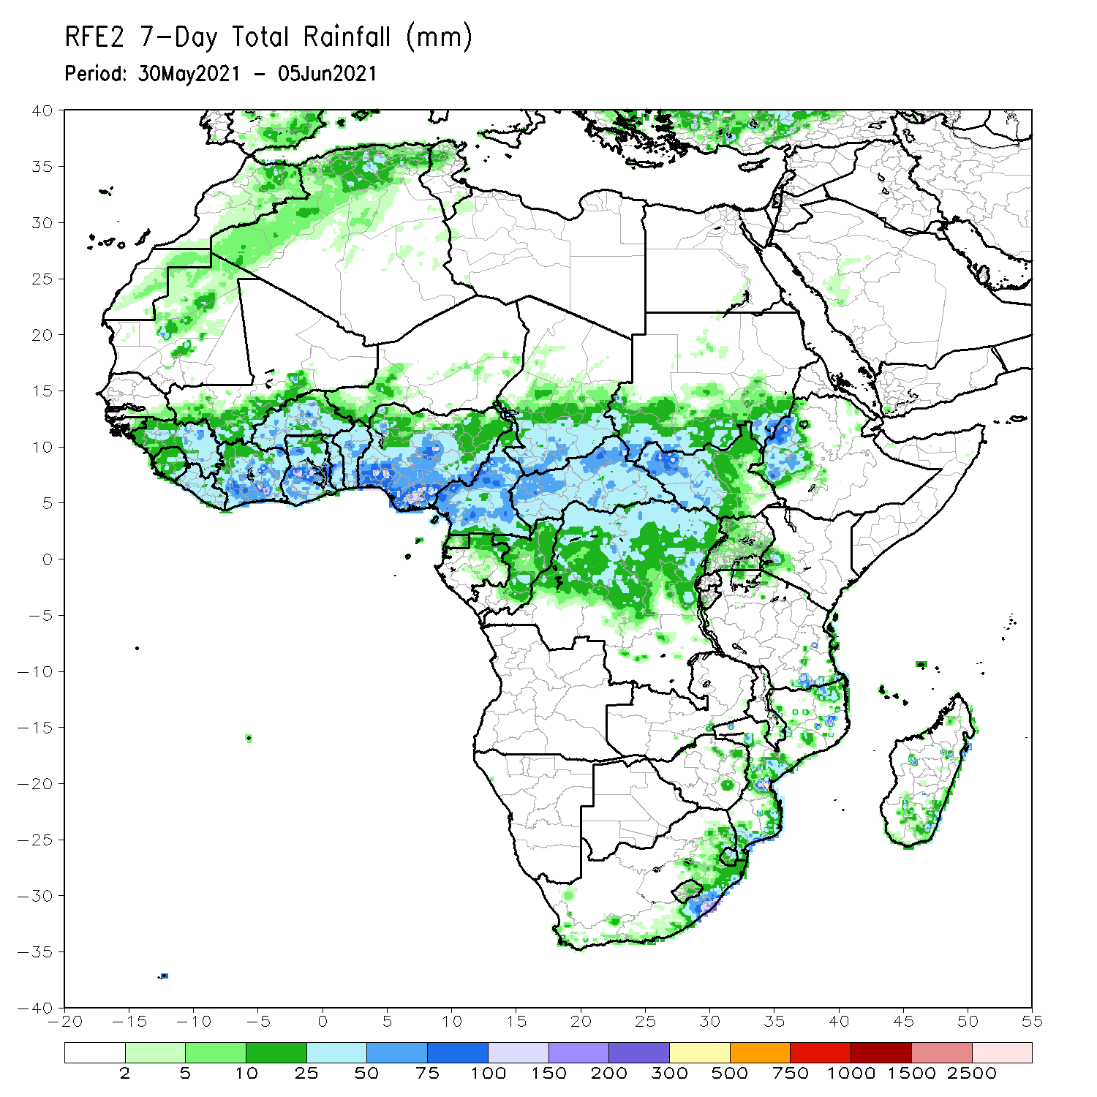
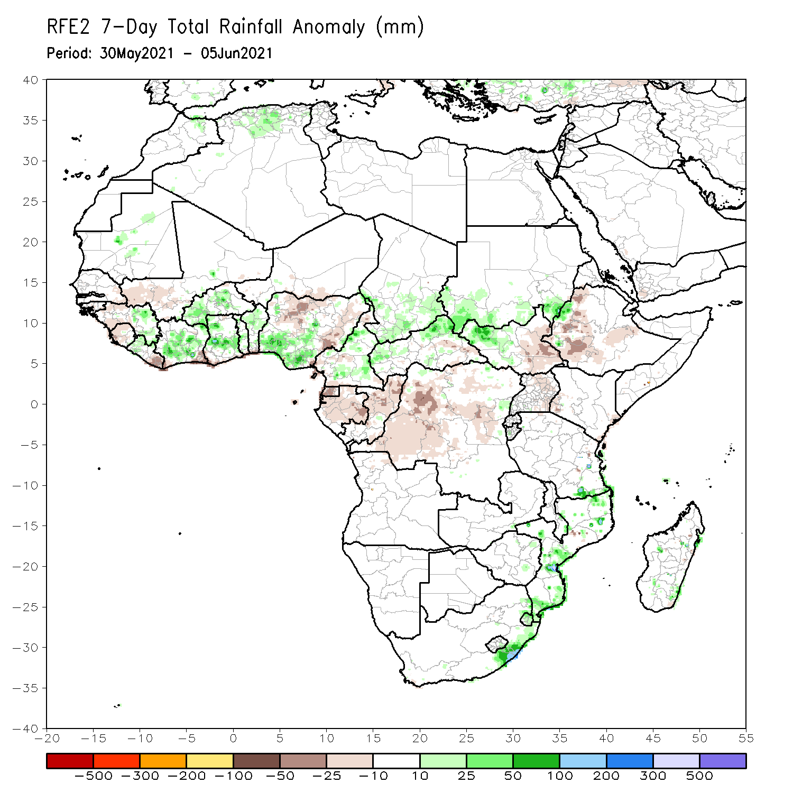
Rainfall Patterns: Last 7 Days
During the past 7 days, in East Africa, rainfall was below average over eastern South Sudan, western and southern Ethiopia, and much of Uganda. Above-average rainfall was observed over pockets of South Sudan Republic and southern Sudan. In Central Africa, rainfall was below-average over Equatorial Guinea, Gabon, Congo and DRC. Above-average rainfall was observed over parts of Cameroon and CAR. In West Africa, above-average rainfall was observed over many places in the Gulf of Guinea region. Rainfall was below-average over pockets of northern Nigeria.

Slide 7
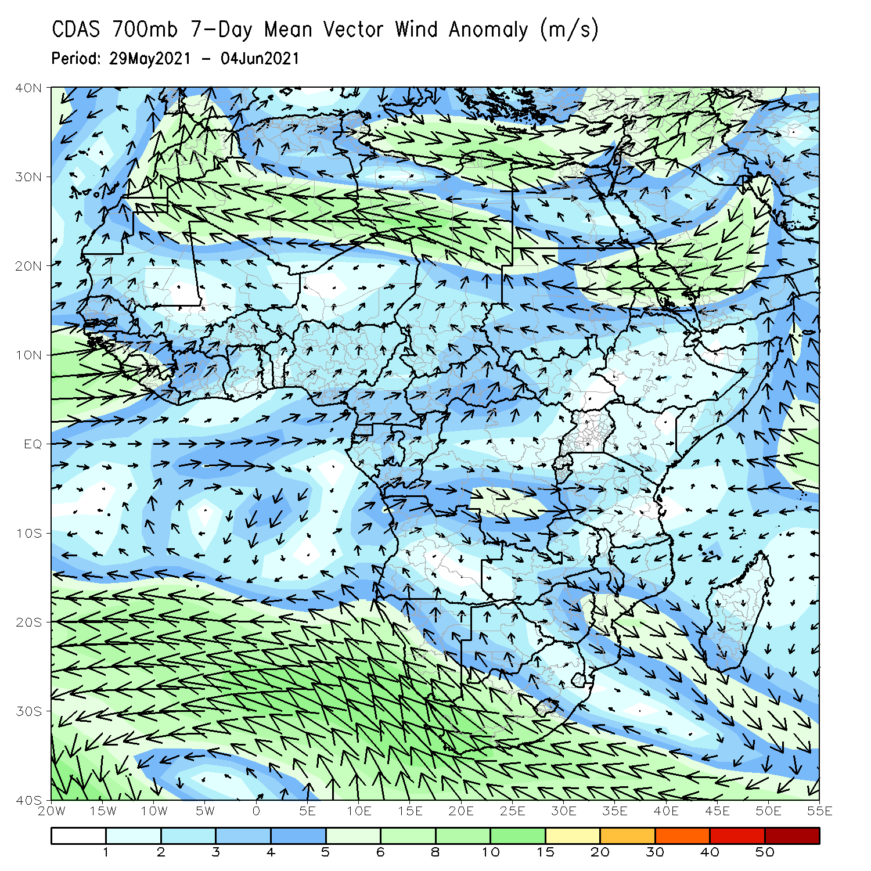
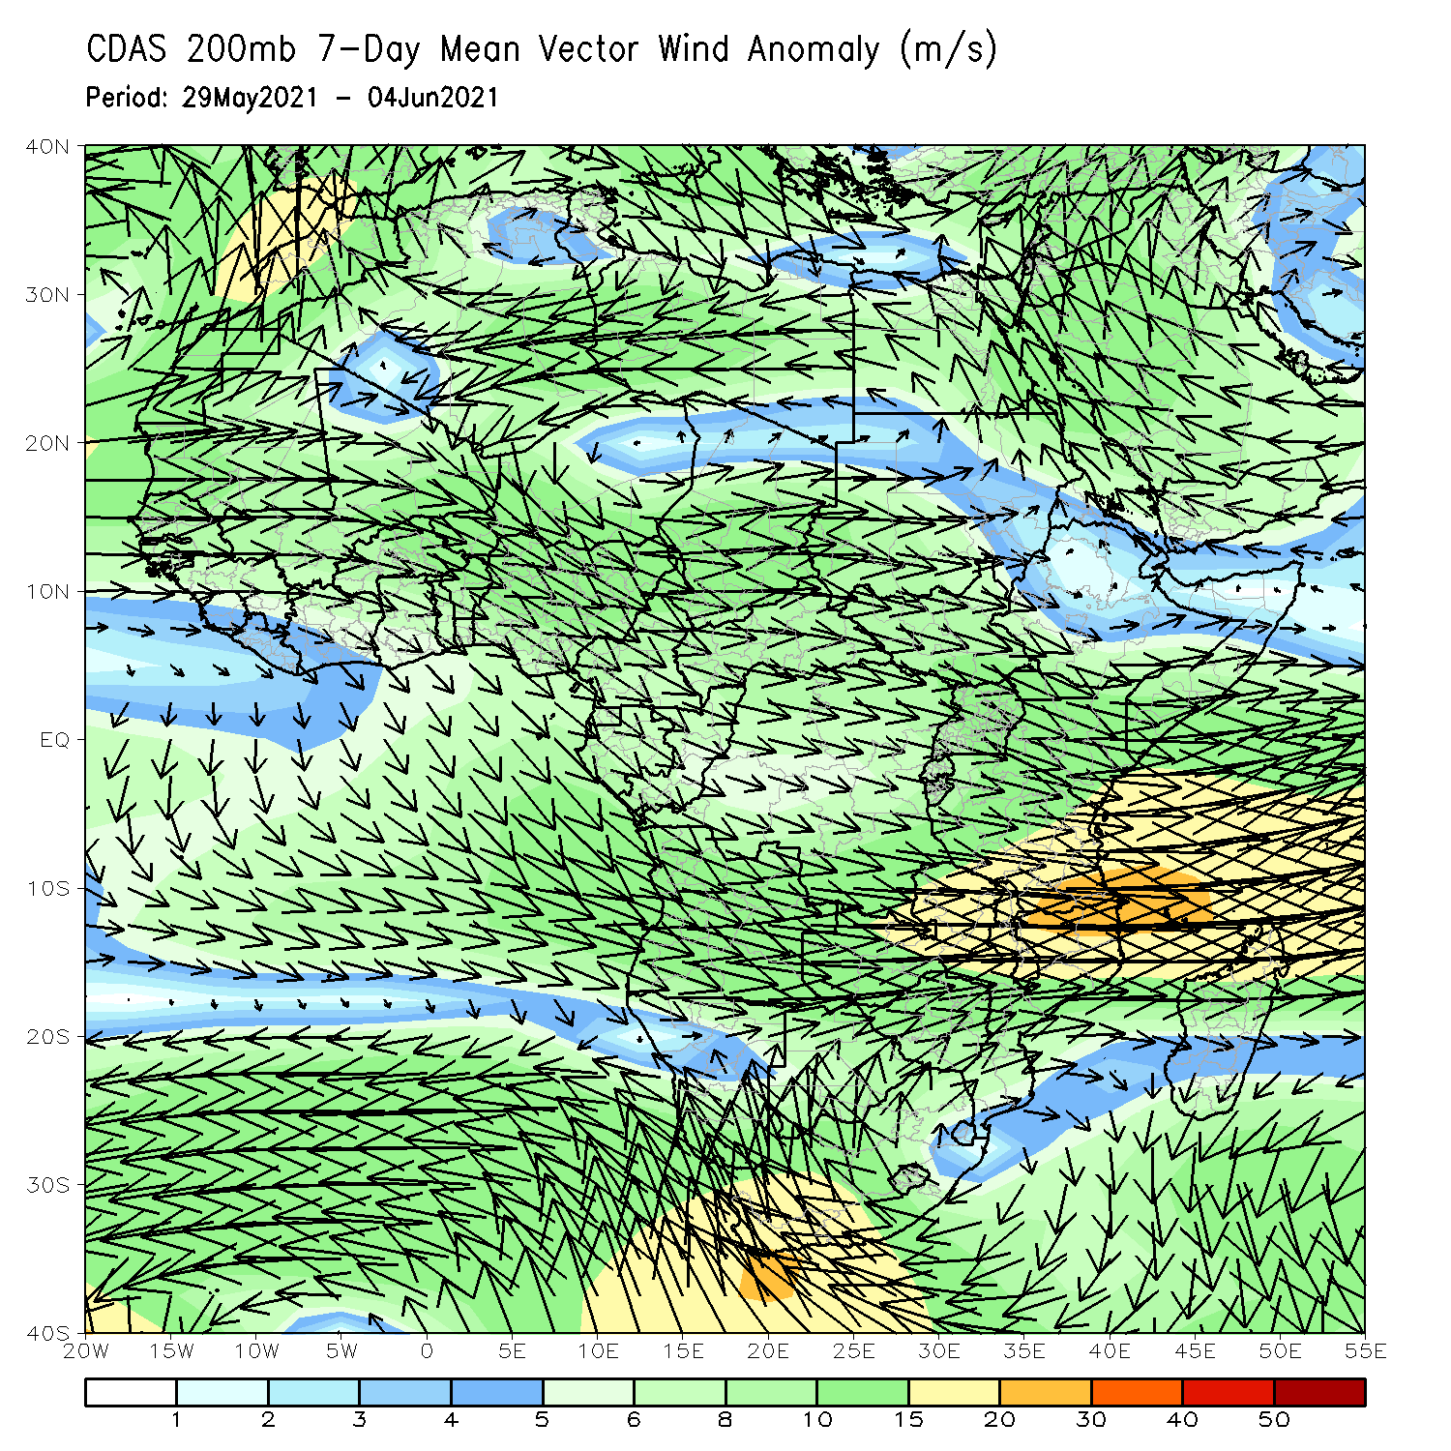
Atmospheric Circulation: Last 7 Days
At 700-hPa level (left panel), anomalous onshore-flow prevailed across the Gulf of Guinea region.

Slide 8
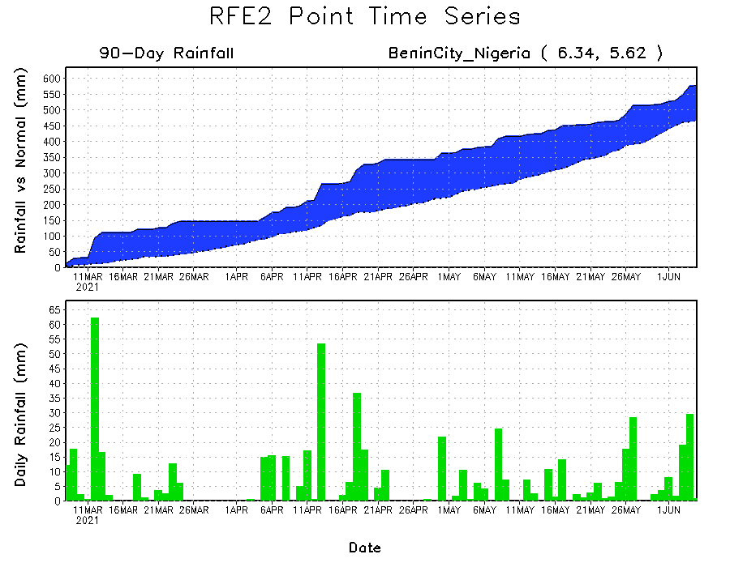
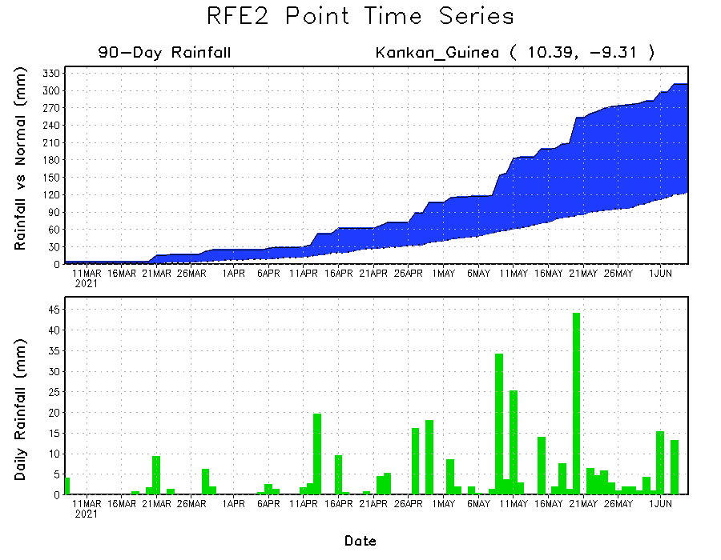
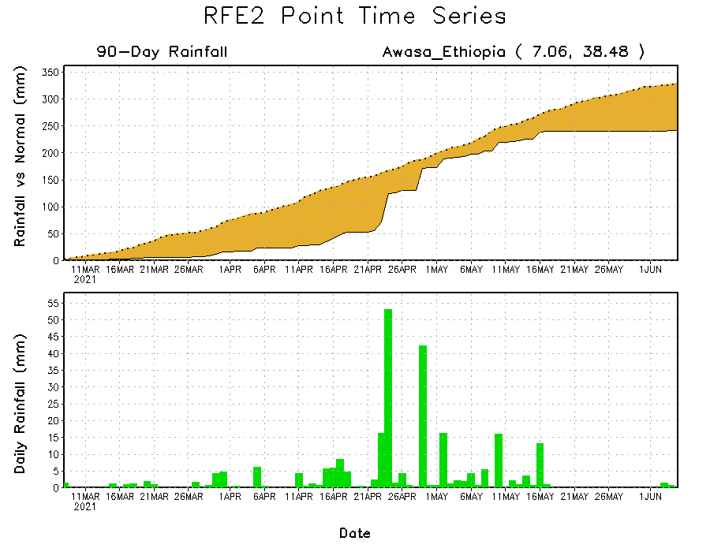
Rainfall Evolution
Daily evolution of rainfall over the last 90 days at selected locations shows moderate to heavy rainfall sustained moisture surpluses over parts of Guinea (bottom left) and southern Nigeria (top right). In contrast, seasonal total rainfall remained below-average over portions of southern Ethiopia (bottom right).

Slide 9
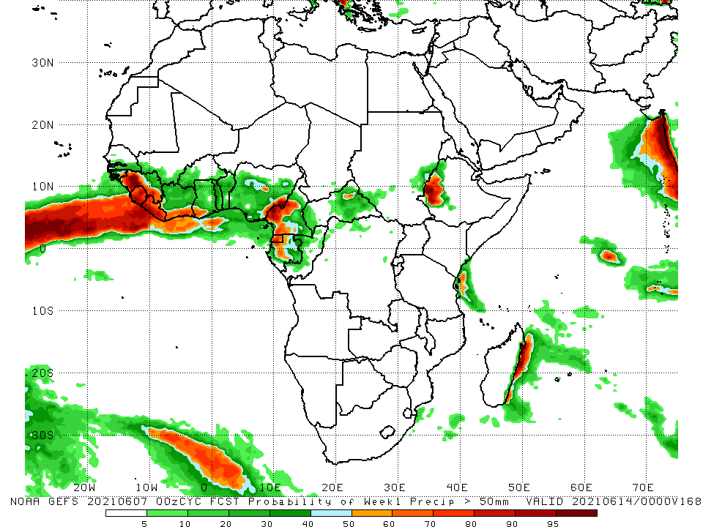
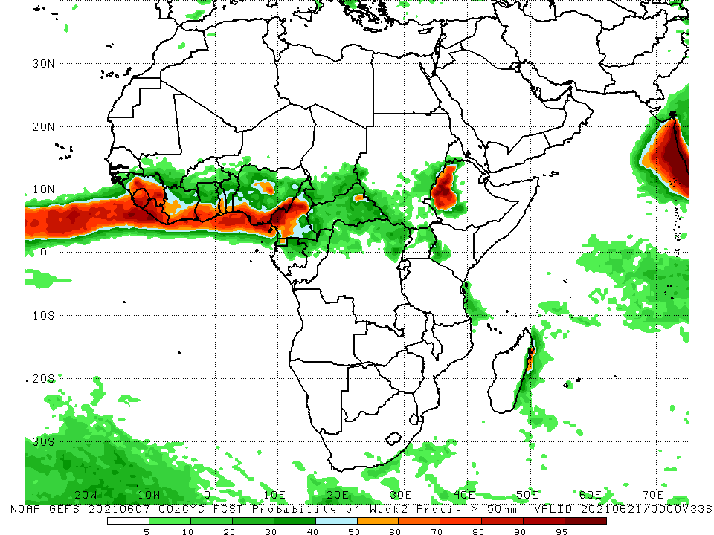
NCEP GEFS Model Forecasts Non-Bias Corrected Probability of precipitation exceedance
Week-1, Valid: 08 – 14 June, 2021
Week-2, Valid: 15 – 21 June, 2021
For week-1 (left panel), the NCEP GEFS indicates a moderate to high chance (over 70%) for rainfall to exceed 50 mm over guinea, Sierra Leone, Liberia, coastal Cote d’Ivoire and Ghana, western Cameroon, Gabon, and western Ethiopia. For week-2 (right panel) there is a moderate to high chance for rainfall to exceed 50mm along the Gulf of Guinea coast and western Ethiopia.
Notes:
9

Slide 10
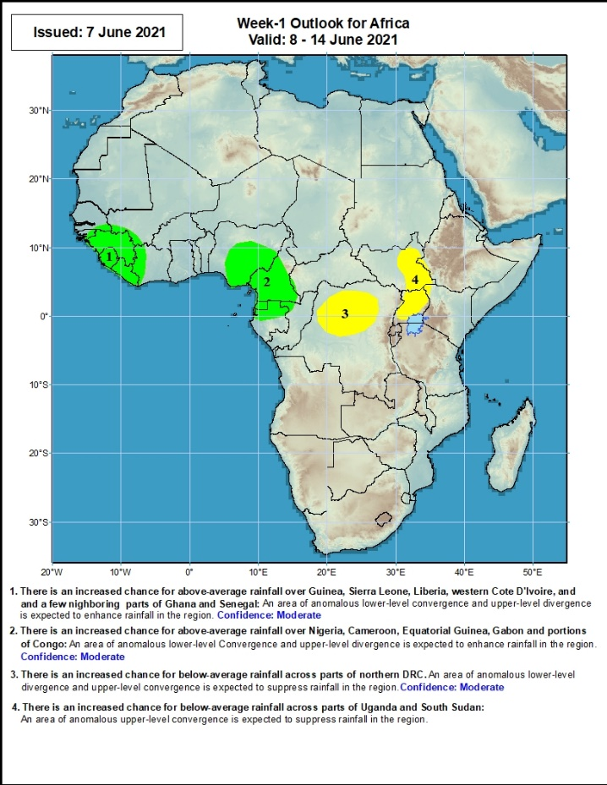
Week-1 Precipitation Outlooks
08 – 14 June, 2021
There is an increased chance for above-average rainfall over much of Guinea, Sierra Leone and Liberia: An area of anomalous lower-level convergence and upper-level divergence is expected to enhance rainfall in the region. Confidence: Moderate
There is an increased chance for above-average rainfall over eastern Nigeria, Cameroon, Equatorial Guinea, and northern Gabon: An area of anomalous lower-level convergence and upper-level divergence is expected to enhance rainfall in the region. Confidence: Moderate
There is an increased chance for below-average rainfall over northern DRC: An area of anomalous lower-level divergence and upper-level convergence is expected to suppress rainfall in the region. Confidence: Moderate
There is an increased chance for below-average rainfall over eastern South Sudan and Uganda: An area of anomalous lower-level divergence and upper-level convergence is expected to suppress rainfall in the region. Confidence: Moderate
Notes:
10

Slide 11
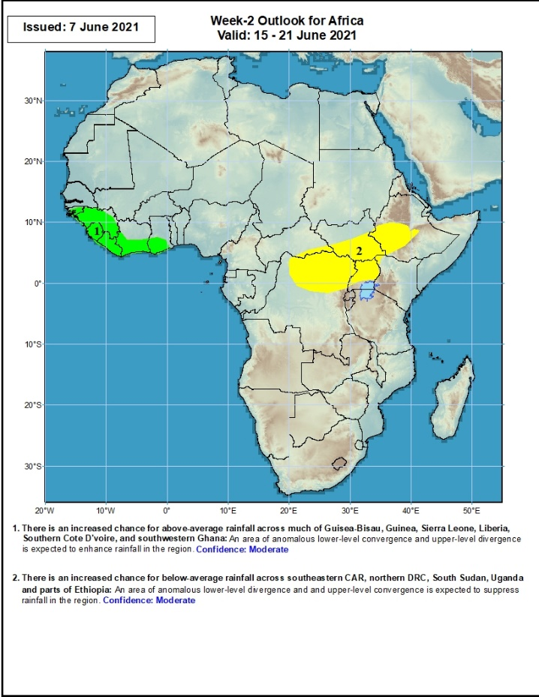
Week-2 Precipitation Outlooks
15 – 21 June, 2021
There is an increased chance for above-average rainfall along the Gulf of Guinea coast: An area of anomalous lower-level convergence and upper-level divergence is expected to enhance rainfall in the region. Confidence: Moderate
There is an increased chance for below-average rainfall across northern DRC, northern Uganda, southern South Sudan and southwestern Ethiopia: An area of anomalous lower-level divergence and upper-level convergence is expected to suppress rainfall in the region. Confidence: Moderate
Notes:
11

Slide 12
Summary
During the past 30 to 90 days, in East Africa, above-average rainfall was observed over western Ethiopia, parts of southern and eastern Sudan, much of South Sudan, and western Kenya. Rainfall was below-average over southern Ethiopia, the far eastern Kenya and pockets of southern South Sudan, and Somalia. In Central Africa, rainfall was below-average over parts of central and northeastern DRC. Rainfall was above-average over much of CAR, Congo, and northwestern and northern DRC. In West Africa, rainfall was above-average over Guinea, Sierra Leone, Burkina Faso and southern Nigeria. Below-average rainfall was observed over southern Senegal, Guinea-Bissau, southwestern Mali, eastern Liberia, much of Cote d’Ivoire, Ghana, Togo, southern Benin,, and central and northern Nigeria.
During the past 7 days, in East Africa, rainfall was below average over eastern South Sudan, western and southern Ethiopia, and much of Uganda. Above-average rainfall was observed over pockets of South Sudan Republic and southern Sudan. In Central Africa, rainfall was below-average over Equatorial Guinea, Gabon, Congo and DRC. Above-average rainfall was observed over parts of Cameroon and CAR. In West Africa, above-average rainfall was observed over many places in the Gulf of Guinea region. Rainfall was below-average over pockets of northern Nigeria.
Week-1 and week-2 outlooks call for an increased chance for above-average rainfall along the Gulf of Guinea coast. In contrast the outlooks call for an increased chance for below-average rainfall over much of Central Africa, the Lake Victoria region, and southwestern Ethiopia.

