Slide 1
The African Monsoon Recent Evolution and Current Status Include Week-1 and Week-2 Outlooks
Update prepared by
17 May 2021
For more information, visit:
http://www.cpc.ncep.noaa.gov/products/Global_Monsoons/African_Monsoons/precip_monitoring.shtml

Slide 2
Outline
Highlights
Recent Evolution and Current Conditions
NCEP GEFS Forecasts
Summary

Slide 3
Highlights: Last 7 Days
During the past 7 days, in East Africa, rainfall was above-average over western Ethiopia, parts of South Sudan, western Kenya, and northern Tanzania. In Central Africa, rainfall was above-average over pockets of Congo, CAR. In West Africa, below-average rainfall was observed along the Gulf of Guinea coast. Above-average rainfall was observed over much of Sierra Leone and Guinea.
Week-1 outlooks call for an increased chance for below-average rainfall over much of the Gulf of Guinea region, and equatorial East Africa. In contrast, there is an increased chance for above average rainfall over parts of Guinea, Sierra Leone, southern Cameroon, Equatorial Guinea, Gabon, western Congo, and the Lake Victoria region.
Week-2 outlooks call for an increased chance for above-average rainfall across southern Cameroon, Equatorial Guinea, and much of Gabon. There is an increased chance for below-average rainfall across northern Congo, southern CAR, central and northern DRC, South Sudan, southwestern Ethiopia, Uganda, western Kenya and Rwanda.

Slide 4
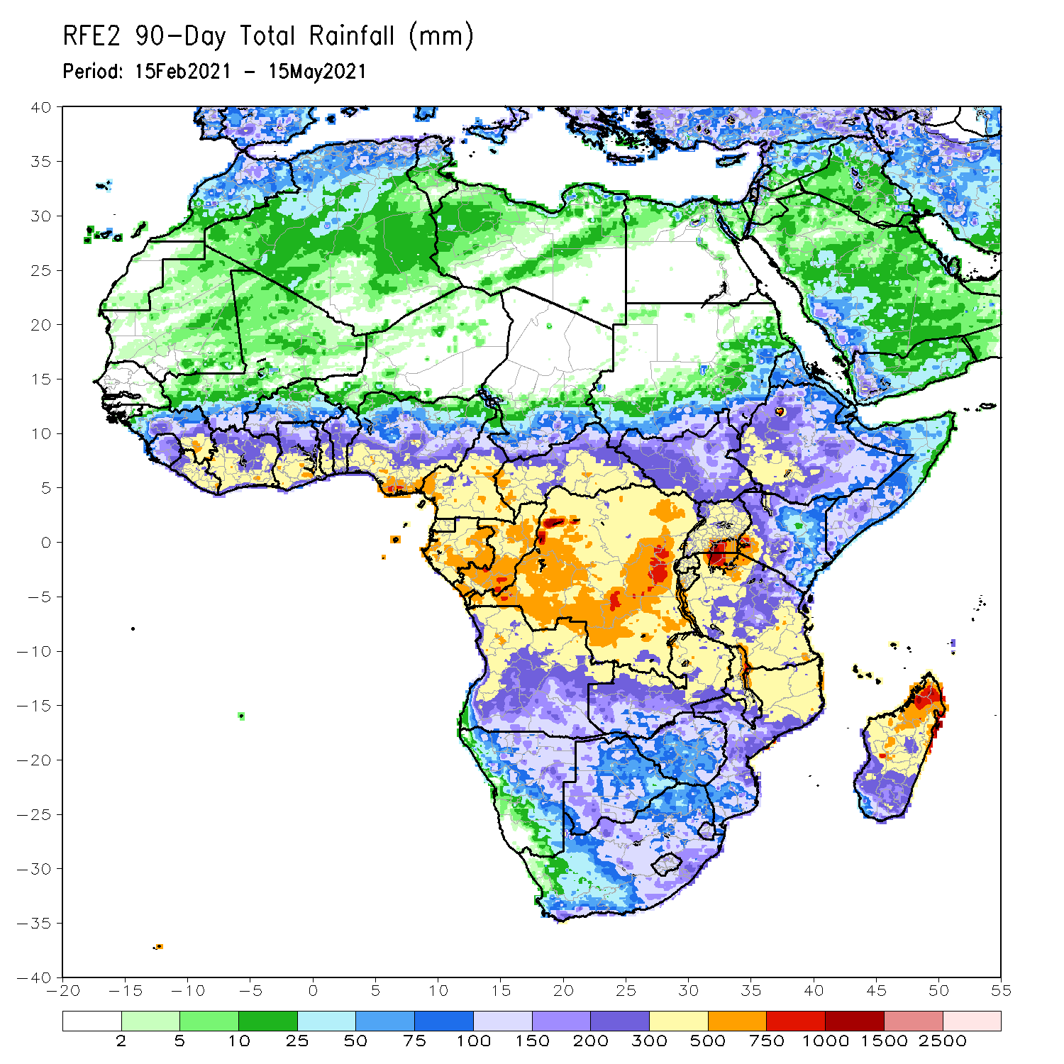
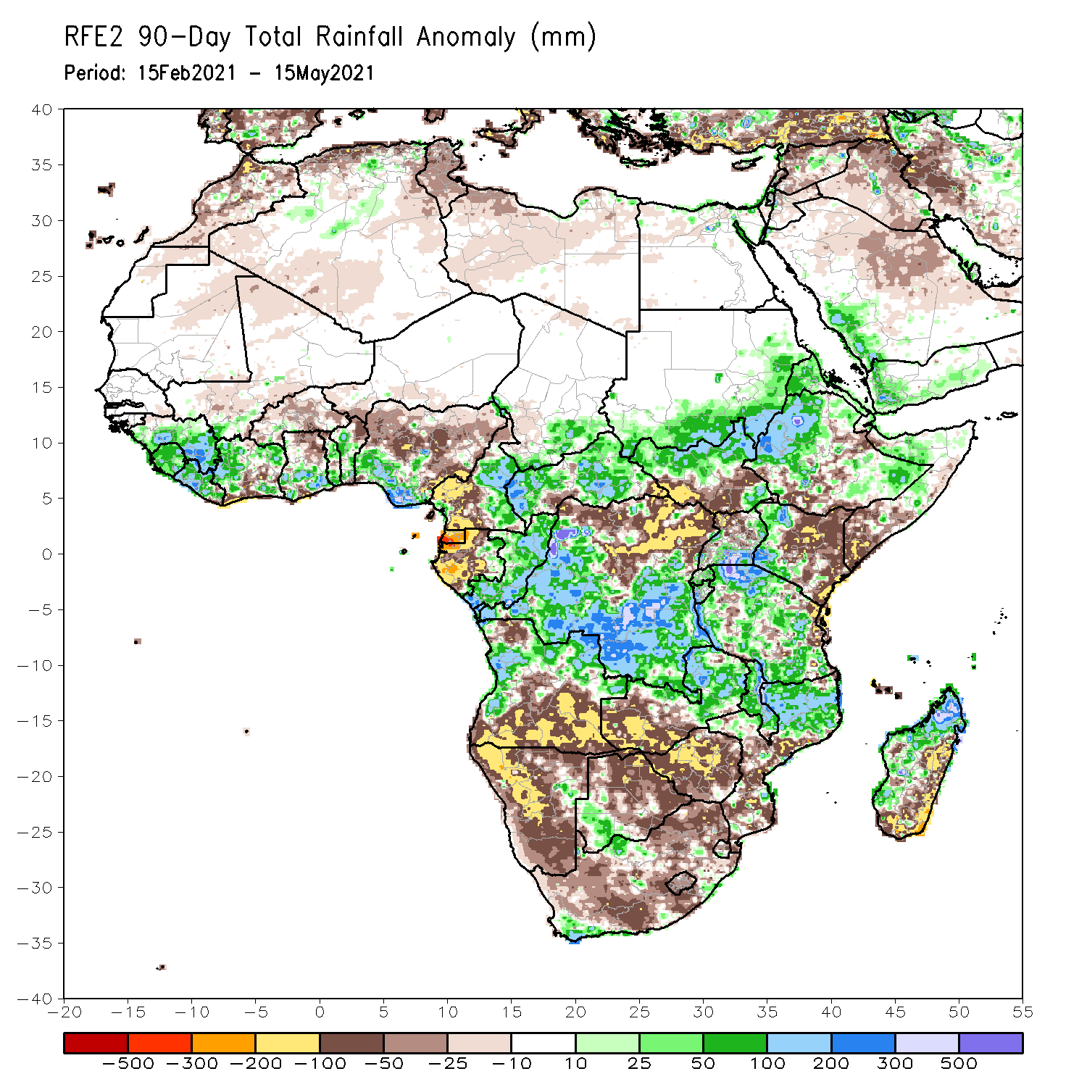
Rainfall Patterns: Last 90 Days
Over the past 90 days, in East Africa, above-average rainfall was observed over western and parts of southeastern Ethiopia, northern South Sudan, southern and eastern Sudan, Eritrea, southern Uganda, much of Tanzania, and parts of central Somalia. Rainfall was below-average over parts of central and southern Ethiopia, southern Somalia, and eastern Kenya. Rainfall was also below-average over southern South Sudan and northern Uganda. In southern Africa, above-average rainfall was observed over western and northern Angola, and pockets of Namibia and Botswana. Rainfall was also above-average over central and eastern Zambia, Malawi, northern Mozambique, local areas in South Africa, and western Madagascar. Persistent light rains resulted in moisture deficits over central and southern Angola, and much of Namibia. Rainfall was also below-average over western Zambia, much of Zimbabwe, eastern Madagascar, and many parts of South Africa. In Central Africa, rainfall was above-average over central and southern DRC, eastern Gabon, Congo, and parts of CAR. Rainfall was below-average over parts northern DRC, and parts of central CAR. Below-average rains were also observed over the western areas of Gabon, Equatorial Guinea, the far northern Congo, and western Cameroon. In West Africa, rainfall was above-average over many places in the Gulf of Guinea countries. Below-average rainfall was observed over pockets of Cote d’Ivoire, northern Ghana, parts of Burkina Faso, and central and northern Nigeria.
Notes:
4

Slide 5
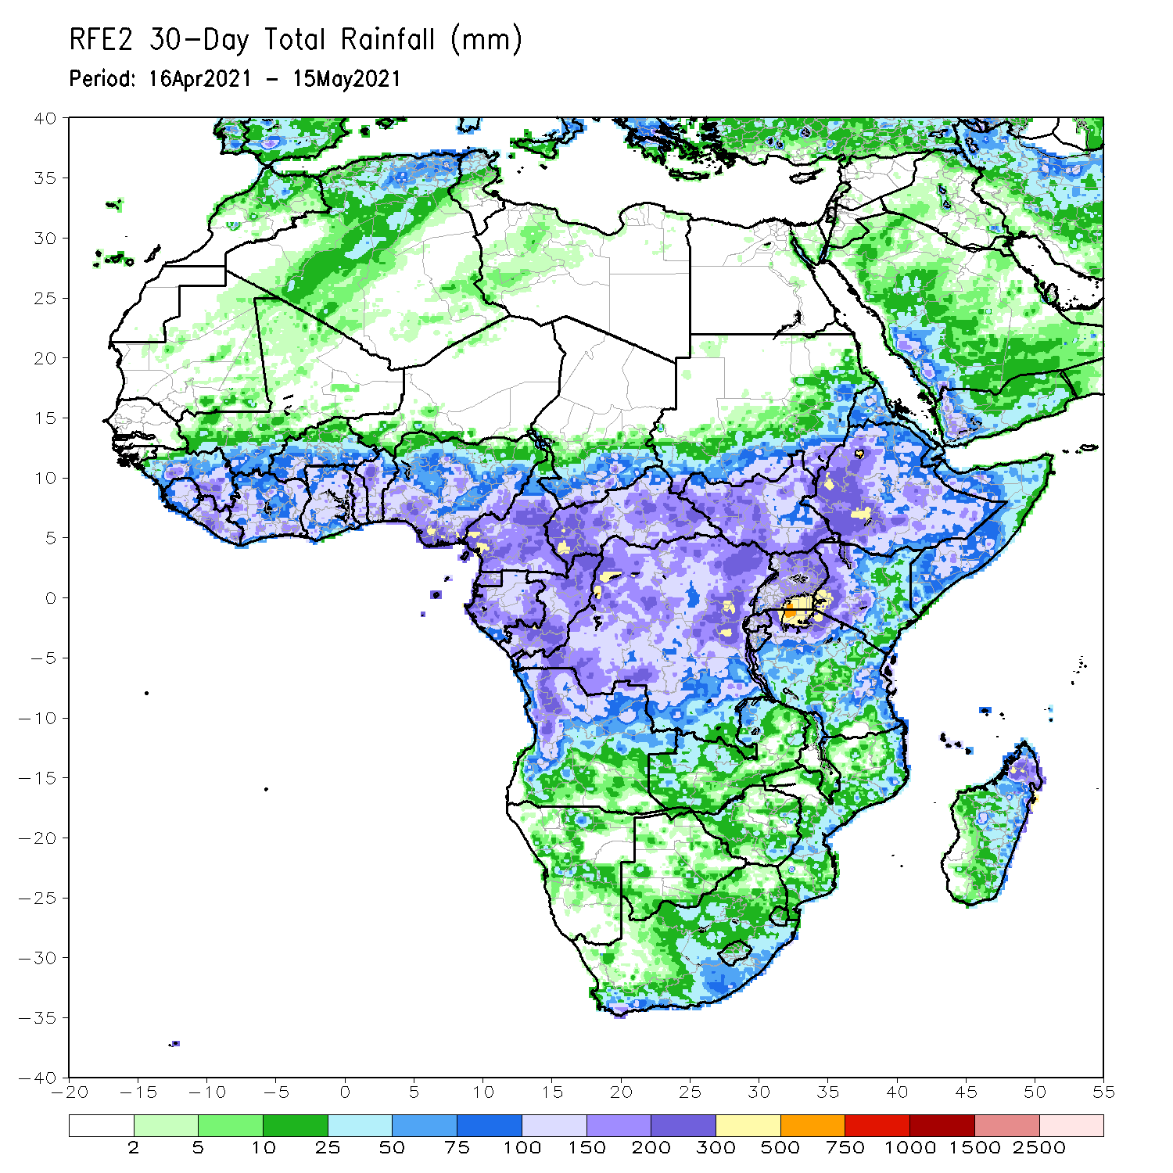
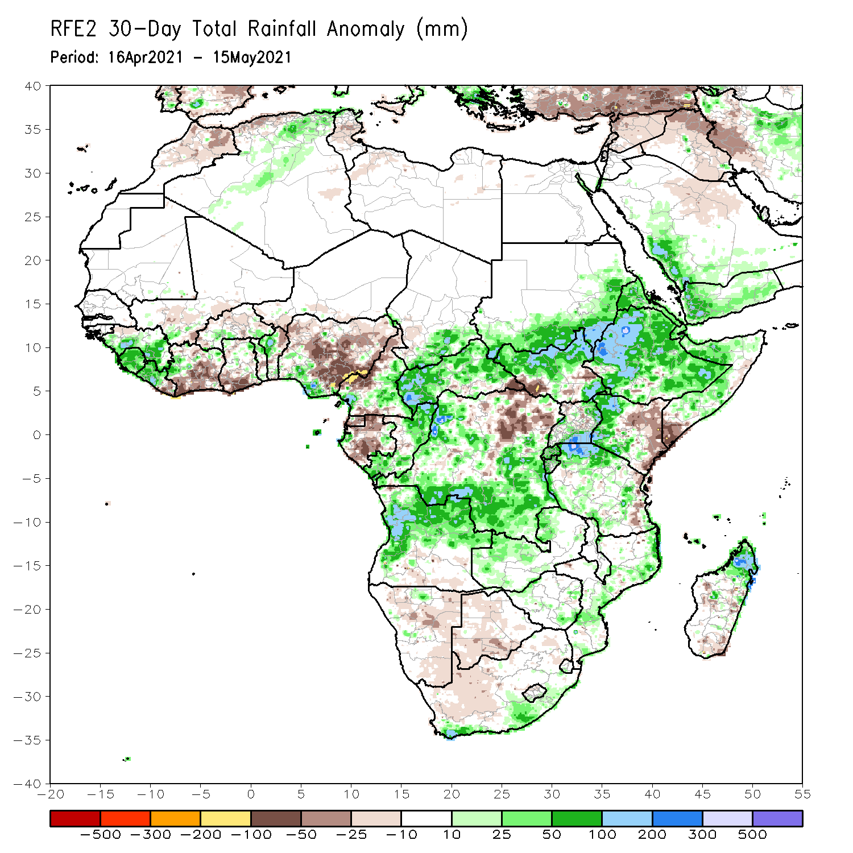
Rainfall Patterns: Last 30 Days
During the past 30 days, in East Africa, above-average rainfall was observed over much of Ethiopia, parts of southern eastern Sudan, much of South Sudan, and parts of Uganda and western Kenya. Rainfall was below-average over eastern Kenya and parts of southern South Sudan, and southern Somalia. In Central Africa, rainfall was below-average over much of Gabon central Congo, and northeastern DRC. Rainfall was above-average over much of CAR, southern and northern Congo, and central and southern DRC. In West Africa, rainfall was above-average over portions of the Gulf of Guinea countries. Below-average rainfall was observed over parts of Cote d’Ivoire, southern Ghana, and central and northern Nigeria.
Notes:
5

Slide 6
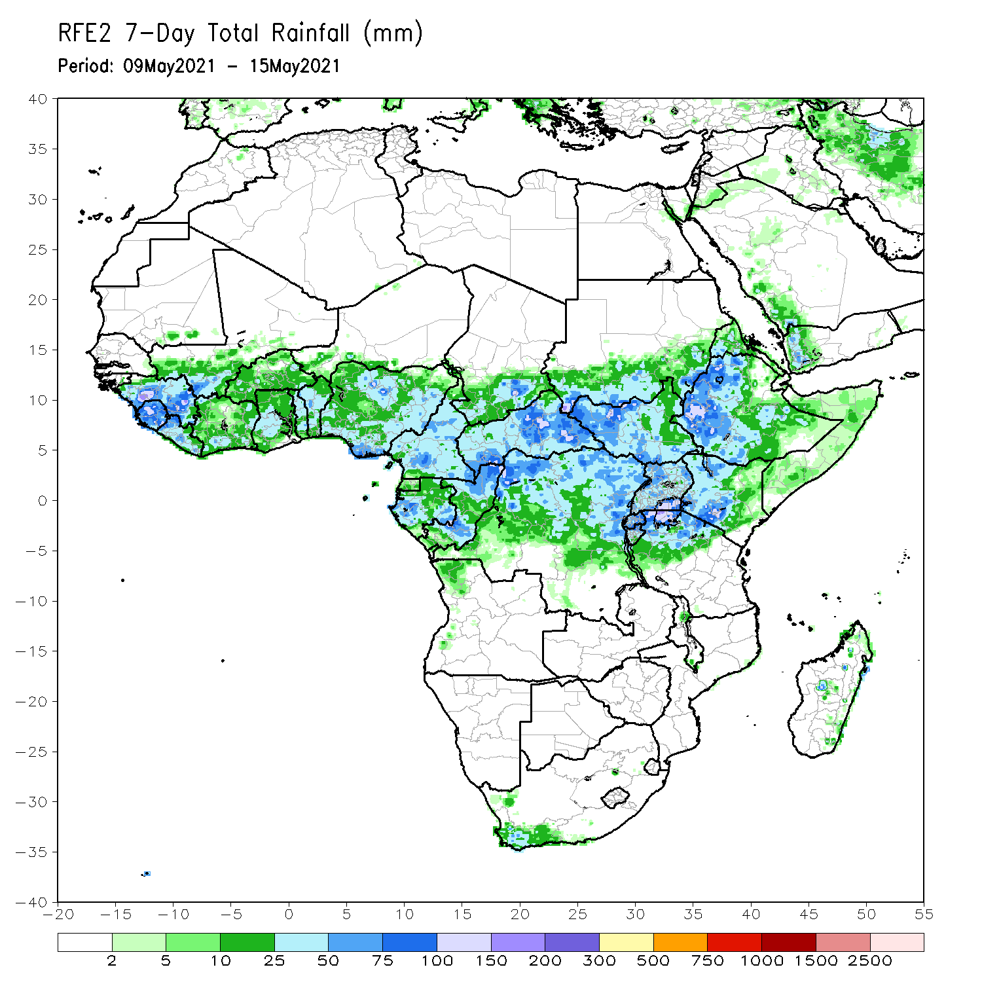
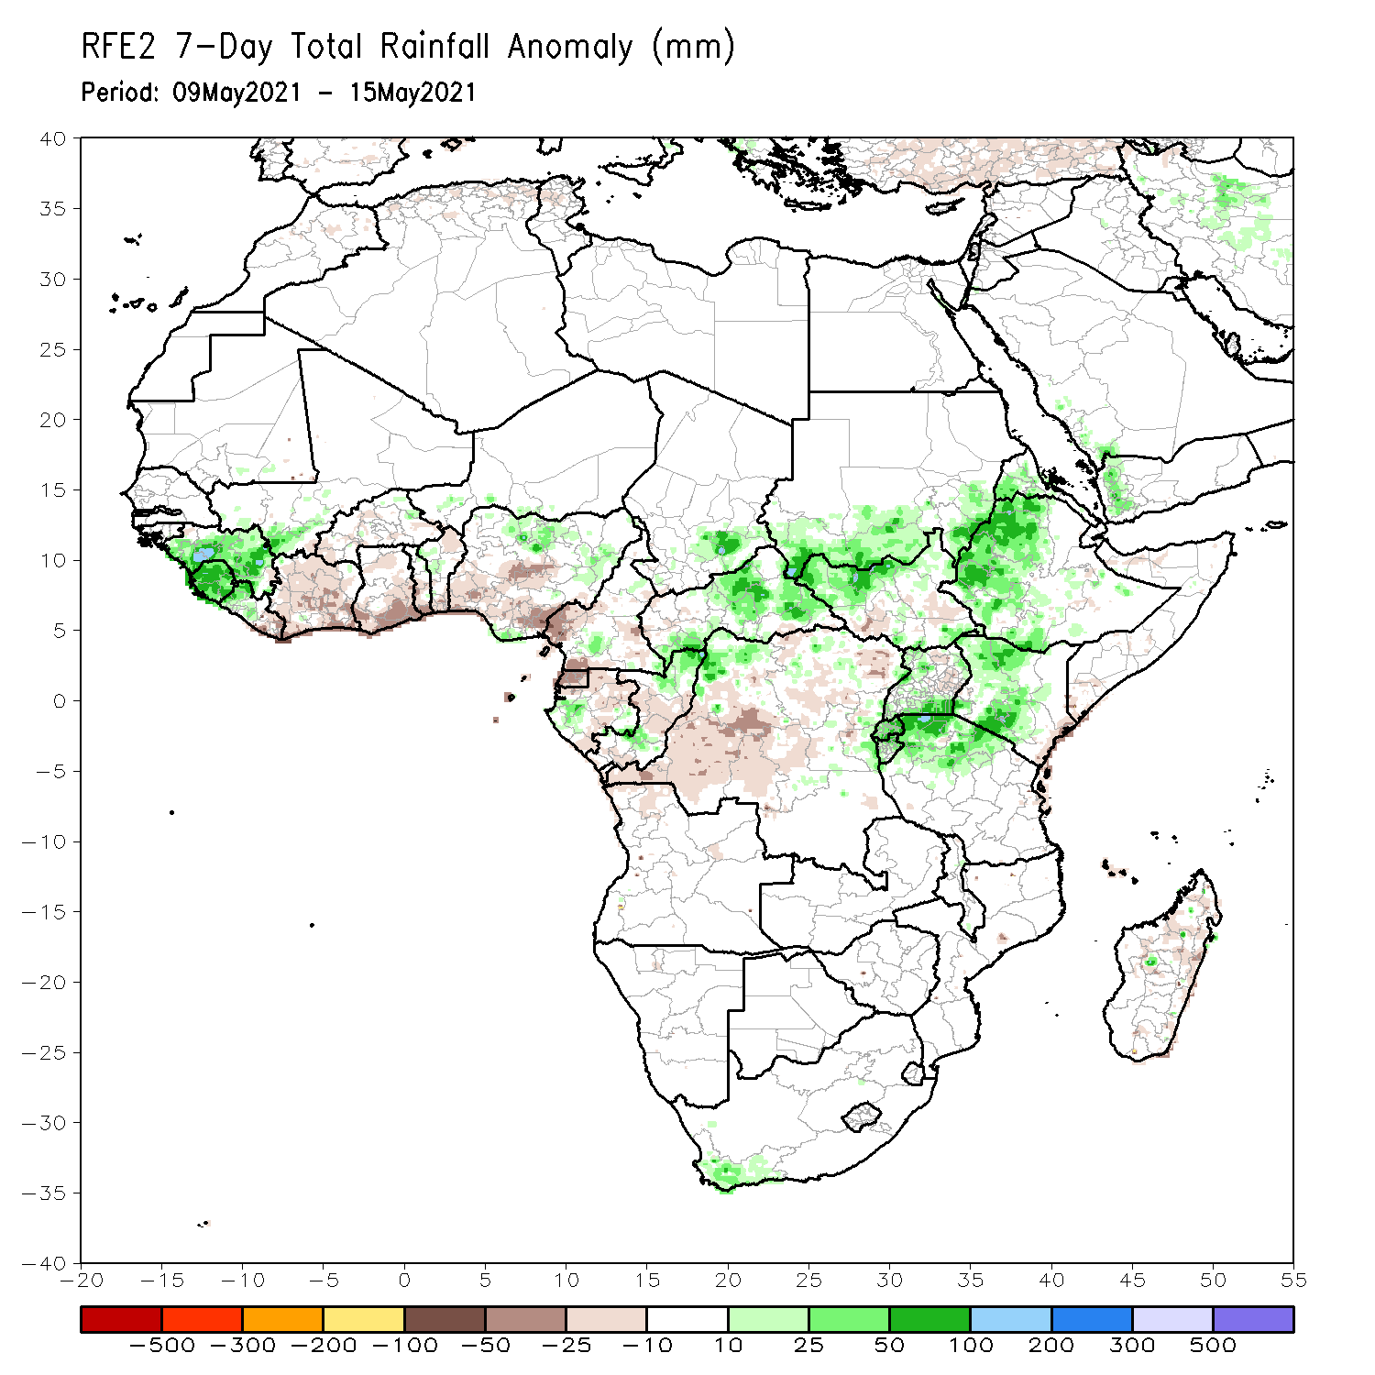
Rainfall Patterns: Last 7 Days
During the past 7 days, in East Africa, rainfall was above-average over western Ethiopia, parts of South Sudan, western Kenya, and northern Tanzania. In Central Africa, rainfall was above-average over pockets of Congo, CAR. In West Africa, below-average rainfall was observed along the Gulf of Guinea coast. Above-average rainfall was observed over much of Sierra Leone and Guinea.

Slide 7
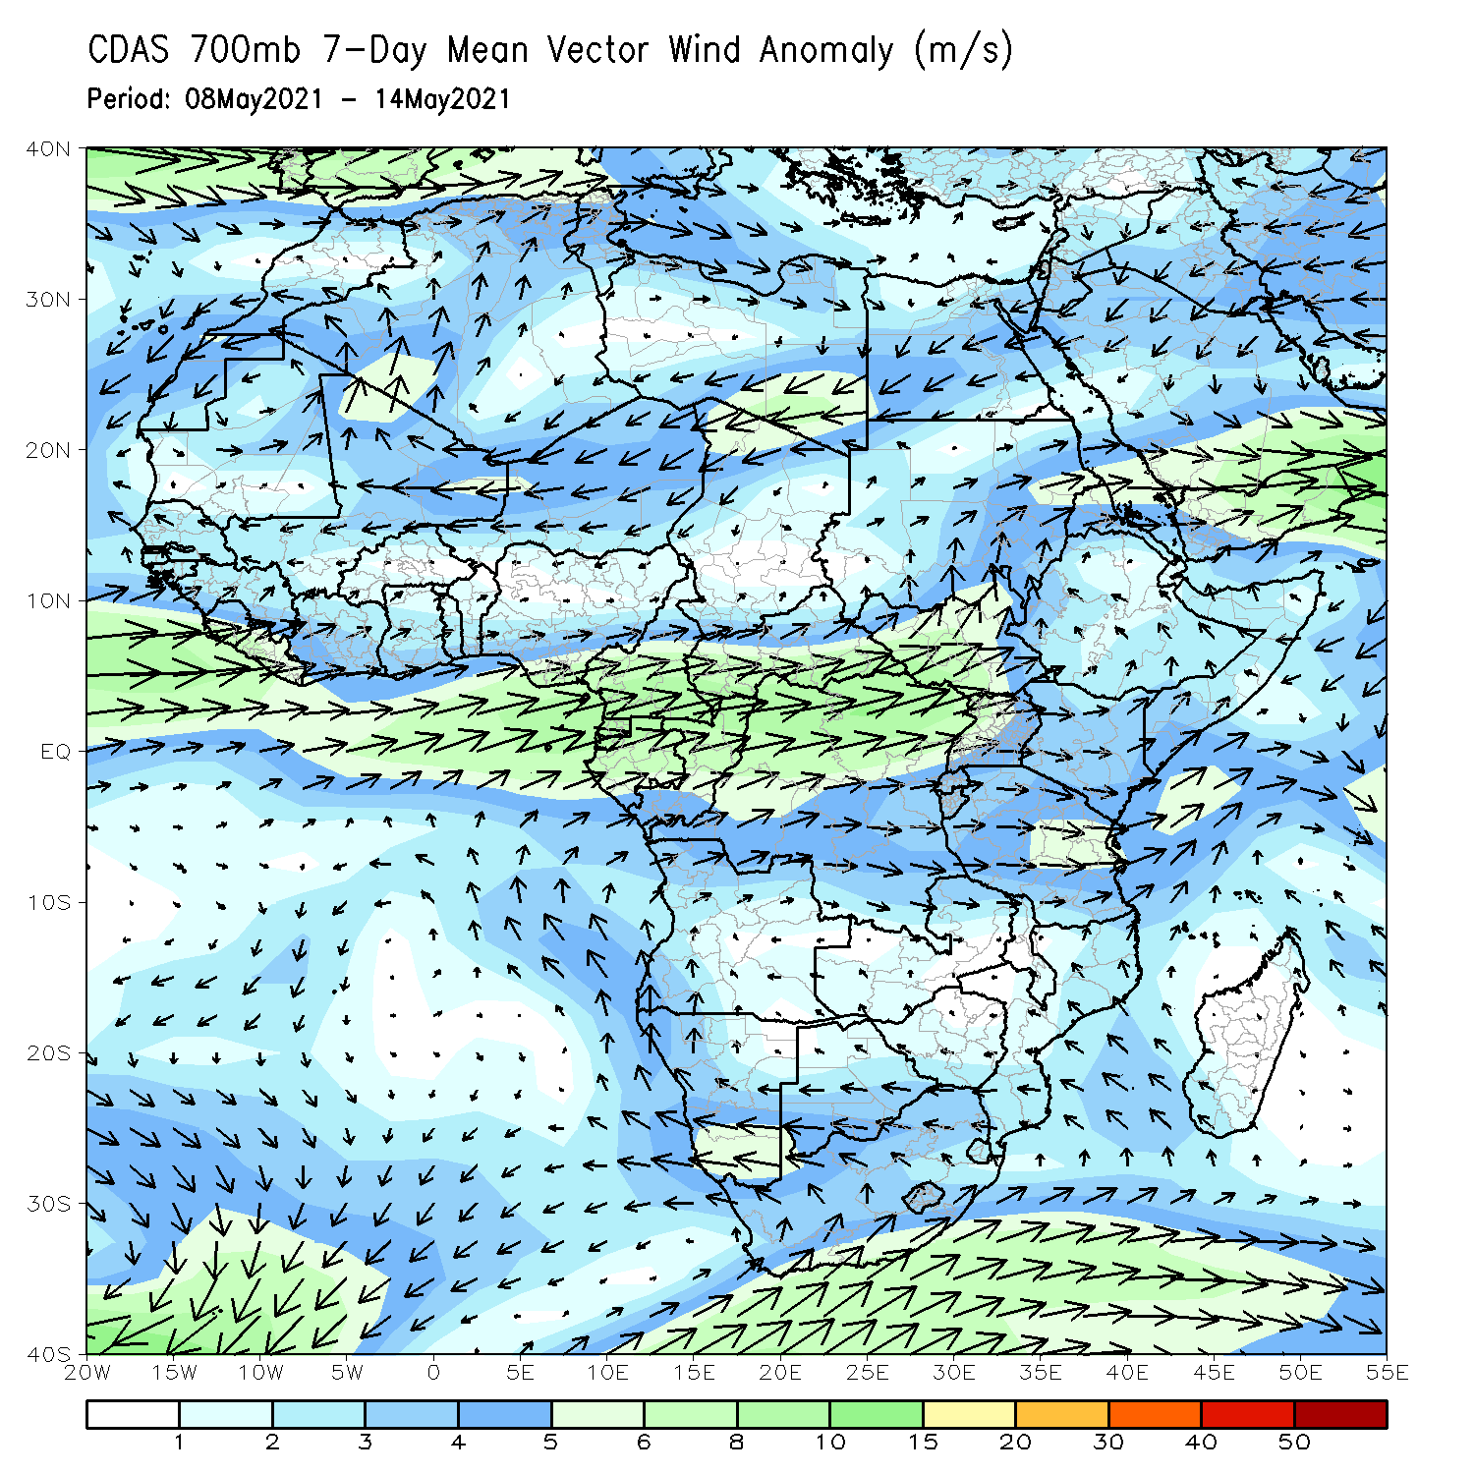
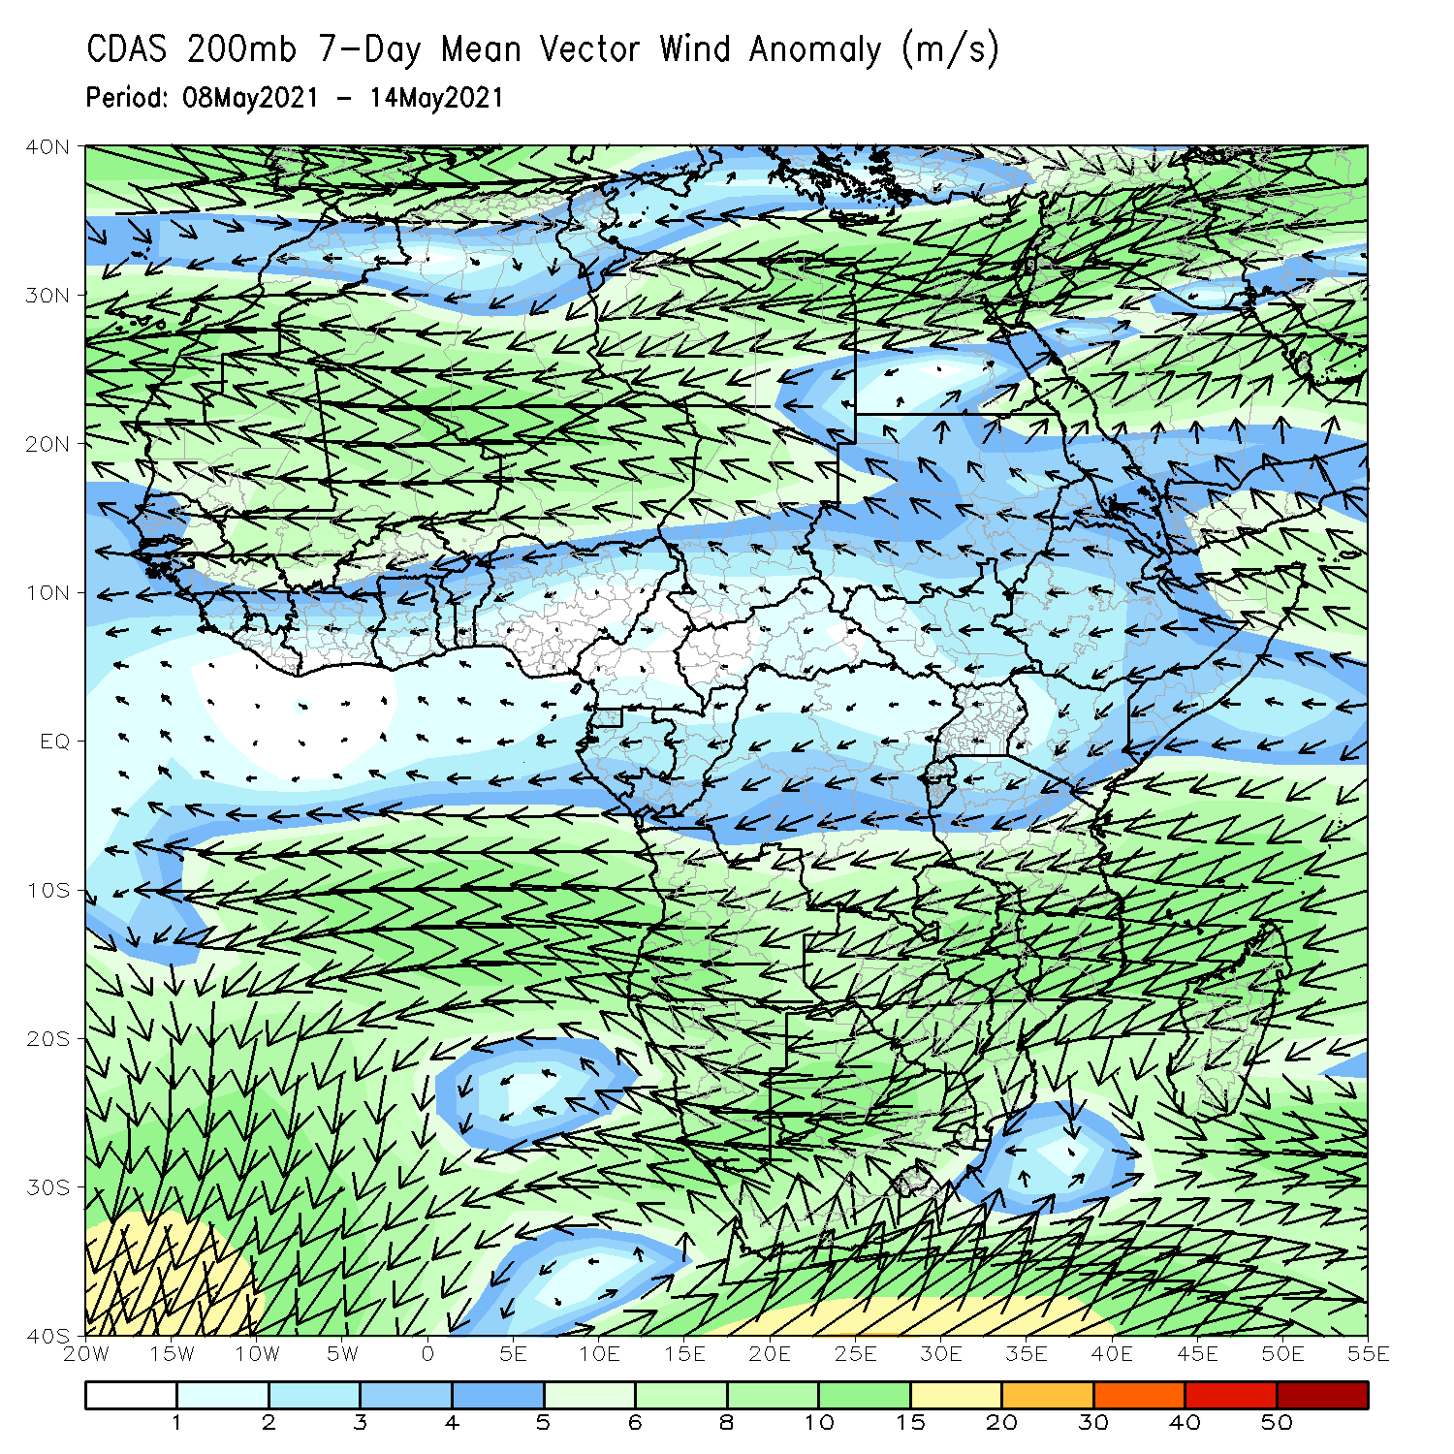
Atmospheric Circulation: Last 7 Days
At lower-level (left panel), anomalous westerly flow was observed across equatorial Africa.

Slide 8
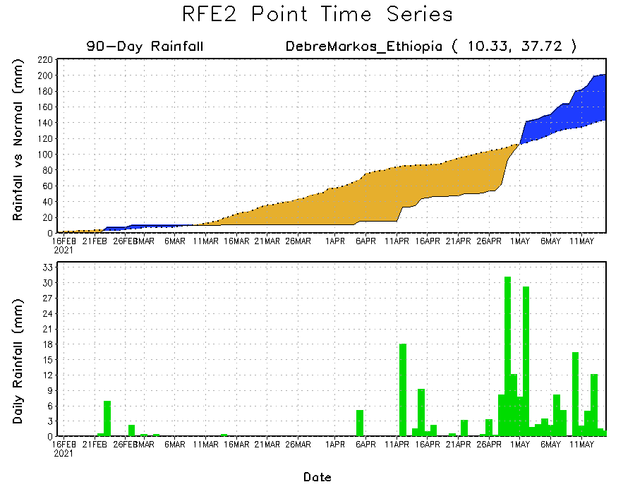
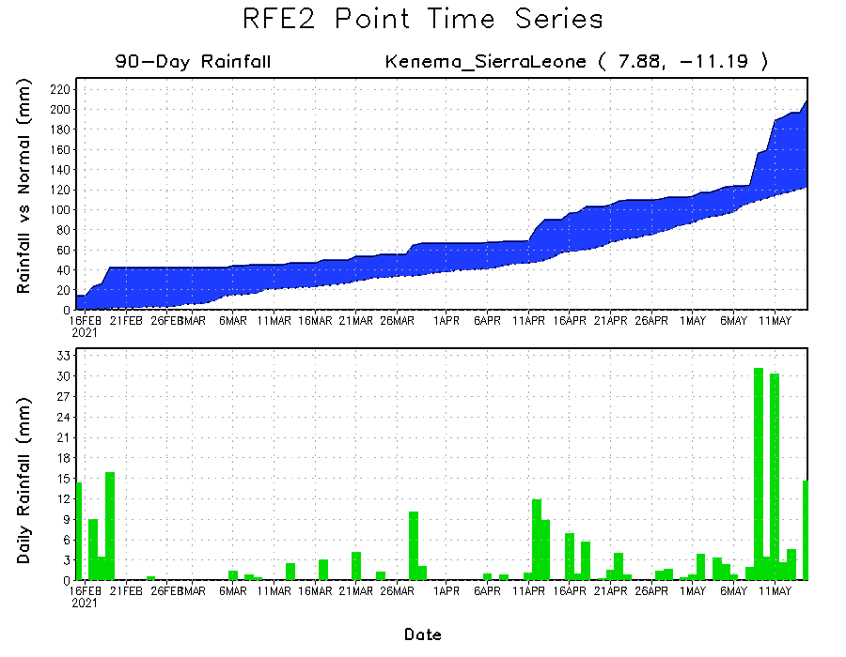
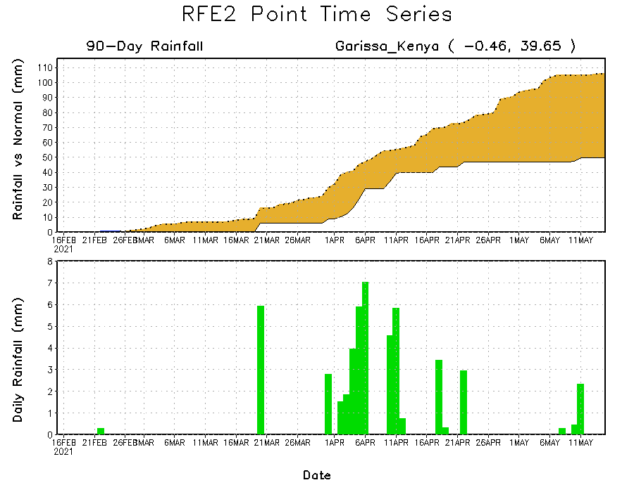
Rainfall Evolution
Daily evolution of rainfall over the last 90 days at selected locations shows moderate to heavy rainfall sustained moisture surpluses over parts of Sierra Leone (bottom left). Moderate to locally heavy rainfall also helped to reduce accumulated rainfall deficits over parts of Ethiopia (top right). In contrast, seasonal total rainfall remained below-average over portions of Kenya (bottom right).

Slide 9
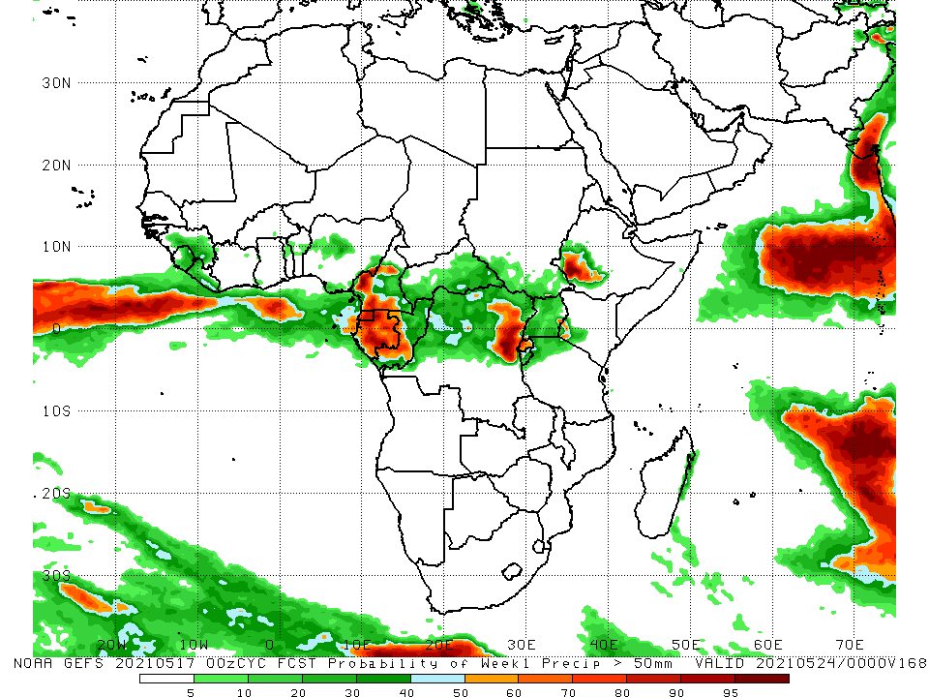
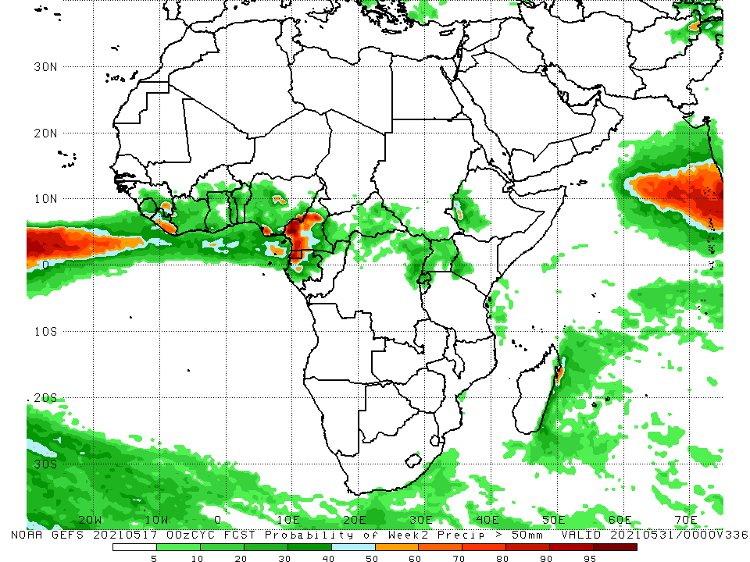
NCEP GEFS Model Forecasts Non-Bias Corrected Probability of precipitation exceedance
Week-1, Valid: 18 - 24 May, 2021
Week-2, Valid: 25 - 31 May, 2021
For week-1 (left panel), week-2 (right panel), the NCEP GEFS indicates a moderate to high chance (over 70%) for rainfall to exceed 50 mm over Sierra Leone, Liberia, parts of Cameroon, Equatorial Guinea, Gabon, parts of northeastern DRC, Rwanda and southwestern Ethiopia.
Notes:
9

Slide 10
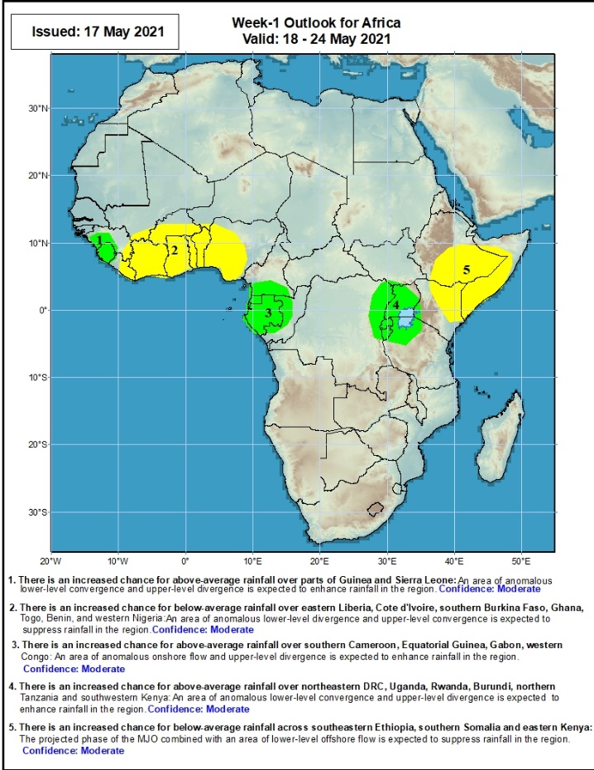
Week-1 Precipitation Outlooks
18 – 24 May, 2021
There is an increased chance for above-average rainfall over parts of Guinea and Sierra Leone: An area of anomalous lower-level convergence and upper-level divergence is expected to enhance rainfall in the region. Confidence: Moderate
There is an increased chance for below-average rainfall over eastern Liberia, Cote d'Ivoire, southern Burkina Faso, Ghana, Togo, Benin, and western Nigeria: An area of anomalous lower-level divergence and upper-level convergence is expected to suppress rainfall in the region. Confidence: Moderate
There is an increased chance for above-average rainfall over southern Cameroon, Equatorial Guinea, Gabon, and western Congo: An area of anomalous onshore flow and upper-level divergence is expected to enhance rainfall in the region. Confidence: Moderate
There is an increased chance for above-average rainfall over northeastern DRC, Uganda, Rwanda, Burundi, northern Tanzania and southwestern Kenya: An area of anomalous lower-level convergence and upper-level divergence is expected to enhance rainfall in the region. Confidence: Moderate
There is an increased chance for below-average rainfall across southeastern Ethiopia, southern Somalia and eastern Kenya: The projected phase of the MJO combined with an area of lower-level offshore flow is expected to suppress rainfall in the region. Confidence: Moderate
Notes:
10

Slide 11
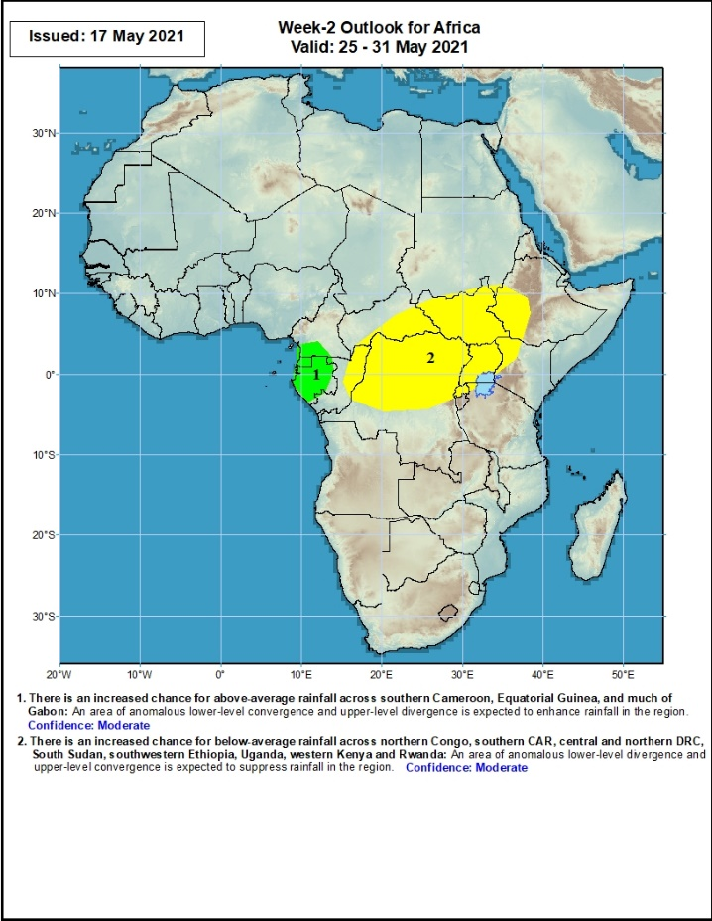
Week-2 Precipitation Outlooks
26 – 31 May, 2021
There is an increased chance for above-average rainfall across southern Cameroon, Equatorial Guinea, and much of Gabon: An area of anomalous lower-level convergence and upper-level divergence is expected to enhance rainfall in the region. Confidence: Moderate
There is an increased chance for below-average rainfall across northern Congo, southern CAR, central and northern DRC, South Sudan, southwestern Ethiopia, Uganda, western Kenya and Rwanda: An area of anomalous lower-level divergence and upper-level convergence is expected to suppress rainfall in the region. Confidence: Moderate
Notes:
11

Slide 12
Summary
During the past 30 to 90 days, in East Africa, above-average rainfall was observed over much of Ethiopia, parts of southern eastern Sudan, much of South Sudan, and parts of Uganda and western Kenya. Rainfall was below-average over eastern Kenya and parts of southern South Sudan, and southern Somalia. In Central Africa, rainfall was below-average over much of Gabon central Congo, and northeastern DRC. Rainfall was above-average over much of CAR, southern and northern Congo, and central and southern DRC. In West Africa, rainfall was above-average over portions of the Gulf of Guinea countries. Below-average rainfall was observed over parts of Cote d’Ivoire, southern Ghana, and central and northern Nigeria.
During the past 7 days, in East Africa, rainfall was above-average over western Ethiopia, parts of South Sudan, western Kenya, and northern Tanzania. In Central Africa, rainfall was above-average over pockets of Congo, CAR. In West Africa, below-average rainfall was observed along the Gulf of Guinea coast. Above-average rainfall was observed over much of Sierra Leone and Guinea.
Week-1 outlooks call for an increased chance for below-average rainfall over much of the Gulf of Guinea region, and equatorial East Africa. There is an increased chance for above average rainfall over parts of Guinea, Sierra Leone, southern Cameroon, Equatorial Guinea, Gabon, western Congo, and the Lake Victoria region. Week-2 outlooks call for an increased chance for above-average rainfall across southern Cameroon, Equatorial Guinea, and much of Gabon. There is an increased chance for below-average rainfall across northern Congo, southern CAR, central and northern DRC, South Sudan, southwestern Ethiopia, Uganda, western Kenya and Rwanda.

