Slide 1
The African Monsoon Recent Evolution and Current Status Include Week-1 and Week-2 Outlooks
Update prepared by
10 May 2021
For more information, visit:
http://www.cpc.ncep.noaa.gov/products/Global_Monsoons/African_Monsoons/precip_monitoring.shtml

Slide 2
Outline
Highlights
Recent Evolution and Current Conditions
NCEP GEFS Forecasts
Summary

Slide 3
Highlights: Last 7 Days
During the past 7 days, in East Africa, rainfall was above-average over much of Ethiopia, central and southern Somalia, much of South Sudan, western Kenya, and parts of Tanzania. In Central Africa, rainfall was above-average over many parts of DRC, Congo, Cameroon and CAR. In West Africa, below-average rainfall was observed along the Gulf of Guinea coast. Above-average rainfall was observed over parts of northern Ghana, northern Togo and northern Benin.
For week-1 and week-2, there is a moderate to high chance (over 70%) for rainfall to exceed 50 mm over parts of Cameroon, Gabon, northeastern DRC, Rwanda, Burundi, Uganda, western Kenya and western Ethiopia.

Slide 4
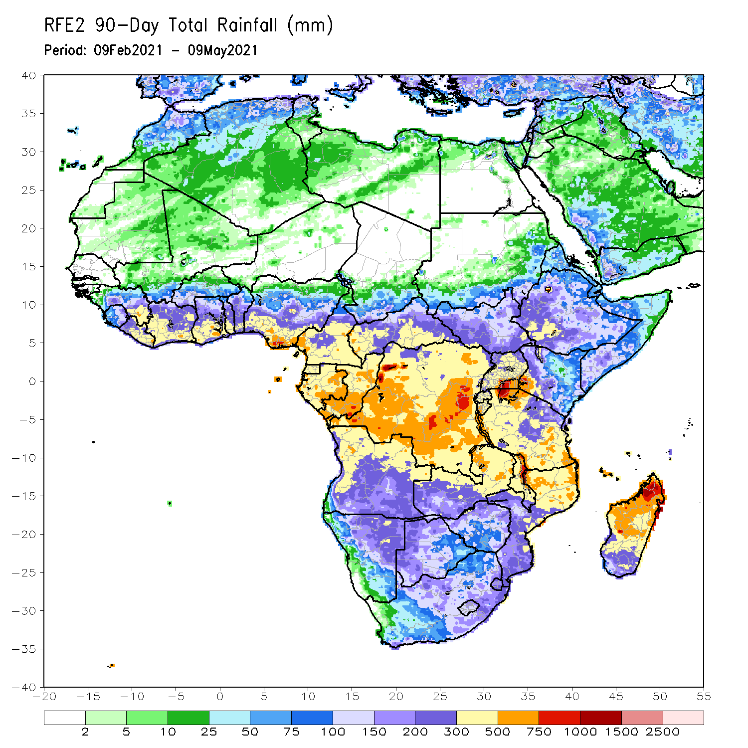
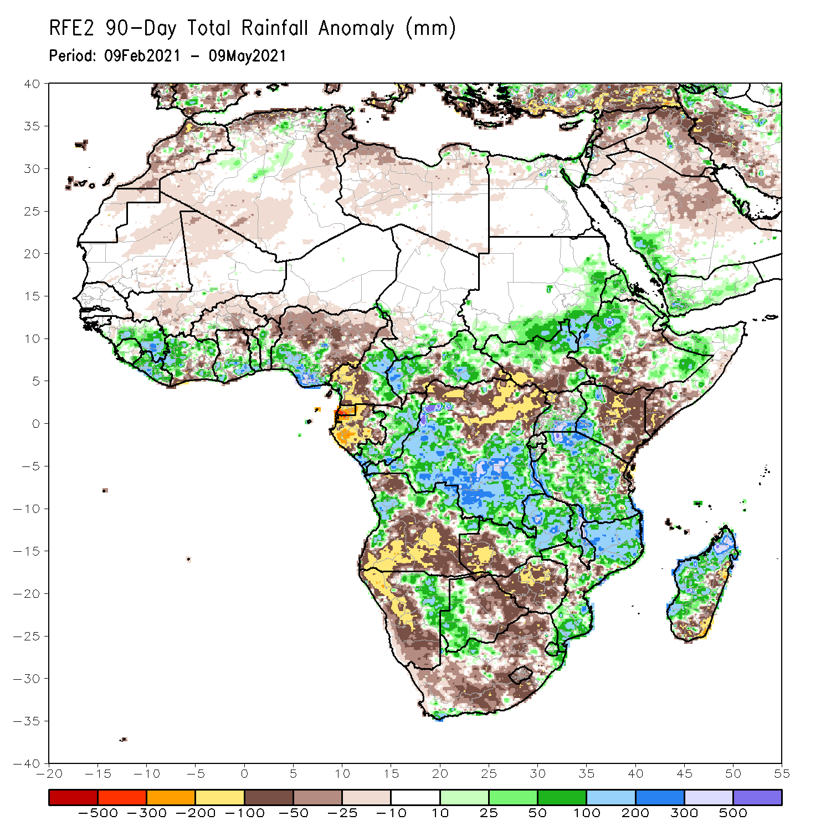
Rainfall Patterns: Last 90 Days
Over the past 90 days, in East Africa, rainfall was below-average over parts of central and southwestern Ethiopia, southern Somalia, and many parts of Kenya. Rainfall was also below-average over southern South Sudan and northern Uganda. Above-average rainfall was observed over western and southeastern Ethiopia, northern South Sudan, southern Uganda, much of Tanzania, and parts of central Somalia. In southern Africa, above-average rainfall was observed over western and eastern Angola, northeastern and eastern Namibia, and western Botswana. Rainfall was also above-average over central and eastern Zambia, Malawi, many parts of Mozambique, local areas in South Africa, and much of Madagascar. Persistent light rains resulted in moisture deficits over central and southern Angola, and western and southern Namibia. Rainfall was also below-average over western Zambia, much of Zimbabwe, pockets of eastern Madagascar, and many parts of South Africa. In Central Africa, rainfall was above-average over central and southern DRC, eastern Gabon, Congo, and parts of CAR. Rainfall was below-average over parts northern DRC, and parts of central CAR. Below-average rains were also observed over the western areas of Gabon, Equatorial Guinea, the far northern Congo, and western Cameroon. In West Africa, rainfall was above-average over many places in the Gulf of Guinea countries. Below-average rainfall was observed over pockets of Cote d’Ivoire, northern Ghana, parts of Burkina Faso, and central and northern Nigeria.
Notes:
4

Slide 5
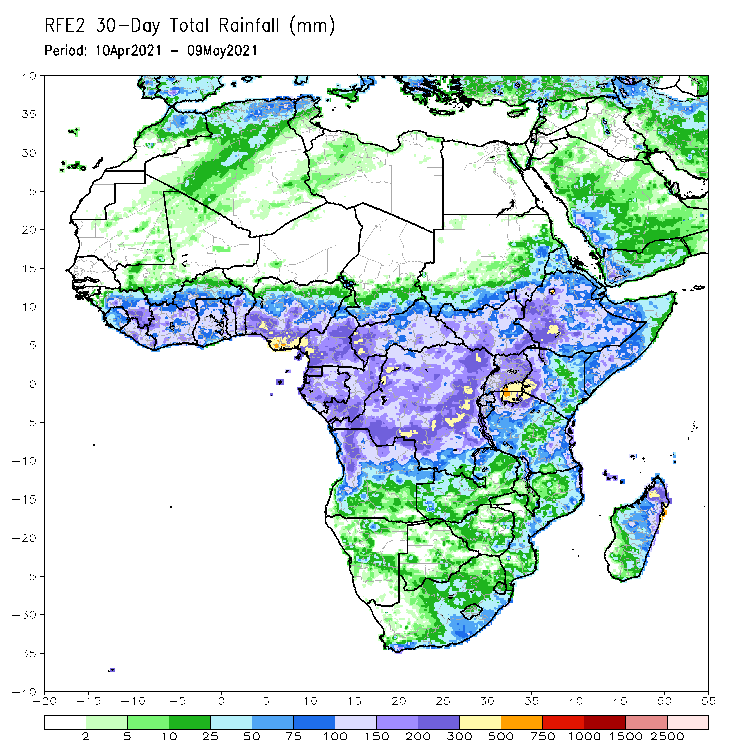
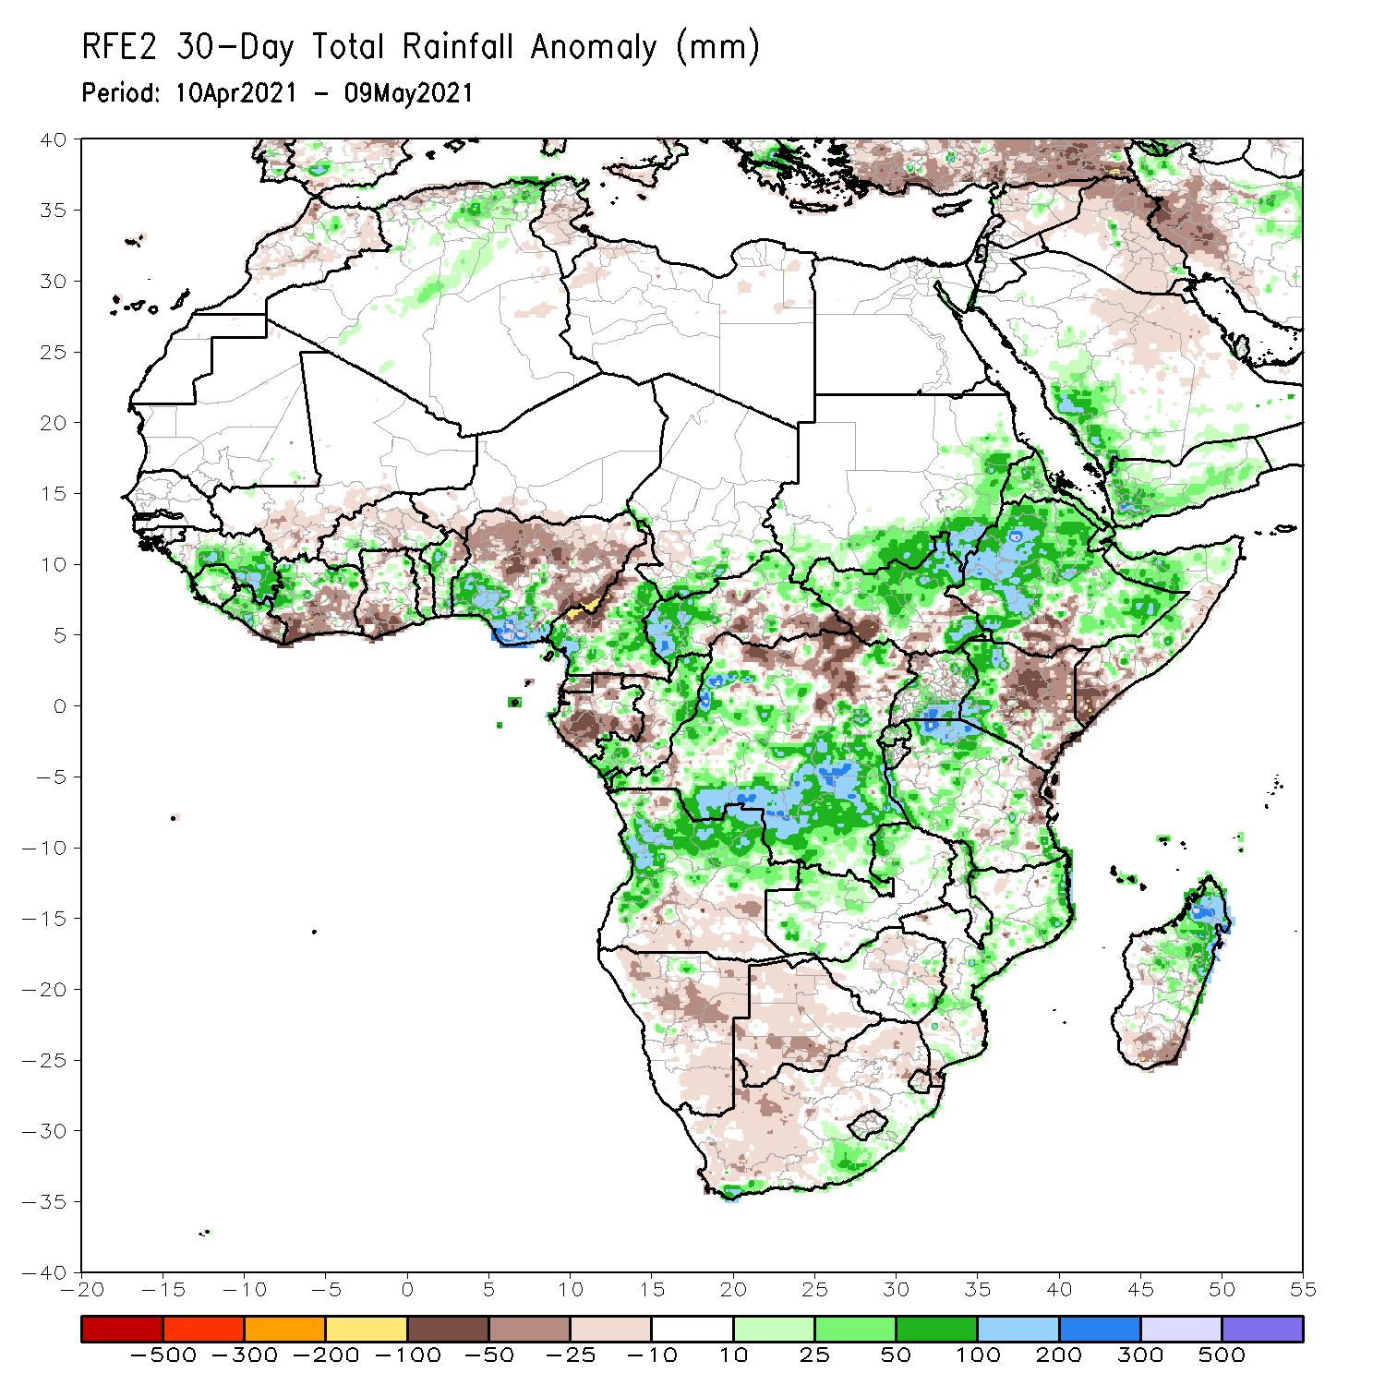
Rainfall Patterns: Last 30 Days
During the past 30 days, in East Africa, above-average rainfall was observed over much of Ethiopia, parts of southern eastern Sudan, much of South Sudan, and parts of Uganda and western Kenya. Rainfall was below-average over local areas in southern Ethiopia, eastern Kenya, parts of southern South Sudan, and southern Somalia. In Central Africa, rainfall was below-average over much of Gabon central Congo, northern DRC and portions of eastern CAR. Rainfall was above-average over western CAR, southern and northern Congo, and central and southern DRC. In West Africa, rainfall was above-average over portions of the Gulf of Guinea countries. Below-average rainfall was observed over parts of Cote d’Ivoire, southern Ghana, and central and northern Nigeria. In southern Africa, rainfall was below-average over much of Southern Africa. Below-average rainfall was observed over northern Malawi and northeastern Madagascar.
Notes:
5

Slide 6
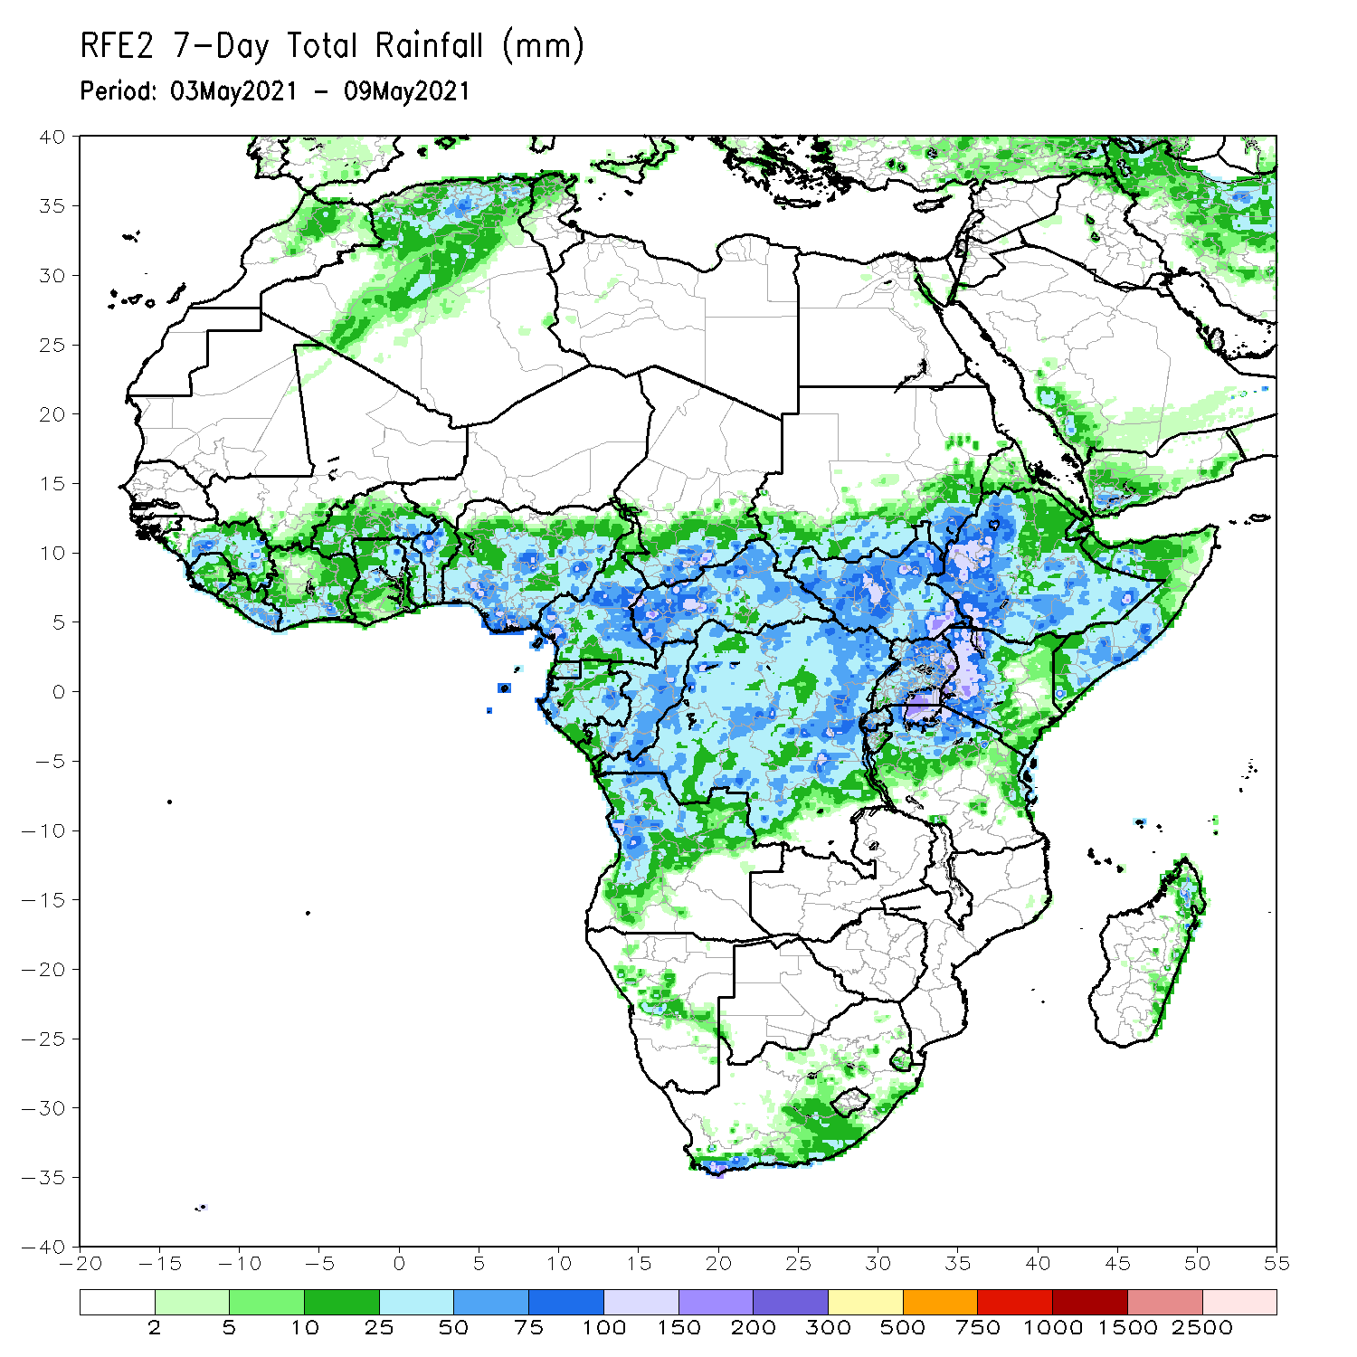
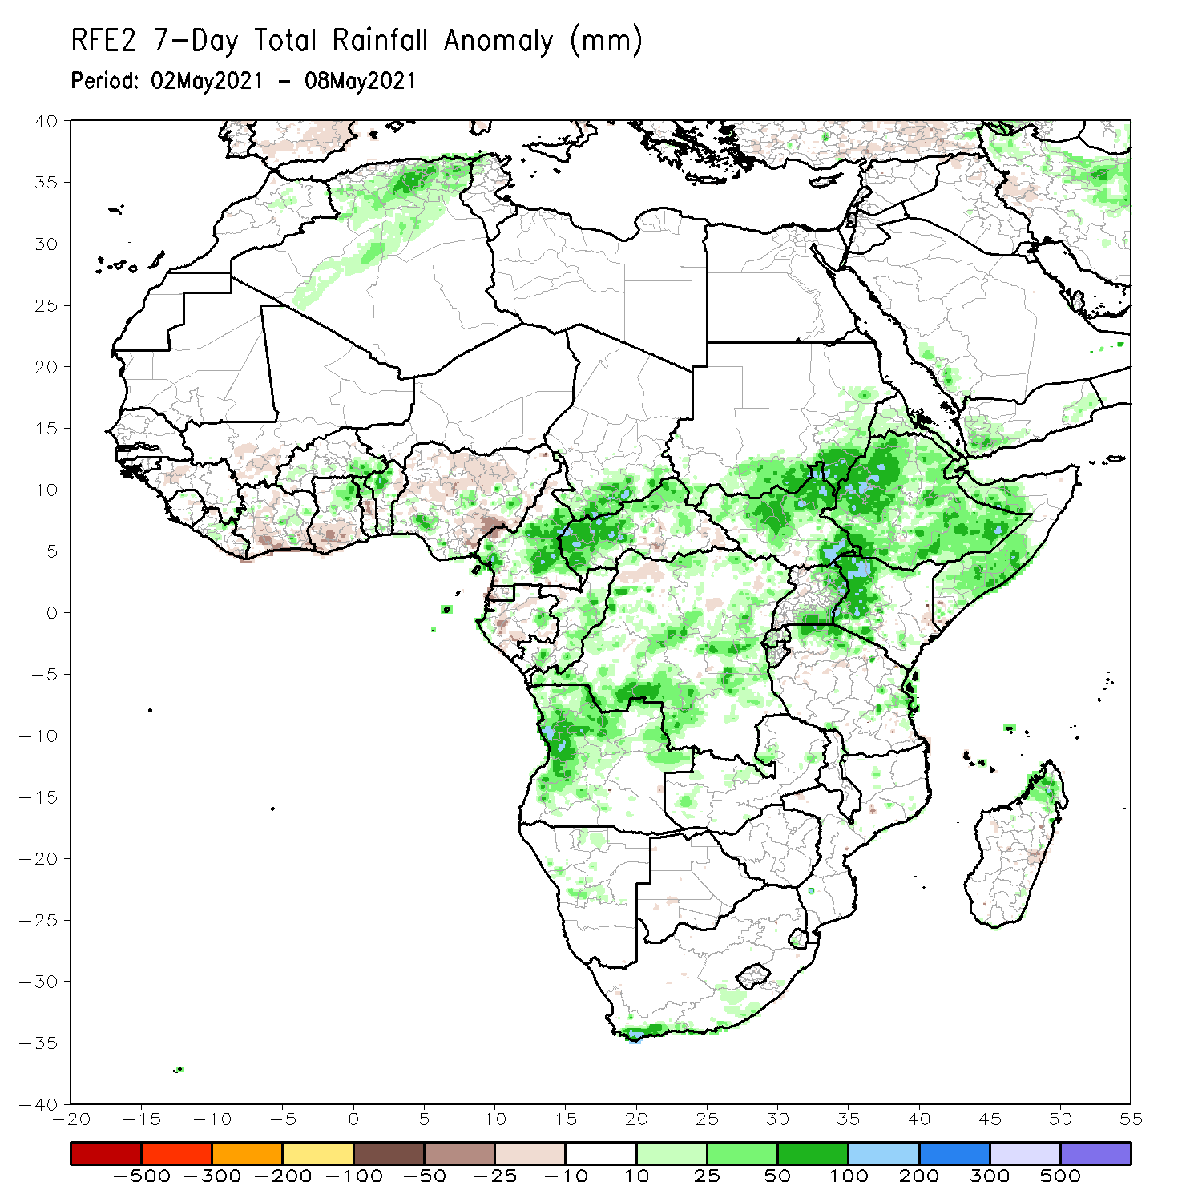
Rainfall Patterns: Last 7 Days
During the past 7 days, in East Africa, rainfall was above-average over much of Ethiopia, central and southern Somalia, much of South Sudan, western Kenya, and parts of Tanzania. In Central Africa, rainfall was above-average over many parts of DRC, Congo, Cameroon and CAR. In West Africa, below-average rainfall was observed along the Gulf of Guinea coast. Above-average rainfall was observed over parts of northern Ghana, northern Togo and northern Benin.

Slide 7
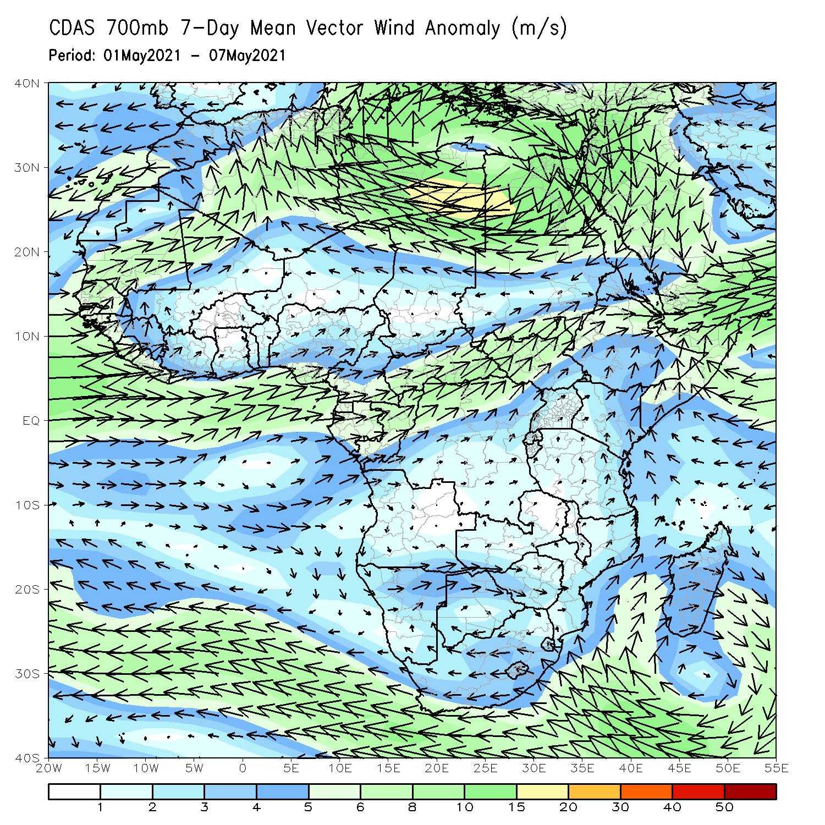
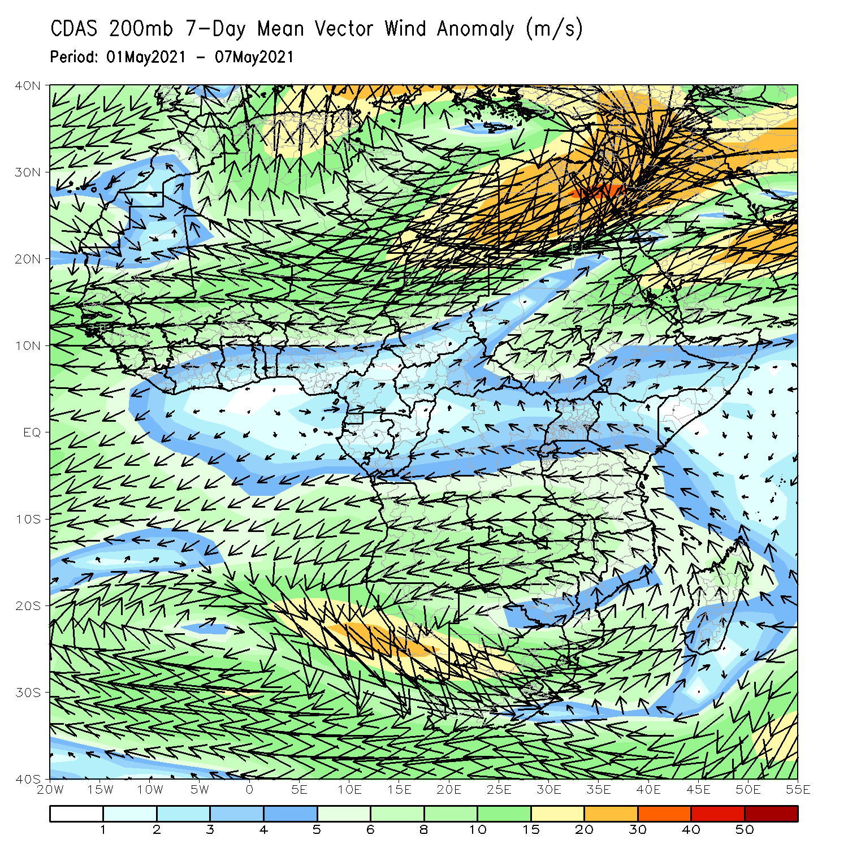
Atmospheric Circulation: Last 7 Days
At lower-level (left panel), anomalous onshore was observed the Gulf of Guinea and East Africa.

Slide 8
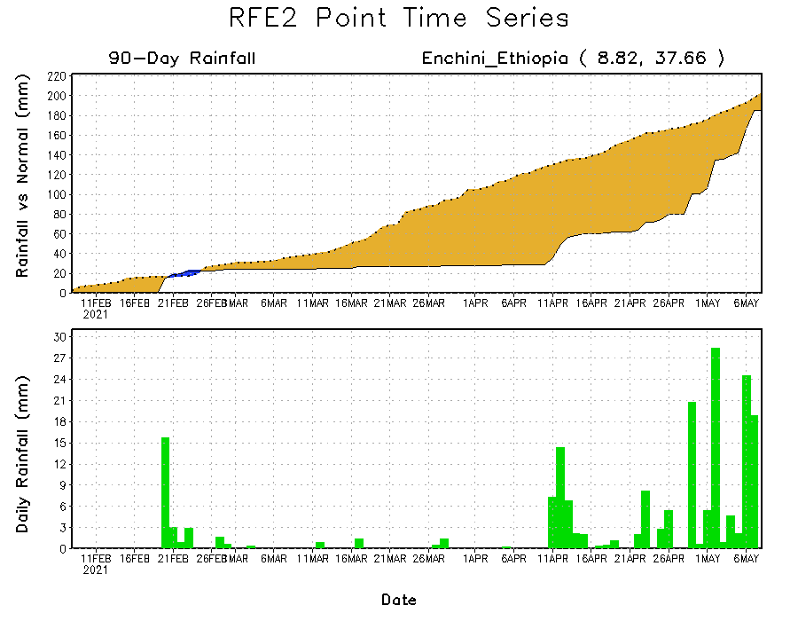
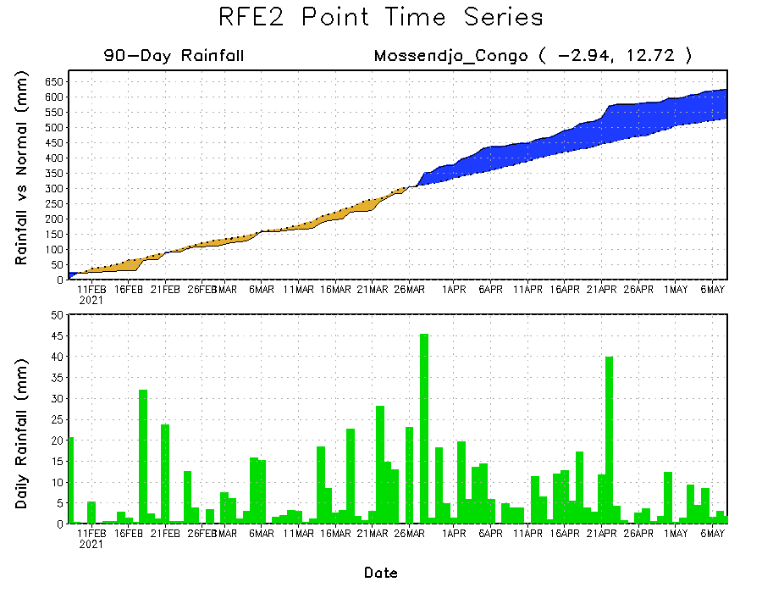
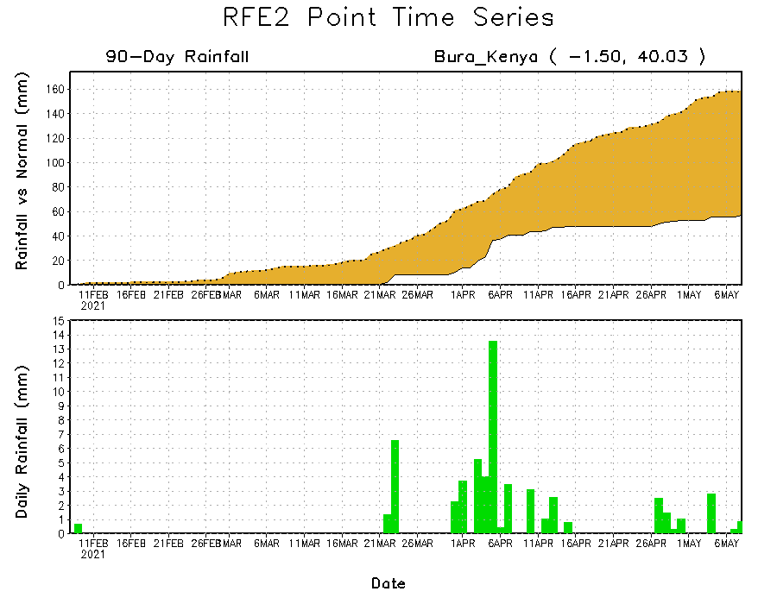
Rainfall Evolution
Daily evolution of rainfall over the last 90 days at selected locations shows moderate to heavy rainfall sustained moisture surpluses over parts of Congo (bottom left). Moderate to locally heavy rainfall also helped to reduce accumulated rainfall deficits over parts of Ethiopia (top right). In contrast, seasonal total rainfall remained below-average over portions of Kenya (bottom right).

Slide 9
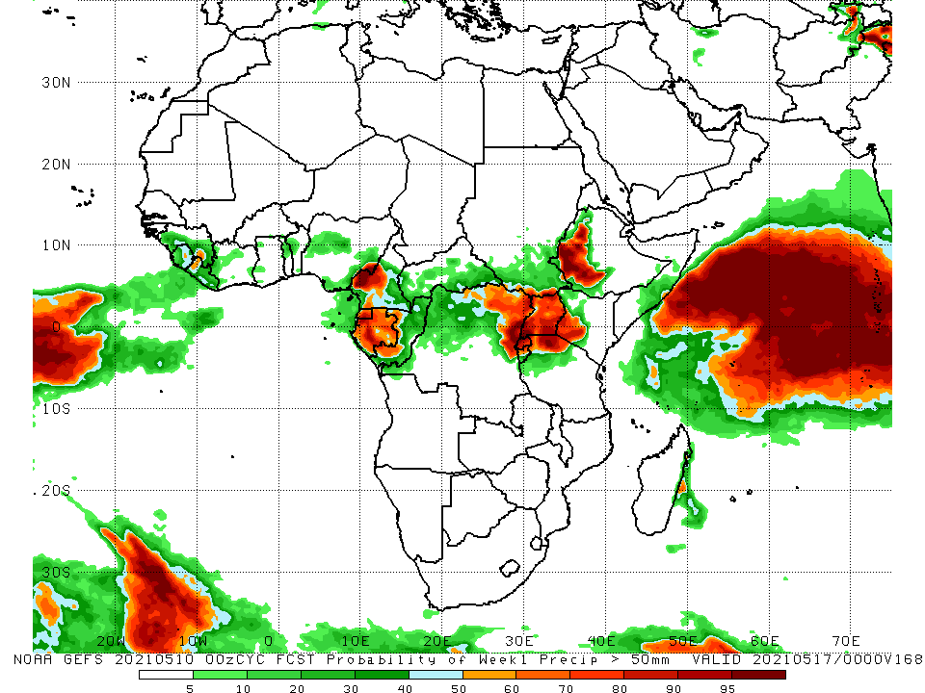
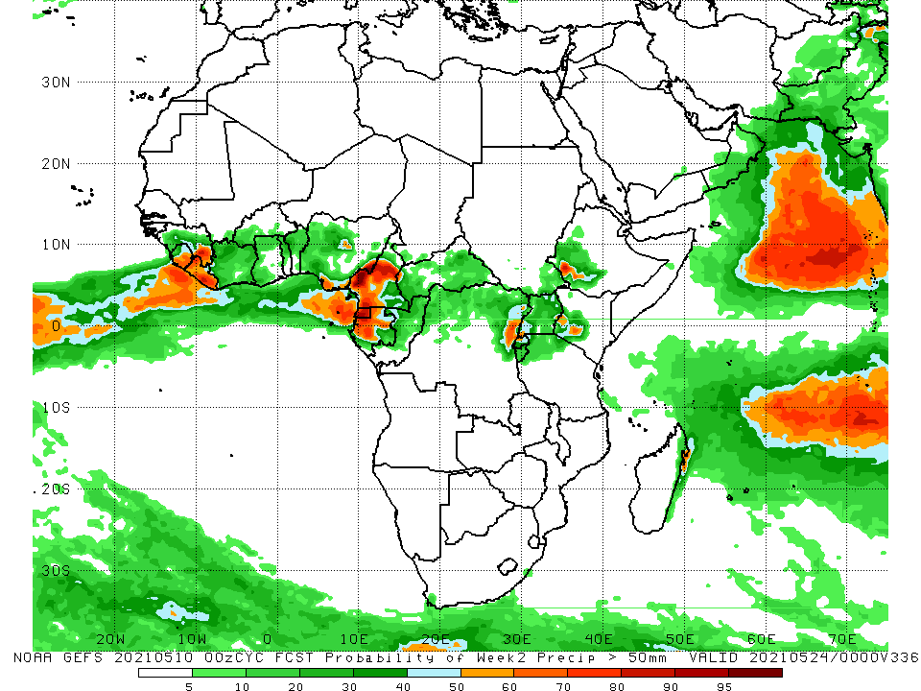
NCEP GEFS Model Forecasts Non-Bias Corrected Probability of precipitation exceedance
Week-1, Valid: 11 - 17 May, 2021
Week-2, Valid: 18 - 24 May, 2021
For week-1 (left panel), week-2 (right panel), the NCEP GEFS indicates a moderate to high chance (over 70%) for rainfall to exceed 50 mm over parts of Cameroon, Gabon, northeastern DRC, Rwanda, Burundi, Uganda, western Kenya and western Ethiopia.
Notes:
9

Slide 10
Summary
During the past 30 to 90 days, in East Africa, below-average rainfall was observed over much of Ethiopia, parts of southern eastern Sudan, much of South Sudan, and parts of Uganda and western Kenya. Rainfall was below-average over local areas in southern Ethiopia, eastern Kenya, parts of southern South Sudan, and southern Somalia. In Central Africa, rainfall was below-average over much of Gabon central Congo, northern DRC and portions of eastern CAR. Rainfall was above-average over western CAR, southern and northern Congo, and central and southern DRC. In West Africa, rainfall was above-average over portions of the Gulf of Guinea countries. Below-average rainfall was observed over parts of Cote d’Ivoire, southern Ghana, and central and northern Nigeria. In southern Africa, rainfall was below-average over much of Southern Africa. Below-average rainfall was observed over northern Malawi and northeastern Madagascar.
During the past 7 days, in East Africa, rainfall was above-average over much of Ethiopia, central and southern Somalia, much of South Sudan, western Kenya, and parts of Tanzania. In Central Africa, rainfall was above-average over many parts of DRC, Congo, Cameroon and CAR. In West Africa, below-average rainfall was observed along the Gulf of Guinea coast. Above-average rainfall was observed over parts of northern Ghana, northern Togo and northern Benin.
For week-1 and week-2, there is a moderate to high chance (over 70%) for rainfall to exceed 50 mm over parts of Cameroon, Gabon, northeastern DRC, Rwanda, Burundi, Uganda, western Kenya and western Ethiopia.

