Slide 1
The African Monsoon Recent Evolution and Current Status Include Week-1 and Week-2 Outlooks
Update prepared by
19 April 2021
For more information, visit:
http://www.cpc.ncep.noaa.gov/products/Global_Monsoons/African_Monsoons/precip_monitoring.shtml

Slide 2
Outline
Highlights
Recent Evolution and Current Conditions
NCEP GEFS Forecasts
Summary

Slide 3
Highlights: Last 7 Days
During the past 7 days, in East Africa, rainfall was below-average over eastern and southeastern Ethiopia, much of Kenya, southern Somalia and parts of South Sudan. Above-average rainfall was observed over parts of Ethiopia and pockets of Tanzania. In Central Africa, rainfall was below-average over much of Gabon, Congo, CAR, and parts of western and northern DRC. Above-average rainfall was observed over parts of southern and eastern DRC. In West Africa, above-average rainfall was observed over portions of the Gulf of Guinea countries.
For week-1 and week-2, there is a moderate to high chance (over 70%) for rainfall to exceed 50 mm over parts of Cameroon, Equatorial Guinea, Gabon, southern Congo, northern Angola, parts of southern and eastern DRC, Rwanda, Burundi, southern Uganda, portions of Tanzania, and pockets of southern Ethiopia and southern Somalia.

Slide 4
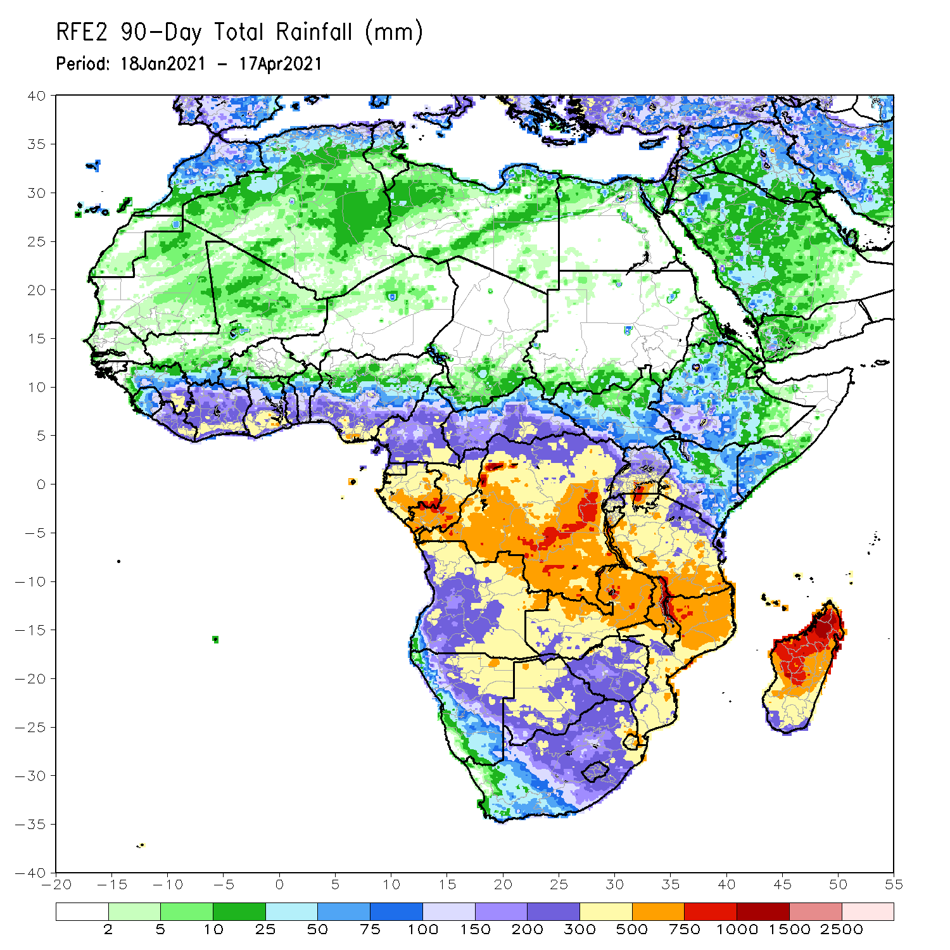
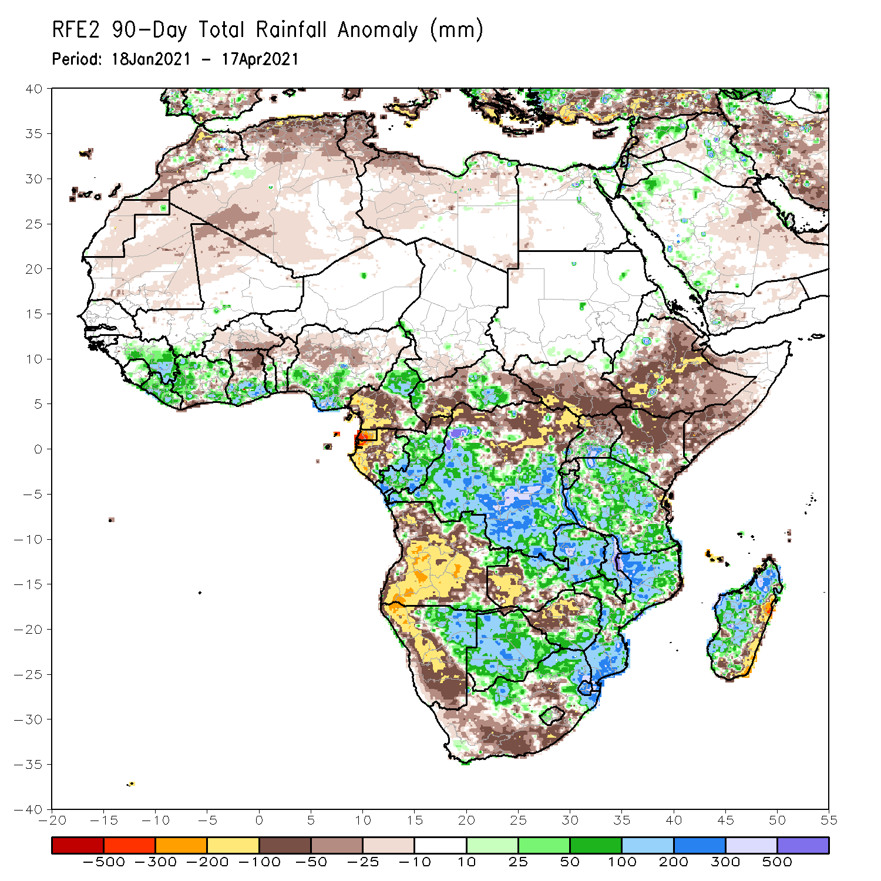
Rainfall Patterns: Last 90 Days
Over the past 90 days, in East Africa, rainfall was below-average over many parts of Ethiopia and Kenya. Rainfall was also below-average over much of South Sudan and northern Uganda. Above-average rainfall was observed over southern Uganda, Rwanda, Burundi and much of Tanzania, and pockets of western Ethiopia and southwestern Kenya. In southern Africa, moderate to locally heavy rains resulted in sustained moisture surpluses over central and eastern Namibia and much of Botswana. Rainfall was also above-average over central and eastern Zambia, Malawi, southern Zimbabwe, much of Mozambique and northern South Africa, and many parts of Madagascar. Persistent light rains resulted in moisture deficits over many parts of Angola, and parts of western Namibia. Rainfall was also below-average over western Zambia, western and northern Zimbabwe, parts of eastern Madagascar, western and southern South Africa, and eastern Madagascar. In Central Africa, rainfall was above-average over many parts of DRC, Congo and eastern CAR. Rainfall was below-average over parts of northeastern DRC and western CAR. Below-average rains were also observed over the western areas of Gabon, Equatorial Guinea, the far northern Congo, and southern Cameroon. In West Africa, rainfall was above-average over portions of the Gulf of Guinea countries. Below-average rainfall was observed over northern Ghana and northern Nigeria.
Notes:
4

Slide 5
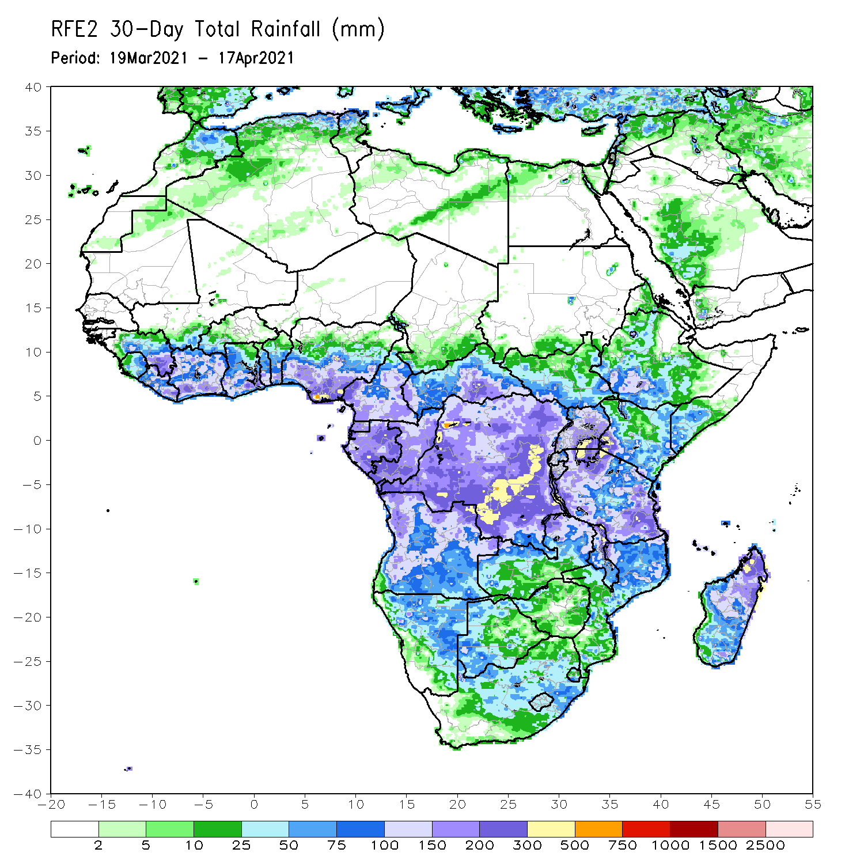
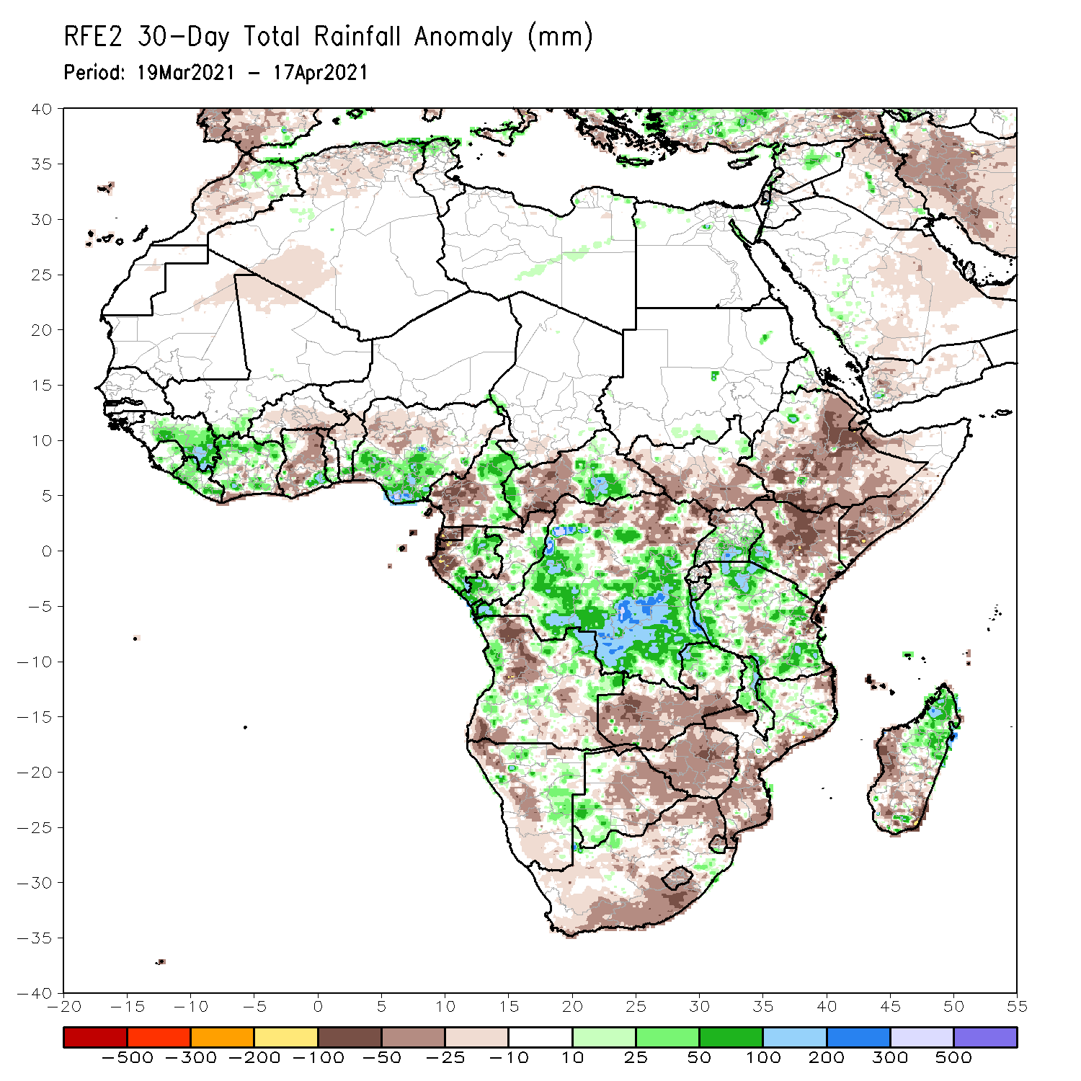
Rainfall Patterns: Last 30 Days
During the past 30 days, in East Africa, below-average rainfall was observed over many parts of Ethiopia, southern South Sudan, much of Kenya, and southern Somalia. In contrast, rainfall was above-average over much of Uganda and Tanzania, and pockets of Kenya and Ethiopia. In southern Africa, above-average rainfall was observed over portions of Angola, Namibia and southwestern Botswana. Rainfall was also above-average over parts of eastern Zambia, Malawi, northern Mozambique, and northern Madagascar. In contrast, persistent light rains sustained moisture deficits over pockets of Angola, western Namibia, southern and western Zambia, central and eastern Botswana, Zimbabwe, many parts of South Africa, southern Mozambique, and parts of western and southern Madagascar. In Central Africa, rainfall was below-average over western Gabon, western CAR and parts of northern DRC. Rainfall was above-average over eastern Gabon, Congo, many parts of DRC, and eastern CAR. In West Africa, rainfall was above-average over many places in the Gulf of Guinea countries. Below-average rainfall was observed over much of Ghana and northern Nigeria.
Notes:
5

Slide 6
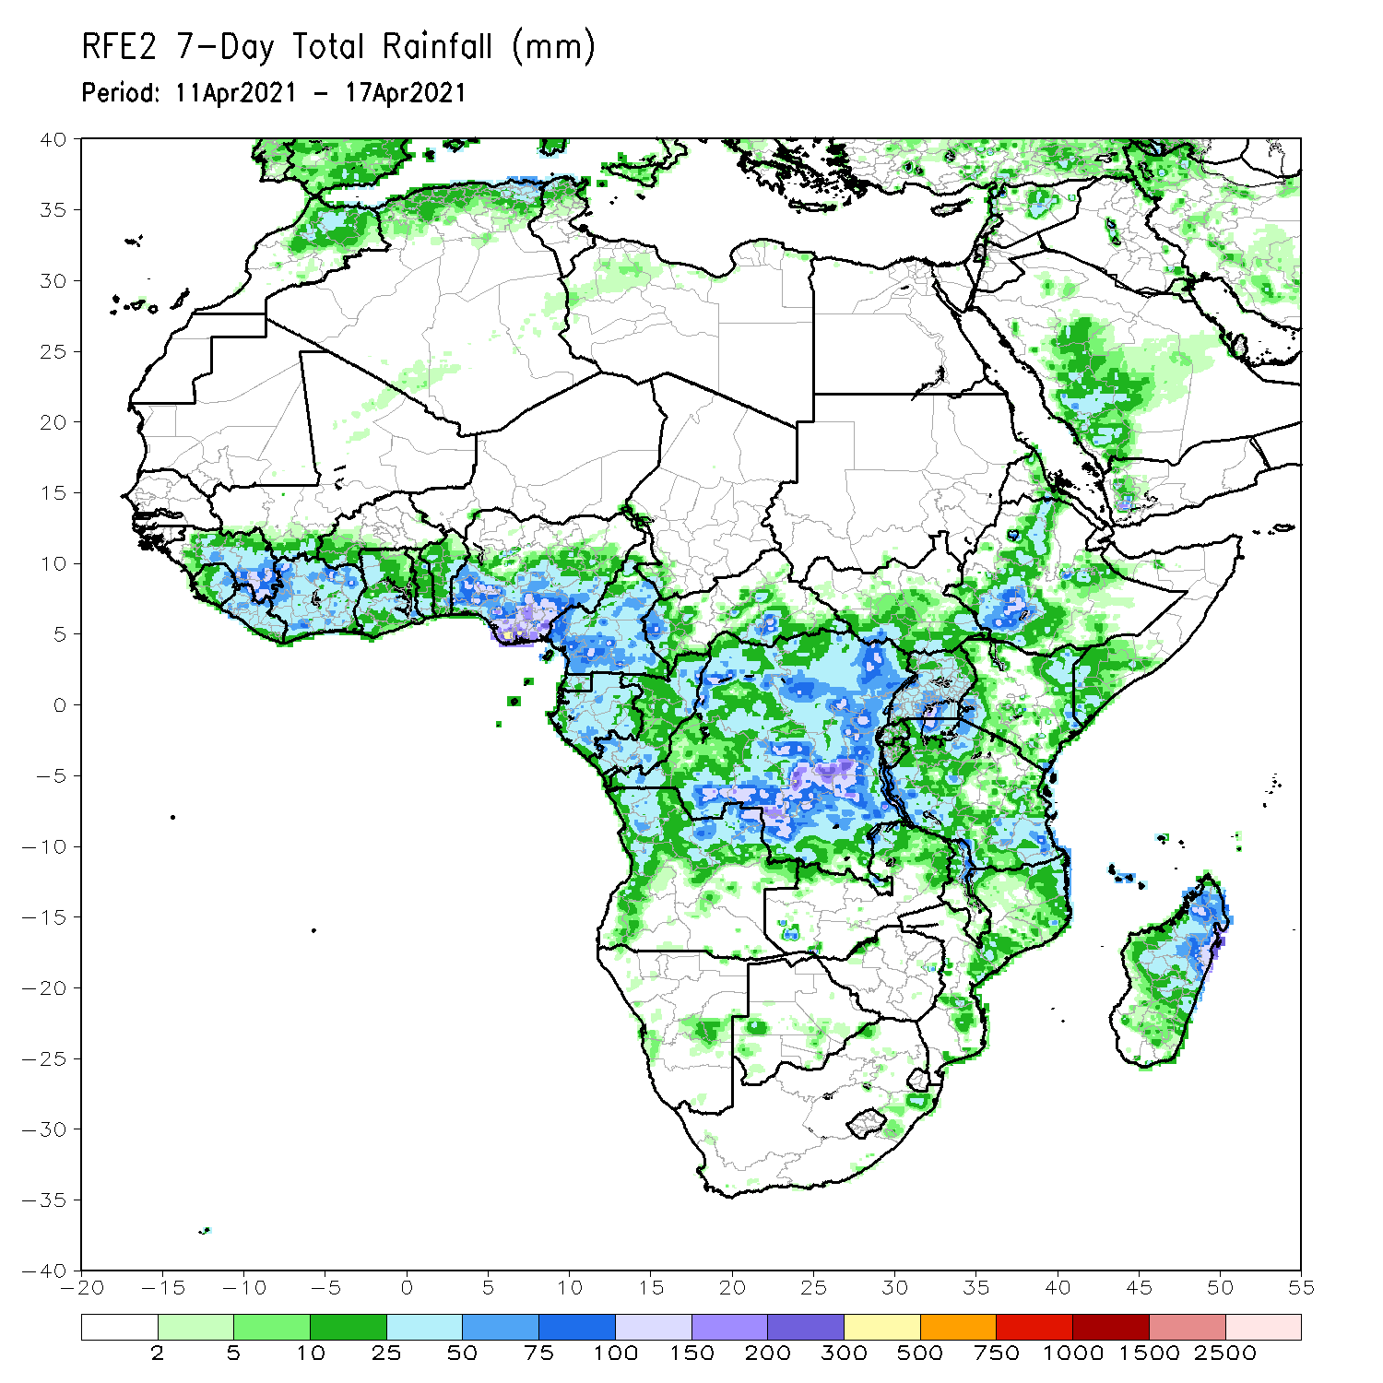
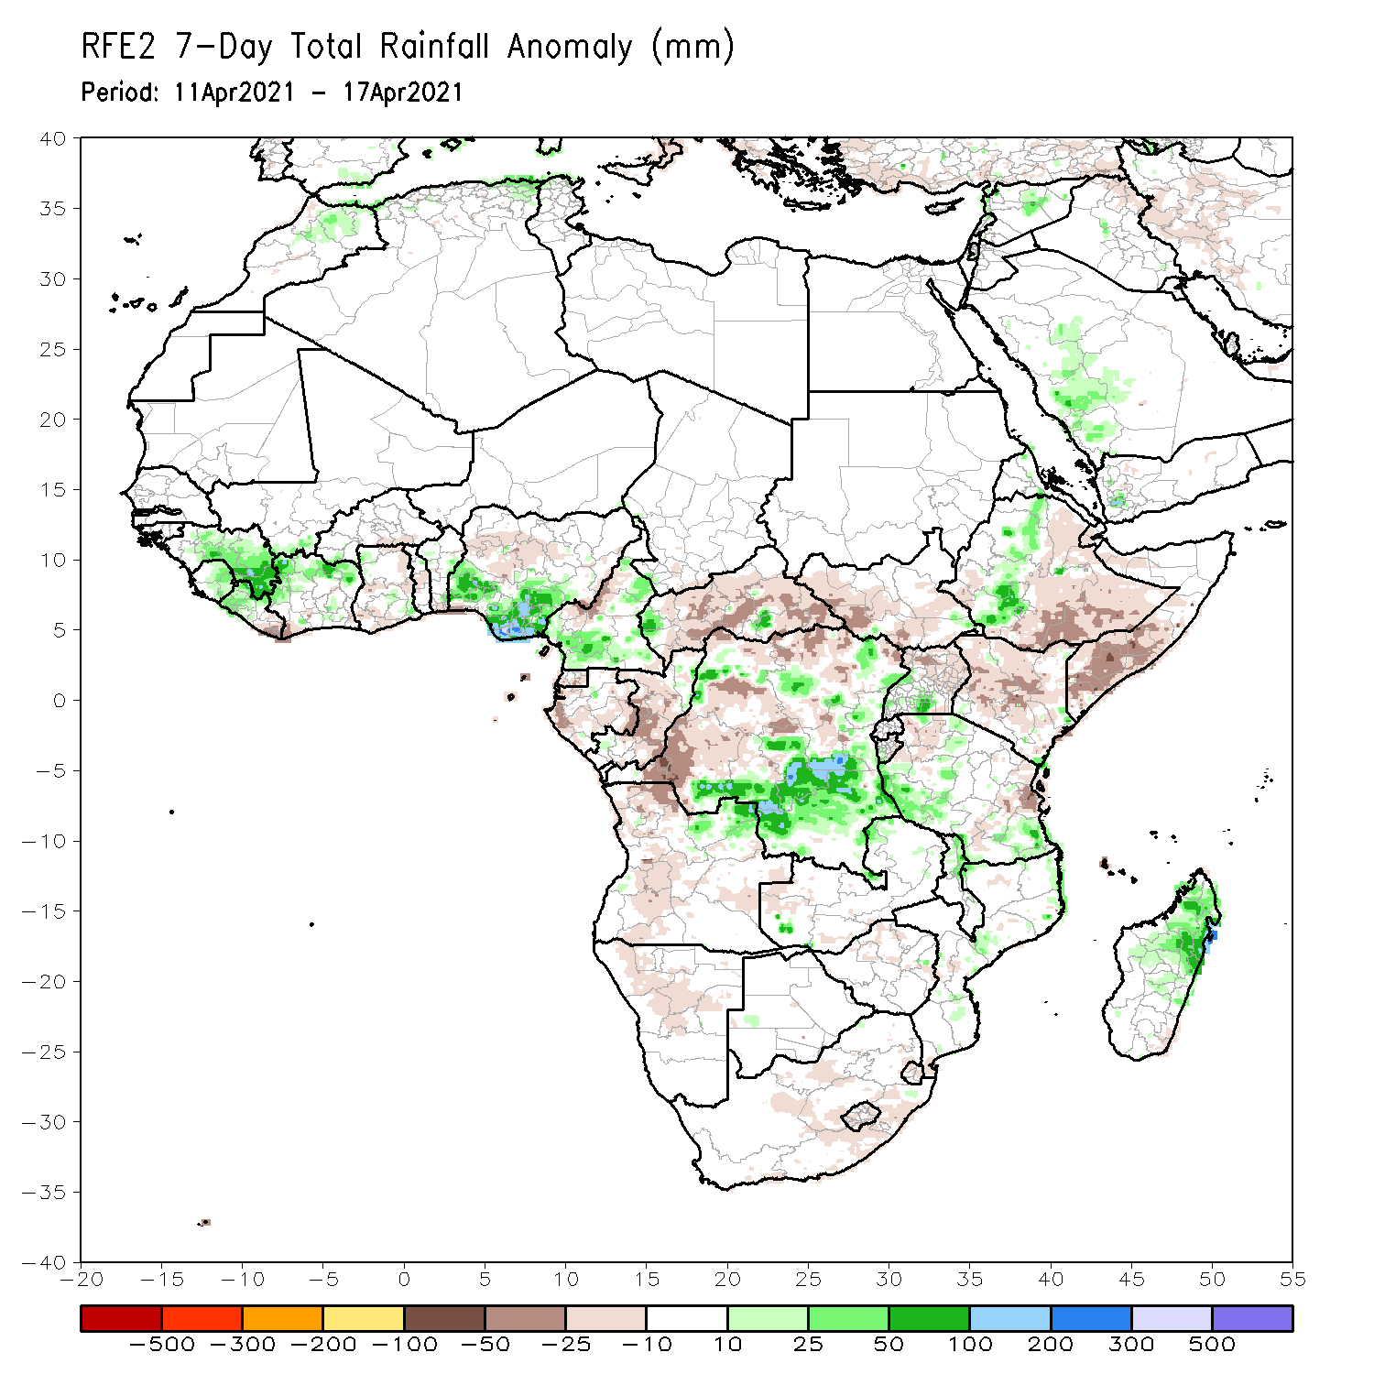
Rainfall Patterns: Last 7 Days
During the past 7 days, in East Africa, rainfall was below-average over eastern and southeastern Ethiopia, much of Kenya, southern Somalia and parts of South Sudan. Above-average rainfall was observed over parts of Ethiopia and pockets of Tanzania. In Central Africa, rainfall was below-average over much of Gabon, Congo, CAR, and parts of western and northern DRC. Above-average rainfall was observed over parts of southern and eastern DRC. In West Africa, above-average rainfall was observed over portions of the Gulf of Guinea countries.

Slide 7
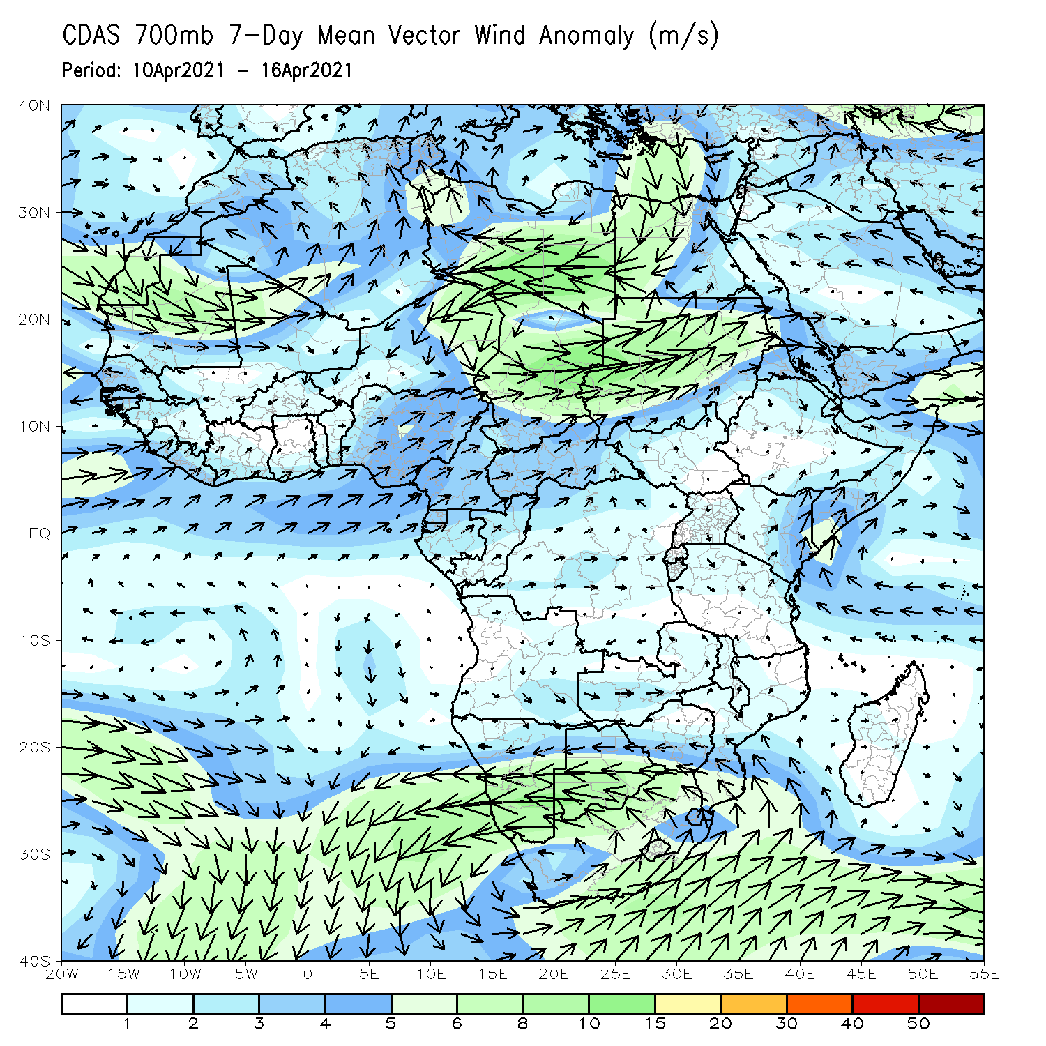
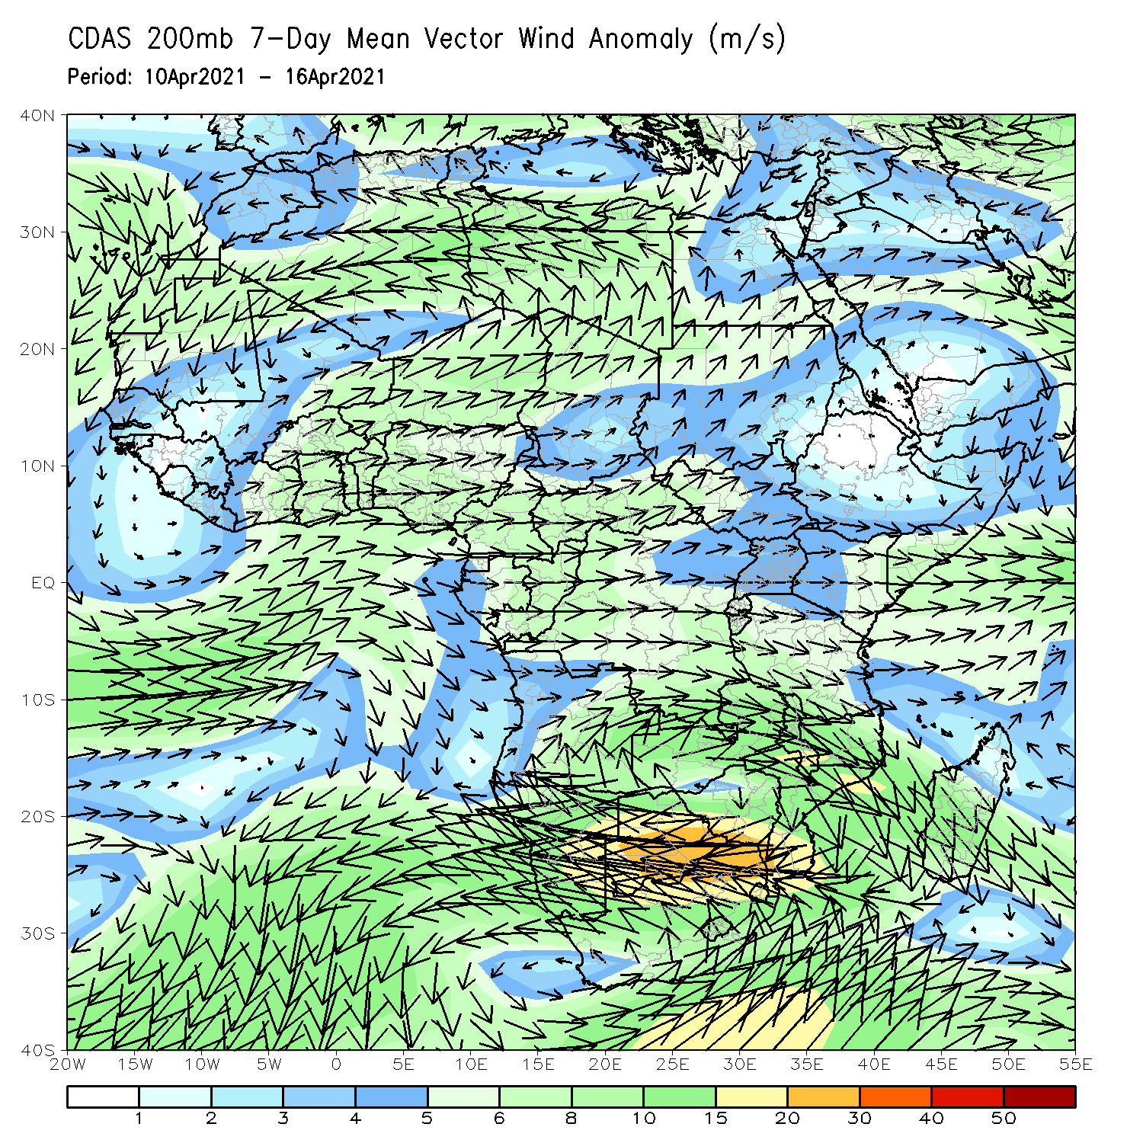
Atmospheric Circulation: Last 7 Days
At lower-level (left panel), anomalous onshore was observed in the Gulf of Guinea and coastal East Africa regions.

Slide 8
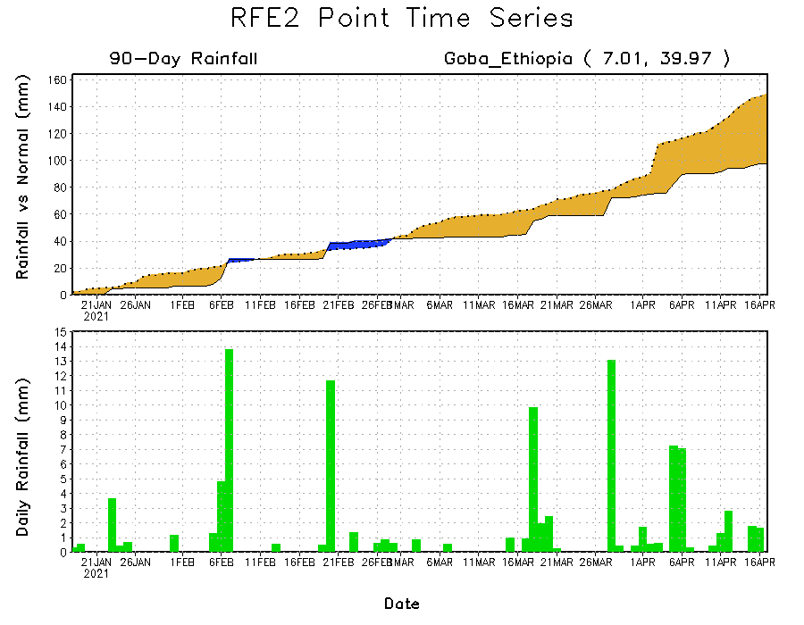
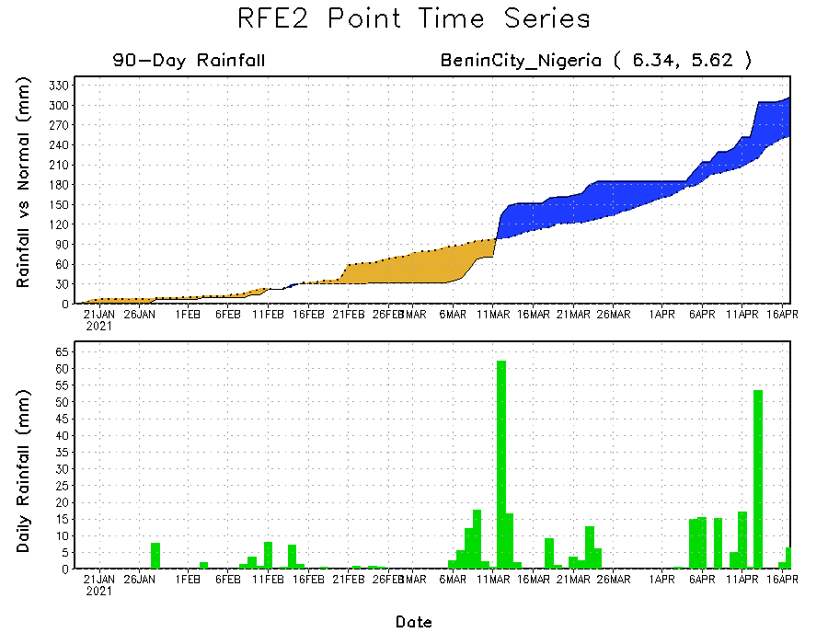
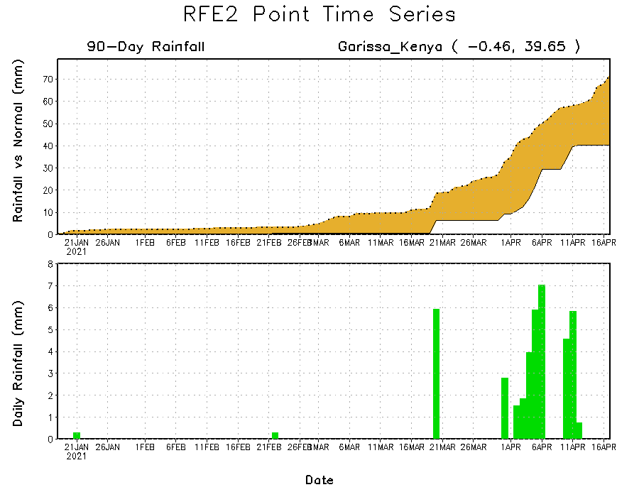
Rainfall Evolution
Daily evolution of rainfall over the last 90 days at selected locations shows moderate to heavy rainfall sustained moisture surpluses over parts of southern Nigeria (bottom left). Seasonal total rainfall remained below-average over portions of Ethiopia (top right) and Kenya (bottom right).

Slide 9
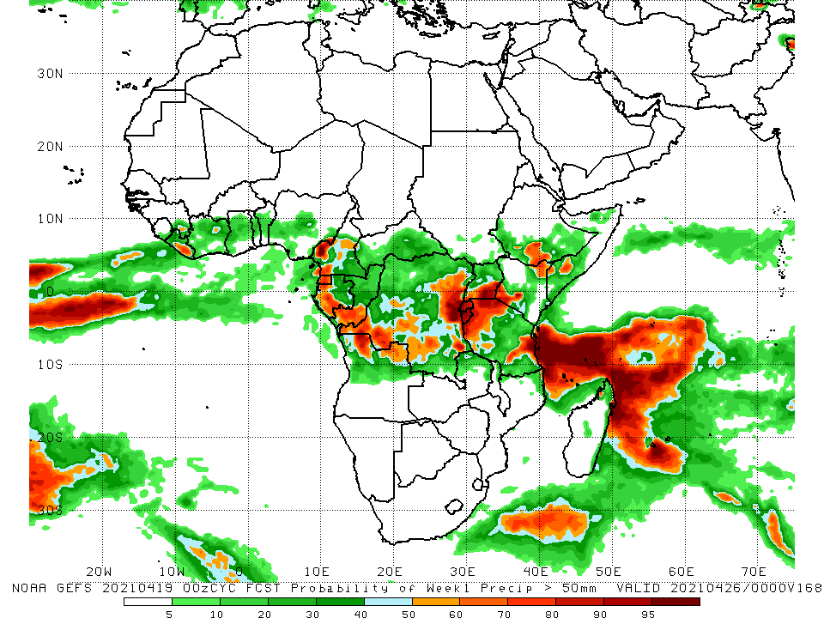
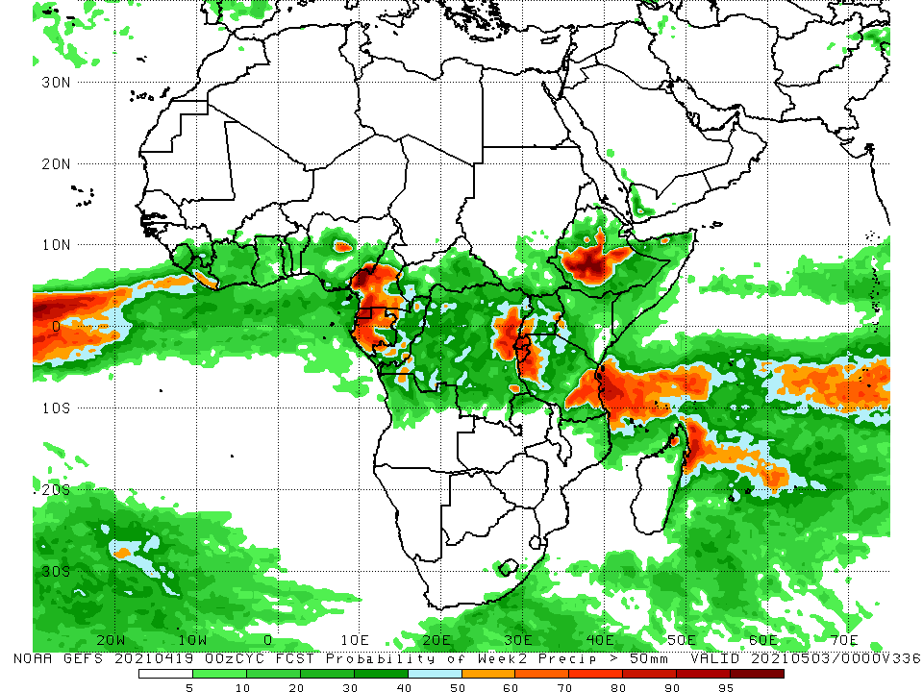
NCEP GEFS Model Forecasts Non-Bias Corrected Probability of precipitation exceedance
Week-1, Valid: 20 - 26 April, 2021
Week-2, Valid: 27 April - 03 May, 2021
For week-1 (left panel), the NCEP GEFS indicates a moderate to high chance (over 70%) for rainfall to exceed 50 mm over parts of Cameroon, Equatorial Guinea, Gabon, southern Congo, northern Angola, parts of southern and eastern DRC, Rwanda, Burundi, southern Uganda, portions of Tanzania, and pockets of southern Ethiopia and southern Somalia. For week-2 (right panel), the chance for rainfall to exceed 50 mm is mostly confined to parts of Cameroon, Gabon, northeastern DRC, Rwanda, Burundi, southern Ethiopia, and parts of western and eastern Tanzania.
Notes:
9

Slide 10
Summary
During the past 30 to 90 days, in East Africa, below-average rainfall was observed over many parts of Ethiopia, southern South Sudan, much of Kenya, and southern Somalia. In contrast, rainfall was above-average over much of Uganda and Tanzania, and pockets of Kenya and Ethiopia. In southern Africa, above-average rainfall was observed over portions of Angola, Namibia and southwestern Botswana. Rainfall was also above-average over parts of eastern Zambia, Malawi, northern Mozambique, and northern Madagascar. In contrast, persistent light rains sustained moisture deficits over pockets of Angola, western Namibia, southern and western Zambia, central and eastern Botswana, Zimbabwe, many parts of South Africa, southern Mozambique, and parts of western and southern Madagascar. In Central Africa, rainfall was below-average over western Gabon, western CAR and parts of northern DRC. Rainfall was above-average over eastern Gabon, Congo, many parts of DRC, and eastern CAR. In West Africa, rainfall was above-average over many places in the Gulf of Guinea countries. Below-average rainfall was observed over much of Ghana and northern Nigeria.
During the past 7 days, in East Africa, rainfall was below-average over eastern and southeastern Ethiopia, much of Kenya, southern Somalia and parts of South Sudan. Above-average rainfall was observed over parts of Ethiopia and pockets of Tanzania. In Central Africa, rainfall was below-average over much of Gabon, Congo, CAR, and parts of western and northern DRC. Above-average rainfall was observed over parts of southern and eastern DRC. In West Africa, above-average rainfall was observed over portions of the Gulf of Guinea countries.
For week-1 and week-2, there is a moderate to high chance (over 70%) for rainfall to exceed 50 mm over parts of Cameroon, Equatorial Guinea, Gabon, southern Congo, northern Angola, parts of southern and eastern DRC, Rwanda, Burundi, southern Uganda, portions of Tanzania, and pockets of southern Ethiopia and southern Somalia.

