Slide 1
The African Monsoon Recent Evolution and Current Status Include Week-1 and Week-2 Outlooks
Update prepared by
15 March 2021
For more information, visit:
http://www.cpc.ncep.noaa.gov/products/Global_Monsoons/African_Monsoons/precip_monitoring.shtml

Slide 2
Outline
Highlights
Recent Evolution and Current Conditions
NCEP GEFS Forecasts
Summary

Slide 3
Highlights: Last 7 Days
During the past 7 days, in East Africa, rainfall was below-average over pockets of Ethiopia and Kenya, and the northern and eastern portions of Tanzania. In Southern Africa, above-average rainfall was observed over western Angola, eastern Zambia, Malawi, northern Mozambique, and the far northern Madagascar. Below-average rainfall was observed over southern Angola, northern Namibia, parts of western Zambia, Botswana, Zimbabwe, central and southern Mozambique, parts of South Africa, and central and southern Madagascar. In Central Africa, below-average rainfall was observed over Equatorial Guinea, Gabon, southern Congo and eastern DRC. In West Africa, above-average rainfall was observed along the Gulf of Guinea coast.
For week-1 and week-2, there is a moderate to high chance (over 70%) for rainfall to exceed 50 mm over southern Cameroon, Equatorial Guinea, Gabon, Congo, parts of DRC, Angola, Zambia, Malawi, southern Tanzania, and parts of northern Mozambique and Madagascar.

Slide 4
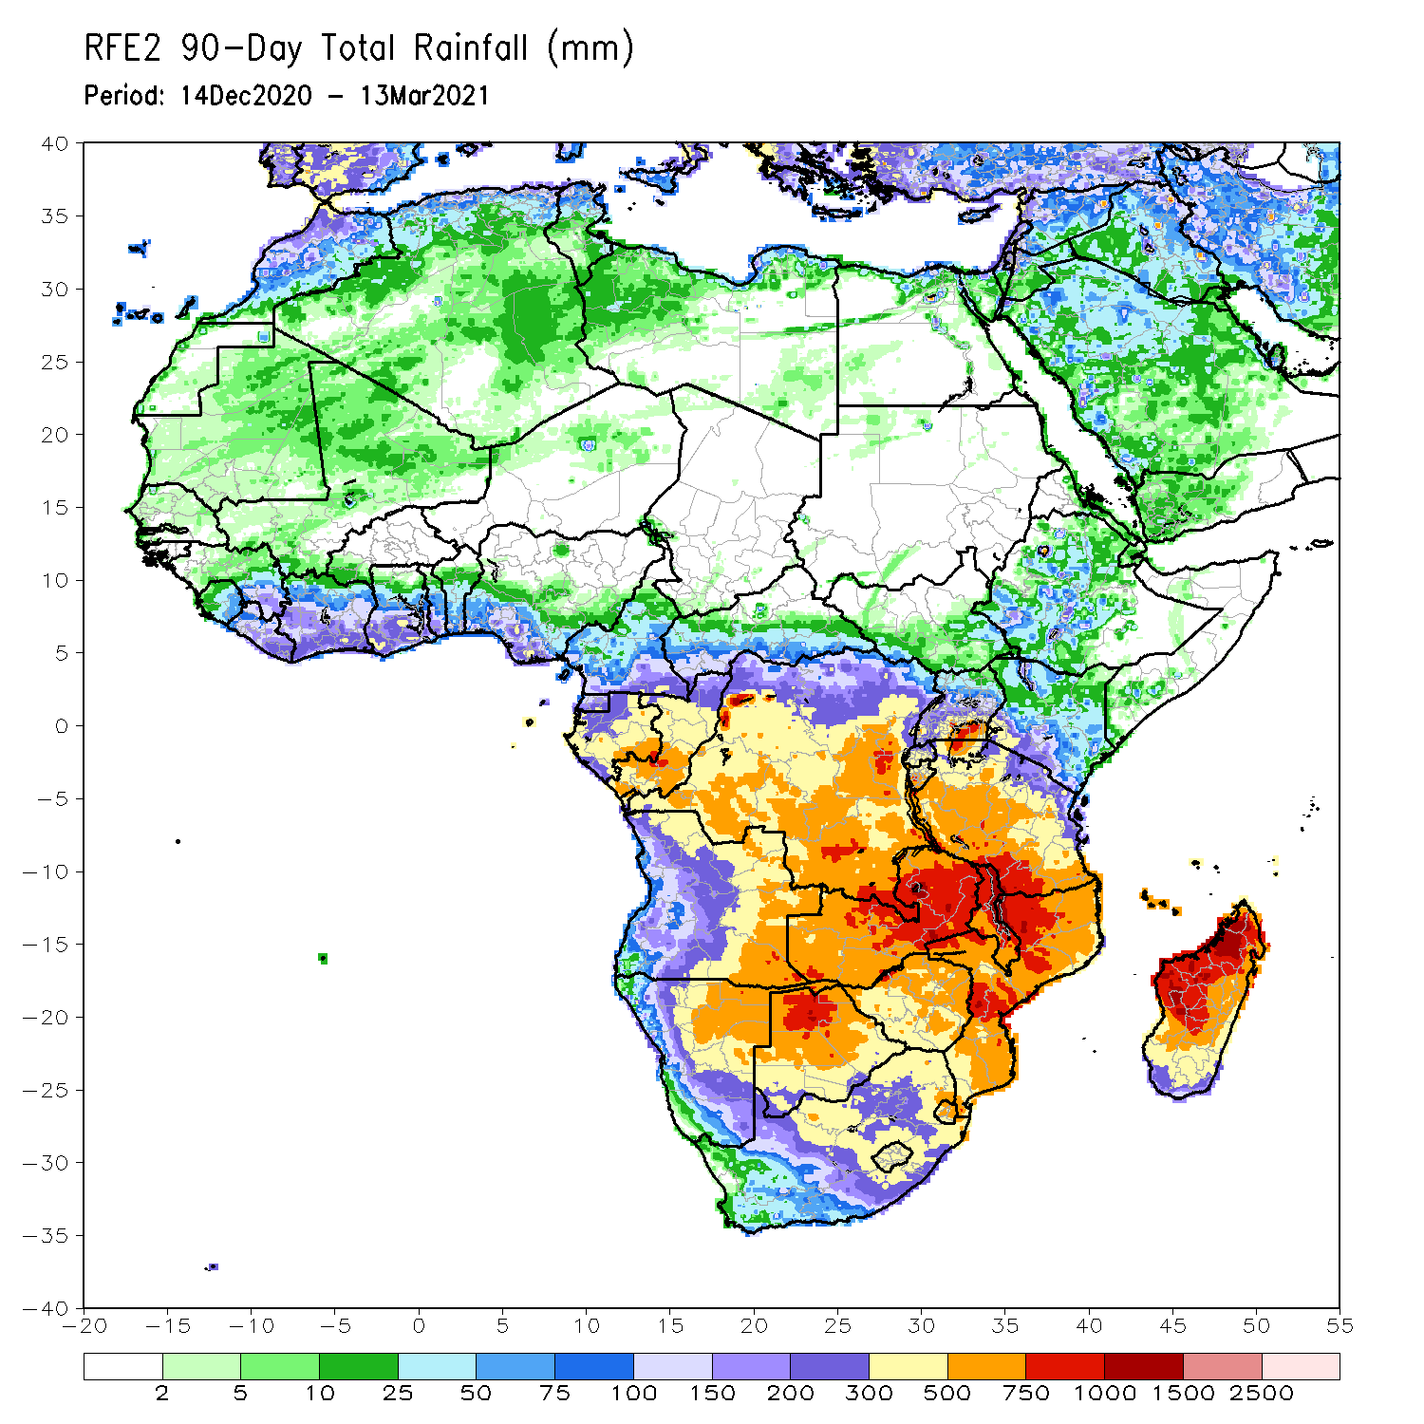
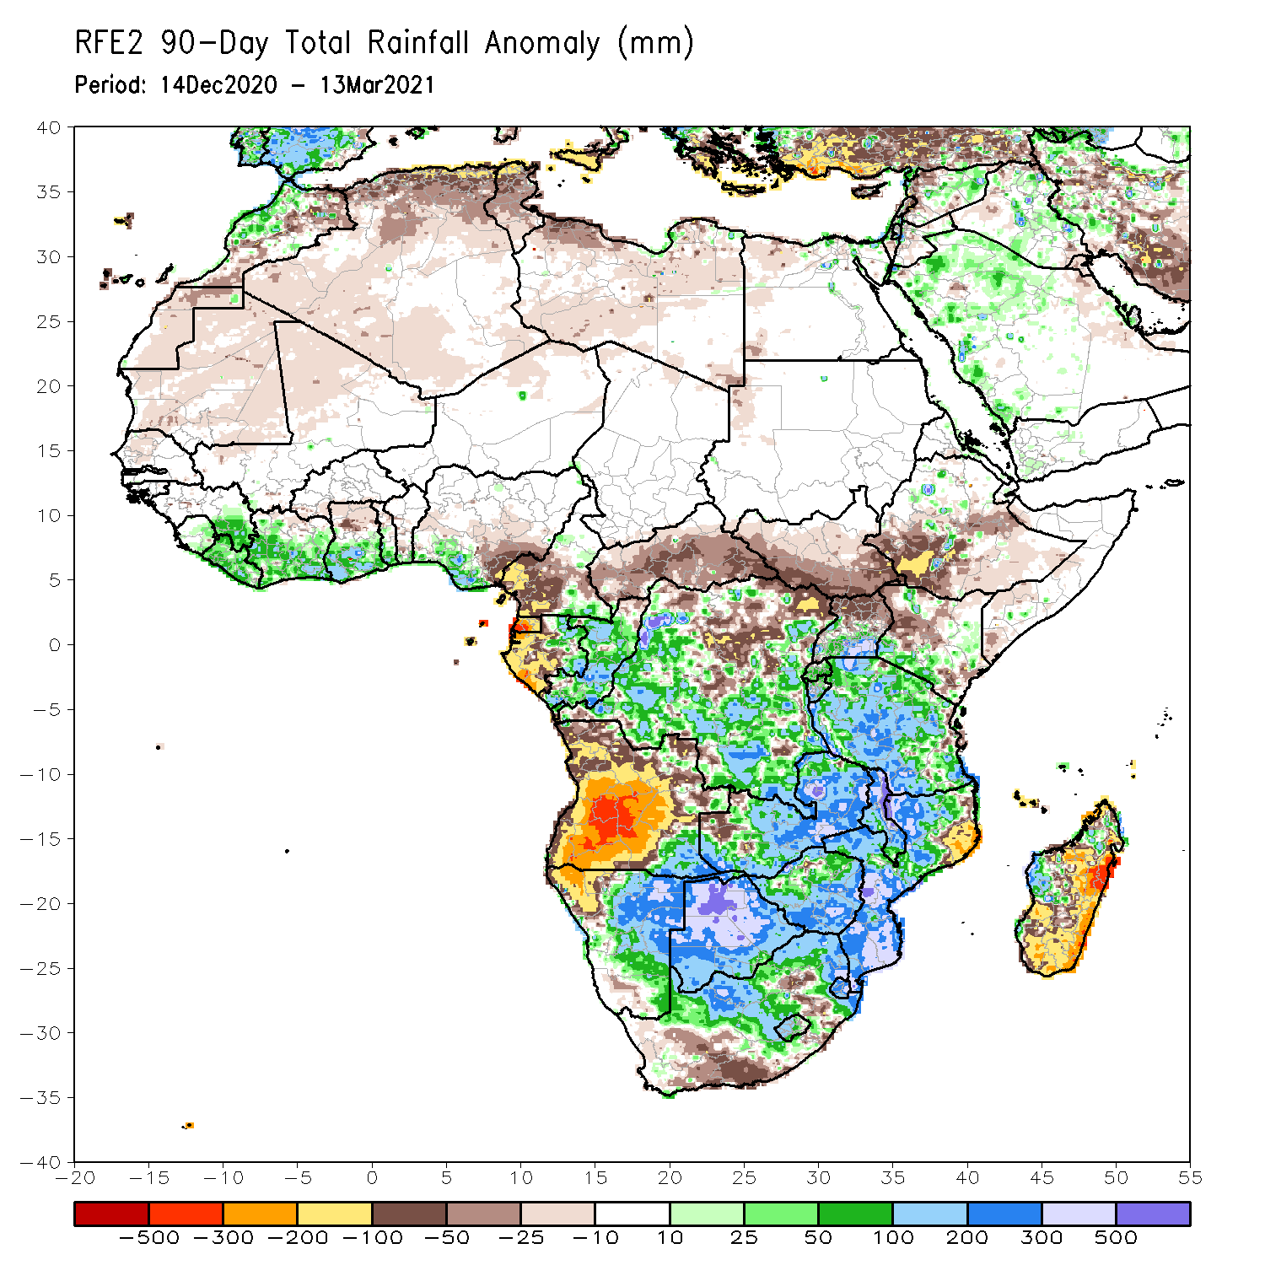
Rainfall Patterns: Last 90 Days
Over the past 90 days, in East Africa, rainfall was below-average over parts of Ethiopia and Kenya. Rainfall was also below-average over much of South Sudan and northern Uganda. Rainfall was above-average over parts of southern Kenya, southern Uganda, Rwanda, Burundi and much of Tanzania. In southern Africa, moderate to locally heavy rains resulted in sustained moisture surpluses over central and eastern Namibia and much of Botswana. Rainfall was also above-average over southeastern Angola, Zambia, Malawi, Zimbabwe, much of Mozambique and South Africa, and parts of western and northern Madagascar. Persistent light rains resulted in moisture deficits over many parts of Angola, and parts of northwestern Namibia. Rainfall was also below-average pockets of northeastern Mozambique, and eastern and southern Madagascar. In Central Africa, rainfall was above-average over many parts of DRC and Congo. Rainfall was below-average over local areas in northern DRC and much of CAR. below-average rains were also observed over the western areas of Gabon and much of Cameroon. In West Africa, rainfall was above-average along the Gulf of Guinea coast.
Notes:
4

Slide 5
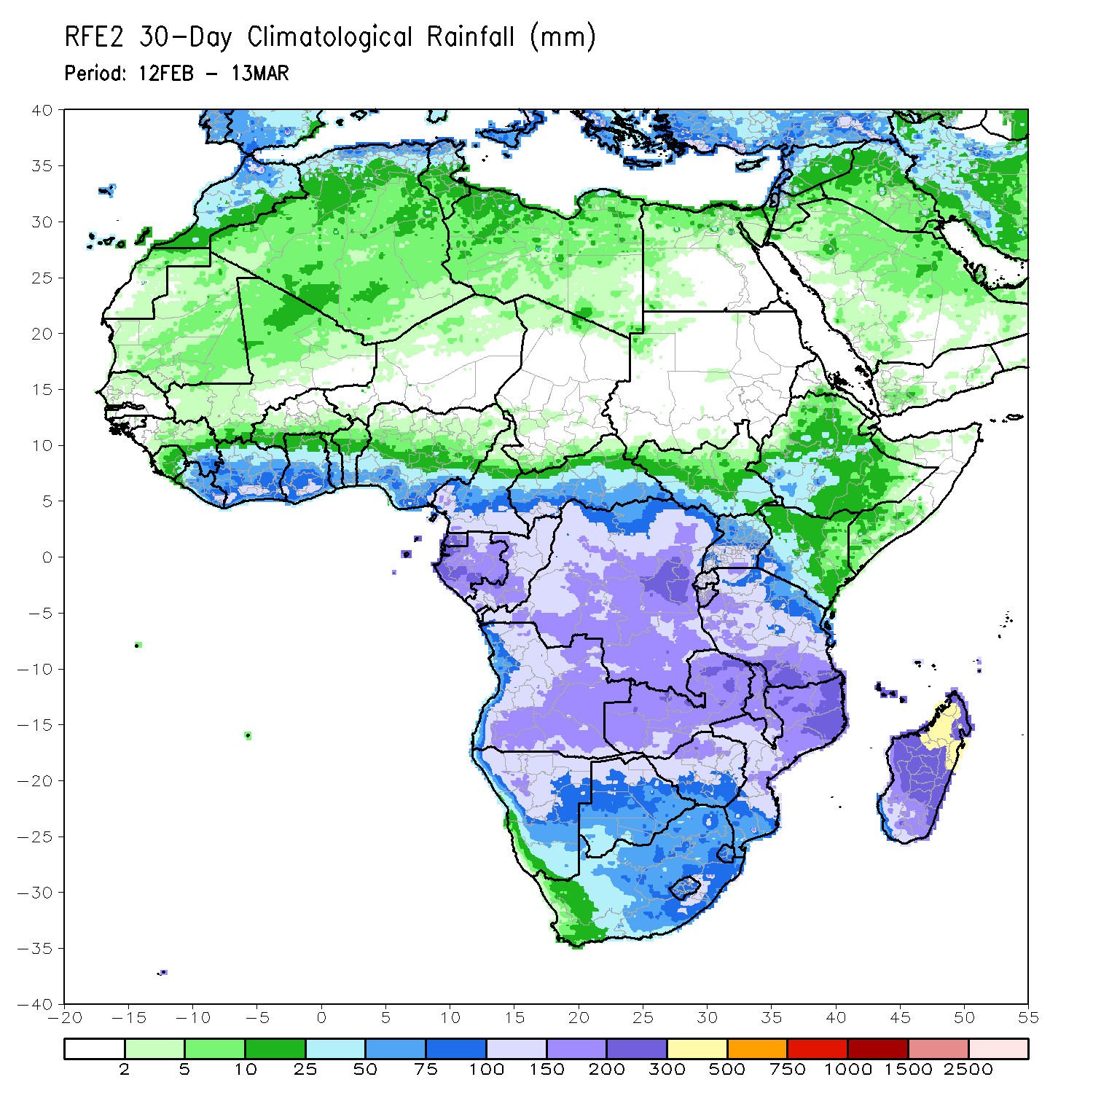
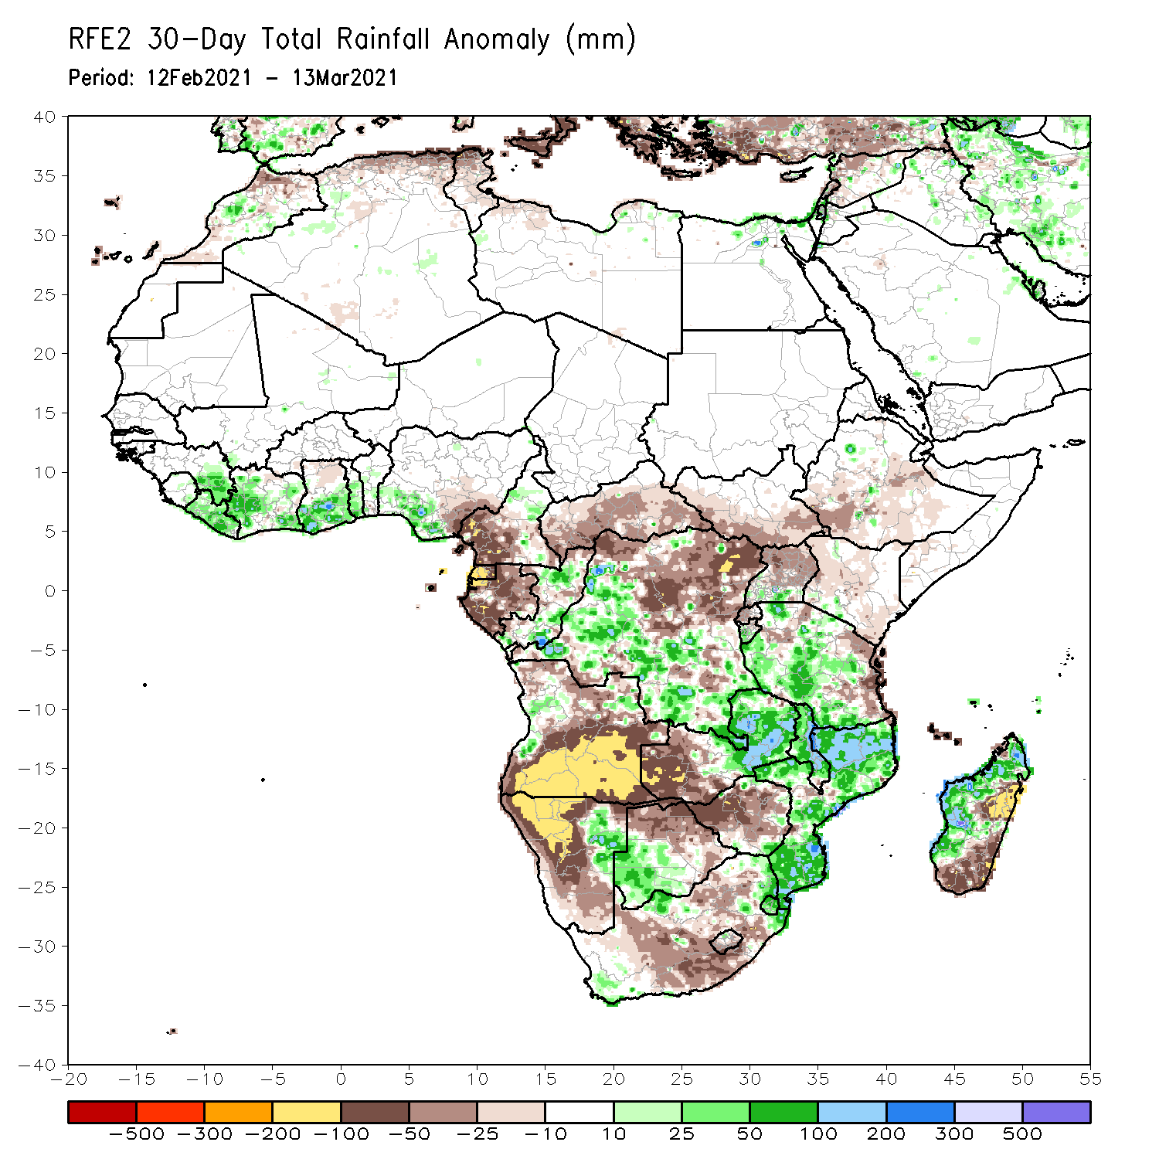
Rainfall Patterns: Last 30 Days
During the past 30 days, in East Africa, below-average rainfall was observed over parts of South Sudan and Ethiopia, Uganda, Rwanda, Burundi, and along the coast of Tanzania. In southern Africa, moderate to heavy rains resulted in moisture surpluses over eastern Namibia and western Botswana. Rainfall was also above-average over eastern Zambia, Malawi much of Mozambique and western Madagascar. Persistent light rains resulted in moisture deficits over much of Angola, western and southern Namibia, and much of South Africa. In Central Africa, rainfall was below-average over much of Gabon, Equatorial Guinea, Cameroon, Central Africa Republic and northern DRC. Rainfall was above-average over much of Tanzania. In West Africa, Rainfall was above-average along the Gulf of Guinea coast.
Notes:
5

Slide 6
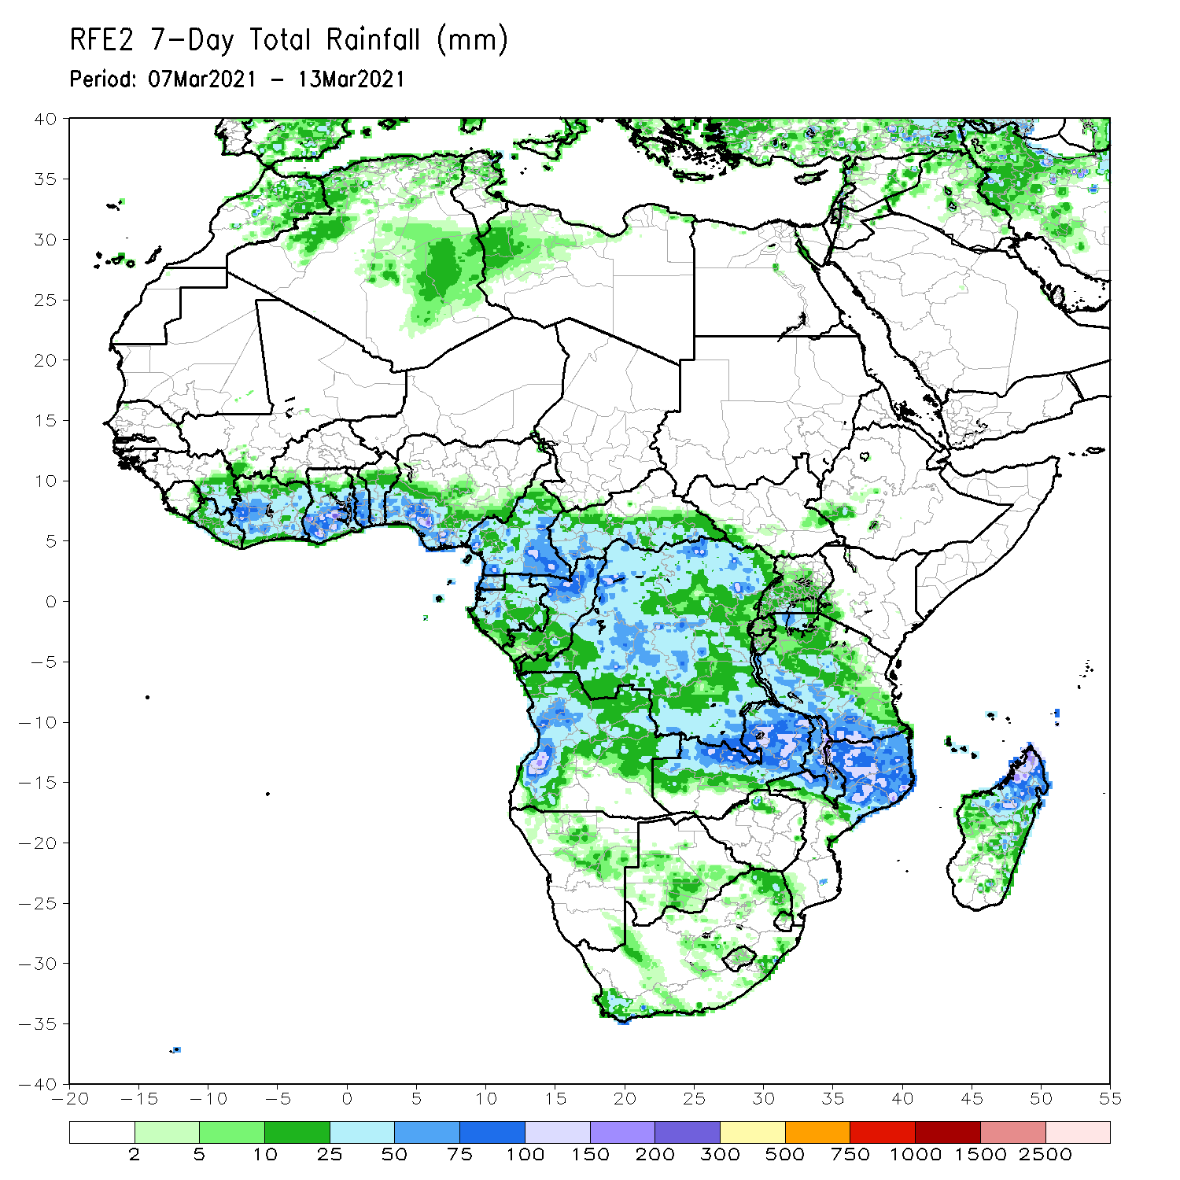
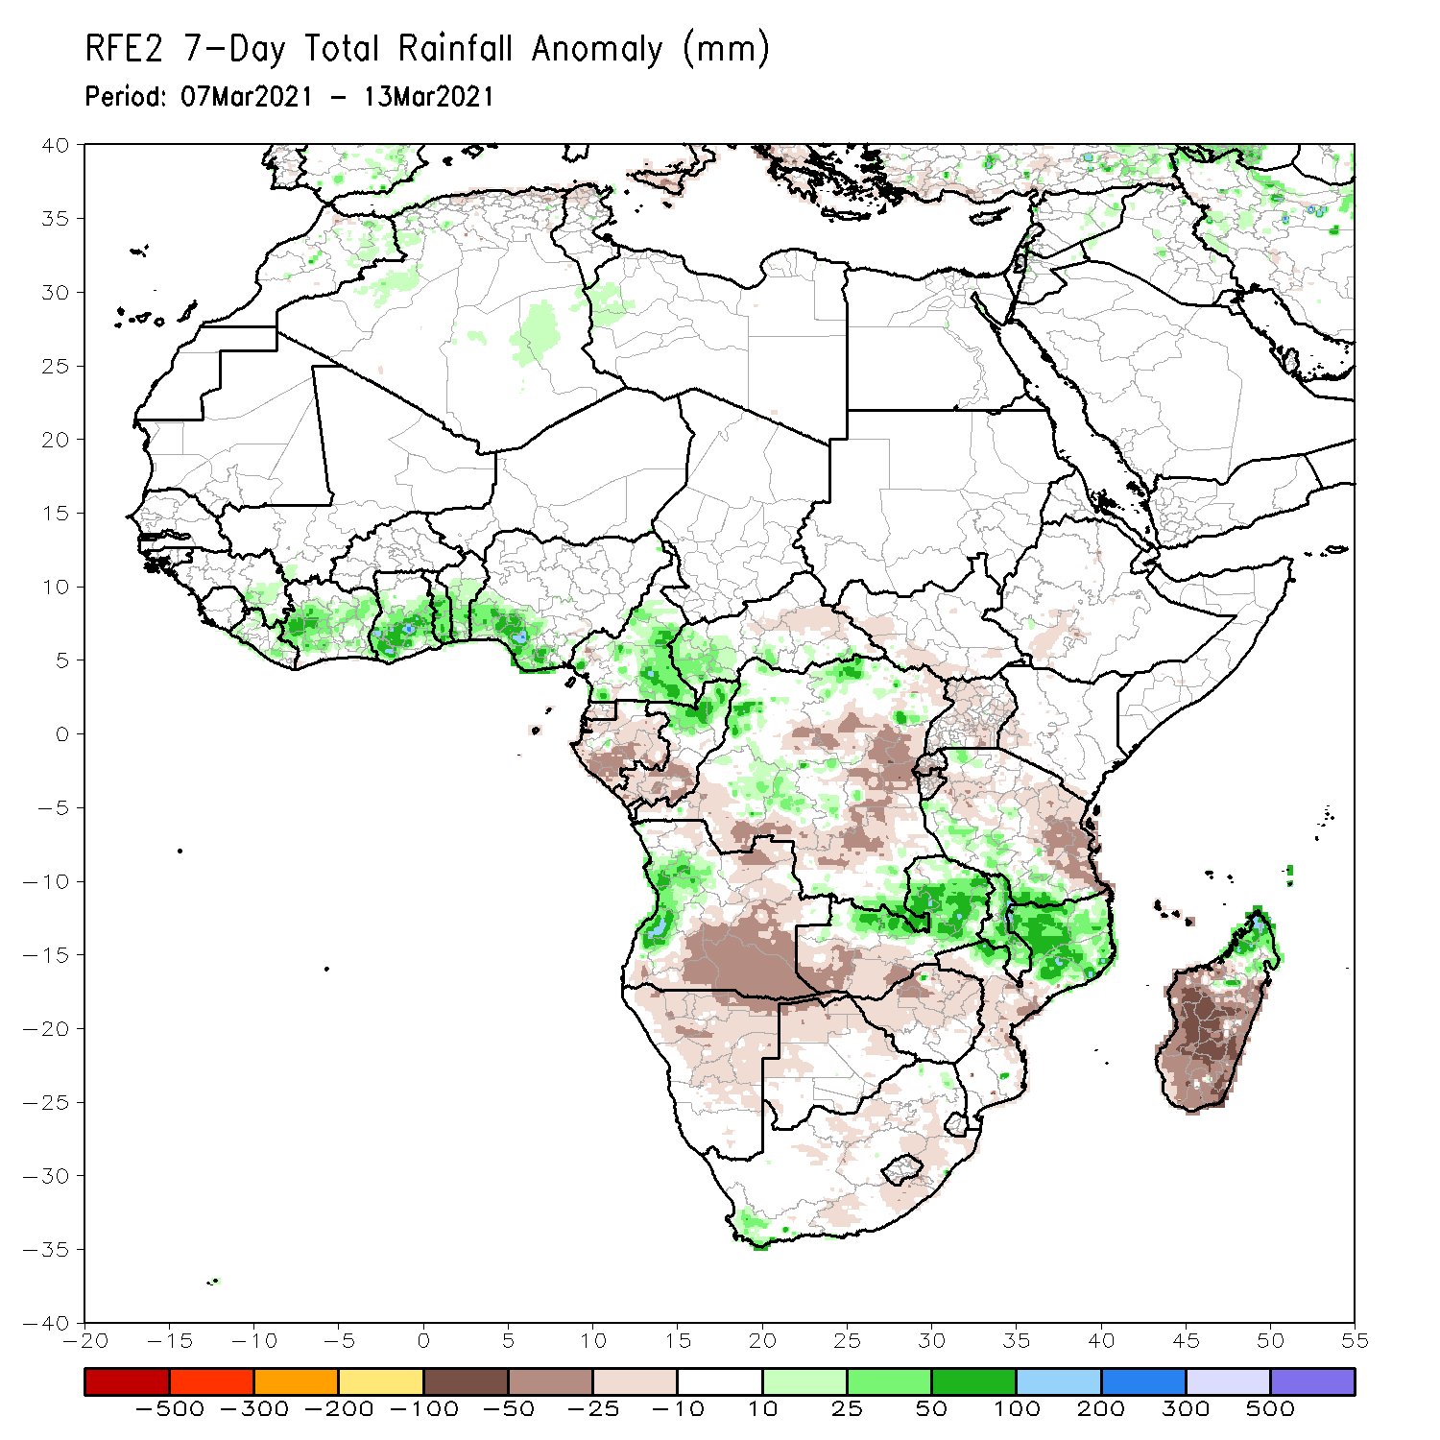
Rainfall Patterns: Last 7 Days
During the past 7 days, in East Africa, rainfall was below-average over pockets of Ethiopia and Kenya, the northern and eastern portions of Tanzania. In Southern Africa, moderate to locally heavy rainfall resulted in moisture surpluses over western Angola, eastern Zambia, Malawi, northern Mozambique, and the far northern Madagascar. Below-average rainfall was observed over southern Angola, northern Namibia, and parts of western Zambia. Rainfall was also below-average over parts of Botswana, Zimbabwe, central and southern Mozambique, parts of South Africa, and central and southern Madagascar. In Central Africa, light rains sustained moisture deficits over Equatorial Guinea, Gabon, southern Congo and eastern DRC. In West Africa, above-average rainfall was observed along the Gulf of Guinea coast.

Slide 7
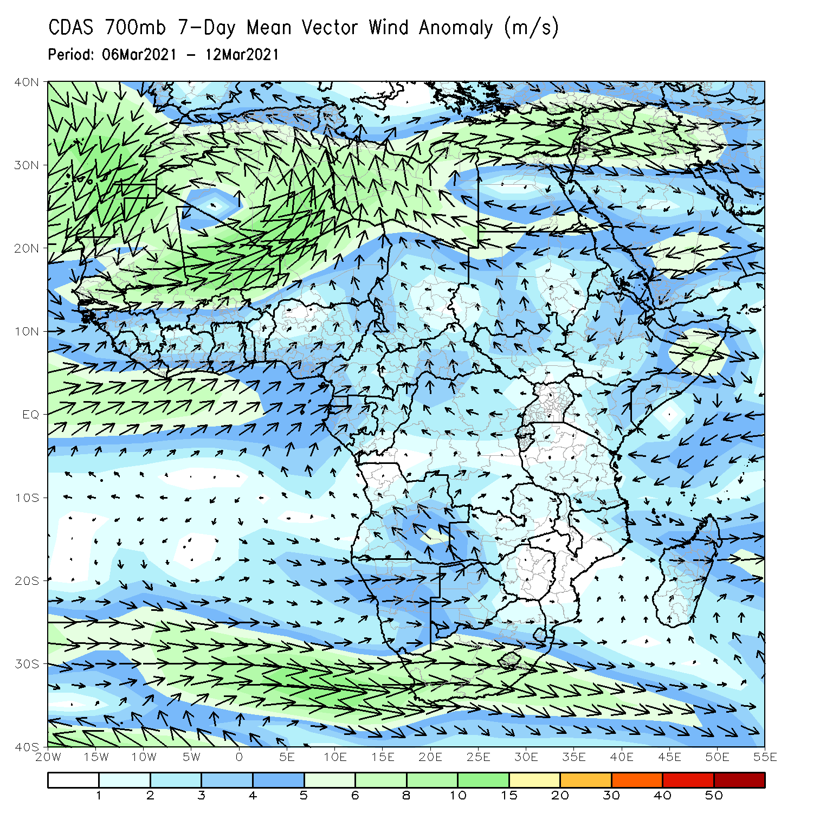
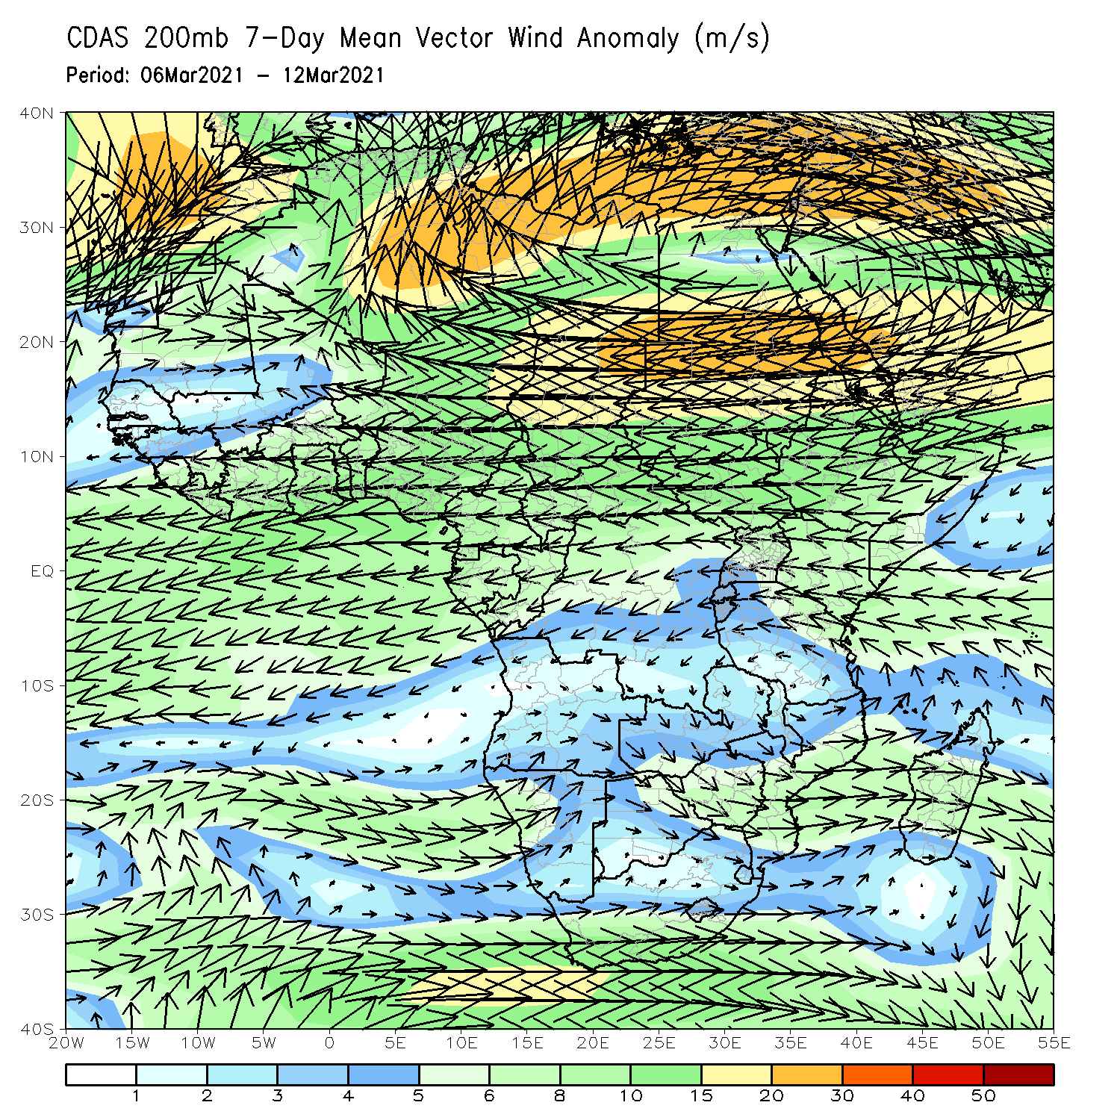
Atmospheric Circulation: Last 7 Days
At lower-level (left panel), anomalous anti-cyclonic circulation was evident across the western portions of Southern Africa.

Slide 8
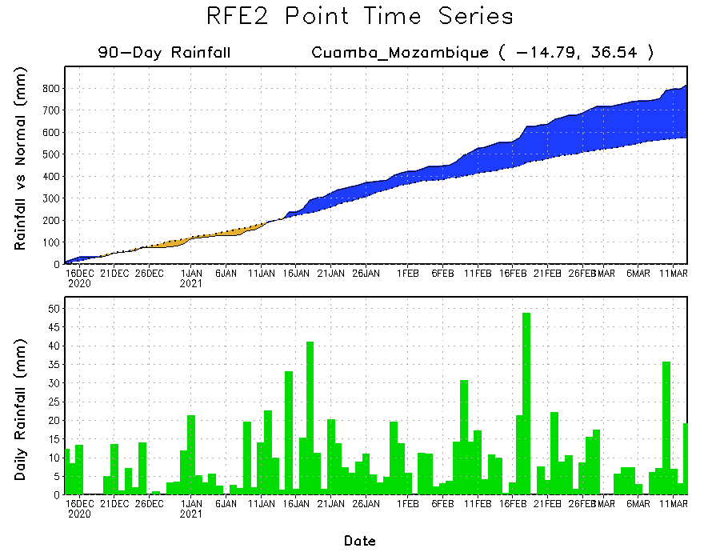
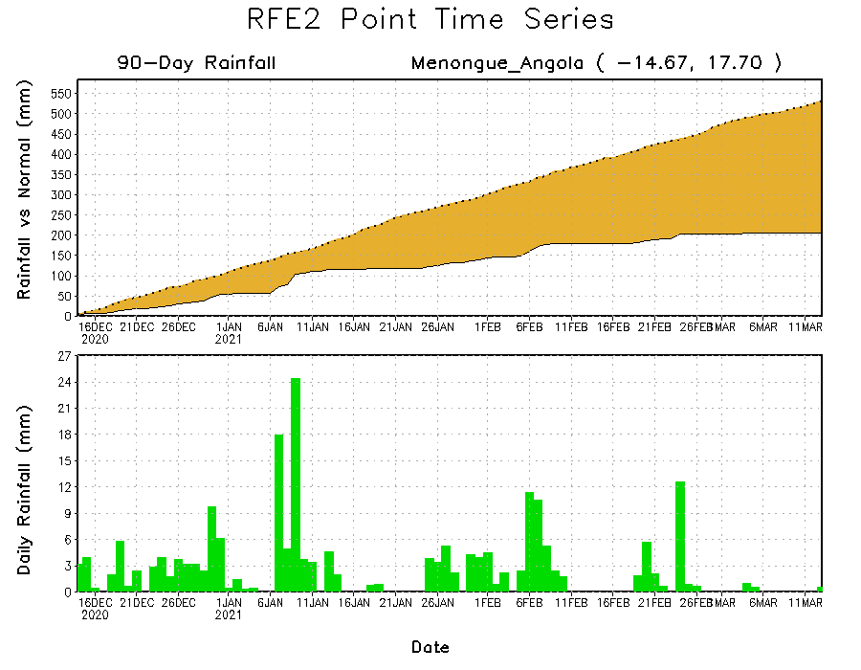
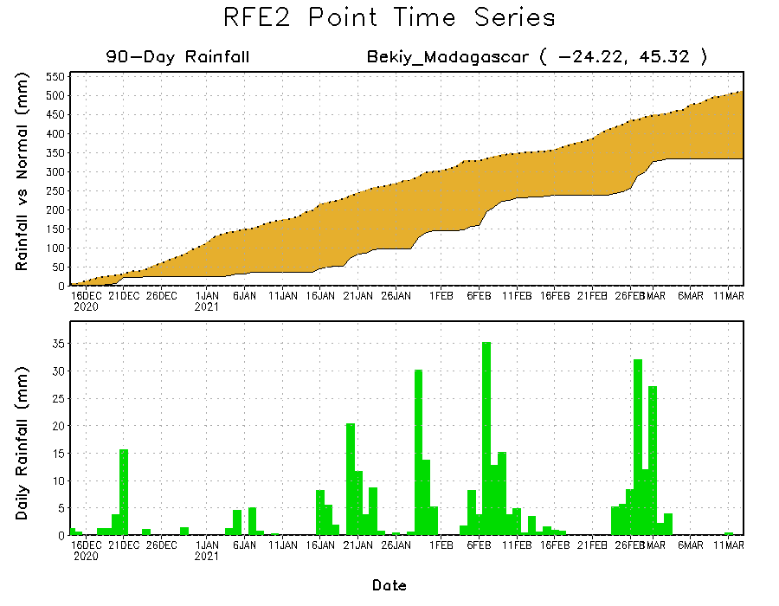
Rainfall Evolution
Daily evolution of rainfall over the last 90 days at selected locations shows moderate to heavy rainfall sustained moisture surpluses over parts of northern Mozambique (top right). Seasonal total rainfall remained below-average over portions of Angola (bottom left) and southern Madagascar (bottom right).

Slide 9
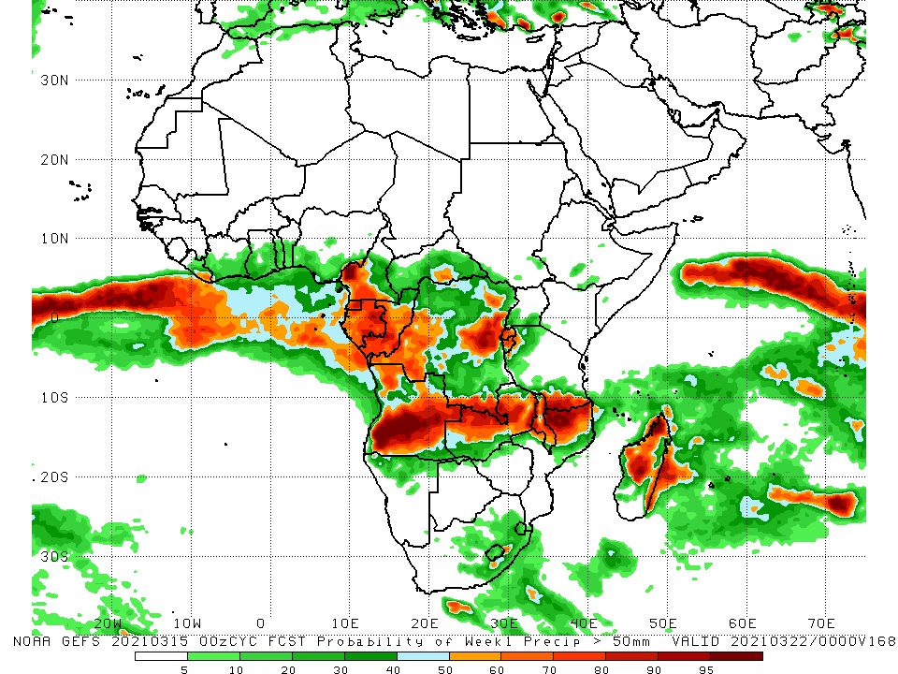
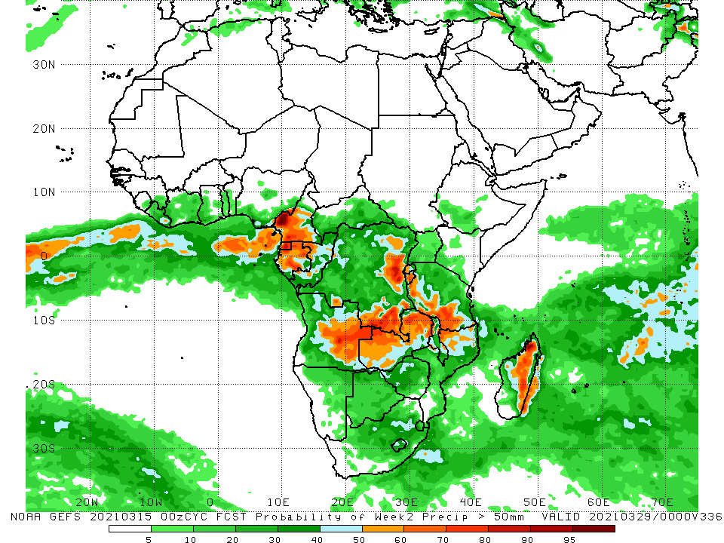
NCEP GEFS Model Forecasts Non-Bias Corrected Probability of precipitation exceedance
Week-1, Valid: 16 - 22 March, 2021
Week-2, Valid: 23 - 29 March, 2021
For week-1 (left panel) and week-2 (right panel), the NCEP GEFS indicates a moderate to high chance (over 70%) for rainfall to exceed 50 mm over southern Cameroon, Equatorial Guinea, Gabon, Congo, parts of DRC, Angola, Zambia, Malawi, southern Tanzania, and parts of northern Mozambique and Madagascar.
Notes:
9

Slide 10
Summary
During the past 30 to 90 days, in East Africa, moisture deficits prevailed over parts of South Sudan and Ethiopia, Uganda, Rwanda, Burundi, and along the coast of Tanzania. Rainfall was above-average much of Tanzania. In southern Africa, moderate to heavy rains resulted in sustained moisture surpluses over eastern Namibia, western Botswana, eastern Zambia, Malawi, much of Mozambique and western Madagascar. Rainfall was below-average over much of Angola, western and southern Namibia, and much of South Africa. In central Africa, rainfall was above-average over much of Gabon, Equatorial Guinea, Cameroon, Central Africa Republic and northern DRC. Rainfall was below-average over western Gabon, Equatorial Guinea and CAR. In West Africa, rainfall was above-average in pockets along the Guinean coast.
During the past 7 days, in East Africa, rainfall was below-average over pockets of Ethiopia and Kenya, and the northern and eastern portions of Tanzania. In Southern Africa, above-average rainfall was observed over western Angola, eastern Zambia, Malawi, northern Mozambique, and the far northern Madagascar. Below-average rainfall was observed over southern Angola, northern Namibia, parts of western Zambia, Botswana, Zimbabwe, central and southern Mozambique, parts of South Africa, and central and southern Madagascar. In Central Africa, below-average rainfall was observed over Equatorial Guinea, Gabon, southern Congo and eastern DRC. In West Africa, above-average rainfall was observed along the Gulf of Guinea coast.
For week-1 and week-2, there is a moderate to high chance (over 70%) for rainfall to exceed 50 mm over southern Cameroon, Equatorial Guinea, Gabon, Congo, parts of DRC, Angola, Zambia, Malawi, southern Tanzania, and parts of northern Mozambique and Madagascar.

