Slide 1
The African Monsoon Recent Evolution and Current Status Include Week-1 and Week-2 Outlooks
Update prepared by
01 March 2021
For more information, visit:
http://www.cpc.ncep.noaa.gov/products/Global_Monsoons/African_Monsoons/precip_monitoring.shtml

Slide 2
Outline
Highlights
Recent Evolution and Current Conditions
NCEP GEFS Forecasts
Summary

Slide 3
Highlights: Last 7 Days
During the past 7 days, in Southern Africa, moderate to locally heavy rainfall resulted in moisture surpluses over eastern Namibia, western Botswana, parts of Zambia, Malawi, northern Mozambique, and western and northern Madagascar. Below-average rainfall was observed over southwestern Angola, northwestern Namibia, central and southern Mozambique and eastern Madagascar. In Central Africa, light rains sustained moisture deficits over Gabon, Congo, much of Cameroon, northern DRC and CAR. In East Africa, local areas in Ethiopia and Kenya, and portions of Tanzania received above-average rainfall. In West Africa, below-average rainfall was observed over portions of the Gulf of Guinea region.
For week-1 , there is a moderate to high chance (over 70%) for rainfall to exceed 50 mm over parts of southern Gabon, southern Congo, northern Angola, southern and eastern DRC, eastern Zambia, Rwanda, Burundi, Tanzania, Malawi, northern Mozambique and much of Madagascar. For week-2, the chance for rainfall to exceed 50 mm is mostly confined to portions of Madagascar and Congo, and northeastern Zambia, southern Tanzania and northern Madagascar.

Slide 4
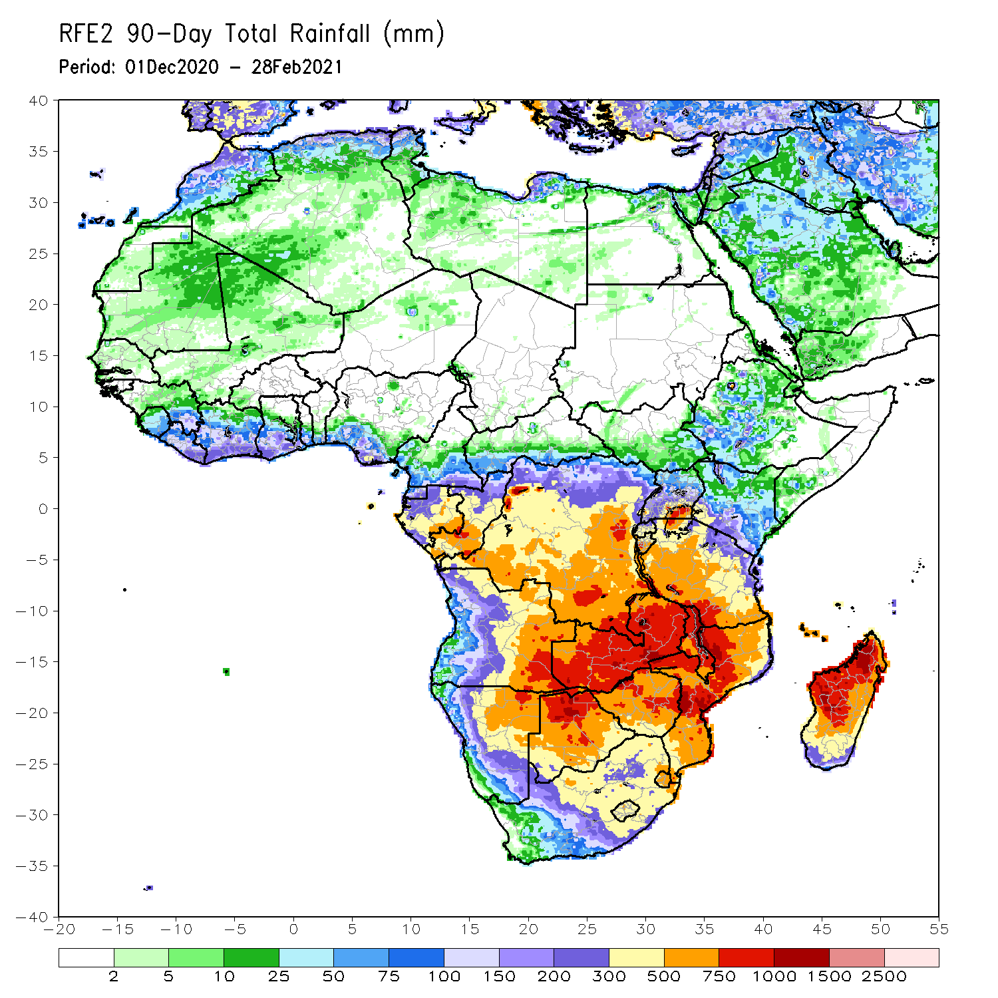
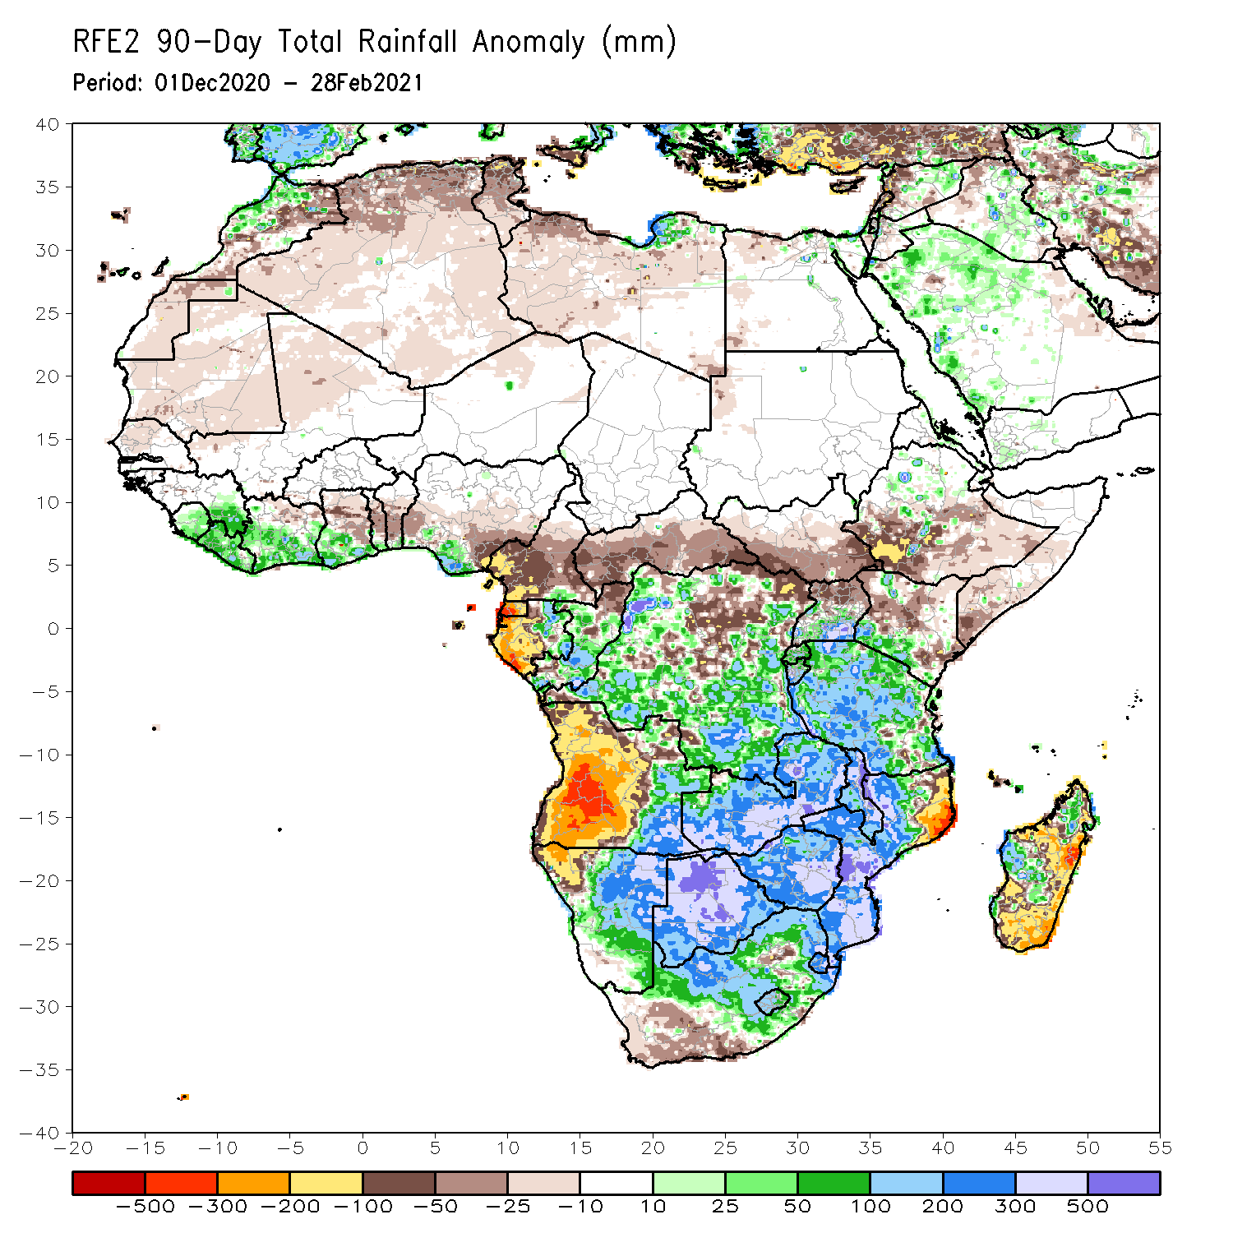
Rainfall Patterns: Last 90 Days
Over the past 90 days, in southern Africa, persistent rains resulted in sustained moisture surpluses over eastern Angola, Zambia, Botswana, Zimbabwe and southern Mozambique. Rainfall was also above average over many parts of Namibia and South Africa, Malawi, and local areas in Madagascar. Persistent light rains resulted in moisture deficits in western Angola and northwestern Namibia. Rainfall was also below average along the border between Tanzania and Mozambique, and over parts of Madagascar. In East Africa, rainfall was below average over parts of southern Ethiopia, Kenya, southern Somalia. Rainfall was also below average over much of South Sudan and northern Uganda. Rainfall was above average over parts of southern Kenya, southern Uganda, Rwanda, Burundi and much of Tanzania. In Central Africa, rainfall was above average over many parts of DRC and Congo. Rainfall was below average over local areas in northern DRC and much of CAR. Below average rains were also observed over the western areas of Gabon and much of Cameroon. In West Africa, rainfall was above average along the Gulf of Guinea coast.
Notes:
4

Slide 5
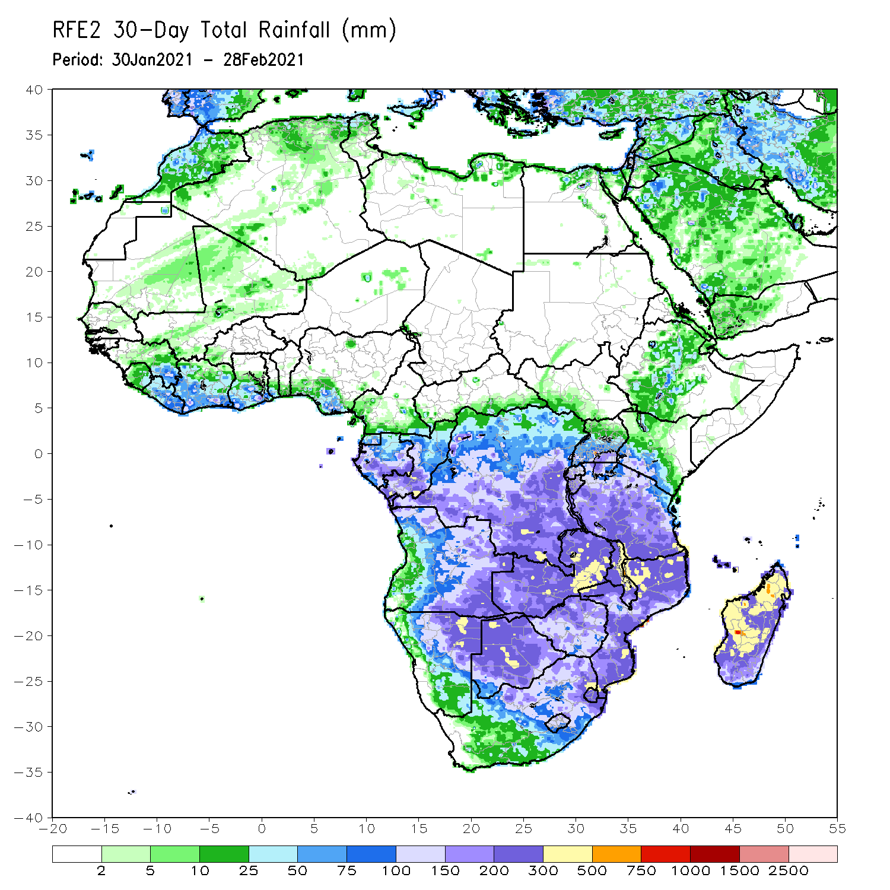
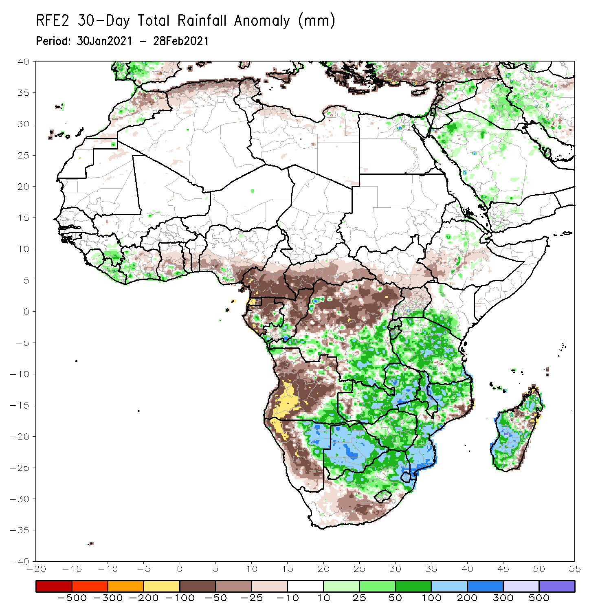
Rainfall Patterns: Last 30 Days
During the past 30 days, in southern Africa, persistent moderate to heavy rains resulted in moisture surpluses over southeastern Angola, eastern Namibia, much of Zambia, Malawi, Botswana, and Zimbabwe. Rainfall was also above average over northern South Africa, and much of Mozambique. Persistent light rains resulted in moisture deficits in western and central Angola, western Namibia and the southern portions of South Africa. In Central Africa, rainfall was below average over much of Gabon, Equatorial Guinea, Cameroon, Central Africa Republic and northern DRC. In East Africa, below rainfall was observed over southwestern Ethiopia. Rainfall was above-average over parts of southern Kenya and much of Tanzania. In West Africa, above-average rainfall was observed over portions of the Gulf of Guinea countries.
Notes:
5

Slide 6
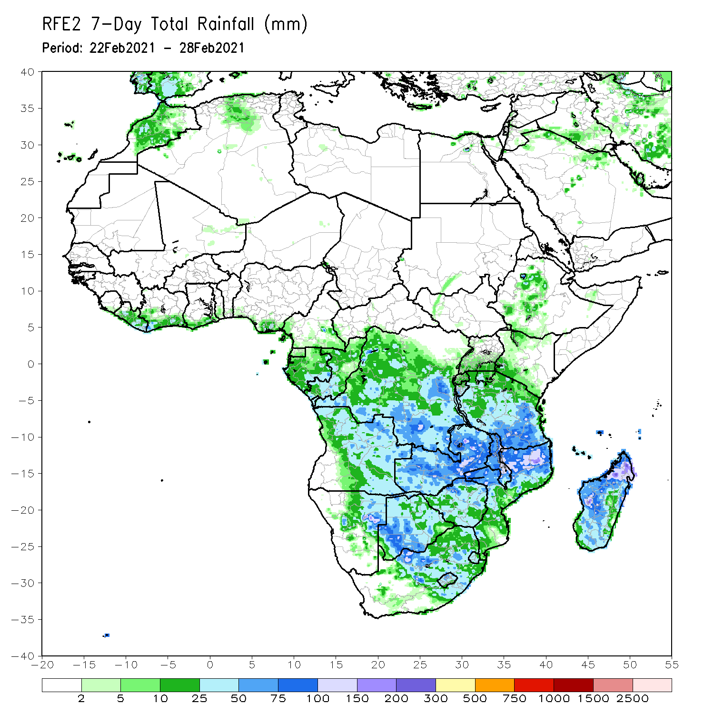
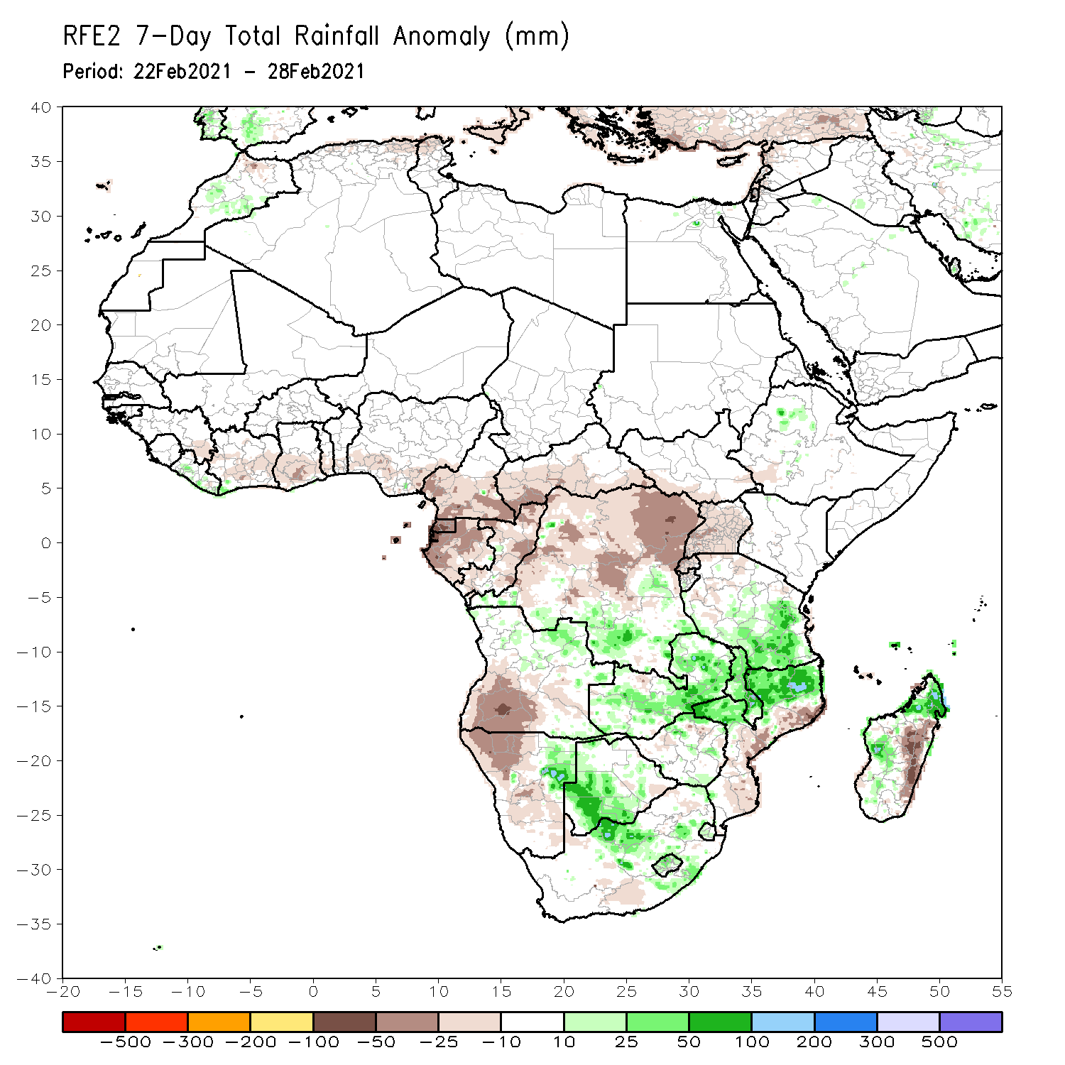
Rainfall Patterns: Last 7 Days
During the past 7 days, in Southern Africa, moderate to locally heavy rainfall resulted in moisture surpluses over eastern Namibia, western Botswana and parts of South Africa. Above-average rainfall was also observed over parts of Zambia, Malawi, northern Mozambique, and western and northern Madagascar. Below-average rainfall was observed over southwestern Angola and northwestern Namibia. Rainfall was also below-average over central and southern Mozambique and eastern Madagascar. In Central Africa, light rains sustained moisture deficits over Gabon, Congo, much of Cameroon, northern DRC and CAR. In East Africa, local areas in Ethiopia and Kenya, and portions of Tanzania received above-average rainfall. In West Africa, below-average rainfall was observed over portions of the Gulf of Guinea region.

Slide 7
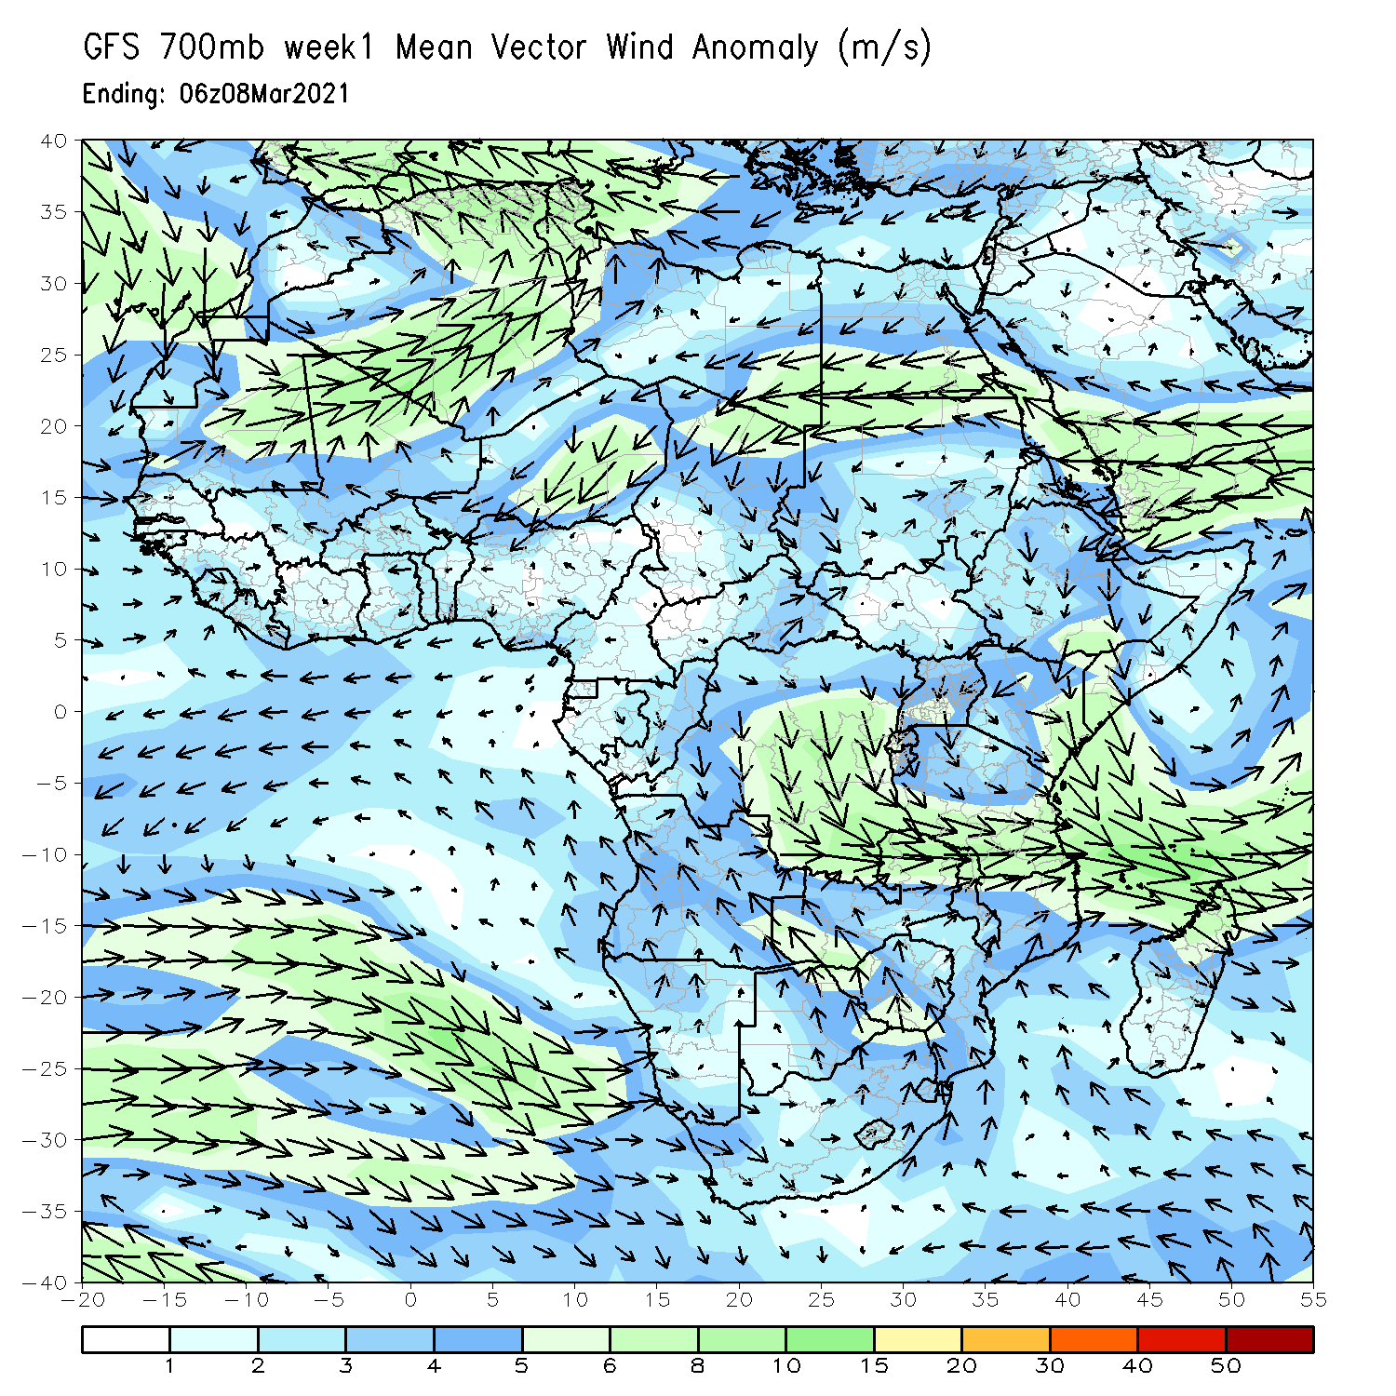
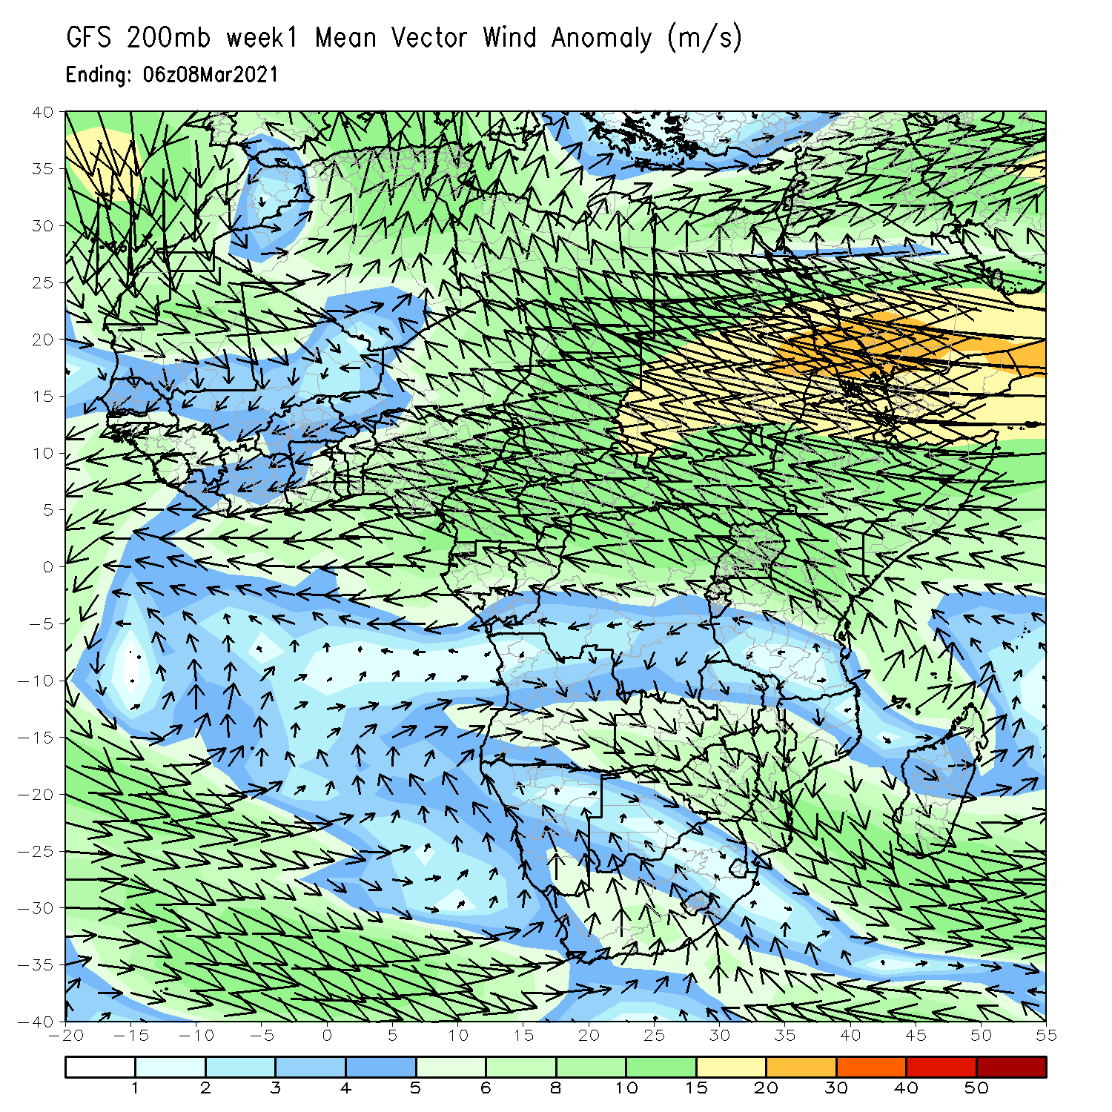
Atmospheric Circulation: Last 7 Days
At lower-level (left panel), anomalous wind convergence across portions of East Africa may have contributed to observed moisture surpluses in the region.

Slide 8
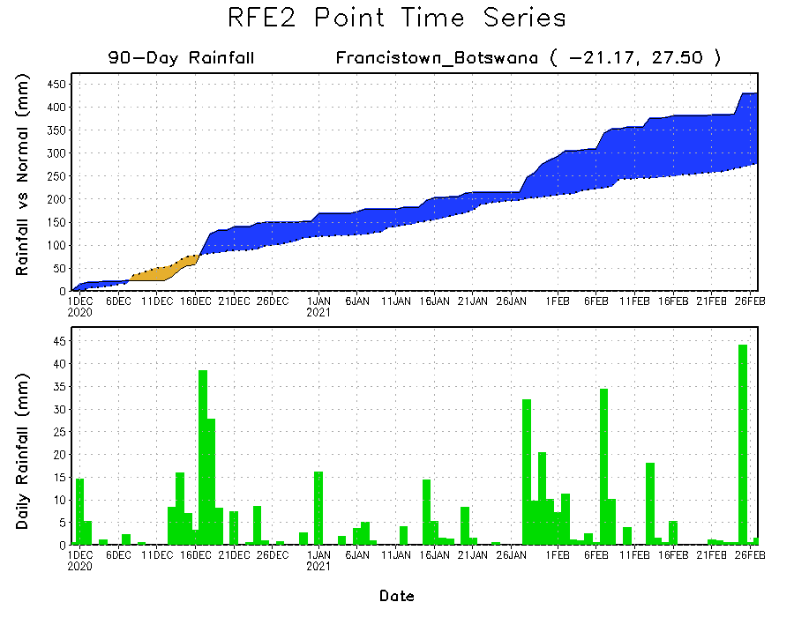
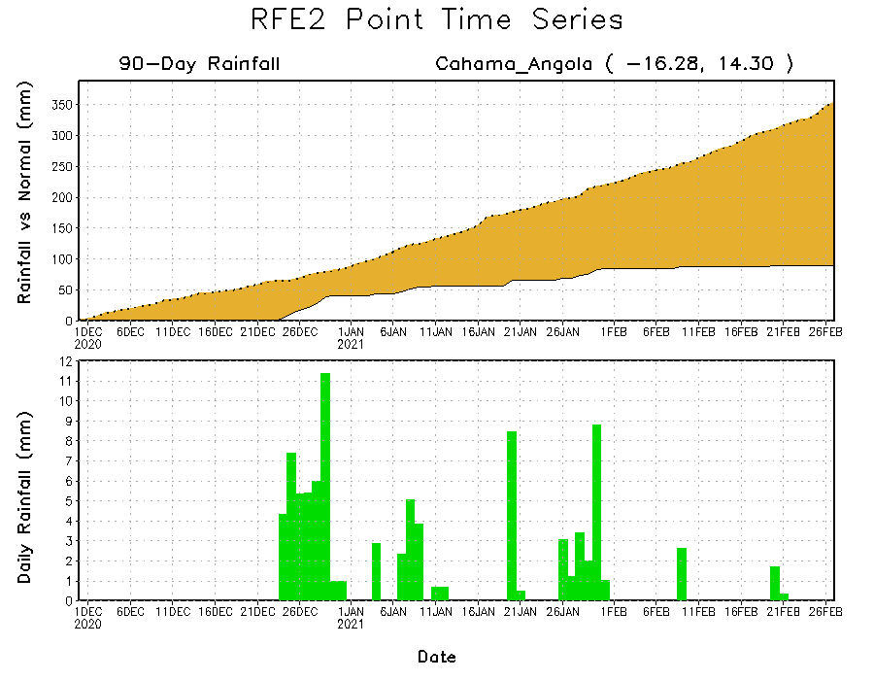
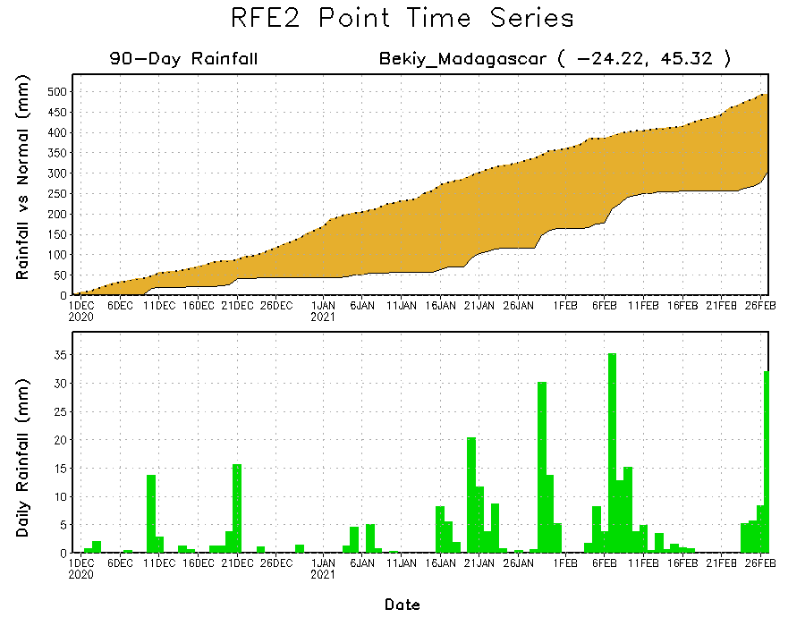
Rainfall Evolution
Daily evolution of rainfall over the last 90 days at selected locations shows moderate to heavy rainfall sustained moisture surpluses over parts of Botswana (top right). Seasonal total rainfall remained below-average over portions of Angola (bottom left) and southern Madagascar (bottom right).

Slide 9
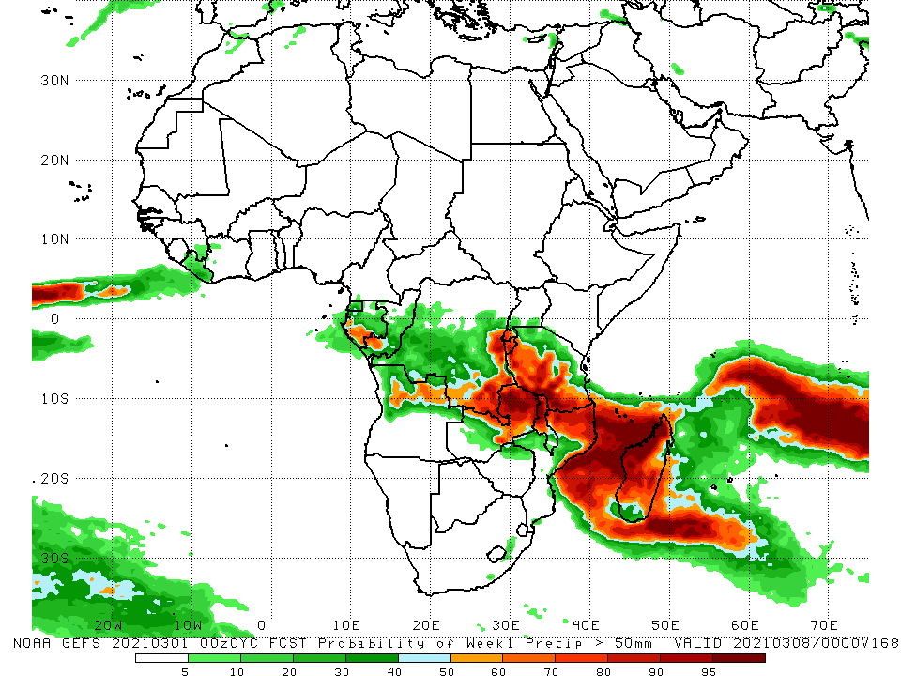
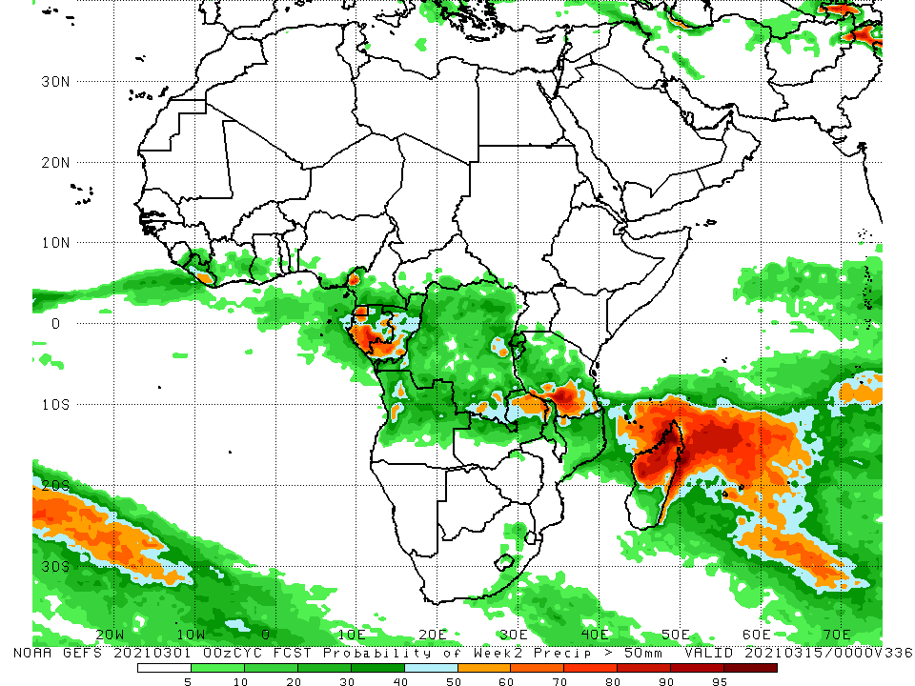
NCEP GEFS Model Forecasts Non-Bias Corrected Probability of precipitation exceedance
Week-1, Valid: 2 - 8 March, 2021
Week-2, Valid: 9 - 15 March, 2021
For week-1 (left panel), the NCEP GEFS indicates a moderate to high chance (over 70%) for rainfall to exceed 50 mm over parts of southern Gabon, southern Congo, northern Angola, southern and eastern DRC, eastern Zambia, Rwanda, Burundi, Tanzania, Malawi, northern Mozambique and much of Madagascar. For week-2 (right panel), the chance for rainfall to exceed 50 mm is mostly confined to portions of Madagascar and Congo, and northeastern Zambia, southern Tanzania and northern Madagascar.
Notes:
9

Slide 10
Summary
During the past 30 to 90 days, in southern Africa, persistent rains resulted in sustained moisture surpluses over southeastern Angola, Zambia, Botswana, Malawi, and Zimbabwe. Rainfall was below average over western and central Angola, and western Namibia. In East Africa, moisture deficits prevailed over portions of southern Ethiopia, and local areas in Somalia and Kenya. Rainfall was above average much of Tanzania and Uganda. In central Africa, rainfall was above average over portions of DRC and southern Congo. Rainfall was below average over western Gabon, Equatorial Africa and CAR. In West Africa, rainfall was slightly above average in pockets along the Guinean coast.
During the past 7 days, in Southern Africa, moderate to locally heavy rainfall resulted in moisture surpluses over eastern Namibia, western Botswana, parts of Zambia, Malawi, northern Mozambique, and western and northern Madagascar. Below-average rainfall was observed over southwestern Angola, northwestern Namibia, central and southern Mozambique and eastern Madagascar. In Central Africa, light rains sustained moisture deficits over Gabon, Congo, much of Cameroon, northern DRC and CAR. In East Africa, local areas in Ethiopia and Kenya, and portions of Tanzania received above-average rainfall. In West Africa, below-average rainfall was observed over portions of the Gulf of Guinea region.
For week-1 , there is a moderate to high chance (over 70%) for rainfall to exceed 50 mm over parts of southern Gabon, southern Congo, northern Angola, southern and eastern DRC, eastern Zambia, Rwanda, Burundi, Tanzania, Malawi, northern Mozambique and much of Madagascar. For week-2, the chance for rainfall to exceed 50 mm is mostly confined to portions of Madagascar and Congo, and northeastern Zambia, southern Tanzania and northern Madagascar.

