Slide 1
The African Monsoon Recent Evolution and Current Status Include Week-1 and Week-2 Outlooks
Update prepared by
16 February 2021
For more information, visit:
http://www.cpc.ncep.noaa.gov/products/Global_Monsoons/African_Monsoons/precip_monitoring.shtml

Slide 2
Outline
Highlights
Recent Evolution and Current Conditions
NCEP GEFS Forecasts
Summary

Slide 3
Highlights: Last 7 Days
During the past 7 days, in Southern Africa, moderate to heavy rainfall sustained moisture surpluses across southeastern Angola, Namibia, parts of southern DRC, and much of Zambia. Rainfall was also above-average over much Malawi, Mozambique and Madagascar. Below-average rainfall was observed over many parts of Angola. In Central Africa, light rains sustained moisture deficits over pocket of Gabon, Congo and much of DRC. In East Africa, parts of southern Kenya and much of Tanzania received above-average rainfall.
For week-1 and week-2, the NCEP GEFS indicates a moderate to high chance for rainfall to exceed 50 mm over parts of Gabon, southern and eastern DRC, eastern Angola, Rwanda, Burundi, parts of Tanzania, much of Zambia, Malawi, northern Zimbabwe, and parts of Mozambique and Madagascar.

Slide 4
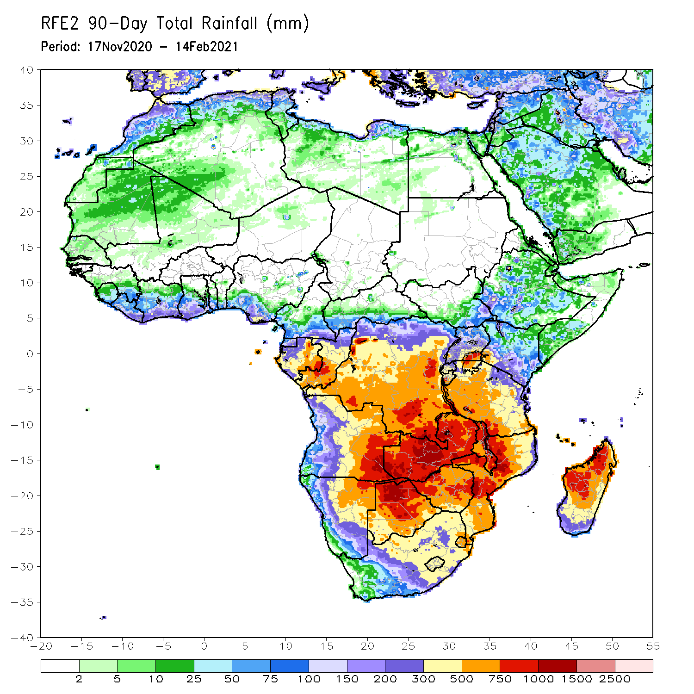
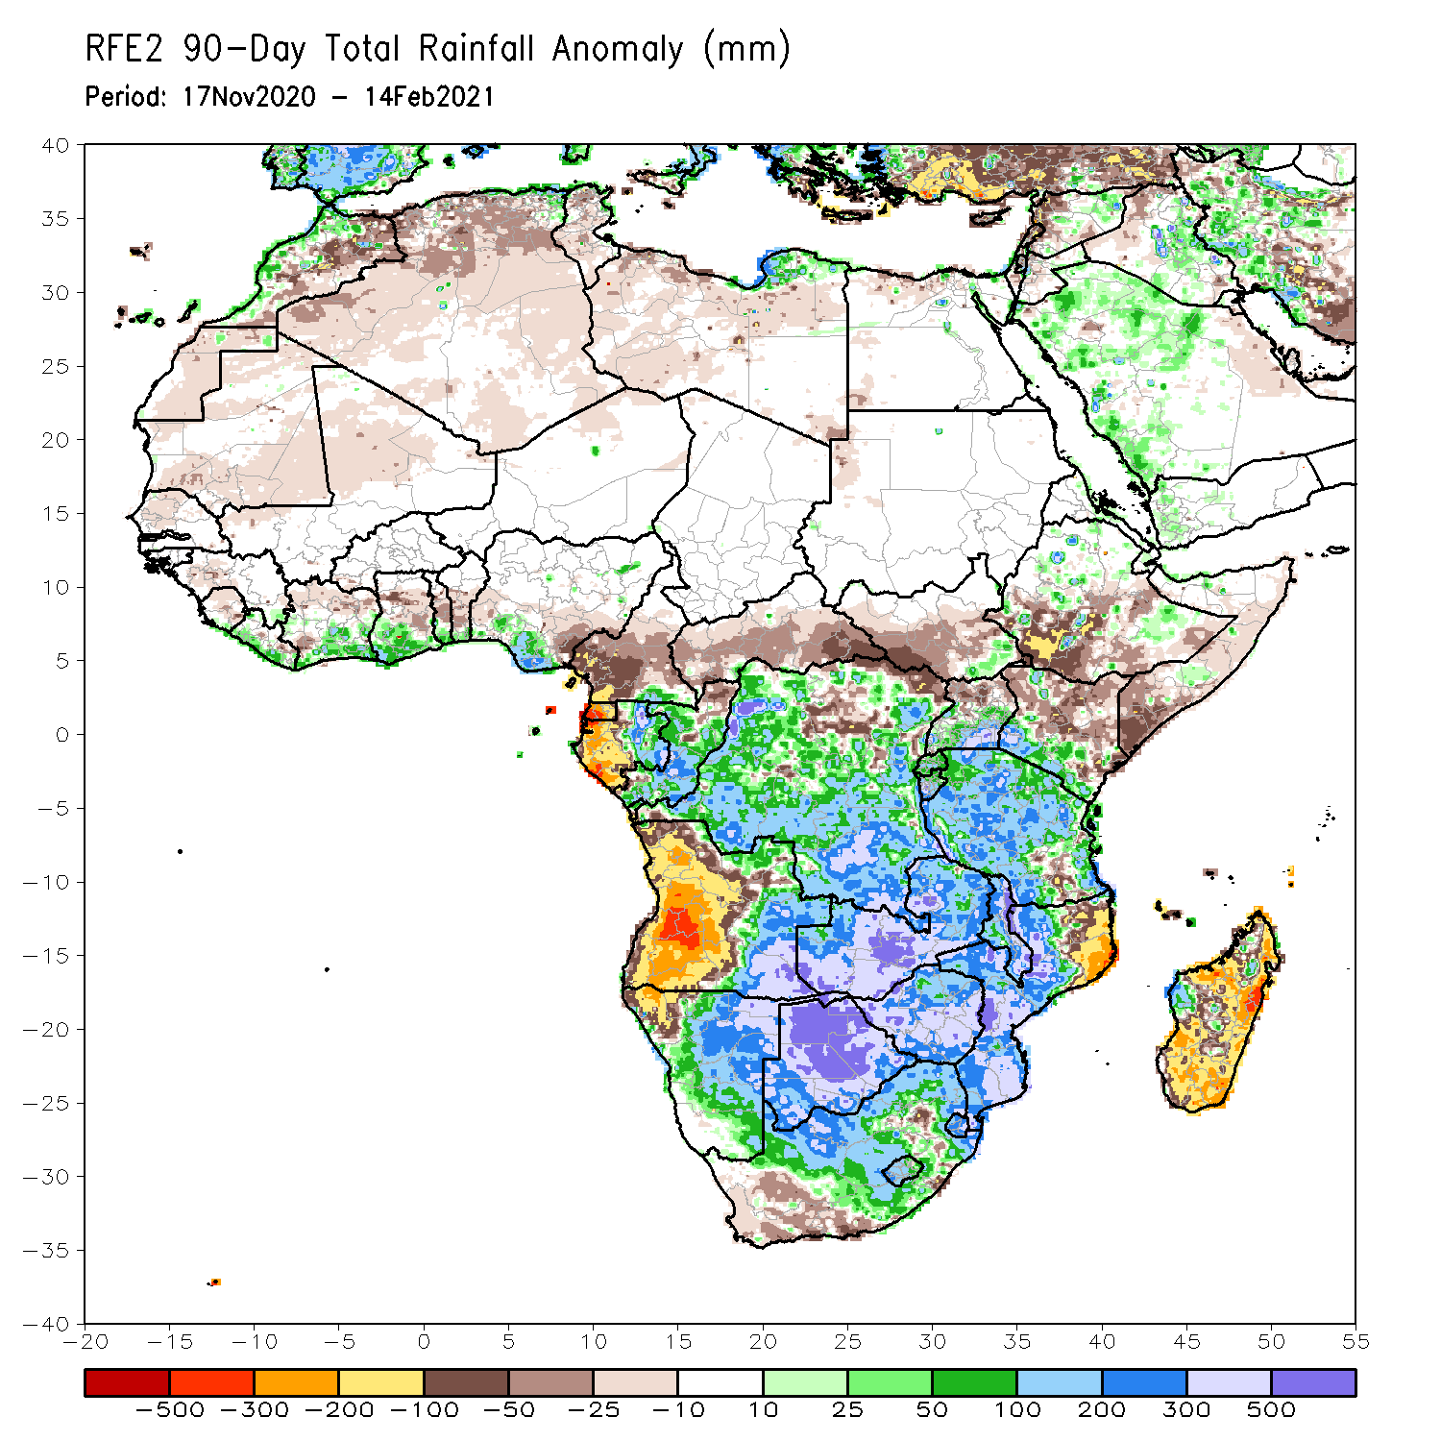
Rainfall Patterns: Last 90 Days
Over the past 90 days, in southern Africa, persistent rains resulted in sustained moisture surpluses over eastern Angola, Zambia, Botswana, and Zimbabwe. Rainfall was also above average over many parts of Namibia and Mozambique, South Africa, Malawi, and local areas in western Madagascar. Persistent light rains resulted in moisture deficits in western Angola and northwestern Namibia. Rainfall was also below average along the border between Tanzania and Mozambique and over central and much of Madagascar. In East Africa, rainfall was below average over parts of southern Ethiopia, Kenya, southern Somalia. Rainfall was also below average over many parts of South Sudan. Rainfall was above average over southeastern South Sudan, parts of southern Kenya, Uganda and much of Tanzania. In Central Africa, rainfall was above average over many parts of DRC and Congo. Rainfall was below average over local areas in northern DRC and much of CAR. Below average rains were also observed over the western areas of Gabon and much of Cameroon. In West Africa, rainfall was above average along the coast.
Notes:
4

Slide 5
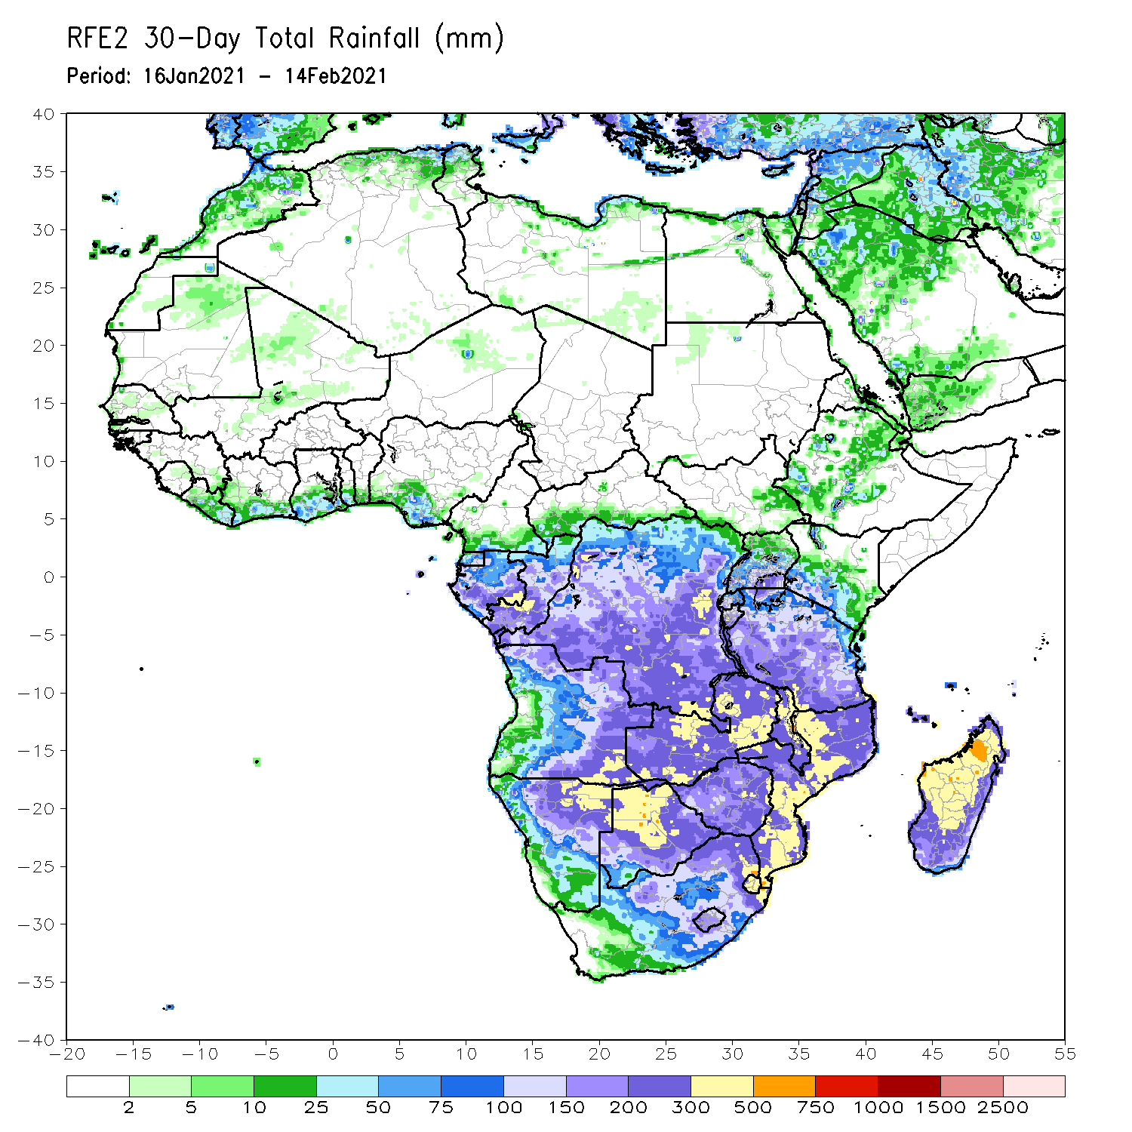
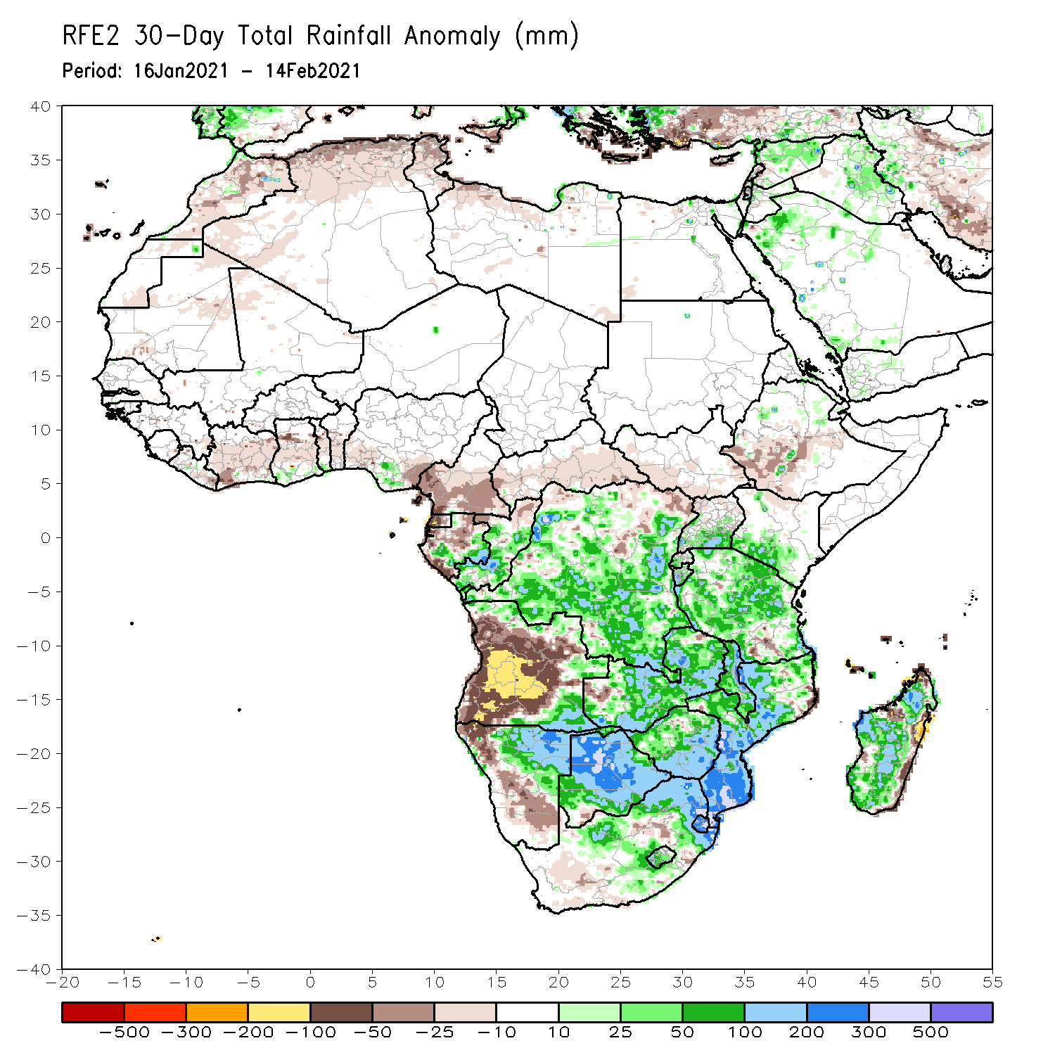
Rainfall Patterns: Last 30 Days
During the past 30 days, in southern Africa, persistent moderate to heavy rains resulted in moisture surpluses over southeastern Angola, Namibia, Zambia, Botswana, and Zimbabwe. Rainfall was also above average over many parts of South Africa, and much of Mozambique. Persistent light rains resulted in moisture deficits in western and central Angola, and northwestern and southwestern Namibia. Rainfall was also below average over local areas in Madagascar. in East Africa, below average in pockets along the Guinean coast.
Notes:
5

Slide 6
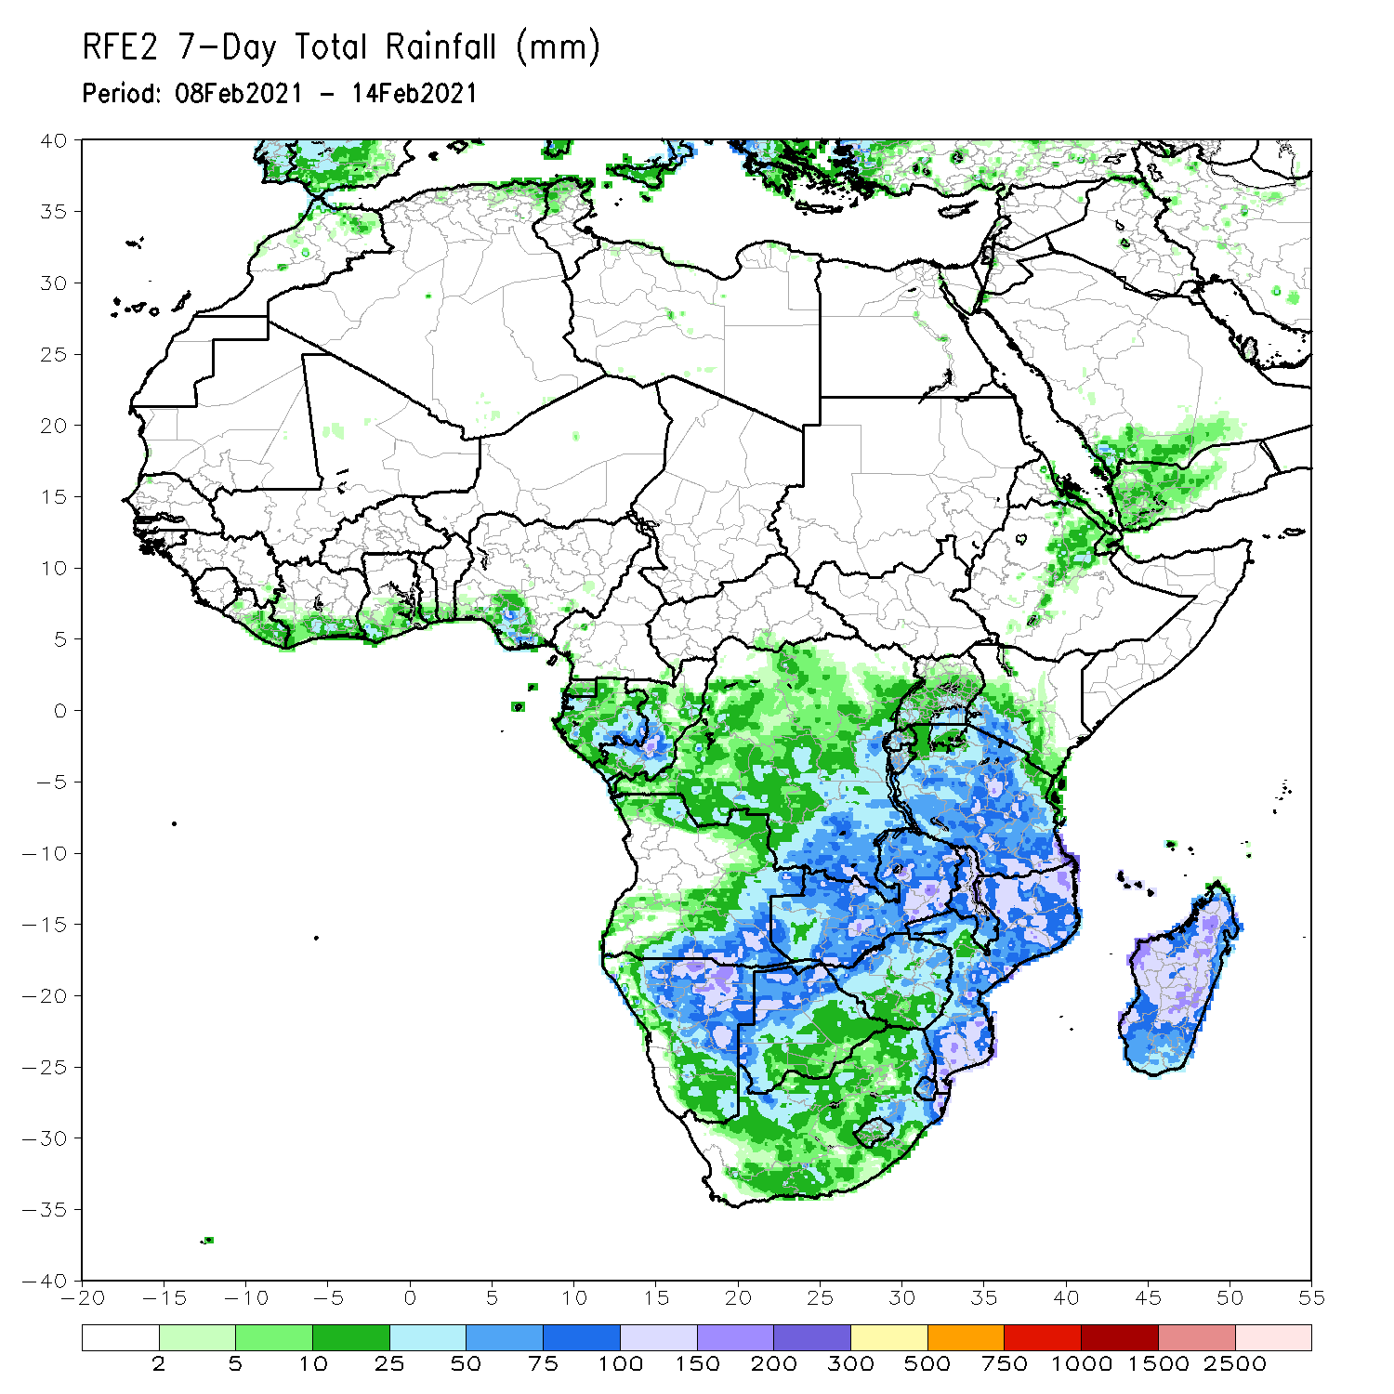
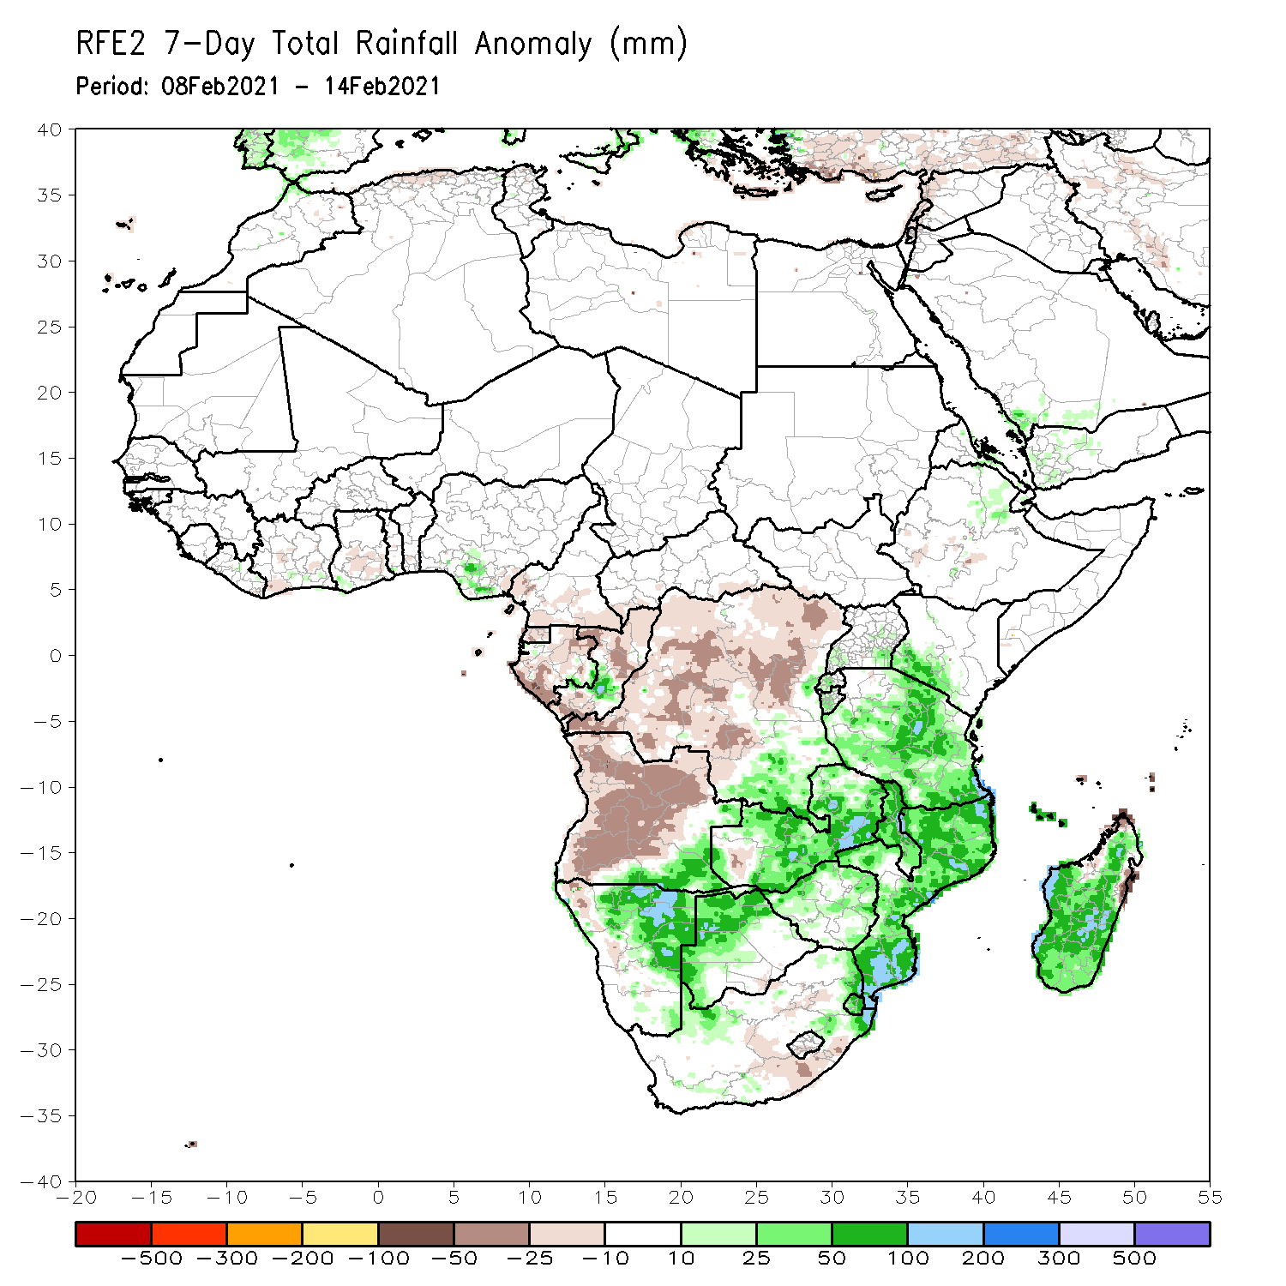
Rainfall Patterns: Last 7 Days
During the past 7 days, in Southern Africa, moderate to heavy rainfall sustained moisture surpluses across southeastern Angola, Namibia, parts of southern DRC, and much of Zambia. Rainfall was also above-average over much Malawi, Mozambique and Madagascar. Below-average rainfall was observed over many parts of Angola. In Central Africa, light rains sustained moisture deficits over pocket of Gabon, Congo and much of DRC. In East Africa, parts of southern Kenya and much of Tanzania received above-average rainfall.

Slide 7
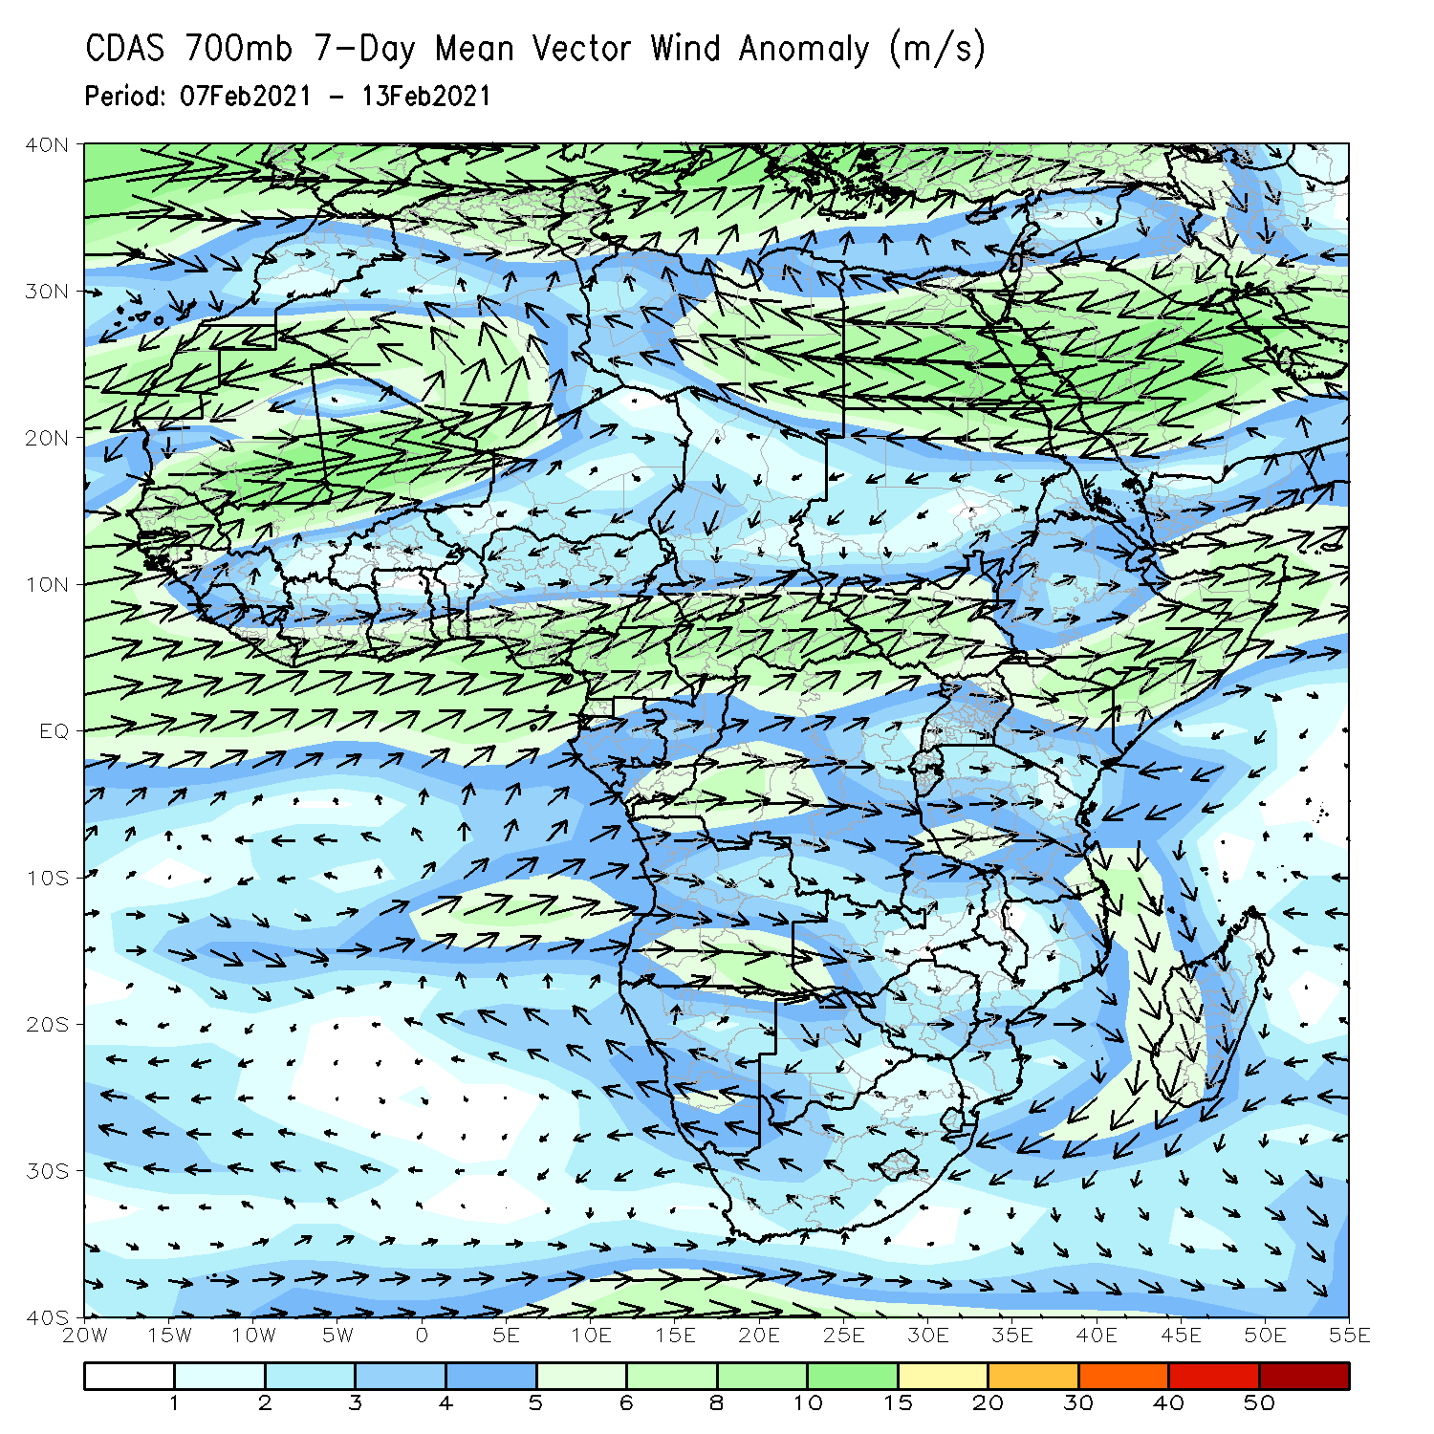
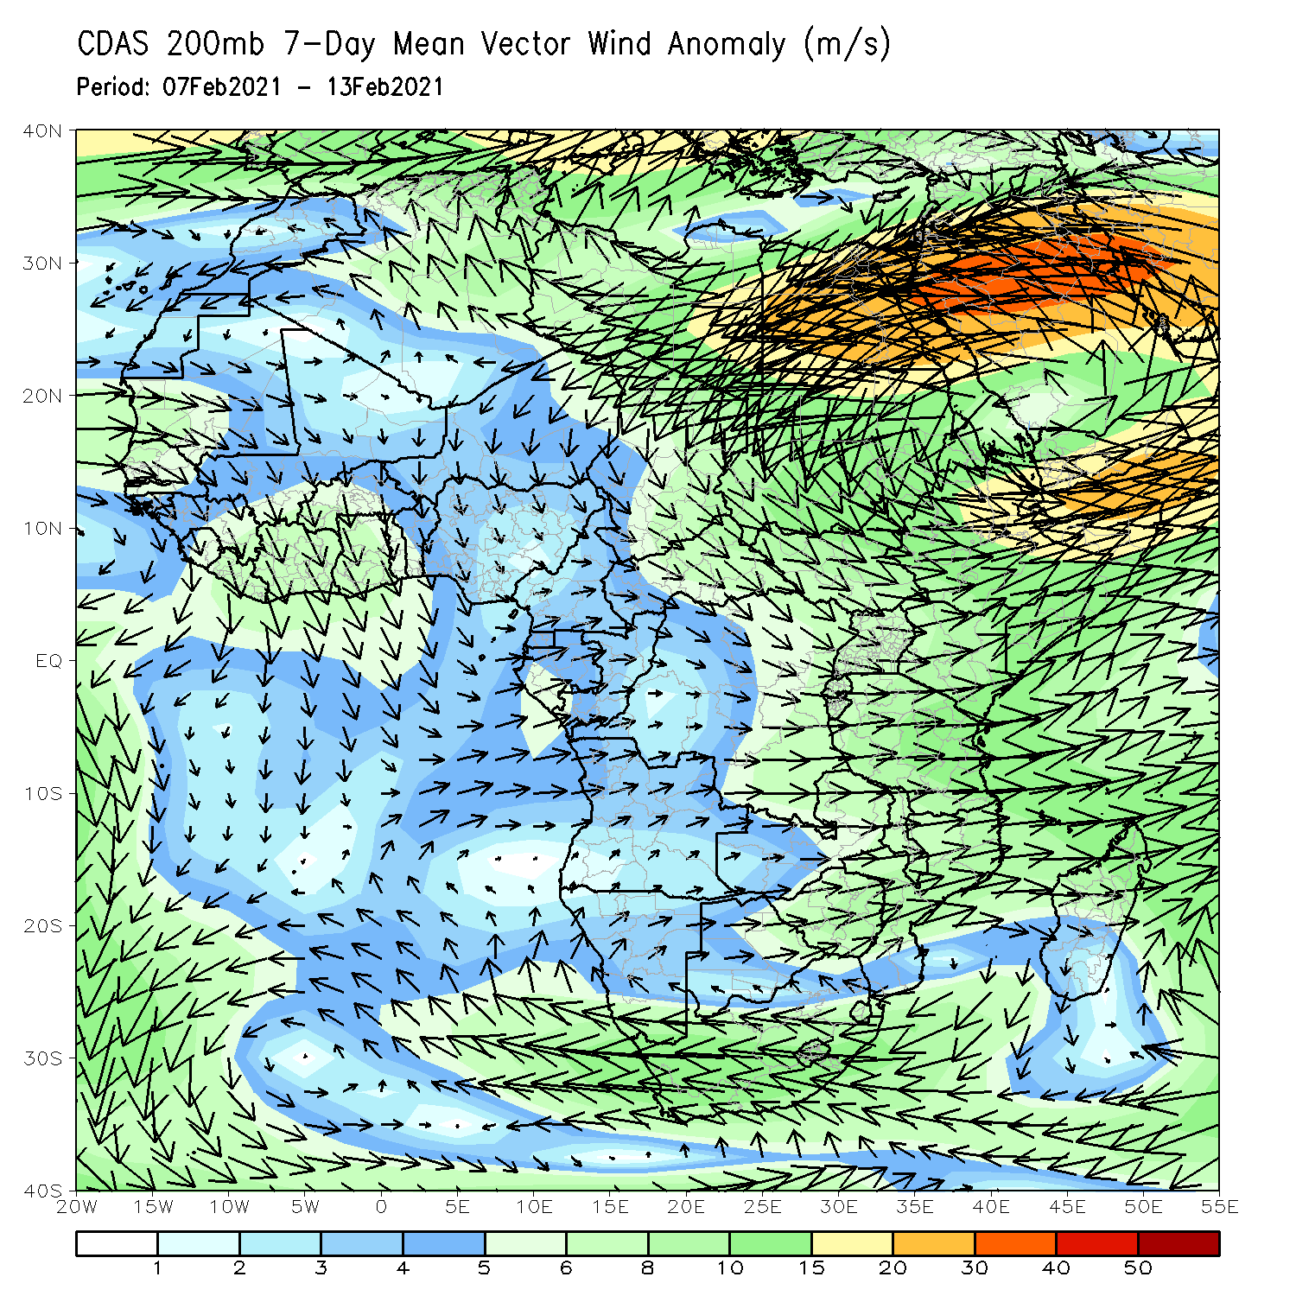
Atmospheric Circulation: Last 7 Days
At lower-level (left panel), anomalous cyclonic circulation over Southeastern Africa may have contributed to the observed above-average rainfall in the region.

Slide 8
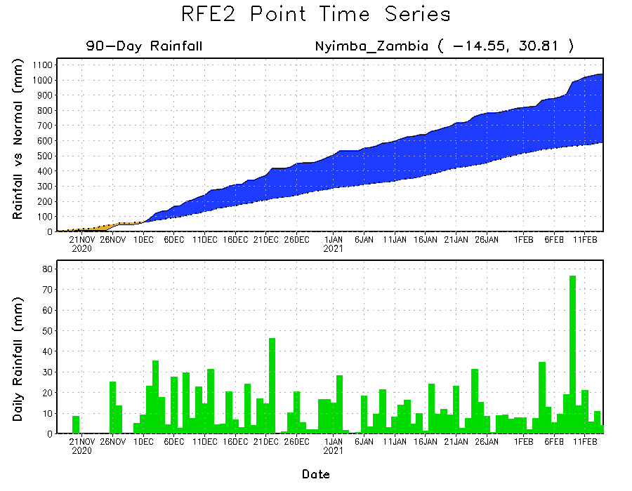
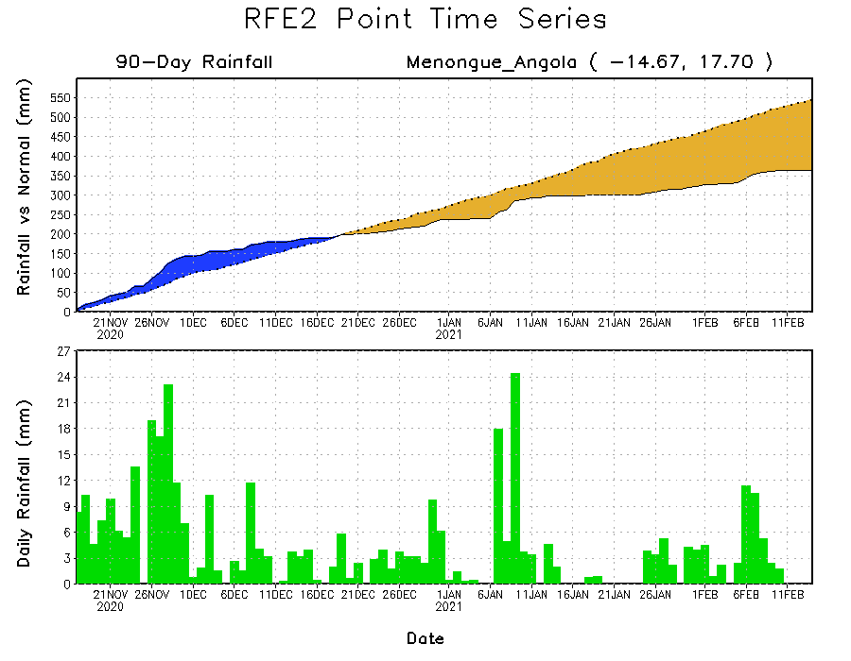
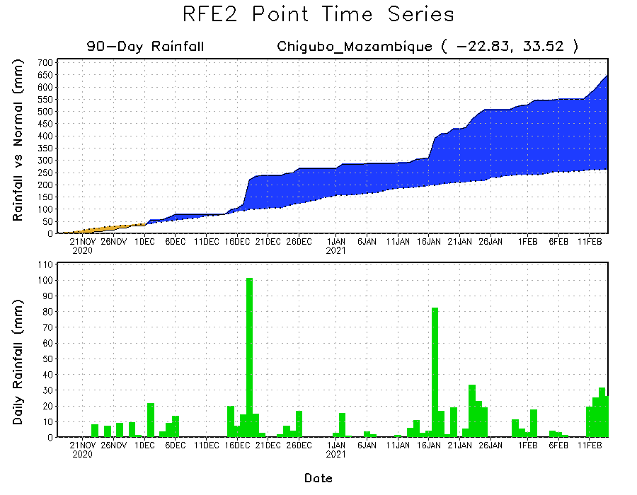
Rainfall Evolution
Daily evolution of rainfall over the last 90 days at selected locations shows moderate to heavy rainfall sustained moisture surpluses over parts of Zambia (top right) and southern Mozambique (bottom right). Seasonal total rainfall remained below-average over portions of Angola (bottom left).

Slide 9
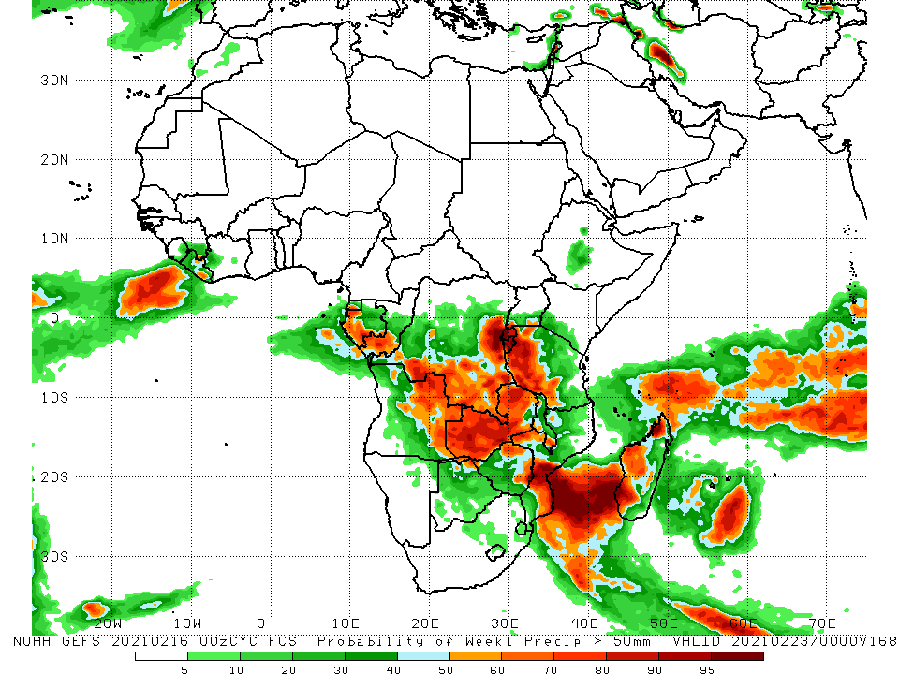
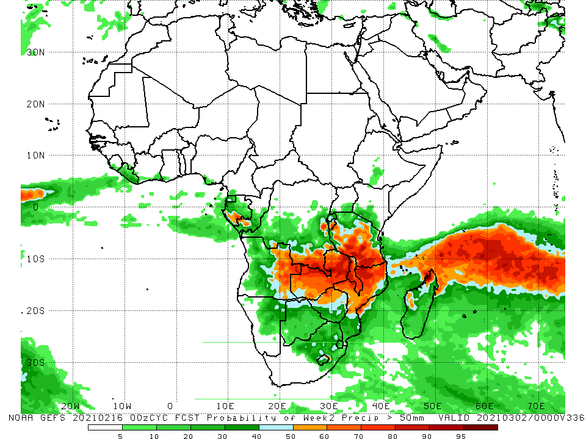
NCEP GEFS Model Forecasts Non-Bias Corrected Probability of precipitation exceedance
Week-1, Valid: 16 - 22 February, 2021
Week-2, Valid: 23 - 29 February, 2021
For week-1 (left panel) and week-2 (right panel), the NCEP GEFS indicates a moderate to high chance (over 70%) for rainfall to exceed 50 mm over parts of Gabon, southern and eastern DRC, eastern Angola, Rwanda, Burundi, parts of Tanzania, much of Zambia, Malawi, northern Zimbabwe, and parts of Mozambique and Madagascar.
Notes:
9

Slide 10
Summary
During the past 30 to 90 days, in southern Africa, persistent rains resulted in sustained moisture surpluses over eastern Angola, Zambia, Botswana, Malawi, and Zimbabwe. Rainfall was below average over western Angola and northwstern Namibia. In East Africa, moisture deficits prevailed over portions of southern Ethiopia, and pocket areas of Somalia and Kenya. Rainfall was above average much of Tanzania and Uganda. In central Africa, rainfall was above average over much of DRC, southern Congo, and eastern Gabon. Rainfall was below average over western Gabon, Equatorial Africa and CAR. In West Africa, rainfall was slightly above average in pockets along the Guinean coast.
During the past 7 days, in Southern Africa, moderate to heavy rainfall sustained moisture surpluses across southeastern Angola, Namibia, parts of southern DRC, and much of Zambia. Rainfall was also above-average over much Malawi, Mozambique and Madagascar. Below-average rainfall was observed over many parts of Angola. In Central Africa, light rains sustained moisture deficits over pocket of Gabon, Congo and much of DRC. In East Africa, parts of southern Kenya and much of Tanzania received above-average rainfall.
For week-1 and week-2, the NCEP GEFS indicates a moderate to high chance (over 70%) for rainfall to exceed 50 mm over parts of Gabon, southern and eastern DRC, eastern Angola, Rwanda, Burundi, parts of Tanzania, much of Zambia, Malawi, northern Zimbabwe, and parts of Mozambique and Madagascar.

