Slide 1
The African Monsoon Recent Evolution and Current Status Include Week-1 and Week-2 Outlooks
Update prepared by
08 February 2021
For more information, visit:
http://www.cpc.ncep.noaa.gov/products/Global_Monsoons/African_Monsoons/precip_monitoring.shtml

Slide 2
Outline
Highlights
Recent Evolution and Current Conditions
NCEP GEFS Forecasts
Summary

Slide 3
Highlights: Last 7 Days
During the past 7 days, in Southern Africa, heavy rainfall sustained moisture surpluses across much of Botswana and eastern South Africa. Rainfall was also above-average over parts of Zimbabwe, and local areas in Zambia, Mozambique and southern Madagascar. Below-average rainfall was observed over much of Angola, Namibia, southern Tanzania, central and northern Mozambique and northern Madagascar. In Central Africa, moderate rains sustained moisture surpluses over pocket of Gabon and DRC. In East Africa, parts of southern Kenya and Tanzania received above-average rainfall.
The week-1 and week-2 outlooks indicate a moderate to high chance for rainfall to exceed 50 mm over southern southeastern Angola, northeastern Namibia, southeastern DRC, Zambia, Tanzania, Malawi, northern Zimbabwe, northern Mozambique and much of Madagascar.

Slide 4
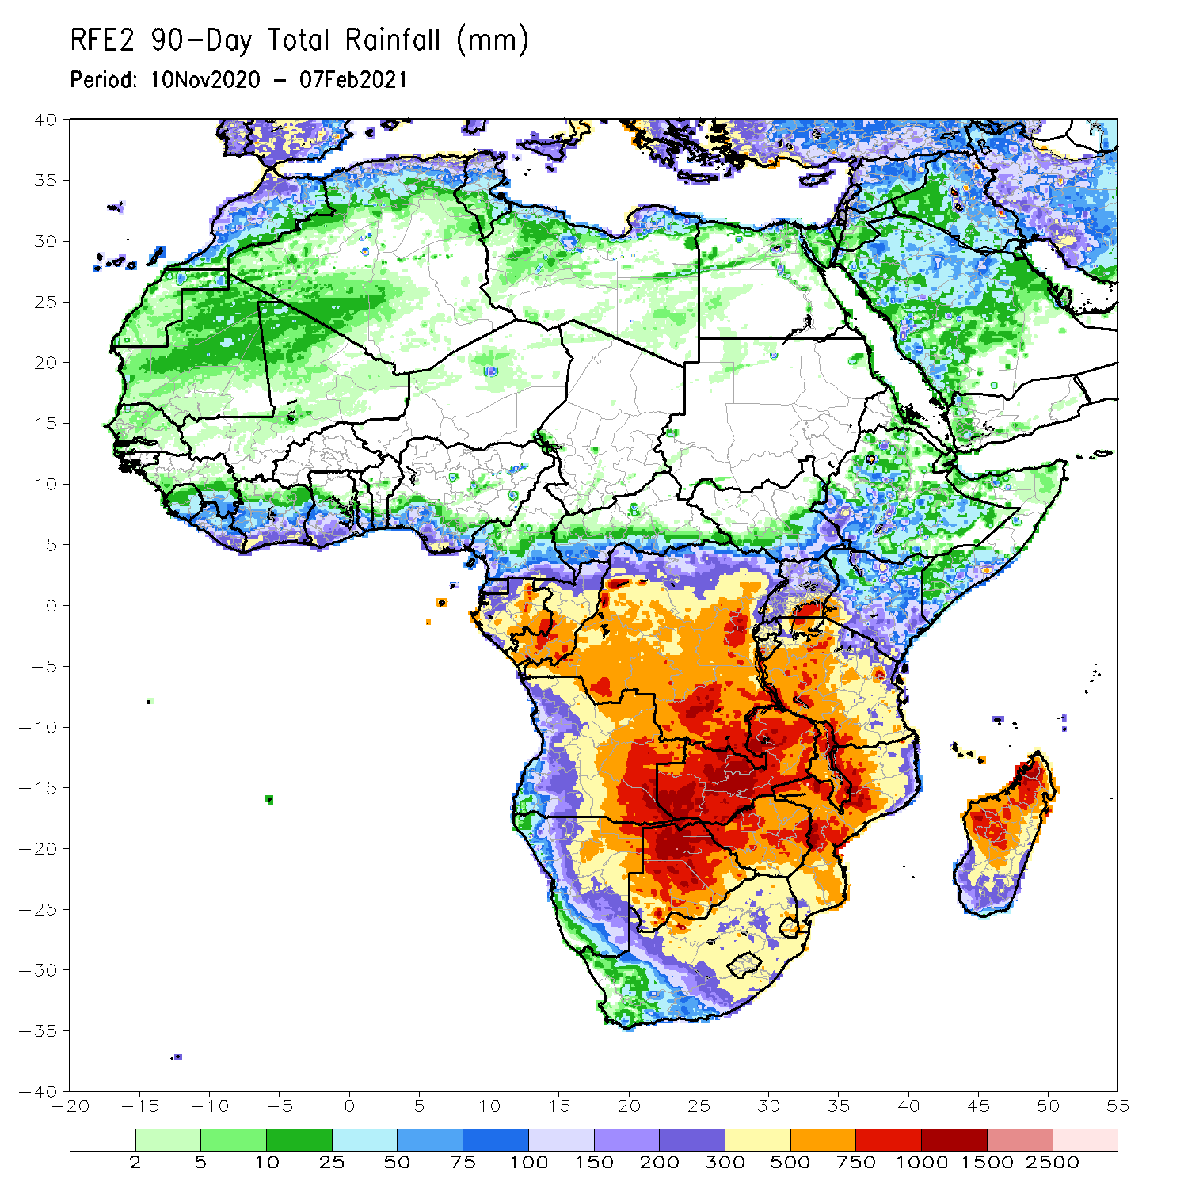
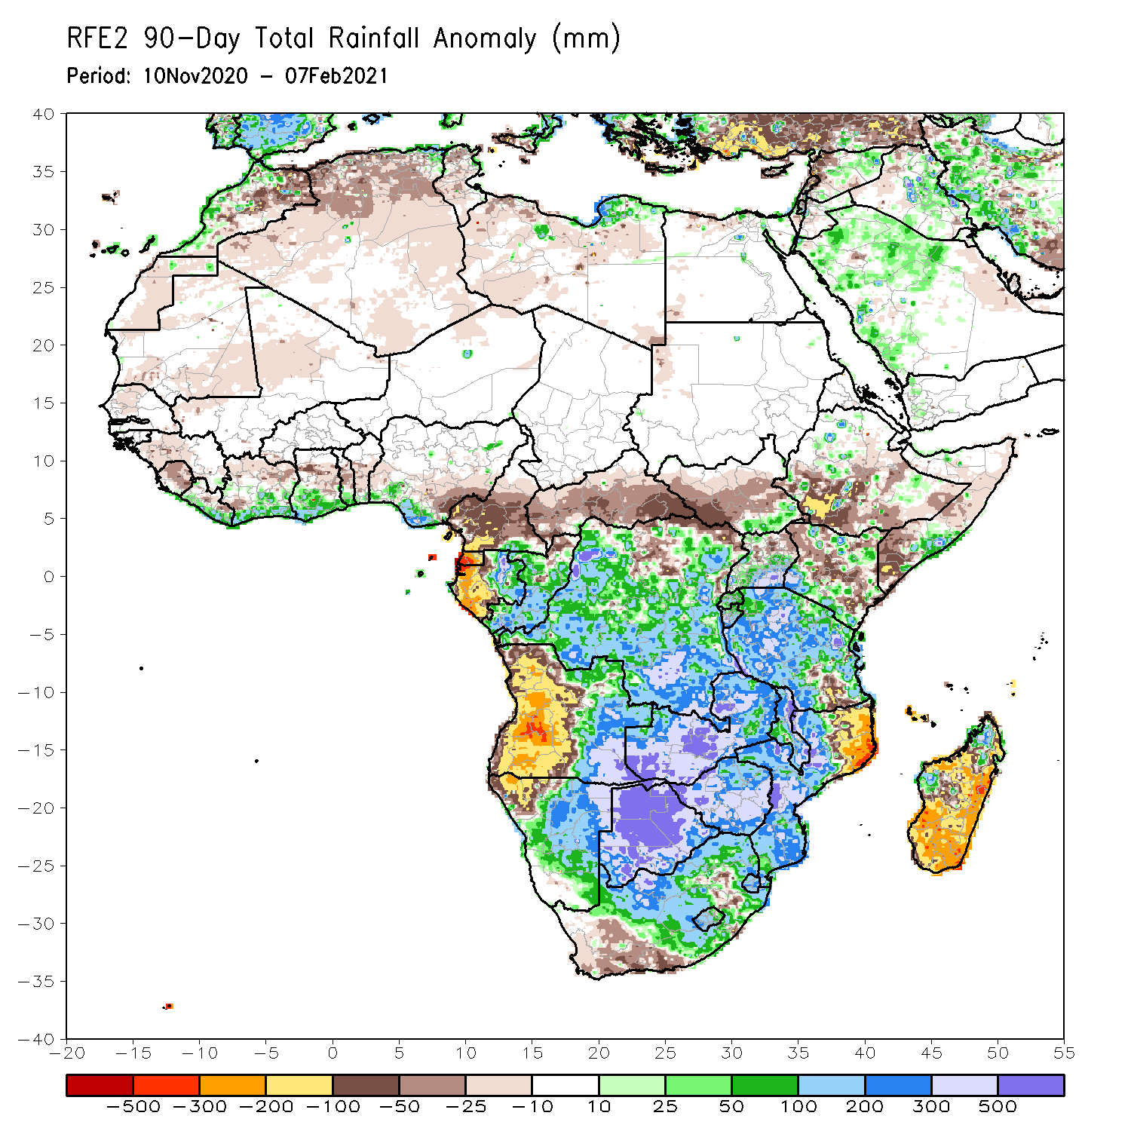
Rainfall Patterns: Last 90 Days
Over the past 90 days, in southern Africa, persistent rains resulted in sustained moisture surpluses over eastern Angola, Zambia, Botswana, and Zimbabwe. Rainfall was also above average over many parts of Namibia and Mozambique, South Africa, Malawi, and pocket areas in northern Madagascar. Persistent light rains resulted in moisture deficits in western Angola and northwestern Namibia. Rainfall was also below average along the border between Tanzania and Mozambique and over central and southern Madagascar. In East Africa, rainfall was below average over parts of southern Ethiopia and Kenya, and local areas in Somalia. Rainfall was also below average over many parts of South Sudan. Rainfall was above average over southeastern South Sudan, pocket areas in Kenya and Somalia, Uganda and much of Tanzania. In Central Africa, rainfall was above average over many parts of DRC and Congo. Rainfall was below average over local areas in northern DRC and much of CAR. Below average rains were also observed over the western areas of Gabon and much of Cameroon. In West Africa, rainfall was below average in the central areas of the Gulf of Guinea region, and above average along the coast.
Notes:
4

Slide 5
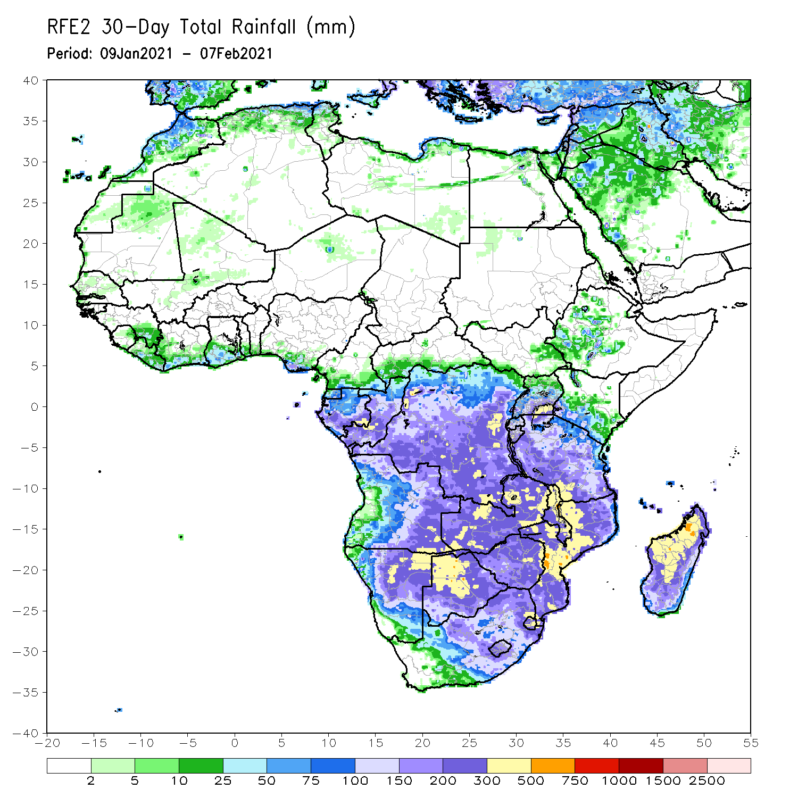
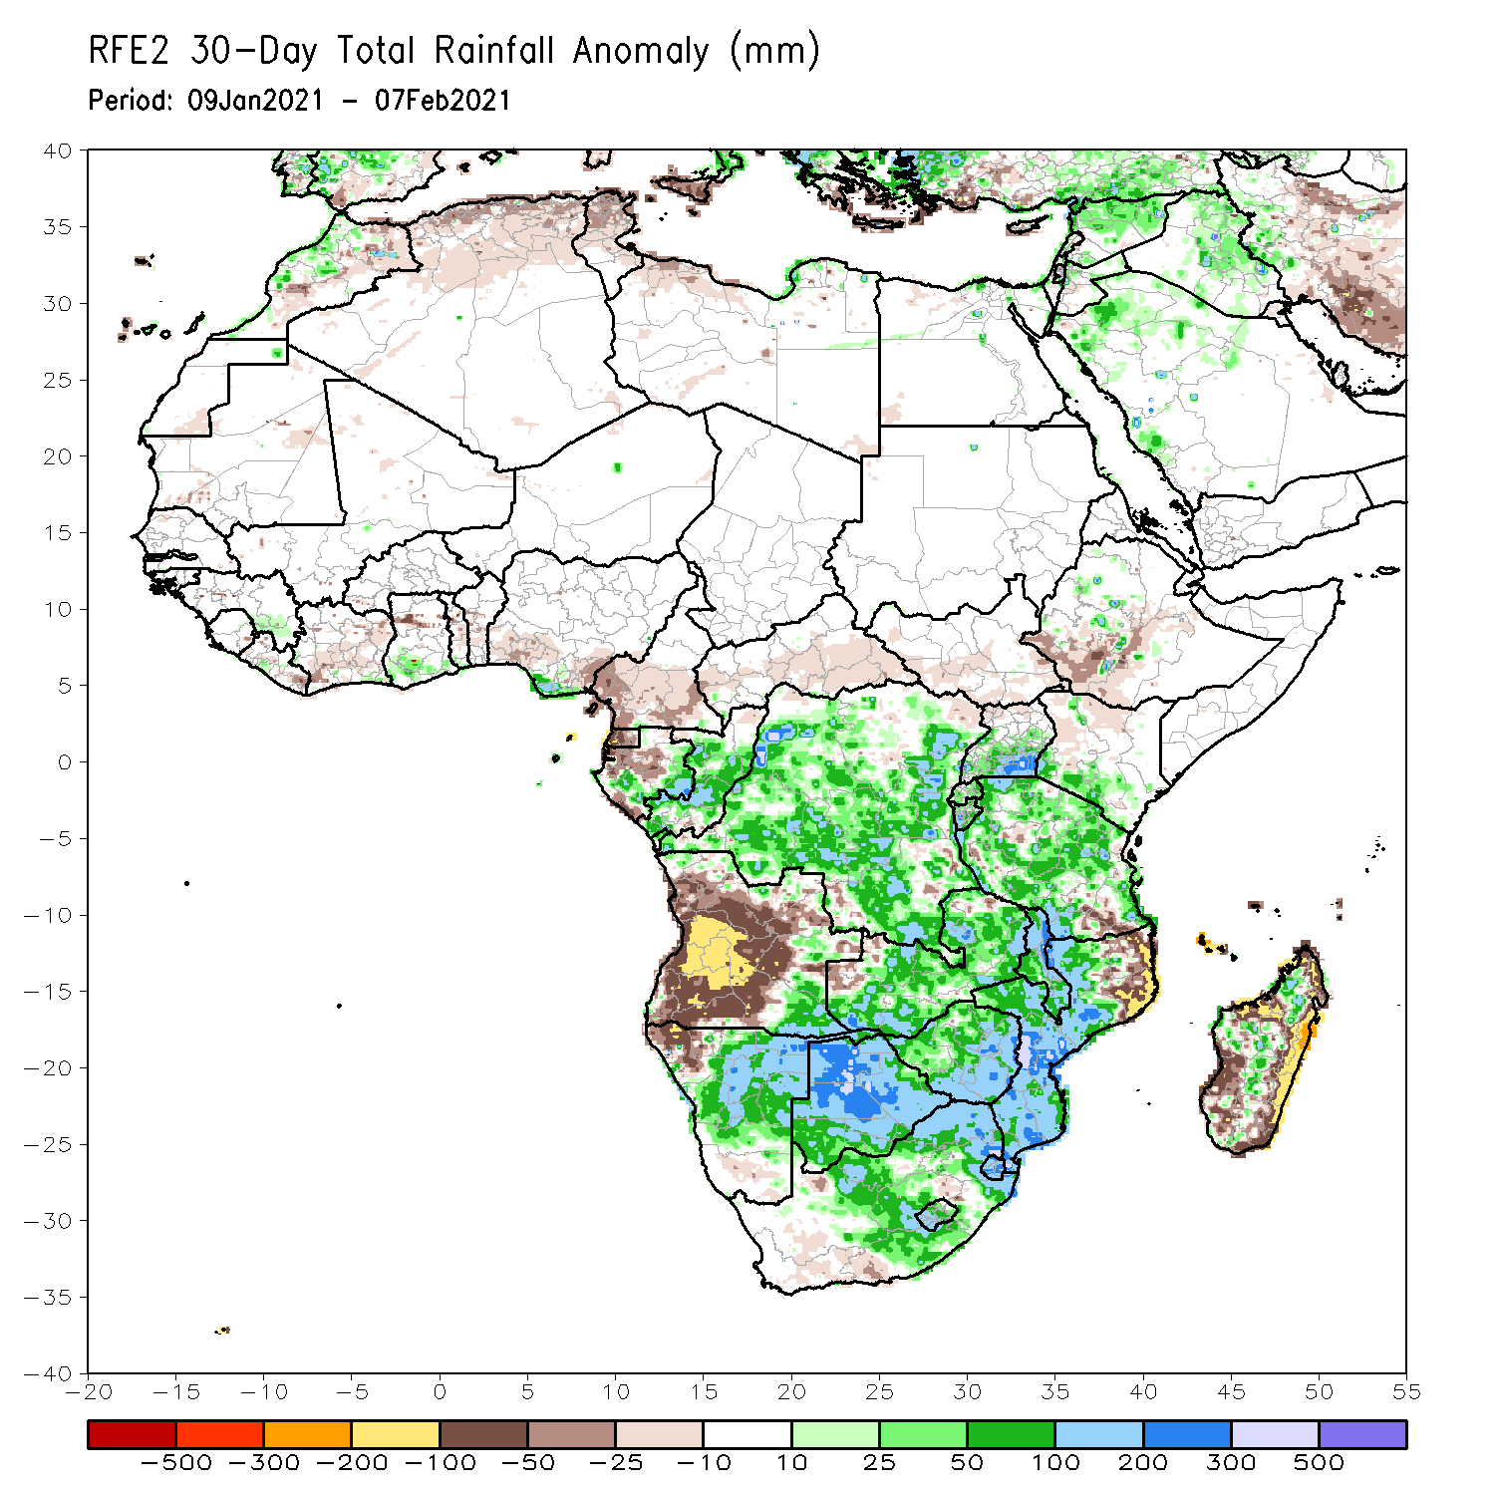
Rainfall Patterns: Last 30 Days
During the past 30 days, in southern Africa, persistent moderate to heavy rains resulted in moisture surpluses over southeastern Angola, Namibia, Zambia, Botswana, and Zimbabwe. Rainfall was also above average over portions of South Africa, central and southern Mozambique. Persistent light rains resulted in moisture deficits in western and central Angola, and northwestern Namibia. Rainfall was also below average over northeastern Mozambique, and over many parts of Madagascar.in East Africa, rainfall was above average over many parts of Tanzania. In central Africa, rainfall was above average over much of DRC and Congo. Rainfall was below average over western and central Gabon. In West Africa, rainfall was slightly above average in pockets along the Guinean coast.
Notes:
5

Slide 6
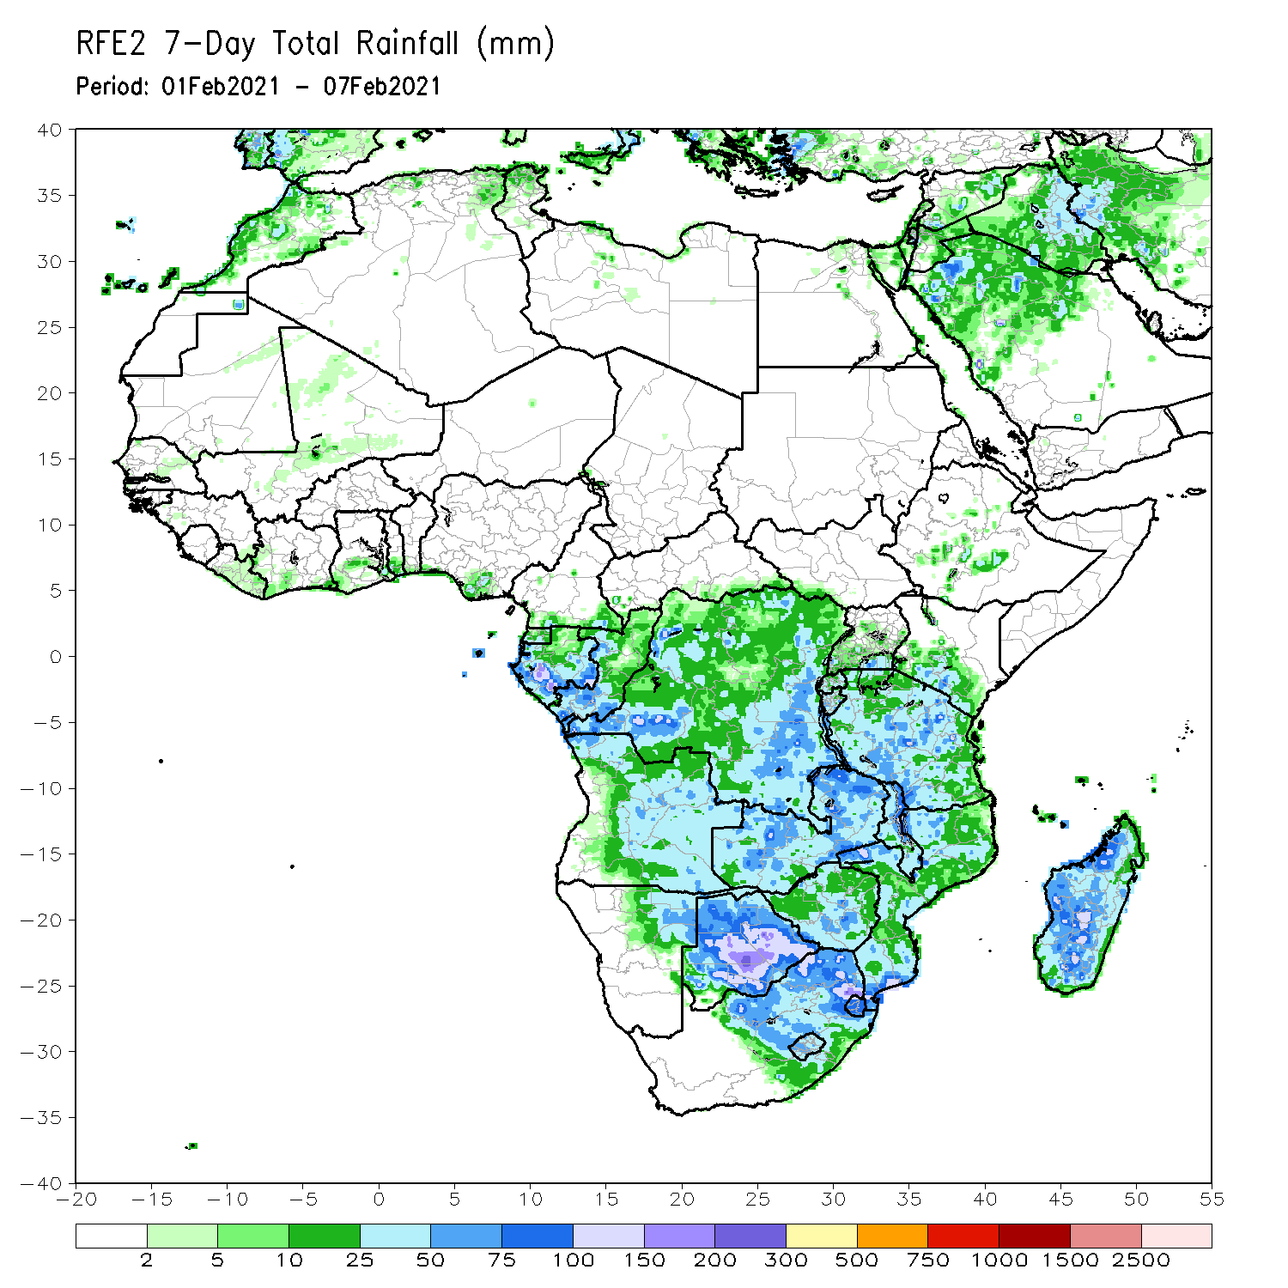
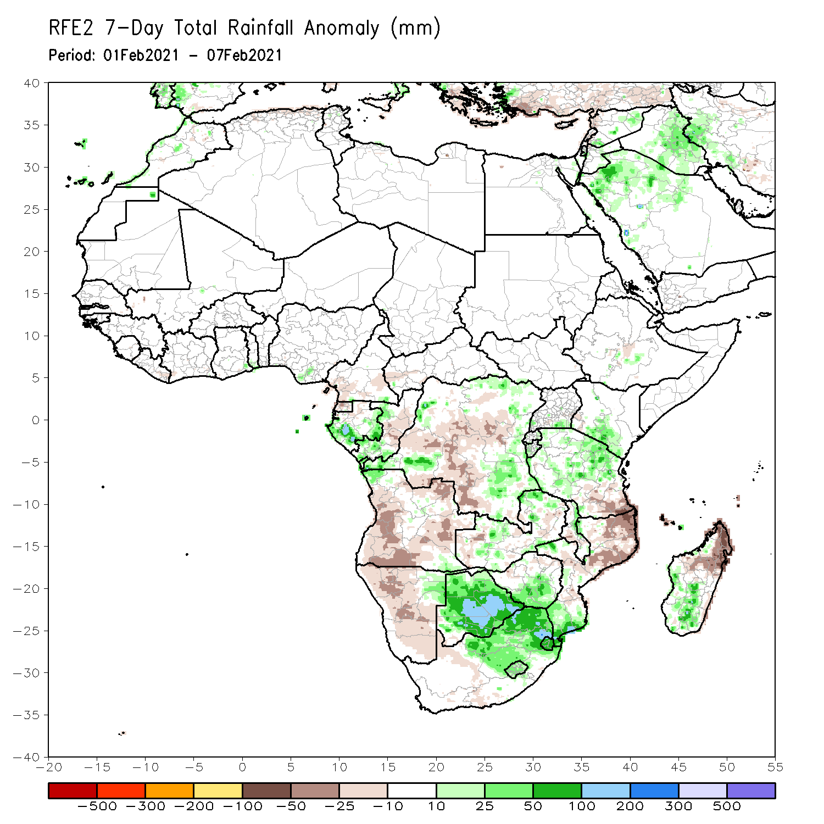
Rainfall Patterns: Last 7 Days
During the past 7 days, in Southern Africa, heavy rainfall sustained moisture surpluses across much of Botswana and eastern South Africa. Rainfall was also above-average over parts of Zimbabwe, and local areas in Zambia, Mozambique and northern Madagascar. Below-average rainfall was observed over much of Angola, Namibia, southern Tanzania, central and northern Mozambique and northern Madagascar. In Central Africa, moderate rains sustained moisture surpluses over pocket of Gabon and DRC. In East Africa, parts of southern Kenya and Tanzania received above-average rainfall.

Slide 7
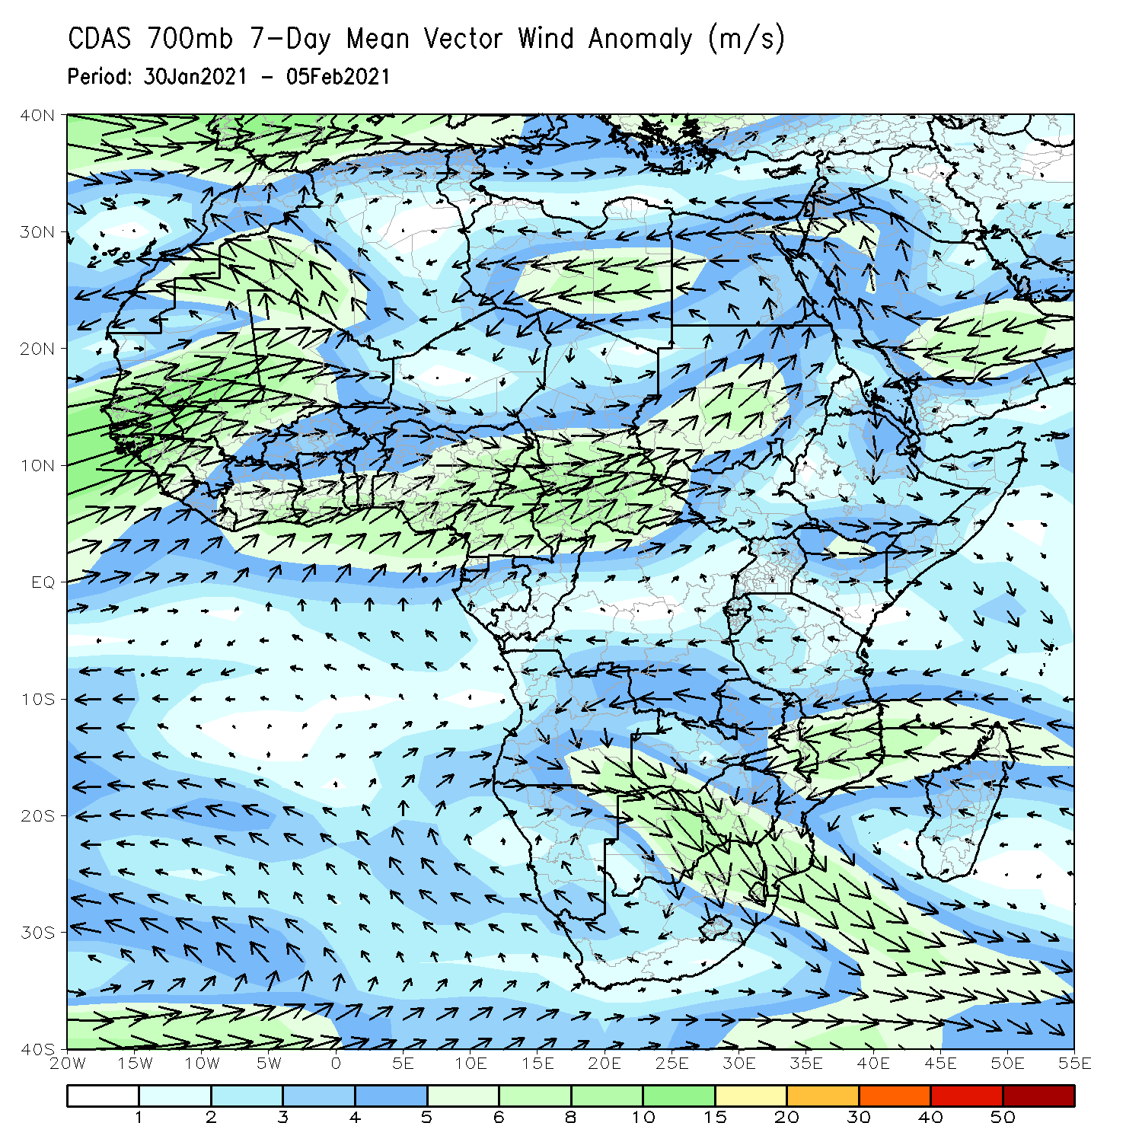
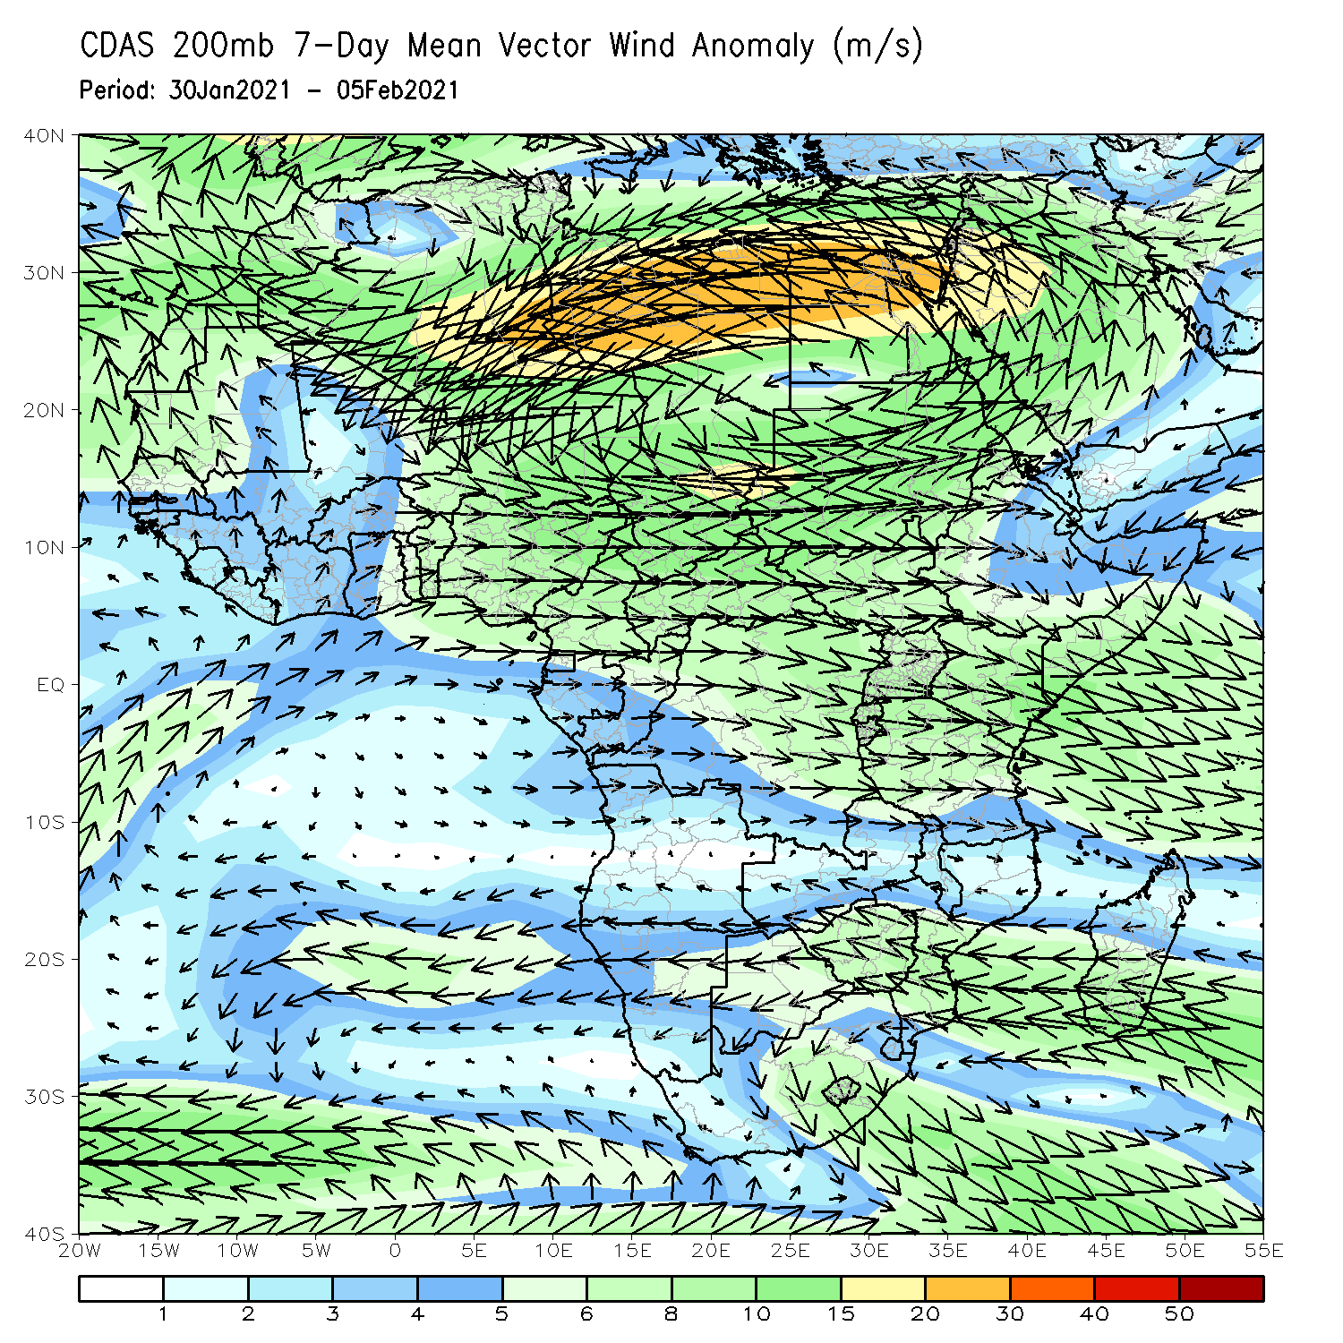
Atmospheric Circulation: Last 7 Days
At lower-level (left panel), anomalous cyclonic circulation over Southern Africa may have contributed to the observed above-average rainfall in the region.

Slide 8
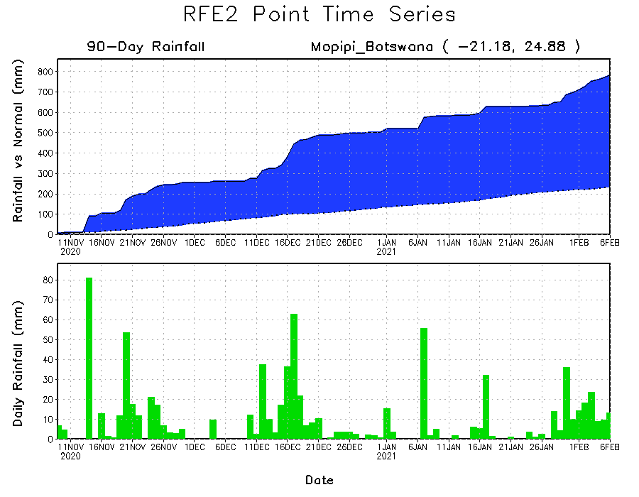
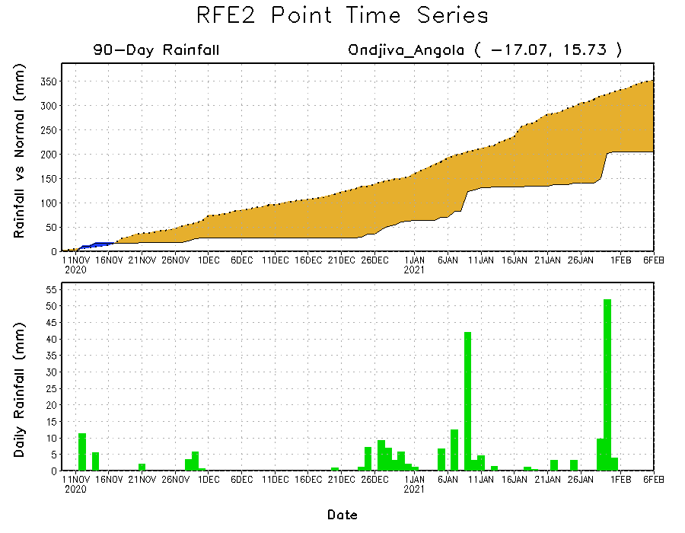
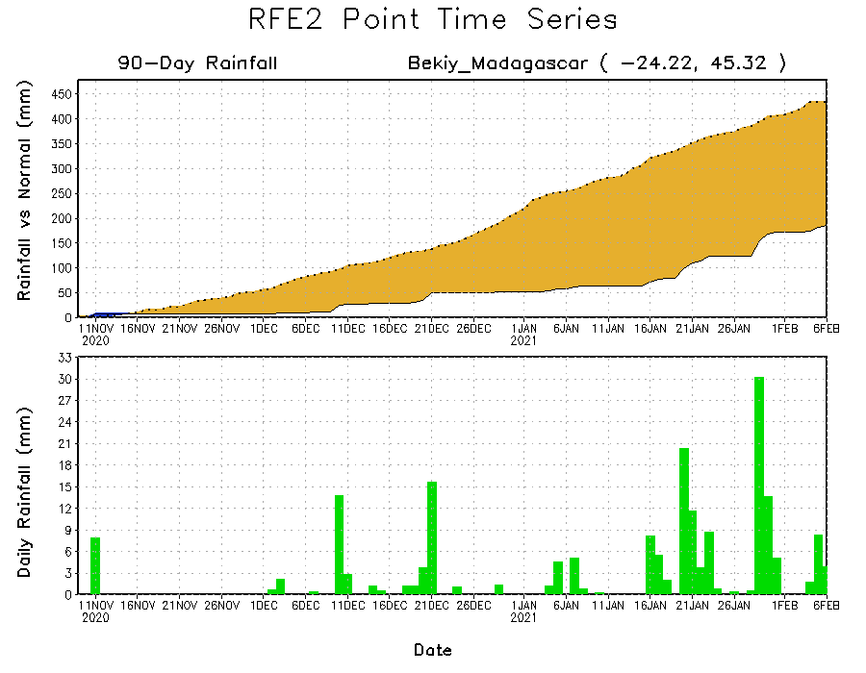
Rainfall Evolution
Daily evolution of rainfall over the last 90 days at selected locations shows heavy rainfall sustained moisture surpluses over much of Botswana (top right). Seasonal total rainfall remained below-average over southern Angola (bottom left) and southern Madagascar (bottom right).

Slide 9
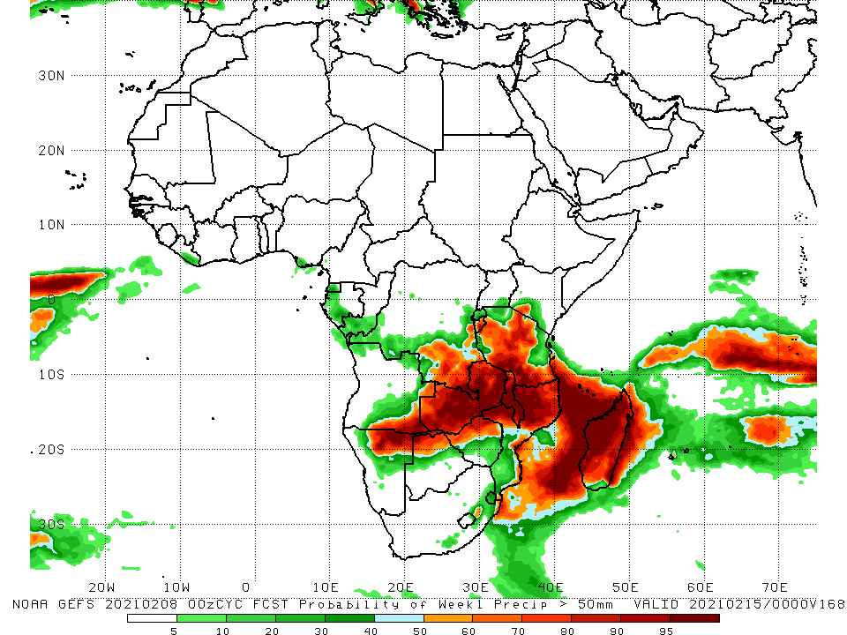
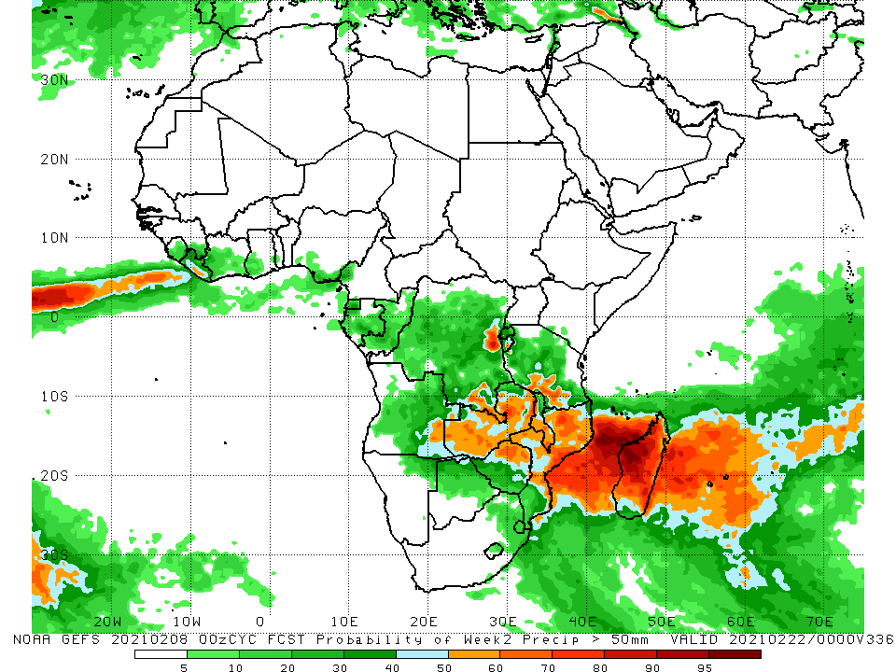
NCEP GEFS Model Forecasts Non-Bias Corrected Probability of precipitation exceedance
Week-1, Valid: 9 - 16 February
Week-2, Valid: 17 - 23 February, 2021
For week-1 (left panel), the NCEP GEFS indicates a moderate to high chance (over 70%) for rainfall to exceed 50 mm over southern southeastern Angola, northeastern Namibia, southeastern DRC, Zambia, Tanzania, Malawi, northern Zimbabwe, northern Mozambique and much of Madagascar. For week-2 (right panel), the chance for rainfall to exceed 50 mm is mostly confined to much of Zambia, Malawi, northern Zimbabwe, Mozambique and Madagascar.
Notes:
9

Slide 10
Summary
During the past 30 to 90 days, in southern Africa, persistent rains resulted in sustained moisture surpluses over eastern Angola, Zambia, Botswana, Malawi, and Zimbabwe. Rainfall was below average over western Angola and northern Namibia. In East Africa, moisture deficits prevailed over portions of southern Ethiopia, and pocket areas of Somalia and Kenya. Rainfall was above average much of Tanzania and Uganda. In central Africa, rainfall was above average over much of DRC, southern Congo, and eastern Gabon. Rainfall was below average over western Gabon, Equatorial Africa and CAR. In West Africa, rainfall was slightly above average in pockets along the Guinean coast.
During the past 7 days, in Southern Africa, heavy rainfall sustained moisture surpluses across much of Botswana and eastern South Africa. Rainfall was also above-average over parts of Zimbabwe, and local areas in Zambia, Mozambique and southern Madagascar. Below-average rainfall was observed over much of Angola, Namibia, southern Tanzania, central and northern Mozambique and northern Madagascar. In Central Africa, moderate rains sustained moisture surpluses over pocket of Gabon and DRC. In East Africa, parts of southern Kenya and Tanzania received above-average rainfall.
The week-1 and week-2 outlooks indicate a moderate to high chance for rainfall to exceed 50 mm over southern southeastern Angola, northeastern Namibia, southeastern DRC, Zambia, Tanzania, Malawi, northern Zimbabwe, northern Mozambique and much of Madagascar.

