Slide 1
The African Monsoon Recent Evolution and Current Status Include Week-1 and Week-2 Outlooks
Update prepared by
25 January 2021
For more information, visit:
http://www.cpc.ncep.noaa.gov/products/Global_Monsoons/African_Monsoons/precip_monitoring.shtml

Slide 2
Outline
Highlights
Recent Evolution and Current Conditions
NCEP GEFS Forecasts
Summary

Slide 3
Highlights: Last 7 Days
During the past 7 days, In Southern Africa, heavy rainfall associated with tropical cyclone Eloise sustained moisture surpluses across Mozambique and northern Madagascar. Rainfall was also above-average over northeastern Angola, Botswana, Zambia and Malawi. In contrast, rainfall was below-average over western and central Angola, southeastern Namibia, southern Botswana, much of South Africa, and parts of Madagascar. In Central Africa, moderate rains sustained moisture surpluses over pocket areas in Congo and DRC.
The week-1 outlooks indicate a moderate to high chance for rainfall to exceed 50 mm over parts of Gabon, southern Congo, southern and eastern DRC, eastern Angola, northeastern Namibia, much of Zambia, Botswana, Zimbabwe, Malawi, eastern South Africa, and parts of Mozambique and Madagascar.

Slide 4
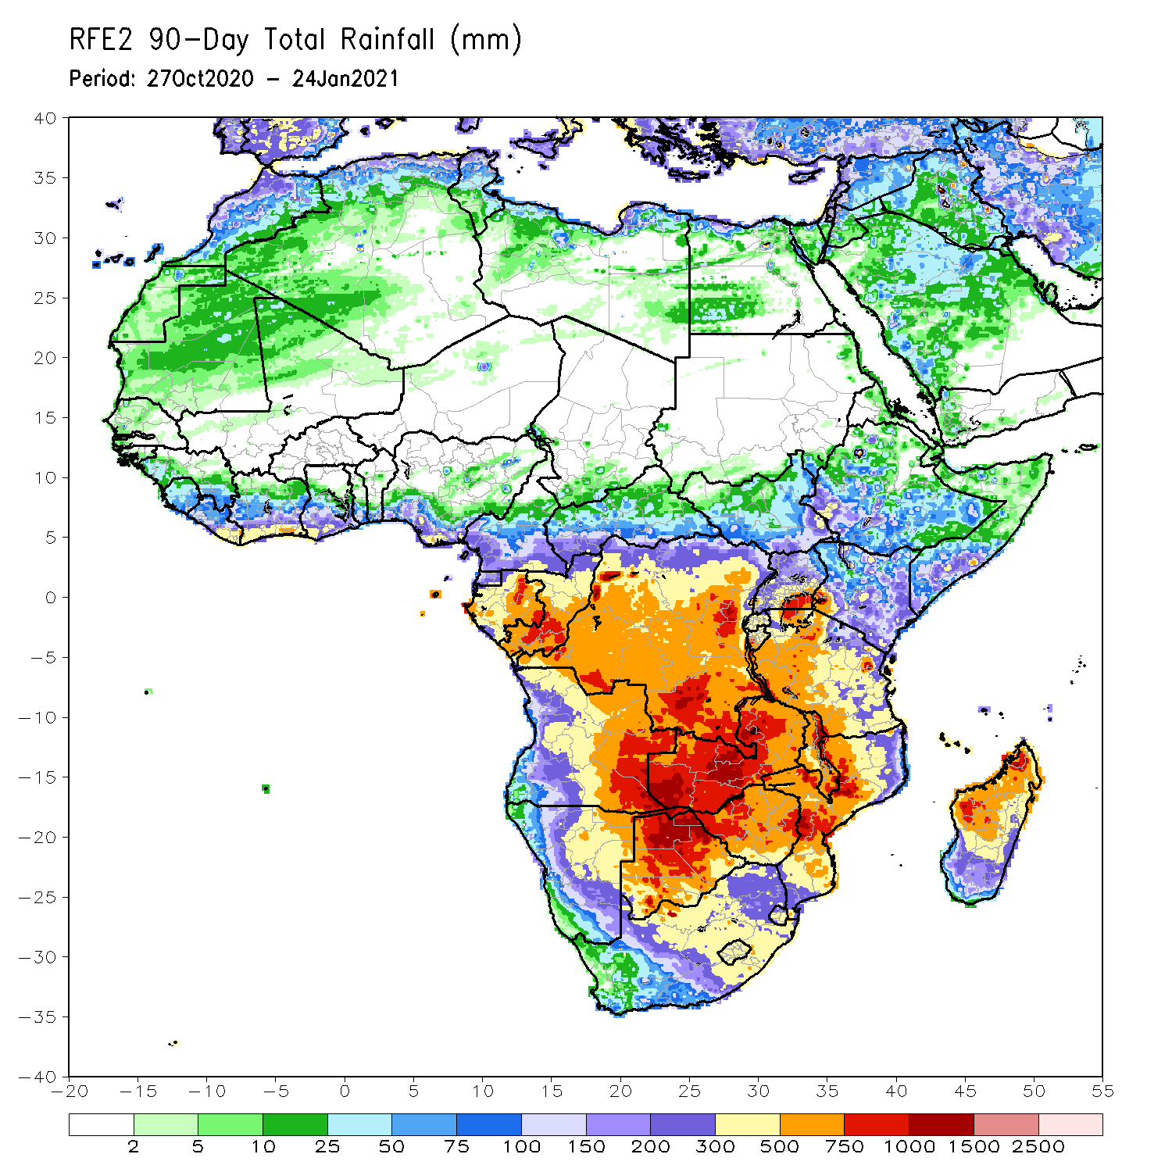
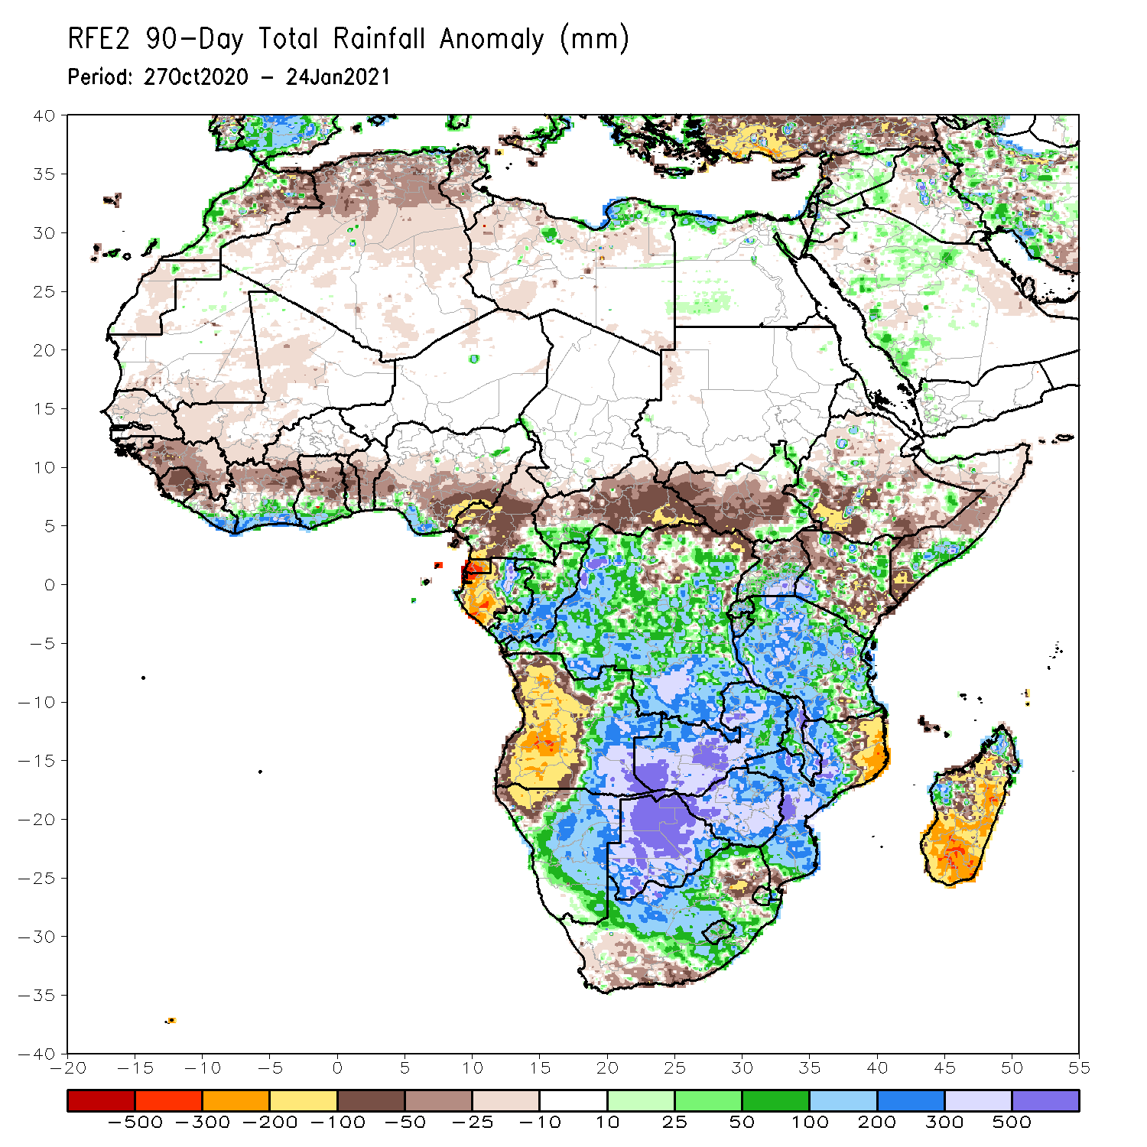
Rainfall Patterns: Last 90 Days
Over the past 90 days, in East Africa, rainfall was significantly below average over parts of Kenya and Somalia, and southern Ethiopia. Rainfall was also below average over many parts of South Sudan. Rainfall was above average over eastern South Sudan, pocket areas in Kenya and Somalia, and Uganda and much of Tanzania. In southern Africa, persistent rains resulted in sustained moisture surpluses over eastern Angola, Zambia, Botswana, and Zimbabwe. Rainfall was also above average over many parts of Mozambique and pocket areas in northern Madagascar. Persistent light rains resulted in moisture deficits in western Angola and northwestern Namibia. Rainfall was also below average along the border between South Africa and Mozambique and over central and southern Madagascar. In Central Africa, rainfall was above average over many parts of DRC and Congo. Rainfall was below average over the far northern DRC, and CAR. Below average rains were also observed over the western areas of Gabon and much of Cameroon. In West Africa, rainfall was below average in the central areas of the Gulf of Guinea region, and above average along the coast.
Notes:
4

Slide 5
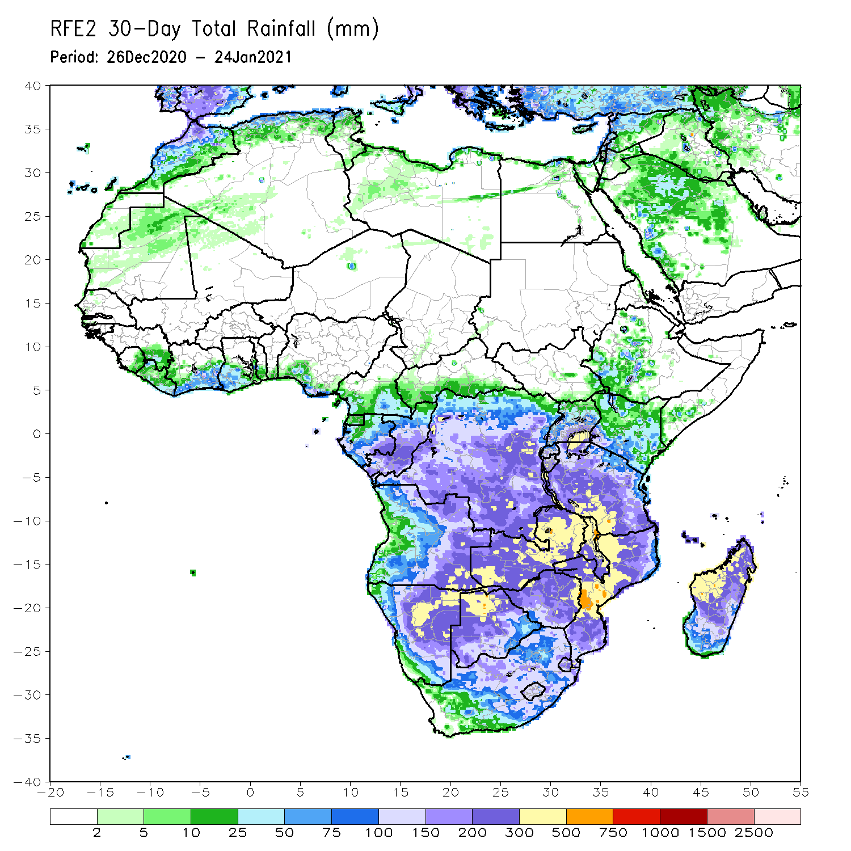
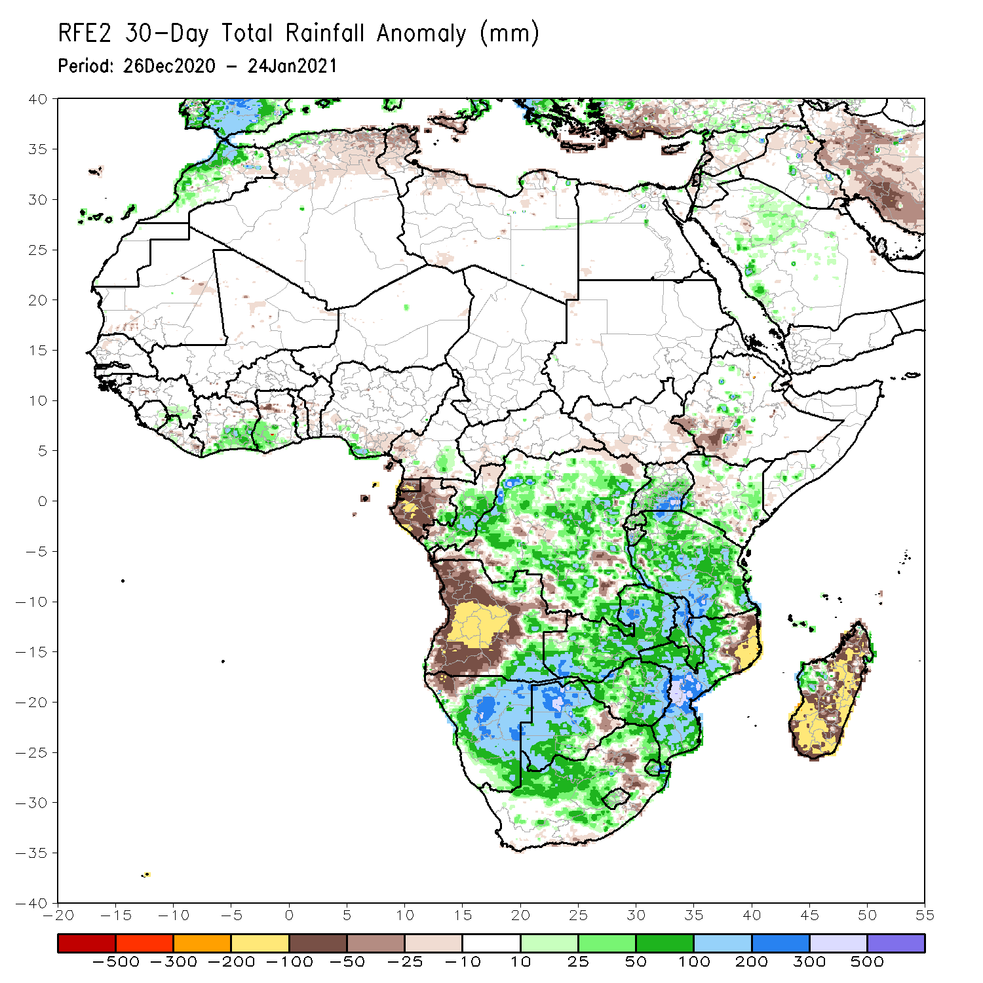
Rainfall Patterns: Last 30 Days
During the past 30 days, in East Africa, several weeks of light rains resulted in moisture deficits over southwestern Ethiopia and parts of Kenya. Rainfall was above average many parts of Tanzania. In southern Africa, persistent moderate to heavy rains resulted in moisture surpluses over eastern Angola, Namibia, Zambia, Botswana, and Zimbabwe. Rainfall was also above average over central and southern Mozambique. Persistent light rains resulted in moisture deficits in western Angola and northwestern Namibia. Rainfall was also below average over pocket areas in northeastern South Africa, northeastern Mozambique, and over much of Madagascar. In central Africa, rainfall was above average over western and northern DRC and Congo. Rainfall was below average over central and southern DRC, and much of Gabon. In West Africa, rainfall was slightly above average in pockets along the Guinean coast.
Notes:
5

Slide 6
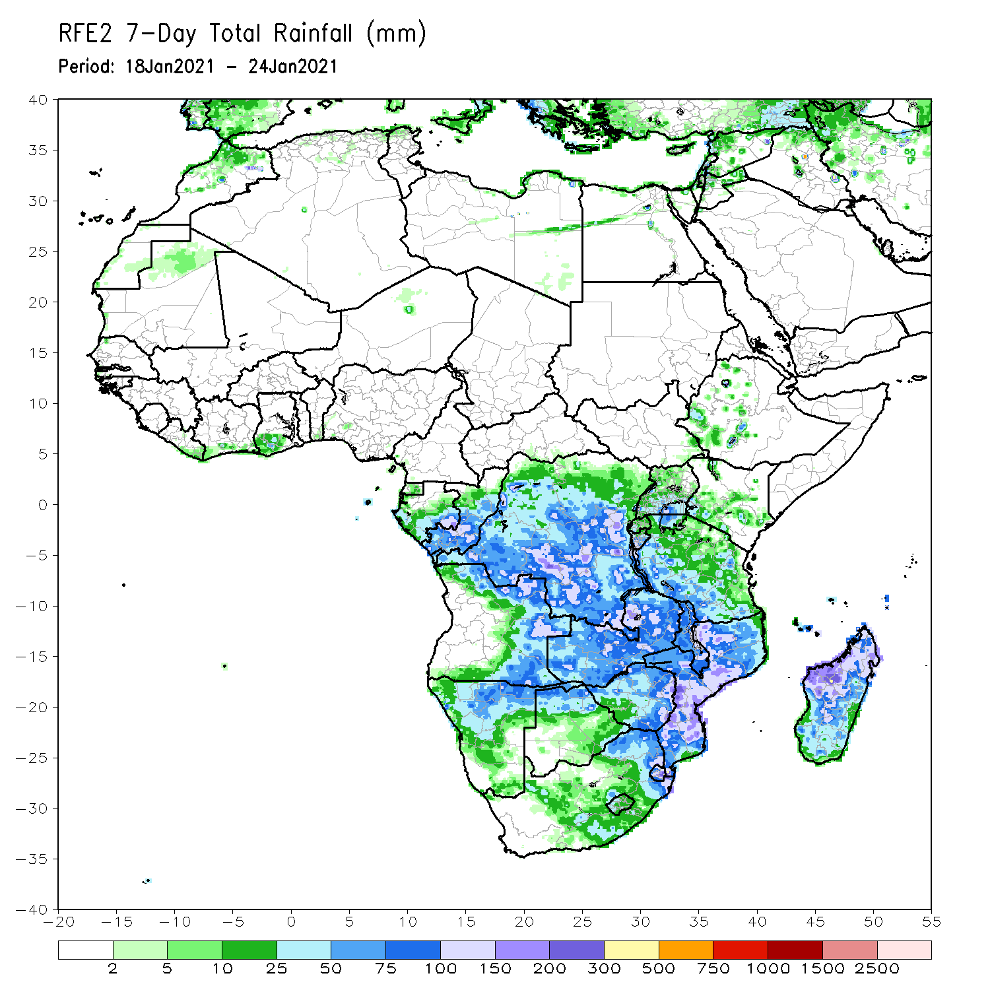
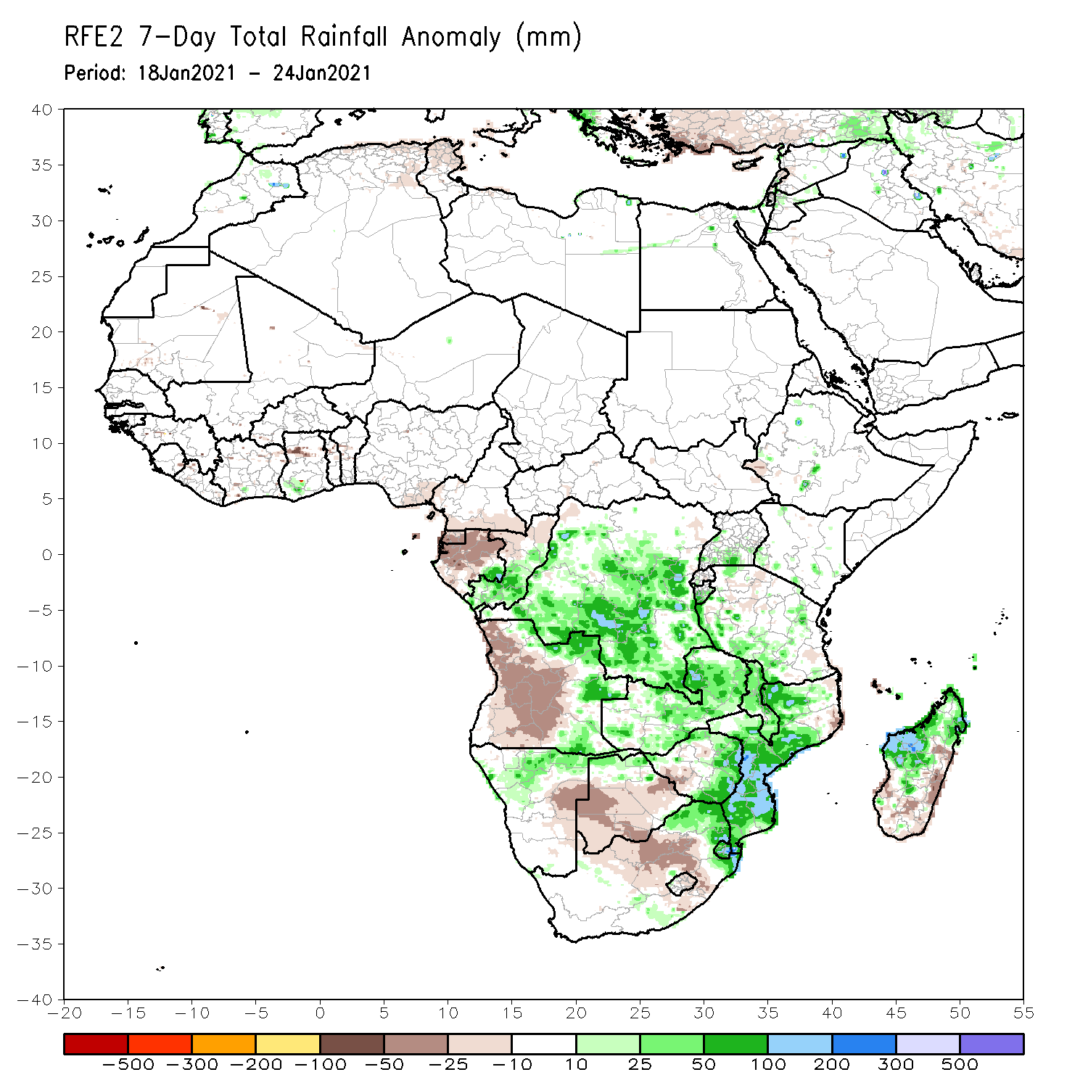
Rainfall Patterns: Last 7 Days
During the past 7 days, in East Africa moderate rains resulted in moisture surpluses over local areas in Uganda and Tanzania. In Southern Africa, heavy rainfall associated with tropical cyclone Eloise sustained moisture surpluses across Mozambique and northern Madagascar. Rainfall was also above-average over northeastern Angola, Botswana, Zambia and Malawi. In contrast, rainfall was below-average over western and central Angola, southeastern Namibia, southern Botswana, much of South Africa, and parts of Madagascar. In Central Africa, moderate rains sustained moisture surpluses over pocket areas in Congo and DRC.

Slide 7
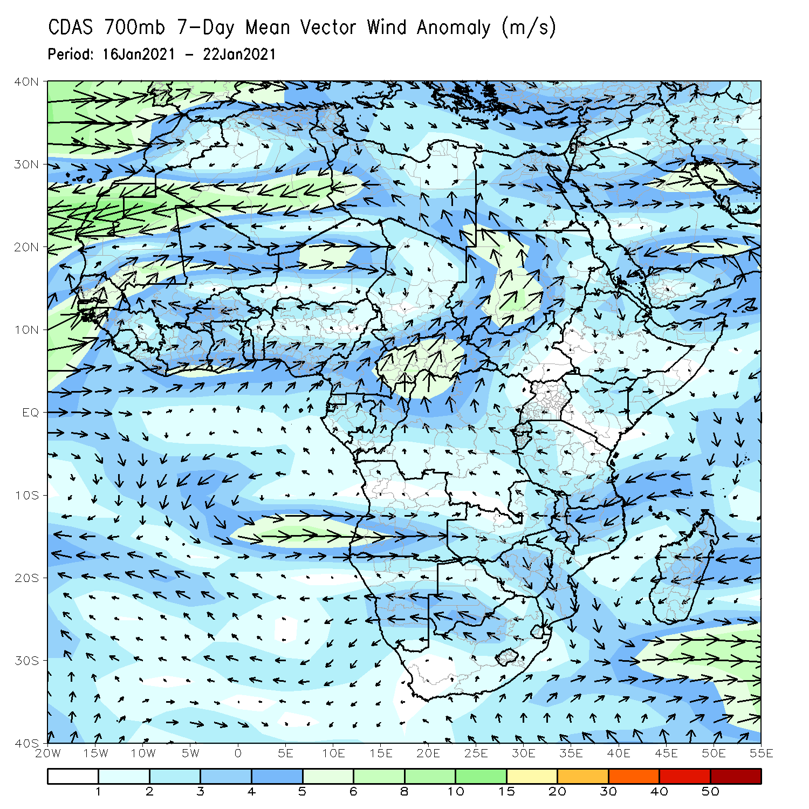
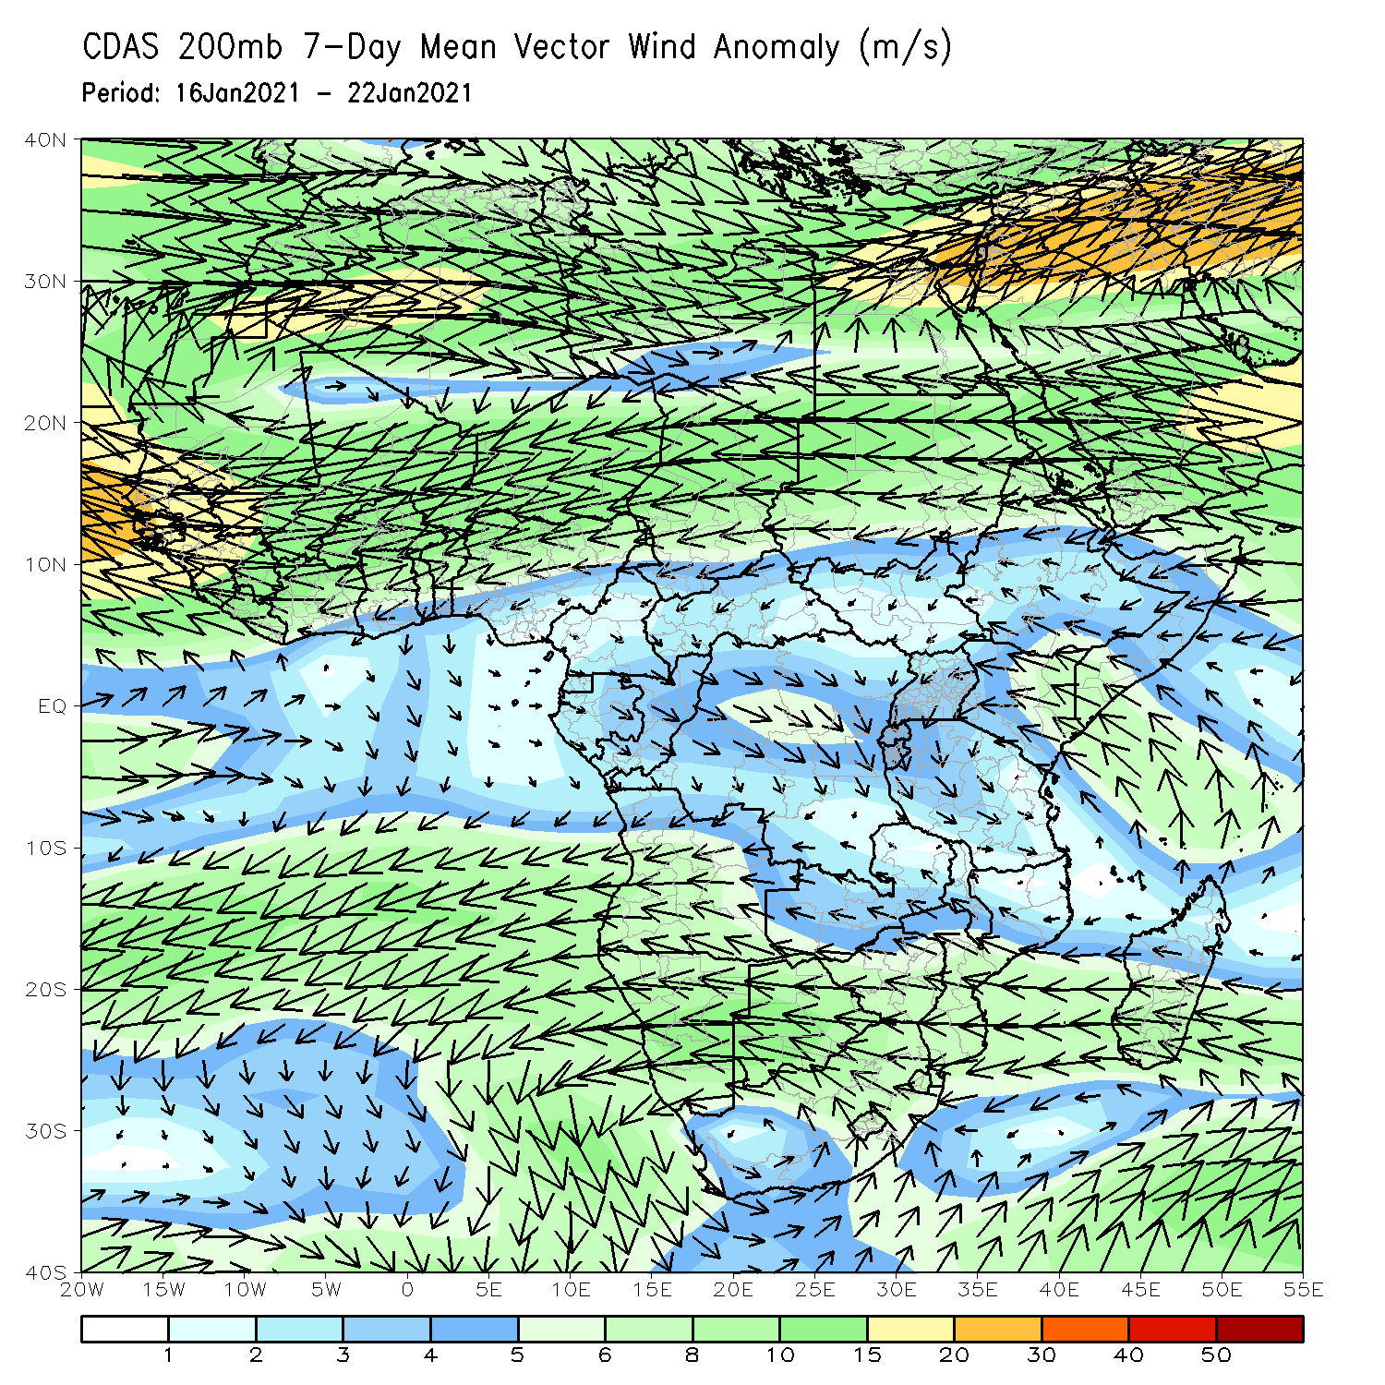
Atmospheric Circulation: Last 7 Days
At lower-level (left panel), anomalous cyclonic circulation over Southern Africa may have contributed to the observed above-average rainfall in the region.

Slide 8
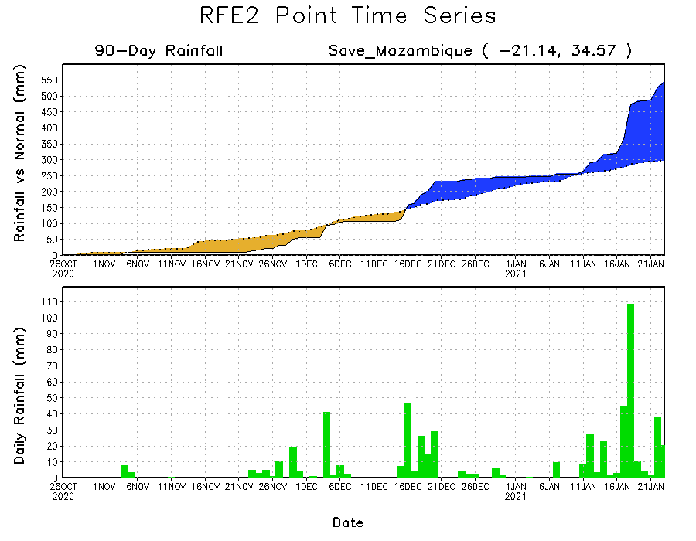
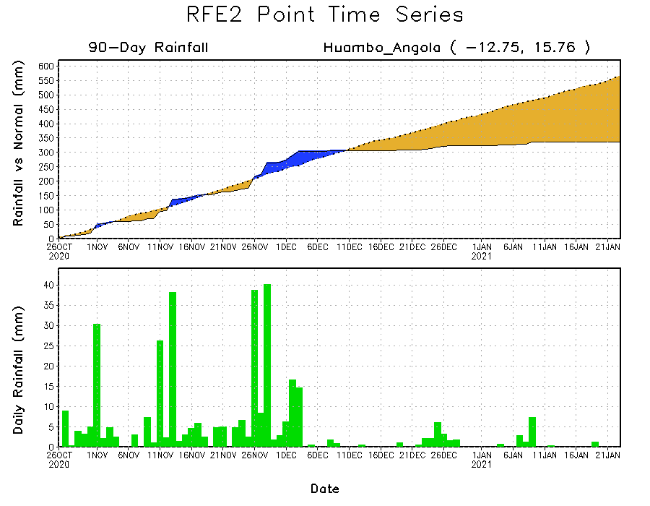
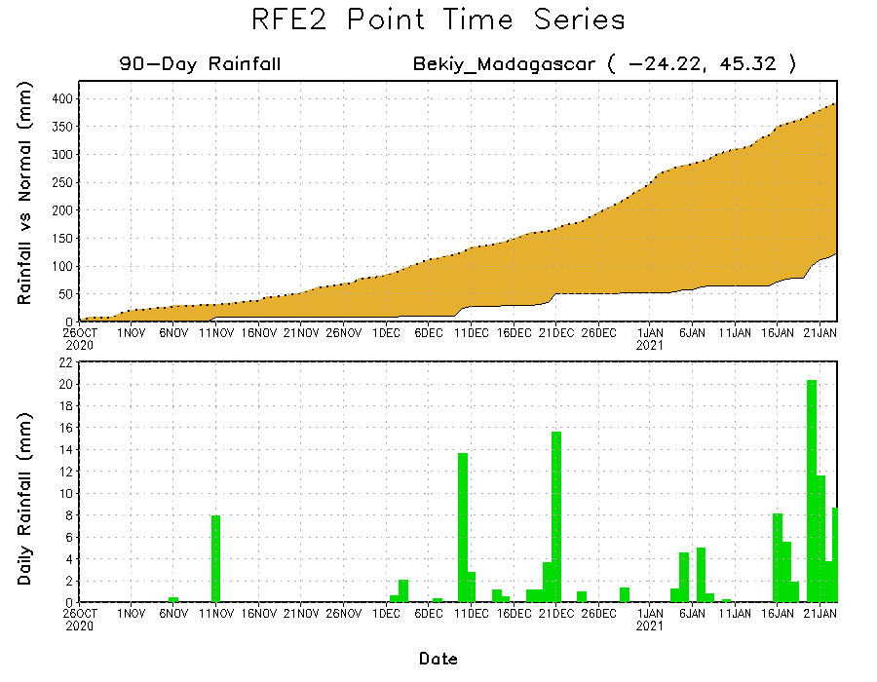
Rainfall Evolution
Daily evolution of rainfall over the last 90 days at selected locations shows heavy rainfall, associated with that tropical cyclone Eloise, sustained moisture surpluses over parts of Mozambique (top right). Seasonal total rainfall remained below-average over southern Angola (bottom left) and southern Madagascar (bottom right).

Slide 9
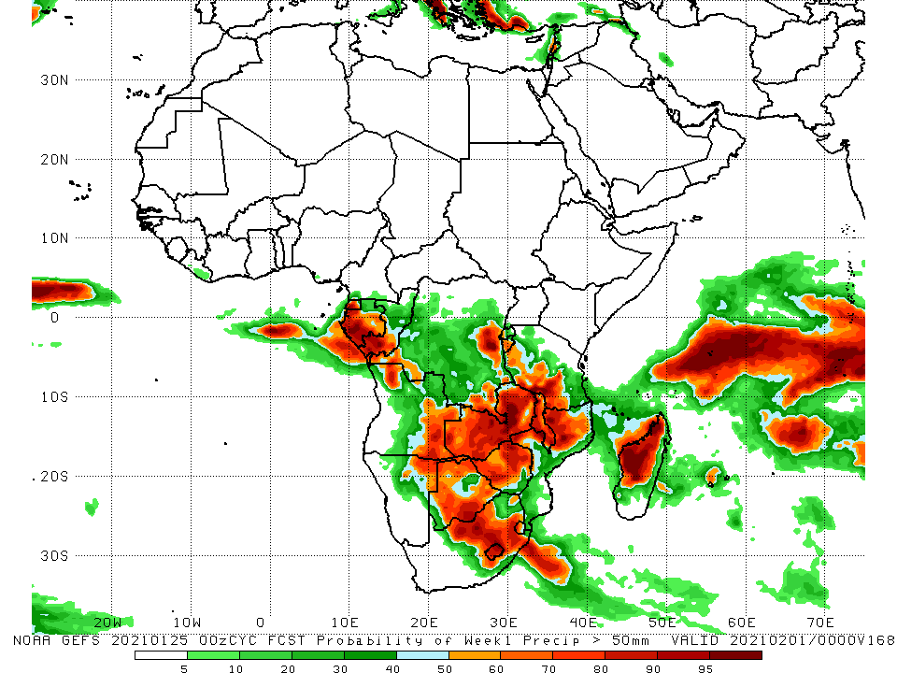
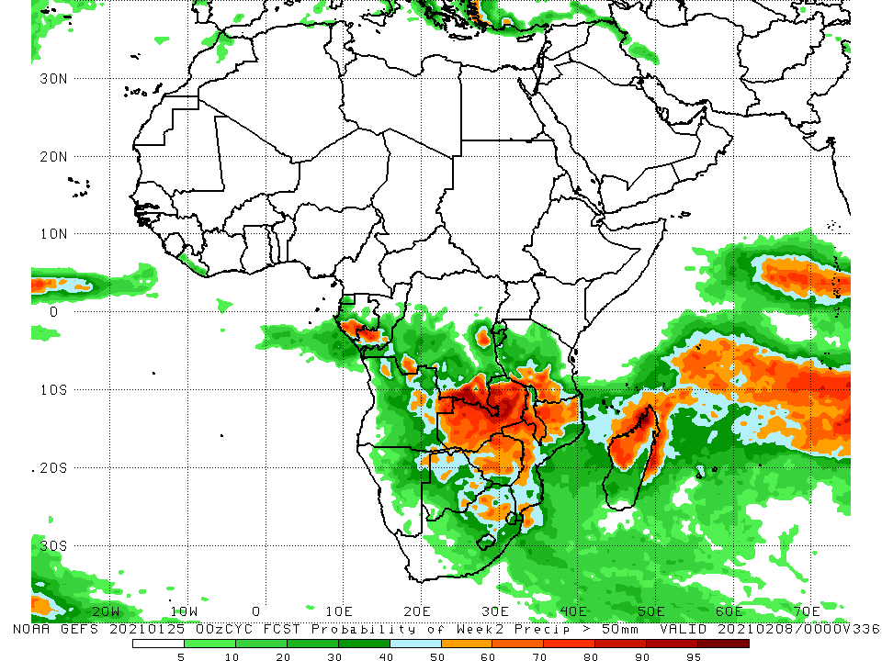
NCEP GEFS Model Forecasts Non-Bias Corrected Probability of precipitation exceedance
Week-1, Valid: 26 January - 1 February, 2021
Week-2, Valid: 2 - 8 February, 2021
For week-1 (left panel) and week-2 (right panel), the NCEP GEFS indicates a moderate to high chance (over 70%) for rainfall to exceed 50 mm over parts of Gabon, southern Congo, southern and eastern DRC, eastern Angola, northeastern Namibia, much of Zambia, Botswana, Zimbabwe, Malawi, eastern South Africa, and parts of Mozambique and Madagascar.
Notes:
9

Slide 10
Summary
During the past 30 to 90 days, in East Africa, moisture deficits prevailed over portions of Somalia, Kenya, and southern Ethiopia. Rainfall was above average much of Tanzania and Uganda. In southern Africa, rainfall was above average over the northern areas of the region. Rainfall was below average over western Angola and northern Namibia. In central Africa, rainfall was above average over central and southern DRC, southern Congo, and eastern Gabon. Rainfall was below average over western Gabon, Equatorial Africa and CAR. In West Africa, rainfall was slightly above average in pockets along the Guinean coast.
During the past 7 days, In Southern Africa, heavy rainfall associated with tropical cyclone Eloise sustained moisture surpluses across Mozambique and northern Madagascar. Rainfall was also above-average over northeastern Angola, Botswana, Zambia and Malawi. In contrast, rainfall was below-average over western and central Angola, southeastern Namibia, southern Botswana, much of South Africa, and parts of Madagascar. In Central Africa, moderate rains sustained moisture surpluses over pocket areas in Congo and DRC.
The week-1 outlooks indicate a moderate to high chance for rainfall to exceed 50 mm over parts of Gabon, southern Congo, southern and eastern DRC, eastern Angola, northeastern Namibia, much of Zambia, Botswana, Zimbabwe, Malawi, eastern South Africa, and parts of Mozambique and Madagascar.

