Slide 1
The African Monsoon Recent Evolution and Current Status Include Week-1 and Week-2 Outlooks
Update prepared by
04 January 2021
For more information, visit:
http://www.cpc.ncep.noaa.gov/products/Global_Monsoons/African_Monsoons/precip_monitoring.shtml

Slide 2
Outline
Highlights
Recent Evolution and Current Conditions
NCEP GEFS Forecasts
Summary

Slide 3
Highlights: Last 7 Days
During the past 7 days, in East Africa moderate rains resulted in moisture surpluses in portions of Kenya, Uganda and Tanzania. In Southern Africa, rainfall was above-average across many areas, including Namibia, portions of Botswana, eastern Zambia, Zimbabwe, western Mozambique and local areas in Madagascar. In contrast, rainfall was below-average over central Angola, parts of central and southern DRC, eastern Mozambique and many parts of Madagascar. In Central Africa, moderate rains sustained moisture surpluses over parts of northern DRC.
The week-1 and week-2 outlooks indicate a moderate to high chance for rainfall to exceed 50 mm southern Gabon, southern Congo, southern DRC, portions of Angola, Namibia, much of Zambia, Zimbabwe, Tanzania, Malawi, northern Mozambique, local areas in South Africa and northern Madagascar.

Slide 4
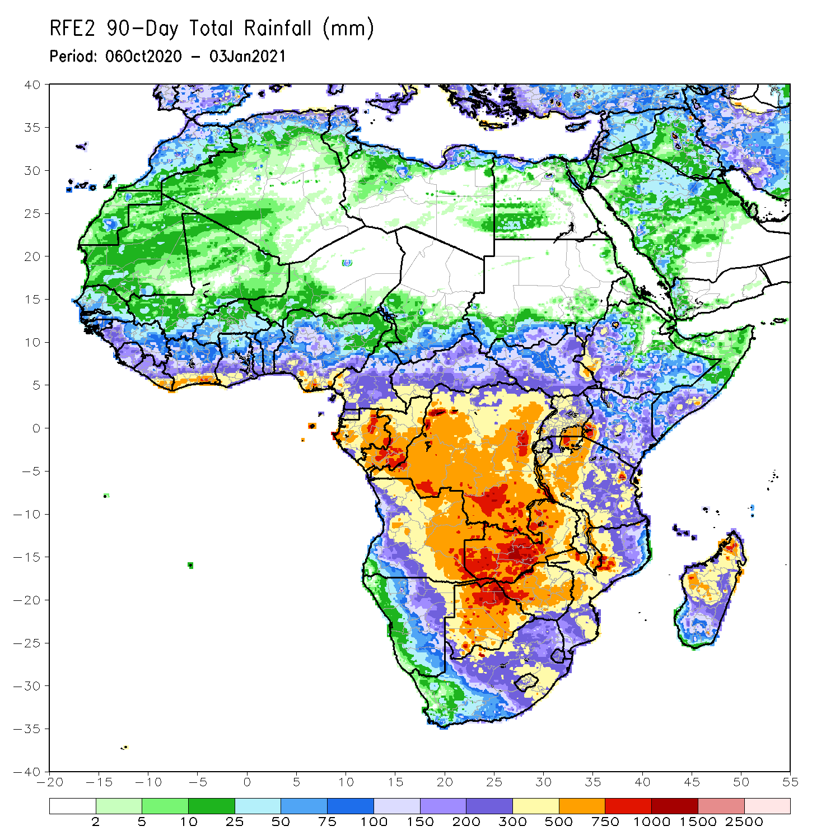
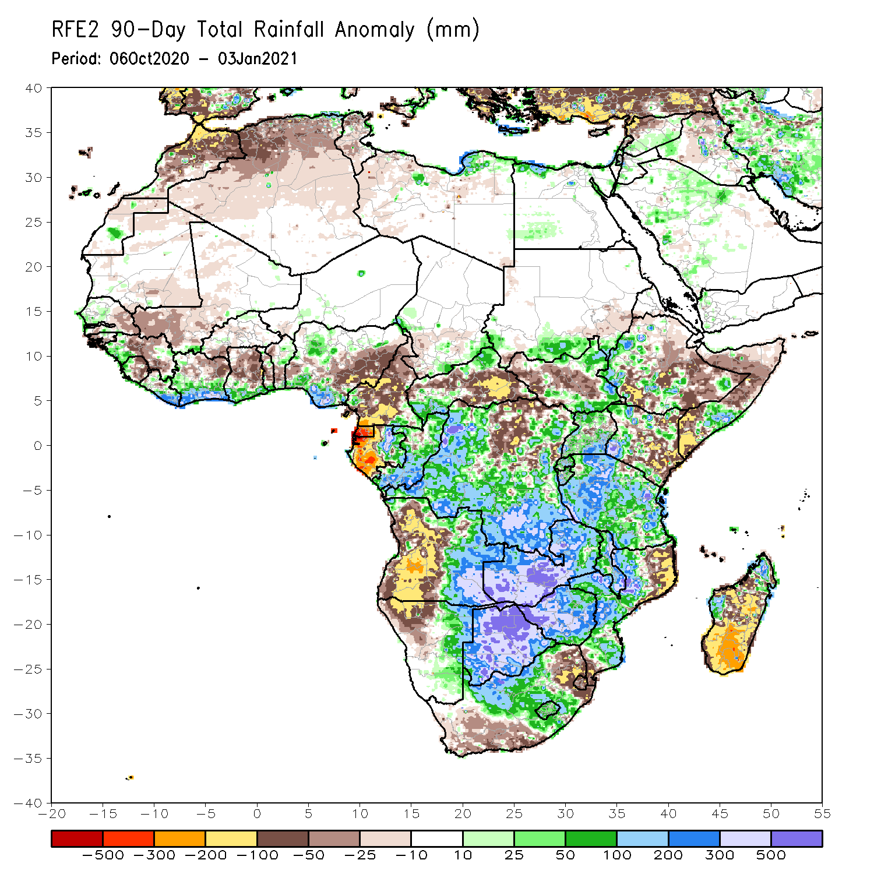
Rainfall Patterns: Last 90 Days
Over the past 90 days, in East Africa, rainfall was significantly below average over eastern Kenya, southern and northern Somalia, and portions of eastern Ethiopia. Rainfall was also below average over parts of South Sudan. Rainfall was above average over the far southern Sudan, eastern South Sudan, western Ethiopia, and Uganda. The uptick in rainfall extended to much of Tanzania. In southern Africa, persistent rains resulted in sustained moisture surpluses over Zambia, Botswana, and Zimbabwe. Rainfall was also above average over many parts of Mozambique and northern Madagascar. Persistent light rains resulted in moisture deficits in western Angola and northwestern Namibia. Rainfall was also below average along the border between South Africa and Mozambique and over southern Madagascar. In Central Africa, rainfall was above average over many parts of DRC and Congo. Rainfall was below average over parts of northern DRC, and CAR. Below average rains were also observed over the western areas of Gabon and much of Cameroon. In West Africa, rainfall was below average in the central areas of the Gulf of Guinea region, and above average along the coast. Rainfall was above average over local areas in the Sahel.
Notes:
4

Slide 5
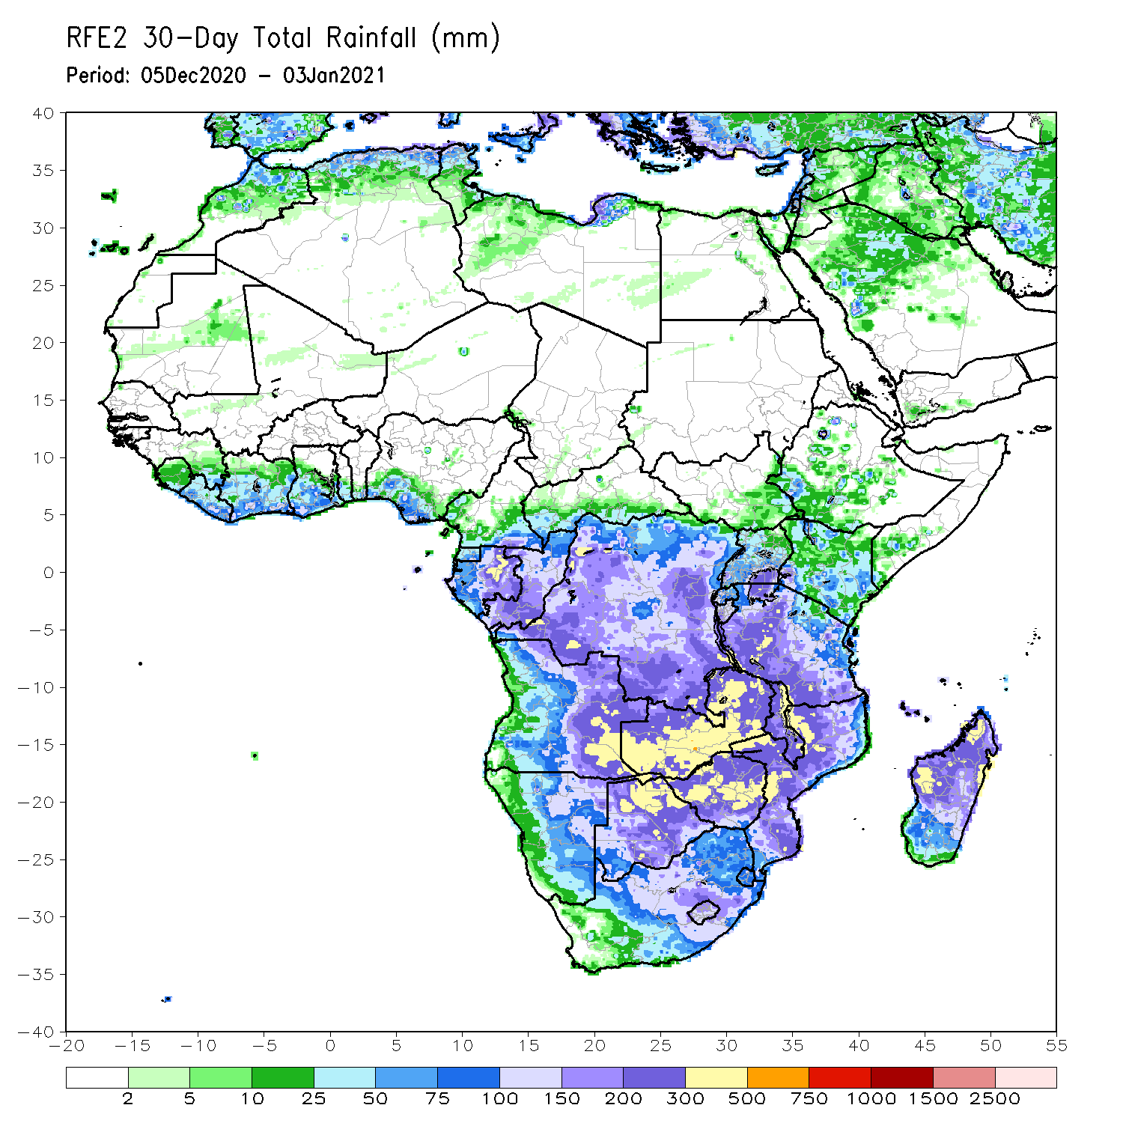
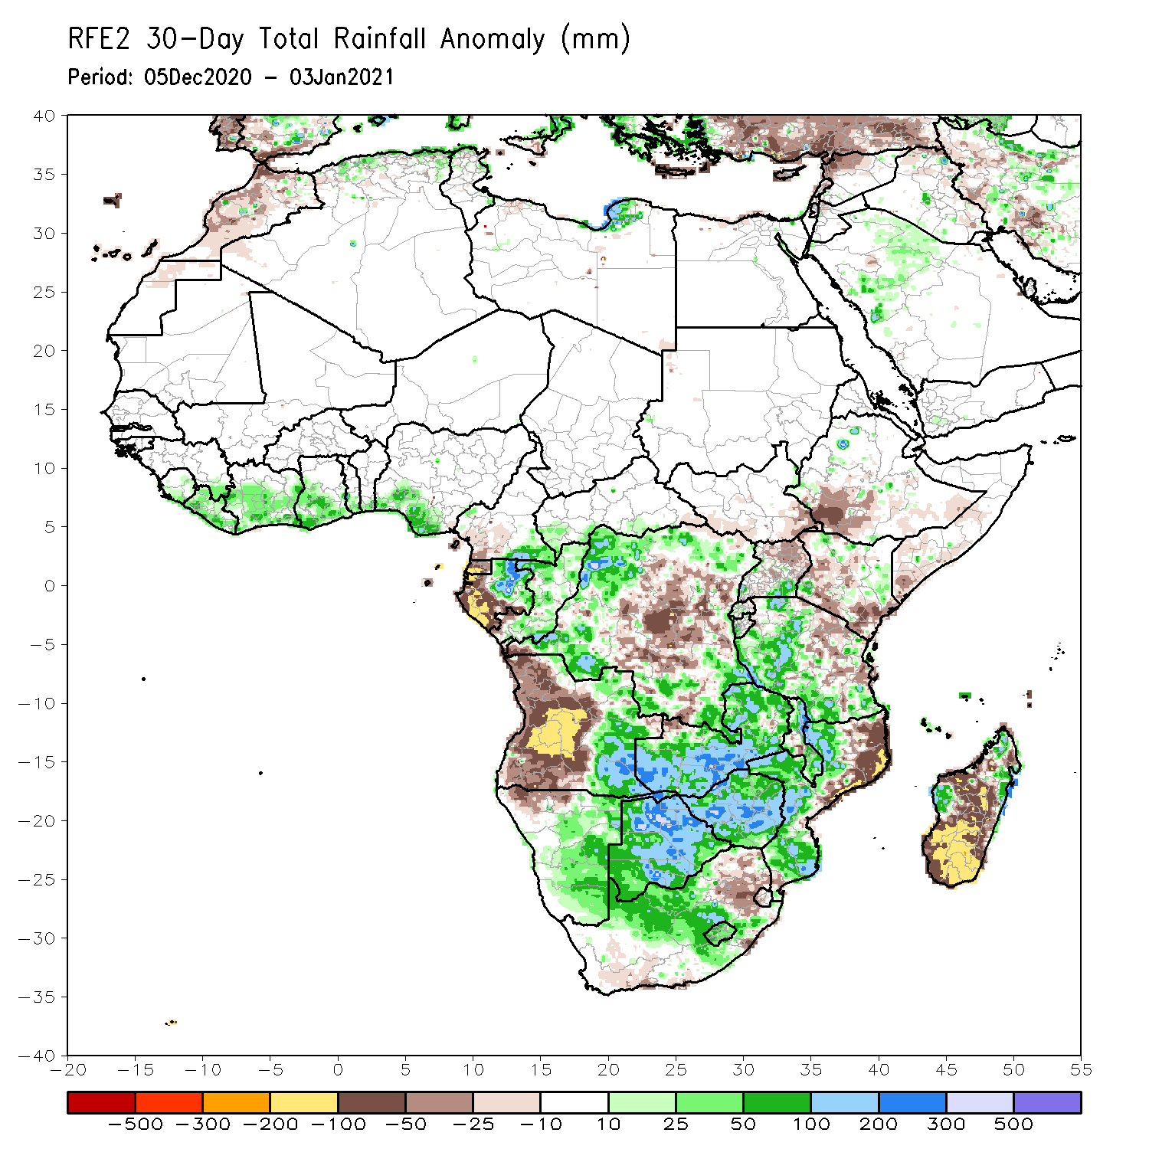
Rainfall Patterns: Last 30 Days
During the past 30 days, in East Africa, several weeks of light rains resulted in moisture deficits over southern Somalia, eastern Kenya, and southern Ethiopia. Rainfall was above average locally over western Tanzania, while below-average rainfall was observed over eastern Tanzania. In southern Africa, persistent moderate to heavy rains resulted in moisture surpluses over eastern Angola, Zambia, Botswana, and Zimbabwe. Rainfall was also above average over central and southern Mozambique and pocket areas in Madagascar. Persistent light rains resulted in moisture deficits in western Angola and northern Namibia. Rainfall was also below average over pocket areas in northeastern South Africa, northeastern Mozambique, and over many parts of Madagascar. In central Africa, rainfall was above average over western and northern DRC, Congo, and eastern Gabon. Rainfall was below average over central and eastern DRC, western Gabon and the southern areas of Cameroon. In West Africa, rainfall was slightly above average in pockets along the Guinean coast.
Notes:
5

Slide 6
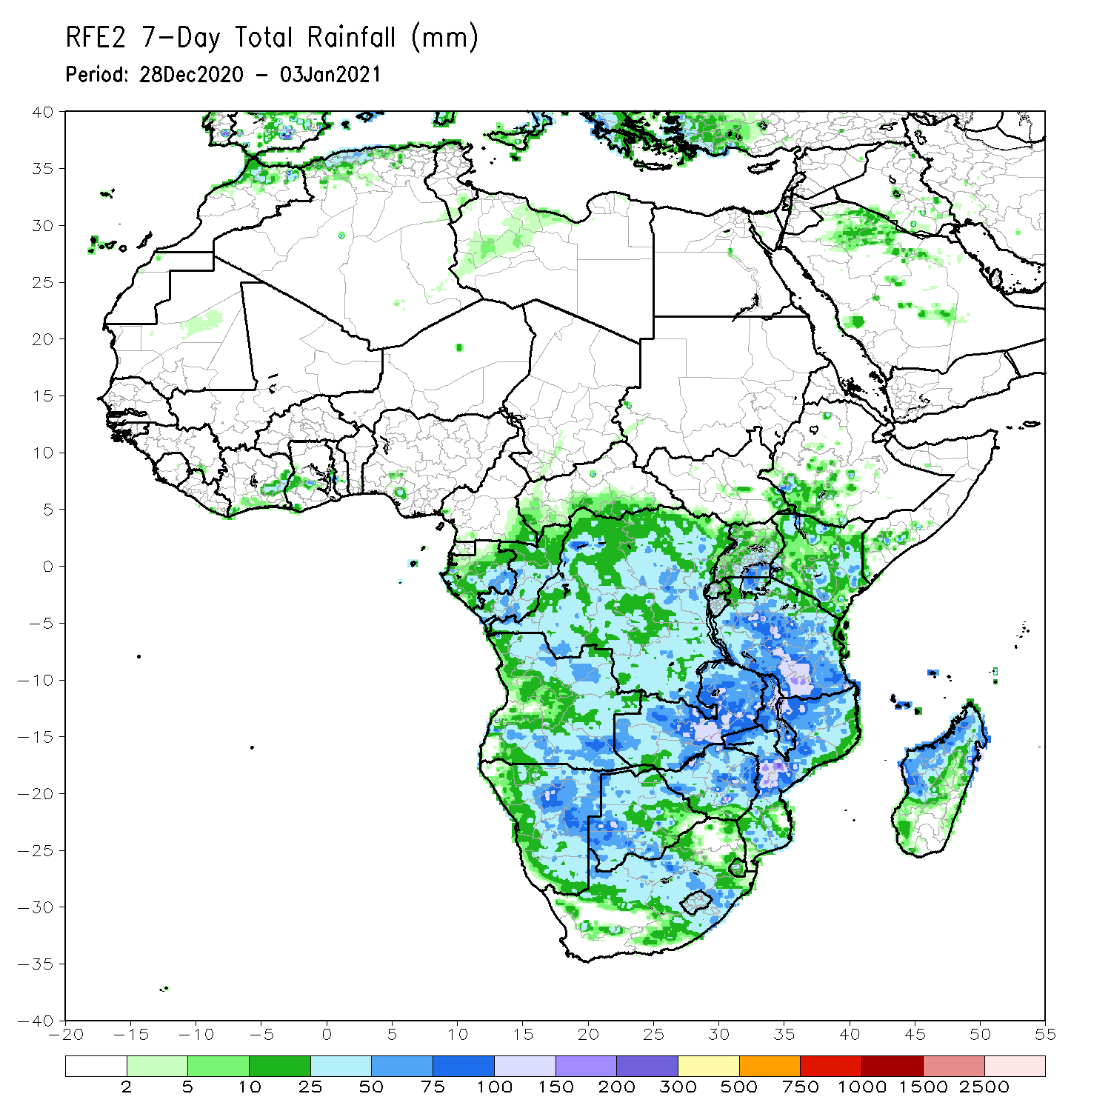
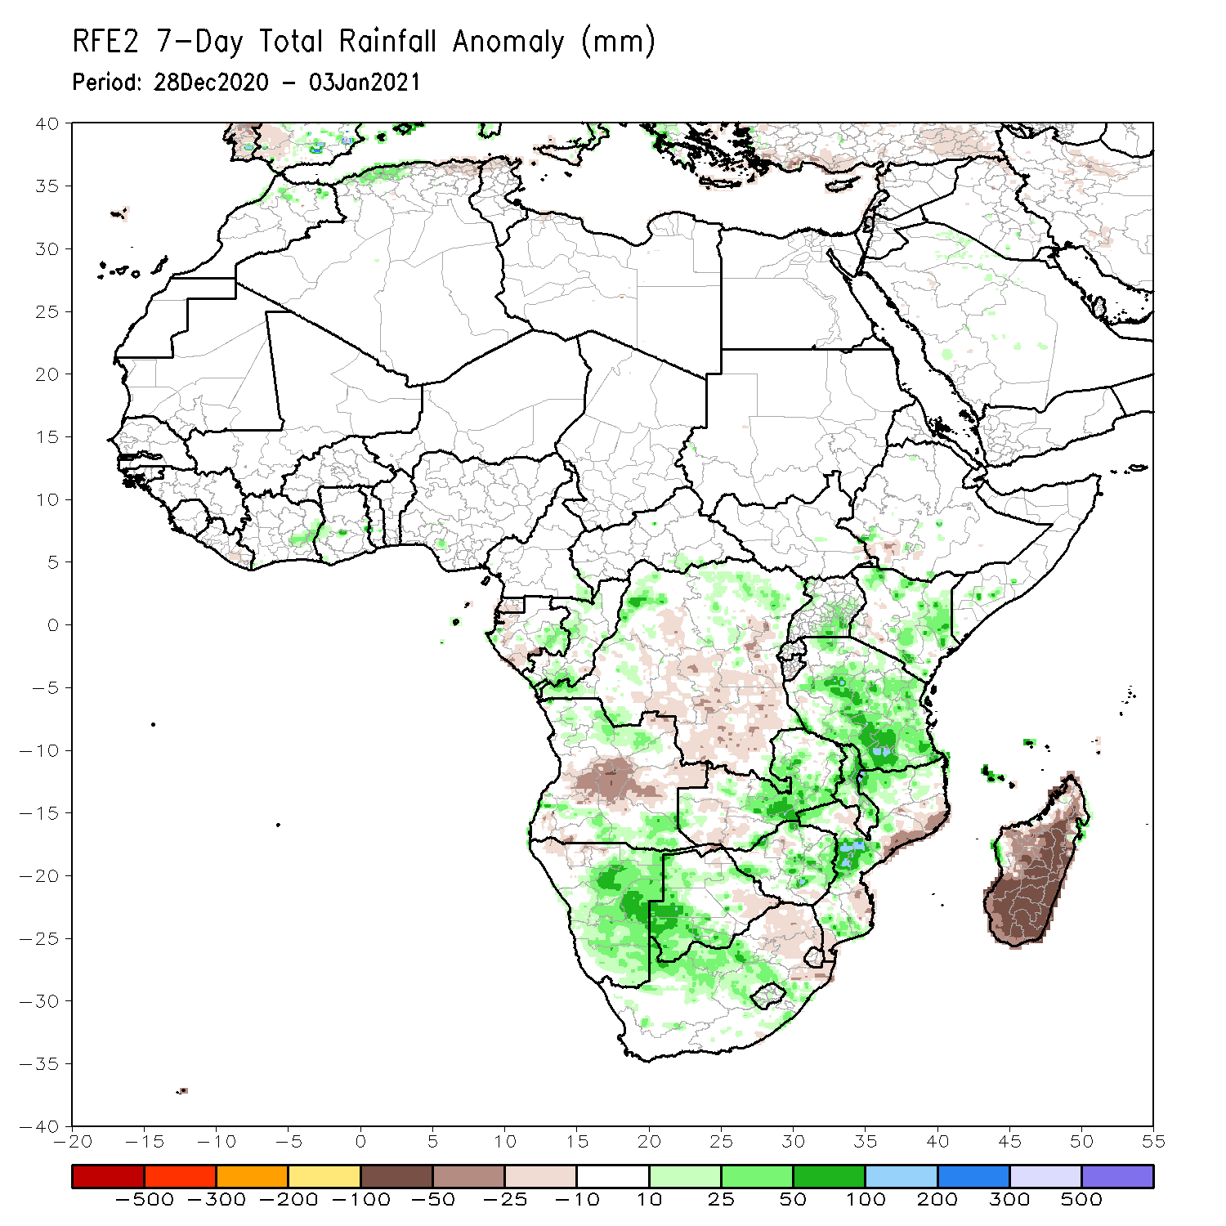
Rainfall Patterns: Last 7 Days
During the past 7 days, in East Africa moderate rains resulted in moisture surpluses in portions of Kenya, Uganda and Tanzania. In Southern Africa, rainfall was above-average across many areas, including Namibia, portions of Botswana, eastern Zambia, Zimbabwe, western Mozambique and local areas in Madagascar. In contrast, rainfall was below-average over central Angola, parts of central and southern DRC, eastern Mozambique and many parts of Madagascar. In Central Africa, moderate rains sustained moisture surpluses over parts of northern DRC.

Slide 7
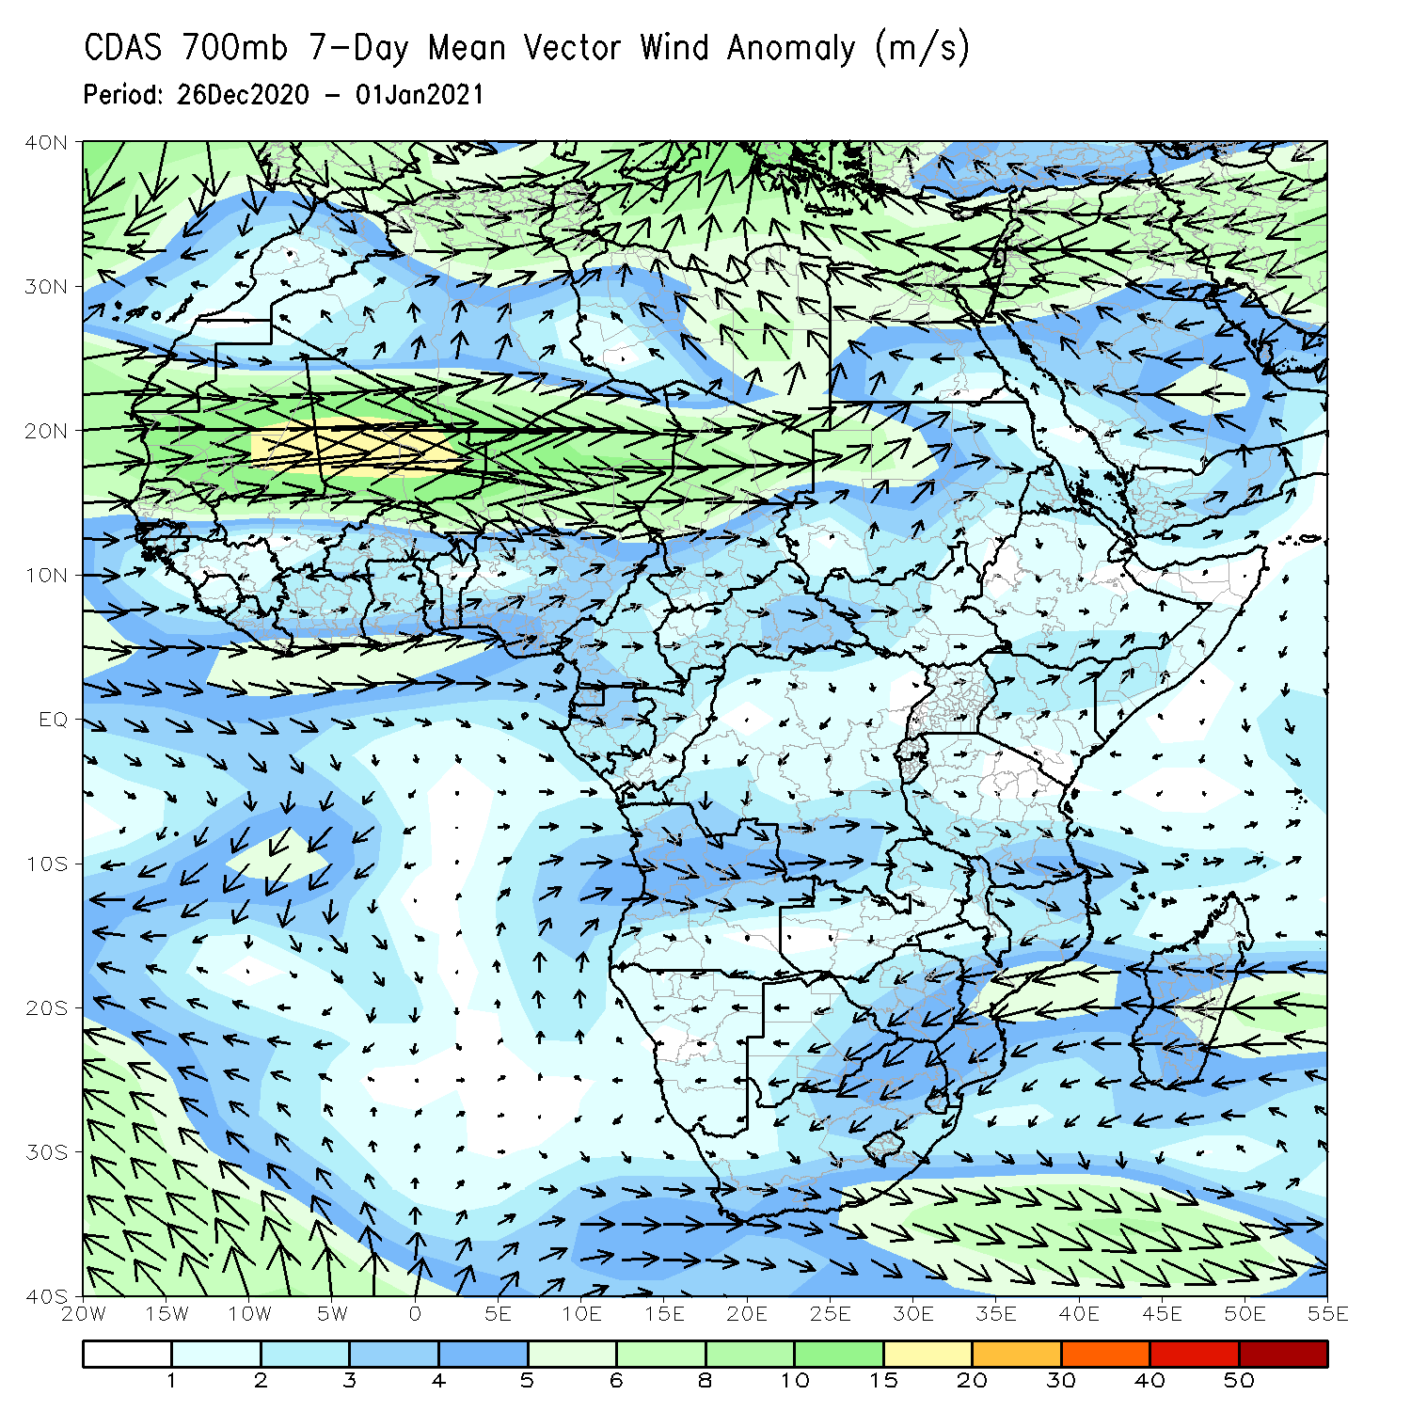
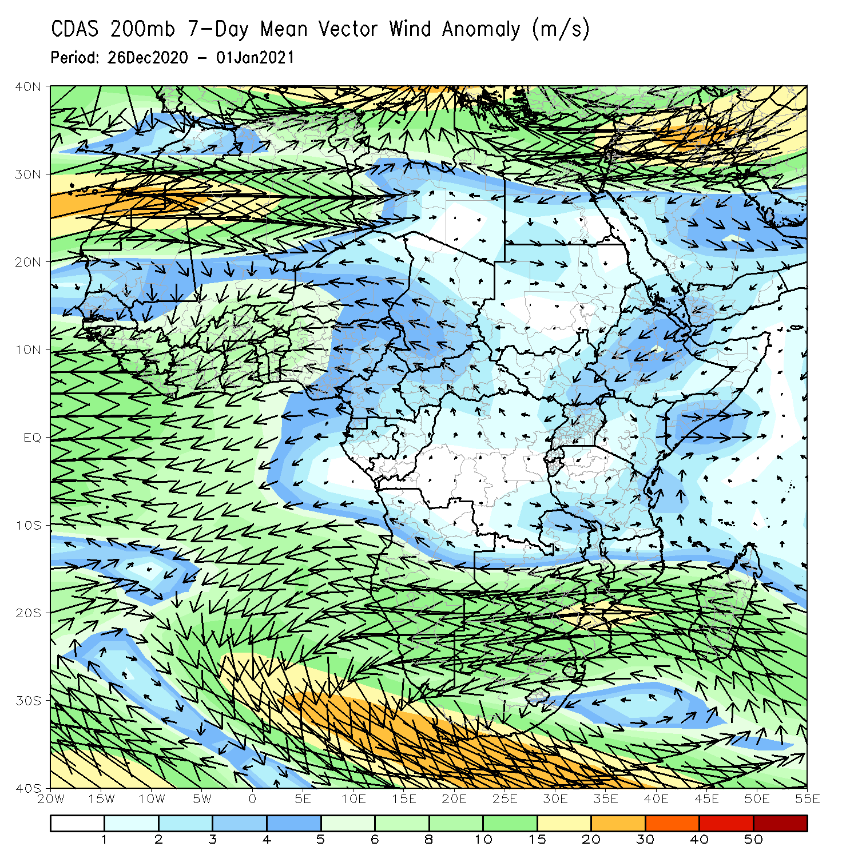
Atmospheric Circulation: Last 7 Days
At upper level (right panel), wind anomalies were anti-cyclonic across Sothern Africa.

Slide 8
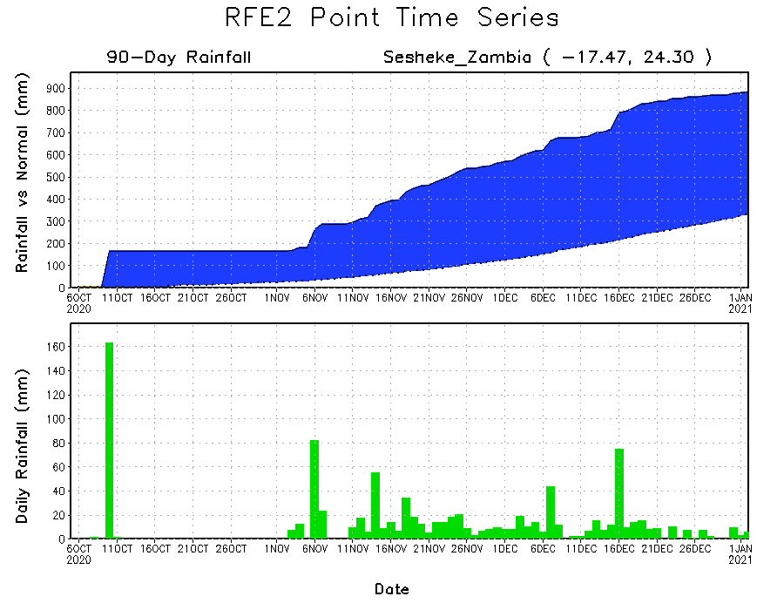
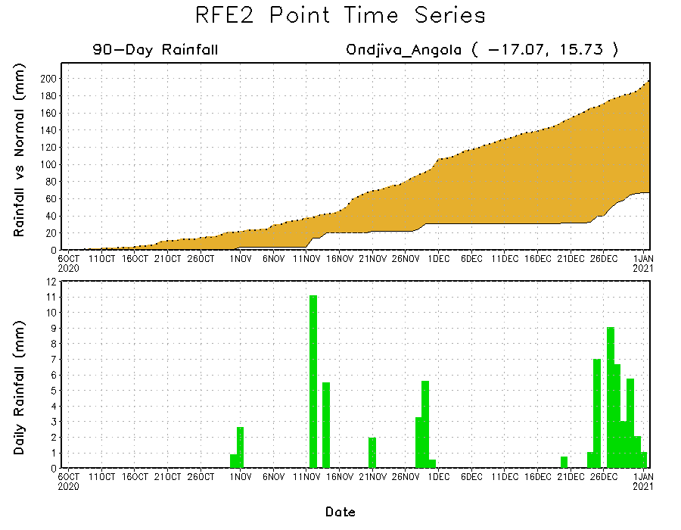
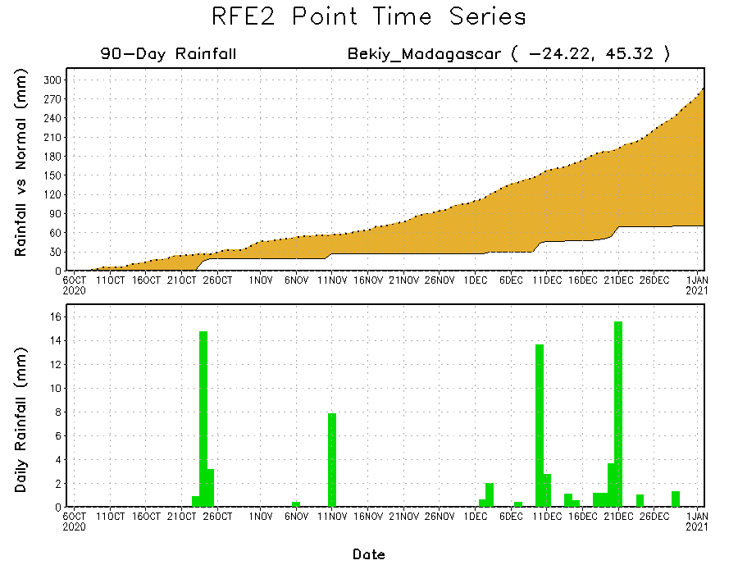
Rainfall Evolution
Daily evolution of rainfall over the last 90 days at selected locations shows that moderate to locally heavy rainfall sustained moisture surpluses over parts of western Zambia (top right). Dry conditions settled in over southern Angola (bottom left) and southern Madagascar (bottom right).

Slide 9
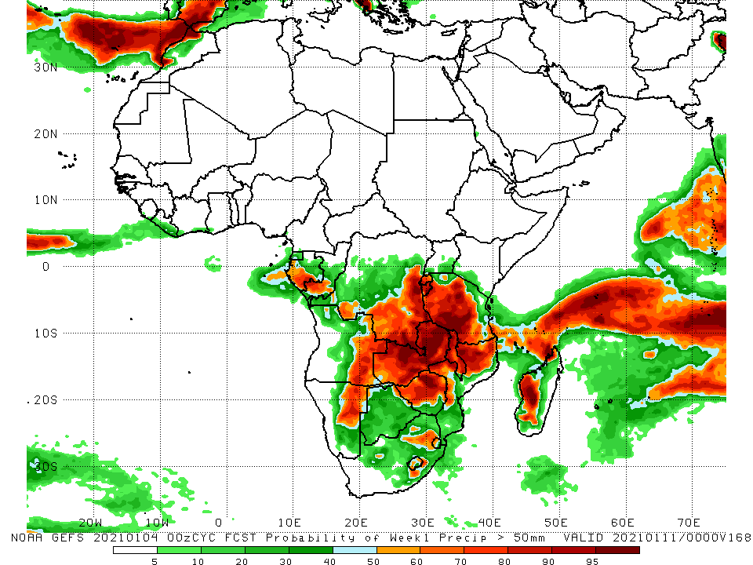
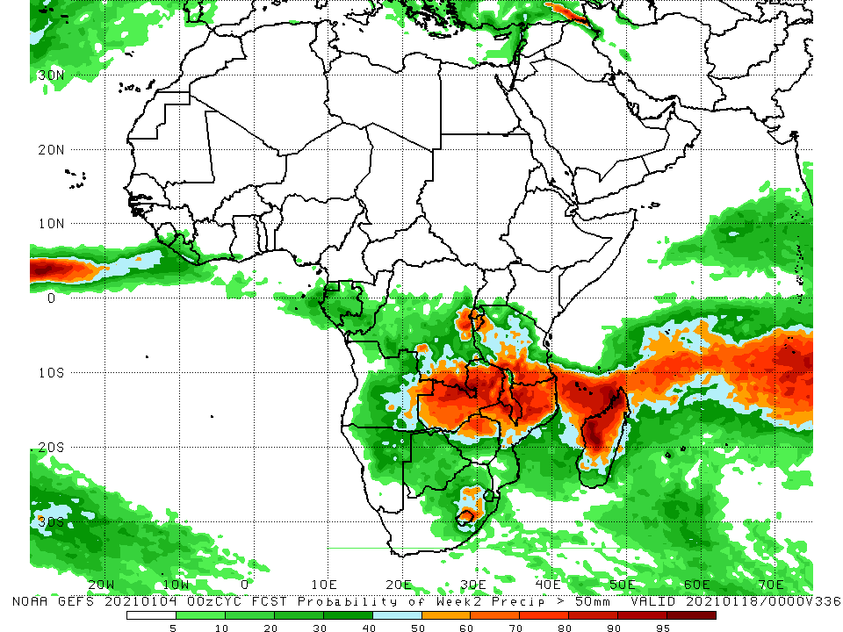
NCEP GEFS Model Forecasts Non-Bias Corrected Probability of precipitation exceedance
Week-1, Valid: 5 - 11 January, 2021
Week-2, Valid: 12 - 18 January, 2021
For week-1 (left panel), the NCEP GEFS indicates a moderate to high chance (over 70%) for rainfall to exceed 50 mm over southern Gabon, southern Congo, southern DRC, portions of Angola, Namibia, much of Zambia, Zimbabwe, Tanzania, Malawi, northern Mozambique, local areas in South Africa and western Madagascar. For week-2 (right panel), the chance for rainfall to exceed 50 mm is mostly confined to Zambia, Malawi, northern Mozambique, southern Tanzania, and central and northern Madagascar.
Notes:
9

Slide 10
Summary
During the past 30 to 90 days, in East Africa, moisture deficits prevailed over southern Somalia, eastern Kenya, and southern Ethiopia. Rainfall was above average locally over southwestern Kenya and much of Tanzania. In southern Africa, rainfall was above average over the northern areas of the region, including northern Madagascar. Rainfall was below average over western Angola and northern Namibia. In central Africa, rainfall was above average over central and southern DRC, southern Congo, and eastern Gabon. Rainfall was below average over western Gabon, and the southern areas of Cameroon and CAR. In West Africa, rainfall was slightly above average in pockets along the Guinean coast.
During the past 7 days, in East Africa moderate rains resulted in moisture surpluses in portions of Kenya, Uganda and Tanzania. In Southern Africa, rainfall was above-average across many areas, including Namibia, portions of Botswana, eastern Zambia, Zimbabwe, western Mozambique and local areas in Madagascar. In contrast, rainfall was below-average over central Angola, parts of central and southern DRC, eastern Mozambique and many parts of Madagascar. In Central Africa, moderate rains sustained moisture surpluses over parts of northern DRC.
The week-1 and week-2 outlooks indicate a moderate to high chance for rainfall to exceed 50 mm southern Gabon, southern Congo, southern DRC, portions of Angola, Namibia, much of Zambia, Zimbabwe, Tanzania, Malawi, northern Mozambique, local areas in South Africa and northern Madagascar.

