Slide 1
The African Monsoon Recent Evolution and Current Status Include Week-1 and Week-2 Outlooks
Update prepared by
Climate Prediction Center / NCEP
28 December 2020
For more information, visit:
http://www.cpc.ncep.noaa.gov/products/Global_Monsoons/African_Monsoons/precip_monitoring.shtml

Slide 2
Outline
Highlights
Recent Evolution and Current Conditions
NCEP GEFS Forecasts
Summary

Slide 3
Highlights: Last 7 Days
During the past 7 days, in East Africa, dry conditions prevailed over much of the Greater Horn of Africa including Ethiopia, Somalia, Kenya and northern Tanzania. In Southern Africa, rainfall was slightly below average across the western and northern areas. In Central Africa, light rains sustained moisture deficits in Gabon and northern DRC.
The week-1 and week-2 outlooks indicate a moderate to high chance for rainfall to exceed 50 mm over southern Gabon, southern Congo, southern DRC, portions of Angola, much of Zambia, Zimbabwe, Tanzania, Malawi and northern Mozambique. For week-2 (right panel), the chance for rainfall to exceed 50 mm is mostly confined to southern DRC, Zambia, Zimbabwe, southern Tanzania, Malawi and northern Mozambique.

Slide 4
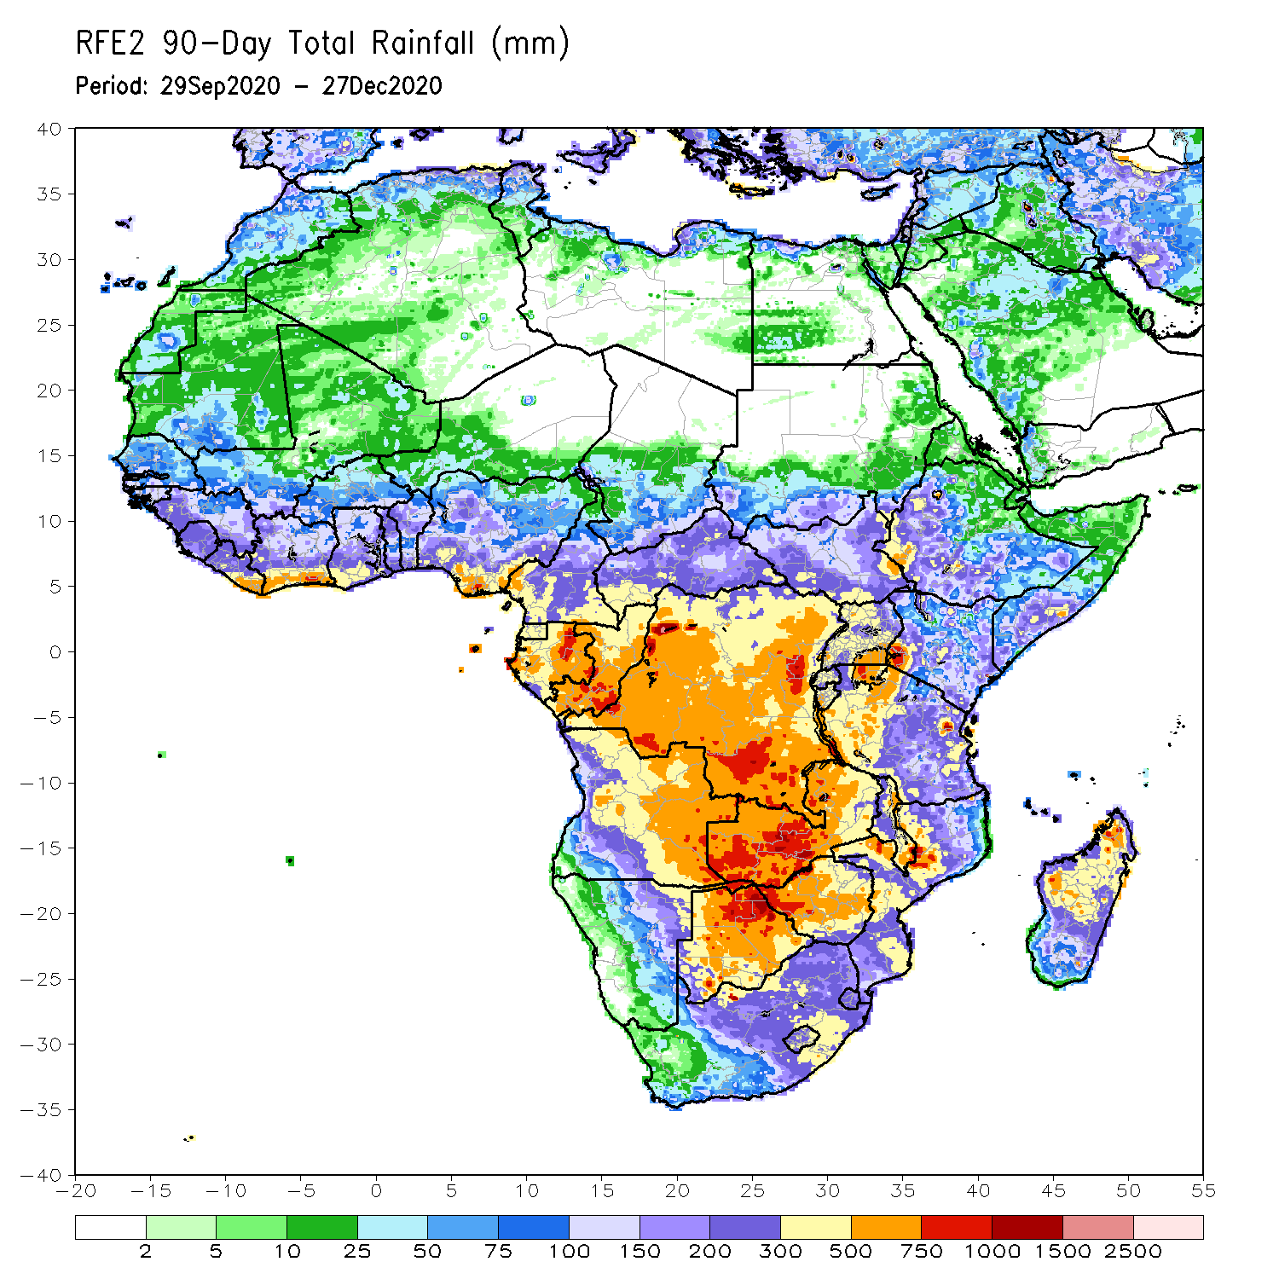
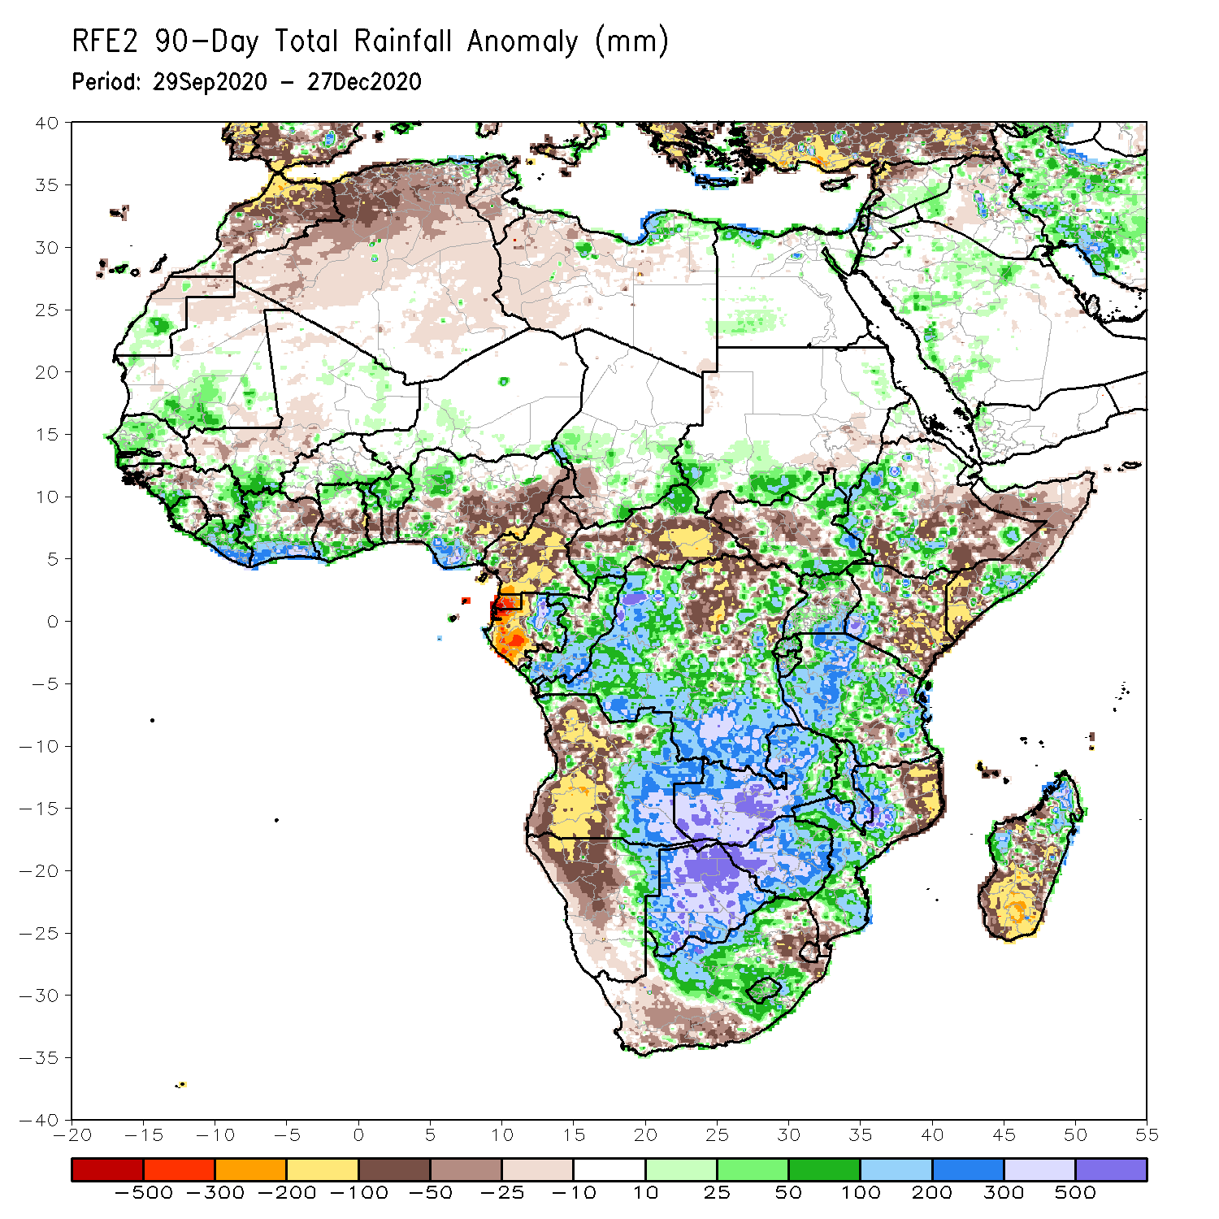
Rainfall Patterns: Last 90 Days
Over the past 90 days, in East Africa, rainfall was significantly below average over eastern Kenya, southern and northern Somalia, and portions of eastern Ethiopia. Rainfall was also below average over parts of South Sudan. Rainfall was above average over southern Sudan, eastern South Sudan, western Ethiopia, and Uganda. The uptick in rainfall extended to much of northern and western Tanzania. In southern Africa, persistent rains resulted in sustained moisture surpluses over Zambia, Botswana, and Zimbabwe. Rainfall was also above average over many parts of Mozambique and northern Madagascar. Persistent light rains resulted in moisture deficits in western Angola and northern Namibia. Rainfall was also below average along the border between South Africa and Mozambique and over southern Madagascar. In Central Africa, rainfall was above average over many parts of DRC and Congo. Rainfall was below average over northern DRC, and CAR. Below average rains were also observed over the western areas of Gabon and Cameroon. In West Africa, rainfall was below average in the central areas of the Gulf of Guinea region, and above average along the coast. Rainfall was generally above average over the Sahel.
Notes:
4

Slide 5
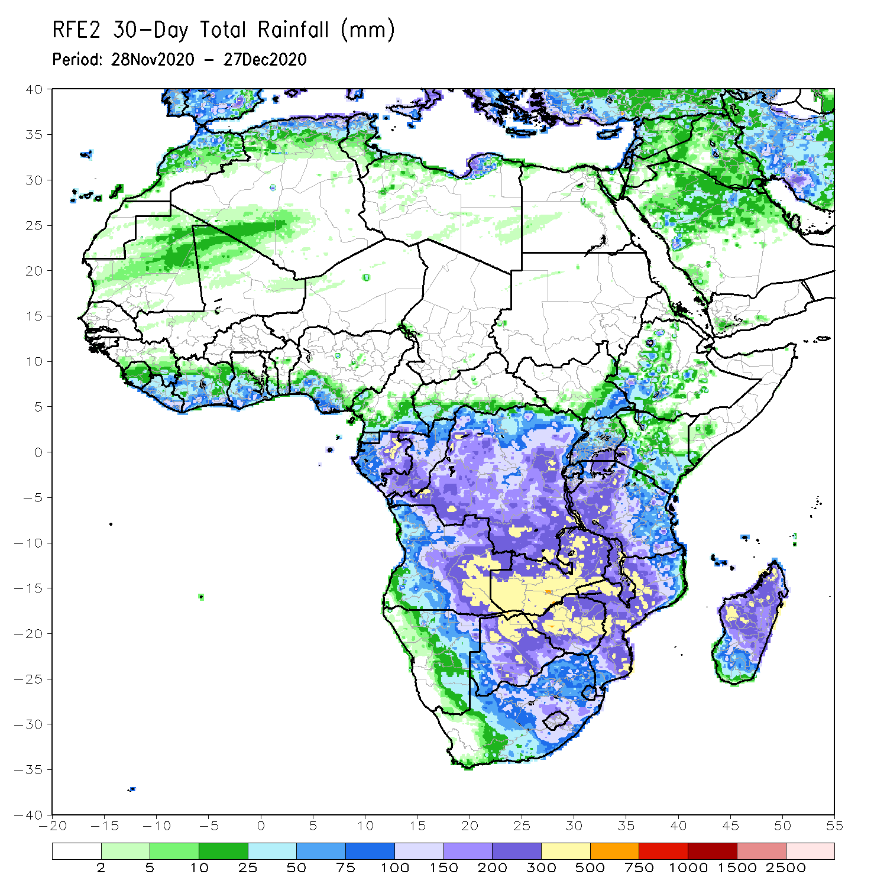
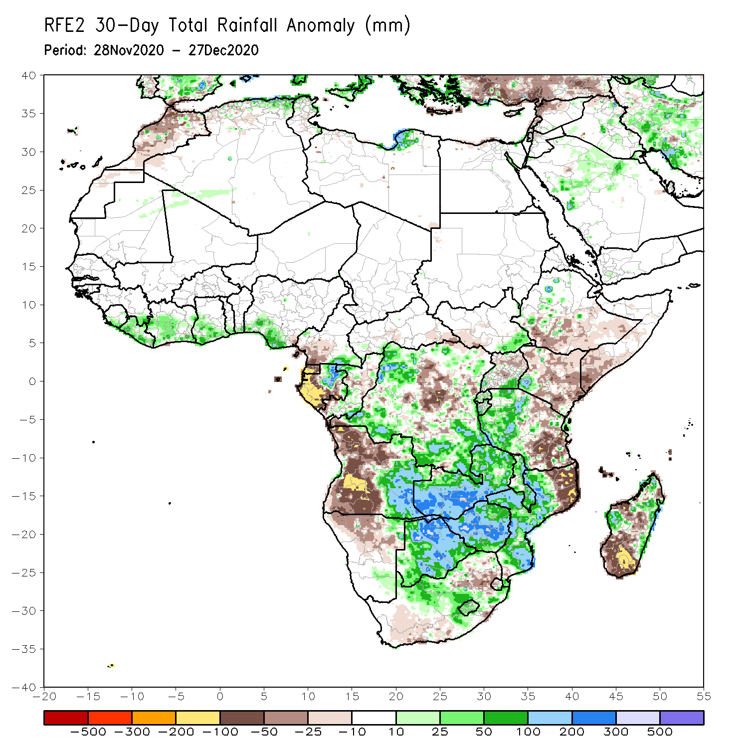
Rainfall Patterns: Last 30 Days
During the past 30 days, in East Africa, several weeks of light rains resulted in moisture deficits over southern Somalia, eastern Kenya, and pockets in southern Ethiopia. Rainfall was above average locally over southwestern Kenya and western Tanzania, while below-average rainfall was observed over southeastern Tanzania. In southern Africa, persistent moderate to heavy rains resulted in moisture surpluses over eastern Angola, Zambia, Botswana, and Zimbabwe. Rainfall was also above average over central and southern Mozambique and pocket areas in Madagascar. Persistent light rains resulted in moisture deficits in western Angola and northern Namibia. Rainfall was also below average over pocket areas in northeastern South Africa, northwestern Mozambique, and over pocket areas in Madagascar. In central Africa, rainfall was above average over many parts of DRC, southern Congo, and eastern Gabon. Rainfall was below average over parts of northern DRC, western Gabon, and the southern areas of Cameroon and CAR. In West Africa, rainfall was slightly above average in pockets along the Guinean coast.
Notes:
5

Slide 6
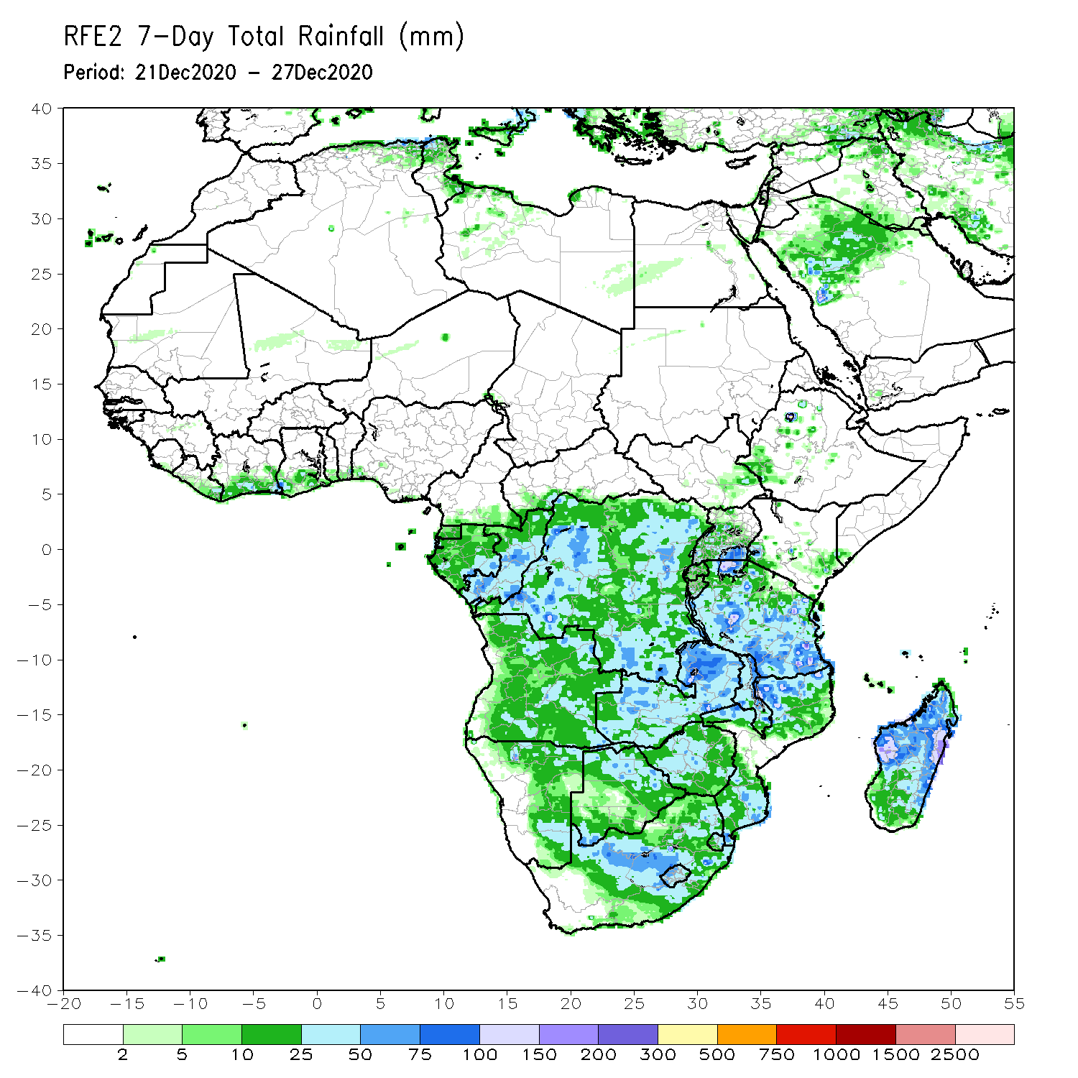
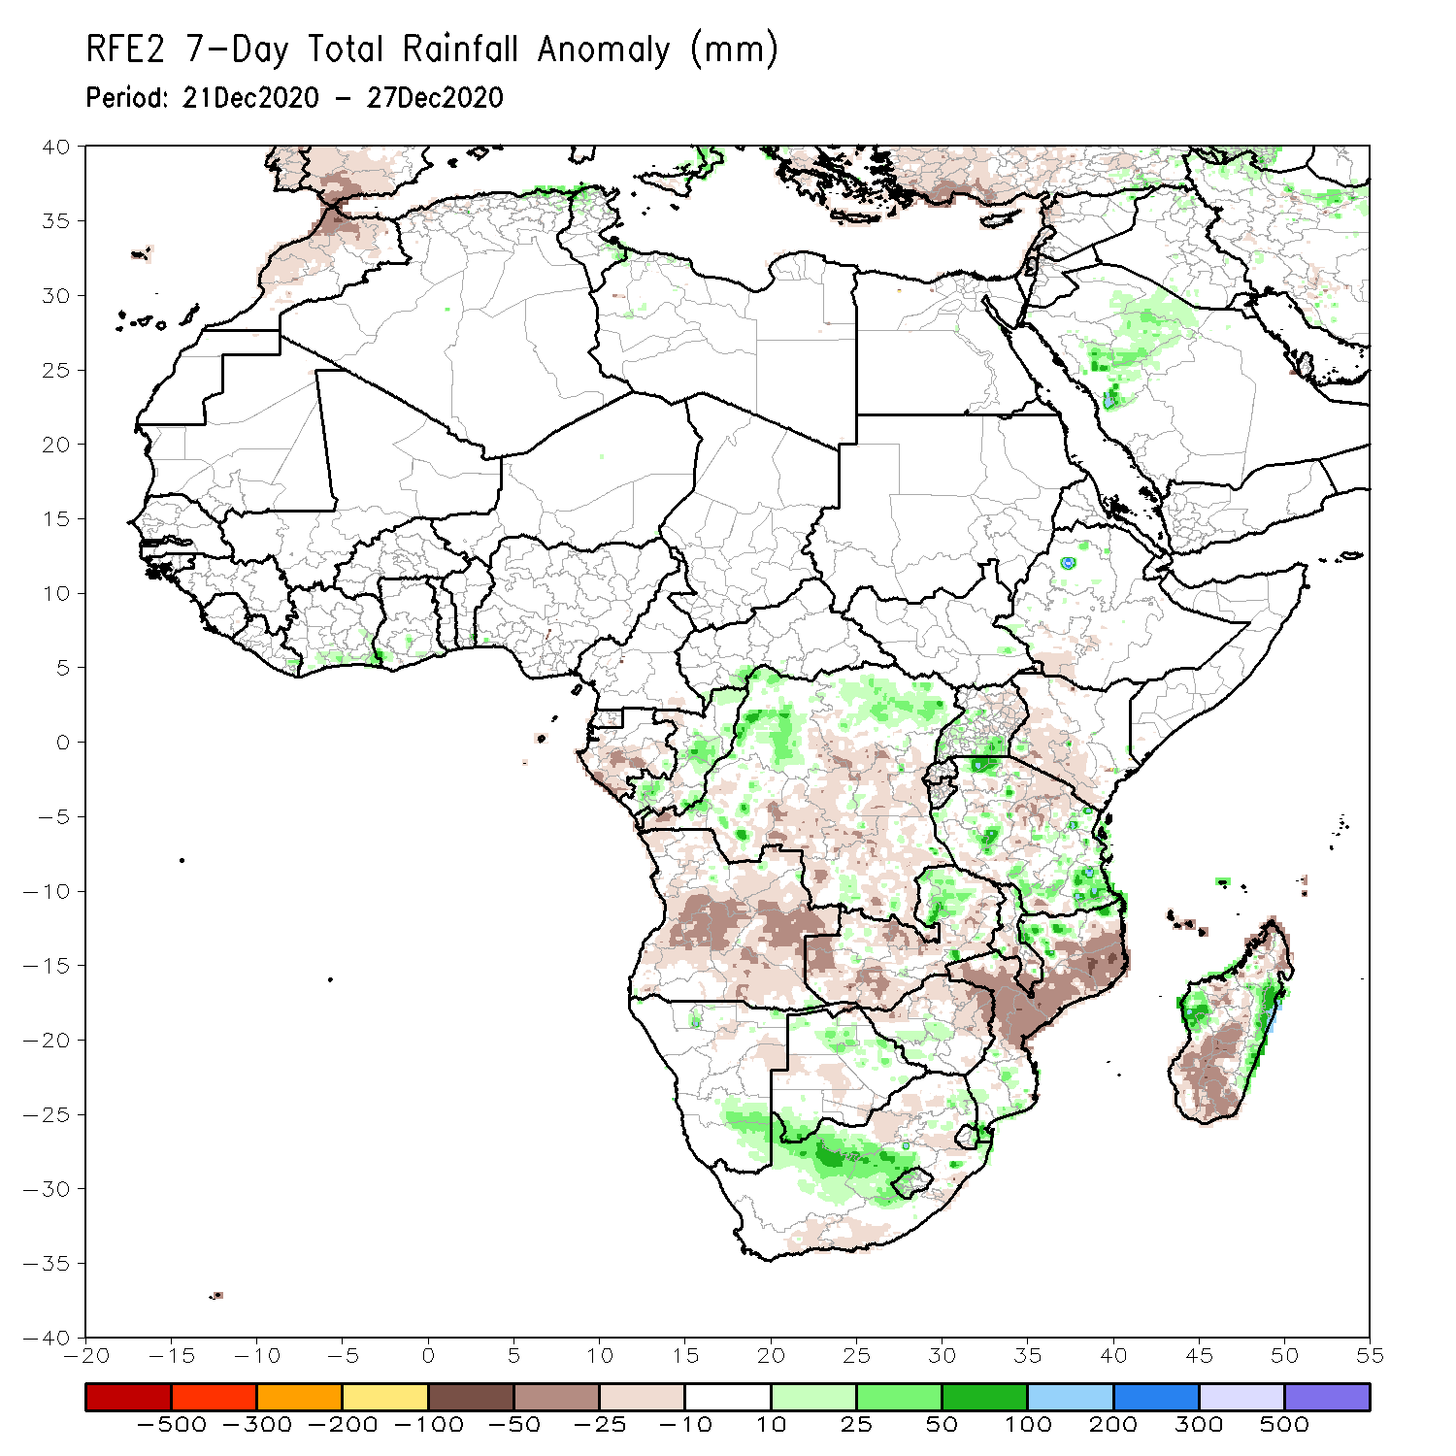
Rainfall Patterns: Last 7 Days
During the past 7 days, in East Africa, dry conditions prevailed over much of the Greater Horn of Africa including Ethiopia, Somalia, and Kenya. Light rains resulted in slight moisture deficits in southern Kenya and northern Tanzania. Rainfall was above-average over pocket areas of Uganda and Tanzania. In Southern Africa, rainfall was below-average across the northern portions of Southern Africa, including Angola, Zambia, and central and northern Mozambique and much of Madagascar. In contrast, rainfall was above-average over southeastern Namibia and parts of northern South Africa. In Central Africa, light rains sustained moisture deficits in Gabon and parts of DRC. In West Africa moderate rains fell along coastal Gulf of Guinea resulting a slight uptick in precipitation in local areas.

Slide 7
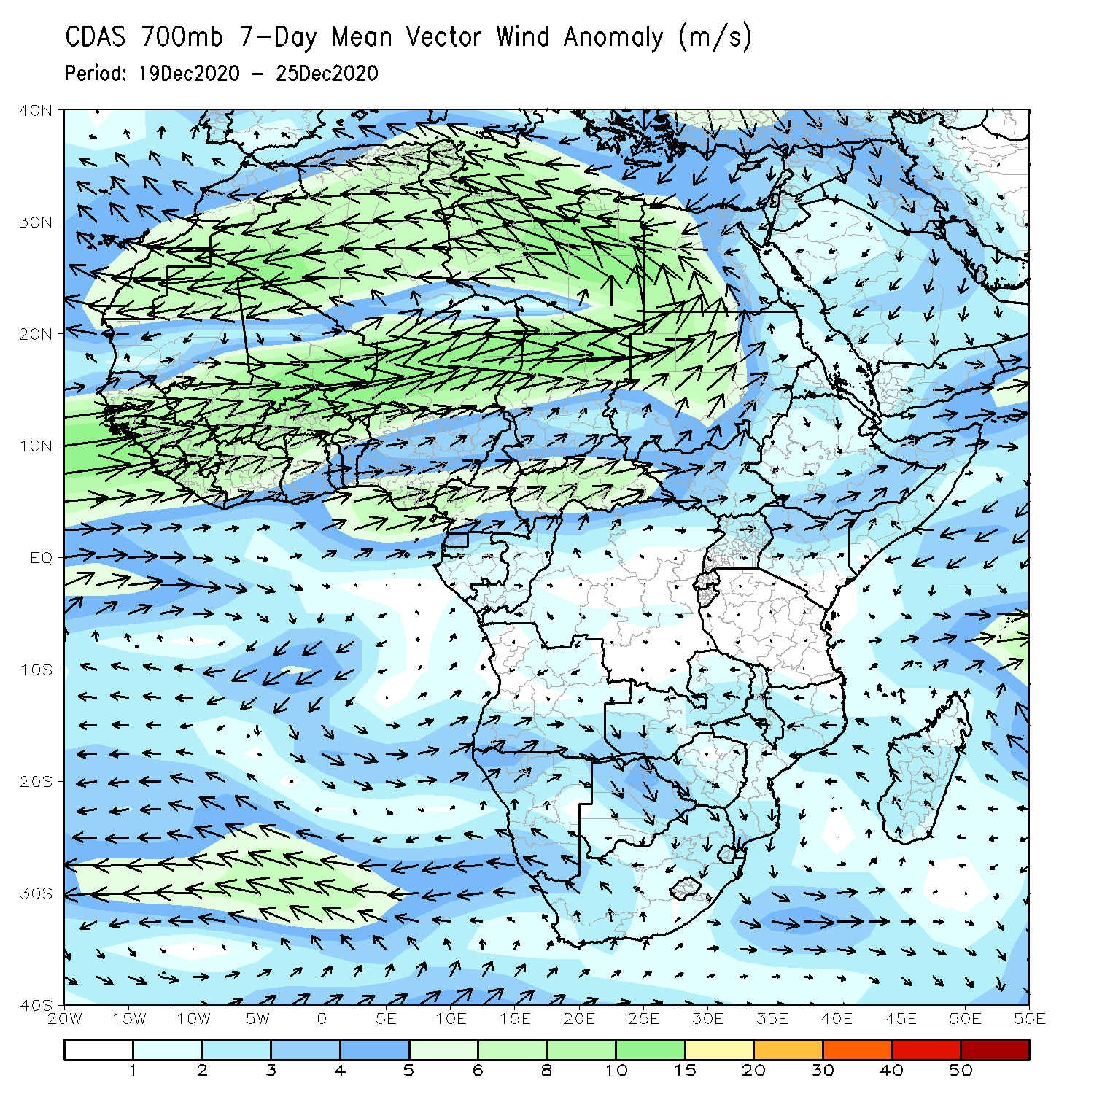
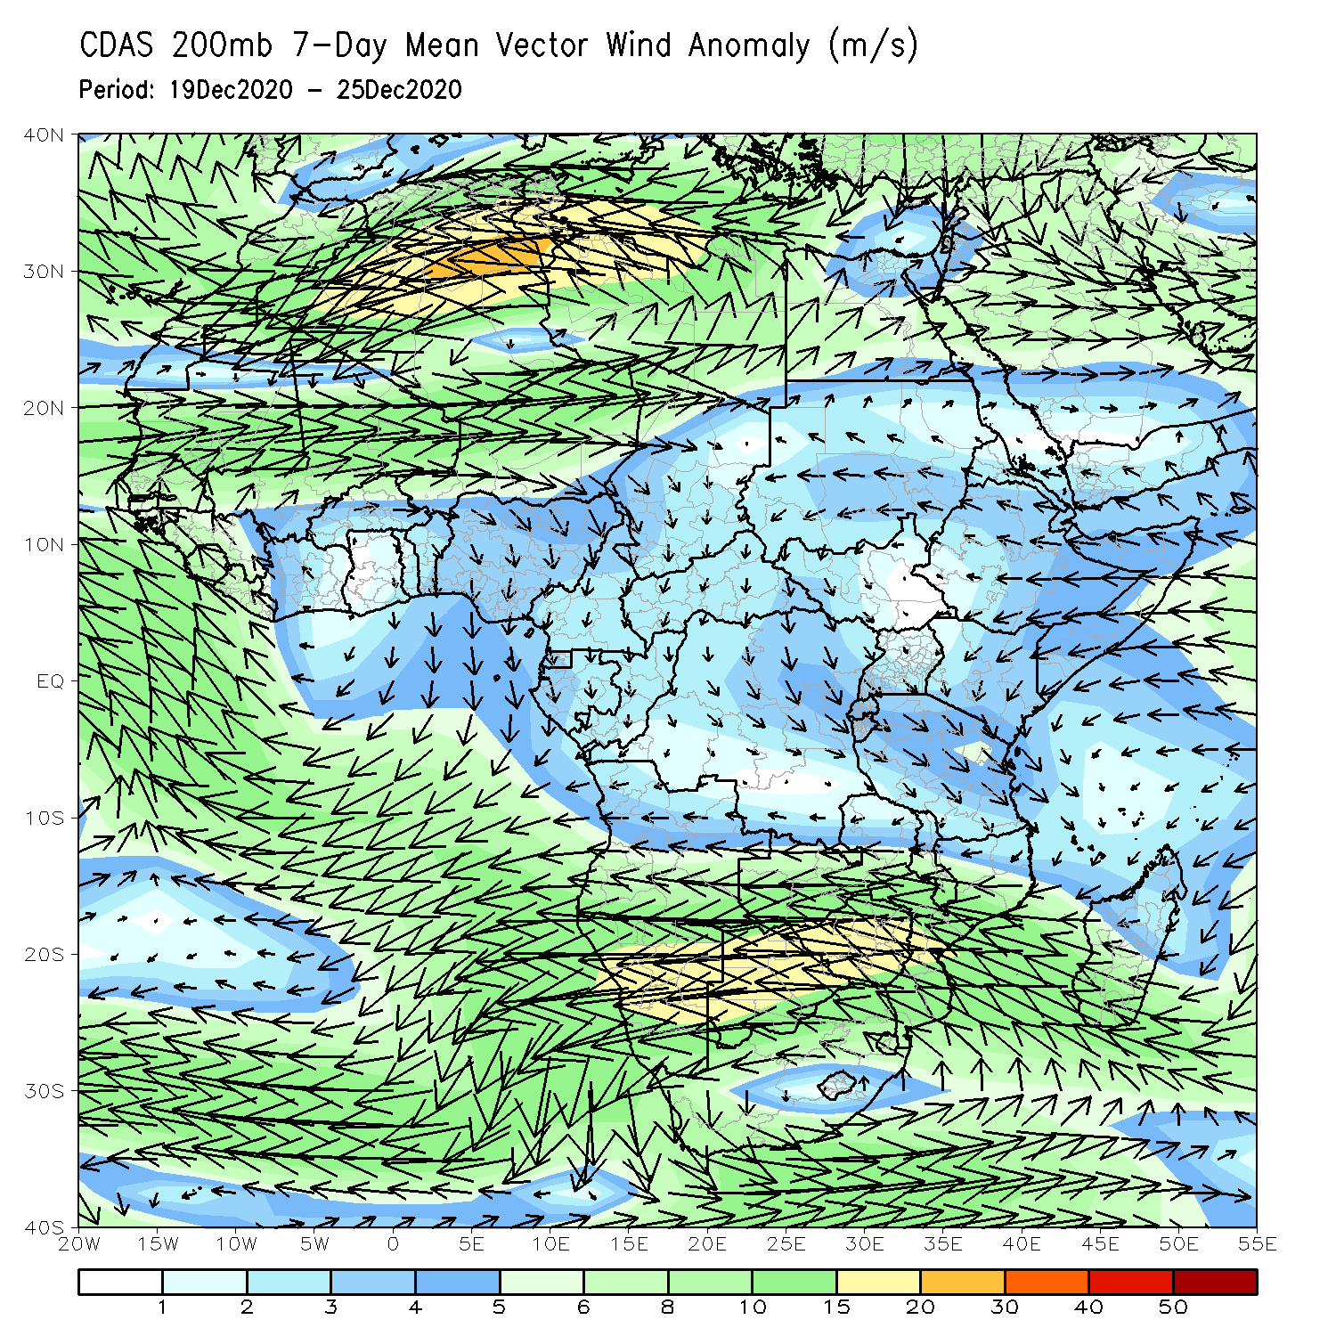
Atmospheric Circulation: Last 7 Days
At upper level (right panel), a strong easterly anomaly prevailed across the northern areas of Southern Africa.

Slide 8
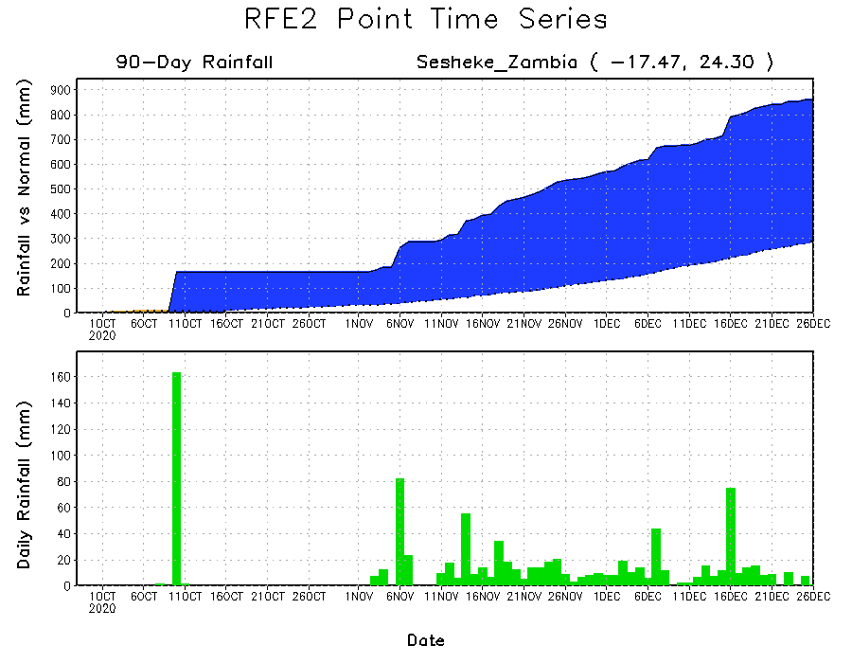
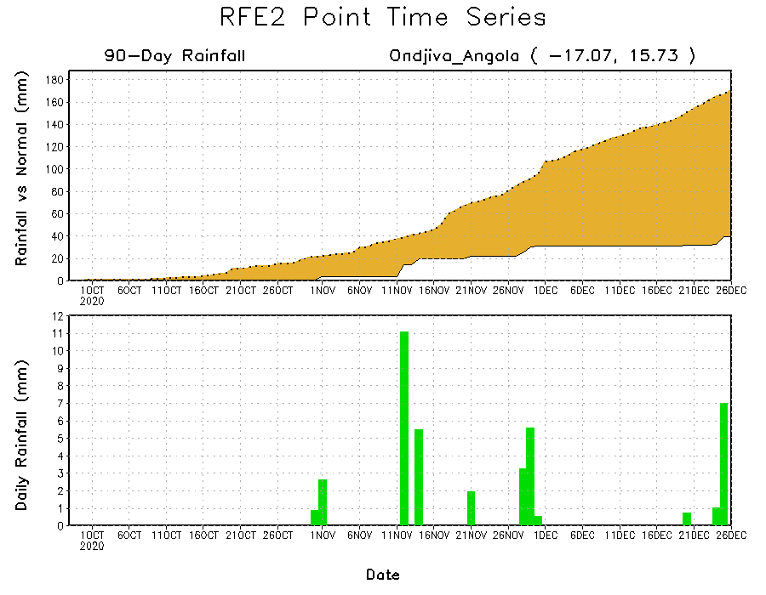
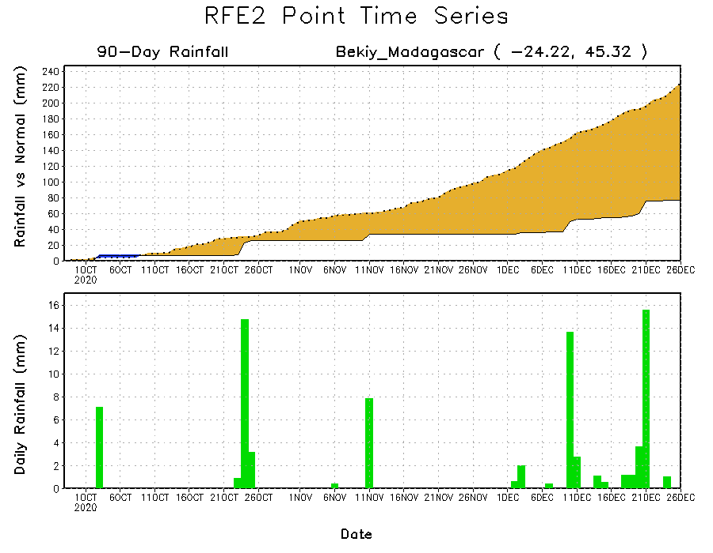
Rainfall Evolution
Daily evolution of rainfall over the last 90 days at selected locations shows that moderate to locally heavy rainfall sustained moisture surpluses over parts of western Zambia (top right). Dry conditions settled in over southern Angola (bottom left) and southern Madagascar (bottom right).

Slide 9
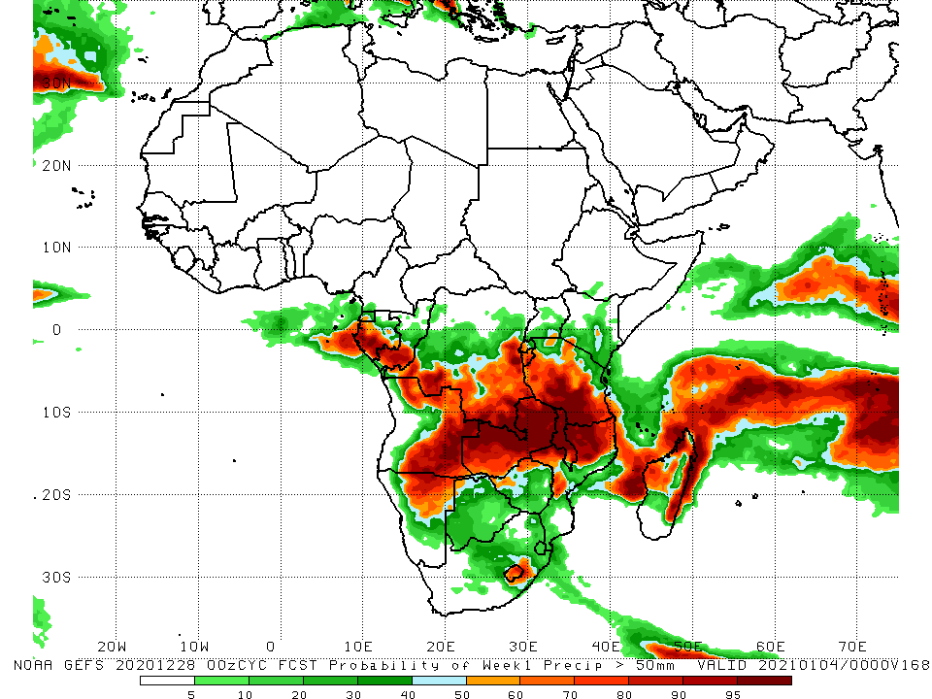
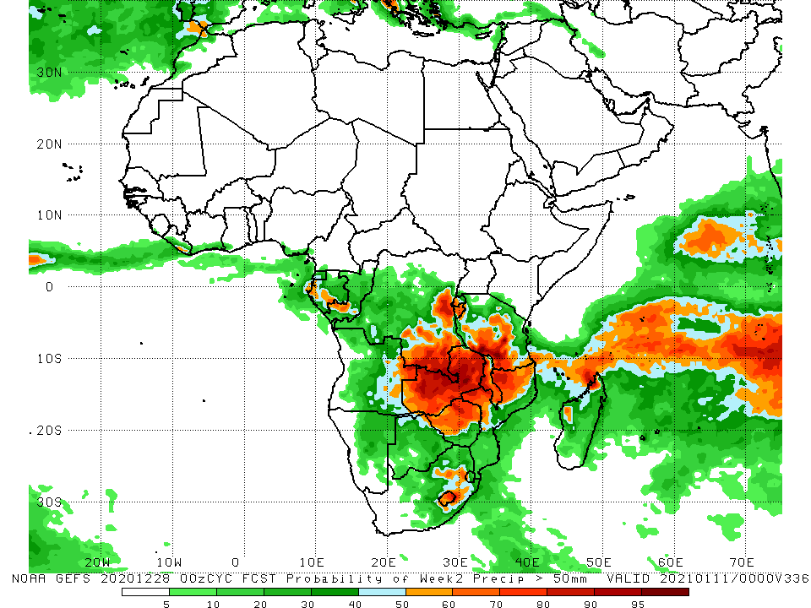
NCEP GEFS Model Forecasts Non-Bias Corrected Probability of precipitation exceedance
Week-1, Valid: Dec 29, 2020 – Jan 4, 2021
Week-2, Valid: 5 - 11 January, 2021
For week-1 (left panel), the NCEP GEFS indicates a moderate to high chance (over 70%) for rainfall to exceed 50 mm over southern Gabon, southern Congo, southern DRC, portions of Angola, much of Zambia, Zimbabwe, Tanzania, Malawi and northern Mozambique. For week-2 (right panel), the chance for rainfall to exceed 50 mm is mostly confined to southern DRC, Zambia, Zimbabwe, southern Tanzania, Malawi and northern Mozambique.
Notes:
9

Slide 10
Summary
During the past 30 to 90 days, in East Africa, moisture deficits prevailed over southern Somalia, eastern Kenya, and pockets in southern Ethiopia. Rainfall was above average locally over southwestern Kenya and much of Tanzania. In southern Africa, rainfall was above average over the northern areas of the region, including northern Madagascar. Rainfall was below average over western Angola and northern Namibia. In central Africa, rainfall was above average over central and southern DRC, southern Congo, and eastern Gabon. Rainfall was below average over western Gabon, and the southern areas of Cameroon and CAR. In West Africa, rainfall was slightly above average in pockets along the Guinean coast.
During the past 7 days, in East Africa, dry conditions prevailed over much of the Greater Horn of Africa including Ethiopia, Somalia, Kenya and northern Tanzania. In Southern Africa, rainfall was slightly below average across the western and northern areas. In Central Africa, light rains sustained moisture deficits in Gabon and northern DRC.
The week-1 and week-2 outlooks indicate a moderate to high chance for rainfall to exceed 50 mm over southern Gabon, southern Congo, southern DRC, portions of Angola, much of Zambia, Zimbabwe, Tanzania, Malawi and northern Mozambique. For week-2 (right panel), the chance for rainfall to exceed 50 mm is mostly confined to southern DRC, Zambia, Zimbabwe, southern Tanzania, Malawi and northern Mozambique.

