Slide 1
The African Monsoon Recent Evolution and Current Status Include Week-1 and Week-2 Outlooks
Update prepared by
Climate Prediction Center / NCEP
21 December 2020
For more information, visit:
http://www.cpc.ncep.noaa.gov/products/Global_Monsoons/African_Monsoons/precip_monitoring.shtml

Slide 2
Outline
Highlights
Recent Evolution and Current Conditions
NCEP GEFS Forecasts
Summary

Slide 3
Highlights: Last 7 Days
During the past 7 days, moderate to heavy rains sustained moisture surpluses in eastern Angola, and portions of Zambia, Botswana, Zimbabwe and southern Mozambique. Moisture deficits prevailed over much of Madagascar.
The week-1 and week-2 outlooks indicate a moderate to high chance for rainfall to exceed 50 mm over southern Gabon, southeastern and eastern DRC, eastern Angola, much of Zambia, northern Zimbabwe, portions of Tanzania and Malawi, and northern Mozambique and northern Madagascar.

Slide 4
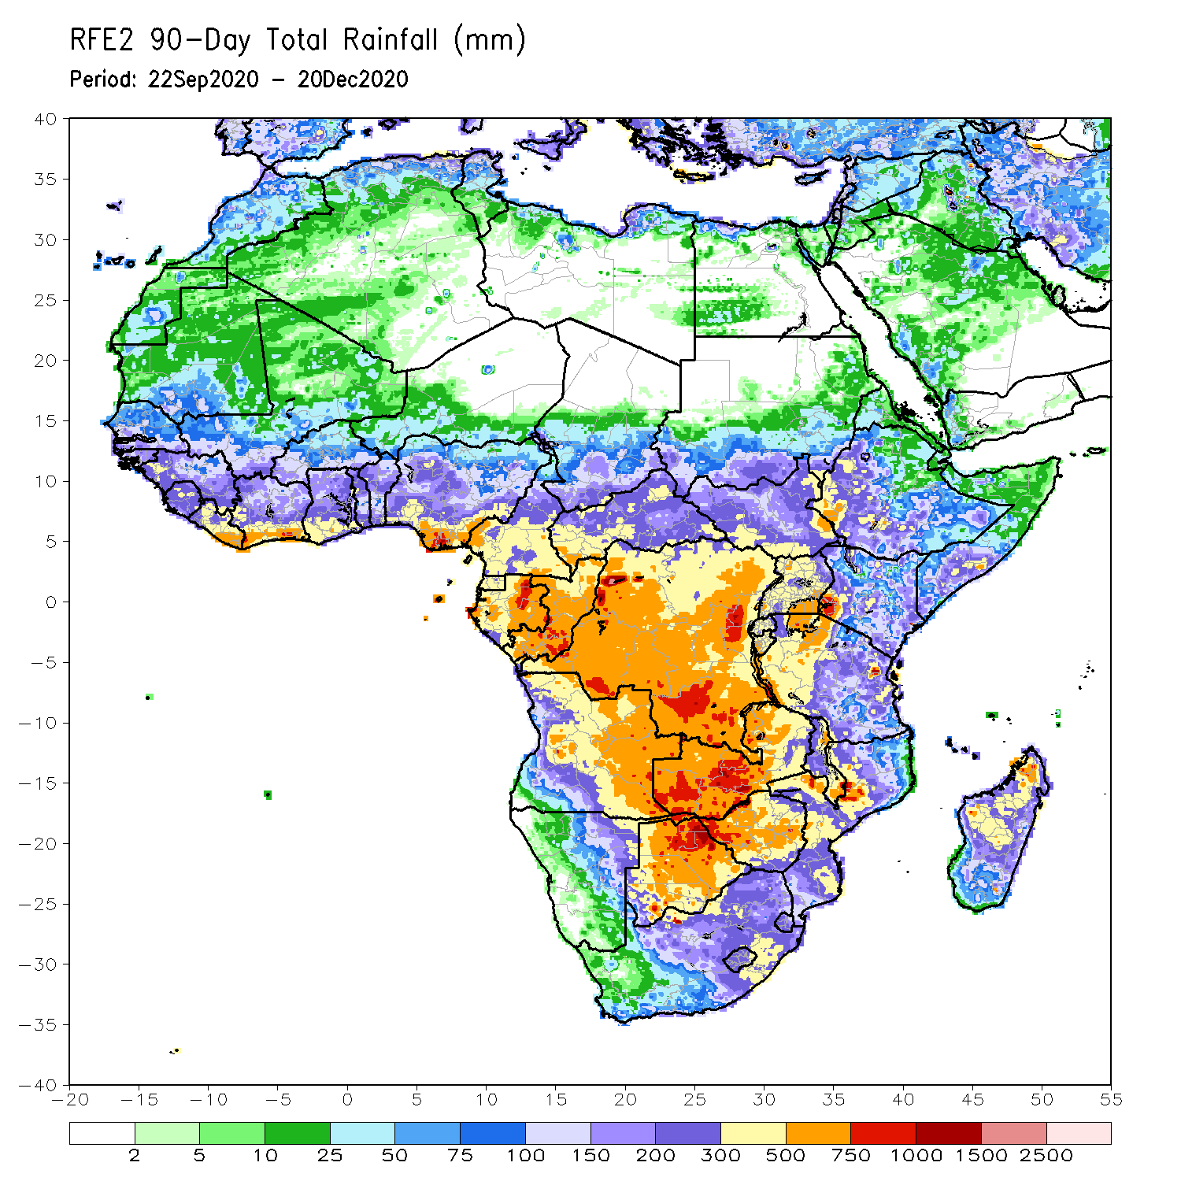
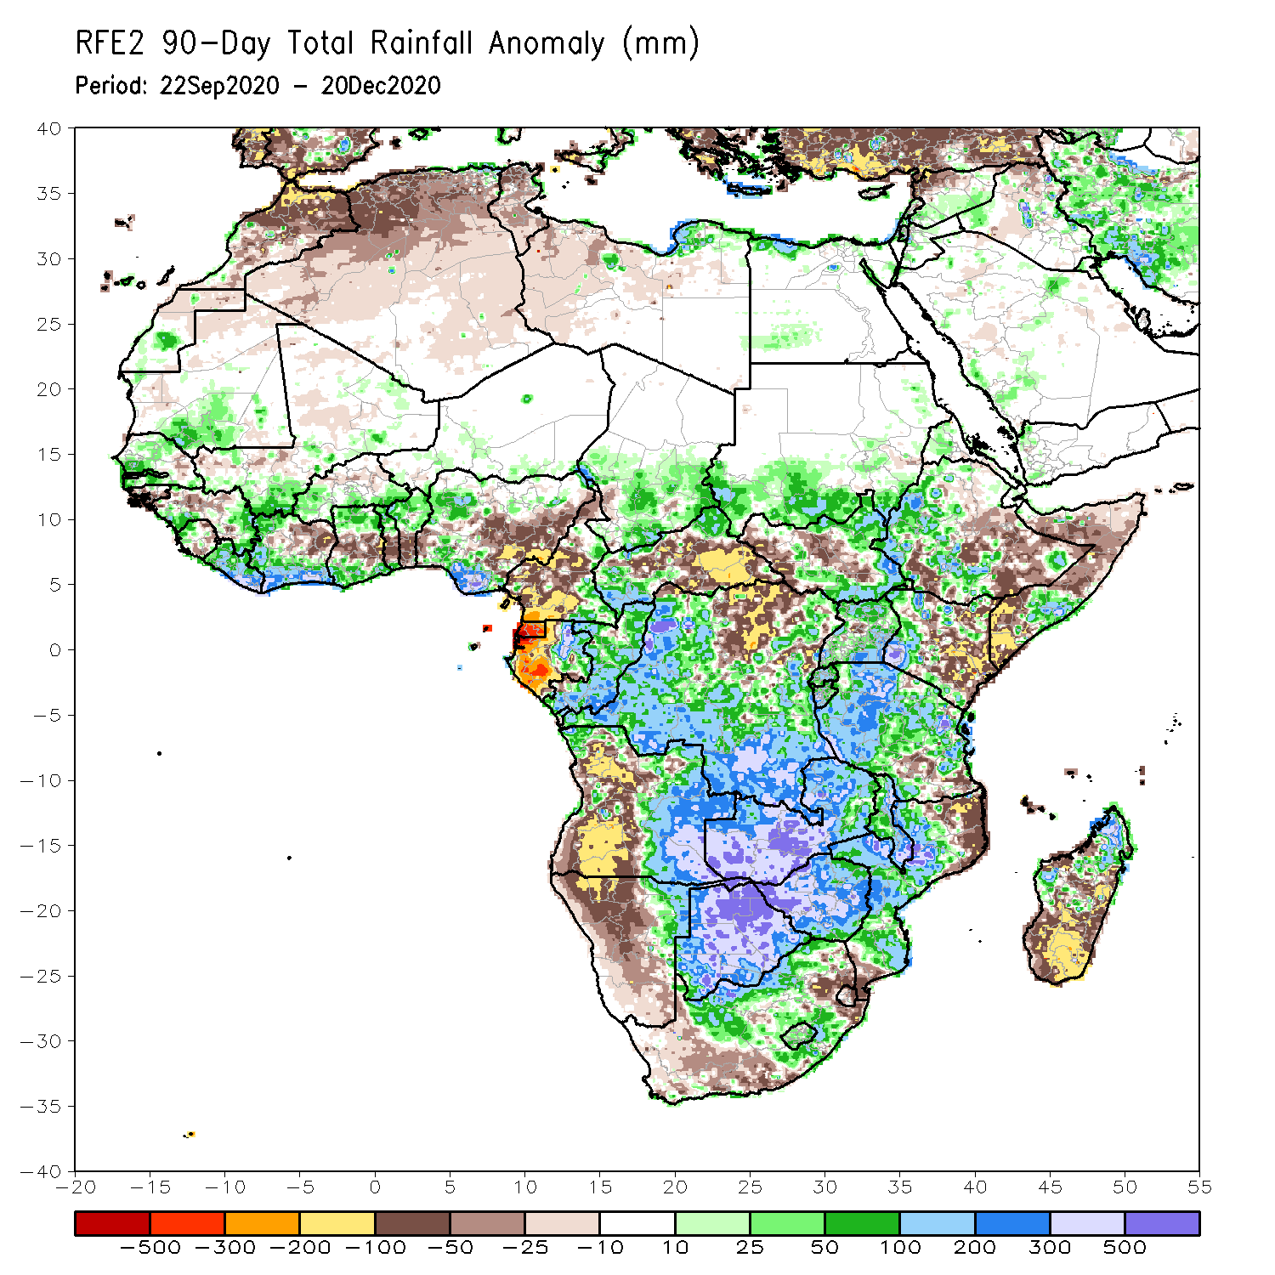
Rainfall Patterns: Last 90 Days
Over the past 90 days, in East Africa, rainfall was significantly below average over eastern Kenya, southern and northern Somalia, and portions of eastern Ethiopia. Rainfall was also below average over parts of South Sudan. Rainfall was above average over southern Sudan, western Ethiopia, and Uganda. The uptick in rainfall extended to much of northern and western Tanzania. In southern Africa, persistent rains resulted in sustained moisture surpluses over Zambia, Botswana, and Zimbabwe. Rainfall was also above average over many parts of Mozambique and northern Madagascar. Persistent light rains resulted in moisture deficits in western Angola and northern Namibia. Rainfall was also below average along the border between South Africa and Mozambique and over southern Madagascar. In Central Africa, rainfall above average over much of DRC and Congo. Rainfall was below average over northern DRC, and CAR. Below average rains were also observed over the western areas of Gabon and Cameroon. In West Africa, rainfall was below average in the central areas of the Gulf of Guinea region, and above average along the coast. Rainfall was generally above average over the Sahel.
Notes:
4

Slide 5
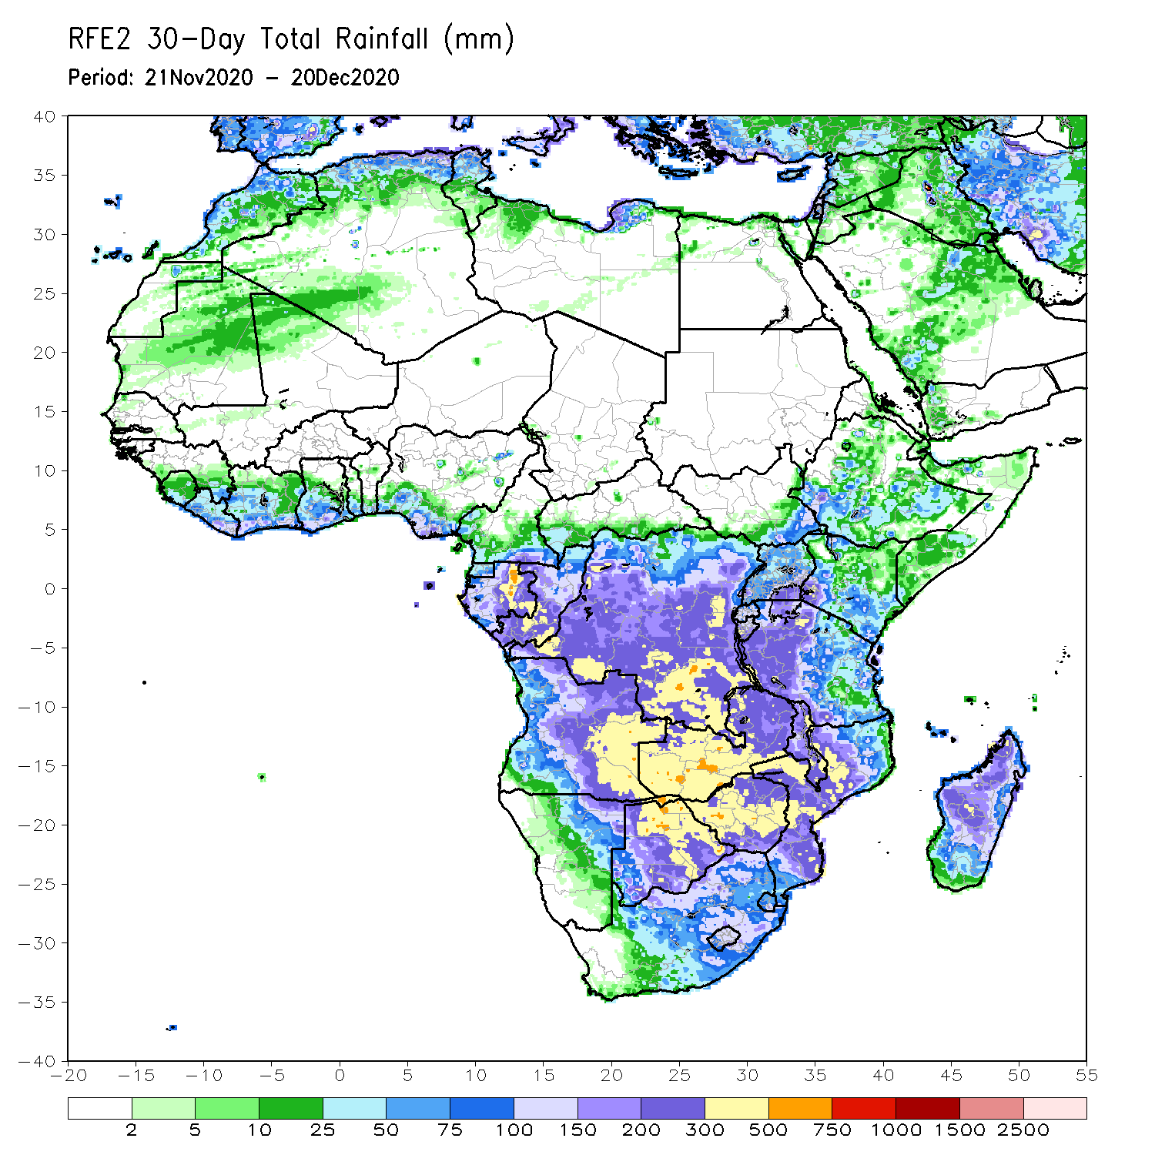
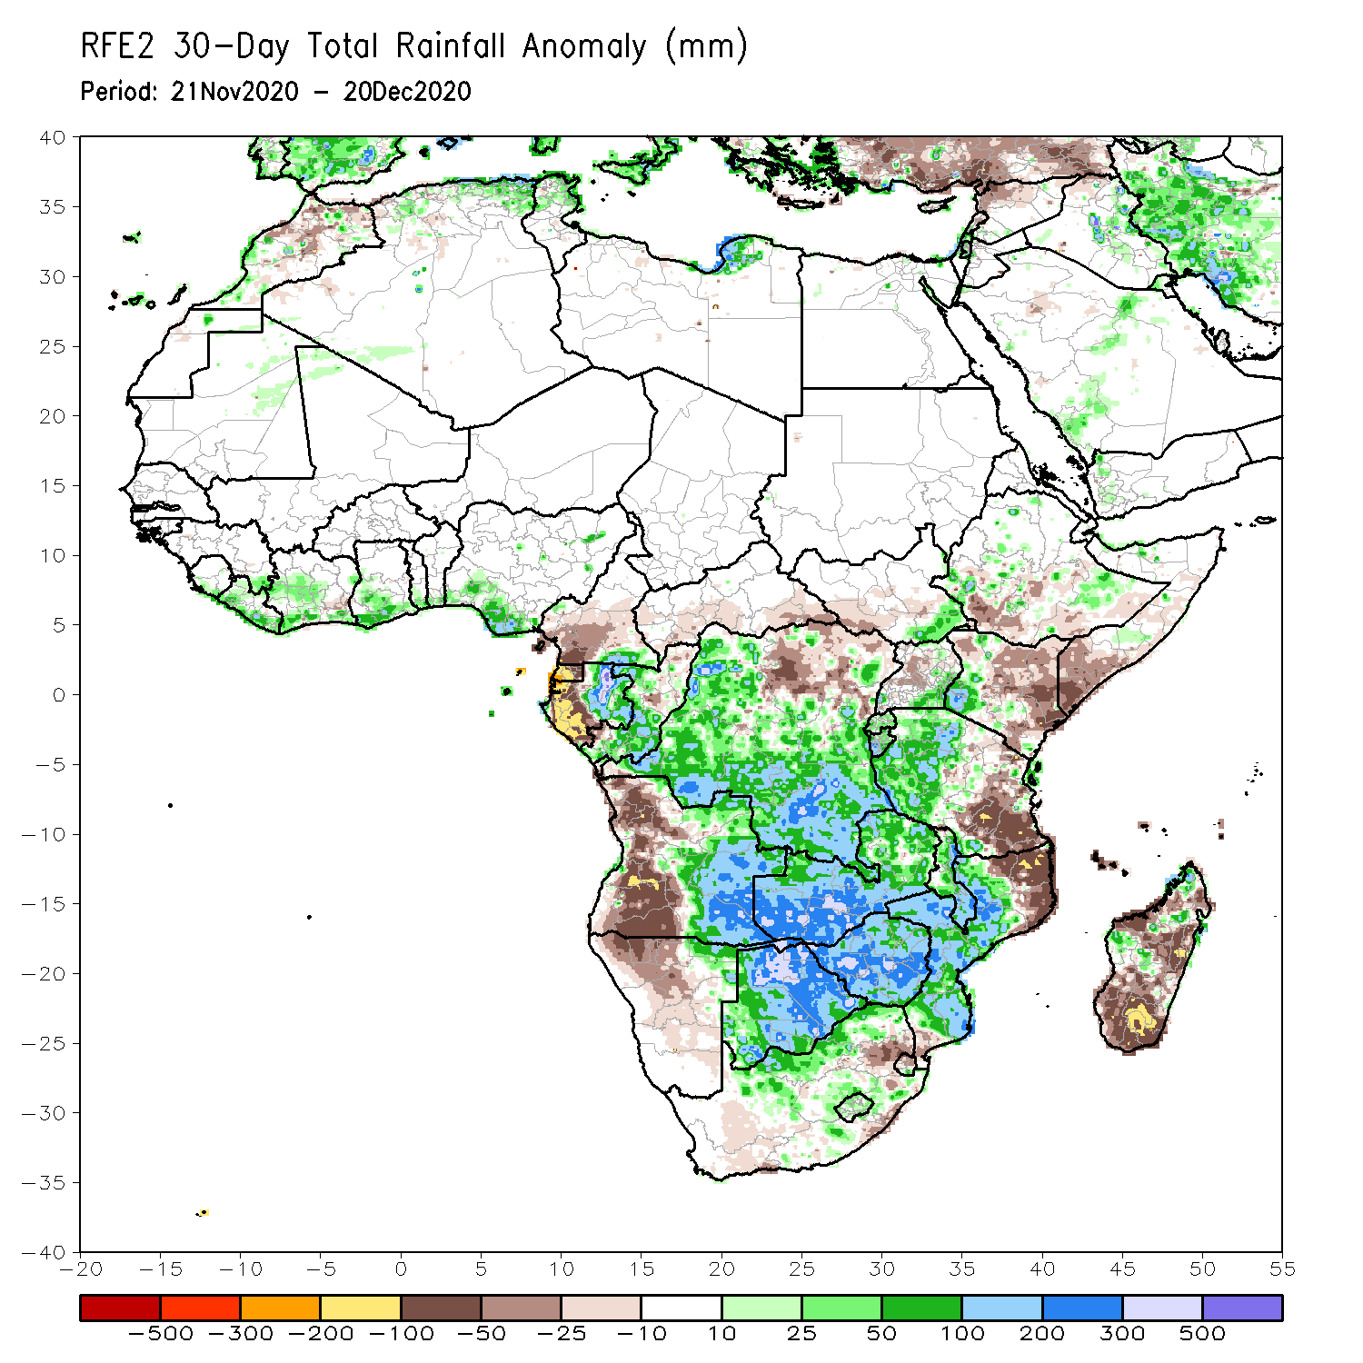
Rainfall Patterns: Last 30 Days
During the past 30 days, in East Africa, several weeks of light rains resulted in moisture deficits over southern Somalia, eastern Kenya, and pockets in southern Ethiopia. Rainfall was above average locally over southwestern Kenya and much of Tanzania, except for the southeastern areas. In southern Africa, persistent moderate to heavy rains resulted in moisture surpluses over Zambia, Botswana, and Zimbabwe. Rainfall was also above average over central and southern Mozambique and pocket areas in Madagascar. Persistent light rains resulted in moisture deficits in western Angola and northern Namibia. Rainfall was also below average over pocket areas in northeastern South Africa, the northern and southern tips of Mozambique and many parts of Madagascar. In central Africa, rainfall was above average over central and southern DRC, southern Congo, and eastern Gabon. Rainfall was below average over parts of northern DRC, western Gabon, and the southern areas of Cameroon and CAR. In West Africa, rainfall was slightly above average in pockets along the Guinean coast.
Notes:
5

Slide 6
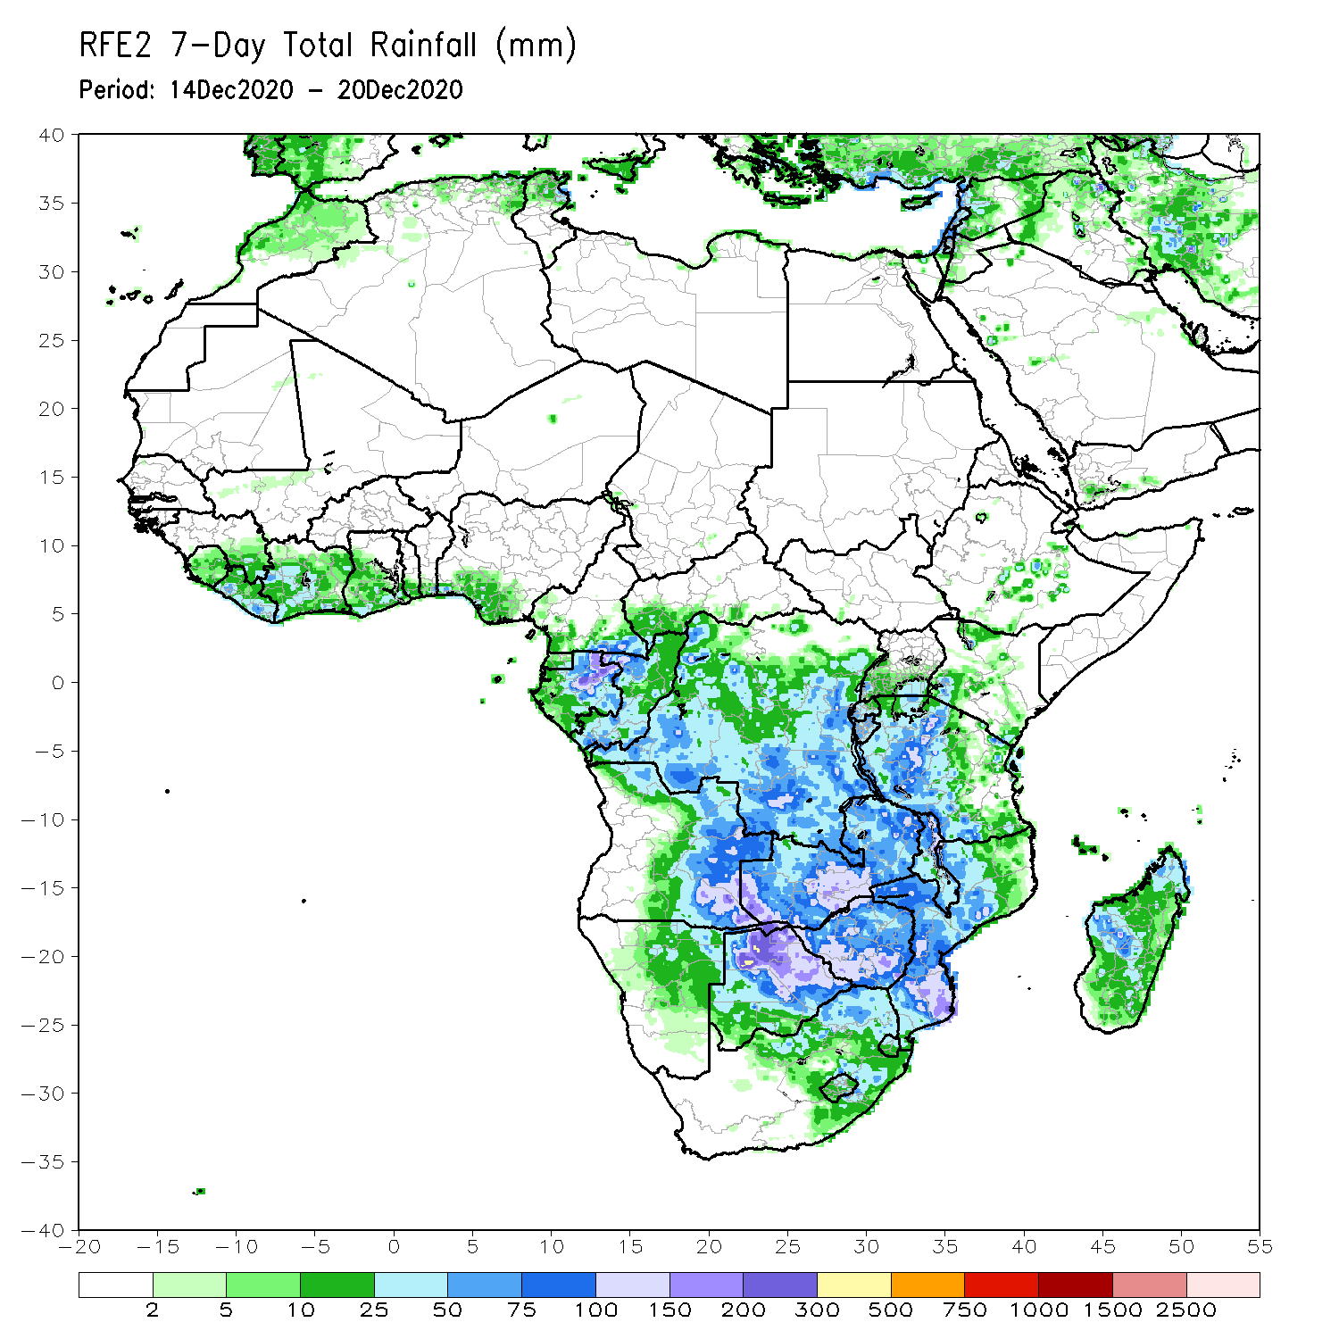
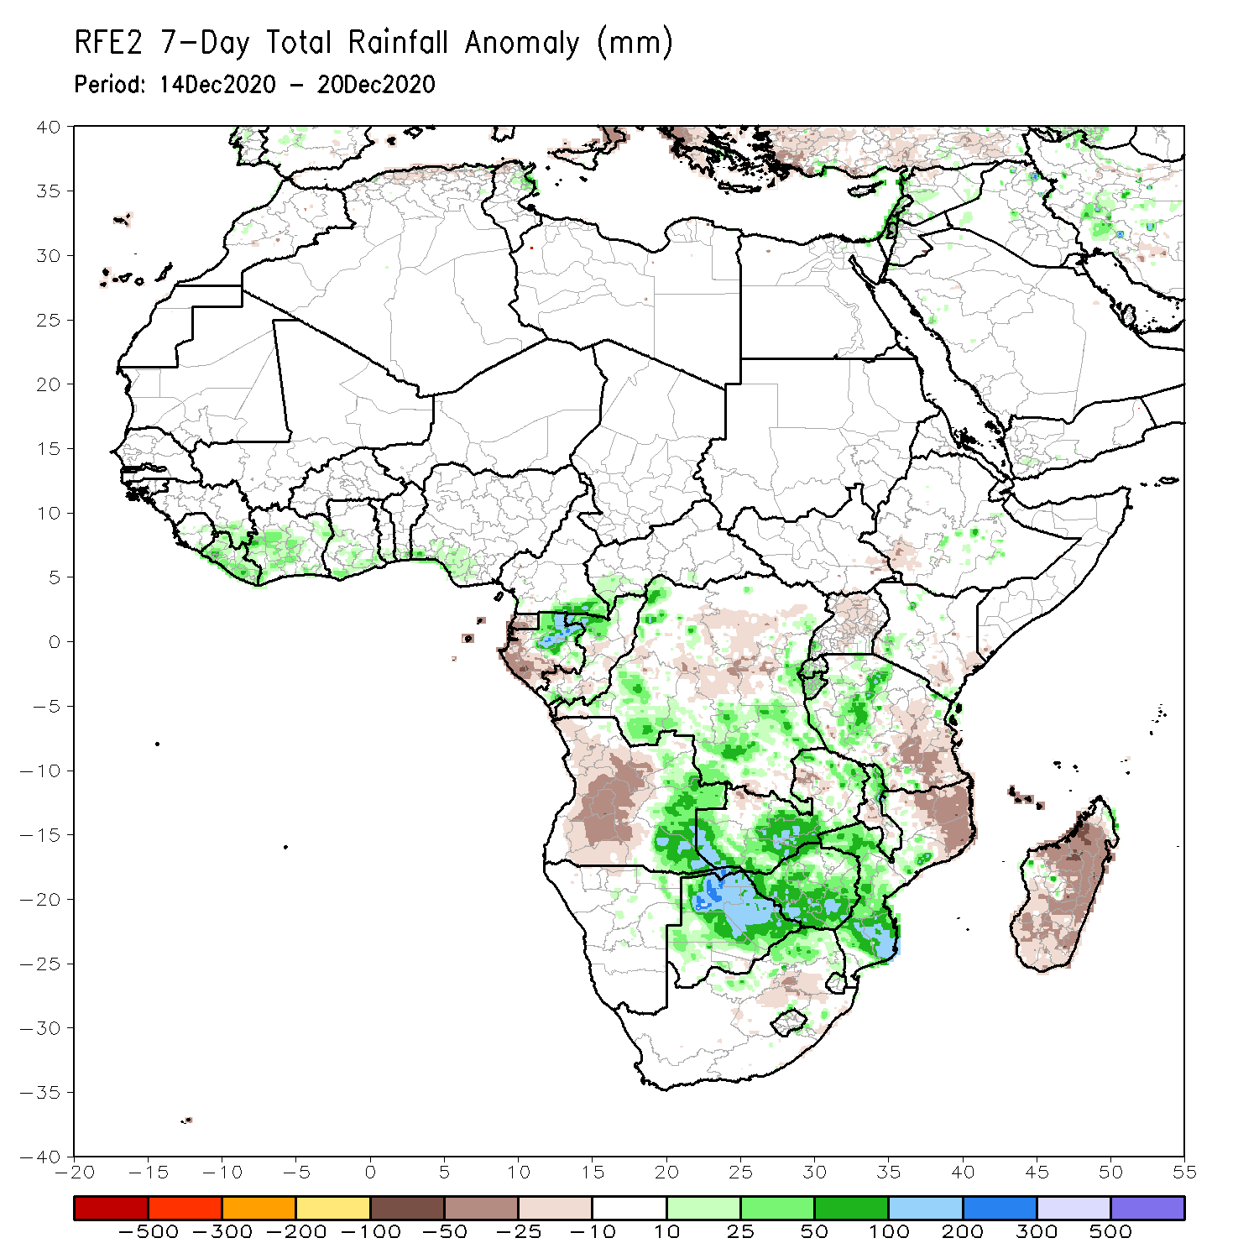
Rainfall Patterns: Last 7 Days
During the past 7 days, in East Africa, dry conditions prevailed over much of the Greater Horn of Africa including Ethiopia, Somalia, and northern Kenya. Light rains resulted in slight moisture deficits in southeastern Kenya, Uganda. Rainfall was also below-average over eastern Tanzania. In Southern Africa, heavy rains sustained moisture surpluses in eastern Angola, and portions of Zambia, Botswana and Zimbabwe. Rainfall was also above average over parts of Malawi, and central and southern Mozambique. In contrast, rainfall was below average over western and central Angola, and northeastern Mozambique and much of Madagascar. In Central Africa, light rains sustained moisture deficits in western Gabon, and above-average over northeastern Gabon. In West Africa moderate rains fell along coastal Gulf of Guinea resulting a slight uptick in precipitation in local areas.

Slide 7
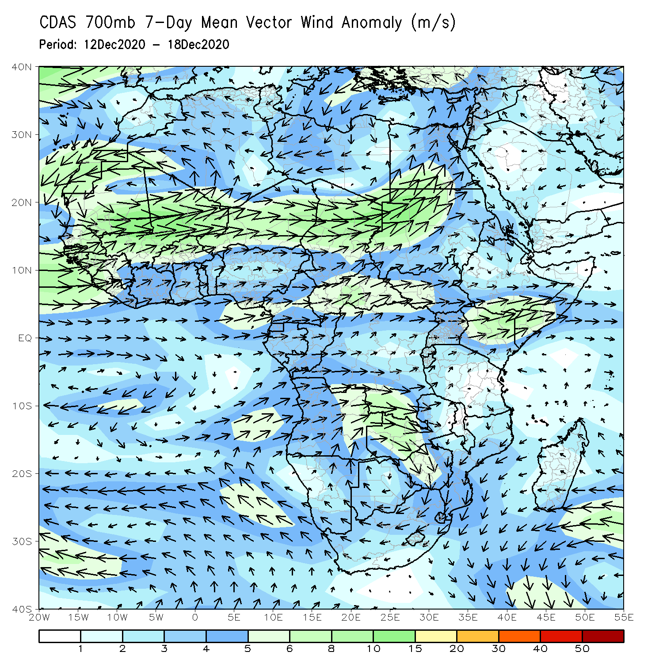
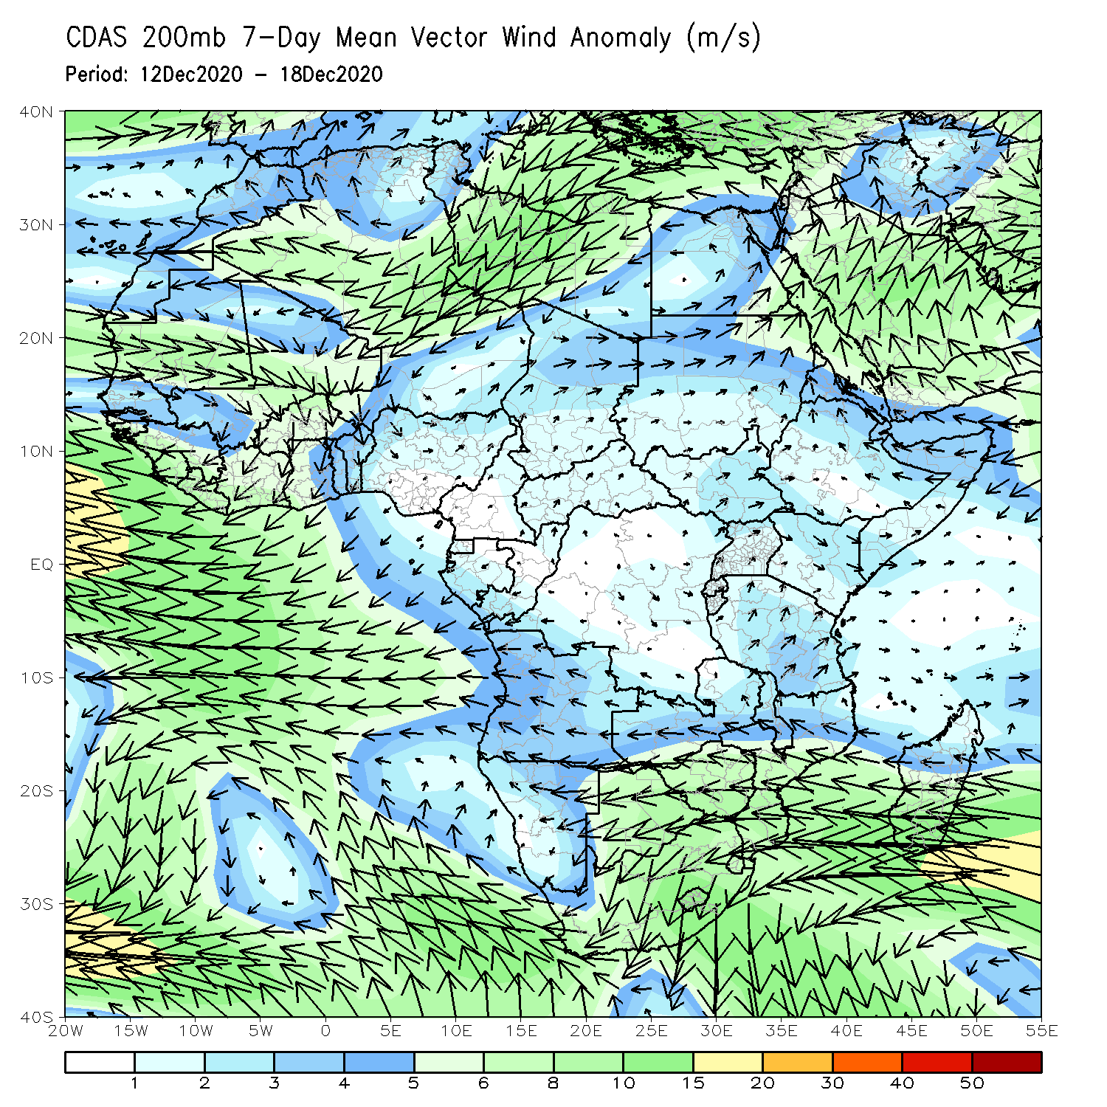
Atmospheric Circulation: Last 7 Days
At low level (left panel), a broad area of lower-level cyclonic circulation is evident across Southern Africa, which may have contributed to the observed above-average rainfall in the region.

Slide 8
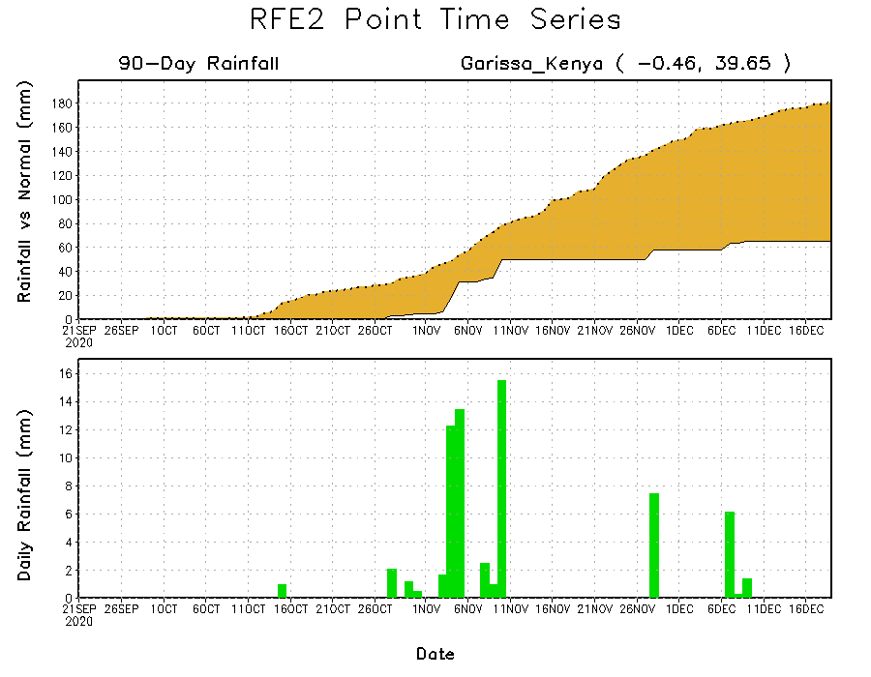
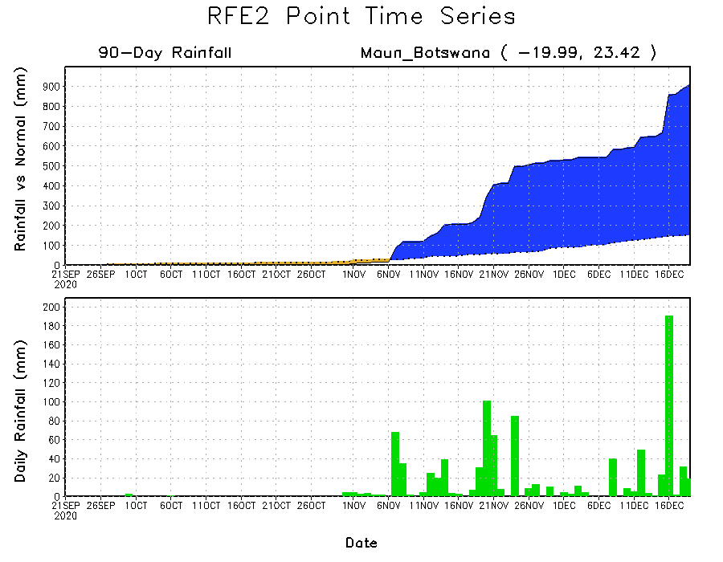
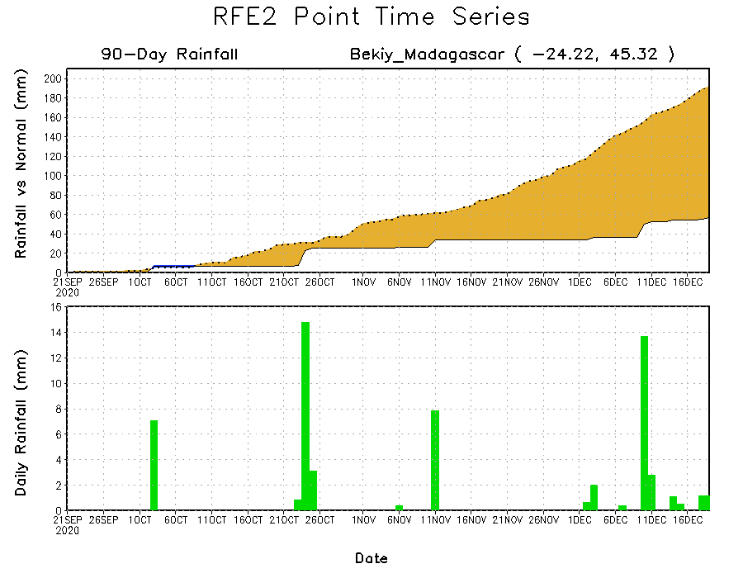
Rainfall Evolution
Daily evolution of rainfall over the last 90 days at selected locations shows that moderate to locally heavy rainfall sustained moisture surpluses over parts of Botswana (bottom left). Dry conditions settled in over eastern Kenya (top right) and southern Madagascar (bottom right).

Slide 9
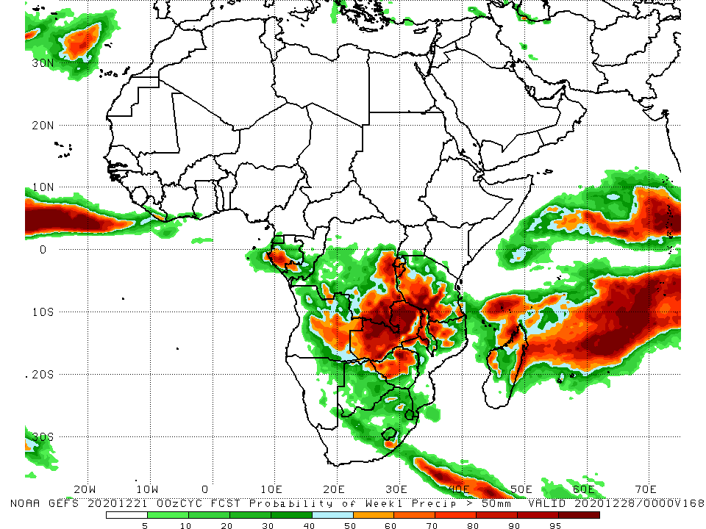
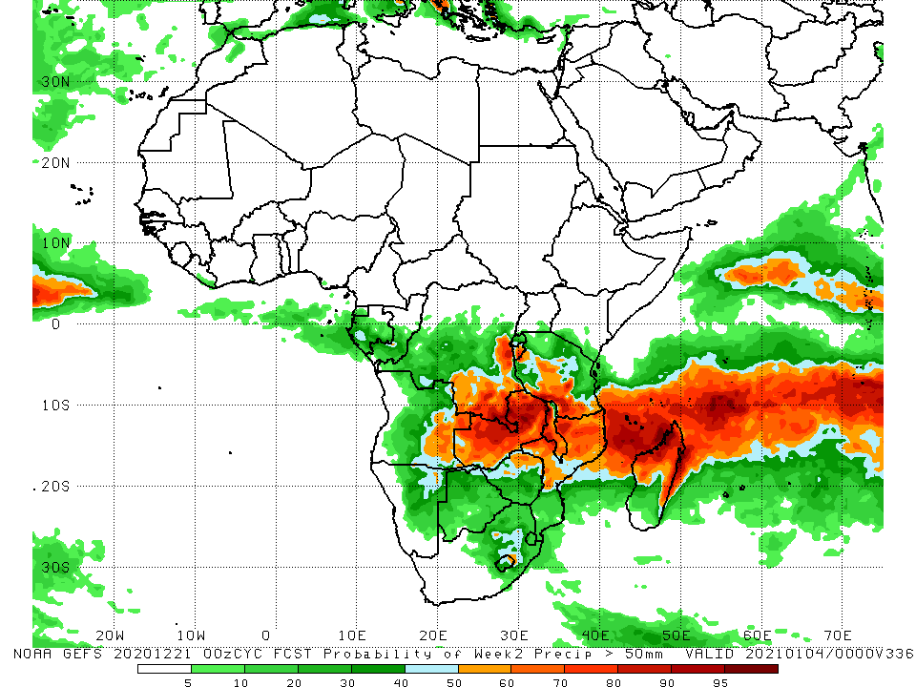
NCEP GEFS Model Forecasts Non-Bias Corrected Probability of precipitation exceedance
Week-1, Valid: 22 – 28 December, 2020
Week-2, Valid: 29 December – January 4, 2020
For week-1 (left panel) and week-2 (right panel), the NCEP GEFS indicates a moderate to high chance (over 70%) for rainfall to exceed 50 mm over southern Gabon, southeastern and eastern DRC, eastern Angola, much of Zambia, northern Zimbabwe, portions of Tanzania and Malawi, and northern Mozambique and northern Madagascar.
Notes:
9

Slide 10
Summary
During the past 30 to 90 days, in East Africa, moisture deficits prevailed over southern Somalia, eastern Kenya, and pockets in southern Ethiopia. Rainfall was above average locally over southwestern Kenya and much of Tanzania. In southern Africa, rainfall was above average over the northern areas of the region, including northern Madagascar. Rainfall was below average over western Angola and northern Namibia. In central Africa, rainfall was above average over central and southern DRC, southern Congo, and eastern Gabon. Rainfall was below average over western Gabon, and the southern areas of Cameroon and CAR. In West Africa, rainfall was slightly above average in pockets along the Guinean coast.
During the past 7 days, in East Africa, dry conditions prevailed over much of the Greater Horn of Africa including Ethiopia, Somalia, and Kenya. In Southern Africa, heavy rains sustained moisture surpluses in eastern Angola, and portions of Zambia, Botswana and Zimbabwe. In contrast, rainfall was slightly below average over the western areas. In Central Africa, light rains sustained moisture deficits in Gabon, while moisture surpluses prevailed over eastern Gabon.
The week-1 and week-2 outlooks indicate a moderate to high chance for rainfall to exceed 50 mm over southern Gabon, southeastern and eastern DRC, eastern Angola, much of Zambia, northern Zimbabwe, portions of Tanzania and Malawi, and northern Mozambique and northern Madagascar.

