Slide 1
The African Monsoon Recent Evolution and Current Status Include Week-1 and Week-2 Outlooks
Update prepared by
Climate Prediction Center / NCEP
7 December 2020
For more information, visit:
http://www.cpc.ncep.noaa.gov/products/Global_Monsoons/African_Monsoons/precip_monitoring.shtml

Slide 2
Outline
Highlights
Recent Evolution and Current Conditions
NCEP GEFS Forecasts
Summary

Slide 3
Highlights: Last 7 Days
During the past 7 days, Heavy rains sustained moisture surpluses in western Zambia, southern Botswana, the central areas of Zimbabwe and Mozambique. Heavy downpours also soaked the west central areas of Tanzania.
For week-1 (left panel), the NCEP GEFS indicates a moderate to high chance (over 70%) for rainfall to exceed 50 mm over southern Gabon, eastern DRC and much of Zambia and northern Madagascar. For week-2 (right panel), the chance for rainfall to exceed 50 mm is confined to Zambia, northern Mozambique, and southern Tanzania.

Slide 4
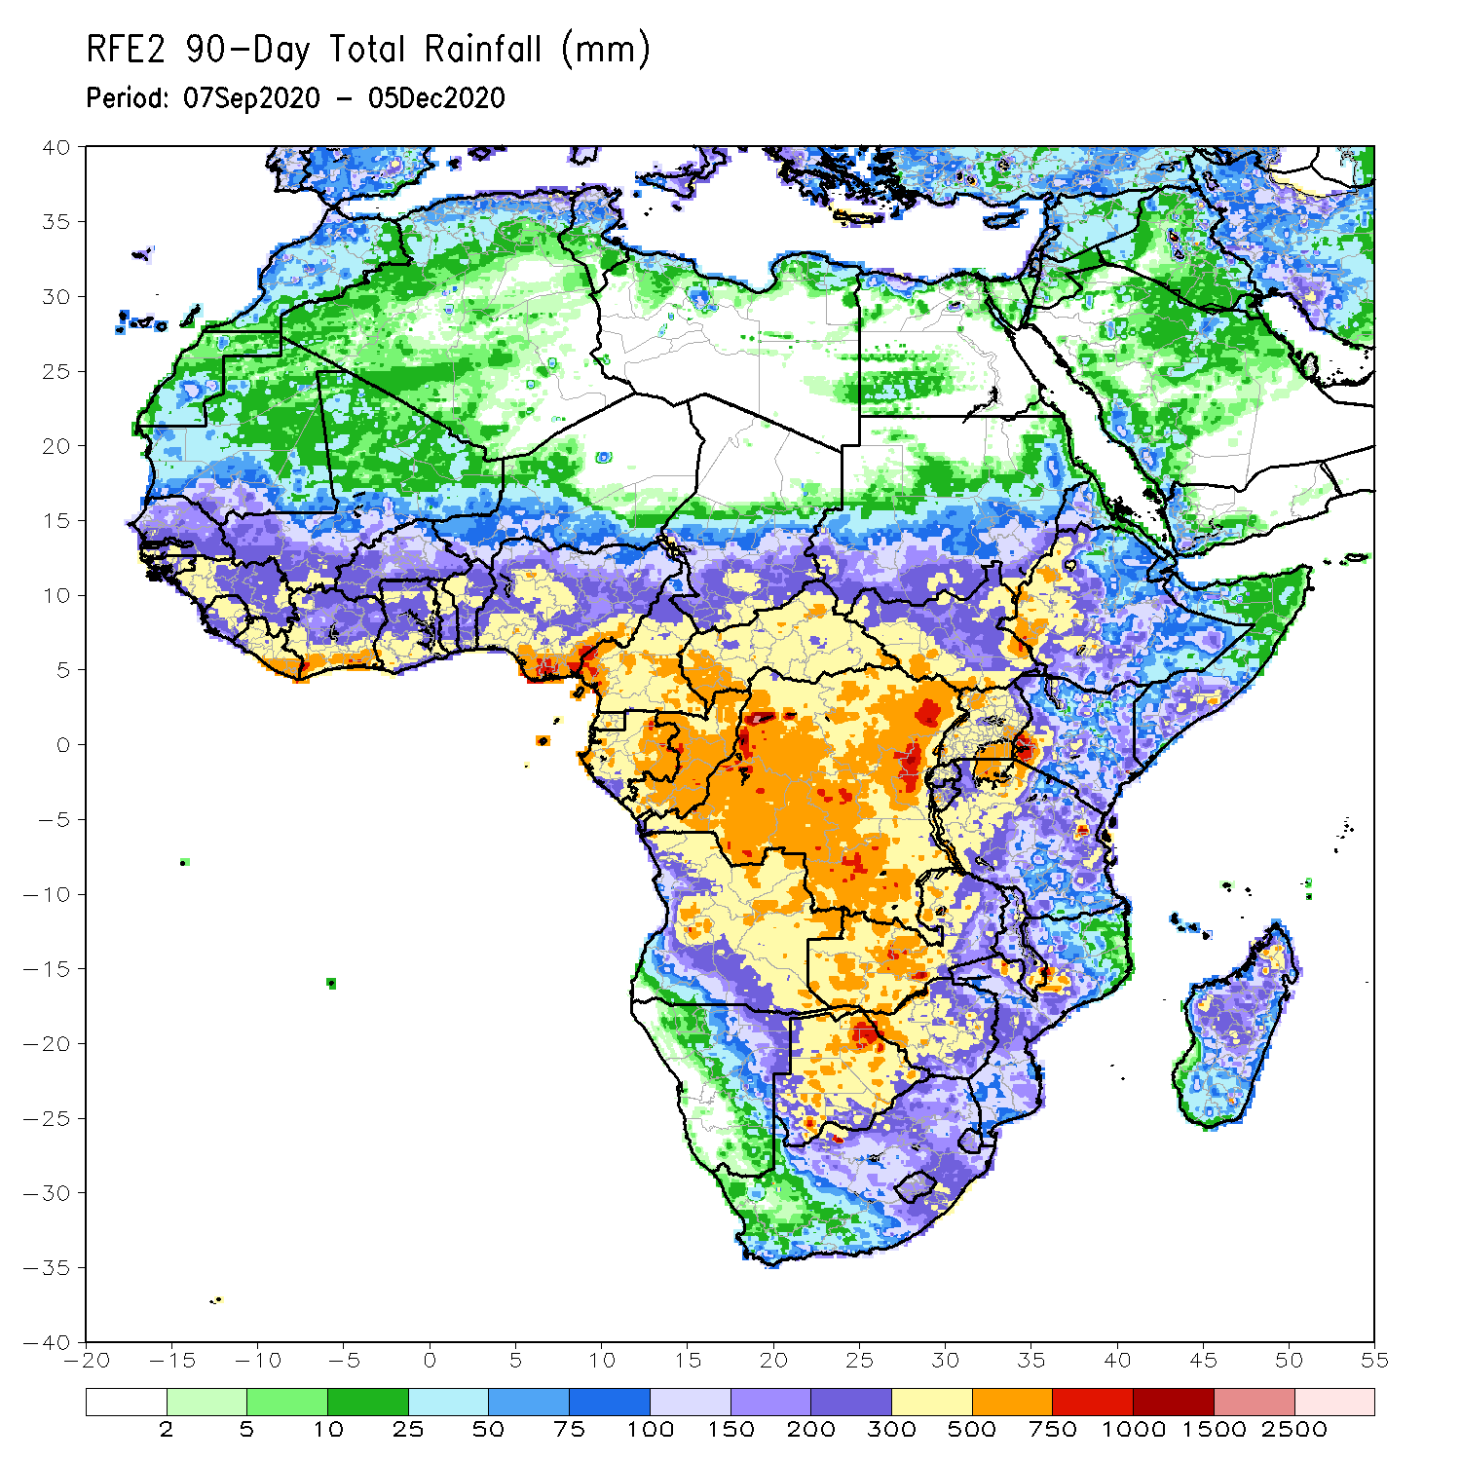
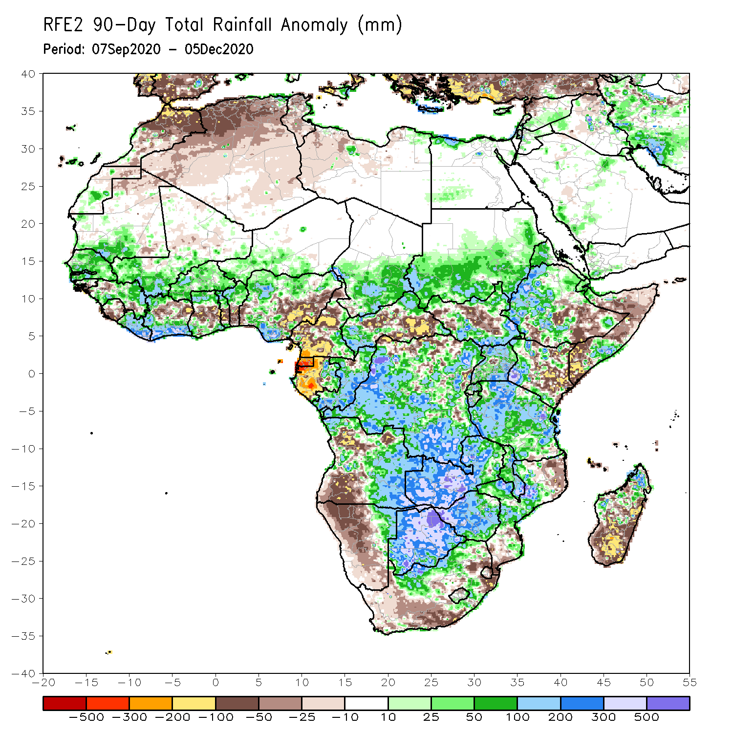
Rainfall Patterns: Last 90 Days
Over the past 90 days, in West Africa, above-average rainfall was observed across much of the Sahel from Senegal eastward to Chad. Rainfall was also above-average over eastern Guinea and along the Gulf of Guinea coast. In contrast, rainfall was below-average over the central areas of the Gulf of Guinea region. The moisture deficits extended to eastern Nigeria, the western areas of Cameroon, Equatorial Guinea and Gabon. Rainfall was also below average over pockets in CAR. Rainfall was much above-average in the remainder of Central Africa from southern Chad to much of DRC. In East Africa, the heaviest amounts 500 to 1500 mm (200 – 500 mm above the mean) occurred over the Ethiopian Highlands. Well above-average rainfall (over 300 mm above the mean) was also observed over portions of South Sudan, southwestern Kenya, Tanzania and Uganda. Rainfall was below-average over southeastern Ethiopia, southeastern Kenya and southern Somalia. In southern Africa, moisture surpluses prevailed over portions of Zambia, Zimbabwe, Botswana, and the northern areas of Madagascar. Rainfall was below-average over northern and southern Angola into Namibia and South Africa. The southern areas of Mozambique and Madagascar also registered below average rainfall.
Notes:
4

Slide 5
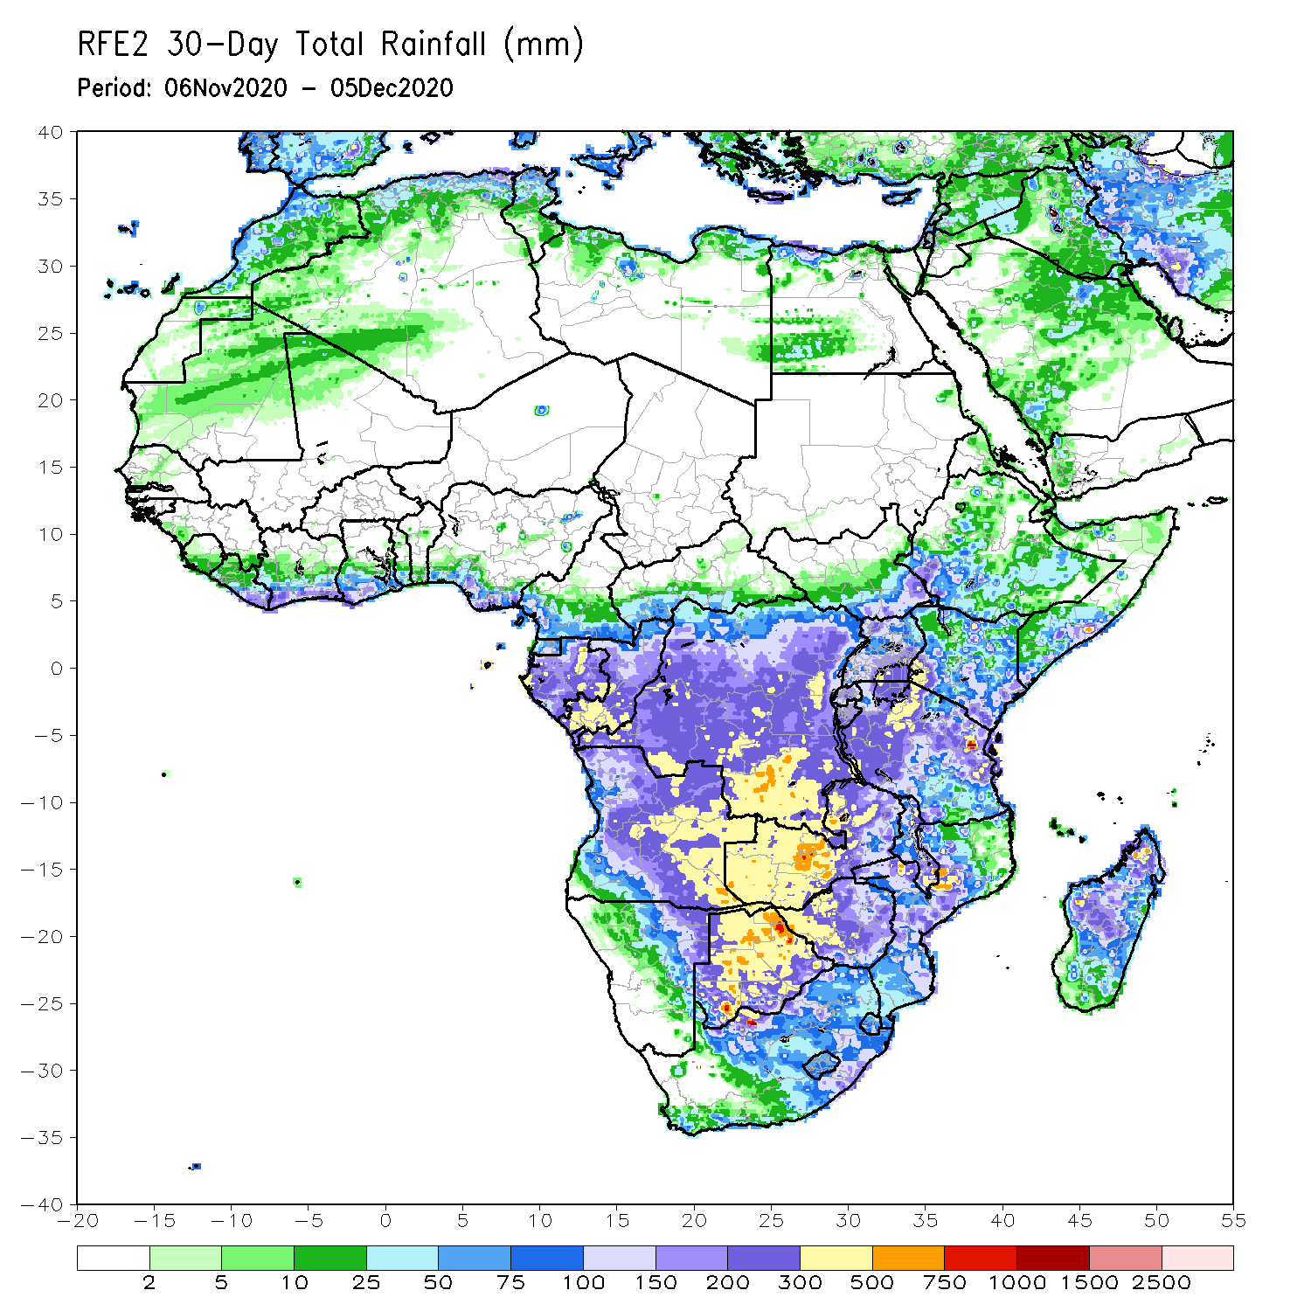
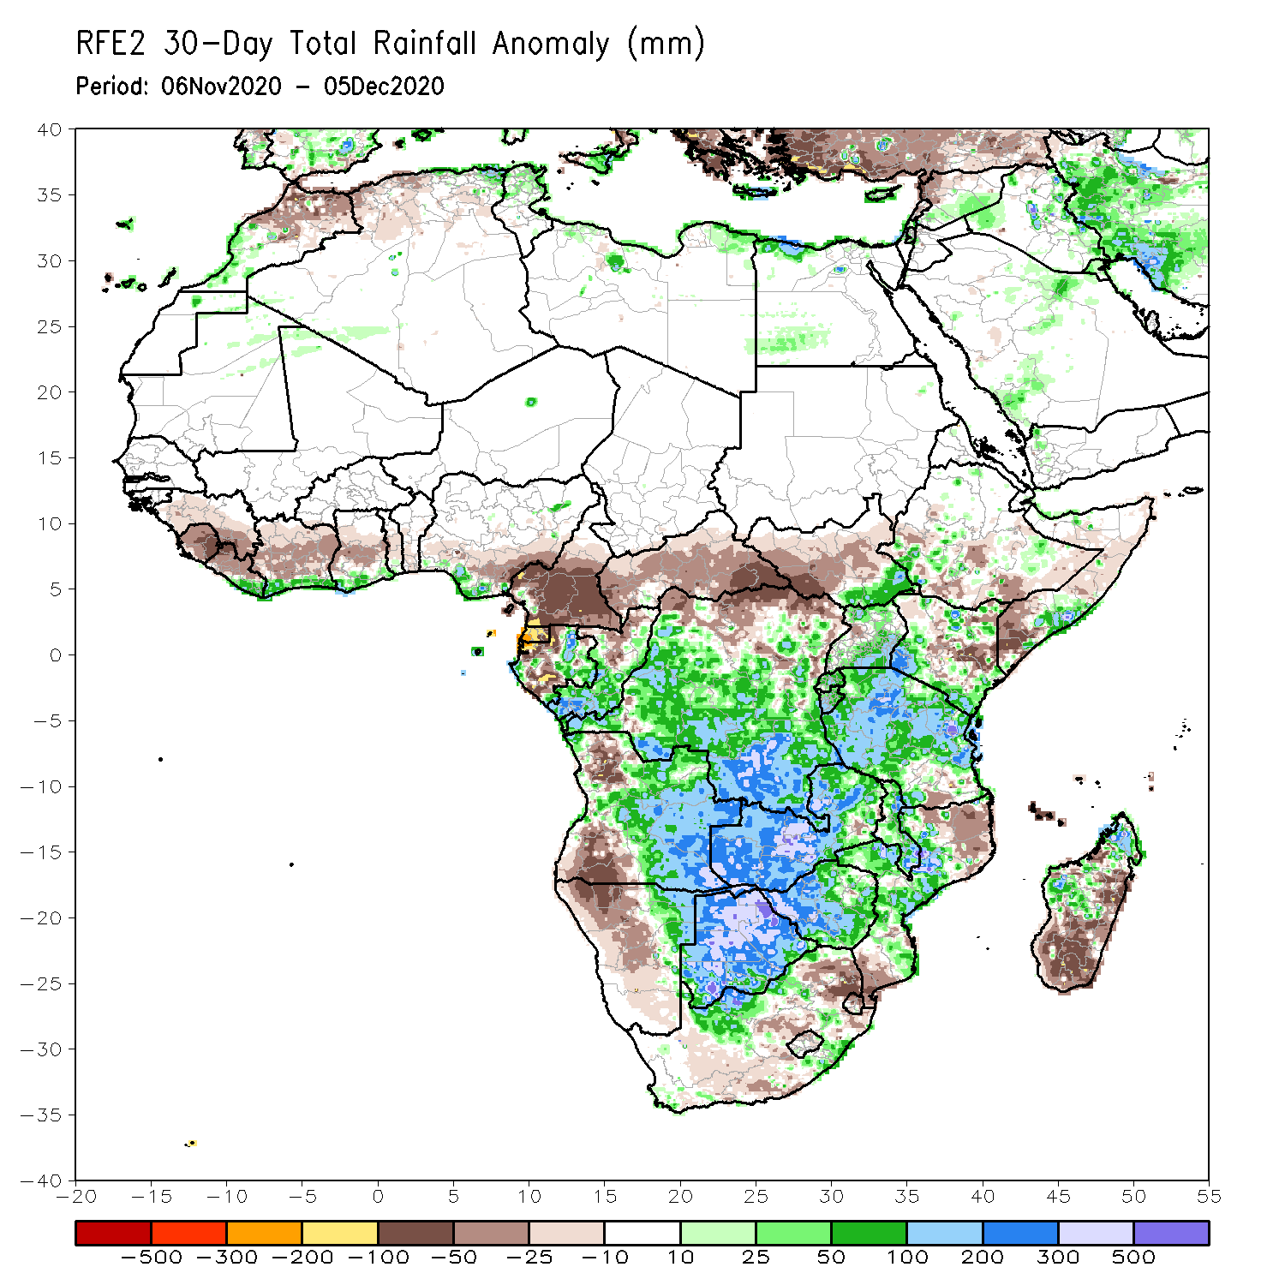
Rainfall Patterns: Last 30 Days
During the past 30 days, rainfall was below-average over much of the northern areas of the Gulf of Guinea region, while the coastal areas received above average rains. In Central Africa, rainfall was below average over much of Cameroon and Equatorial Guinea, and much of CAR. Rainfall was also below-average over northern DRC. Rainfall was above-average over the southern areas of Congo and DRC. In East Africa, rainfall was was heavy in much of Tanzania, while below average rainfall was observed over parts of Ethiopia and Somalia. In Southern Africa, rainfall was above average over portions of Zambia, Botswana and Zimbabwe. Parts of South Africa and southern Mozambique received below average rainfall. Rainfall was also below average over southern Madagascar.
Notes:
5

Slide 6
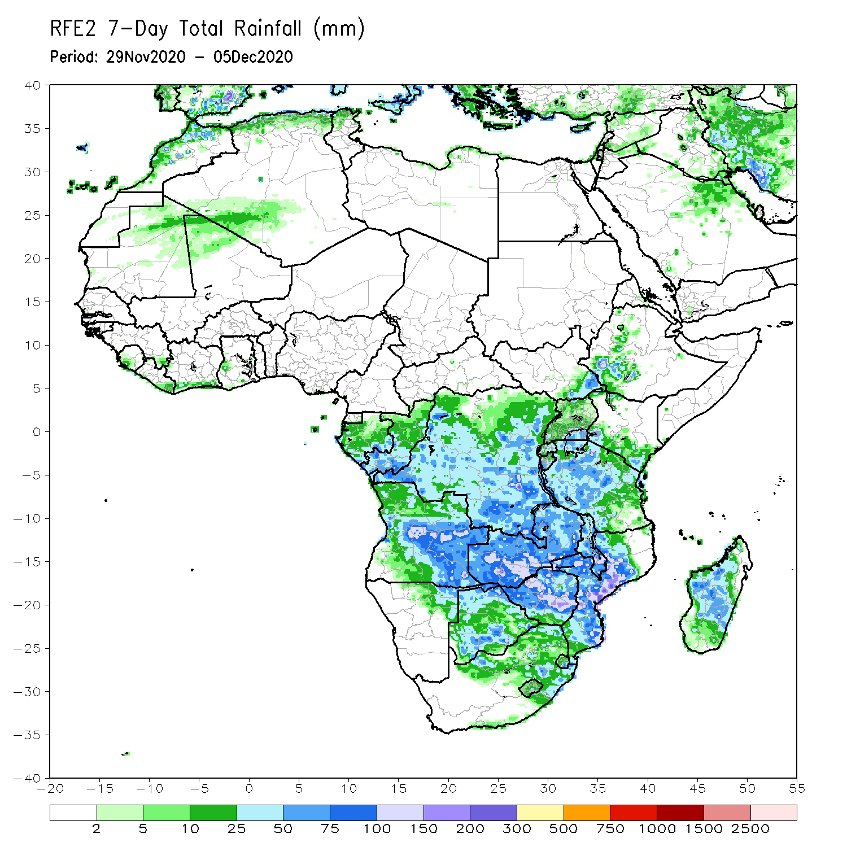
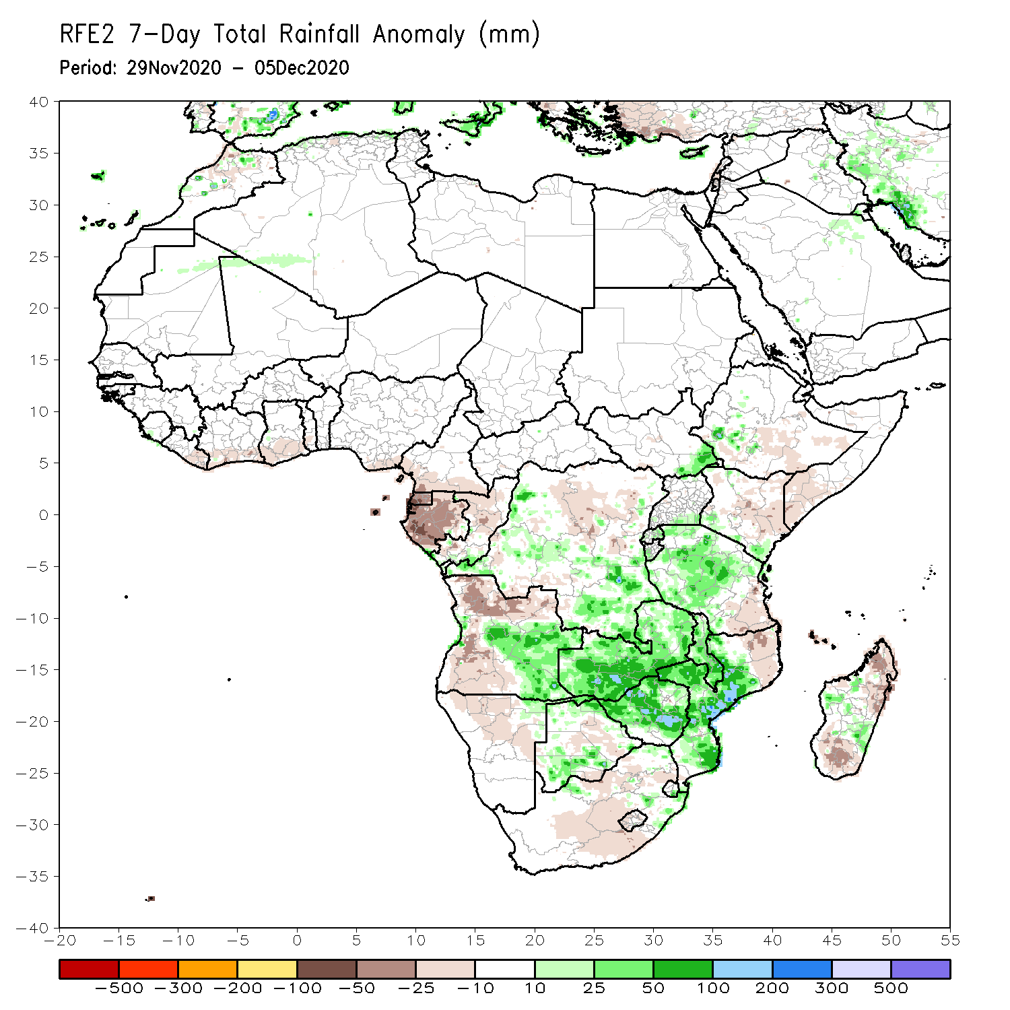
Rainfall Patterns: Last 7 Days
During the past 7 days, in East Africa, dry conditions prevailed over much of the Greater Horn of Africa including the eastern half of Ethiopia, Somalia, and northern Kenya. Light rains (10-50 mm) resulted in slight moisture deficits in southern Kenya and Uganda. Heavy downpours (50-150 mm) soaked the west central areas of Tanzania. In Southern Africa, heavy rains sustained moisture surpluses in western Zambia, southern Botswana, pockets in central Zimbabwe and much of central Mozambique. Rainfall was also above average over portions of northwestern and central Madagascar. In contrast, rainfall was slightly below average over northern and southern Angola, much of Namibia, and South Africa. In Central Africa, light rains sustained moisture deficits in Gabon. Rainfall was locally heavy and above average over pockets in DRC. In West Africa light rains fell along coastal Cote d’Ivoire, while seasonably dry weather prevailed over the Sahel.

Slide 7
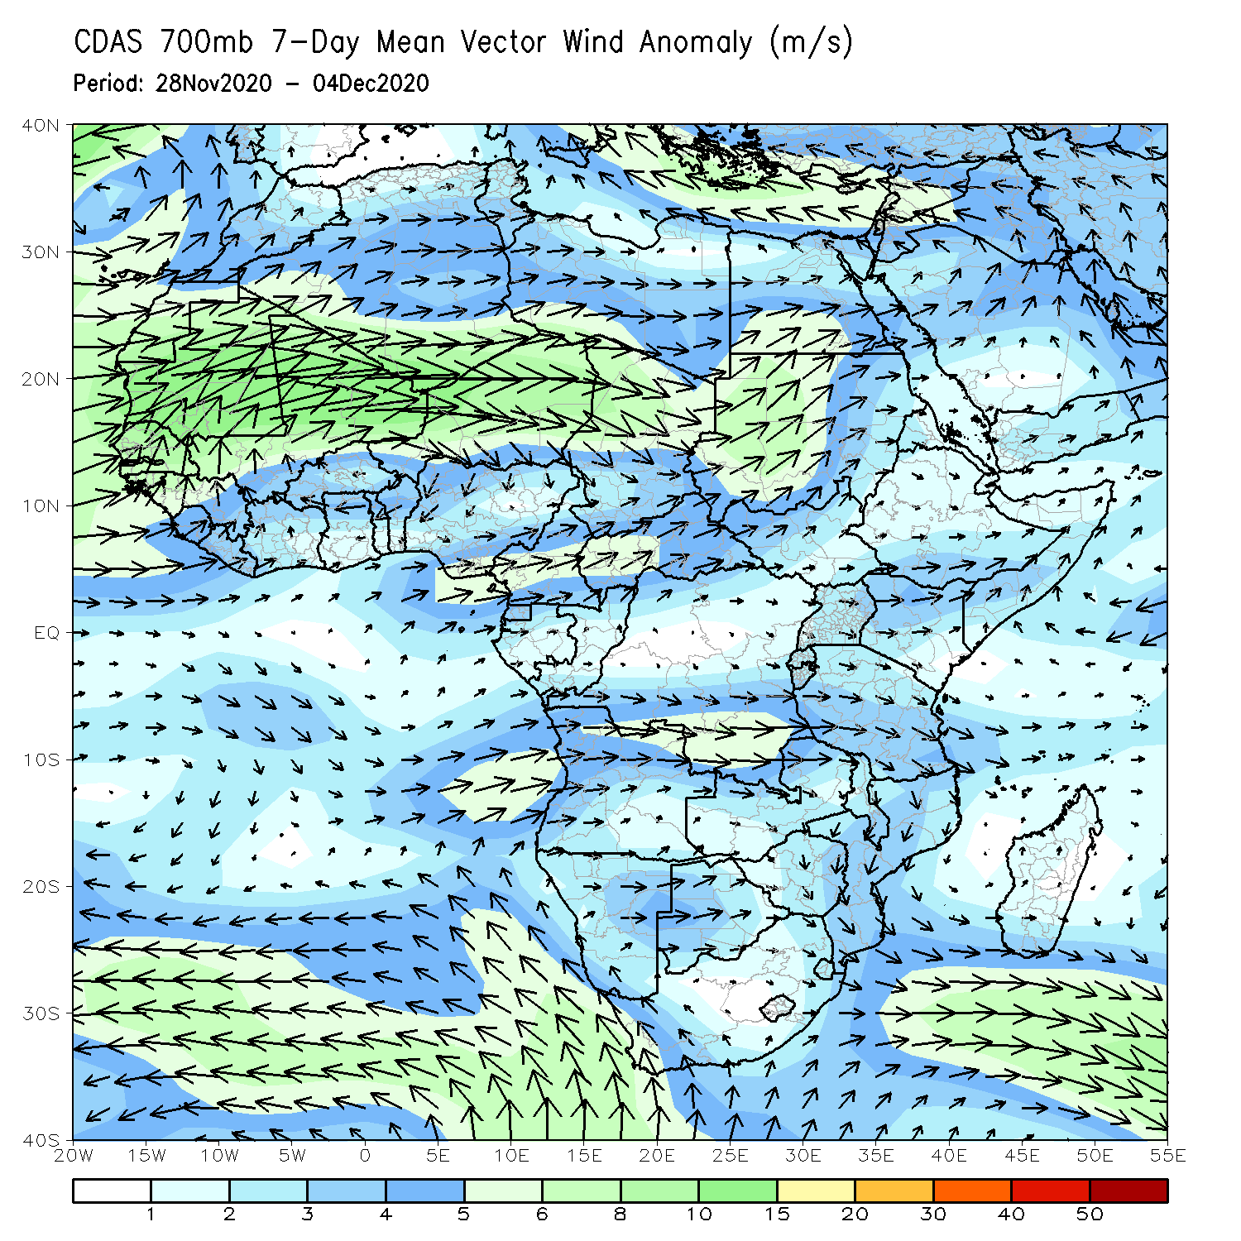
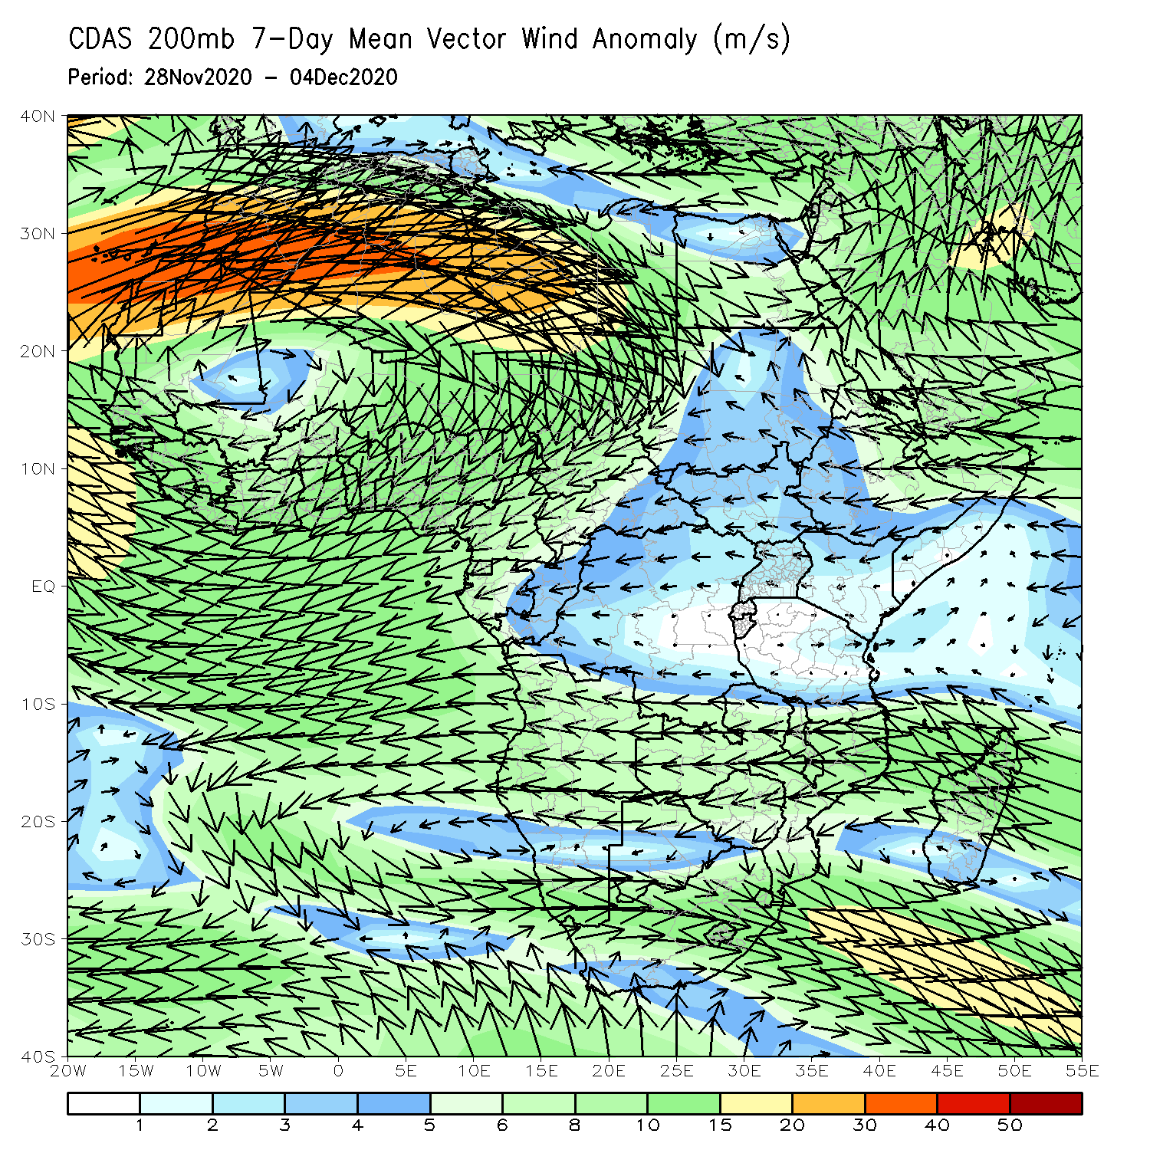
Atmospheric Circulation: Last 7 Days
At low level (right panel), anomalous winds are predominantly from the eastern Atlantic crossing into the northern areas of southern Africa. The Mascarene High Pressure system is reduced, while the St Helena High amplified. The Upper level (right panel) features an amplified Mascarene High Pressure system.

Slide 8
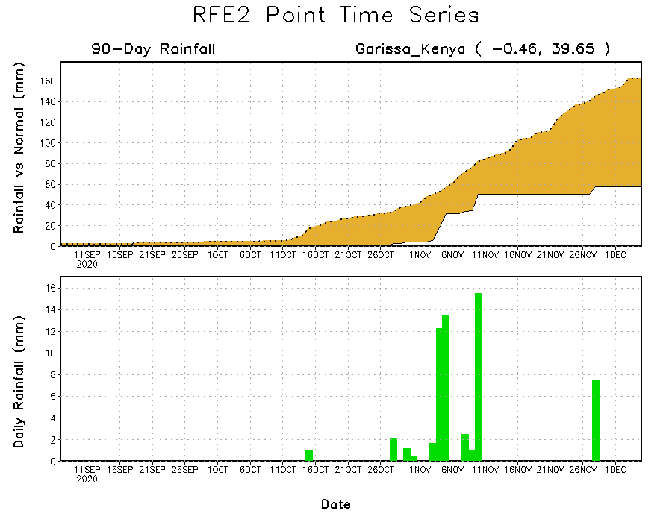
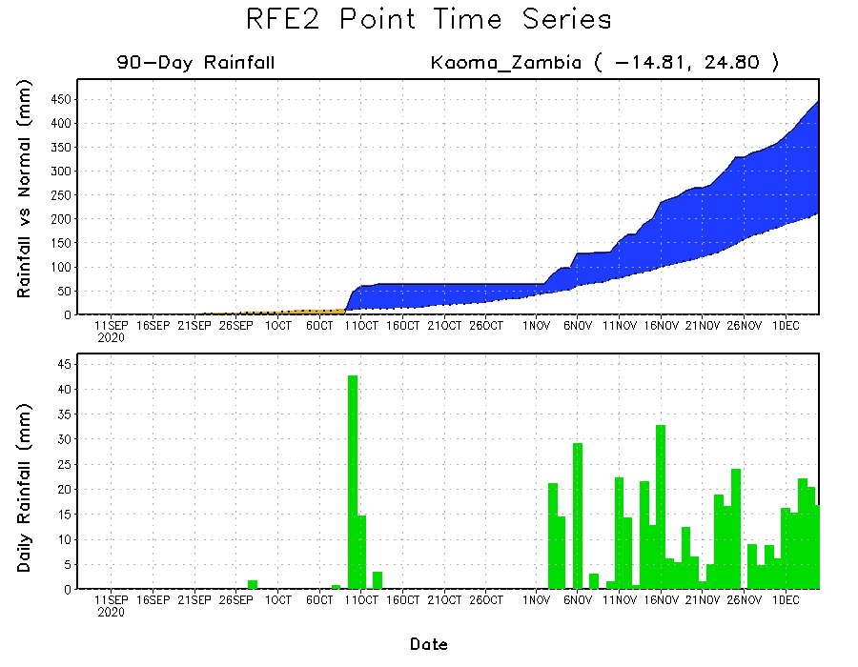
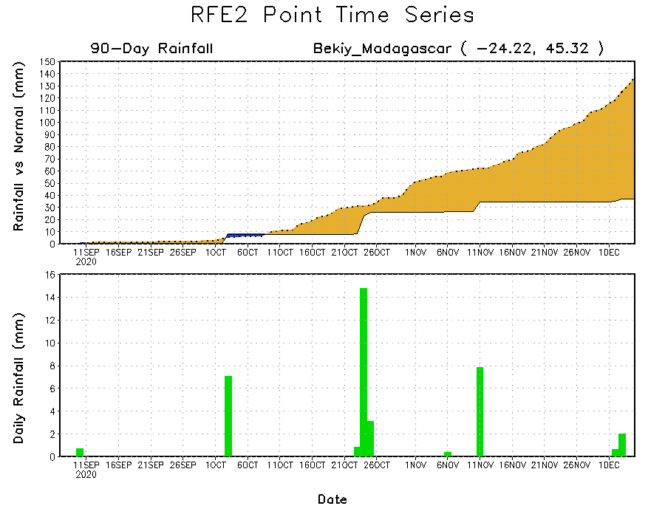
Rainfall Evolution
Daily evolution of rainfall over the last 90 days at selected locations shows that moderate to locally heavy rainfall sustained moisture surpluses over western Zambia (bottom left). Dry conditions settled in over eastern Kenya (top right) and southern Madagascar (bottom right).

Slide 9
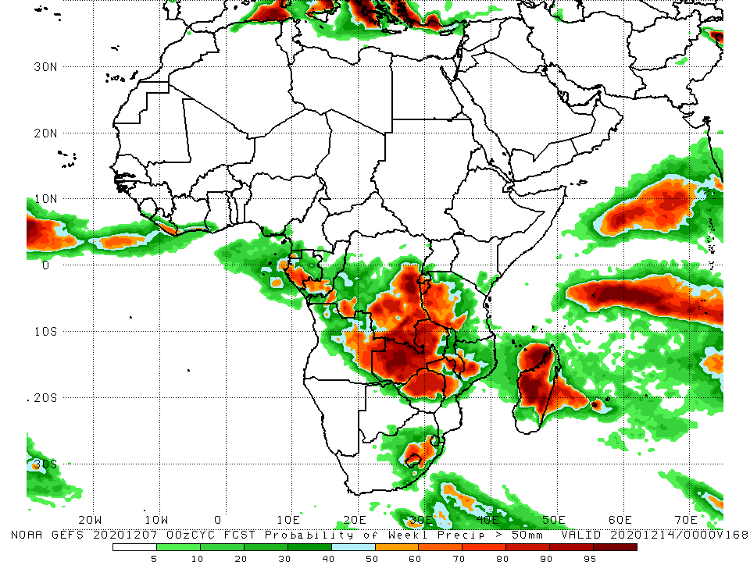
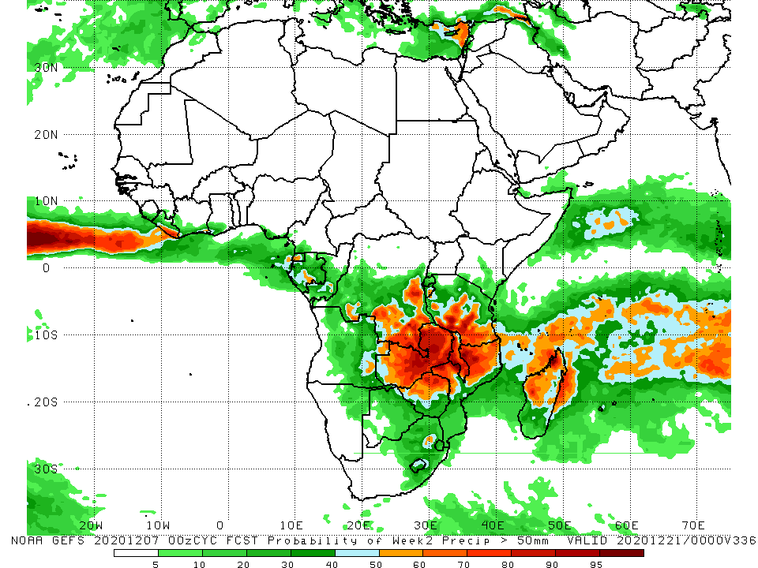
NCEP GEFS Model Forecasts Non-Bias Corrected Probability of precipitation exceedance
Week-1, Valid: 8 – 14 December, 2020
Week-2, Valid: 15 – 21 December, 2020
For week-1 (left panel), the NCEP GEFS indicates a moderate to high chance (over 70%) for rainfall to exceed 50 mm over southern Gabon, eastern DRC and much of Zambia and northern Madagascar. For week-2 (right panel), the chance for rainfall to exceed 50 mm is confined to Zambia, northern Mozambique, and southern Tanzania.
Notes:
9

Slide 10
Summary
Over the past 30 to 90 days, in West Africa, rainfall was above average over the Sahel and below average over parts of the Gulf of Guinea region. In Central Africa, rainfall was below average over many areas, except for the southern areas of Congo and DRC. In East Africa, rainfall was extremely heavy over the Ethiopian Highlands and parts of the Greater Horn of Africa, including portions of Tanzania. Rainfall was below-average over southern Somalia. In southern Africa, moisture surpluses prevailed over the northern areas of southern Africa. Rainfall was below-average over parts of Angola into Namibia and South Africa.
During the past 7 days, in East Africa, dry conditions prevailed over much of the Greater Horn of Africa. Heavy downpours soaked the west central areas of Tanzania. In Southern Africa, heavy rains sustained moisture surpluses in western Zambia and southern Botswana, and central Mozambique. Rainfall was slightly below average over parts of Angola, much of Namibia, and South Africa. In Central Africa, light rains sustained moisture deficits in Gabon.
The week-1 and week-2 outlooks indicate a moderate to high chance for rainfall to exceed 50 mm over southern Gabon, eastern DRC and much of Zambia and northern Madagascar. For week-2, the chance for rainfall to exceed 50 mm is confined to Zambia, northern Mozambique, and southern Tanzania.

