Slide 1
The African Monsoon Recent Evolution and Current Status Include Week-1 and Week-2 Outlooks
Update prepared by
Climate Prediction Center / NCEP
16 November 2020
For more information, visit:
http://www.cpc.ncep.noaa.gov/products/Global_Monsoons/African_Monsoons/precip_monitoring.shtml

Slide 2
Outline
Highlights
Recent Evolution and Current Conditions
NCEP GEFS Forecasts
Summary

Slide 3
Highlights: Last 7 Days
Heavy rains brought relief to the abnormal dryness that prevailed over eastern Kenya and southern Somalia during the past several weeks. Coastal and western Tanzania received extremely heavy rains. Heavy downpours sustained flooding in northern Zimbabwe and Botswana.
The week-1 outlooks indicate a moderate to high chance for rainfall to exceed 50 mm over Central Africa extending into Tanzania and southeastern Kenya. For week-2, the high chance for rainfall to exceed 50 mm is confined to Gabon, and the southern areas of Congo and DRC.

Slide 4
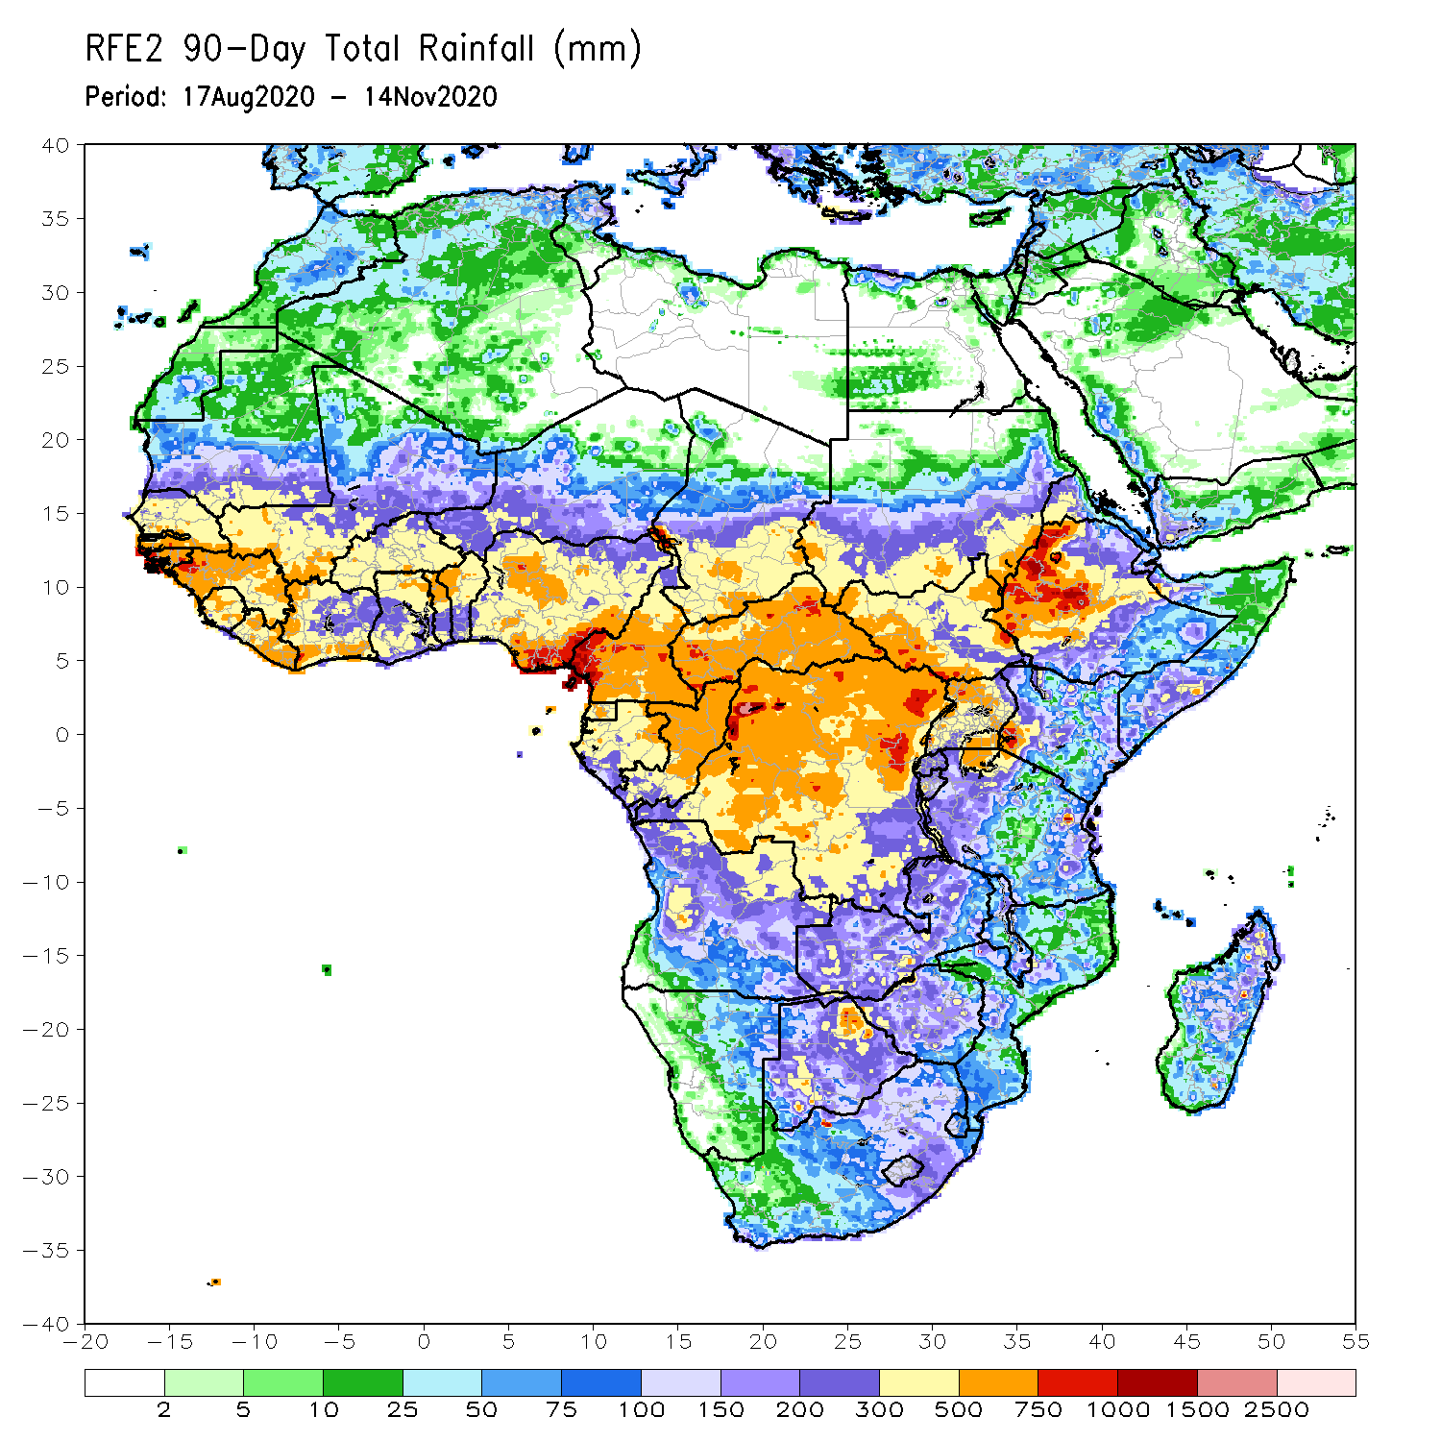
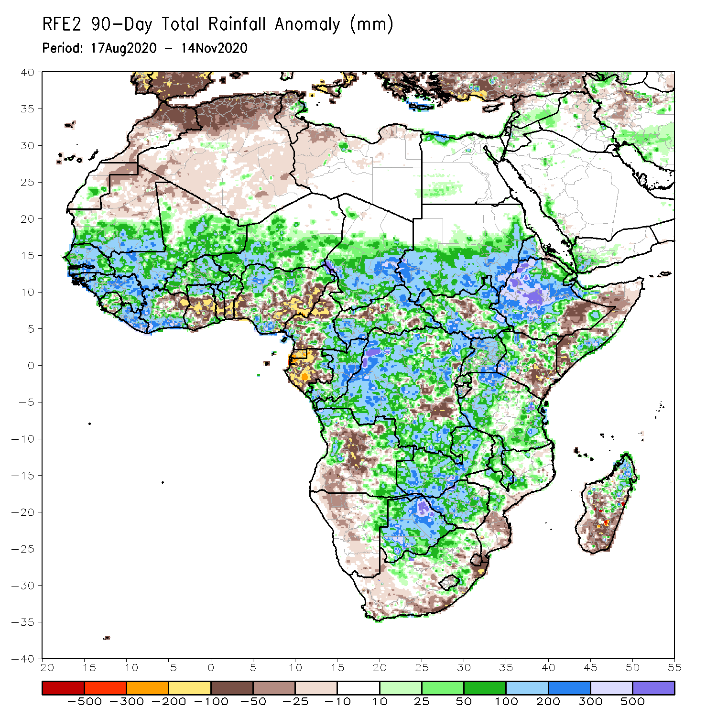
Rainfall Patterns: Last 90 Days
Over the past 90 days, in West Africa, above-average rainfall was observed across much of the Sahel from Senegal eastward to Chad. Rainfall was also above-average from Guinea to much of Cote D’Ivoire. In contrast, rainfall was below-average over the southern areas of the Gulf of Guinea region from northeastern Cote d’Ivoire eastward to Nigeria. The moisture deficits extended to the western areas of Cameroon and Gabon. Rainfall was also below average over pockets in CAR southeastern DRC. Rainfall was much above-average in the remainder of Central Africa from southern Chad to much of DRC. In East Africa, the heaviest amounts 500 to 1500 mm (200 – 500 mm above the mean) occurred over the Ethiopian Highlands and locally over southern Sudan. Well above-average rainfall (over 300 mm above the mean) was also observed over south Sudan and Uganda. Rainfall was below-average over southeastern Kenya and southern Somalia. In southern Africa, moisture surpluses prevailed over Zambia, Zimbabwe, Botswana, and the northern areas of Madagascar. Rainfall was below-average over central and southern Angola into Namibia and South Africa. The southern areas of Mozambique and Madagascar also registered below average rainfall.
Notes:
4

Slide 5
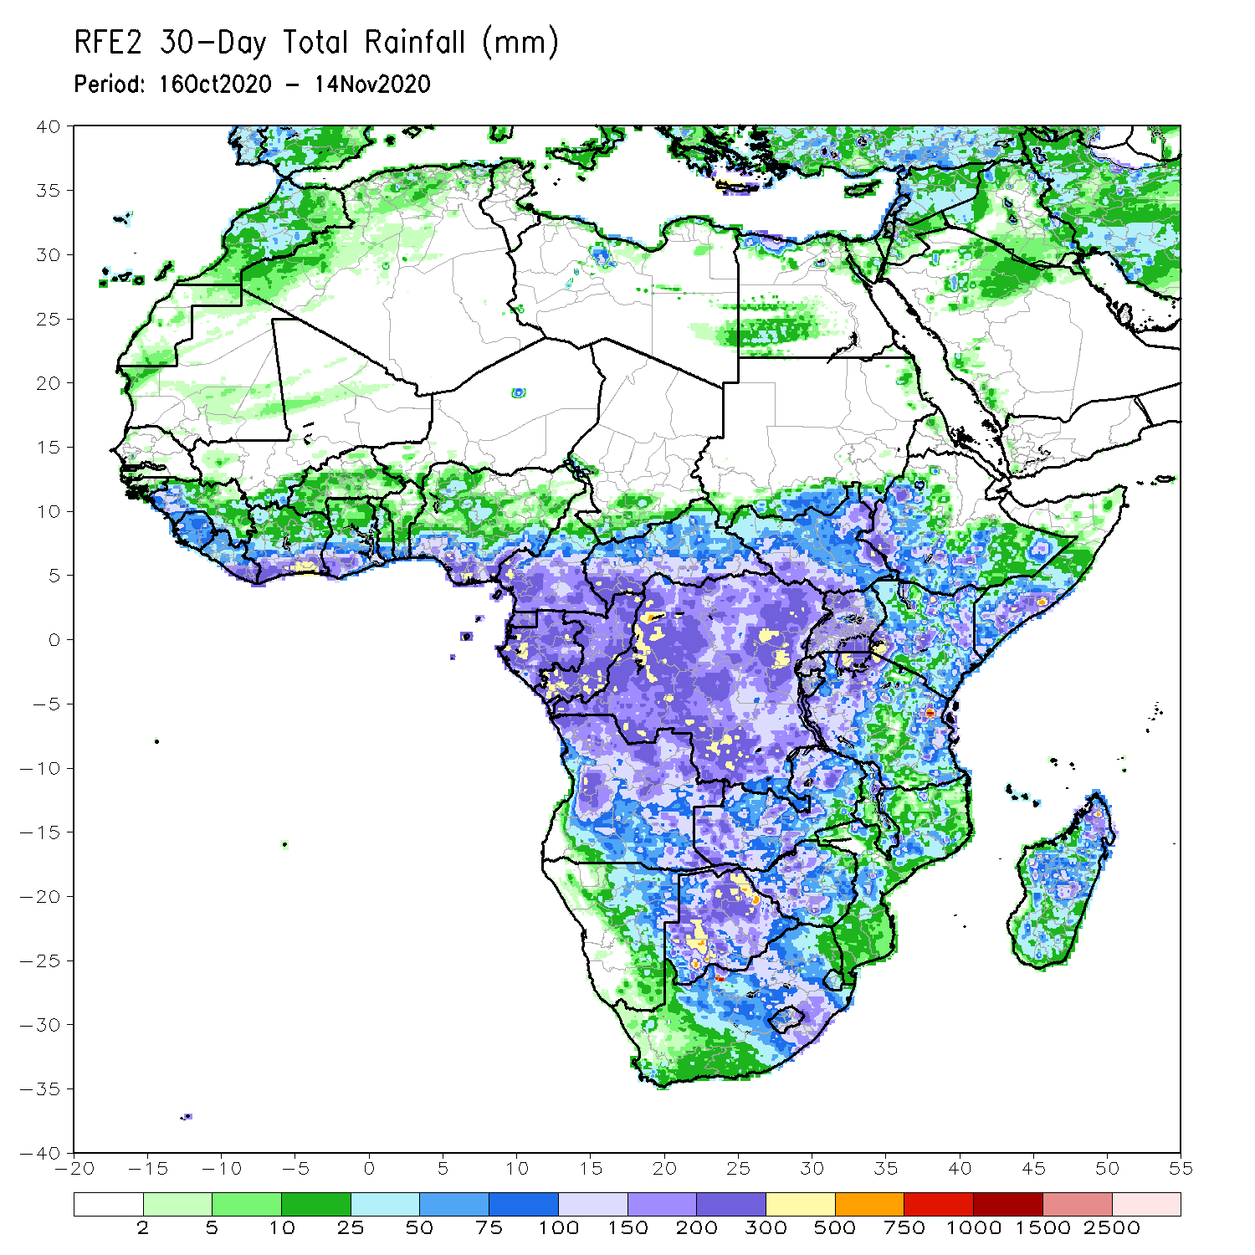
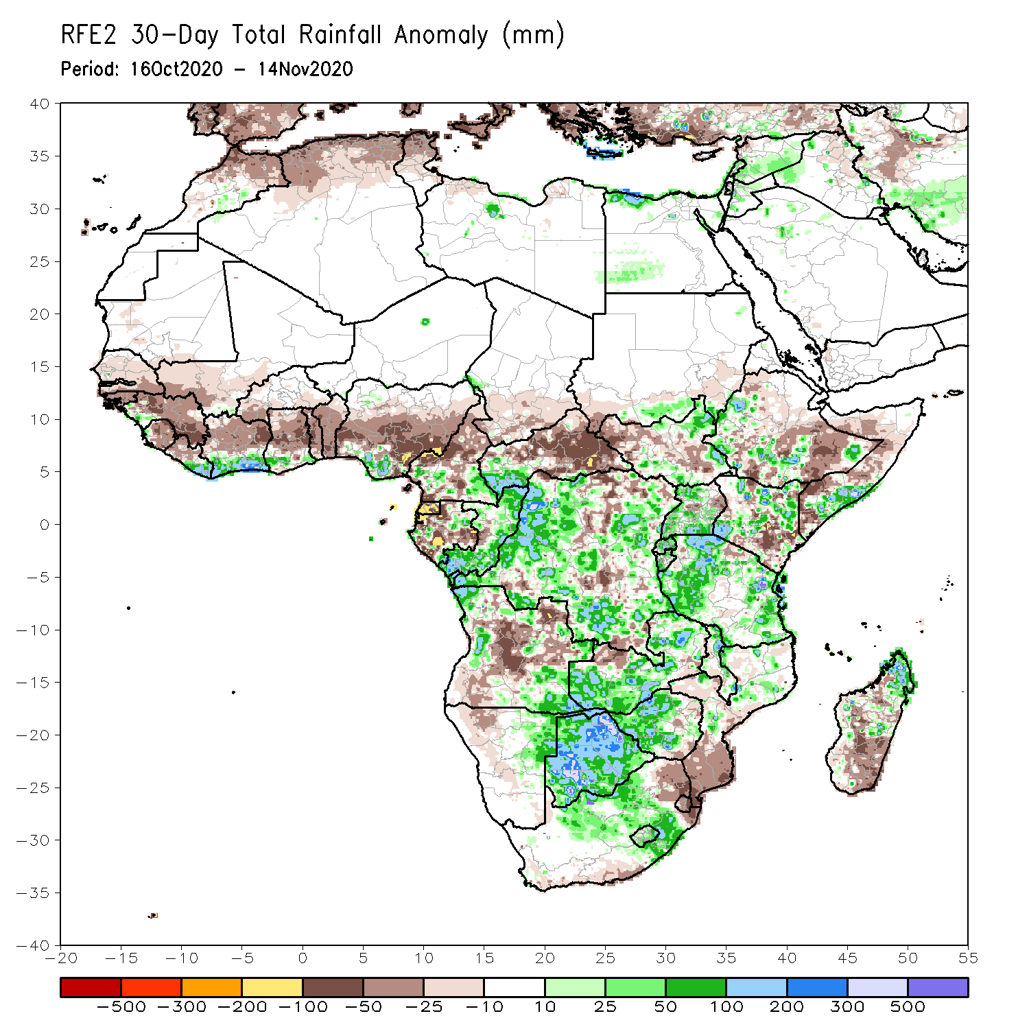
Rainfall Patterns: Last 30 Days
During the past 30 days, rainfall totals diminished over West Africa as the West African Monsoon retreated over the past several weeks. Rainfall was below-average over much of the northern areas of the Gulf of Guinea region, while the coastal areas received above average rains. In Central Africa, rainfall was below average over northern Cameroon, Gabon, and much of CAR. Rainfall was also below average over pockets in DRC. Rainfall was above average over eastern Congo, much of DRC. In East Africa, moisture surpluses prevailed over local areas in Ethiopia, much of Uganda, and northern Kenya. Rainfall was also above average over western and eastern Tanzania. Below average rainfall was observed over eastern Ethiopia, northern and southern Somalia. In Southern Africa, rainfall was much above average over Zambia, Botswana and western Zimbabwe. Moisture surpluses were also registered over the central areas of South Africa, including portions of the Maize Triangle, and the northern areas of Madagascar. Rainfall was below average over the southern areas of Mozambique and Madagascar.
Notes:
5

Slide 6
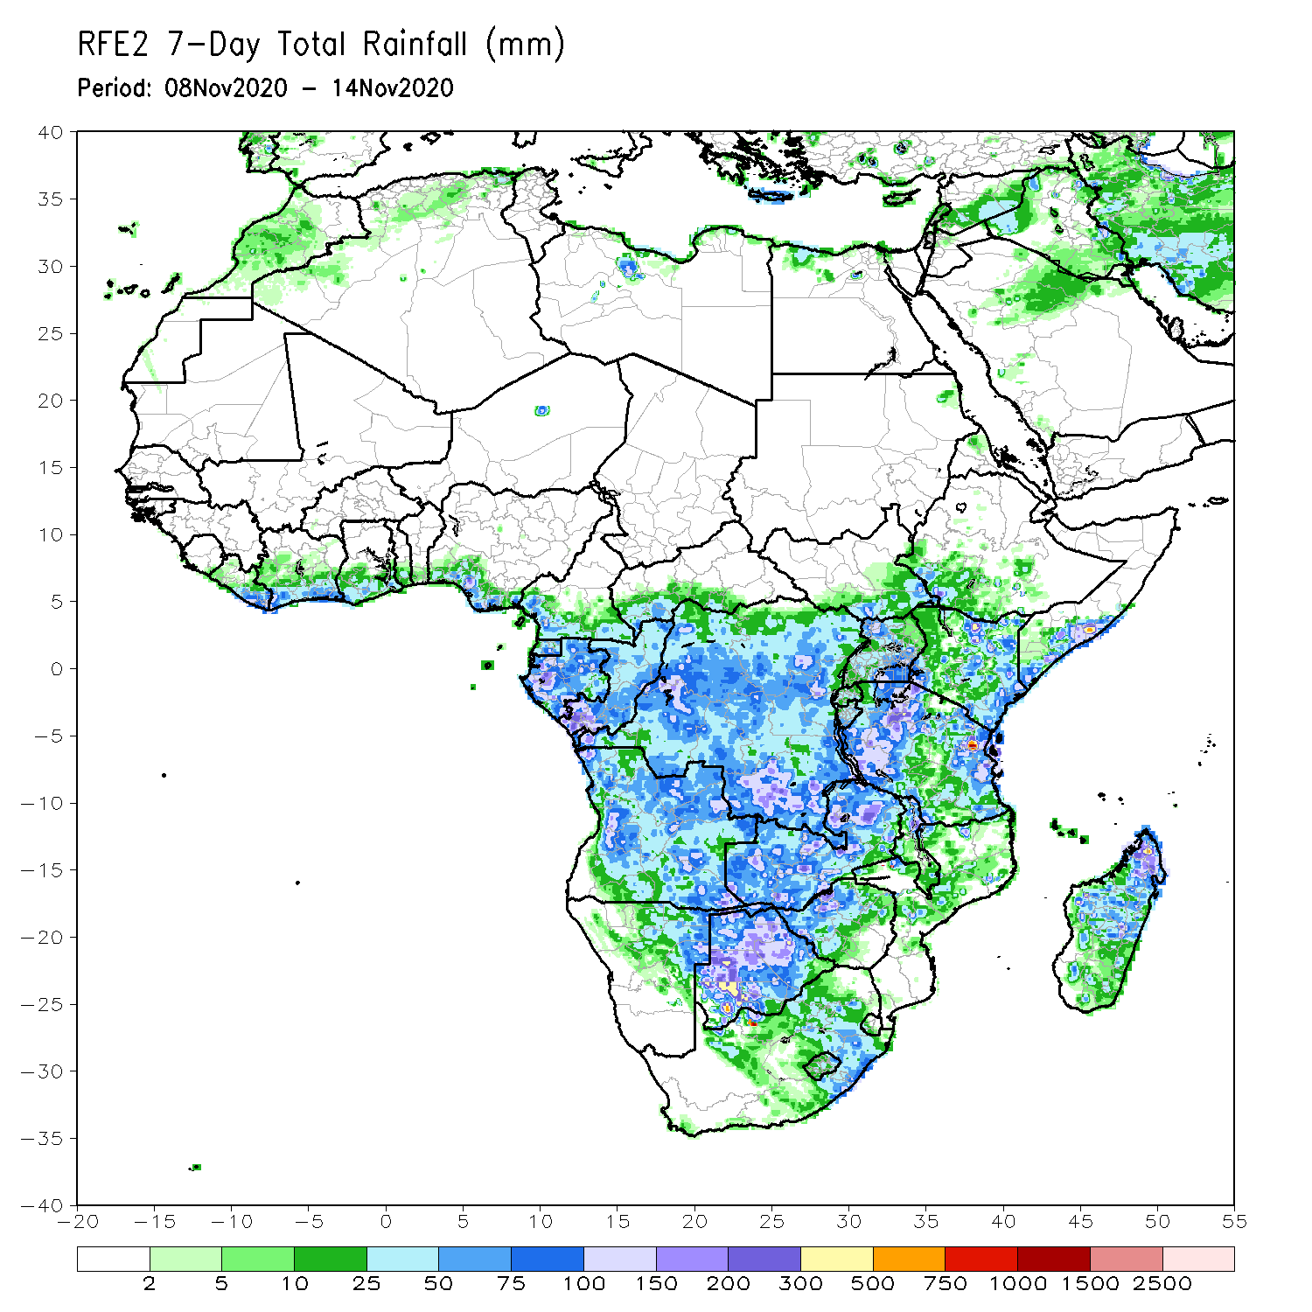
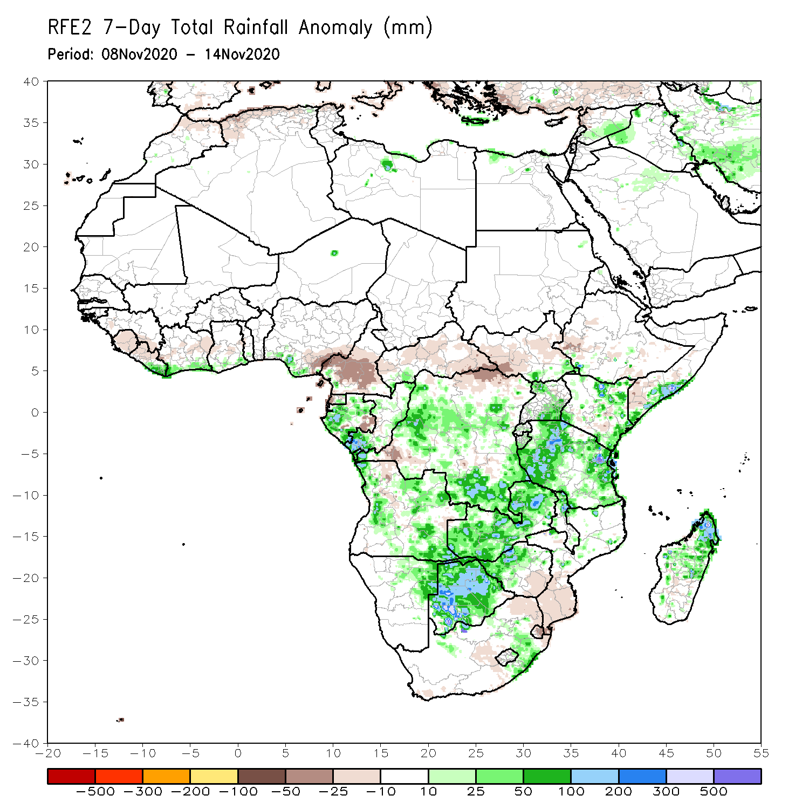
Rainfall Patterns: Last 7 Days
During the past 7 days, in East Africa, moderate to heavy rains (50-100 mm; 25-50 mm above the mean) fell eastern Kenya and along coastal southern Somalia, and brought relief to the abnormal dryness that prevailed over the past several weeks. Widespread rains fell over Tanzania with the heaviest amounts (100-200 mm; 50-100 mm above the mean) registered along coastal Tanzania and the western areas, while the central areas received average rains (25-75 mm). Near-average rains (50-100 mm) also fell over the southern areas of Ethiopia, South Sudan and much of Uganda. In Southern Africa, heavy rains (75-200 mm; 50-100 mm above the mean fell over Zambia and sustained flooding in northern Zimbabwe and Botswana. Sizable rainfall amounts fell over local areas in Angola, while near average rains (25-50 mm) fell over much of northwestern Namibia, South Africa, eastern Zimbabwe and Mozambique. Northern Madagascar saw an uptick in rains with amounts ranging between 50 and 100 mm; 25-50 mm above the mean), while to south received beneficial rains. In Central Africa, rainfall was above average over portions of northern and southern DRC, southern Congo, and much of Gabon. Light rains sustained moisture deficits in southern Cameroon. Moderate rains fell along coastal Gulf of Guinea, while seasonable dry weather prevailed across the Sahel.

Slide 7
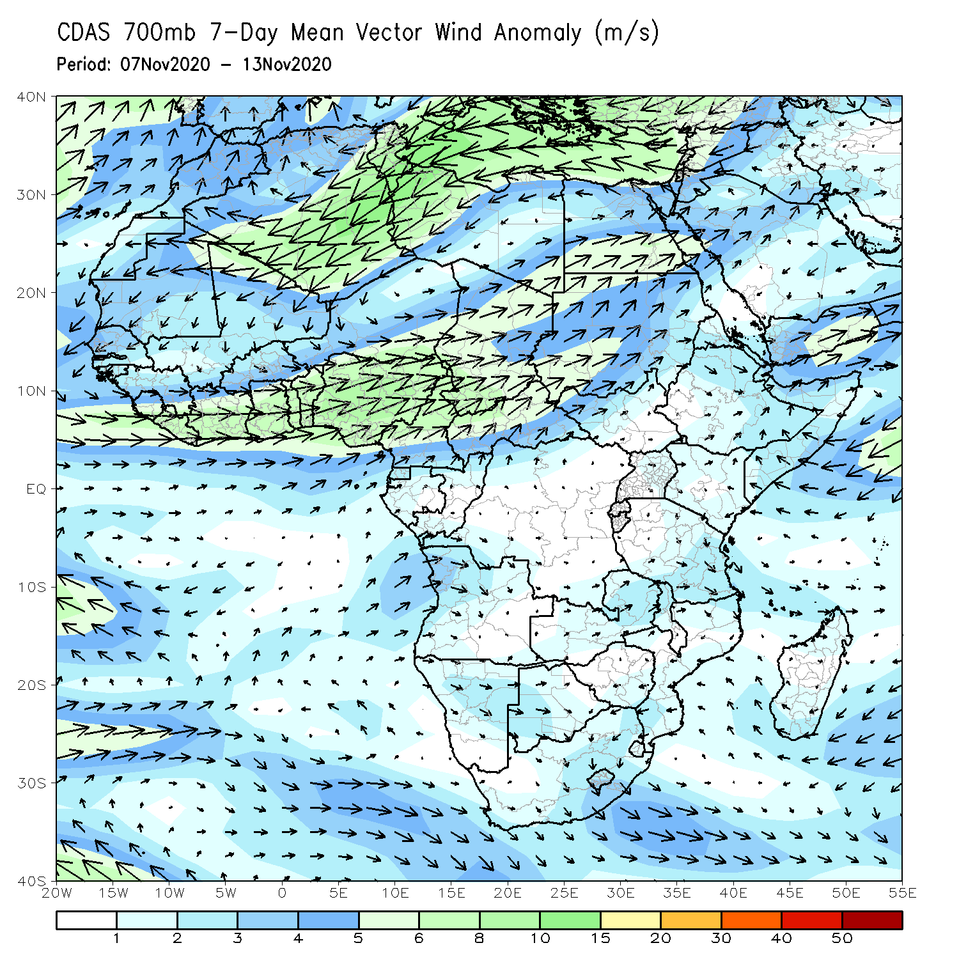
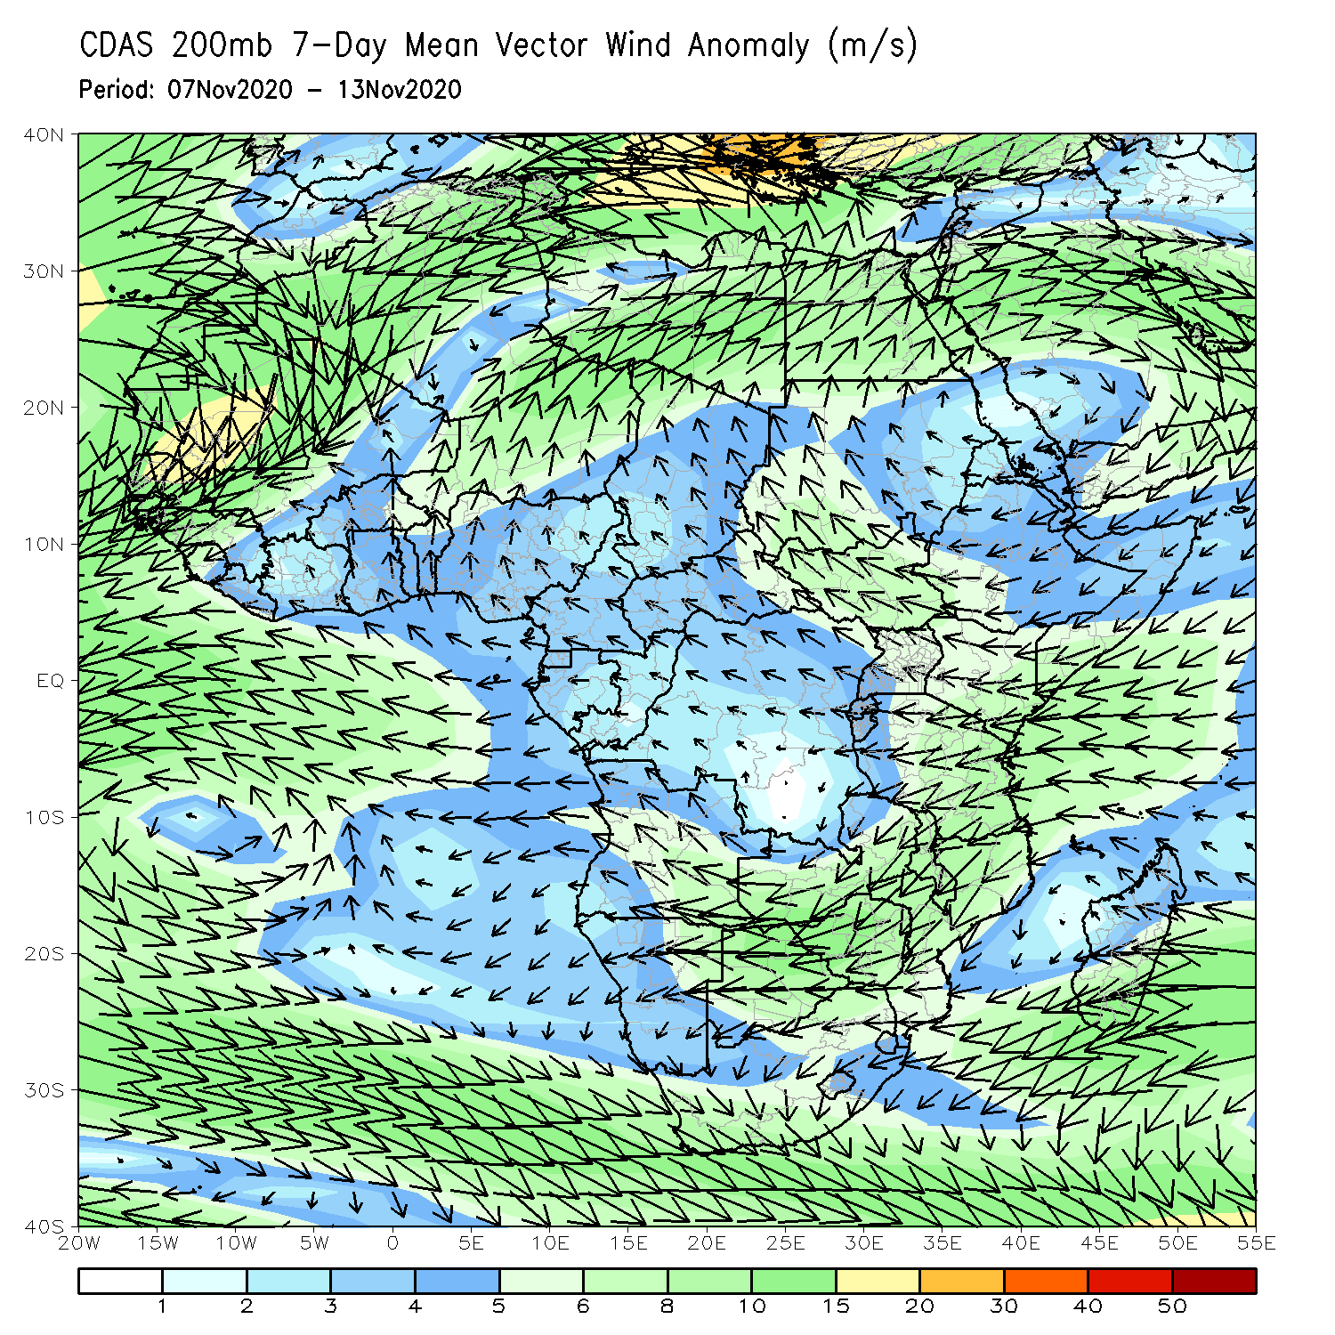
Atmospheric Circulation: Last 7 Days
An anomalous lower-level westerly flow (left panel) was observed along the Gulf of Guinea coast into Central Africa. At upper level (right panel), the anomalous easterly flow from the Indian Ocean became divergent crossing into equatorial East Africa.

Slide 8
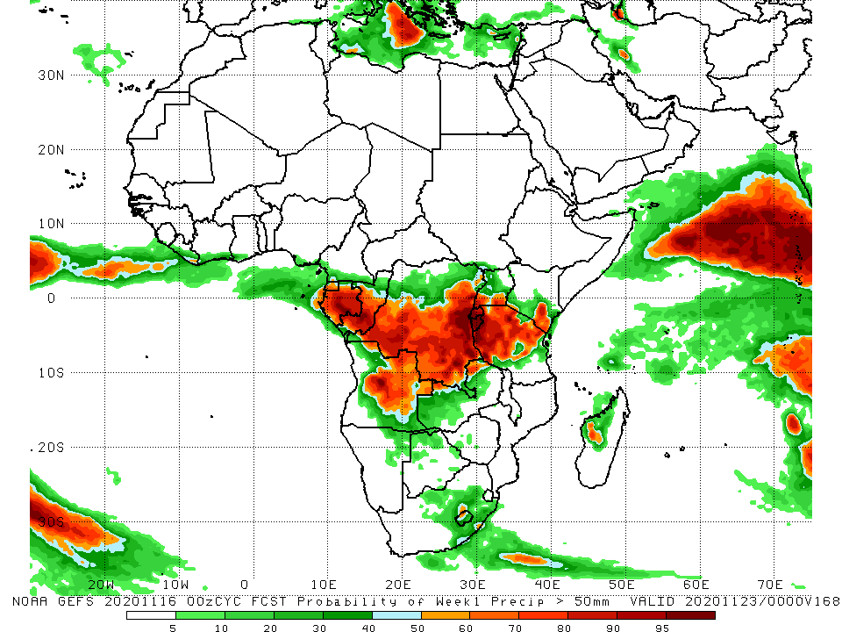
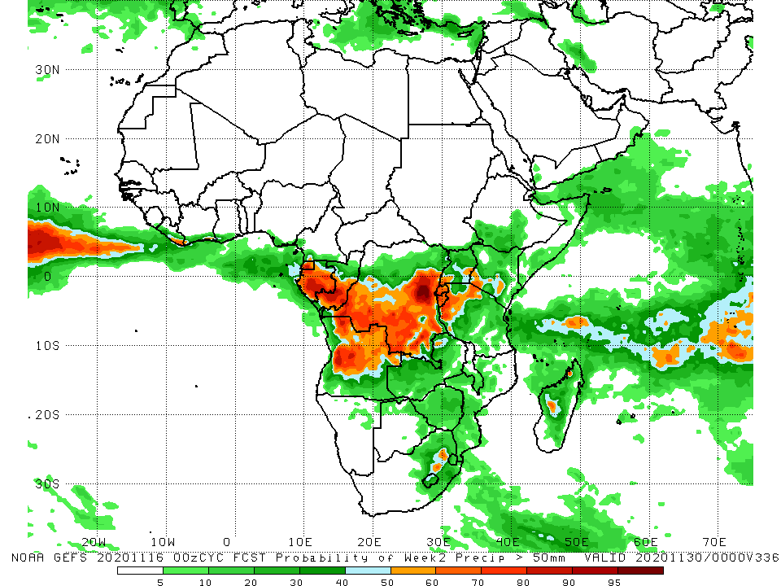
NCEP GEFS Model Forecasts Non-Bias Corrected Probability of precipitation exceedance
Week-1 Valid 17 – 23 November, 2020
Week-2: Valid 24 – 30 November, 2020
For week-1 (left panel), the NCEP GEFS indicates a moderate to high chance (over 70%) for rainfall to exceed 50 mm over Central Africa extending into Tanzania and southeastern Kenya. For week-2 (right panel), the high chance for rainfall to exceed 50 mm is confined to Gabon, and the southern areas of Congo and DRC.
Notes:
8

Slide 9
Summary
During the past 30 to 90 days, in West Africa, rainfall was above average over much of the Sahel, but as the West African monsoon retreated, seasonable dry weather prevailed over the Sahel during the past several weeks, while rainfall was below average over the northern areas of the Gulf of Guinea region. However, rainfall was above average along the coast. In Central Africa, rainfall was above average across much of the region, except for the western areas, which continued to register below average rainfall over the past several weeks. In East Africa, rainfall was above average in much of the Greater Horn of Africa, except for eastern Ethiopia, northern and southern Somalia, and southeastern Kenya. Rainfall was much above average over the northern areas of southern Africa, but below average over the southern areas of Mozambique and Madagascar.
Over the past 7 days, moderate to heavy rains brought relief to the abnormal dryness over southern Somalia and eastern Kenya, while sizable rainfall amounts fell over Tanzania. Rainfall was also extremely heavy in portions of Botswana, Zambia, and Zimbabwe, while dry conditions prevailed over southern Mozambique.
The GEFS indicates a moderate to high chance for rainfall to exceed 50 mm over parts of Central Africa and pockets in equatorial East Africa.

