Slide 1
The African Monsoon Recent Evolution and Current Status Include Week-1 and Week-2 Outlooks
Update prepared by
Climate Prediction Center / NCEP
09 November 2020
For more information, visit:
http://www.cpc.ncep.noaa.gov/products/Global_Monsoons/African_Monsoons/precip_monitoring.shtml

Slide 2
Outline
Highlights
Recent Evolution and Current Conditions
NCEP GEFS Forecasts
Summary

Slide 3
Highlights: Last 7 Days
Dry conditions sustained moisture deficits in southeastern Kenya and locally over southeastern Somalia. Heavy downpours soaked local areas in southwestern, central, and eastern Kenya, and southern Somalia. Zimbabwe and northern Botswana received sizable rainfall amounts that could result in flooding.
The week-1 outlooks indicate a moderate to high chance for rainfall to exceed 50 mm over Central Africa and pockets in equatorial East Africa. For week-2, the chance for rainfall to exceed 50 mm is limited to Gabon, Congo, and south-central DRC.

Slide 4
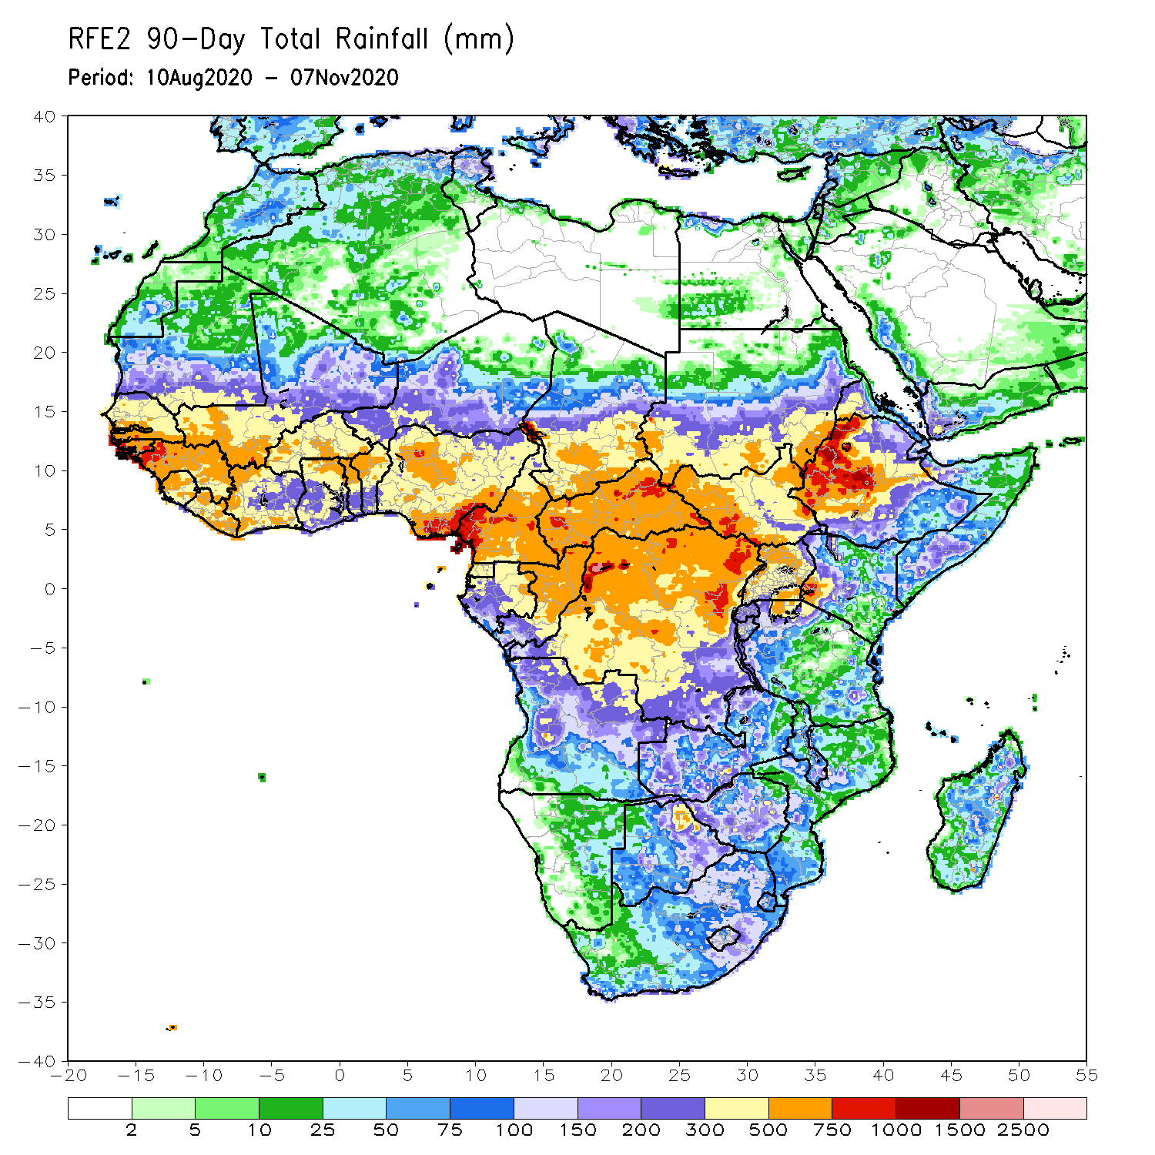
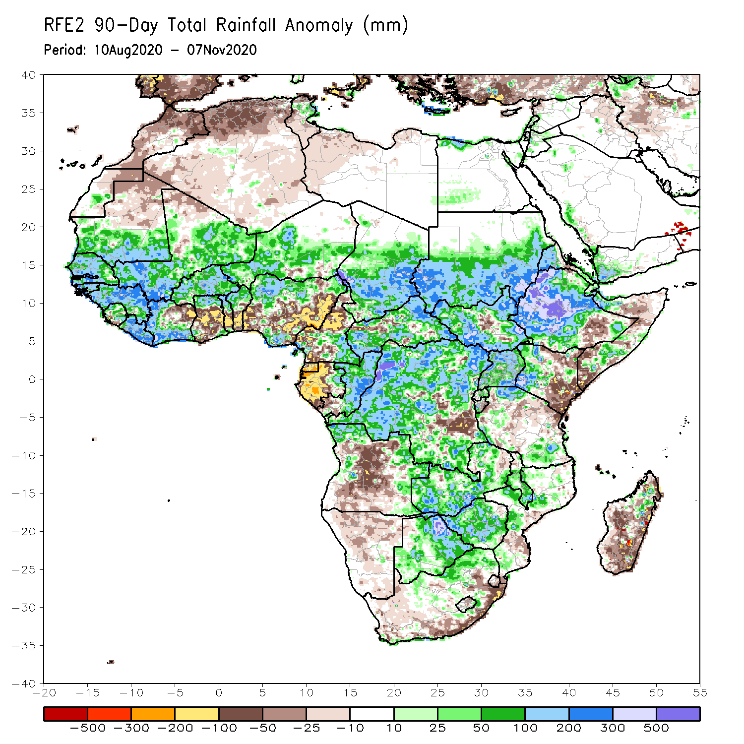
Rainfall Patterns: Last 90 Days
Over the past 90 days, in West Africa, above-average rainfall was observed across much of the Sahel from Senegal eastward to Chad. Rainfall was also above-average from Guinea to much of Cote D’Ivoire. In contrast, rainfall was below-average over the southern areas of the Gulf of Guinea region from northeastern Cote d’Ivoire eastward to Nigeria. The moisture deficits extended to western Central Africa in the area encompassing Cameroon, Gabon and southeastern Congo. Rainfall was much above-average in the remainder of Central Africa from southern Chad to the northern two third of DRC. Rainfall was locally below average in southeastern DRC. In East Africa, the heaviest amounts 500 to 1500 mm (200 – 500 mm above the mean) occurred over the Ethiopian Highlands and locally over southern Sudan. Well above-average rainfall (over 300 mm above the mean) was also observed over south Sudan and Uganda. Rainfall was below-average over eastern Kenya and southern Somalia. In southern Africa, moisture surpluses prevailed over Zambia, Zimbabwe, and the northern tip of Madagascar. Rainfall was below-average from northcentral Angola to eastern South Africa and the southern two third of Madagascar.
Notes:
4

Slide 5
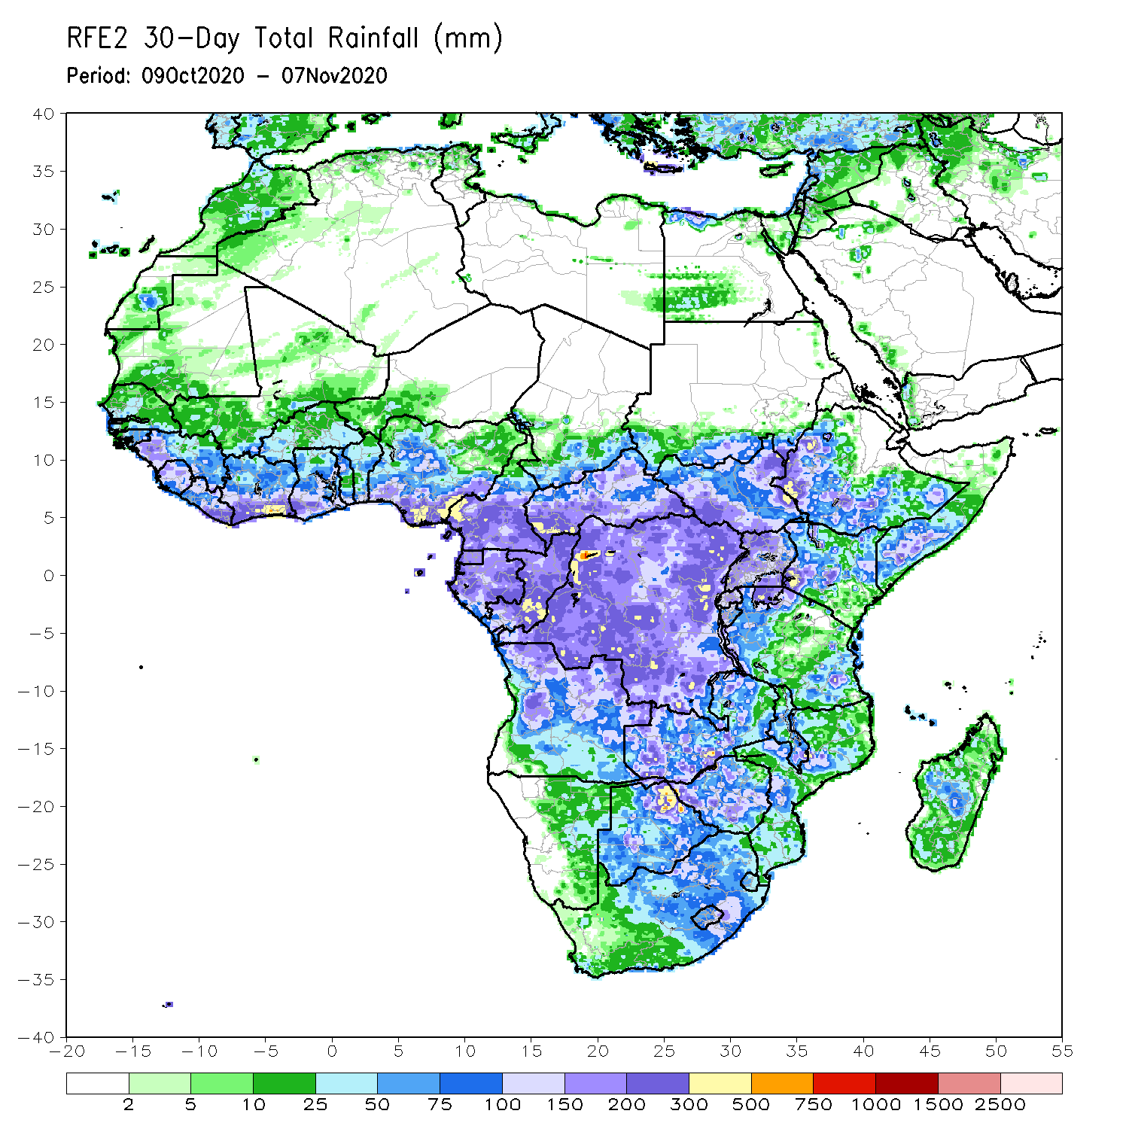
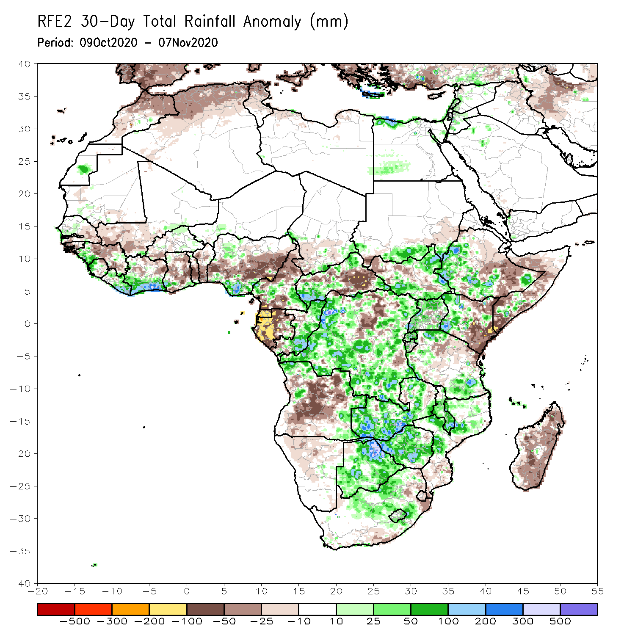
Rainfall Patterns: Last 30 Days
During the past 30 days, rainfall totals diminished over West Africa as the West African Monsoon has been retreating over the past several weeks. Rainfall was below-average over portions of the Sahel and across much of central areas of the Gulf of Guinea region. In contrast, rainfall was above average along coast Guinea. In Central Africa, rainfall was below average along the coastal areas and over south eastern CAR and pockets in northern DRC. Rainfall was above average over eastern Congo, much of DRC. In East Africa, moisture surpluses prevailed over the Ethiopian Highlands and over southern Sudan along the border with South Sudan. Above average rainfall was also observed over parts of South Sudan, northern Uganda, and western Kenya. In contrast, rainfall was below average over eastern Kenya and southern Somalia. In Southern Africa, rainfall was above average over Zambia, Zimbabwe, and southern Malawi. Rainfall was below average across Madagascar.
Notes:
5

Slide 6
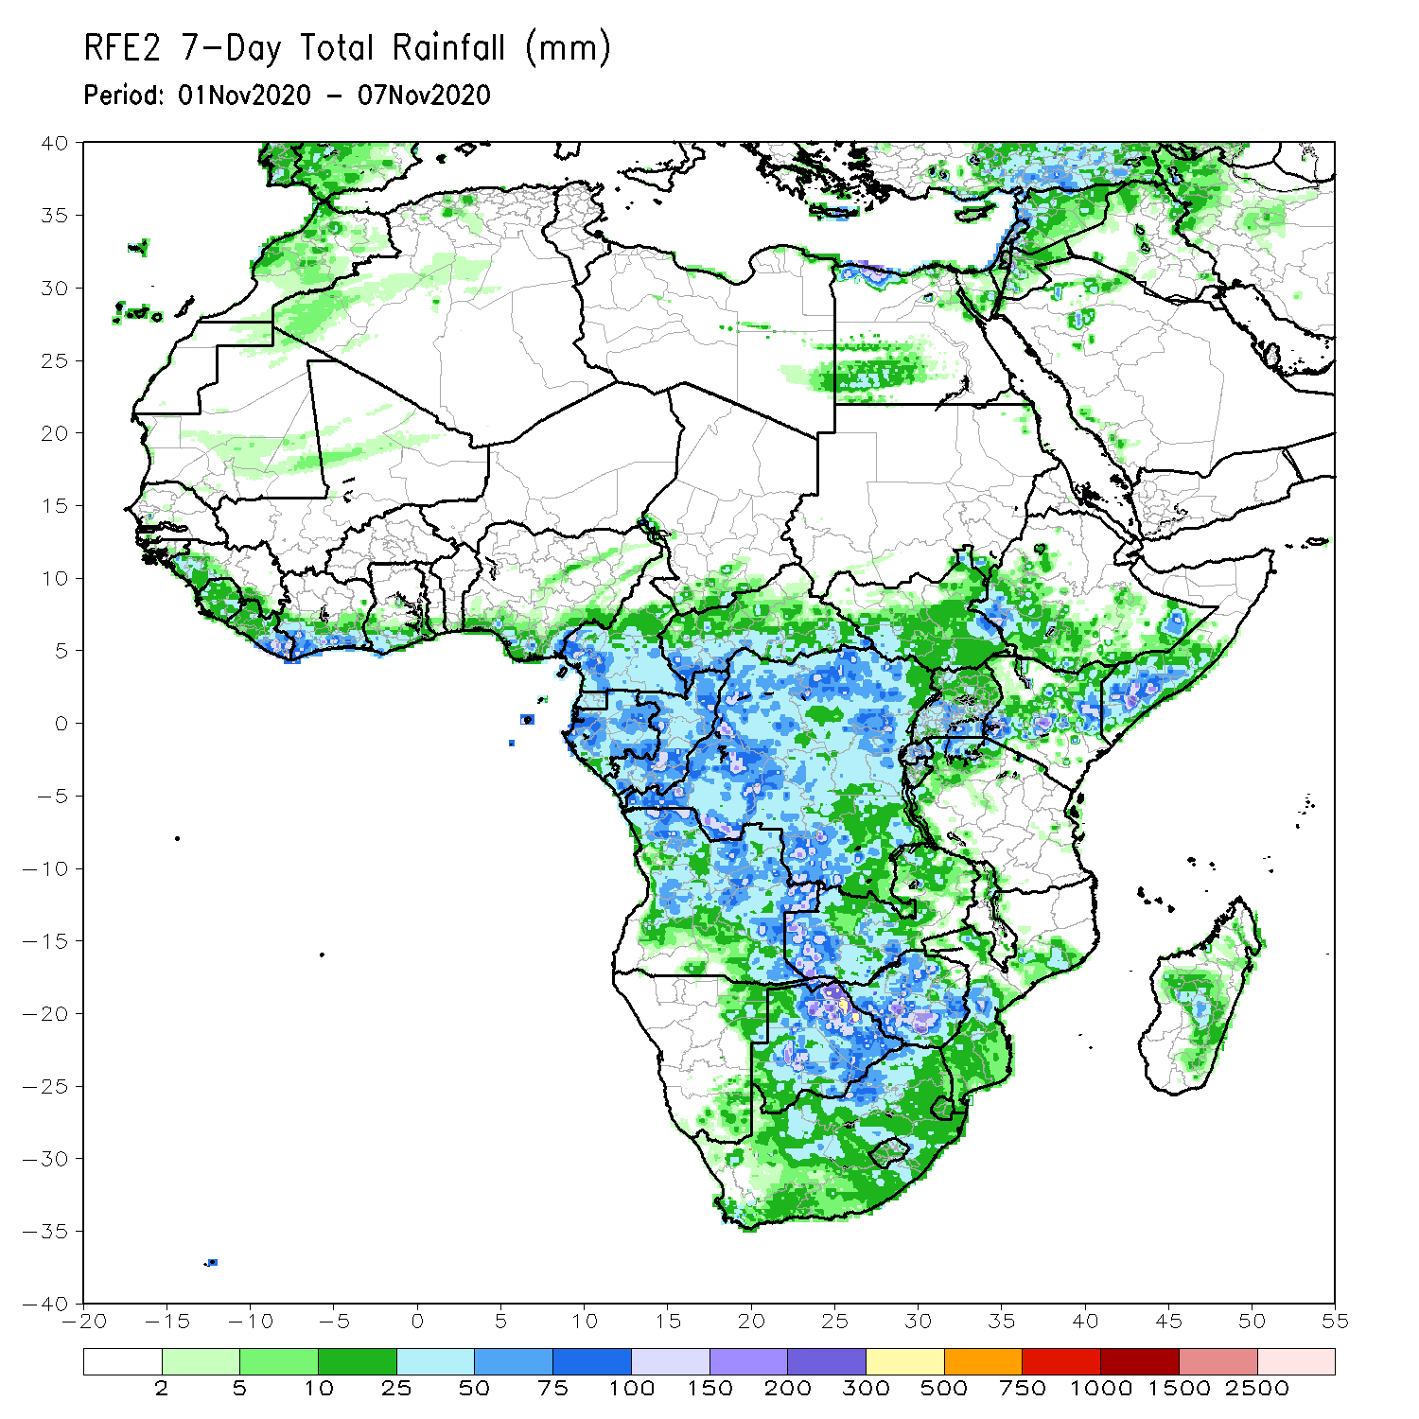
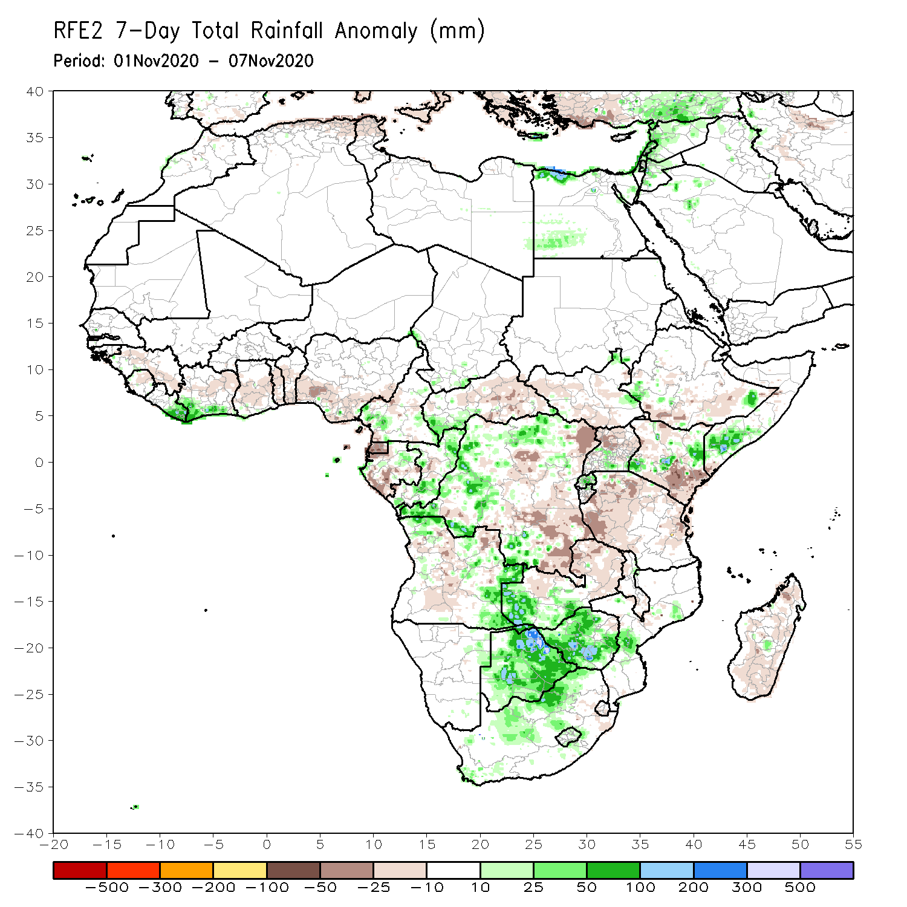
Rainfall Patterns: Last 7 Days
During the past 7 days, in East Africa, dry conditions sustained moisture deficits in southeastern Kenya and locally over southeastern Somalia. Seasonably dry weather prevailed over much of Tanzania. However, light rains less than 10 mm resulted in moisture deficits in western Tanzania. Rainfall was also below average over northern Uganda. Moderate to heavy downpours (50-150 mm; 25-50 mm above the mean) soaked local areas in southwestern, central, and eastern Kenya, and southern Somalia. Average rains with totals ranging between 10 and 75 mm were observed over the southern areas of Ethiopia and Sudan. In Southern Africa, heavy rains (75-150 mm; 50-100 mm above the mean fell over portions of Zimbabwe and northern Botswana. Rainfall was slightly below average across Madagascar. In Central Africa, rainfall was below average over eastern DRC and southern Gabon. Moisture surpluses prevailed in local areas over western DRC and Congo. In West Africa, light to moderate rains resulted in moisture deficits over much of the Gulf of Guinea Region, except for coastal Cote d’Ivoire, where amounts were about 25-50 mm above the mean.

Slide 7
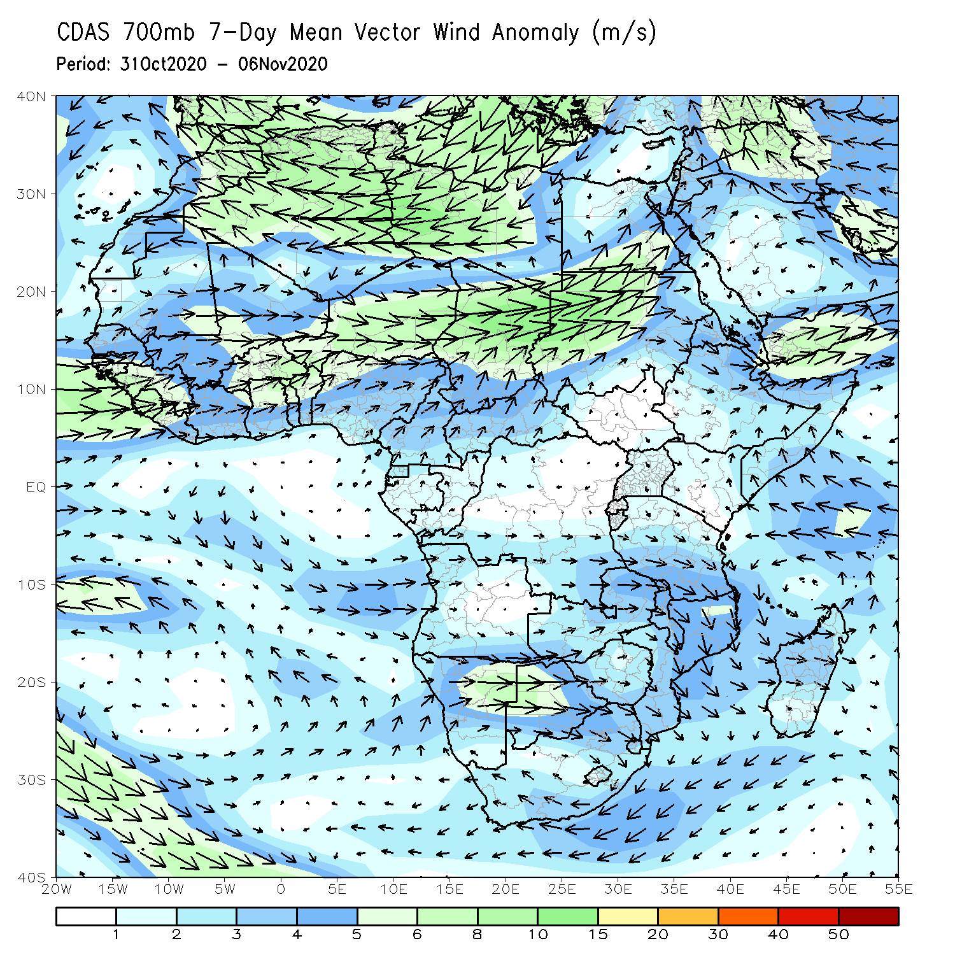
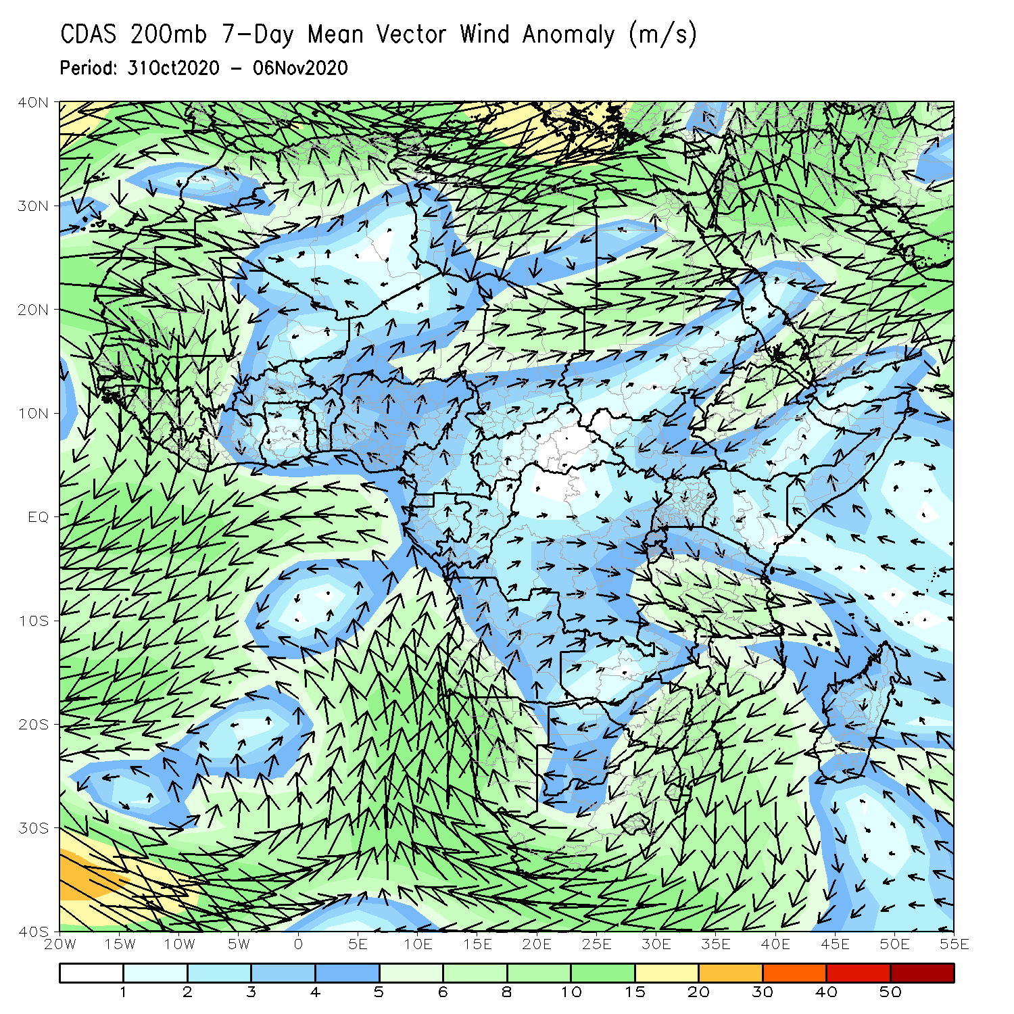
Atmospheric Circulation: Last 7 Days
An anomalous lower-level southwest – northeast flow (left panel) was observed across northern Africa south of the Sahara. At upper level (right panel), an anomalous cyclonic flow prevailed across southern Africa, while an anomalous northeasterly flow was observed from the Arabian Peninsula into Ethiopia.

Slide 8
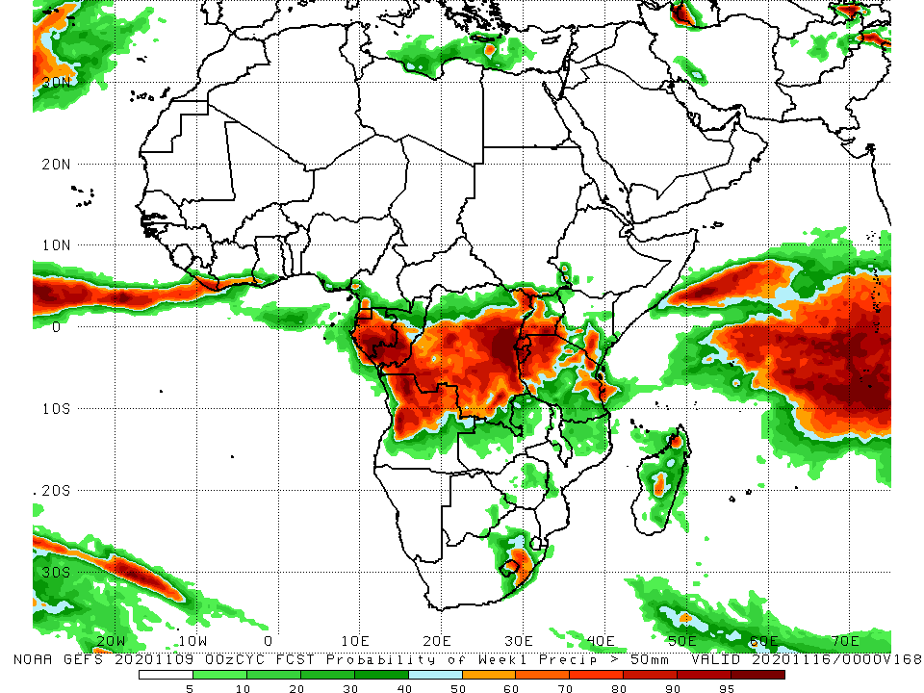
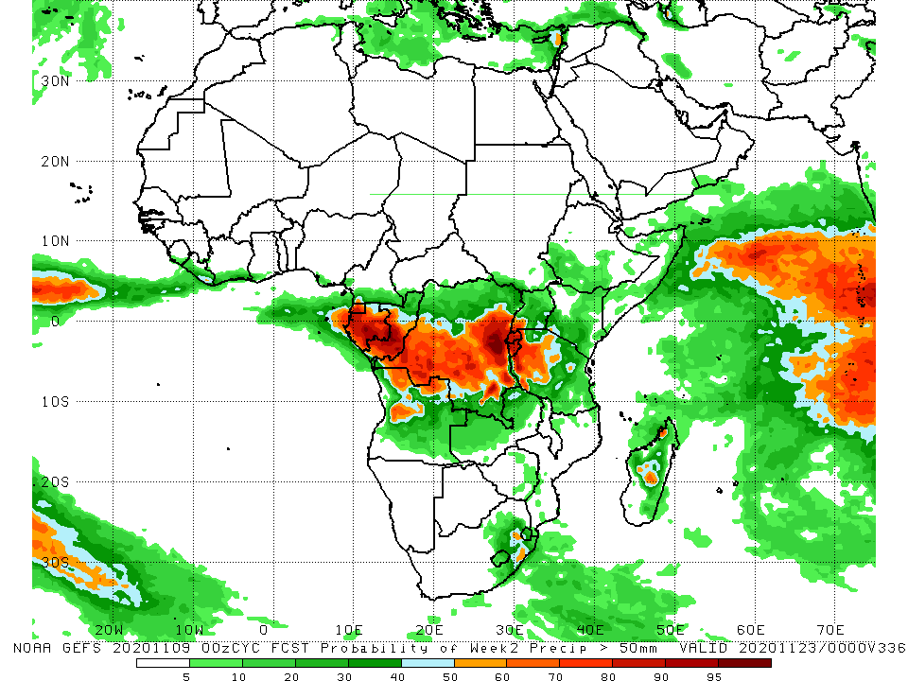
NCEP GEFS Model Forecasts Non-Bias Corrected Probability of precipitation exceedance
Week-1 Valid 10 – 16 November, 2020
Week-2: Valid 17 – 23 November, 2020
For week-1 (left panel), the NCEP GEFS indicates a moderate to high chance (over 70%) for rainfall to exceed 50 mm over Central Africa and pockets in equatorial East Africa. For week-2 (right panel), the chance for rainfall to exceed 50 mm is confined to Gabon, southern Congo, and south-central DRC.
Notes:
8

Slide 9
Summary
During the past 30 to 90 days, in West Africa, above-average rainfall was observed across much of the Sahel. However, light rains from the past several weeks resulted in moisture deficits. The Central areas of the Gulf of Guinea received below average rains. However rainfall was above average along the coast. In Central Africa, rainfall was above average across much of the region, except for the western areas, where sustained moisture deficits were observed. In East Africa, rainfall was below average in the eastern areas and above average in the west..
Over the past 7 days, in East Africa, dry conditions sustained moisture deficits in southeastern Kenya and locally over southeastern Somalia. Light rains less than 10 mm resulted in moisture deficits in western Tanzania. Rainfall was also below average over northern Uganda. Heavy downpours soaked local areas in central Kenya, and southern Somalia. In Southern Africa, heavy rains fell over portions of Zimbabwe and northern Botswana. Rainfall was slightly below average across Madagascar. In Central Africa, rainfall was below average over eastern DRC and southern Gabon. Moisture surpluses prevailed in local areas over western DRC and Congo. In West Africa, light to moderate rains resulted in moisture deficits over much of the Gulf of Guinea Region.
The GEFS indicates a moderate to high chance for rainfall to exceed 50 mm over parts of Central Africa and pockets in equatorial East Africa.

