Slide 1
The African Monsoon Recent Evolution and Current Status Include Week-1 and Week-2 Outlooks
Update prepared by
Climate Prediction Center / NCEP
21 September 2020
For more information, visit:
http://www.cpc.ncep.noaa.gov/products/Global_Monsoons/African_Monsoons/precip_monitoring.shtml

Slide 2
Outline
Highlights
Recent Evolution and Current Conditions
NCEP GEFS Forecasts
Summary

Slide 3
Highlights: Last 7 Days
The northern areas of Senegal and Burkina Faso received substantial rains sustaining local flooding. However, much of the Sahel broke from the heavy rains observed over the past several weeks. In East Africa, heavy rains continued to pound the western Ethiopian Highlands. Rainfall was also well above-average in portions of Central Africa.
Week-1 and week-2 outlooks call for an increased chance for above-average rainfall over the Gulf of Guinea region and portions of central Africa.

Slide 4
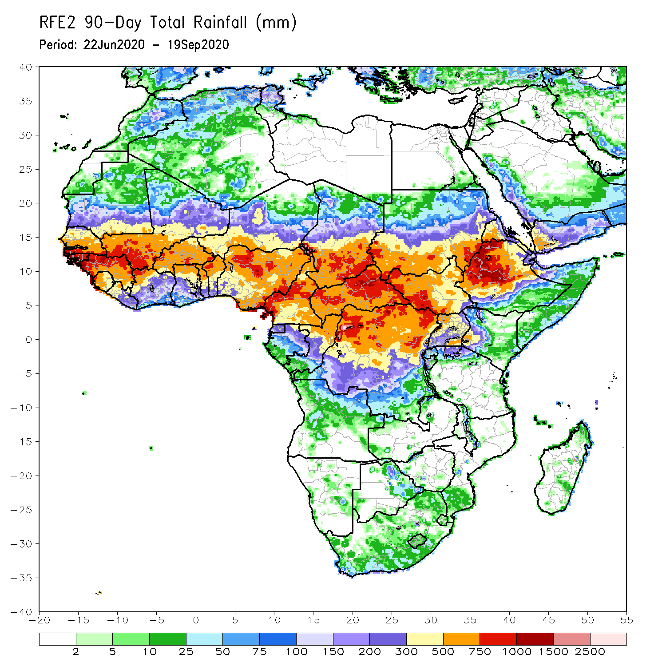
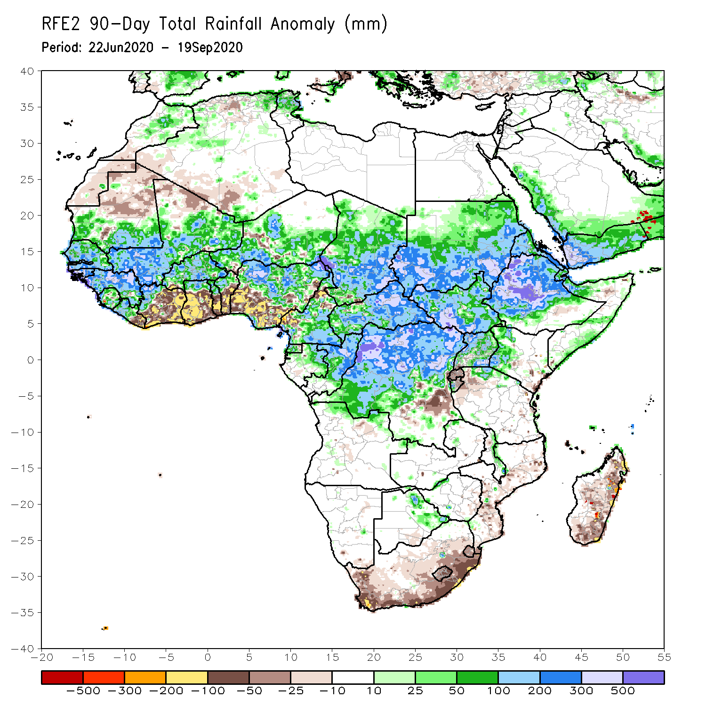
Rainfall Patterns: Last 90 Days
During the past 90 days, in West Africa, above-average rainfall was observed across much of the Sahel from Senegal eastward to Chad. The border between Mali and Guinea registered rainfall amounts in the range between 700 and 1000 mm (300 mm above the mean). In contrast, rainfall was below-average over the southern areas of the Gulf of Guinea region with totals ranging between 100 and 300 mm (50 to 200 mm below the mean). In East Africa, the heaviest amounts 1000 to 1500 mm (over 500 mm above the mean) occurred over the Ethiopian Highlands. Well above-average rainfall (over 300 mm above the mean) was also observed in portions of southern Sudan. Rainfall was much above-average over Central Africa from southern Chad southward to the northern two-third of DRC. Rainfall was locally below-average over southeastern DRC.
Notes:
4

Slide 5
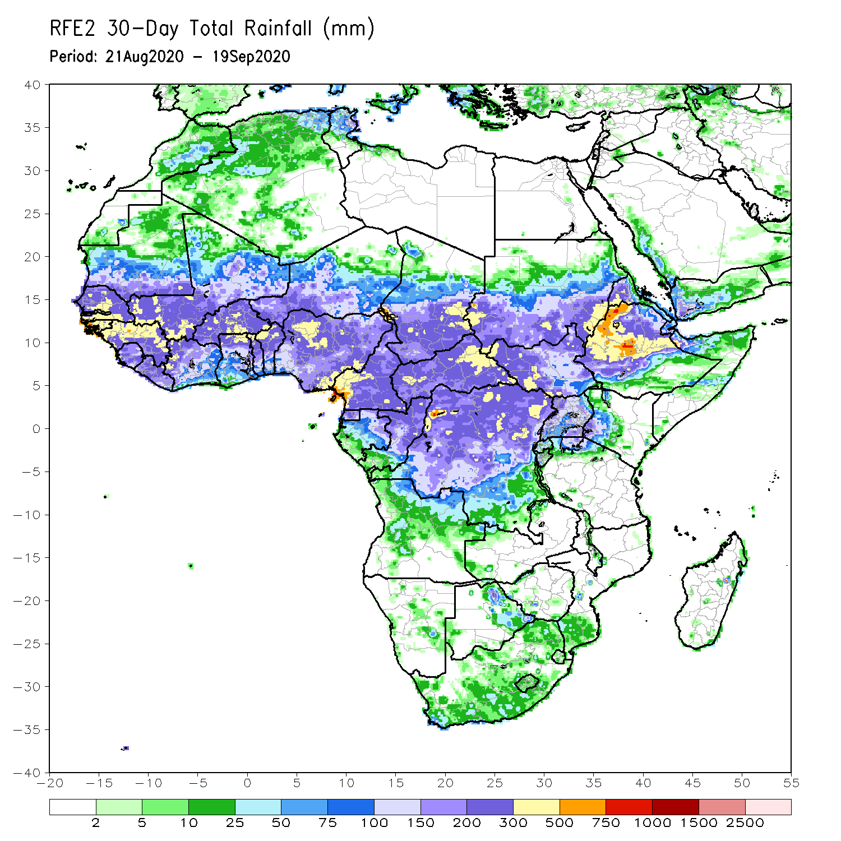
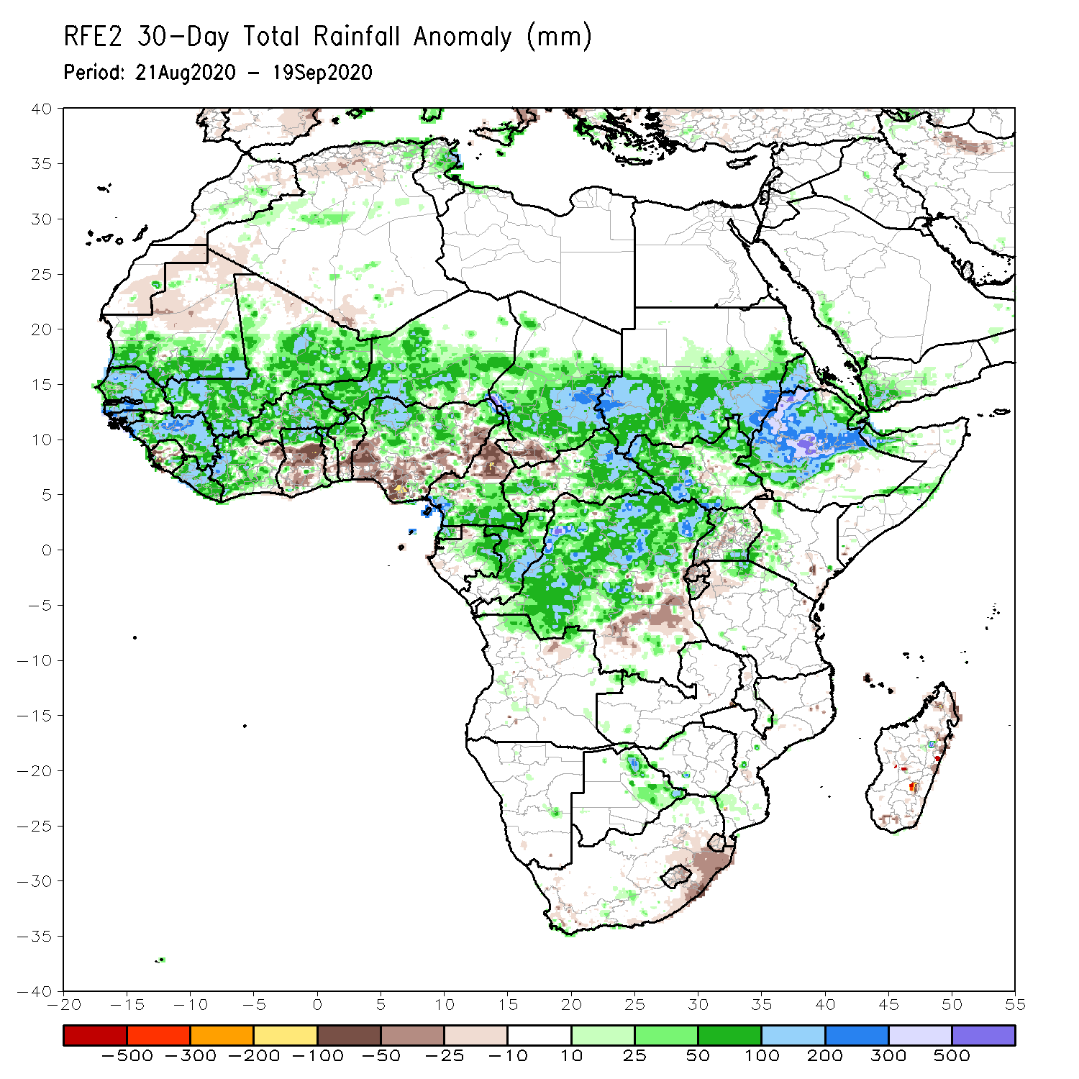
Rainfall Patterns: Last 30 Days
During the past 30 days, above-average rainfall prevailed over much of West Africa in the areas including the Sahel and the western Gulf of Guinea region, where totals exceeded 500 mm in the northern areas of Guinea. Local areas in western Sahel registered rainfall more than 300 mm above the mean. The exceptions were portions of the Gulf of Guinea region, where pockets in Ghana and Nigeria received about 100 mm (50 to 100 mm below the mean). In East Africa, moisture surpluses prevailed over the Ethiopian Highlands and southern Sudan. Rainfall was also above-average across much of Central Africa, except for northern Cameroon, where amounts were less than 300 mm (about 50 to 100 mm below the mean).
Notes:
5

Slide 6
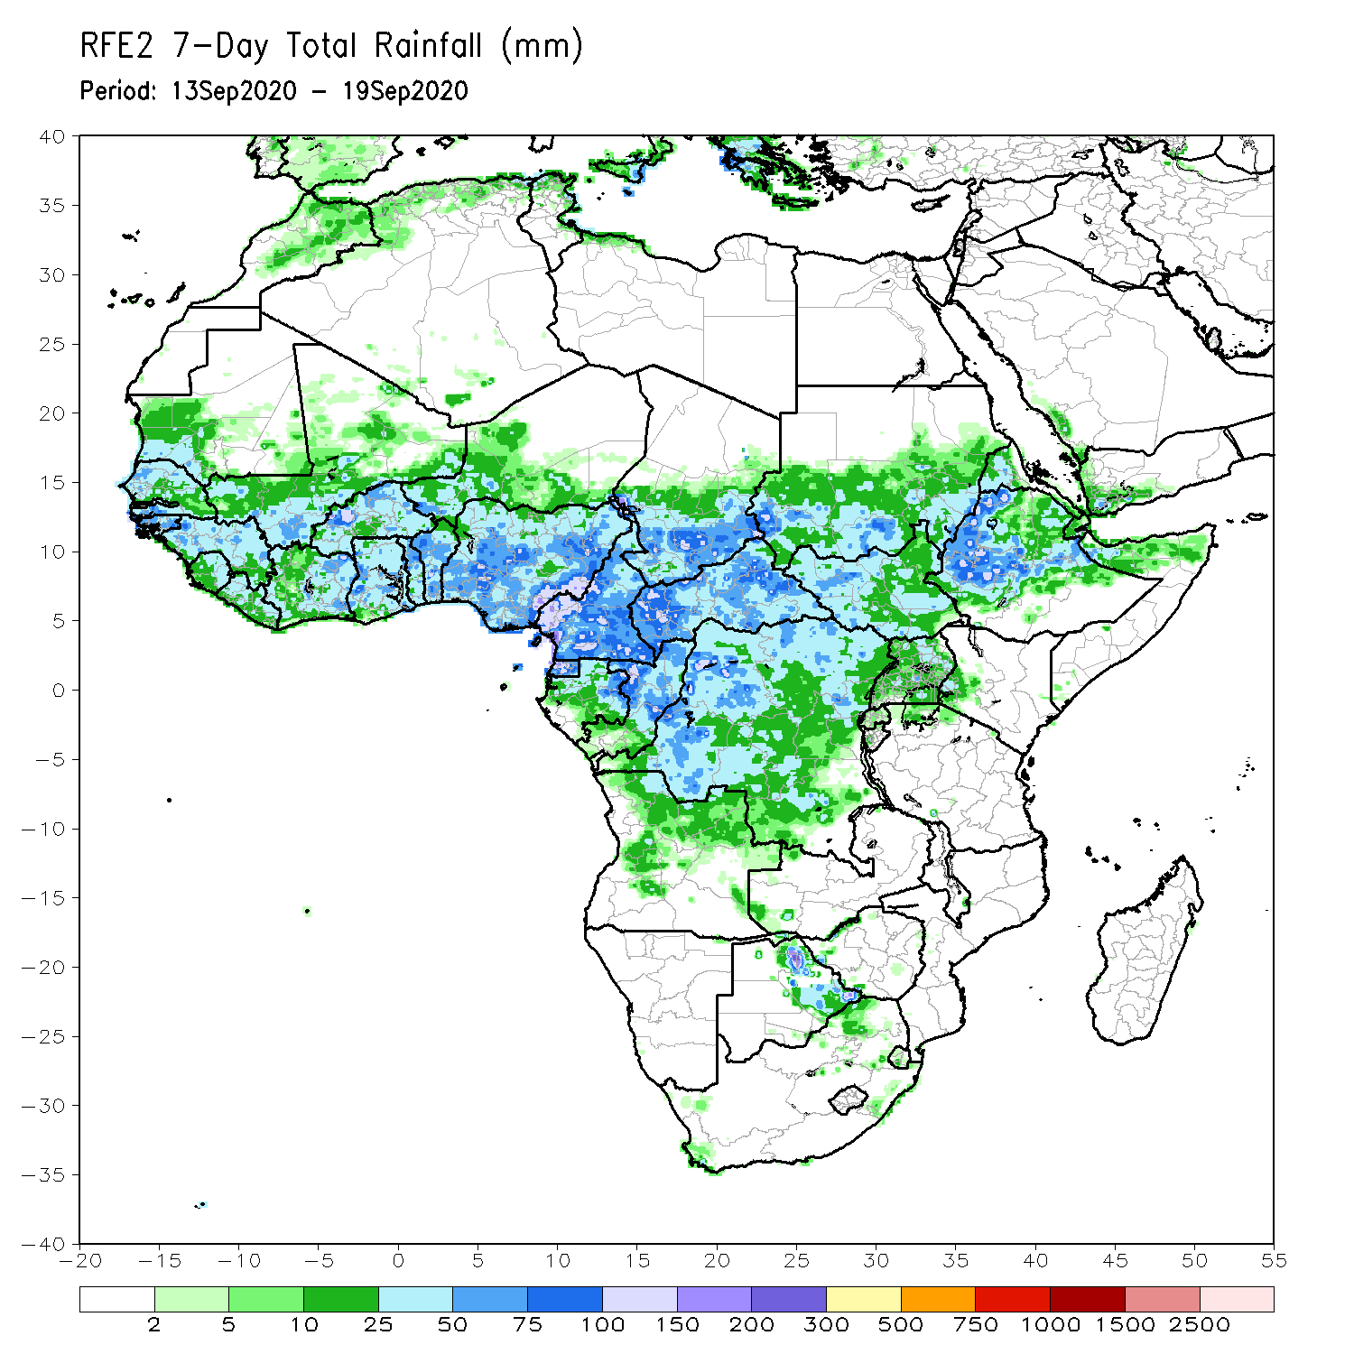
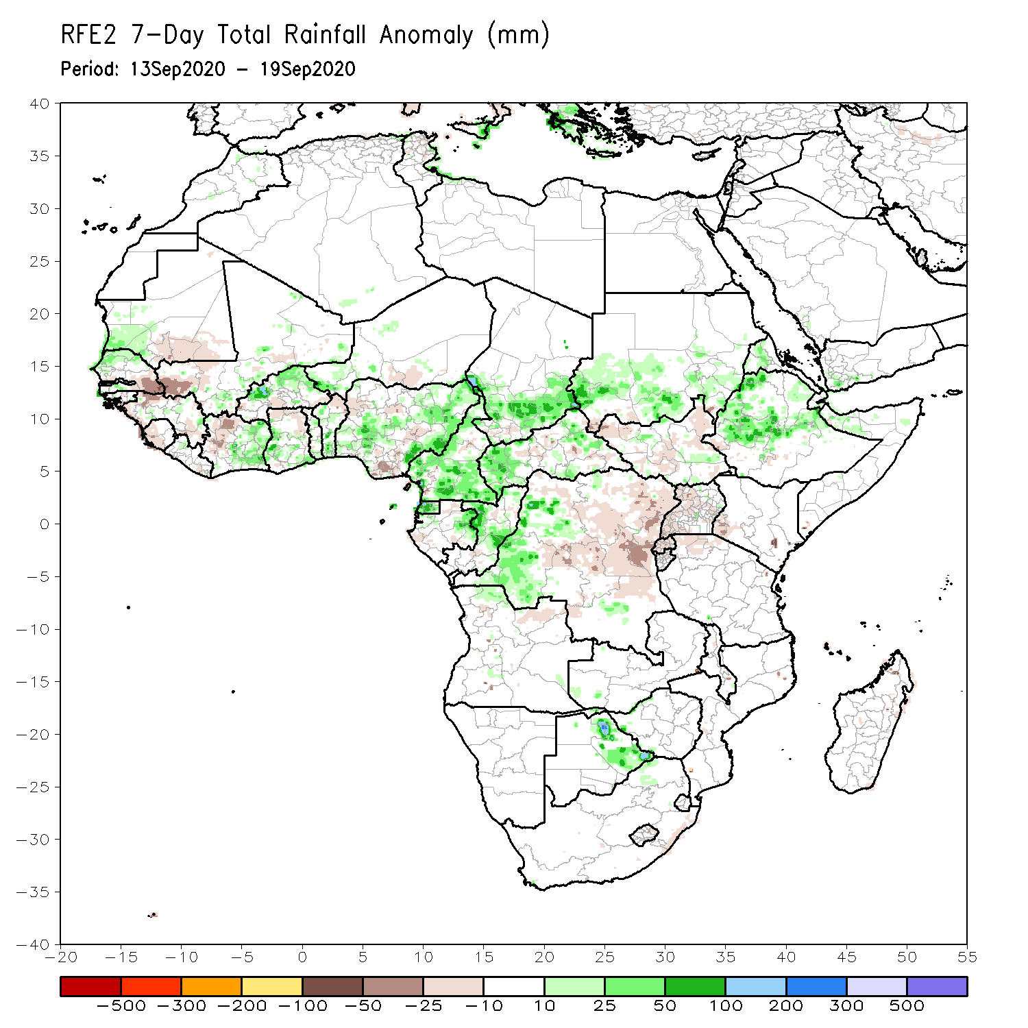
Rainfall Patterns: Last 7 Days
During the past 7 days, rainfall tapered off quite a bit over the Sahel and overall, average conditions prevailed. The border between Senegal and Mali registered less than 50 mm (about 50 mm below the mean). However, the northern areas of Senegal and Burkina Faso received substantial rains with totals exceeding 100 mm (about 50 mm above the mean). Rainfall was near average across much of the Gulf of Guinea region. In East Africa, heavy downpours (over 300 mm, about 50 mm above the mean) continued to soak the western Ethiopian Highlands. In Central Africa, rainfall was above-average in the areas encompassing Cameroon and southern Chad, and below-average in eastern DRC.

Slide 7
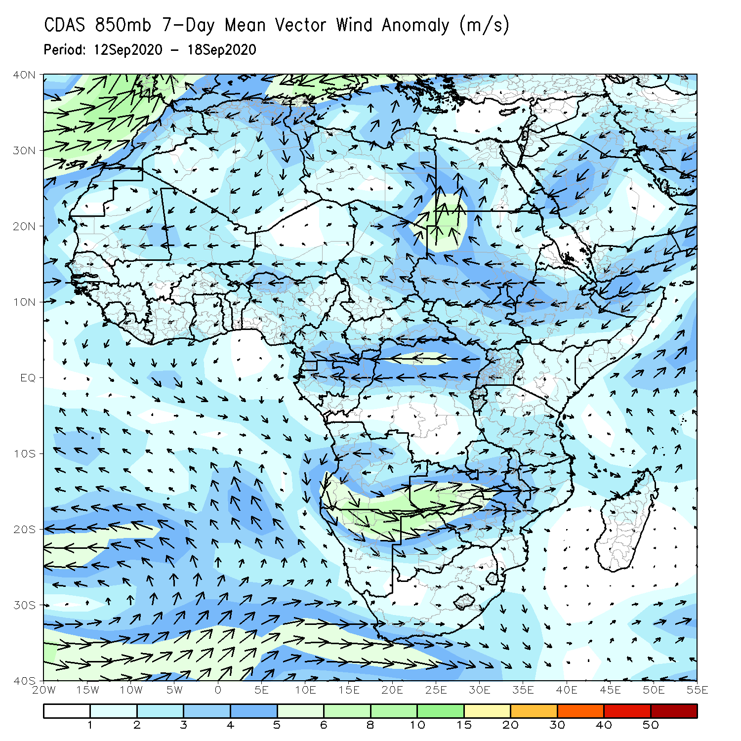
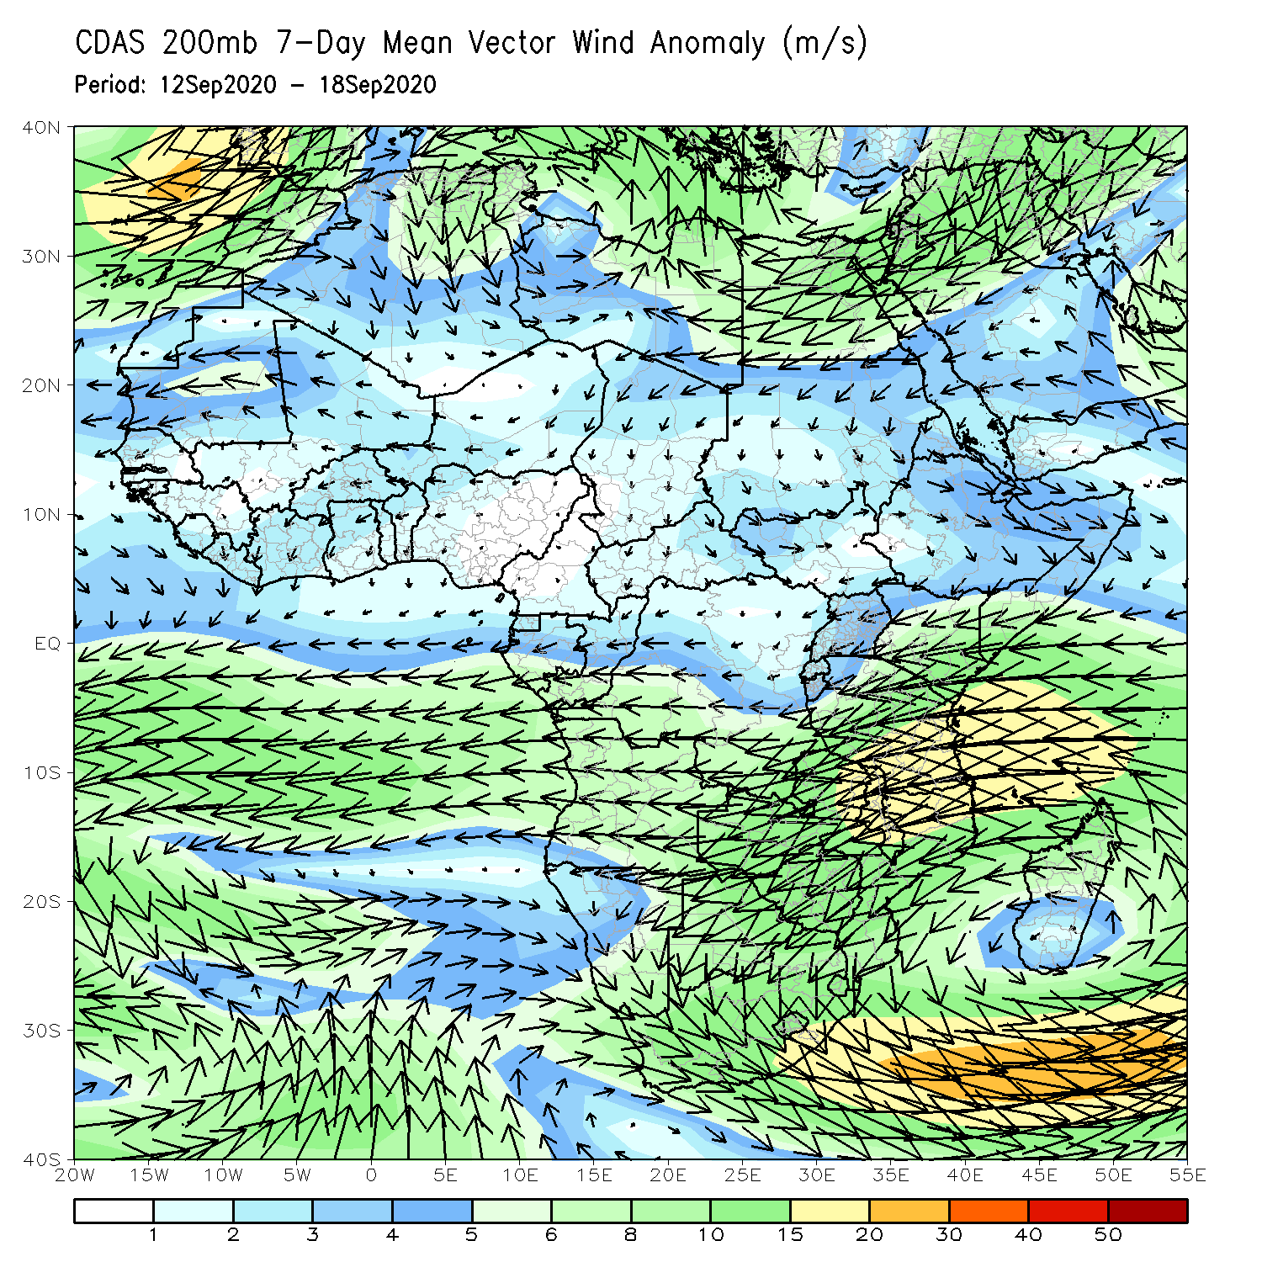
Atmospheric Circulation: Last 7 Days
At low-level, easterly wind anomalies across the Sahel converged with westerly wind anomalies from the East Atlantic onto coastal West Africa. Northeasterly wind anomalies prevailed over East Africa. At upper level, the Mascarene High Pressure System extended farther to the north to reach equatorial East Africa. Easterly wind anomalies prevailed in West Africa north of the Sahel.

Slide 8
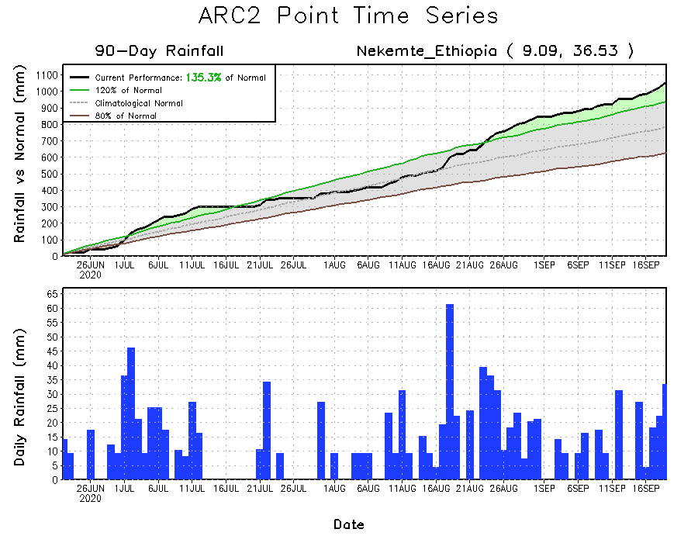
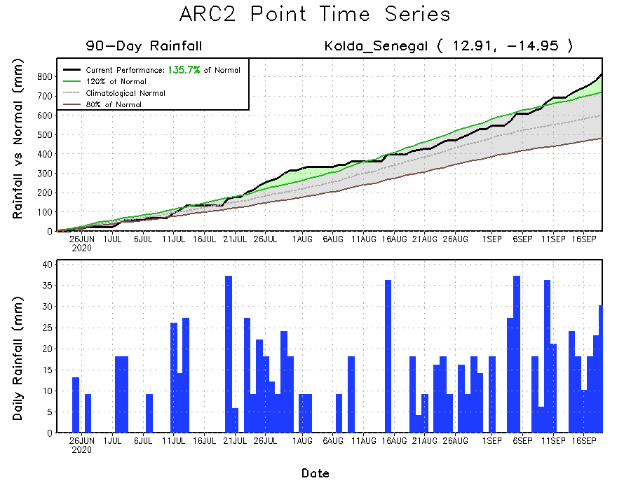
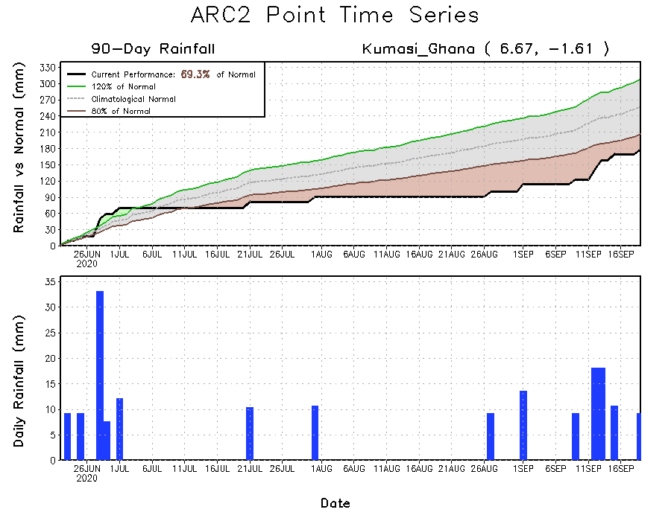
Rainfall Evolution
Daily evolution of rainfall over the last 90 days at selected locations indicated that moisture surpluses continued over the far western West Africa (bottom left) and Ethiopia (top right). The rainfall time series (bottom right) revealed a break in the dry spell observed during the past several weeks with a return of the rains in recent days.

Slide 9
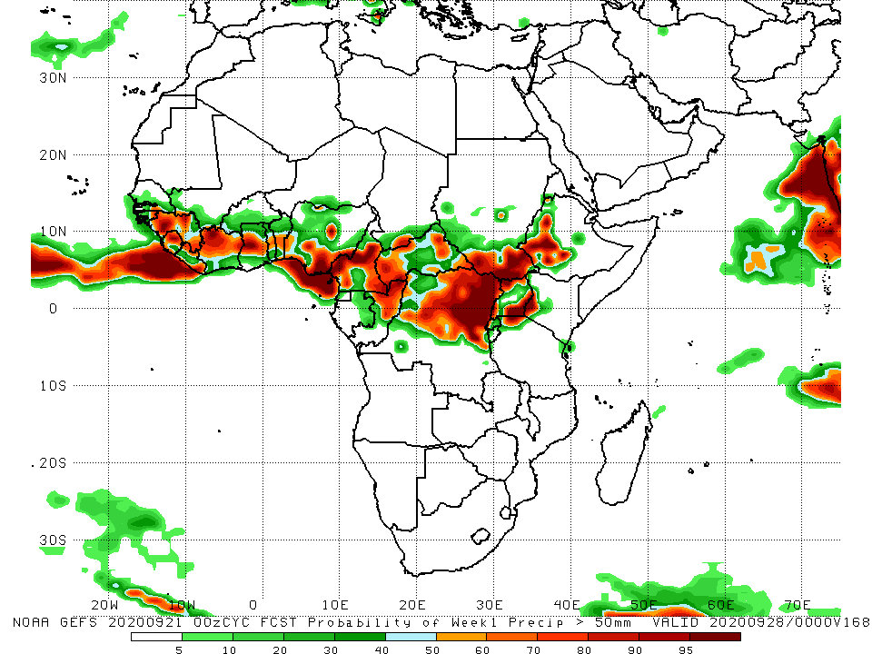
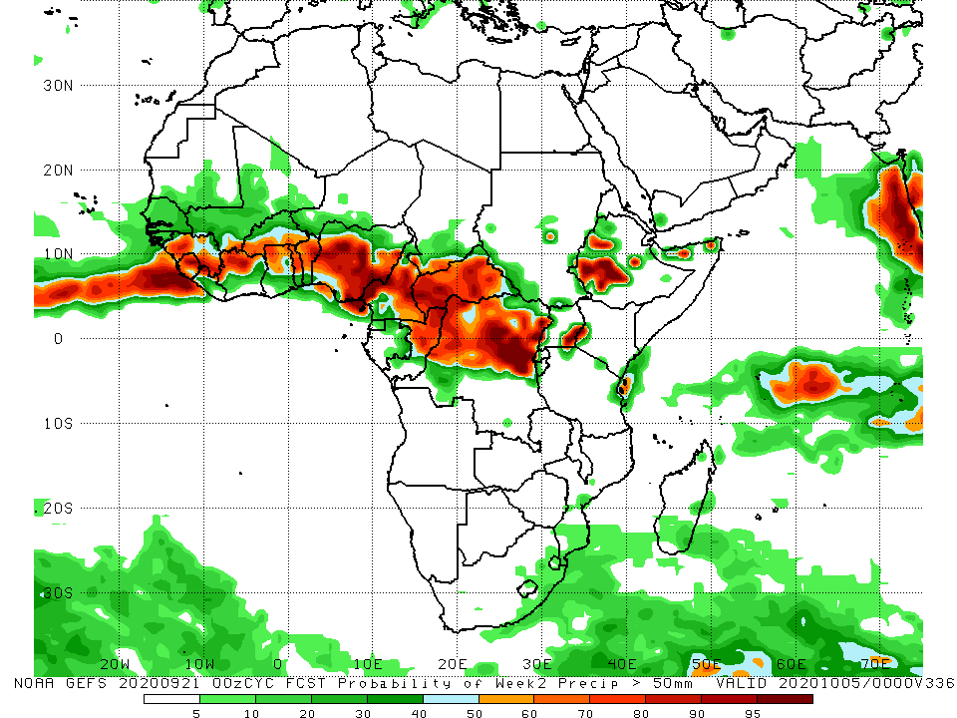
NCEP GEFS Model Forecasts Non-Bias Corrected Probability of precipitation exceedance
Week-1 Valid 22 – 28 September, 2020
Week-2: Valid 29 – 05 October, 2020
For week-1 (left panel), and week-2 (right panel), the NCEP GEFS forecasts suggest an increased chance for weekly rainfall totals to exceed 50mm across portions of the Gulf of Guinea, parts of Central Africa, and local areas in western Ethiopia.
Notes:
9

Slide 10
Summary
Over the past 30 to 90 days rainfall has consistently been above-average over the Sahel, resulting in widespread flooding. In contrast, overall, below average rainfall prevailed over the Gulf of Guinea region. In East Africa, the western Ethiopian Highlands received much above-average rainfall. Well above-average rainfall prevailed over Central Africa, except for northern Cameroon, where rainfall was below-average.
Over the past 7 days, little rainfall eased flooding in parts of the Sahel, while areas in the Gulf of Guinea region received above-average rainfall. In East Africa, heavy downpours continued to soak the western Ethiopian Highlands. Portions of Central Africa received above-average rainfall.
The week-1 and week-2 forecasts call for an increased chance for above-average rainfall over the northern areas of the Gulf of Guinea region and parts of Central Africa.

