Slide 1
The African Monsoon Recent Evolution and Current Status Include Week-1 and Week-2 Outlooks
Update prepared by
Climate Prediction Center / NCEP
17 August 2020
For more information, visit:
http://www.cpc.ncep.noaa.gov/products/Global_Monsoons/African_Monsoons/precip_monitoring.shtml

Slide 2
Outline
Highlights
Recent Evolution and Current Conditions
NCEP GEFS Forecasts
Summary

Slide 3
Highlights: Last 7 Days
Rainfall was below average over many places in the Gulf of Guinea region, while moderate to locally heavy rainfall sustained moisture surpluses across much of Central and the Greater Horn of Africa.
Week-1 outlooks call for an increased chance for above-average rainfall over Guinea, Sierra Leone, southern Mali, northern Cote d'Ivoire, Burkina Faso, eastern Nigeria, southern Chad, northern Cameroon, CAR, northern DRC, southwestern Sudan and western South Sudan. In contrast, there is an increased chance for below-average rainfall over parts of southern Mauritania, Senegal, Gambia, Guinea-Bissau, southwestern Mali, eastern Liberia, central and southern Cote d'Ivoire, Ghana, Togo, Benin and southwestern Nigeria.
Week-2 outlooks call for an increased chance for above-average rainfall over southern Senegal, Gambia, Guinea-Bissau, Guinea, Sierra Leone, southern Mali, Burkina Faso, southern Niger, parts of northern and eastern Nigeria, Cameroon, western CAR, Equatorial Guinea, Gabon, northern Congo, Chad and western Sudan. In contrast, there is an increased chance for below-average rainfall over eastern Liberia, Cote d'Ivoire, southern Ghana, southern Togo and southern Benin.

Slide 4
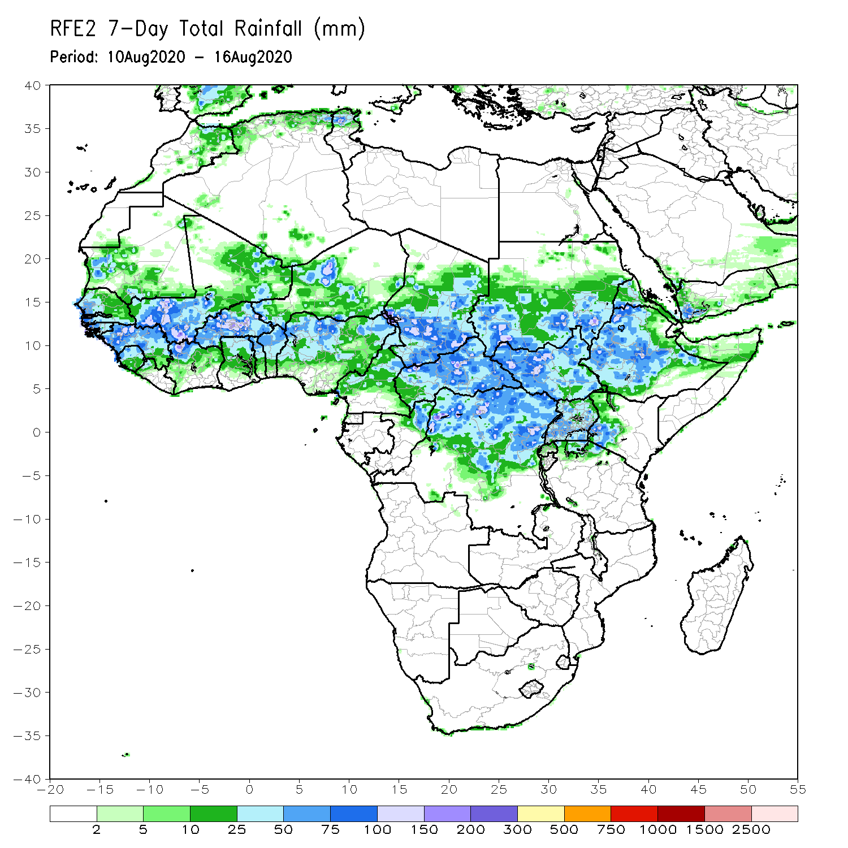
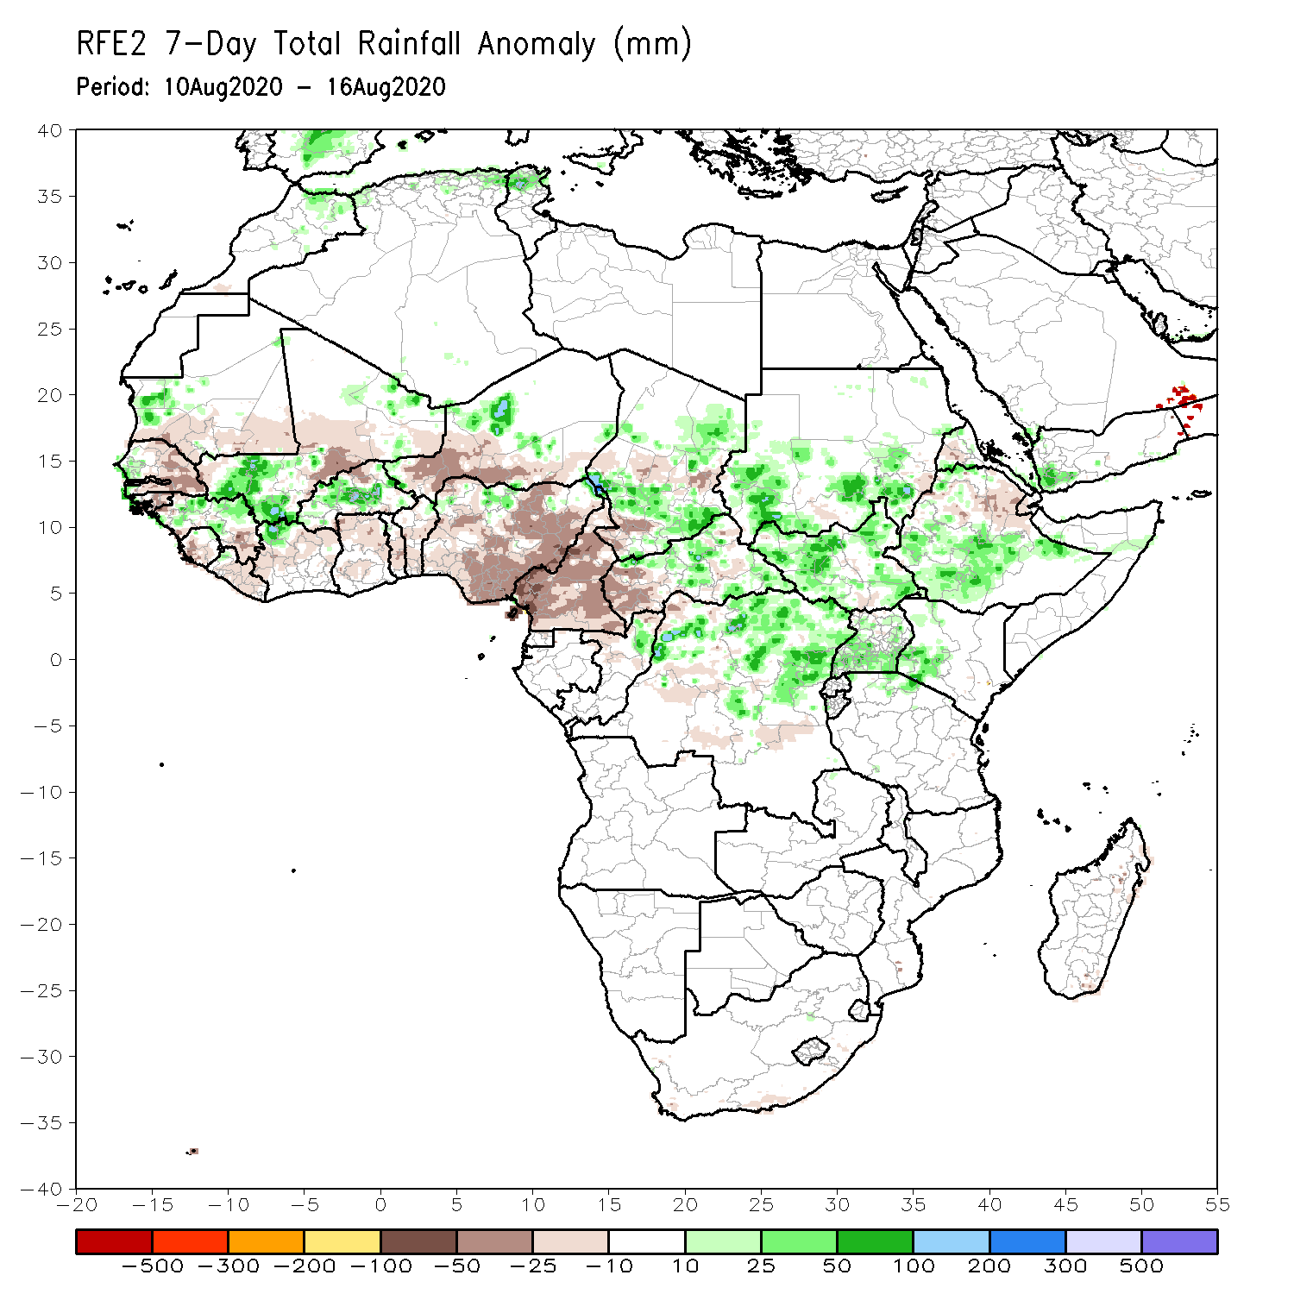
Rainfall Patterns: Last 7 Days
During the past 7 days, rainfall was above-average over local areas in Mauritania and Senegal, western Mali, northern Guinea, Burkina Faso, local areas in northern Nigeria and Niger, many parts of Chad, central and eastern CAR, southern Sudan, northern DRC, many parts of South Sudan, Uganda, southwestern Kenya, and southern Ethiopia.
Below-average rainfall was observed over southern Mauritania, much of Senegal, local areas in Guinea, Sierra Leone, Liberia, central Mali, Cote d’Ivoire, Ghana, western and southern Niger, much of Nigeria, Cameroon, western CAR, central Chad, and northeastern Ethiopia.

Slide 5
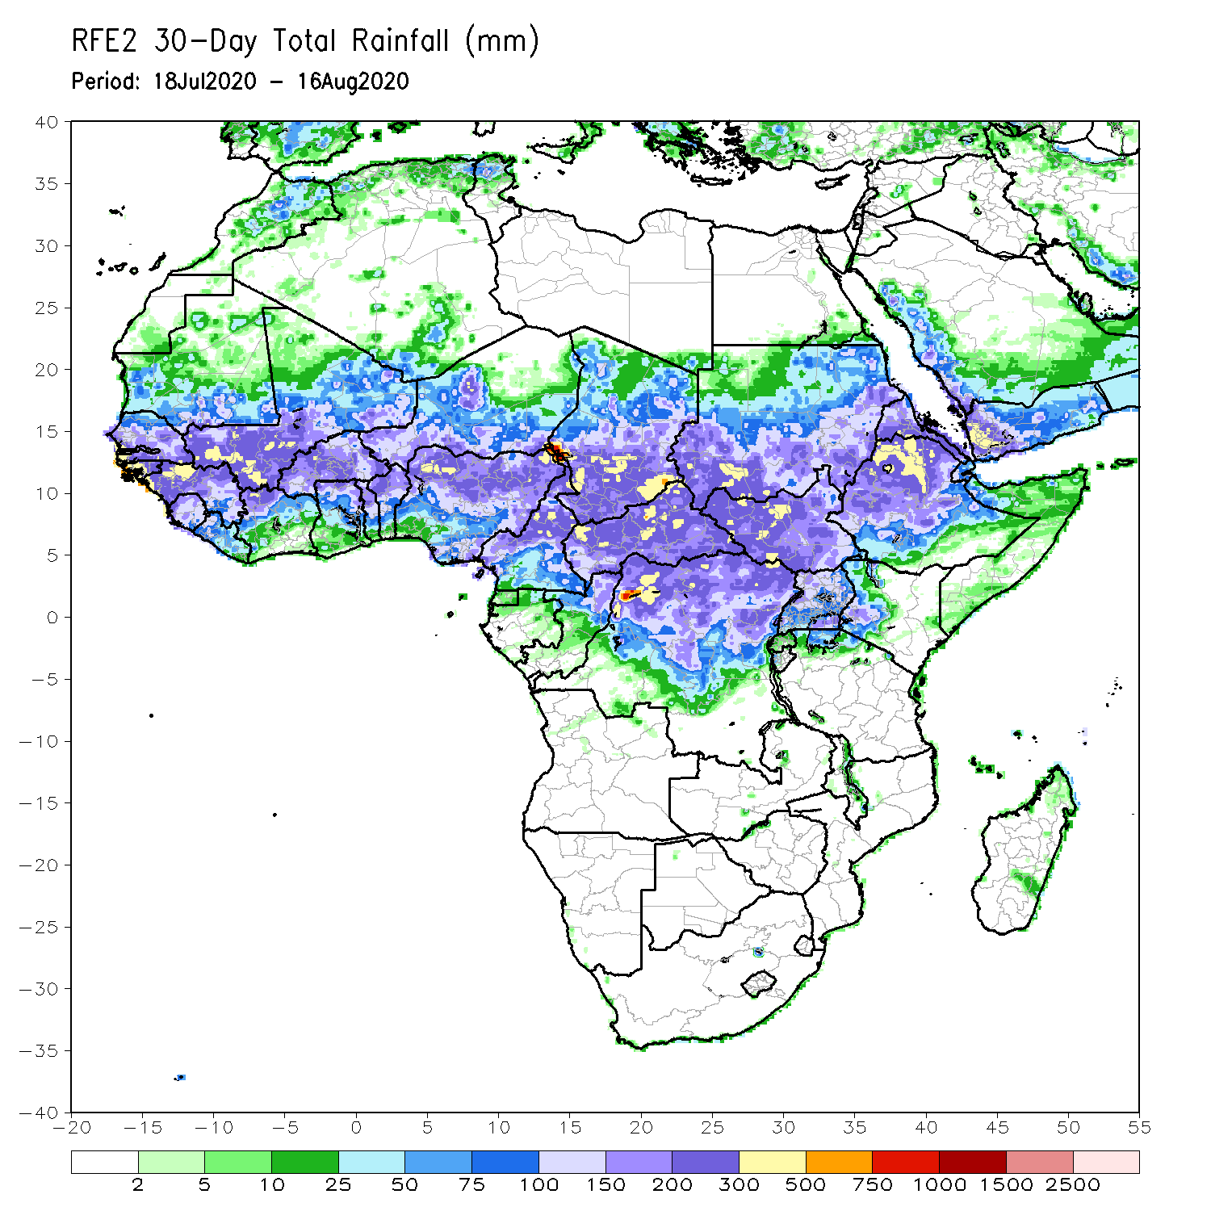
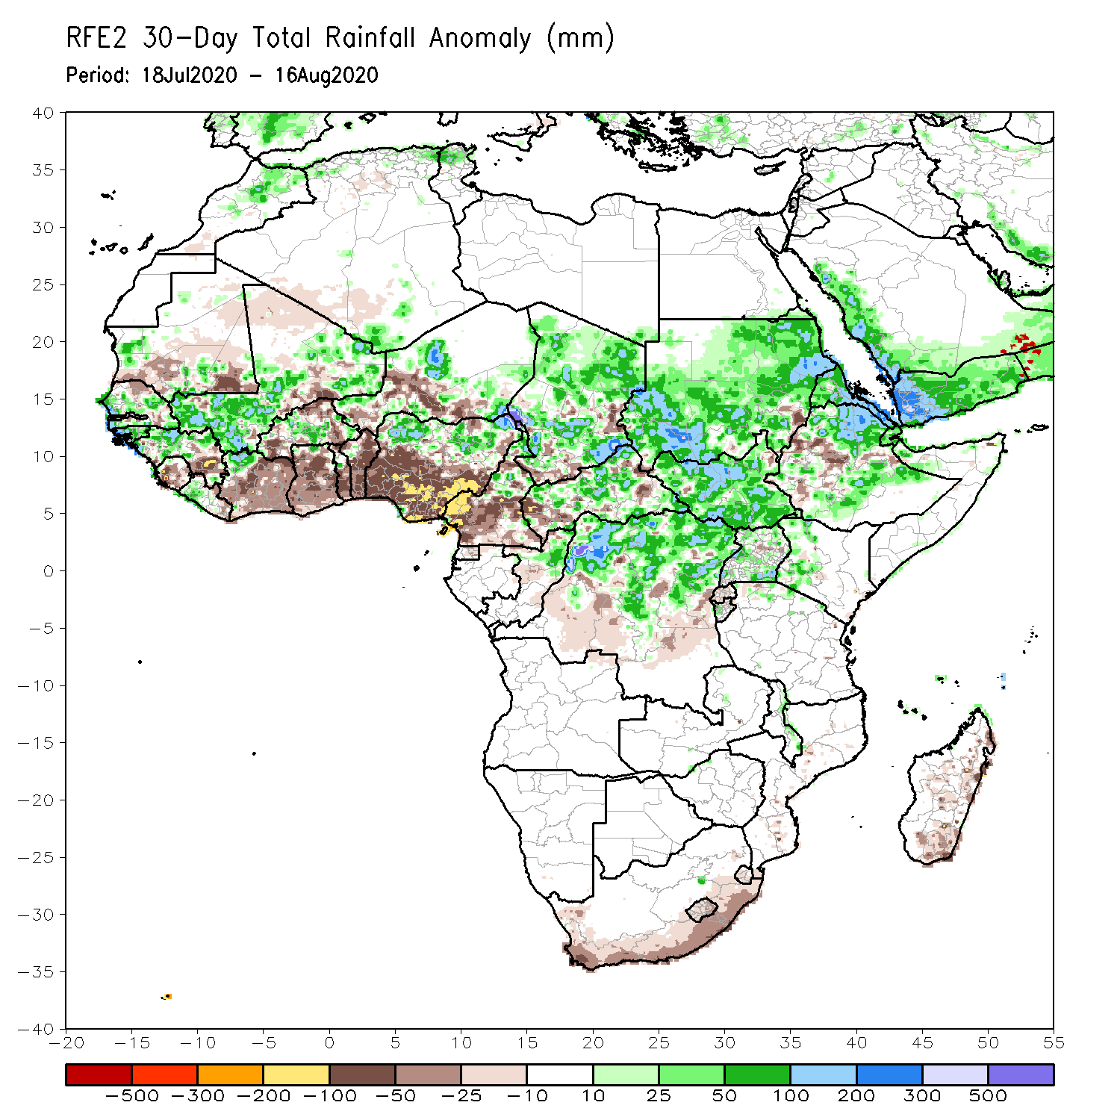
Rainfall Patterns: Last 30 Days
During the past 30 days, rainfall was above-average over local areas in Mauritania, Senegal, Guinea, Mali, parts of Burkina Faso, local areas in Niger, northern Nigeria, much of Chad, local areas in northern Cameroon, much of CAR, Sudan, South Sudan, northern DRC, Eritrea, and many parts of Ethiopia.
Rainfall was below-average over local areas in Mauritania, northern Senegal, local areas in Guinea and Mali, Sierra Leone, Burkina Faso, Togo, Benin, parts of Niger, southern Nigeria, parts of Cameroon, local areas in Chad and CAR, parts of western Ethiopia, and local areas in DRC.
Notes:
5

Slide 6
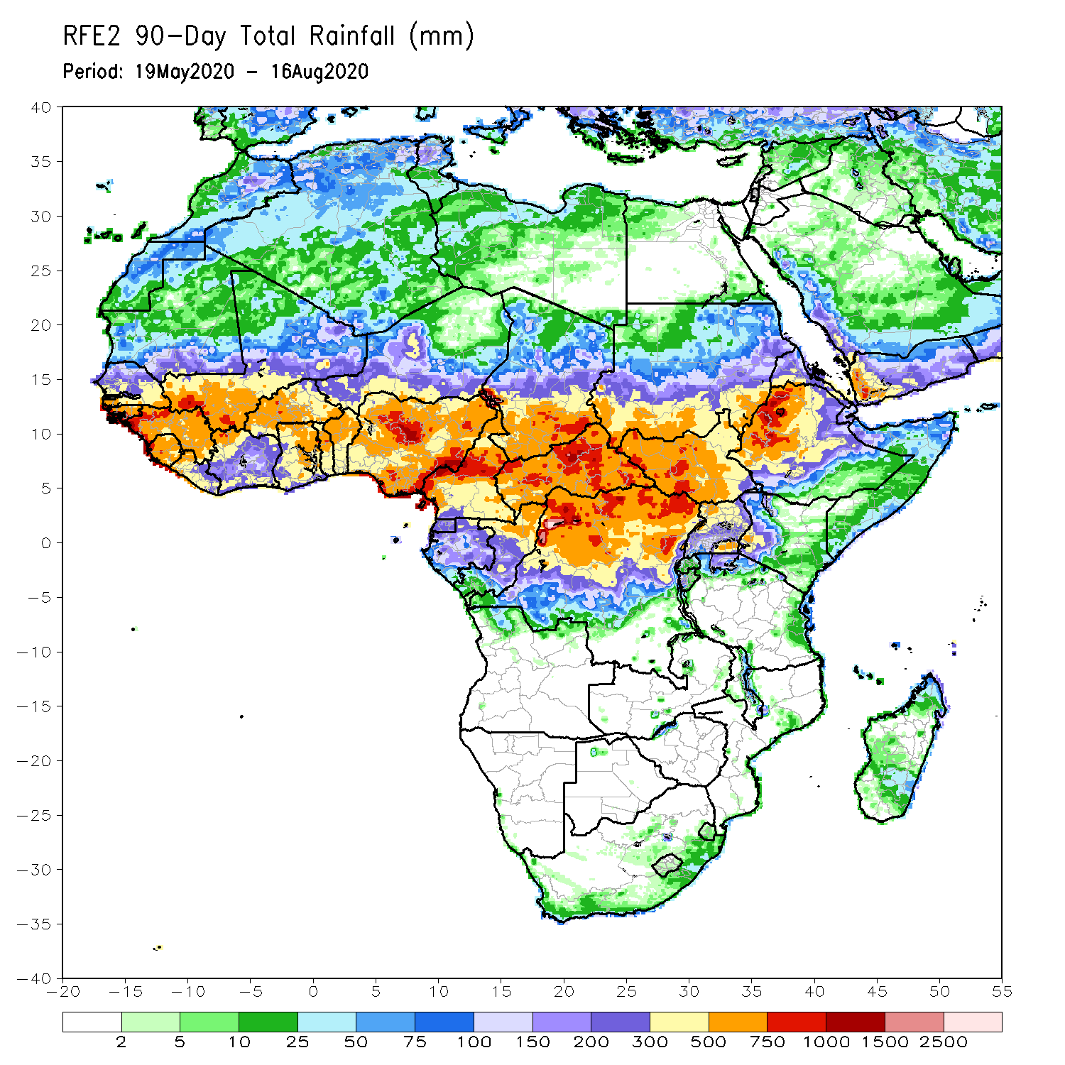
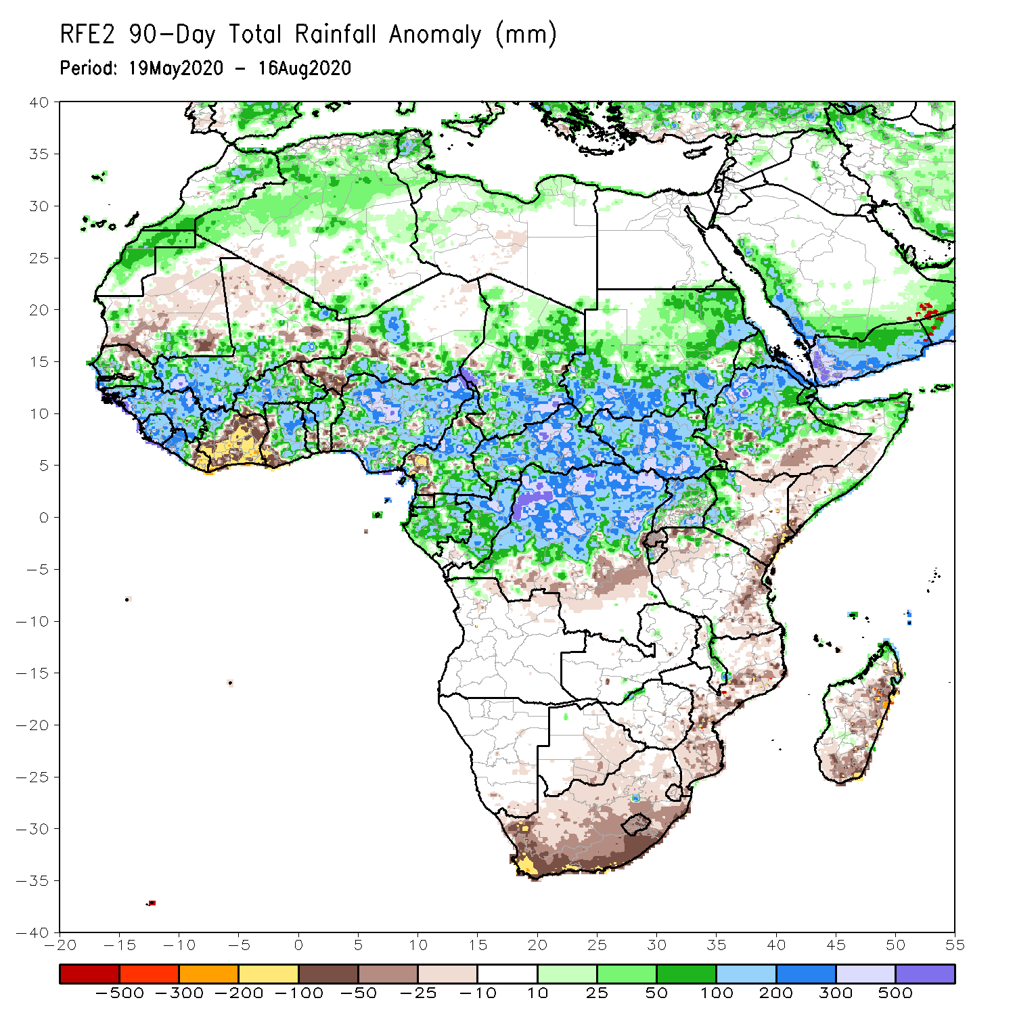
Rainfall Patterns: Last 90 Days
During the past 90 days, rainfall was above-average over much of West, Central and the Greater Horn of Africa.
Below-average rainfall was observed over local areas in Mauritania and Mali, parts of Cote d’Ivoire, local areas in Niger, southern Ethiopia, parts of Kenya, southern Somalia, parts of Tanzania, South Africa, Mozambique and Madagascar.
Notes:
6

Slide 7
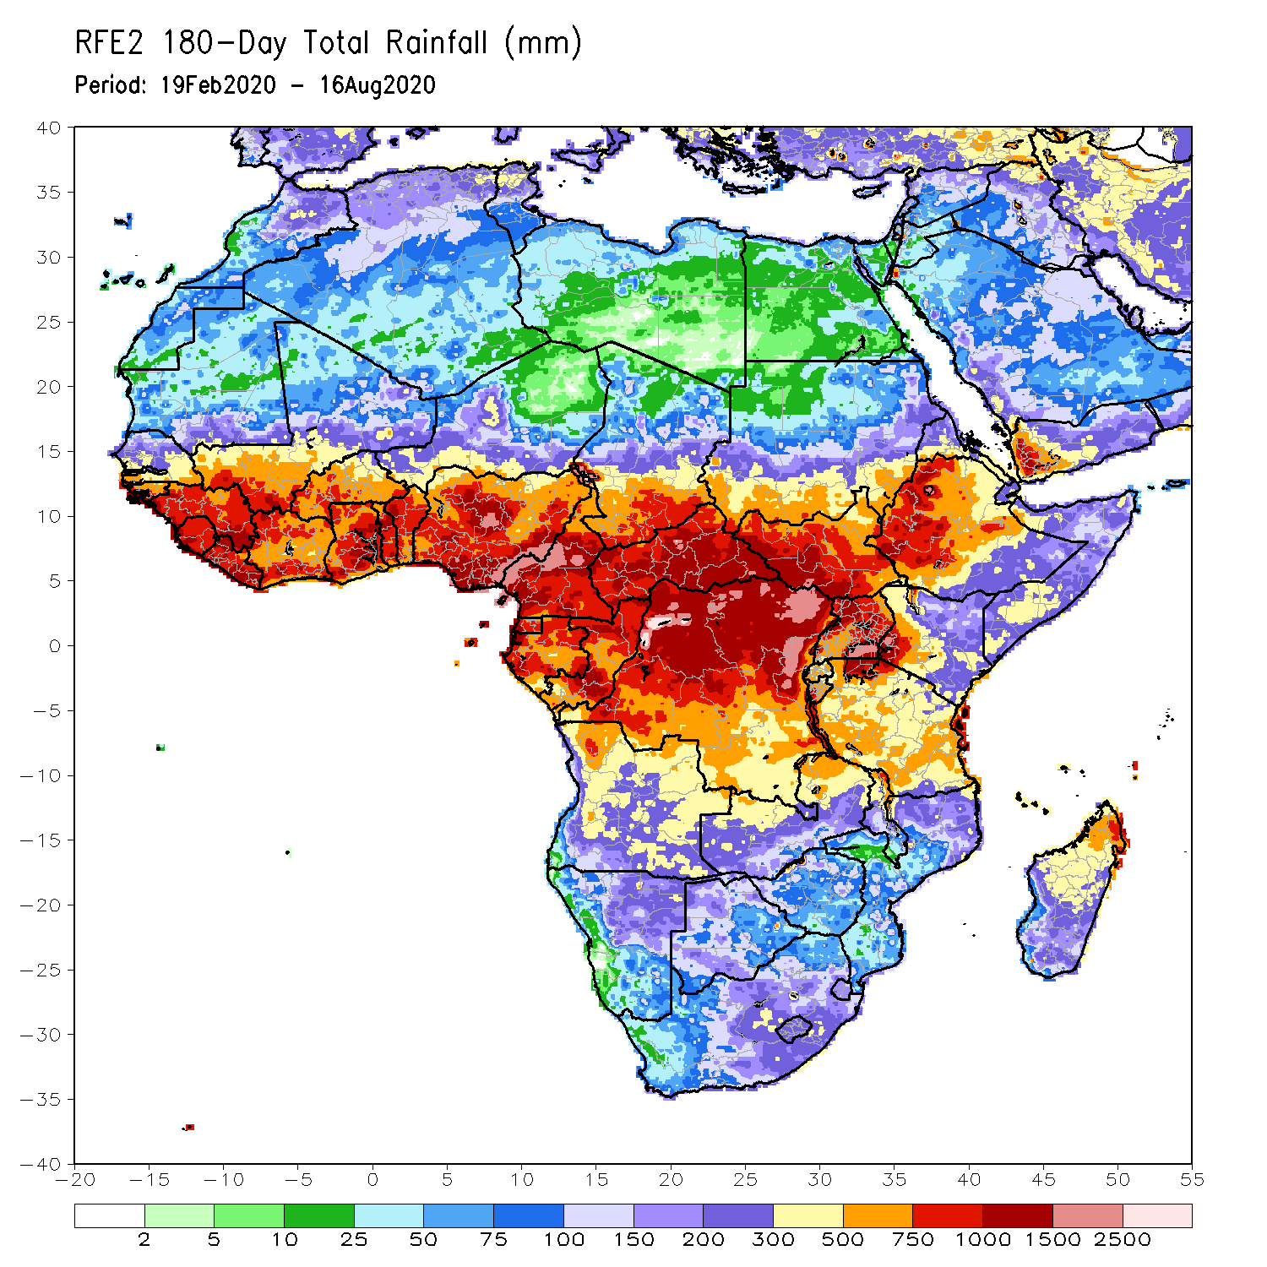
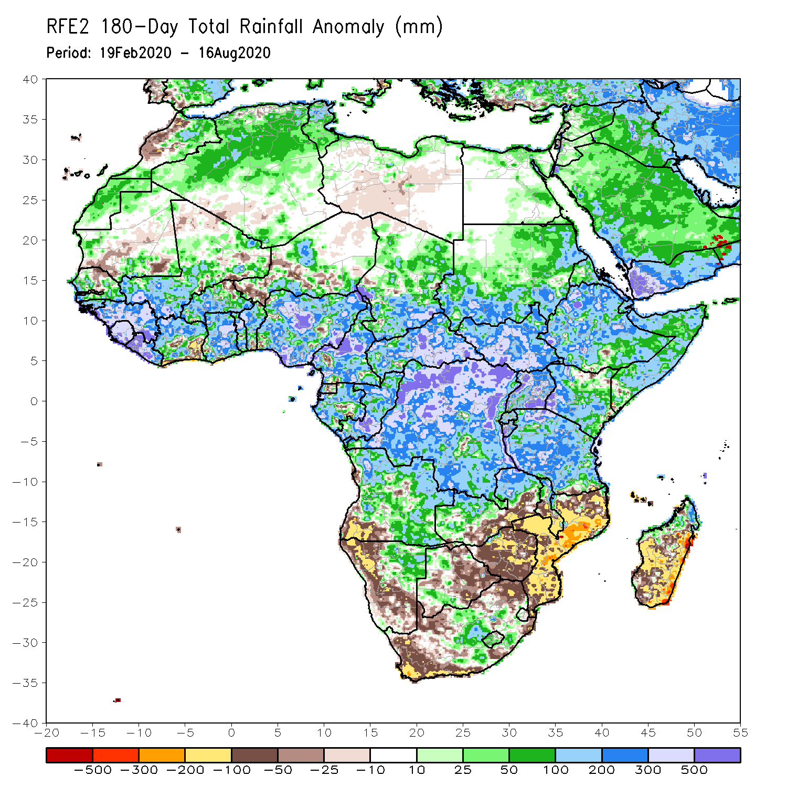
Rainfall Patterns: Last 180 Days
During the past 180 days, rainfall was above-average over much of West, Central and the Greater Horn of Africa, including the northern portions of Southern Africa. Rainfall was also above-average over northeastern Namibia, western Botswana, portions of South Africa, and northern Madagascar.
Below-average rainfall was observed over portions of southwestern Angola, western and southern Namibia, western South Africa, local areas in southern Zambia, eastern Botswana, Zimbabwe, many parts of Mozambique, and central and southern Madagascar.
Notes:
7

Slide 8
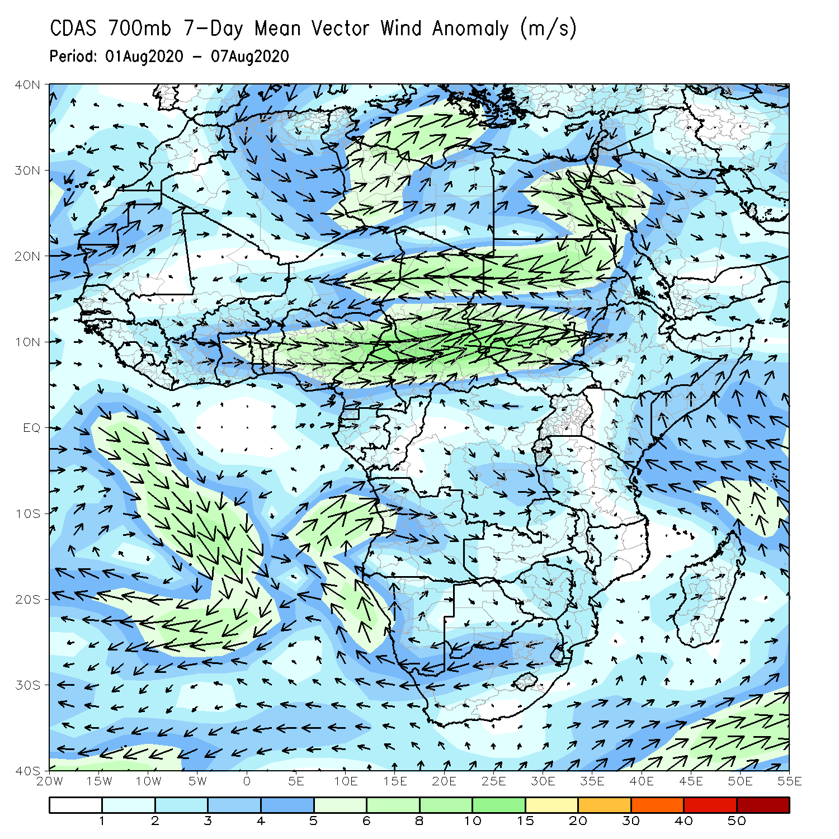
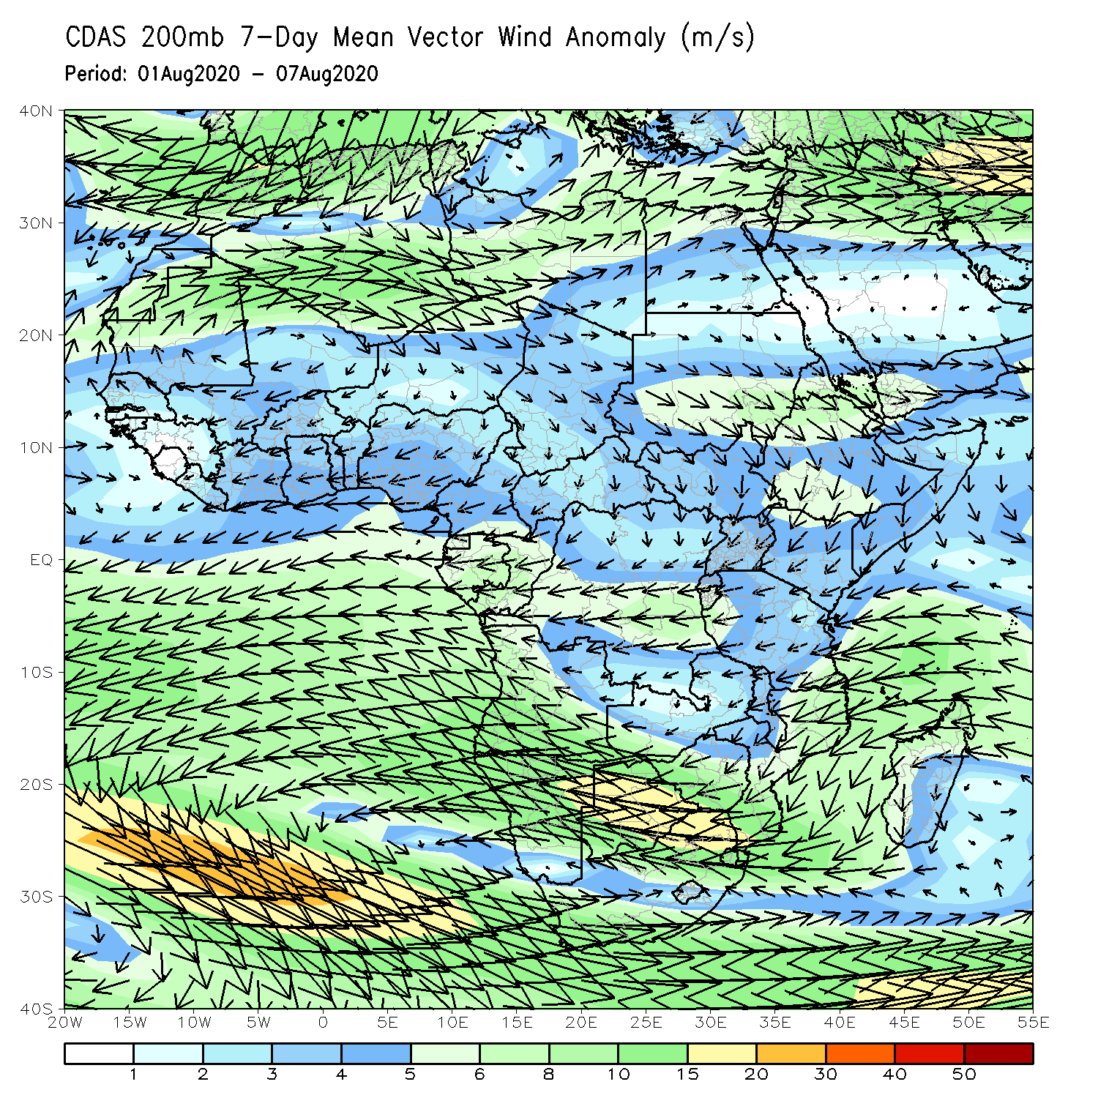
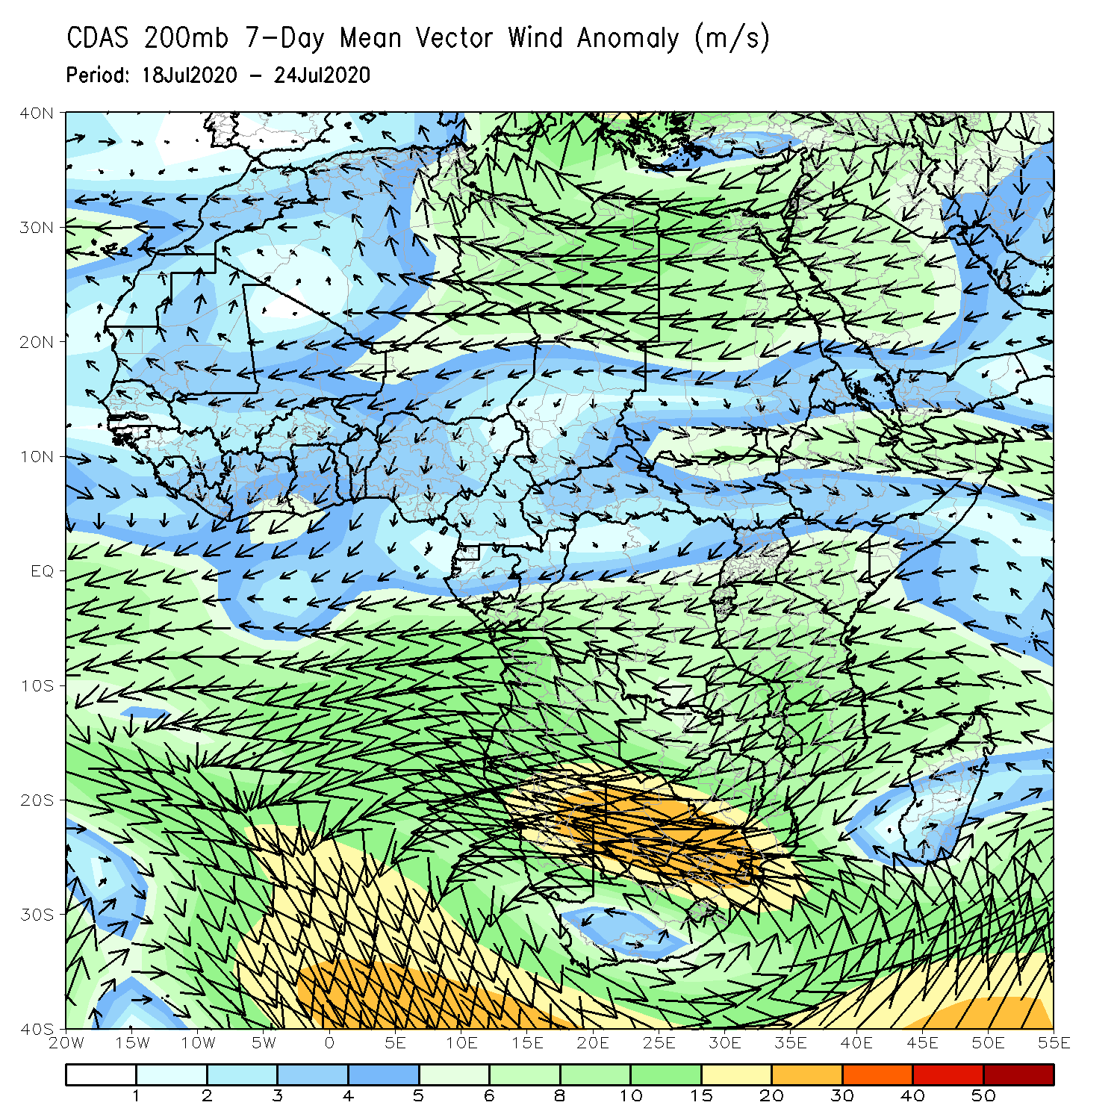
Atmospheric Circulation: Last 7 Days
An area of anomalous lower-level cyclonic shear was observed across central and eastern Sahel (left panel).

Slide 9
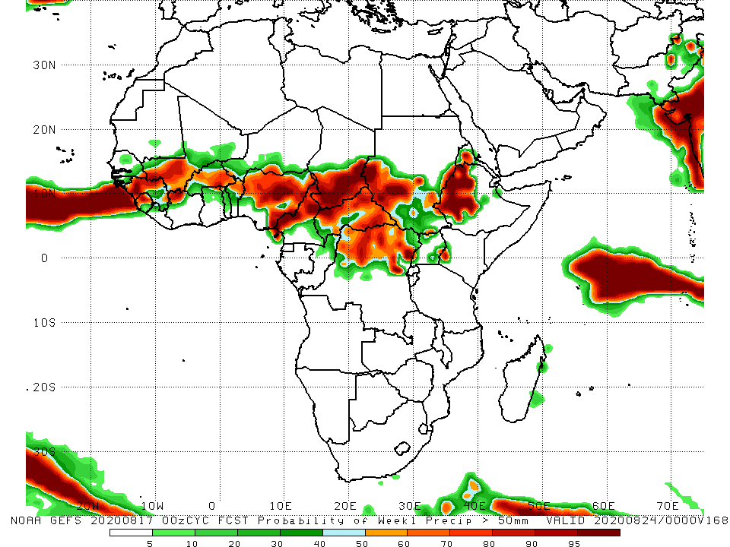
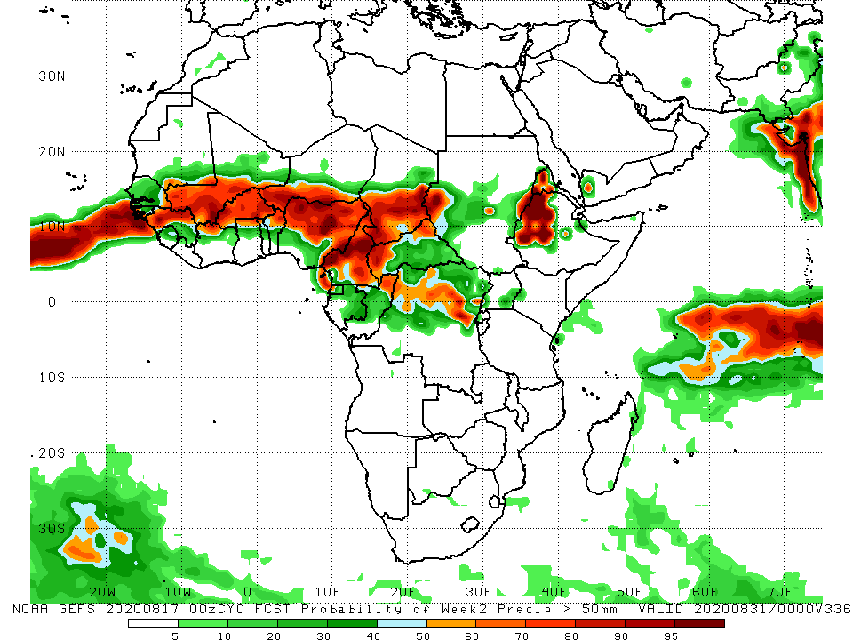
NCEP GEFS Model Forecasts Non-Bias Corrected Probability of precipitation exceedance
Week-1 Valid 18 – 24 August, 2020
Week-2: Valid 25 – 31 August, 2020
For week-1 (left panel) and Week-2 (right panel), there is an increased chance for weekly rainfall totals to exceed 50mm over many places in the Sahel region, and Eritrea and western Ethiopia.
Notes:
9

Slide 10
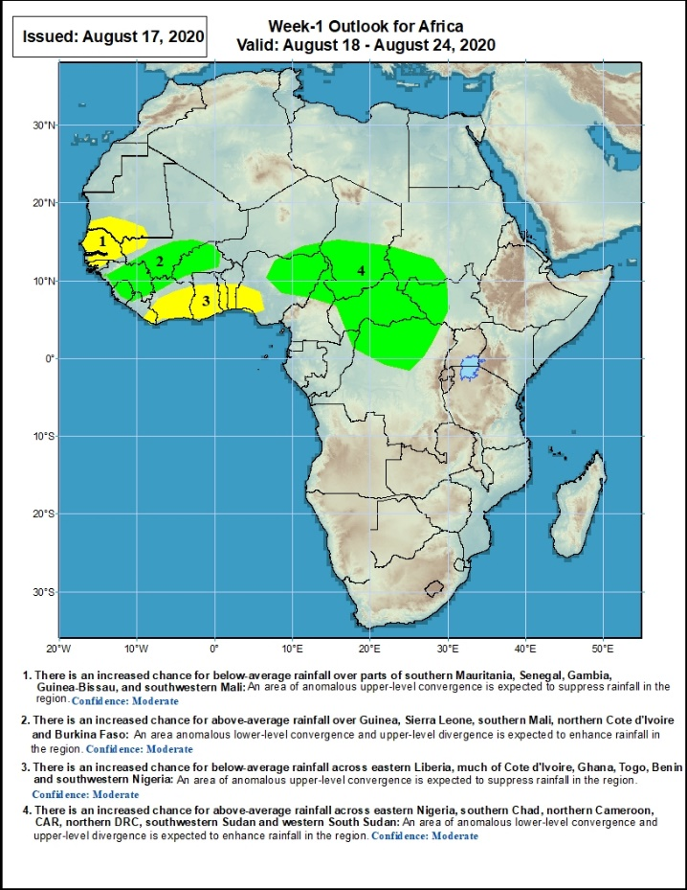
Week-1 Precipitation Outlooks
18 – 24 August, 2020
There is an increased chance for below-average rainfall over parts of southern Mauritania, Senegal, Gambia, Guinea-Bissau, and southwestern Mali: An area of anomalous upper-level convergence is expected to suppress rainfall in the region. Confidence: Moderate
There is an increased chance for above-average rainfall over Guinea, Sierra Leone, southern Mali, northern Cote d'Ivoire and Burkina Faso: An area anomalous lower-level convergence and upper-level divergence is expected to enhance rainfall in the region. Confidence: Moderate
There is an increased chance for below-average rainfall across eastern Liberia, much of Cote d'Ivoire, Ghana, Togo, Benin and southwestern Nigeria: An area of anomalous upper-level convergence is expected to suppress rainfall in the region. Confidence: Moderate
Notes:
10

Slide 11
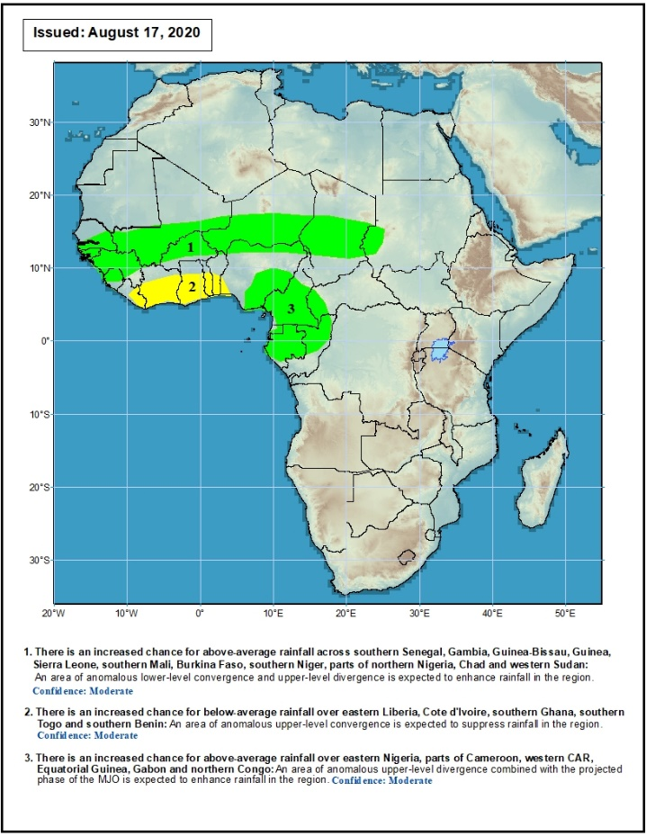
Week-2 Precipitation Outlooks
25 – 31 August, 2020
There is an increased chance for above-average rainfall across southern Senegal, Gambia, Guinea-Bissau, Guinea, Sierra Leone, southern Mali, Burkina Faso, southern Niger, parts of northern Nigeria, Chad and western Sudan: An area of anomalous lower-level convergence and upper-level divergence is expected to enhance rainfall in the region. Confidence: Moderate
There is an increased chance for below-average rainfall over eastern Liberia, Cote d'Ivoire, southern Ghana, southern Togo and southern Benin: An area of anomalous upper-level convergence is expected to suppress rainfall in the region. Confidence: Moderate
There is an increased chance for above-average rainfall over eastern Nigeria, parts of Cameroon, western CAR, Equatorial Guinea, Gabon and northern Congo: An area of anomalous upper-level divergence combined with the projected phase of the MJO is expected to enhance rainfall in the region. Confidence: Moderate
There is an increased chance for above-average rainfall across eastern Nigeria, southern Chad, northern Cameroon, CAR, northern DRC, southwestern Sudan and western South Sudan: An area of anomalous lower-level convergence and upper-level divergence is expected to enhance rainfall in the region. Confidence: Moderate
Notes:
11

Slide 12
Summary
During the past 7 days, rainfall was above-average over local areas in Mauritania and Senegal, western Mali, northern Guinea, Burkina Faso, local areas in northern Nigeria and Niger, many parts of Chad, central and eastern CAR, southern Sudan, northern DRC, many parts of South Sudan, Uganda, southwestern Kenya, and southern Ethiopia. Below-average rainfall was observed over southern Mauritania, much of Senegal, local areas in Guinea, Sierra Leone, Liberia, central Mali, Cote d’Ivoire, Ghana, western and southern Niger, much of Nigeria, Cameroon, western CAR, central Chad, and northeastern Ethiopia.
During the past 30 days, rainfall was above-average over local areas in Mauritania, Senegal, Guinea, Mali, parts of Burkina Faso, local areas in Niger, northern Nigeria, much of Chad, local areas in northern Cameroon, much of CAR, Sudan, South Sudan, northern DRC, Eritrea, and many parts of Ethiopia. Rainfall was below-average over local areas in Mauritania, northern Senegal, local areas in Guinea and Mali, Sierra Leone, Burkina Faso, Togo, Benin, parts of Niger, southern Nigeria, parts of Cameroon, local areas in Chad and CAR, parts of western Ethiopia, and local areas in DRC.
During the past 90 days, rainfall was above-average over much of West, Central and the Greater Horn of Africa. Below-average rainfall was observed over local areas in Mauritania and Mali, parts of Cote d’Ivoire, local areas in Niger, southern Ethiopia, parts of Kenya, southern Somalia, parts of Tanzania, South Africa, Mozambique and Madagascar.
Week-1 outlooks call for an increased chance for above-average rainfall over Guinea, Sierra Leone, southern Mali, northern Cote d'Ivoire, Burkina Faso, eastern Nigeria, southern Chad, northern Cameroon, CAR, northern DRC, southwestern Sudan and western South Sudan. In contrast, there is an increased chance for below-average rainfall over parts of southern Mauritania, Senegal, Gambia, Guinea-Bissau, southwestern Mali eastern Liberia, central and southern Cote d'Ivoire, Ghana, Togo, Benin and southwestern Nigeria.
Week-2 outlooks call for an increased chance for above-average rainfall over southern Senegal, Gambia, Guinea-Bissau, Guinea, Sierra Leone, southern Mali, Burkina Faso, southern Niger, parts of northern and eastern Nigeria, Cameroon, western CAR, Equatorial Guinea, Gabon, northern Congo, Chad and western Sudan. In contrast, there is an increased chance for below-average rainfall over eastern Liberia, Cote d'Ivoire, southern Ghana, southern Togo and southern Benin.
Notes:
12

