Slide 1
The African Monsoon Recent Evolution and Current Status Include Week-1 and Week-2 Outlooks
Update prepared by
Climate Prediction Center / NCEP
27 July 2020
For more information, visit:
http://www.cpc.ncep.noaa.gov/products/Global_Monsoons/African_Monsoons/precip_monitoring.shtml

Slide 2
Outline
Highlights
Recent Evolution and Current Conditions
NCEP GEFS Forecasts
Summary

Slide 3
Highlights: Last 7 Days
Weekly rainfall surpluses exceeded 100mm over local areas in Senegal, Mali, Cote d’Ivoire, Nigeria, Chad and DRC.
Week-1 outlooks call for an increased chance for above-average rainfall over southern Mauritania, much of Senegal, southwestern Mali, Guinea-Bissau, Guinea, Sierra Leone, Sierra Leone, western Liberia, northern Cote d'Ivoire, western Burkina Faso, southern Niger, northern Nigeria, central Chad, western and eastern Sudan, western Ethiopia, and eastern South Sudan. In contrast, there is an increased chance for below-average rainfall over eastern Liberia, southern Cote d'Ivoire, southern Ghana, southern Togo, southern Benin, and southwestern Nigeria.
Week-2 outlooks call for an increased chance for above-average rainfall over much of Senegal, Guinea-Bissau, Guinea, Sierra Leone, southern Mali, Burkina Faso, southern Niger, northern Nigeria, southern Chad, western and eastern Sudan, eastern South Sudan, and western Ethiopia. In contrast, there is an increased chance for below-average rainfall along the Gulf of Guinea coast.

Slide 4
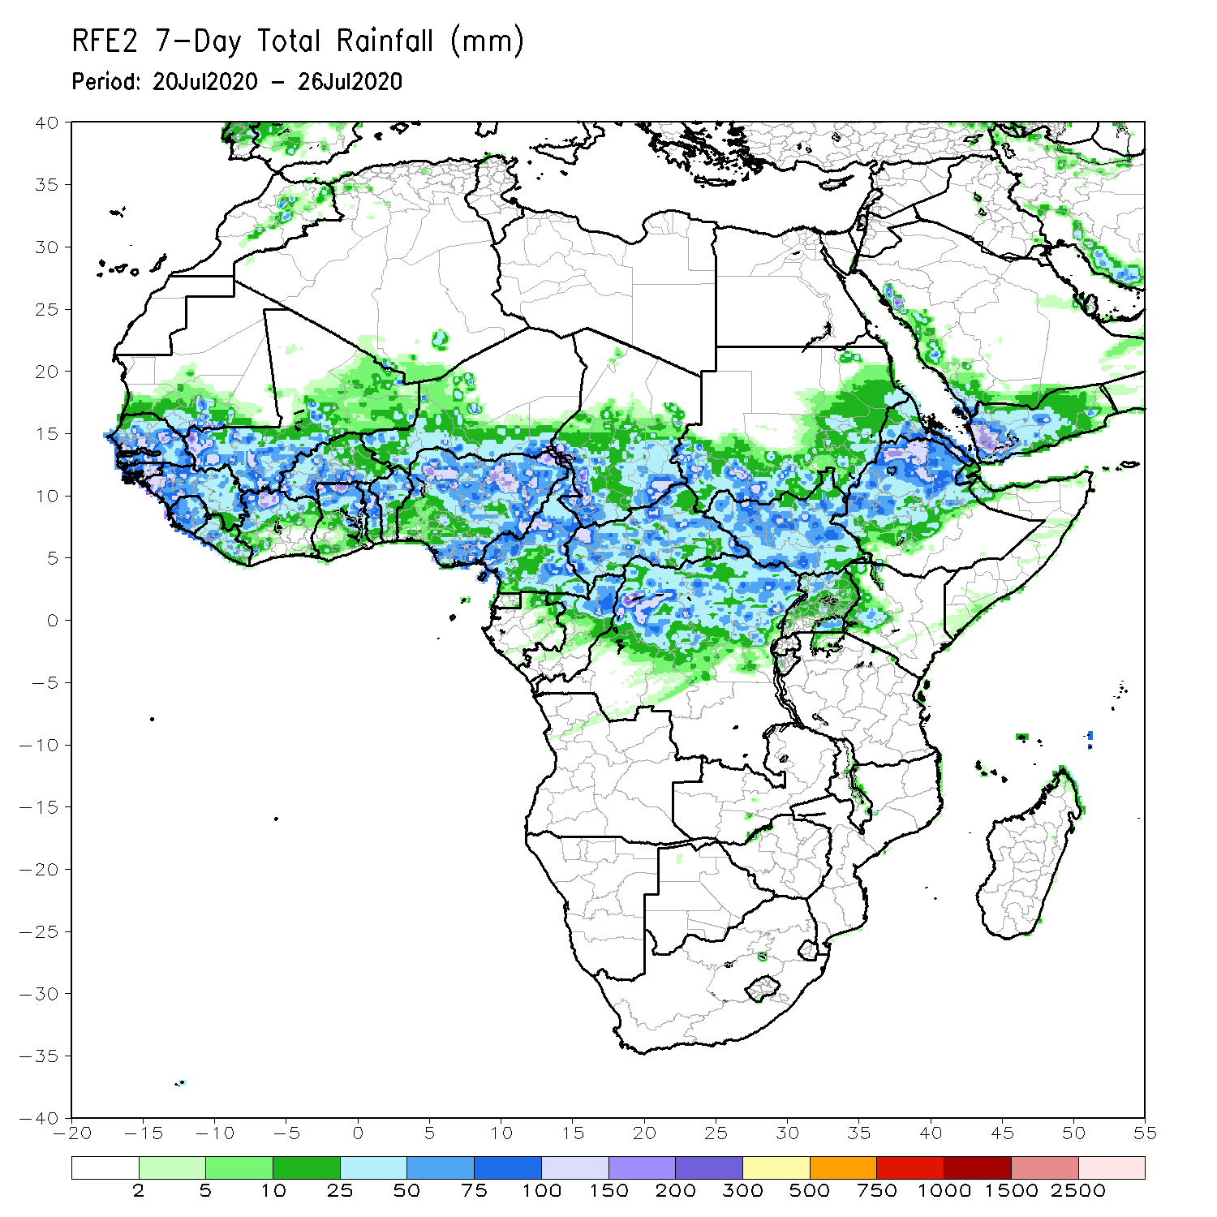
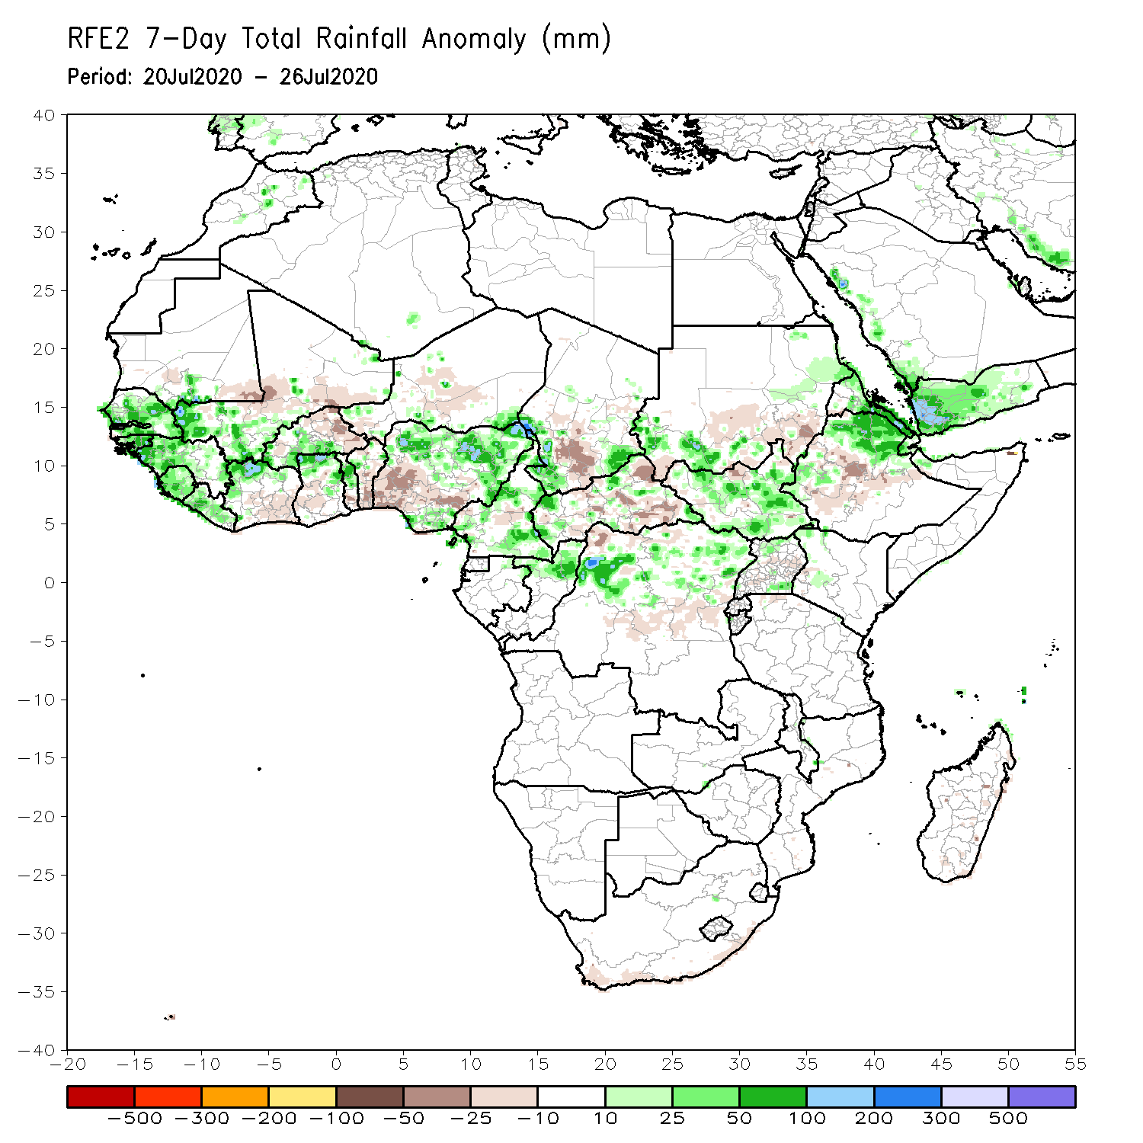
Rainfall Patterns: Last 7 Days
During the past 7 days, rainfall was above-average over much of Senegal, local areas in southern Mauritania, Guinea, Sierra Leone, Liberia, northern Cote d’Ivoire, southwestern Mali, northern Ghana, local areas in Burkina Faso, Cameroon, parts of Chad, Congo, local areas in CAR, northern DRC, South Sudan, portions of southern, northeastern Ethiopia and eastern Eritrea.
Below-average rainfall was observed over portions of Cote d’Ivoire, local areas in Mali, Burkina Faso, southern Ghana, southern Togo, Benin, southern Nigeria, Chad, CAR, parts of Sudan and Ethiopia.

Slide 5
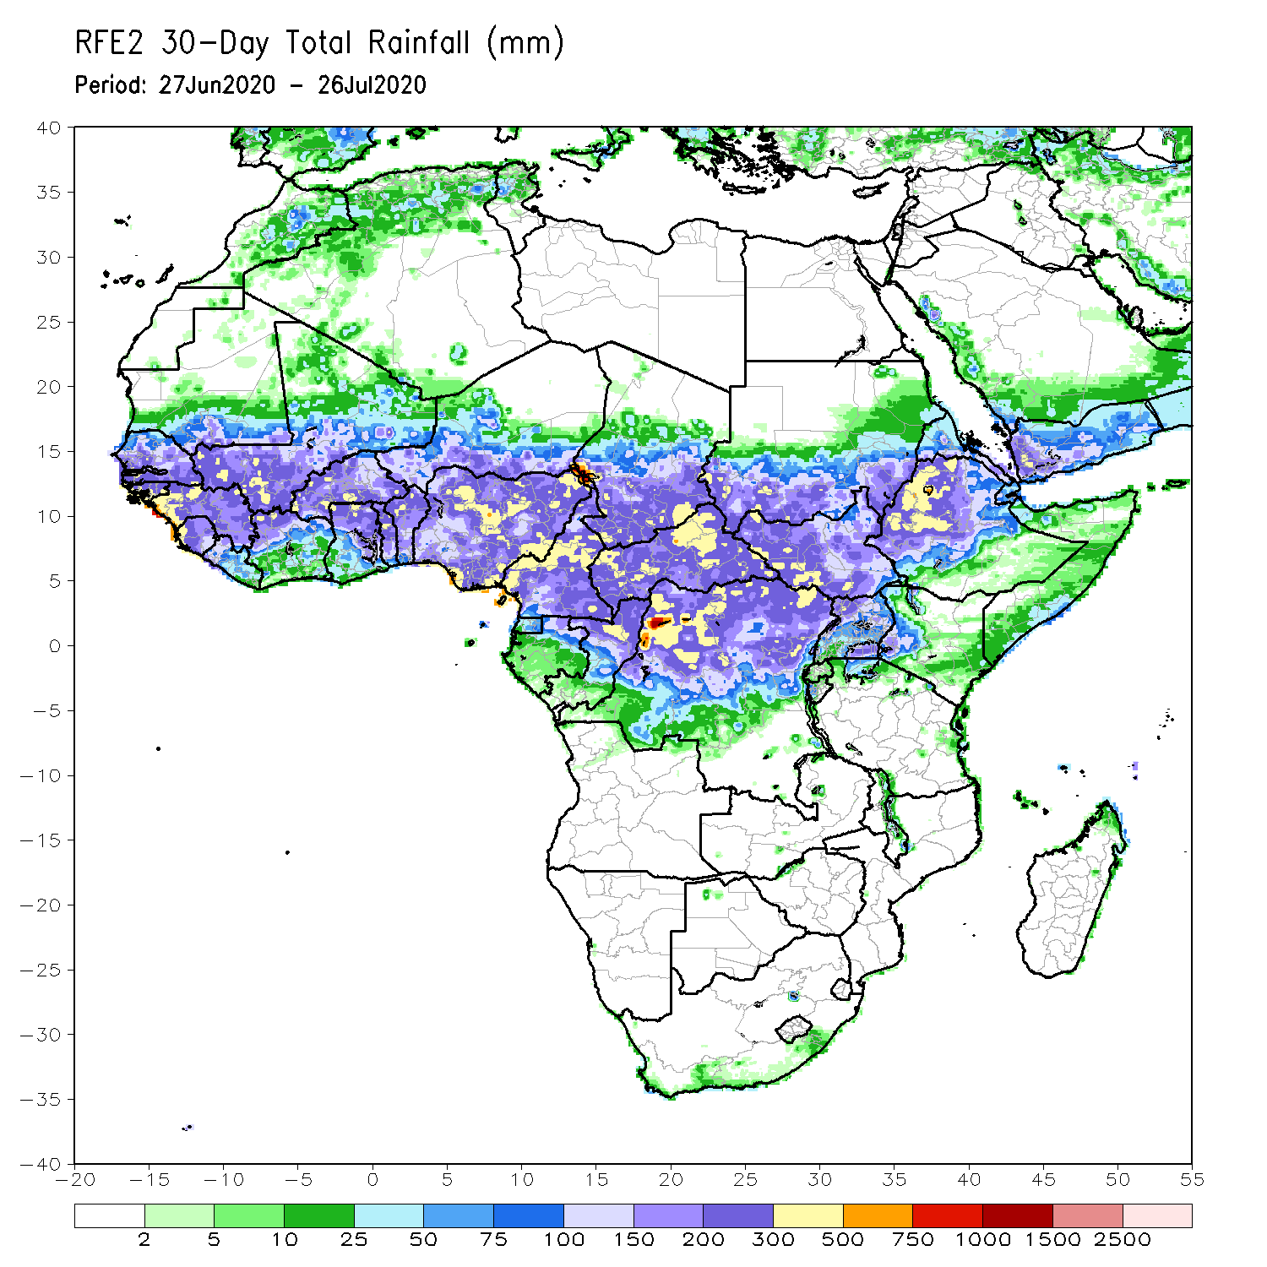
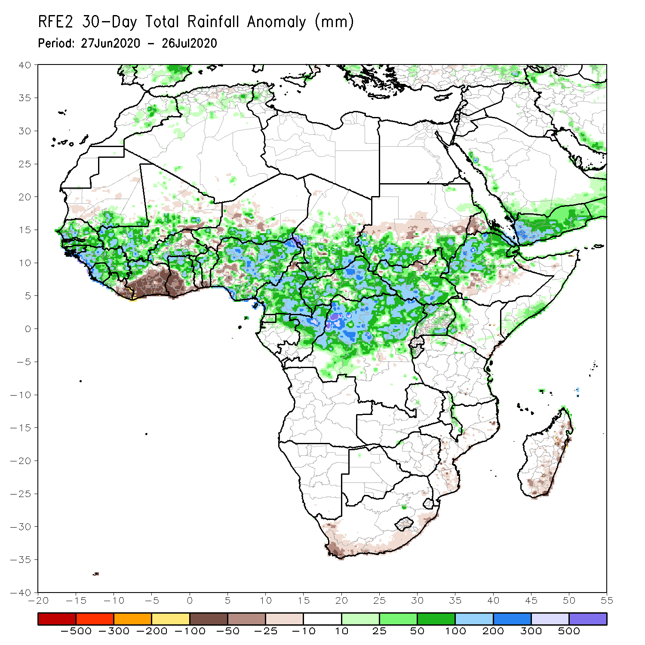
Rainfall Patterns: Last 30 Days
During the past 30 days, rainfall was above-average over many places in the Sahel region, the far western and eastern Gulf of Guinea, and Central Africa countries. Above-average rainfall was also observed over South Sudan, parts of southern and eastern and southern Sudan, Uganda, Ethiopia, and local areas in western Kenya and southern Somalia.
Rainfall was below-average over eastern Liberia, portions of Cote d’Ivoire, southwestern Ghana, local areas in Burkina Faso Nigeria, and Niger, and parts of Sudan Eritrea.
Notes:
5

Slide 6
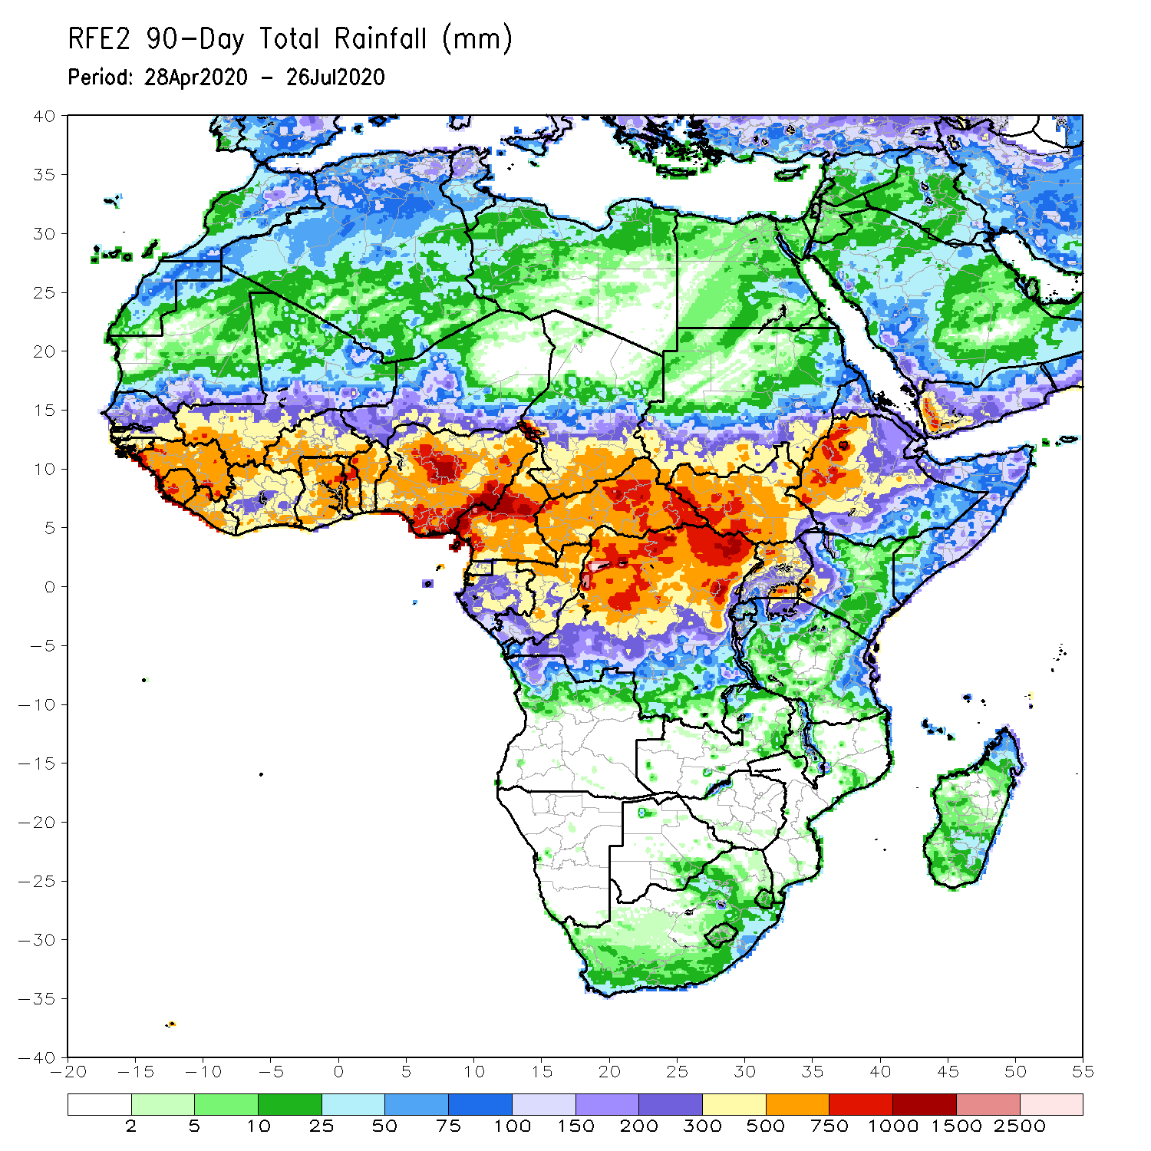
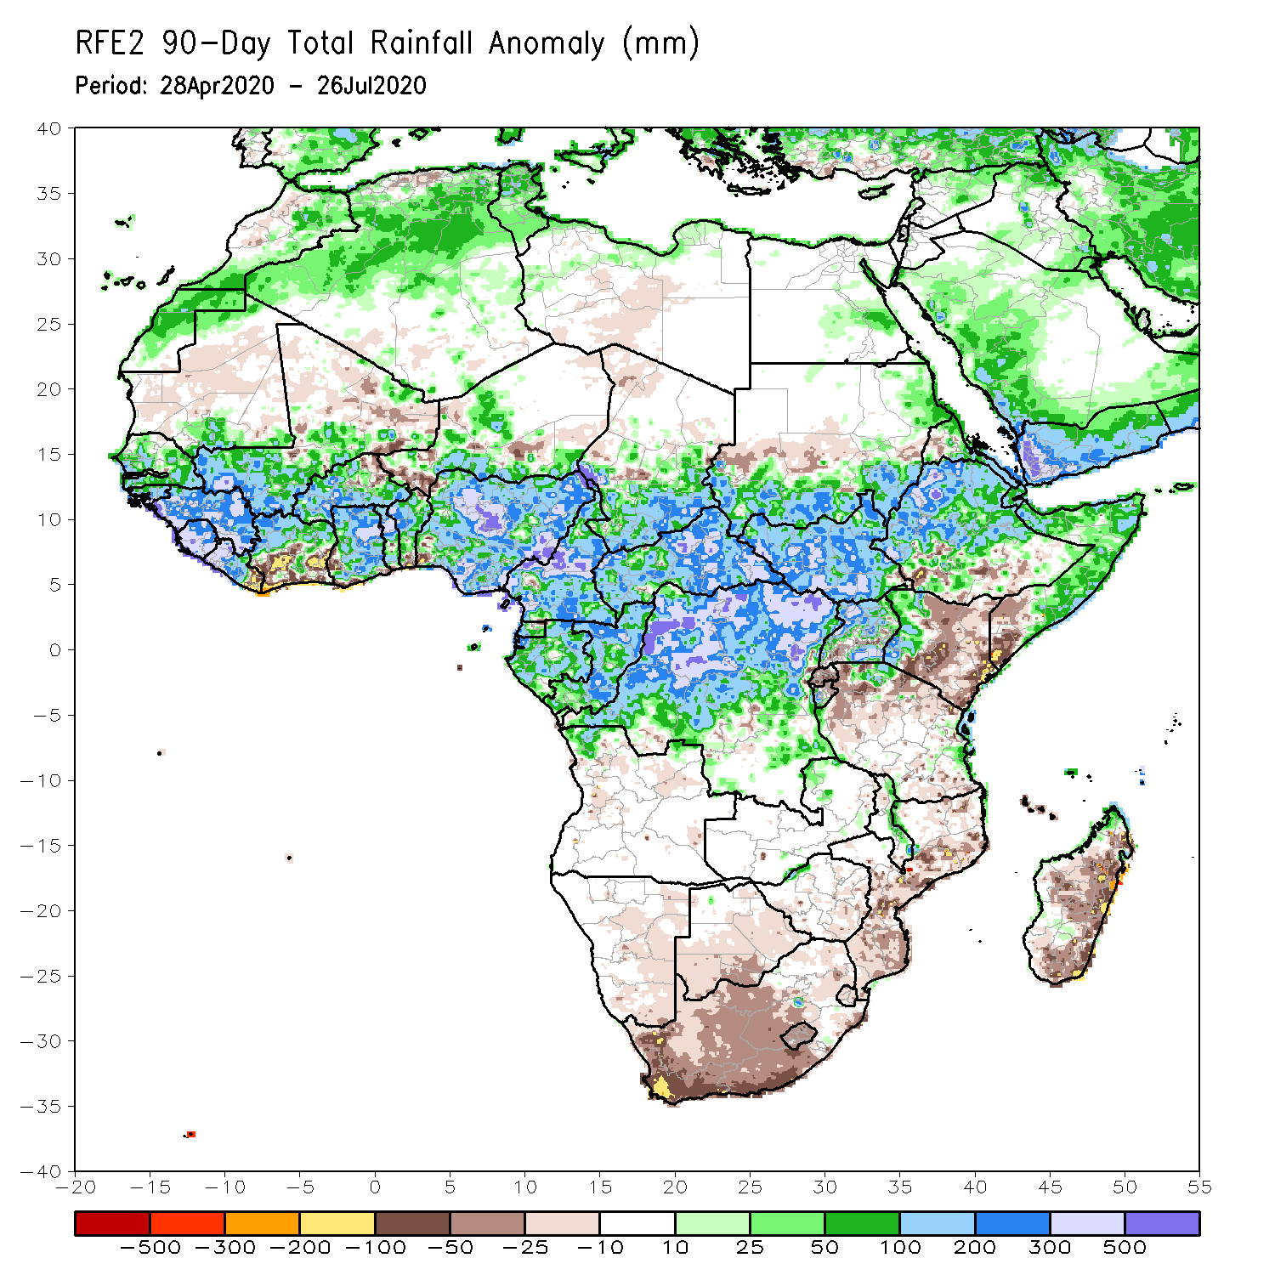
Rainfall Patterns: Last 90 Days
During the past 90 days, rainfall was above-average over much of West, Central and many places in the Greater Horn of Africa. Below-average rainfall was observed over parts of Cote d’Ivoire, local areas in Niger, parts of Sudan, many parts of Kenya, Tanzania, and many places in Southern Africa including Madagascar.
Notes:
6

Slide 7
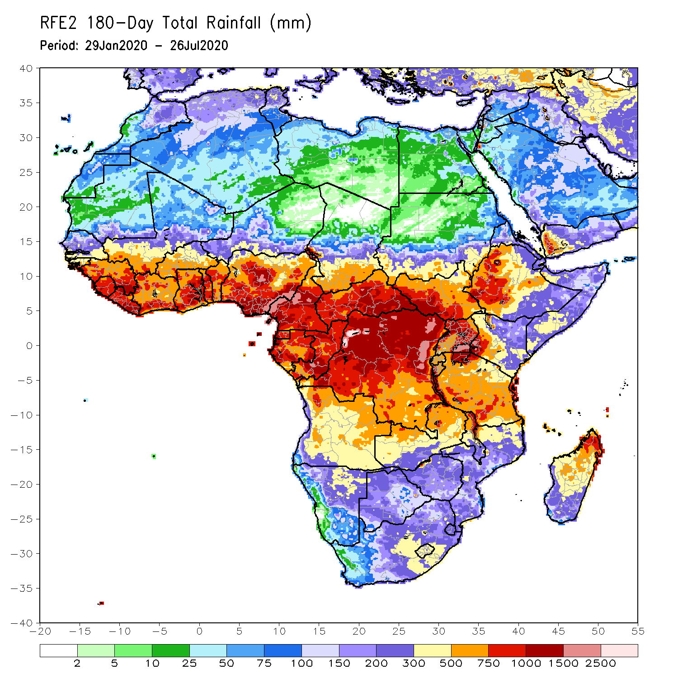
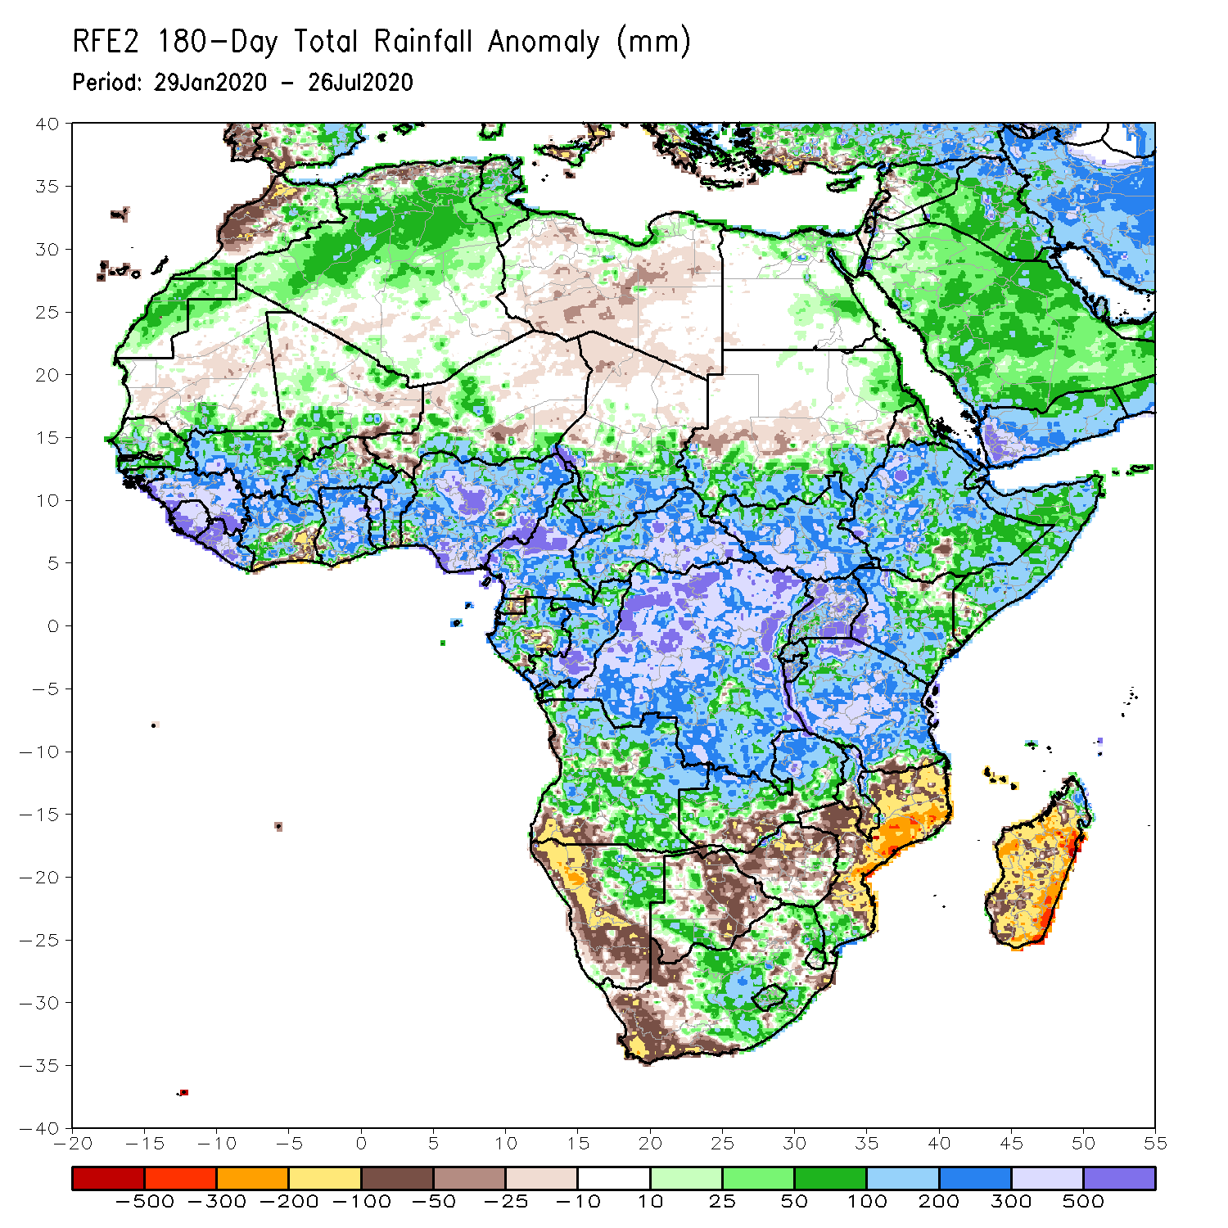
Rainfall Patterns: Last 180 Days
During the past 180 days, rainfall was above-average over much of West, Central and the Greater Horn of Africa, including the northern portions of Southern Africa. Rainfall was also above-average over local areas in northern Namibia, Botswana, portions of South Africa, and northern Madagascar.
Below-average rainfall was observed over portions of Gabon, local areas in Angola, many parts of Namibia, parts of South Africa, southern Zambia, much of Botswana, Zimbabwe, many parts of Mozambique, and central and southern Madagascar.
Notes:
7

Slide 8
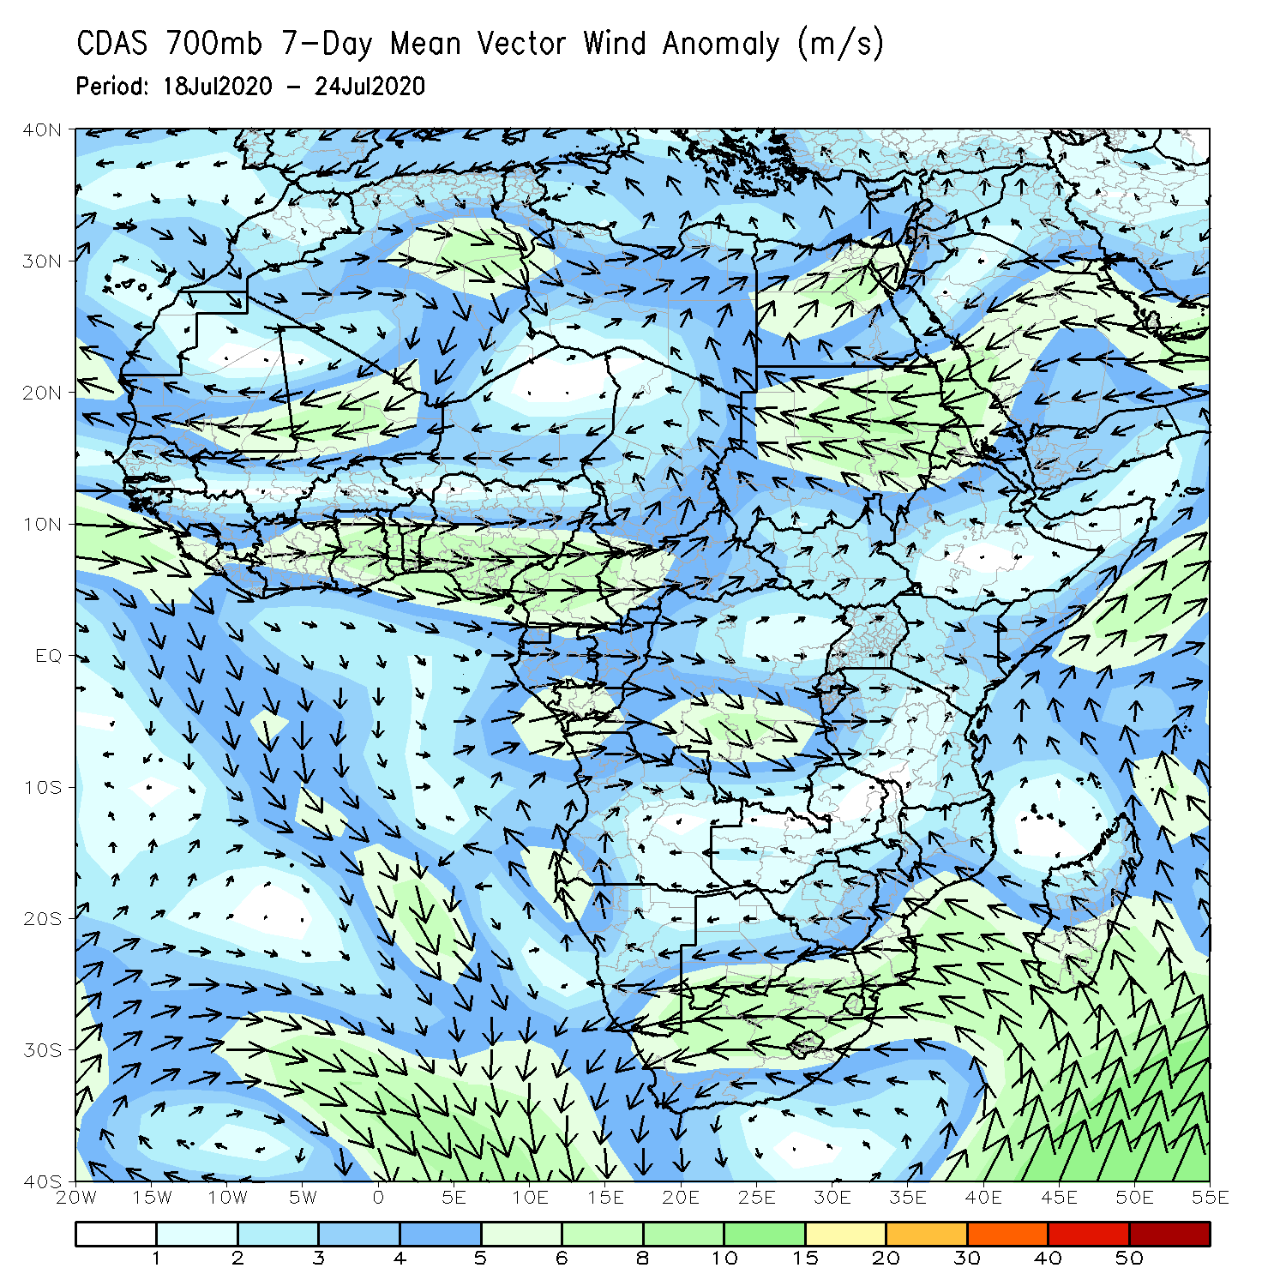
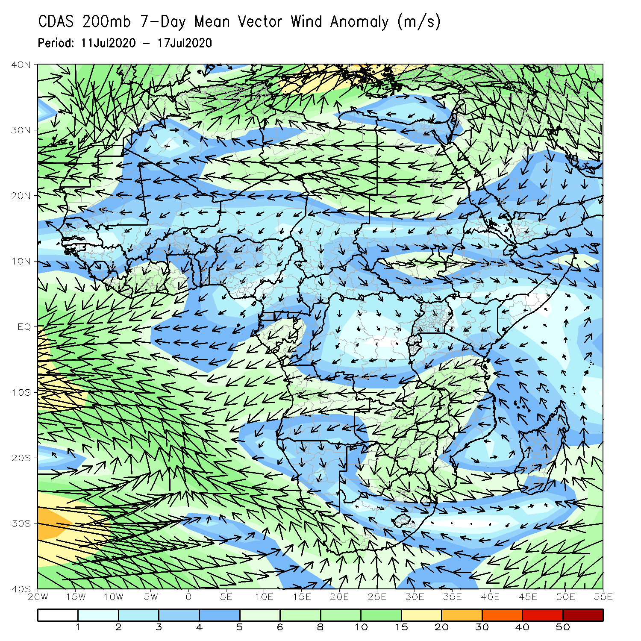
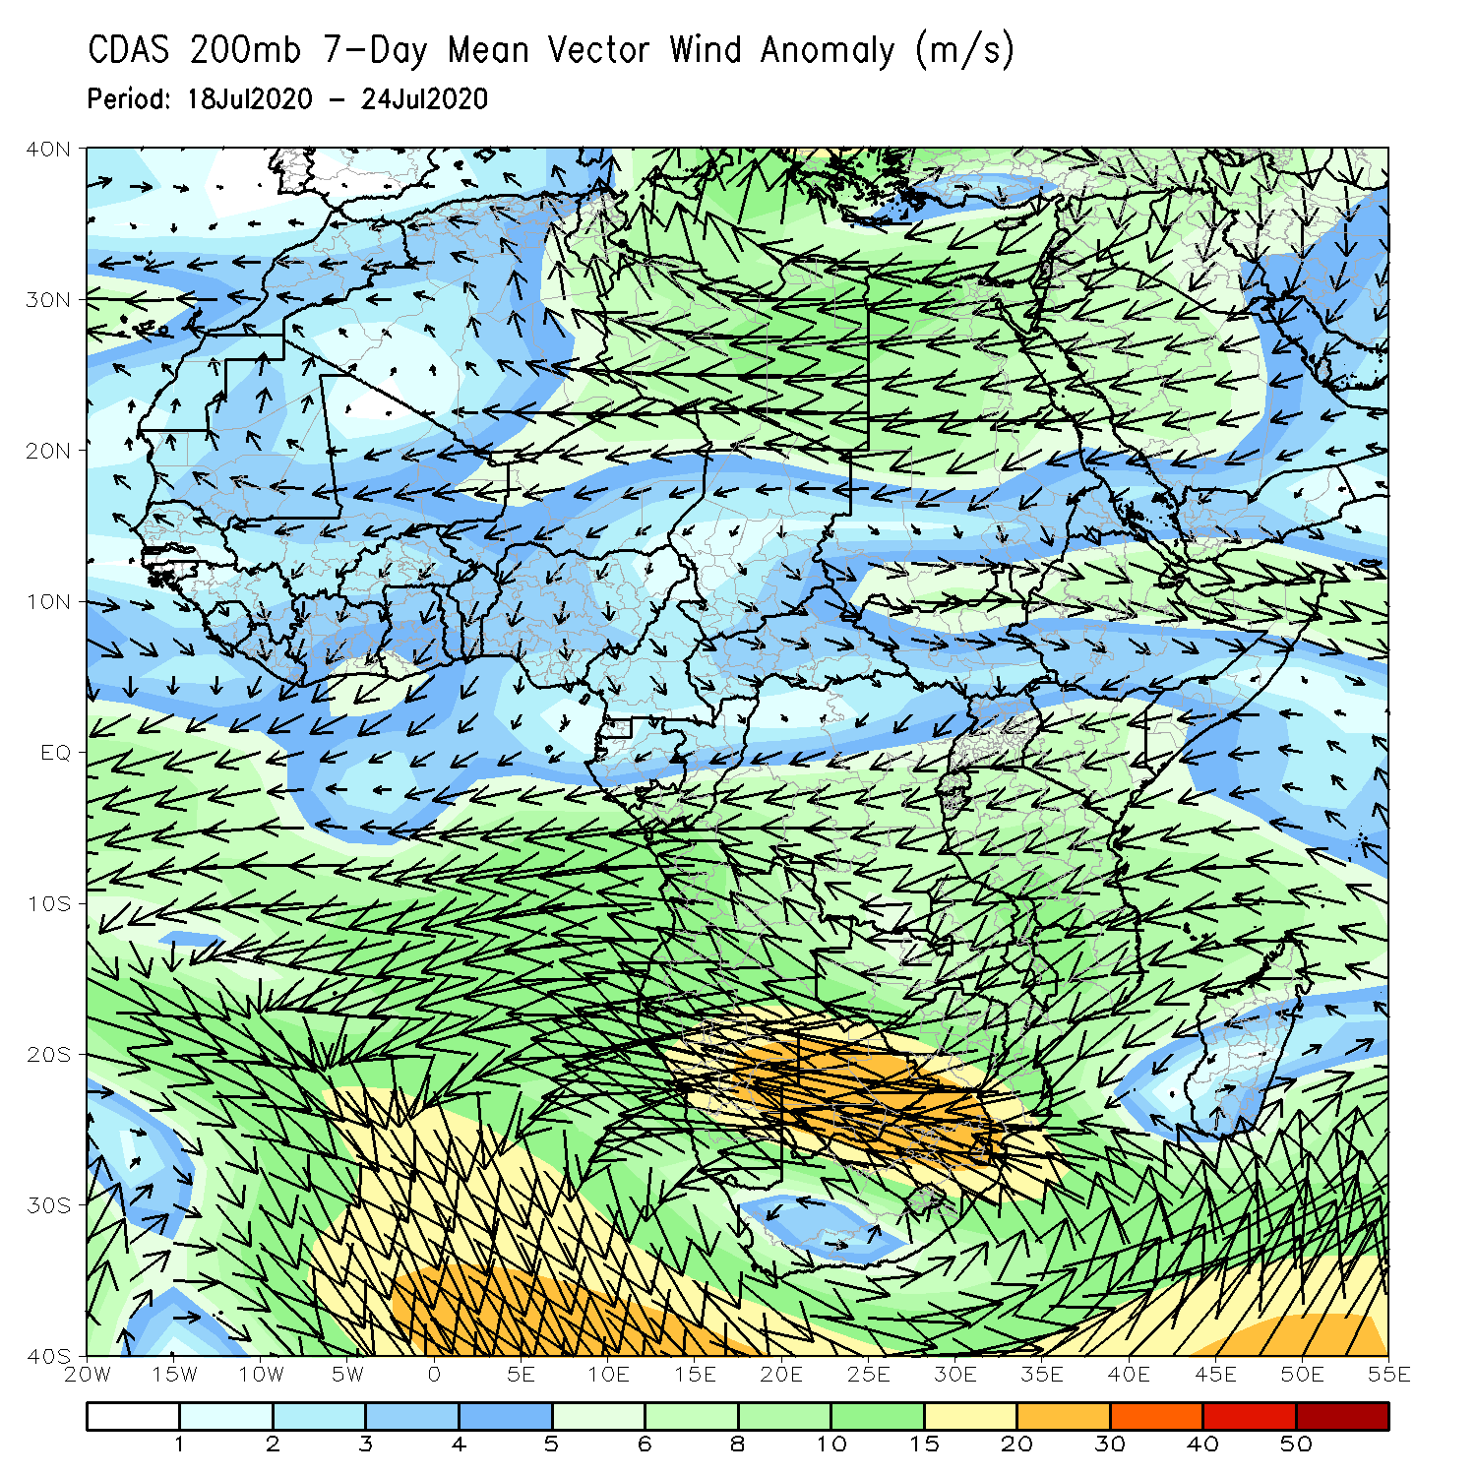
Atmospheric Circulation: Last 7 Days
Anomalous lower-level westerly flow with its associated cyclonic shear prevailed over West Africa (left panel).

Slide 9
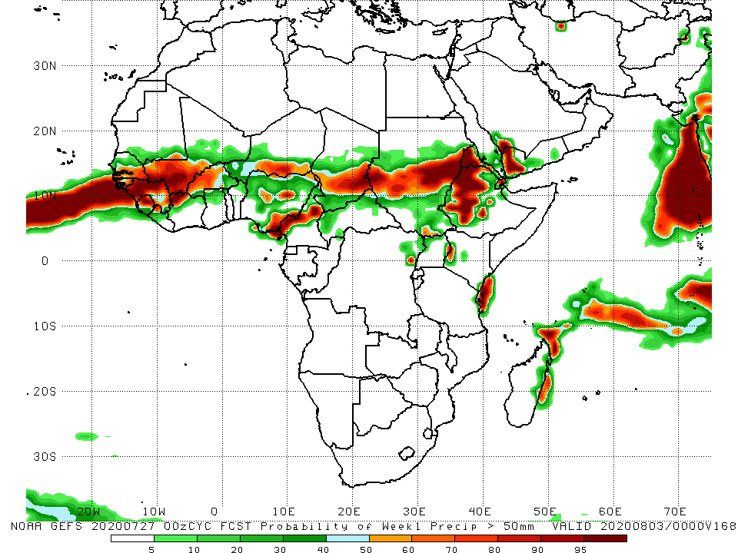
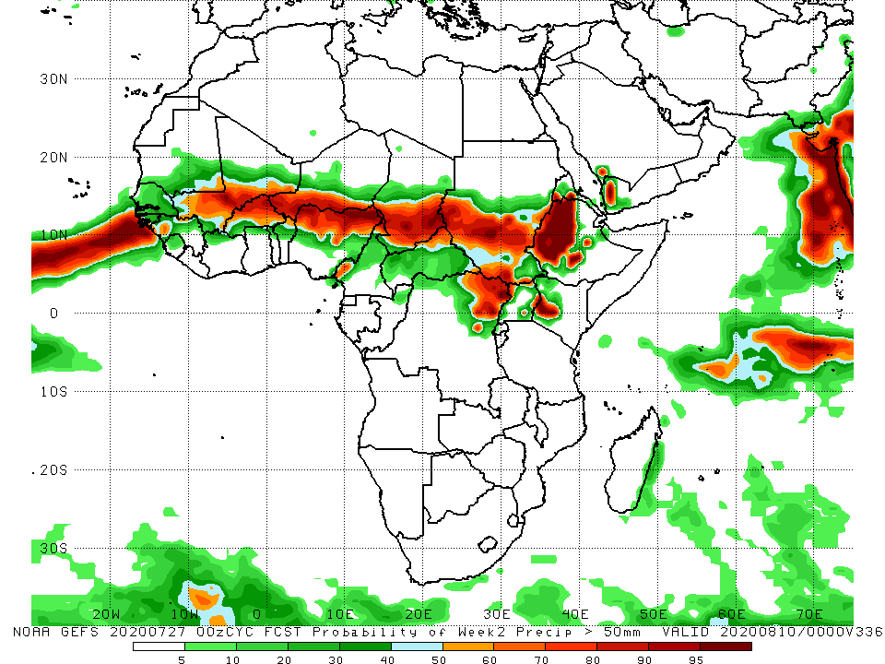
NCEP GEFS Model Forecasts Non-Bias Corrected Probability of precipitation exceedance
Week-1 Valid 28 July – 3 August, 2020
Week-2: Valid 4 – 10 August, 2020
For week-1 (left panel) and Week-2 (right panel), there is an increased chance for weekly rainfall totals to exceed 50mm over many places in the Sahel region, and portions of the Greater Horn of Africa.
Notes:
9

Slide 10
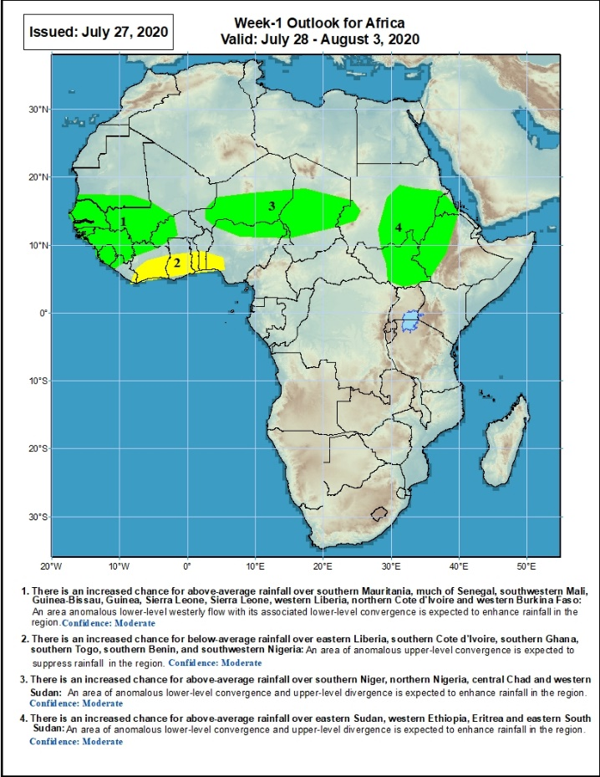
Week-1 Precipitation Outlooks
28 July – 3 August, 2020
There is an increased chance for above-average rainfall over southern Mauritania, much of Senegal, southwestern Mali, Guinea-Bissau, Guinea, Sierra Leone, Sierra Leone, western Liberia, northern Cote d'Ivoire and western Burkina Faso: An area anomalous lower-level westerly flow with its associated lower-level convergence is expected to enhance rainfall in the region. Confidence: Moderate
There is an increased chance for below-average rainfall over eastern Liberia, southern Cote d'Ivoire, southern Ghana, southern Togo, southern Benin, and southwestern Nigeria: An area of anomalous upper-level convergence is expected to suppress rainfall in the region. Confidence: Moderate
There is an increased chance for above-average rainfall over southern Niger, northern Nigeria, central Chad and western Sudan: An area of anomalous lower-level convergence and upper-level divergence is expected to enhance rainfall in the region. Confidence: Moderate
There is an increased chance for above-average rainfall over eastern Sudan, western Ethiopia, Eritrea and eastern South Sudan: An area of anomalous lower-level convergence and upper-level divergence is expected to enhance rainfall in the region. Confidence: Moderate
Notes:
10

Slide 11
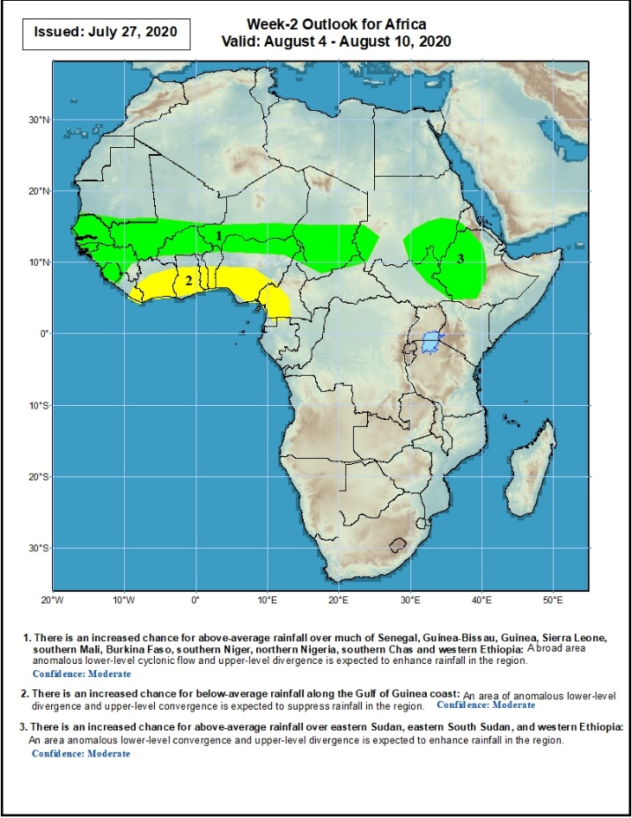
Week-2 Precipitation Outlooks
4 – 10 August, 2020
There is an increased chance for above-average rainfall over much of Senegal, Guinea-Bissau, Guinea, Sierra Leone, southern Mali, Burkina Faso, southern Niger, northern Nigeria, southern Chad and western Sudan: A broad area anomalous lower-level cyclonic flow and upper-level divergence is expected to enhance rainfall in the region. Confidence: Moderate
There is an increased chance for below-average rainfall along the Gulf of Guinea coast: An area of anomalous lower-level divergence and upper-level convergence is expected to suppress rainfall in the region. Confidence: Moderate
There is an increased chance for above-average rainfall over eastern Sudan, eastern South Sudan, and western Ethiopia: An area anomalous lower-level convergence and upper-level divergence is expected to enhance rainfall in the region. Confidence: Moderate
Notes:
11

Slide 12
Summary
During the past 7 days, rainfall was above-average over much of Senegal, local areas in southern Mauritania, Guinea, Sierra Leone, Liberia, northern Cote d’Ivoire, southwestern Mali, northern Ghana, local areas in Burkina Faso, Cameroon, parts of Chad, Congo, local areas in CAR, northern DRC, South Sudan, portions of southern, northeastern Ethiopia and eastern Eritrea. Below-average rainfall was observed over portions of Cote d’Ivoire, local areas in Mali, Burkina Faso, southern Ghana, southern Togo, Benin, southern Nigeria, Chad, CAR, parts of Sudan and Ethiopia.
During the past 30 days, rainfall was above-average over many places in the Sahel region, the far western and eastern Gulf of Guinea, and Central Africa countries. Above-average rainfall was also observed over South Sudan, parts of southern and eastern and southern Sudan, Uganda, Ethiopia, and local areas in western Kenya and southern Somalia. Rainfall was below-average over eastern Liberia, portions of Cote d’Ivoire, southwestern Ghana, local areas in Burkina Faso Nigeria, and Niger, and parts of Sudan Eritrea.
During the past 90 days, rainfall was above-average over much of West, Central and many places in the Greater Horn of Africa. Below-average rainfall was observed over parts of Cote d’Ivoire, local areas in Niger, parts of Sudan, many parts of Kenya, Tanzania, and many places in Southern Africa including Madagascar.
Week-1 outlooks call for an increased chance for above-average rainfall over southern Mauritania, much of Senegal, southwestern Mali, Guinea-Bissau, Guinea, Sierra Leone, Sierra Leone, western Liberia, northern Cote d'Ivoire, western Burkina Faso, southern Niger, northern Nigeria, central Chad, western and eastern Sudan, western Ethiopia, and eastern South Sudan. In contrast, there is an increased chance for below-average rainfall over eastern Liberia, southern Cote d'Ivoire, southern Ghana, southern Togo, southern Benin, and southwestern Nigeria.
Week-2 outlooks call for an increased chance for above-average rainfall over much of Senegal, Guinea-Bissau, Guinea, Sierra Leone, southern Mali, Burkina Faso, southern Niger, northern Nigeria, southern Chad, western and eastern Sudan, eastern South Sudan, and western Ethiopia. In contrast, there is an increased chance for below-average rainfall along the Gulf of Guinea coast.
Notes:
12

