Slide 1
The African Monsoon Recent Evolution and Current Status Include Week-1 and Week-2 Outlooks
Update prepared by
Climate Prediction Center / NCEP
20 July 2020
For more information, visit:
http://www.cpc.ncep.noaa.gov/products/Global_Monsoons/African_Monsoons/precip_monitoring.shtml

Slide 2
Outline
Highlights
Recent Evolution and Current Conditions
NCEP GEFS Forecasts
Summary

Slide 3
Highlights: Last 7 Days
Above-average rainfall was observed over many places in the Sahel region and Central Africa.
Week-1 outlooks call for an increased chance for above-average rainfall over much of Senegal, Guinea-Bissau, Guinea, Sierra Leone, western Liberia, northern Cote d'Ivoire southern Mali, western Burkina Faso, portions of Nigeria, Cameroon, western Chad and western CAR, eastern South Sudan, eastern Sudan and western Ethiopia. In contrast, there is an increased chance for below-average rainfall over eastern Liberia, southern Cote d'Ivoire, southern Ghana, northern DRC, parts of northern Congo and southern CAR.
Week-2 outlooks call for an increased chance for above-average rainfall over many places in the Sahel region and western Ethiopia. In contrast, there is an increased chance for below-average rainfall over southern Nigeria, Cameroon, northern Gabon, southern CAR and northern DRC.

Slide 4
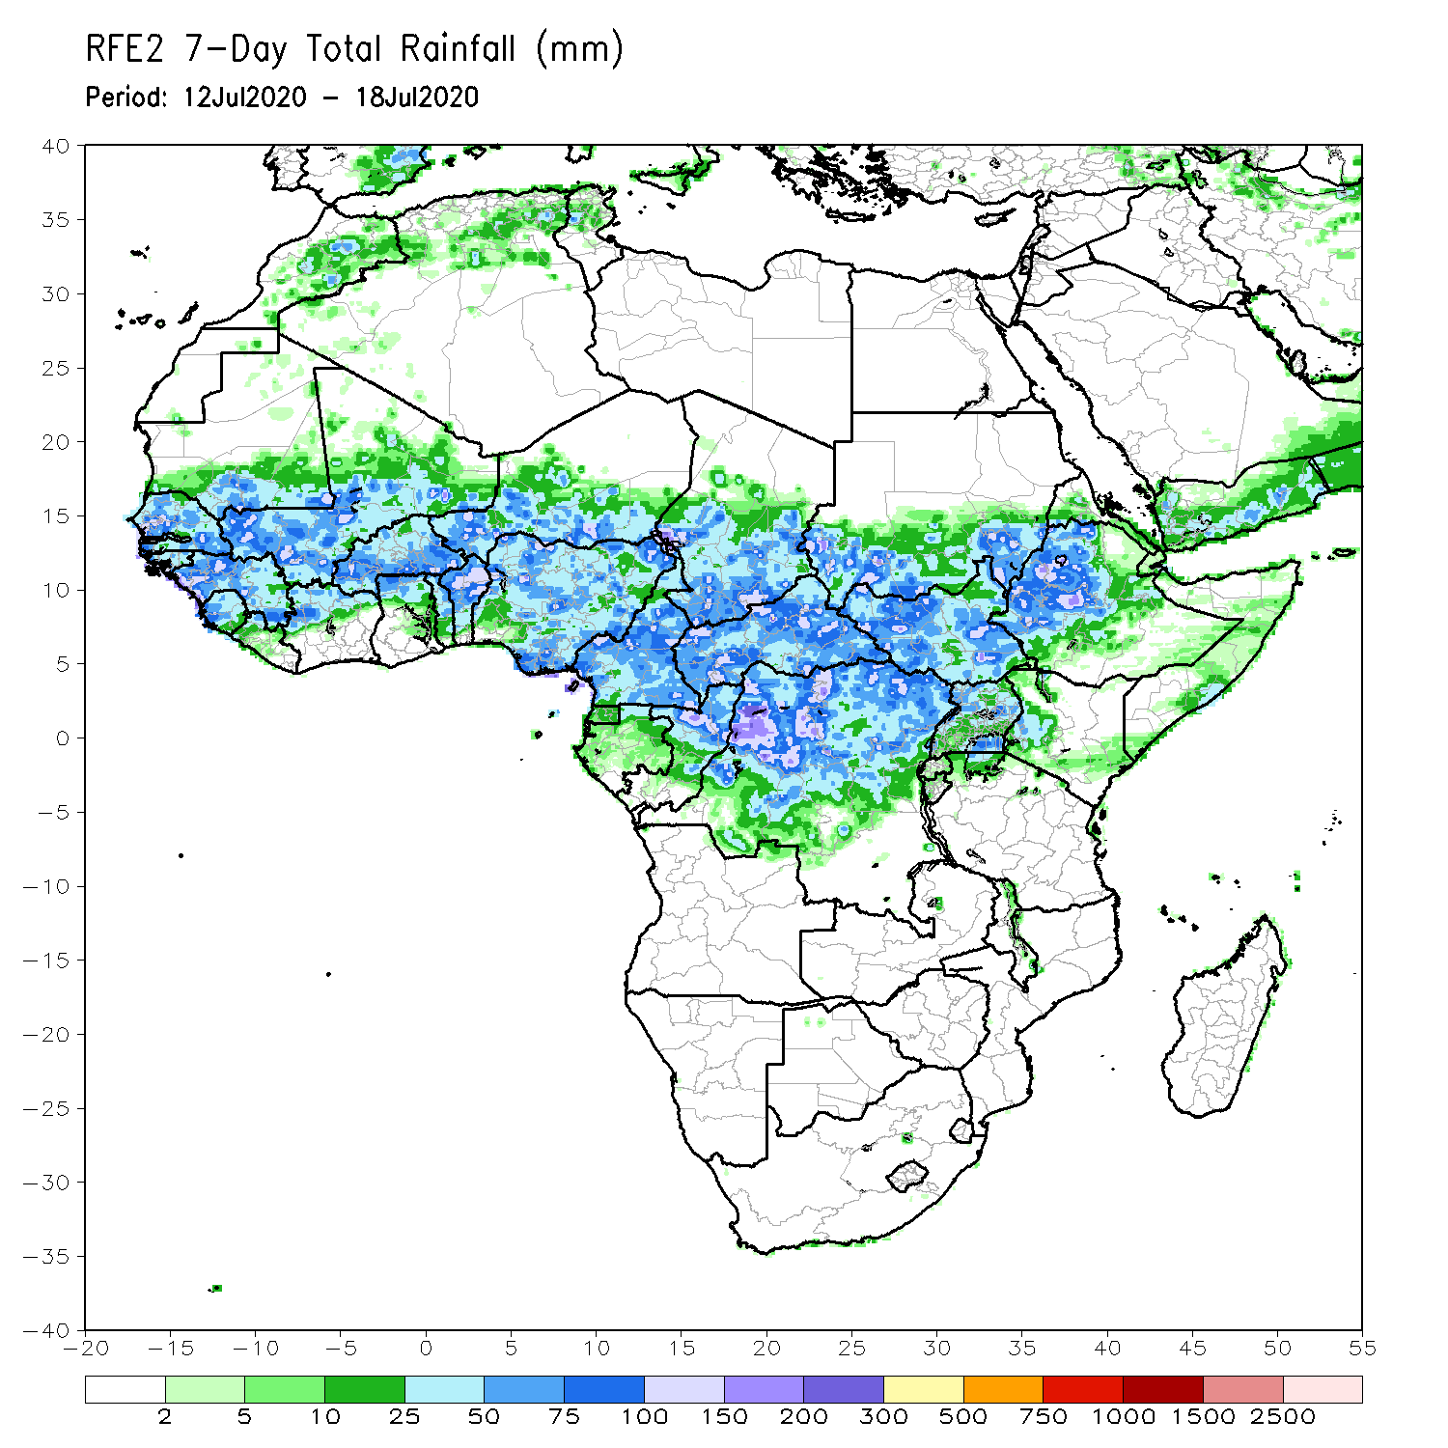
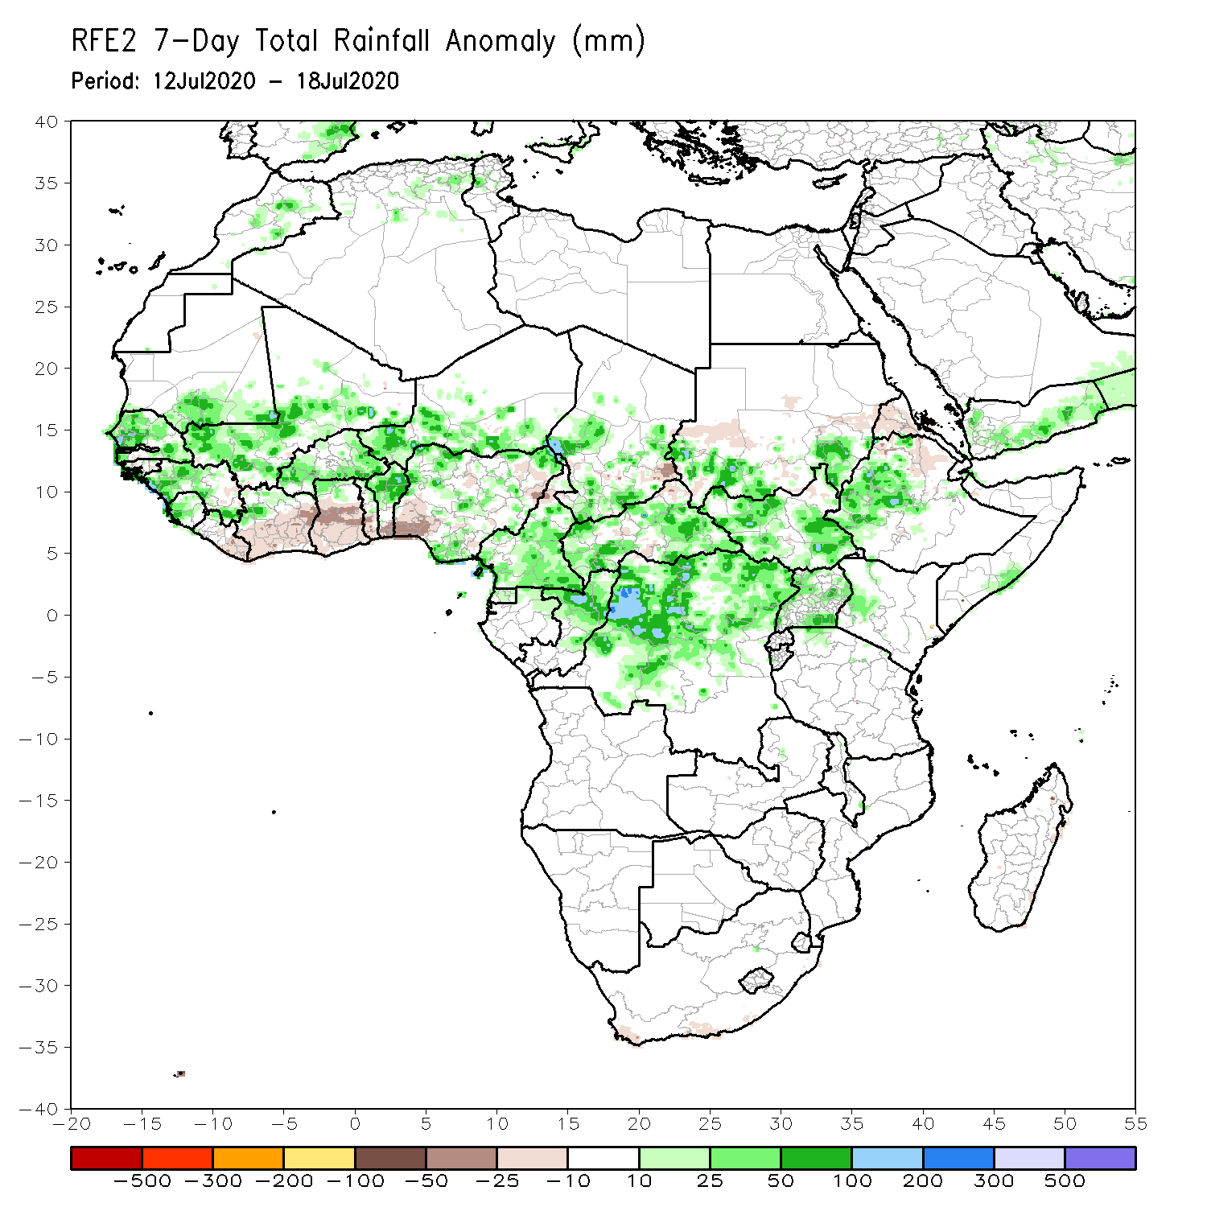
Rainfall Patterns: Last 7 Days
During the past 7 days, rainfall was above-average over much of Senegal, southern Mauritania, Guinea, Sierra Leone, northern Cote d’Ivoire, Mali, northern Ghana, portions of Burkina Faso, southern Niger, Cameroon, parts of Chad, Congo, CAR, northern DRC, South Sudan, portions of southern and eastern Sudan, local areas in Uganda, and western Ethiopia.
Below-average rainfall was observed over eastern Liberia, portions of Cote d’Ivoire, southern Ghana, southern Togo, Benin, southwestern Nigeria, parts of Eritrea and northeastern Ethiopia.

Slide 5
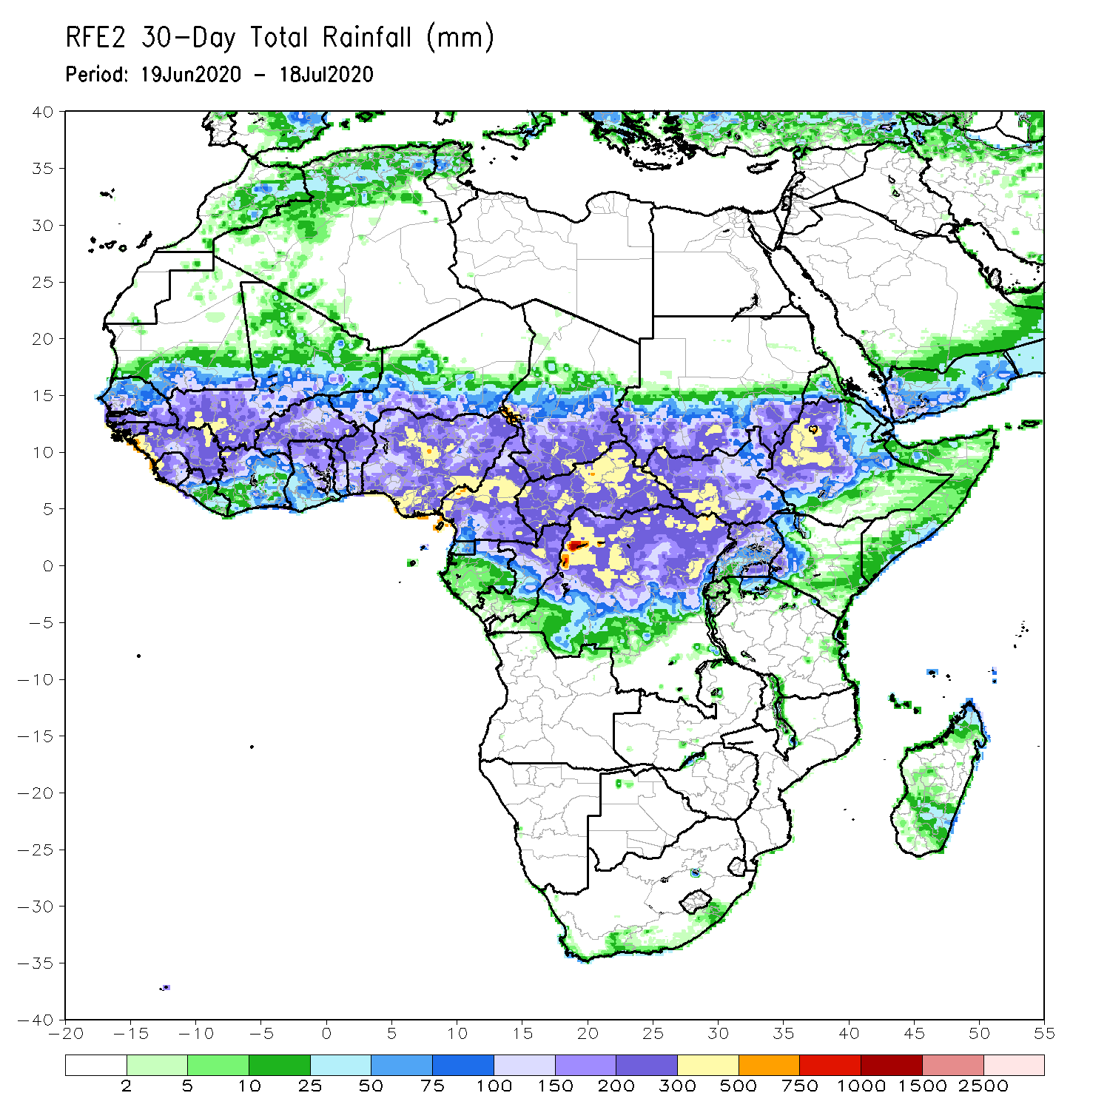
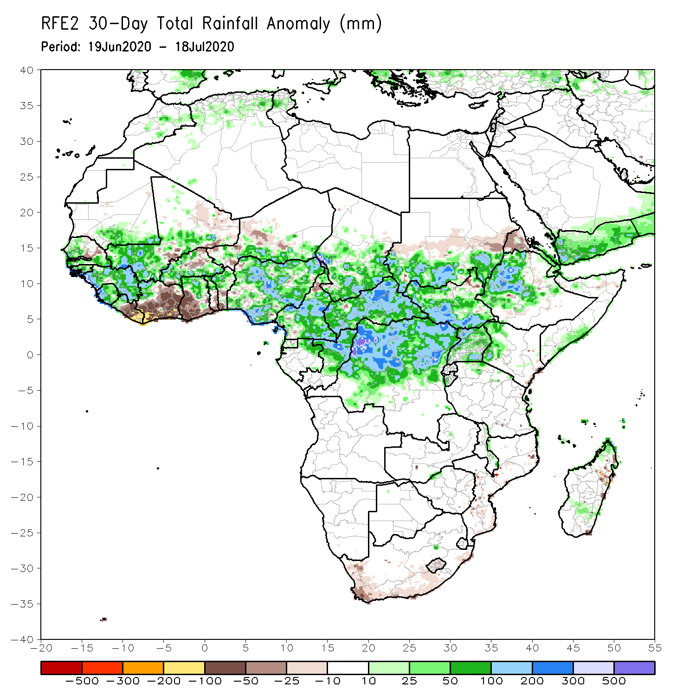
Rainfall Patterns: Last 30 Days
During the past 30 days, rainfall was above-average over many places in the Sahel region, the far western and eastern Gulf of Guinea, and Central Africa countries. Above-average rainfall was also observed over South Sudan, parts of southern and eastern and southern Sudan, Uganda, Ethiopia, and local areas in western Kenya and southern Somalia.
Rainfall was below-average over eastern Liberia, much of Cote d’Ivoire, southwestern Ghana, local areas in Burkina Faso and Niger, and Eritrea.
Notes:
5

Slide 6
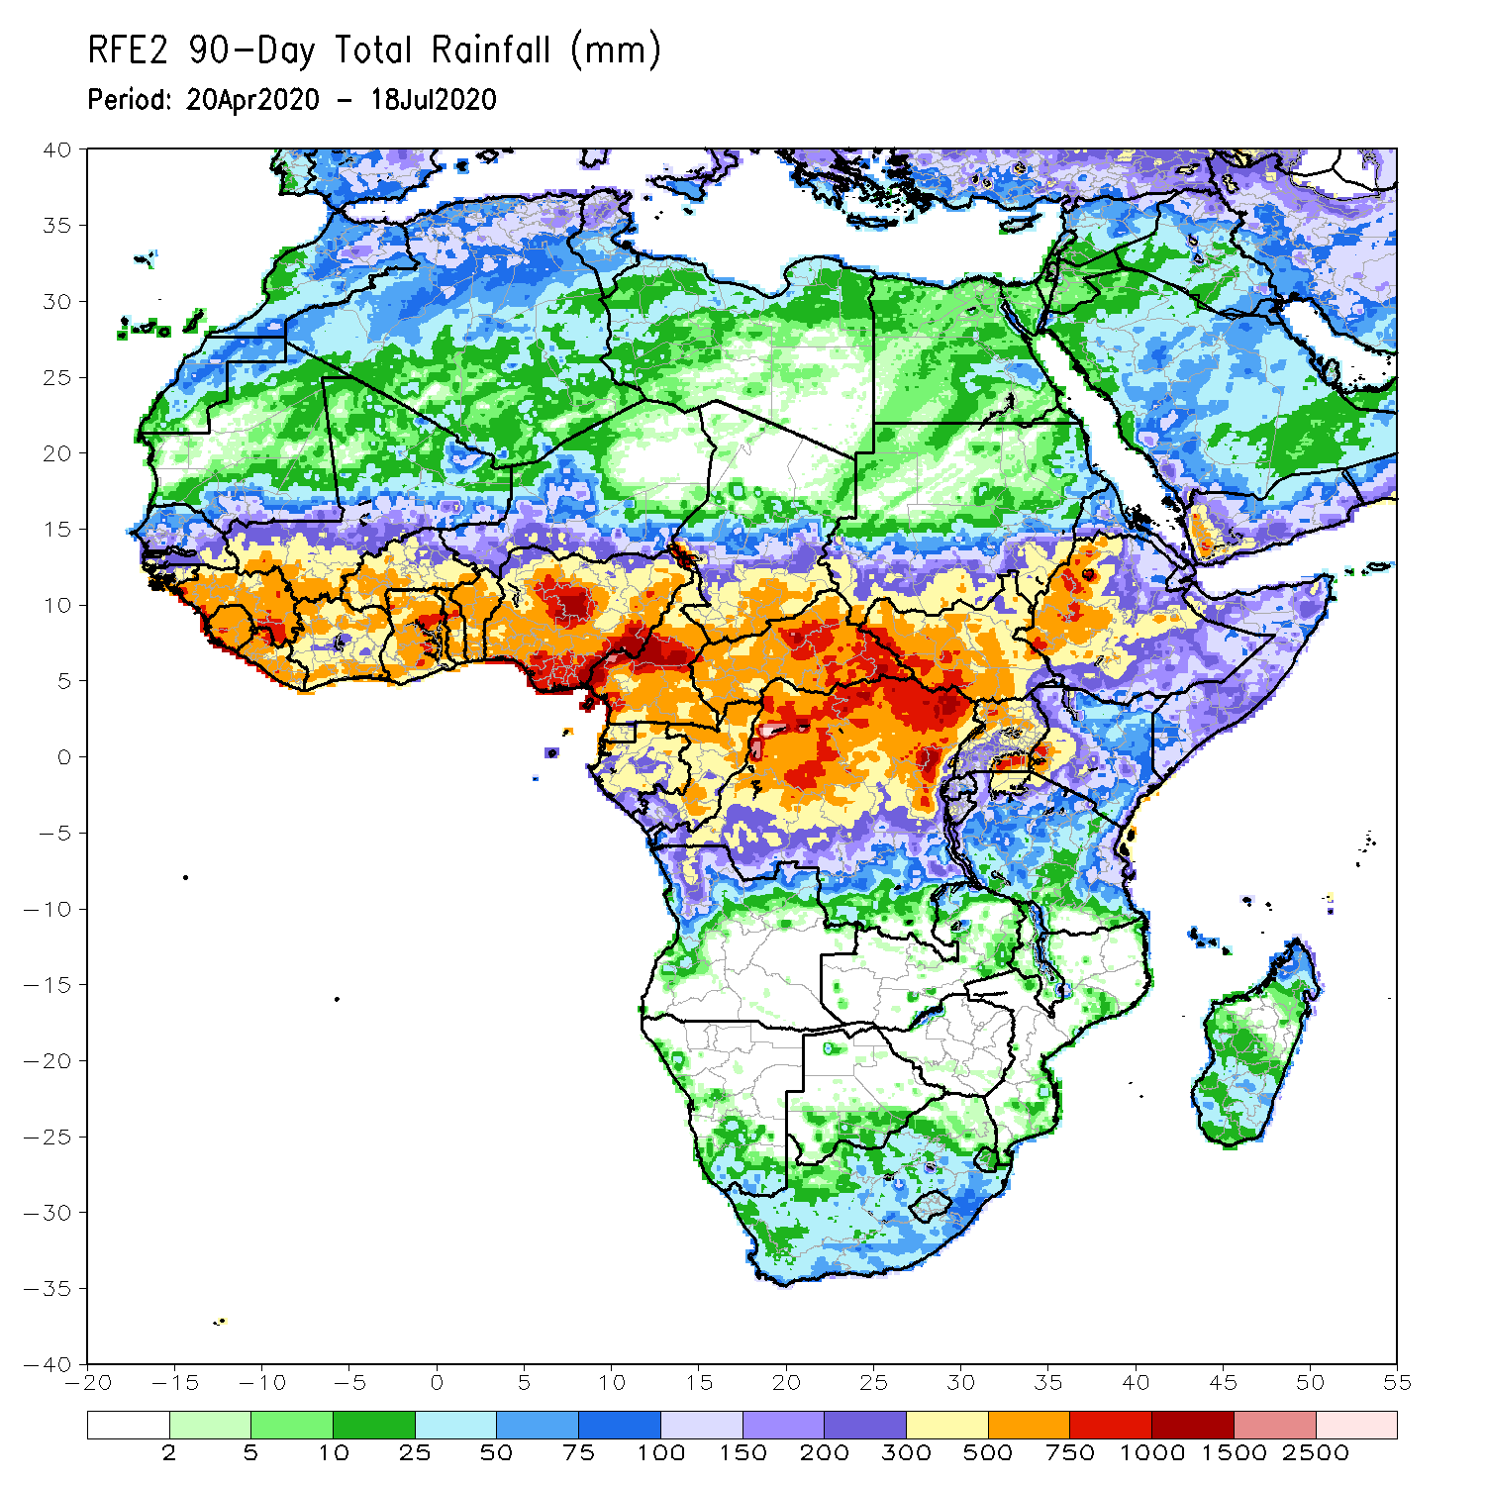
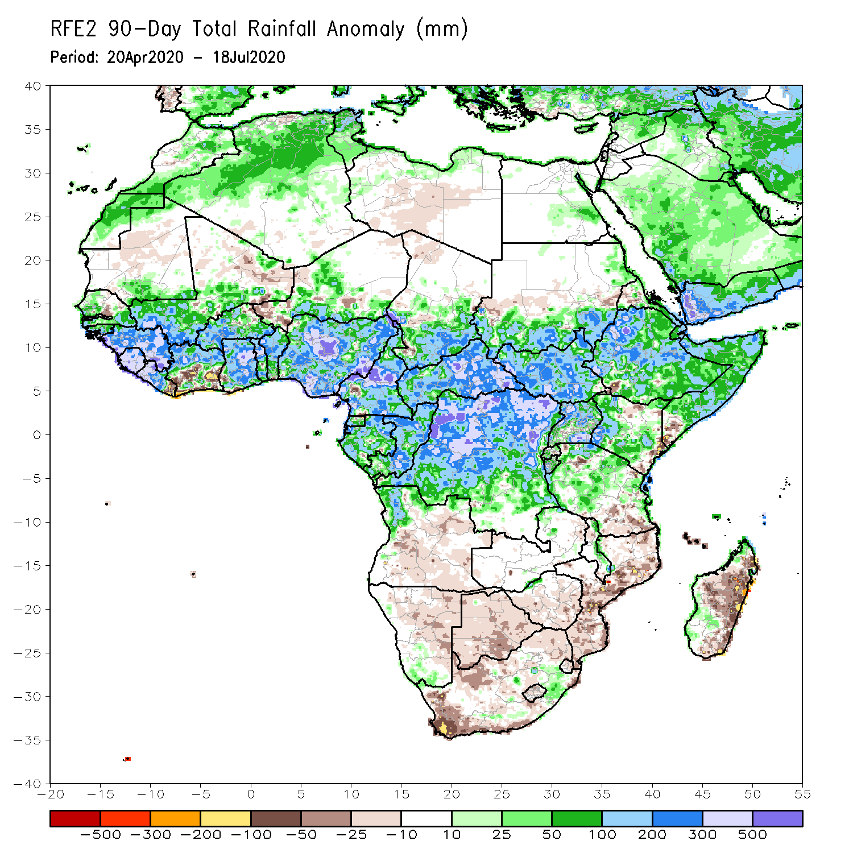
Rainfall Patterns: Last 90 Days
During the past 90 days, rainfall was above-average over much of West, Central and the Greater Horn of Africa, including the northern portions of Southern Africa. Rainfall was also above-average over local areas in South Africa.
Below-average rainfall was observed over local areas in Cote d’Ivoire and Niger, and many places in Southern Africa including Madagascar.
Notes:
6

Slide 7
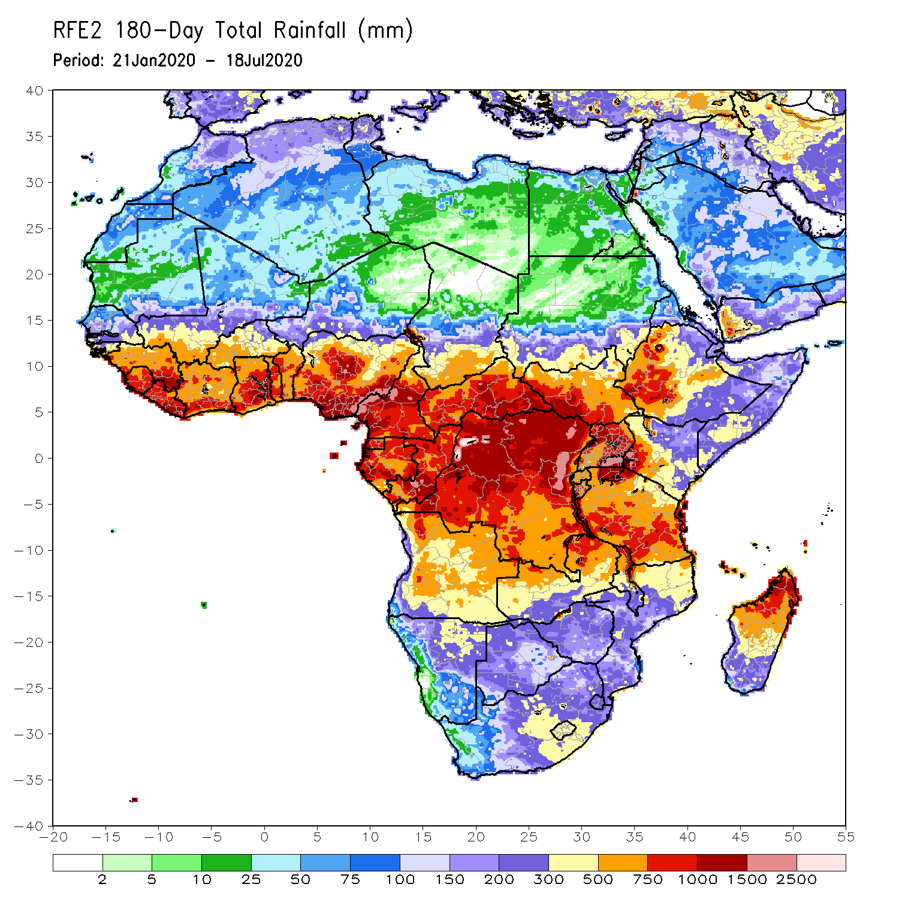
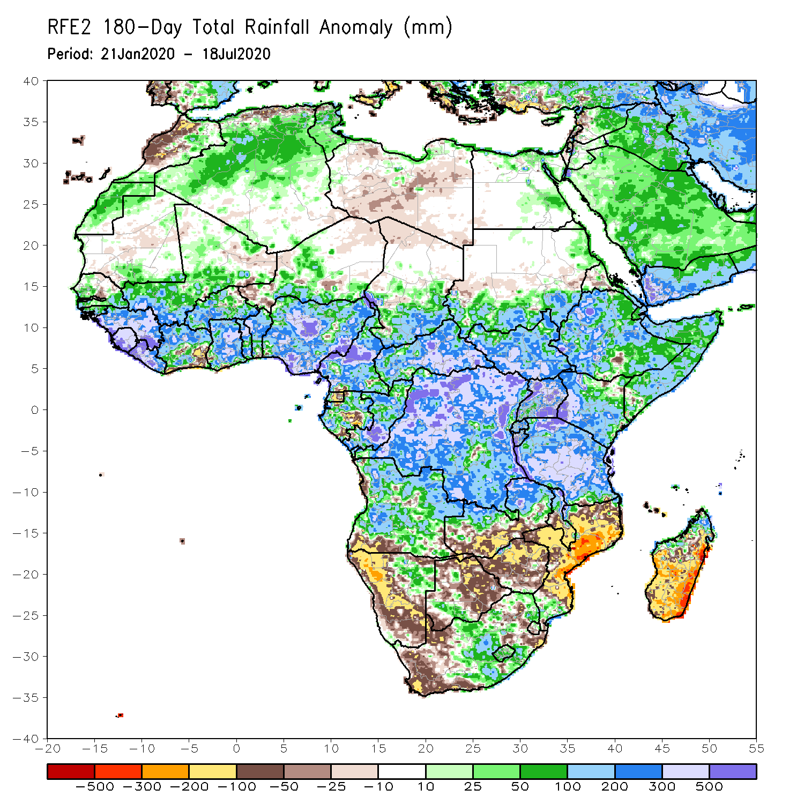
Rainfall Patterns: Last 180 Days
During the past 180 days, rainfall was above-average over much of West, Central and the Greater Horn of Africa, including the northern portions of Southern Africa. Rainfall was also above-average over local areas in northern Namibia, Botswana, portions of South Africa, and northern Madagascar.
Below-average rainfall was observed over portions of Gabon, local areas in Angola, many parts of Namibia, parts of South Africa, southern Zambia, much of Botswana, Zimbabwe, many parts of Mozambique, and central and southern Madagascar.
Notes:
7

Slide 8
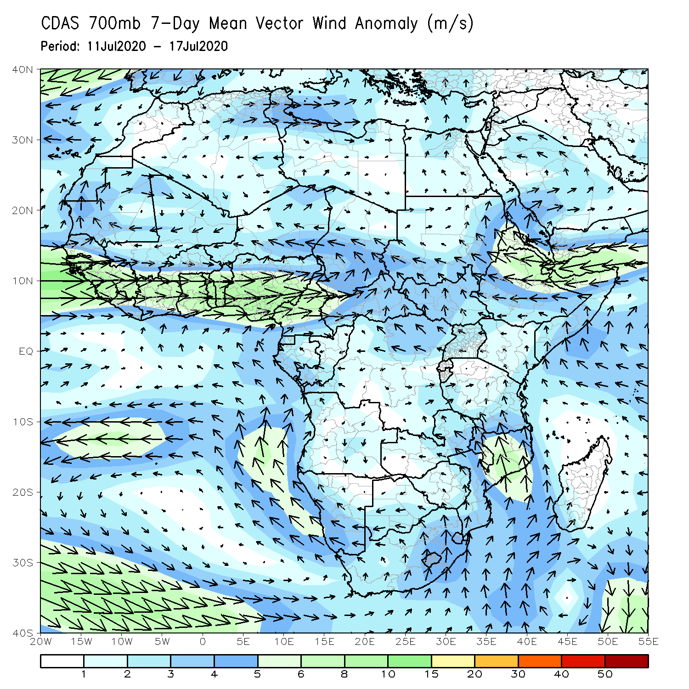
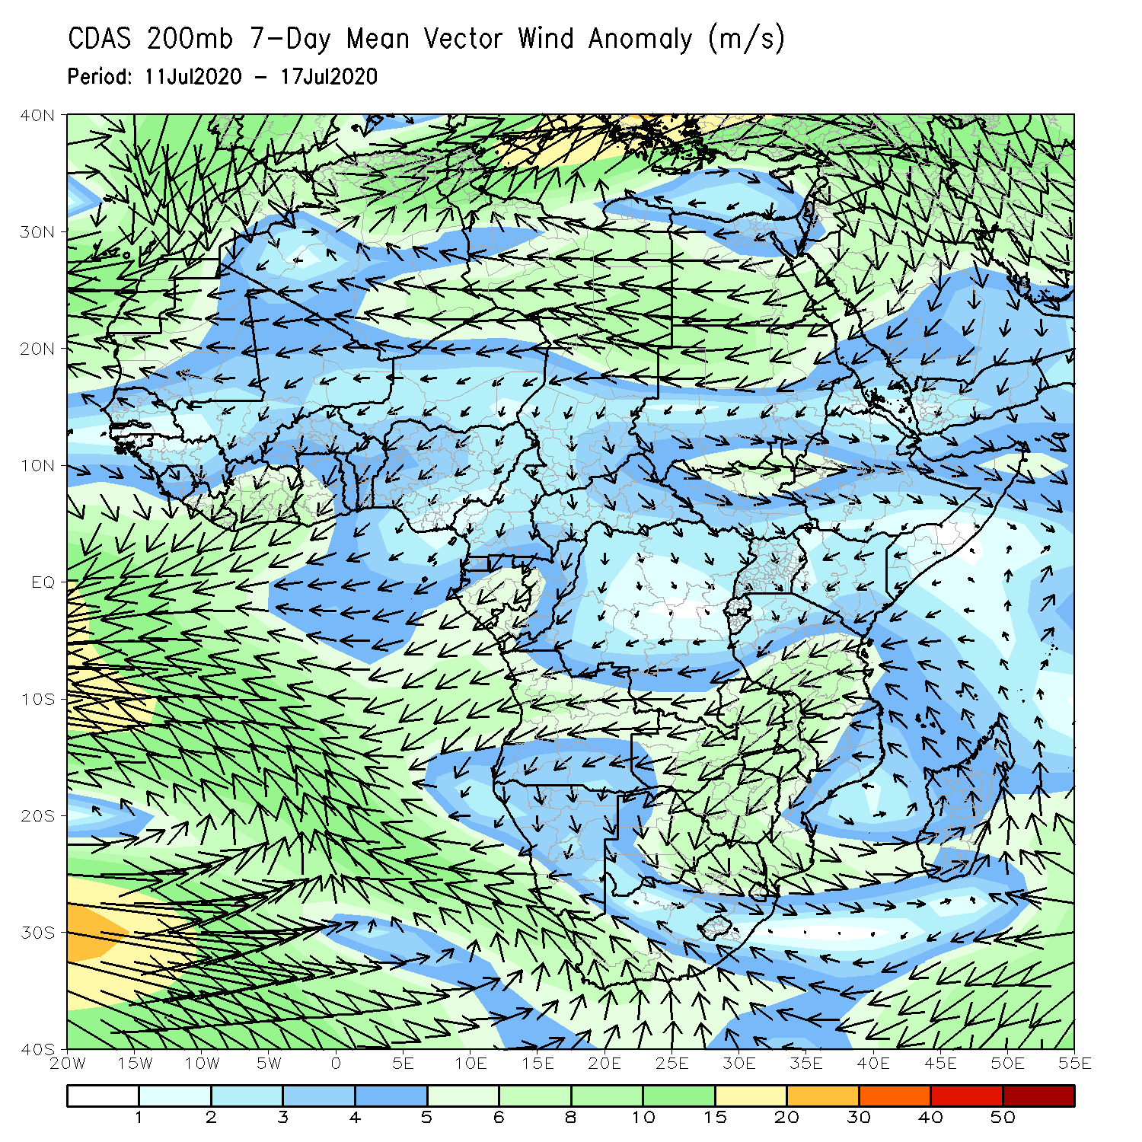
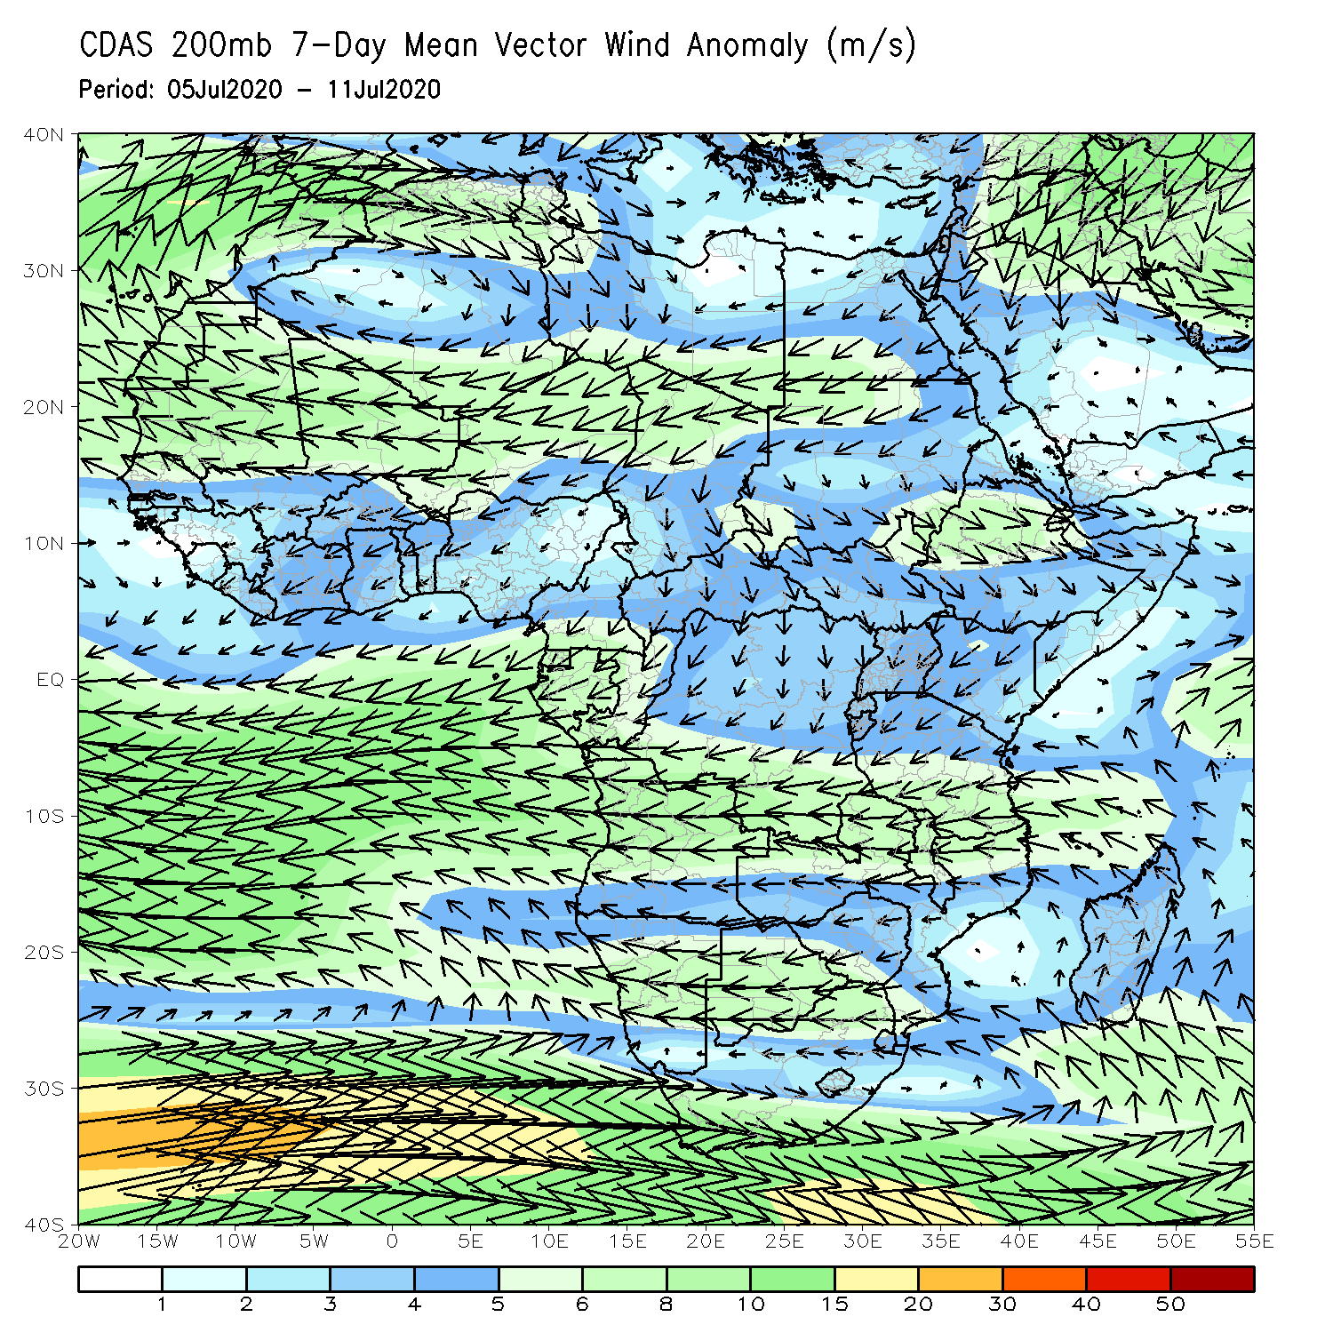
Atmospheric Circulation: Last 7 Days
Anomalous lower-level westerly flow with its associated cyclonic shear prevailed West Africa.(left panel).

Slide 9
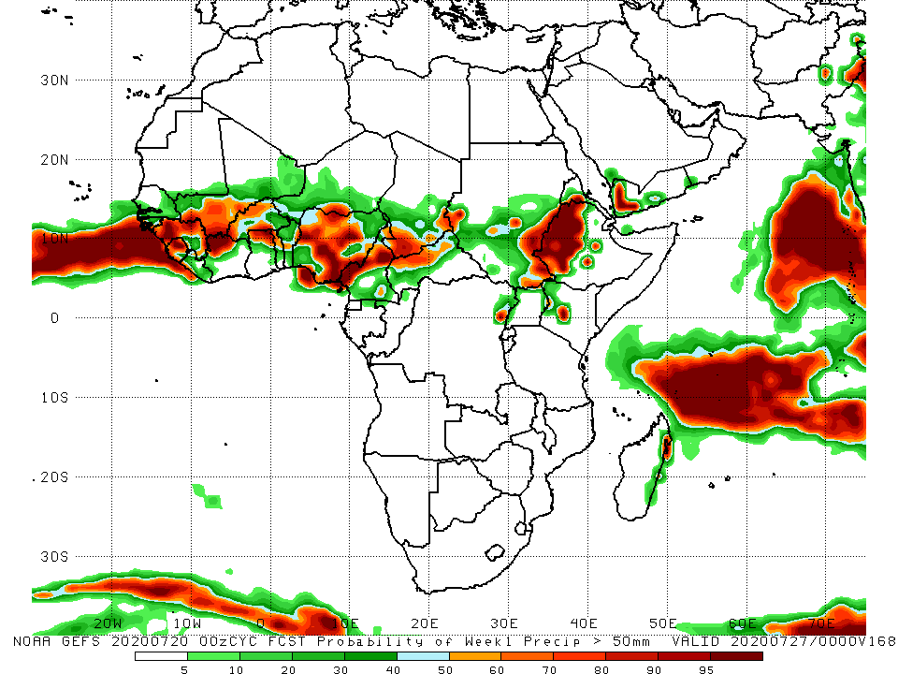
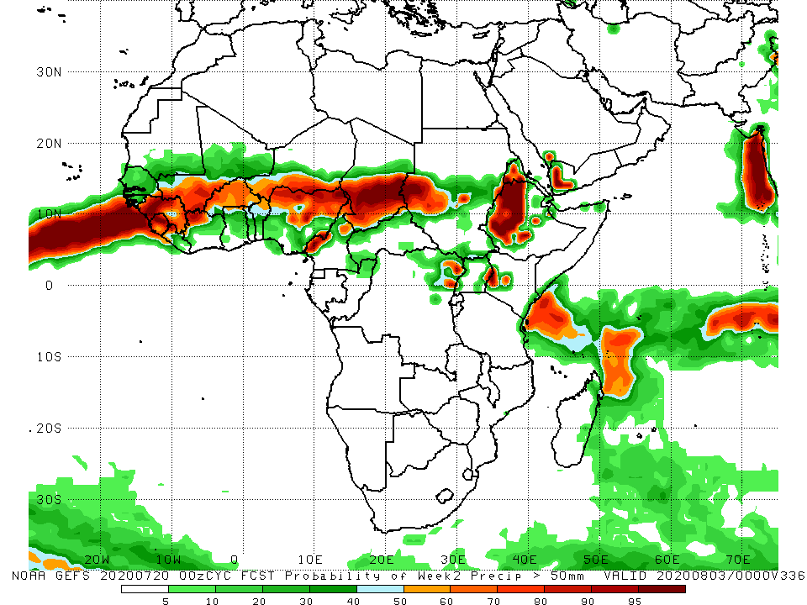
NCEP GEFS Model Forecasts Non-Bias Corrected Probability of precipitation exceedance
Week-1 Valid 21 – 27 July, 2020
Week-2: Valid 28 July – 3 August, 2020
For week-1 (left panel) and Week-2 (right panel), there is an increased chance for weekly rainfall totals to exceed 50mm over many places in the Sahel region, and western Ethiopia.
Notes:
9

Slide 10
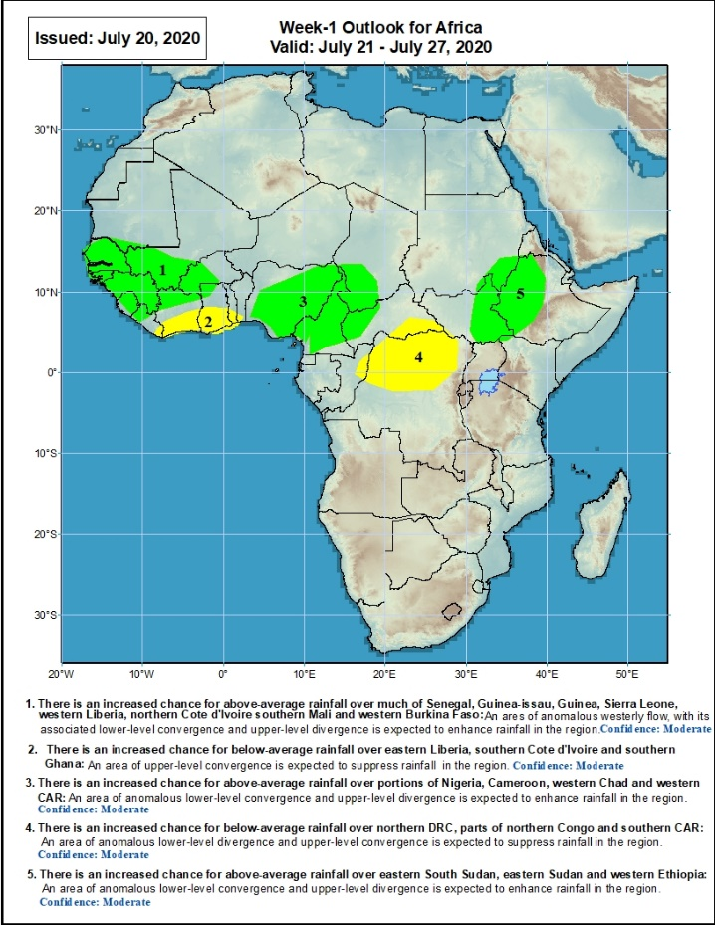
Week-1 Precipitation Outlooks
21 – 27 July, 2020
There is an increased chance for above-average rainfall over much of Senegal, Guinea-Bissau, Guinea, Sierra Leone, western Liberia, northern Cote d'Ivoire southern Mali and western Burkina Faso: An area of anomalous westerly flow, with its associated lower-level convergence and upper-level divergence is expected to enhance rainfall in the region. Confidence: Moderate
There is an increased chance for below-average rainfall over eastern Liberia, southern Cote d'Ivoire and southern Ghana: An area of upper-level convergence is expected to suppress rainfall in the region. Confidence: Moderate
There is an increased chance for above-average rainfall over portions of Nigeria, Cameroon, western Chad and western CAR: An area of anomalous lower-level convergence and upper-level divergence is expected to enhance rainfall in the region. Confidence: Moderate
There is an increased chance for below-average rainfall over northern DRC, parts of northern Congo and southern CAR: An area of anomalous lower-level divergence and upper-level convergence is expected to suppress rainfall in the region. Confidence: Moderate
There is an increased chance for above-average rainfall over eastern South Sudan, eastern Sudan and western Ethiopia: An area of anomalous lower-level convergence and upper-level divergence is expected to enhance rainfall in the region. Confidence: Moderate
Notes:
10

Slide 11
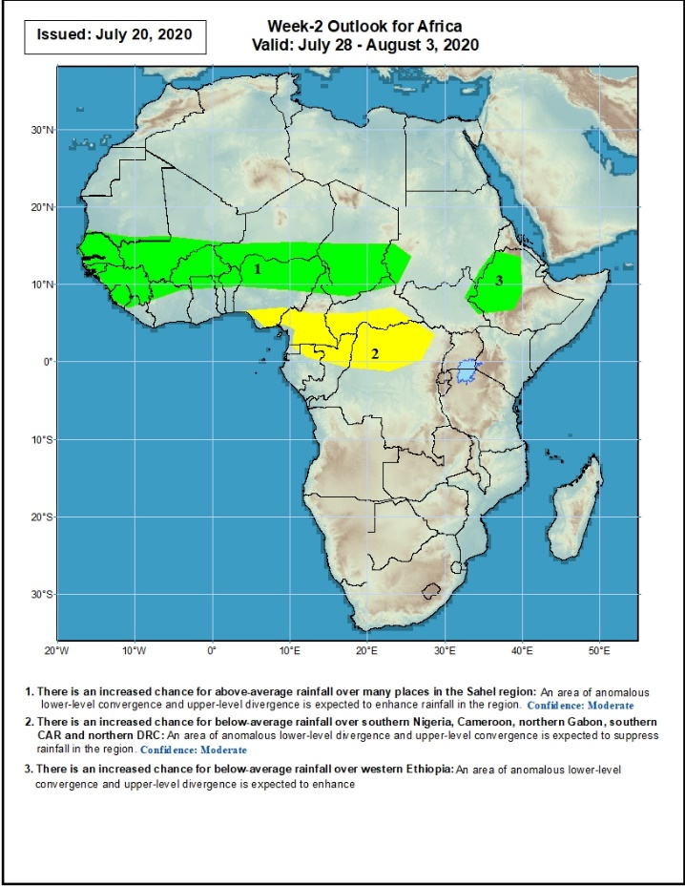
Week-2 Precipitation Outlooks
28 July – 4 August, 2020
There is an increased chance for above-average rainfall over many places in the Sahel region: An area of anomalous lower-level convergence and upper-level divergence is expected to enhance rainfall in the region. Confidence: Moderate
There is an increased chance for below-average rainfall over southern Nigeria, Cameroon, northern Gabon, southern CAR and northern DRC: An area of anomalous lower-level divergence and upper-level convergence is expected to suppress rainfall in the region. Confidence: Moderate
There is an increased chance for below-average rainfall over western Ethiopia: An area of anomalous lower-level convergence and upper-level divergence is expected to enhance rainfall in the region. Confidence: Moderate
Notes:
11

Slide 12
Summary
During the past 7 days, rainfall was above-average over much of Senegal, southern Mauritania, Guinea, Sierra Leone, northern Cote d’Ivoire, Mali, northern Ghana, portions of Burkina Faso, southern Niger, Cameroon, parts of Chad, Congo, CAR, northern DRC, South Sudan, portions of southern and eastern Sudan, local areas in Uganda, and western Ethiopia. Below-average rainfall was observed over eastern Liberia, portions of Cote d’Ivoire, southern Ghana, southern Togo, Benin, southwestern Nigeria, parts of Eritrea and northeastern Ethiopia.
During the past 30 days, rainfall was above-average over many places in the Sahel region, the far western and eastern Gulf of Guinea, and Central Africa countries. Above-average rainfall was also observed over South Sudan, parts of southern and eastern and southern Sudan, Uganda, Ethiopia, and local areas in western Kenya and southern Somalia. Rainfall was below-average over eastern Liberia, much of Cote d’Ivoire, southwestern Ghana, local areas in Burkina Faso and Niger, and Eritrea.
During the past 90 days, rainfall was above-average over much of West, Central and the Greater Horn of Africa, including the northern portions of Southern Africa. Rainfall was also above-average over local areas in South Africa. Below-average rainfall was observed over local areas in Cote d’Ivoire and Niger, and many places in Southern Africa including Madagascar.
Week-1 outlooks call for an increased chance for above-average rainfall over much of Senegal, Guinea-Bissau, Guinea, Sierra Leone, western Liberia, northern Cote d'Ivoire southern Mali, western Burkina Faso, portions of Nigeria, Cameroon, western Chad and western CAR, eastern South Sudan, eastern Sudan and western Ethiopia. In contrast, there is an increased chance for below-average rainfall over eastern Liberia, southern Cote d'Ivoire, southern Ghana, northern DRC, parts of northern Congo and southern CAR.
Week-2 outlooks call for an increased chance for above-average rainfall over many places in the Sahel region and western Ethiopia. In contrast, there is an increased chance for below-average rainfall over southern Nigeria, Cameroon, northern Gabon, southern CAR and northern DRC.
Notes:
12

