Slide 1
The African Monsoon Recent Evolution and Current Status Include Week-1 and Week-2 Outlooks
Update prepared by
Climate Prediction Center / NCEP
13 July 2020
For more information, visit:
http://www.cpc.ncep.noaa.gov/products/Global_Monsoons/African_Monsoons/precip_monitoring.shtml

Slide 2
Outline
Highlights
Recent Evolution and Current Conditions
NCEP GEFS Forecasts
Summary

Slide 3
Highlights: Last 7 Days
Weekly rainfall totals exceeded 100mm over local areas in Guinea and Mali, central and southern Nigeria, CAR, northern DRC, eastern Sudan and western Ethiopia.
Week-1 outlooks call for an increased chance for above-average rainfall over much of Guinea, Sierra Leone, southern Mali, Burkina Faso, southern Niger, northern Benin, Nigeria, Cameroon, parts of southern Chad, western CAR, northern Congo, northeastern DRC, northern Uganda, South Sudan and western Ethiopia. In contrast, there is an increased chance for below-average rainfall over eastern Liberia, southern Cote d'Ivoire, southern Ghana, southern Togo, southern Benin and southwestern Nigeria.
Week-2 outlooks call for an increased chance for above-average rainfall over portions of Senegal, Guinea-Bissau, much of Guinea, southern Mali, Burkina Faso, northern Liberia, northern Cote d'Ivoire, northern Ghana, southern Niger, northern Benin, northern Nigeria, northern Cameroon, southwestern Chad, southern Sudan, much of South Sudan, and western Ethiopia. In contrast, there is an increased chance for below-average rainfall along the Gulf of Guinea coast, and much of Equatorial Guinea, southern Cameroon, southern CAR, Gabon, northern Congo and northwestern DRC.

Slide 4
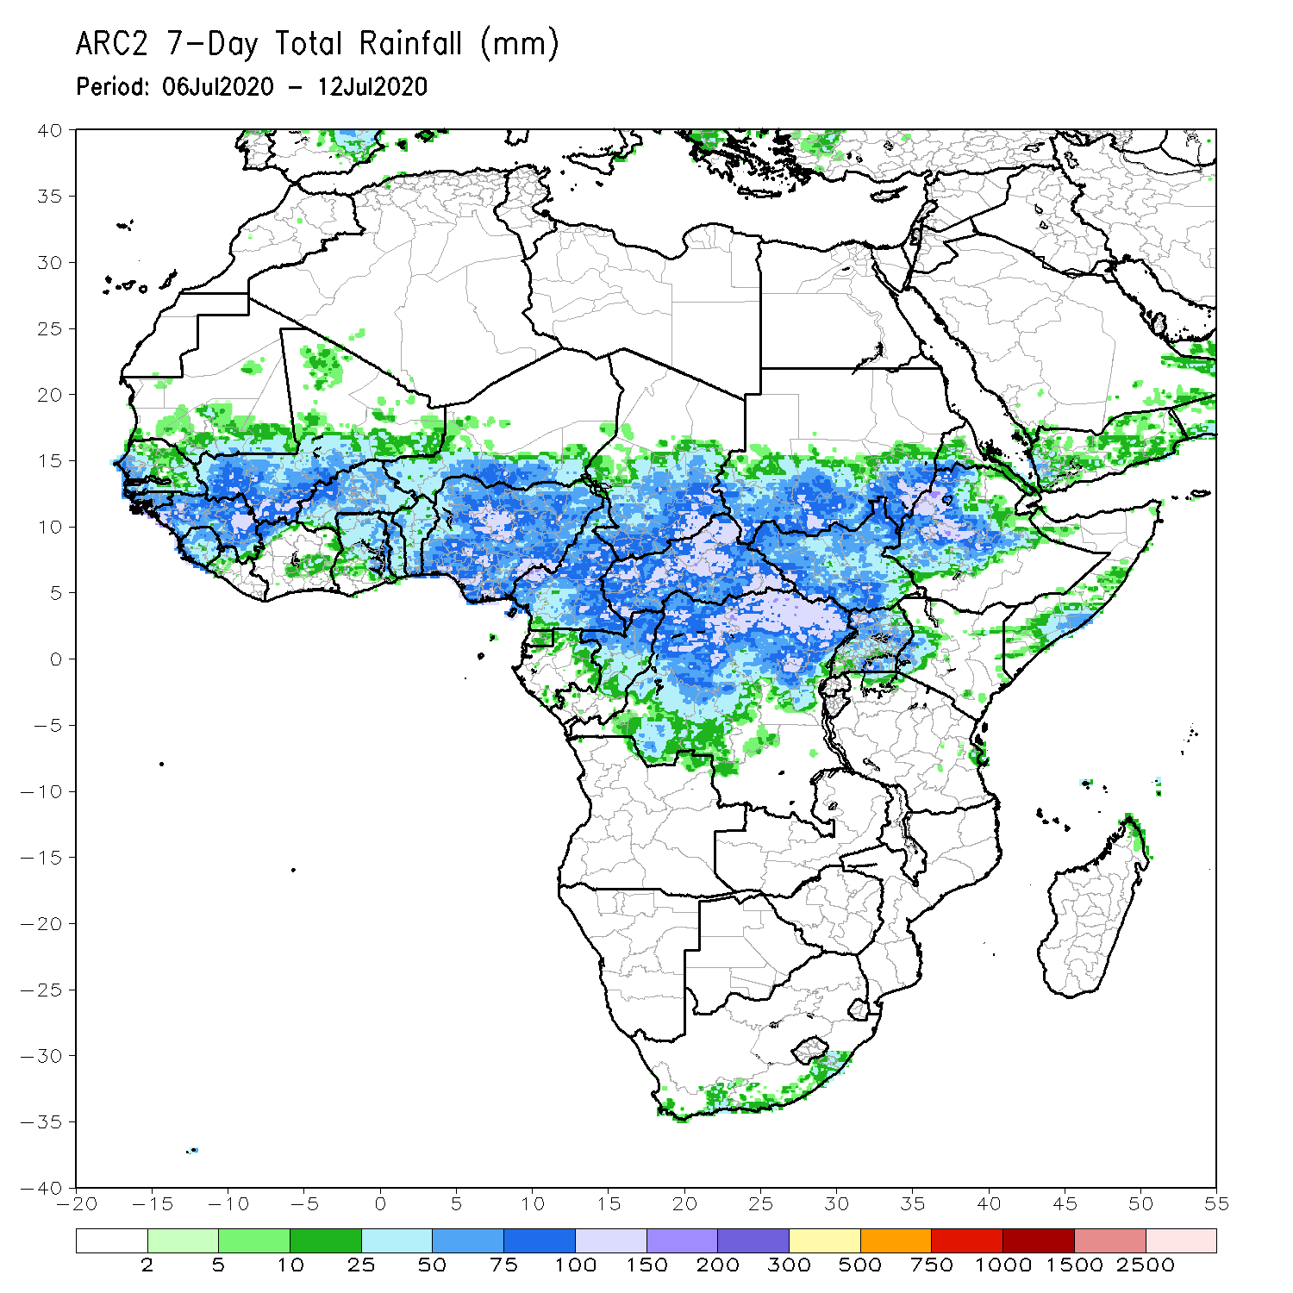
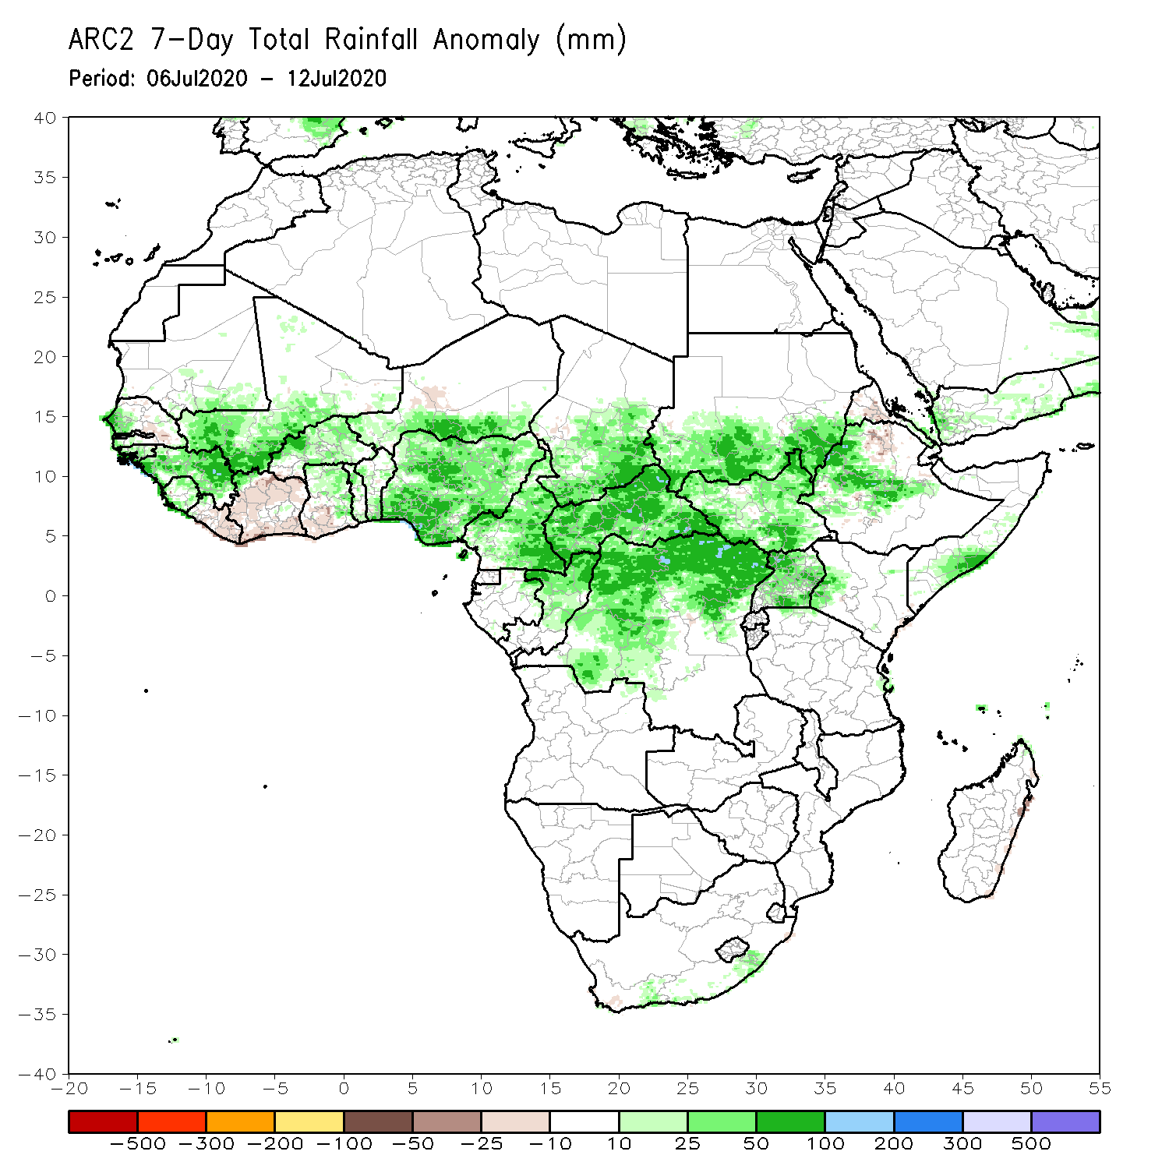
Rainfall Patterns: Last 7 Days
During the past 7 days, rainfall was above-average over western Senegal, Guinea, Sierra Leone, southern Mali, Burkina Faso, northern Ghana, southern Niger, Tog, Benin, Nigeria, Cameroon, southern Chad, CAR, northern Congo, western and northern DRC, southern Sudan, much of South Sudan, Uganda, portions of Ethiopia and local areas in southern Somalia.
Below-average rainfall was observed over local areas in Senegal, eastern Liberia, Cote d’Ivoire, western Ghana, western Chad, and northeastern Ethiopia.

Slide 5
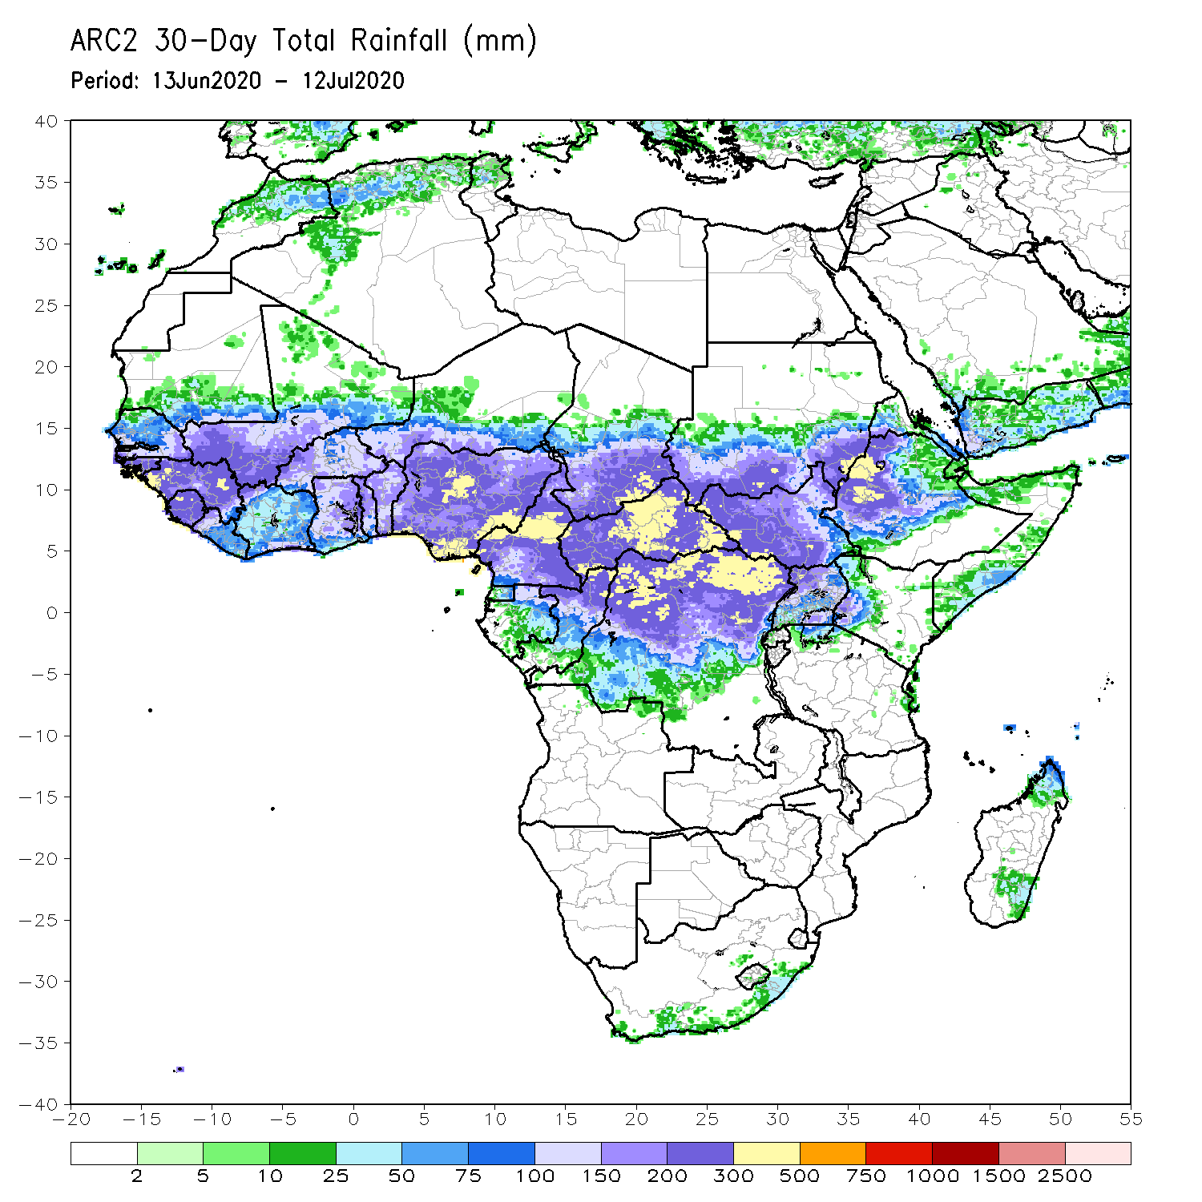
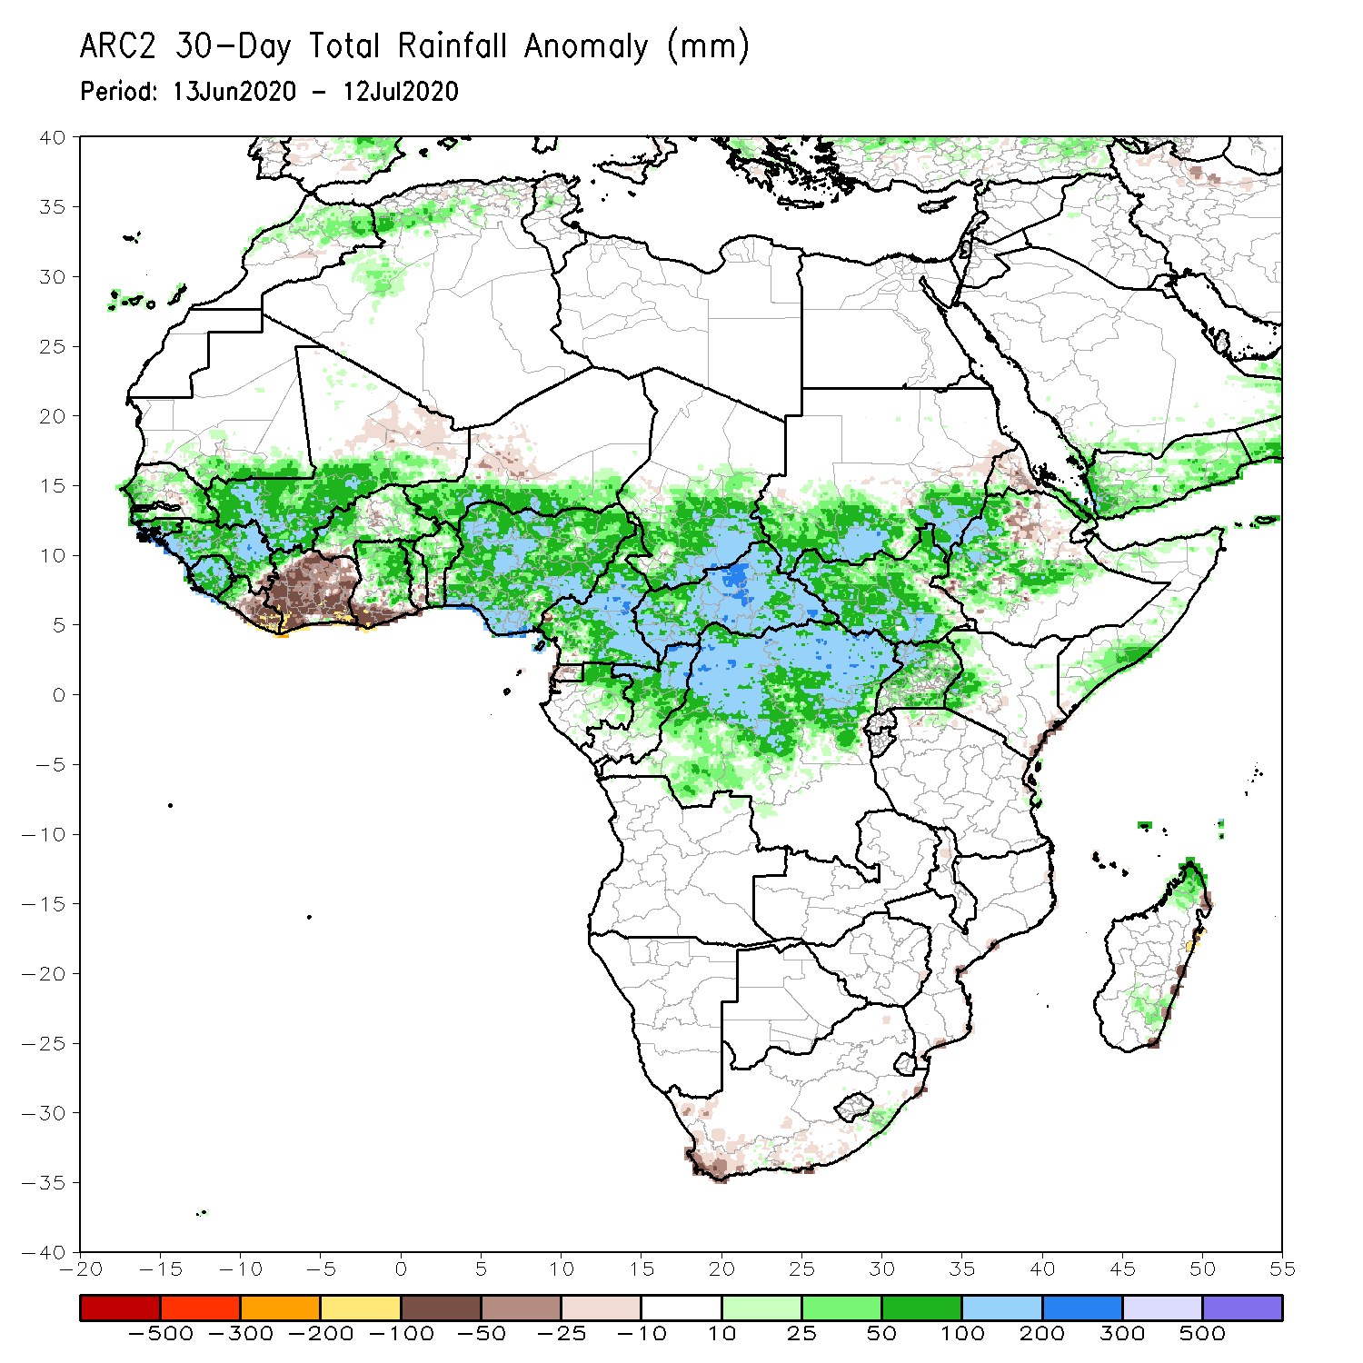
Rainfall Patterns: Last 30 Days
During the past 30 days, rainfall was above-average over many places in West and Central Africa countries. Above-average rainfall was also observed over South Sudan, parts of eastern and southern Sudan, Uganda, Ethiopia, and local areas in western Kenya and southern Somalia.
Rainfall was below-average over eastern Liberia, much of Cote d’Ivoire, southwestern Ghana, local areas in Burkina Faso and northeastern Ethiopia.
Notes:
5

Slide 6
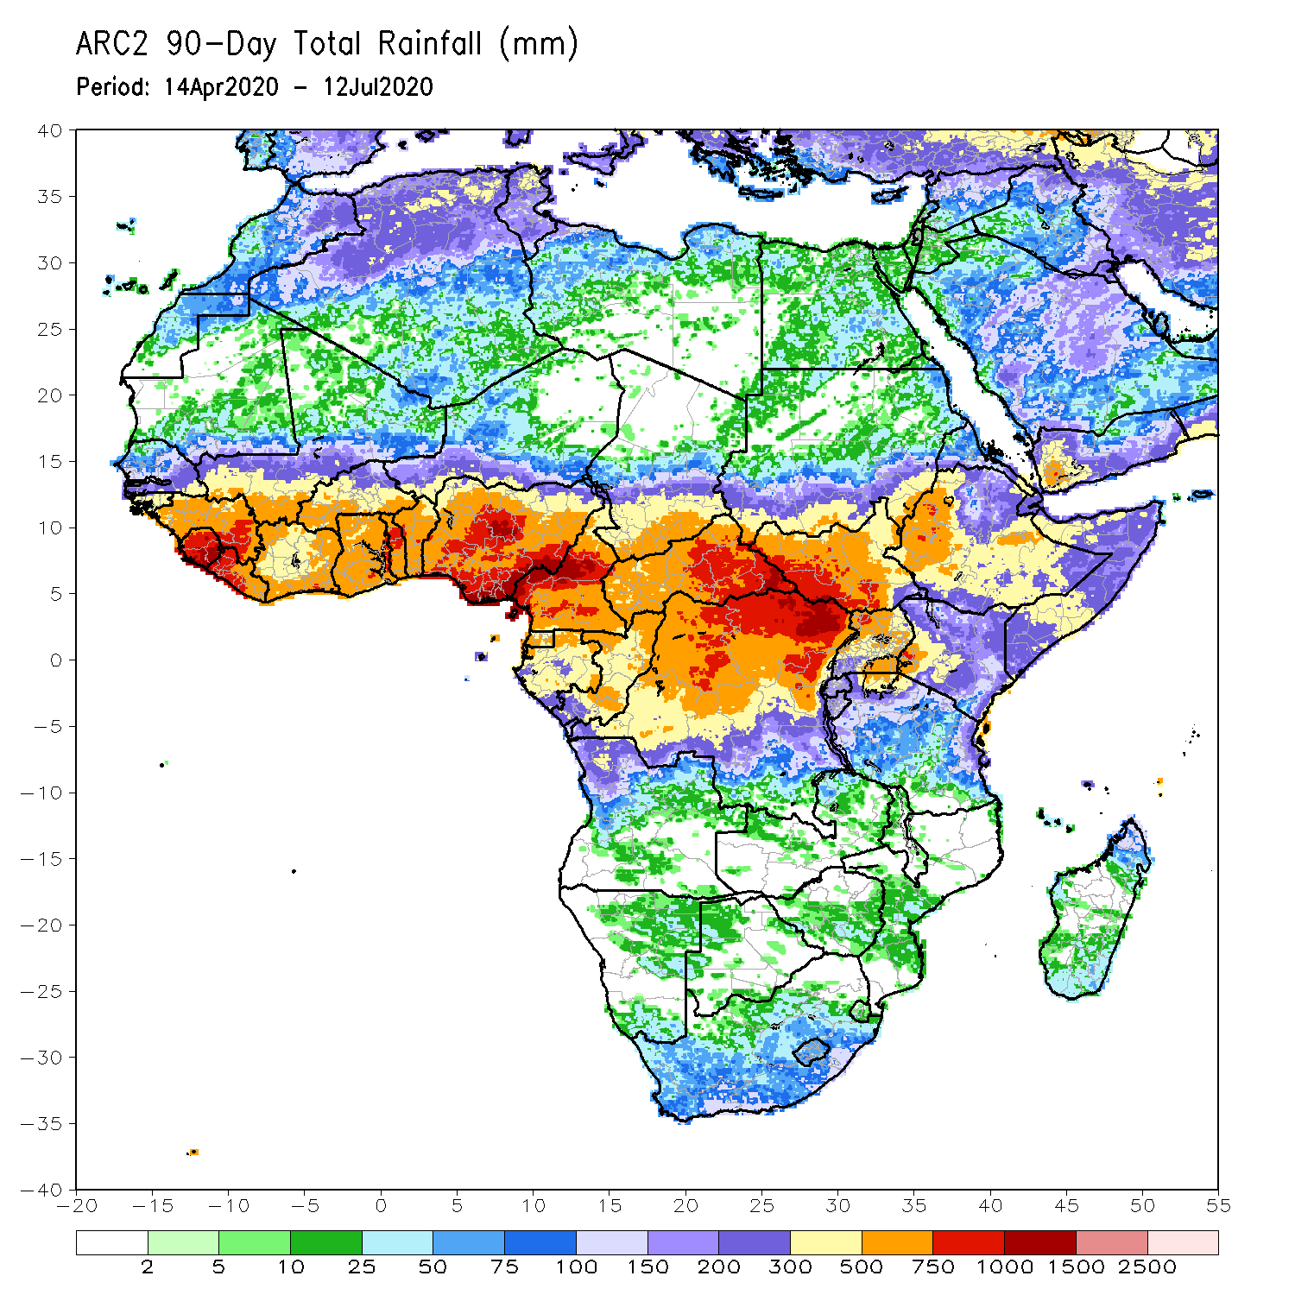
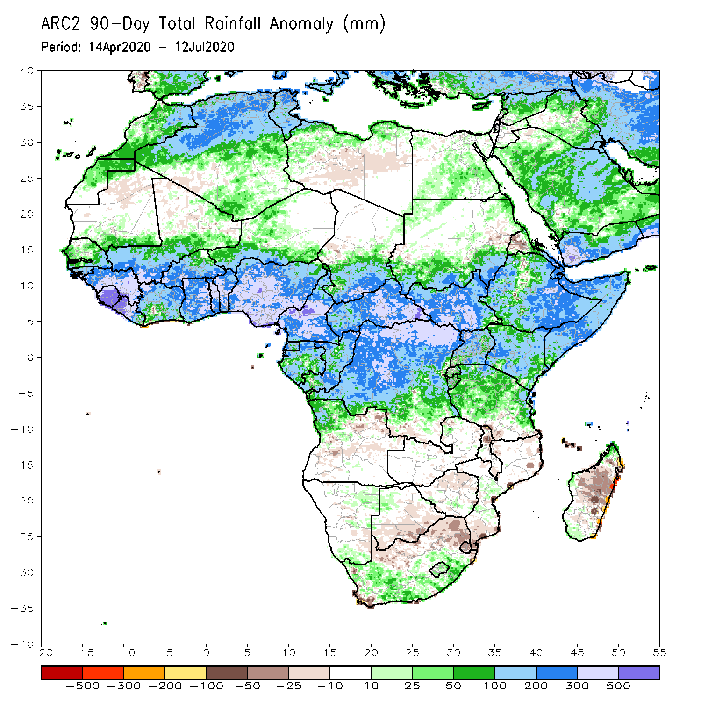
Rainfall Patterns: Last 90 Days
During the past 90 days, rainfall was above-average over much of West, Central and the Greater Horn of Africa, including the northern portions of Southern Africa. Rainfall was also above-average over portions of South Africa.
Southern and eastern Botswana, and local areas in Angola, Zambia, Zimbabwe, Malawi and Mozambique had below-average rainfall. Rainfall was also below-average over northern South Africa and much of Madagascar.
Notes:
6

Slide 7
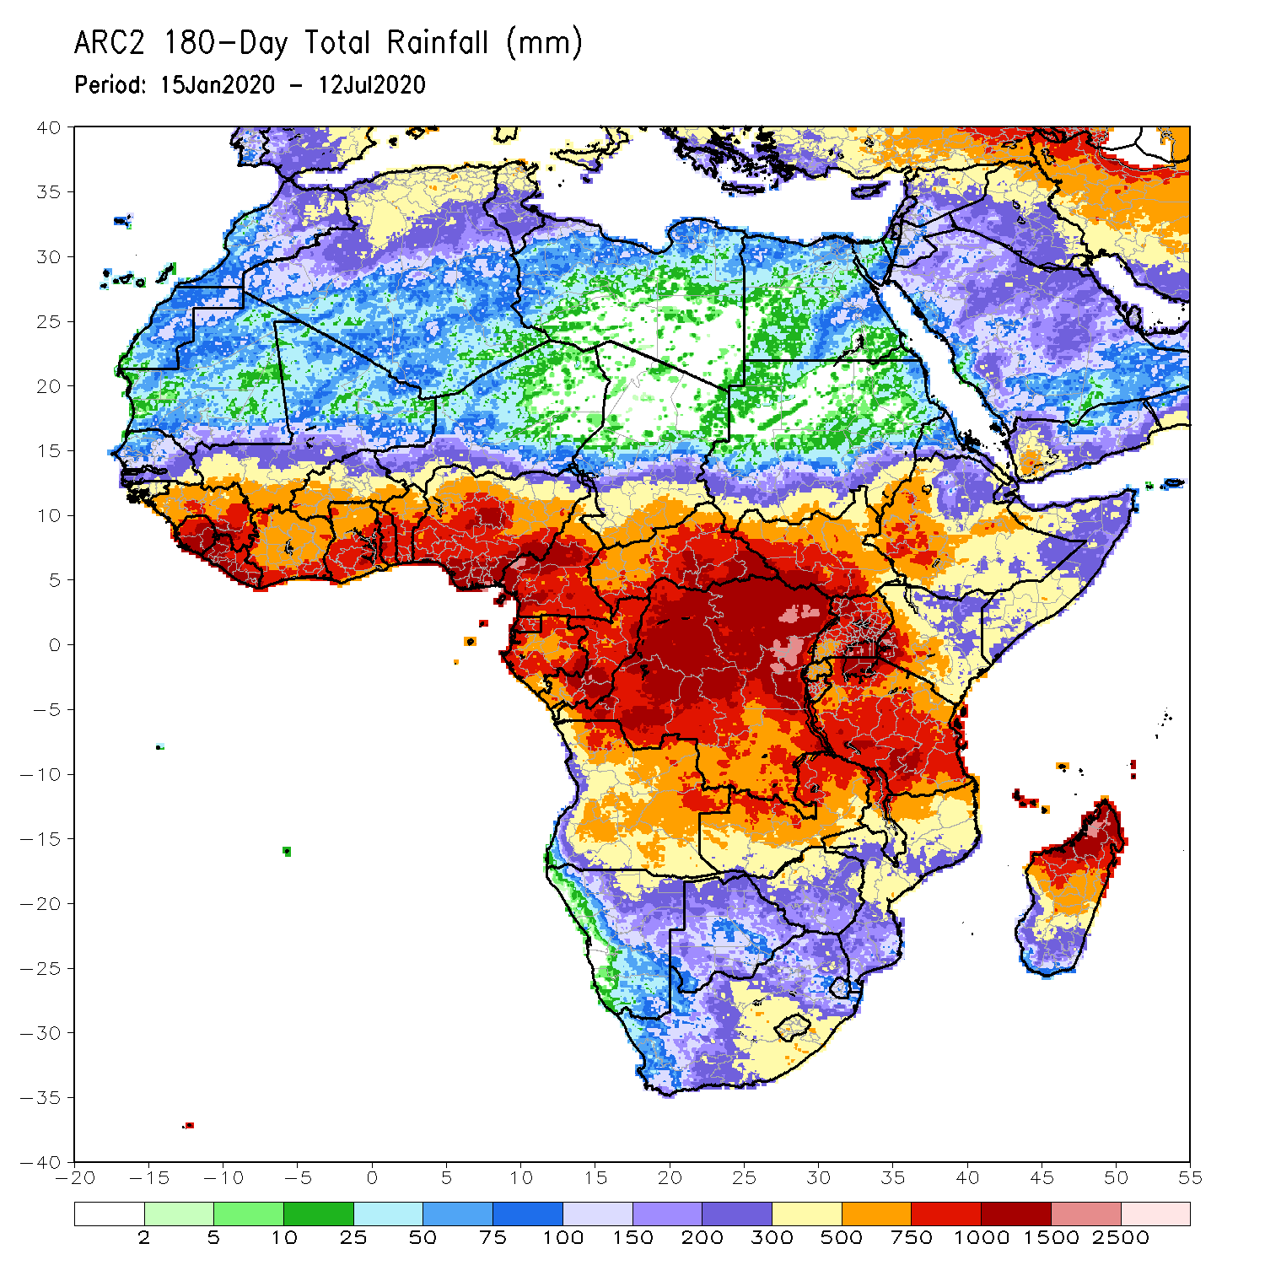
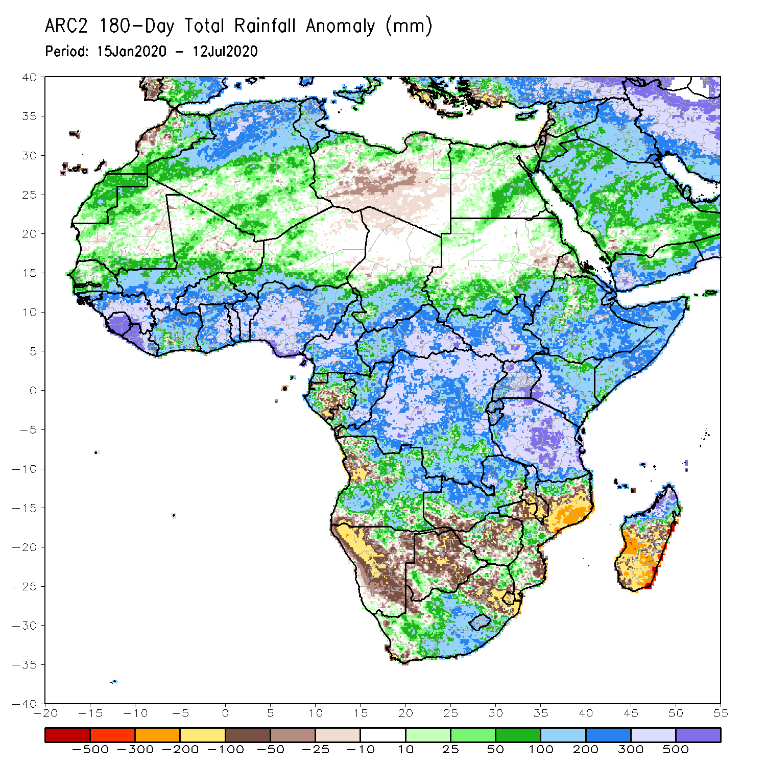
Rainfall Patterns: Last 180 Days
During the past 180 days, rainfall was above-average over much of West, Central and the Greater Horn of Africa, including the northern portions of Southern Africa. Rainfall was also above-average over local areas in northern Namibia, Botswana, portions of South Africa, and northern Madagascar.
Below-average rainfall was observed over portions of Gabon, local areas in Angola, many parts of Namibia, parts of South Africa, local areas in southern Zambia, much of Botswana, Zimbabwe, many parts of Mozambique and southern Madagascar.
Notes:
7

Slide 8
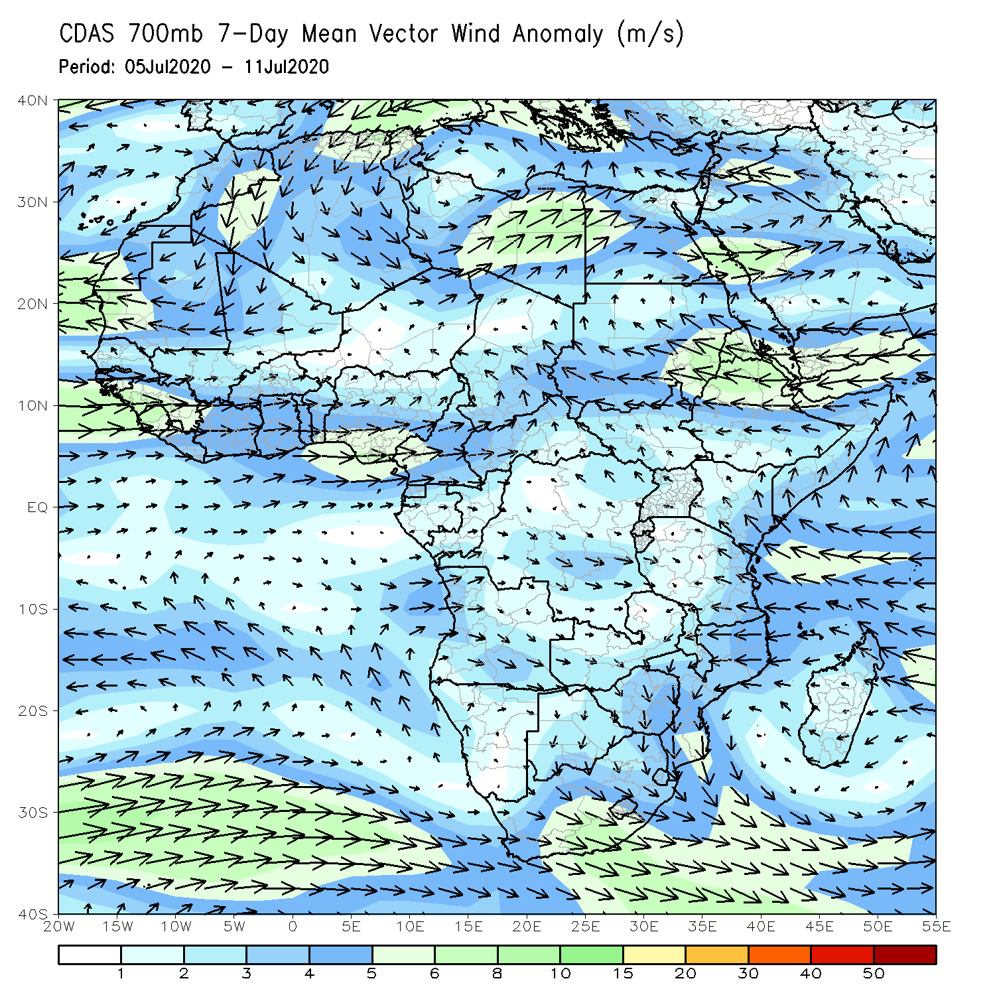
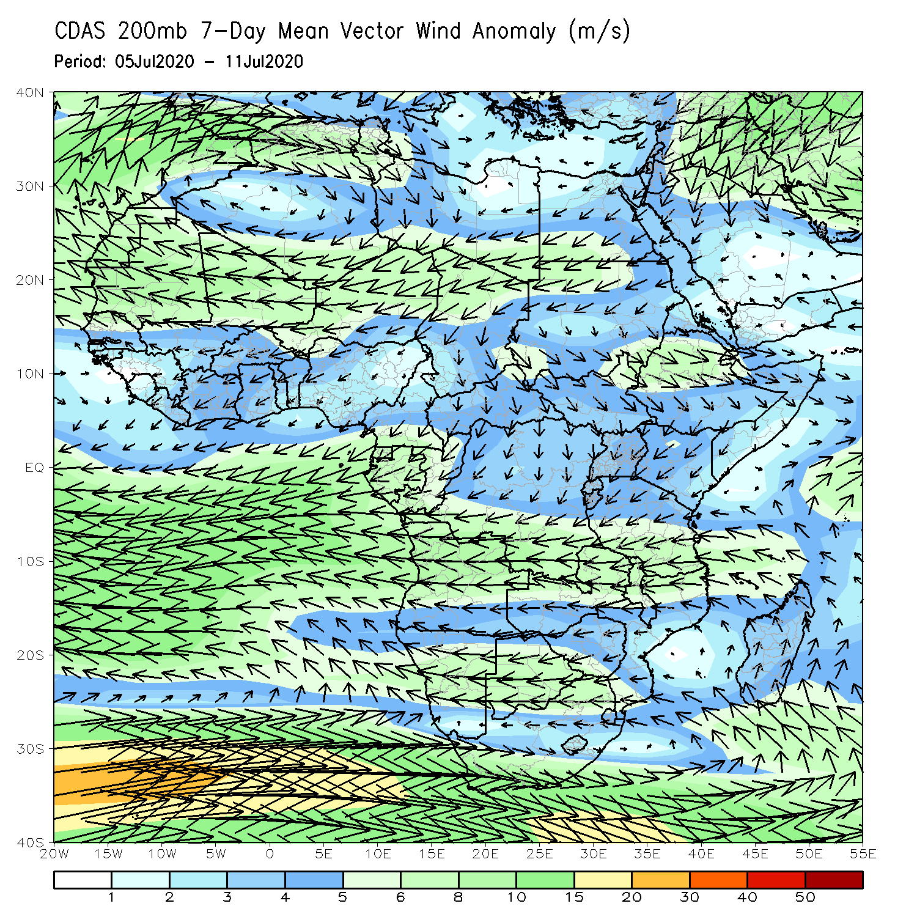
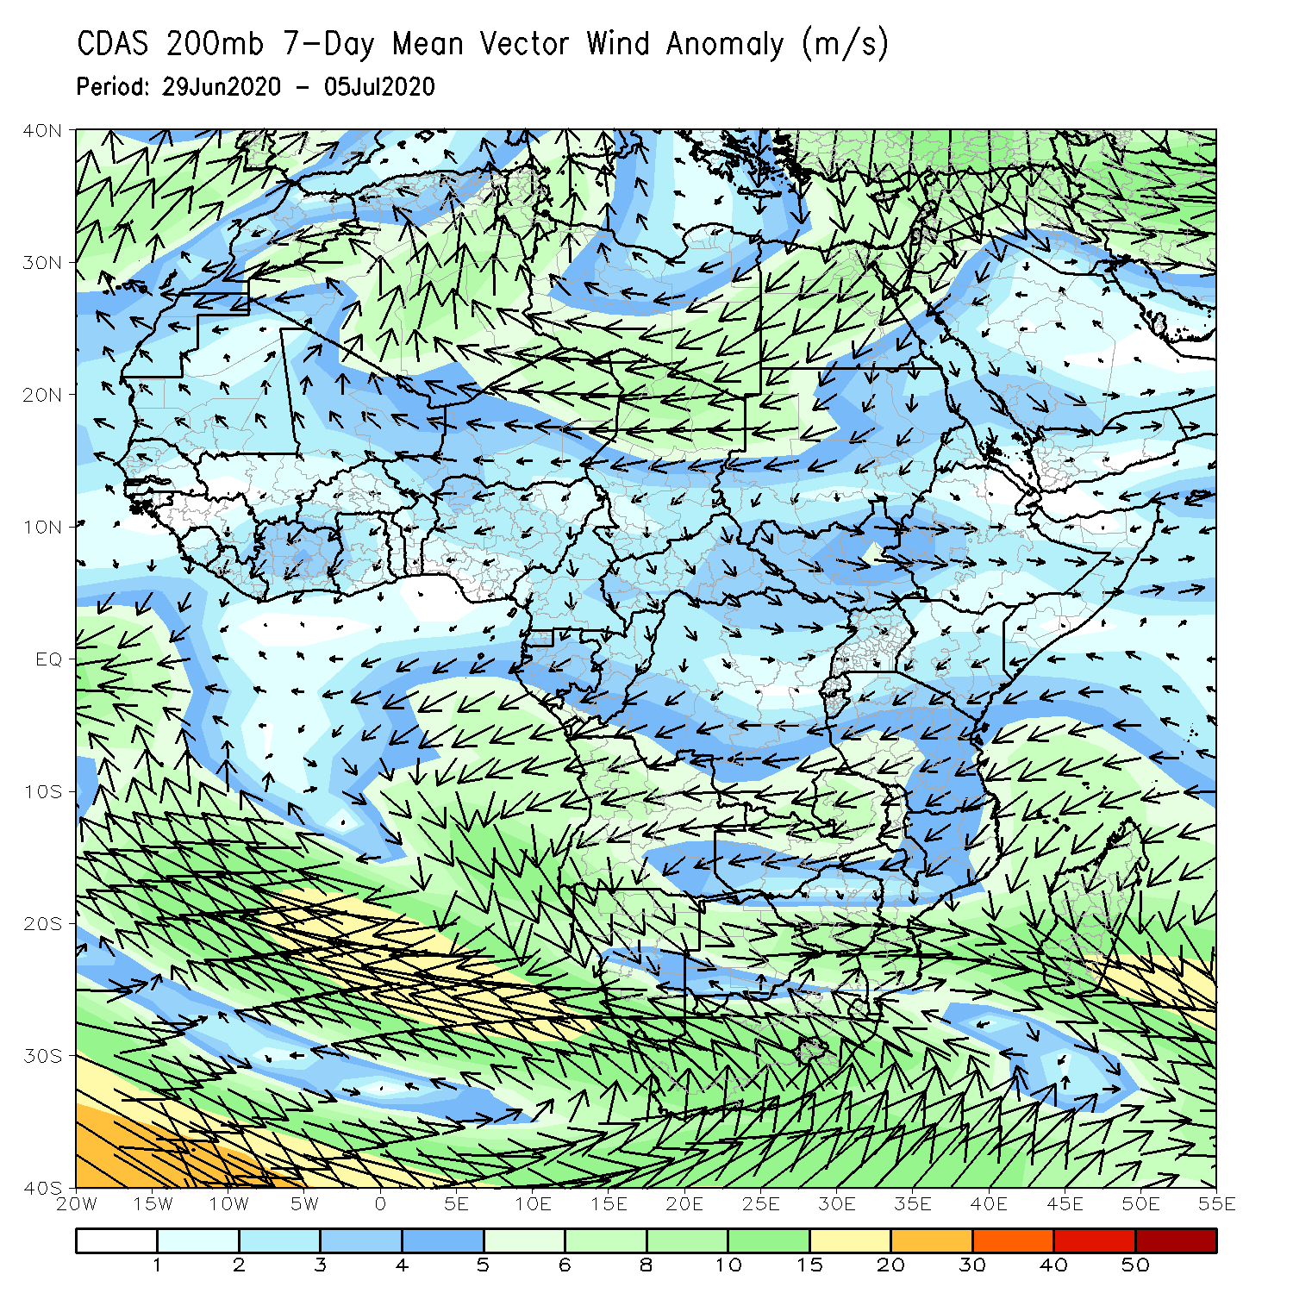
Atmospheric Circulation: Last 7 Days
Anomalous lower-level westerly flow was observed across the Gulf of Guinea region (left panel).

Slide 9
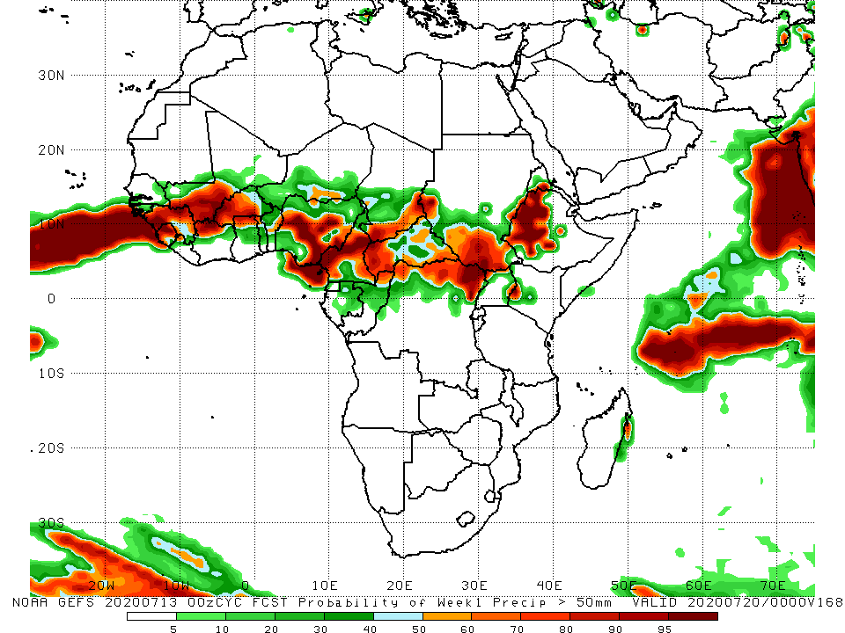
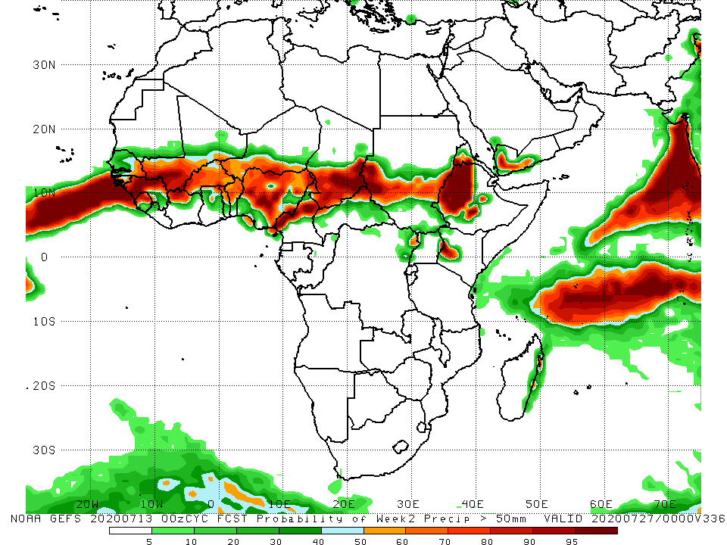
NCEP GEFS Model Forecasts Non-Bias Corrected Probability of precipitation exceedance
Week-1 Valid 14 – 20 July, 2020
Week-2: Valid 21 – 27 July, 2020
For week-1 (left panel) and Week-2 (right panel), there is an increased chance for weekly rainfall totals to exceed 50mm over many places in the Sahel region, and South Sudan and western Ethiopia.
Notes:
9

Slide 10
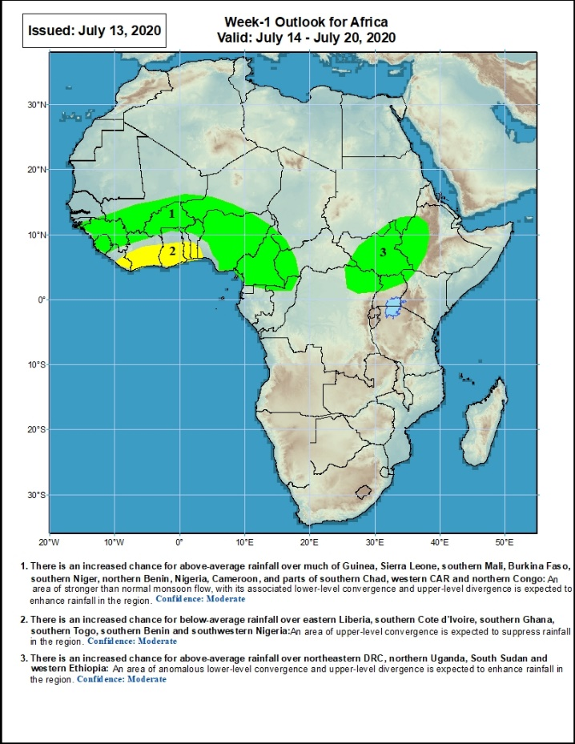
Week-1 Precipitation Outlooks
14 – 20 July, 2020
There is an increased chance for above-average rainfall over much of Guinea, Sierra Leone, southern Mali, Burkina Faso, southern Niger, northern Benin, Nigeria, Cameroon, and parts of southern Chad, western CAR and northern Congo: An area of stronger than normal monsoon flow, with its associated lower-level convergence and upper-level divergence is expected to enhance rainfall in the region. Confidence: Moderate
There is an increased chance for below-average rainfall over eastern Liberia, southern Cote d'Ivoire, southern Ghana, southern Togo, southern Benin and southwestern Nigeria: An area of anomalous upper-level convergence is expected to suppress rainfall in the region. Confidence: Moderate
There is an increased chance for above-average rainfall over northeastern DRC, northern Uganda, South Sudan and western Ethiopia: An area of anomalous lower-level convergence and upper-level divergence is expected to enhance rainfall in the region. Confidence: Moderate
Notes:
10

Slide 11
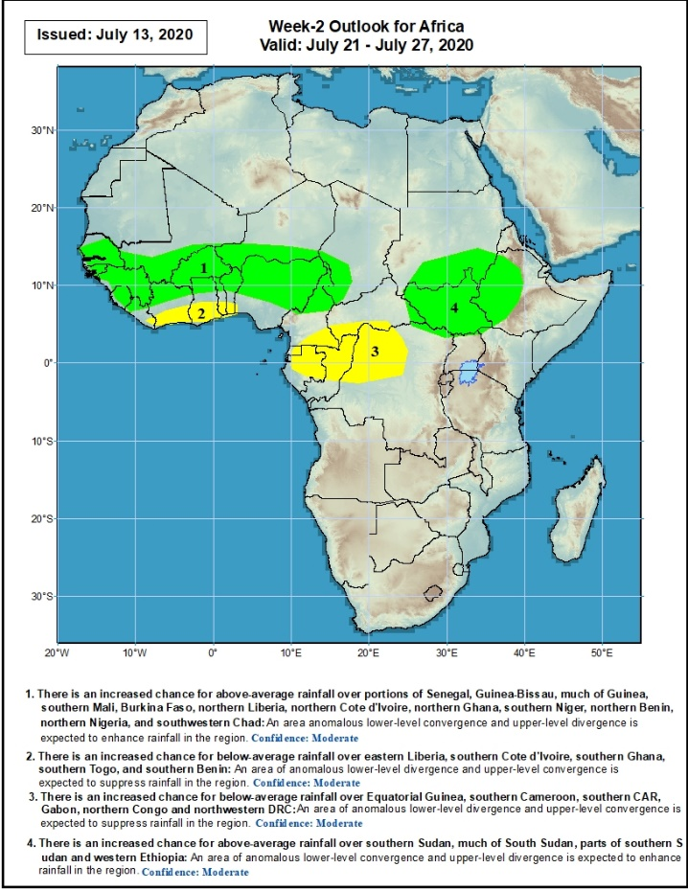
Week-2 Precipitation Outlooks
21 – 27 July, 2020
There is an increased chance for above-average rainfall over portions of Senegal, Guinea-Bissau, Guinea, southern Mali, Burkina Faso, northern Liberia, northern Cote d'Ivoire, northern Ghana, southern Niger, northern Benin, northern Nigeria, northern Cameroon, and southwestern Chad: An area anomalous lower-level convergence and upper-level divergence is expected to enhance rainfall in the region. Confidence: Moderate
There is an increased chance for below-average rainfall over eastern Liberia, southern Cote d'Ivoire, southern Ghana, southern Togo, and southern Benin: An area of anomalous upper-level convergence is expected to suppress rainfall in the region. Confidence: Moderate
There is an increased chance for below-average rainfall over Equatorial Guinea, southern Cameroon, southern CAR, Gabon, northern Congo and northwestern DRC: An area of anomalous lower-level divergence and upper-level convergence is expected to suppress rainfall in the region. Confidence: Moderate
There is an increased chance for above-average rainfall over much of South Sudan, parts of southern Sudan and western Ethiopia: An area of anomalous lower-level convergence and upper-level divergence is expected to enhance rainfall in the region. Confidence: Moderate
Notes:
11

Slide 12
Summary
During the past 7 days, rainfall was above-average over western Senegal, Guinea, Sierra Leone, southern Mali, Burkina Faso, northern Ghana, southern Niger, Tog, Benin, Nigeria, Cameroon, southern Chad, CAR, northern Congo, western and northern DRC, southern Sudan, much of South Sudan, Uganda, portions of Ethiopia and local areas in southern Somalia. Below-average rainfall was observed over parts of Senegal, eastern Liberia, Cote d’Ivoire, western Ghana, western Chad, and northeastern Ethiopia.
During the past 30 days, rainfall was above-average over many places in West and Central Africa countries. Above-average rainfall was also observed over South Sudan, parts of eastern and southern Sudan, Uganda, Ethiopia, and local areas in western Kenya. Rainfall was below-average over local areas in Senegal, parts of Cote d’Ivoire, western and southern Niger, and local areas in Nigeria and Chad. Below-average rainfall was also observed over portions of South Africa.
During the past 90 days, rainfall was above-average over much of West, Central and the Greater Horn of Africa, including the northern portions of Southern Africa. Rainfall was also above-average over portions of South Africa. Southern and eastern Botswana, and local areas in Angola, Zambia, Zimbabwe, Malawi and Mozambique had below-average rainfall. Rainfall was also below-average over northern South Africa and much of Madagascar.
Week-1 outlooks call for an increased chance for above-average rainfall over much of Guinea, Sierra Leone, southern Mali, Burkina Faso, southern Niger, northern Benin, Nigeria, Cameroon, parts of southern Chad, western CAR, northern Congo, northeastern DRC, northern Uganda, South Sudan and western Ethiopia. In contrast, there is an increased chance for below-average rainfall over eastern Liberia, southern Cote d'Ivoire, southern Ghana, southern Togo, southern Benin and southwestern Nigeria.
Week-2 outlooks call for an increased chance for above-average rainfall over portions of Senegal, Guinea-Bissau, much of Guinea, southern Mali, Burkina Faso, northern Liberia, northern Cote d'Ivoire, northern Ghana, southern Niger, northern Benin, northern Nigeria, northern Cameroon, southwestern Chad, southern Sudan, much of South Sudan, and western Ethiopia. In contrast, there is an increased chance for below-average rainfall over Equatorial Guinea, southern Cameroon, southern CAR, Gabon, northern Congo and northwestern DRC.
Notes:
12

