Slide 1
The African Monsoon Recent Evolution and Current Status Include Week-1 and Week-2 Outlooks
Update prepared by
Climate Prediction Center / NCEP
08 June 2020
For more information, visit:
http://www.cpc.ncep.noaa.gov/products/Global_Monsoons/African_Monsoons/precip_monitoring.shtml

Slide 2
Outline
Highlights
Recent Evolution and Current Conditions
NCEP GEFS Forecasts
Summary

Slide 3
Highlights: Last 7 Days
Another week of moderate to locally heavy rainfall sustained moisture surpluses over many places in the Gulf of Guinea region.
Week-1 outlooks call for an increased chance for above-average rainfall over much of Guinea, Sierra Leone, Liberia, Togo, Benin, southern Niger, much of Nigeria, and parts of northeastern DRC and western Uganda.

Slide 4
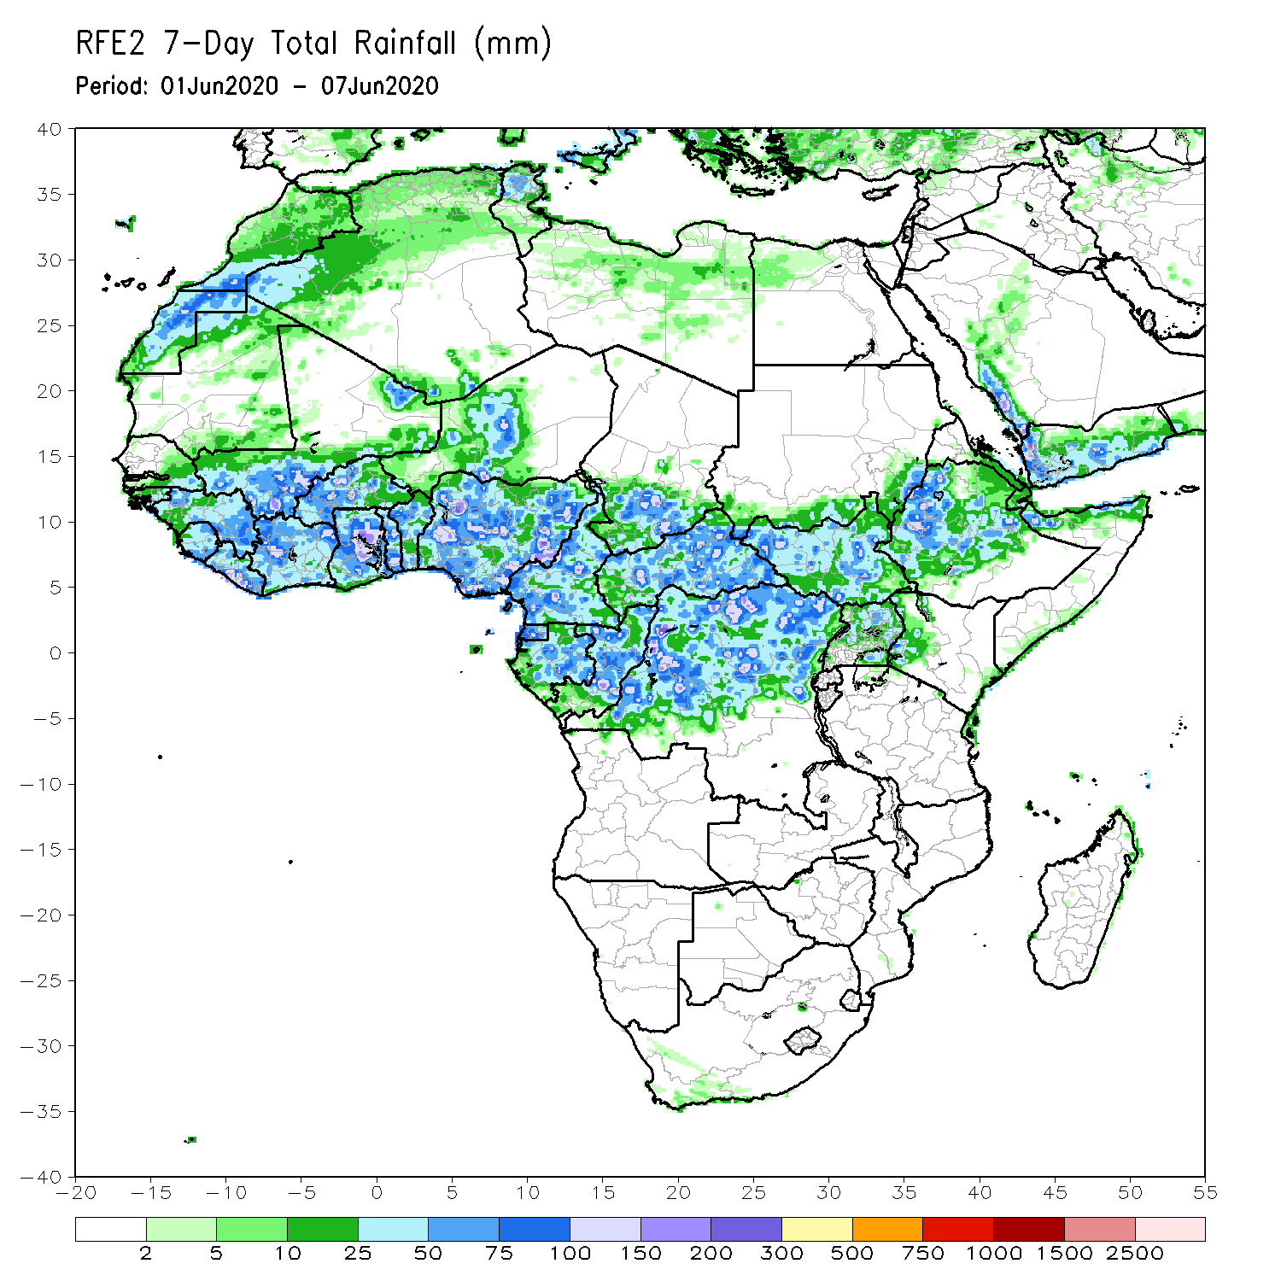
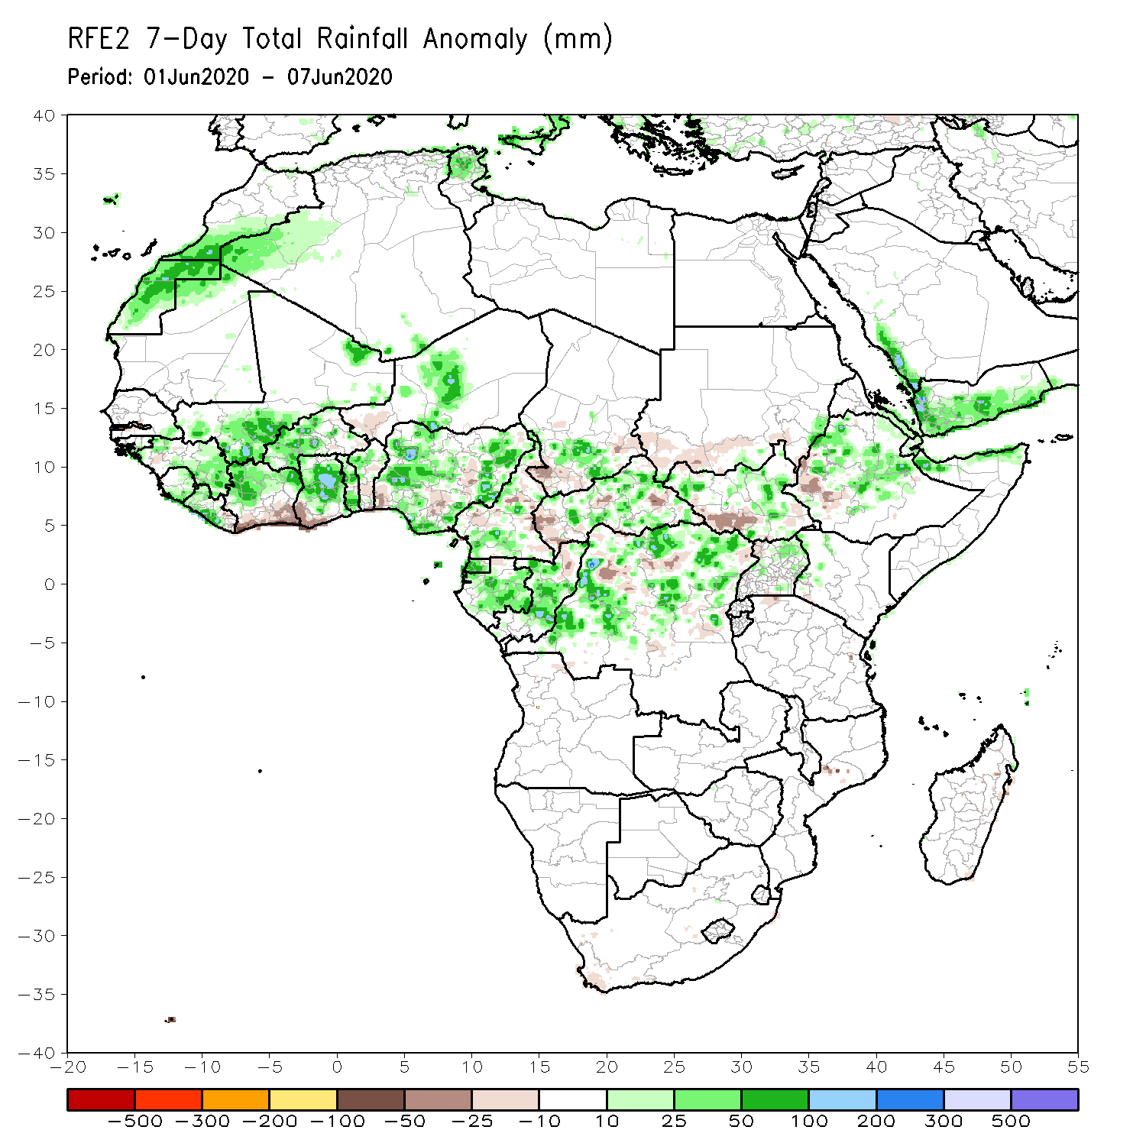
Rainfall Patterns: Last 7 Days
During the past 7 days, rainfall was above-average over Western Sahara, southern Morocco, northwestern Algeria, parts of Mali, Guinea, Sierra Leone, Liberia, northern Cote d’Ivoire, western Burkina Faso, Ghana, northern Togo and Benin, local areas in Niger, many parts of Nigeria, Cameroon, parts of southern Chad and CAR, Equatorial Guinea, Gabon, Congo, and portions of DRC, South Sudan and Ethiopia.
Below-average rainfall was observed over southern Cote d’Ivoire, eastern Burkina Faso, southern Benin, and local areas in CAR, DRC, South Sudan and southwestern Ethiopia.

Slide 5
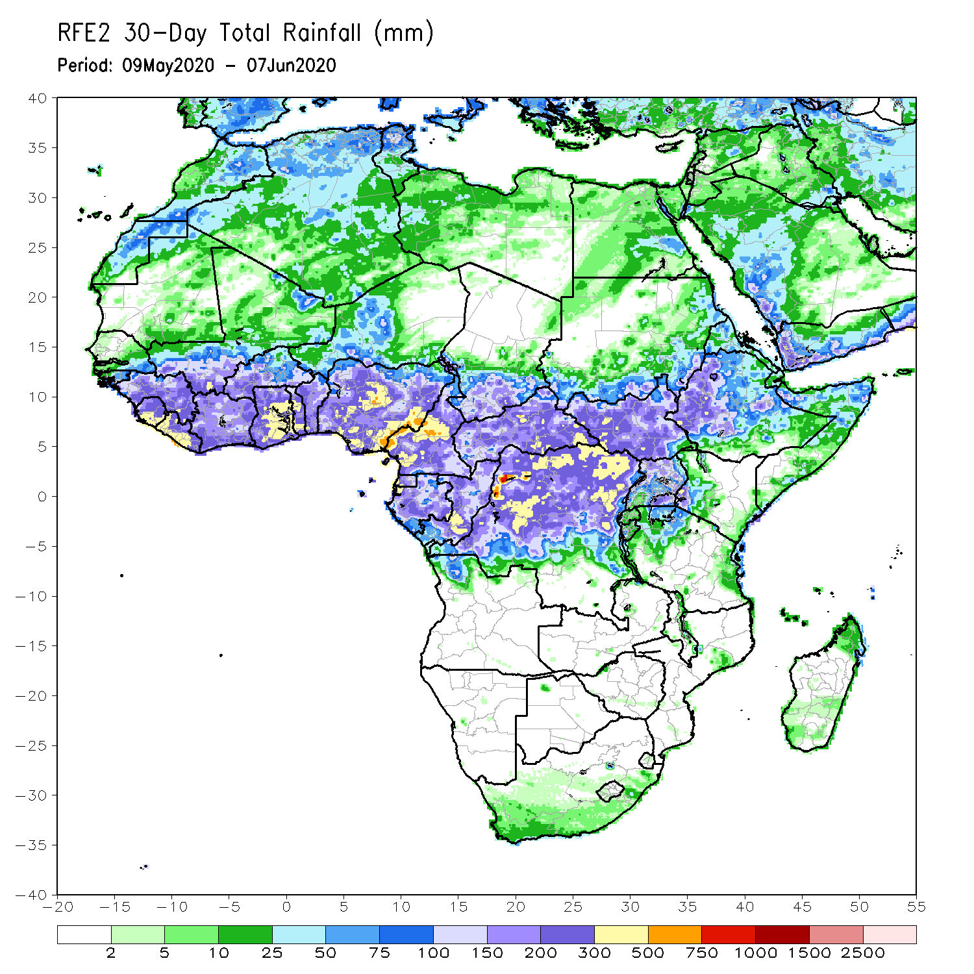
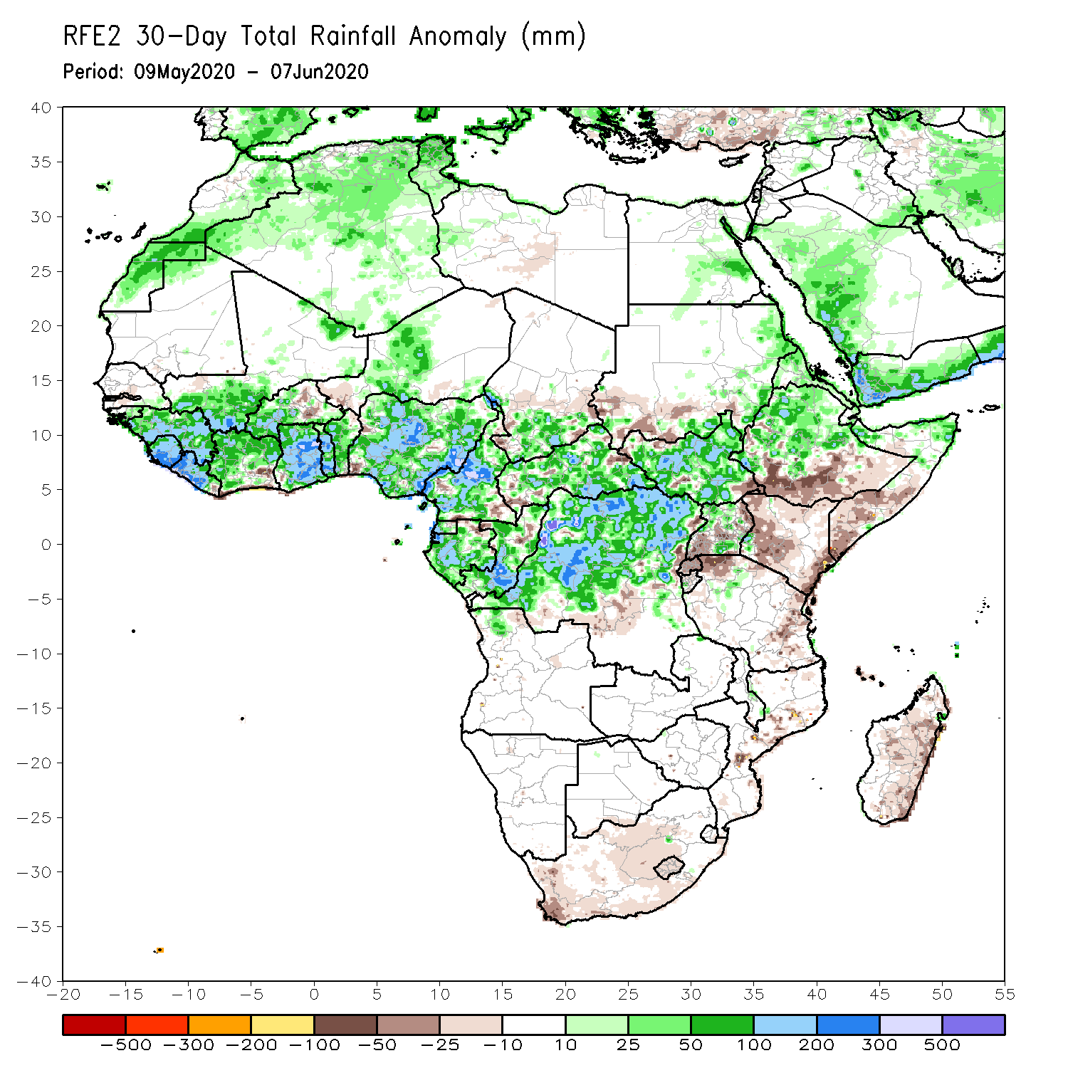
Rainfall Patterns: Last 30 Days
During the past 30 days, rainfall was above-average over many places in the Gulf of Guinea and Central Africa countries, including, South Sudan, parts of eastern Sudan, Uganda, Eritrea, central and northern Ethiopia, local areas in western Kenya, and northern Somalia.
Rainfall was below-average over local areas in eastern Burkina Faso, western Niger, local areas in northern Congo, Rwanda, Burundi, and Uganda, southern Sudan, central and eastern Kenya, parts of Tanzania, Somalia, local area in Mozambique, and much of Madagascar.
Notes:
5

Slide 6
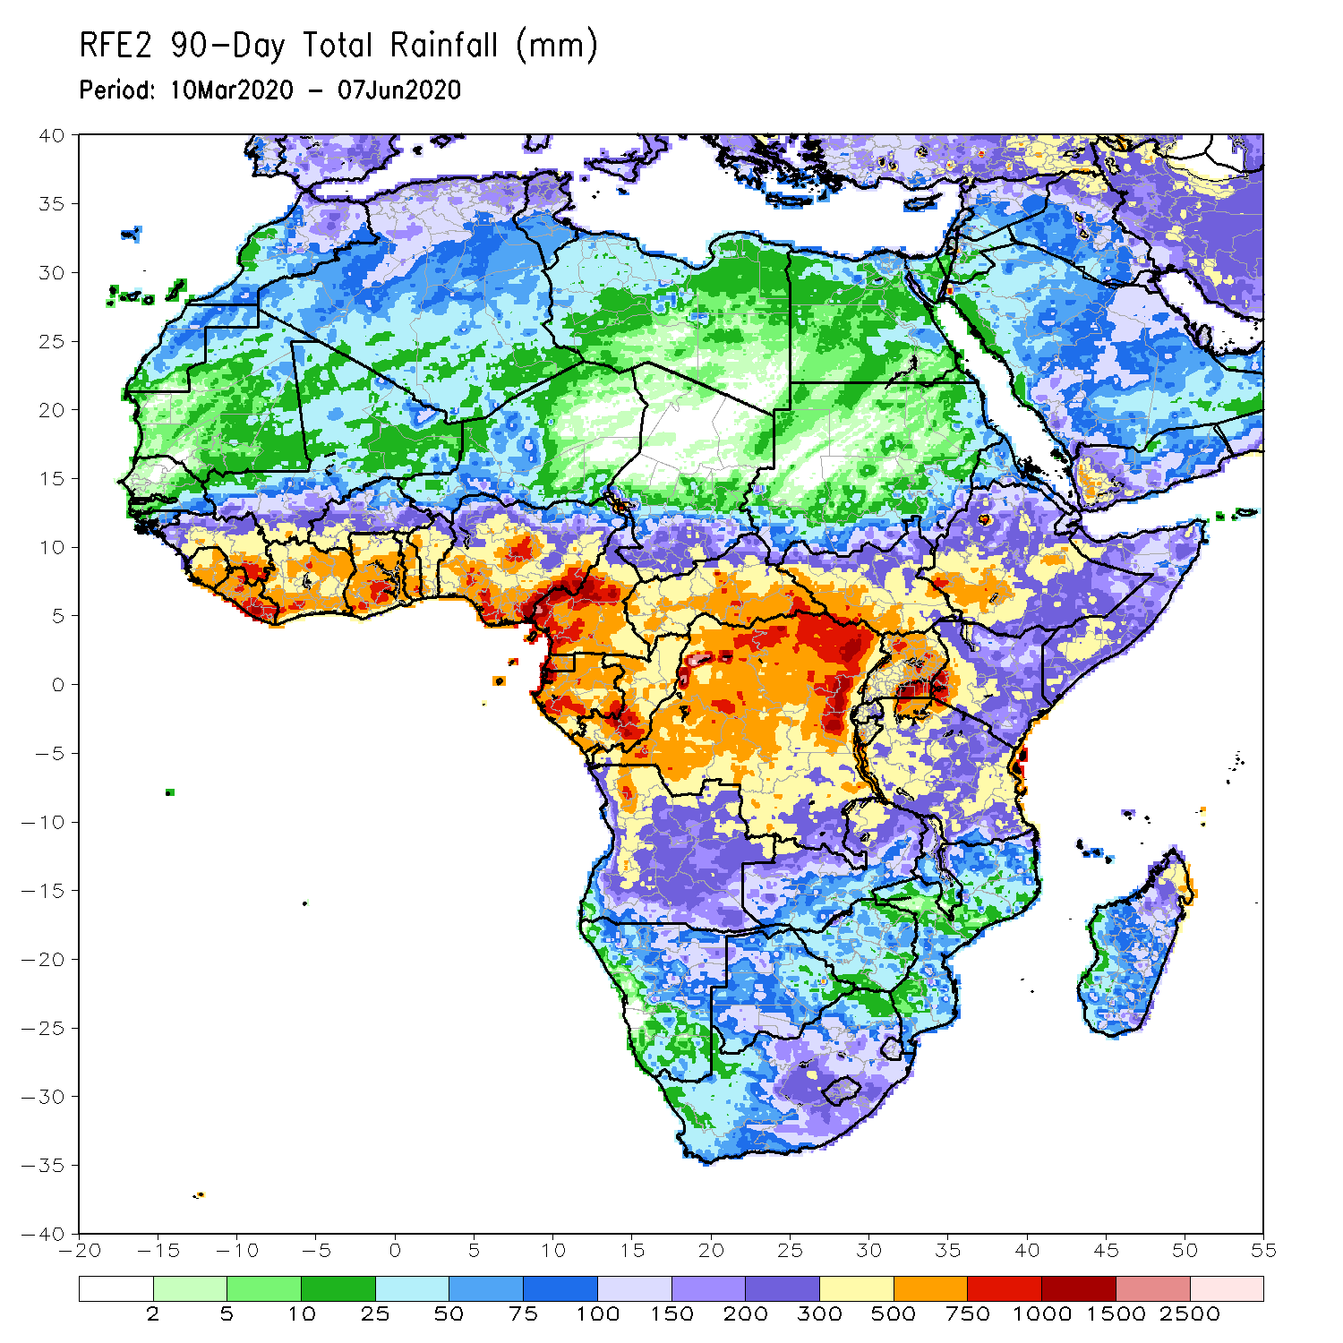
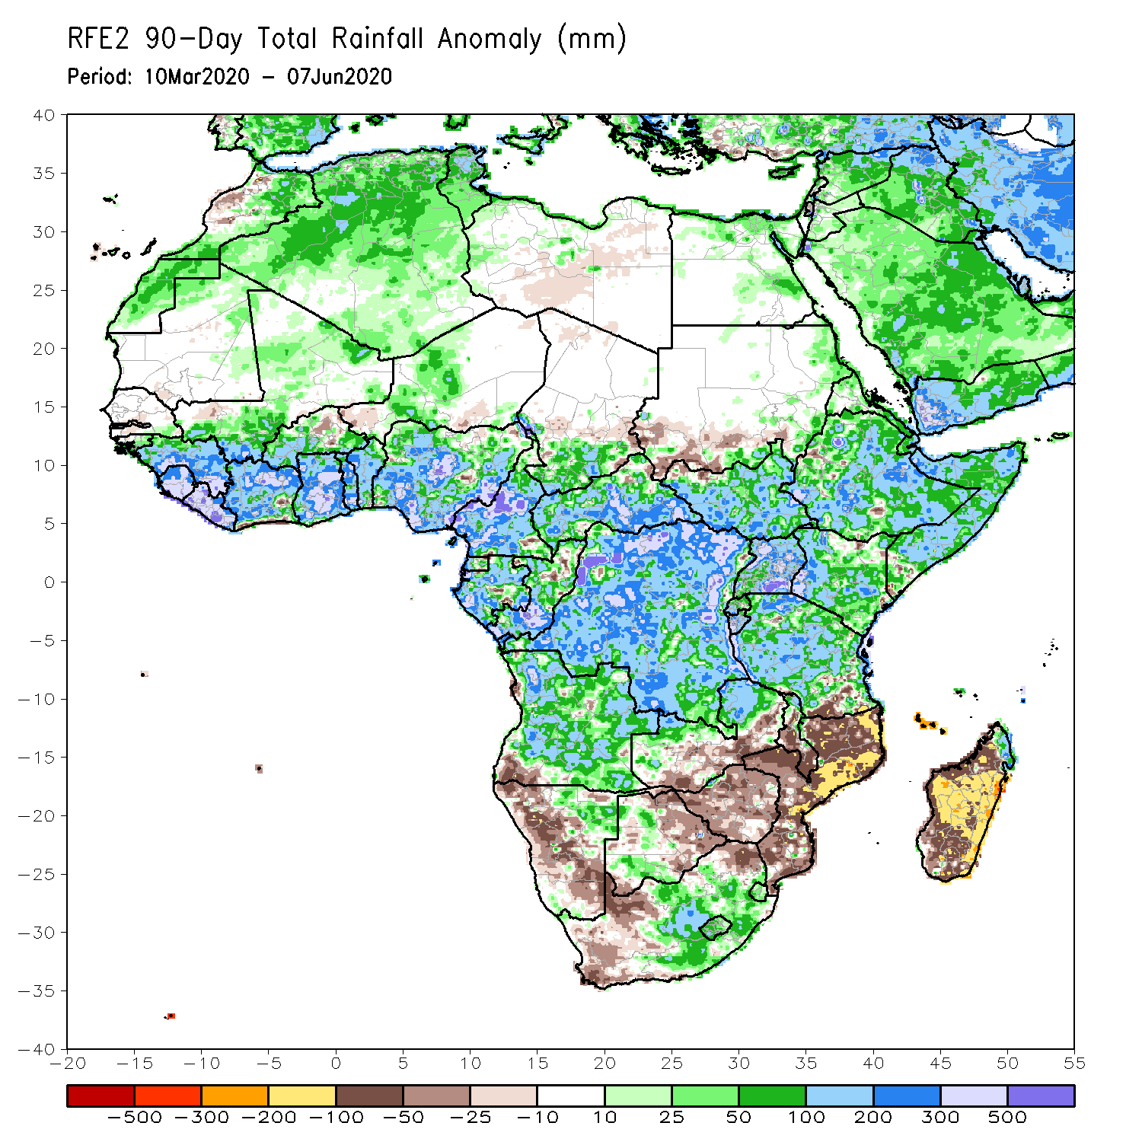
Rainfall Patterns: Last 90 Days
During the past 90 days, rainfall was above-average over much of West, Central and the Greater Horn of Africa, including the northern portions of Southern Africa. Rainfall was also above-average over northeastern Namibia, western Botswana, portions of South Africa, and the far northern Madagascar.
Local areas in Burkina Faso, southern Sudan, southwestern Angola, western and southern Namibia, eastern Botswana, much of Zimbabwe, parts of southern Zambia, western South Arica, much of Mozambique, and central and southern Madagascar had below-average rainfall.
Notes:
6

Slide 7
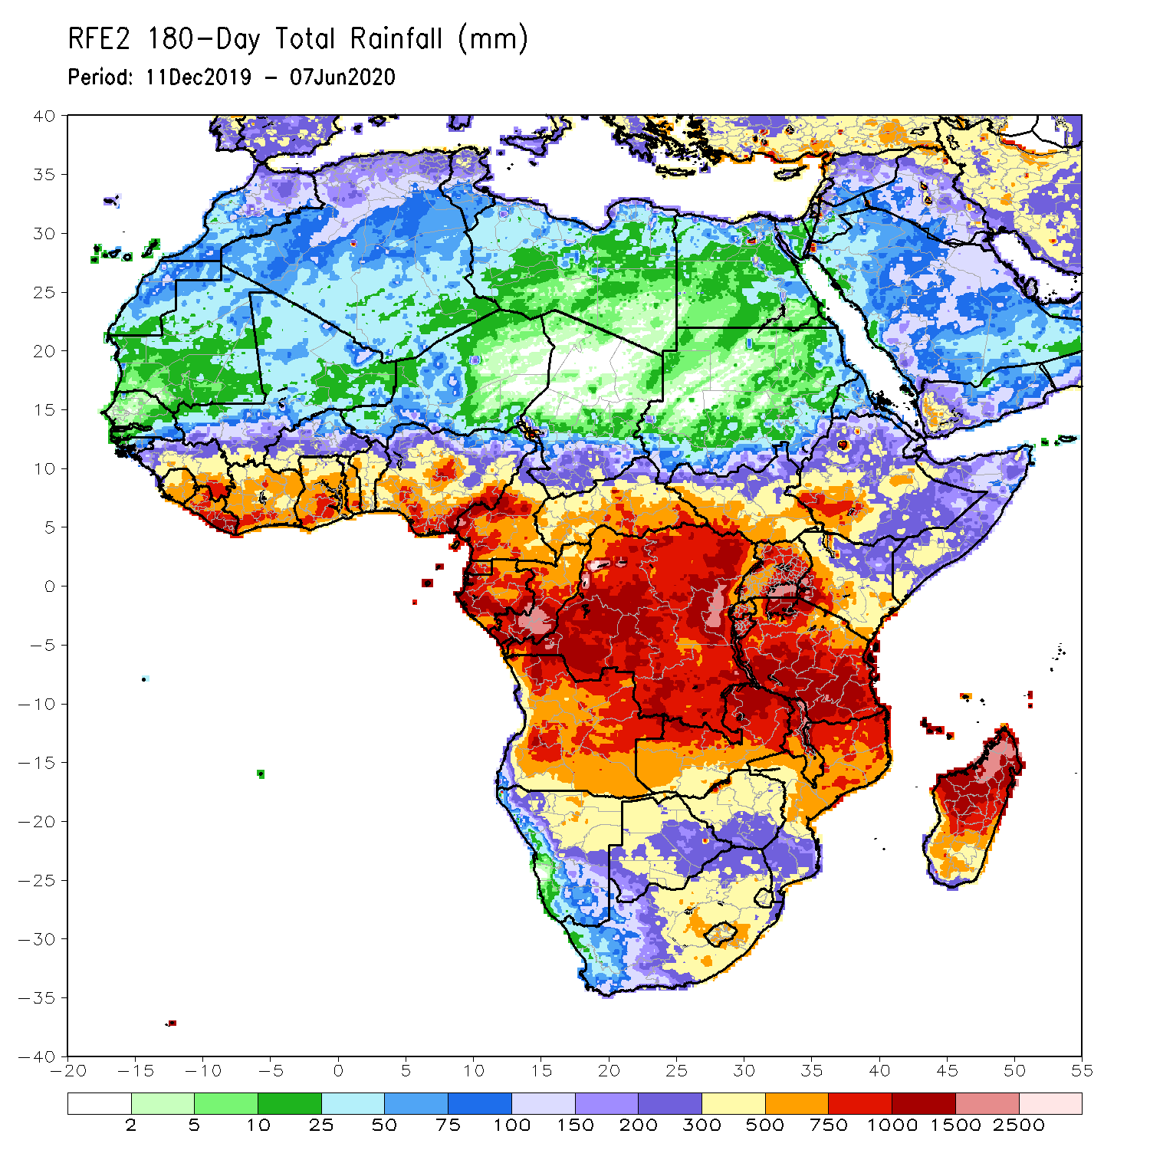
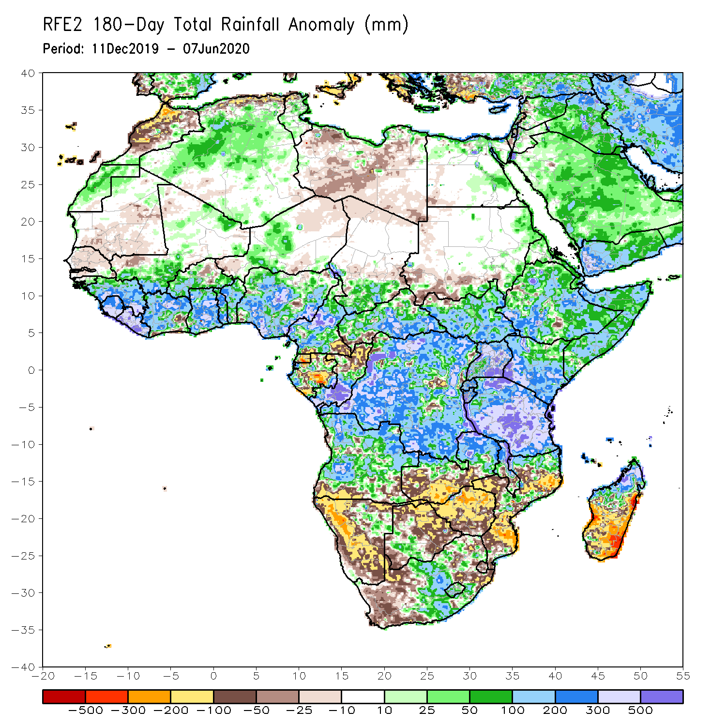
Rainfall Patterns: Last 180 Days
During the past 180 days, many places in the Gulf of Guinea and the neighboring areas of the Sahel region, Cameroon, southern Chad, much of CAR, DRC and South Sudan, Uganda, Eritrea, Ethiopia, much Somalia, Kenya, Tanzania, many parts of Angola, northeastern Namibia, northern Zambia, Malawi, parts of South Africa, portions of Mozambique and northern Madagascar had above-average rainfall.
Below-average rainfall was observed over Equatorial Guinea, Gabon, northern Congo, local areas in DRC and Angola, western and southern Namibia, western South Africa, southern Zambia, northern and eastern Botswana, much of Zimbabwe, parts of Mozambique and southern Madagascar.
Notes:
7

Slide 8
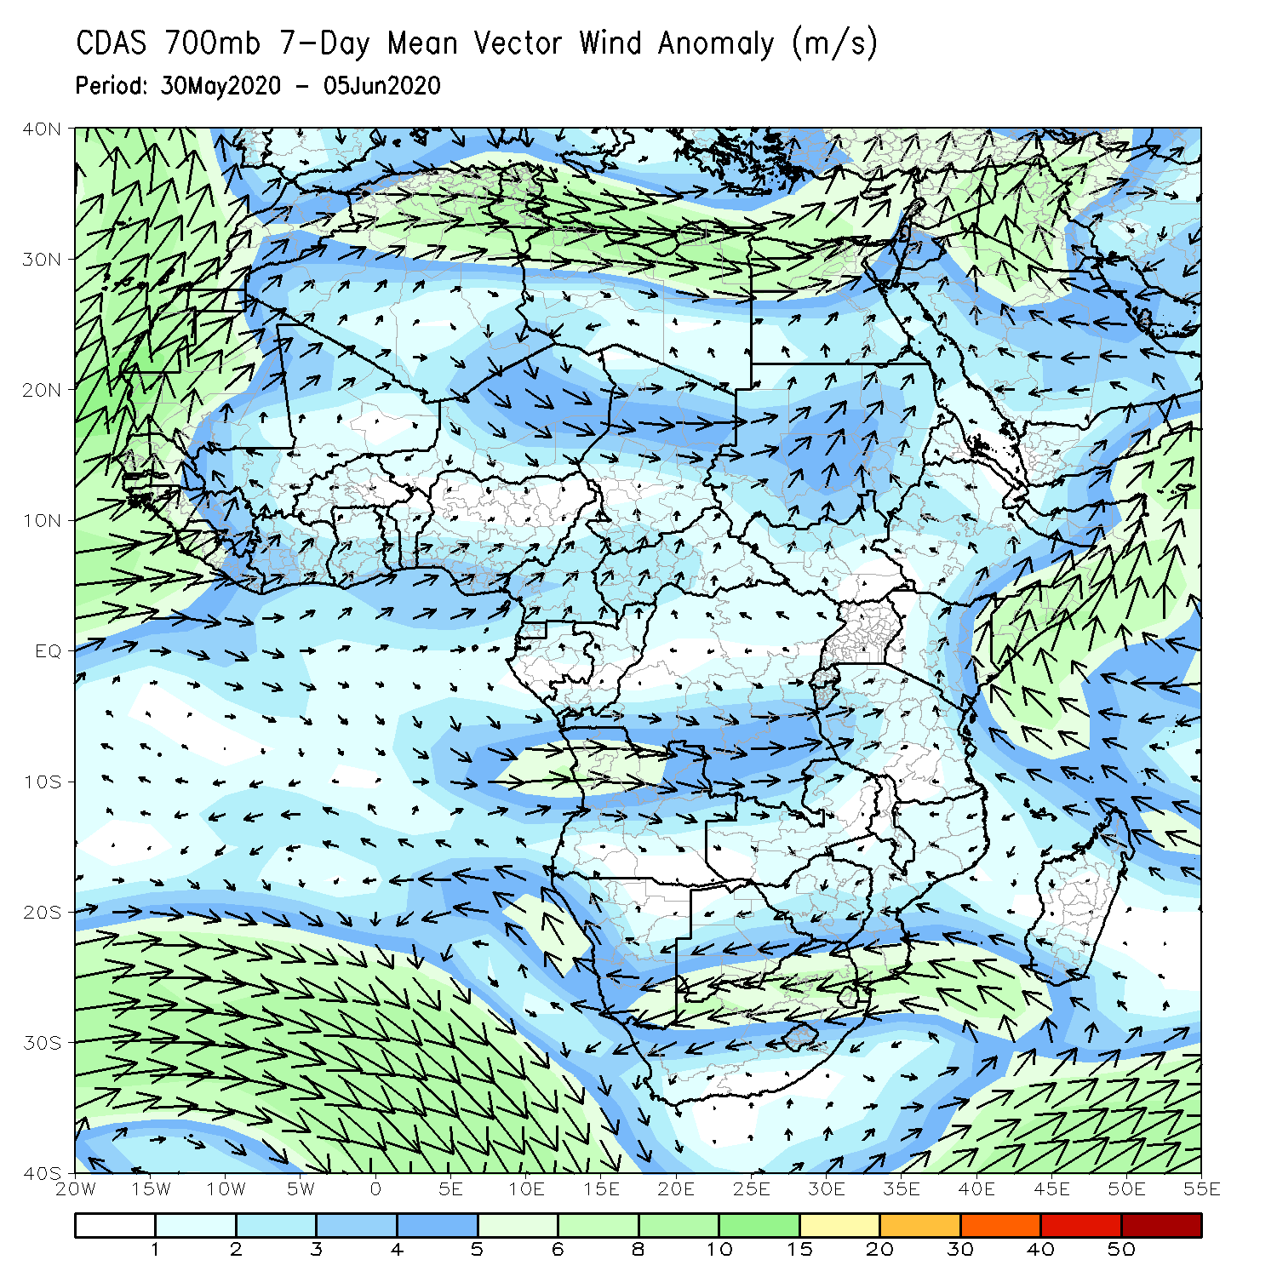
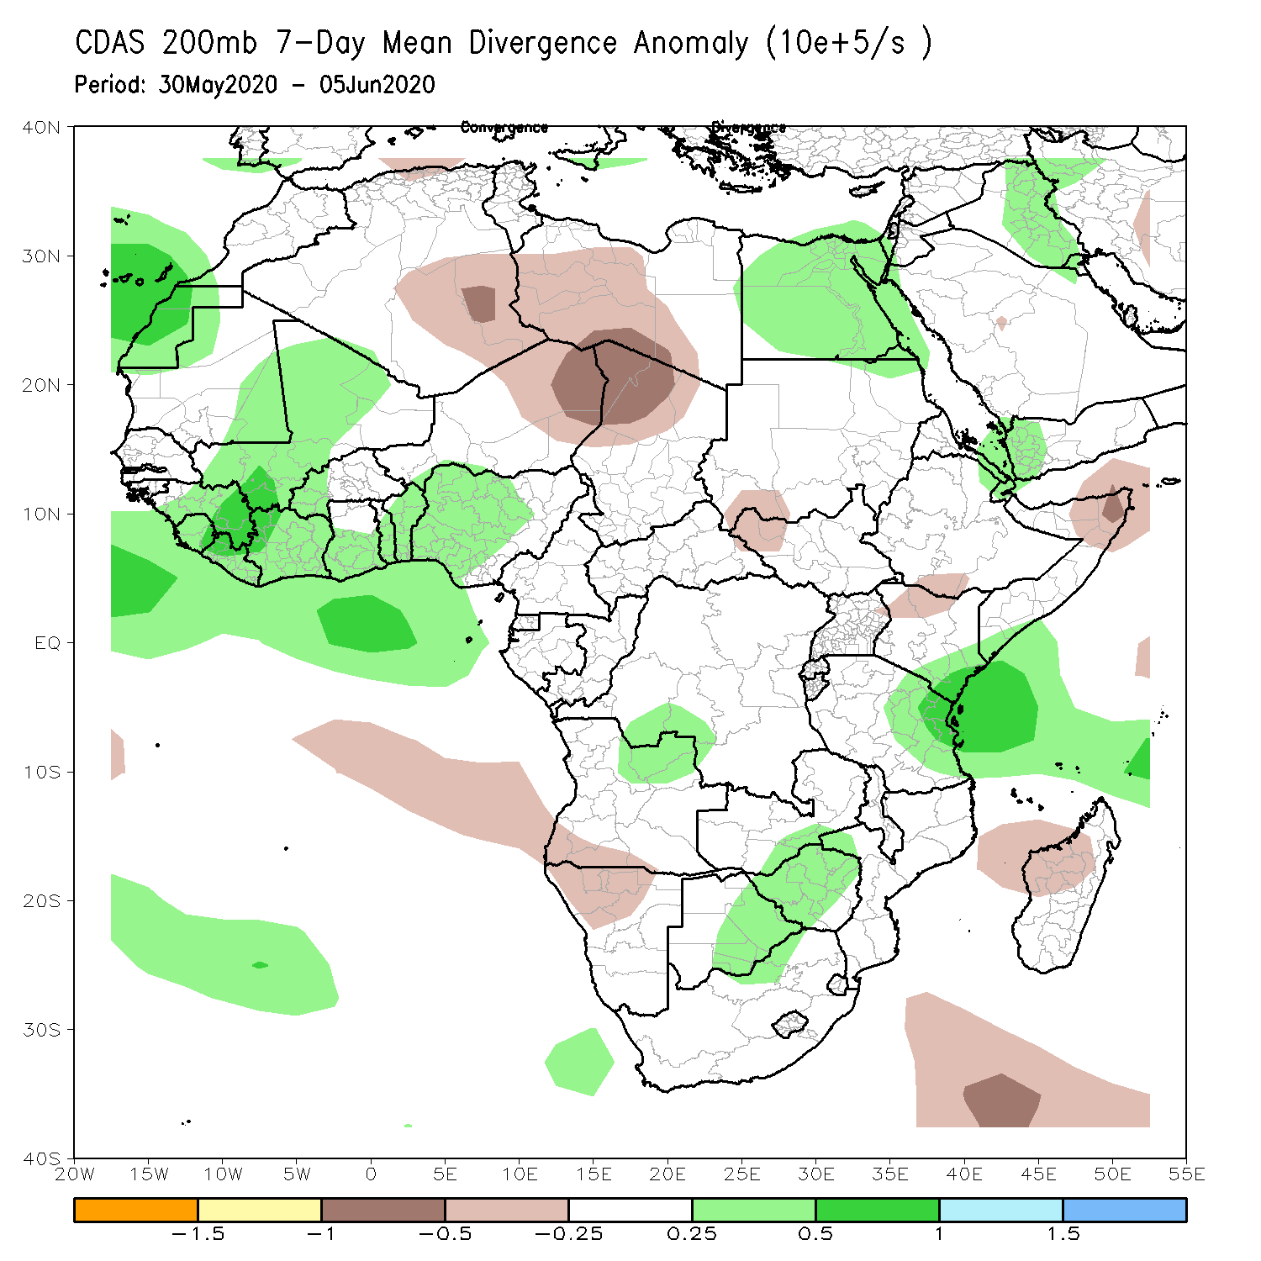
Atmospheric Circulation: Last 7 Days
Anomalous lower-level onshore flow, coupled with anomalous upper-level divergence may have contributed to the observed above-average rainfall over portions of West Africa.

Slide 9
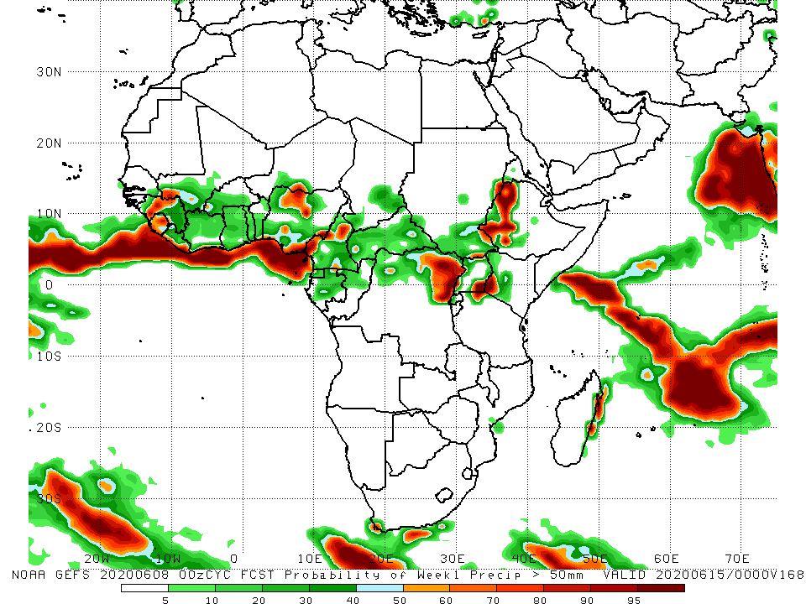
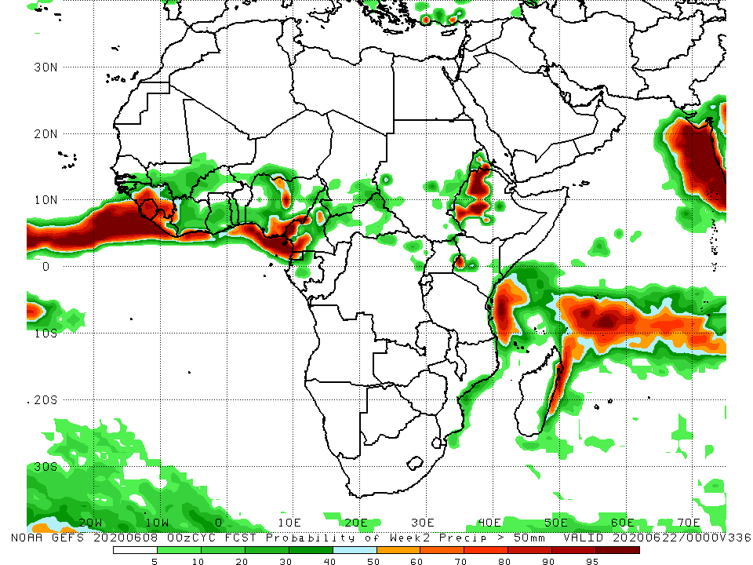
NCEP GEFS Model Forecasts Non-Bias Corrected Probability of precipitation exceedance
Week-1 Valid: 9 – 15 June, 2020
Week-2: Valid 16 – 22 June, 2020
For week-1 (left panel) and week-2 (right panel), there is an increased chance for weekly rainfall totals to exceed 50mm over local areas in Guinea, Sierra Leone, Liberia, Nigeria, Cameroon, DRC, western Kenya and western Ethiopia.
Notes:
9

Slide 10
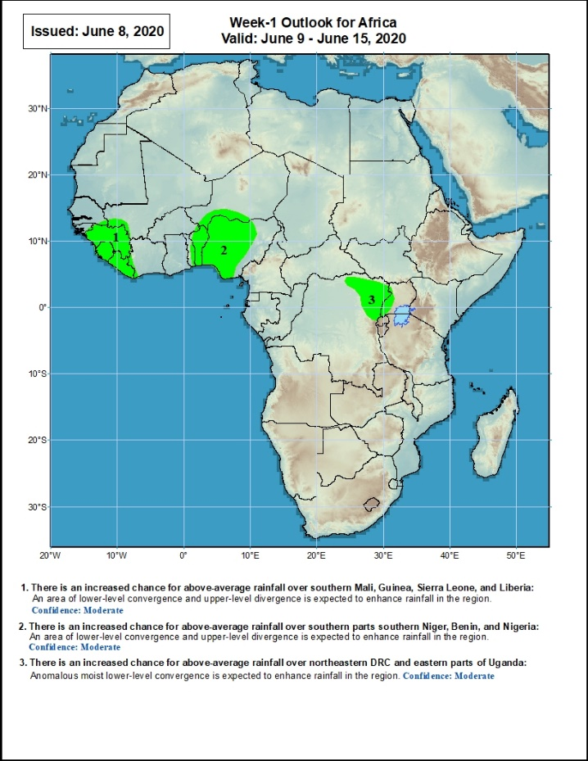
Week-1 Precipitation Outlooks
9 – 15 June, 2020
There is an increased chance for above-average rainfall over southern Mali, Guinea, Sierra Leone, and Liberia: An area of anomalous lower-level convergence and upper-level divergence is expected to enhance rainfall in the region. Confidence: Moderate
There is an increased chance for above-average rainfall over southern parts southern Niger, Benin, and Nigeria: An area of anomalous lower-level convergence and upper-level divergence is expected to enhance rainfall in the region. Confidence: Moderate
There is an increased chance for above-average rainfall over northeastern DRC and western parts of Uganda: An area of anomalous lower-level convergence and upper-level divergence is expected to enhance rainfall in the region. Confidence: Moderate
Notes:
10

Slide 11
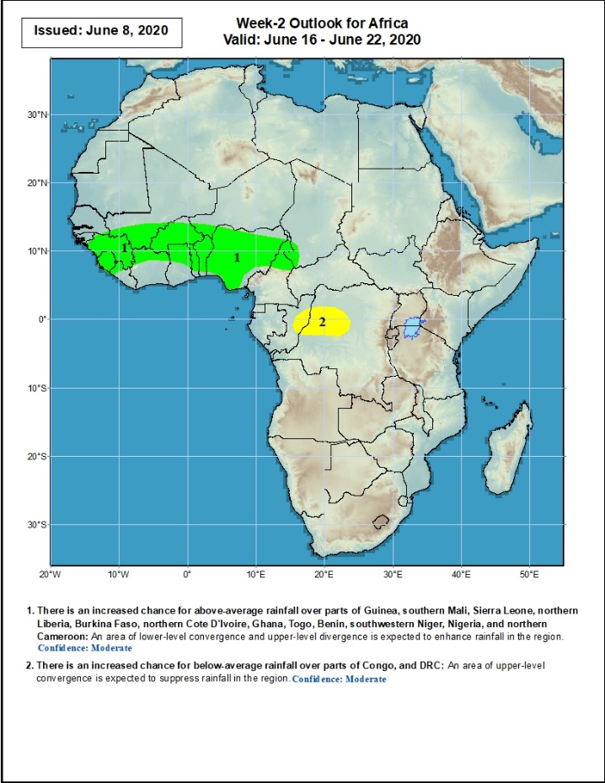
Week-2 Precipitation Outlooks
16 – 22 June, 2020
There is an increased chance for above-average rainfall over parts of Guinea, southern Mali, Sierra Leone, western Liberia, Burkina Faso, northern Cote d'Ivoire, Ghana, Togo, Benin, southwestern Niger, Nigeria, and northern Cameroon: An area of lower-level convergence and upper-level divergence is expected to enhance rainfall in the region. Confidence: Moderate
There is an increased chance for below-average rainfall over parts of Congo and northwestern DRC: An area of lower-level divergence and upper-level convergence is expected to suppress rainfall in the region. Confidence: Moderate
Notes:
11

Slide 12
Summary
During the past 7 days, rainfall was above-average over Western Sahara, southern Morocco, northwestern Algeria, parts of Mali, Guinea, Sierra Leone, Liberia, northern Cote d’Ivoire, western Burkina Faso, Ghana, northern Togo and Benin, local areas in Niger, many parts of Nigeria, Cameroon, parts of southern Chad and CAR, Equatorial Guinea, Gabon, Congo, and portions of DRC, South Sudan and Ethiopia. Below-average rainfall was observed over southern Cote d’Ivoire, eastern Burkina Faso, southern Benin, and local areas in CAR, DRC, South Sudan and southwestern Ethiopia.
During the past 30 days, rainfall was above-average over many places in the Gulf of Guinea and Central Africa countries, including, South Sudan, parts of eastern Sudan, Uganda, Eritrea, central and northern Ethiopia, local areas in western Kenya, and northern Somalia. Rainfall was below-average over local areas in eastern Burkina Faso, western Niger, local areas in northern Congo, Rwanda, Burundi, and Uganda, southern Sudan, central and eastern Kenya, parts of Tanzania, Somalia, local area in Mozambique, and much of Madagascar.
During the past 90 days, rainfall was above-average over much of West, Central and the Greater Horn of Africa, including the northern portions of Southern Africa. Rainfall was also above-average over northeastern Namibia, western Botswana, portions of South Africa, and the far northern Madagascar. Local areas in Burkina Faso, southern Sudan, southwestern Angola, western and southern Namibia, eastern Botswana, much of Zimbabwe, parts of southern Zambia, western South Arica, much of Mozambique, and central and southern Madagascar had below-average rainfall.
Week-1 outlooks call for an increased chance for above-average rainfall over much of Guinea, Sierra Leone, Liberia, Togo, Benin, southern Niger, much of Nigeria, and parts of northeastern DRC and western Uganda.
Notes:
12

