Slide 1
The African Monsoon Recent Evolution and Current Status Include Week-1 and Week-2 Outlooks
Update prepared by
Climate Prediction Center / NCEP
18 May 2020
For more information, visit:
http://www.cpc.ncep.noaa.gov/products/Global_Monsoons/African_Monsoons/precip_monitoring.shtml

Slide 2
Outline
Highlights
Recent Evolution and Current Conditions
NCEP GEFS Forecasts
Summary

Slide 3
Highlights: Last 7 Days
Weekly rainfall surpluses exceeded 100mm over local areas in Guinea, Cameroon, southern Congo and eastern CAR.
Week-1 outlooks call for an increased chance for above-average rainfall over Equatorial Guinea, Gabon, Congo, portions of DRC, Uganda, Rwanda and Ethiopia. In contrast, there is an increased chance for below-average rainfall over Sierra Leone eastern Guinea, Liberia, Cote d'Ivoire, parts of Burkina Faso, Ghana and Togo.

Slide 4
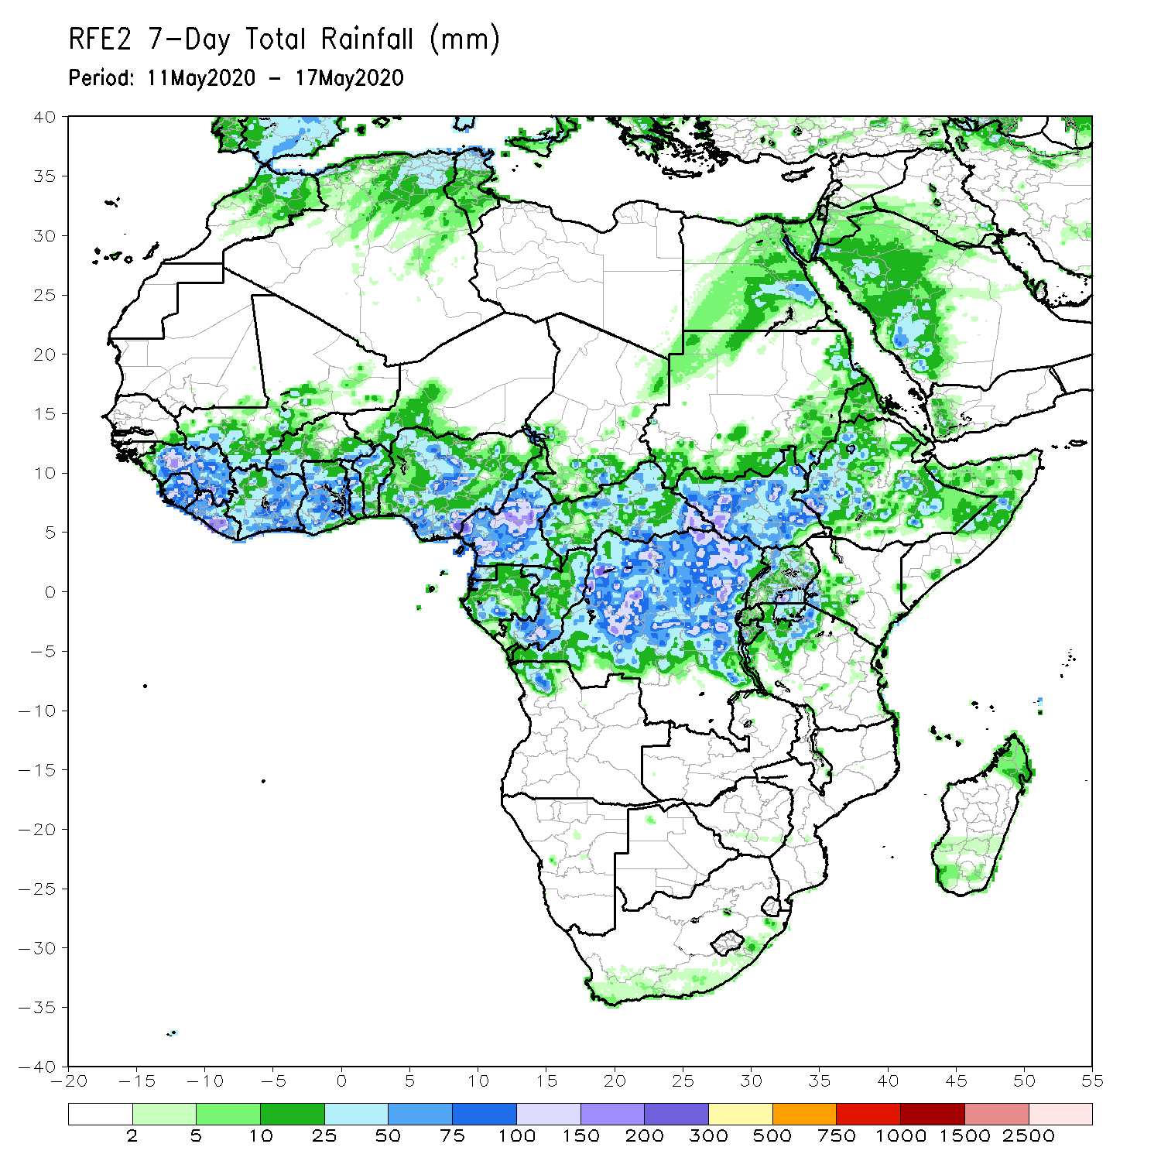
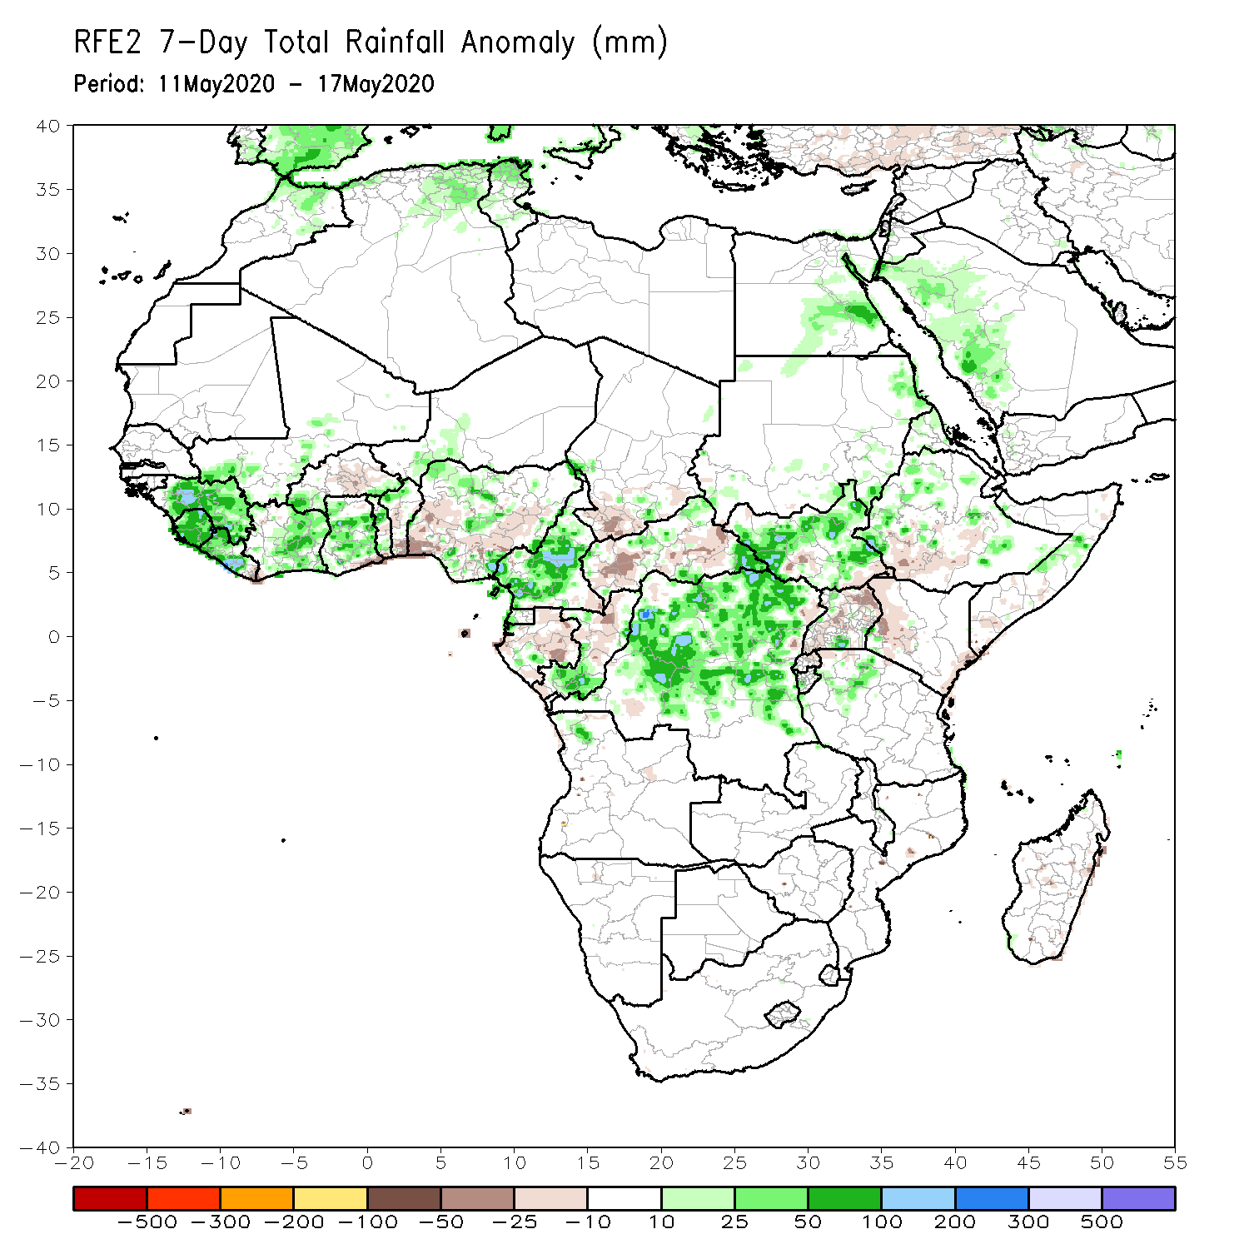
Rainfall Patterns: Last 7 Days
During the past 7 days, rainfall was above-average over much of Guinea, Sierra Leone, Liberia, local areas in Mali, Cote d’Ivoire and Burkina Faso, much of Ghana, parts of Nigeria, Cameroon, local areas in Chad and CAR, Equatorial Guinea, southern Congo, DRC, many parts of South Sudan, and local areas in Tanzania, Ethiopia and Somalia.
Below-average rainfall was observed over southern Benin, parts of Nigeria, southern Chad, local areas in Gabon, northern Congo, much of CAR, local areas in South Sudan, Uganda, and local areas in Ethiopia and Kenya.

Slide 5
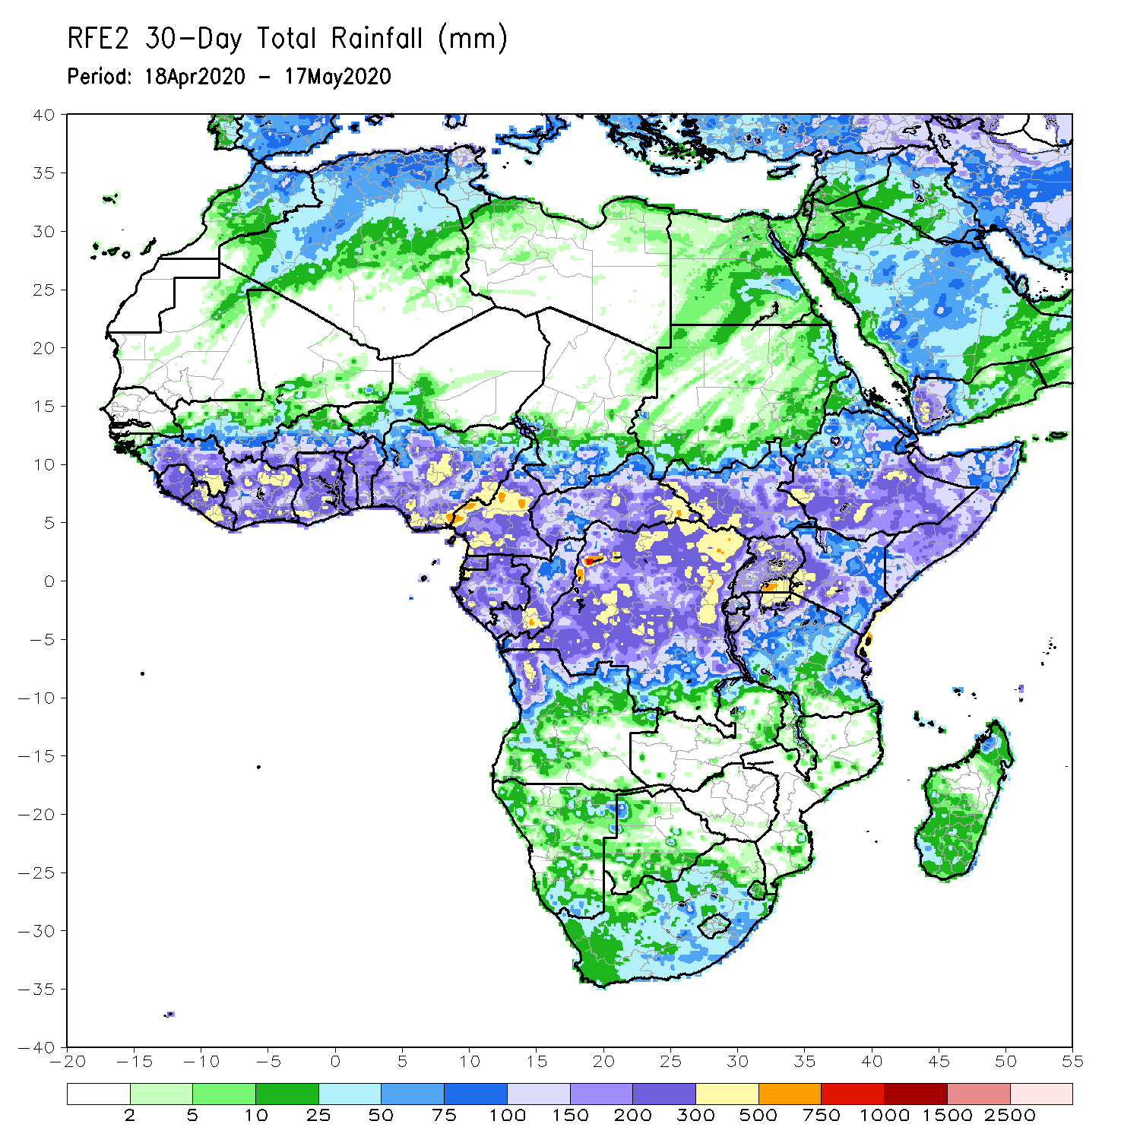
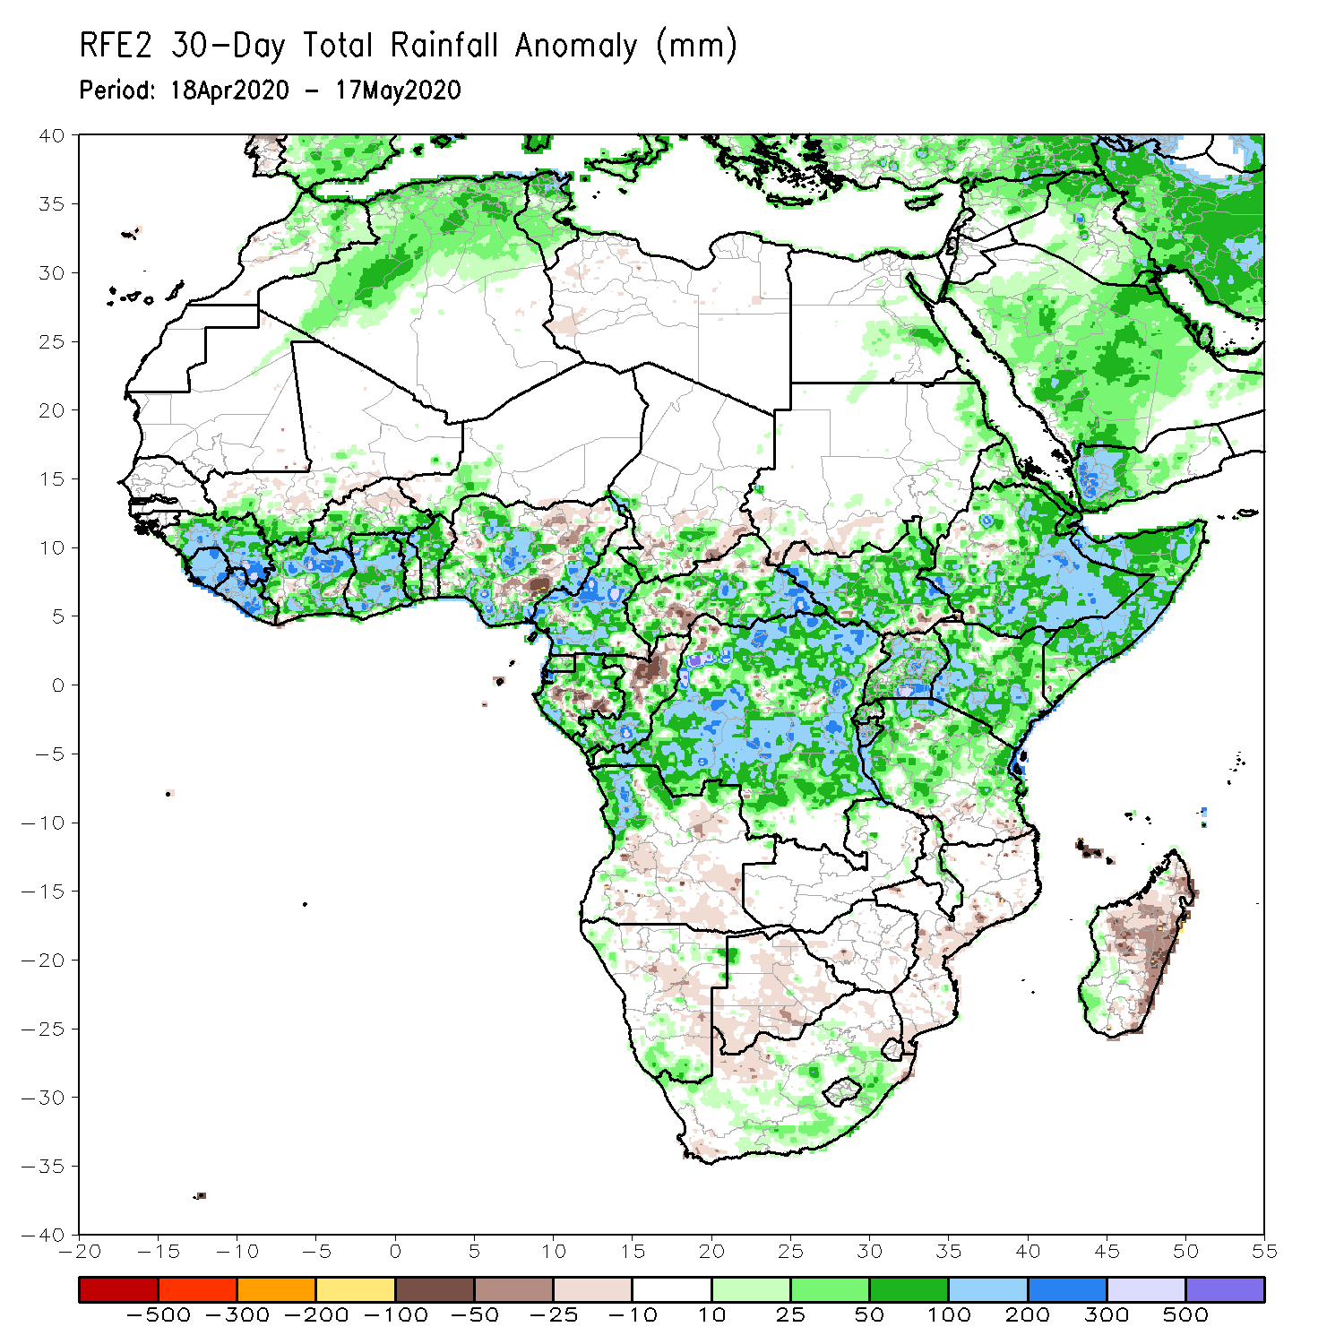
Rainfall Patterns: Last 30 Days
During the past 30 days, rainfall was above-average over many places in the Gulf of Guinea region, including much of Cameroon, Gabon and Congo, CAR, much of DRC, South Sudan, Uganda, many parts of Ethiopia, much of Kenya, Somalia, Rwanda, Burundi, Tanzania, northern Angola, and local areas in South Africa.
Rainfall was below-average over local areas in Cote d’Ivoire, Nigeria, CAR, and Congo, and many parts of Madagascar.
Notes:
5

Slide 6
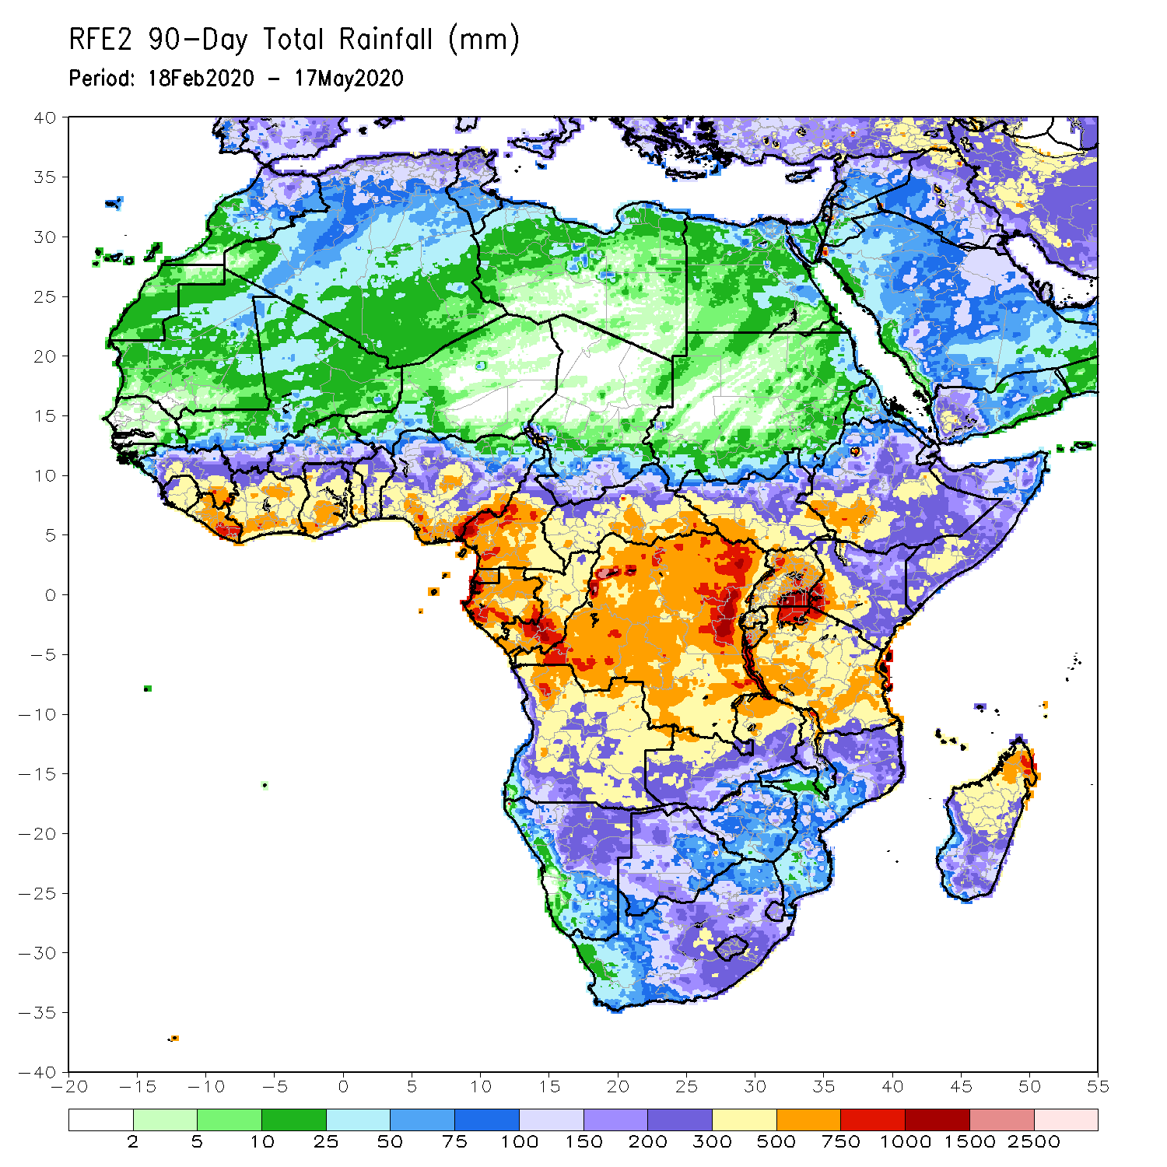
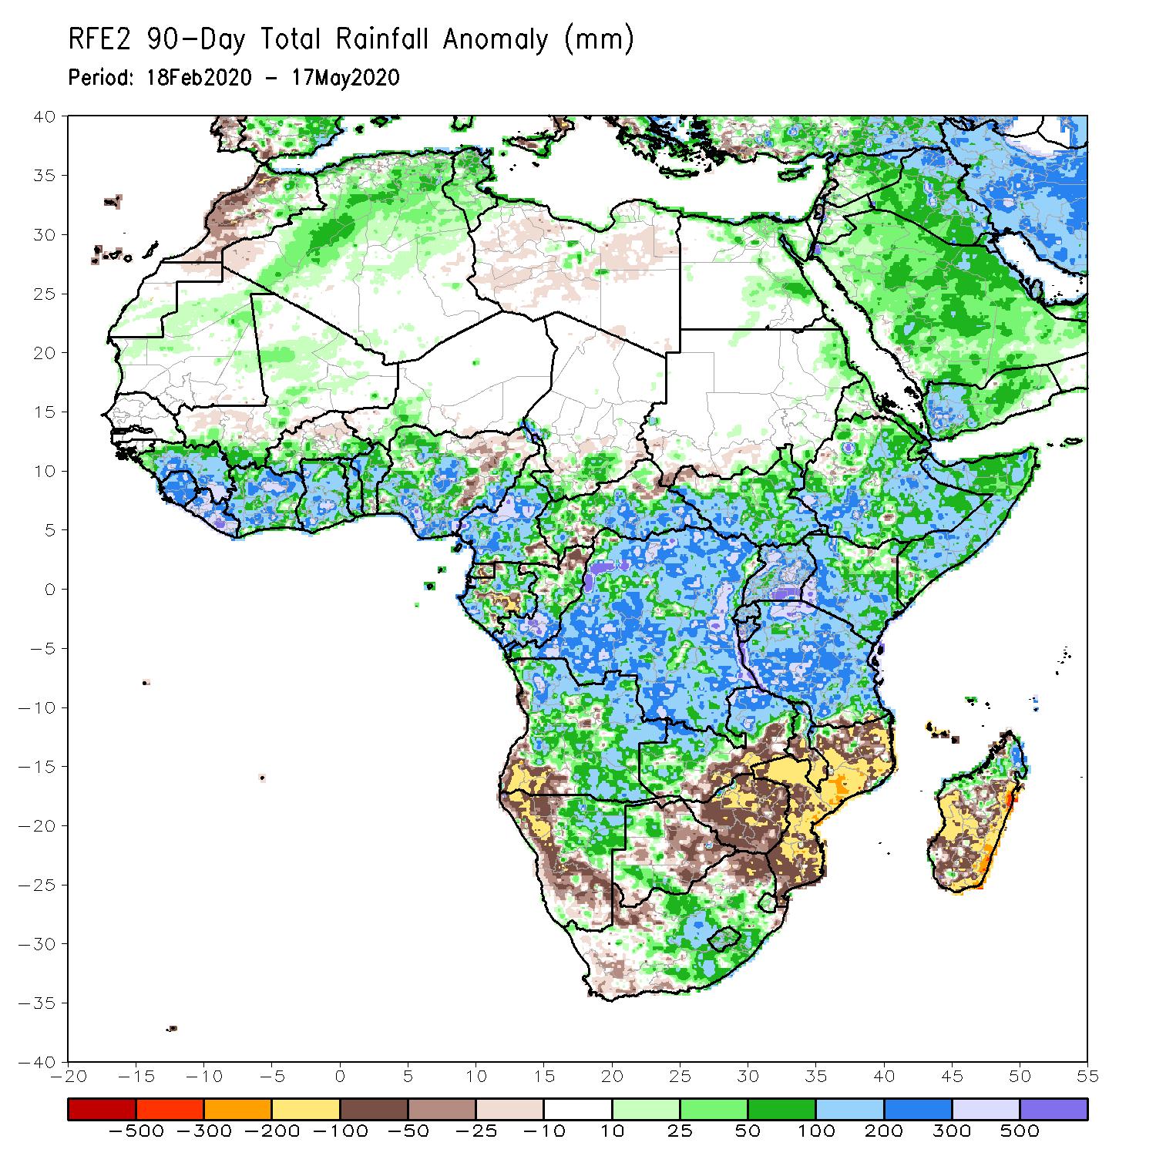
Rainfall Patterns: Last 90 Days
During the past 90 days, rainfall was above-average over many places in the Gulf of Guinea region, including Cameroon, and much of CAR, South Sudan, many parts of Gabon, Congo, DRC, Rwanda, Burundi, Uganda, Kenya, many parts of Ethiopia, Somalia, much of Tanzania, many parts of Angola and northern Zambia, northern Malawi, northeastern Namibia, western Botswana, portions of South Africa, and northern Madagascar.
Local areas in Nigeria, Equatorial Guinea, Gabon, Congo and CAR, southwestern Angola, local areas in western Ethiopia, western and southern Namibia, eastern Botswana, much of Zimbabwe, parts of southern Zambia, western South Arica, much of Mozambique, and central and southern Madagascar.
Notes:
6

Slide 7
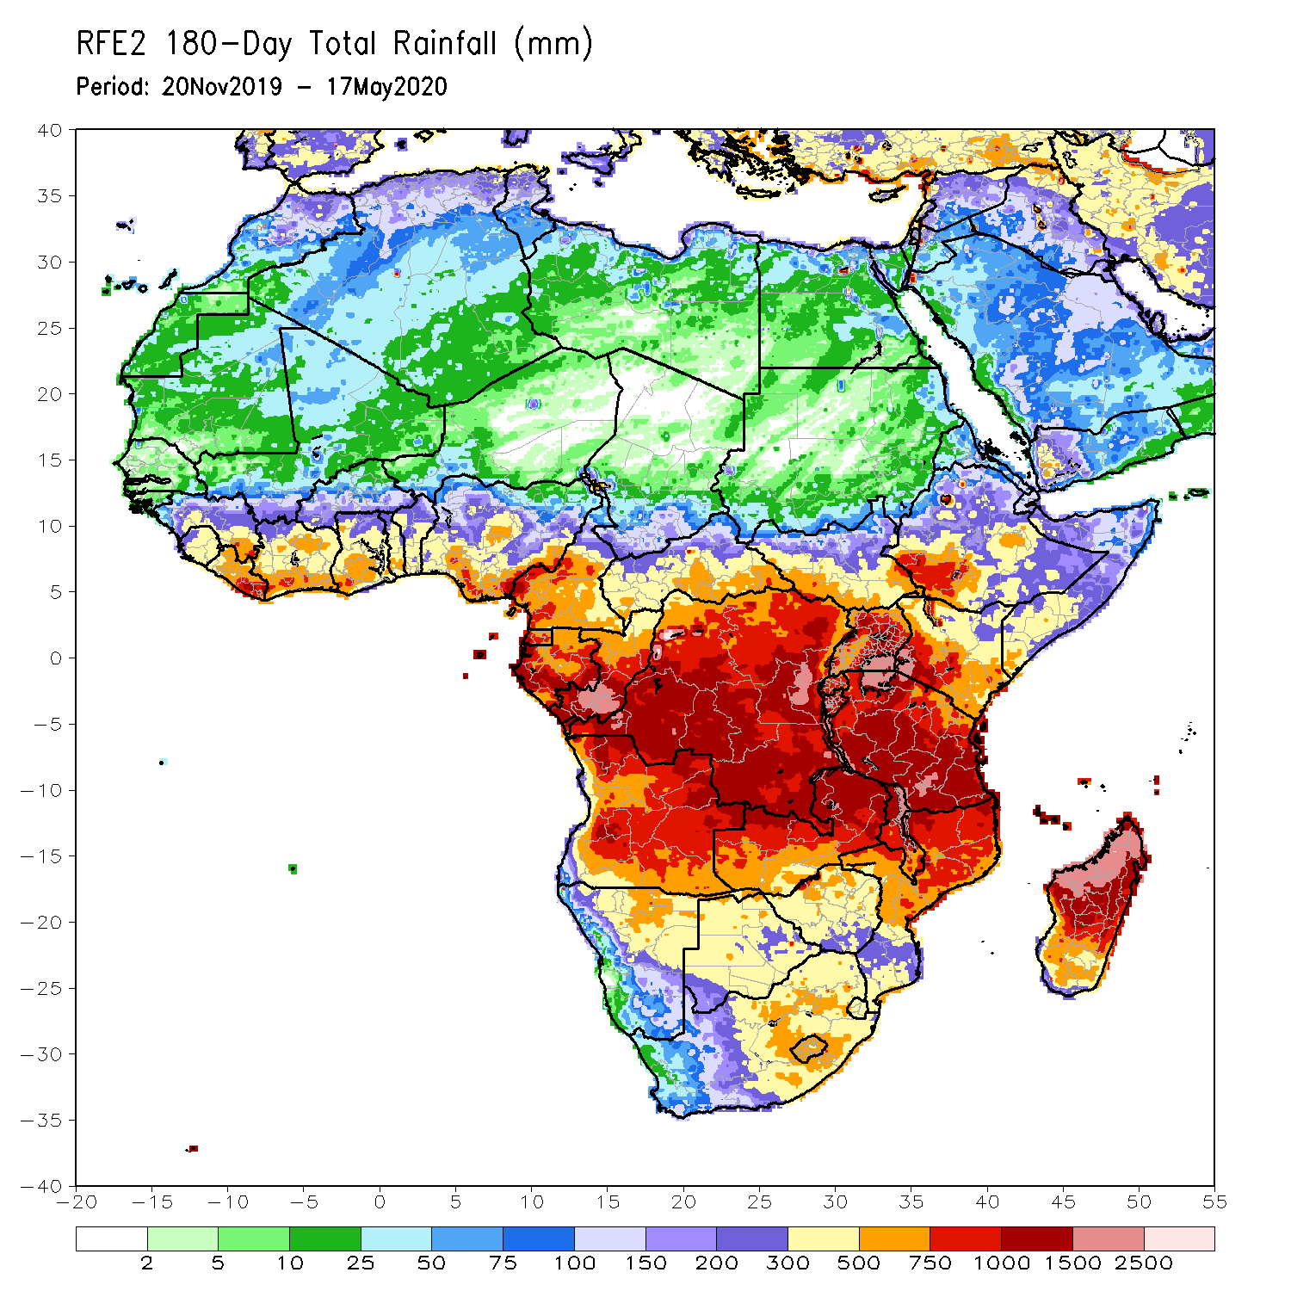
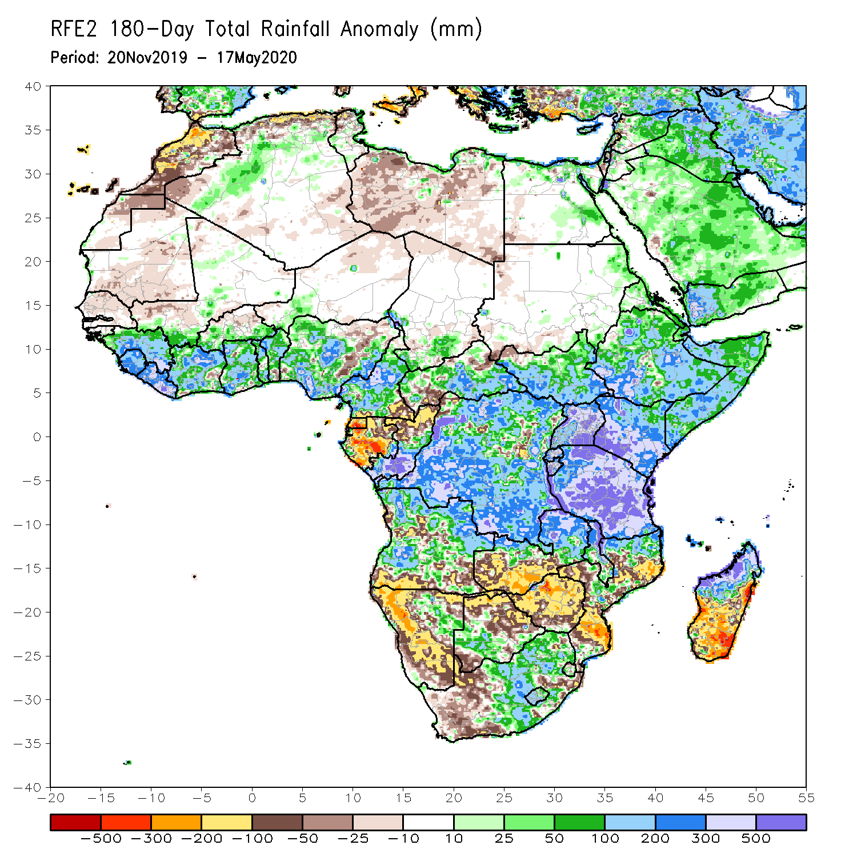
Rainfall Patterns: Last 180 Days
During the past 180 days, many places in the Gulf of Guinea region including Cameroon, local areas in southern Chad, much of CAR, DRC and South Sudan, Uganda, Ethiopia, much Somalia, Kenya, Tanzania, parts of Angola, local areas in Namibia, parts of Zambia, Malawi, parts of South Africa, portions of Mozambique and northern Madagascar had above-average rainfall.
Below-average rainfall was observed over Equatorial Guinea, Gabon, northern Congo, local areas in CAR and DRC, parts of Angola, Namibia, western South Africa, western Zambia, northern and eastern Botswana, much of Zimbabwe, parts of Mozambique and southern Madagascar.
Notes:
7

Slide 8
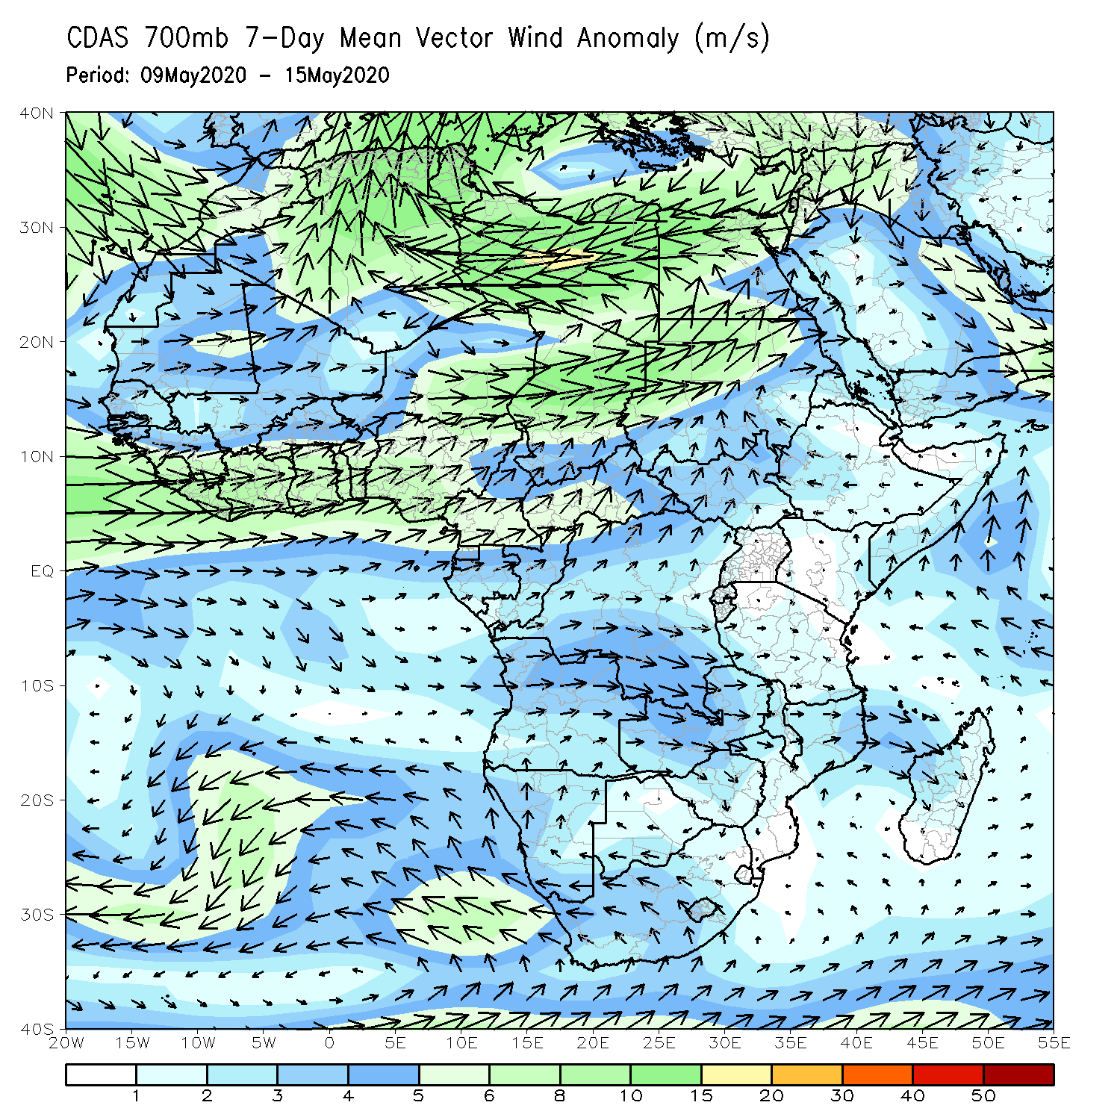
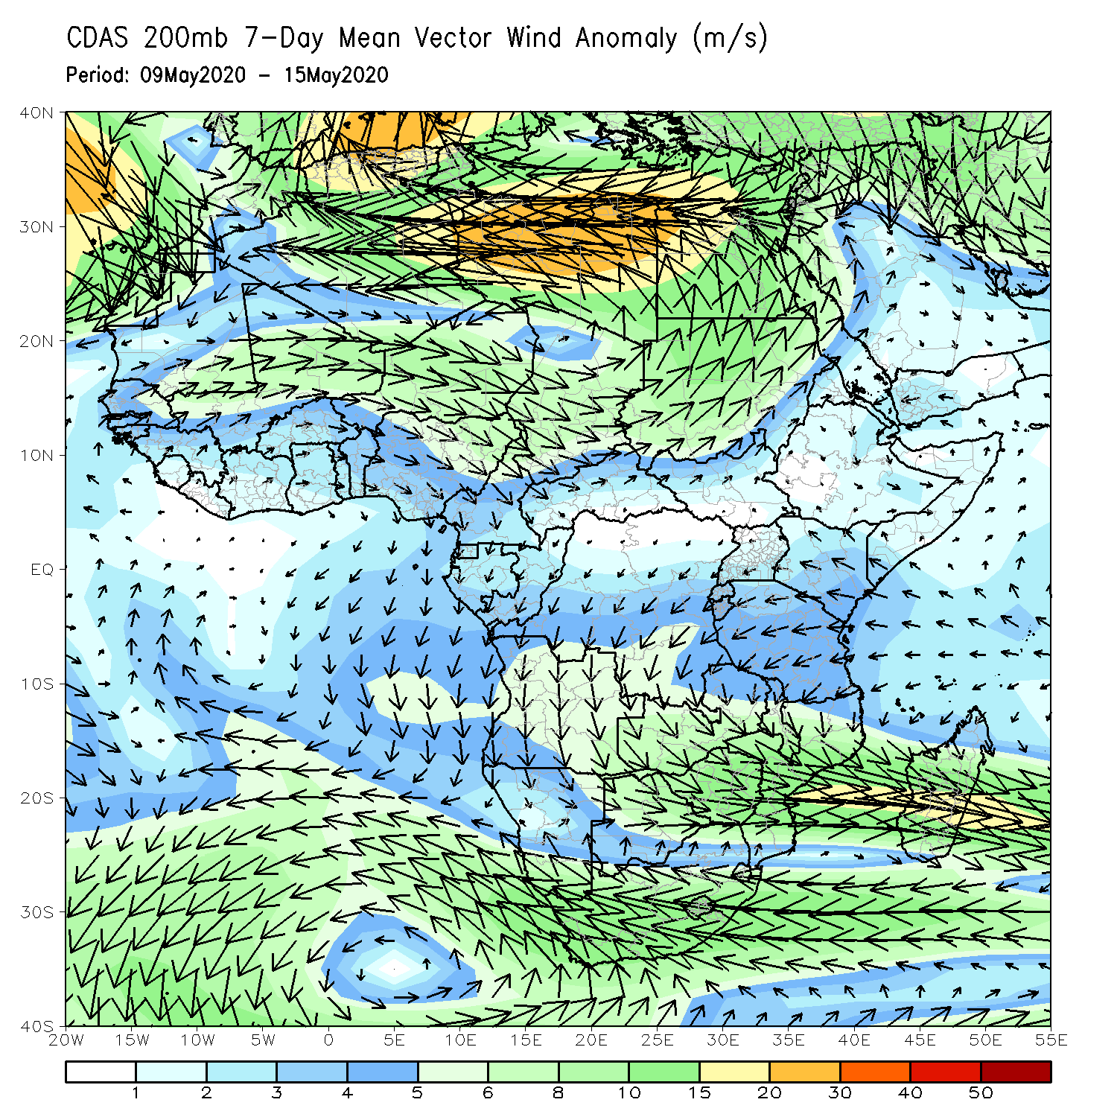
Atmospheric Circulation: Last 7 Days
A broad area of anomalous lower-level westerly flow prevailed across the Gulf of Guinea region (left panel). A broad area of anomalous upper-level cyclonic trough was observed across the Sahel region and the neighboring areas (right panel).

Slide 9
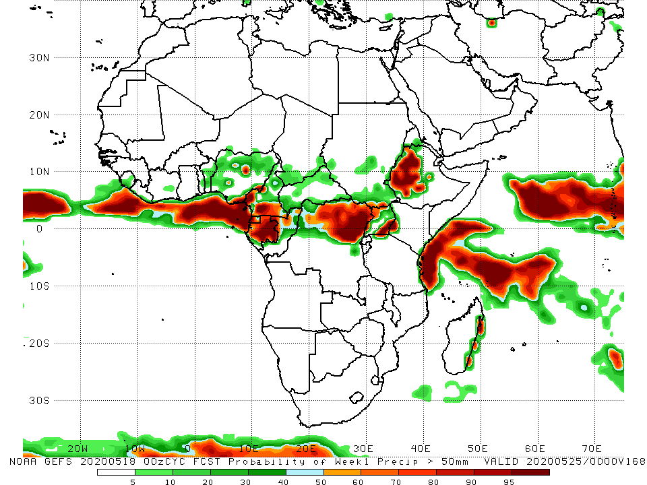
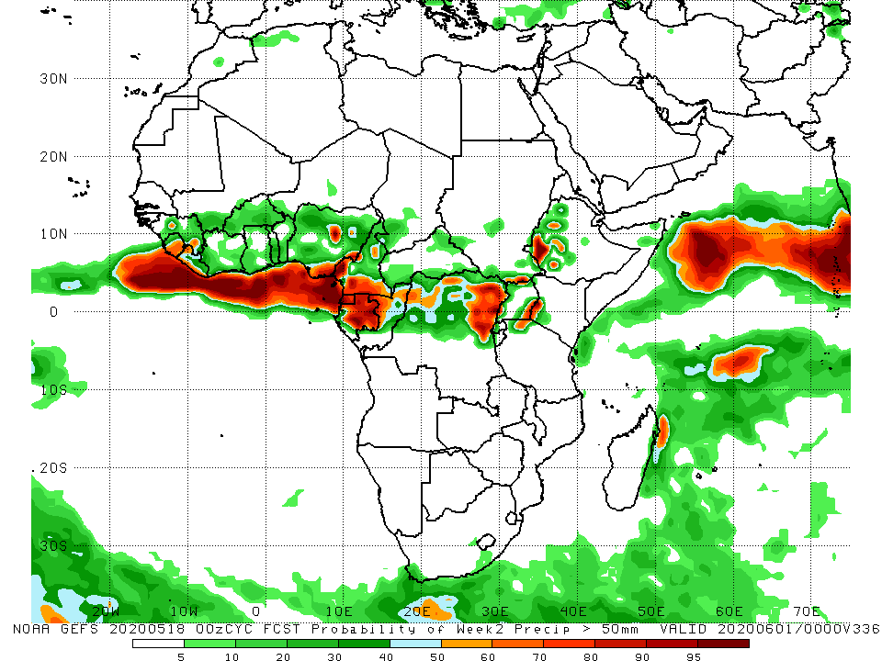
NCEP GEFS Model Forecasts Non-Bias Corrected Probability of precipitation exceedance
Week-1: 12 - 18 May, 2020
Week-2: Valid 12 - 18 May, 2020
For week-1 (left panel) and week-2 (right panel), there is an increased chance for weekly rainfall totals to exceed 50mm over local areas in Nigeria, western and southern Cameroon, Equatorial Guinea, Gabon, northern DRC, parts of Uganda and western Ethiopia.
Notes:
9

Slide 10
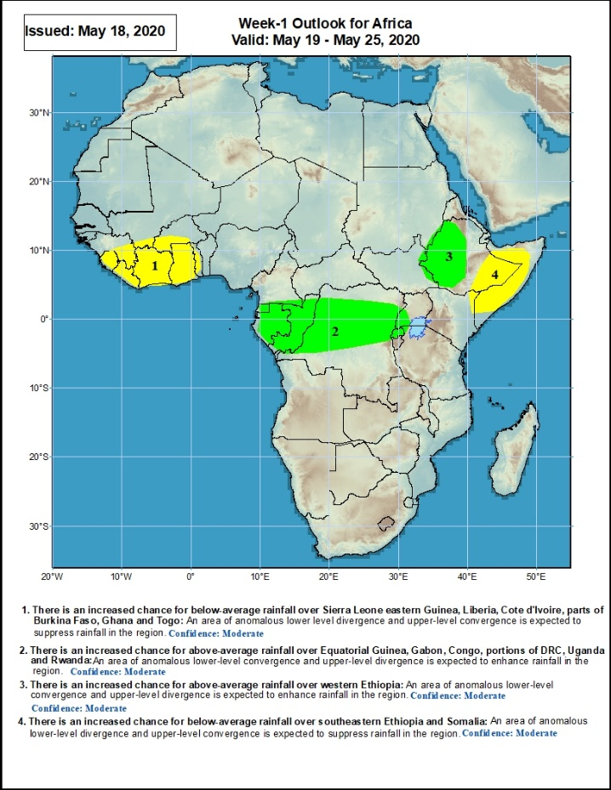
Week-1 Precipitation Outlooks
19 – 25 May, 2020
There is an increased chance for below-average rainfall over Sierra Leone eastern Guinea, Liberia, Cote d'Ivoire, parts of Burkina Faso, Ghana and Togo: An area of anomalous lower-level convergence and upper-level divergence is expected to enhance rainfall in the region. Confidence: Moderate
There is an increased chance for above-average rainfall over Equatorial Guinea, Gabon, Congo, portions of DRC, Uganda and Rwanda: An area of anomalous lower level convergence and upper-level divergence is expected to enhance rainfall in the region. Confidence: Moderate
There is an increased chance for above-average rainfall over western Ethiopia: An area of anomalous lower level convergence and upper-level divergence is expected to enhance rainfall in the region. Confidence: Moderate
There is an increased chance for below-average rainfall over southeastern Ethiopia and Somalia: An area of anomalous lower-level divergence and upper-level convergence is expected to suppress rainfall in the region. Confidence: Moderate
Notes:
10

Slide 11
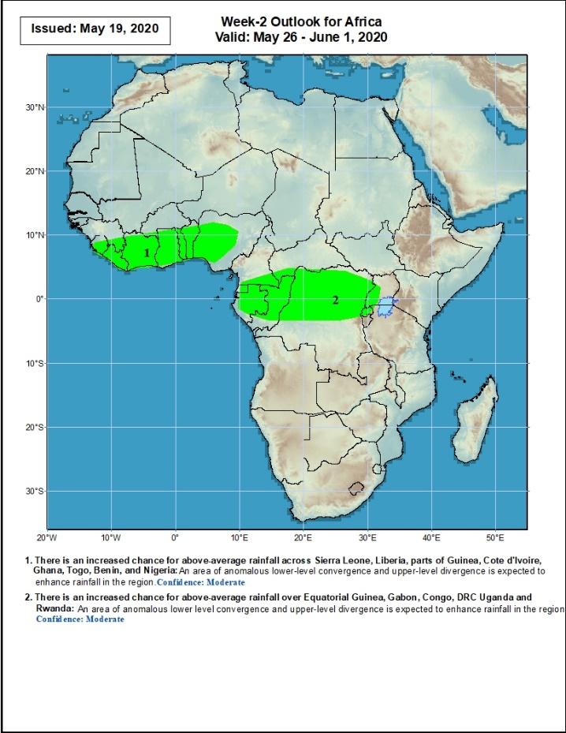
Week-2 Precipitation Outlooks
26 May – 1 June, 2020
There is an increased chance for above-average rainfall across Sierra Leone, Liberia, parts of Guinea, Cote d'Ivoire, Ghana, Togo, Benin, and Nigeria: An area of anomalous lower-level convergence and upper-level divergence is expected to enhance rainfall in the region. Confidence: Moderate
There is an increased chance for above-average rainfall over Equatorial Guinea, Gabon, Congo, DRC Uganda and Rwanda: An area of anomalous lower level convergence and upper-level divergence is expected to enhance rainfall in the region. Confidence: Moderate
Notes:
11

Slide 12
Summary
During the past 7 days, rainfall was above-average over much of Guinea, Sierra Leone, Liberia, local areas in Mali, Cote d’Ivoire and Burkina Faso, much of Ghana, parts of Nigeria, Cameroon, local areas in Chad and CAR, Equatorial Guinea, southern Congo, DRC, many parts of South Sudan, and local areas in Tanzania, Ethiopia and Somalia. Below-average rainfall was observed over southern Benin, parts of Nigeria, southern Chad, local areas in Gabon, northern Congo, much of CAR, local areas in South Sudan, Uganda, and local areas in Ethiopia and Kenya.
During the past 30 days, rainfall was above-average over many places in the Gulf of Guinea region, including much of Cameroon, Gabon and Congo, CAR, much of DRC, South Sudan, Uganda, many parts of Ethiopia, much of Kenya, Somalia, Rwanda, Burundi, Tanzania, northern Angola, and local areas in South Africa. Rainfall was below-average over local areas in Cote d’Ivoire, Nigeria, CAR, and Congo, and many parts of Madagascar.
During the past 90 days, rainfall was above-average over many places in the Gulf of Guinea region, including Cameroon, and much of CAR, South Sudan, many parts of Gabon, Congo, DRC, Rwanda, Burundi, Uganda, Kenya, many parts of Ethiopia, Somalia, much of Tanzania, many parts of Angola and northern Zambia, northern Malawi, northeastern Namibia, western Botswana, portions of South Africa, and northern Madagascar. Local areas in Nigeria, Equatorial Guinea, Gabon, Congo and CAR, southwestern Angola, local areas in western Ethiopia, western and southern Namibia, eastern Botswana, much of Zimbabwe, parts of southern Zambia, western South Arica, much of Mozambique, and central and southern Madagascar.
Week-1 outlooks call for an increased chance for above-average rainfall over Equatorial Guinea, Gabon, Congo, portions of DRC, Uganda, Rwanda and Ethiopia. In contrast, there is an increased chance for below-average rainfall over Sierra Leone eastern Guinea, Liberia, Cote d'Ivoire, parts of Burkina Faso, Ghana and Togo.
Notes:
12

