Slide 1
The African Monsoon Recent Evolution and Current Status Include Week-1 and Week-2 Outlooks
Update prepared by
Climate Prediction Center / NCEP
20 April 2020
For more information, visit:
http://www.cpc.ncep.noaa.gov/products/Global_Monsoons/African_Monsoons/precip_monitoring.shtml

Slide 2
Outline
Highlights
Recent Evolution and Current Conditions
NCEP GEFS Forecasts
Summary

Slide 3
Highlights: Last 7 Days
Many places in Central Africa and the Greater Horn of Africa received above-average rainfall.
Week-1 outlooks call for an increased chance for above-average rainfall over eastern Guinea, Sierra Leone, Liberia, Cote d’Ivoire, northern Ghana, northern Togo, northern Benin, northwestern Nigeria, northern Angola, southern DRC, Rwanda, Burundi, portions of Tanzania, Kenya, eastern and southern Ethiopia and southern Somalia. In contrast, there is an increased chance for below-average rainfall over eastern CAR, South Sudan and western Ethiopia.

Slide 4
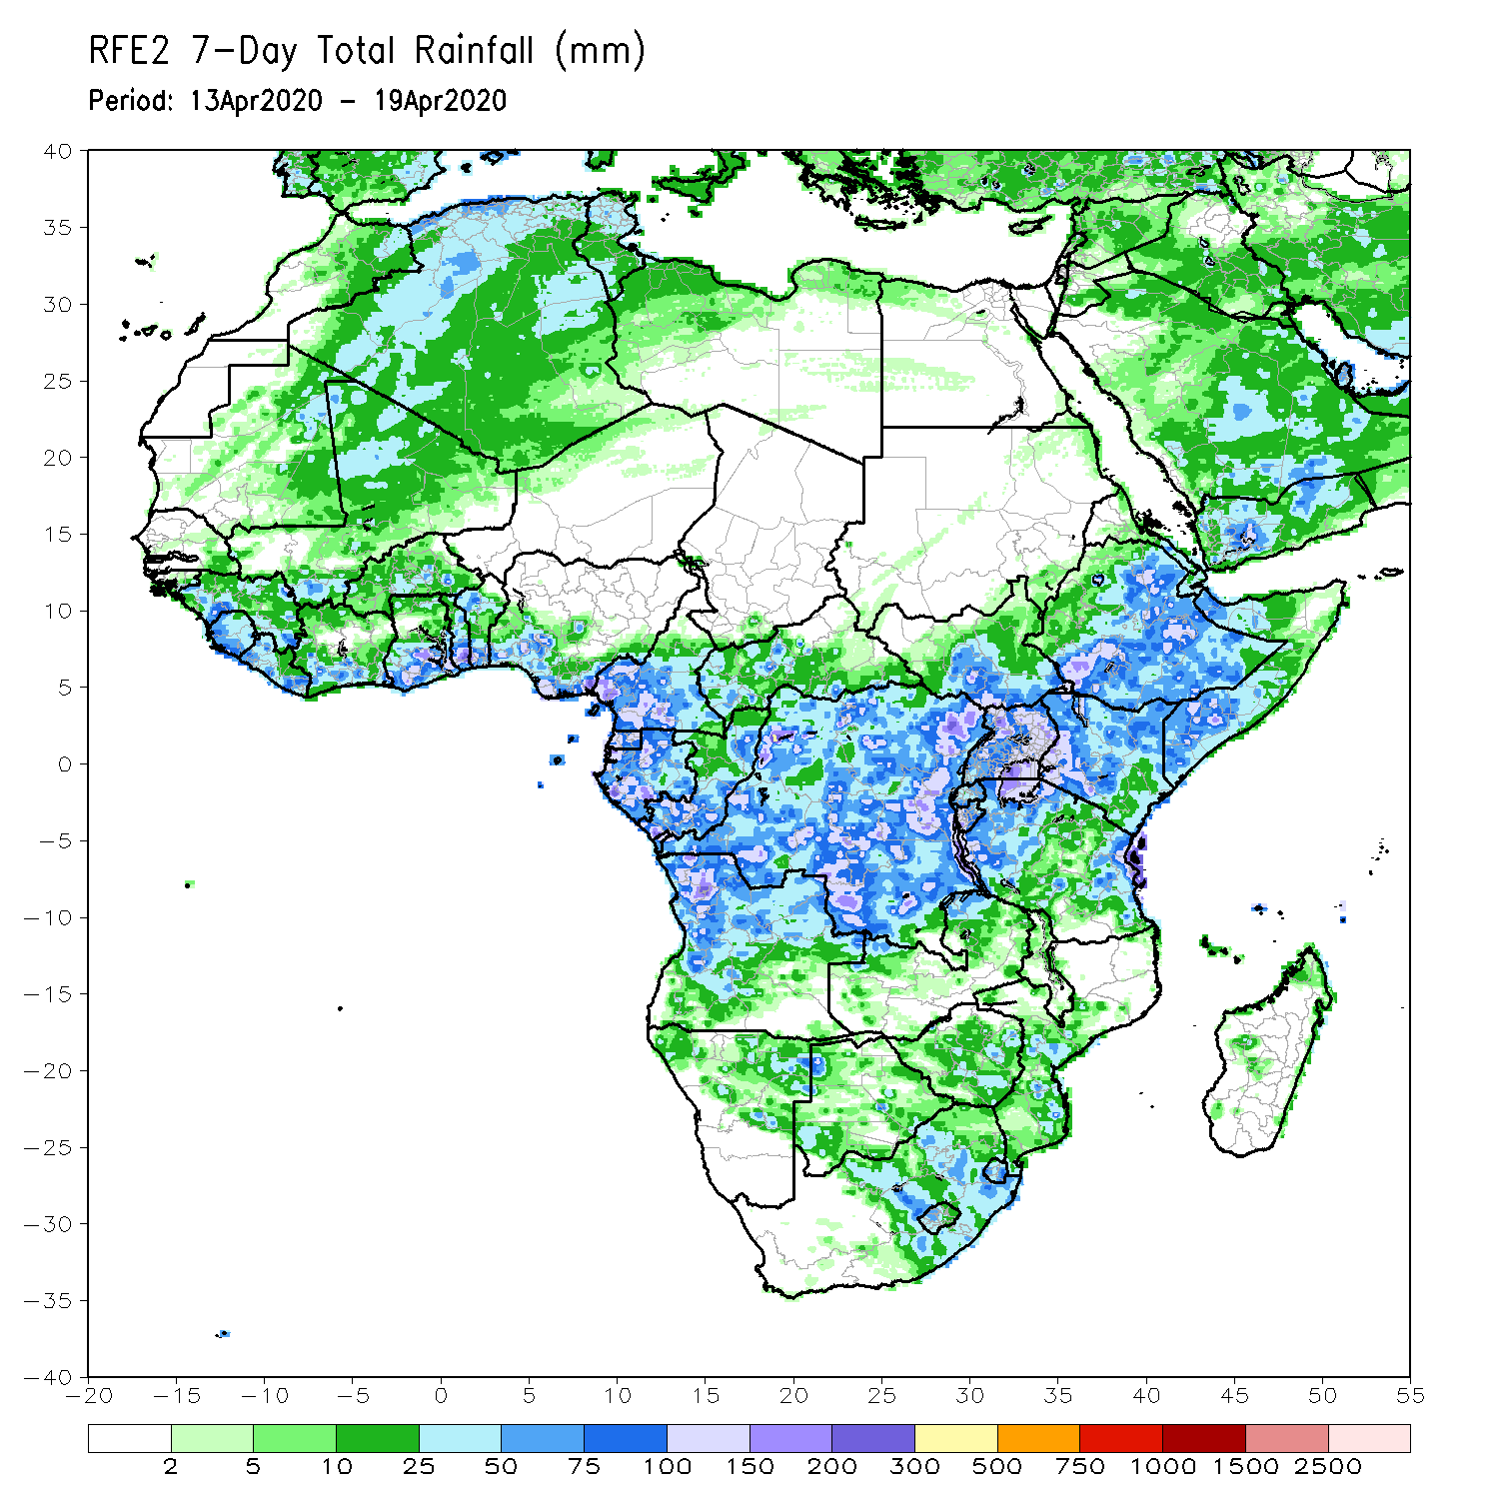
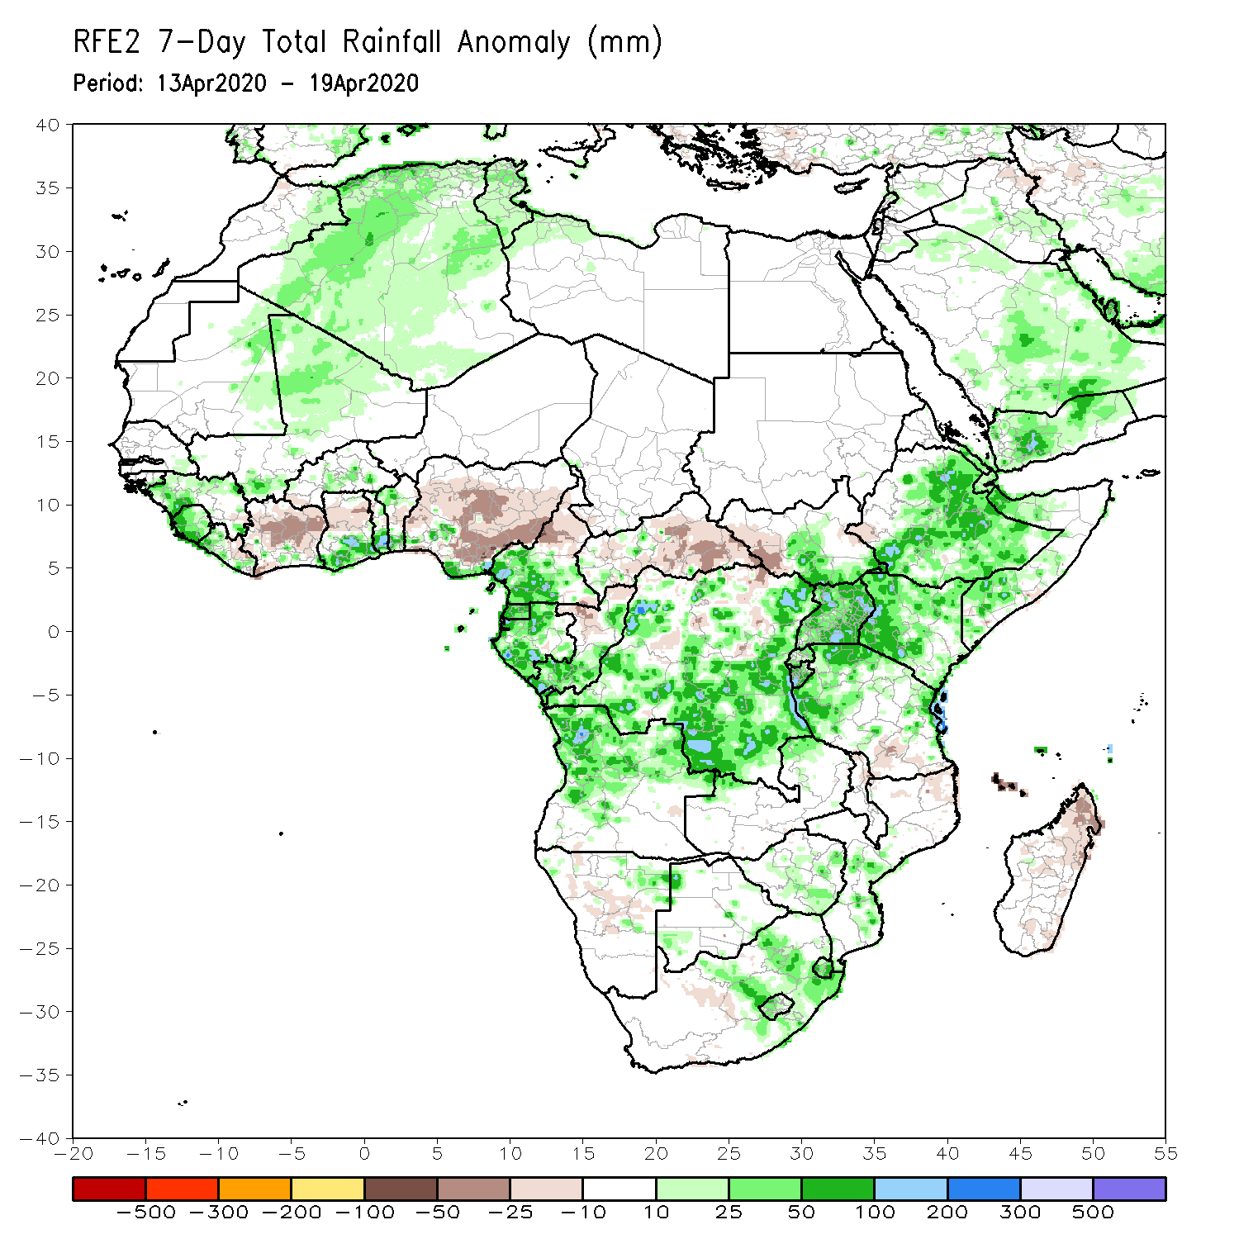
Rainfall Patterns: Last 7 Days
During the past 7 days, rainfall was above-average over parts of Guinea, Sierra Leone, parts of Mali and Ghana, Togo, Benin, local areas in Nigeria, southern Cameroon, Equatorial Guinea, Gabon, parts of Congo, many parts of DRC, Angola, parts of South Sudan, Uganda, Rwanda, Burundi, Tanzania, Kenya, Ethiopia, Somalia, and parts of South Africa. Above-average rainfall was also observed over local areas in Namibia, Zimbabwe and Mozambique.
Below-average rainfall was observed over portions of Cote d’Ivoire, northern Ghana, much of Nigeria, northern Cameroon, CAR, local areas in Congo, western South Sudan, local areas in DRC and Tanzania, and parts of Madagascar.

Slide 5
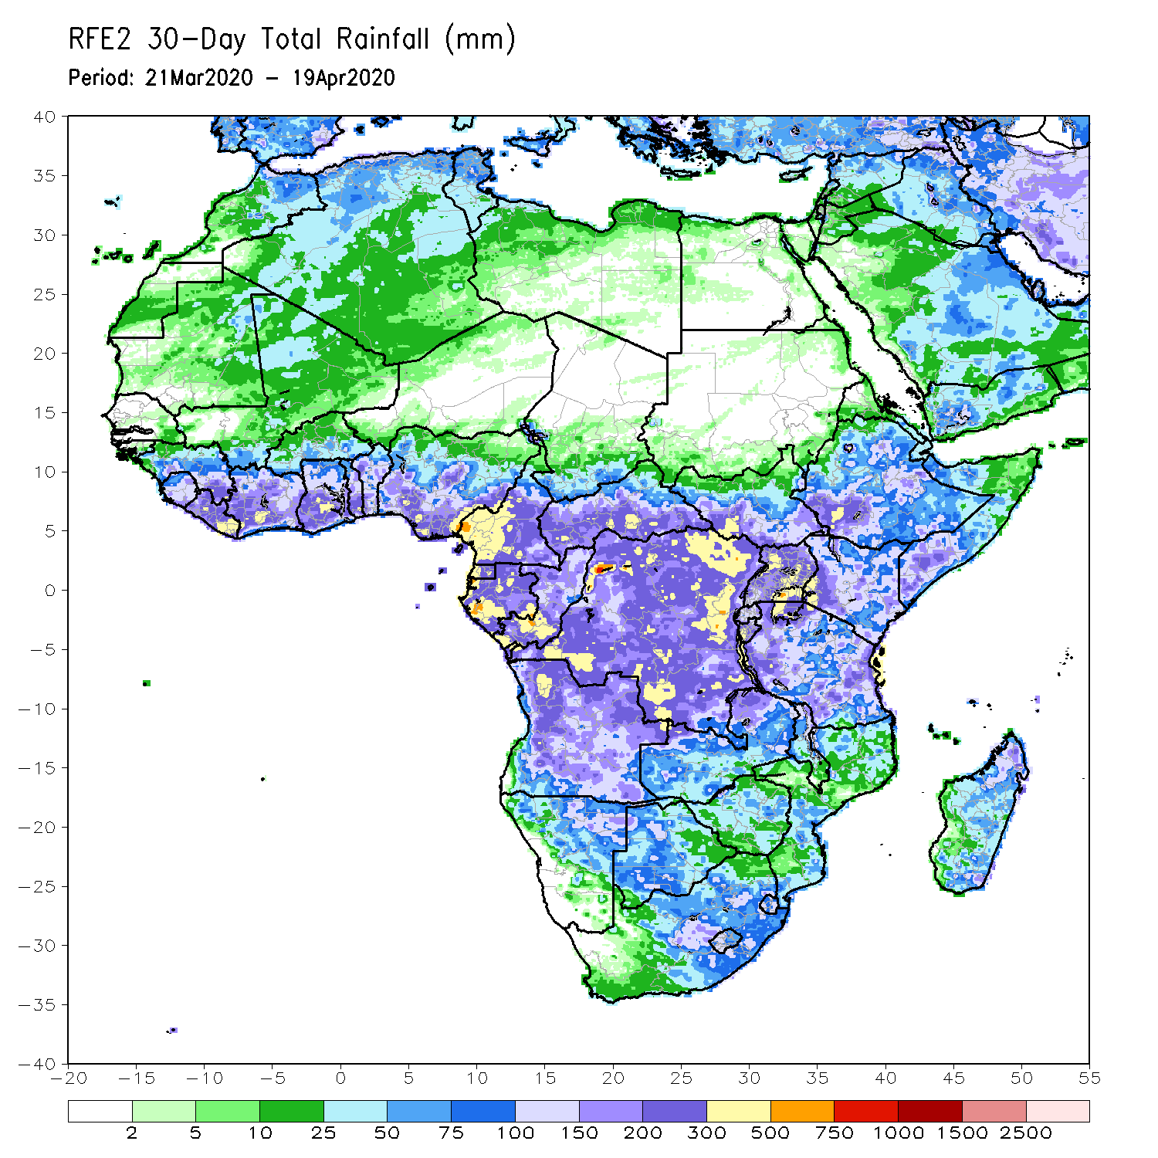
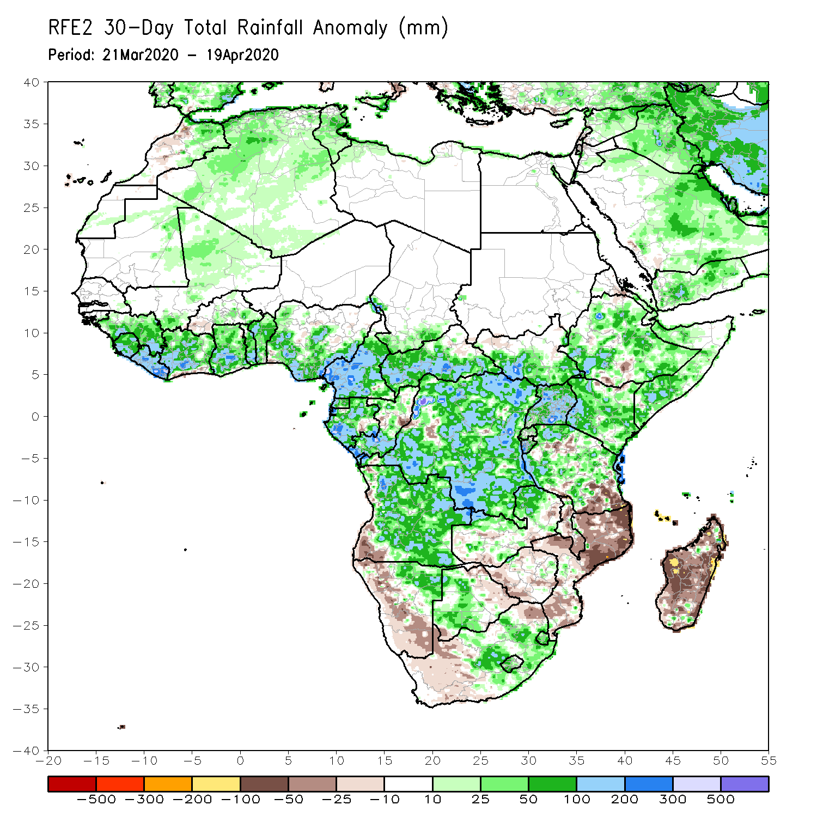
Rainfall Patterns: Last 30 Days
During the past 30 days, rainfall was above-average over many places in the Gulf of Guinea region, including much of Cameroon, parts of Gabon and Congo, CAR, much of DRC, parts of South Sudan, Uganda, parts of Ethiopia, much of Kenya, southern Somalia, Rwanda, Burundi, Tanzania, Angola, northeastern Namibia, Botswana, northern Zambia, central South Africa, Lesotho, and Eswatini.
Rainfall was below-average over local areas in Congo and DRC, parts of southwestern Angola, local areas in Ethiopia, western Namibia, eastern Botswana, Zimbabwe, Malawi, Mozambique, parts of South Africa, and much of Madagascar.
Notes:
5

Slide 6
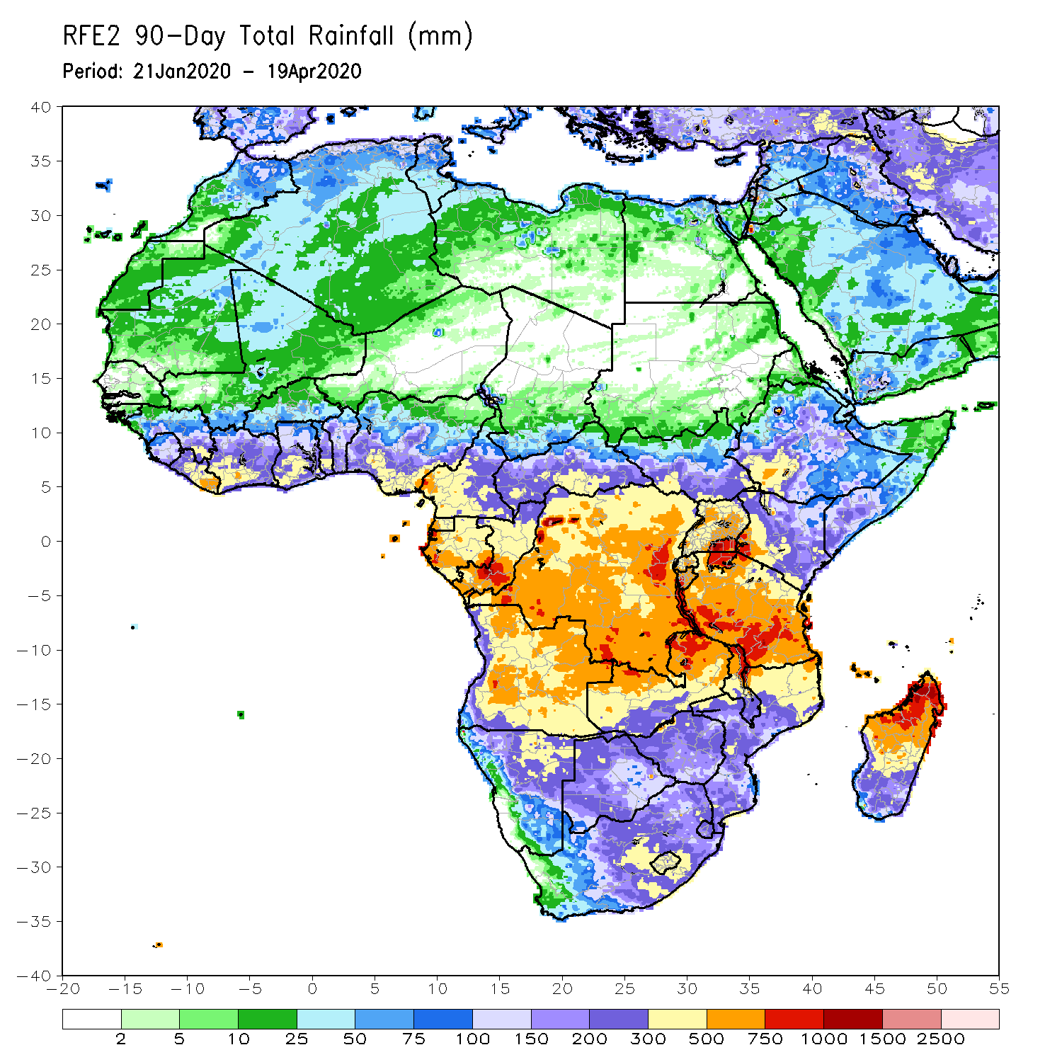
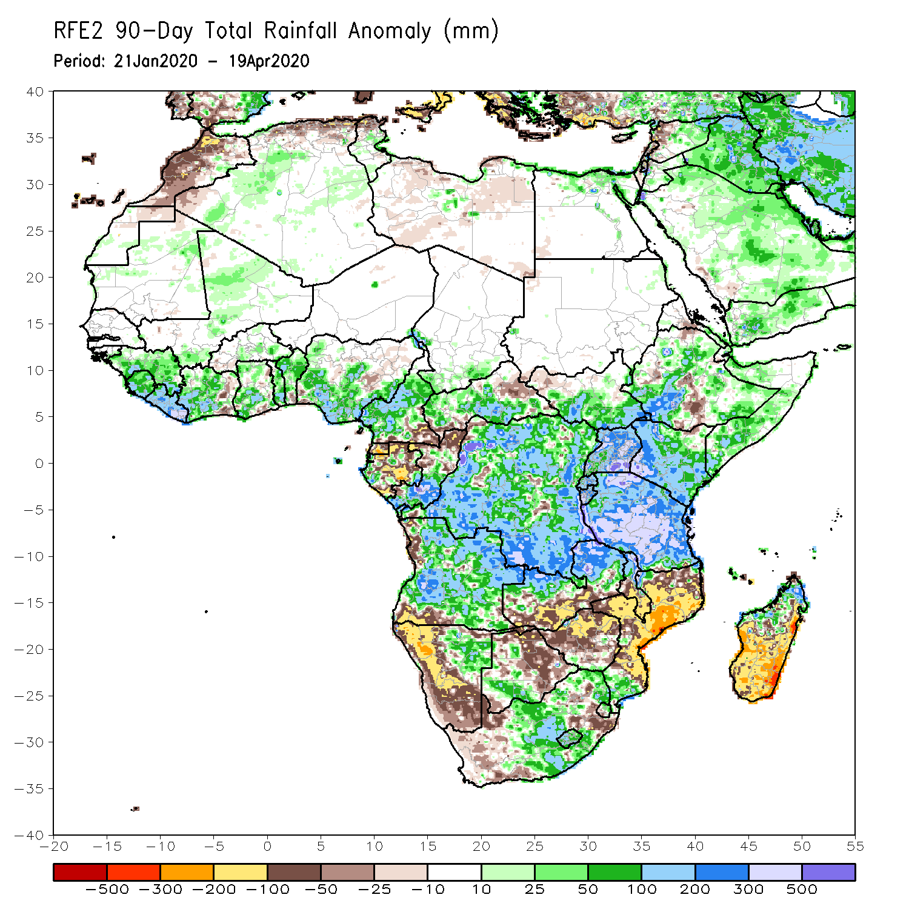
Rainfall Patterns: Last 90 Days
During the past 90 days, rainfall was above-average over many places in the Gulf of Guinea region, including central and northern Cameroon, CAR, parts of South Sudan, southern Congo, many parts of DRC, Rwanda, Burundi, Uganda, Kenya, many parts of Ethiopia, Somalia, much of Tanzania, many parts of Angola and northern Zambia, northern Malawi, northeastern Namibia, western Botswana, portions of South Africa, local areas in southern Mozambique, and northern Madagascar.
Parts of Cameroon, Equatorial Guinea, Gabon, local areas in CAR, Angola and DRC, local areas in Ethiopia, western and southern Namibia, parts of Botswana, much of Zimbabwe, southern Zambia, portions of South Arica, many parts of Mozambique, and central and southern Madagascar.
Notes:
6

Slide 7
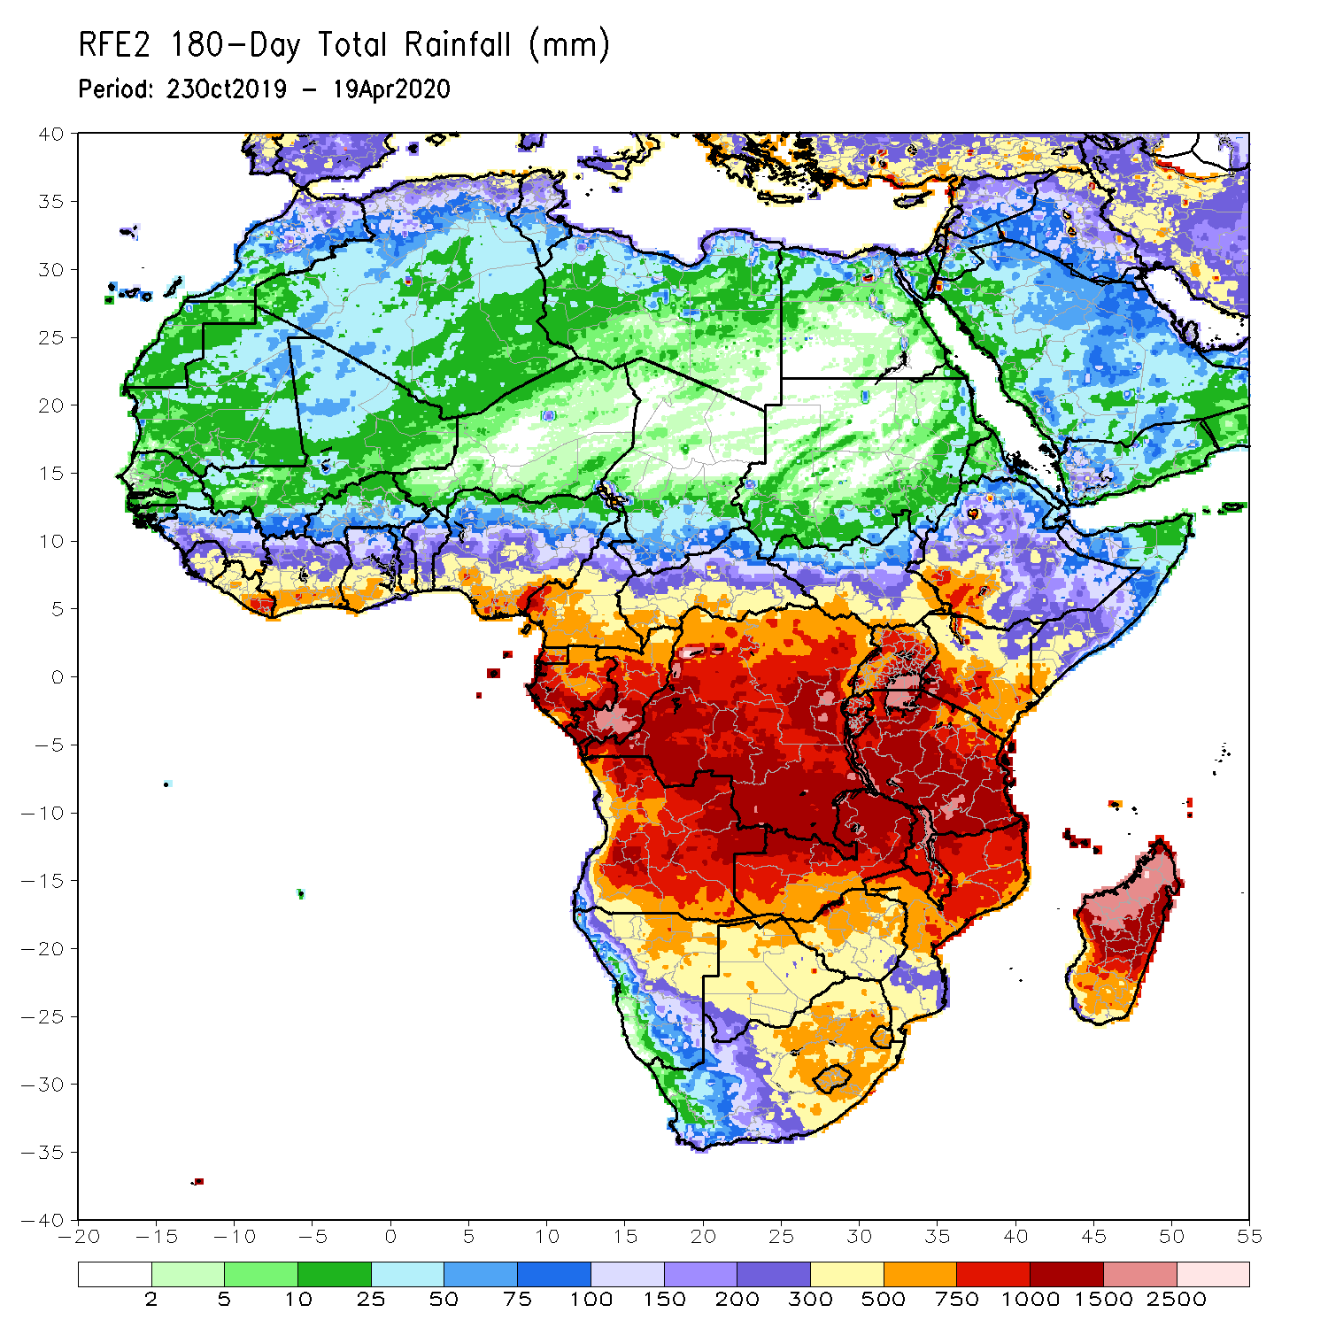
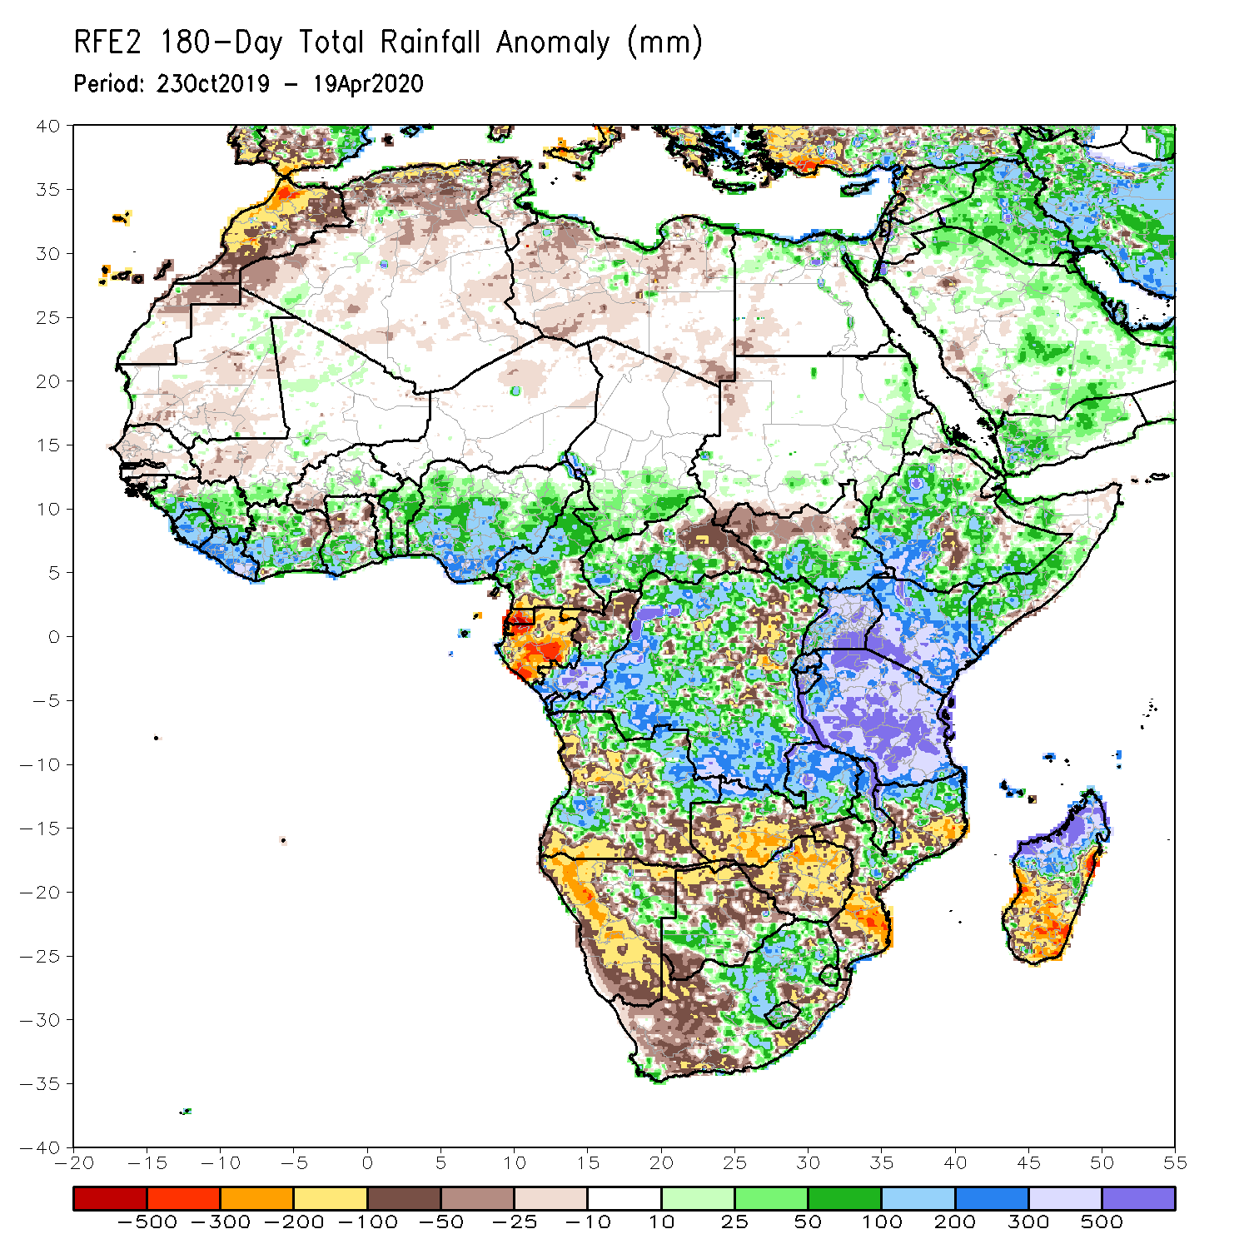
Rainfall Patterns: Last 180 Days
During the past 180 days, eastern Guinea, Sierra Leone, Liberia, many parts of Cote d’Ivoire and Ghana, Togo, Benin, Nigeria, Cameroon, southern Chad, portions of CAR, DRC and South Sudan, Uganda, many parts of Ethiopia, southern Somalia, Kenya, Tanzania, parts of Angola, local areas in Namibia, parts of Zambia, Malawi, parts of South Africa, portions of Mozambique and northern Madagascar had above-average rainfall.
Below-average rainfall was observed over portions of Senegal, Guinea-Bissau, western Mali, Equatorial Guinea, Gabon, parts of northeastern DRC, parts of Angola, Namibia, South Africa, western Zambia, many parts of Botswana and Zimbabwe, parts of Mozambique and southern Madagascar.
Notes:
7

Slide 8
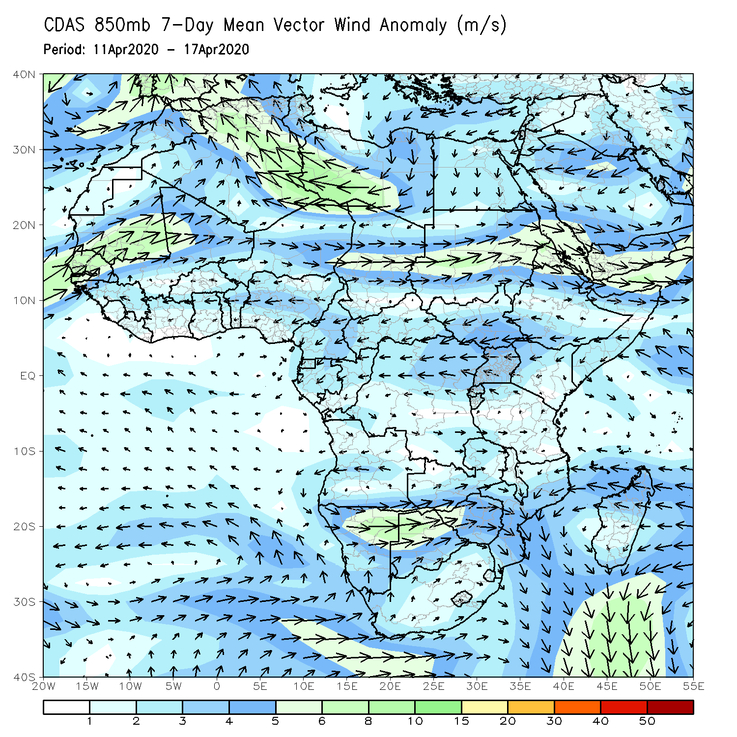
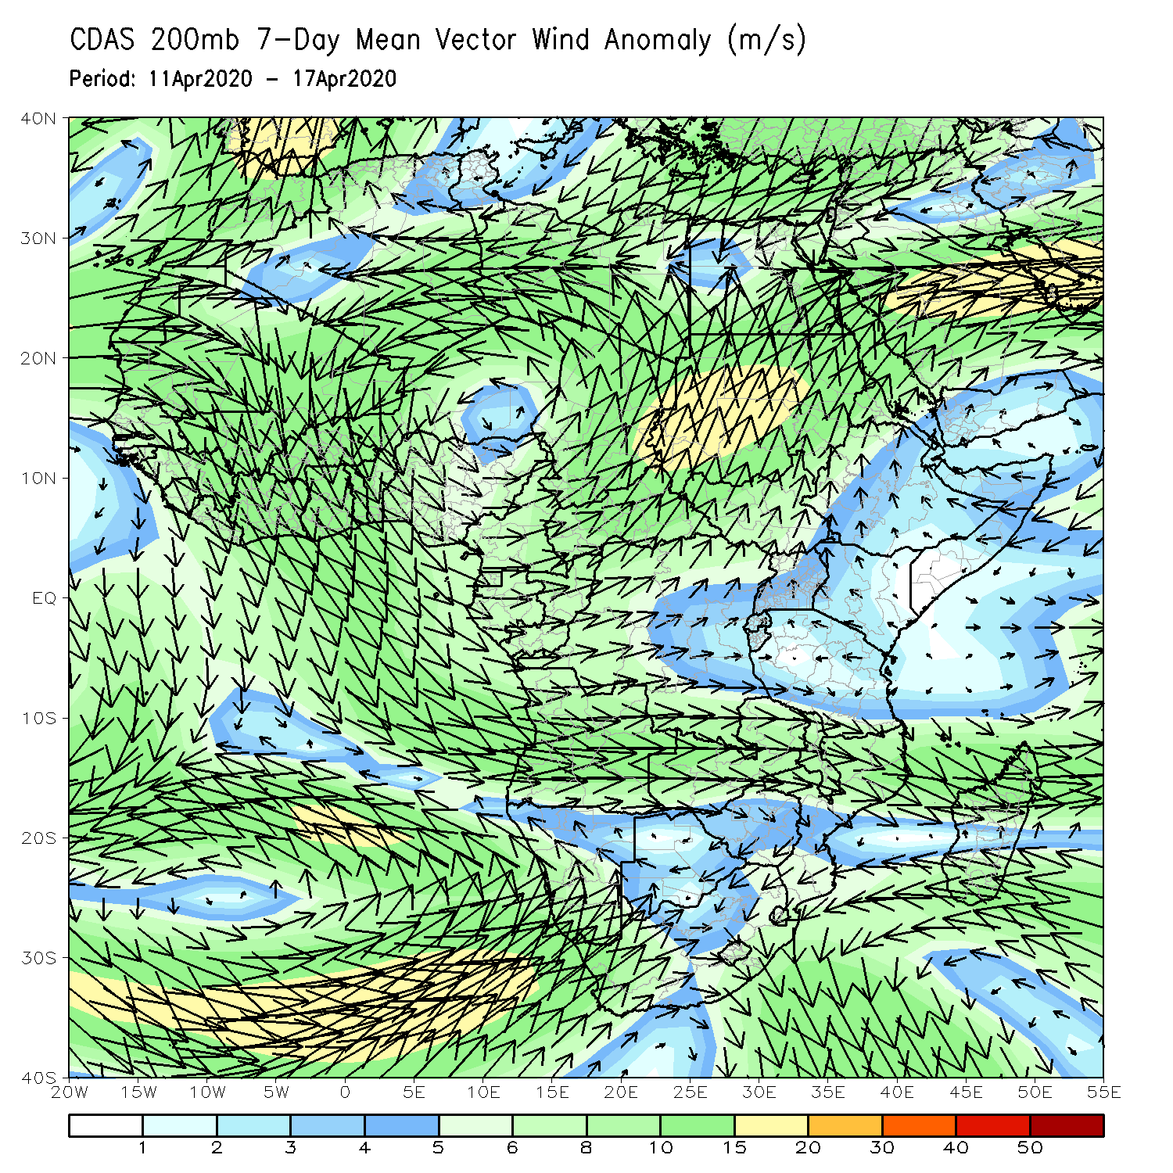
Atmospheric Circulation: Last 7 Days
Lower-level wind anomalies were easterly across much of equatorial Africa (left panel).

Slide 9
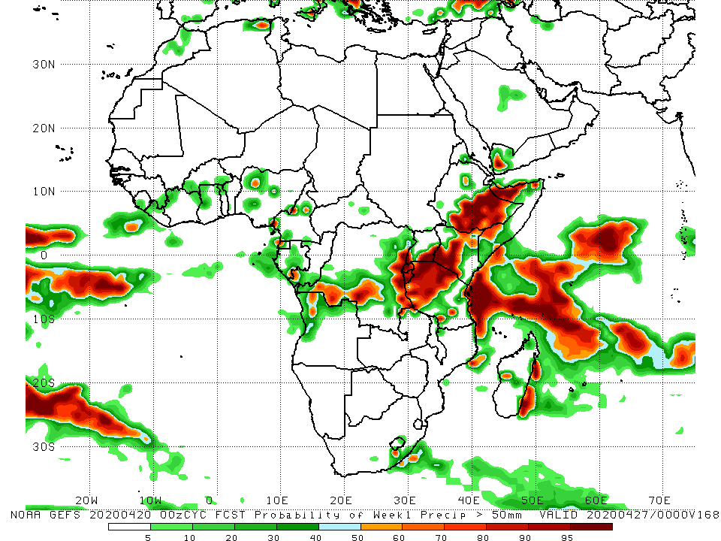
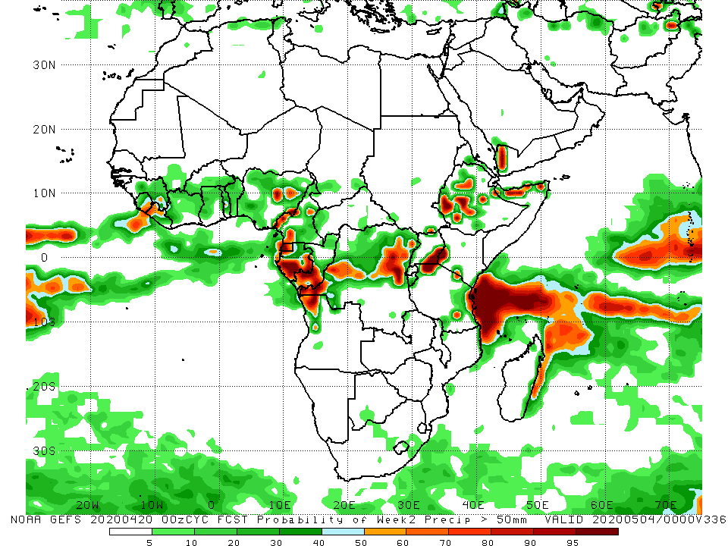
NCEP GEFS Model Forecasts Non-Bias Corrected Probability of precipitation exceedance
Week-2: Valid 21 - 27 April, 2020
Week-2: Valid 28 April - 4 May, 2020
For week-1 (left panel) and weeke-2 (right panel), there is an increased chance for weekly rainfall totals to exceed 50mm over local areas in Nigeria and Cameroon, Gabon, southern Congo, portions of DRC, Rwanda, Burundi, Tanzania, Kenya, Ethiopia and parts of Somalia.
Notes:
9

Slide 10
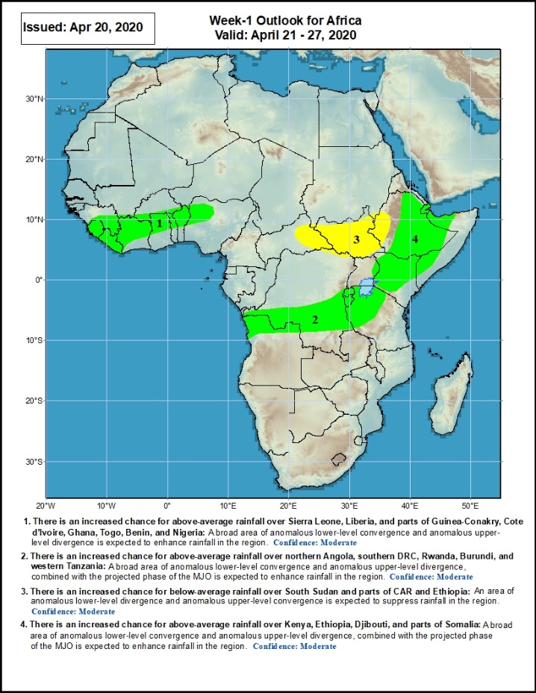
Week-1 Precipitation Outlooks
21 – 27 April, 2020
There is an increased chance for above-average rainfall over Sierra Leone, Liberia, and parts of Guinea-Conakry, Cote d’Ivoire, Ghana, Togo, Benin, and Nigeria: A broad area of anomalous lower-level convergence and upper-level divergence is expected to enhance rainfall in the region. Confidence: Moderate
There is an increased chance for above-average rainfall over northern Angola, southern DRC, Rwanda, Burundi, and western Tanzania: A broad area of anomalous lower-level convergence and upper-level divergence, combined with the projected phase of the MJO is expected to enhance rainfall in the region. Confidence: Moderate
There is an increased chance for below-average rainfall over South Sudan, and parts of CAR and Ethiopia: An area of anomalous lower-level divergence and upper-level convergence is expected to suppress rainfall in the region. Confidence: Moderate
There is an increased chance for above-average rainfall over Kenya, Ethiopia, Djibouti, and parts of Somalia: A broad area of anomalous lower-level convergence and upper-level divergence, combined with the projected phase of the MJO is expected to enhance rainfall in the region. Confidence: Moderate
Notes:
10

Slide 11
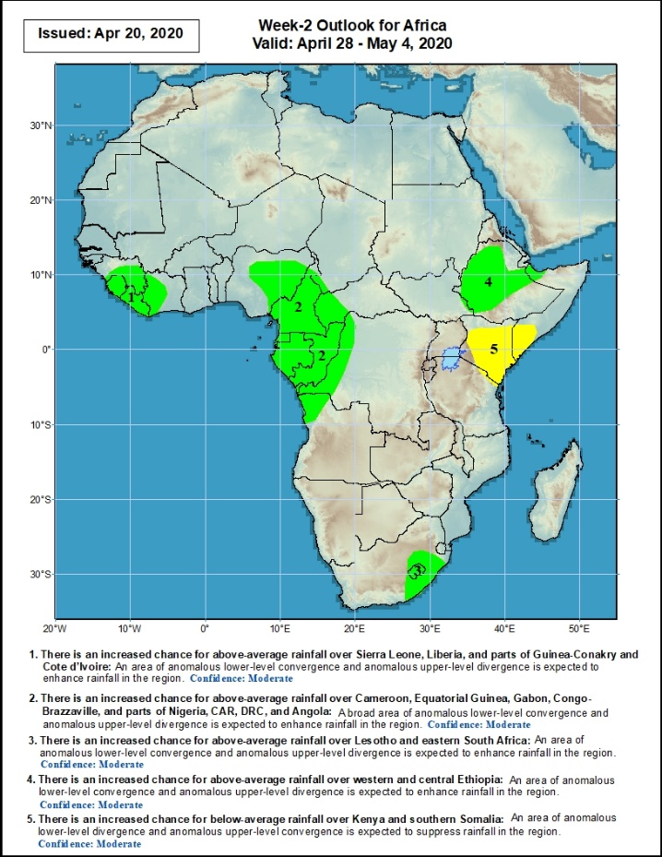
Week-2 Precipitation Outlooks
28 April – 04 May, 2020
There is an increased chance for above-average rainfall over Sierra Leone, Liberia, and parts of Guinea-Conakry and Cote d’Ivoire: An area of anomalous lower-level convergence and upper-level divergence is expected to enhance rainfall in the region. Confidence: Moderate
There is an increased chance for above-average rainfall over Cameroon, Equatorial Guinea, Gabon, Congo-Brazzaville, and parts of Nigeria, CAR, DRC, and Angola: A broad area of anomalous lower-level convergence and upper-level divergence is expected to enhance rainfall in the region. Confidence: Moderate
There is an increased chance for above-average rainfall over Lesotho and eastern South Africa: An area of anomalous lower-level convergence and upper-level divergence is expected to enhance rainfall in the region. Confidence: Moderate
There is an increased chance for above-average rainfall over many parts of Ethiopia: An area of anomalous lower-level convergence and upper-level divergence is expected to enhance rainfall in the region. Confidence: Moderate
There is an increased chance for below-average rainfall over Kenya and southern Somalia: An area of anomalous lower-level divergence and upper-level convergence is expected to suppress rainfall in the region. Confidence: Moderate
Notes:
11

Slide 12
Summary
local areas in Nigeria, southern Cameroon, Equatorial Guinea, Gabon, parts of Congo, many parts of DRC, Angola, parts of South Sudan, Uganda, Rwanda, Burundi, Tanzania, Kenya, Ethiopia, Somalia, and parts of South Africa. Above-average rainfall was also observed over local areas in Namibia, Zimbabwe and Mozambique. Below-average rainfall was observed over portions of Cote d’Ivoire, northern Ghana, much of Nigeria, northern Cameroon, CAR, local areas in Congo, western South Sudan, local areas in DRC and Tanzania, and parts of Madagascar.
During the past 30 days, rainfall was above-average over many places in the Gulf of Guinea region, including much of Cameroon, parts of Gabon and Congo, CAR, much of DRC, parts of South Sudan, Uganda, parts of Ethiopia, much of Kenya, southern Somalia, Rwanda, Burundi, Tanzania, Angola, northeastern Namibia, Botswana, northern Zambia, central South Africa, Lesotho, and Eswatini. Rainfall was below-average over local areas in Congo and DRC, parts of southwestern Angola, local areas in Ethiopia, western Namibia, eastern Botswana, Zimbabwe, Malawi, Mozambique, parts of South Africa, and much of Madagascar.
During the past 90 days, rainfall was above-average over many places in the Gulf of Guinea region, including central and northern Cameroon, CAR, parts of South Sudan, southern Congo, many parts of DRC, Rwanda, Burundi, Uganda, Kenya, many parts of Ethiopia, Somalia, much of Tanzania, many parts of Angola and northern Zambia, northern Malawi, northeastern Namibia, western Botswana, portions of South Africa, local areas in southern Mozambique, and northern Madagascar. Parts of Cameroon, Equatorial Guinea, Gabon, local areas in CAR, Angola and DRC, local areas in Ethiopia, western and southern Namibia, parts of Botswana, much of Zimbabwe, southern Zambia, portions of South Arica, many parts of Mozambique, and central and southern Madagascar.
Week-1 outlooks call for an increased chance for above-average rainfall over eastern Guinea, Sierra Leone, Liberia, Cote d’Ivoire, northern Ghana, northern Togo, northern Benin, northwestern Nigeria, northern Angola, southern DRC, Rwanda, Burundi, portions of Tanzania, Kenya, eastern and southern Ethiopia and southern Somalia. In contrast, there is an increased chance for below-average rainfall over eastern CAR, South Sudan and western Ethiopia.
Notes:
12

