Slide 1
The African Monsoon Recent Evolution and Current Status Include Week-1 and Week-2 Outlooks
Update prepared by
Climate Prediction Center / NCEP
30 March 2020
For more information, visit:
http://www.cpc.ncep.noaa.gov/products/Global_Monsoons/African_Monsoons/precip_monitoring.shtml

Slide 2
Outline
Highlights
Recent Evolution and Current Conditions
NCEP GEFS Forecasts
Summary

Slide 3
Highlights: Last 7 Days
Rainfall was above-average over many places in the Gulf of Guinea region, local areas in Gabon, and Congo, CAR, parts of southern DRC, Uganda, local areas in South Sudan, southern Ethiopia, southern Somalia, Kenya, Tanzania, parts of Angola, Zambia, local areas in Namibia and Botswana, and northern Madagascar.
Week-1 outlooks call for an increased chance for above-average rainfall over portions of Angola, eastern Namibia, western Botswana, central South Africa, and much of Tanzania. In contrast, there is an increased chance for below-average rainfall over parts of South Sudan, Botswana, Zimbabwe, and central and southern Mozambique.

Slide 4
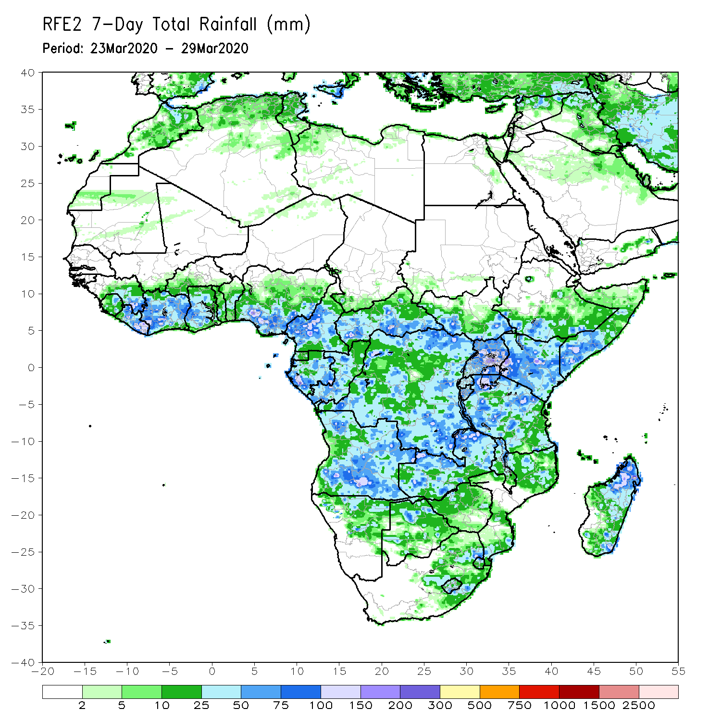
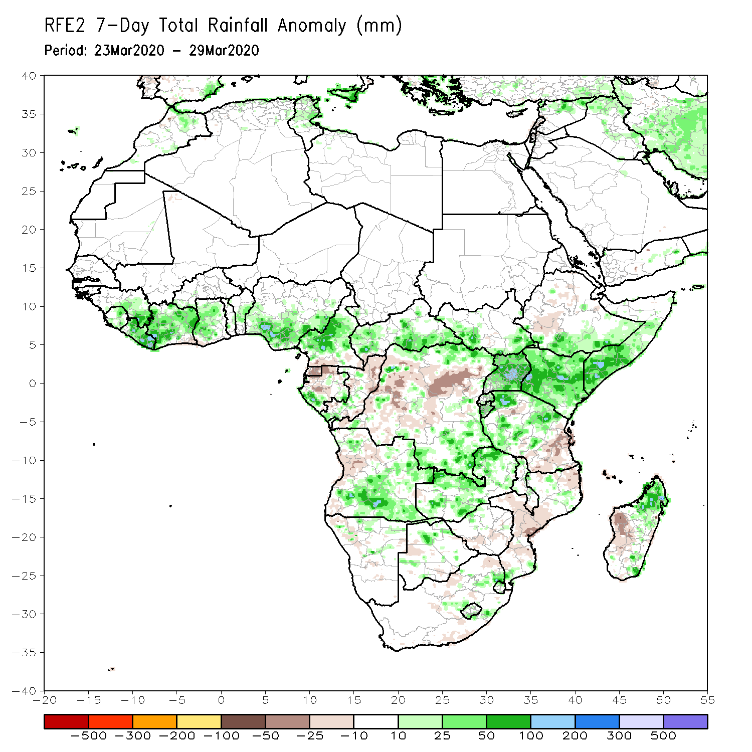
Rainfall Patterns: Last 7 Days
During the past 7 days, rainfall was above-average over many places in the Gulf of Guinea region, local areas in Gabon, and Congo, CAR, parts of southern DRC, Uganda, local areas in South Sudan, southern Ethiopia, southern Somalia, Kenya, Tanzania, parts of Angola, Zambia, local areas in Namibia and Botswana, and northern Madagascar.
Below-average rainfall was observed over local areas in Equatorial Guinea, Congo, portions of DRC, parts of Angola, Namibia, Botswana, Zimbabwe, southern Malawi, Mozambique and western Madagascar.

Slide 5
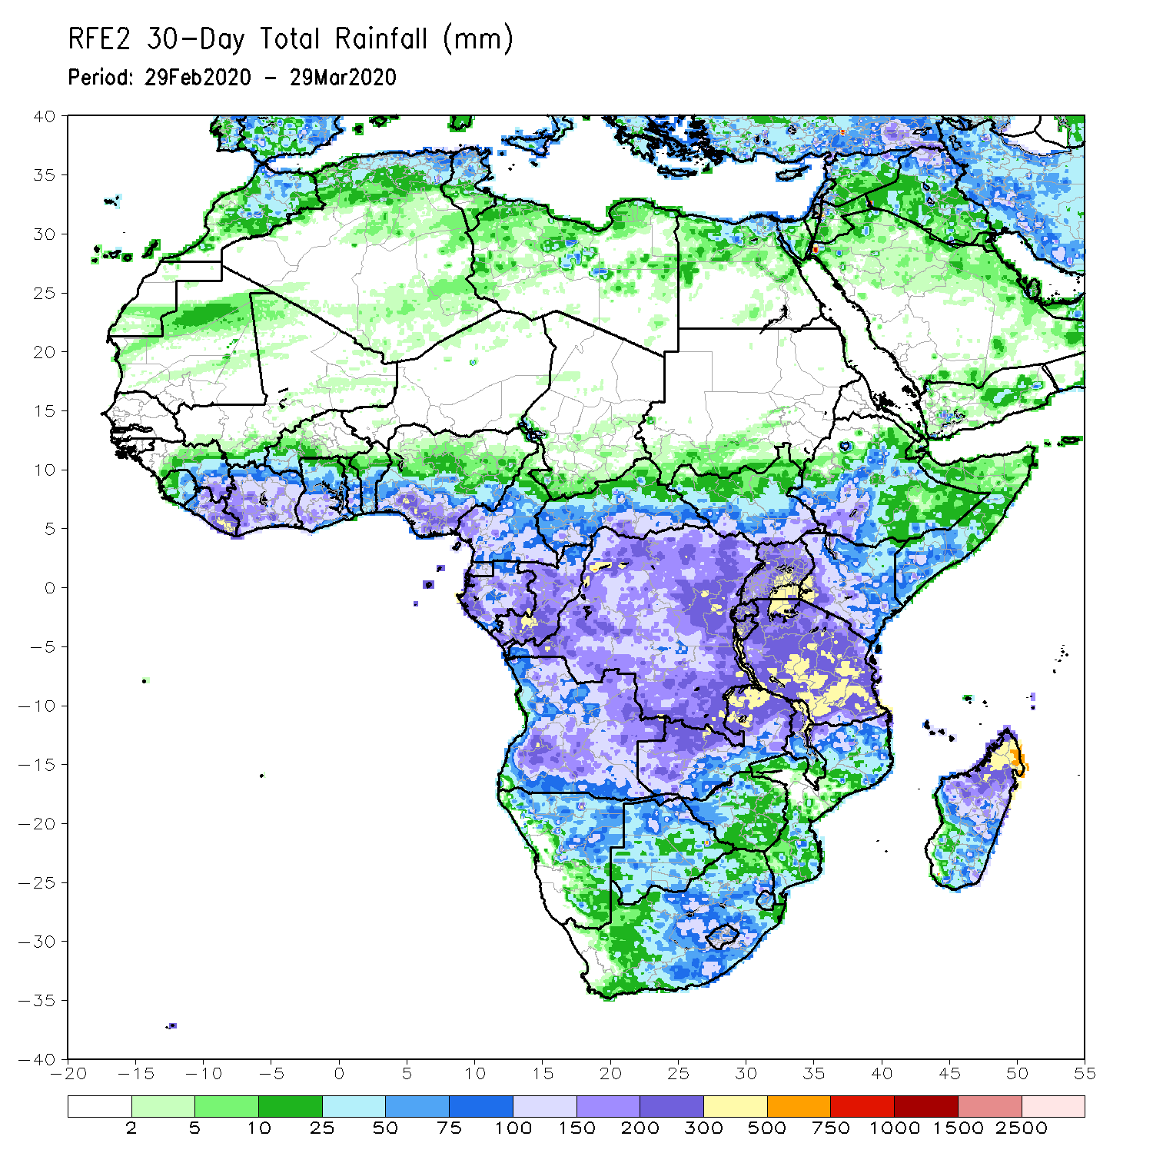
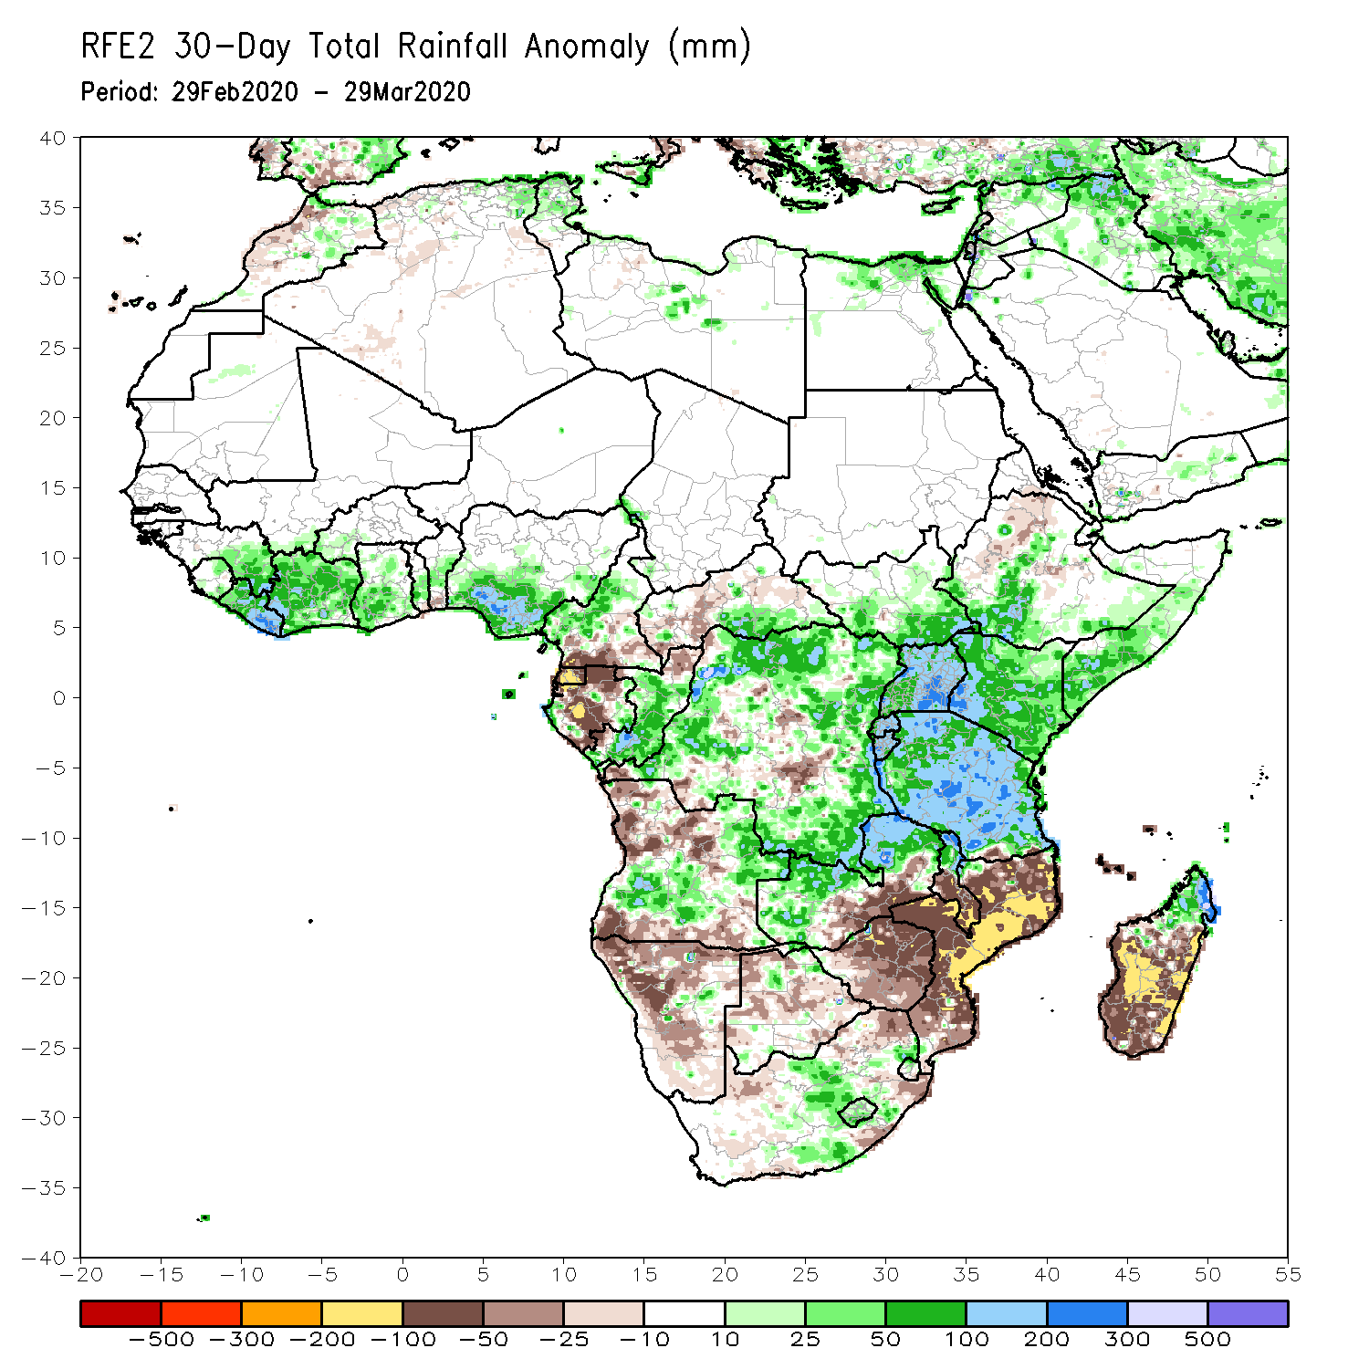
Rainfall Patterns: Last 30 Days
During the past 30 days, rainfall was above-average over many places in the Gulf of Guinea region, Congo, southern CAR, much of DRC, South Sudan, Uganda, parts of Ethiopia, much of Kenya, southern Somalia, Tanzania, northern Zambia, parts of Angola, central South Africa, Lesotho, and central and northern Madagascar.
Rainfall was below-average over southern Cameroon, Gabon, parts of CAR, parts of Angola, local areas in DRC, parts of western Ethiopia, Namibia, Botswana, Malawi, Mozambique, and parts of South Africa, southern Madagascar.
Notes:
5

Slide 6
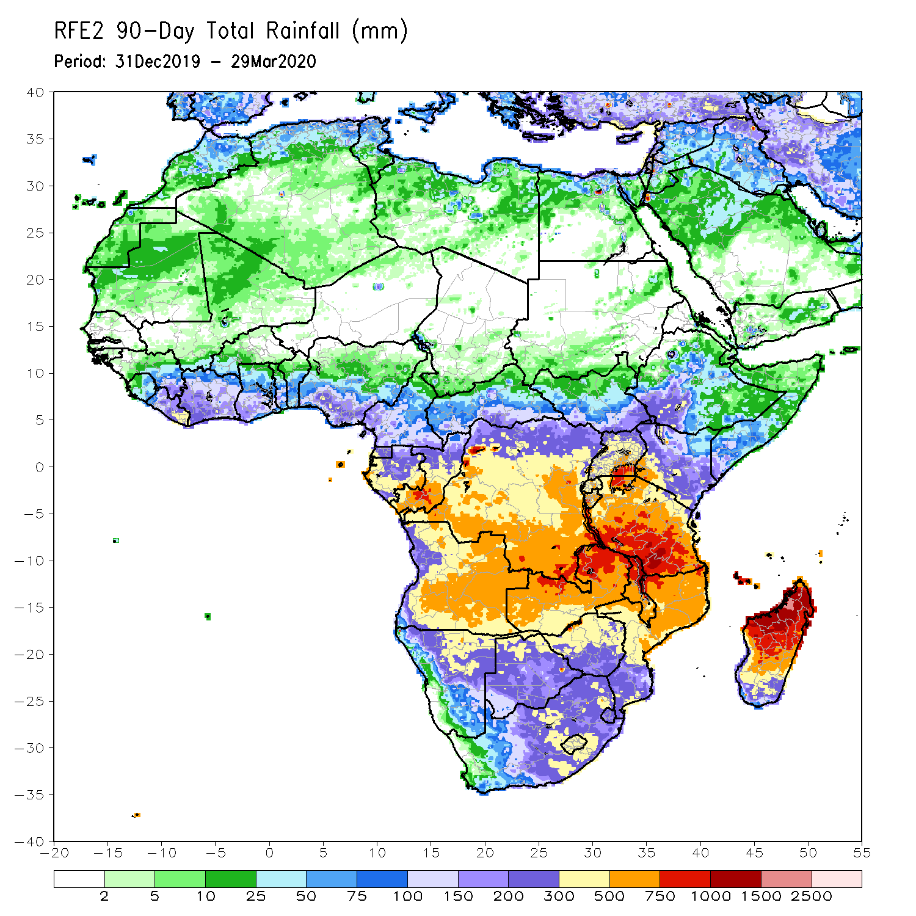
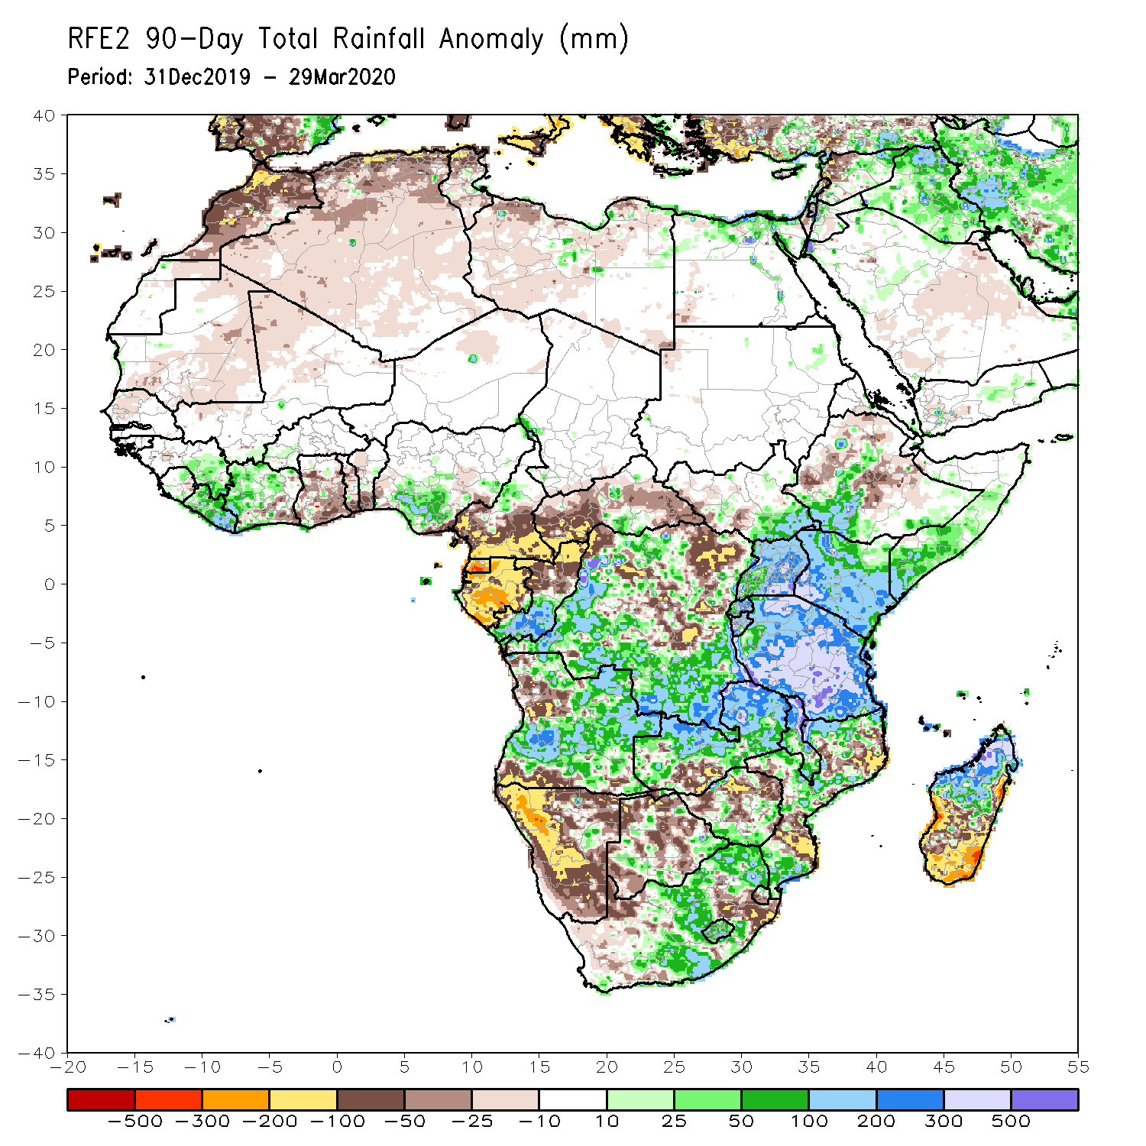
Rainfall Patterns: Last 90 Days
During the past 90 days, rainfall was above-average over portions of the Gulf of Guinea region, southeastern South Sudan, southern Congo, parts of DRC, Rwanda, Burundi, Uganda, Kenya, parts of Ethiopia, Somalia, much of Tanzania, many parts of Angola and Zambia, Malawi, local areas in Namibia and Botswana, portions of South Africa and Mozambique, and northern Madagascar.
Much of Ghana, Togo, Benin, Cameroon, Equatorial Guinea, Gabon, CAR, parts of Angola and DRC, local areas in South Sudan, parts of Ethiopia, Namibia, parts of Botswana and Zimbabwe, southern Zambia, eastern South Arica, parts of Mozambique and Madagascar.
Notes:
6

Slide 7
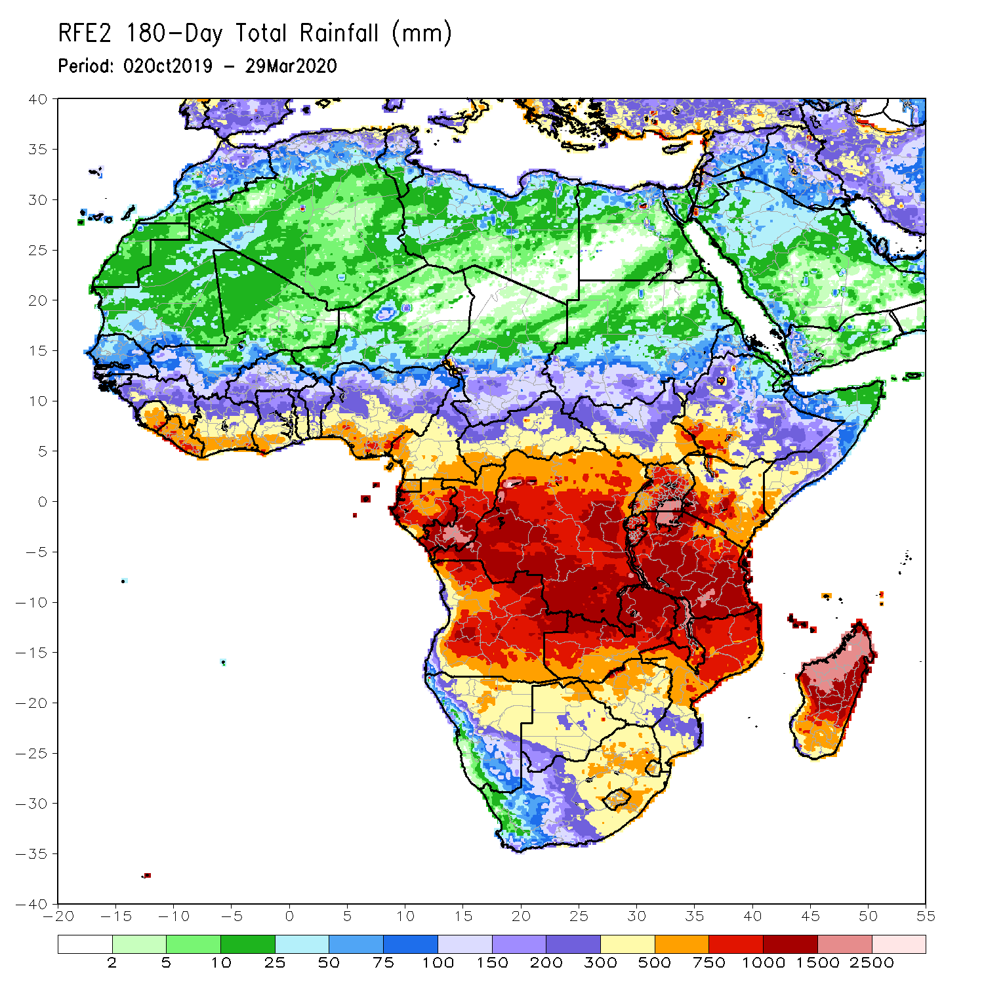
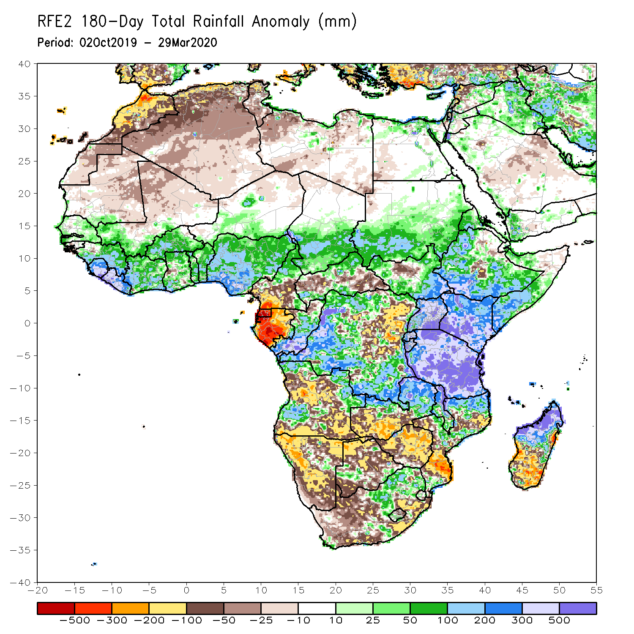
Rainfall Patterns: Last 180 Days
During the past 180 days, parts of Southern Mauritania, eastern Guinea, Sierra Leone, portions of southern Mali, Liberia, Cote d’Ivoire, Burkina Faso, Ghana, Togo, Benin, Nigeria, portions of Cameroon, Niger, Chad, portions of CAR and DRC, South Sudan, Sudan, Uganda, Eritrea, Ethiopia, Somalia, Kenya, Tanzania, parts of Angola, local areas in Namibia, parts of Zambia, Malawi and parts of South Africa, many parts of Mozambique and northern Madagascar had above-average rainfall.
Below-average rainfall was observed over portions of Cameroon, Equatorial Guinea, Gabon, parts of northeastern DRC, parts of Angola, Namibia, South Africa, western Zambia, many parts of Botswana and Zimbabwe, parts of southern Mozambique and southern Madagascar.
Notes:
7

Slide 8
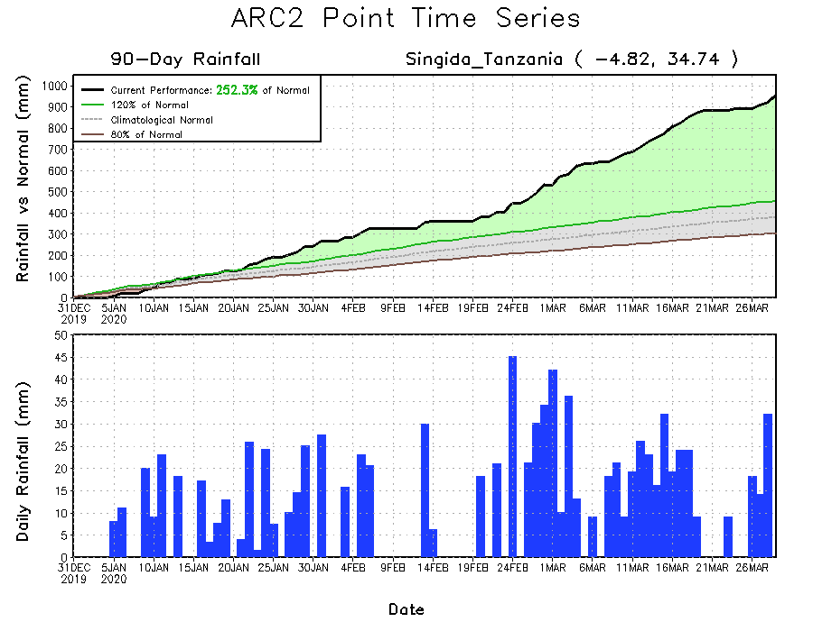
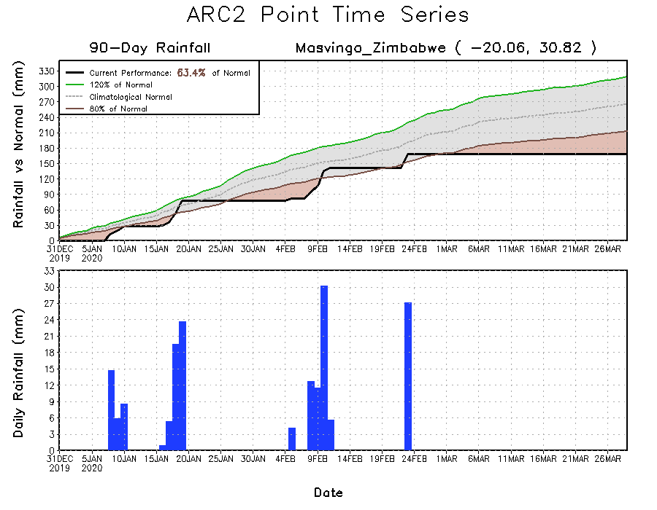
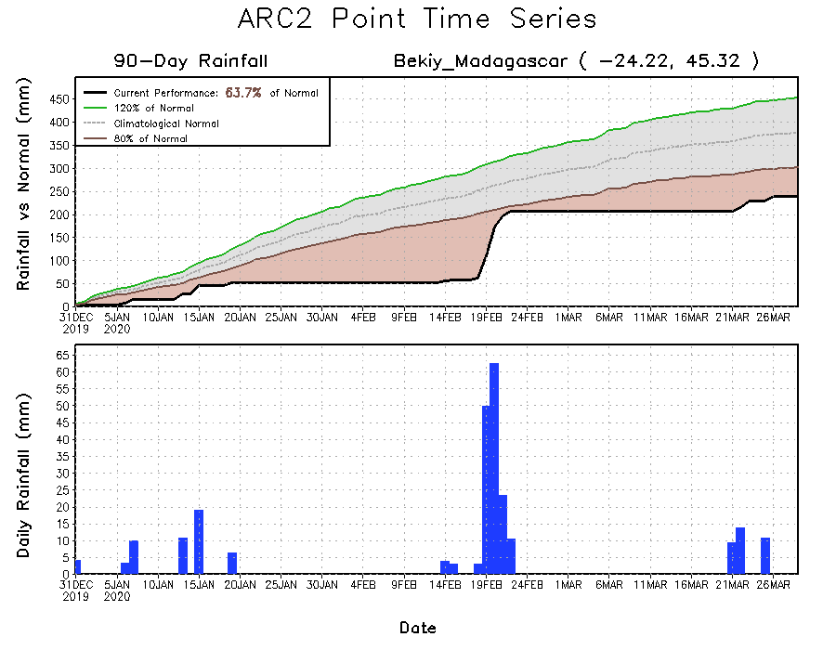
Recent Rainfall Evolution
Daily evolution of rainfall over the last 90 days at selected locations shows that moderate to locally heavy rainfall sustained moisture surpluses over portions of Tanzania (top right). Seasonal total rainfall remained below-average over parts of Zimbabwe (bottom left) and southern Madagascar(bottom right).

Slide 9
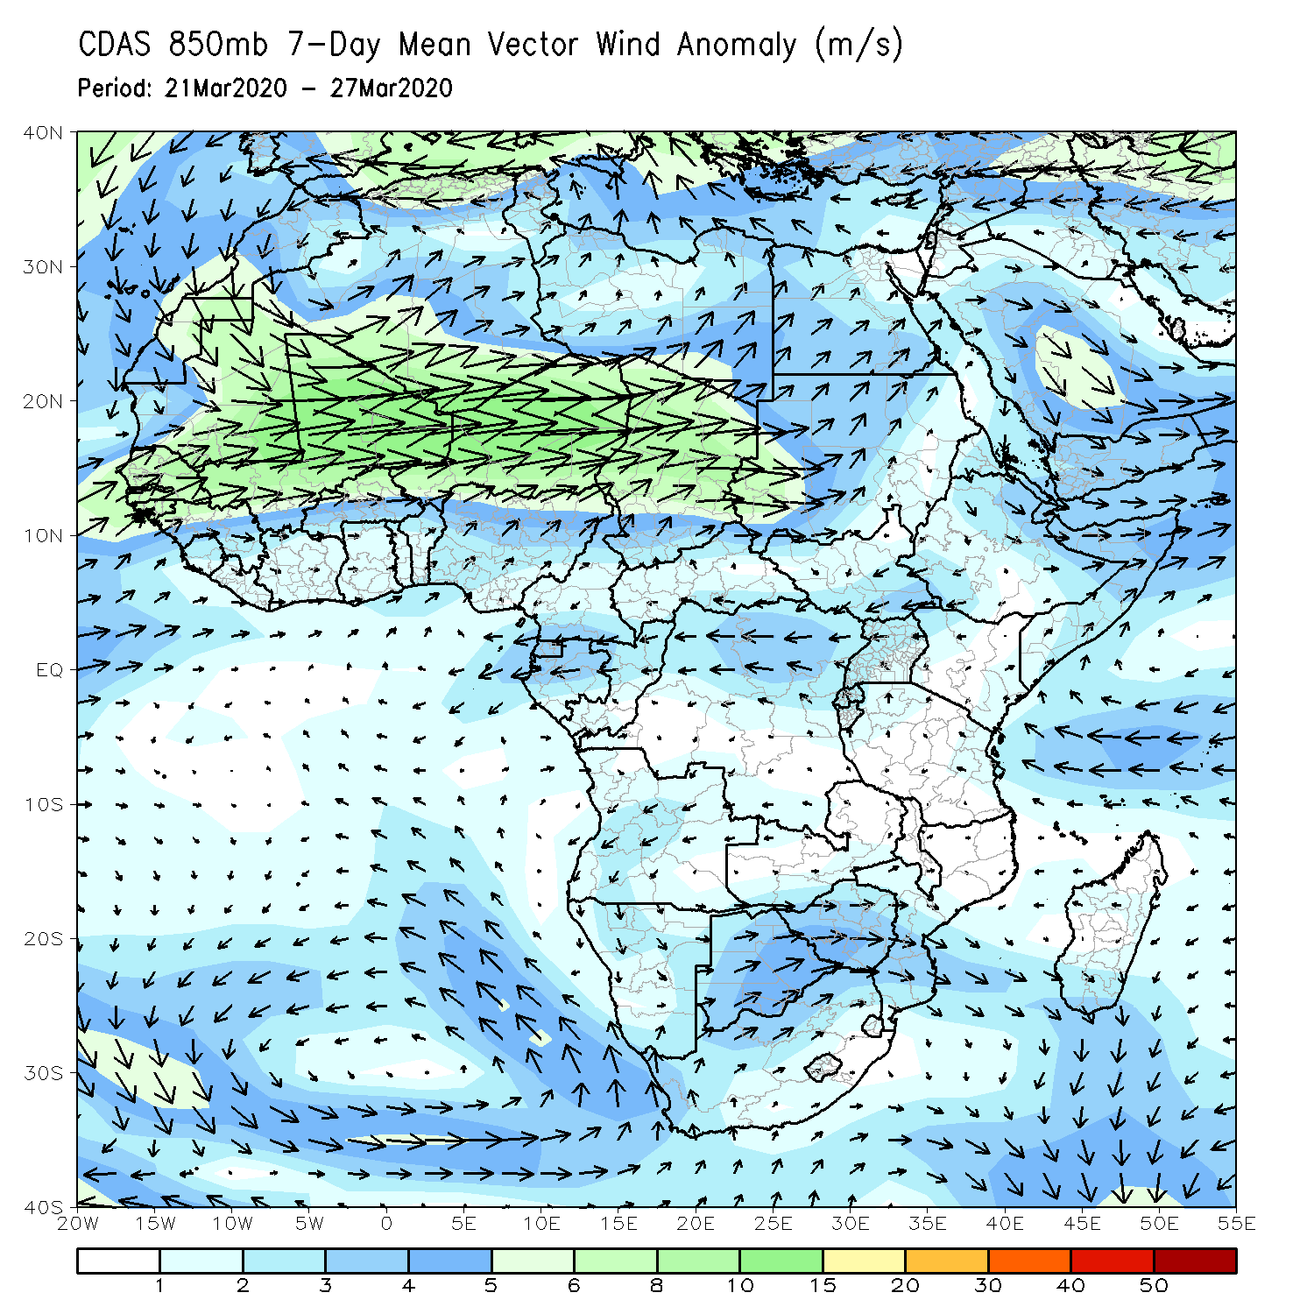
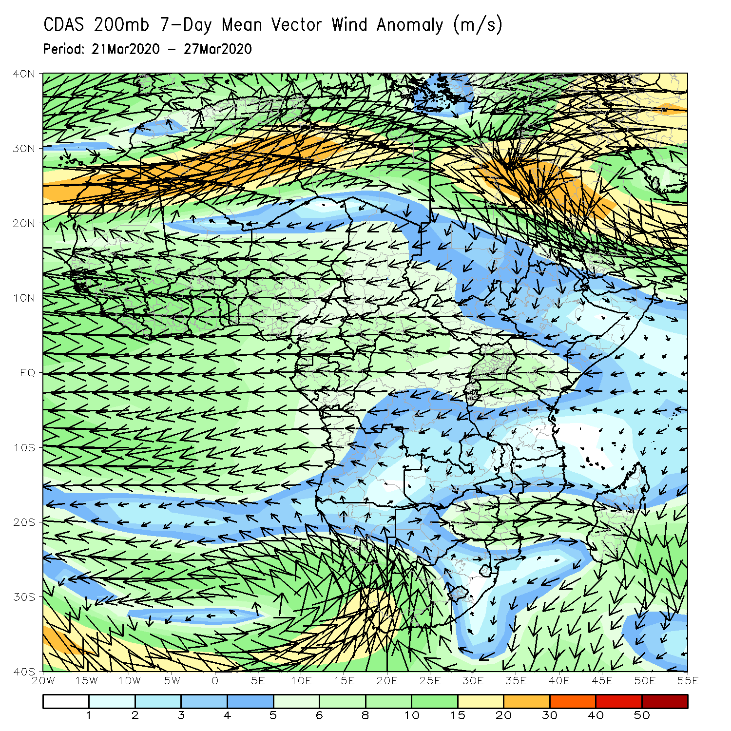
Atmospheric Circulation: Last 7 Days
Lower-level wind anomalies were easterly across equatorial Africa region.(left panel).

Slide 10
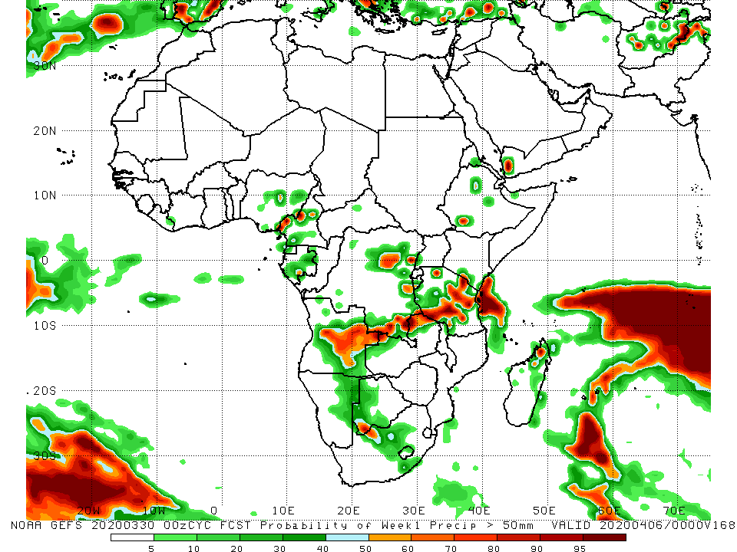
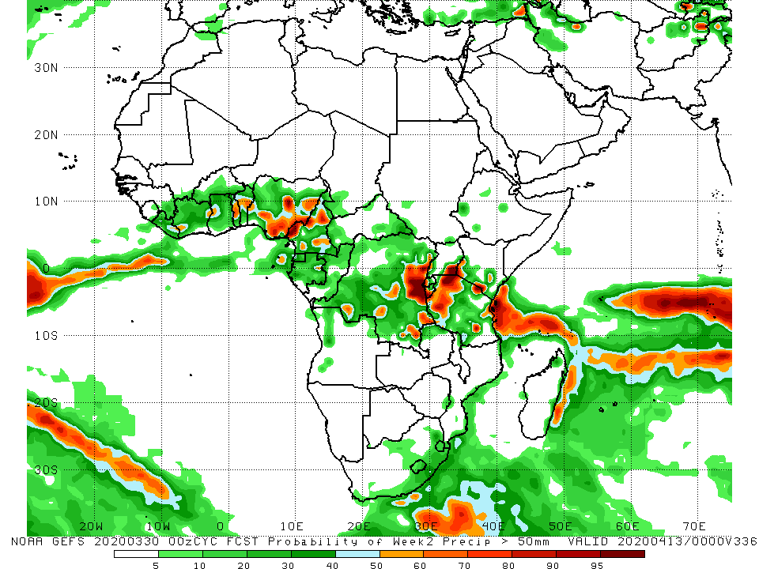
NCEP GEFS Model Forecasts Non-Bias Corrected Probability of precipitation exceedance
Week-1: Valid 31 March – 6 April, 2020
Week-2: Valid 7 - 13 April, 2020
For week-1 (left panel), there is an increased chance for weekly rainfall totals to exceed 50mm over local areas in Nigeria and Cameroon, parts of Angola, southern and eastern DRC, local areas in Ethiopia, and Tanzania. For week-2 (right panel), there is an increased chance for weekly rainfall totals to exceed 50mm over local areas in Cote d’Ivore and Ghana, Togo, Benin, Nigeria, Cameroon, DRC, and Tanzania.
Notes:
10

Slide 11
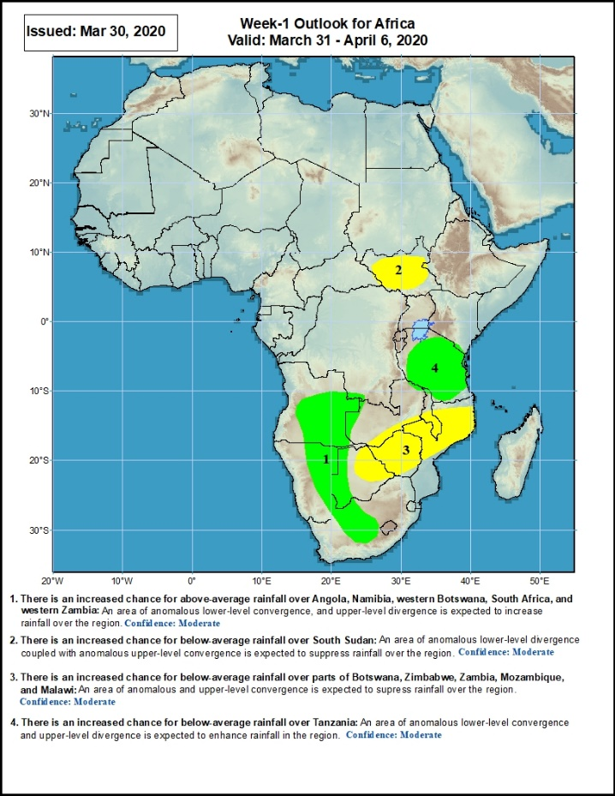
Week-1 Precipitation Outlooks
31 March – 6 April, 2020
There is an increased chance for above-average rainfall over Angola, Namibia, western Botswana, South Africa, and parts of western Zambia: An area of anomalous lower-level convergence and upper-level divergence is expected to enhance rainfall in the region. Confidence: Moderate
There is an increased chance for below-average rainfall over South Sudan: An area of anomalous lower-level divergence and upper-level convergence is expected to suppress rainfall over the region. Confidence: Moderate
There is an increased chance for below-average rainfall over parts of Botswana, Zimbabwe, Zambia, Mozambique, and Malawi: An area of anomalous lower-level divergence and upper-level convergence is expected to suppress rainfall over the region. Confidence: Moderate
There is an increased chance for below-average rainfall over Tanzania: An area of anomalous lower-level convergence and upper-level divergence is expected to enhance rainfall over the region. Confidence: Moderate
Notes:
11

Slide 12
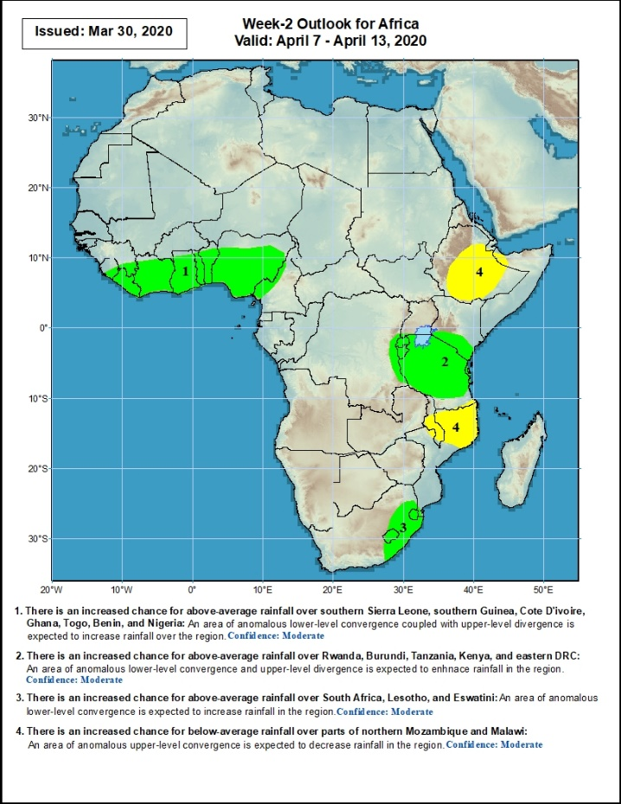
Week-2 Precipitation Outlooks
7 – 13 April, 2020
There is an increased chance for above-average rainfall over southern Sierra Leone, southern Guinea, Cote d’Ivoire, Ghana, Togo, Benin, and Nigeria: An area of anomalous lower level convergence and upper-level divergence is expected to enhance rainfall in the region. Confidence: Moderate
There is an increased chance for above-average rainfall over parts of eastern DRC and southern Kenya, Rwanda, Burundi and Tanzania: An area of anomalous lower-level convergence and upper-level divergence is expected to enhance rainfall in the region. Confidence: Moderate
There is an increased chance for above-average rainfall over parts of South Africa, Lesotho, and Eswatini: An area of anomalous lower-level convergence and upper-level divergence is expected to enhance rainfall in the region.. Confidence: Moderate
There is an increased chance for below-average rainfall over parts of northern Mozambique and Malawi: An area of anomalous lower-level divergence and upper-level convergence is expected to suppress rainfall in the region. Confidence: Moderate
Notes:
12

Slide 13
Summary
DDuring the past 7 days, rainfall was above-average over many places in the Gulf of Guinea region, local areas in Gabon, and Congo, CAR, parts of southern DRC, Uganda, local areas in South Sudan, southern Ethiopia, southern Somalia, Kenya, Tanzania, parts of Angola, Zambia, local areas in Namibia and Botswana, and northern Madagascar. Below-average rainfall was observed over local areas in Equatorial Guinea, Congo, portions of DRC, parts of Angola, Namibia, Botswana, Zimbabwe, southern Malawi, Mozambique and western Madagascar.
During the past 30 days, rainfall was above-average over many places in the Gulf of Guinea region, Congo, southern CAR, much of DRC, South Sudan, Uganda, parts of Ethiopia, much of Kenya, southern Somalia, Tanzania, northern Zambia, parts of Angola, central South Africa, Lesotho, and central and northern Madagascar. Rainfall was below-average over southern Cameroon, Gabon, parts of CAR, parts of Angola, local areas in DRC, parts of western Ethiopia, Namibia, Botswana, Malawi, Mozambique, and parts of South Africa, southern Madagascar.
During the past 90 days, rainfall was above-average over portions of the Gulf of Guinea region, southeastern South Sudan, southern Congo, parts of DRC, Rwanda, Burundi, Uganda, Kenya, parts of Ethiopia, Somalia, much of Tanzania, many parts of Angola and Zambia, Malawi, local areas in Namibia and Botswana, portions of South Africa and Mozambique, and northern Madagascar. Much of Ghana, Togo, Benin, Cameroon, Equatorial Guinea, Gabon, CAR, parts of Angola and DRC, local areas in South Sudan, parts of Ethiopia, Namibia, parts of Botswana and Zimbabwe, southern Zambia, eastern South Arica, parts of Mozambique and Madagascar.
Week-1 outlooks call for an increased chance for above-average rainfall over portions of Angola, eastern Namibia, western Botswana, central South Africa, and much of Tanzania. In contrast, there is an increased chance for below-average rainfall over parts of South Sudan, Botswana, Zimbabwe, and central and southern Mozambique.
Notes:
13

