Slide 1
The African Monsoon Recent Evolution and Current Status Include Week-1 and Week-2 Outlooks
Update prepared by
Climate Prediction Center / NCEP
09 March 2020
For more information, visit:
http://www.cpc.ncep.noaa.gov/products/Global_Monsoons/African_Monsoons/precip_monitoring.shtml

Slide 2
Outline
Highlights
Recent Evolution and Current Conditions
NCEP GEFS Forecasts
Summary

Slide 3
Highlights: Last 7 Days
Weekly rainfall surpluses exceeded 100mm over local areas in Tanzania and Kenya. Rainfall was above-average over most of the equatorial countries and below average for many countries in the southern part of the continent except over northern Madagascar.
Week-1 outlooks call for an increased chance for above-average rainfall over parts of Central Angola and southwestern DRC, southwestern Kenya, most of Tanzania, northern Zambia, northern Malawi and southern South Africa. In contrast, there is an increased chance for below-average rainfall over parts of northern Namibia, parts of western Botswana, part of northern Mozambique and a broad area from central to southern Madagascar.

Slide 4
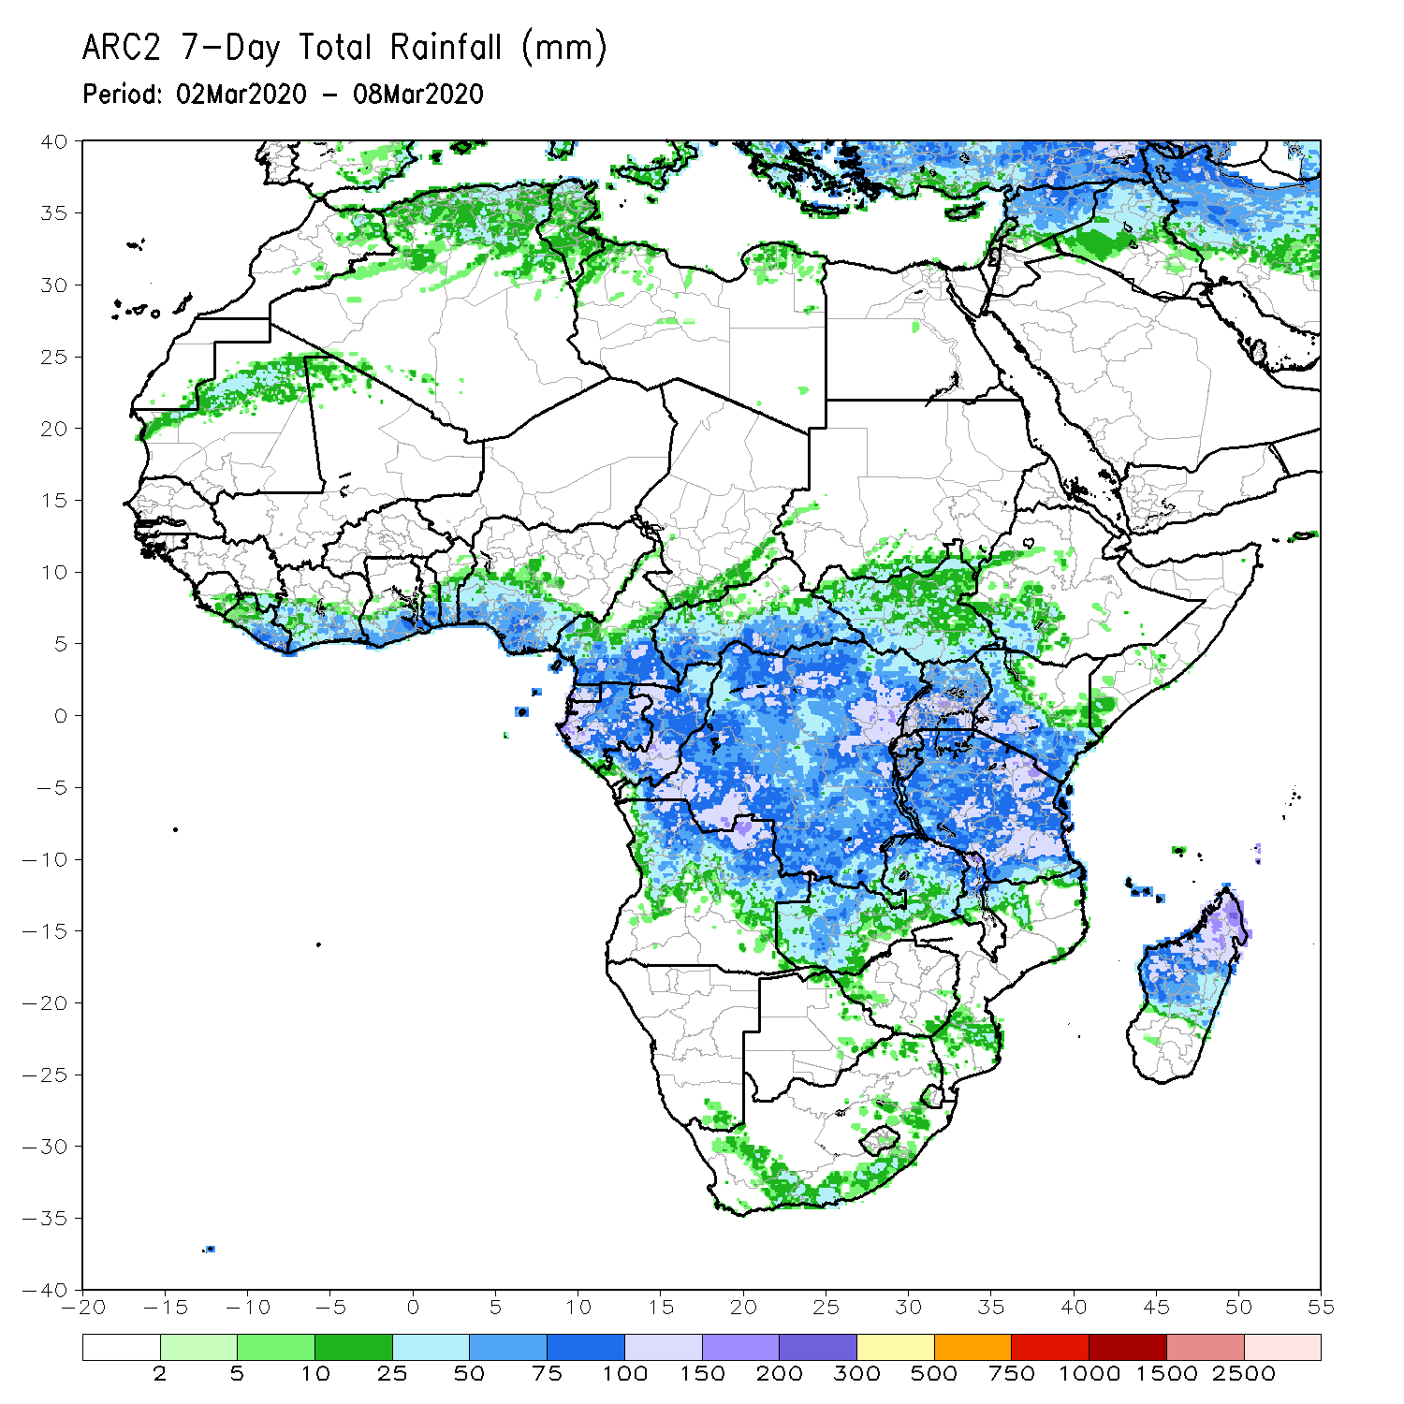
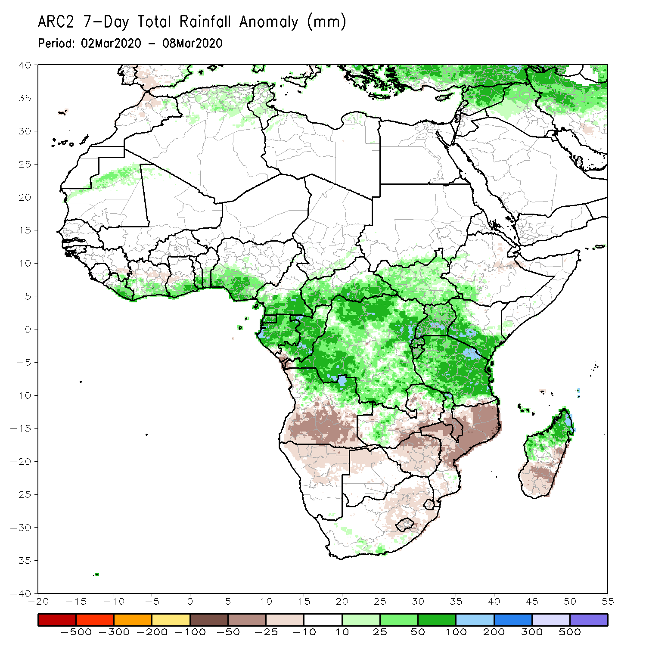
Rainfall Patterns: Last 7 Days
During the past 7 days, weekly rainfall totals exceeded 100mm over areas in eastern Tanzania, northern Madagascar, parts of southwestern Kenya, central Uganda, local areas in DRC, parts of northern Angola, Congo, Gabon, southern CAR and southern Cameroon. Rainfall was above-average over most of the equatorial countries including Gabon, Congo, Equatorial Guinea, DRC, southern CAR, much of South Sudan, Tanzania, Uganda, Rwanda, Burundi, local areas in Zambia, parts of northeastern Angola, local areas in South Africa, and northern Madagascar. Rainfall surpluses exceeded 100mm over local areas in Tanzania and Kenya.
Rainfall was slightly below average over Namibia, Botswana, part of Zimbabwe, southern Mozambique, eastern South Africa. Below-average rainfall was also observed over southern Angola, northeastern Zimbabwe, southern Malawi, northern Mozambique and southern Madagascar.
Notes:
Week-1 outlooks call for an increased chance for above-average rainfall over parts of Central Angola and southwestern DRC, southwestern Kenya, most of Tanzania, northern Zambia, northern Malawi and southern South Africa. In contrast, there is an increased chance for below-average rainfall over parts of northern Namibia, parts of western Botswana, part of northern Mozambique and a broad area form central to southern Madagascar.

Slide 5
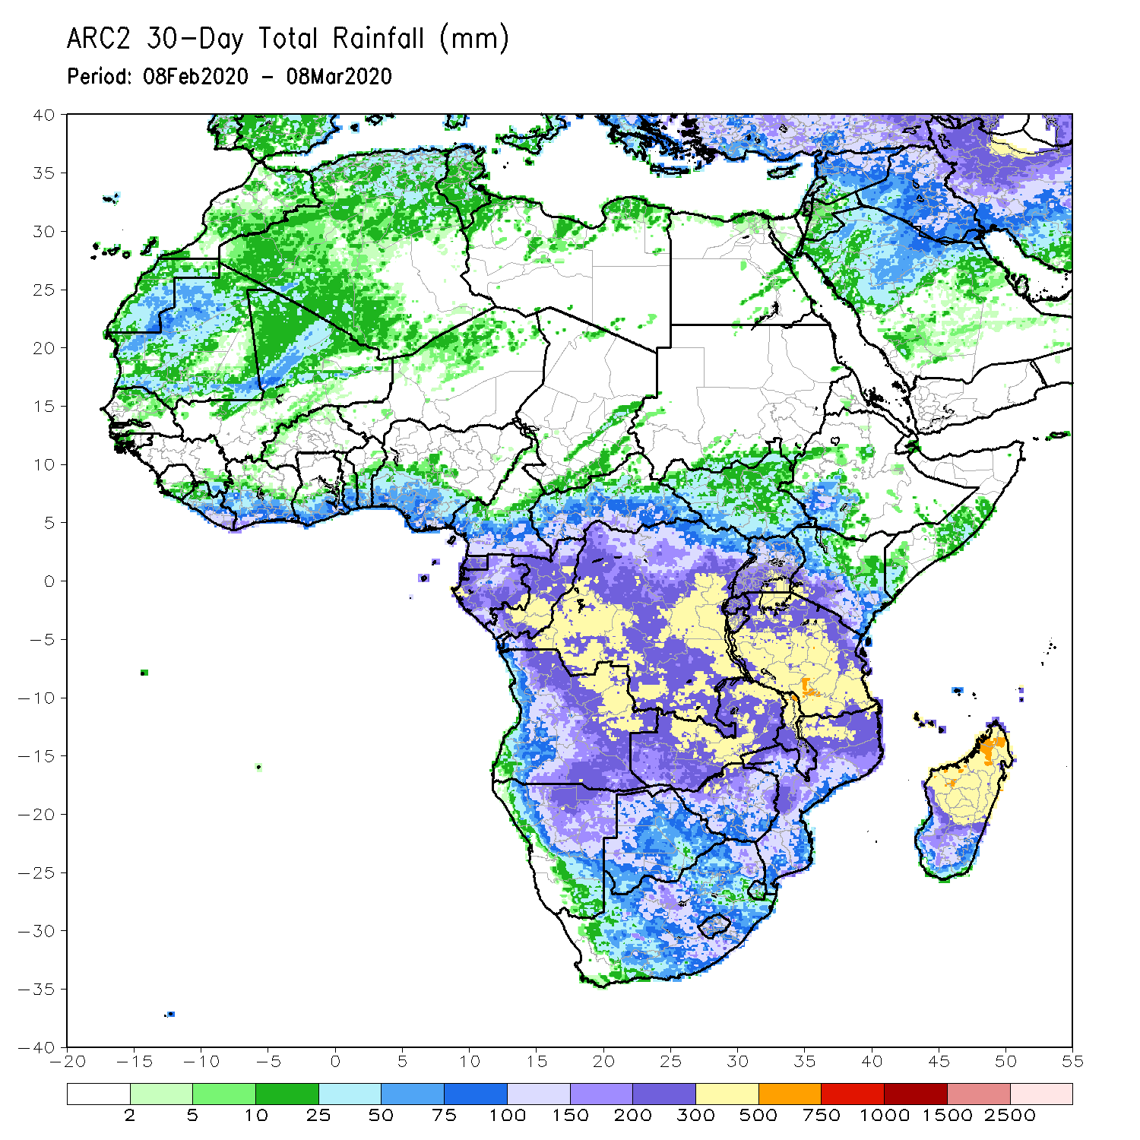
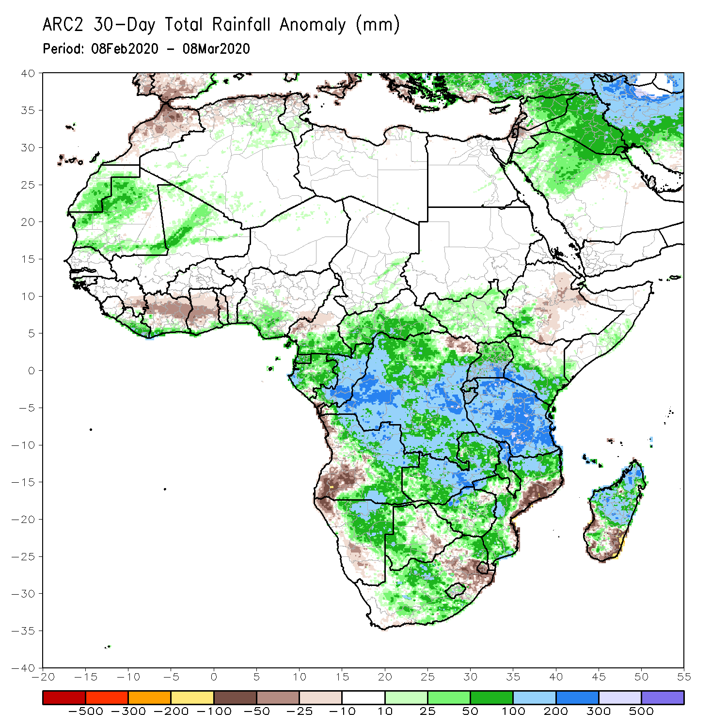
Rainfall Patterns: Last 30 Days
During the past 30 days, rainfall totals exceeded 300mm over local areas in Congo, parts of DRC, parts of eastern Angola, from central to southern Tanzania, central Zambia, northern Malawi, northern Madagascar and part of northeastern Mozambique, with rainfall totals in excess of 500mm observed over local areas in central Tanzania and northern Madagascar. Rainfall was above-average over Gabon, Congo, much of DRC, Uganda and western and southern Kenya, Tanzania, Zambia, many parts of eastern Angola, Malawi, much of western, southern and northern Mozambique, central South Africa, Lesotho, and a broad area from central to northern Madagascar. Rainfall surpluses exceeded 200mm over parts of central Tanzania, central Zambia and local areas in DRC and Congo.
Rainfall was below-average over western Angola, parts of northwestern Namibia, portions of northeastern DRC, parts of eastern Mozambique, local areas in Namibia and eastern South Africa, much of Eswatini, and local areas in southern Madagascar.
Notes:
5

Slide 6
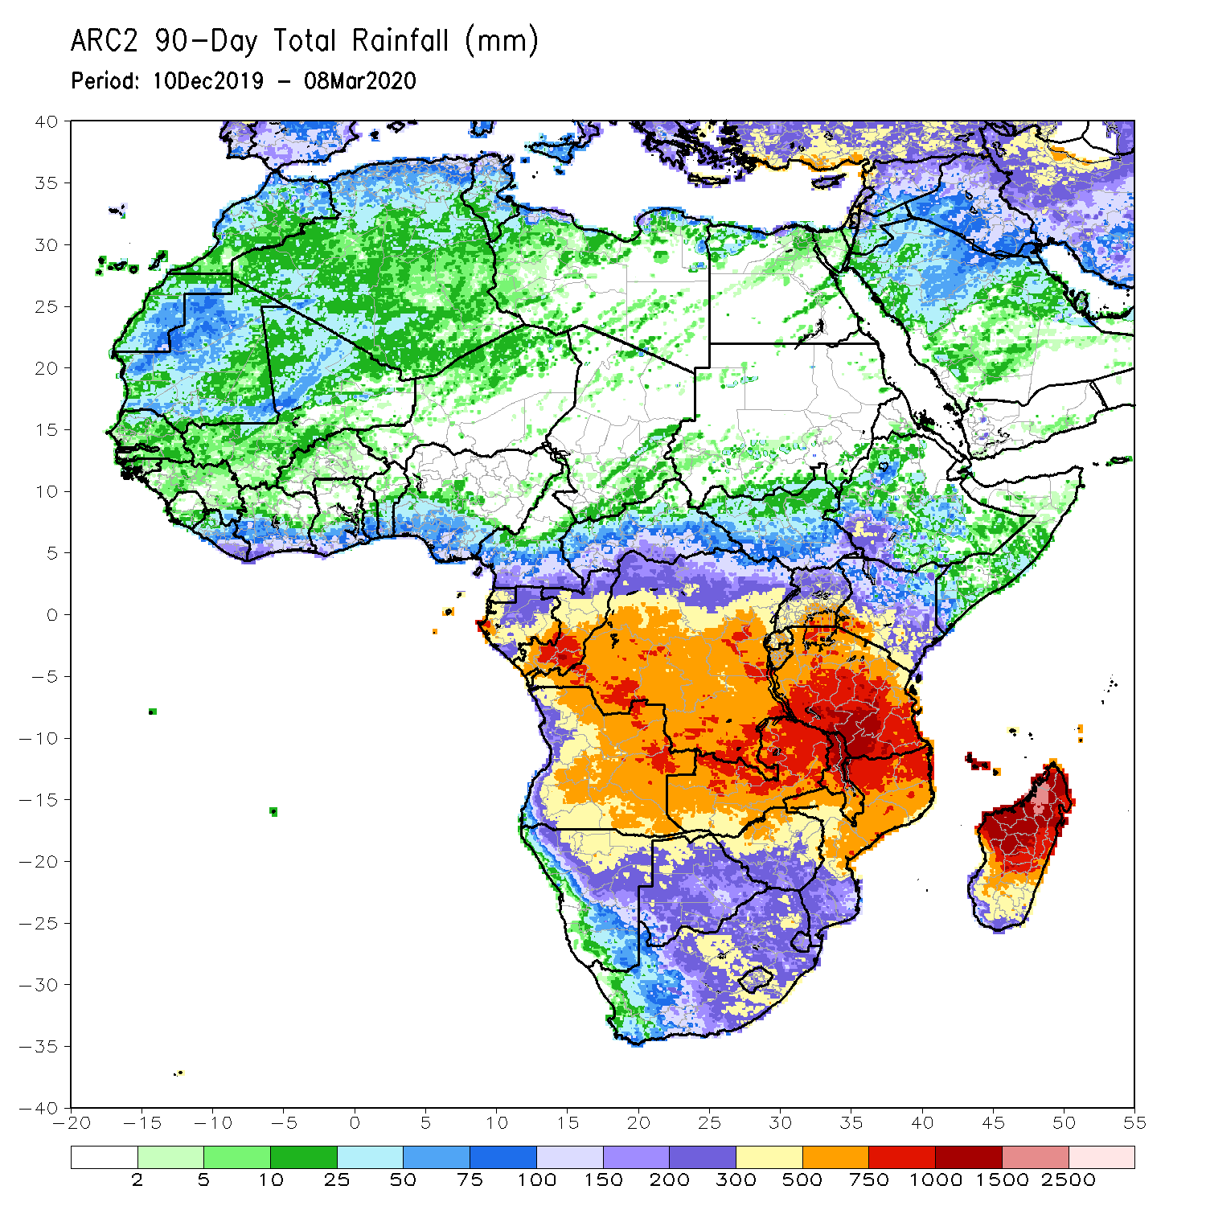
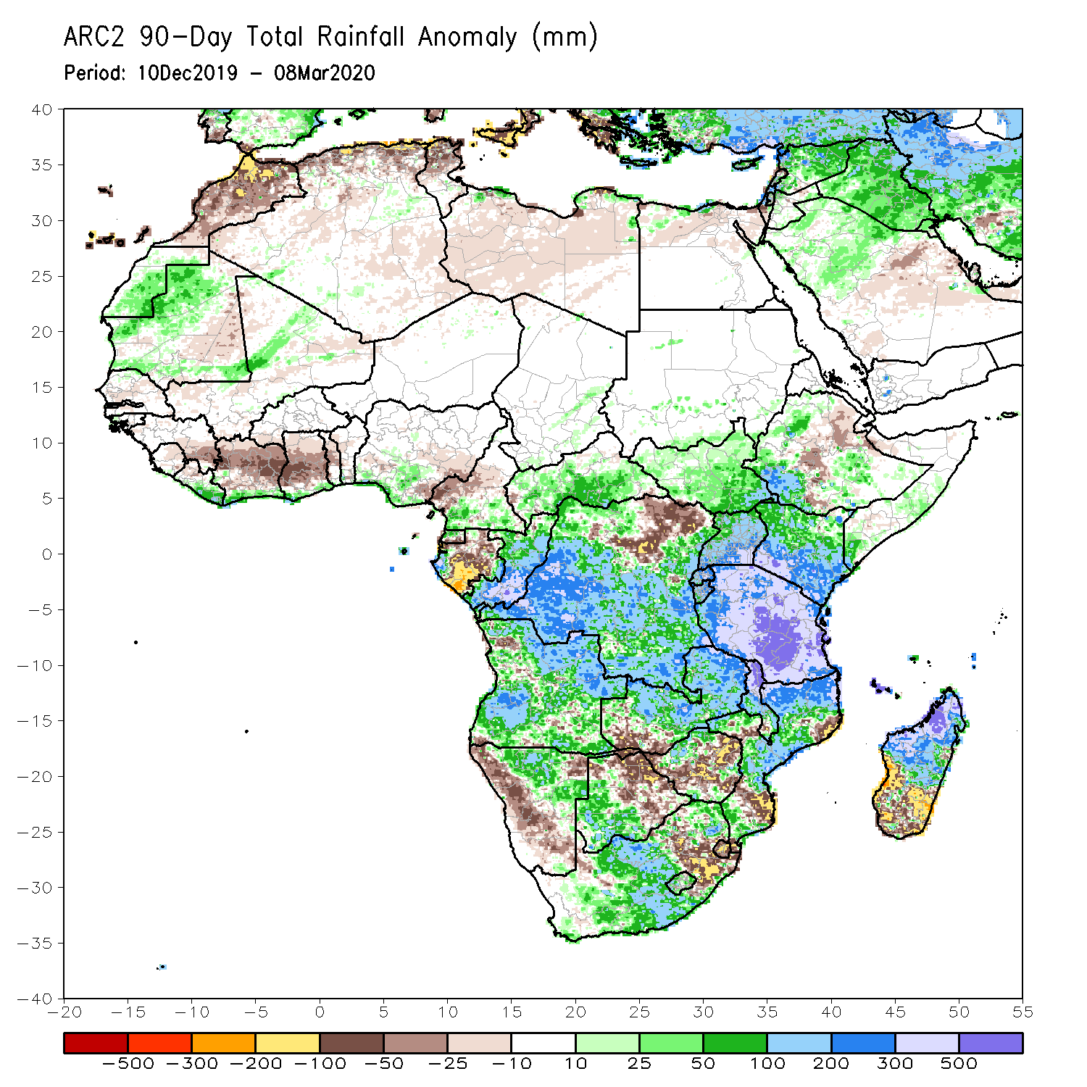
Rainfall Patterns: Last 90 Days
During the past 90 days, rainfall totals exceeded 750mm over parts of southern Congo and local areas in DRC, local areas in eastern Angola, central and southern Tanzania, central and eastern Zambia, northern Malawi, northern Mozambique, and central and northern Madagascar. Rainfall above 1500mm were recorded over areas in northern Madagascar. Rainfall was above-average over parts of CAR, South Sudan, much of Congo and DRC, Rwanda, Burundi, Uganda, Kenya, over areas in Ethiopia, local areas in Somalia, much of Tanzania, many parts of Angola, many parts of Zambia, eastern Malawi, western Botswana, central South Africa, central and northern Mozambique, and northern Madagascar. Rainfall surpluses exceeded 500mm over local areas in central Tanzania and northern Madagascar.
Many places in the Gulf of Guinea countries including central Cote d’Ivoire and Ghana, western Cameroon, northeastern of DRC, much of Gabon, local areas in Angola, parts of southwestern Zambia, areas in Zimbabwe and northeastern Botswana, western Namibia, local areas in Mozambique, Eswatini and local areas in eastern South Africa, and southern Madagascar had below-average rainfall. Rainfall deficits exceeded 300mm over parts of Gabon.
Notes:
6

Slide 7
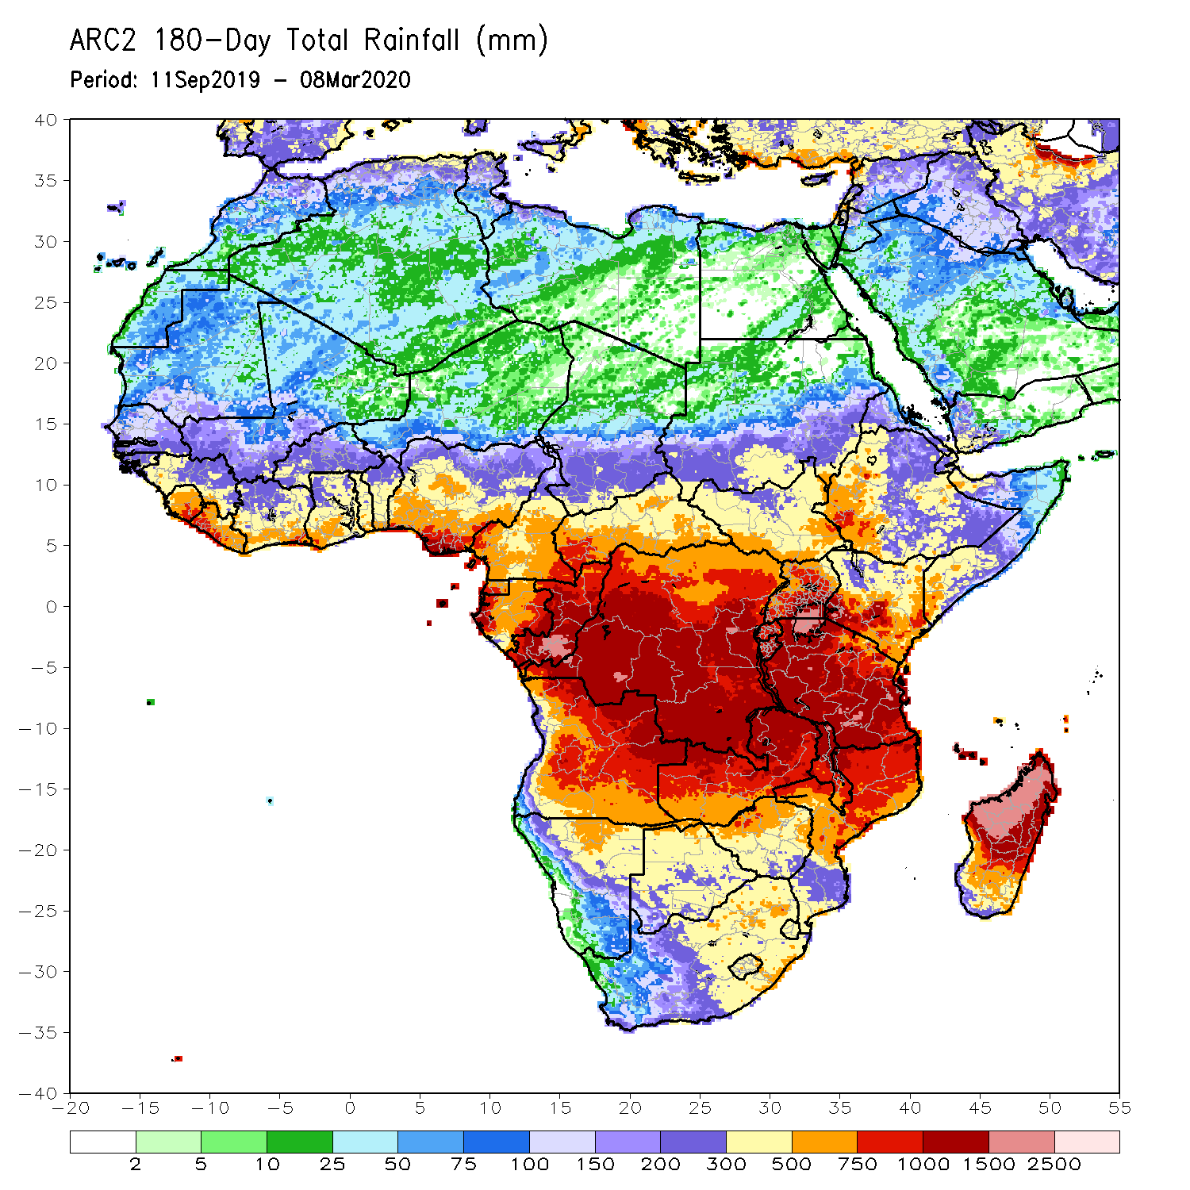
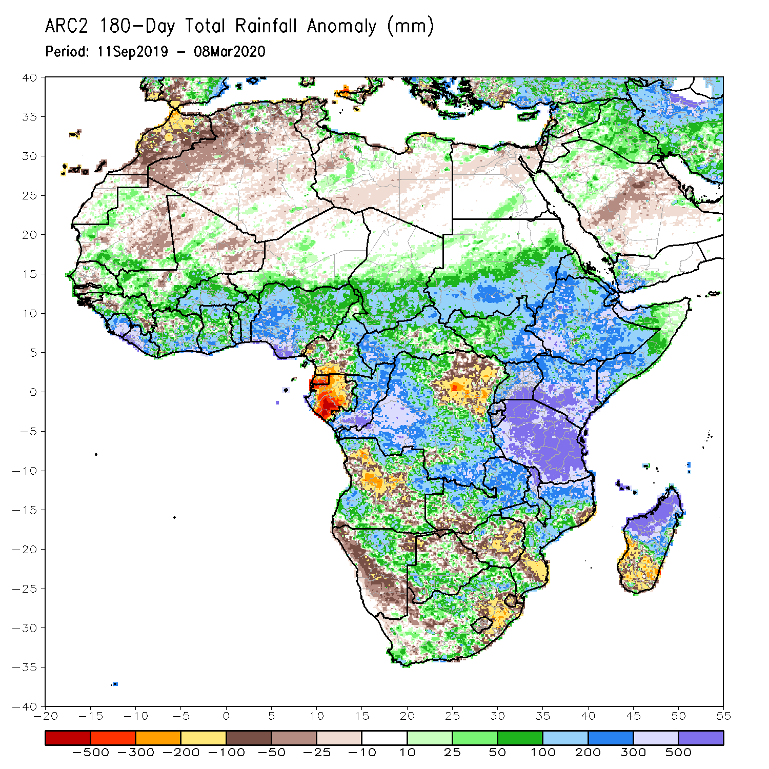
Rainfall Patterns: Last 180 Days
During the past 180 days, rainfall totals in excess of 1500mm were observed over parts of northern Madagascar and local areas in southern Congo. Southern Mauritania, portions of Senegal, Guinea-Bissau, Guinea, Sierra Leone, much of southern Mali, Liberia, Cote d’Ivoire, Burkina Faso, Ghana, Togo, Benin, Nigeria, portions of Cameroon, Niger, Chad, portions of CAR and DRC, South Sudan, Sudan, Uganda, Eritrea, Ethiopia, Somalia, Kenya, Tanzania, parts of Angola, parts of northern Namibia, many parts of Zambia, parts of Namibia, Malawi and South Africa, many parts of Mozambique and northern Madagascar had above-average rainfall. Rainfall surpluses exceeded 500mm over parts of southern Nigeria, local areas in Congo, Kenya, Tanzania, and northern Madagascar.
Below-average rainfall was observed over portions of southern Cameroon, Equatorial Guinea, Gabon, local areas in southern CAR and northeastern DRC, much areas in central Angola, in western Namibia, in southeastern parts of South Africa, western Zambia, in Zimbabwe, and parts of southern Mozambique, western Botswana and southern Madagascar. Rainfall deficits exceeded 500mm over parts of Gabon and Equatorial Guinea.
Notes:
7

Slide 8
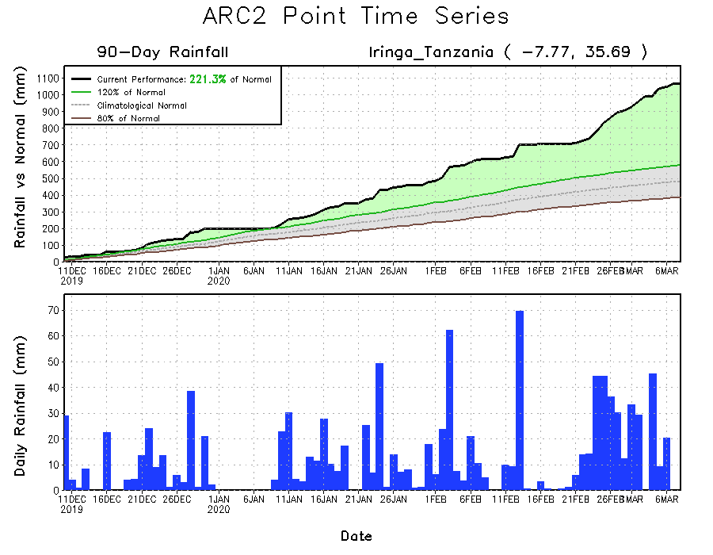
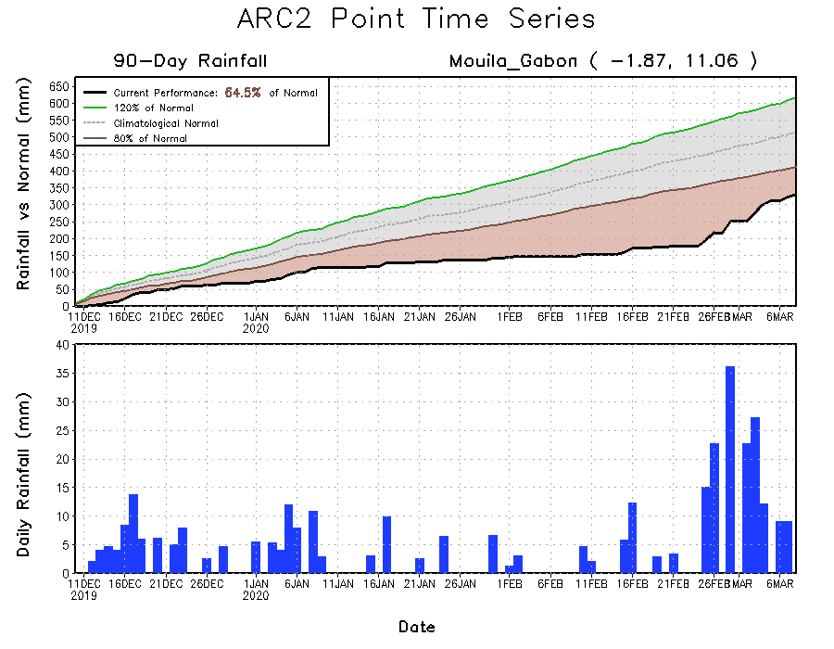
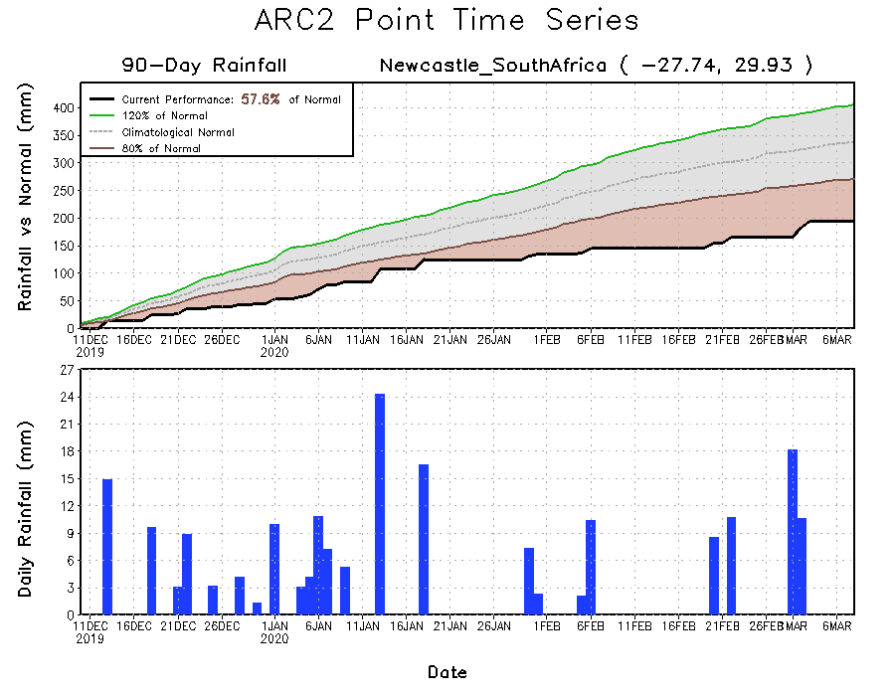
Recent Rainfall Evolution
Daily evolution of rainfall over the last 90 days at selected locations shows that continuous moderate to locally heavy rainfall sustained moisture surpluses over portions of Tanzania (top right). Suppress to moderate rainfall also helped to reduce accumulated rainfall deficits over parts of South Africa (bottom right). Seasonal total rainfall remained below-average over parts of southern Gabon (bottom left).

Slide 9
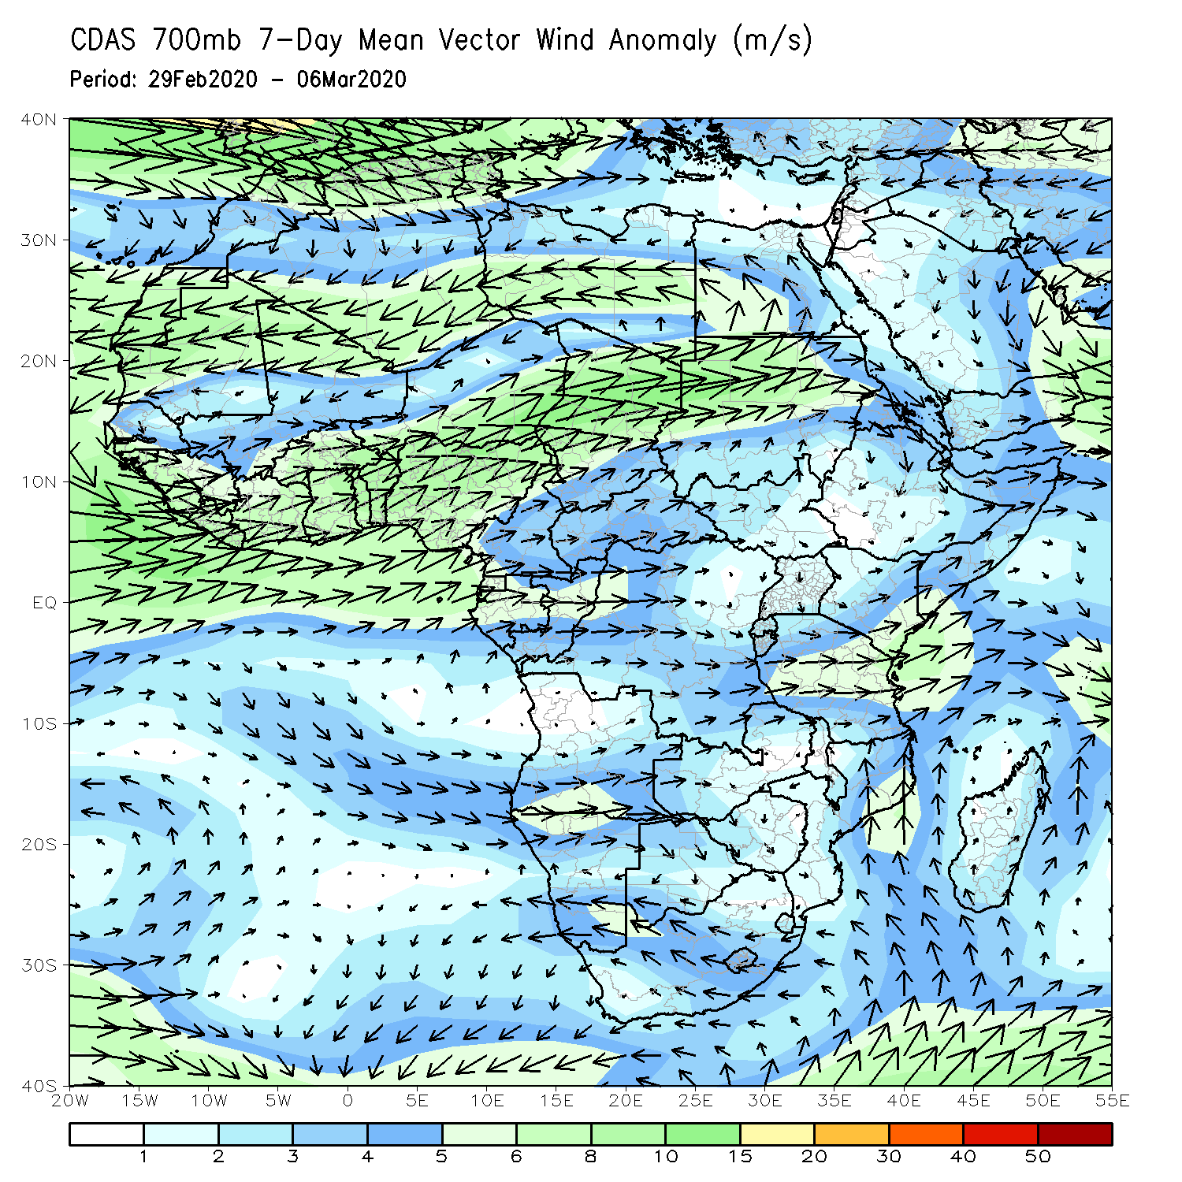
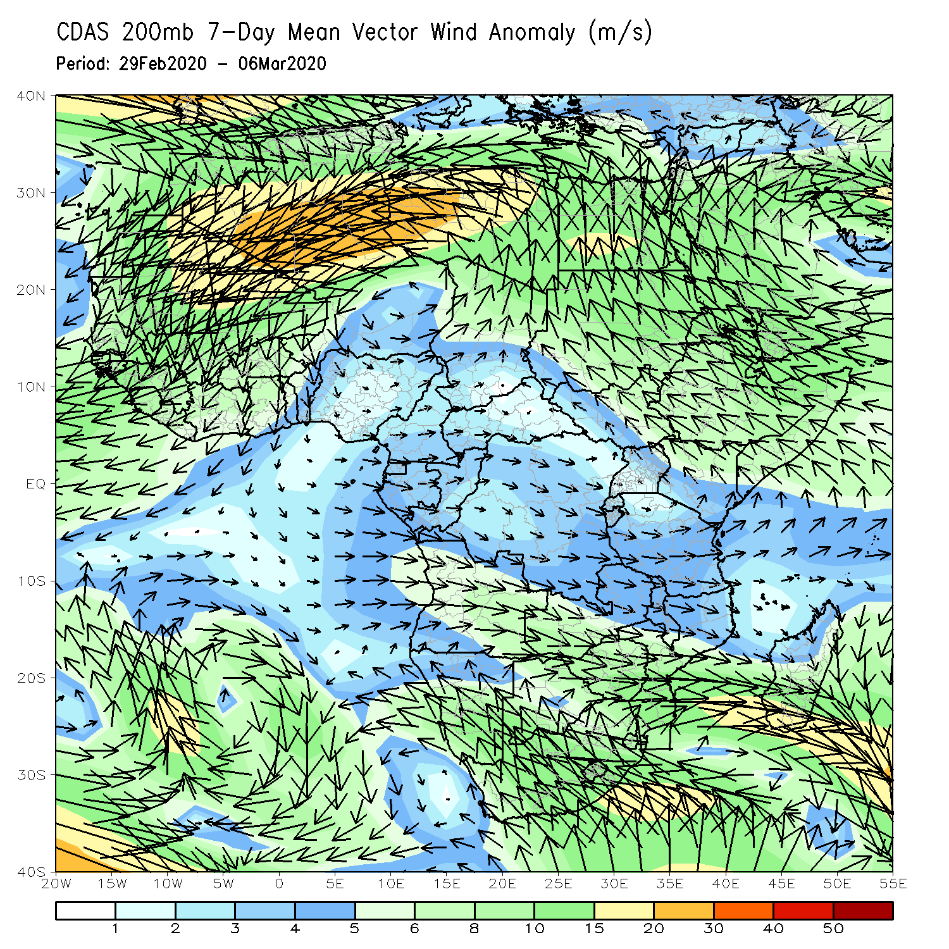
Atmospheric Circulation: Last 7 Days
Lower-level wind anomalies were westerly across much of DRC and the neighboring areas (left panel). These anomalies combined with warm presence of water over Gulf of Guinea strengthen the moisture advection over central equatorial Africa.

Slide 10
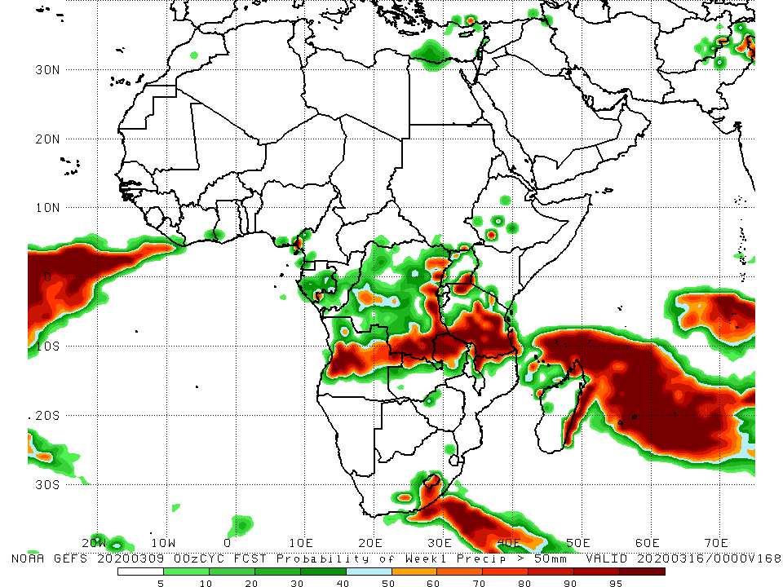
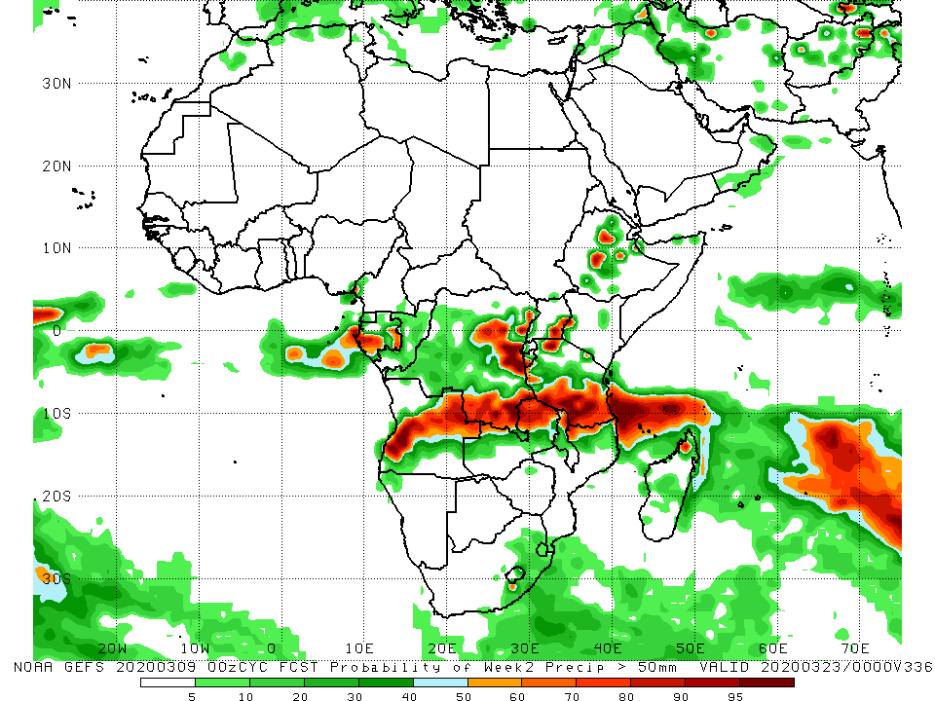
NCEP GEFS Model Forecasts Non-Bias Corrected Probability of precipitation exceedance
Week-1: Valid 10 – 16 March, 2020
Week-2: Valid 17 - 23 March, 2020
For week-1 (left panel), there is an increased chance for weekly rainfall totals to exceed 50mm over central Angola, parts of southern and local areas in eastern DRC, northeastern Zambia, central to southern Tanzania, parts of northern Mozambique, local areas in South Africa, and local areas in northern Madagascar. For week-2 (right panel), there is an increased chance for weekly rainfall totals to exceed 50mm over southern Gabon, central Angola, parts of southern and local areas in central eastern DRC, northeastern Zambia, southern Tanzania, and local areas in Ethiopia.
Notes:
10

Slide 11
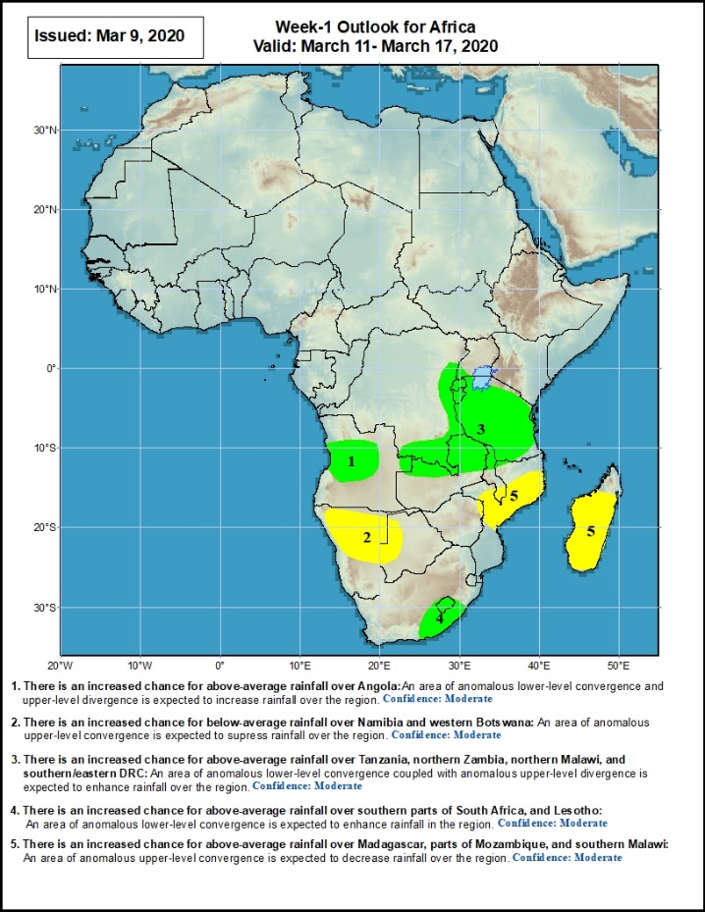
Week-1 Precipitation Outlooks
There is an increased chance for above-average rainfall over Angola: An area of anomalous lower-level convergence and upper-level divergence is expected to increase rainfall over the region. Confidence: Moderate
There is an increased chance for below-average rainfall over Namibia and western Botswana: An area of anomalous upper-level convergence is expected to suppress rainfall over the region. Confidence: Moderate
There is an increased chance for above-average rainfall over Tanzania, northern Zambia, northern Malawi, and southern/eastern DRC: An area of anomalous lower-level convergence coupled with upper-level divergence is expected to enhance rainfall over the region. Confidence: Moderate
There is an increased chance for above-average rainfall over southern parts of South Africa and Lesotho: An area of anomalous lower-level convergence is expected to enhance rainfall over the region. Confidence: Moderate
There is an increased chance for below-average rainfall over Madagascar, parts of Mozambique and southern Malawi: An area of anomalous upper-level convergence is expected to decrease rainfall over the region. Confidence: Moderate
10 – 16 March, 2020
Notes:
11

Slide 12
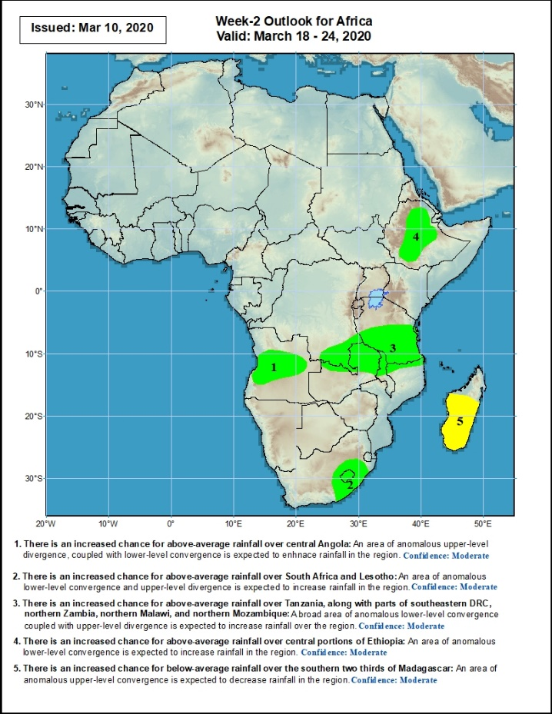
Week-2 Precipitation Outlooks
17 – 23 March, 2020
There is an increased chance for above-average central Angola: An area of anomalous upper-level divergence, coupled with lower-level convergence is expected to enhance rainfall in the region. Confidence: Moderate
There is an increased chance for above-average rainfall over southern parts of South Africa and Lesotho: An area of anomalous lower-level convergence and upper-level divergence is expected to increase rainfall over the region. Confidence: Moderate
There is an increased chance for above-average rainfall over Tanzania, along with parts of southeastern DRC, northern Zambia, northern Malawi, and northern Mozambique: A broad area anomalous lower-level convergence, coupled with upper-level divergence is expected to increase rainfall over the region. Confidence: Moderate
There is an increased chance for above-average rainfall over central portions of Ethiopia: An area of anomalous lower-level convergence is expected to increase rainfall over the region. Confidence: Moderate
There is an increased chance for below-average rainfall over southern two thirds of Madagascar: A broad area anomalous upper-level divergence is expected to decrease rainfall in the region. Confidence: Moderate
Notes:
12

Slide 13
Summary
During the past 7 days, weekly rainfall totals exceeded 100mm over areas in eastern Tanzania, northern Madagascar, parts of southwestern Kenya, central Uganda, local areas in DRC, parts of northern Angola, Congo, Gabon, southern CAR and southern Cameroon. Rainfall was above-average over most of the equatorial countries including Gabon, Congo, Equatorial Guinea, DRC, southern CAR, much of South Sudan, Tanzania, Uganda, Rwanda, Burundi, local areas in Zambia, parts of northeastern Angola, local areas in South Africa, and northern Madagascar. Rainfall surpluses exceeded 100mm over local areas in Tanzania and Kenya. Rainfall was slightly below average over Namibia, Botswana, part of Zimbabwe, southern Mozambique, eastern South Africa. Below-average rainfall was also observed over southern Angola, northeastern Zimbabwe, southern Malawi, northern Mozambique and southern Madagascar.
During the past 30 days, rainfall totals exceeded 300mm over local areas in Congo, parts of DRC, parts of eastern Angola, from central to southern Tanzania, central Zambia, northern Malawi, northern Madagascar and part of northeastern Mozambique, with rainfall totals in excess of 500mm observed over local areas in central Tanzania and northern Madagascar. Rainfall was above-average over Gabon, Congo, much of DRC, Uganda and western and southern Kenya, Tanzania, Zambia, many parts of eastern Angola, Malawi, much of western, southern and northern Mozambique, central South Africa, Lesotho, and a broad area from central to northern Madagascar. Rainfall surpluses exceeded 200mm over parts of central Tanzania, central Zambia and local areas in DRC and Congo. Rainfall was below-average over western Angola, parts of northwestern Namibia, portions of northeastern DRC, parts of eastern Mozambique, local areas in Namibia and eastern South Africa, much of Eswatini, and local areas in southern Madagascar.
During the past 90 days, rainfall totals exceeded 750mm over parts of southern Congo and local areas in DRC, local areas in eastern Angola, central and southern Tanzania, central and eastern Zambia, northern Malawi, northern Mozambique, and central and northern Madagascar. Rainfall above 1500mm were recorded over areas in northern Madagascar. Rainfall was above-average over parts of CAR, South Sudan, much of Congo and DRC, Rwanda, Burundi, Uganda, Kenya, over areas in Ethiopia, local areas in Somalia, much of Tanzania, many parts of Angola, many parts of Zambia, eastern Malawi, western Botswana, central South Africa, central and northern Mozambique, and northern Madagascar. Rainfall surpluses exceeded 500mm over local areas in central Tanzania and northern Madagascar. Many places in the Gulf of Guinea countries including central Cote d’Ivoire and Ghana, western Cameroon, northeastern of DRC, much of Gabon, local areas in Angola, parts of southwestern Zambia, areas in Zimbabwe and northeastern Botswana, western Namibia, local areas in Mozambique, Eswatini and local areas in eastern South Africa, and southern Madagascar had below-average rainfall. Rainfall deficits exceeded 300mm over parts of Gabon.
Week-1 outlooks call for an increased chance for above-average rainfall over parts of Central Angola and southwestern DRC, southwestern Kenya, most of Tanzania, northern Zambia, northern Malawi and southern South Africa. In contrast, there is an increased chance for below-average rainfall over parts of northern Namibia, parts of western Botswana, part of northern Mozambique and a broad area form central to southern Madagascar.
Notes:
13

