Slide 1
The African Monsoon Recent Evolution and Current Status Include Week-1 and Week-2 Outlooks
Update prepared by
Climate Prediction Center / NCEP
3 February 2020
For more information, visit:
http://www.cpc.ncep.noaa.gov/products/Global_Monsoons/African_Monsoons/precip_monitoring.shtml

Slide 2
Outline
Highlights
Recent Evolution and Current Conditions
NCEP GEFS Forecasts
Summary

Slide 3
Highlights: Last 7 Days
Another week of moderate to locally heavy rainfall sustained moisture surpluses over East Africa.
Rainfall was below-average over many places in Southern Africa, including Madagascar.
Week-1 outlooks call for an increased chance for above-average rainfall over parts of Angola, southern DRC, portions of northern and eastern Zambia, Tanzania, Malawi, eastern South Africa, Lesotho and Eswatini. In contrast, there is an increased chance for below-average rainfall over Congo, northern DRC, and central and southern Madagascar.

Slide 4
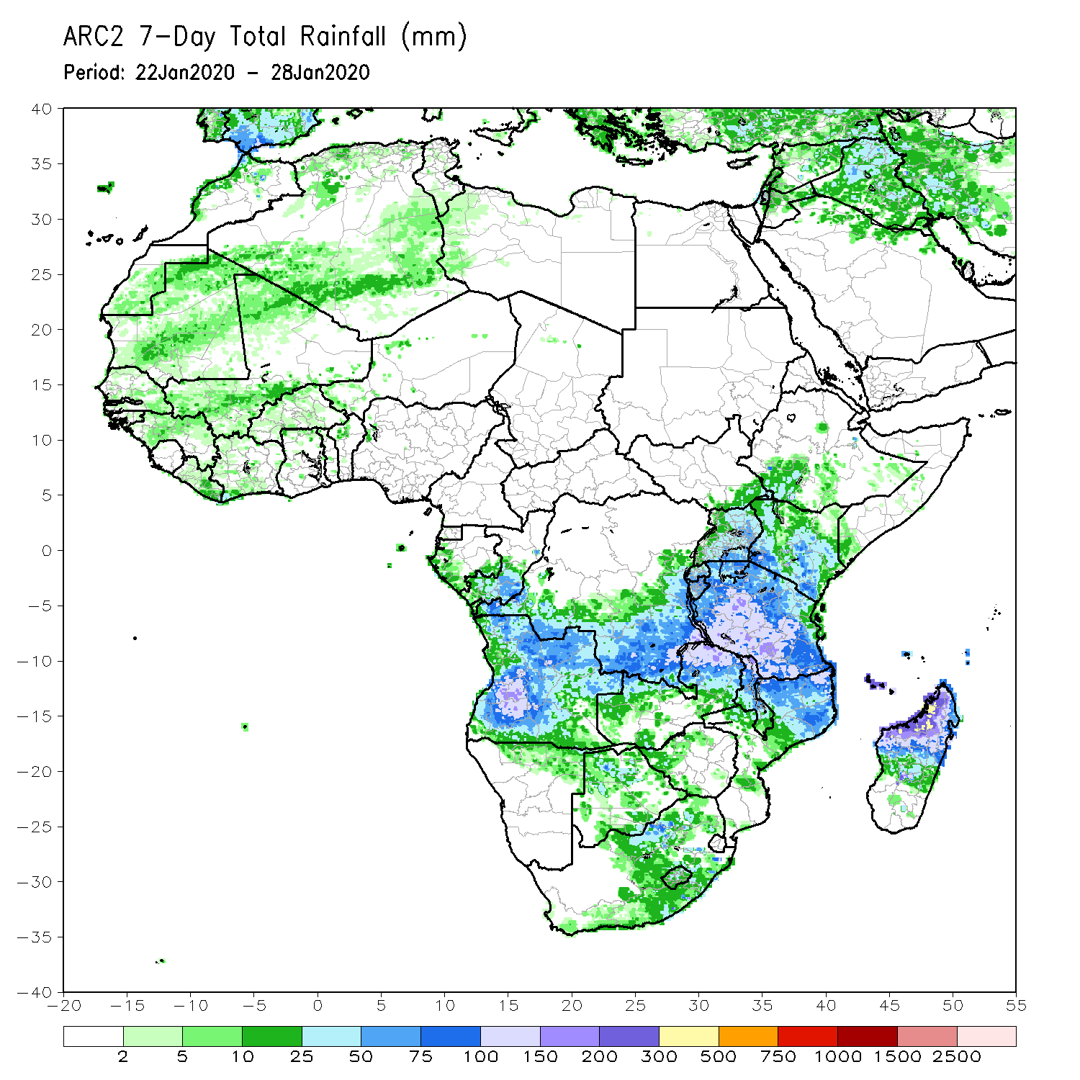
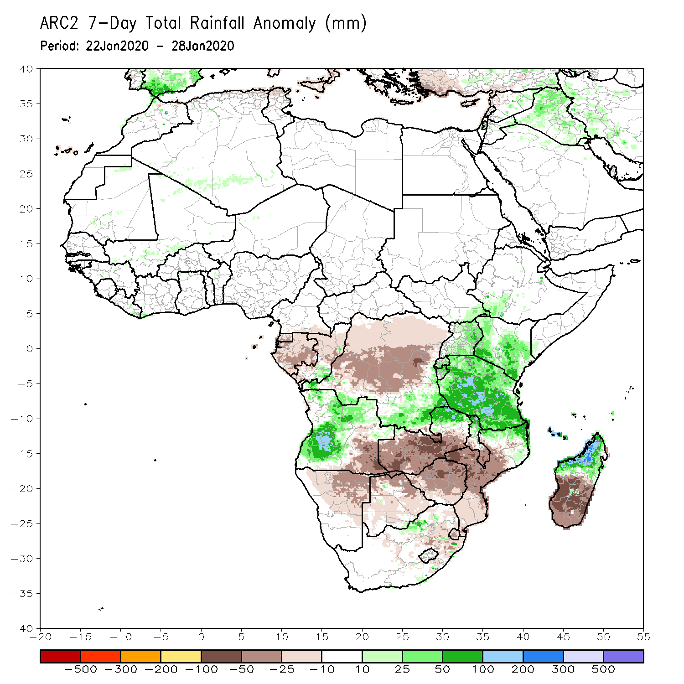
Rainfall Patterns: Last 7 Days
During the past 7 days, weekly rainfall totals exceeded 100mm over southwestern Angola, parts of Tanzania, local areas in northern Mozambique, northern Malawi and northern Madagascar, and northwestern Madagascar. Rainfall was above-average over local areas in Congo, parts of Angola, local areas in southern DRC and eastern Zambia, Uganda, Kenya, southwestern Ethiopia, Tanzania, and parts of northern Mozambique and northern Madagascar. Weekly rainfall surpluses exceeded 100mm over local areas in Angola and Tanzania.
Parts of DRC, eastern and southeastern Angola, Namibia, southern Zambia, Botswana, South Africa, Zimbabwe, southern Mozambique and much of Madagascar had below-average rainfall. Rainfall deficits exceeded 100mm over local areas in southern Zambia, northern Zimbabwe and western Mozambique, and many parts of Madagascar.

Slide 5
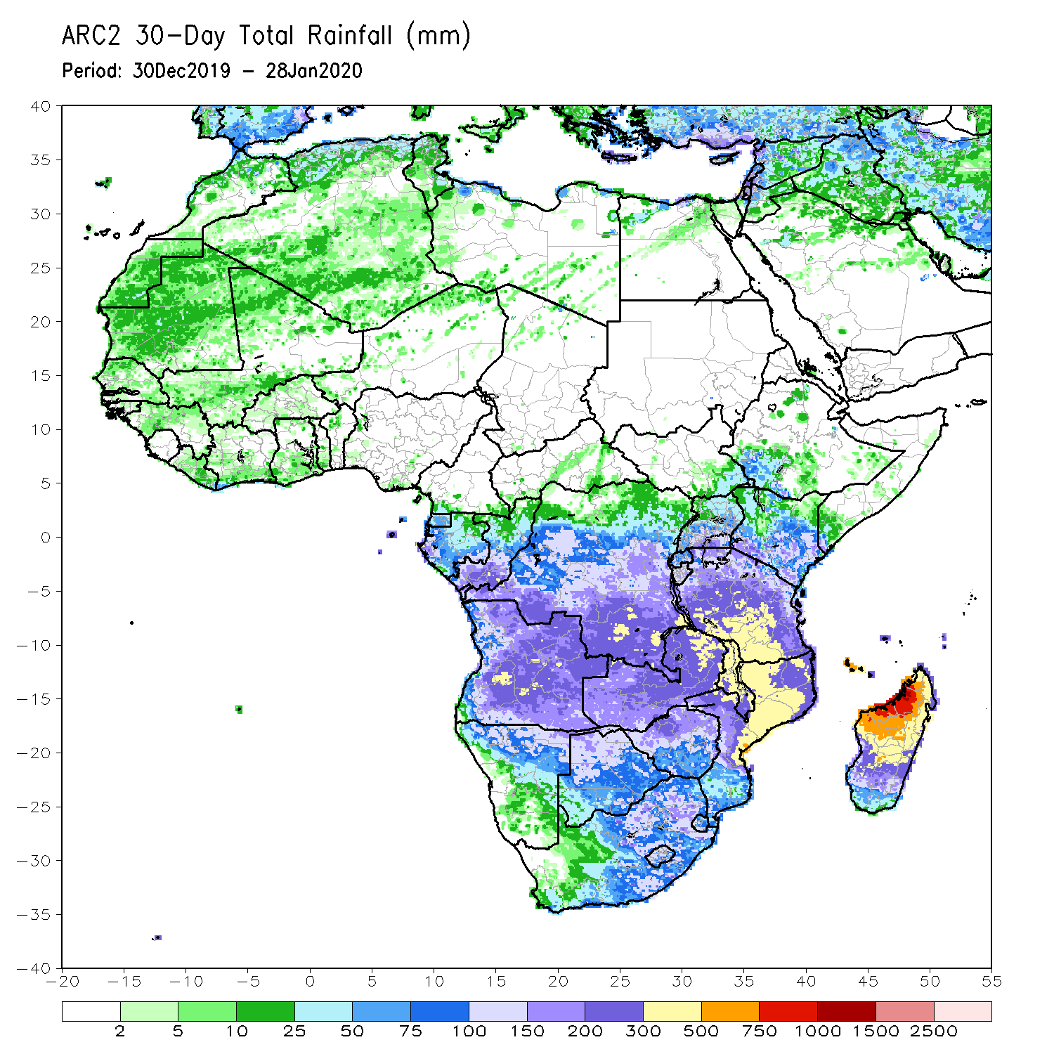
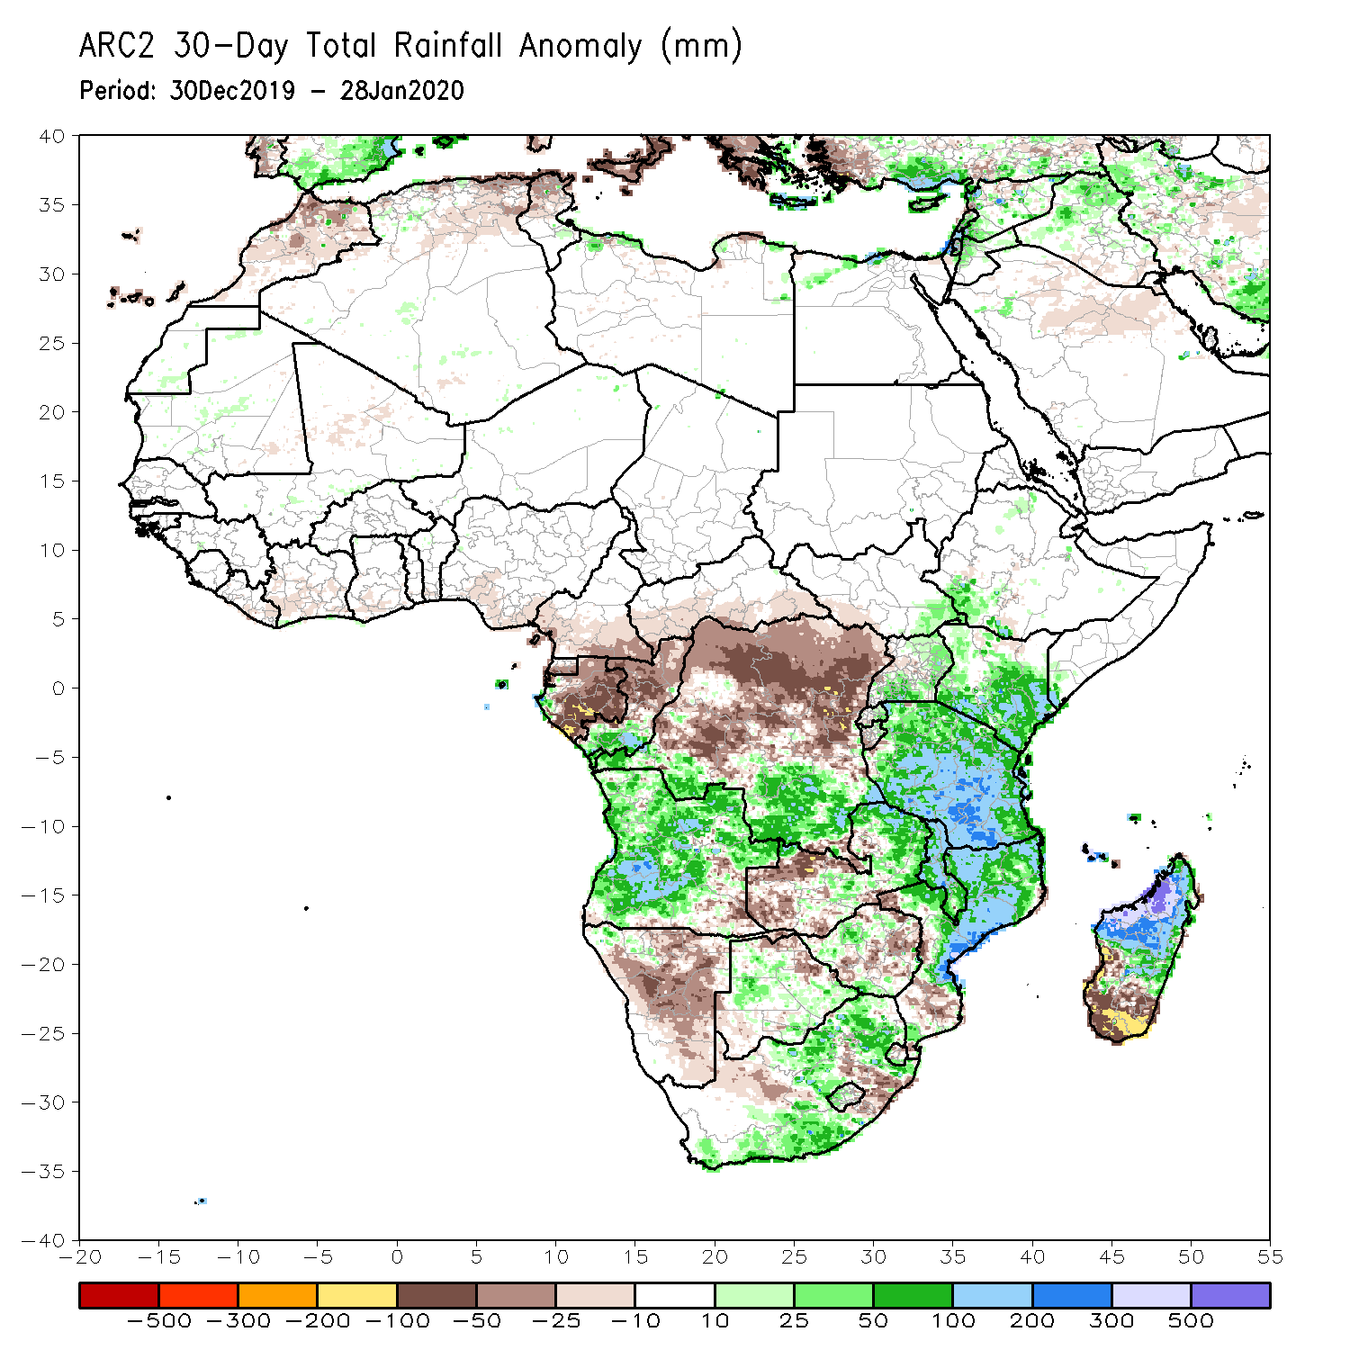
Rainfall Patterns: Last 30 Days
During the past 30 days, rainfall totals exceeded 300mm over local areas in Angola and DRC, eastern Zambia, Malawi, central and southern Tanzania, central and northern Mozambique and northern Madagascar, with rainfall totals in excess of 750mm observed over northwestern Madagascar. Rainfall was above-average over southern Congo, southern DRC, local areas in southwestern Ethiopia, Uganda, Kenya, Tanzania, many parts of Angola, parts of Zambia, Malawi, central and northern Mozambique, parts of South Africa, and northern Madagascar. Rainfall surpluses exceeded 300mm over northwestern Madagascar.
Equatorial Guinea, Gabon, northern Congo, central and northern DRC, parts of eastern and southern Angola, western Zambia, Zimbabwe, Namibia, local areas in Botswana and South Africa, parts of southern Mozambique and southern Madagascar had below-average rainfall. Rainfall deficits exceeded 200mm parts of southern Madagascar.
Notes:
5

Slide 6
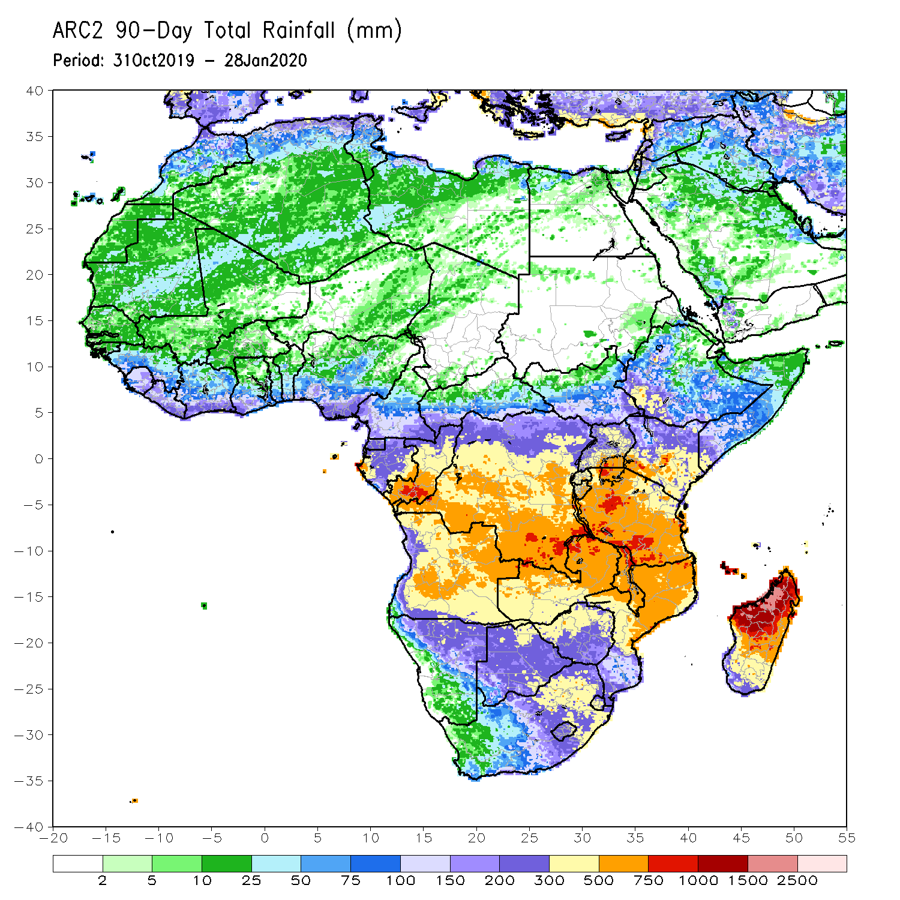
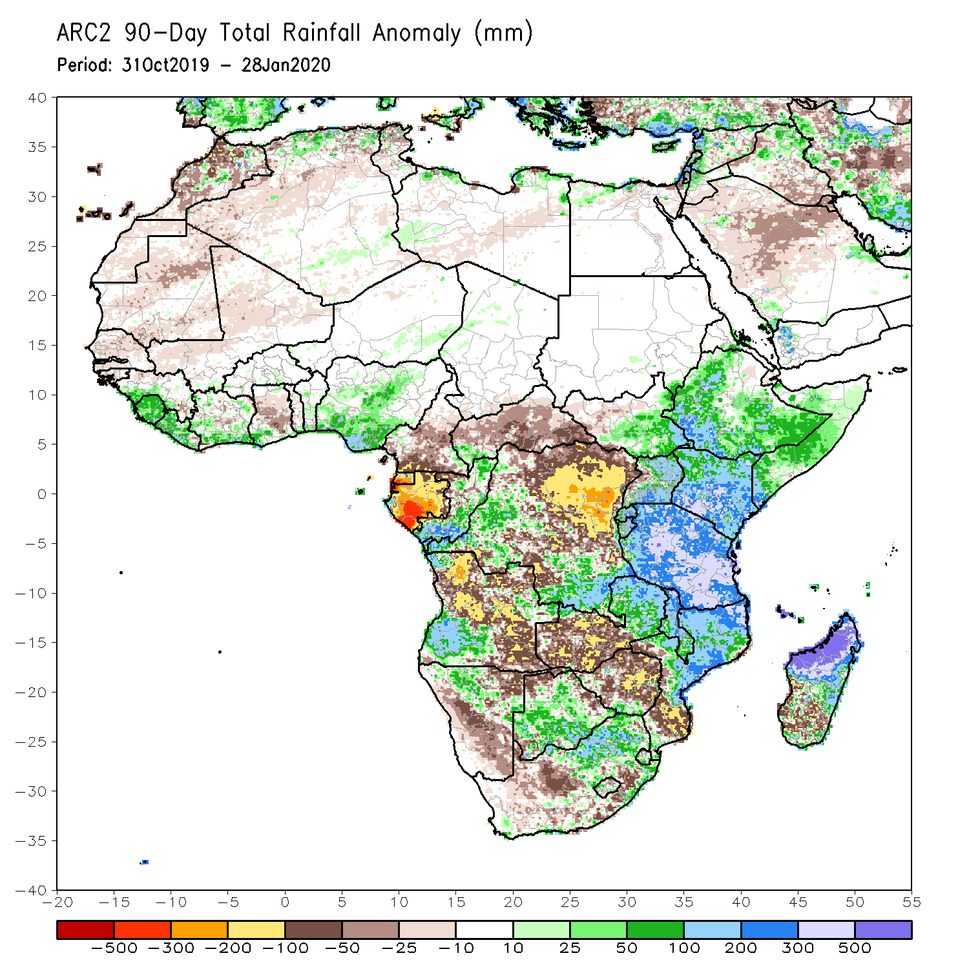
Rainfall Patterns: Last 90 Days
During the past 90 days, rainfall totals exceeded 750mm over parts of southern Congo, local areas in southern DRC, and Tanzania, and central and northern Madagascar. Rainfall was above-average over western Guinea, much of Sierra Leone, local areas in Liberia and Cote d’Ivoire, parts of southern Ghana, Nigeria, Congo, parts of western and southern DRC, South Sudan, Rwanda, Burundi, Uganda, Ethiopia, Kenya, Somalia, Tanzania, southwestern Angola, eastern Zambia, parts of Botswana, Malawi, northern South Africa, northern Mozambique, and central and northern Madagascar. Rainfall surpluses exceeded 500mm over northern Madagascar.
Many parts of Guinea, eastern Liberia, Cote d’Ivoire, Ghana, Togo, Benin, Cameroon, Equatorial Guinea, Gabon, CAR, many parts of DRC and Angola, western Zambia, Zimbabwe, Namibia, parts of Botswana, southern Mozambique, and parts of southern Madagascar and South Africa had below-average rainfall. Rainfall deficits exceeded 300mm over parts of Equatorial Guinea and Gabon.
Notes:
6

Slide 7
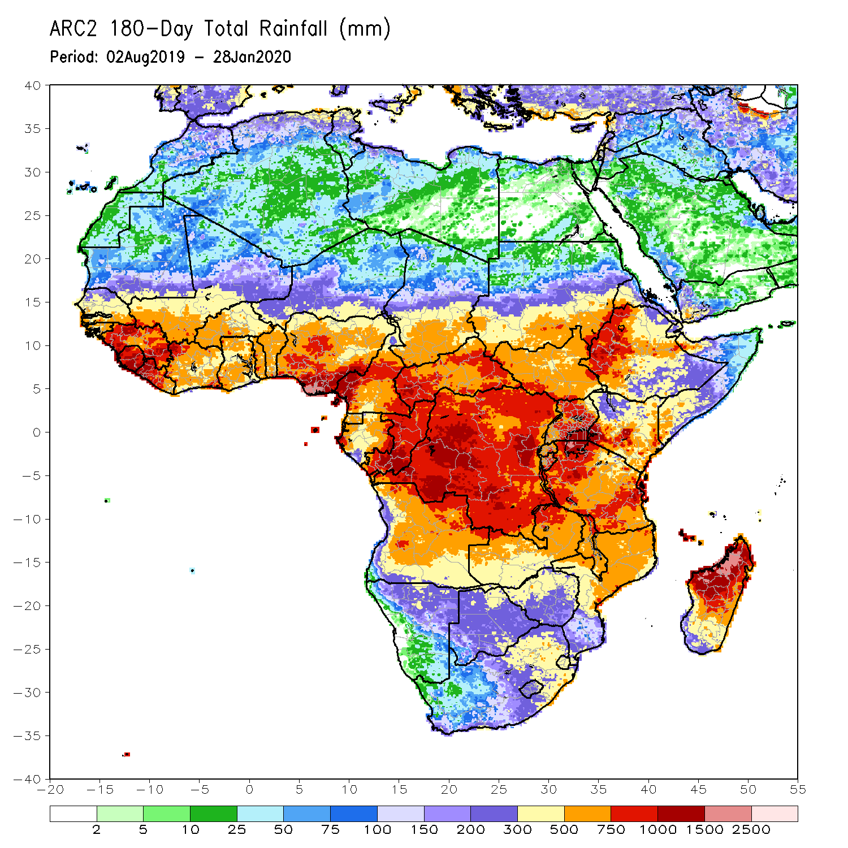
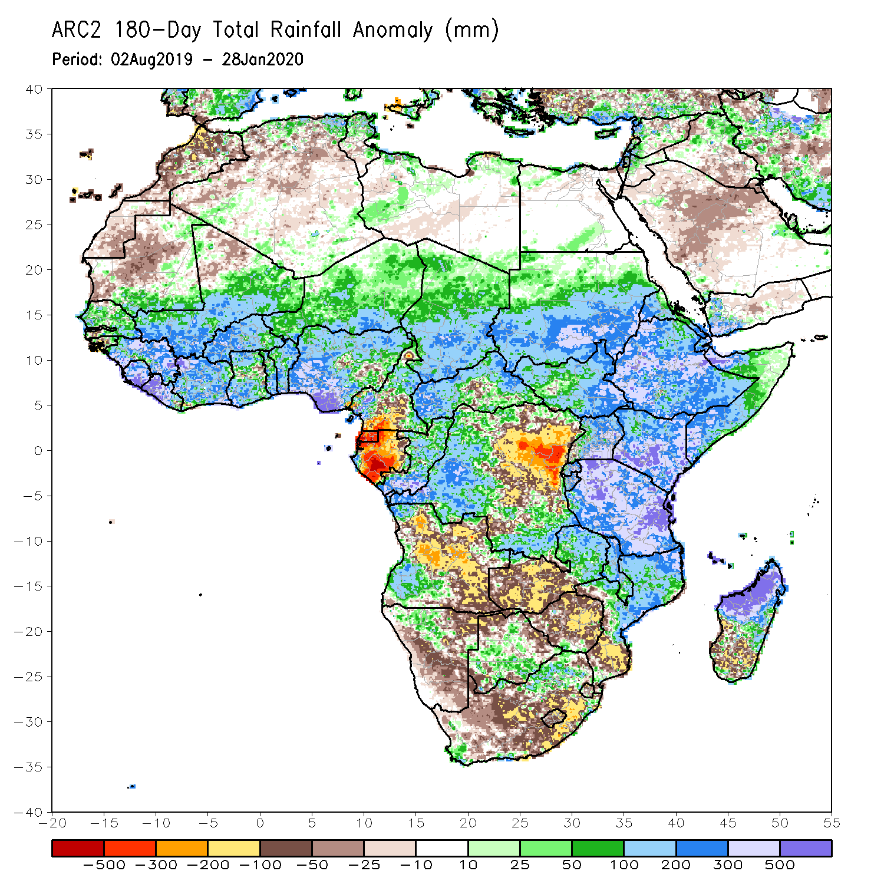
Rainfall Patterns: Last 180 Days
During the past 180 days, rainfall totals in excess of 1500mm were observed over parts of northern Madagascar. Southern Mauritania, much of Senegal, Guinea-Bissau, Guinea, Sierra Leone, Mali, Liberia, Cote d’Ivoire, Burkina Faso, Ghana, Togo, Benin, Nigeria, many parts of Cameroon, Niger, Chad, CAR, portions of DRC, South Sudan, Sudan, Uganda, Eritrea, Ethiopia, Somalia, Kenya, Tanzania, parts of Angola, northern Namibia, eastern Zambia, parts of Botswana, Malawi, northern South Africa, central and northern Mozambique and many parts of Madagascar had above-average rainfall. Rainfall surpluses exceeded 500mm over parts of Sierra Leone and Liberia, southern Nigeria, Kenya, Tanzania, and northern Madagascar.
Below-average rainfall was observed over portions of Cameroon, Equatorial Guinea, Gabon, parts of central and eastern DRC, many parts of Angola, parts of Namibia and South Africa, western Zambia, Zimbabwe, and southern Mozambique and southern Madagascar. Rainfall deficits exceeded 500mm over parts of Equatorial Guinea and Gabon.
Notes:
7

Slide 8
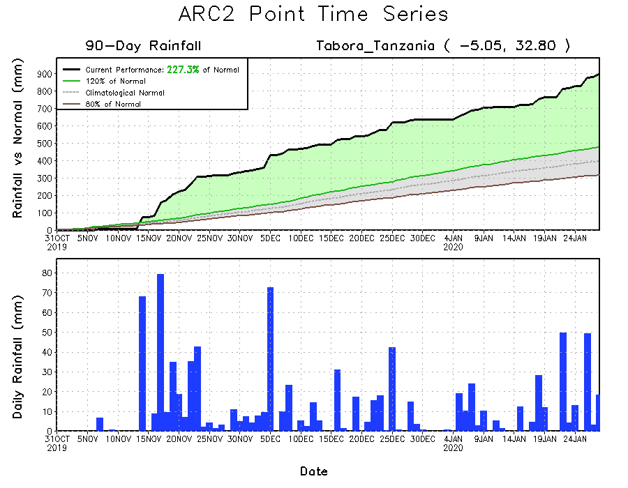
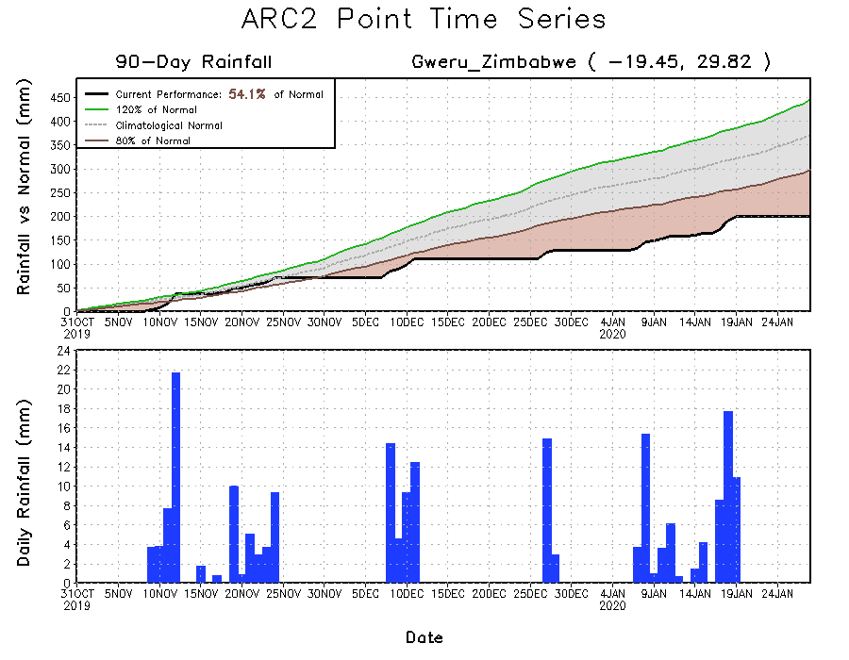
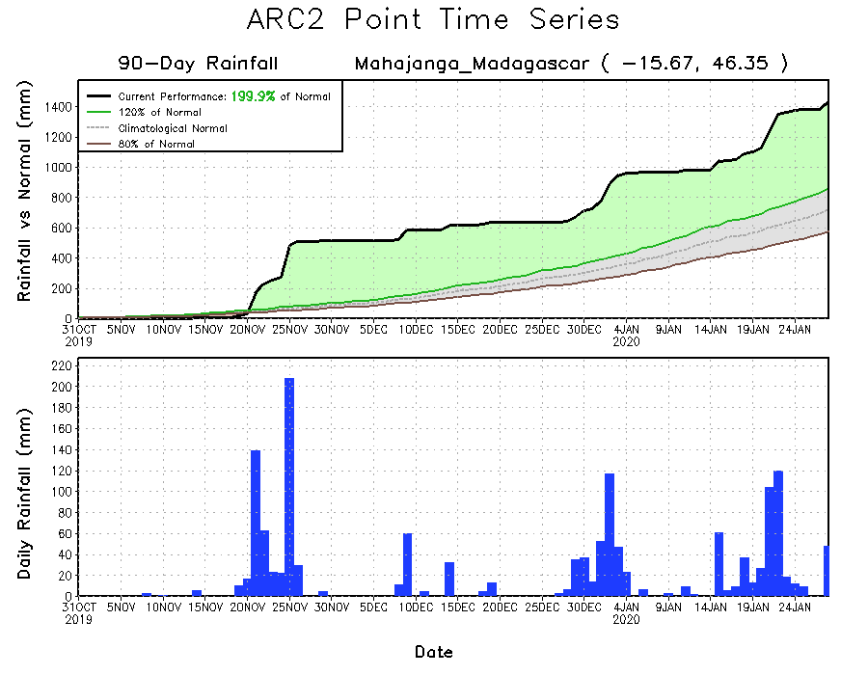
Recent Rainfall Evolution
Daily evolution of rainfall over the last 90 days at selected locations shows that moderate to locally heavy rainfall sustained moisture surpluses over many parts of Tanzania (top right) and northern Madagascar (bottom right). Seasonal total rainfall remained below-average over parts of Zimbabwe (bottom left).

Slide 9
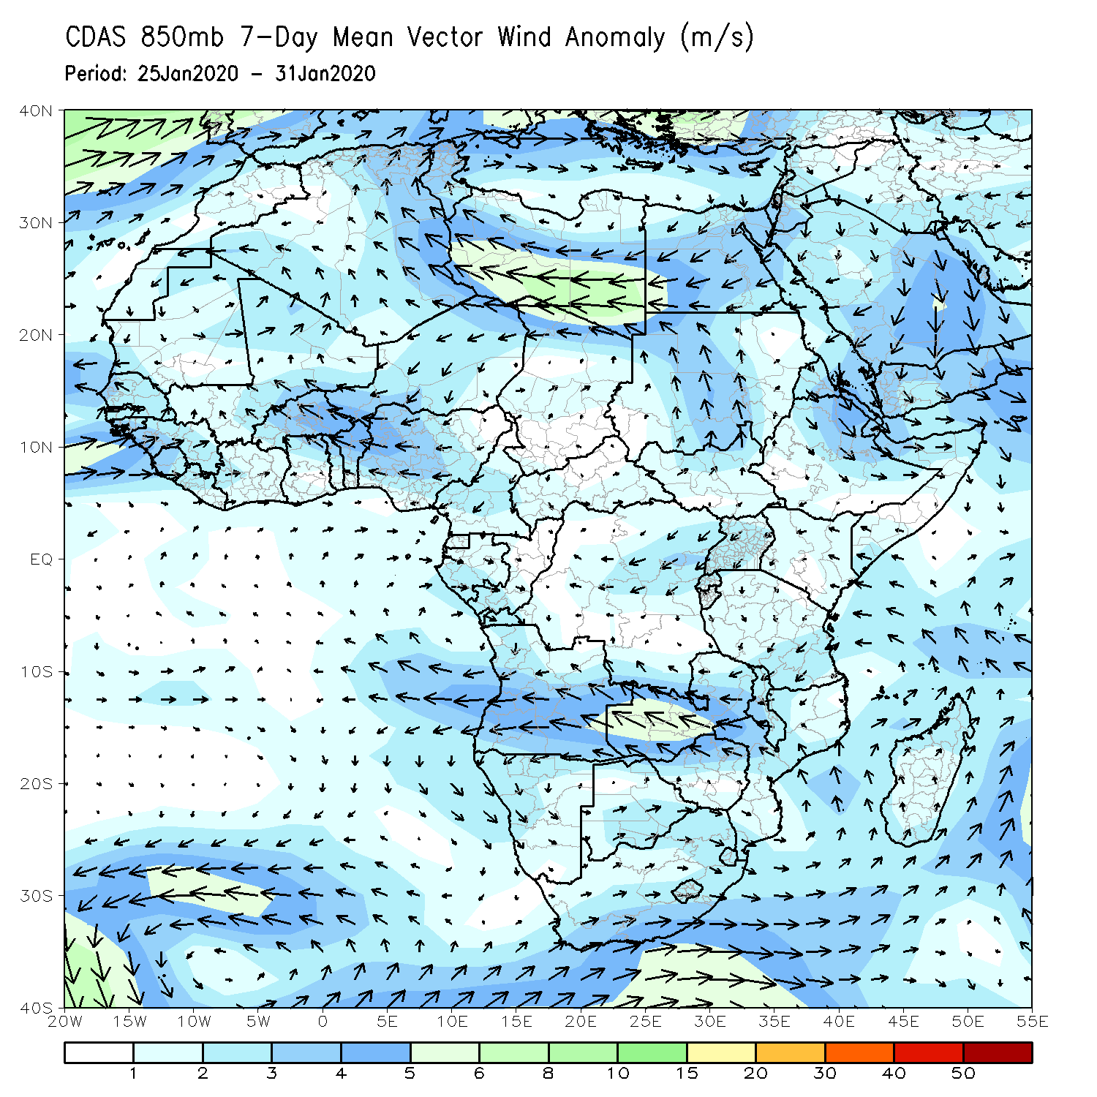
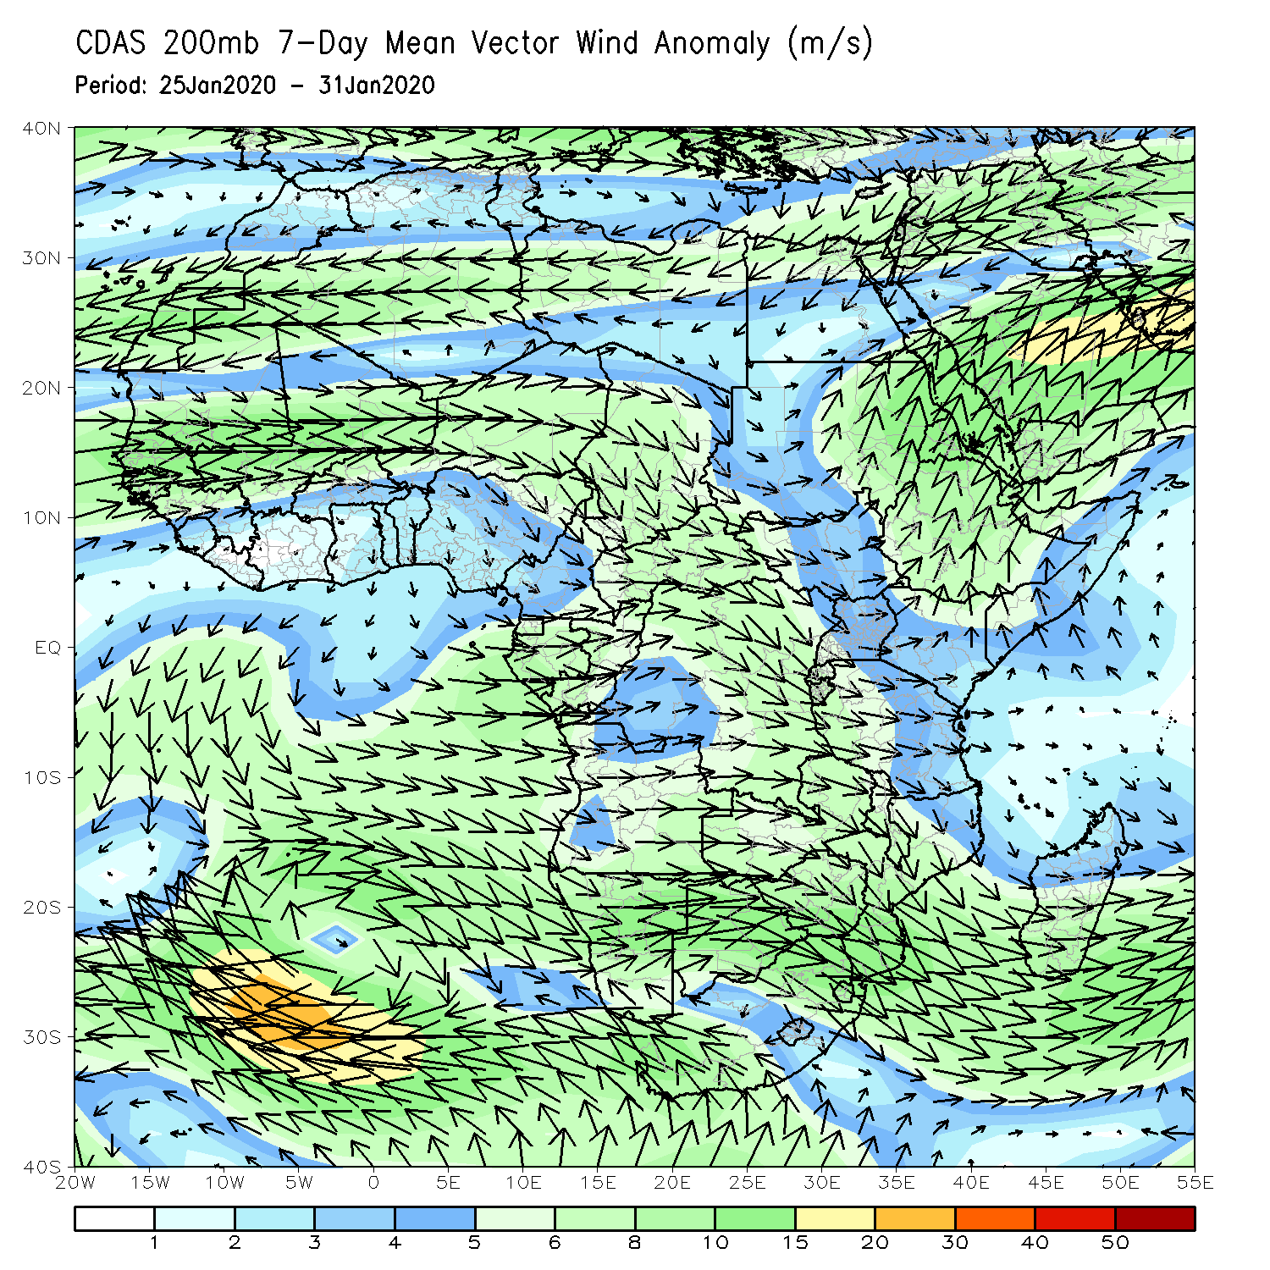
Atmospheric Circulation: Last 7 Days
An area of anomalous lower-level anti-cyclonic flow and upper-level cyclonic flow may have contributed to the observed suppressed rainfall across Southern Africa .

Slide 10
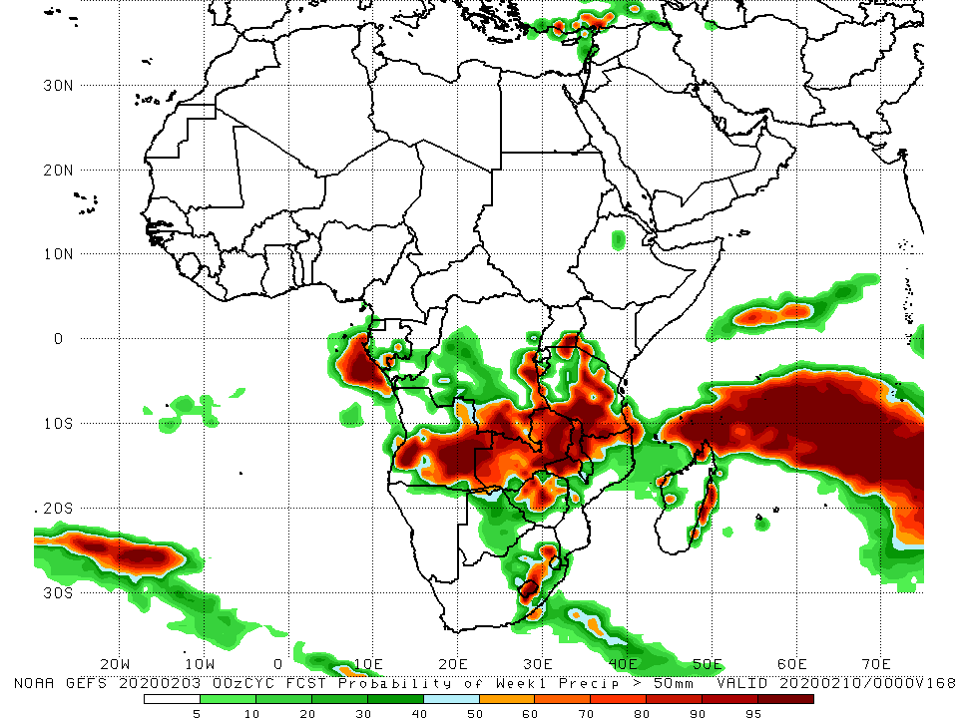
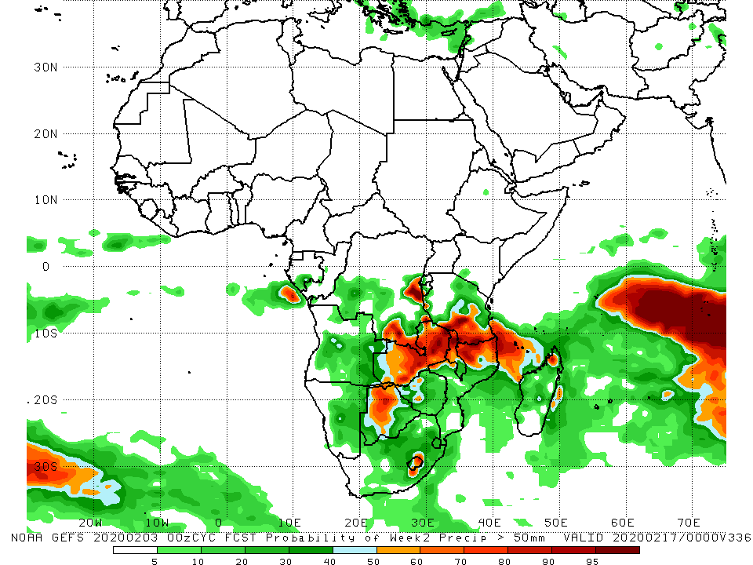
NCEP GEFS Model Forecasts Non-Bias Corrected Probability of precipitation exceedance
Week-1: Valid 4 – 10 February, 2020
Week-2: Valid 11 – 17 February, 2020
For week-1 (left panel), there is an increased chance for weekly rainfall totals to exceed 50mm across southern and eastern Angola, parts of southern and eastern DRC, Zambia, Malawi, southeastern Uganda, many parts of Tanzania, Zimbabwe, northern Mozambique, and local areas in South Africa and Madagascar. For week-2 (right panel), there is an increased chance for weekly rainfall totals to exceed 50mm parts of southern and eastern DRC, western Botswana, Zambia, Malawi, southern Tanzania, northern Mozambique, and local areas in South Africa and Madagascar.
Notes:
10

Slide 11
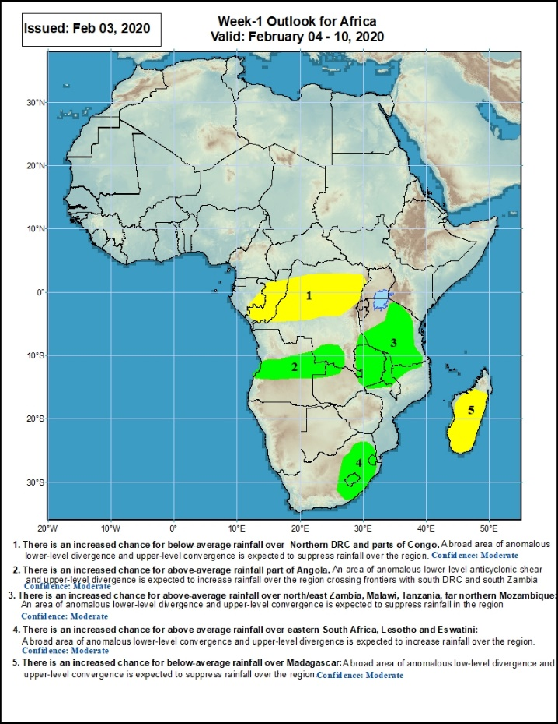
Week-1 Precipitation Outlooks
4 - 10 February, 2020
There is an increased chance for below-average rainfall over much of Congo and northern DRC: An area of anomalous lower-level divergence and upper-level convergence is expected to suppress rainfall in the region. Confidence: Moderate
There is an increased chance for above-average rainfall parts of Angola: An area of anomalous lower-level convergence and upper-level divergence is expected to enhance rainfall in the region. Confidence: Moderate
There is an increased chance for above-average rainfall over northeastern Zambia, Malawi, Tanzania, and far northern Mozambique: An area of anomalous lower-level convergence and upper-level divergence is expected to enhance rainfall in the region. Confidence: Moderate
There is an increased chance for above-average rainfall over eastern South Africa, Lesotho and Eswatini: An area of anomalous lower-level convergence and upper-level divergence is expected to enhance rainfall in the region. Confidence: Moderate
There is an increased chance for below-average rainfall over much of Madagascar: An area of anomalous lower-level divergence and upper-level convergence is expected to suppress rainfall in the region. Confidence: Moderate
Notes:
11

Slide 12
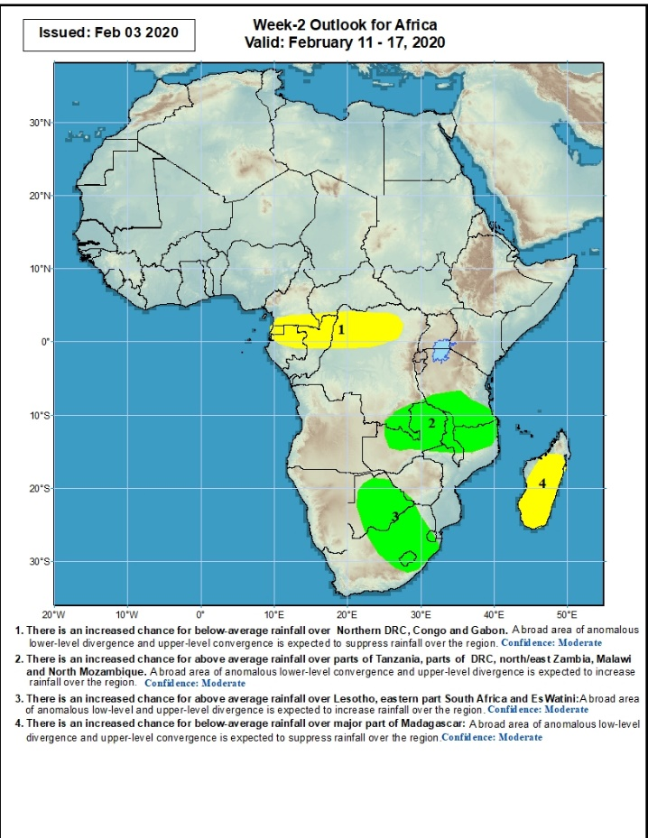
Week-2 Precipitation Outlooks
11 - 17 February, 2020
There is an increased chance for below-average rainfall over southern Cameroon, Equatorial Guinea, northern Gabon, northern Congo and northern DRC: An area of anomalous lower-level divergence and upper-level convergence is expected to suppress rainfall in the region. Confidence: Moderate
There is an increased chance for above-average rainfall over parts of southern DRC, northern and eastern Zambia, Malawi, southern Tanzania and northern Mozambique: An area of anomalous lower-level convergence and upper-level divergence is expected to enhance rainfall in the region. Confidence: Moderate
There is an increased chance for above-average rainfall over Botswana, eastern South Africa, Lesotho and Eswatini: An area of anomalous lower-level convergence and upper-level divergence is expected to enhance rainfall in the region. Confidence: Moderate
There is an increased chance for below-average rainfall over much of Madagascar: An area of anomalous lower-level divergence and upper-level convergence is expected to suppress rainfall in the region. Confidence: Moderate
Notes:
12

Slide 13
Summary
During the past 7 days, weekly rainfall totals exceeded 100mm over southwestern Angola, parts of Tanzania, local areas in northern Mozambique, northern Malawi and northern Madagascar, and northwestern Madagascar. Rainfall was above-average over local areas in Congo, parts of Angola, local areas in southern DRC and eastern Zambia, Uganda, Kenya, southwestern Ethiopia, Tanzania, and parts of northern Mozambique and northern Madagascar. Weekly rainfall surpluses exceeded 100mm over local areas in Angola and Tanzania. Parts of DRC, eastern and southeastern Angola, Namibia, southern Zambia, Botswana, South Africa, Zimbabwe, southern Mozambique and much of Madagascar had below-average rainfall. Rainfall deficits exceeded 100mm over local areas in southern Zambia, northern Zimbabwe and western Mozambique, and many parts of Madagascar.
During the past 30 days, rainfall totals exceeded 300mm over local areas in Angola and DRC, eastern Zambia, Malawi, central and southern Tanzania, central and northern Mozambique and northern Madagascar, with rainfall totals in excess of 750mm observed over northwestern Madagascar. Rainfall was above-average over southern Congo, southern DRC, local areas in southwestern Ethiopia, Uganda, Kenya, Tanzania, many parts of Angola, parts of Zambia, Malawi, central and northern Mozambique, parts of South Africa, and northern Madagascar. Rainfall surpluses exceeded 300mm over northwestern Madagascar. Equatorial Guinea, Gabon, northern Congo, central and northern DRC, parts of eastern and southern Angola, western Zambia, Zimbabwe, Namibia, local areas in Botswana and South Africa, parts of southern Mozambique and southern Madagascar had below-average rainfall. Rainfall deficits exceeded 200mm parts of southern Madagascar.
During the past 90 days, rainfall totals exceeded 750mm over parts of southern Congo, local areas in southern DRC, and Tanzania, and central and northern Madagascar. Rainfall was above-average over western Guinea, much of Sierra Leone, local areas in Liberia and Cote d’Ivoire, parts of southern Ghana, Nigeria, Congo, parts of western and southern DRC, South Sudan, Rwanda, Burundi, Uganda, Ethiopia, Kenya, Somalia, Tanzania, southwestern Angola, eastern Zambia, parts of Botswana, Malawi, northern South Africa, northern Mozambique, and central and northern Madagascar. Rainfall surpluses exceeded 500mm over northern Madagascar. Many parts of Guinea, eastern Liberia, Cote d’Ivoire, Ghana, Togo, Benin, Cameroon, Equatorial Guinea, Gabon, CAR, many parts of DRC and Angola, western Zambia, Zimbabwe, Namibia, parts of Botswana, southern Mozambique, and parts of southern Madagascar and South Africa had below-average rainfall. Rainfall deficits exceeded 300mm over parts of Equatorial Guinea and Gabon.
Week-1 outlooks call for an increased chance for above-average rainfall over parts of Angola, southern DRC, portions of northern and eastern Zambia, Tanzania, Malawi, eastern South Africa, Lesotho and Eswatini. In contrast, there is an increased chance for below-average rainfall over Congo, northern DRC, and central and southern Madagascar.
Notes:
13

