Slide 1
The African Monsoon Recent Evolution and Current Status Include Week-1 and Week-2 Outlooks
Update prepared by
Climate Prediction Center / NCEP
27 January 2020
For more information, visit:
http://www.cpc.ncep.noaa.gov/products/Global_Monsoons/African_Monsoons/precip_monitoring.shtml

Slide 2
Outline
Highlights
Recent Evolution and Current Conditions
NCEP GEFS Forecasts
Summary

Slide 3
Highlights: Last 7 Days
Another week of moderate to locally heavy rainfall sustained moisture surpluses over portions of equatorial East Africa and southeastern Africa.
Week-1 outlooks call for an increased chance for above-average rainfall over parts of Angola, southern DRC, portions of northern and eastern Zambia, Tanzania, eastern Uganda, western Kenya and northern Madagascar. In contrast, there is an increased chance for below-average rainfall over parts of northern Congo, northern DRC, Botswana, Zimbabwe, southern Mozambique and southern Madagascar.

Slide 4
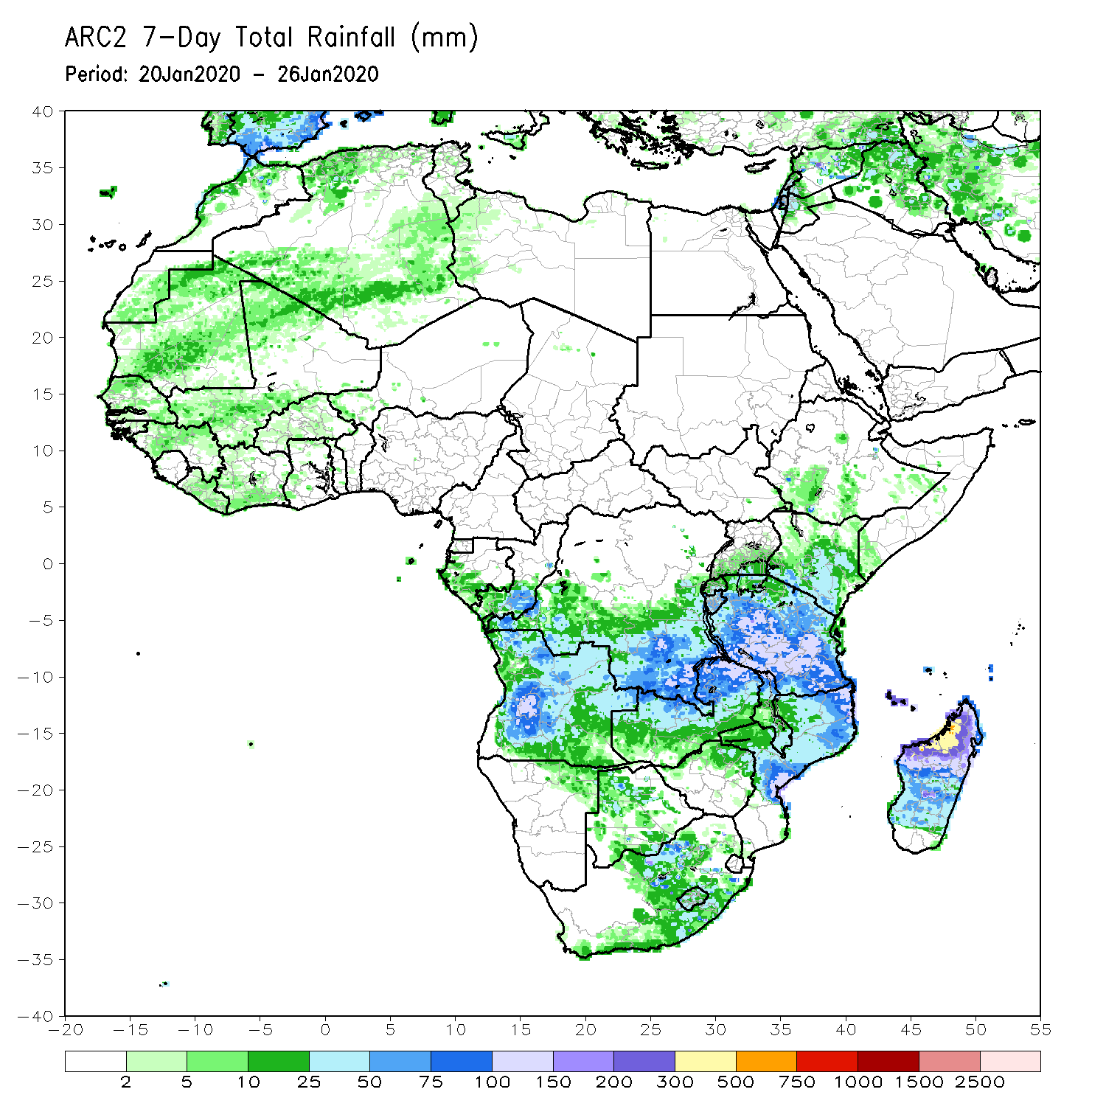
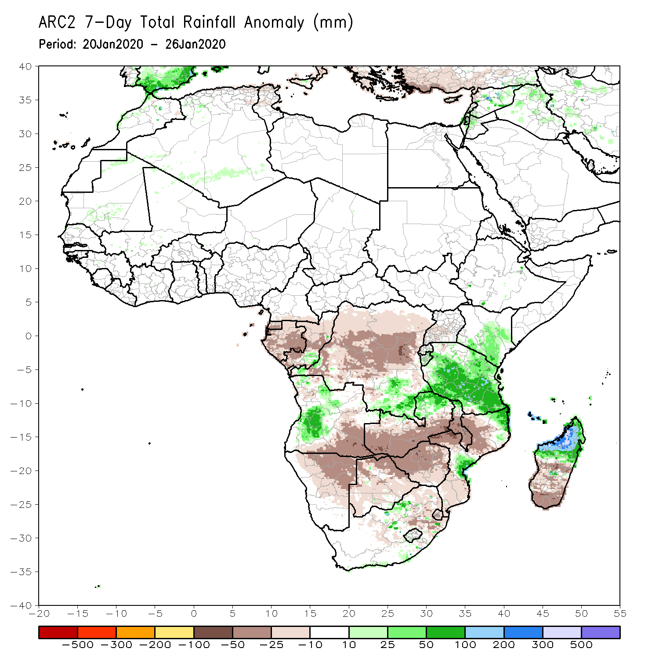
Rainfall Patterns: Last 7 Days
During the past 7 days, weekly rainfall totals exceeded 100mm over local areas in Angola, parts of Tanzania, central Mozambique and northern Madagascar. Rainfall was above-average over local areas in Congo, central Angola, parts of southern DRC and eastern Zambia, much of Tanzania, parts of Kenya, local areas in South Africa, central Mozambique and northern Madagascar. Weekly rainfall surpluses exceeded 100mm over parts of northeastern Madagascar.
Equatorial Guinea, Gabon, many parts of Congo and DRC, southeastern Angola, Botswana, Zimbabwe, western and southern Zambia, parts of South Africa, Malawi, parts of Mozambique and southern Madagascar had below-average rainfall.

Slide 5
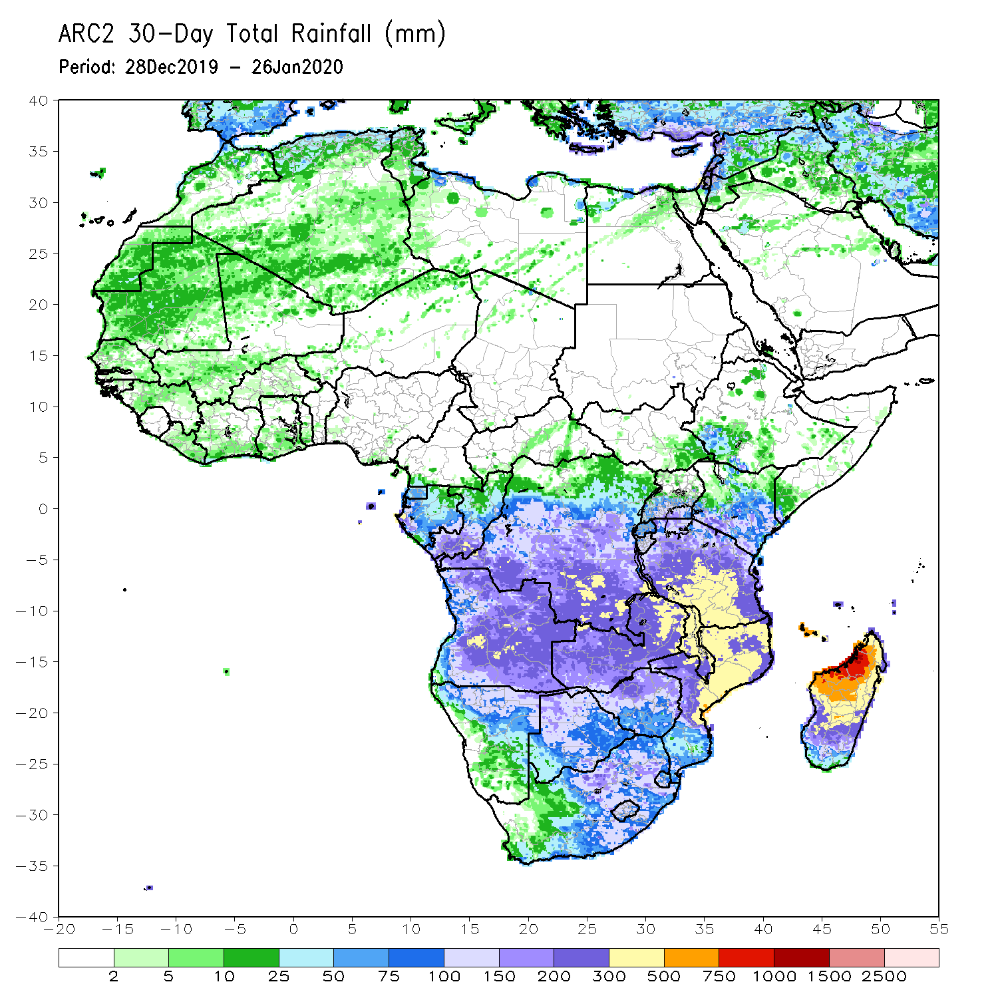
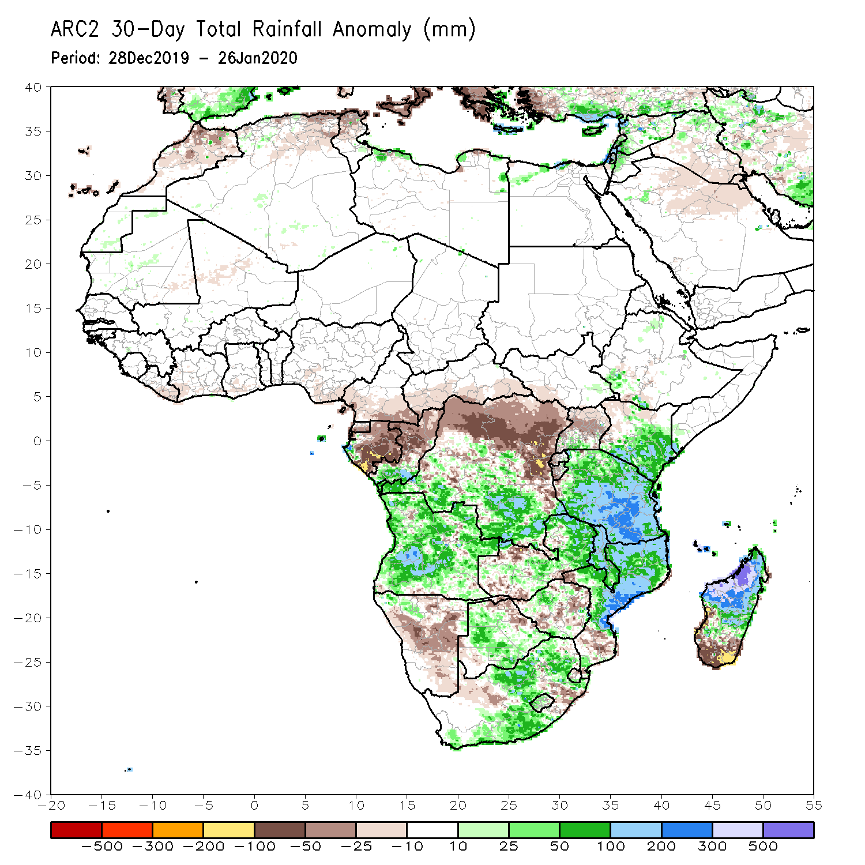
Rainfall Patterns: Last 30 Days
During the past 30 days, rainfall totals exceeded 300mm over local areas in Angola and DRC, eastern Zambia, Malawi, central and southern Tanzania, central and northern Mozambique and northern Madagascar, with rainfall totals in excess of 750mm observed over northwestern Madagascar. Rainfall was above-average over southern Congo, central and southern DRC, local areas in southwestern Ethiopia, southwestern Uganda, southern Kenya, Tanzania, Angola, northern Namibia, Botswana, many parts of Zambia, Malawi, central and northern Mozambique, many parts of South Africa and Madagascar. Rainfall surpluses exceeded 300mm over northern Madagascar.
Equatorial Guinea, Gabon, northern Congo, northern and eastern DRC, Rwanda, Burundi, local areas in northern Zambia and Zimbabwe, portions of Namibia, local areas in Botswana, parts of southern Mozambique and southern Madagascar had below-average rainfall.
Notes:
5

Slide 6
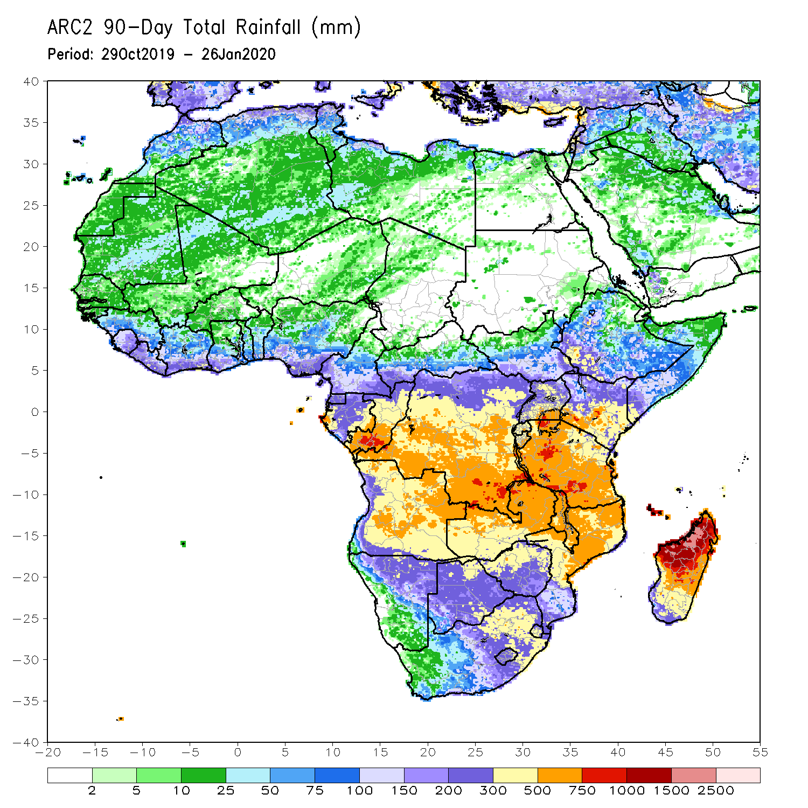
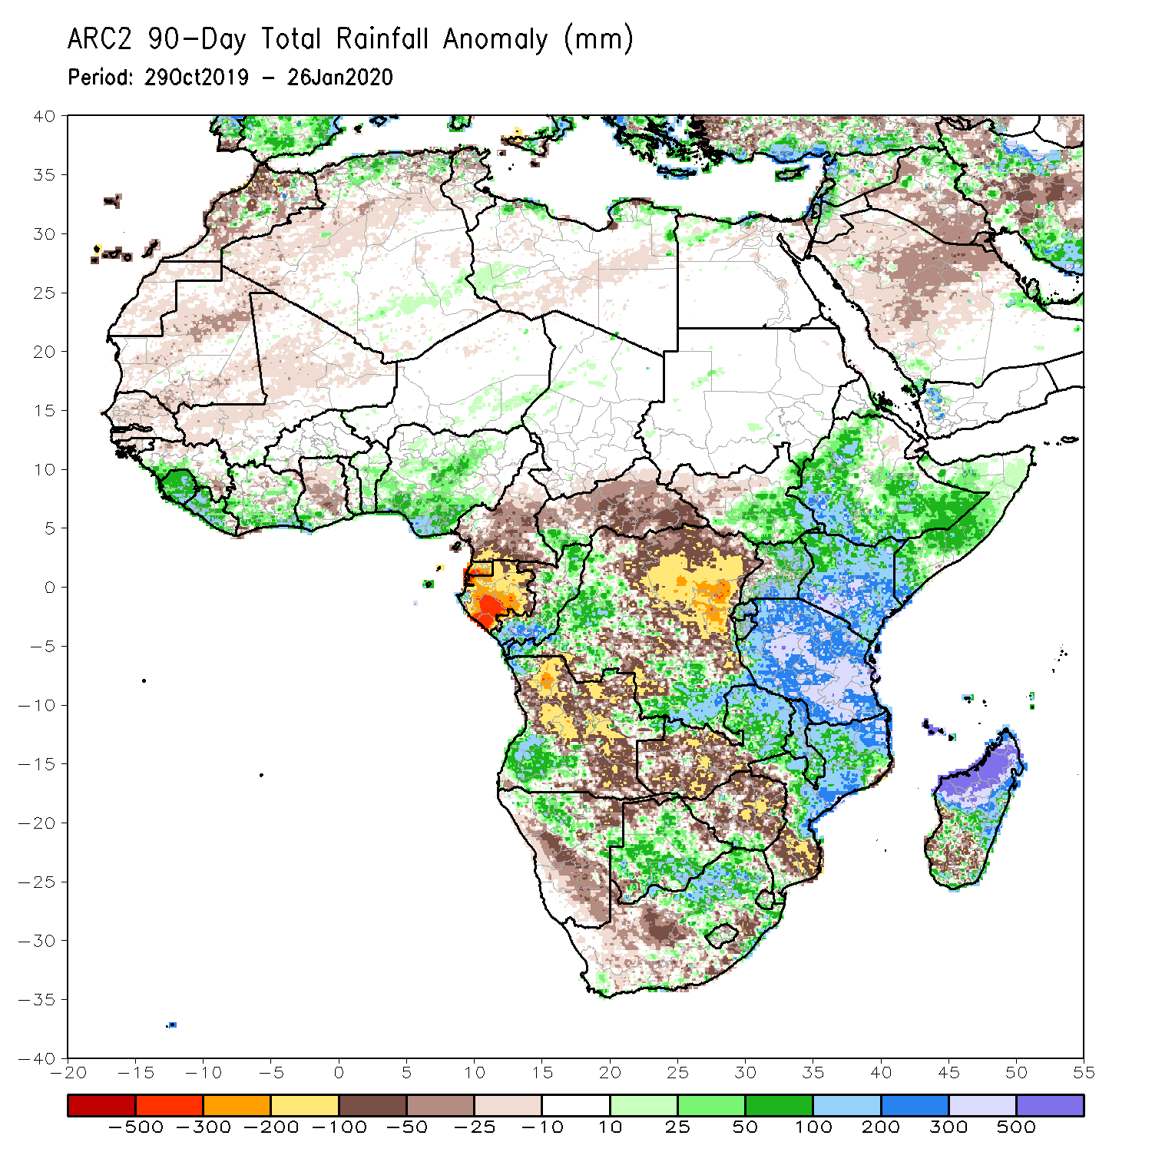
Rainfall Patterns: Last 90 Days
During the past 90 days, rainfall totals exceeded 750mm over parts of southern Congo, local areas in southern DRC, Kenya and Tanzania, and central and northern Madagascar. Rainfall was above-average over local areas in Guinea, much of Sierra Leone, Liberia, Cote d’Ivoire, parts of Ghana, Benin, Nigeria, southwestern CAR, western and southern DRC, eastern South Sudan, Rwanda, Burundi, Uganda, Ethiopia, Kenya, Somalia, Tanzania, southwestern Angola, eastern Zambia, parts of Namibia, Botswana, Malawi, northern South Africa, northern Mozambique, and central and northern Madagascar. Rainfall surpluses exceeded 500mm over northern Madagascar.
Much of Guinea, southern Cameroon, Equatorial Guinea, Gabon, eastern CAR, portions DRC and Angola, western Zambia, Zimbabwe, parts of Namibia, local areas in Botswana, southern Mozambique, and parts of southern Madagascar and South Africa had below-average rainfall.
Notes:
6

Slide 7
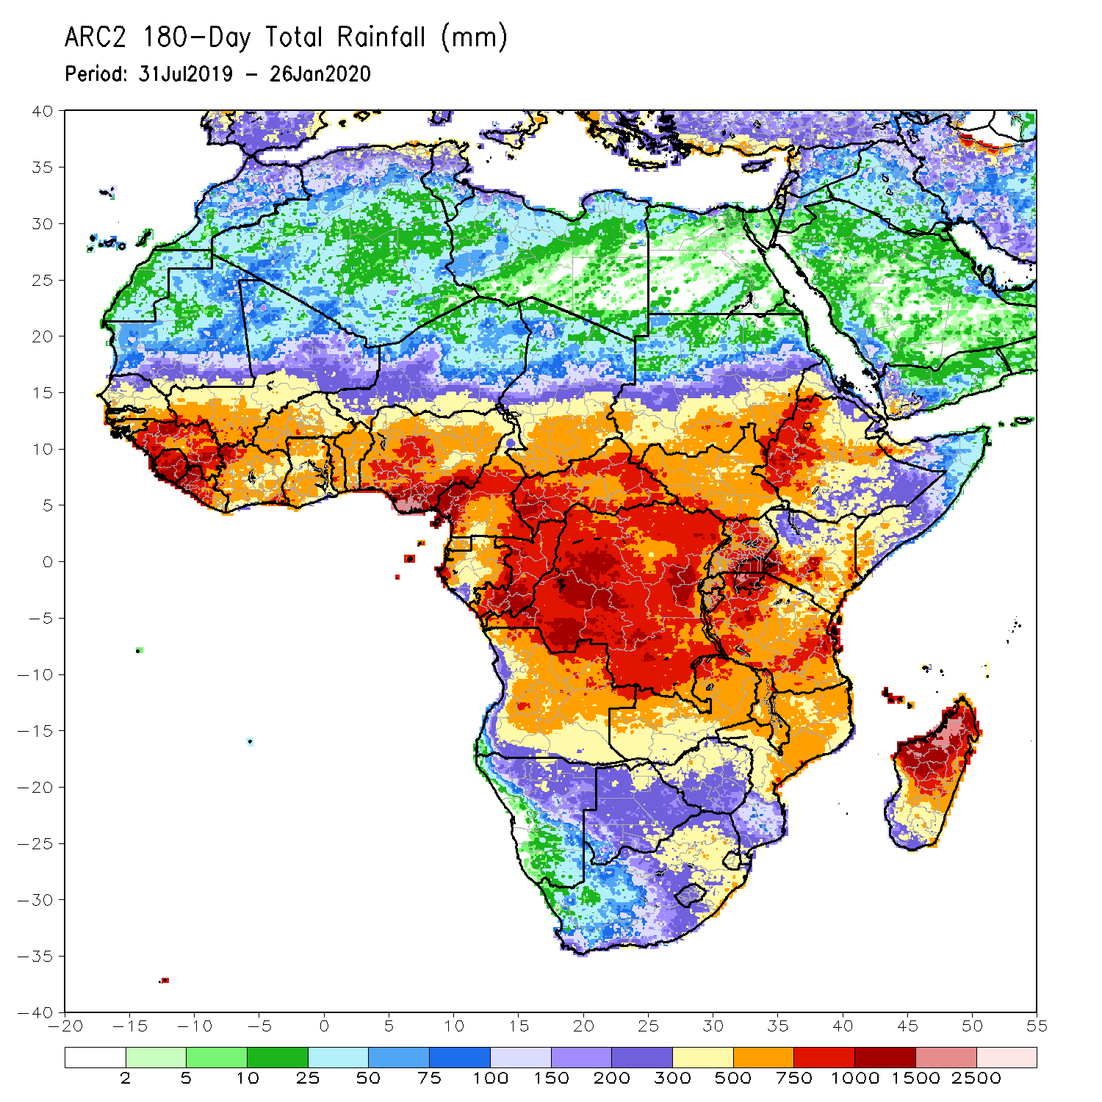
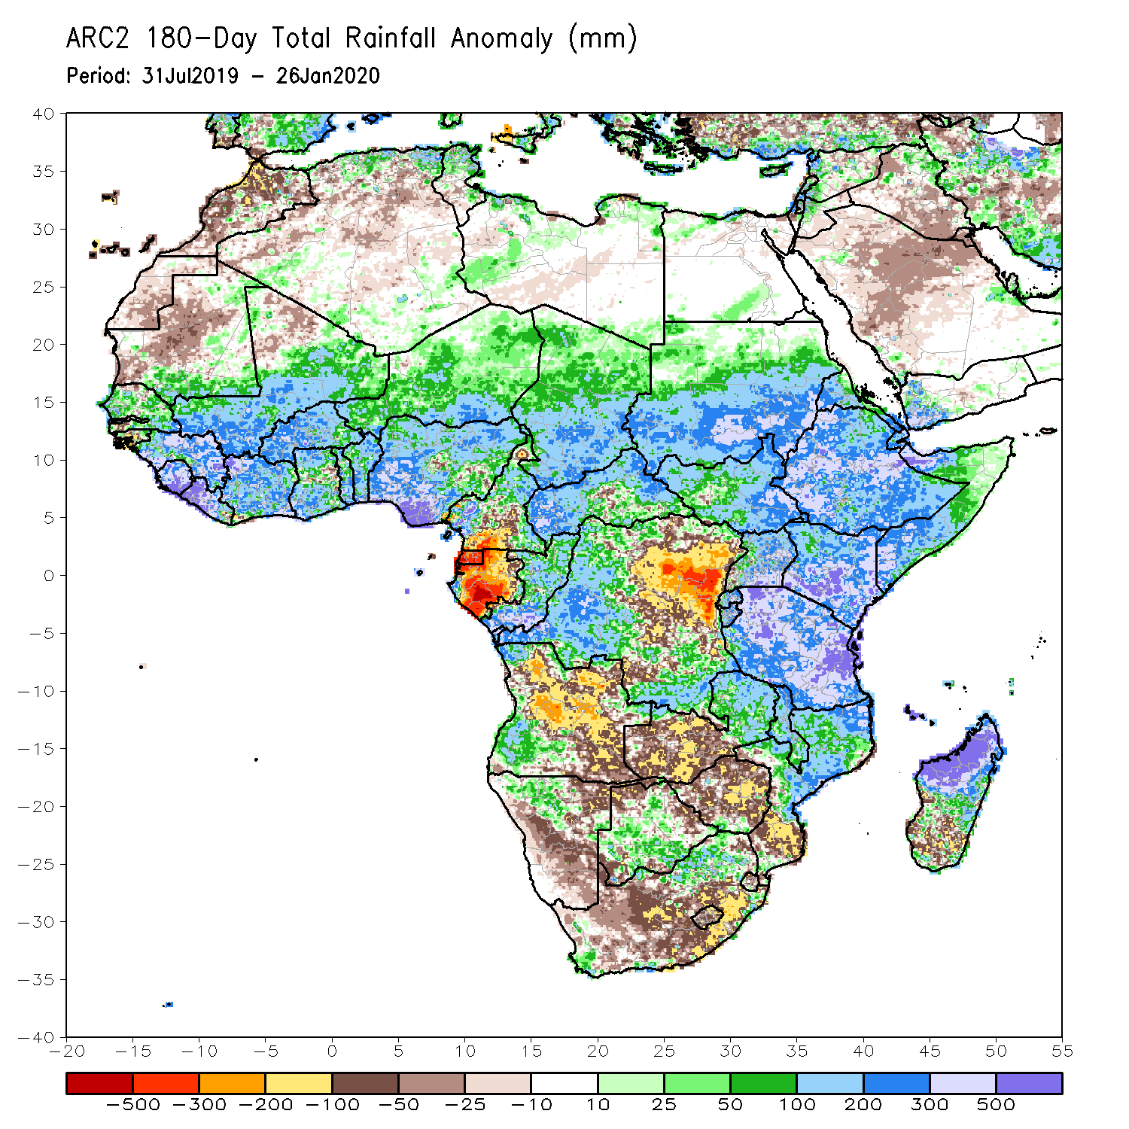
Rainfall Patterns: Last 180 Days
During the past 180 days, rainfall totals in excess of 1500mm were observed over Parts of northern Madagascar. Southern Mauritania, much of Senegal, Guinea-Bissau, Guinea, Sierra Leone, Mali, Liberia, Cote d’Ivoire, Burkina Faso, Ghana, Togo, Benin, Nigeria, many parts of Cameroon, Niger, Chad, CAR, portions of DRC, South Sudan, Sudan, Uganda, Eritrea, Ethiopia, Somalia, Kenya, Tanzania, parts of Angola, northern Namibia, eastern Zambia, much of Botswana, Malawi, northern South Africa, central and northern Mozambique and many parts of Madagascar had above-average rainfall. Rainfall surpluses exceeded 500mm over parts of Sierra Leone and Liberia, southern Nigeria, Kenya, Tanzania, and northern Madagascar.
Below-average rainfall was observed over portions of southern Cameroon, Equatorial Guinea, Gabon, parts of central and eastern DRC, many parts of Angola, parts of Namibia and South Africa, western Zambia, Zimbabwe, and southern Mozambique and southern Madagascar.
Notes:
7

Slide 8
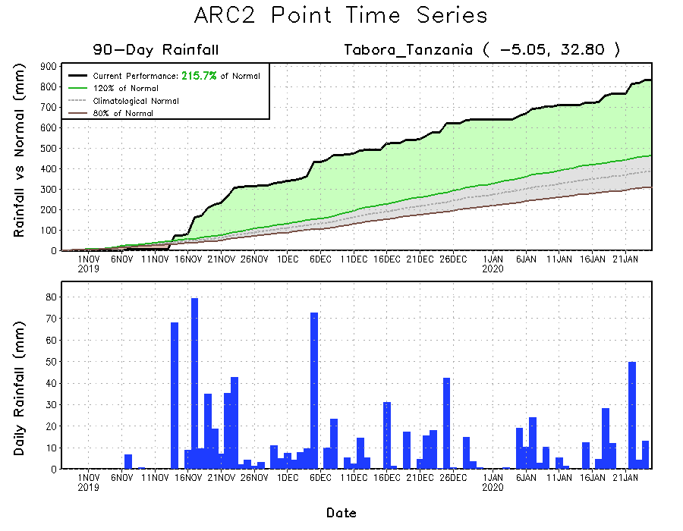
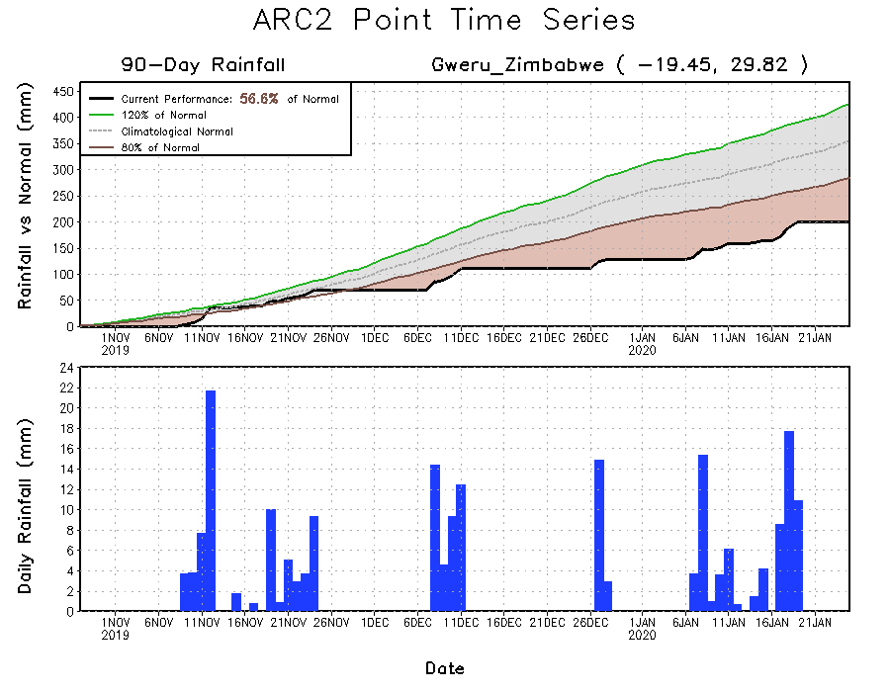
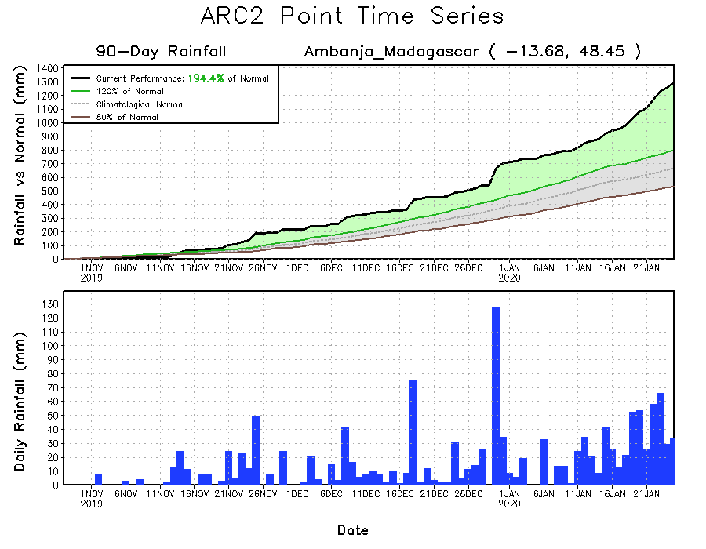
Recent Rainfall Evolution
Daily evolution of rainfall over the last 90 days at selected locations shows that moderate to locally heavy rainfall sustained moisture surpluses over many parts of Tanzania (top right) and northern Madagascar (bottom right). Seasonal total rainfall remained below-average over parts of Zimbabwe (bottom left).

Slide 9
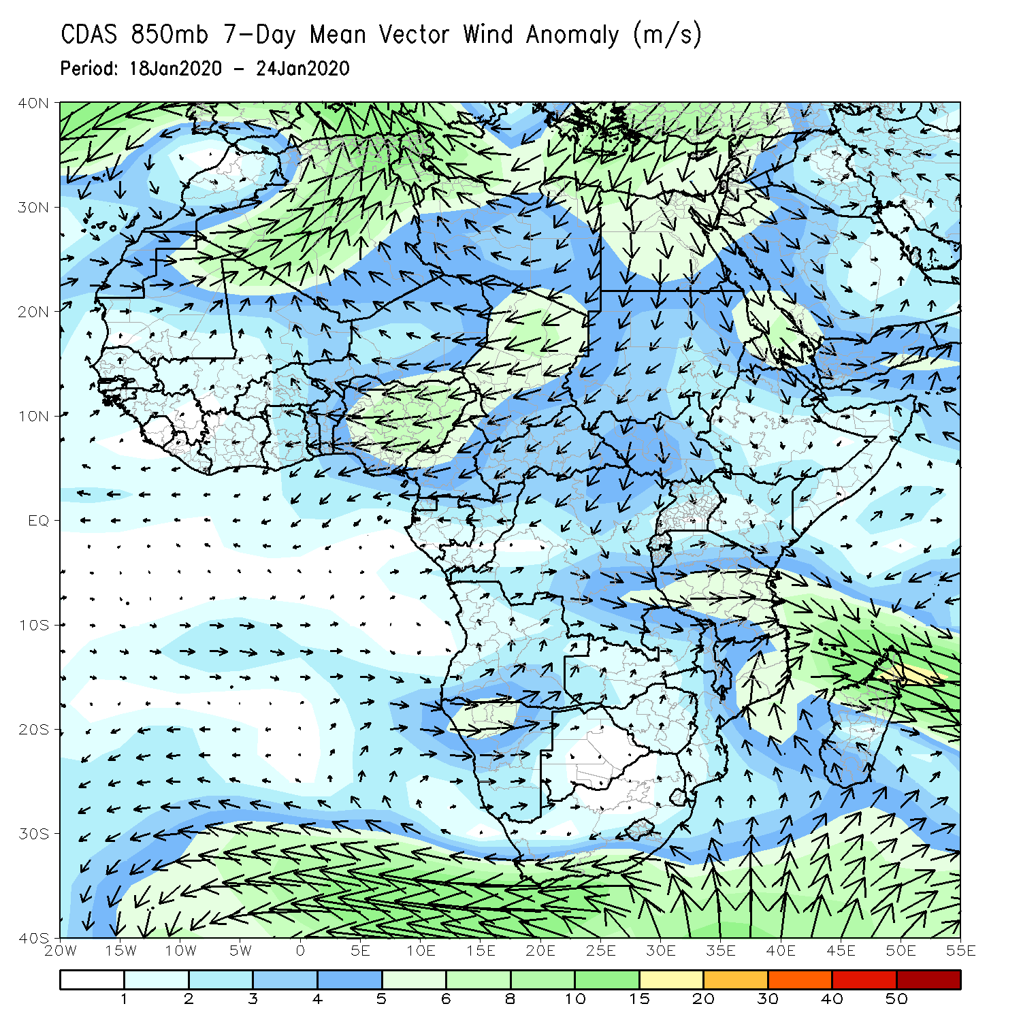
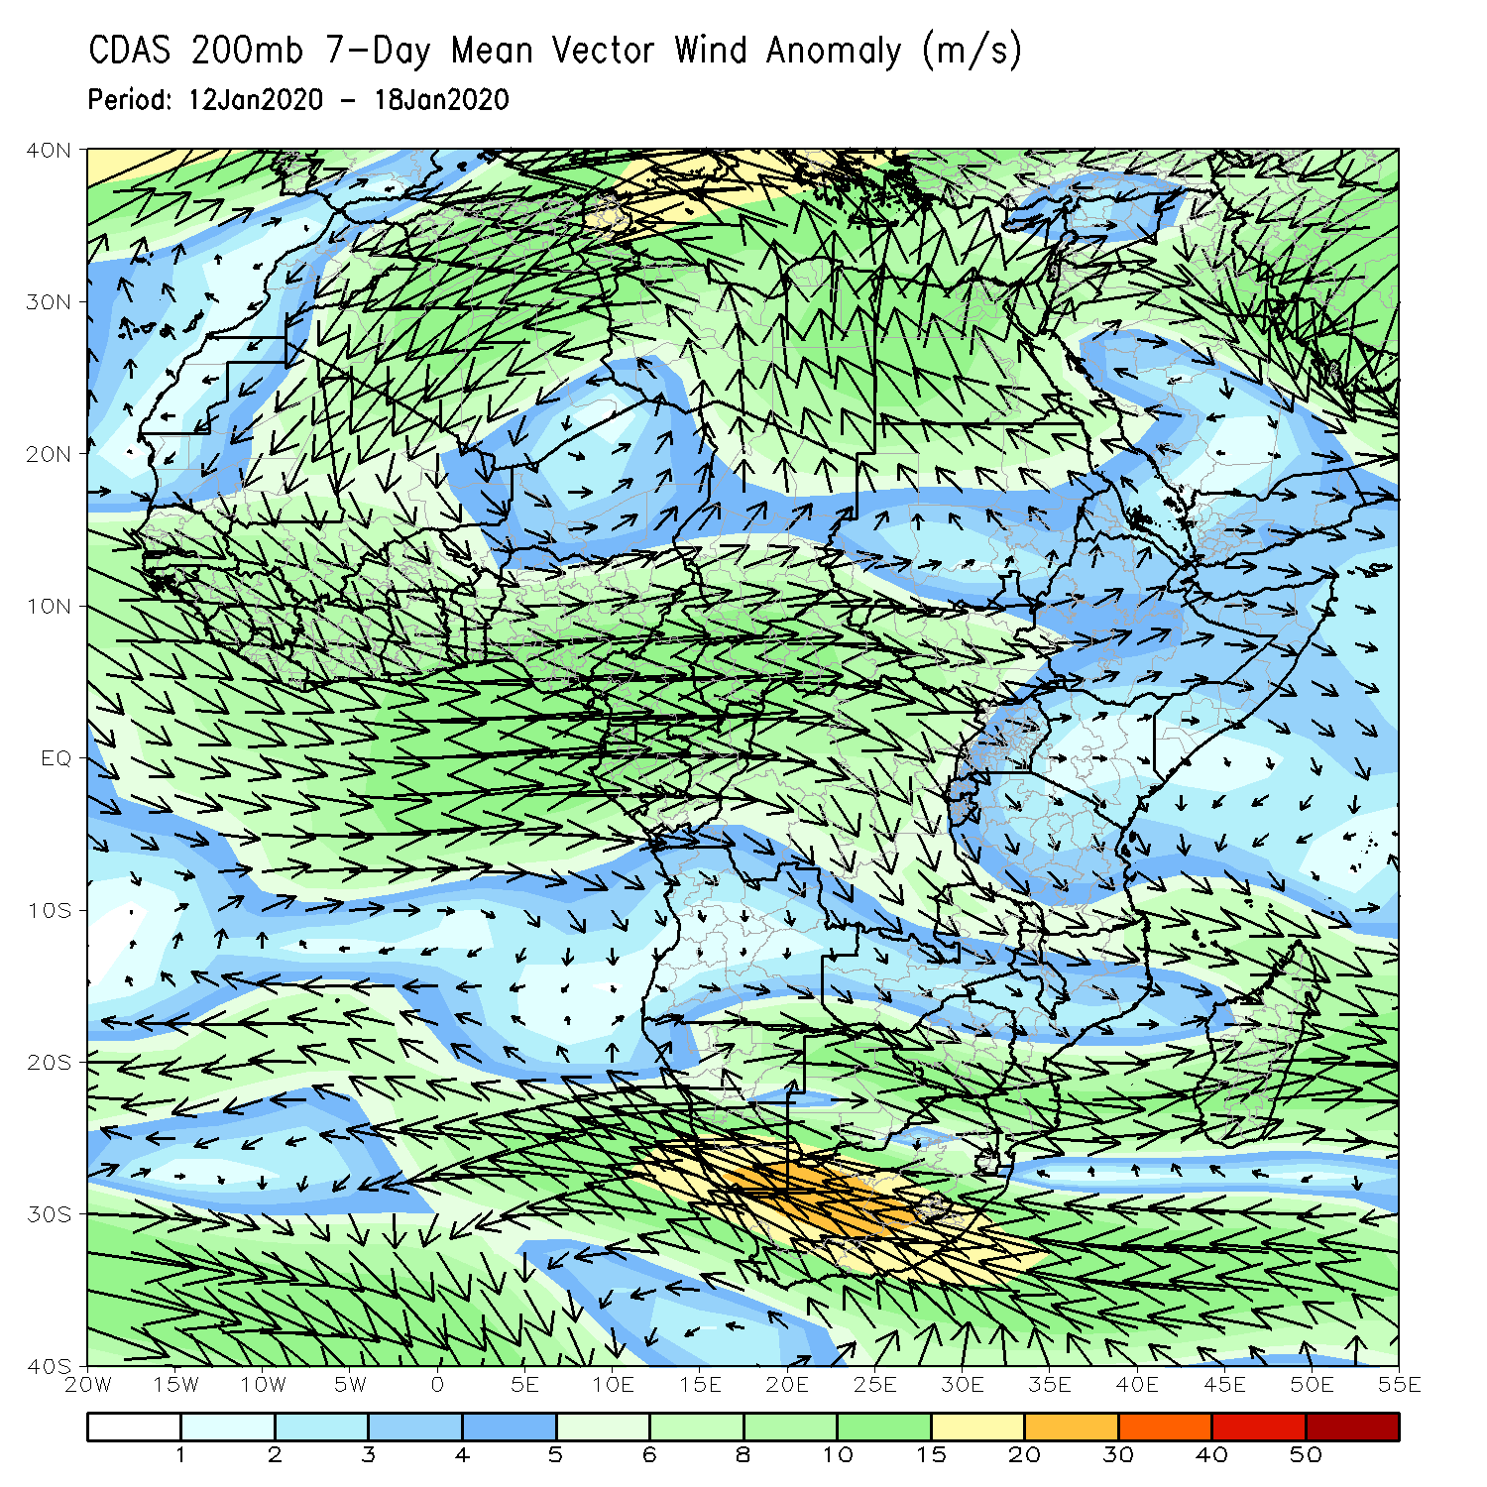
Atmospheric Circulation: Last 7 Days
An area of anomalous lower-level cyclonic flow across southeastern Africa may have contributed to the observed above-average rainfall in the region (left panel) .

Slide 10
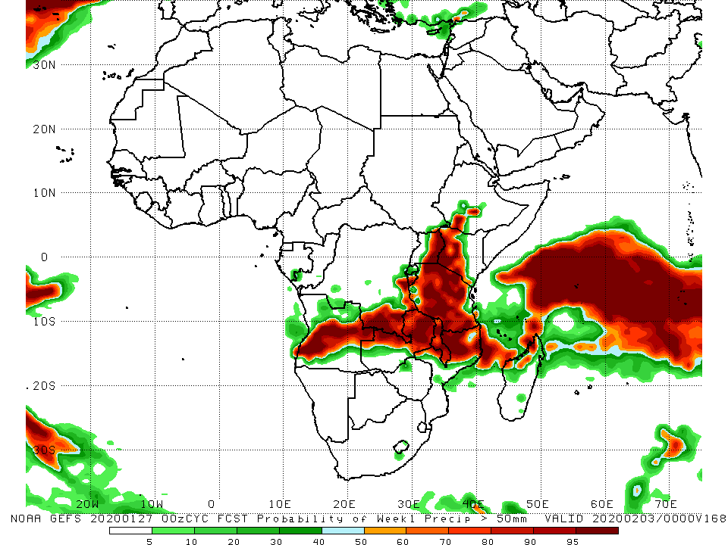
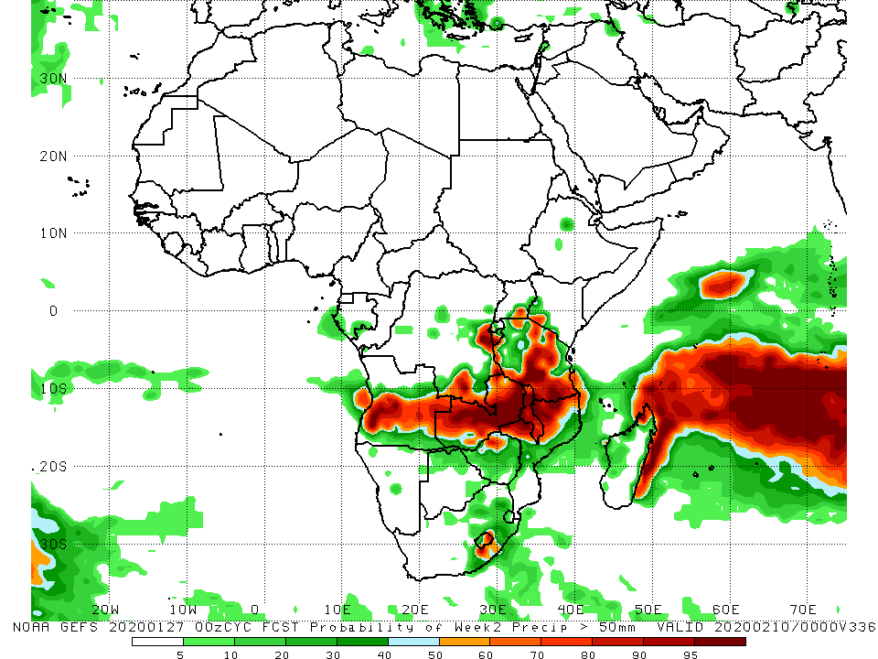
NCEP GEFS Model Forecasts Non-Bias Corrected Probability of precipitation exceedance
Week-1: Valid 28 January – 3 February, 2020
Week-2: Valid 4 – 10 February, 2020
For week-1 (left panel) and week-2 (right panel), there is an increased chance for weekly rainfall totals to exceed 50mm across portions of Angola, southern DRC, Zambia, Malawi, Kenya, Tanzania, northern Mozambique, and parts of northern Madagascar.
Notes:
10

Slide 11
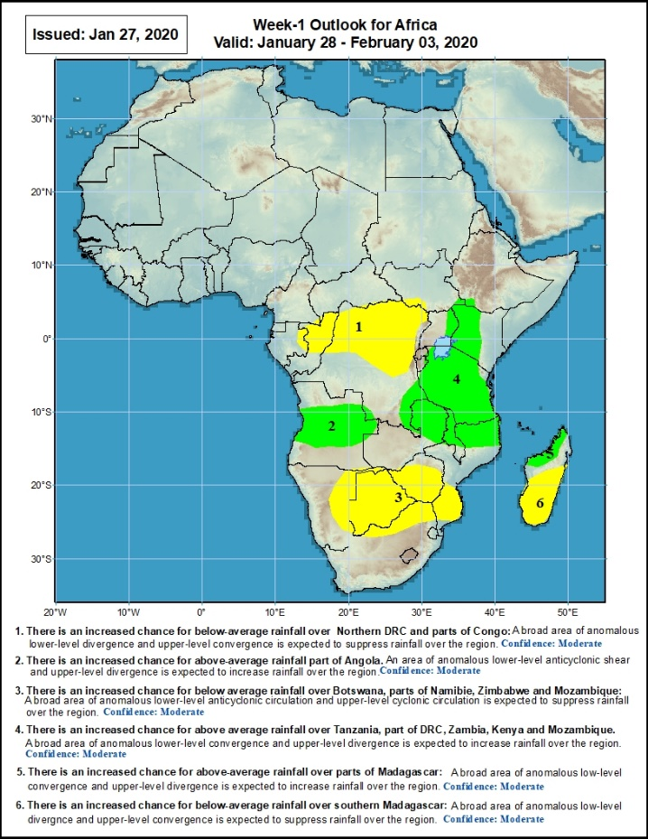
Week-1 Precipitation Outlooks
There is an increased chance for below-average rainfall over northern Congo and northern DRC: An area of anomalous lower-level divergence and upper-level convergence is expected to suppress rainfall in the region. Confidence: Moderate
There is an increased chance for above-average rainfall parts of Angola: An area of anomalous lower-level convergence and upper-level divergence is expected to enhance rainfall in the region. Confidence: Moderate
There is an increased chance for below-average rainfall over parts of eastern Namibia, Botswana, Zimbabwe, northern South Africa and southern Mozambique: An area of anomalous lower-level divergence and upper-level convergence is expected to suppress rainfall in the region. Confidence: Moderate
There is an increased chance for above-average rainfall over southeastern DRC, eastern Uganda, western Kenya, Tanzania, Malawi and northern Mozambique: A broad area of anomalous lower-level convergence and upper-level divergence is expected to enhance rainfall in the region. Confidence: Moderate
There is an increased chance for above-average rainfall over parts of northern Madagascar: An area of anomalous lower-level convergence and upper-level divergence is expected to enhance rainfall in the region. Confidence: Moderate
There is an increased chance for below-average rainfall over southern Madagascar: An area of anomalous lower-level divergence and upper-level convergence is expected to suppress rainfall in the region. Confidence: Moderate
28 January - 3 February, 2020
Notes:
11

Slide 12
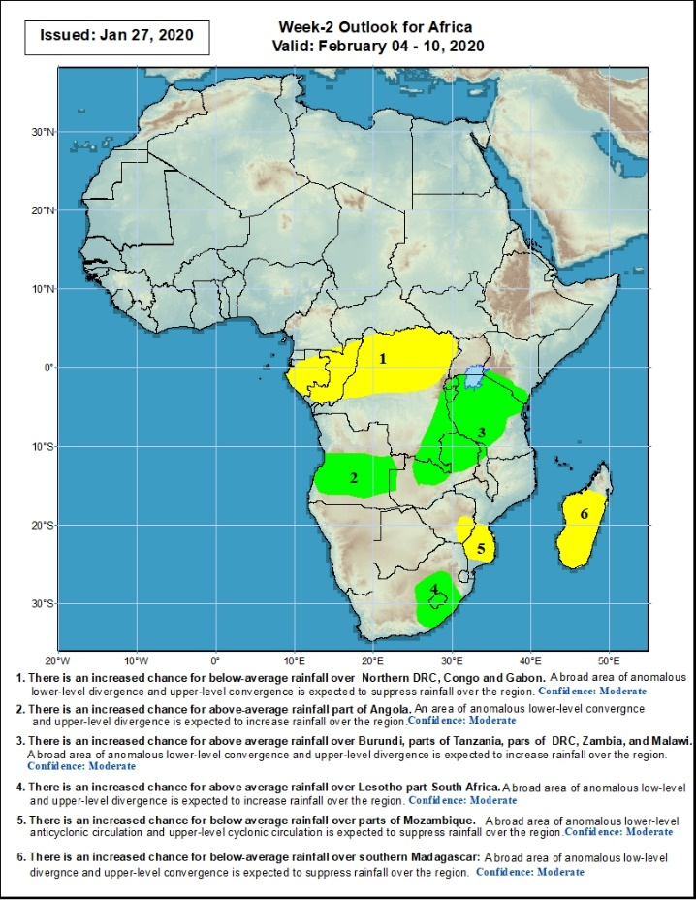
Week-2 Precipitation Outlooks
There is an increased chance for below-average rainfall over Gabon, Congo, and northern DRC: An area of anomalous lower-level divergence and upper-level convergence is expected to suppress rainfall in the region. Confidence: Moderate
There is an increased chance for above-average rainfall parts of Angola: An area of anomalous lower-level convergence and upper-level divergence is expected to enhance rainfall in the region. Confidence: Moderate
There is an increased chance for above-average rainfall over Rwanda, Burundi, parts of eastern DRC, much of Tanzania, Zambia and northern Malawi: An area of anomalous lower-level convergence and upper-level divergence is expected to enhance rainfall in the region. Confidence: Moderate
There is an increased chance for above-average rainfall over Lesotho and portions of South Africa: An area of anomalous lower-level convergence and upper-level divergence is expected to enhance rainfall in the region. Confidence: Moderate
There is an increased chance for below-average rainfall over parts of eastern Zimbabwe and southern Mozambique: An area of anomalous lower-level divergence and upper-level convergence is expected to suppress rainfall in the region. Confidence: Moderate
There is an increased chance for below-average rainfall over much of Madagascar: An area of anomalous lower-level divergence and upper-level convergence is expected to suppress rainfall in the region. Confidence: Moderate
4 - 10 February, 2020
Notes:
12

Slide 13
Summary
During the past 7 days, weekly rainfall totals exceeded 100mm over local areas in Angola, parts of Tanzania, central Mozambique and northern Madagascar. Rainfall was above-average over local areas in Congo, central Angola, parts of southern DRC and eastern Zambia, much of Tanzania, parts of Kenya, local areas in South Africa, central Mozambique and northern Madagascar. Weekly rainfall surpluses exceeded 100mm over parts of northeastern Madagascar. Equatorial Guinea, Gabon, many parts of Congo and DRC, southeastern Angola, Botswana, Zimbabwe, western and southern Zambia, parts of South Africa, Malawi, parts of Mozambique and southern Madagascar had below-average rainfall.
During the past 30 days, rainfall totals exceeded 300mm over local areas in Angola and DRC, eastern Zambia, Malawi, central and southern Tanzania, central and northern Mozambique and northern Madagascar, with rainfall totals in excess of 750mm observed over northwestern Madagascar. Rainfall was above-average over southern Congo, central and southern DRC, local areas in southwestern Ethiopia, southwestern Uganda, southern Kenya, Tanzania, Angola, northern Namibia, Botswana, many parts of Zambia, Malawi, central and northern Mozambique, many parts of South Africa and Madagascar. Rainfall surpluses exceeded 300mm over northern Madagascar. Equatorial Guinea, Gabon, northern Congo, northern and eastern DRC, Rwanda, Burundi, local areas in northern Zambia and Zimbabwe, portions of Namibia, local areas in Botswana, parts of southern Mozambique and southern Madagascar had below-average rainfall.
During the past 90 days, rainfall was above-average over Sierra Leone, Liberia, southern Cote d’Ivoire, parts of Ghana, Togo, Benin, Nigeria, parts of Chad, portions of Cameroon, western CAR, portions of DRC, South Sudan, Uganda, parts of southern and eastern Sudan, Ethiopia, Kenya, Somalia, many parts of Tanzania, parts of Angola, eastern Zambia, parts of Namibia, Botswana, Malawi, northeastern South Africa, northern Mozambique, and central and northern Madagascar. Much of Guinea, southern Cameroon, Equatorial Guinea, Gabon, eastern CAR, portions DRC and Angola, western Zambia, Zimbabwe, parts of Namibia, local areas in Botswana, southern Mozambique, and parts of southern Madagascar and South Africa had below-average rainfall.
Week-1 outlooks call for an increased chance for above-average rainfall over parts of Angola, southern DRC, portions of northern and eastern Zambia, Tanzania, eastern Uganda, western Kenya and northern Madagascar. In contrast, there is an increased chance for below-average rainfall over parts of northern Congo, northern DRC, Botswana, Zimbabwe, southern Mozambique and southern Madagascar.
Notes:
13

