Slide 1
The African Monsoon Recent Evolution and Current Status Include Week-1 and Week-2 Outlooks
Update prepared by
Climate Prediction Center / NCEP
06 January 2020
For more information, visit:
http://www.cpc.ncep.noaa.gov/products/Global_Monsoons/African_Monsoons/precip_monitoring.shtml

Slide 2
Outline
Highlights
Recent Evolution and Current Conditions
NCEP GEFS Forecasts
Summary

Slide 3
Highlights: Last 7 Days
Weekly rainfall totals exceeded 150mm over parts of northern Mozambique and northern Madagascar.
Week-1 outlooks call for an increased chance for above-average rainfall over central and southern Angola, northern Namibia, northwestern Botswana, parts of western Zambia, eastern South Africa Lesotho, eastern DRC, Rwanda, Burundi, Tanzania, Malawi, northern Mozambique and northern Madagascar. In contrast, there is an increased chance for below-average rainfall over northeastern South Africa, eastern Zimbabwe, southern Mozambique and southern Madagascar.

Slide 4
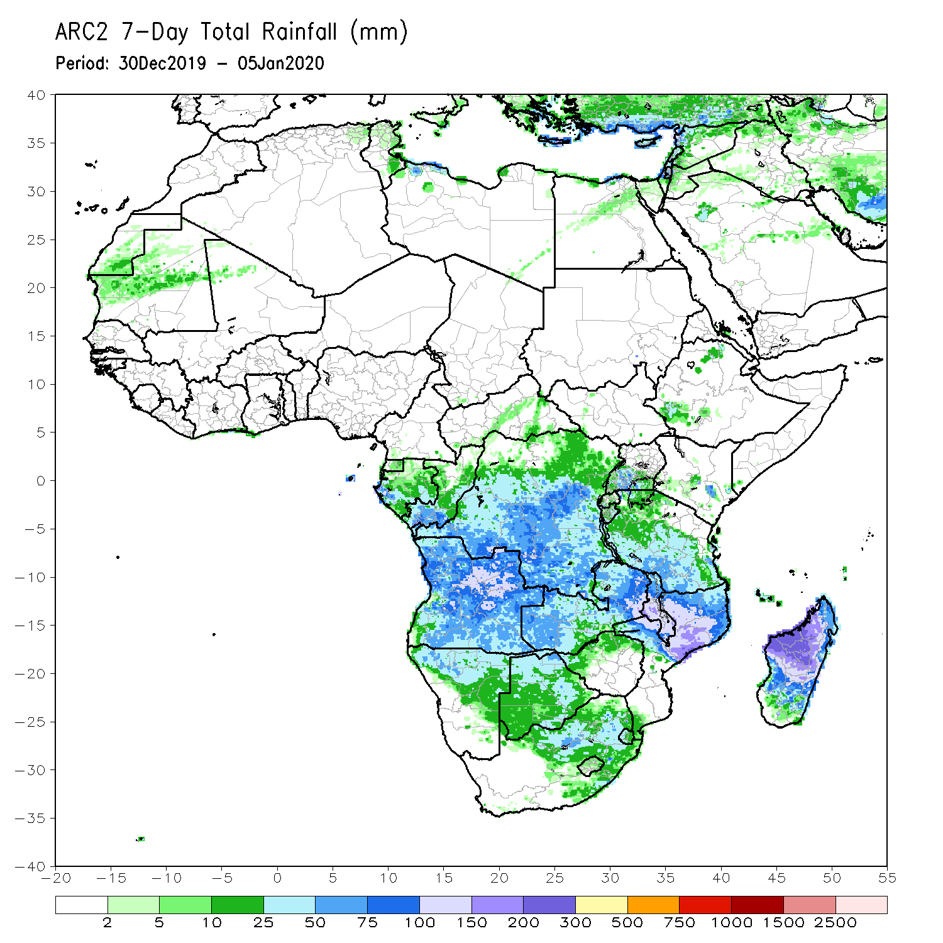
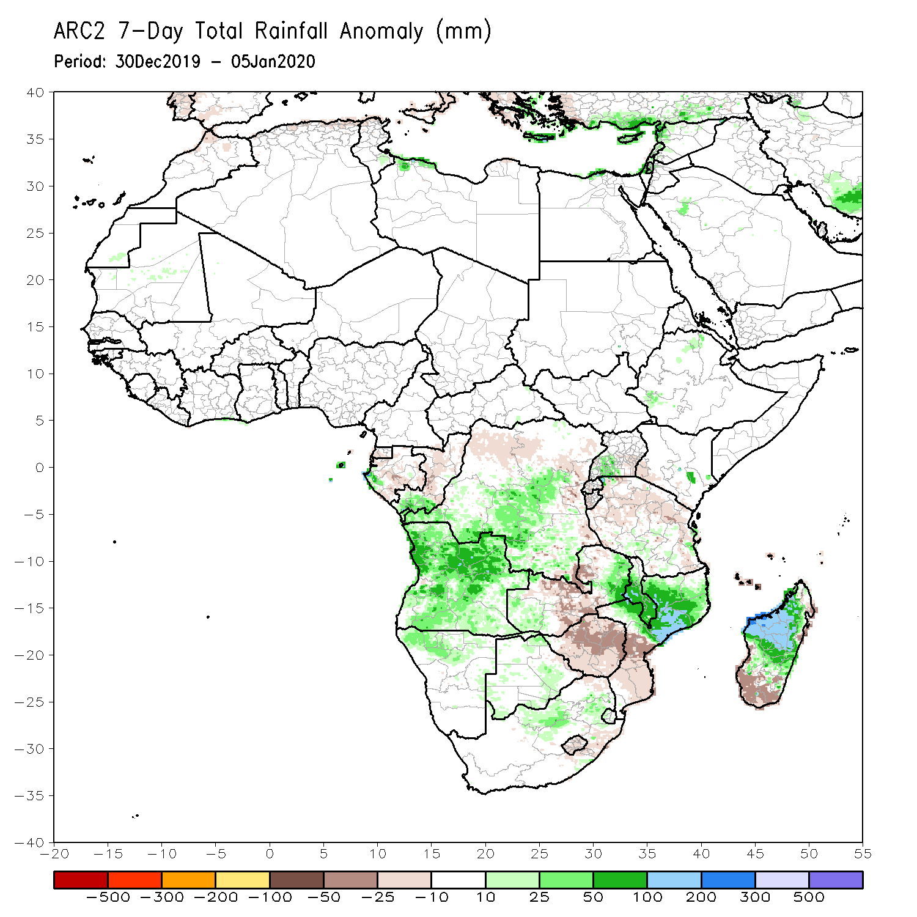
Rainfall Patterns: Last 7 Days
During the past 7 days, weekly rainfall totals exceeded 150mm over parts of northern Mozambique and northern Madagascar. Rainfall was above-average over parts of southern Congo, much of Angola, parts of DRC, southwestern Uganda, local areas in Kenya, northern Namibia, parts of Zambia, Malawi, northern Mozambique, and northern Madagascar.
Parts of eastern and southern DRC, Tanzania, central Zambia, Zimbabwe, central Mozambique and southern Madagascar had below-average rainfall.

Slide 5
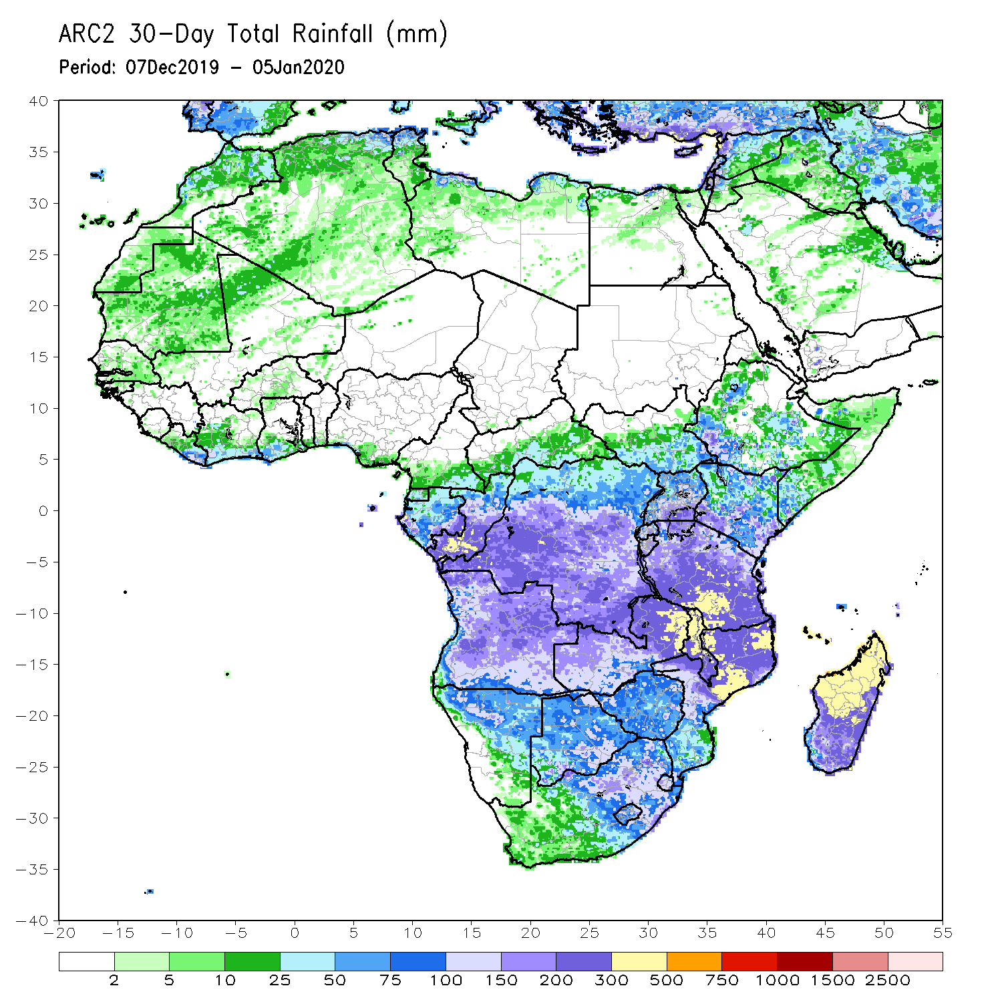
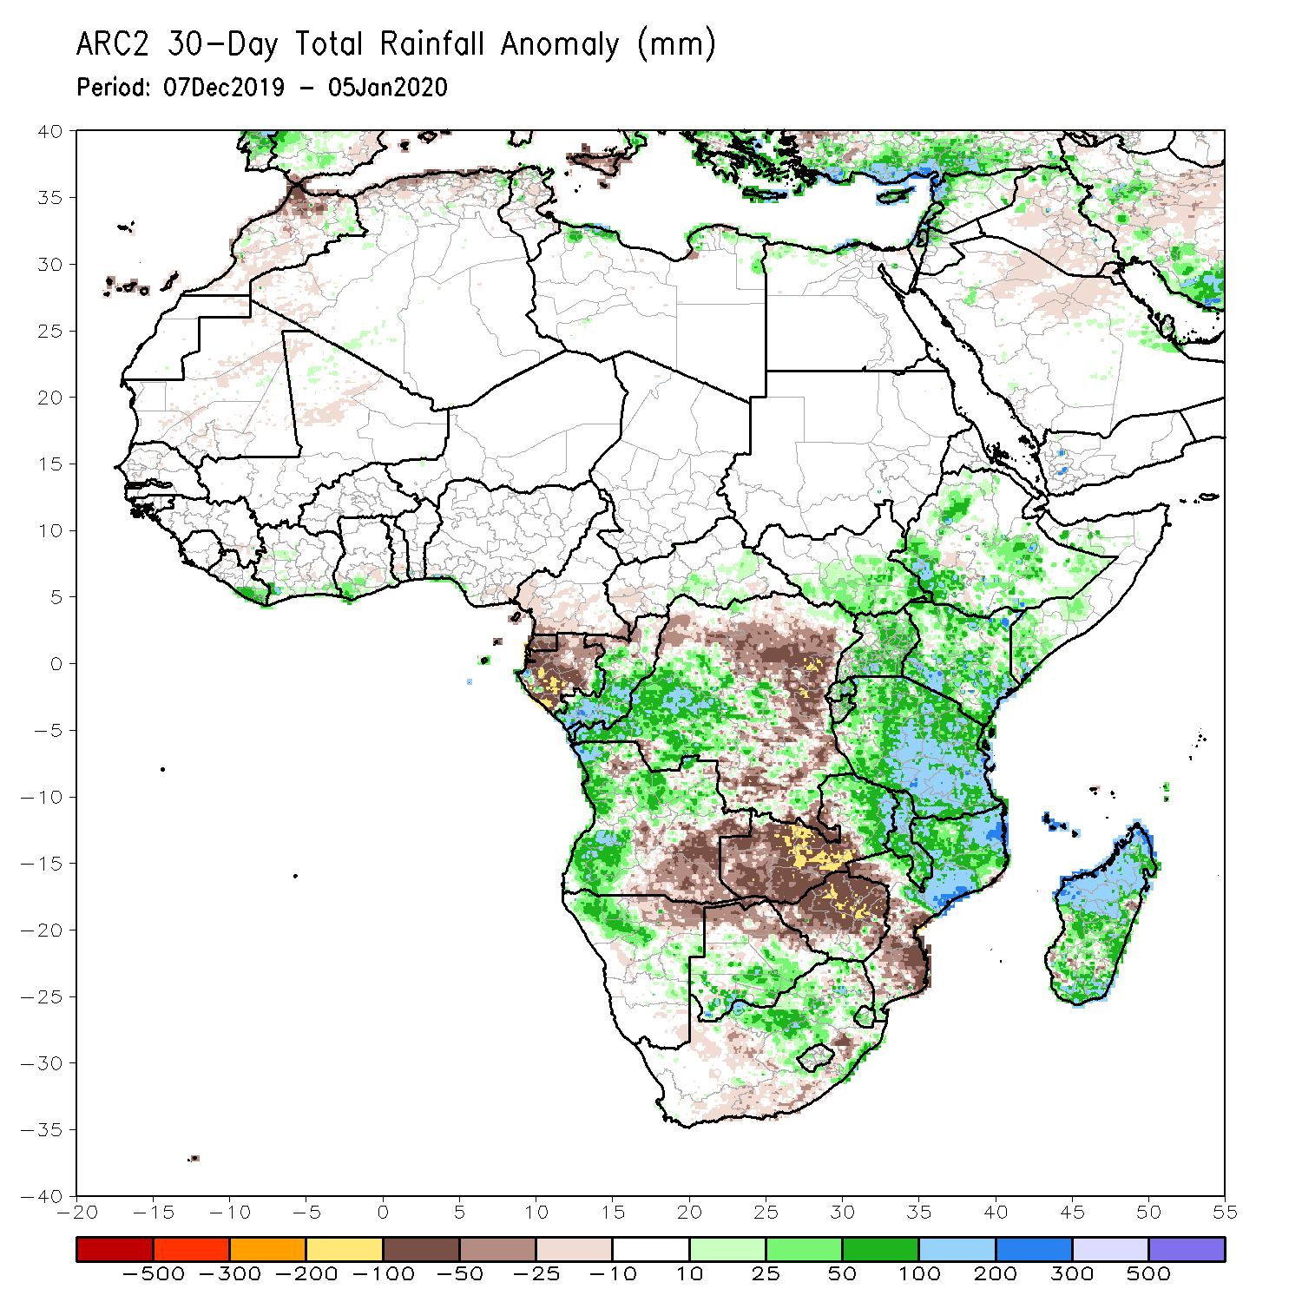
Rainfall Patterns: Last 30 Days
During the past 30 days, rainfall was above-average over central and southern Congo, western DRC, parts of South Sudan and Ethiopia, Rwanda, Burundi, Uganda, Kenya, Tanzania, parts of Somalia, portions of Angola, northern Namibia, southern Botswana, parts of eastern Zambia, Malawi, northern Mozambique, South Africa and parts of Madagascar.
Equatorial Guinea, Gabon, many parts of Angola and DRC, western and central Zambia, Zimbabwe, northern Botswana, and southern Mozambique had below-average rainfall.
Notes:
5

Slide 6
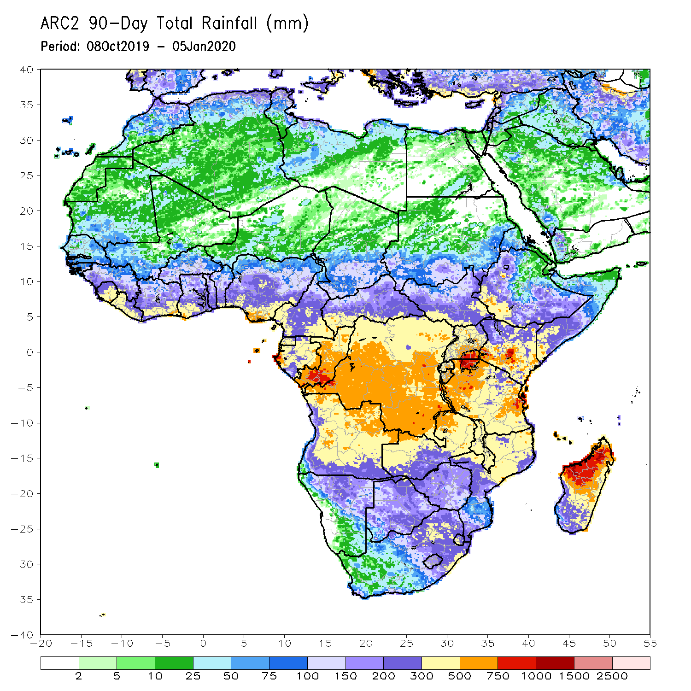
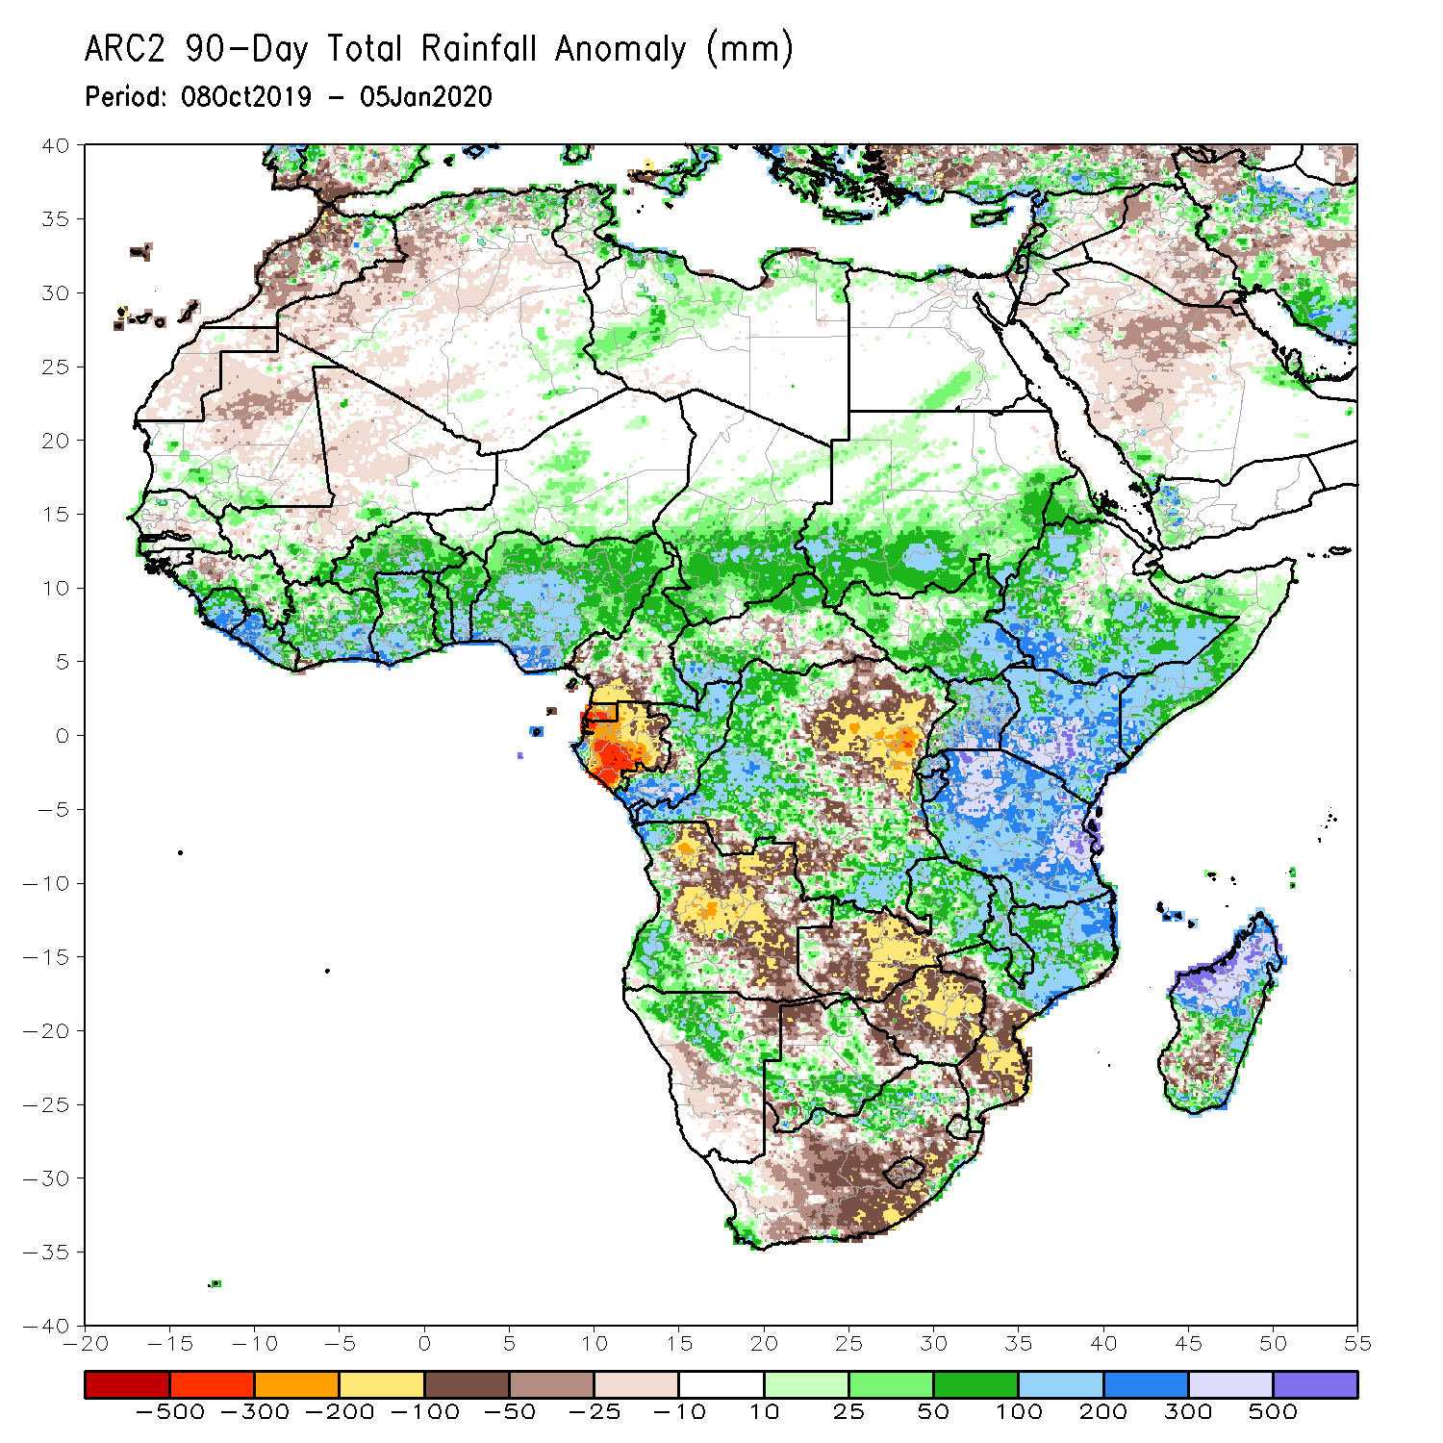
Rainfall Patterns: Last 90 Days
During the past 90 days, rainfall was above-average over parts of Guinea, Sierra Leone, Liberia, Cote d’Ivoire, Burkina Faso, Ghana, Togo, Benin, parts of Niger, Nigeria, Chad, portions of Cameroon and CAR, portions of DRC, South Sudan, Uganda, southern and eastern Sudan, Eritrea, Ethiopia, Kenya, Somalia, many parts of Tanzania, western Angola, eastern Zambia, parts of Namibia and Botswana, Malawi, northeastern South Africa, northern Mozambique, and many parts of Madagascar.
Local areas in Guinea, parts of southern Cameroon, Equatorial Guinea, Gabon, parts of CAR, portions of central and eastern DRC, many parts of Angola, western Zambia, Zimbabwe, parts of Namibia and Botswana, southern Mozambique, parts of southern Madagascar and many parts of South Africa had below-average rainfall.
Notes:
6

Slide 7
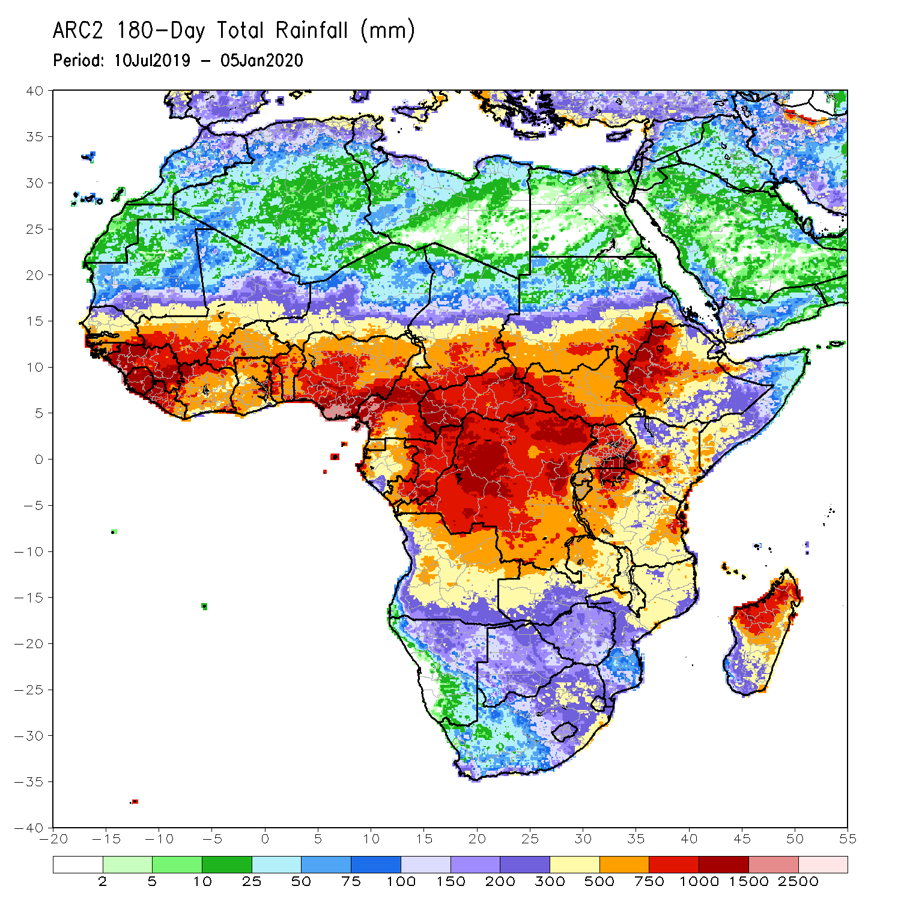
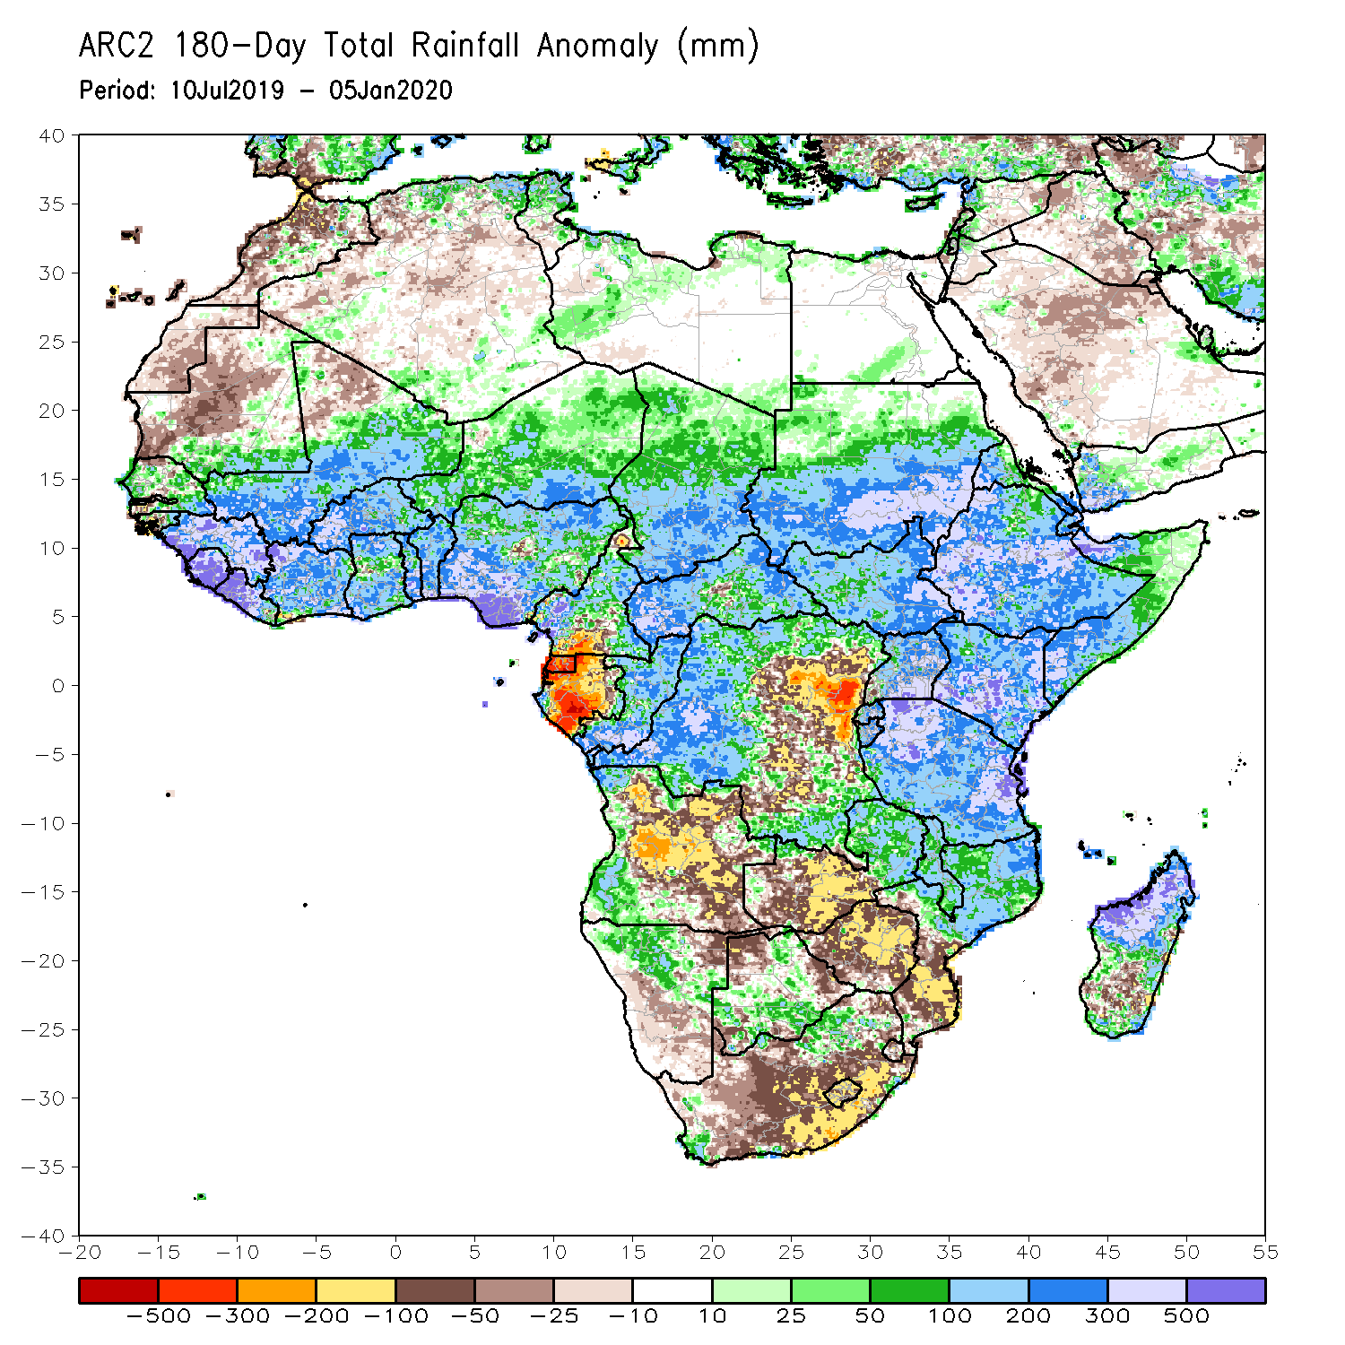
Rainfall Patterns: Last 180 Days
During the past 180 days, below-average rainfall was observed over portions of southern Cameroon, Equatorial Guinea, Gabon, parts of central and eastern DRC, many parts of Angola, parts of Namibia and Botswana, much of South Africa, western Zambia, Zimbabwe, and southern Mozambique and southern Madagascar.
Parts of Southern and eastern Mauritania, much of Senegal, Guinea-Bissau, Guinea, Sierra Leone, Mali, Liberia, Cote d’Ivoire, Burkina Faso, Ghana, Togo, Benin, Nigeria, much of Cameroon, Niger, Chad, CAR, many parts of DRC, South Sudan, Sudan, Uganda, Eritrea, Ethiopia, Somalia, Kenya, Tanzania, local areas in Angola, portions of Zambia, Namibia and Botswana, much of Malawi, northern Mozambique and many parts of Madagascar had above-average rainfall.
Notes:
7

Slide 8
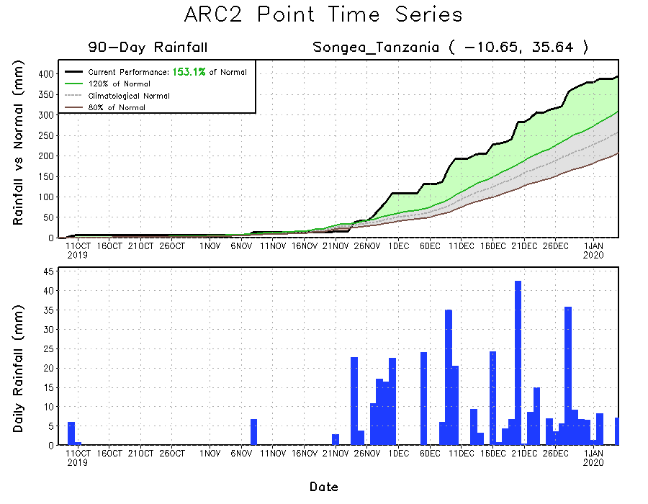
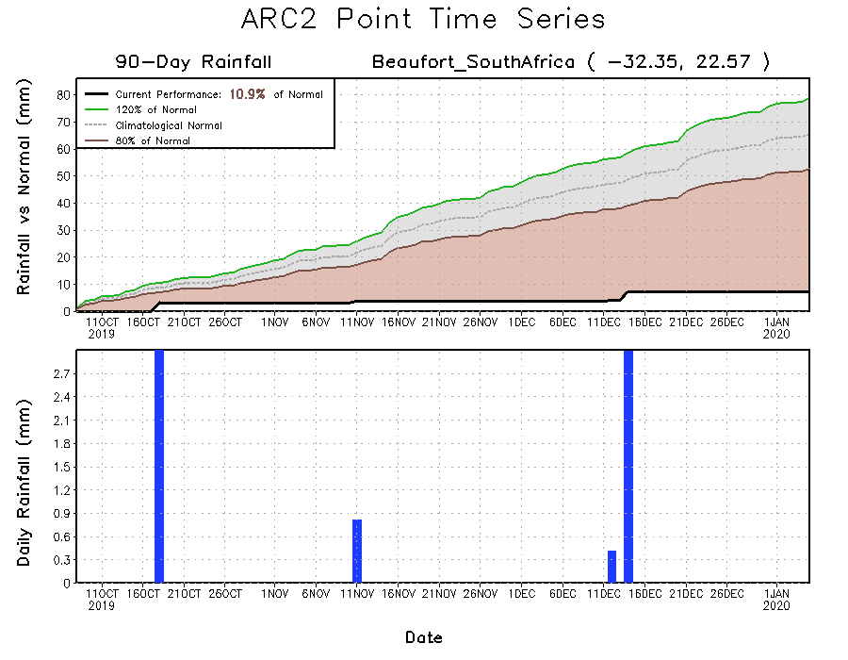
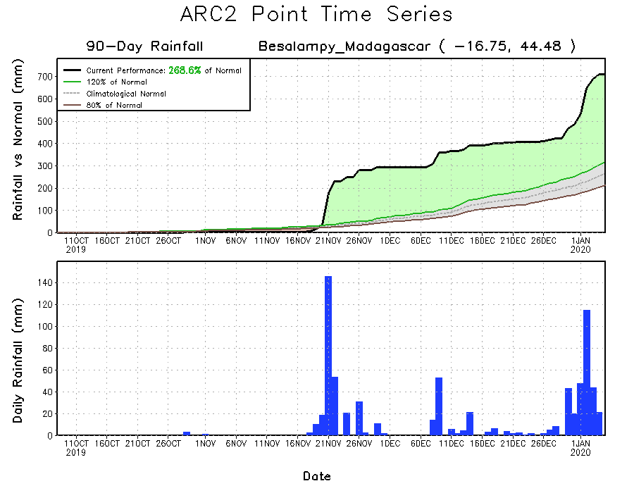
Recent Rainfall Evolution
Daily evolution of rainfall over the last 90 days at selected locations shows that moderate to locally heavy rainfall sustained moisture surpluses over man parts of Tanzania (top right) and northern Madagascar (bottom right). Seasonal total rainfall remained below-average over many parts of South Africa (bottom left).

Slide 9
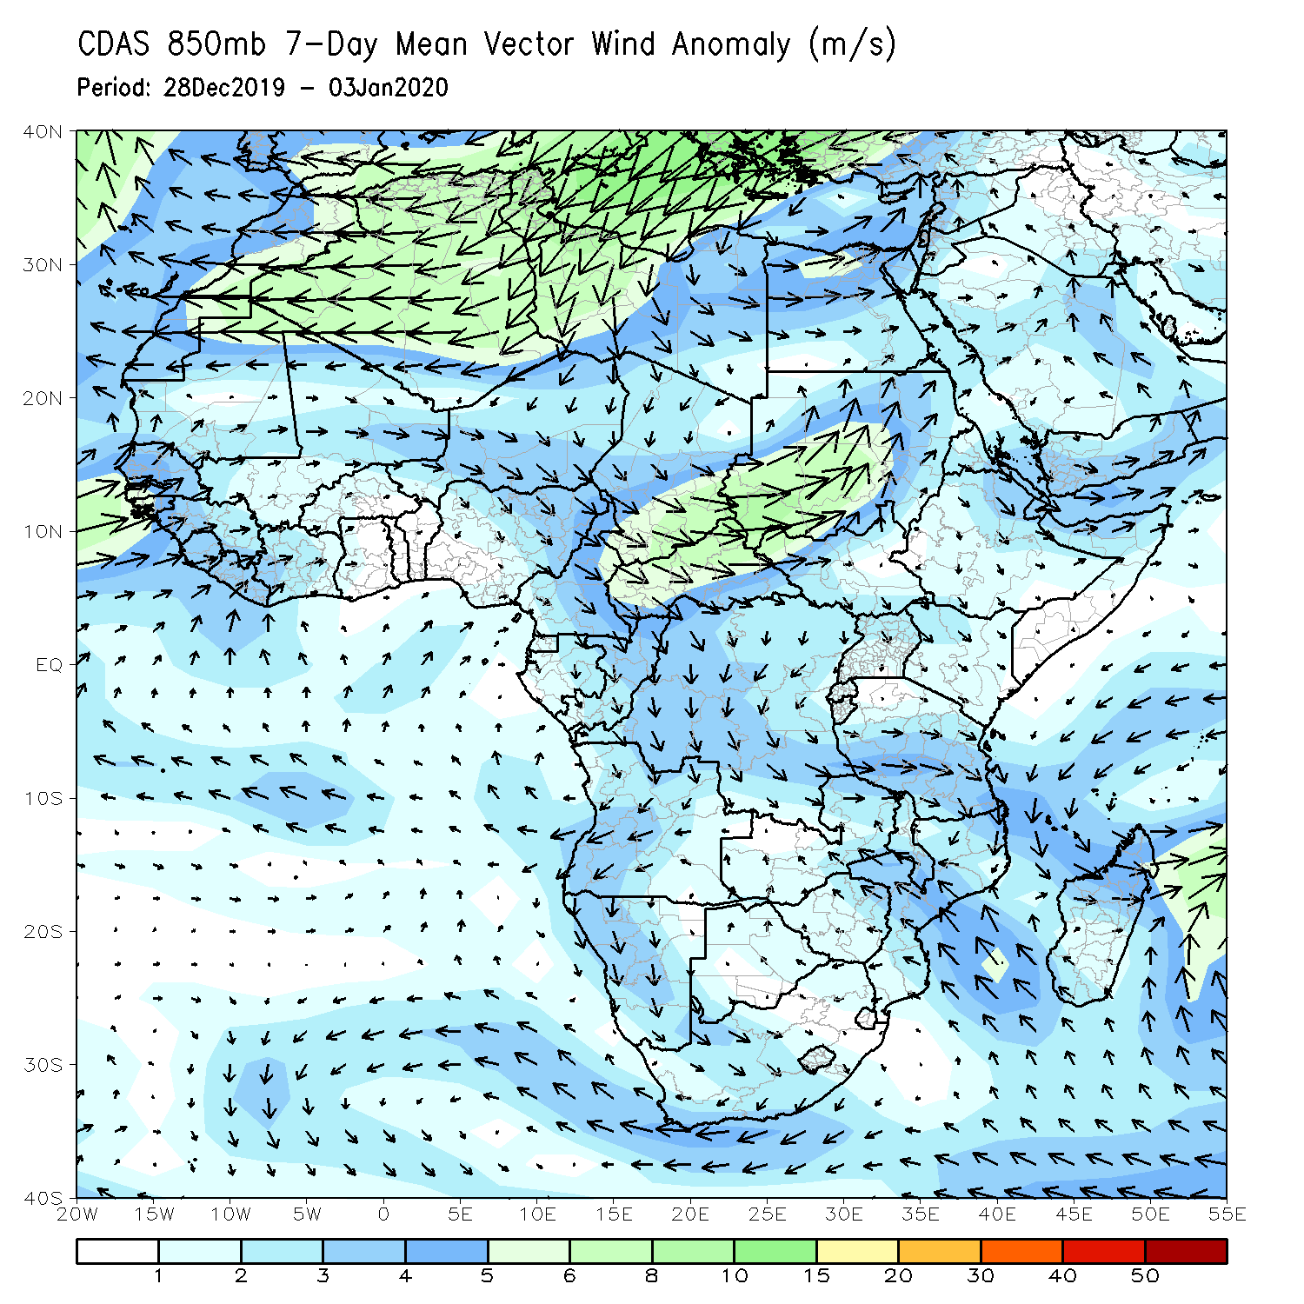
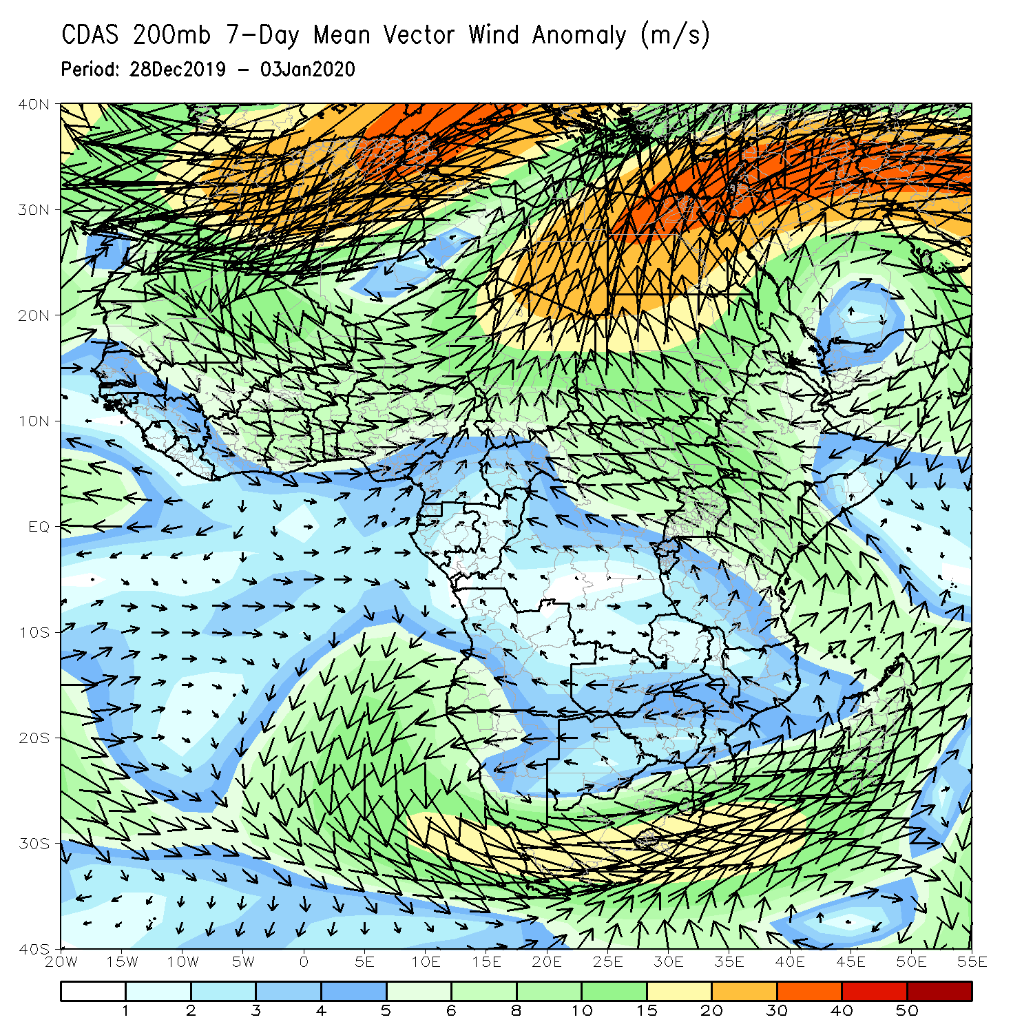
Atmospheric Circulation: Last 7 Days
An area of anomalous southeasterly onshore flow with its associated lower-level cyclonic circulation over southeastern Africa may have contributed to observed heavy rainfall in the region (left panel).

Slide 10
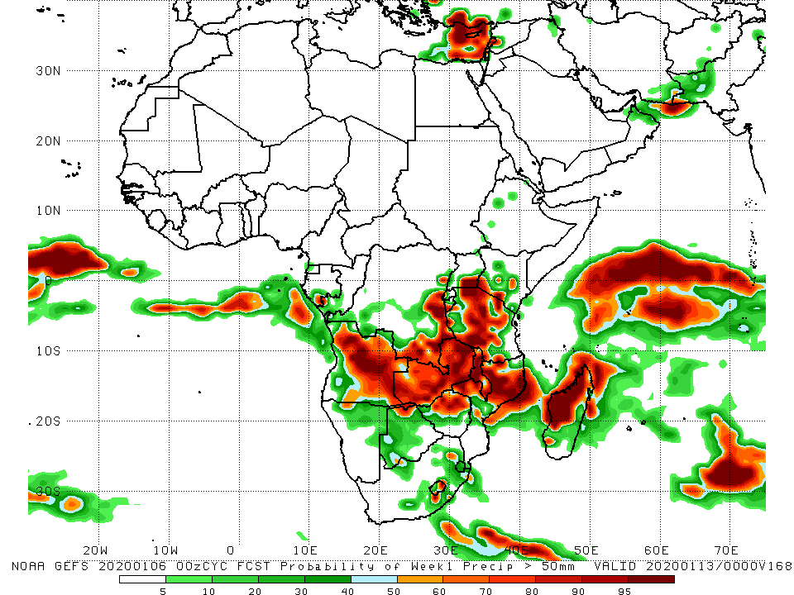
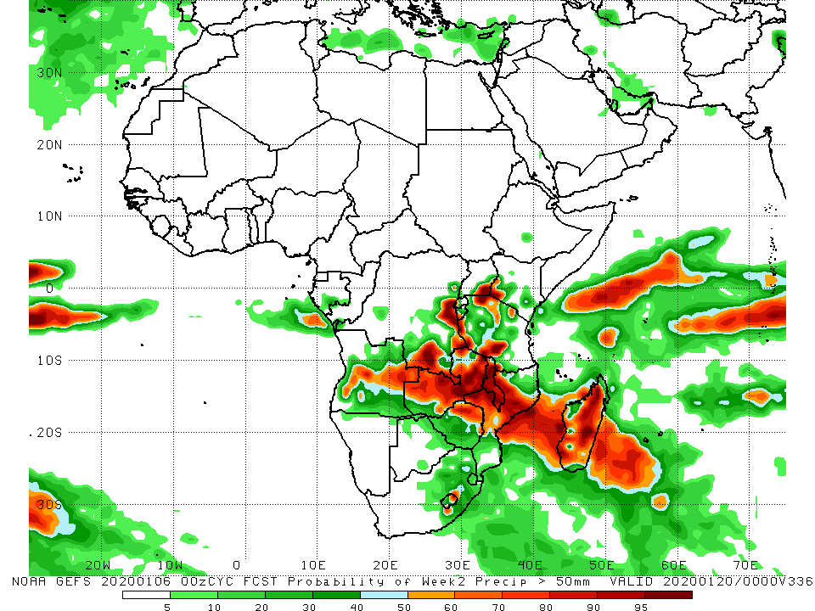
NCEP GEFS Model Forecasts Non-Bias Corrected Probability of precipitation exceedance
Week-1: Valid 7 – 13 January, 2020
Week-2: Valid 14 – 20 January, 2020
For week-1 (left panel) and week-2 (right panel), there is an increased chance for weekly rainfall totals to exceed 50mm over central and eastern Angola, parts of southern and eastern DRC, Zambia, Malawi, Tanzania, northern Mozambique, and western and northern Madagascar.
Notes:
10

Slide 11
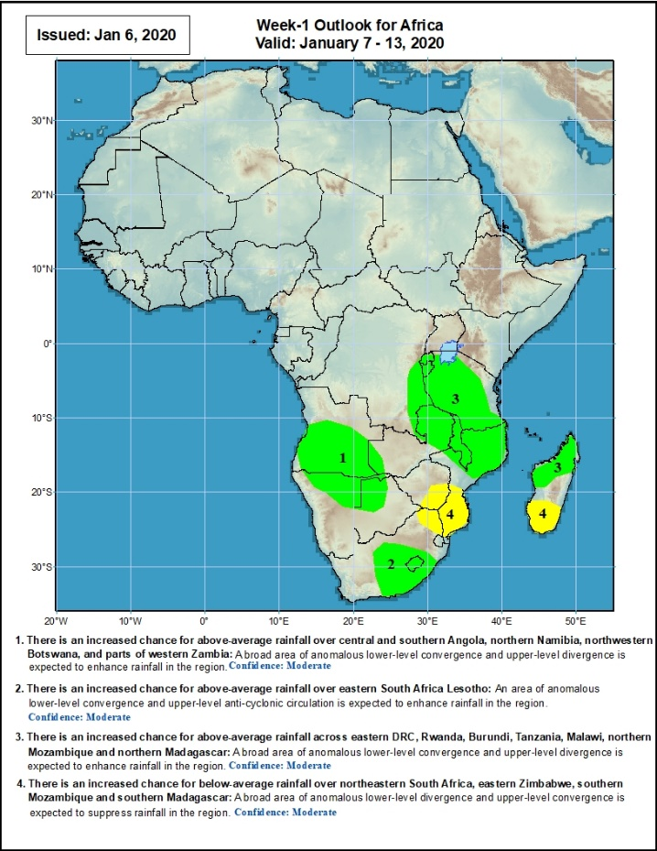
Week-1 Precipitation Outlooks
7 - 13 January, 2020
There is an increased chance for above-average rainfall over central and southern Angola, northern Namibia, northwestern Botswana, and parts of western Zambia: A broad area of anomalous lower-level convergence and upper-level divergence is expected to enhance rainfall in the region. Confidence: Moderate
There is an increased chance for above-average rainfall over eastern South Africa Lesotho: An area of anomalous lower-level convergence and upper-level anti-cyclonic circulation is expected to enhance rainfall in the region. Confidence: Moderate
There is an increased chance for above-average rainfall across eastern DRC, Rwanda, Burundi, Tanzania, Malawi, northern Mozambique and northern Madagascar: A broad area of anomalous lower-level convergence and upper-level divergence is expected to enhance rainfall in the region. Confidence: Moderate
There is an increased chance for below-average rainfall over northeastern South Africa, eastern Zimbabwe, southern Mozambique and southern Madagascar: A broad area of anomalous lower-level divergence and upper-level convergence is expected to suppress rainfall in the region. Confidence: Moderate
Notes:
11

Slide 12
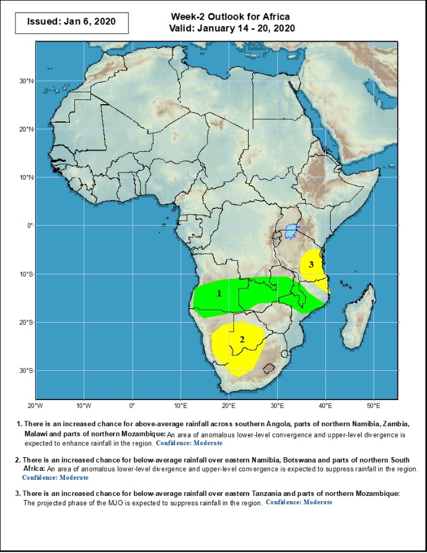
Week-2 Precipitation Outlooks
14 - 20 January, 2020
There is an increased chance for above-average rainfall across southern Angola, parts of northern Namibia, Zambia, Malawi and parts of northern Mozambique: An area of anomalous lower-level convergence and upper-level divergence is expected to enhance rainfall in the region. Confidence: Moderate
There is an increased chance for below-average rainfall over eastern Namibia, Botswana and parts of northern South Africa: An area of anomalous lower-level divergence and upper-level convergence is expected to suppress rainfall in the region. Confidence: Moderate
There is an increased chance for below-average rainfall over eastern Tanzania and parts of northern Mozambique: The projected phase of the MJO is expected to suppress rainfall in the region. Confidence: Moderate
Notes:
12

Slide 13
Summary
During the past 7 days, weekly rainfall totals exceeded 150mm over parts of northern Mozambique and northern Madagascar. Rainfall was above-average over parts of southern Congo, much of Angola, parts of DRC, southwestern Uganda, local areas in Kenya, northern Namibia, parts of Zambia, Malawi, northern Mozambique, and northern Madagascar. Parts of eastern and southern DRC, Tanzania, central Zambia, Zimbabwe, central Mozambique and southern Madagascar had below-average rainfall.
During the past 30 days, rainfall was above-average over central and southern Congo, western DRC, parts of South Sudan and Ethiopia, Rwanda, Burundi, Uganda, Kenya, Tanzania, parts of Somalia, portions of Angola, northern Namibia, southern Botswana, parts of eastern Zambia, Malawi, northern Mozambique, South Africa and parts of Madagascar. Equatorial Guinea, Gabon, many parts of Angola and DRC, western and central Zambia, Zimbabwe, northern Botswana, and southern Mozambique had below-average rainfall.
During the past 90 days, rainfall was above-average over parts of Guinea, Sierra Leone, Liberia, Cote d’Ivoire, Burkina Faso, Ghana, Togo, Benin, parts of Niger, Nigeria, Chad, portions of Cameroon and CAR, portions of DRC, South Sudan, Uganda, southern and eastern Sudan, Eritrea, Ethiopia, Kenya, Somalia, many parts of Tanzania, western Angola, eastern Zambia, parts of Namibia and Botswana, Malawi, northeastern South Africa, northern Mozambique, and many parts of Madagascar. Local areas in Guinea, parts of southern Cameroon, Equatorial Guinea, Gabon, parts of CAR, portions of central and eastern DRC, many parts of Angola, western Zambia, Zimbabwe, parts of Namibia and Botswana, southern Mozambique, parts of southern Madagascar and many parts of South Africa had below-average rainfall.
Week-1 outlooks call for an increased chance for above-average rainfall over central and southern Angola, northern Namibia, northwestern Botswana, parts of western Zambia, eastern South Africa Lesotho, eastern DRC, Rwanda, Burundi, Tanzania, Malawi, northern Mozambique and northern Madagascar. In contrast, there is an increased chance for below-average rainfall over northeastern South Africa, eastern Zimbabwe, southern Mozambique and southern Madagascar.
Notes:
13

