Slide 1
The African Monsoon Recent Evolution and Current Status Include Week-1 and Week-2 Outlooks
Update prepared by
Climate Prediction Center / NCEP
30 December 2019
For more information, visit:
http://www.cpc.ncep.noaa.gov/products/Global_Monsoons/African_Monsoons/precip_monitoring.shtml

Slide 2
Outline
Highlights
Recent Evolution and Current Conditions
NCEP GEFS Forecasts
Summary

Slide 3
Highlights: Last 7 Days
Weekly rainfall surpluses exceeded 100mm over parts of northern Mozambique and northern Madagascar.
Week-1 outlooks call for an increased chance for above-average rainfall over southern Angola, northern Namibia, parts of southern DRC, Zambia, eastern South Africa, parts of Botswana, northern Mozambique, western Madagascar, and parts of Zambia and Malawi. In contrast, there is an increased chance for below-average rainfall over Zimbabwe, western and southern Mozambique, and southern Madagascar.

Slide 4
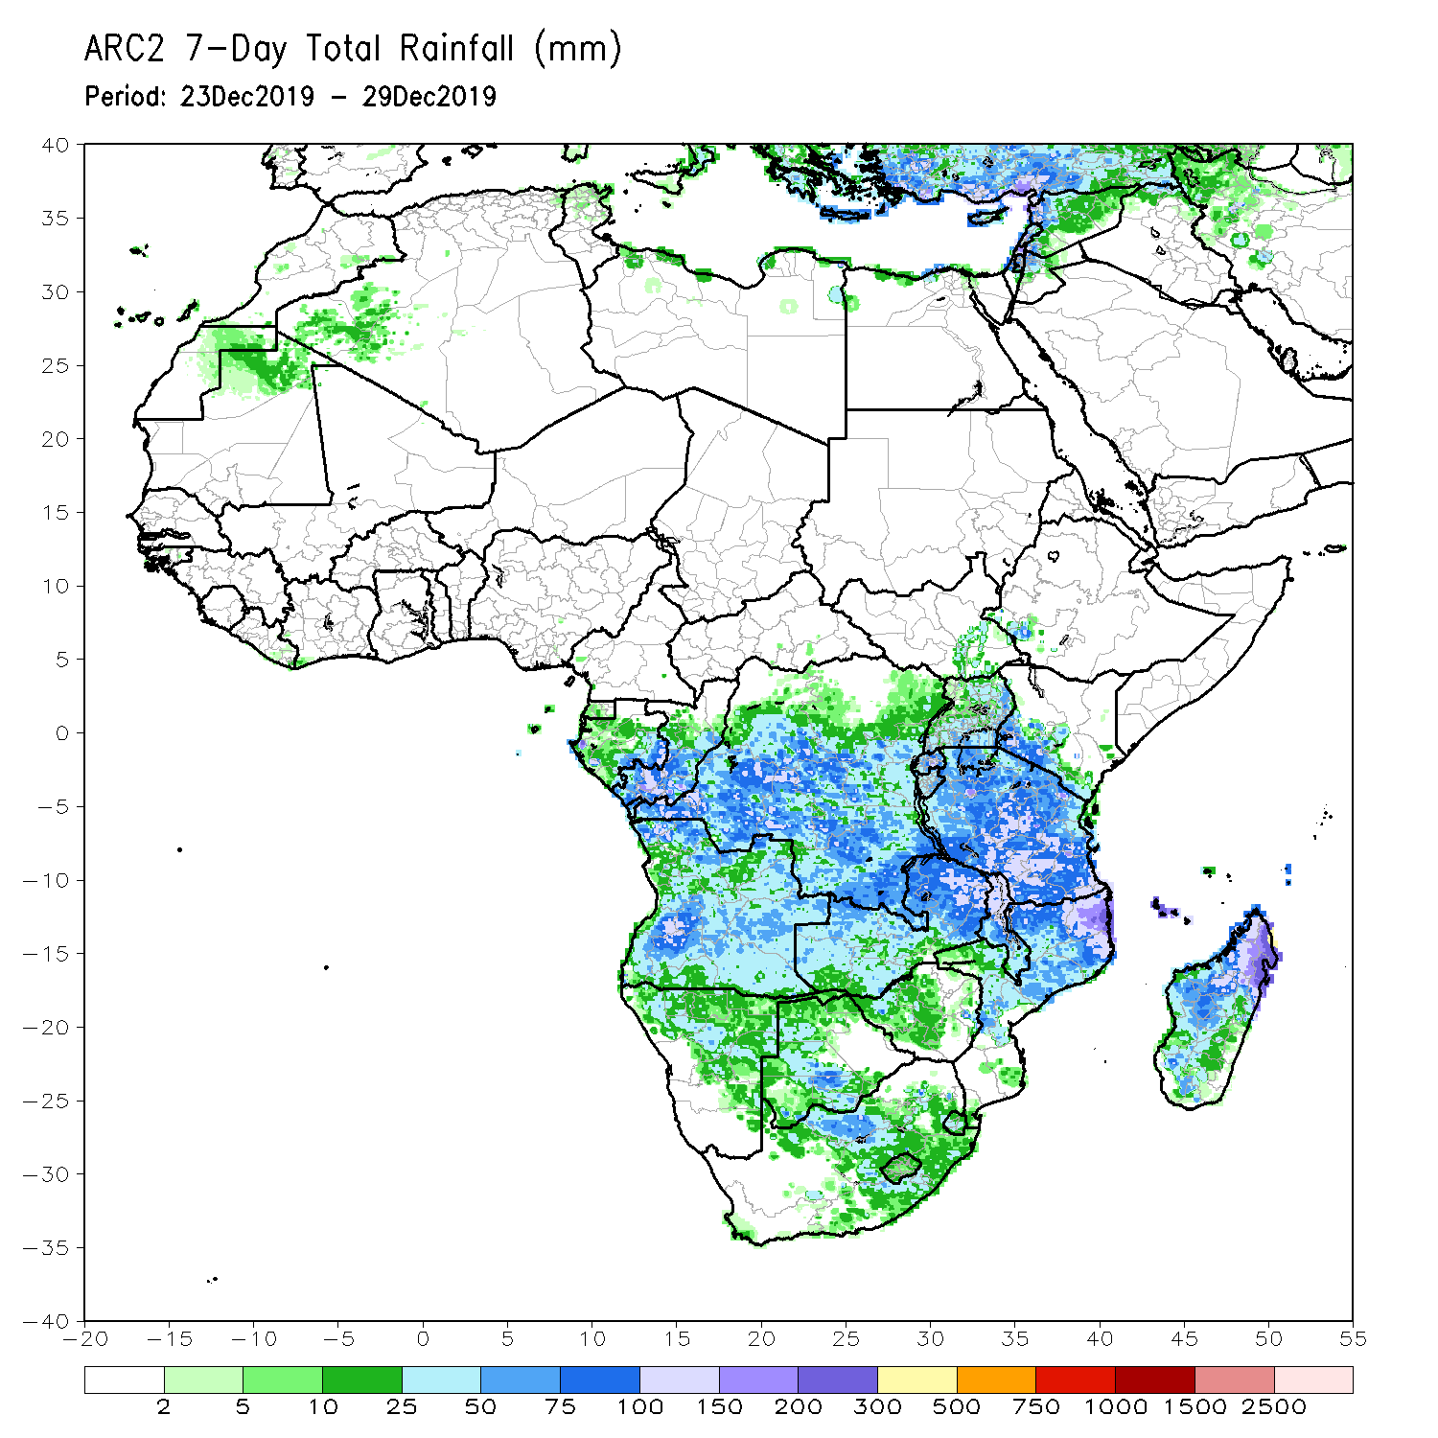
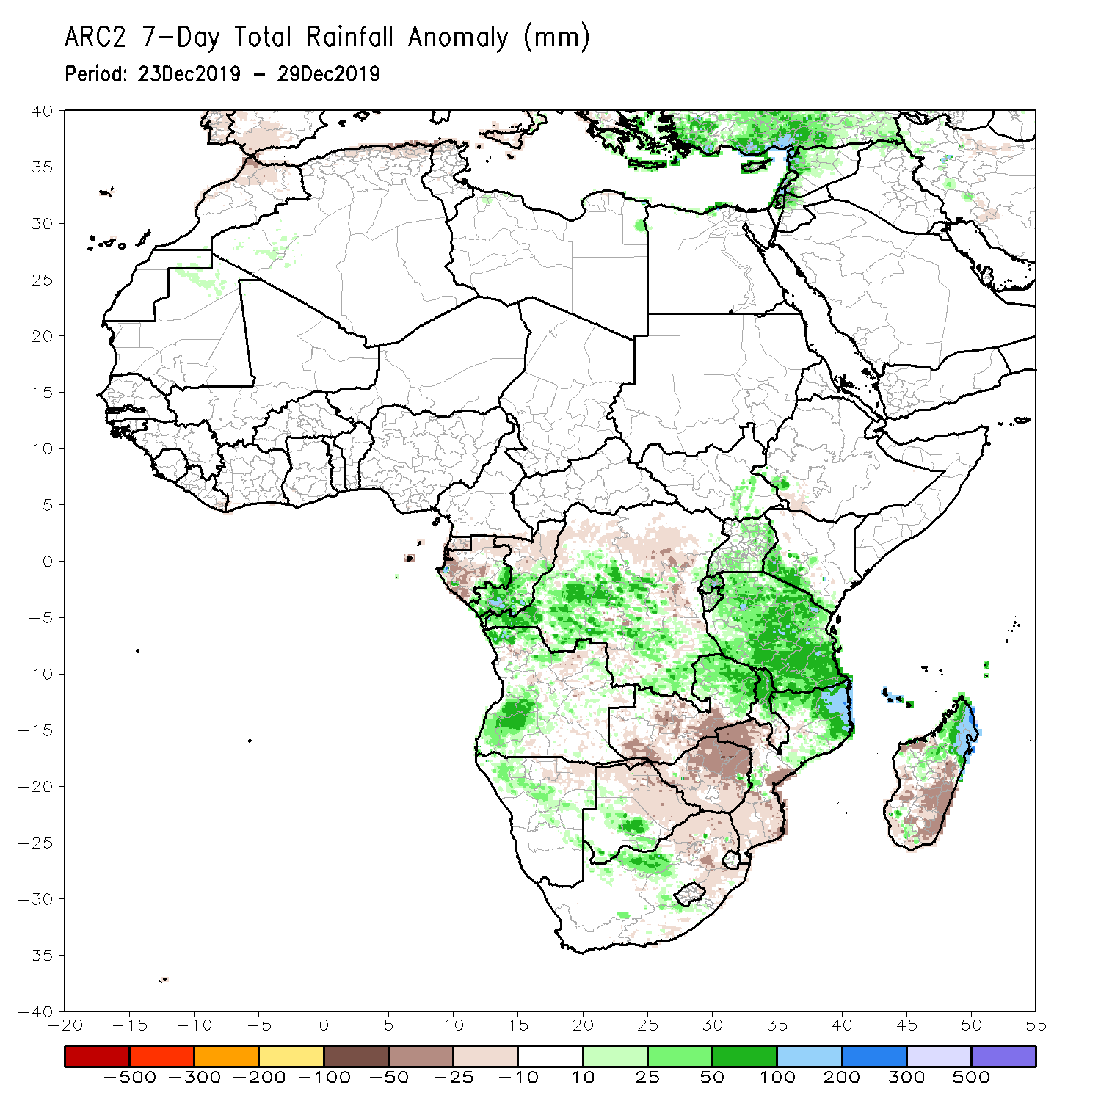
Rainfall Patterns: Last 7 Days
During the past 7 days, rainfall was below-average over parts of Gabon, western Zambia, eastern Botswana, Zimbabwe, northeastern South Africa, southern Mozambique and southern Madagascar.
Weekly rainfall totals exceeded 100mm over parts of Tanzania, Malawi, eastern Zambia, northern Mozambique and northern Madagascar. Southern Congo, portions of Angola, many parts of DRC, eastern Zambia, Uganda, much of Tanzania, Malawi, northern Mozambique and northern Madagascar had above-average rainfall.

Slide 5
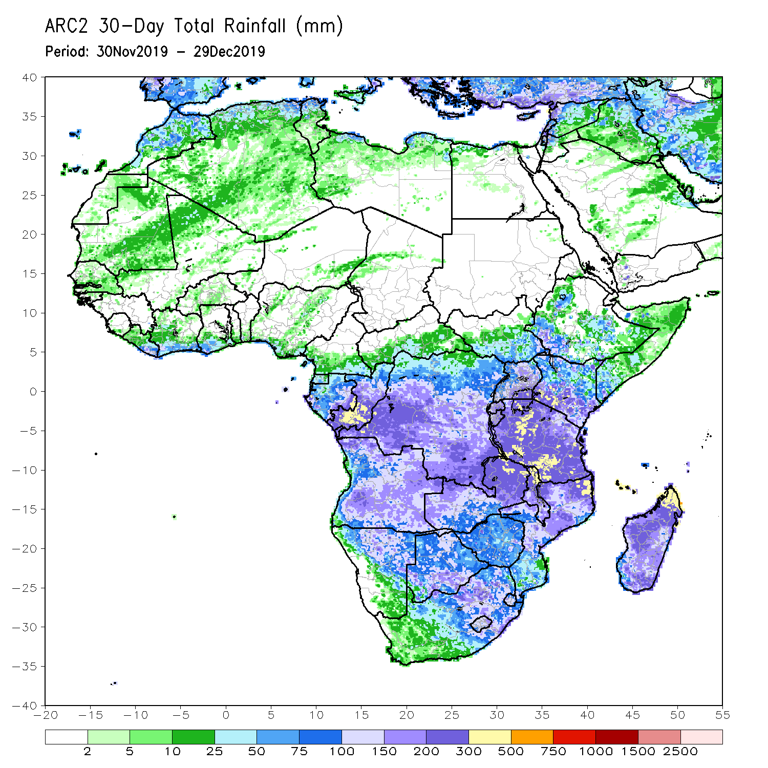
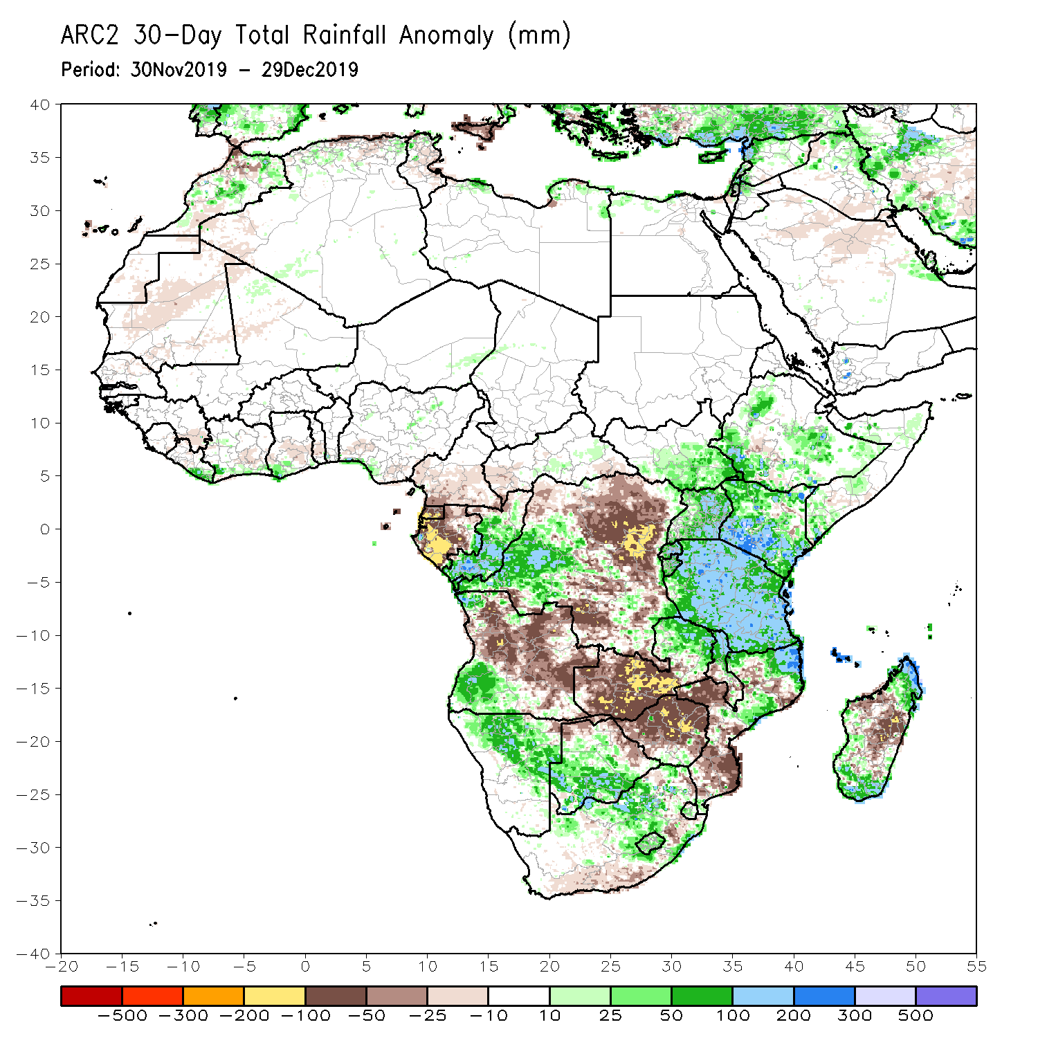
Rainfall Patterns: Last 30 Days
During the past 30 days, rainfall was above-average over central and southern Congo, western DRC, parts of South Sudan and Ethiopia, Rwanda, Burundi, Uganda, Kenya, Tanzania, parts of Somalia, southwestern Angola, Namibia, Botswana, eastern Zambia, eastern South Africa, Malawi, northern Mozambique, South Africa and parts of Madagascar.
Equatorial Guinea, Gabon, many parts of Angola and DRC, western and southern Zambia, Zimbabwe, southern Mozambique, and parts of Madagascar had below-average rainfall.
Notes:
5

Slide 6
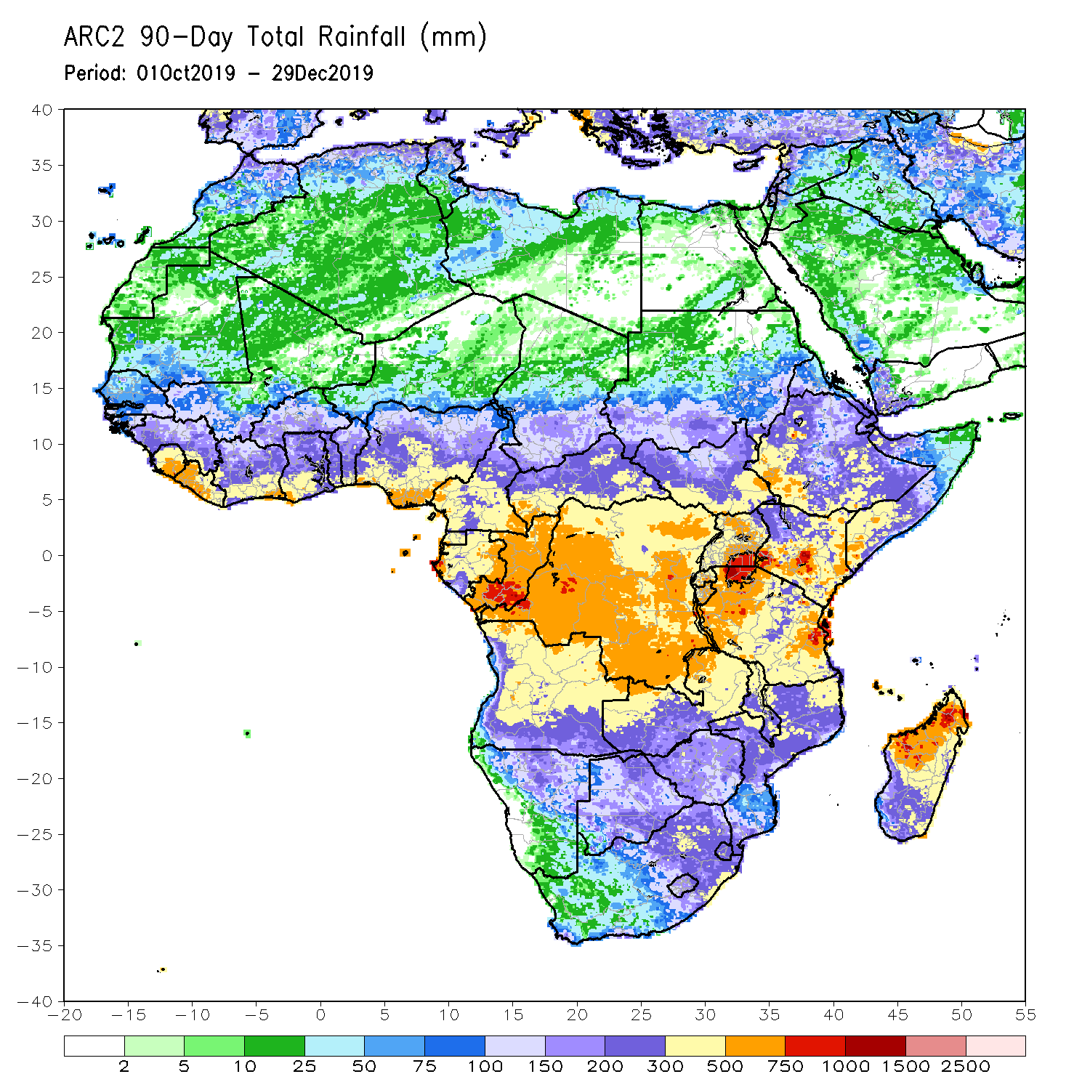
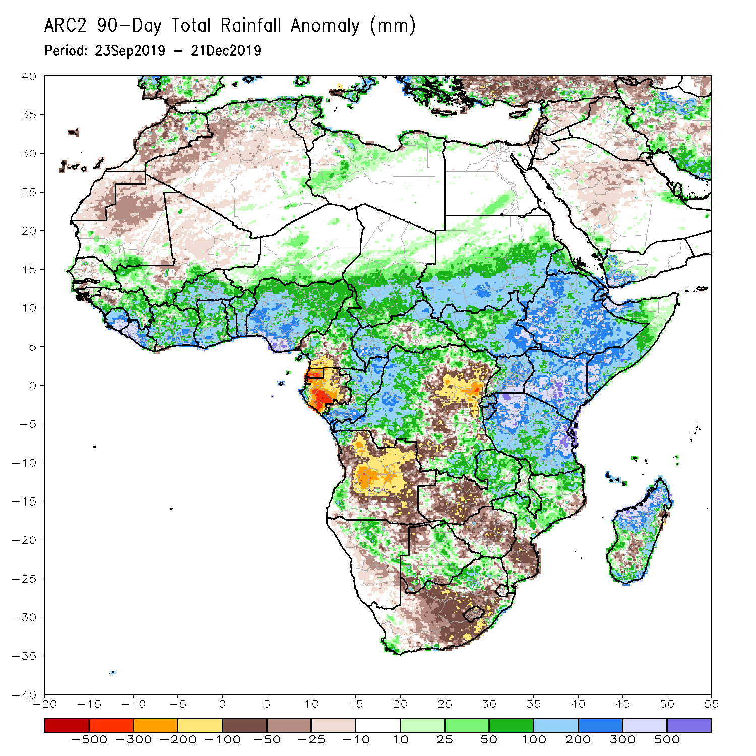
Rainfall Patterns: Last 90 Days
During the past 90 days, rainfall was above-average over parts of Guinea, Sierra Leone, Liberia, southwestern Mali, Cote d’Ivoire, Burkina Faso, Ghana, Togo, Benin, parts of Niger, Nigeria, Chad, portions of Cameroon and CAR, portions of DRC, South Sudan, Uganda, southern and eastern Sudan, Eritrea, Ethiopia, Kenya, Somalia, many parts of Tanzania, local areas in Angola, eastern Zambia, parts of Namibia and Botswana, Malawi, northeastern South Africa, northern Mozambique, and many parts of Madagascar.
Local areas in Guinea, parts of southern Cameroon, Equatorial Guinea, Gabon, parts of CAR, portions of central and eastern DRC, many parts of Angola, western Zambia, Zimbabwe, parts of Namibia and Botswana, southern Mozambique, parts of southern Madagascar and many parts of South Africa had below-average rainfall.
Notes:
6

Slide 7
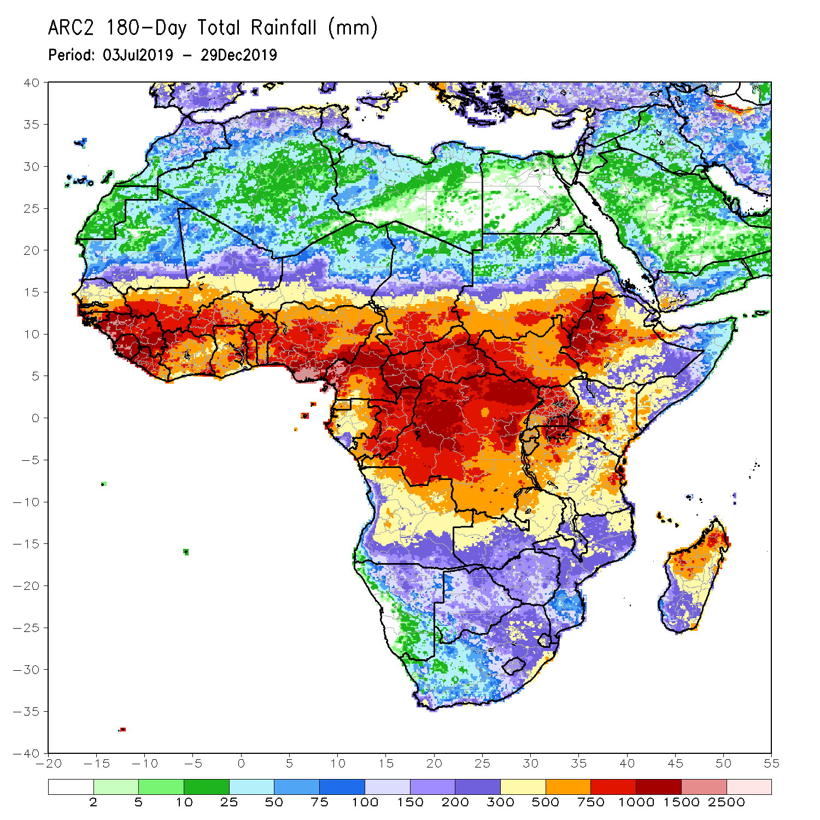
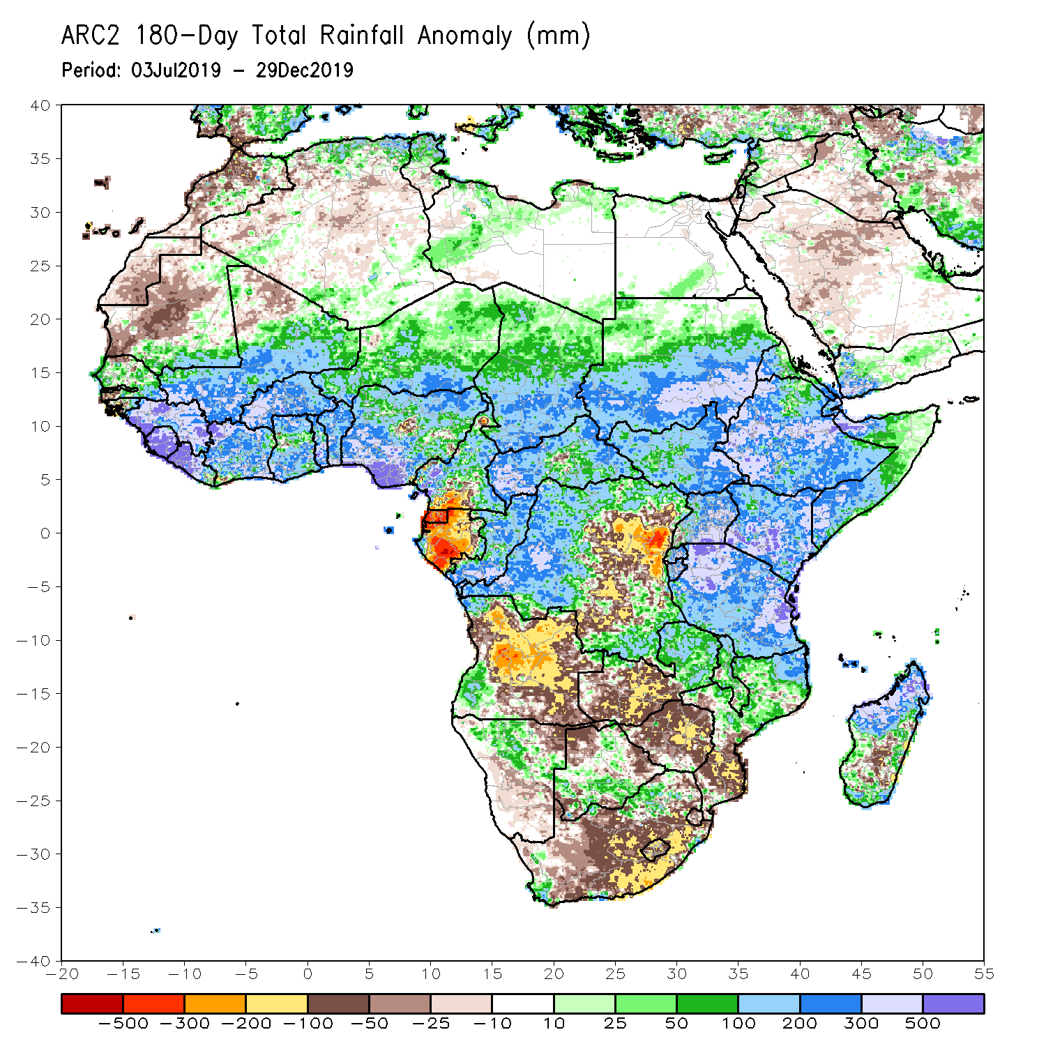
Rainfall Patterns: Last 180 Days
During the past 180 days, below-average rainfall was observed over portions of southern Cameroon, Equatorial Guinea, Gabon, parts of central and eastern DRC, many parts of Angola, parts of Namibia and Botswana, much of South Africa, western Zambia, Zimbabwe, and southern Mozambique and southern Madagascar.
Parts of Southern and eastern Mauritania, much of Senegal, Guinea-Bissau, Guinea, Sierra Leone, Mali, Liberia, Cote d’Ivoire, Burkina Faso, Ghana, Togo, Benin, Nigeria, much of Cameroon, Niger, Chad, CAR, many parts of DRC, South Sudan, Sudan, Uganda, Eritrea, Ethiopia, Somalia, Kenya, Tanzania, local areas in Angola, portions of Zambia, Namibia and Botswana, much of Malawi, northern Mozambique and many parts of Madagascar had above-average rainfall.
Notes:
7

Slide 8
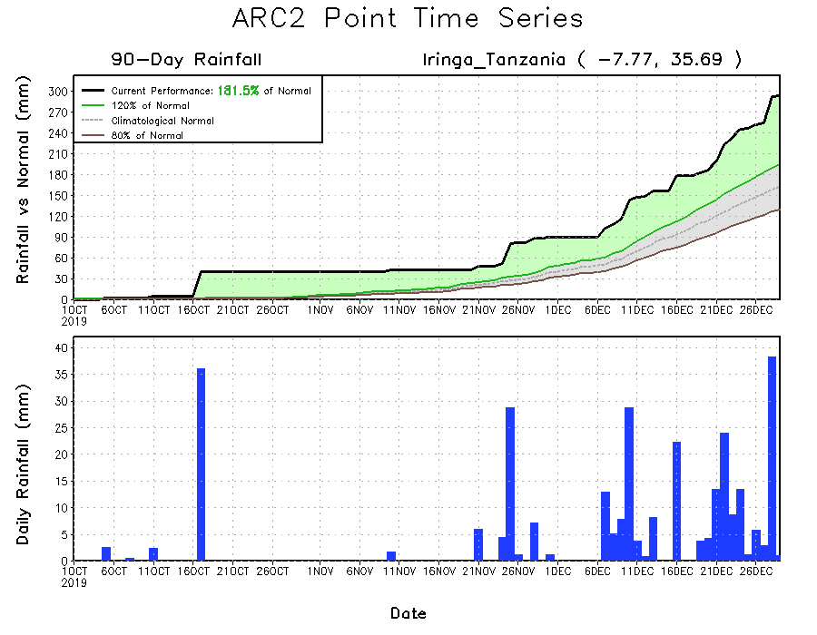
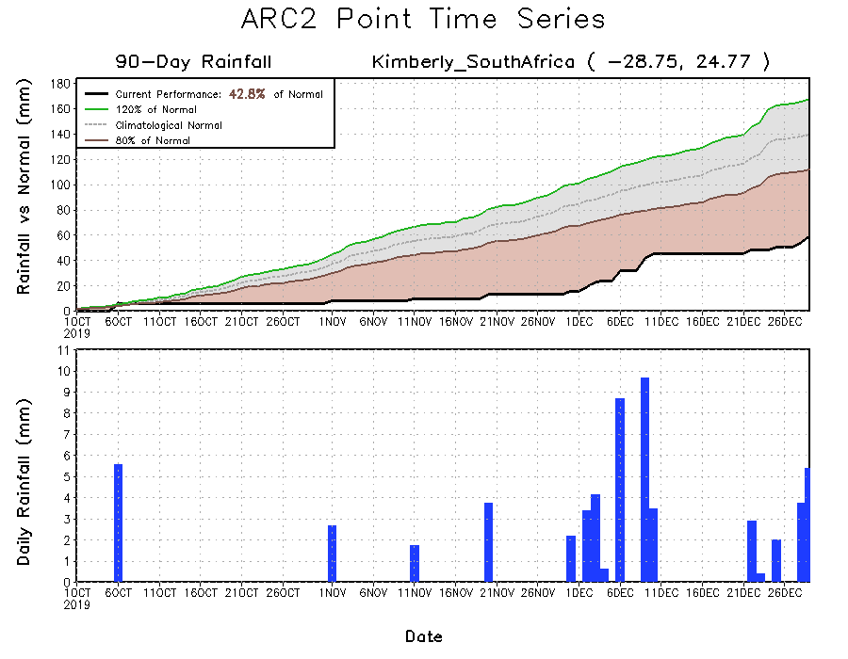
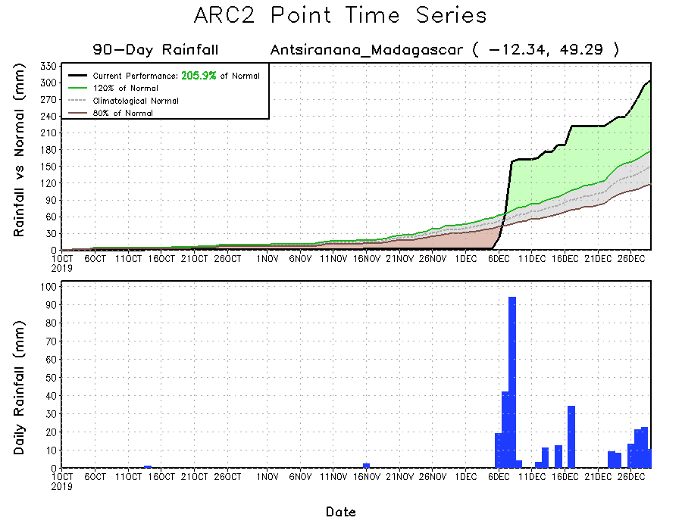
Recent Rainfall Evolution
Daily evolution of rainfall over the last 90 days at selected locations shows that moderate to locally heavy rainfall sustained moisture surpluses over man parts of Tanzania (top right) and northern Madagascar (bottom right). Seasonal total rainfall remained below-average over many parts of South Africa (bottom left).

Slide 9
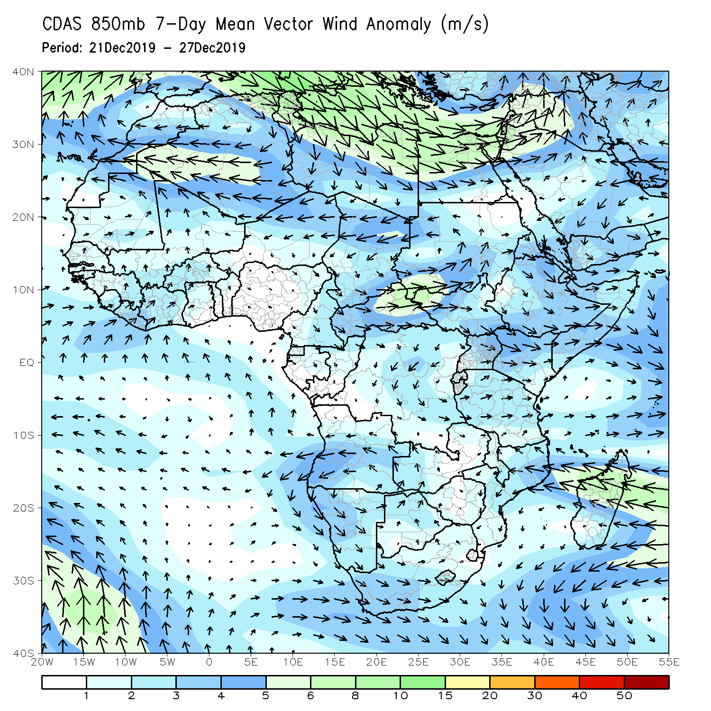
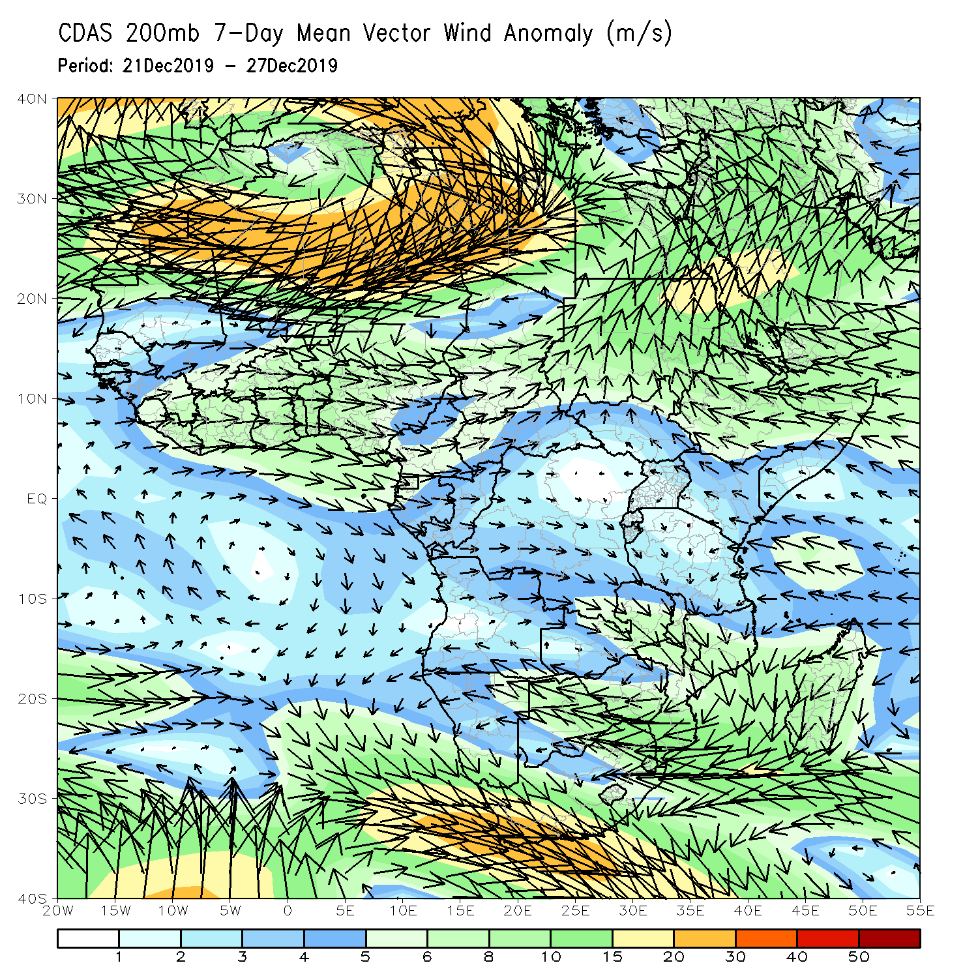
Atmospheric Circulation: Last 7 Days
An area of anomalous lower-level anti-cyclonic circulation (left) and upper level-cyclonic circulation (right) may have contributed the observed rainfall deficits across Southern Africa.

Slide 10
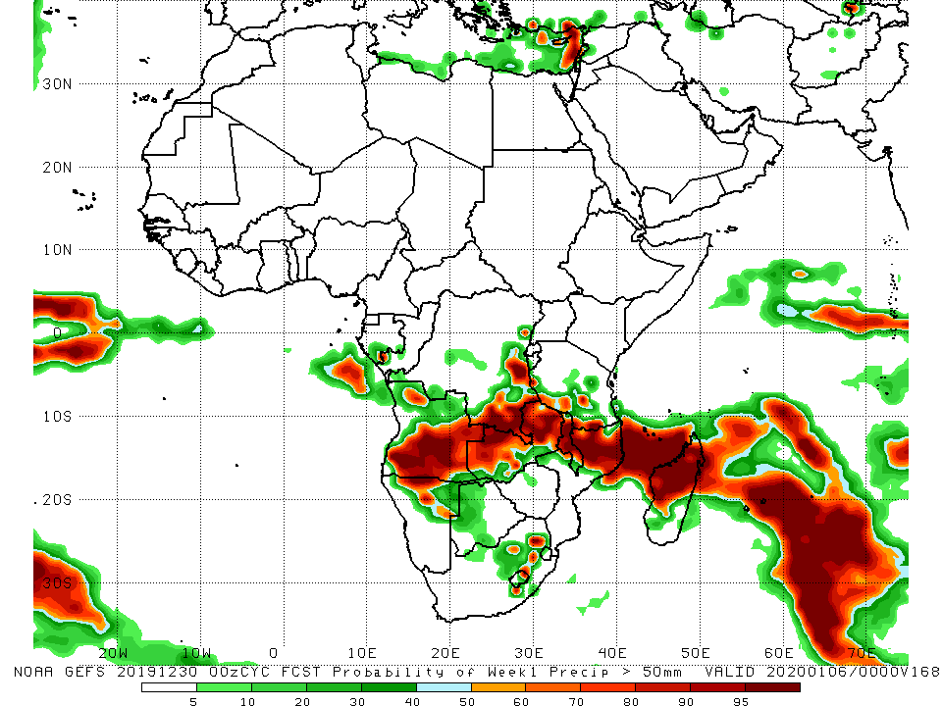
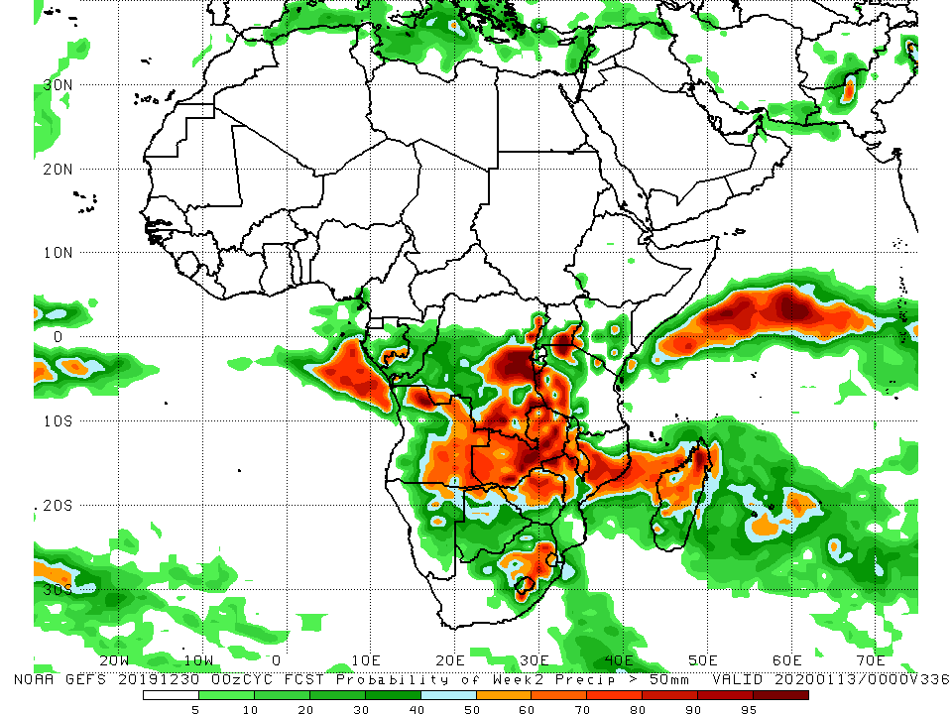
NCEP GEFS Model Forecasts Non-Bias Corrected Probability of precipitation exceedance
Week-1: Valid 31 December 2019 – 6 January, 2020
Week-2: Valid 7 – 13 January, 2020
For week-1 (left panel), there is an increased chance for weekly rainfall totals to exceed 50mm over central and southern Angola, parts of southern and eastern DRC, Zambia, Malawi, parts of southern Tanzania, northern Mozambique, local areas in South Africa, and northern Madagascar. For week-2 (right panel), there is an increased chance for weekly rainfall totals to exceed 50mm over portions of Angola and DRC, Zambia, Zimbabwe, western Tanzania, northern Mozambique, Malawi, parts of South Africa, and northern Madagascar.
Notes:
10

Slide 11
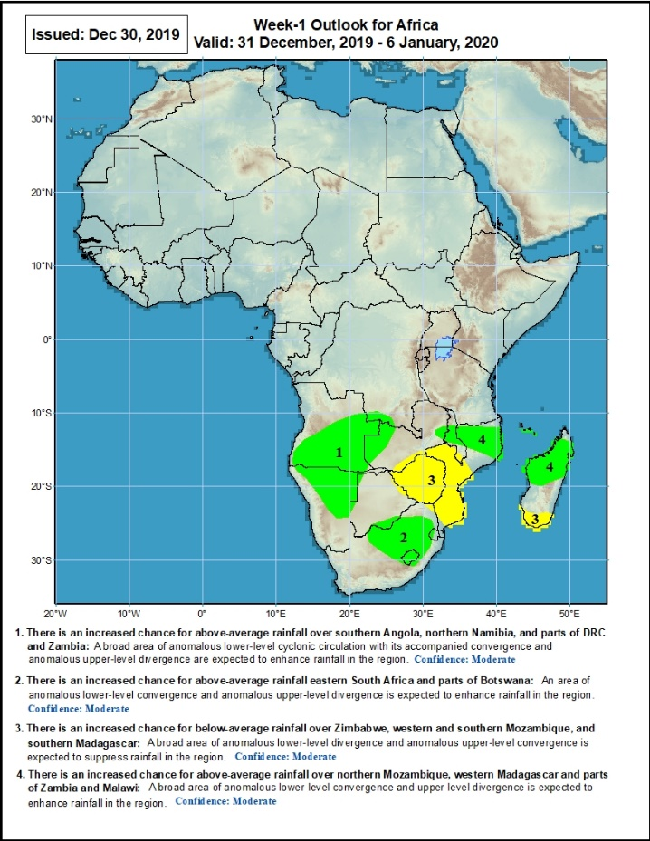
Week-1 Precipitation Outlooks
31 December 2019 - 6 January, 2020
There is an increased chance for above-average rainfall over southern Angola, northern Namibia, and parts of DRC and Zambia: A broad area of anomalous lower-level cyclonic circulation and upper-level divergence is expected to enhance rainfall in the region. Confidence: Moderate
There is an increased chance for above-average rainfall eastern South Africa and parts of Botswana: An area of anomalous lower-level convergence and upper-level divergence is expected to enhance rainfall in the region. Confidence: Moderate
There is an increased chance for below-average rainfall over Zimbabwe, western and southern Mozambique, and southern Madagascar: A broad area anomalous lower-level divergence and upper-level convergence is expected to suppress rainfall in the region. Confidence: Moderate
There is an increased chance for above-average rainfall over northern Mozambique, western Madagascar and parts of Zambia and Malawi: A broad area of anomalous lower-level convergence and upper-level divergence is expected to enhance rainfall in the region. Confidence: Moderate
Notes:
11

Slide 12
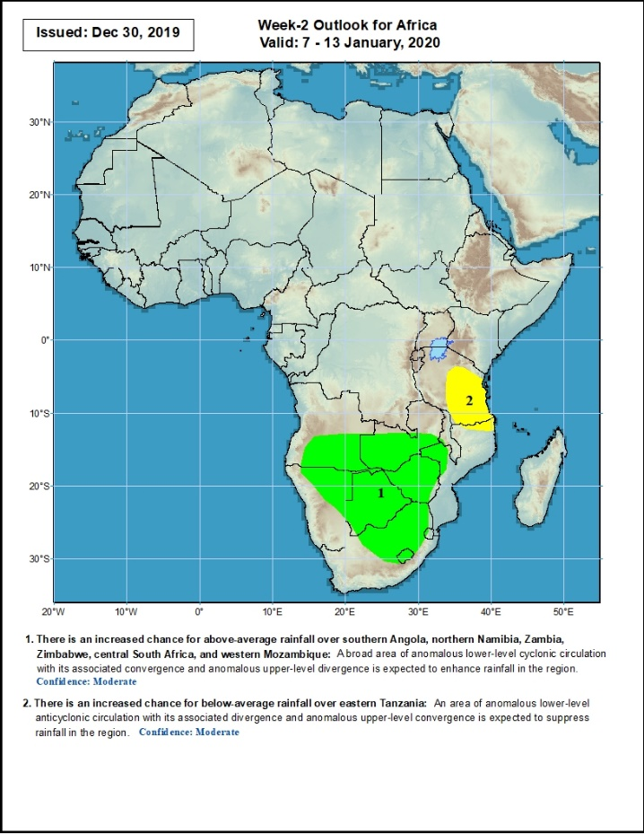
Week-2 Precipitation Outlooks
7 - 13 January, 2020
There is an increased chance for above-average rainfall over southern Angola, northern Namibia, Zambia, Zimbabwe, central South Africa, and western Mozambique: A broad area of anomalous lower-level cyclonic circulation and upper-level divergence is expected to enhance rainfall in the region. Confidence: Moderate
There is an increased chance for below-average rainfall over eastern Tanzania: An area of anomalous lower-level anti-cyclonic flow and upper-level convergence is expected to suppress rainfall in the region. Confidence: Moderate
Notes:
12

Slide 13
Summary
During the past 7 days, rainfall was below-average over parts of Gabon, western Zambia, eastern Botswana, Zimbabwe, northeastern South Africa, southern Mozambique and southern Madagascar. Weekly rainfall totals exceeded 100mm over parts of Tanzania, Malawi, eastern Zambia, northern Mozambique and northern Madagascar. Southern Congo, portions of Angola, many parts of DRC, eastern Zambia, Uganda, much of Tanzania, Malawi, northern Mozambique and northern Madagascar had above-average rainfall.
During the past 30 days, rainfall was above-average over central and southern Congo, western DRC, parts of South Sudan and Ethiopia, Rwanda, Burundi, Uganda, Kenya, Tanzania, parts of Somalia, southwestern Angola, Namibia, Botswana, eastern Zambia, eastern South Africa, Malawi, northern Mozambique, South Africa and parts of Madagascar. Equatorial Guinea, Gabon, many parts of Angola and DRC, western and southern Zambia, Zimbabwe, southern Mozambique, and parts of Madagascar had below-average rainfall.
During the past 90 days, rainfall was above-average over parts of Guinea, Sierra Leone, Liberia, southwestern Mali, Cote d’Ivoire, Burkina Faso, Ghana, Togo, Benin, parts of Niger, Nigeria, Chad, portions of Cameroon and CAR, portions of DRC, South Sudan, Uganda, southern and eastern Sudan, Eritrea, Ethiopia, Kenya, Somalia, many parts of Tanzania, local areas in Angola, eastern Zambia, parts of Namibia and Botswana, Malawi, northeastern South Africa, northern Mozambique, and many parts of Madagascar. Local areas in Guinea, parts of southern Cameroon, Equatorial Guinea, Gabon, parts of CAR, portions of central and eastern DRC, many parts of Angola, western Zambia, Zimbabwe, parts of Namibia and Botswana, southern Mozambique, parts of southern Madagascar and many parts of South Africa had below-average rainfall.
Week-1 outlooks call for an increased chance for above-average rainfall over southern Angola, northern Namibia, parts of southern DRC, Zambia, eastern South Africa, parts of Botswana, northern Mozambique, western Madagascar, and parts of Zambia and Malawi. In contrast, there is an increased chance for below-average rainfall over Zimbabwe, western and southern Mozambique, and southern Madagascar.
Notes:
13

