Slide 1
The African Monsoon Recent Evolution and Current Status Include Week-1 and Week-2 Outlooks
Update prepared by
Climate Prediction Center / NCEP
18 November 2019
For more information, visit:
http://www.cpc.ncep.noaa.gov/products/Global_Monsoons/African_Monsoons/precip_monitoring.shtml

Slide 2
Outline
Highlights
Recent Evolution and Current Conditions
NCEP GEFS Forecasts
Summary

Slide 3
Highlights: Last 7 Days
Weekly rainfall totals exceeded 100mm over parts of Sierra Leone and Liberia, eastern and southern DRC, northeastern Zambia, western Tanzania, parts of Kenya, and local areas in Ethiopia and southern Somalia.
Week-1 outlooks call for an increased chance for above-average rainfall over parts of eastern Botswana and southern Zimbabwe, northeastern South Africa, Eswantini, and southern Mozambique. Outlooks also call for above-average rainfall over eastern DRC, eastern South Sudan, southern Ethiopia, Uganda, Rwanda, Burundi, northern Tanzania, and Kenya. In contrast, there is an increased chance for below-average rainfall over portions of Angola and Namibia, western Zambia, western Botswana, parts of southern Tanzania, southern Malawi and northern Mozambique.

Slide 4
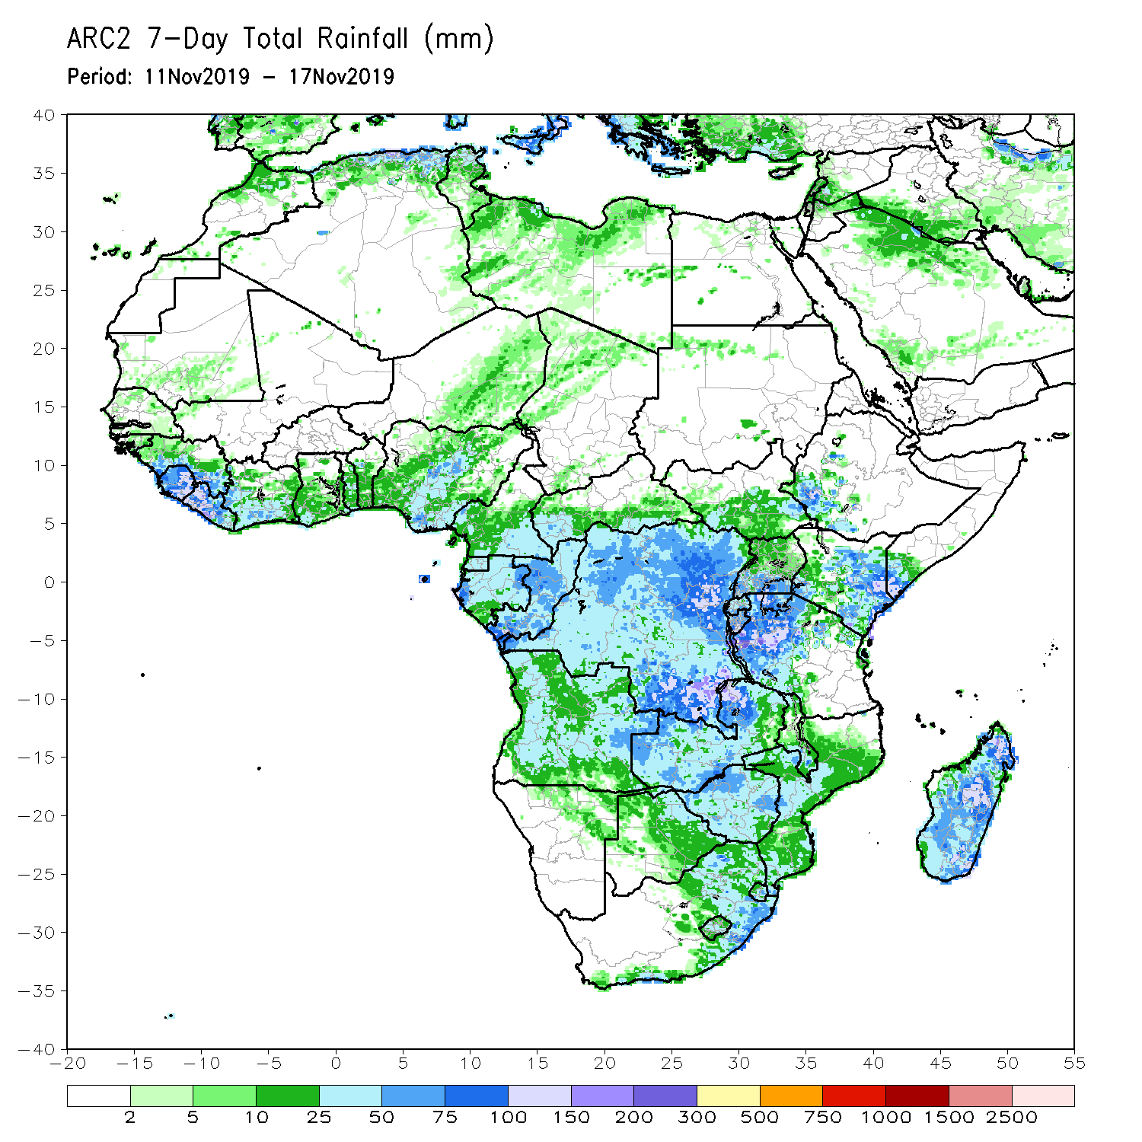
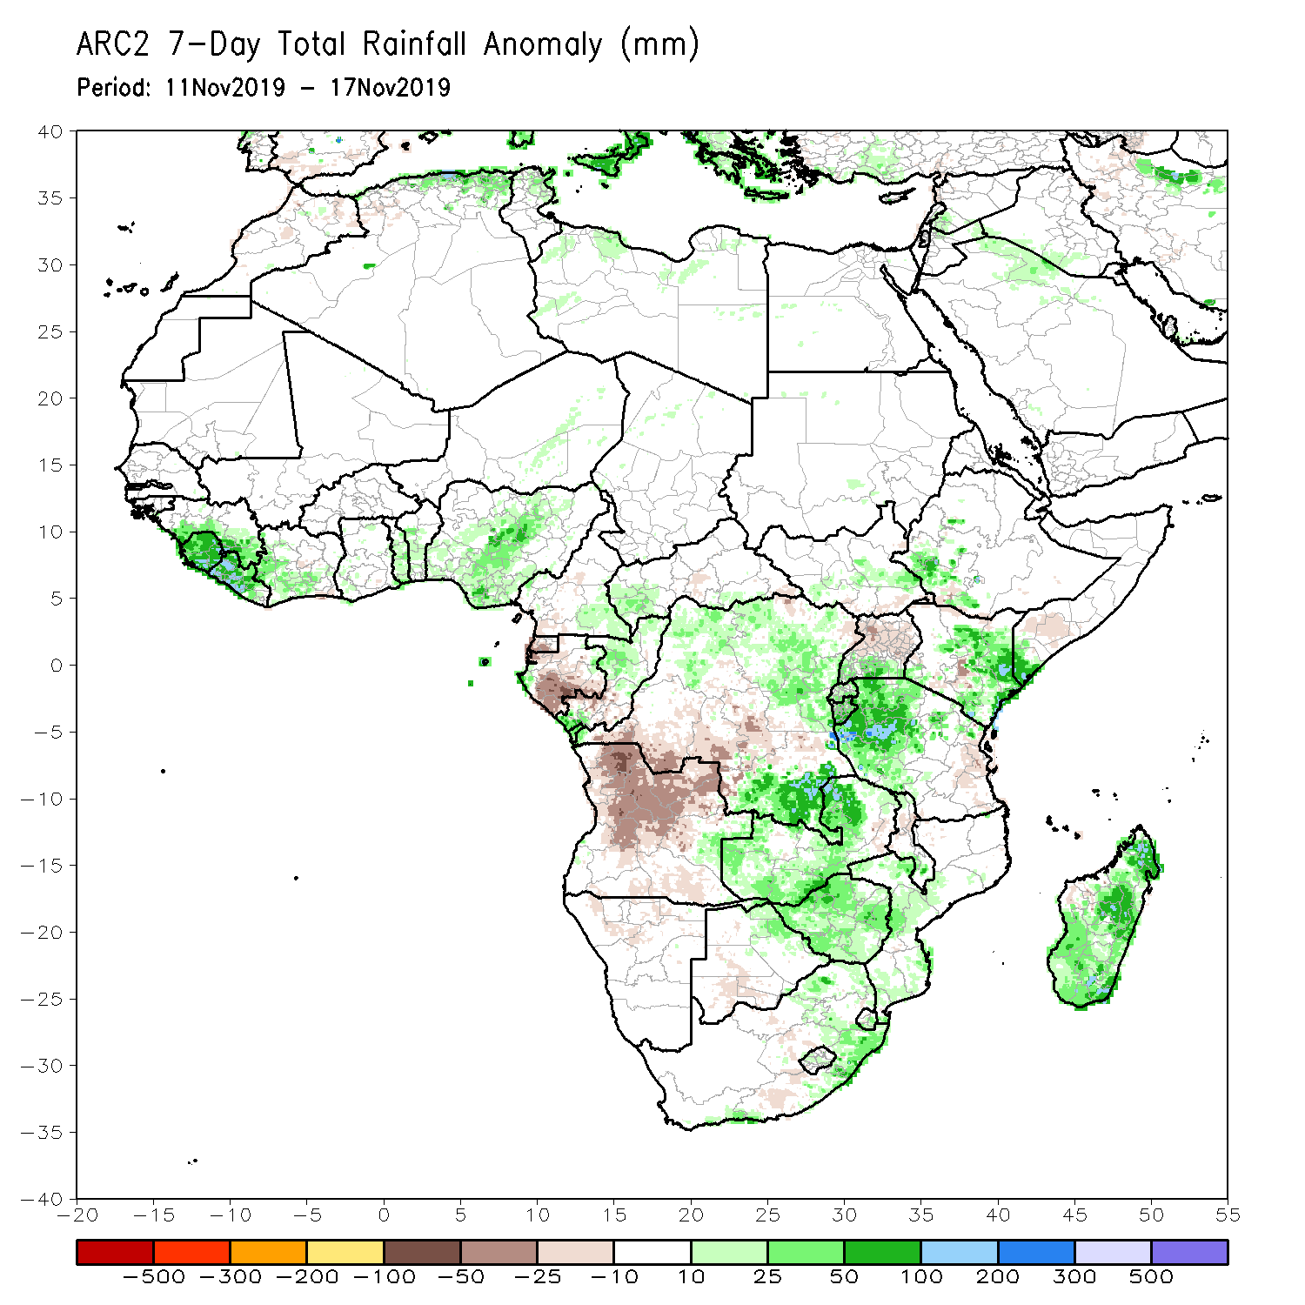
Rainfall Patterns: Last 7 Days
During the past 7 days, Weekly rainfall totals exceeded 100mm over parts of Sierra Leone and Liberia, eastern and southern DRC, northeastern Zambia, western Tanzania, parts of Kenya, and local areas in Ethiopia and southern Somalia. Parts of Guinea, Sierra Leone, Liberia, Cote d’Ivoire, parts of Togo and Benin, Nigeria, eastern Cameroon, western CAR, parts of Congo and DRC, local areas in South Sudan, southwestern Ethiopia, southern Uganda, central and eastern Kenya, southern Somalia, Tanzania, Zambia, Zimbabwe, Mozambique, eastern South Africa and Madagascar had above-average rainfall.
Below-average rainfall was observed over Equatorial Guinea, Gabon, southern Congo, parts of DRC, parts of Uganda, southeastern Tanzania, local areas in Kenya, and much of Angola.

Slide 5
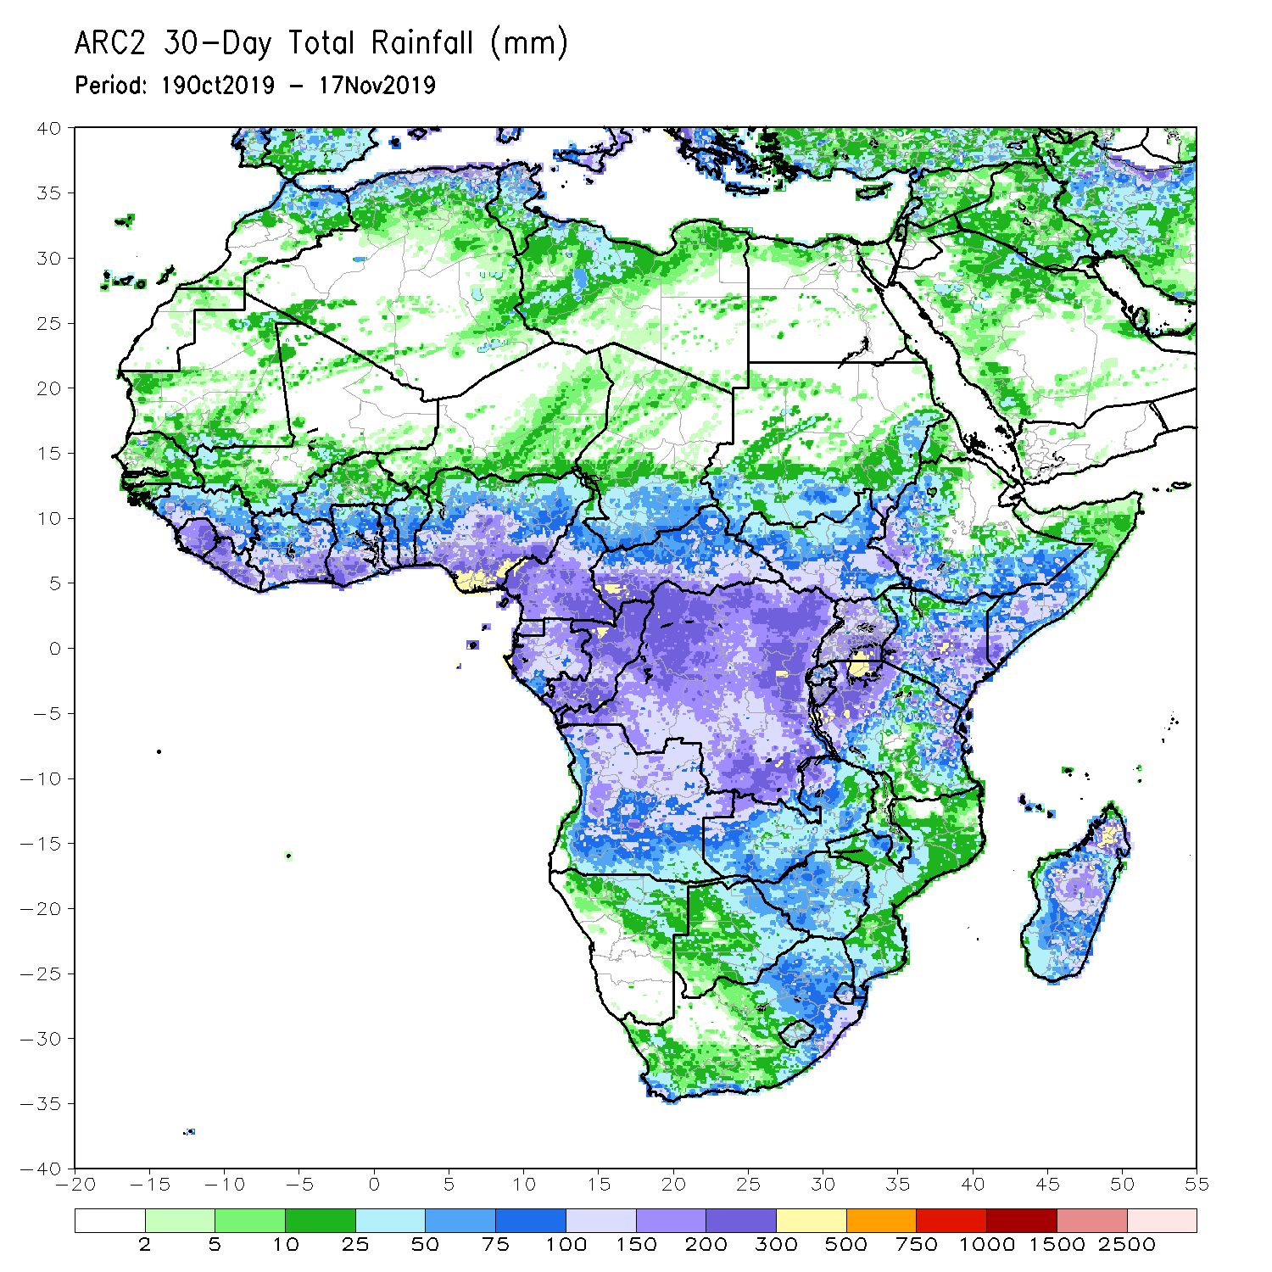
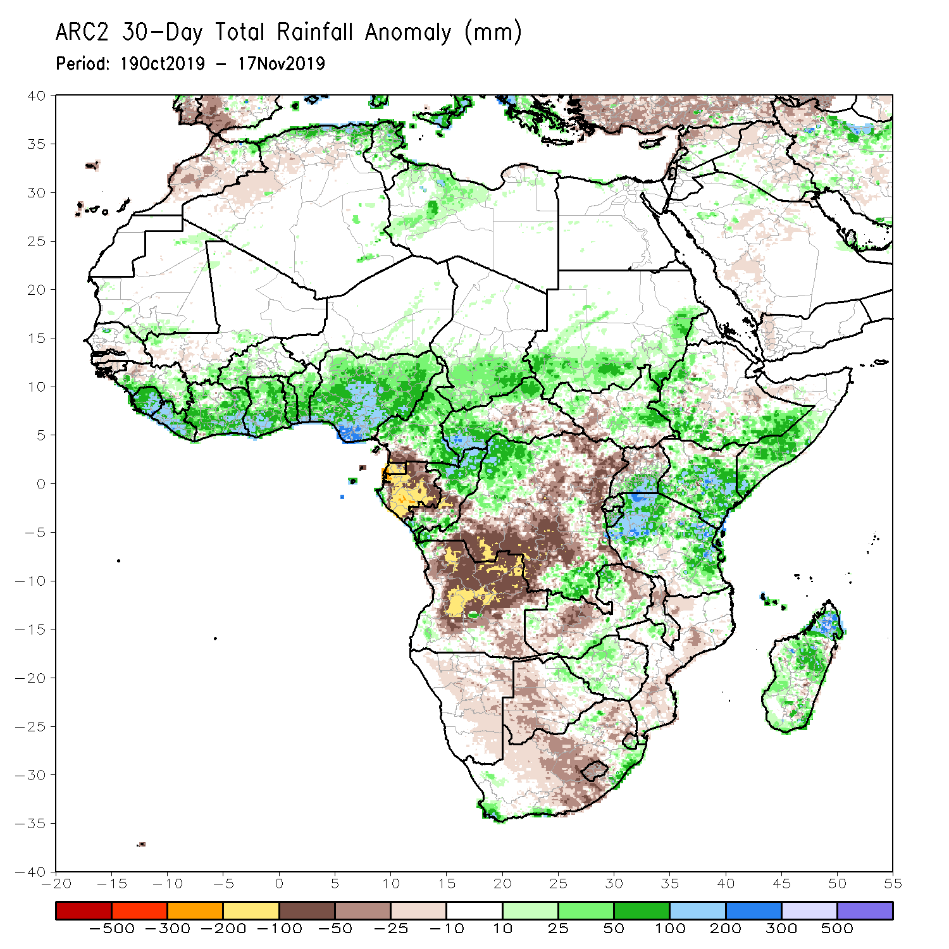
Rainfall Patterns: Last 30 Days
During the past 30 days, rainfall was above-average over local areas in southern Mauritania and Senegal parts of Guinea, Sierra Leone, Liberia, parts of southern Mali and Burkina Faso, Ghana, Cote d’Ivoire, Togo, Benin, much of Nigeria, Cameroon, southern Chad, portions of CAR and Congo, portions of DRC and South Sudan, Sudan, western and southern Ethiopia, southern Uganda, Tanzania, Somalia, Kenya, local areas in eastern Botswana, Zambia and South Africa, and many parts of Madagascar.
Parts of Senegal, Guinea-Bissau, western Guinea, parts of Mali, southern Cameroon, many parts of Gabon, central Congo, much of Angola, many parts of DRC, Namibia, Zambia, Malawi, Botswana, Zimbabwe, Mozambique, and many parts of South Africa had below-average rainfall.
Notes:
5

Slide 6
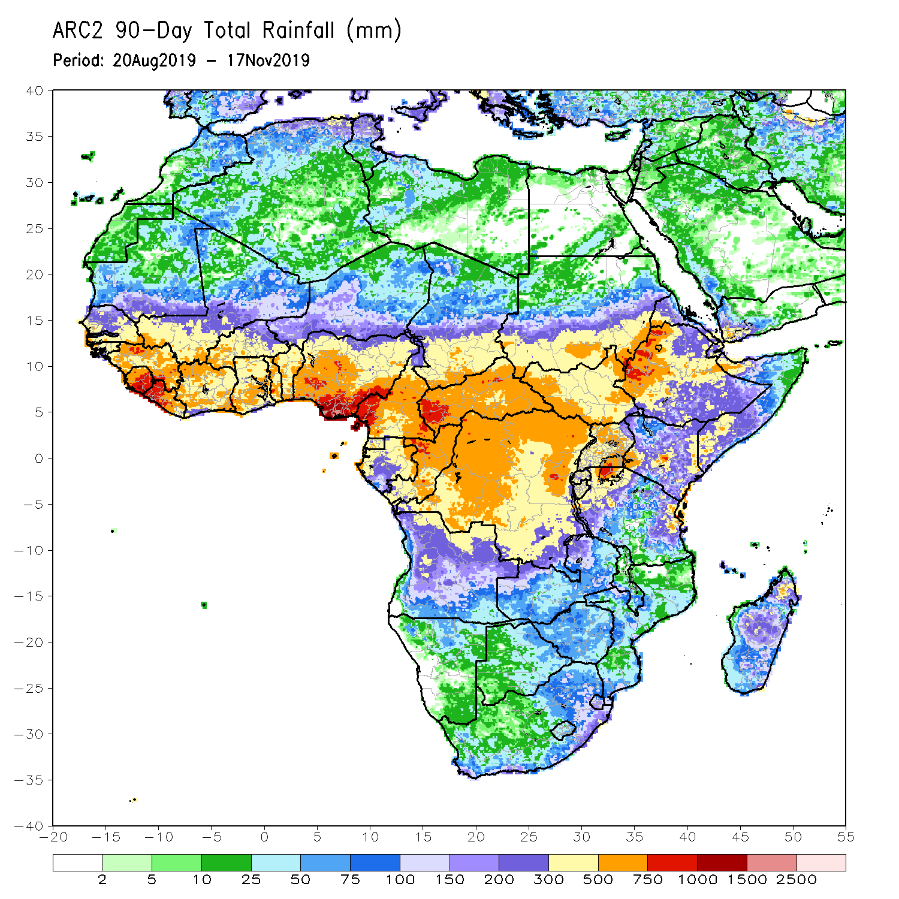
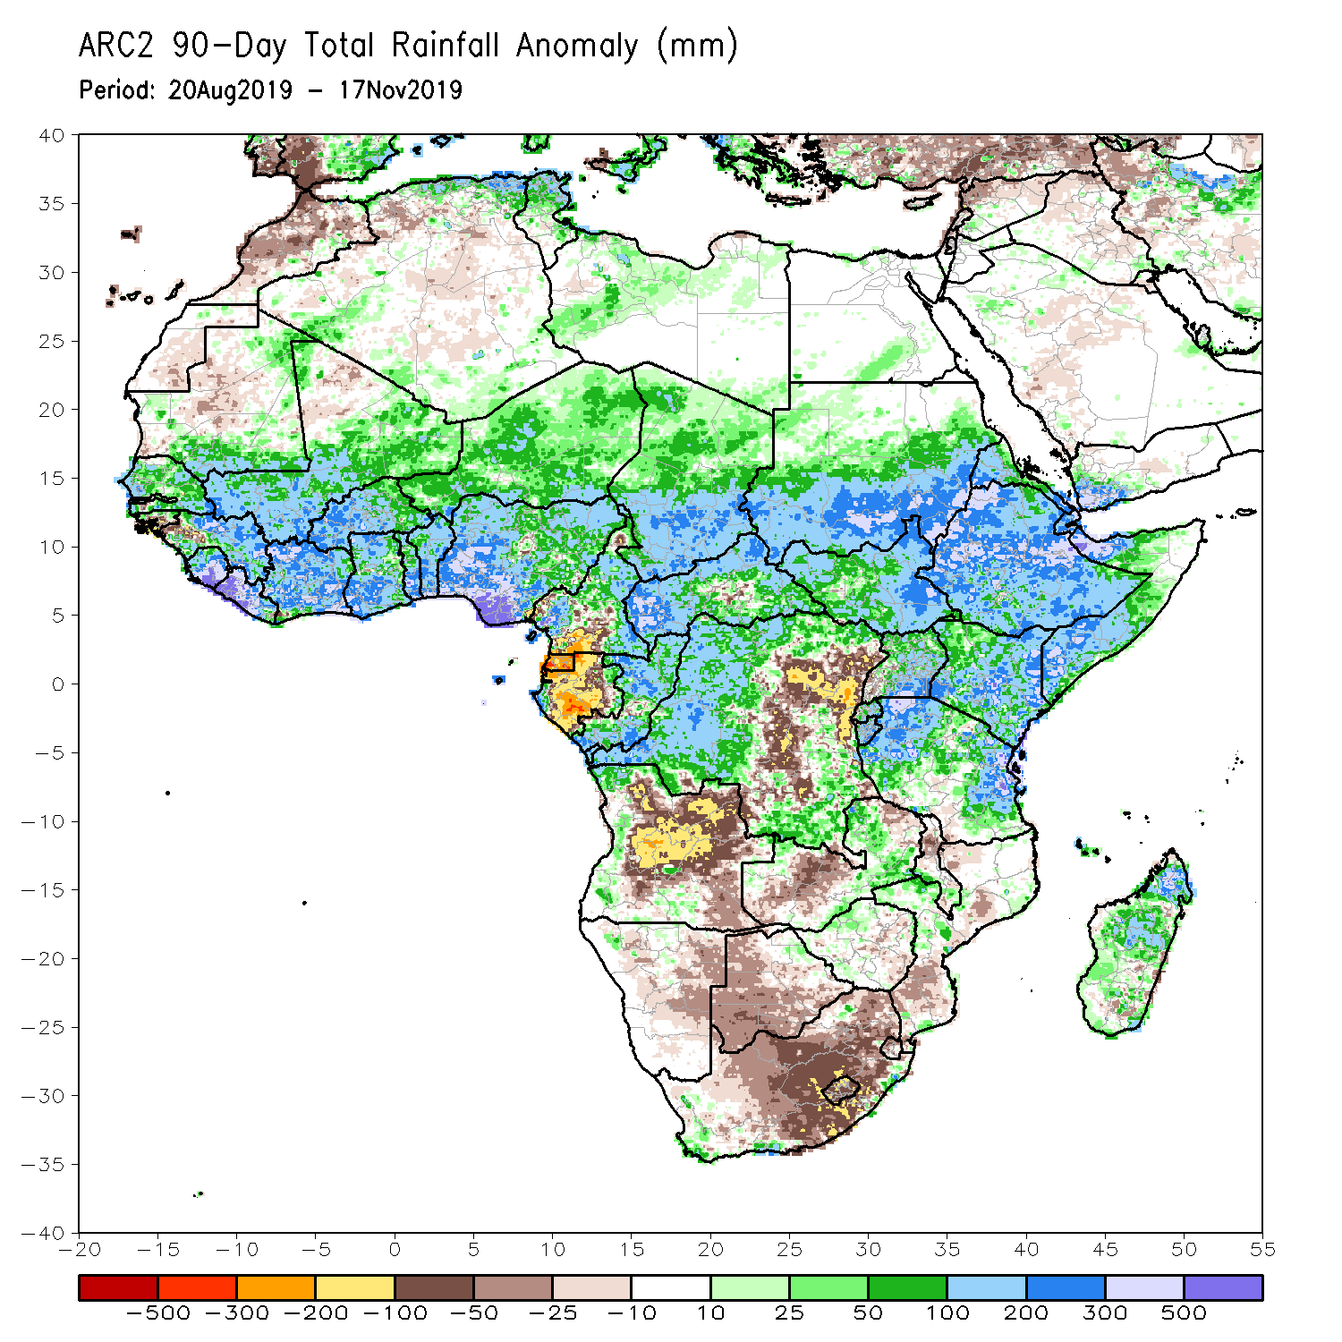
Rainfall Patterns: Last 90 Days
During the past 90 days, rainfall was above-average over parts of southern Mauritania, much of Senegal, Guinea-Bissau, Guinea, Sierra Leone, Liberia, Mali, Cote d’Ivoire, Burkina Faso, Ghana, Togo, Benin, Niger, many parts of Nigeria, Chad, portions of Cameroon, CAR, many parts of DRC, South Sudan, Uganda, Sudan, Eritrea, Ethiopia, Kenya, Somalia, many parts of Tanzania, portions of Angola, eastern Zambia, and local areas in Mozambique and Madagascar.
Western and central Mauritania, parts of Cameroon, Gabon, portions of central and eastern DRC, many parts of Angola, Zambia, Zimbabwe, eastern Namibia, Botswana, southern Madagascar and many parts of South Africa had below-average rainfall.
Notes:
6

Slide 7
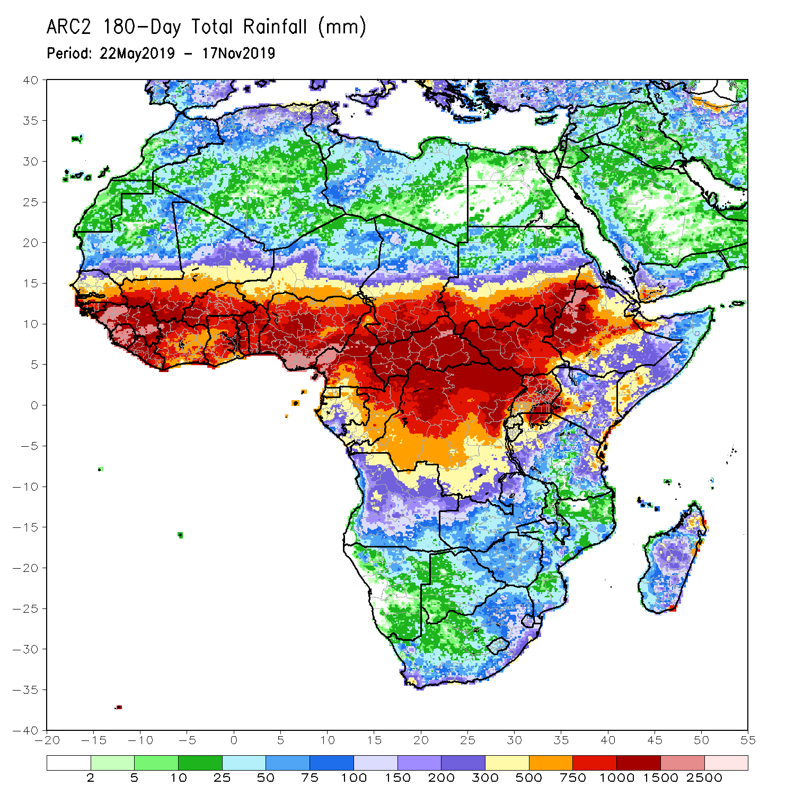
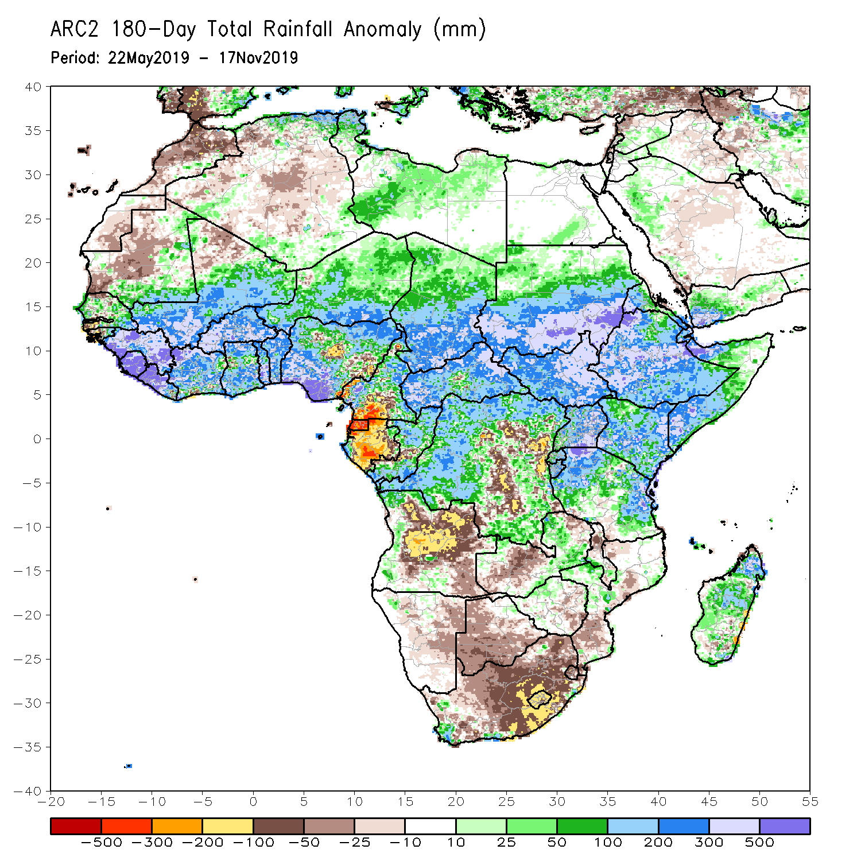
Rainfall Patterns: Last 180 Days
During the past 180 days, below-average rainfall was observed over western and central Mauritania, portions of Nigeria and Cameroon, Equatorial Guinea, Gabon, local areas in Congo, parts of central and eastern DRC, many parts of Angola, Namibia, much of South Africa, western Zambia, Botswana, Zimbabwe, and portions of Mozambique.
Southern and eastern Mauritania, much of Senegal, Guinea-Bissau, Guinea, Sierra Leone, Mali, Liberia, Cote d’Ivoire, Burkina Faso, Ghana, Togo, Benin, many parts of Nigeria and Cameroon, Niger, Chad, CAR, many parts of DRC, South Sudan, Sudan, Uganda, Eritrea, Ethiopia, Somalia, Kenya, Tanzania, western Angola and parts of eastern Zambia, local areas in Mozambique and South Africa and many parts of Madagascar had above-average rainfall.
Notes:
7

Slide 8
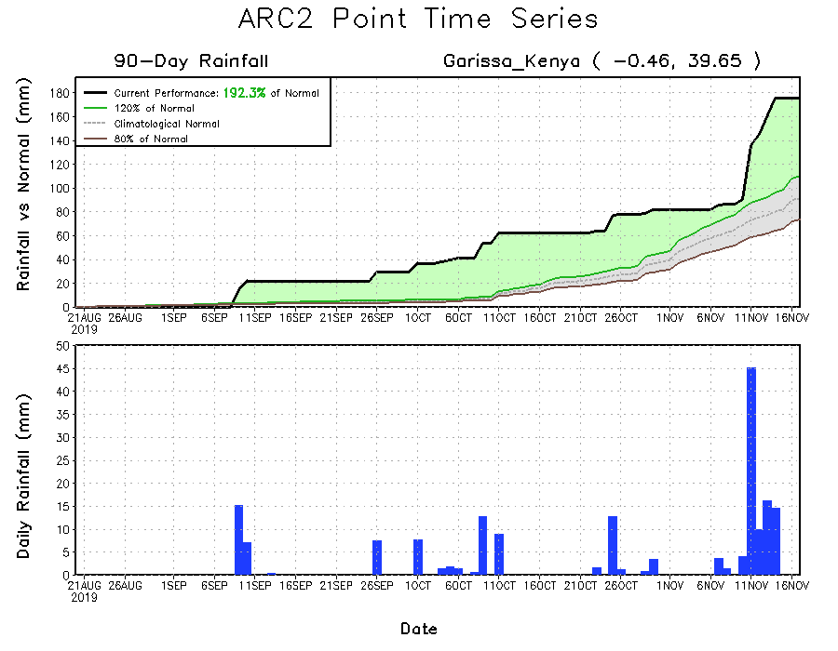
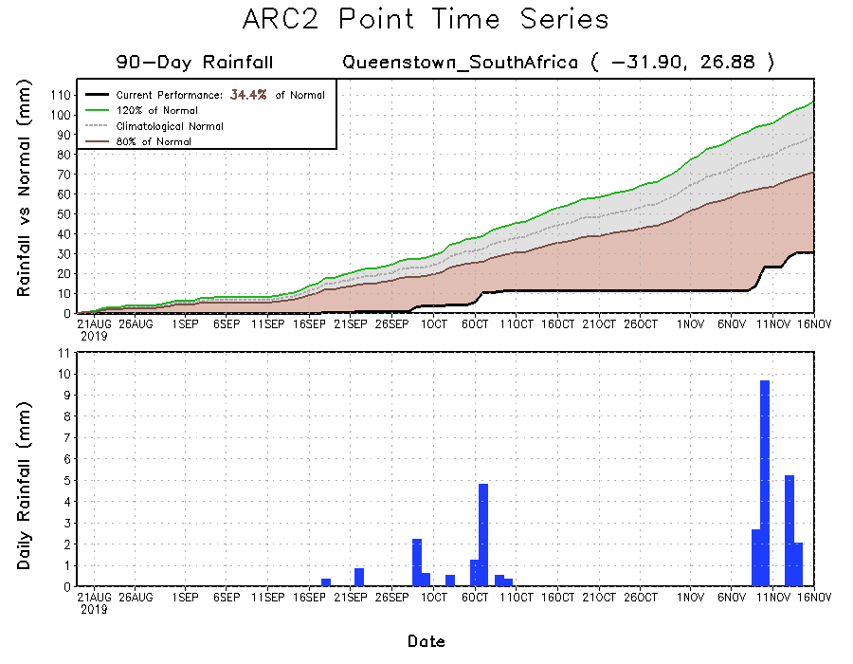
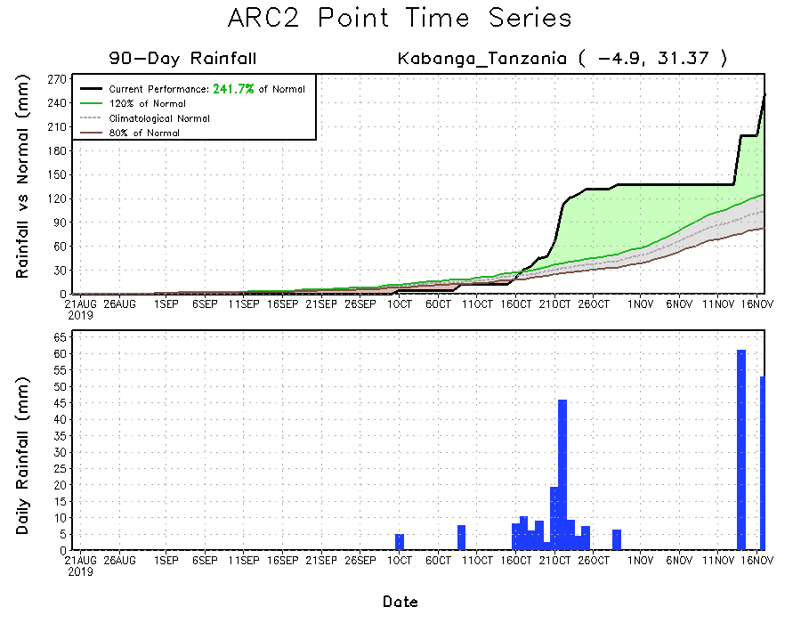
Recent Rainfall Evolution
Daily evolution of rainfall over the last 90 days at selected locations shows that moderate to locally heavy rainfall sustained moisture surpluses over parts of Tanzania (bottom right) and Kenya (top right). Seasonal total rainfall remained below-average over many parts of South Africa (bottom left).

Slide 9
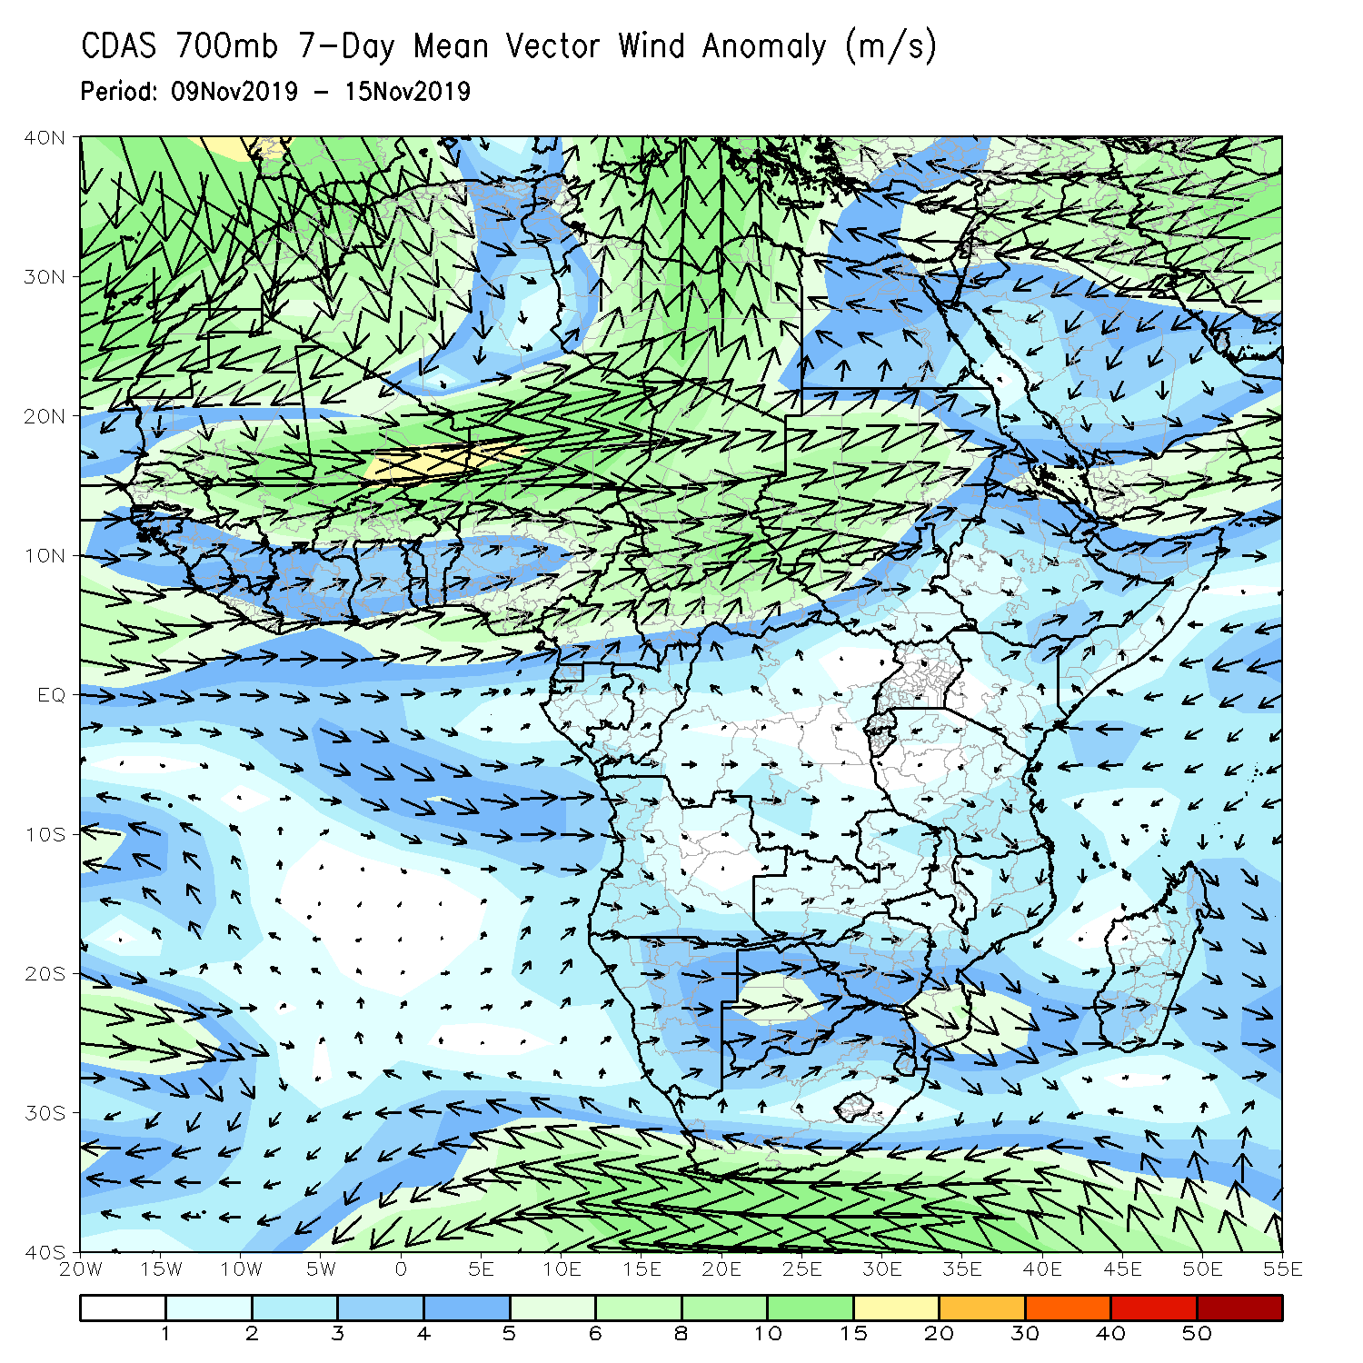
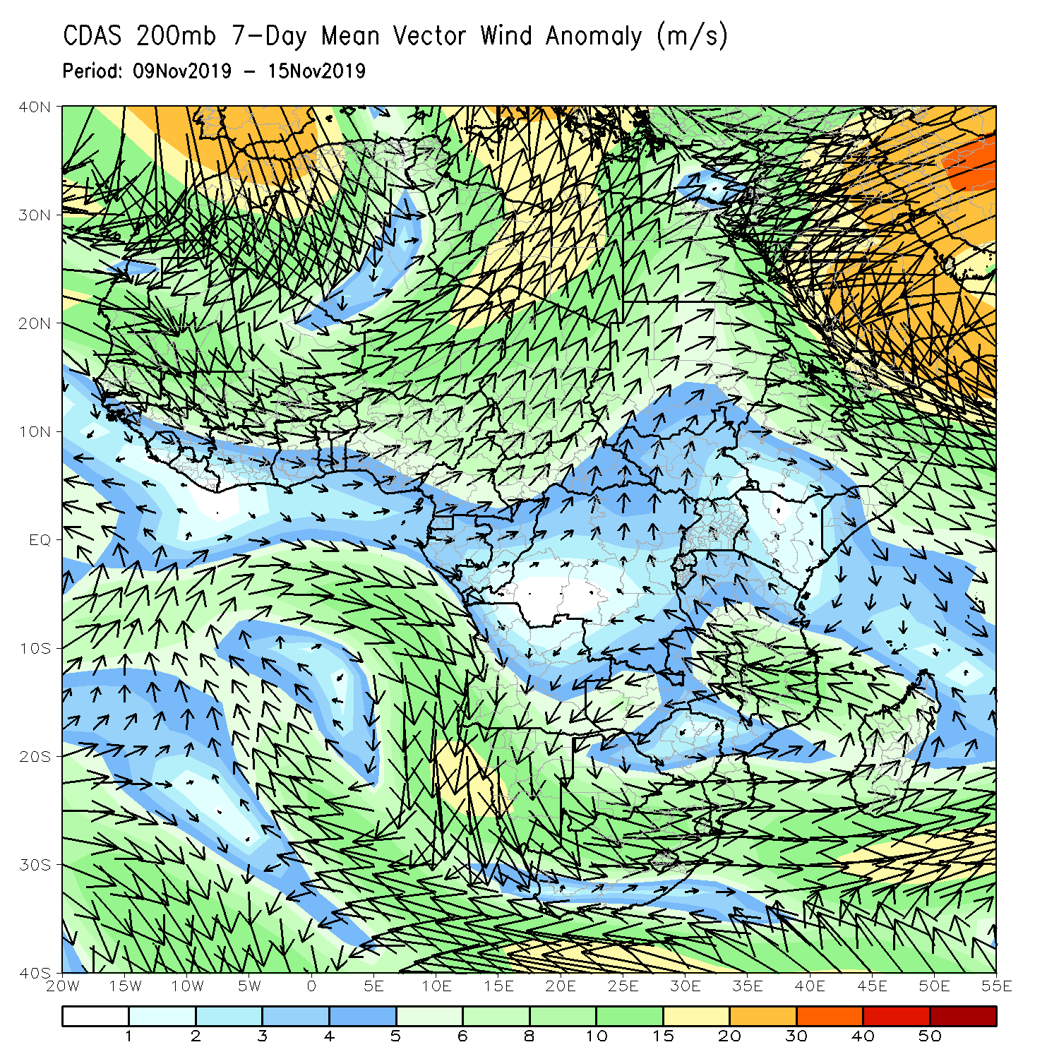
Atmospheric Circulation: Last 7 Days
Lower-level anomalies were westerly across much of West and Central Africa (left panel).

Slide 10
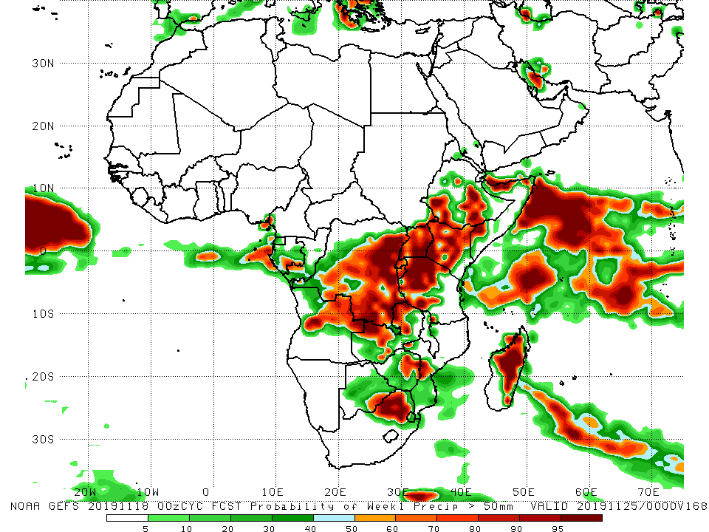
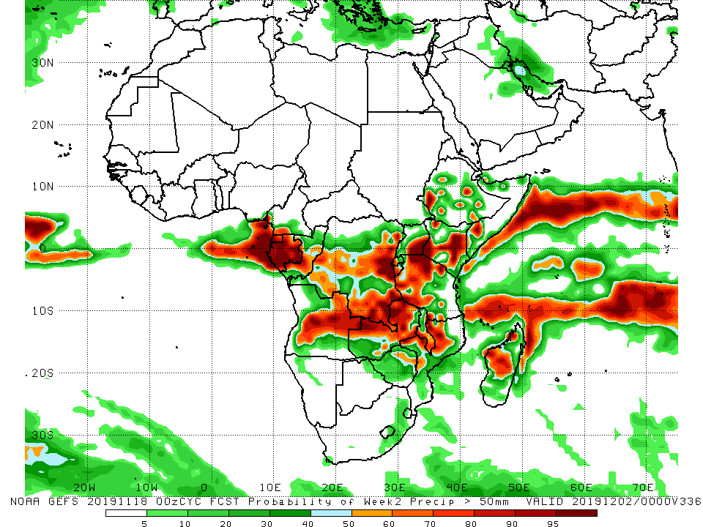
NCEP GEFS Model Forecasts Non-Bias Corrected Probability of precipitation exceedance
Week-1: Valid 19 – 25 November, 2019
Week-2: Valid 26 November – 2 December, 2019
For week-1 (left panel) and week-2 (right panel) there is an increased chance for weekly rainfall totals to exceed 50mm over many places in Central and East Africa, and portions southern Africa.
Notes:
10

Slide 11
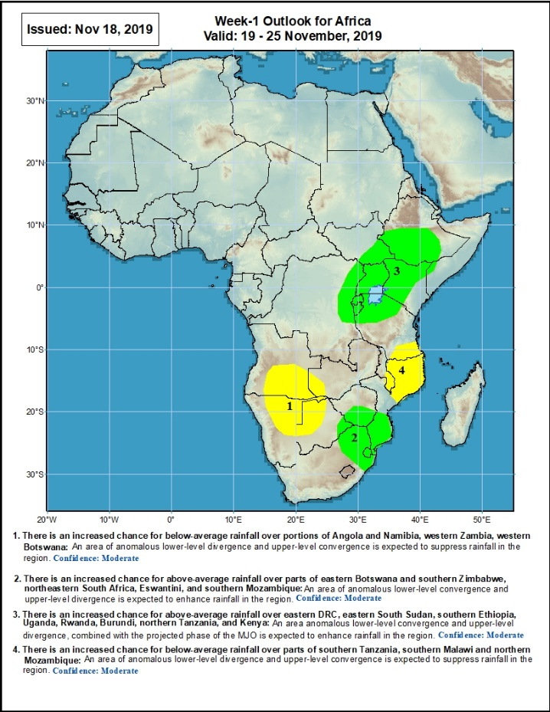
Week-1 Precipitation Outlooks
19 – 25 November, 2019
There is an increased chance for below-average rainfall over portions of Angola and Namibia, western Zambia, and western Botswana: An area of anomalous lower-level divergence and upper-level convergence is expected to suppress rainfall in the region. Confidence: Moderate
There is an increased chance for above-average rainfall over parts of eastern Botswana and southern Zimbabwe, northeastern South Africa, Eswantini, and southern Mozambique: An area of anomalous lower-level convergence and upper-level divergence is expected to enhance rainfall in the region. Confidence: Moderate
There is an increased chance for above-average rainfall over eastern DRC, eastern South Sudan, southern Ethiopia, Uganda, Rwanda, Burundi, northern Tanzania, and Kenya: An area anomalous lower-level convergence and upper-level divergence, combined with the projected phase of the MJO is expected to enhance rainfall in the region. Confidence: Moderate
There is an increased chance for below-average rainfall over parts of southern Tanzania, southern Malawi and northern Mozambique: An area of anomalous lower-level divergence and upper-level convergence is expected to suppress rainfall in the region. Confidence: Moderate
Notes:
11

Slide 12
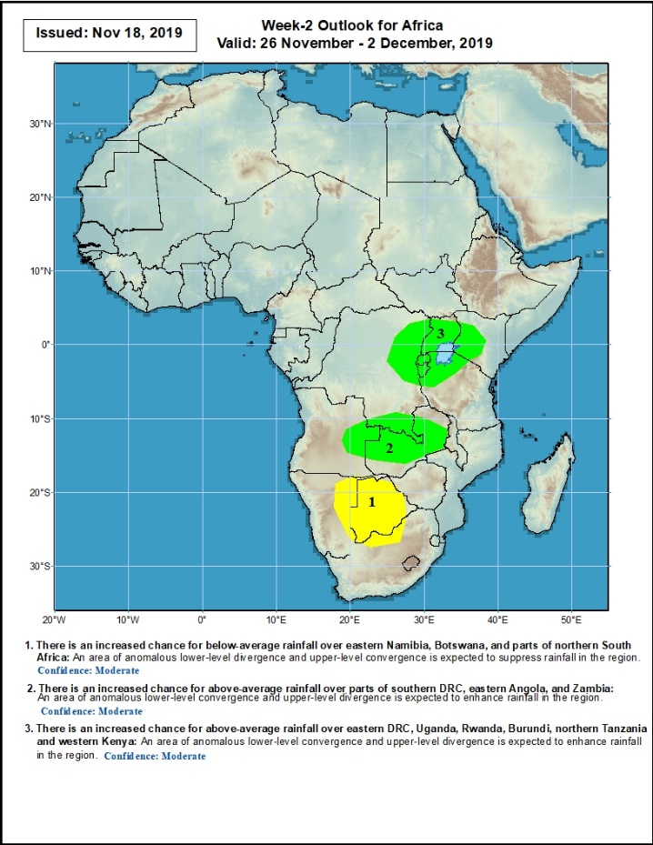
Week-2 Precipitation Outlooks
25 November – 2 December, 2019
There is an increased chance for below-average rainfall over eastern Namibia, Botswana, and parts of northern South Africa: An area of anomalous lower-level divergence and upper-level convergence is expected to suppress rainfall in the region. Confidence: Moderate
There is an increased chance for above-average rainfall over parts of southern DRC, eastern Angola, and Zambia: An area of anomalous lower-level convergence and upper-level divergence is expected to enhance rainfall in the region. Confidence: Moderate
There is an increased chance for above-average rainfall over eastern DRC, Uganda, Rwanda, Burundi, northern Tanzania and western Kenya: An area of anomalous lower-level convergence and upper-level divergence is expected to enhance rainfall in the region. Confidence: Moderate
Notes:
12

Slide 13
Summary
During the past 7 days, Weekly rainfall totals exceeded 100mm over parts of Sierra Leone and Liberia, eastern and southern DRC, northeastern Zambia, western Tanzania, parts of Kenya, and local areas in Ethiopia and southern Somalia. Parts of Guinea, Sierra Leone, Liberia, Cote d’Ivoire, parts of Togo and Benin, Nigeria, eastern Cameroon, western CAR, parts of Congo and DRC, local areas in South Sudan, southwestern Ethiopia, southern Uganda, central and eastern Kenya, southern Somalia, Tanzania, Zambia, Zimbabwe, Mozambique, eastern South Africa and Madagascar had above-average rainfall. Below-average rainfall was observed over Equatorial Guinea, Gabon, southern Congo, parts of DRC, parts of Uganda, southeastern Tanzania, local areas in Kenya, and much of Angola.
During the past 30 days, rainfall was above-average over local areas in southern Mauritania and Senegal parts of Guinea, Sierra Leone, Liberia, parts of southern Mali and Burkina Faso, Ghana, Cote d’Ivoire, Togo, Benin, much of Nigeria, Cameroon, southern Chad, portions of CAR and Congo, portions of DRC and South Sudan, Sudan, western and southern Ethiopia, southern Uganda, Tanzania, Somalia, Kenya, local areas in eastern Botswana, Zambia and South Africa, and many parts of Madagascar. Parts of Senegal, Guinea-Bissau, western Guinea, parts of Mali, southern Cameroon, many parts of Gabon, central Congo, much of Angola, many parts of DRC, Namibia, Zambia, Malawi, Botswana, Zimbabwe, Mozambique, and many parts of South Africa had below-average rainfall.
During the past 90 days, rainfall was above-average over parts of southern Mauritania, much of Senegal, Guinea-Bissau, Guinea, Sierra Leone, Liberia, Mali, Cote d’Ivoire, Burkina Faso, Ghana, Togo, Benin, Niger, many parts of Nigeria, Chad, portions of Cameroon, CAR, many parts of DRC, South Sudan, Uganda, Sudan, Eritrea, Ethiopia, Kenya, Somalia, many parts of Tanzania, portions of Angola, eastern Zambia, and local areas in Mozambique and Madagascar. Western and central Mauritania, parts of Cameroon, Gabon, portions of central and eastern DRC, many parts of Angola, Zambia, Zimbabwe, eastern Namibia, Botswana, southern Madagascar and many parts of South Africa had below-average rainfall.
Week-1 outlooks call for an increased chance for above-average rainfall over parts of eastern Botswana and southern Zimbabwe, northeastern South Africa, Eswantini, and southern Mozambique. Outlooks also call for above-average rainfall over eastern DRC, eastern South Sudan, southern Ethiopia, Uganda, Rwanda, Burundi, northern Tanzania, and Kenya. In contrast, there is an increased chance for below-average rainfall over portions of Angola and Namibia, western Zambia, western Botswana, parts of southern Tanzania, southern Malawi and northern Mozambique.
Notes:
13

