Slide 1
The African Monsoon Recent Evolution and Current Status Include Week-1 and Week-2 Outlooks
Update prepared by
Climate Prediction Center / NCEP
11 November 2019
For more information, visit:
http://www.cpc.ncep.noaa.gov/products/Global_Monsoons/African_Monsoons/precip_monitoring.shtml

Slide 2
Outline
Highlights
Recent Evolution and Current Conditions
NCEP GEFS Forecasts
Summary

Slide 3
Highlights: Last 7 Days
Another week of moderate to locally heavy rainfall sustained moisture surpluses over portions of southeastern Ethiopia and southern Somalia.
Week-1 outlooks call for an increased chance for above-average rainfall over western and northern Angola, southern Congo, and portions of DRC. Outlooks also call for above-average rainfall over eastern Botswana, southern Zimbabwe, eastern South Africa, Lesotho, Eswantini, and southern Mozambique. In contrast, there is an increased chance for below-average rainfall over southeastern Angola, eastern Namibia, southwestern Zambia, western Botswana, southern Tanzania, Malawi and northern Mozambique.

Slide 4
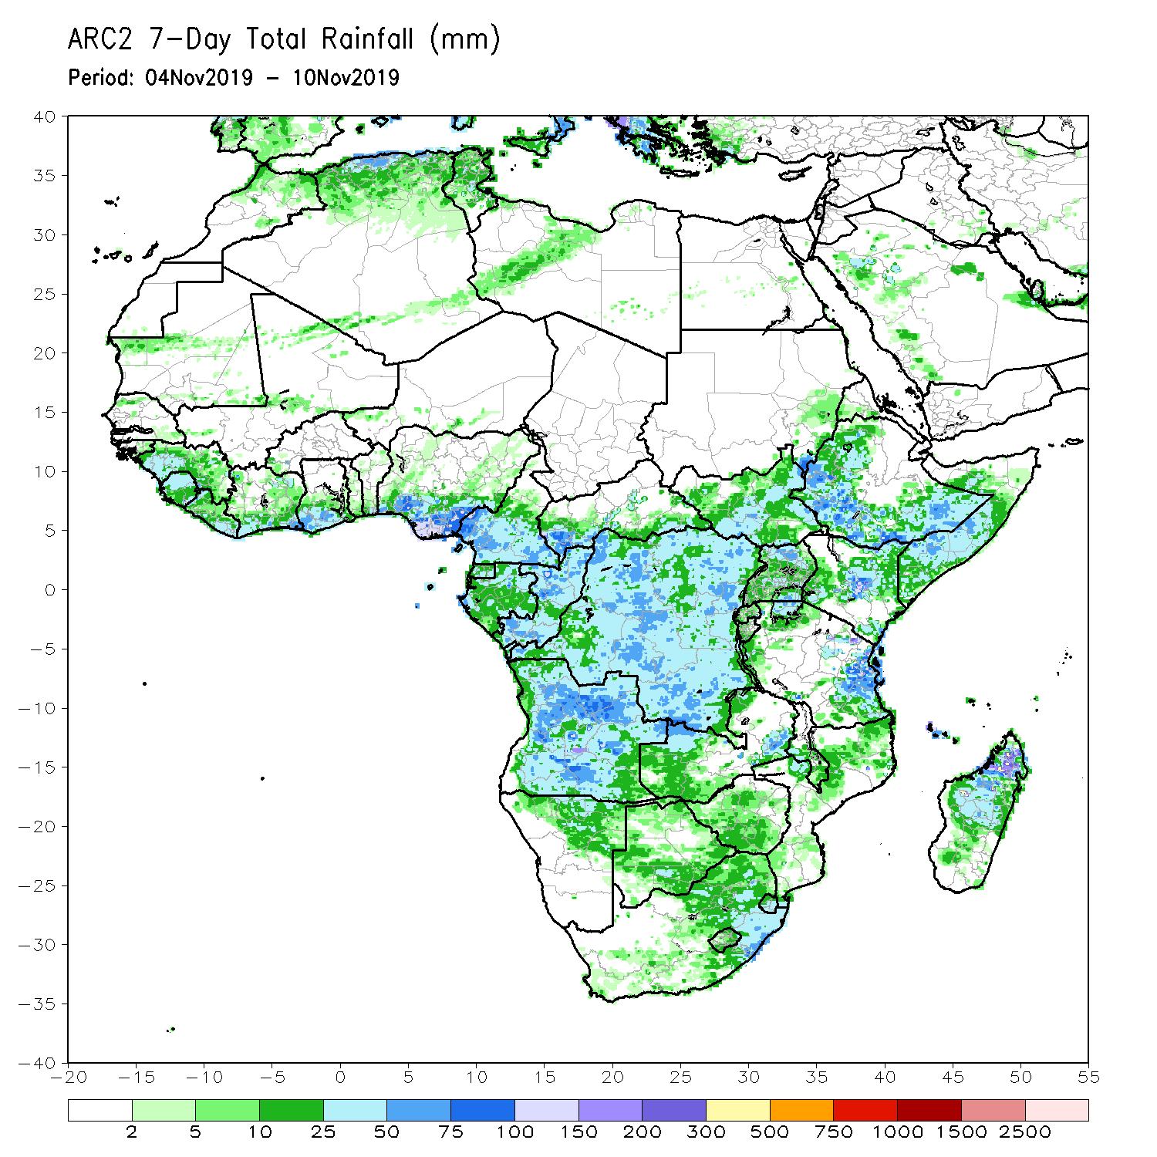
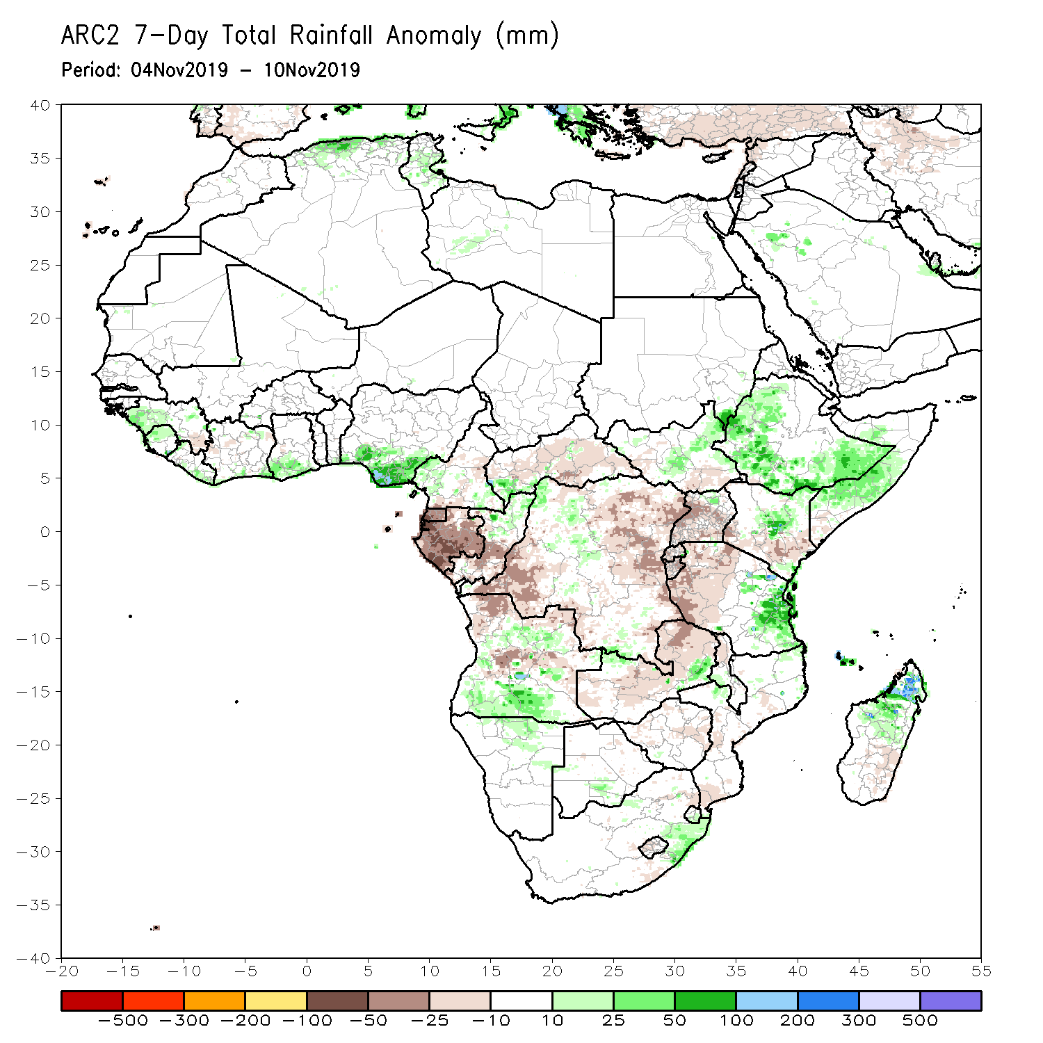
Rainfall Patterns: Last 7 Days
During the past 7 days, rainfall was above-average over parts of Guinea, Sierra Leone, Liberia, southern Ghana, southern Nigeria, local areas in CAR, Congo and DRC, portions of South Sudan, many parts of Ethiopia, Somalia, parts of Kenya and Tanzania, portions of Angola, local areas in Zambia, and northern Madagascar.
Much of Equatorial Guinea, Gabon, southern Congo, many parts of DRC, portions of CAR and Uganda, parts of Tanzania and Kenya, portions of Angola and Zambia had below-average rainfall.

Slide 5
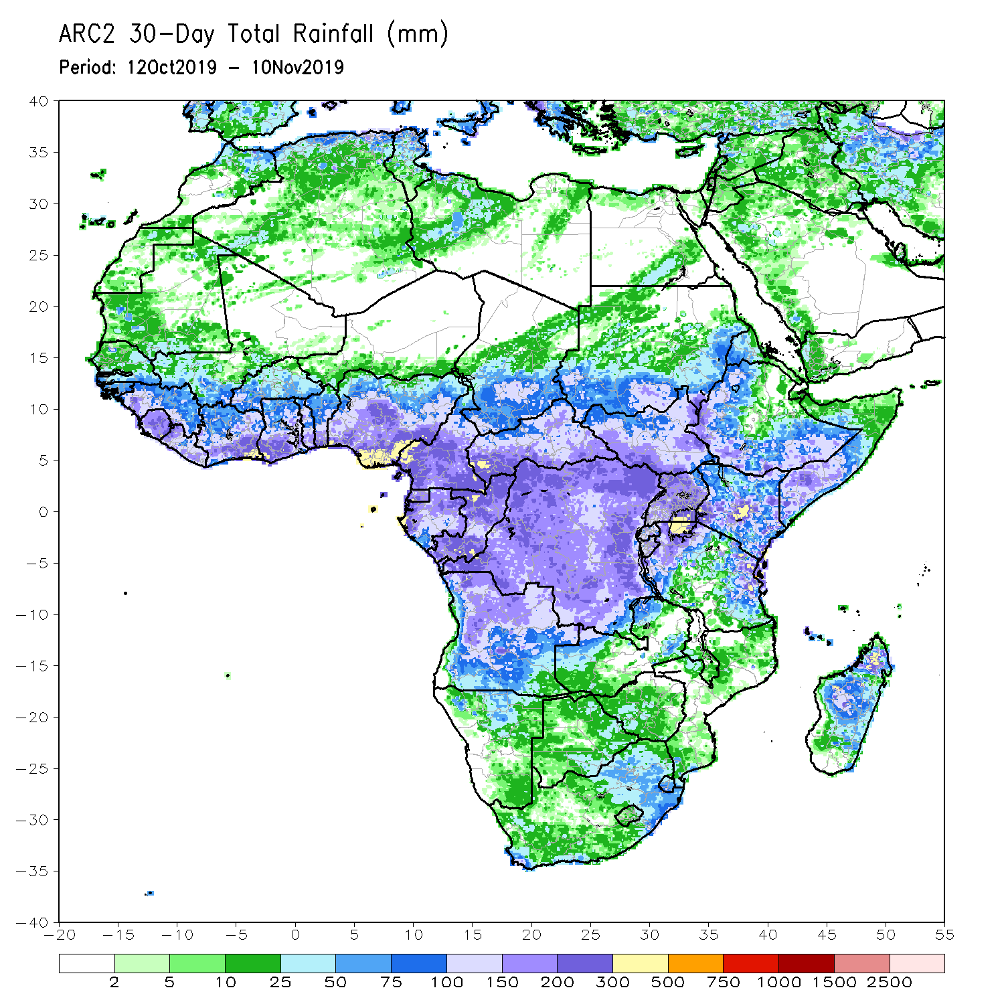
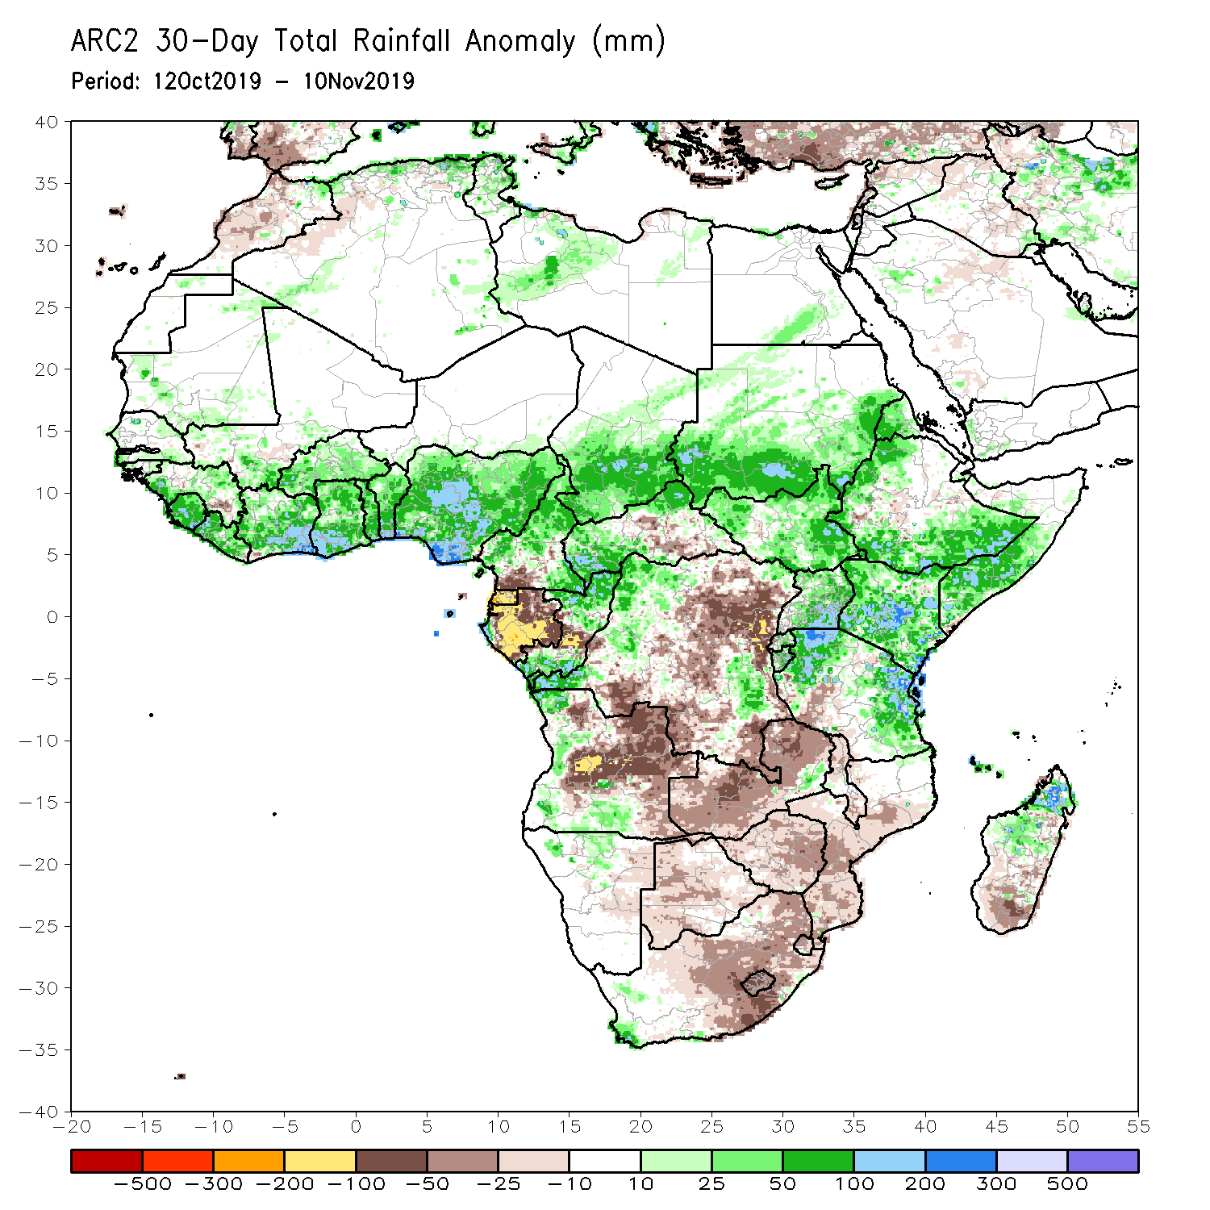
Rainfall Patterns: Last 30 Days
During the past 30 days, rainfall was above-average over parts of southern Mauritania, Senegal, Guinea-Bissau, much of Guinea, Sierra Leone, Liberia, southern Mali, Burkina Faso, Ghana, Cote d’Ivoire, Togo, Benin, much of Nigeria, portions of Cameroon, central and southern Chad, portions of CAR and Congo, parts of western Gabon, portions of DRC, South Sudan, Sudan, many parts of Ethiopia, Eritrea, Uganda, Tanzania, Somalia, Kenya, parts of Angola, local areas in Namibia and portions of Madagascar.
Local areas in Guinea and Mali, parts of Cameroon, many parts of Gabon, portions of Angola and DRC, eastern Namibia, Zambia, Malawi, Botswana, Zimbabwe, portions of Madagascar and many parts of South Africa had below-average rainfall.
Notes:
5

Slide 6
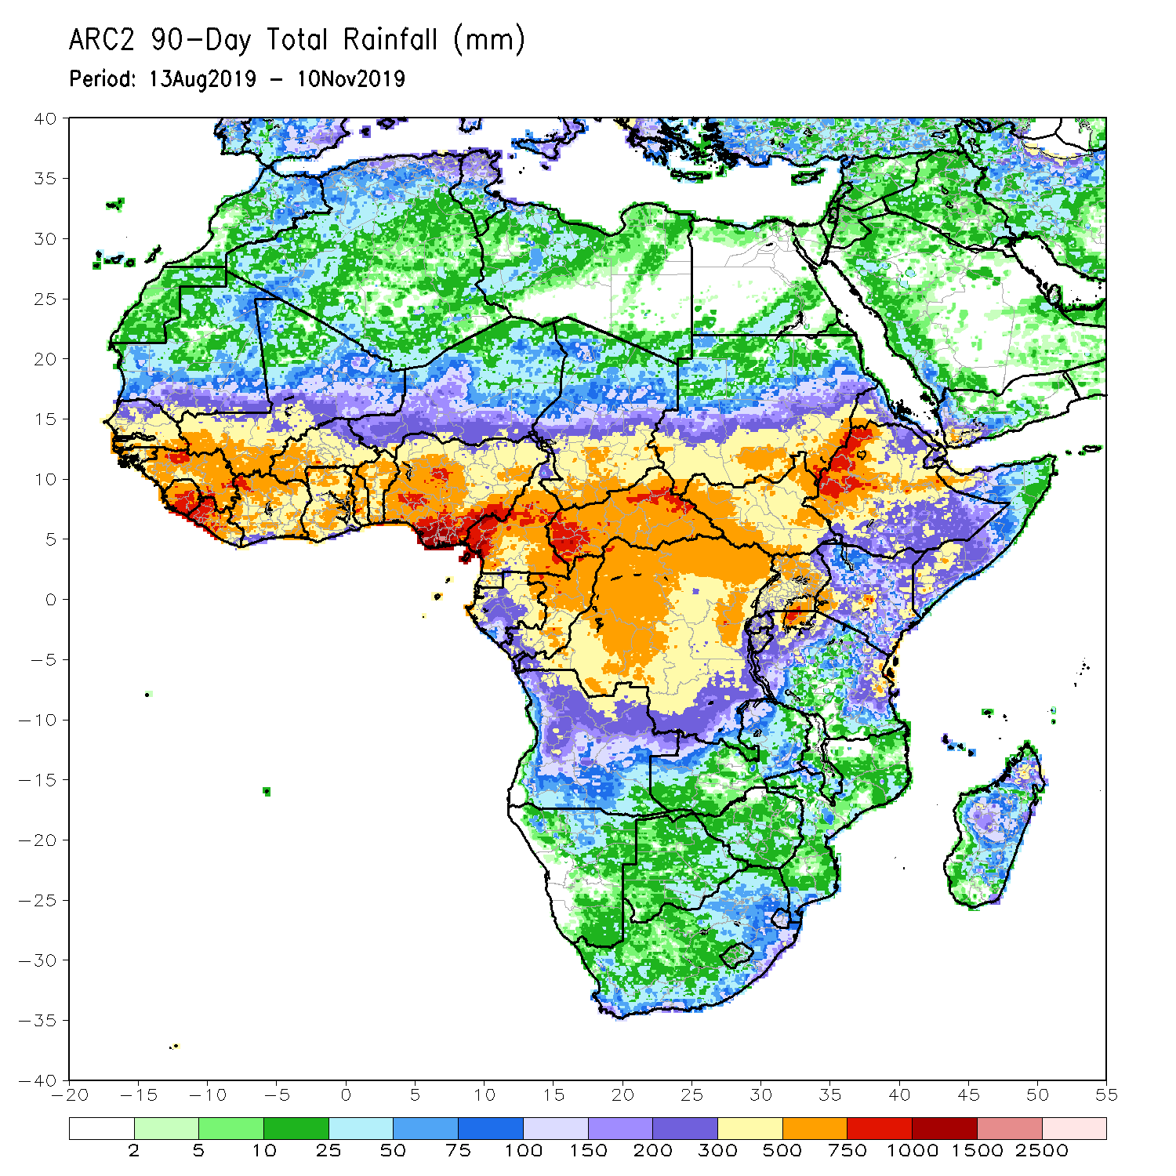
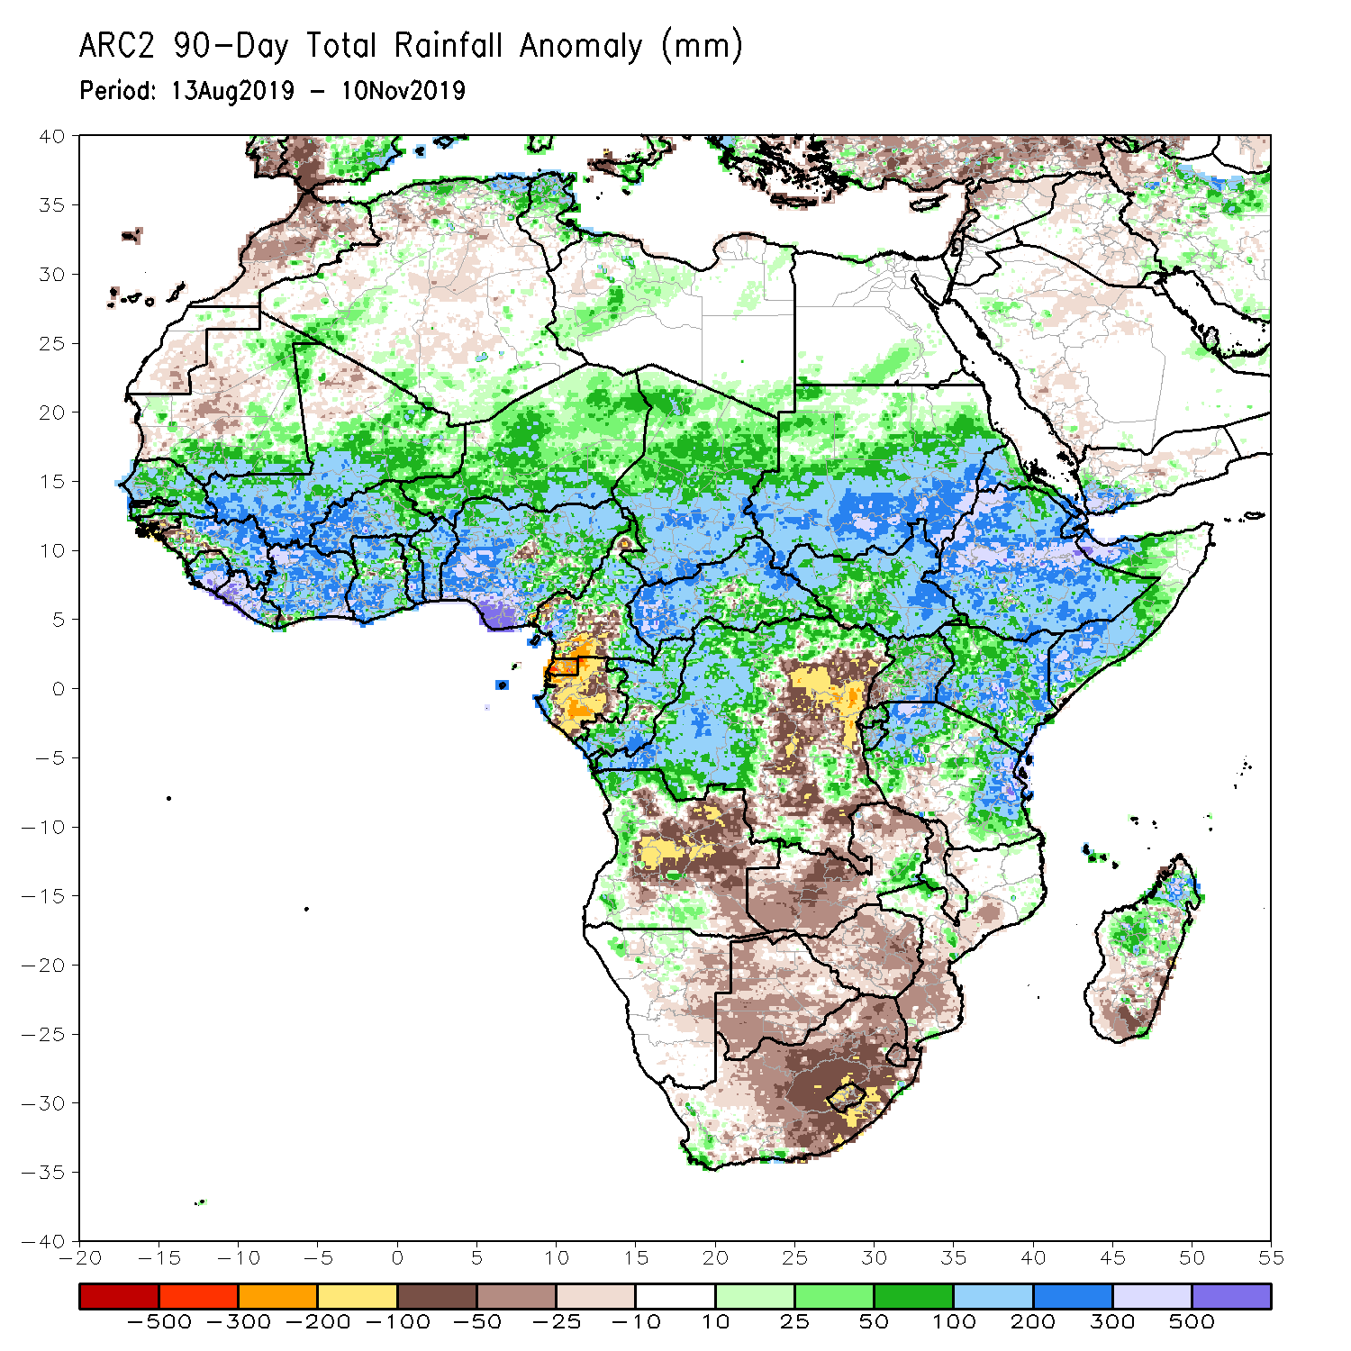
Rainfall Patterns: Last 90 Days
During the past 90 days, rainfall was above-average over southern and eastern Mauritania, much of Senegal, Guinea-Bissau, Guinea, Sierra Leone, Liberia, Mali, Cote d’Ivoire, Burkina Faso, Ghana, Togo, Benin, Niger, many parts of Nigeria, Chad, portions of Cameroon, CAR, many parts of DRC, South Sudan, Uganda, Sudan, Eritrea, Ethiopia, Kenya, Somalia, many parts of Tanzania, portions of Angola, eastern Zambia, and local areas in Mozambique and Madagascar.
Western and central Mauritania, parts of Nigeria and Cameroon, Gabon, portions of central and eastern DRC, many parts of Angola, Zambia, Zimbabwe, eastern Namibia, Botswana, southern Madagascar and many parts of South Africa had below-average rainfall.
Notes:
6

Slide 7
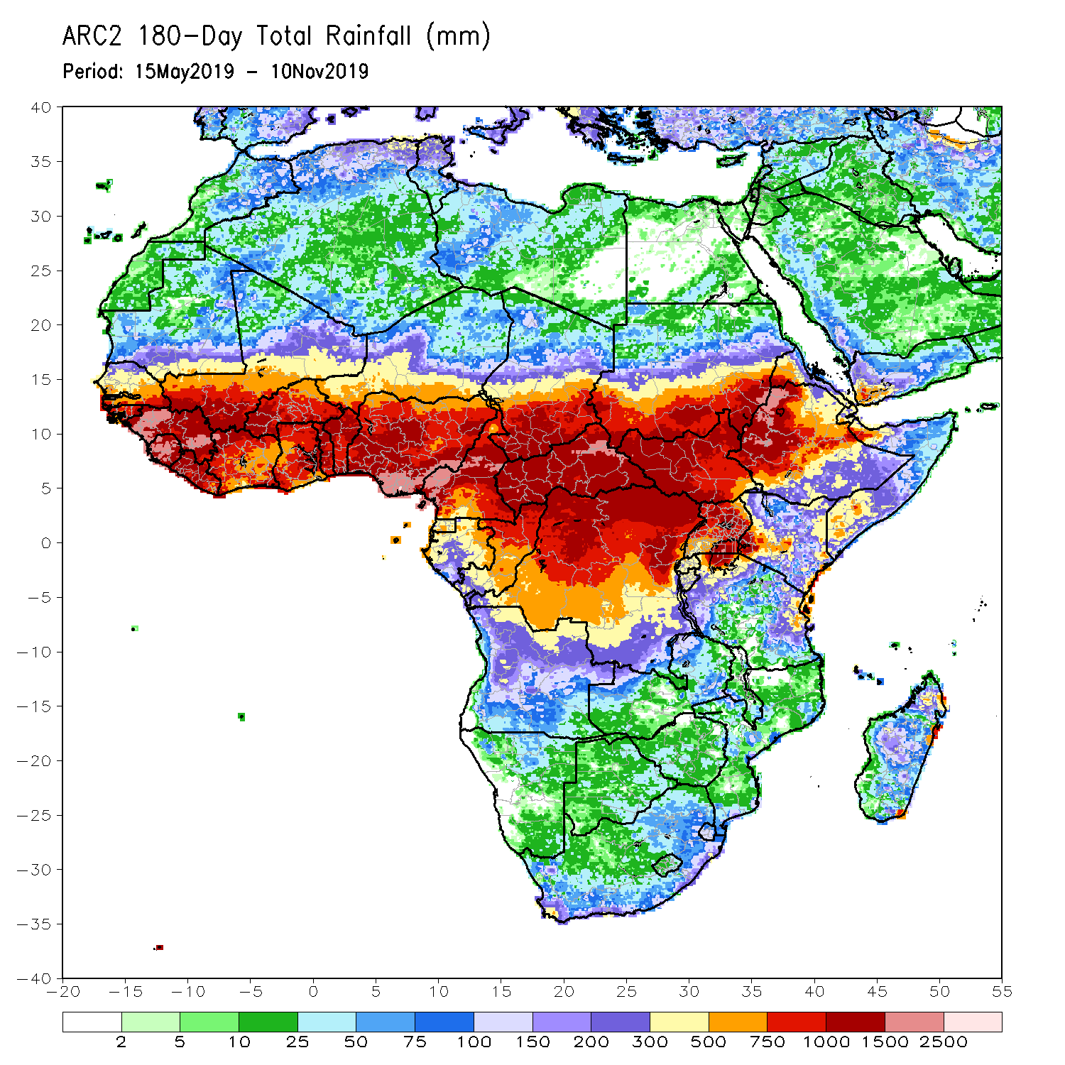
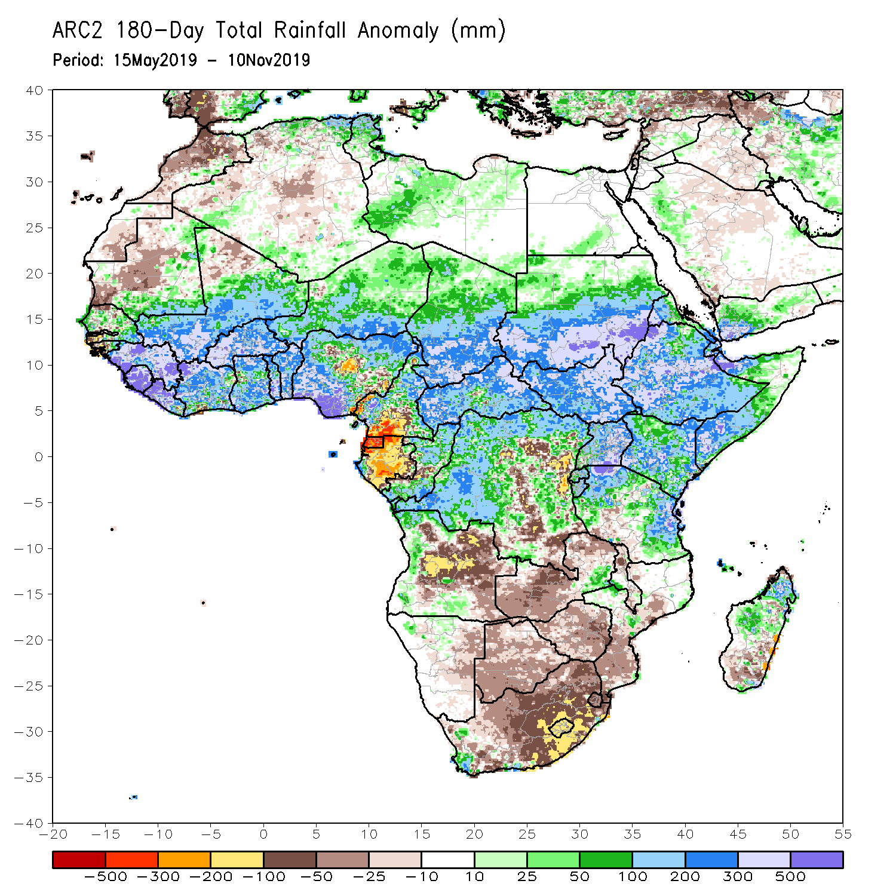
Rainfall Patterns: Last 180 Days
During the past 180 days, below-average rainfall was observed over western and central Mauritania, portions of Nigeria and Cameroon, Equatorial Guinea, Gabon, local areas in Congo, parts of central and eastern DRC, many parts of Angola, Namibia, western and northeastern South Africa, Zambia, parts of Botswana, Zimbabwe, southern Mozambique and southern Madagascar.
Southern and eastern Mauritania, much of Senegal, Guinea-Bissau, Guinea, Sierra Leone, Mali, Liberia, Cote d’Ivoire, Burkina Faso, Ghana, Togo, Benin, portions of Nigeria and Cameroon, Niger, Chad, CAR, many parts of DRC, South Sudan, Sudan, Uganda, Eritrea, Ethiopia, Somalia, Kenya, Tanzania, western Angola and parts of eastern Zambia, local areas in Mozambique and South Africa and portions of Madagascar had above-average rainfall.
Notes:
7

Slide 8
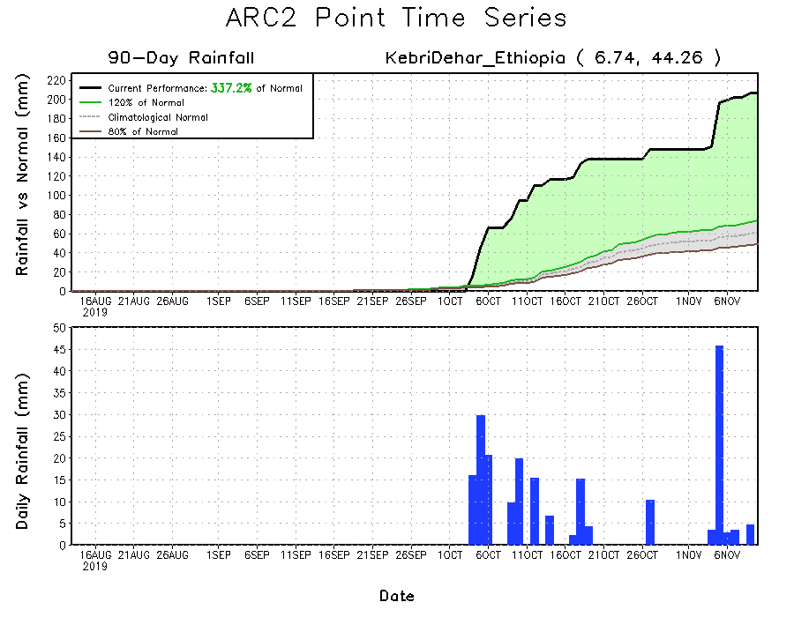
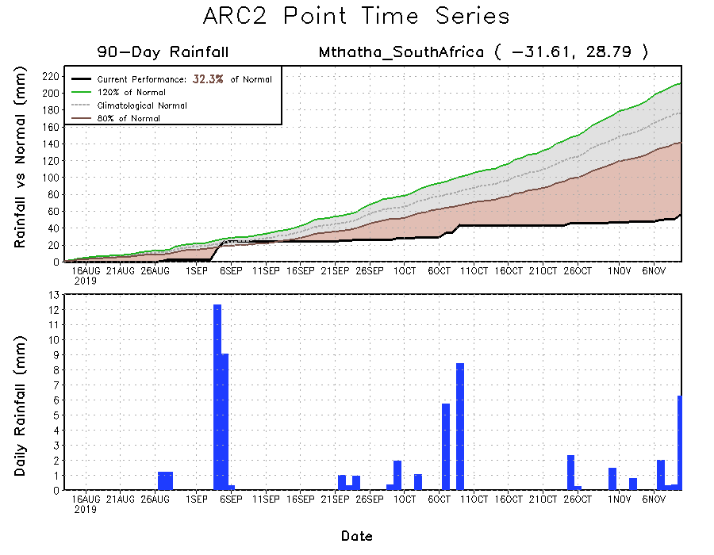
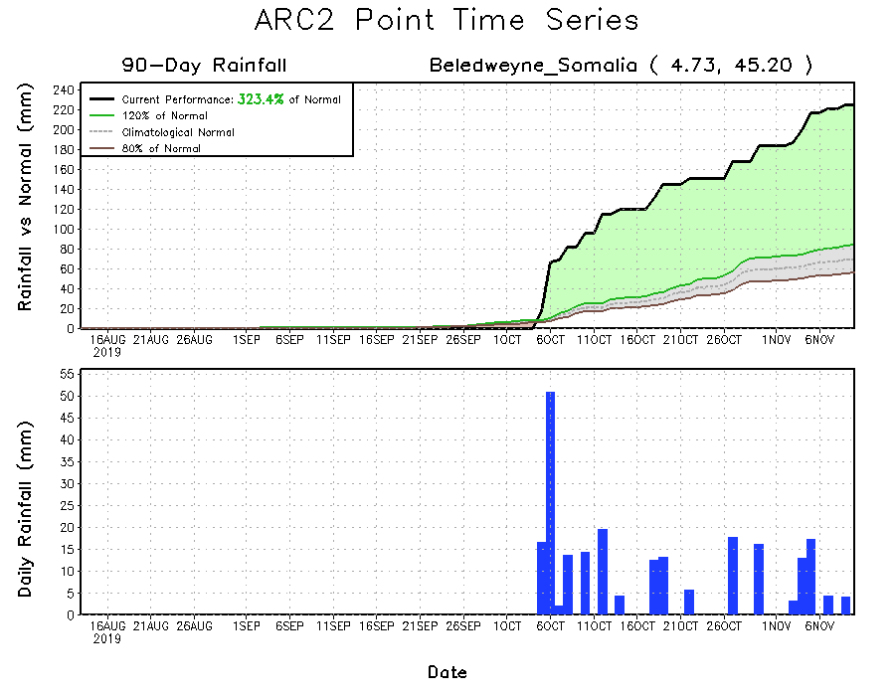
Recent Rainfall Evolution
Daily evolution of rainfall over the last 90 days at selected locations shows that moderate to locally heavy rainfall sustained moisture surpluses over parts of southern Somalia (bottom right) and southeastern Ethiopia (top right). Seasonal total rainfall remained below-average over many parts of South Africa (bottom left).

Slide 9
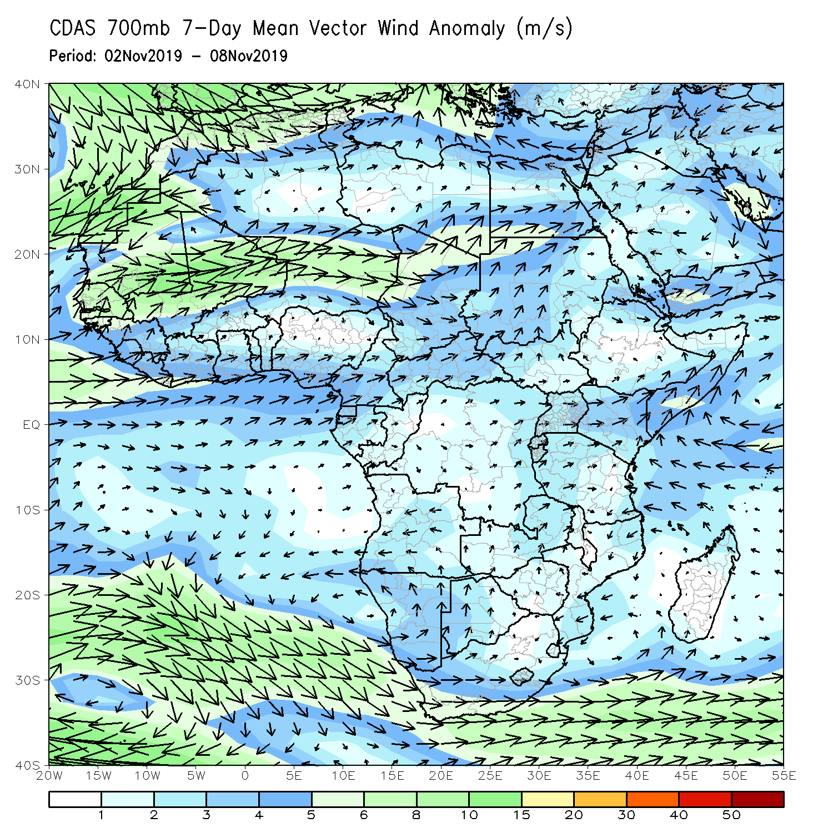
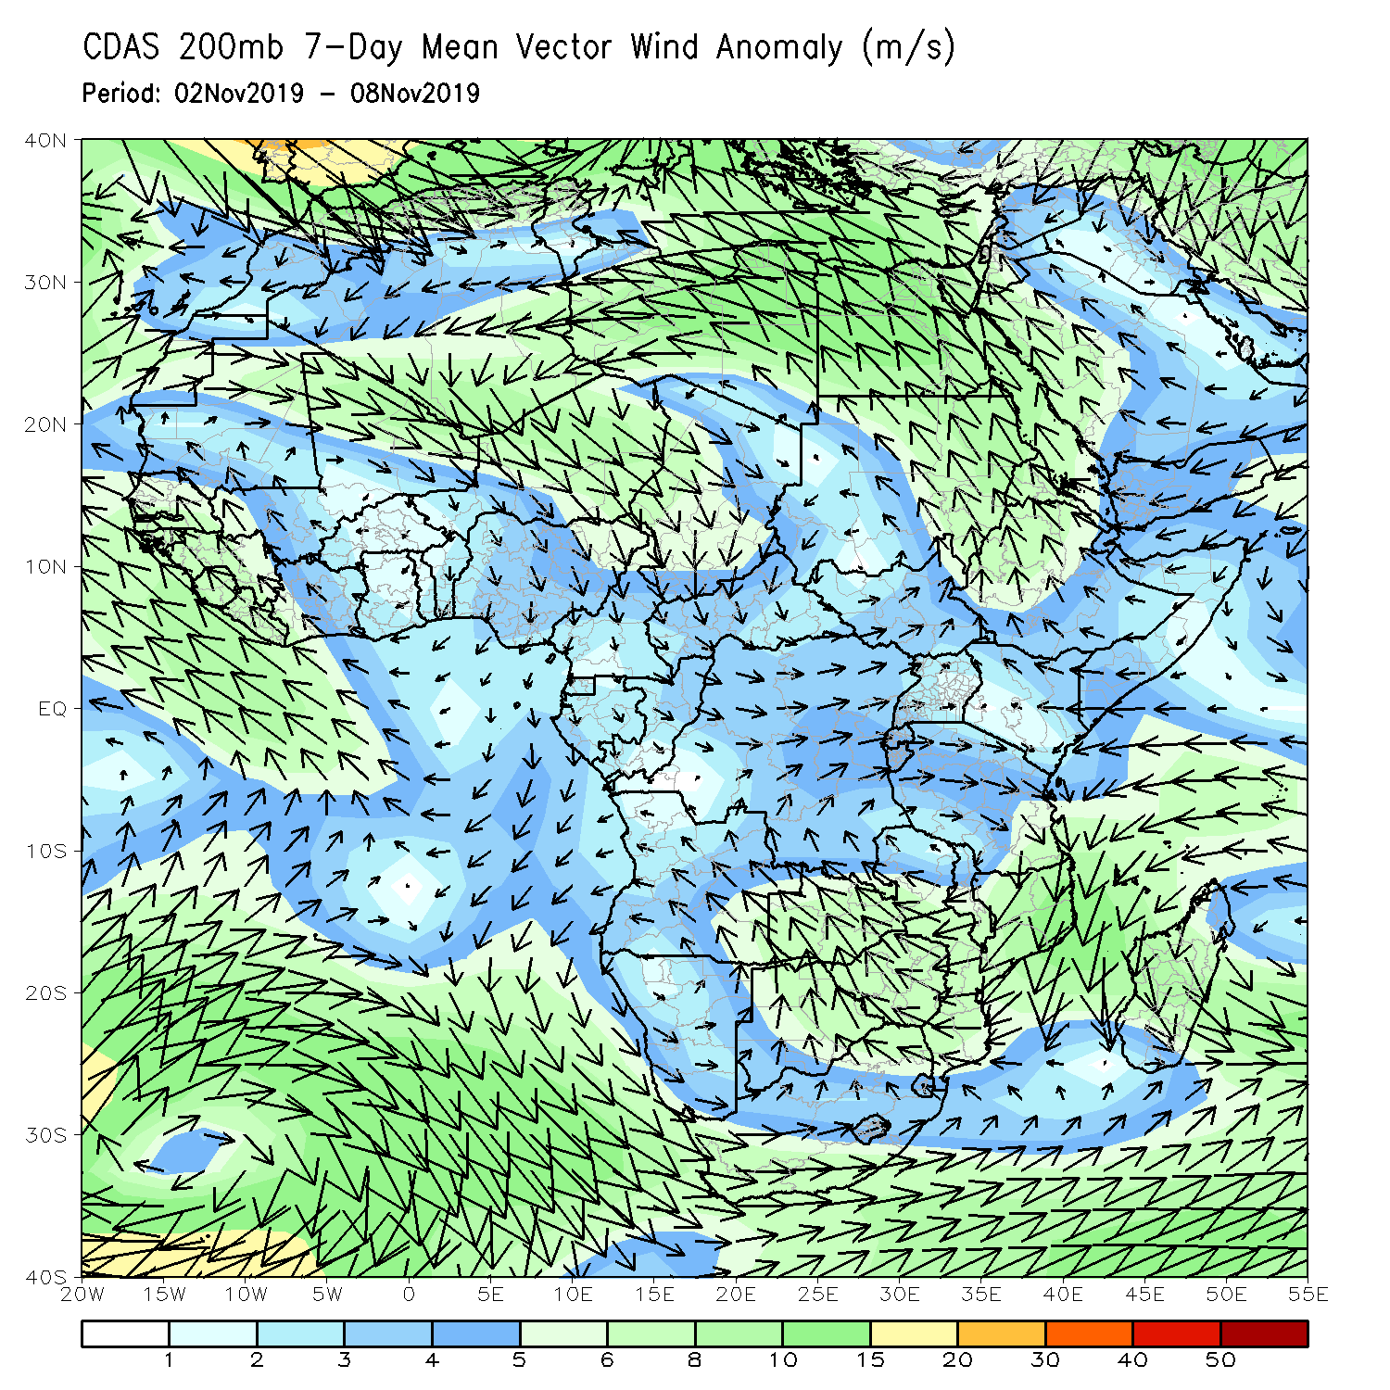
Atmospheric Circulation: Last 7 Days
An area anomalous lower-level convergence (left) and upper-level divergence (right) may have contributed to the observed above-average rainfall over portions of the Greater Horn of Africa.

Slide 10
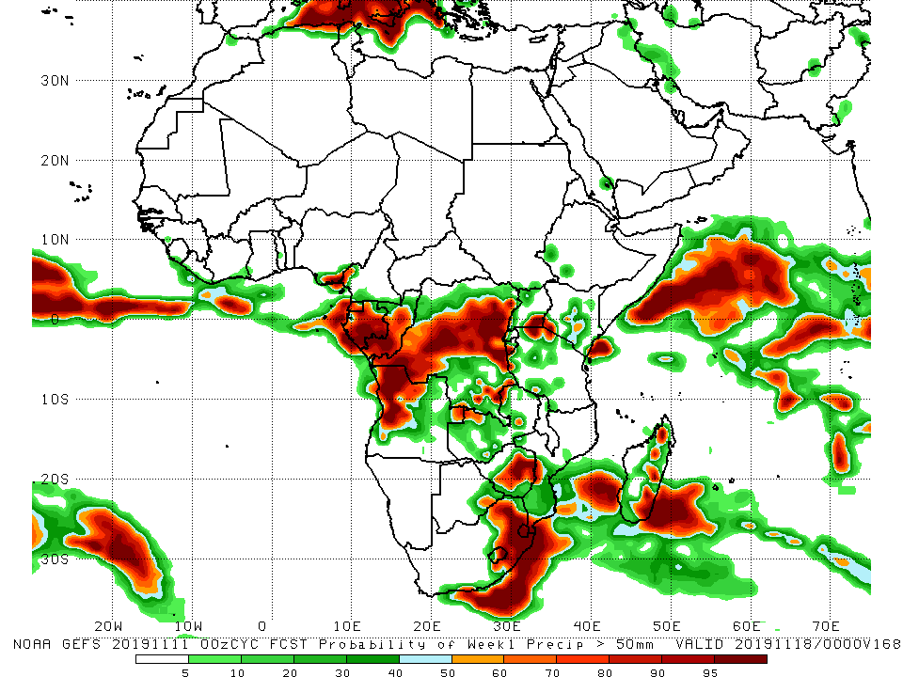
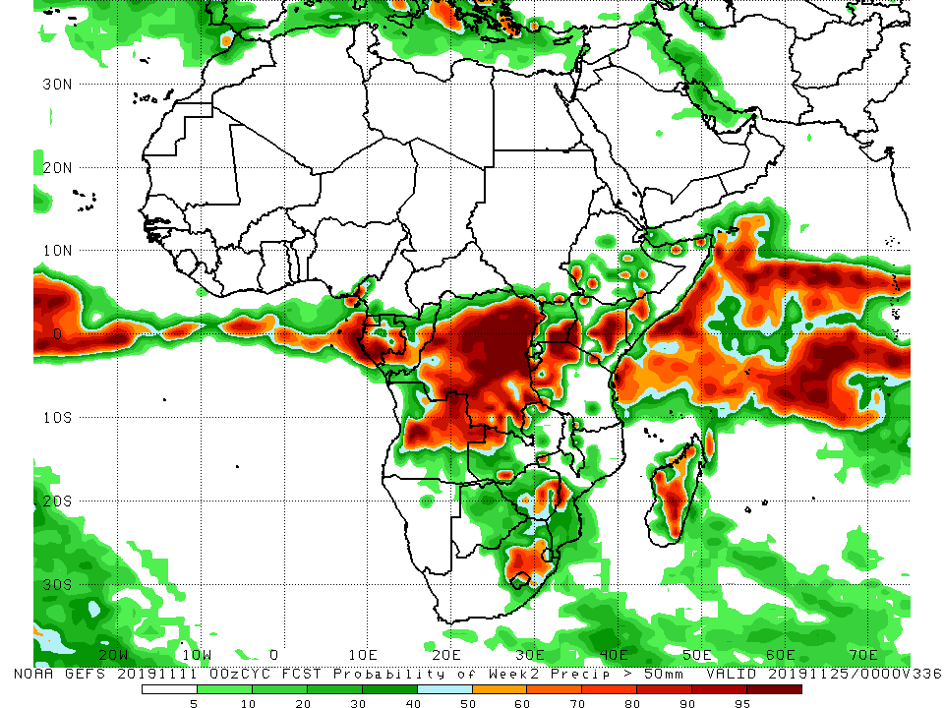
NCEP GEFS Model Forecasts Non-Bias Corrected Probability of precipitation exceedance
Week-1: Valid 12 – 18 November, 2019
Week-2: Valid 19 – 26 November, 2019
For week-1 (left panel) and week-2 (right panel) there is an increased chance for weekly rainfall totals to exceed 50mm over many places in central Africa, and portions of eastern and southeastern Africa.
Notes:
10

Slide 11
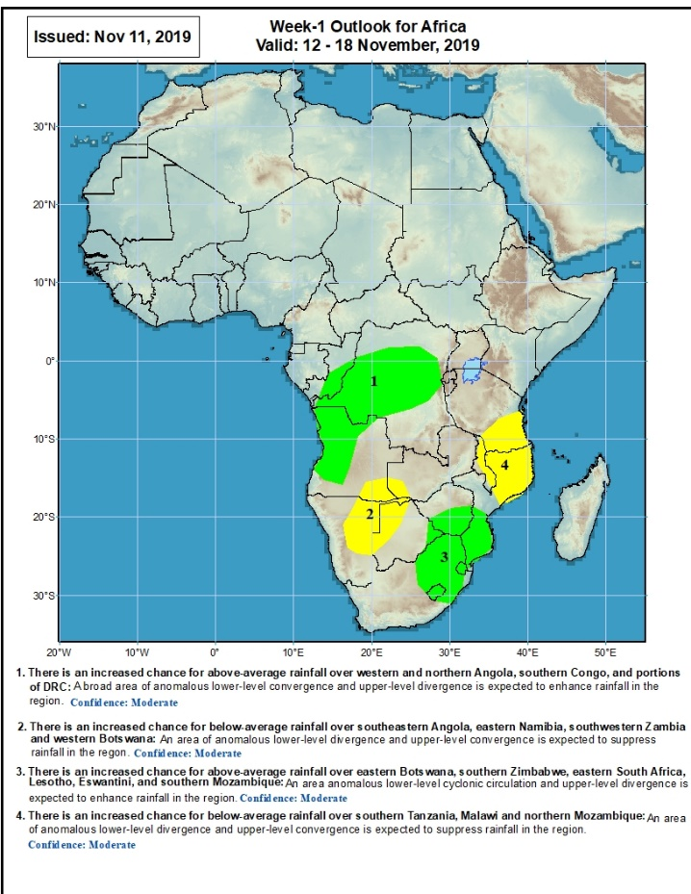
Week-1 Precipitation Outlooks
12 – 18 November, 2019
There is an increased chance for above-average rainfall over western and northern Angola, southern Congo, and portions of DRC: A broad area of anomalous lower-level convergence and upper-level divergence is expected to enhance rainfall in the region. Confidence: Moderate
There is an increased chance for below-average rainfall over southeastern Angola, eastern Namibia, southwestern Zambia and western Botswana: An area of anomalous lower-level divergence and upper-level convergence is expected to suppress rainfall in the region. Confidence: Moderate
There is an increased chance for above-average rainfall over eastern Botswana, southern Zimbabwe, eastern South Africa, Lesotho, Eswantini, and southern Mozambique: An area anomalous lower-level cyclonic circulation and upper-level divergence is expected to enhance rainfall in the region. Confidence: Moderate
There is an increased chance for below-average rainfall over southern Tanzania, Malawi and northern Mozambique: An area of anomalous lower-level divergence and upper-level convergence is expected to suppress rainfall in the region. Confidence: Moderate
Notes:
11

Slide 12
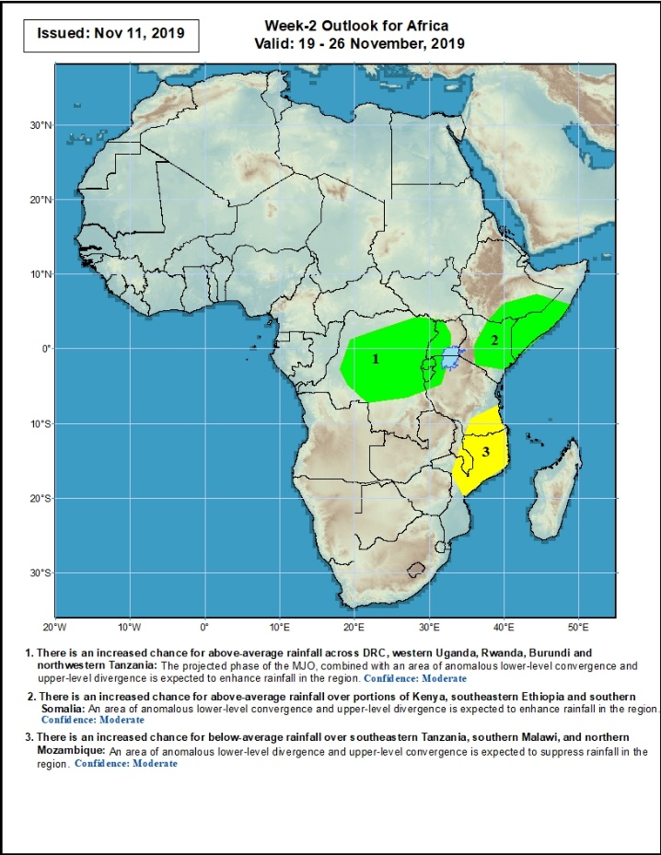
Week-2 Precipitation Outlooks
19 – 26 November, 2019
There is an increased chance for above-average rainfall across DRC, western Uganda, Rwanda, Burundi and northwestern Tanzania: The projected phase of the MJO, combined with an area of anomalous lower-level convergence and upper-level divergence is expected to enhance rainfall in the region. Confidence: Moderate
There is an increased chance for above-average rainfall over portions of Kenya, southeastern Ethiopia and southern Somalia: An area of anomalous lower-level convergence and upper-level divergence is expected to enhance rainfall in the region. Confidence: Moderate
There is an increased chance for below-average rainfall over southeastern Tanzania, southern Malawi, and northern Mozambique: An area of anomalous lower-level divergence and upper-level convergence is expected to suppress rainfall in the region. Confidence: Moderate
Notes:
12

Slide 13
Summary
During the past 7 days, rainfall was above-average over parts of Guinea, Sierra Leone, Liberia, southern Ghana, southern Nigeria, local areas in CAR, Congo and DRC, portions of South Sudan, many parts of Ethiopia, Somalia, parts of Kenya and Tanzania, portions of Angola, local areas in Zambia, and northern Madagascar. Much of Equatorial Guinea, Gabon, southern Congo, many parts of DRC, portions of CAR and Uganda, parts of Tanzania and Kenya, portions of Angola and Zambia had below-average rainfall.
During the past 30 days, rainfall was above-average over parts of southern Mauritania, Senegal, Guinea-Bissau, much of Guinea, Sierra Leone, Liberia, southern Mali, Burkina Faso, Ghana, Cote d’Ivoire, Togo, Benin, much of Nigeria, portions of Cameroon, central and southern Chad, portions of CAR and Congo, parts of western Gabon, portions of DRC, South Sudan, Sudan, many parts of Ethiopia, Eritrea, Uganda, Tanzania, Somalia, Kenya, parts of Angola, local areas in Namibia and portions of Madagascar. Local areas in Guinea and Mali, parts of Cameroon, many parts of Gabon, portions of Angola and DRC, eastern Namibia, Zambia, Malawi, Botswana, Zimbabwe, portions of Madagascar and many parts of South Africa had below-average rainfall.
During the past 90 days, rainfall was above-average over southern and eastern Mauritania, much of Senegal, Guinea-Bissau, Guinea, Sierra Leone, Liberia, Mali, Cote d’Ivoire, Burkina Faso, Ghana, Togo, Benin, Niger, many parts of Nigeria, Chad, portions of Cameroon, CAR, many parts of DRC, South Sudan, Uganda, Sudan, Eritrea, Ethiopia, Kenya, Somalia, many parts of Tanzania, portions of Angola, eastern Zambia, and local areas in Mozambique and Madagascar. Western and central Mauritania, parts of Nigeria and Cameroon, Gabon, portions of central and eastern DRC, many parts of Angola, Zambia, Zimbabwe, eastern Namibia, Botswana, southern Madagascar and many parts of South Africa had below-average rainfall.
Week-1 outlooks call for an increased chance for above-average rainfall over western and northern Angola, southern Congo, and portions of DRC. Outlooks also call for above-average rainfall over eastern Botswana, southern Zimbabwe, eastern South Africa, Lesotho, Eswantini, and southern Mozambique. In contrast, there is an increased chance for below-average rainfall over southeastern Angola, eastern Namibia, southwestern Zambia, western Botswana, southern Tanzania, Malawi and northern Mozambique.
Notes:
13

