Slide 1
The African Monsoon Recent Evolution and Current Status Include Week-1 and Week-2 Outlooks
Update prepared by
Climate Prediction Center / NCEP
28 October 2019
For more information, visit:
http://www.cpc.ncep.noaa.gov/products/Global_Monsoons/African_Monsoons/precip_monitoring.shtml

Slide 2
Outline
Highlights
Recent Evolution and Current Conditions
NCEP GEFS Forecasts
Summary

Slide 3
Highlights: Last 7 Days
Weekly rainfall surpluses exceeded 100mm over local areas Nigeria, Tanzania and Kenya.
Week-1 outlooks call for an increased chance for above-average rainfall over Sierra Leone, Liberia, southeastern Guinea, Cote d’Ivoire, southern Ghana, southern Togo, southern Benin, southern Nigeria, western and southern Cameroon, Equatorial Guinea, Gabon, southwestern Congo. Outlooks also call for above-average rainfall over northeastern DRC, western Uganda, western Rwanda, southern Ethiopia, northeastern Kenya, southern Somalia, and southern Botswana and northern South Africa. In contrast, there is an increased chance for below-average rainfall over southern DRC, and much of Zambia.

Slide 4
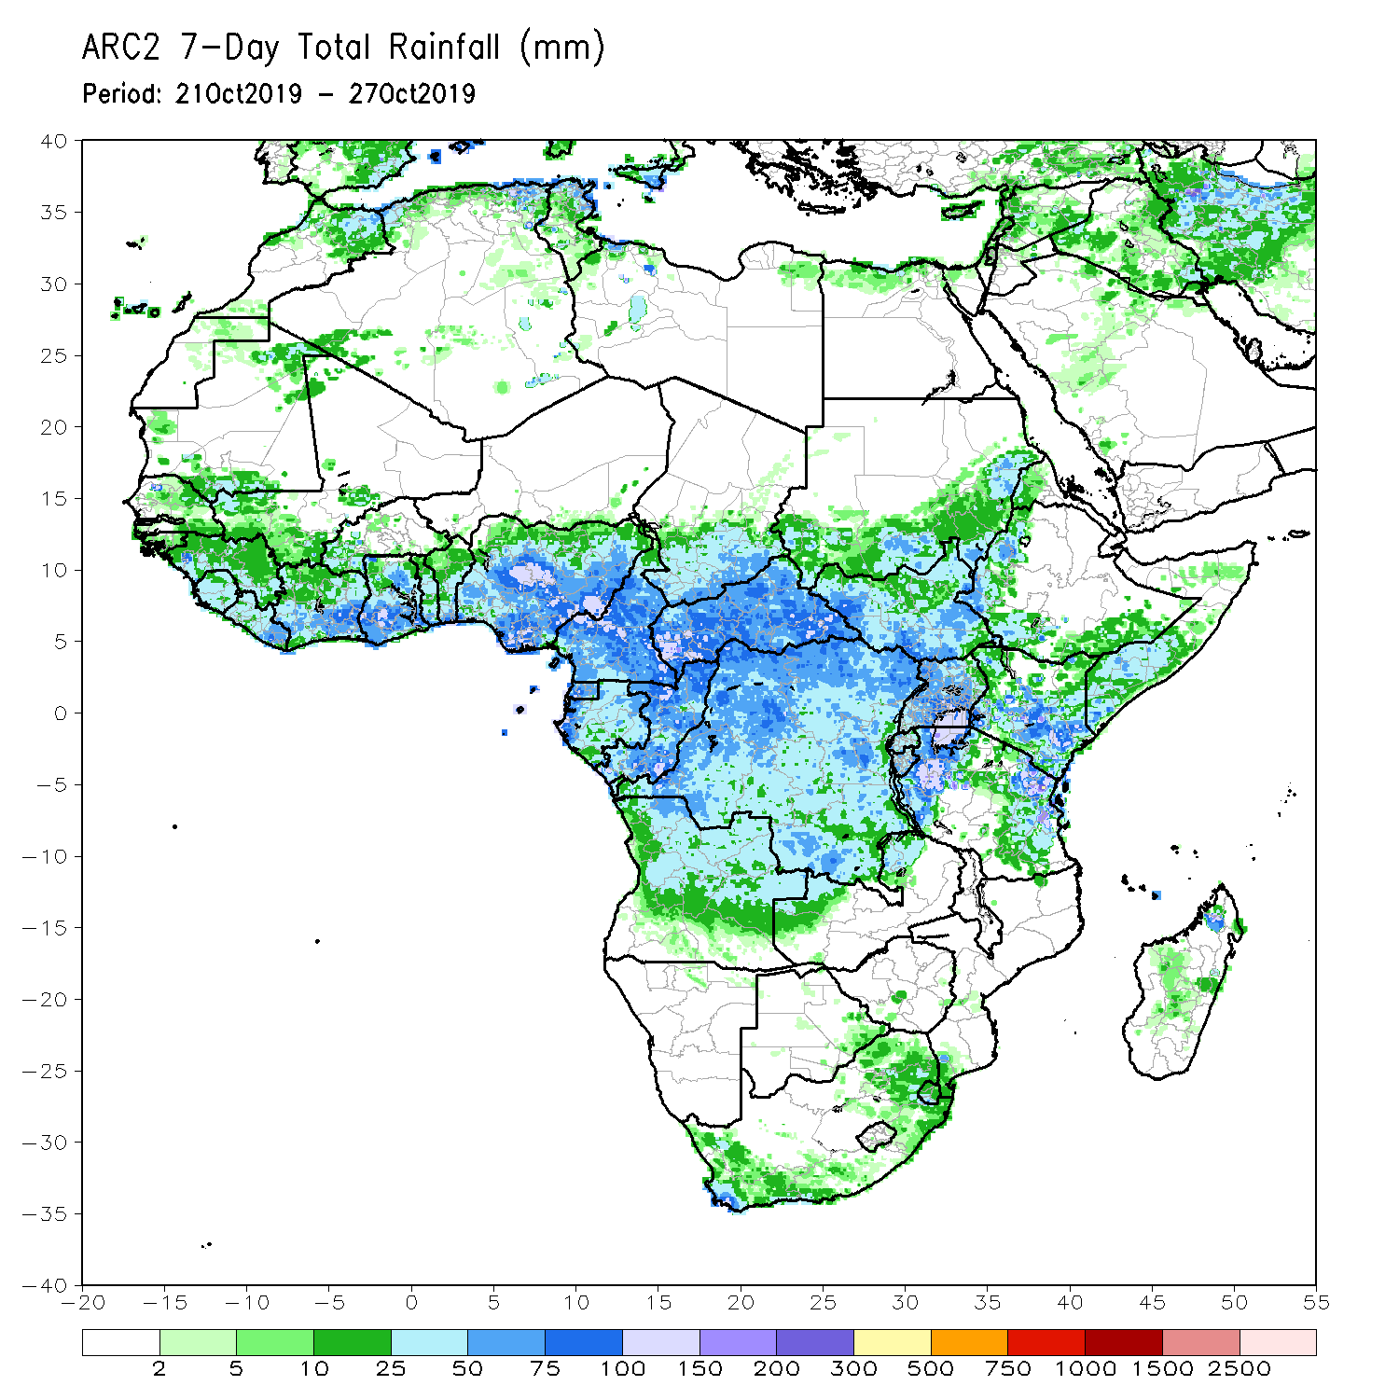
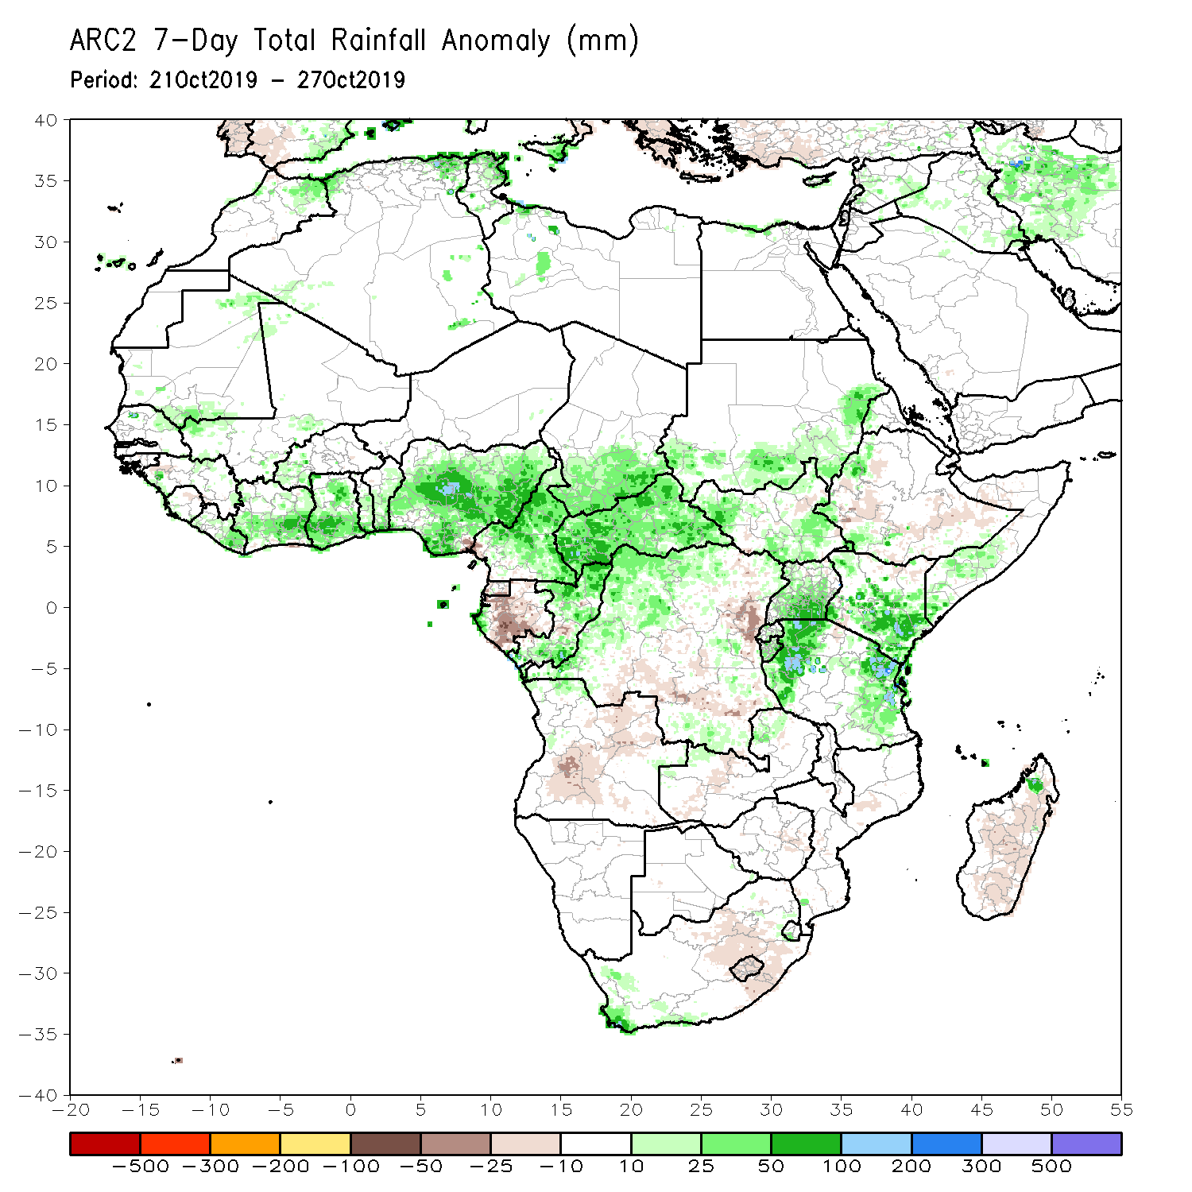
Rainfall Patterns: Last 7 Days
During the past 7 days, rainfall was above-average over local areas in southern Mauritania, Senegal, Mali and Guinea, Above-average rainfall was also observed across eastern Liberia, Cote d’Ivoire, western Burkina Faso, Ghana, Togo, Benin, Nigeria, Cameroon, southern Chad, CAR, parts of Congo and DRC, southern and eastern Sudan, parts of South Sudan, parts of western and southern Ethiopia, southern Uganda, Kenya, Tanzania, southern Somalia, and local areas in northern Madagascar. Weekly, rainfall surpluses exceeded 100mm over parts of Nigeria, Tanzania and Kenya.
Southern Cameroon, Equatorial Guinea, much of Gabon, local areas in Congo, many parts of DRC, Angola, portions of South Sudan and Ethiopia, western Zambia, and parts of South Africa and Madagascar.

Slide 5
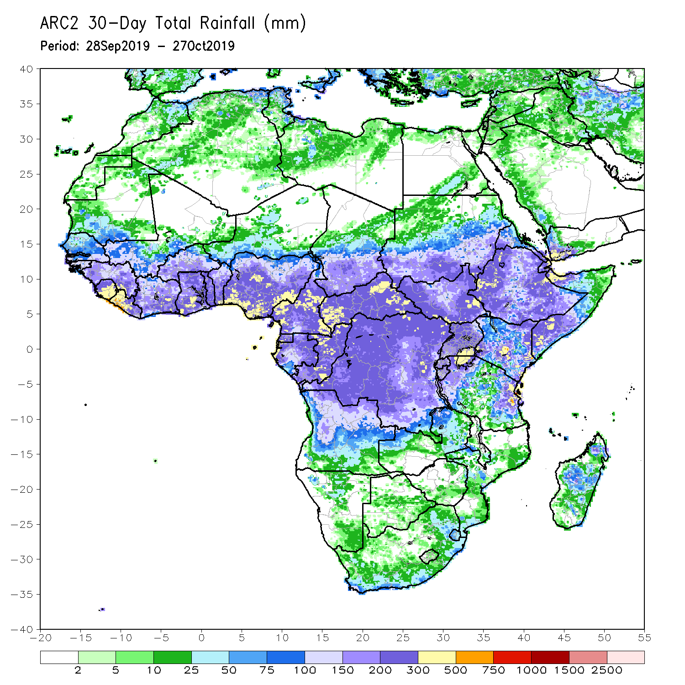
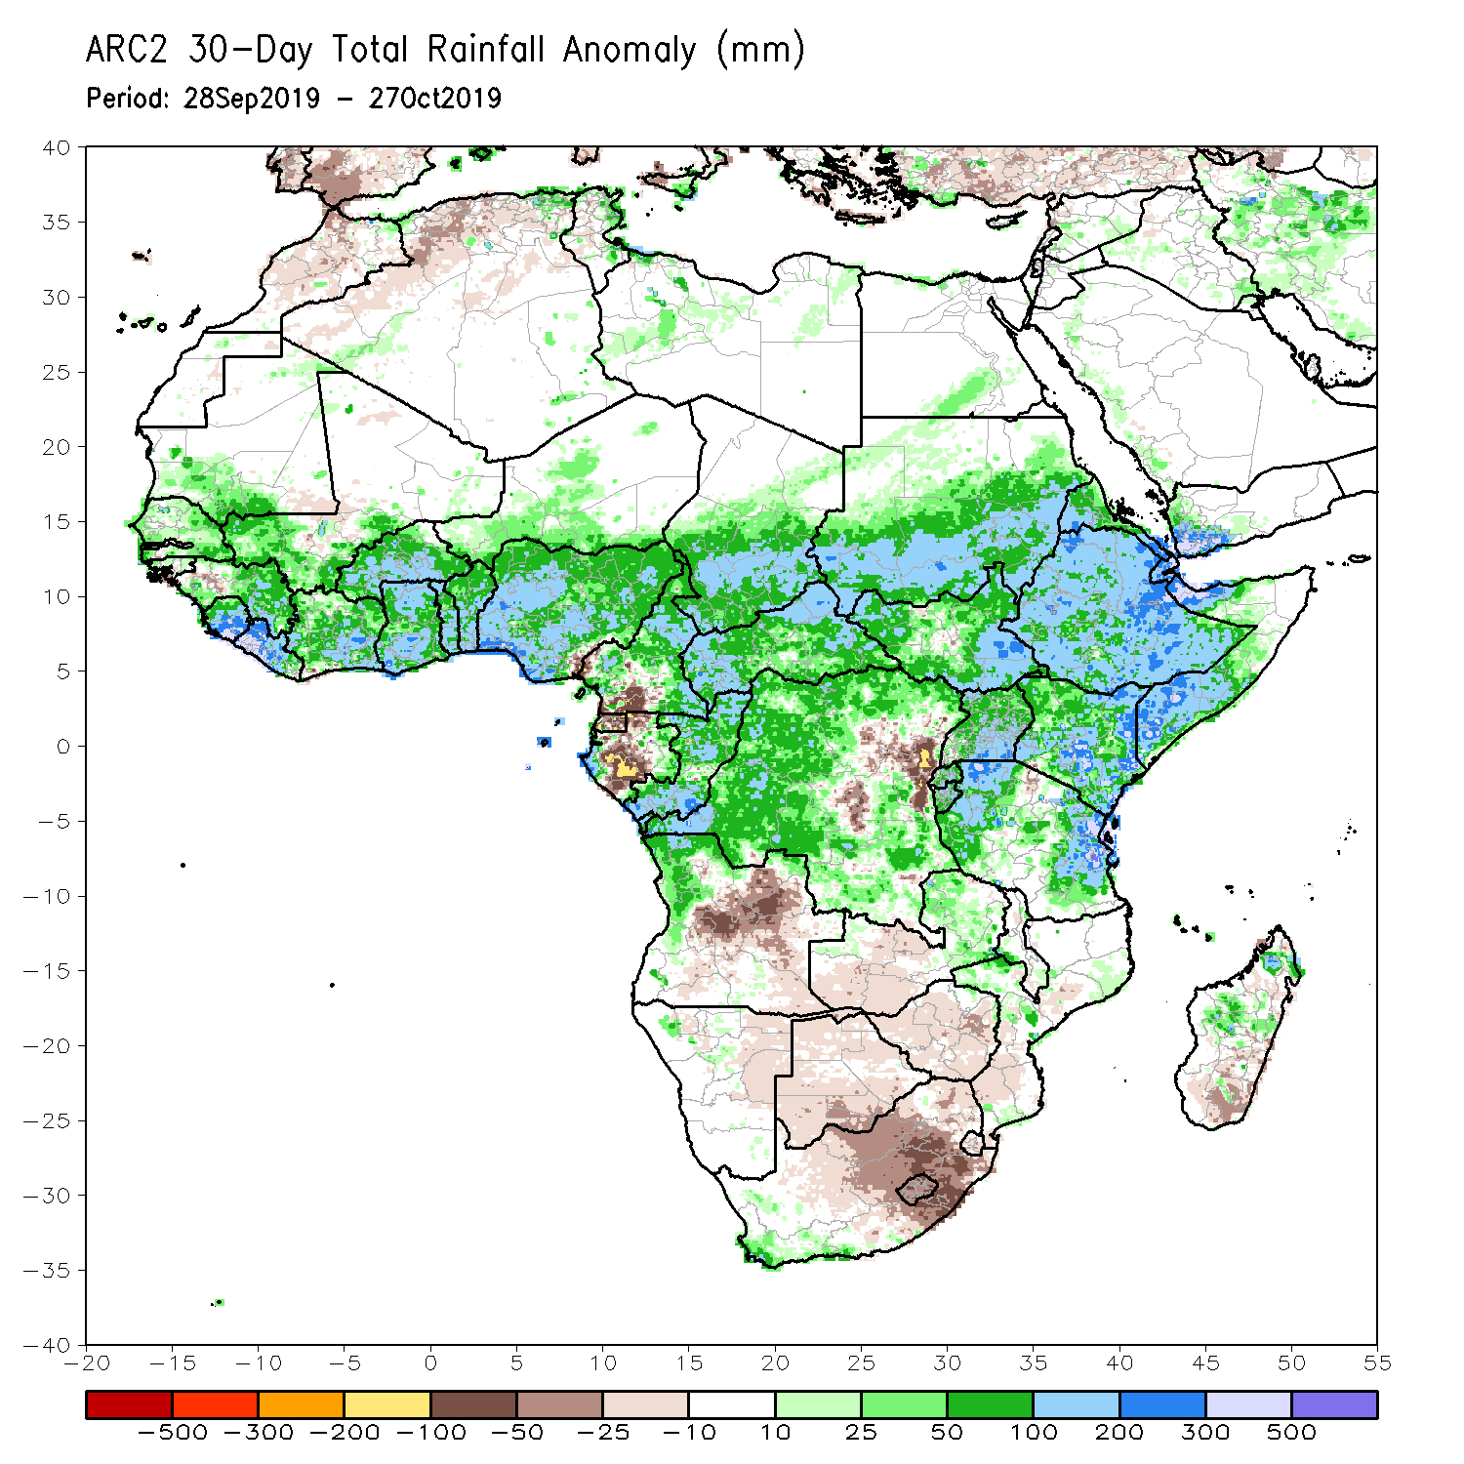
Rainfall Patterns: Last 30 Days
During the past 30 days, rainfall was above-average over southern Mauritania, many parts of Senegal, Guinea-Bissau and Guinea, Sierra Leone, Liberia, southern Mali, Burkina Faso, Ghana, Cote d’Ivoire, Togo, Benin, much of Nigeria, portions of Cameroon, central and southern Chad, much of CAR and Congo, portions of Gabon, many parts of DRC, much of South Sudan, Sudan, Ethiopia, Eritrea, Uganda, Tanzania, Somalia, Kenya, portions of Angola, eastern Zambia, and local areas in Namibia and Mozambique, and portions of Madagascar.
Local areas in Guinea and Mali, parts of Cameroon, many parts of Gabon, portions of Angola and DRC, eastern Namibia, western Zambia, Botswana, Zimbabwe, southern Madagascar and many parts of South Africa had below-average rainfall.
Notes:
5

Slide 6
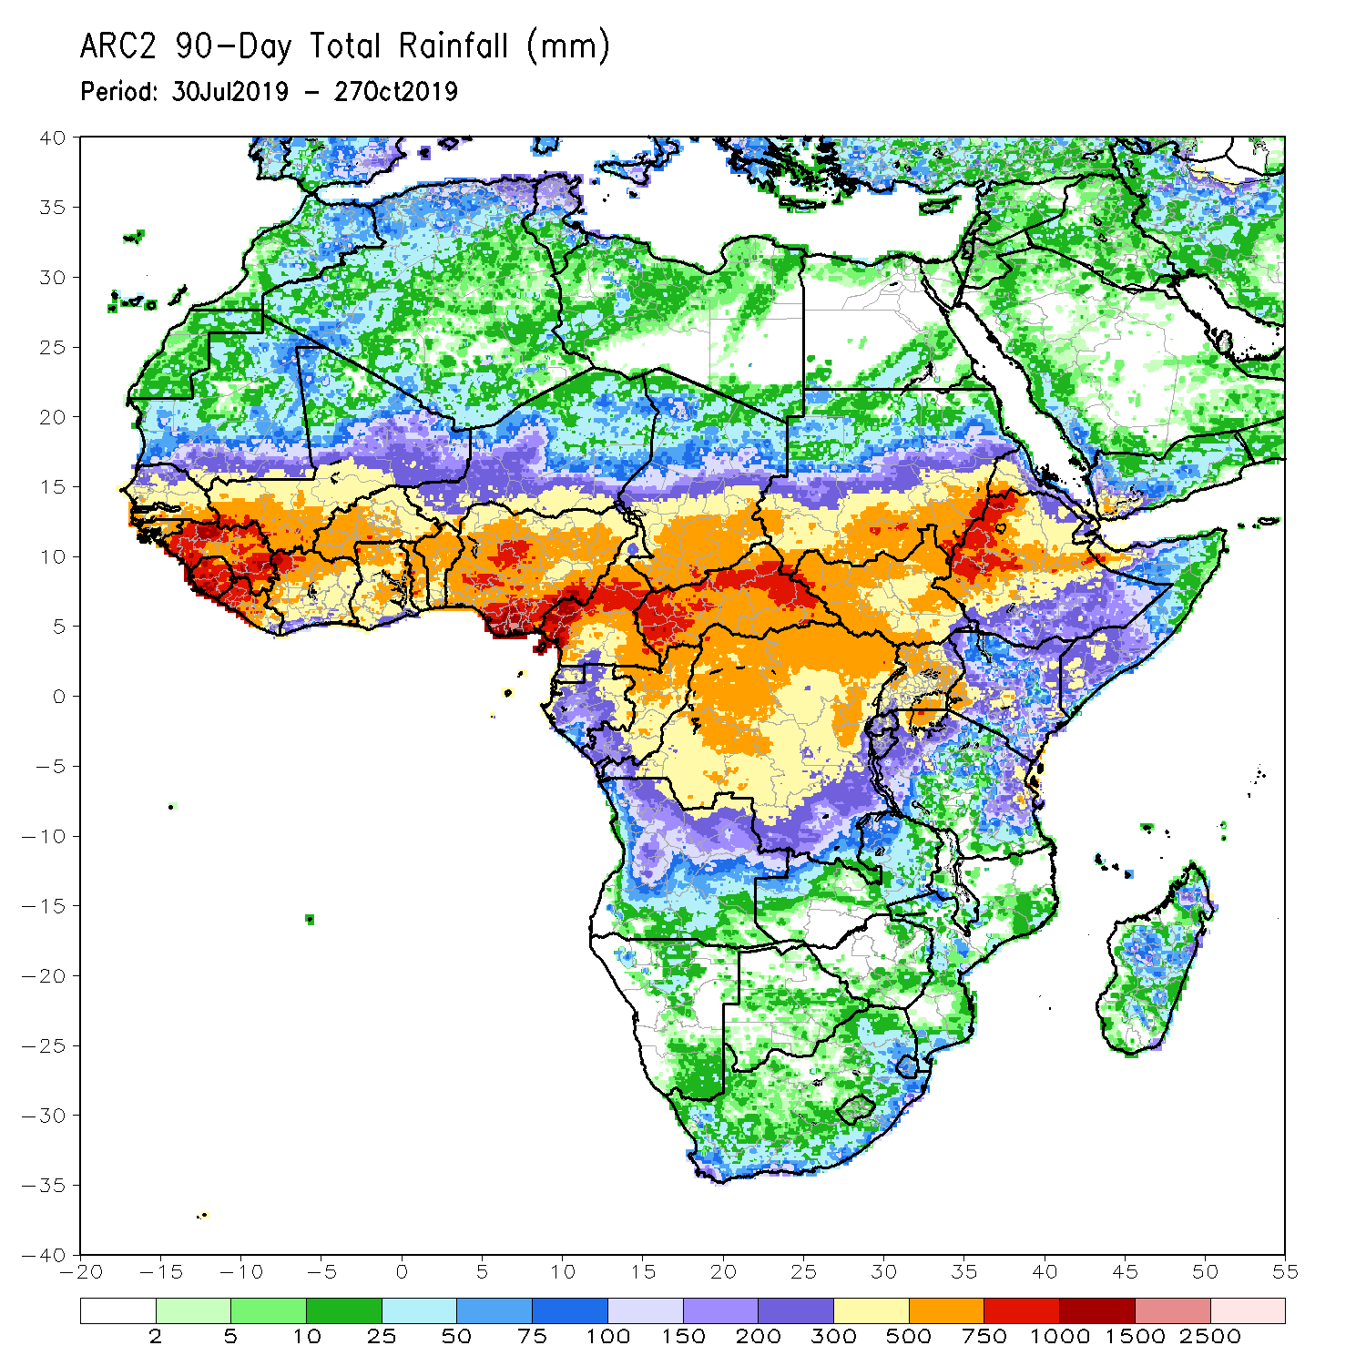
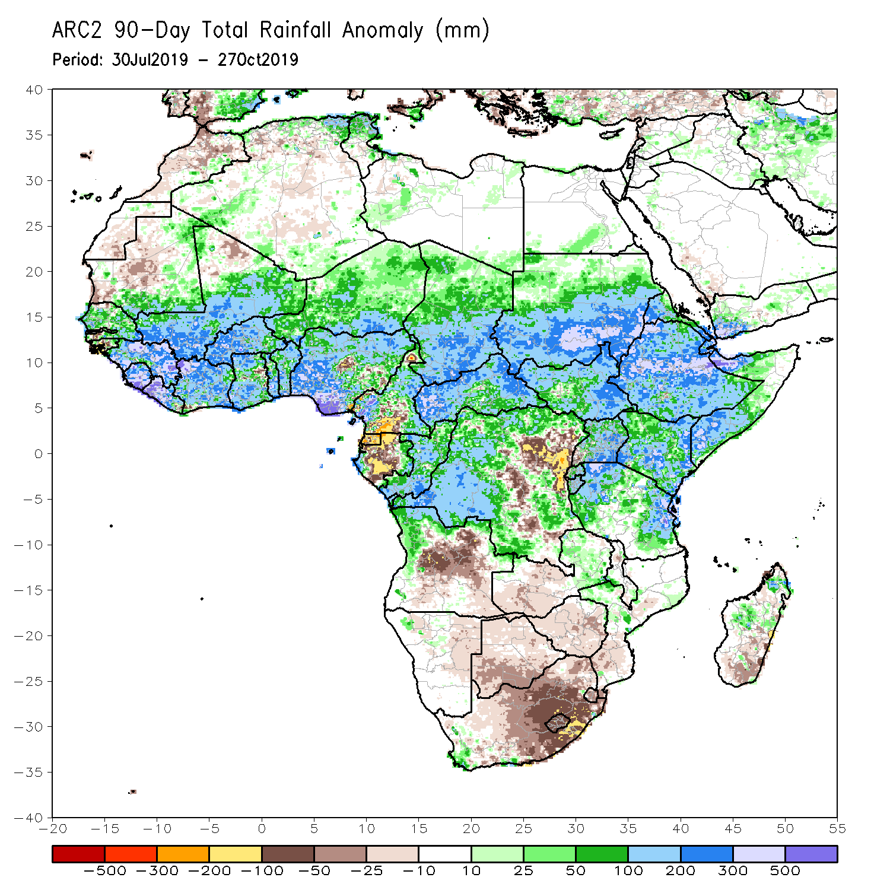
Rainfall Patterns: Last 90 Days
During the past 90 days, rainfall was above-average over southern and eastern Mauritania, much of Senegal, Guinea-Bissau, Guinea, Sierra Leone, Liberia, Mali, Cote d’Ivoire, Burkina Faso, Ghana, Togo, Benin, Niger, many parts of Nigeria, Chad, portions of Cameroon, CAR, many parts of DRC, South Sudan, Uganda, Sudan, Eritrea, Ethiopia, Kenya, Somalia, many parts of Tanzania, portions of Angola, eastern Zambia, and local areas in Mozambique and Madagascar.
Western and central Mauritania, parts of Nigeria and Cameroon, Gabon, portions of central and eastern DRC, many parts of Angola, western Zambia, Zimbabwe, eastern Namibia, Botswana, southern Madagascar and many parts of South Africa had below-average rainfall.
Notes:
6

Slide 7
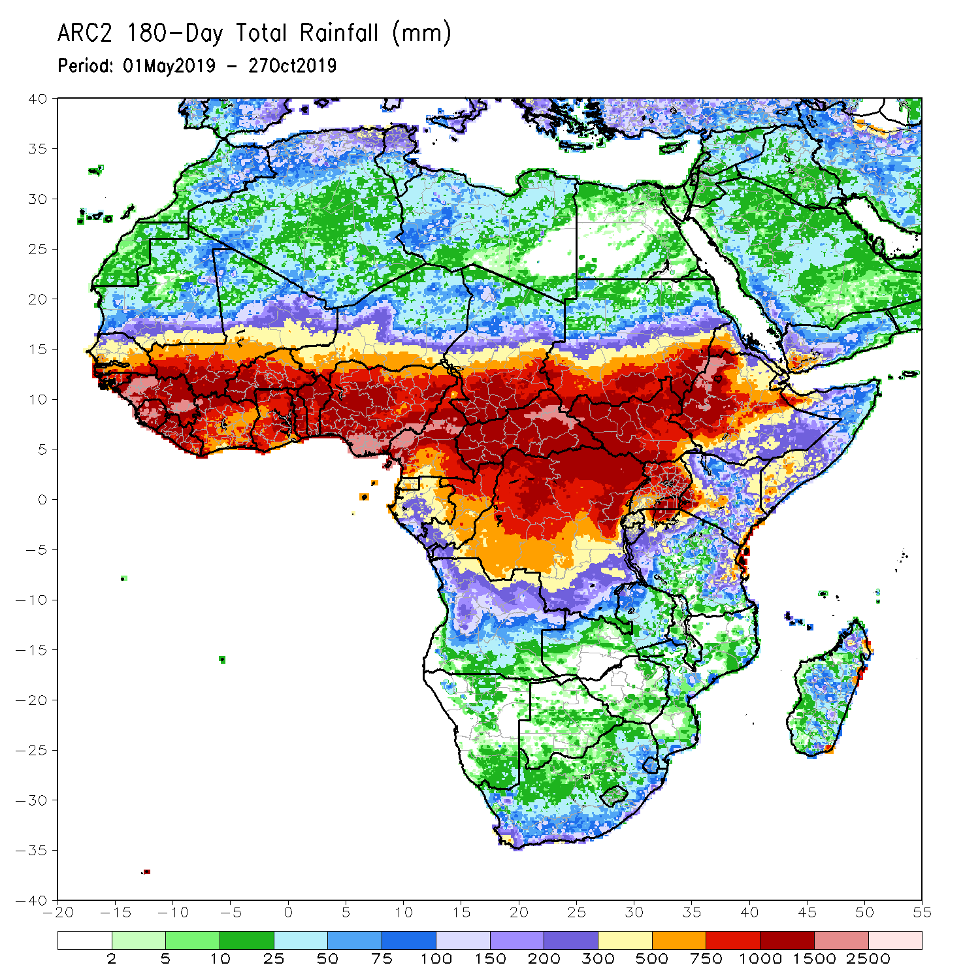
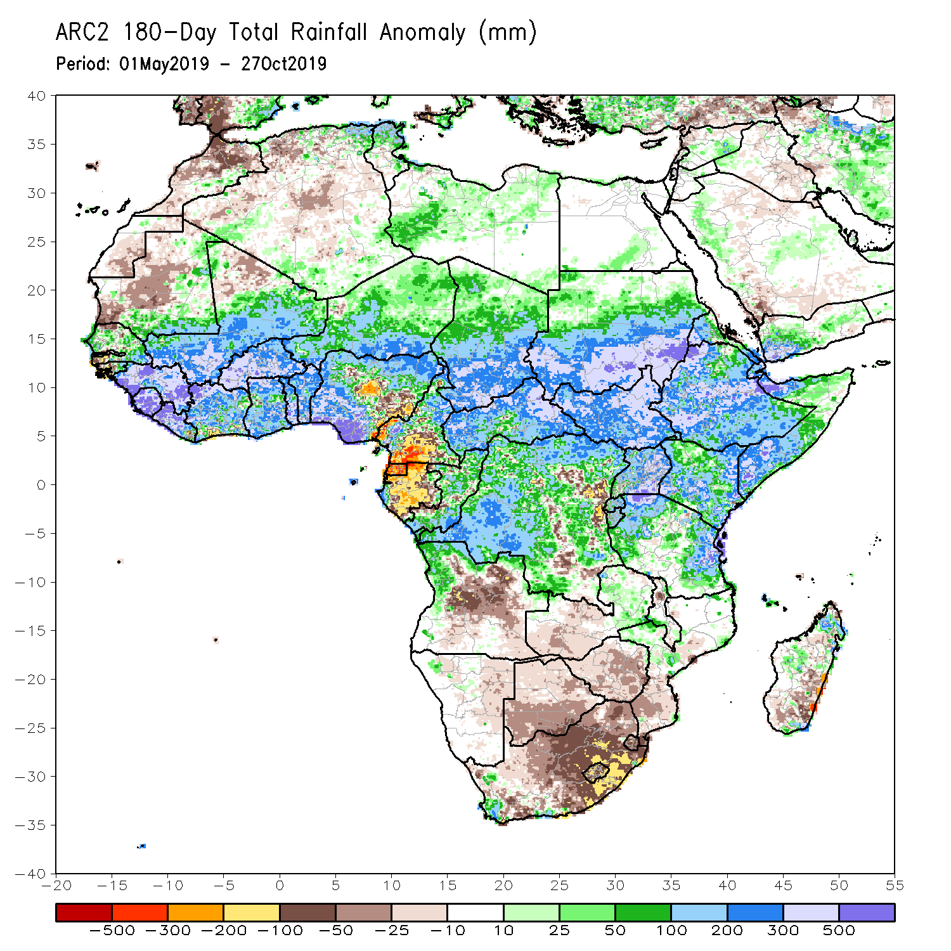
Rainfall Patterns: Last 180 Days
During the past 180 days, below-average rainfall was observed over western and central Mauritania, portions of Nigeria and Cameroon, Equatorial Guinea, Gabon, local areas in Congo, parts of central and eastern DRC, many parts of Angola, Namibia, western and northeastern South Africa, eastern Zambia, parts of Botswana, Zimbabwe, southern Mozambique and southern Madagascar.
Southern and eastern Mauritania, much of Senegal, Guinea-Bissau, Guinea, Sierra Leone, Mali, Liberia, Cote d’Ivoire, Burkina Faso, Ghana, Togo, Benin, portions of Nigeria and Cameroon, Niger, Chad, CAR, many parts of DRC, South Sudan, Sudan, Uganda, Eritrea, Ethiopia, Somalia, Kenya, Tanzania, portions of Angola and eastern Zambia, local areas in Malawi and Mozambique, local areas in South Africa and portions of Madagascar had above-average rainfall.
Notes:
7

Slide 8
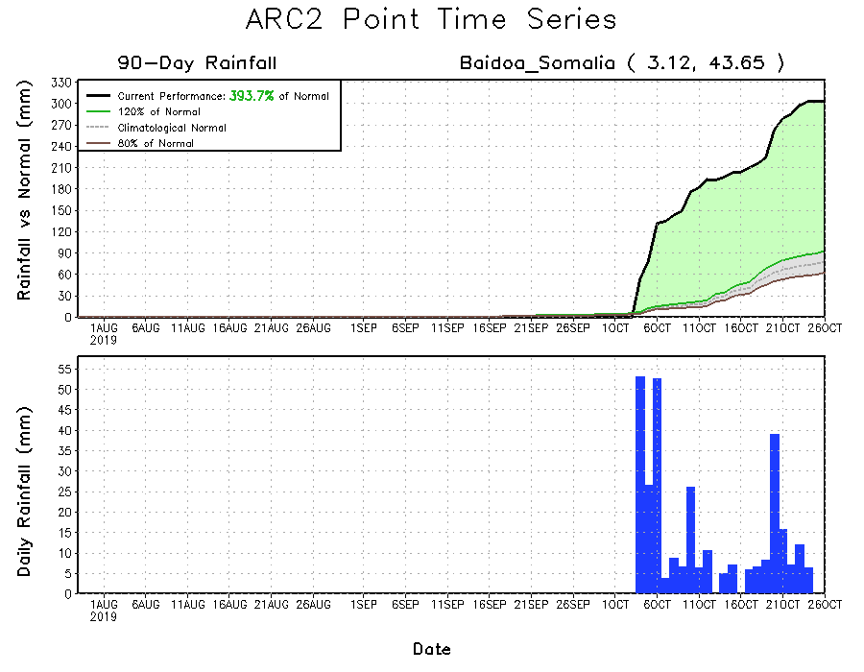
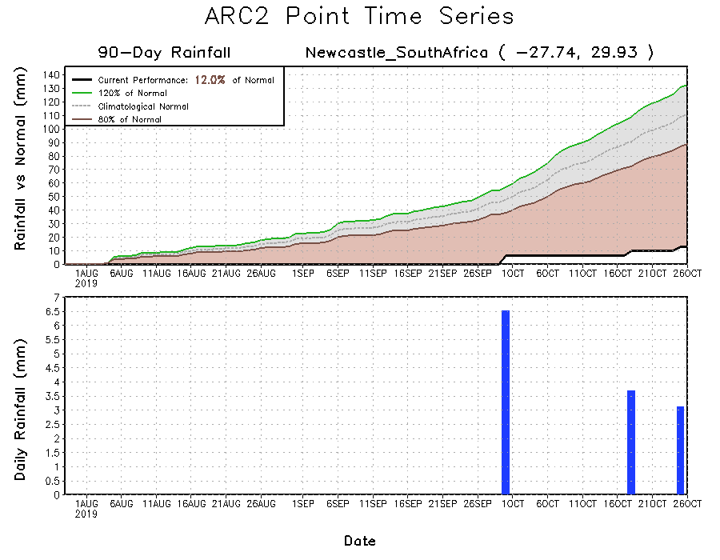
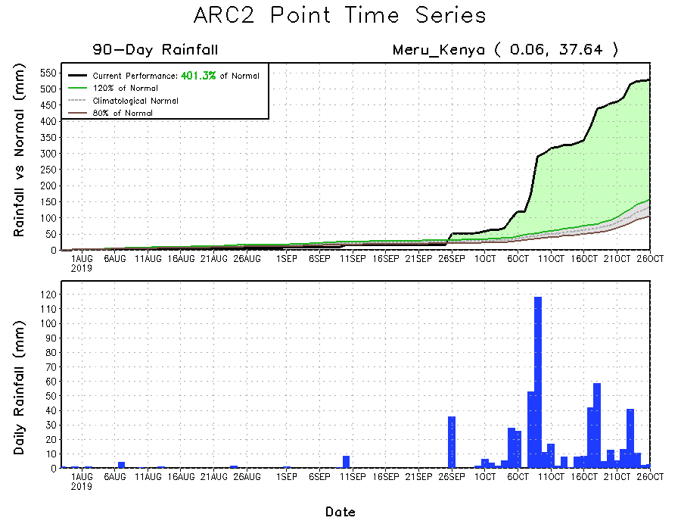
Recent Rainfall Evolution
Daily evolution of rainfall over the last 90 days at selected locations shows that moderate to locally heavy rainfall sustained moisture surpluses over parts of Kenya (bottom right) and southern Somalia (top right). Seasonal total rainfall is below-average over many parts of South Africa (bottom left).

Slide 9
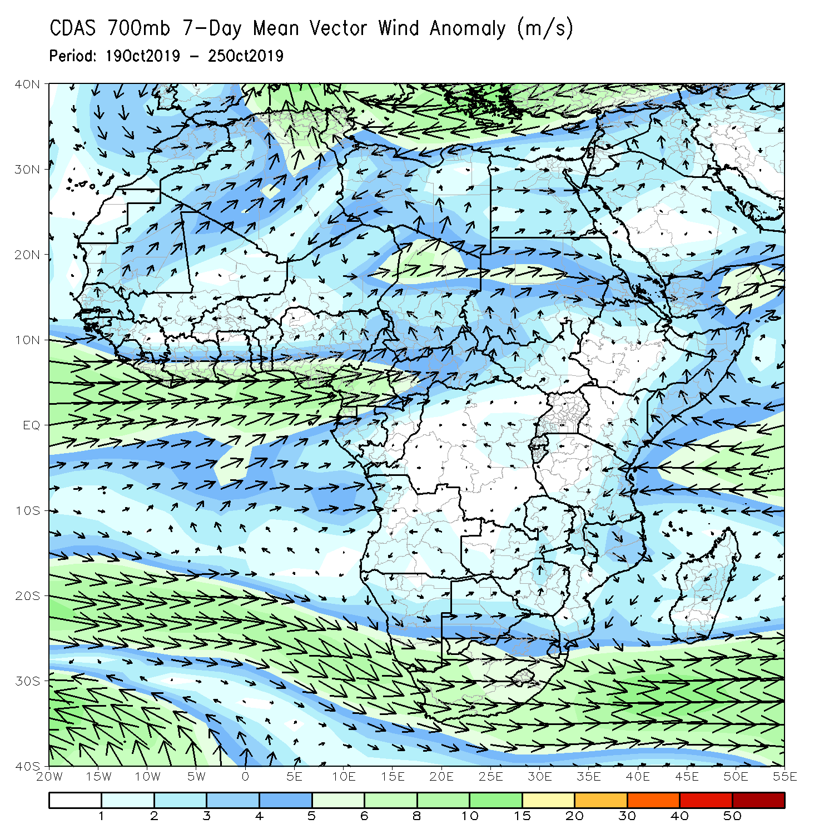
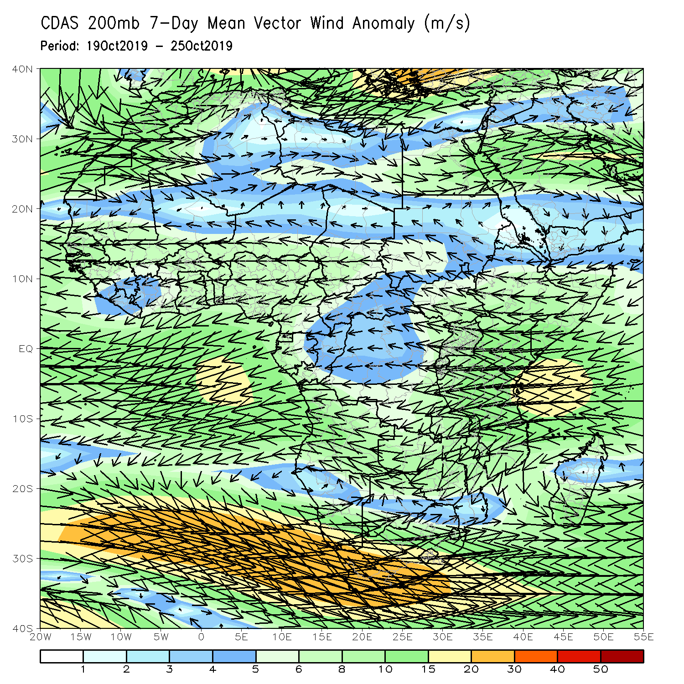
Atmospheric Circulation: Last 7 Days
Anomalous westerly flow with its associated cyclonic shear was observed across the Gulf of Guinea countries. Another week of onshore flow from the Indian Ocean may have contributed to the observed above-average rainfall over equatorial East Africa (left panel).

Slide 10
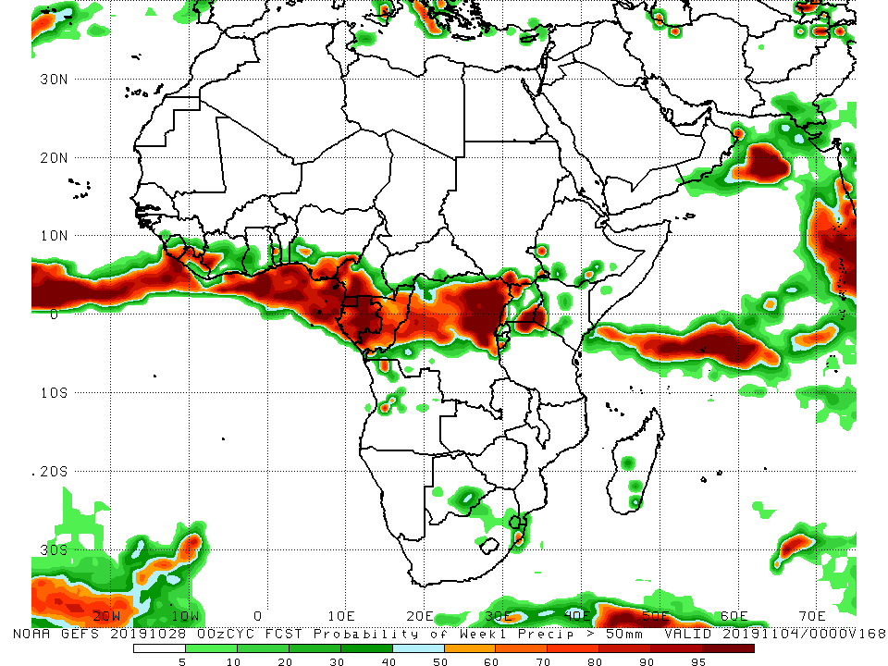
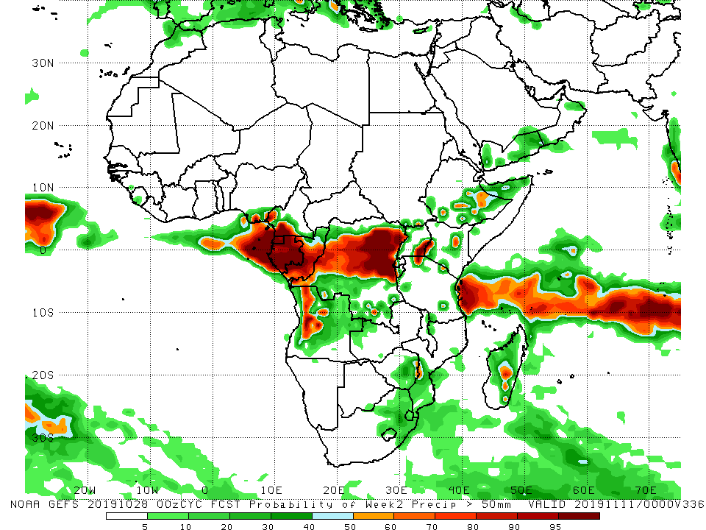
NCEP GEFS Model Forecasts Non-Bias Corrected Probability of precipitation exceedance
Week-1: Valid 29 October – 4 November, 2019
Week-2: Valid 5 – 11 November, 2019
For week-1 (left panel) and week-2 (right panel), there is an increased chance for weekly rainfall totals to exceed 50mm along the Gulf of Guinea coast, and portions of Central and East Africa.
Notes:
10

Slide 11
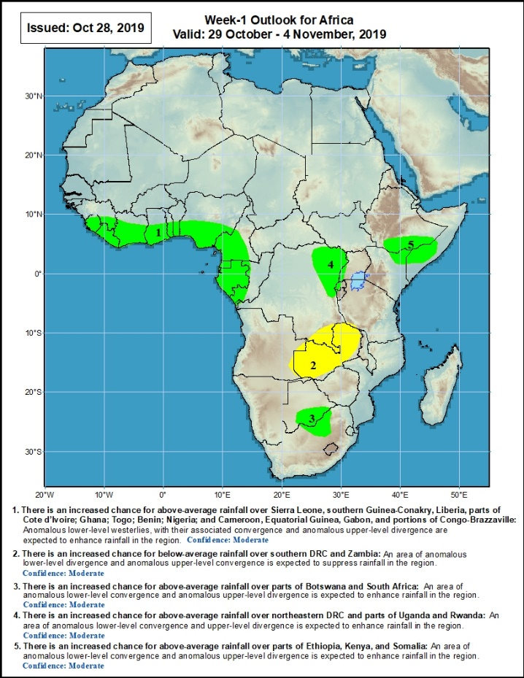
Week-1 Precipitation Outlooks
29 October – 4 November, 2019
There is an increased chance for above-average rainfall over Sierra Leone, southern Guinea-Conakry, Liberia, parts of Cote d’Ivoire, Ghana, Togo, Benin, Nigeria, Cameroon, Equatorial Guinea, Gabon, and portions of Congo-Brazzaville: An area of anomalous lower-level westerlies, with their associated lower-level convergence and anomalous upper-level divergence is expected to enhance rainfall in the region. Confidence: Moderate
There is an increased chance for below-average rainfall over southern DRC and Zambia: An area of anomalous lower-level divergence and anomalous upper-level convergence is expected to suppress rainfall in the region. Confidence: Moderate
There is an increased chance for above-average rainfall over parts of Botswana and South Africa: An area of anomalous lower-level convergence and anomalous upper-level divergence is expected to enhance rainfall in the region. Confidence: Moderate
There is an increased chance for above-average rainfall over northeastern DRC and parts of Uganda and Rwanda: An area of anomalous lower-level convergence and upper-level divergence is expected to enhance rainfall in the region. Confidence: Moderate
There is an increased chance for above-average rainfall over parts of Ethiopia, Kenya, and Somalia: An area of anomalous lower-level convergence and anomalous upper-level divergence is expected to enhance rainfall in the region. Confidence: Moderate
Notes:
11

Slide 12
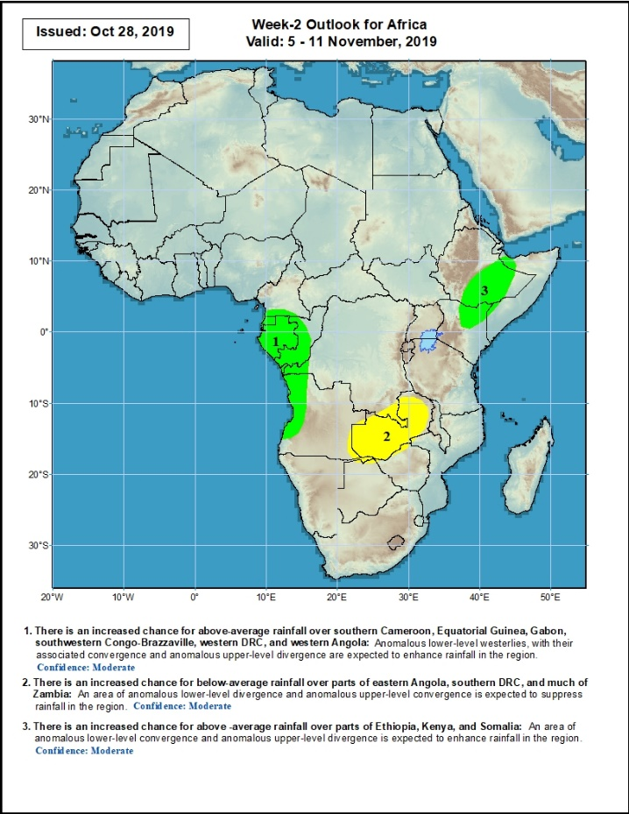
Week-2 Precipitation Outlooks
5 – 11 November, 2019
There is an increased chance for above-average rainfall over parts of southern Cameroon, Equatorial Guinea, Gabon, southwestern Congo-Brazzaville, western DRC, and western Angola: An area of anomalous lower-level westerlies, with their associated convergence and anomalous upper-level divergence is expected to enhance rainfall in the region. . Confidence: Moderate
There is an increased chance for below-average rainfall over parts of eastern Angola, southern DRC, and much of Zambia: An area of anomalous lower-level divergence and anomalous upper-level convergence is expected to suppress rainfall in the region. Confidence: Moderate
There is an increased chance for above-average rainfall over parts of Ethiopia, Kenya, and Somalia: An area of anomalous lower-level convergence and anomalous upper-level divergence is expected to enhance rainfall in the region. Confidence: Moderate
Notes:
12

Slide 13
Summary
During the past 7 days, rainfall was above-average over local areas in southern Mauritania, Senegal, Mali and Guinea, Above-average rainfall was also observed across eastern Liberia, Cote d’Ivoire, western Burkina Faso, Ghana, Togo, Benin, Nigeria, Cameroon, southern Chad, CAR, parts of Congo and DRC, southern and eastern Sudan, parts of South Sudan, parts of western and southern Ethiopia, southern Uganda, Kenya, Tanzania, southern Somalia, and local areas in northern Madagascar. Weekly, rainfall surpluses exceeded 100mm over parts of Nigeria, Tanzania and Kenya. Southern Cameroon, Equatorial Guinea, much of Gabon, local areas in Congo, many parts of DRC, Angola, portions of South Sudan and Ethiopia, western Zambia, and parts of South Africa and Madagascar.
During the past 30 days, rainfall was above-average over southern Mauritania, many parts of Senegal, Guinea-Bissau and Guinea, Sierra Leone, Liberia, southern Mali, Burkina Faso, Ghana, Cote d’Ivoire, Togo, Benin, much of Nigeria, portions of Cameroon, central and southern Chad, much of CAR and Congo, portions of Gabon, many parts of DRC, much of South Sudan, Sudan, Ethiopia, Eritrea, Uganda, Tanzania, Somalia, Kenya, portions of Angola, eastern Zambia, and local areas in Namibia and Mozambique, and portions of Madagascar. Local areas in Guinea and Mali, parts of Cameroon, many parts of Gabon, portions of Angola and DRC, eastern Namibia, western Zambia, Botswana, Zimbabwe, southern Madagascar and many parts of South Africa had below-average rainfall.
During the past 90 days, rainfall was above-average over southern and eastern Mauritania, much of Senegal, Guinea-Bissau, Guinea, Sierra Leone, Liberia, Mali, Cote d’Ivoire, Burkina Faso, Ghana, Togo, Benin, Niger, many parts of Nigeria, Chad, portions of Cameroon, CAR, many parts of DRC, South Sudan, Uganda, Sudan, Eritrea, Ethiopia, Kenya, Somalia, many parts of Tanzania, portions of Angola, eastern Zambia, and local areas in Mozambique and Madagascar. Western and central Mauritania, parts of Nigeria and Cameroon, Gabon, portions of central and eastern DRC, many parts of Angola, western Zambia, Zimbabwe, eastern Namibia, Botswana, southern Madagascar and many parts of South Africa had below-average rainfall.
Week-1 outlooks call for an increased chance for above-average rainfall over Sierra Leone, Liberia, southeastern Guinea, Cote d’Ivoire, southern Ghana, southern Togo, southern Benin, southern Nigeria, western and southern Cameroon, Equatorial Guinea, Gabon, southwestern Congo. Outlooks also call for above-average rainfall over northeastern DRC, western Uganda, western Rwanda, southern Ethiopia, northeastern Kenya, southern Somalia, and southern Botswana and northern South Africa. In contrast, there is an increased chance for below-average rainfall over southern DRC, and much of Zambia.
Notes:
13

