Slide 1
The African Monsoon Recent Evolution and Current Status Include Week-1 and Week-2 Outlooks
Update prepared by
Climate Prediction Center / NCEP
15 October 2019
For more information, visit:
http://www.cpc.ncep.noaa.gov/products/Global_Monsoons/African_Monsoons/precip_monitoring.shtml

Slide 2
Outline
Highlights
Recent Evolution and Current Conditions
NCEP GEFS Forecasts
Summary

Slide 3
Highlights: Last 7 Days
Rainfall was above-average over many places in West Africa and the Greater Horn of Africa, and portions of Central Africa. Weekly rainfall surpluses exceeded 100mm over many parts of Sierra Leone and Liberia, parts of Burkina Faso and Ghana, local areas in Ethiopia, portions of Kenya and eastern Tanzania.
Week-1 outlooks call for an increased chance for above-average rainfall over, southern Togo, Benin, Nigeria, northern Cameroon, CAR, southern Sudan, much of South Sudan and DRC, Rwanda, Burundi, Uganda, southeastern Ethiopia, eastern Kenya and parts of southern Somalia. In contrast, there is an increased chance for below-average rainfall over parts of southern Mali, and northeastern Angola.

Slide 4
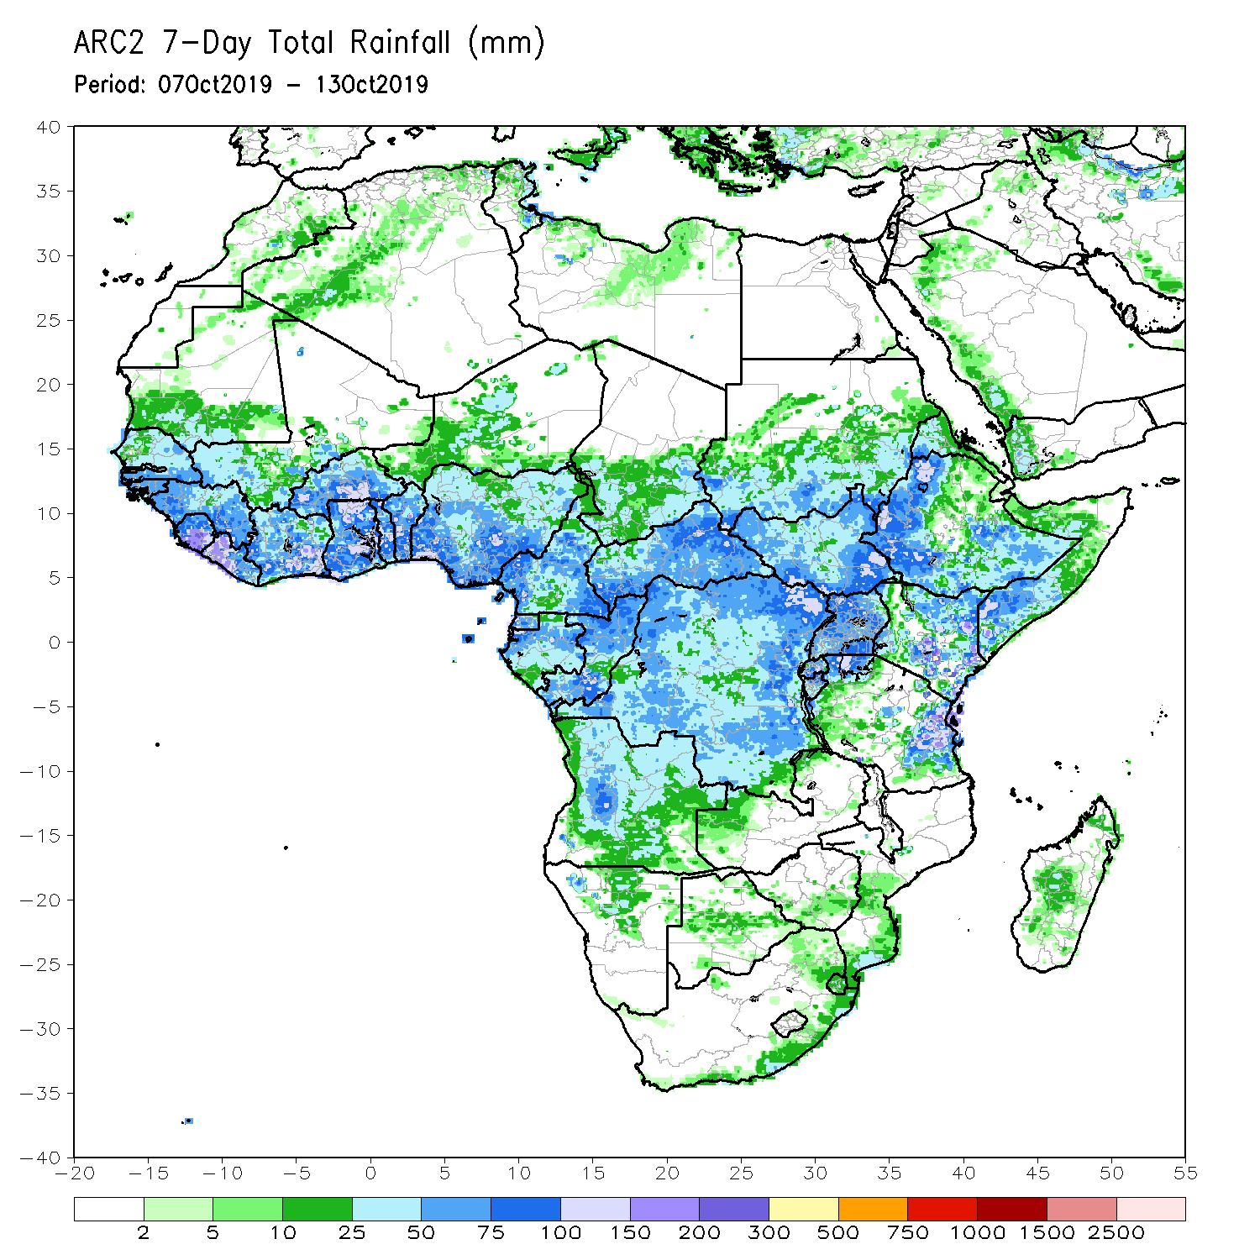
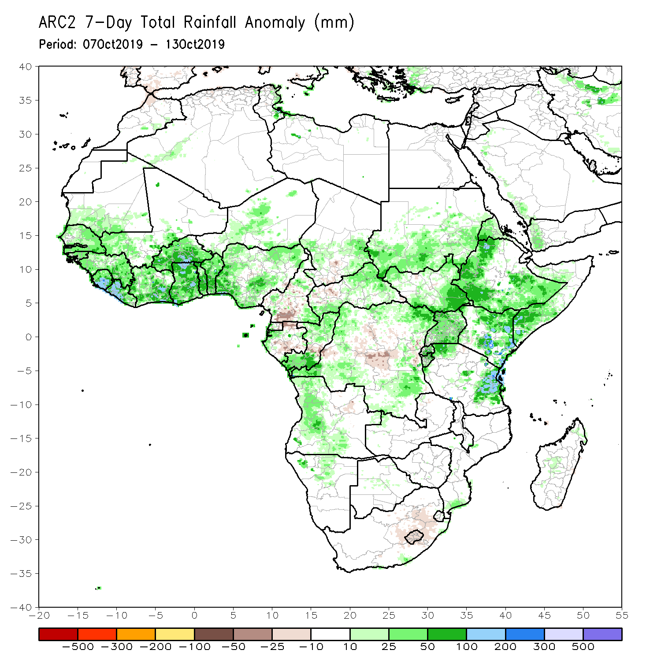
Rainfall Patterns: Last 7 Days
During the past 7 days, rainfall was above-average over southern Mauritania, Senegal, Guinea-Bissau, Guinea, Sierra Leone, Liberia, southern Mali, Cote d’Ivoire, Burkina Faso, Ghana, Togo, Benin, parts of Niger and Chad, Nigeria, portions of Cameroon and CAR, local areas in Gabon, many parts of Congo, portions of Angola and DRC, southern and eastern Sudan, South Sudan, many parts of Ethiopia, Uganda, many parts of Kenya, southern Somalia, northern and eastern Tanzania, northern Namibia, and local areas in Mozambique and Madagascar.
Local areas in Chad, parts of Cameroon and Gabon, portions of DRC, and local areas in Angola had below-average rainfall.

Slide 5
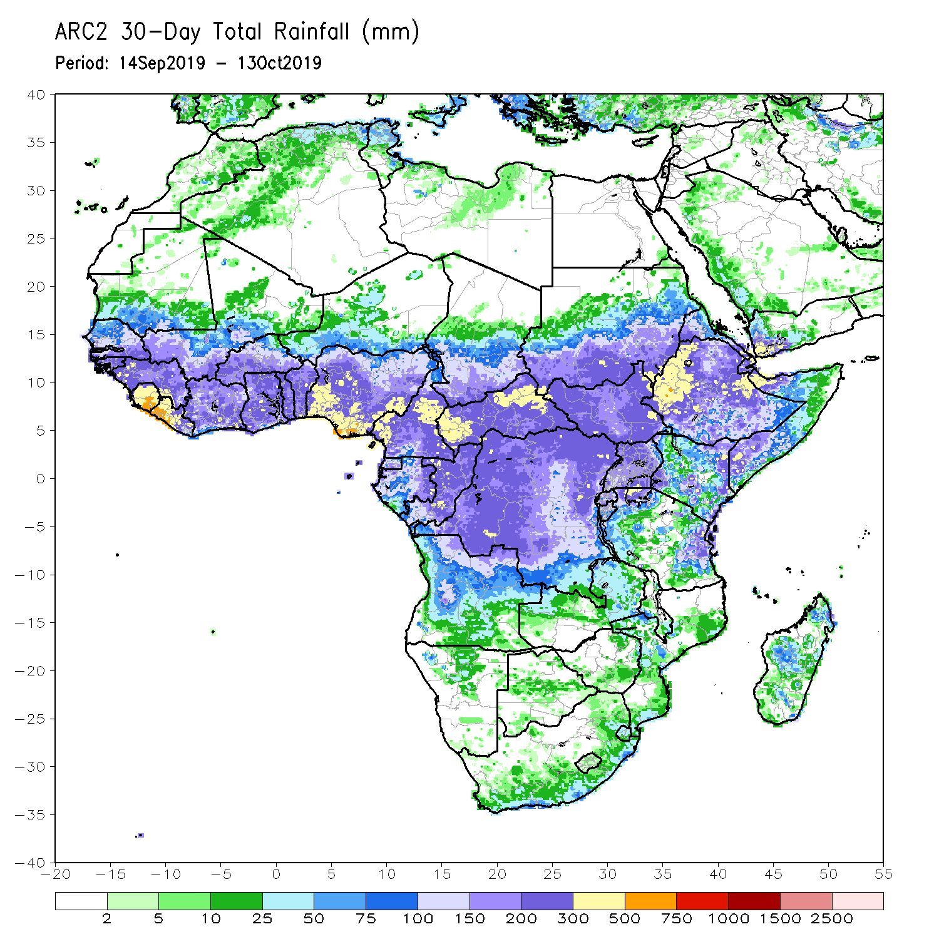
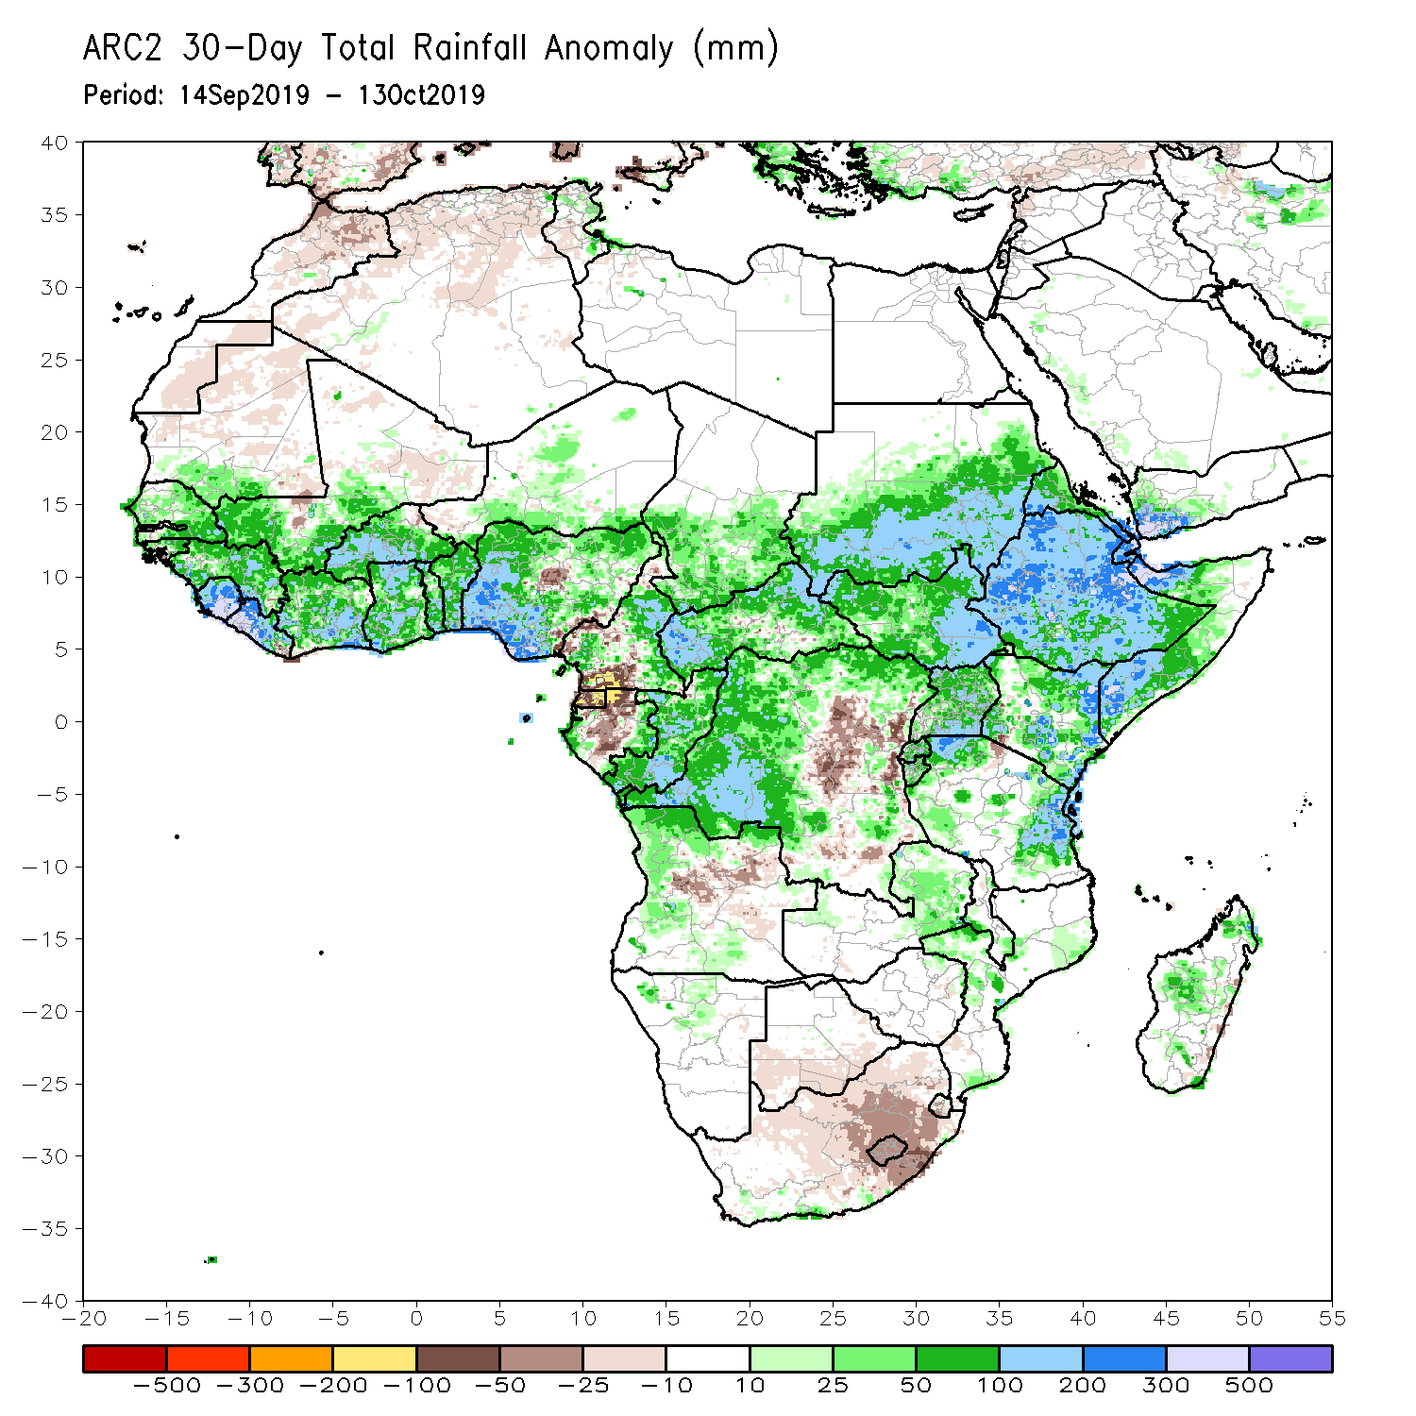
Rainfall Patterns: Last 30 Days
During the past 30 days, rainfall was above-average over parts of southern Mauritania, many parts of Senegal, Guinea, Sierra Leone, Liberia, Mali, Burkina Faso, Ghana, Cote d’Ivoire, Togo, Benin, many parts of Nigeria and Cameroon, southern Chad, much of CAR and Congo, western and northern DRC, much of South Sudan, southern and eastern Sudan, Ethiopia, Eritrea, many parts of Uganda, Tanzania, Somalia and Kenya, portions of Angola, eastern Zambia, and local areas in Mozambique and Madagascar.
Local areas in Mali and Nigeria, parts of Cameroon, many parts of Gabon, portions of Angola and DRC, Botswana, and many parts of South Africa had below-average rainfall.
Notes:
5

Slide 6
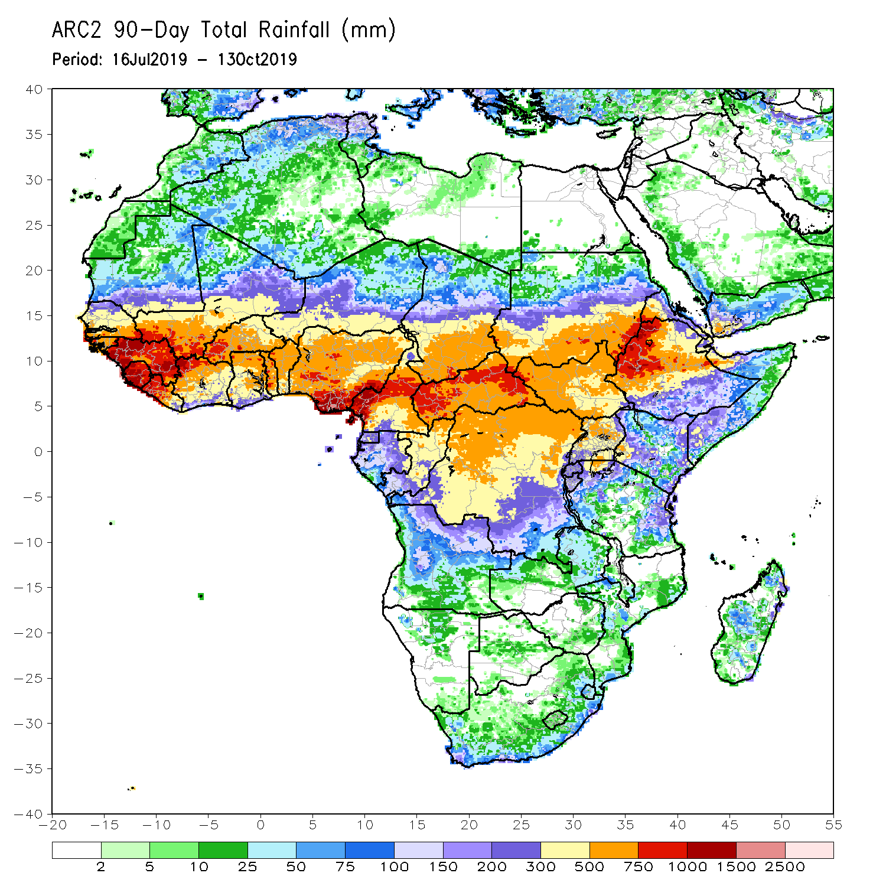
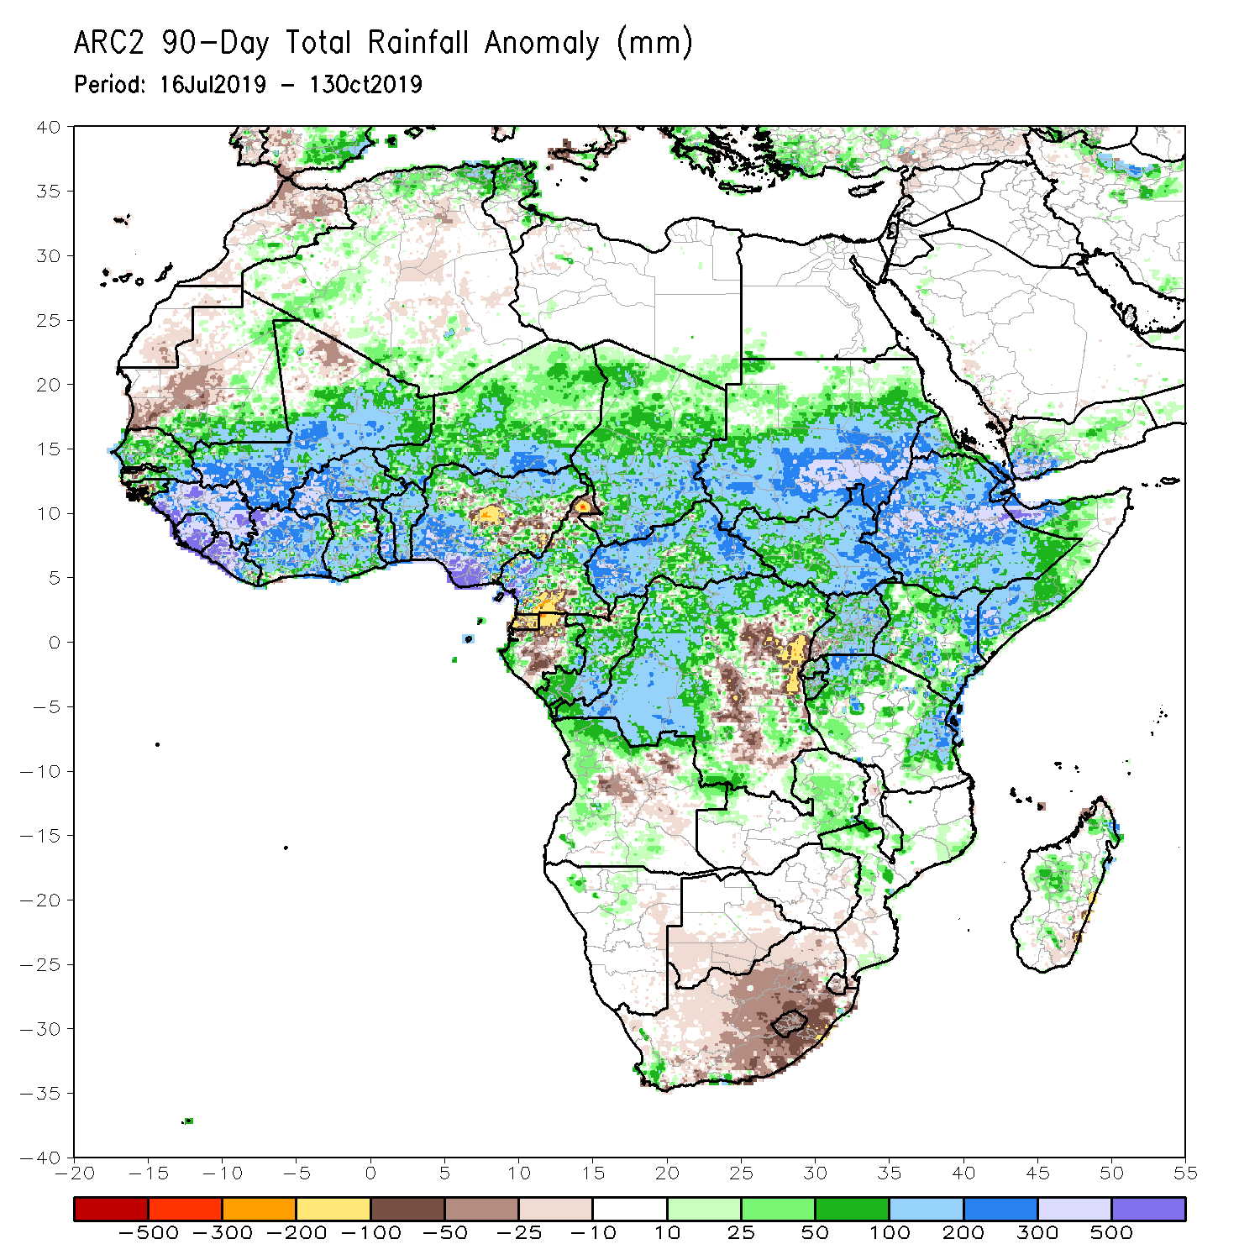
Rainfall Patterns: Last 90 Days
During the past 90 days, rainfall was above-average over southern and eastern Mauritania, much of Senegal, Guinea-Bissau, Guinea, Sierra Leone, Liberia, Mali, Cote d’Ivoire, Burkina Faso, Ghana, Togo, Benin, Niger, many parts of Nigeria, Chad, many parts of Cameroon, CAR, many parts of DRC, South Sudan, Uganda, Sudan, Eritrea, Ethiopia, Kenya, Somalia, many parts of Tanzania, portions of Angola, eastern Zambia, and local areas in Mozambique and Madagascar.
Western and central Mauritania, parts of Nigeria and Cameroon, Gabon, portions of central and eastern DRC, portions of Angola, Botswana and many parts of South Africa had below-average rainfall.
Notes:
6

Slide 7
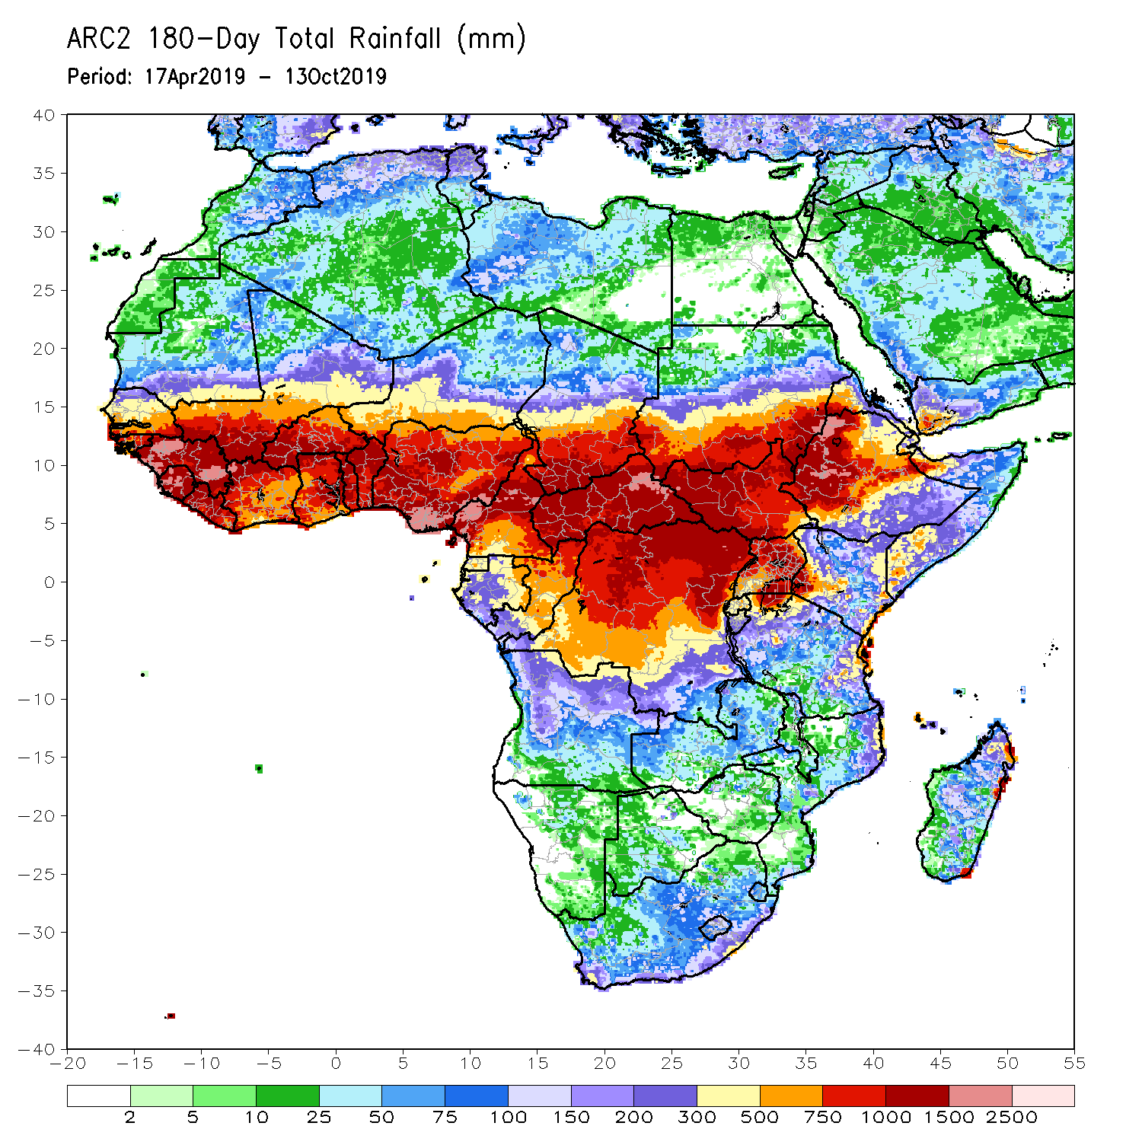
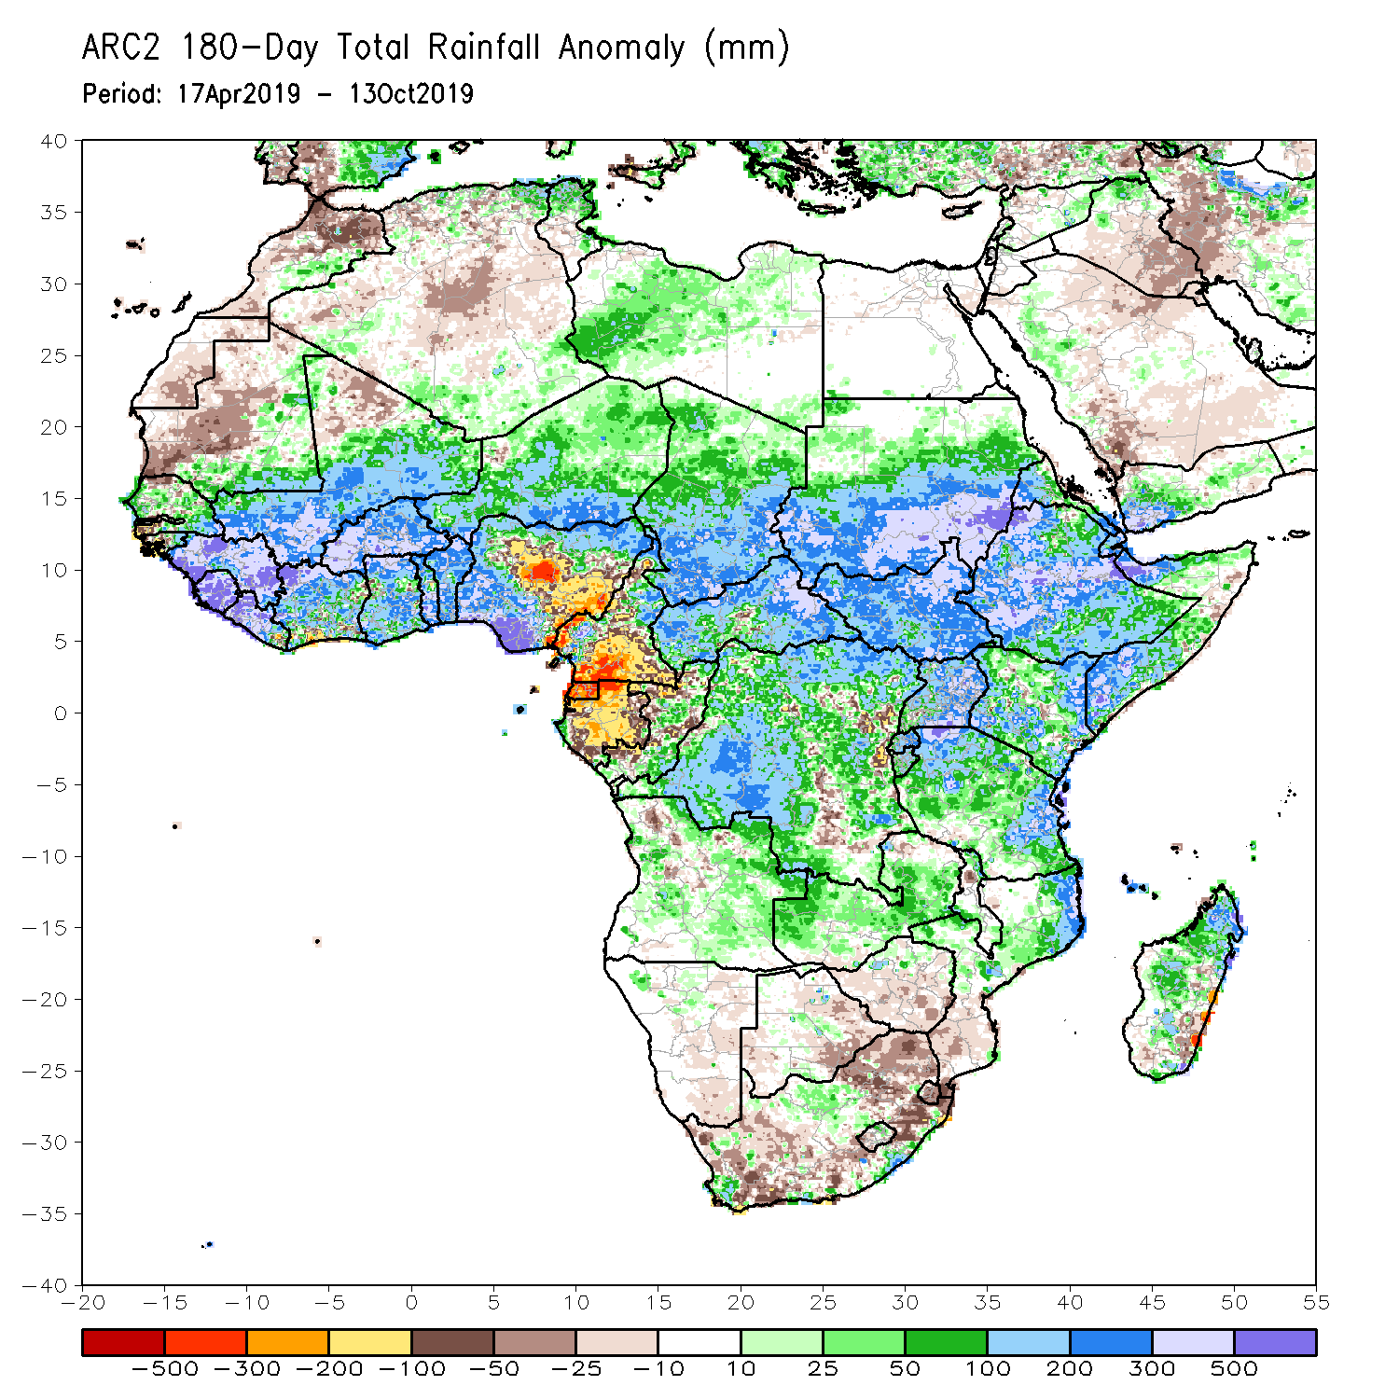
Rainfall Patterns: Last 180 Days
During the past 180 days, below-average rainfall was observed over western and central Mauritania, portions of Nigeria and Cameroon, Equatorial Guinea, Gabon, local areas in Congo, parts of central and eastern DRC, local areas in Angola, Namibia, western and northeastern South Africa, eastern Zambia, parts of Botswana, Zimbabwe, southern Mozambique and local areas in Madagascar.
Southern and eastern Mauritania, much of Senegal, Guinea-Bissau, Guinea, Sierra Leone, Mali, Liberia, Cote d’Ivoire, Burkina Faso, Ghana, Togo, Benin, portions of Nigeria and Cameroon, Niger, Chad, CAR, many parts of DRC, South Sudan, Sudan, Uganda, Eritrea, Ethiopia, Somalia, Kenya, Tanzania, portions of Angola and Zambia, local areas in Malawi, northern Mozambique, local areas in South Africa and portions of Madagascar had above-average rainfall.
Notes:
7

Slide 8
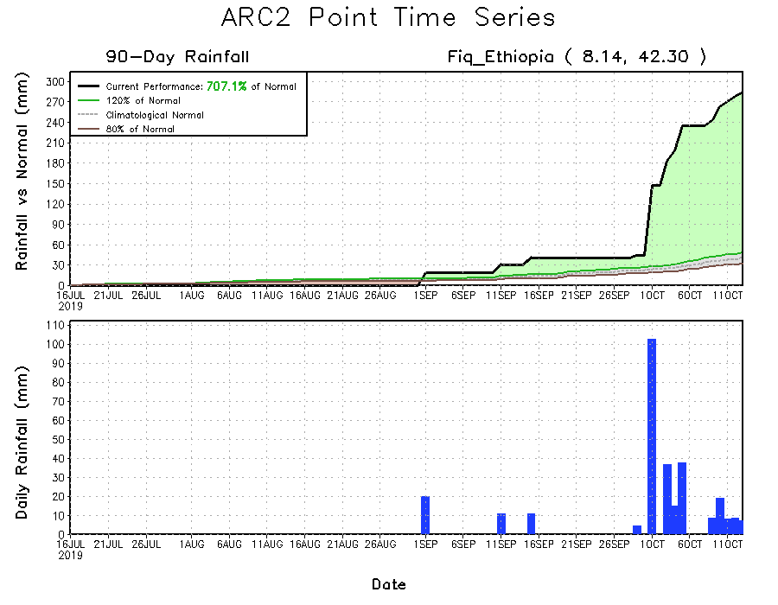
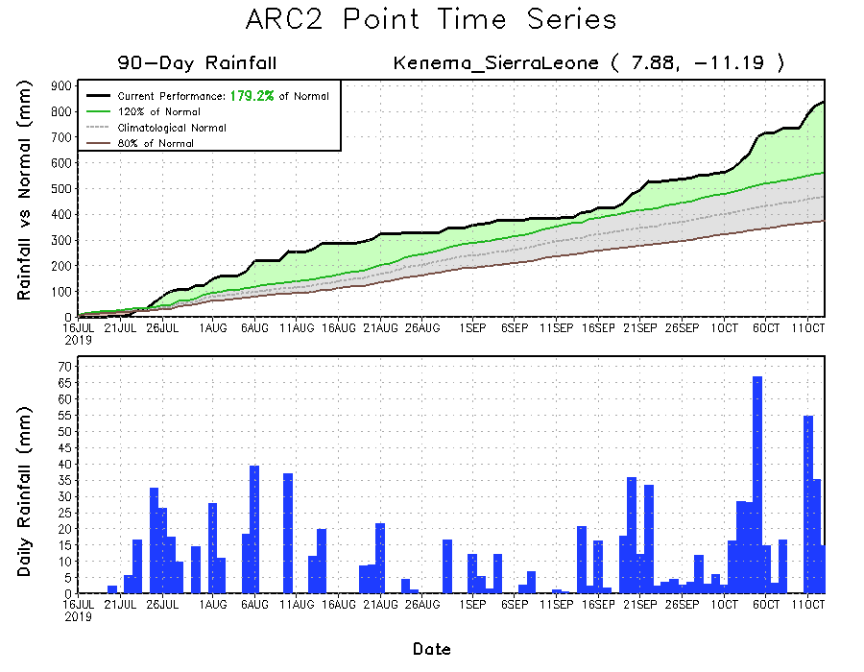
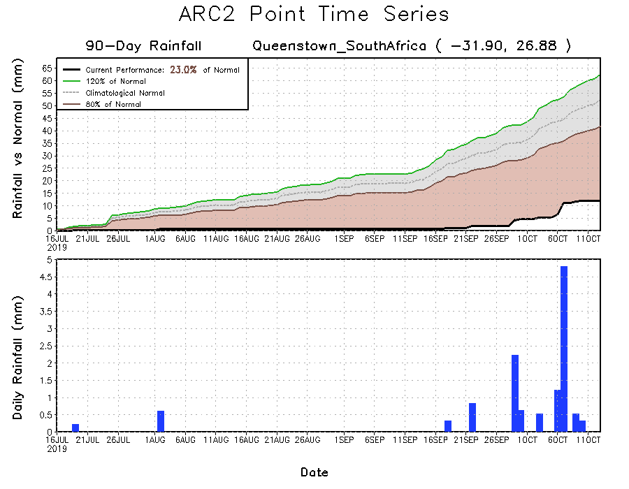
Recent Rainfall Evolution
Daily evolution of rainfall over the last 90 days at selected locations shows that moderate to locally heavy rainfall sustained moisture surpluses over parts of Sierra Leone (bottom left) and many parts of Ethiopia (top right). Early season dryness was observed across southern South Africa (bottom right).

Slide 9
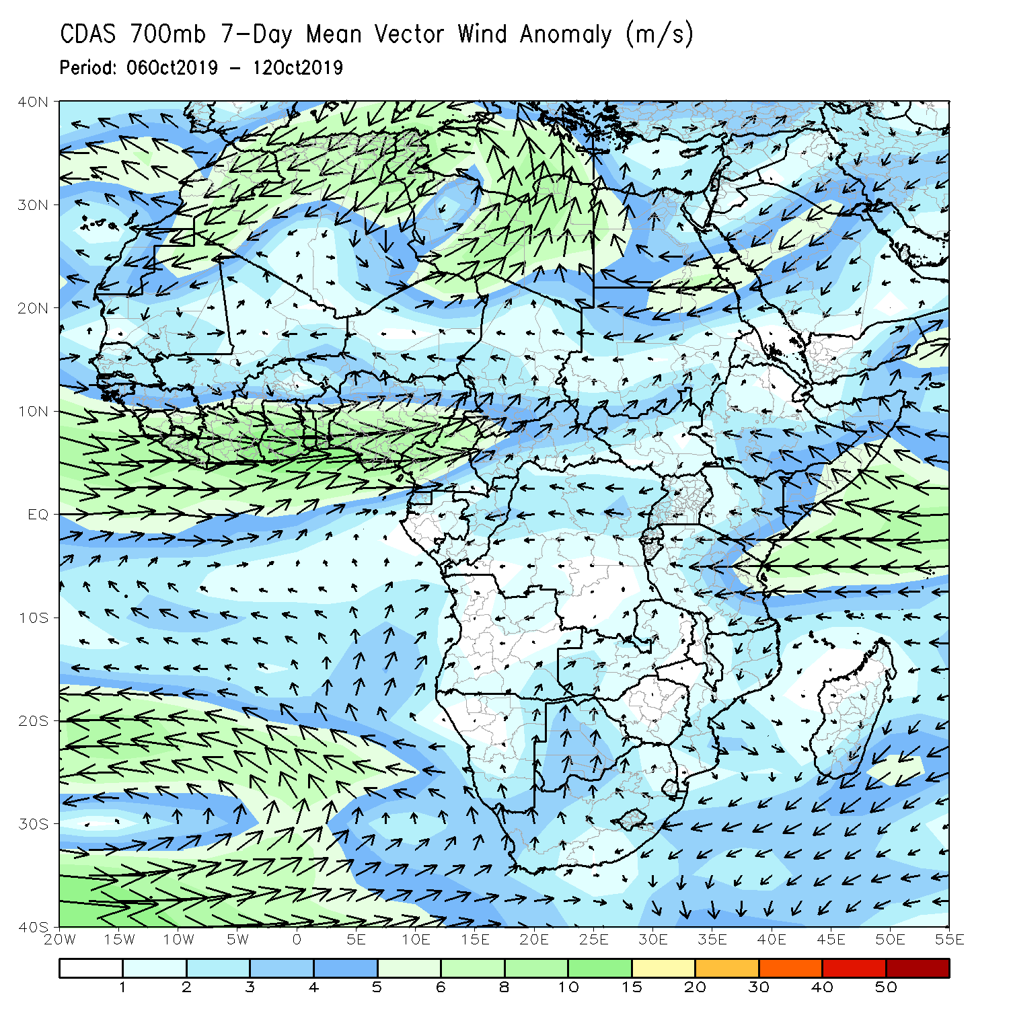
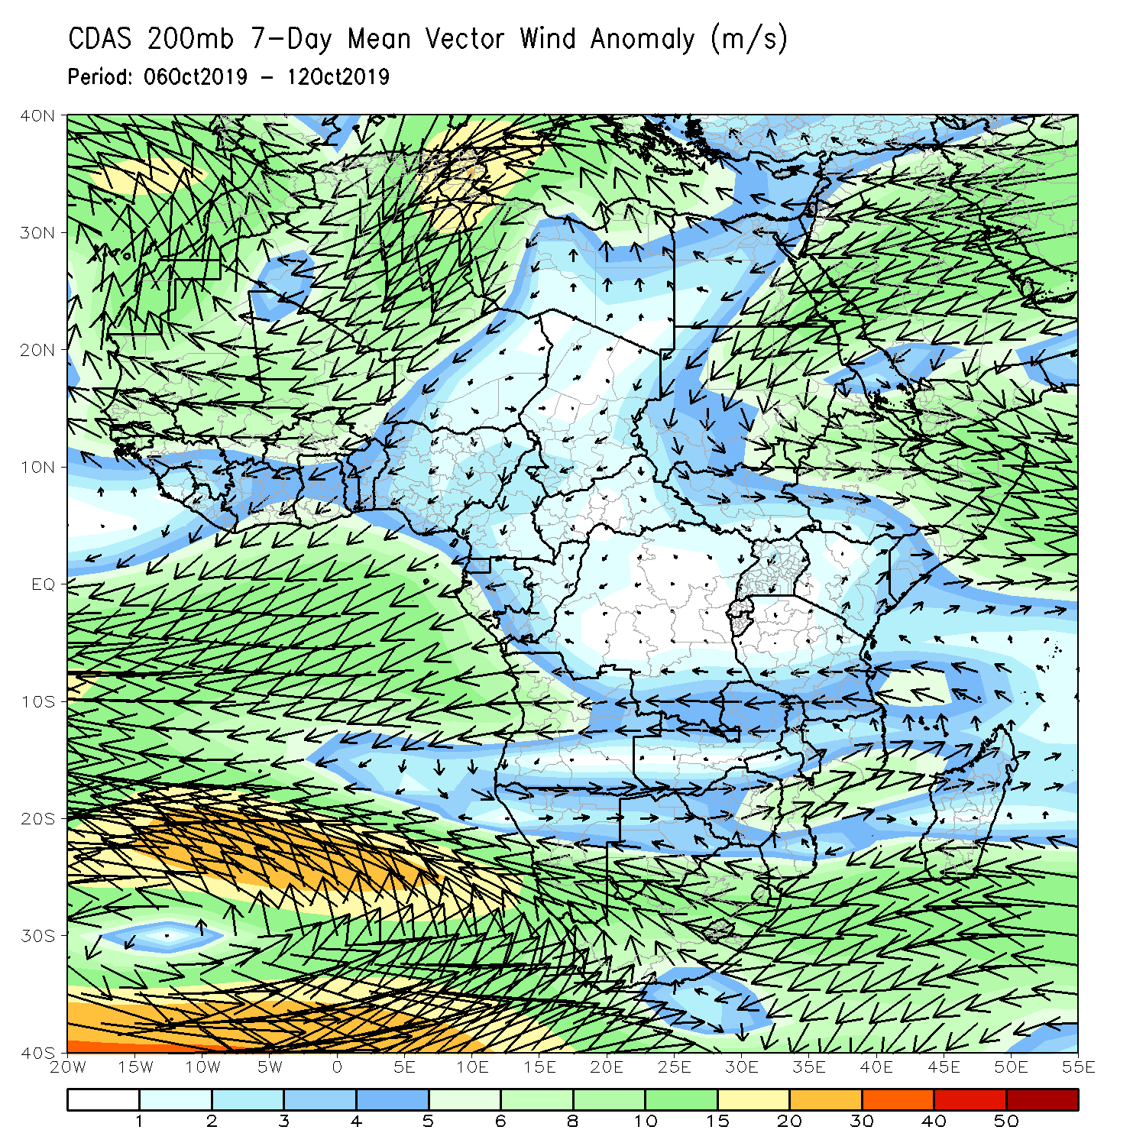
Atmospheric Circulation: Last 7 Days
A broad area of anomalous lower-level cyclonic shear prevailed across West Africa. Anomalous onshore flow from the Indian Ocean may have also contributed to the observed above-average rainfall over portions of the Greater Horn of Africa (left).

Slide 10
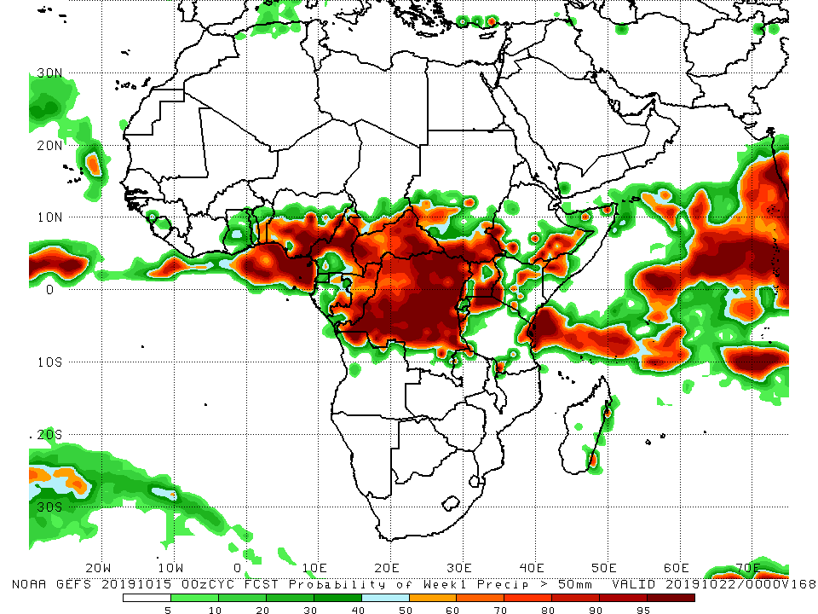
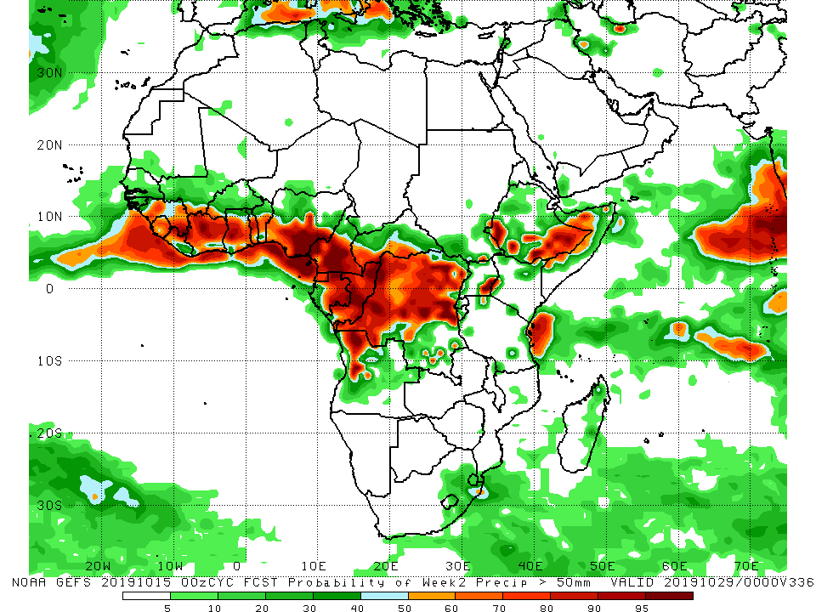
NCEP GEFS Model Forecasts Non-Bias Corrected Probability of precipitation exceedance
Week-1: Valid 16 – 22 October, 2019
Week-2: Valid 23 – 29 October, 2019
For week-1 (left panel), there is an increased chance for weekly rainfall totals to exceed 50mm across eastern Gulf of Guinea and Central Africa counties, portions of the Greater Horn of Africa, and coastal Kenya and Tanzania. For week-2 (right panel), there is an increased chance for weekly rainfall totals to exceed 50mm across much of the Gulf of Guinea and Central Africa counties, portions of Ethiopia, and Tanzania.
Notes:
10

Slide 11
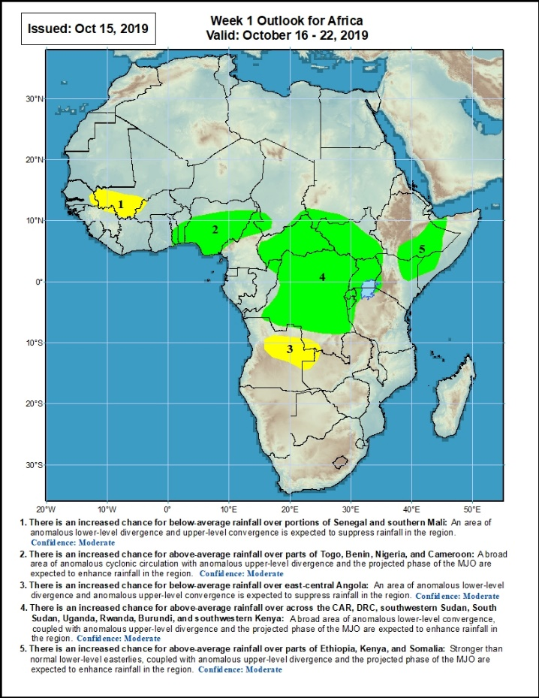
Week-1 Precipitation Outlooks
16 – 22 October, 2019
There is an increased chance for below-average rainfall over portions of eastern Senegal and southern Mali: An area of anomalous lower-level divergence and upper-level convergence is expected to suppress rainfall in the region. Confidence: Moderate
There is an increased chance for above-average rainfall over parts of Togo, Benin, Nigeria, and Cameroon: An area of anomalous lower-level cyclonic circulation, combined with anomalous upper-level divergence is expected to enhance rainfall in the region. Confidence: Moderate
There is an increased chance for below-average rainfall over east-central Angola: An area of anomalous lower-level divergence and upper-level convergence is expected to suppress rainfall in the region.. Confidence: Moderate
There is an increased chance for above-average rainfall over across the CAR, DRC, southwestern Sudan, South Sudan, Uganda, Rwanda, Burundi, and southwestern Kenya: An area of anomalous lower-level convergence, combined with anomalous upper-level divergence is expected to enhance rainfall in the region. Confidence: Moderate
There is an increased chance for above-average rainfall over parts of Ethiopia, Kenya, and Somalia: Onshore flow from the Indian Ocean, combined with anomalous upper-level divergence is expected to enhance rainfall in the region. Confidence: Moderate
Notes:
11

Slide 12
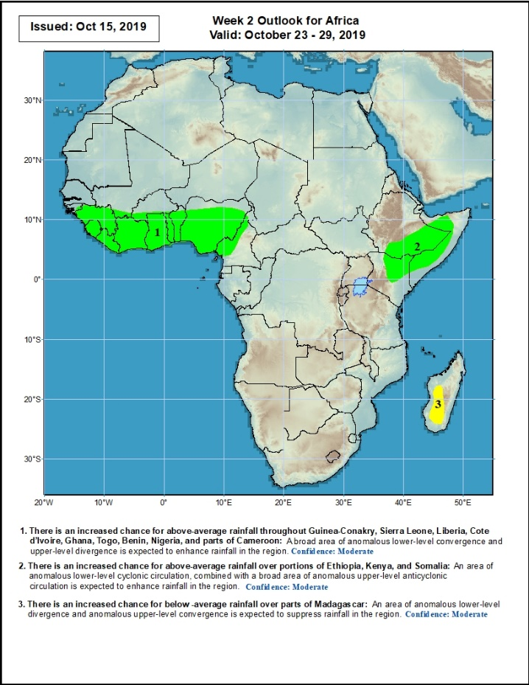
Week-2 Precipitation Outlooks
23 – 29 October, 2019
There is an increased chance for above-average rainfall throughout Guinea-Conakry, Sierra Leone, Liberia, Cote d’Ivoire, Ghana, Togo, Benin, Nigeria, and parts of Cameroon: A broad area of anomalous lower-level convergence and upper-level divergence is expected to enhance rainfall in the region. Confidence: Moderate
There is an increased chance for above-average rainfall over portions of Ethiopia, Kenya, and Somalia: An area of anomalous lower-level cyclonic circulation, combined with anomalous upper-level divergence is expected to enhance rainfall in the region. Confidence: Moderate
There is an increased chance for below -average rainfall over parts of Madagascar: An area of anomalous lower-level divergence and upper-level convergence is expected to suppress rainfall in the region. Confidence: Moderate
Notes:
12

Slide 13
Summary
During the past 7 days, rainfall was above-average over southern Mauritania, Senegal, Guinea-Bissau, Guinea, Sierra Leone, Liberia, southern Mali, Cote d’Ivoire, Burkina Faso, Ghana, Togo, Benin, parts of Niger and Chad, Nigeria, portions of Cameroon and CAR, local areas in Gabon, many parts of Congo, portions of Angola and DRC, southern and eastern Sudan, South Sudan, many parts of Ethiopia, Uganda, many parts of Kenya, southern Somalia, northern and eastern Tanzania, northern Namibia, and local areas in Mozambique and Madagascar. Local areas in Chad, parts of Cameroon and Gabon, portions of DRC, and local areas in Angola had below-average rainfall.
During the past 30 days, rainfall was above-average over parts of southern Mauritania, many parts of Senegal, Guinea, Sierra Leone, Liberia, Mali, Burkina Faso, Ghana, Cote d’Ivoire, Togo, Benin, many parts of Nigeria and Cameroon, southern Chad, much of CAR and Congo, western and northern DRC, much of South Sudan, southern and eastern Sudan, Ethiopia, Eritrea, many parts of Uganda, Tanzania, Somalia and Kenya, portions of Angola, eastern Zambia, and local areas in Mozambique and Madagascar. Local areas in Mali and Nigeria, parts of Cameroon, many parts of Gabon, portions of Angola and DRC, Botswana, and many parts of South Africa had below-average rainfall.
During the past 90 days, rainfall was above-average over southern and eastern Mauritania, much of Senegal, Guinea-Bissau, Guinea, Sierra Leone, Liberia, Mali, Cote d’Ivoire, Burkina Faso, Ghana, Togo, Benin, Niger, many parts of Nigeria, Chad, many parts of Cameroon, CAR, many parts of DRC, South Sudan, Uganda, Sudan, Eritrea, Ethiopia, Kenya, Somalia, many parts of Tanzania, portions of Angola, eastern Zambia, and local areas in Mozambique and Madagascar. Western and central Mauritania, parts of Nigeria and Cameroon, Gabon, portions of central and eastern DRC, portions of Angola, Botswana and many parts of South Africa had below-average rainfall.
Week-1 outlooks call for an increased chance for above-average rainfall over, southern Togo, Benin, Nigeria, northern Cameroon, CAR, southern Sudan, much of South Sudan and DRC, Rwanda, Burundi, Uganda, southeastern Ethiopia, eastern Kenya and parts of southern Somalia. In contrast, there is an increased chance for below-average rainfall over parts of southern Mali, and northeastern Angola.
Notes:
13

