Slide 1
The African Monsoon Recent Evolution and Current Status Include Week-1 and Week-2 Outlooks
Update prepared by
Climate Prediction Center / NCEP
07 October 2019
For more information, visit:
http://www.cpc.ncep.noaa.gov/products/Global_Monsoons/African_Monsoons/precip_monitoring.shtml

Slide 2
Outline
Highlights
Recent Evolution and Current Conditions
NCEP GEFS Forecasts
Summary

Slide 3
Highlights: Last 7 Days
Weekly rainfall surpluses exceeded 100mm over many parts of Ethiopia. Rainfall surpluses in excess of 100mm were also observed over parts of Sierra Leone and Liberia, southern Nigeria, local areas in Sudan, eastern Kenya and parts of Somalia.
Week-1 outlooks call for an increased chance for above-average rainfall across much of the Gulf of Guinea countries, and portions of Congo, northern Angola, DRC, and southern Ethiopia.

Slide 4
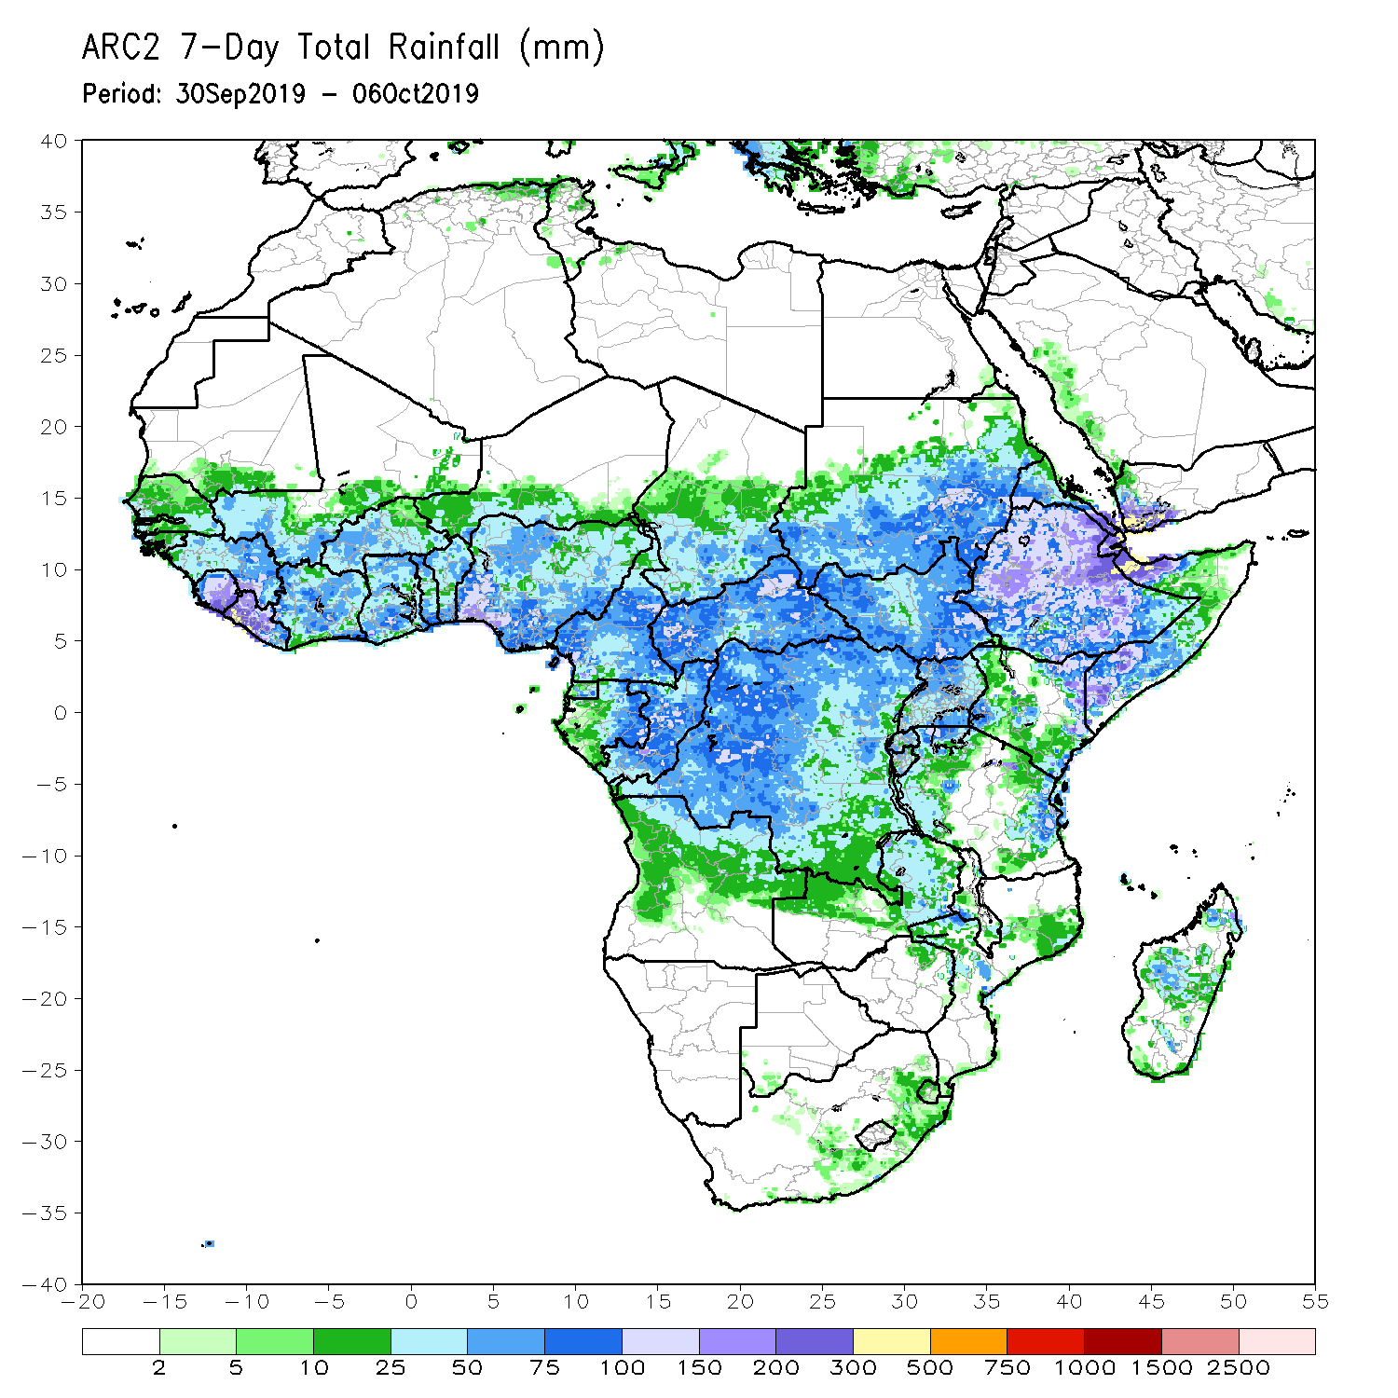
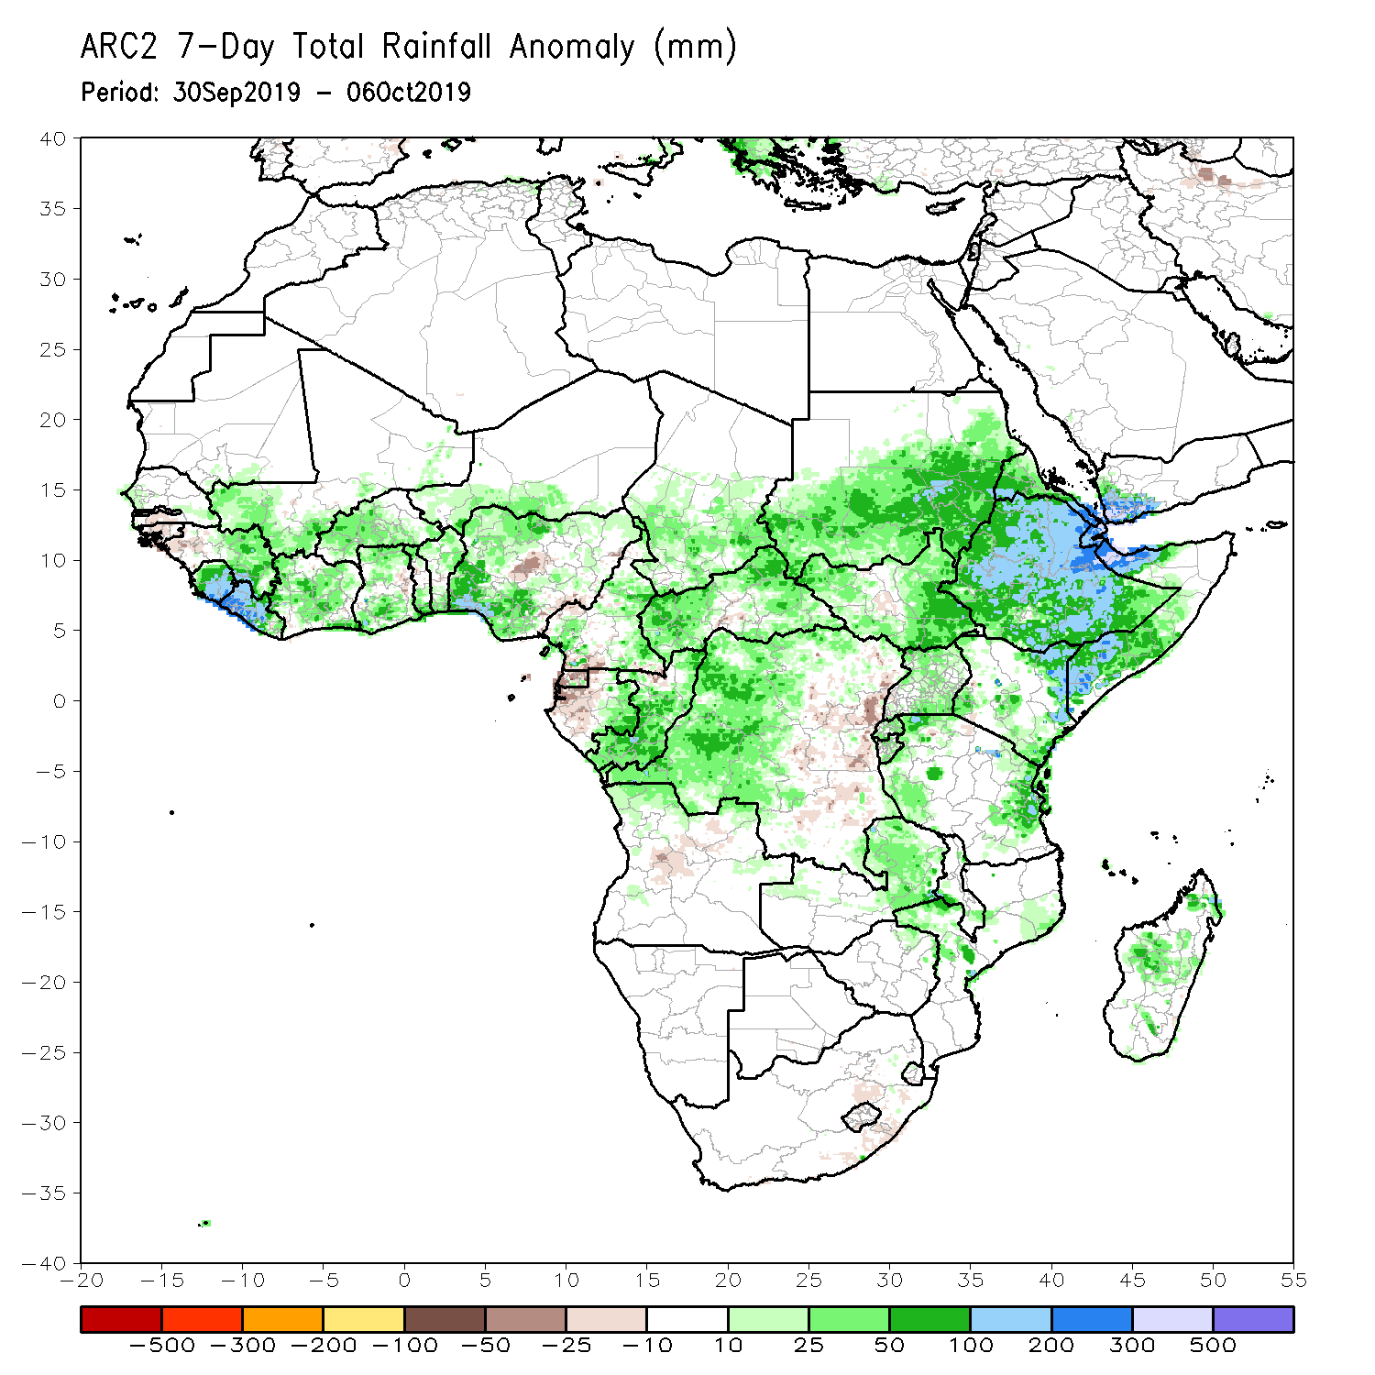
Rainfall Patterns: Last 7 Days
During the past 7 days, portions of Guinea, southern Mali, Sierra Leone, Liberia, Cote d’Ivoire, many parts of Ghana, Benin, many parts of Nigeria, portions of Cameroon, eastern Gabon, Chad, CAR, Congo, many parts of DRC, southern and eastern Sudan, much South Sudan, much of Ethiopia, Eritrea, Djibouti, portions of Uganda, Somalia, parts of Tanzania, eastern Zambia, and local areas in Kenya and parts of Madagascar had above-average rainfall. Weekly rainfall surpluses exceeded 100mm over many parts of Ethiopia. Rainfall surpluses in excess of 100mm were also observed over parts of Sierra Leone and Liberia, southern Nigeria, local areas in Sudan, eastern Kenya and parts of Somalia.
Rainfall was below-average over local areas in Nigeria, Equatorial Guinea, western Gabon, and parts of eastern DRC.

Slide 5
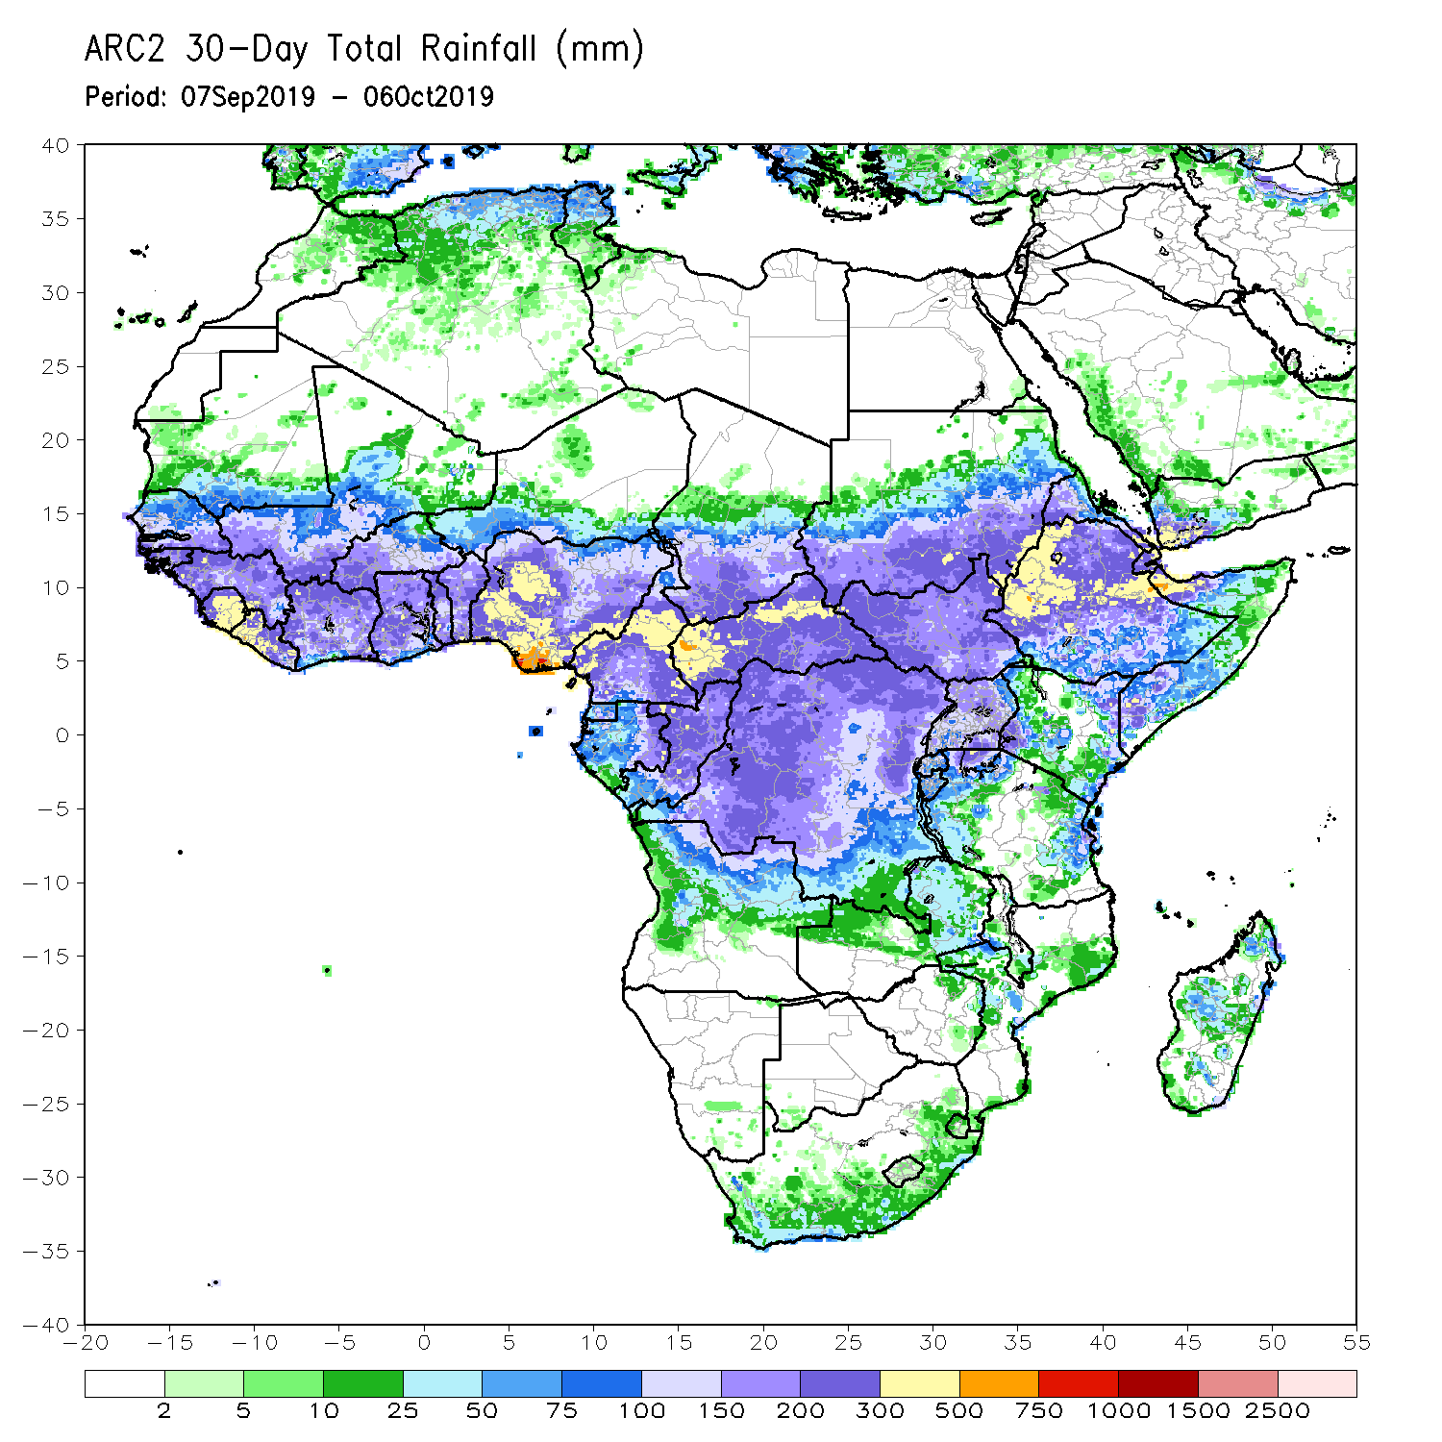
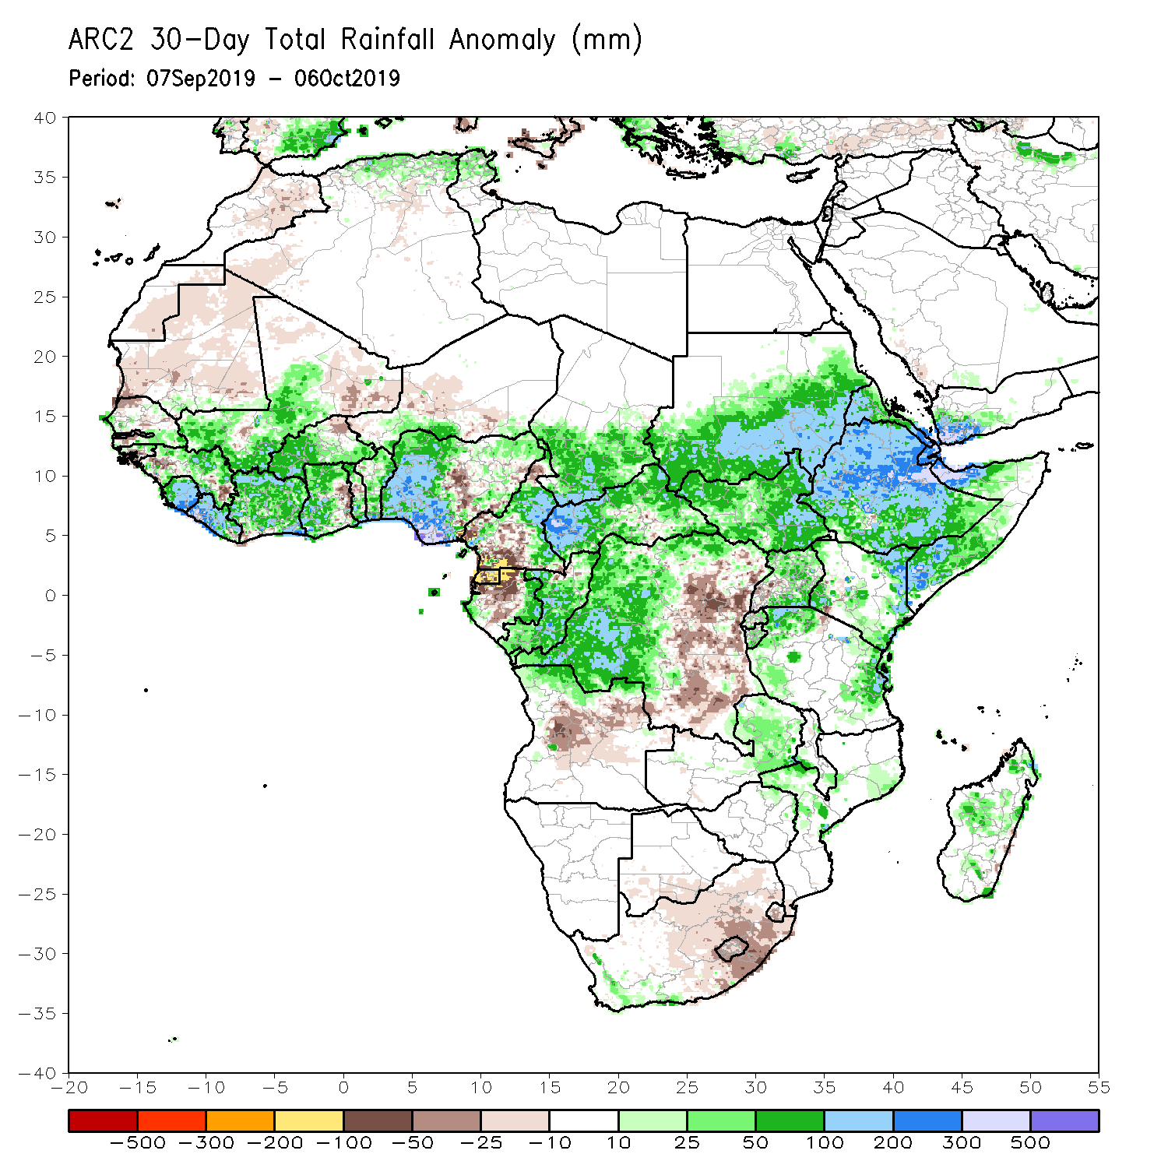
Rainfall Patterns: Last 30 Days
During the past 30 days, rainfall was above-average over local areas in Senegal, many parts of Guinea, Sierra Leone, Liberia, Mali, western Burkina Faso, many parts of Ghana, Cote d’Ivoire, Togo, Benin, portions of Nigeria and Cameroon, southern Chad, much of CAR and Congo, western DRC, much of South Sudan, southern and eastern Sudan, many parts of Ethiopia, Eritrea, northern and eastern Tanzania, and parts of Somalia and Kenya.
Portions of Mauritania, Senegal, Guinea-Bissau, local areas in Guinea, parts of northeastern Ghana, local areas in eastern Burkina Faso, portions of Nigeria and Cameroon, eastern DRC, Equatorial Guinea, parts of Gabon, Angola and South Africa had below-average rainfall.
Notes:
5

Slide 6
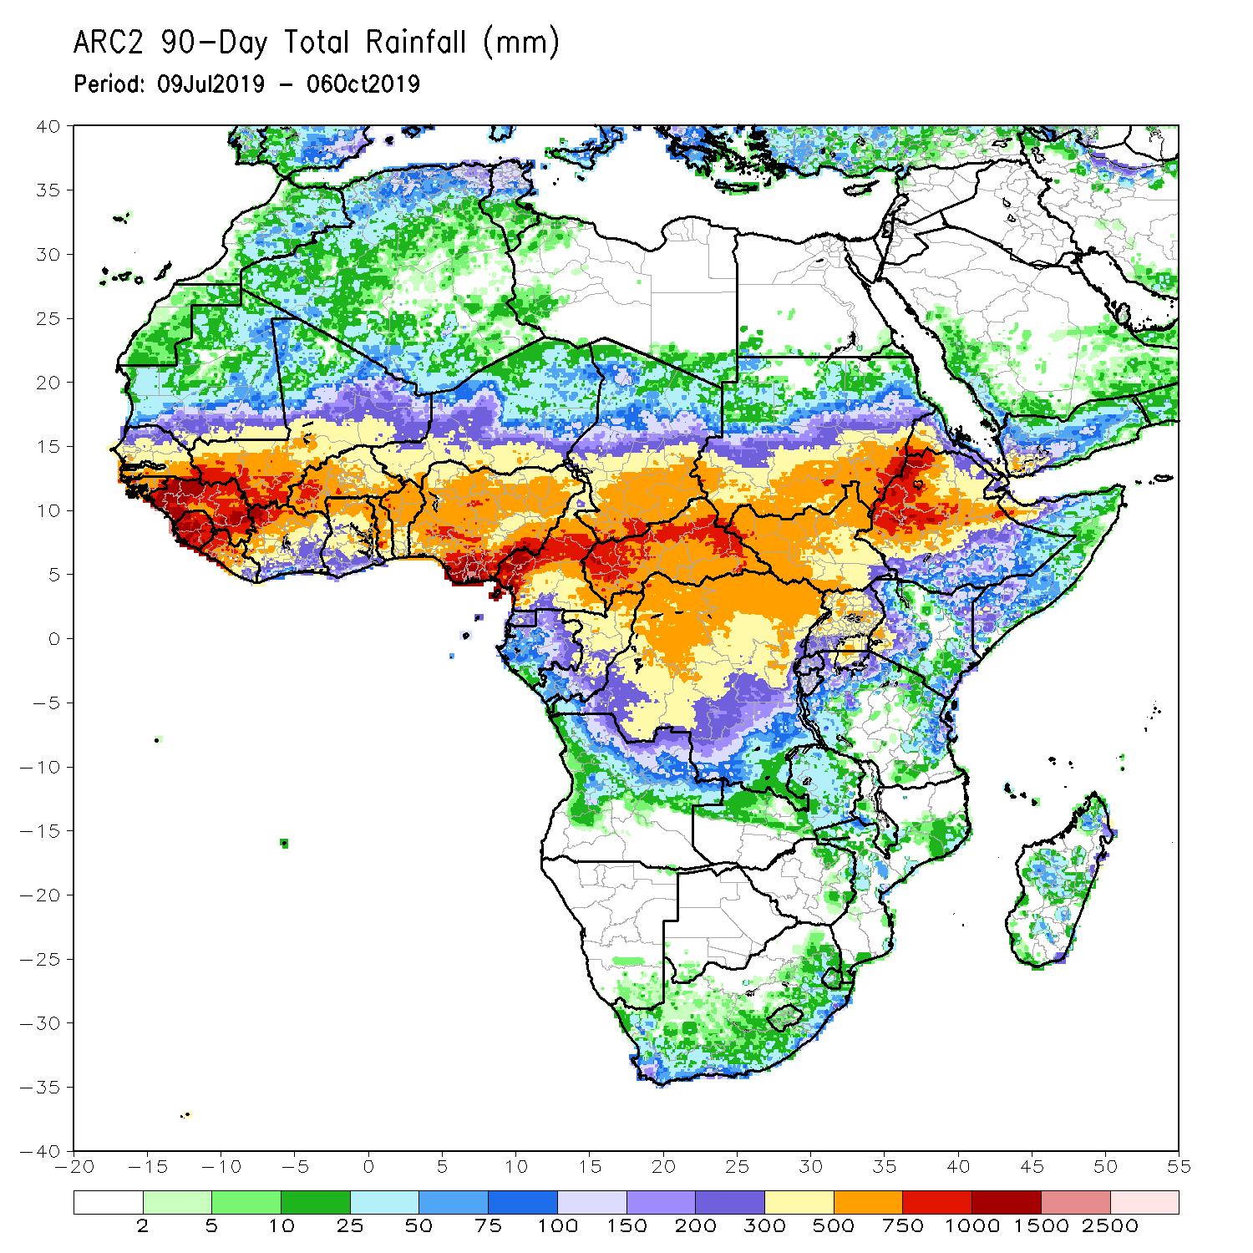
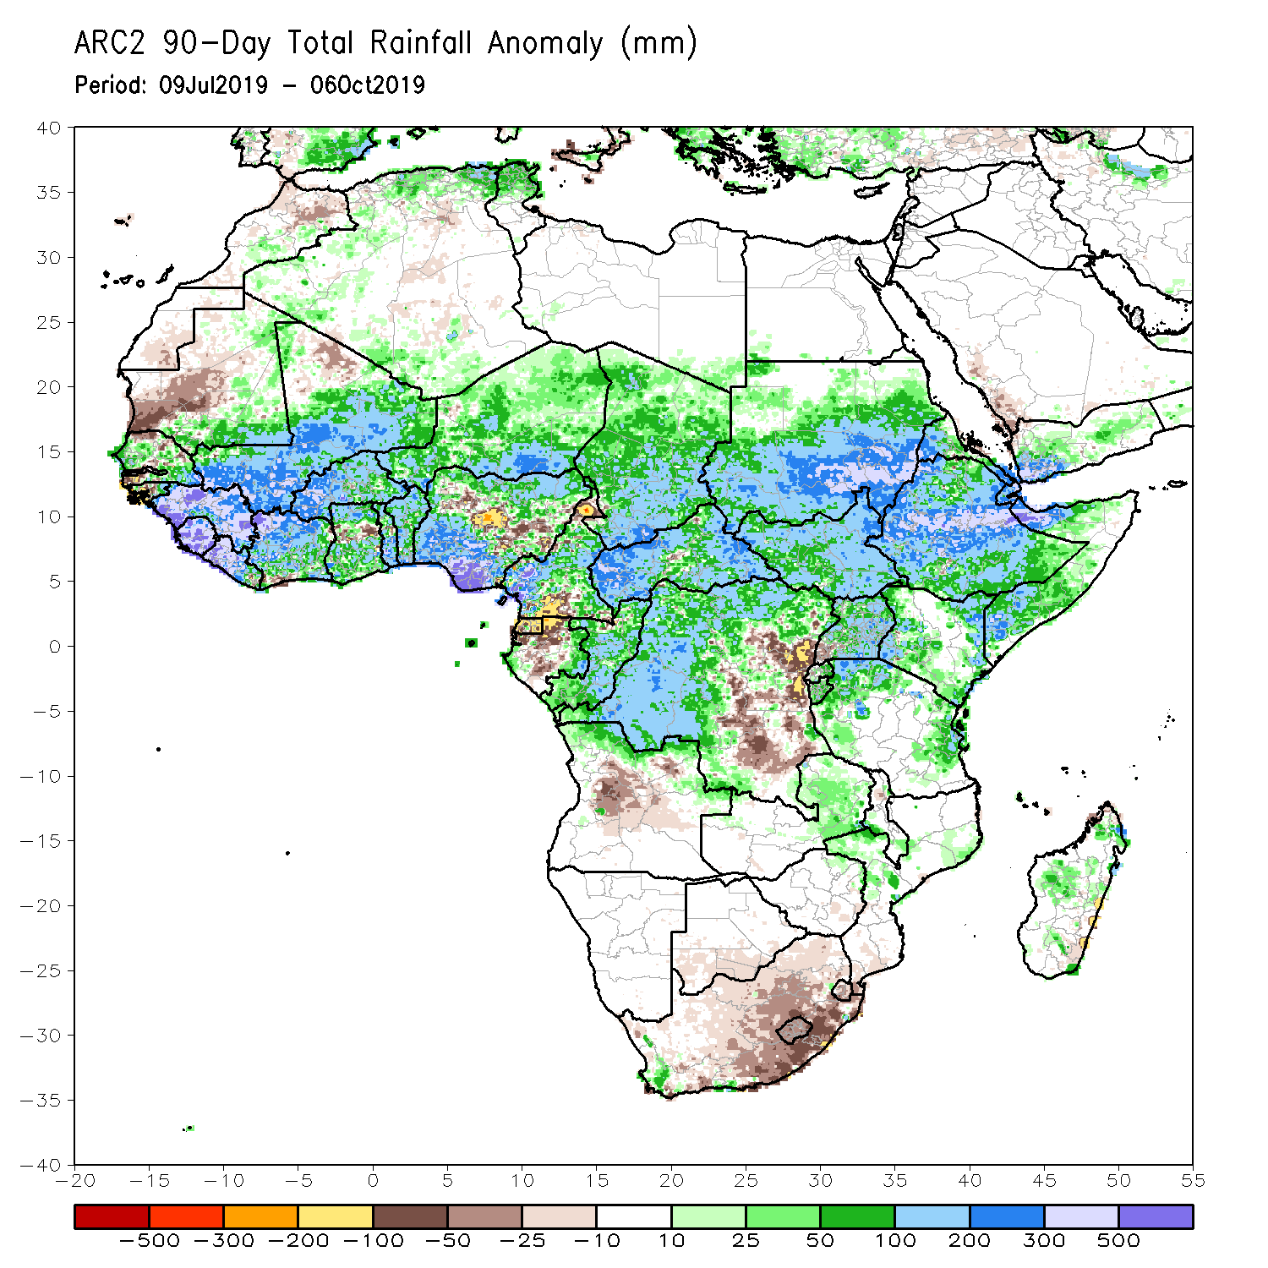
Rainfall Patterns: Last 90 Days
During the past 90 days, western and central Mauritania, local areas in Senegal, western Guinea-Bissau, local areas in Ghana, portions of Nigeria and Cameroon, Gabon, portions of DRC, and portions of Angola and South Africa had below-average rainfall.
Rainfall was above-average over many parts of Senegal, much Guinea, southern and eastern Mauritania, Sierra Leone, Liberia, Mali, much of Cote d’Ivoire, Burkina Faso, Ghana, Togo, Benin, Niger, portions of Nigeria, much of Chad, many parts of Cameroon, CAR, many parts of DRC, South Sudan, Uganda, Sudan, many parts of Ethiopia, and western Kenya, parts of Somalia, and northern and eastern Tanzania.
Notes:
6

Slide 7
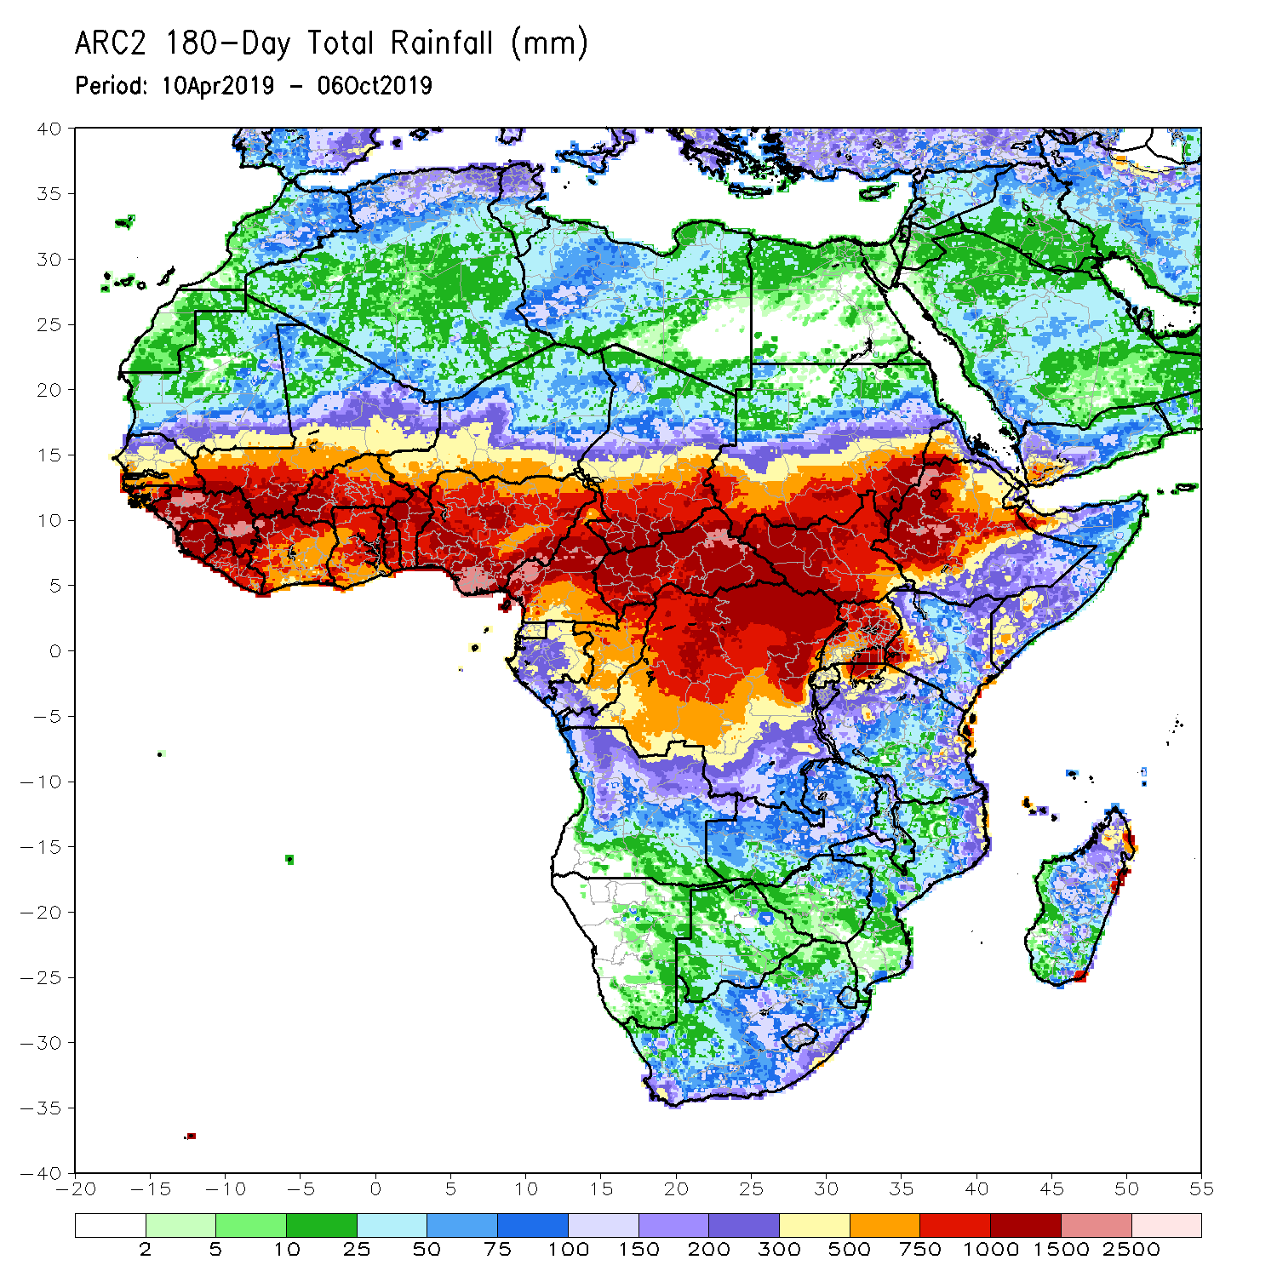
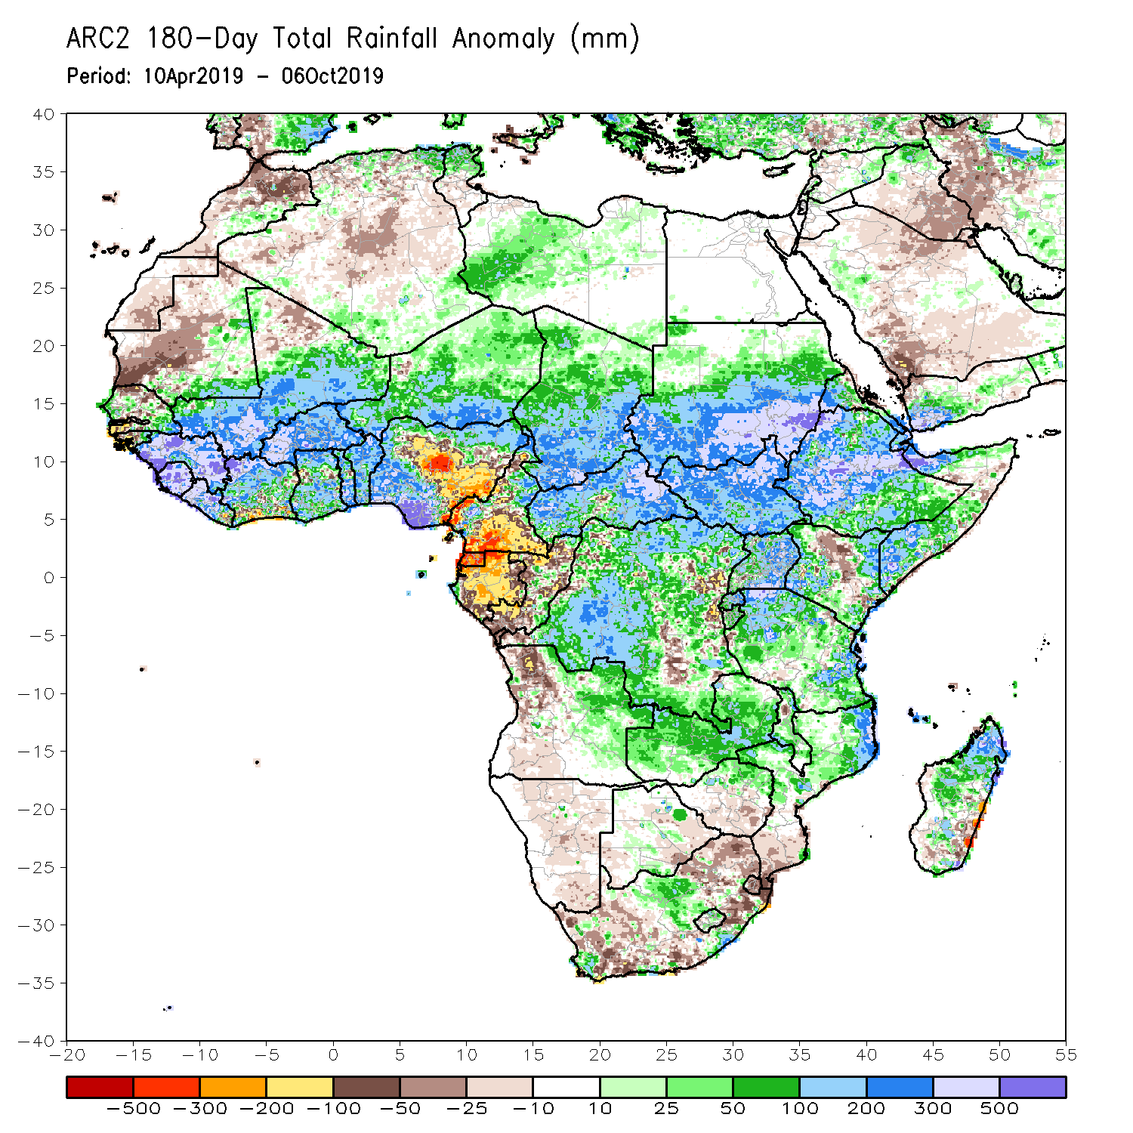
Rainfall Patterns: Last 180 Days
During the past 180 days, below-average rainfall was observed over western and central Mauritania, local areas in Senegal, western Guinea-Bissau, local areas in Liberia, Cote d’Ivoire and Ghana, portions of Nigeria, many parts of Cameroon, Equatorial Guinea, Gabon, Congo, portions of DRC, much of Angola, Namibia, western and northeastern South Africa, eastern Zambia, parts of Botswana, Zimbabwe, many parts of Mozambique, parts of Madagascar, local areas in Tanzania, many parts of Kenya, and portions of Ethiopia and Somalia.
Many parts of Senegal, eastern Guinea-Bissau, much of Guinea, Sierra Leone, Mali, much of Liberia and Cote d’Ivoire, Burkina Faso, Ghana, Togo, Benin, parts of Nigeria, Niger, Chad, CAR, many parts of DRC, South Sudan, Sudan, Uganda, many parts of Ethiopia and Tanzania, Zambia, local areas in Malawi, northern Mozambique, and portions of South Africa and Madagascar had above-average rainfall.
Notes:
7

Slide 8
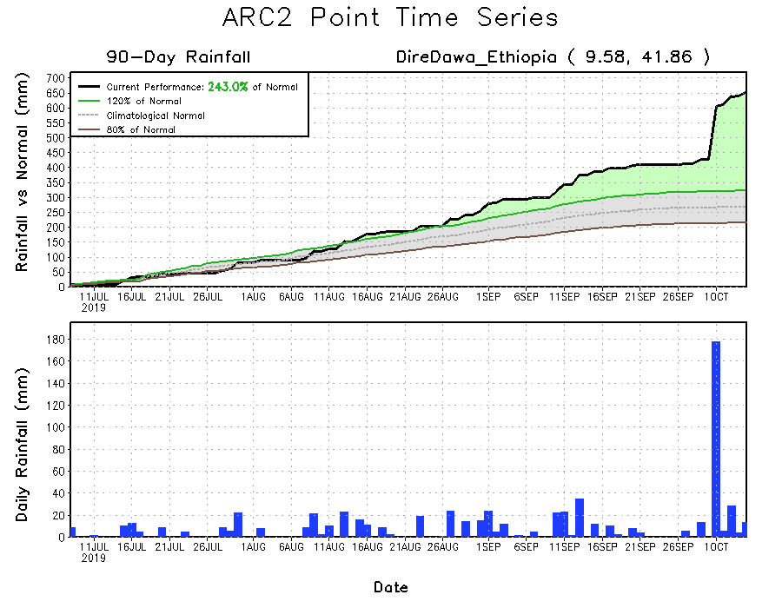
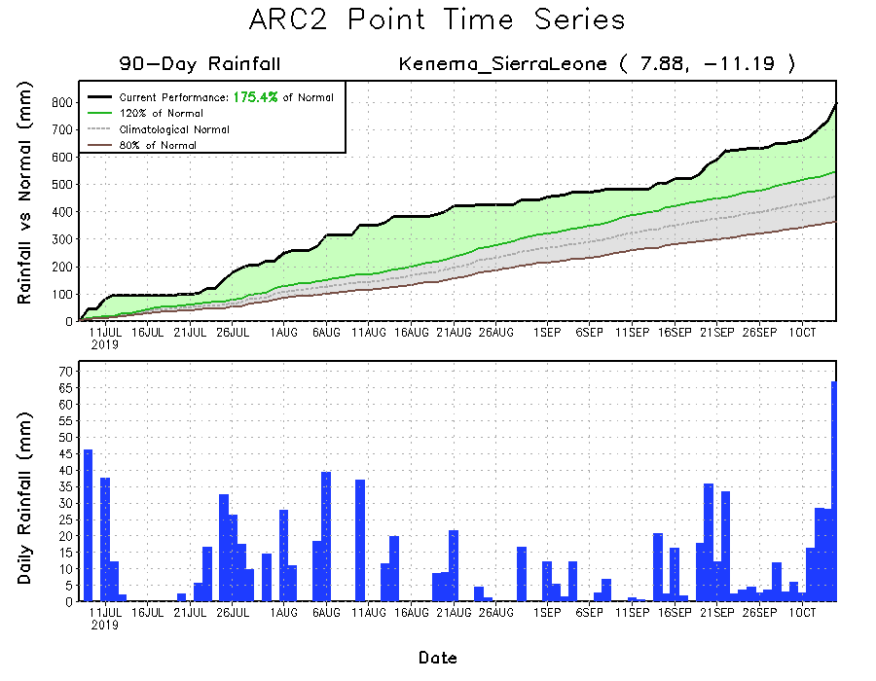
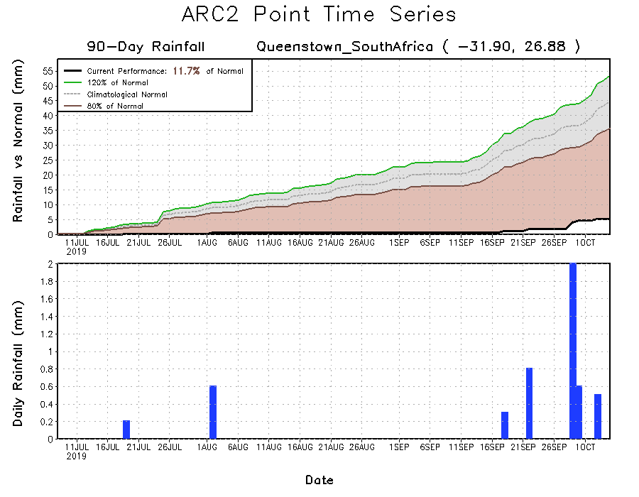
Recent Rainfall Evolution
Daily evolution of rainfall over the last 90 days at selected locations shows that moderate to locally heavy rainfall sustained moisture surpluses over parts of Sierra Leone (bottom left) and many parts of Ethiopia (top right). Early season dryness was observed across southern South Africa (bottom right).

Slide 9
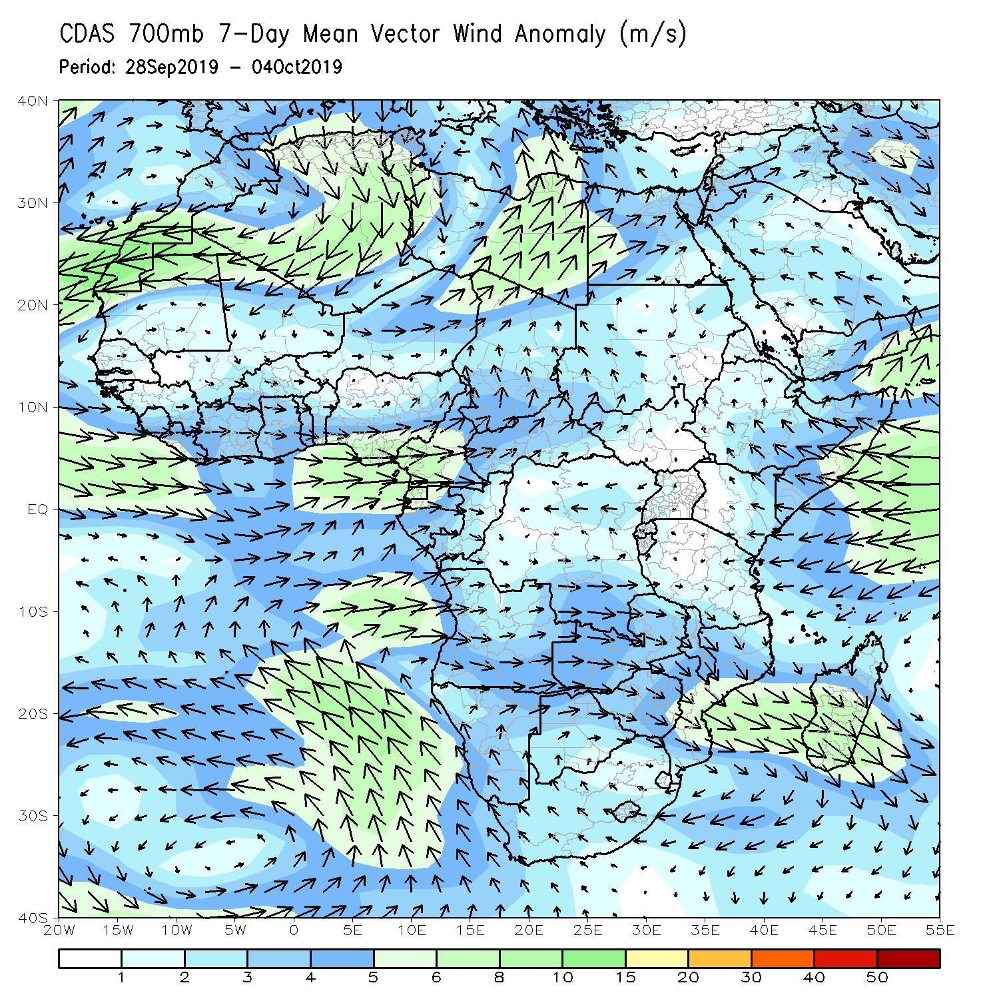
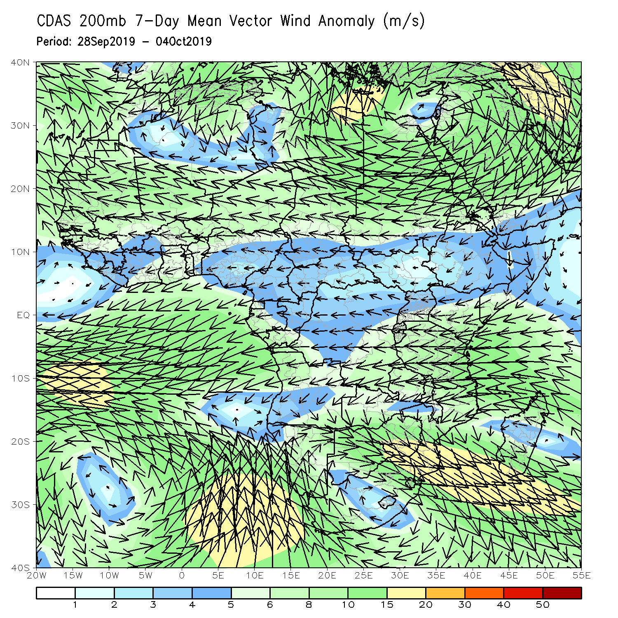
Atmospheric Circulation: Last 7 Days
Anomalous lower-level westerly to southwesterly flow was observed along the Gulf of Guinea coast and the neighboring areas of central Africa. Anomalous onshore flow from the Indian Ocean may have also contributed to the observed above-average rainfall over portions of the Greater Horn of Africa (left).

Slide 10
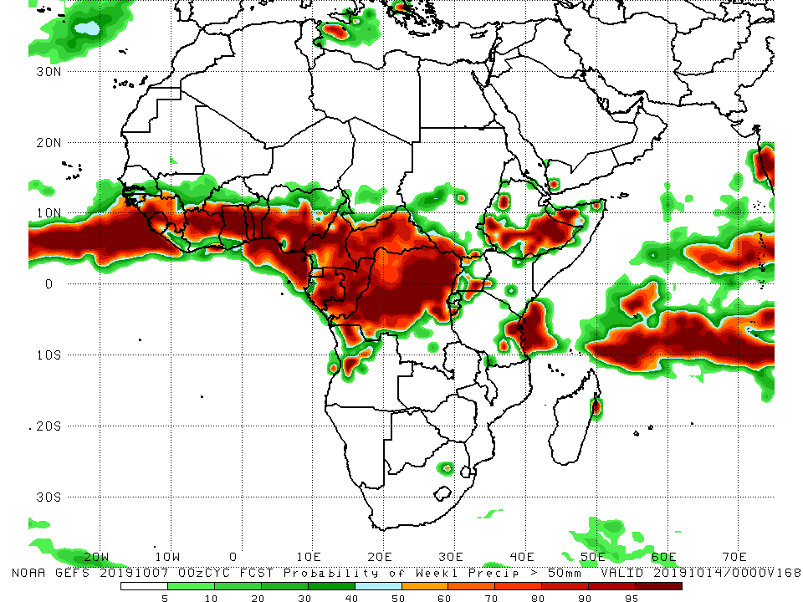
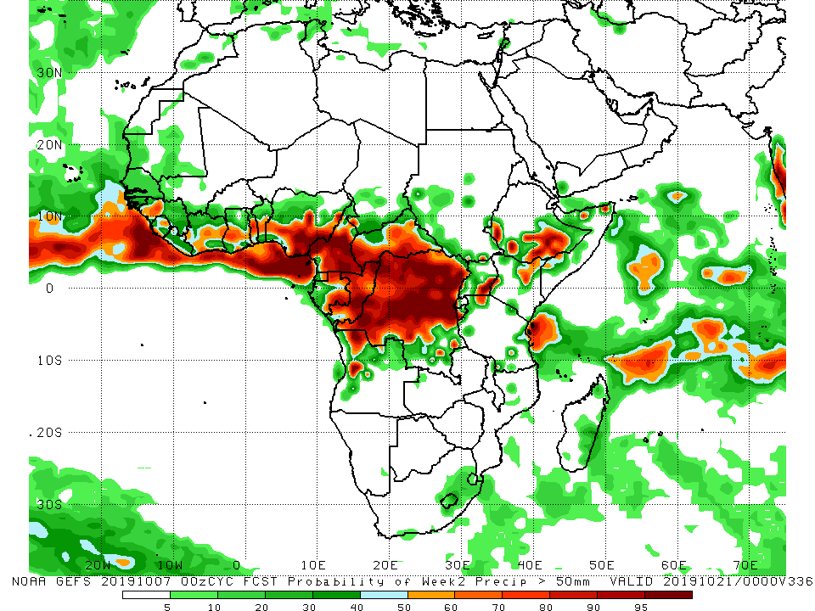
NCEP GEFS Model Forecasts Non-Bias Corrected Probability of precipitation exceedance
Week-1: Valid 8 – 14 October, 2019
Week-2: Valid 15 – 21 October, 2019
For week-1 (left panel) and week-2 (right panel), there is an increased chance for weekly rainfall totals to exceed 50mm across the Gulf of Guinea and Central Africa counties, portions of Ethiopia, and coastal Tanzania.
Notes:
10

Slide 11
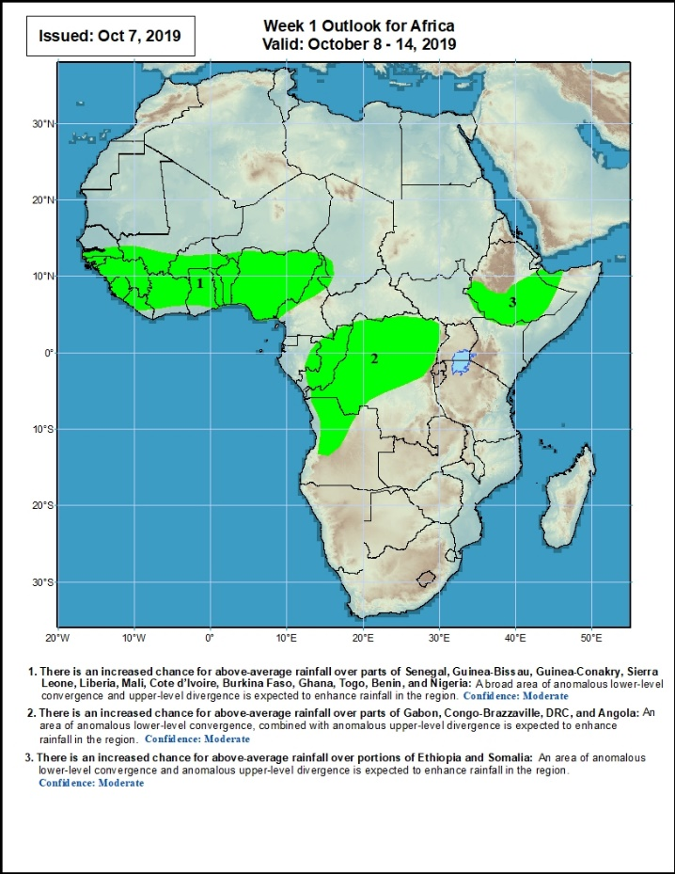
Week-1 Precipitation Outlooks
8 – 14 October, 2019
There is an increased chance for above-average rainfall over parts of Senegal, Guinea-Bissau, Guinea-Conakry, Sierra Leone, Liberia, Mali, Cote d’Ivoire, Burkina Faso, Ghana, Togo, Benin, and Nigeria: A broad area of anomalous lower-level convergence and upper-level divergence is expected to enhance rainfall in the region. Confidence: Moderate
There is an increased chance for above-average rainfall over parts of Gabon, Congo-Brazzaville, DRC, and Angola: An area of anomalous lower-level convergence, combined with anomalous upper-level divergence is expected to enhance rainfall in the region. Confidence: Moderate
There is an increased chance for above-average rainfall over portions of Ethiopia and Somalia: An area of anomalous lower-level convergence and upper-level divergence is expected to enhance rainfall in the region.. Confidence: Moderate
Notes:
11

Slide 12
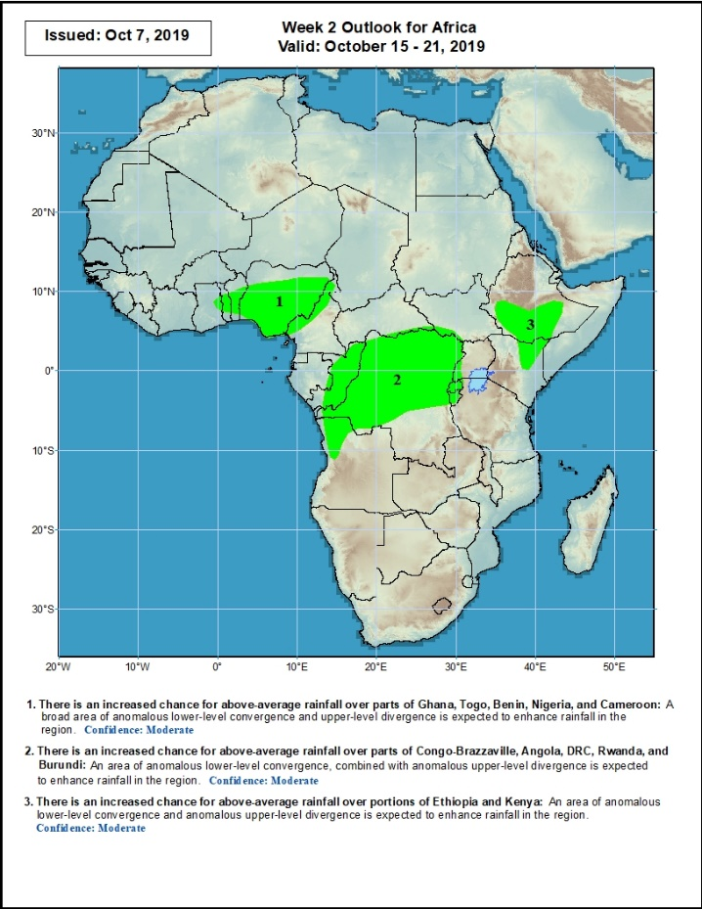
Week-2 Precipitation Outlooks
15 – 21 October, 2019
There is an increased chance for above-average rainfall over parts of Ghana, Togo, Benin, Nigeria, and Cameroon: A broad area of anomalous lower-level convergence and upper-level divergence is expected to enhance rainfall in the region. Confidence: Moderate
There is an increased chance for above-average rainfall over parts of Congo-Brazzaville, Angola, DRC, Rwanda, and Burundi: An area of anomalous lower-level convergence, combined with anomalous upper-level divergence is expected to enhance rainfall in the region. Confidence: Moderate
There is an increased chance for above-average rainfall over portions of Ethiopia and Kenya: An area of anomalous lower-level convergence and upper-level divergence is expected to enhance rainfall in the region. Confidence: Moderate
Notes:
12

Slide 13
Summary
During the past 7 days, portions of Guinea, southern Mali, Sierra Leone, Liberia, Cote d’Ivoire, many parts of Ghana, Benin, many parts of Nigeria, portions of Cameroon, eastern Gabon, Chad, CAR, Congo, many parts of DRC, southern and eastern Sudan, much South Sudan, much of Ethiopia, Eritrea, Djibouti, portions of Uganda, Somalia, parts of Tanzania, eastern Zambia, and local areas in Kenya and parts of Madagascar had above-average rainfall. Weekly rainfall surpluses exceeded 100mm over many parts of Ethiopia. Rainfall surpluses in excess of 100mm were also observed over parts of Sierra Leone and Liberia, southern Nigeria, local areas in Sudan, eastern Kenya and parts of Somalia. Rainfall was below-average over local areas in Nigeria, Equatorial Guinea, western Gabon, and parts of eastern DRC.
During the past 30 days, rainfall was above-average over local areas in Senegal, many parts of Guinea, Sierra Leone, Liberia, Mali, western Burkina Faso, many parts of Ghana, Cote d’Ivoire, Togo, Benin, portions of Nigeria and Cameroon, southern Chad, much of CAR and Congo, western DRC, much of South Sudan, southern and eastern Sudan, many parts of Ethiopia, Eritrea, northern and eastern Tanzania, and parts of Somalia and Kenya. Portions of Mauritania, Senegal, Guinea-Bissau, local areas in Guinea, parts of northeastern Ghana, local areas in eastern Burkina Faso, portions of Nigeria and Cameroon, eastern DRC, Equatorial Guinea, parts of Gabon, Angola and South Africa had below-average rainfall.
During the past 90 days, western and central Mauritania, local areas in Senegal, western Guinea-Bissau, local areas in Ghana, portions of Nigeria and Cameroon, Gabon, portions of DRC, and portions of Angola and South Africa had below-average rainfall. Rainfall was above-average over many parts of Senegal, much Guinea, southern and eastern Mauritania, Sierra Leone, Liberia, Mali, much of Cote d’Ivoire, Burkina Faso, Ghana, Togo, Benin, Niger, portions of Nigeria, much of Chad, many parts of Cameroon, CAR, many parts of DRC, South Sudan, Uganda, Sudan, many parts of Ethiopia, and western Kenya, parts of Somalia, and northern and eastern Tanzania
Week-1 outlooks call for an increased chance for above-average rainfall across much of the Gulf of Guinea countries, and portions of Congo, northern Angola, DRC, and southern Ethiopia.
Notes:
13

