Slide 1
The African Monsoon Recent Evolution and Current Status Include Week-1 and Week-2 Outlooks
Update prepared by
Climate Prediction Center / NCEP
23 September 2019
For more information, visit:
http://www.cpc.ncep.noaa.gov/products/Global_Monsoons/African_Monsoons/precip_monitoring.shtml

Slide 2
Outline
Highlights
Recent Evolution and Current Conditions
NCEP GEFS Forecasts
Summary

Slide 3
Highlights: Last 7 Days
Weekly rainfall totals exceeded 100mm over many parts of Sierra Leone, and portions of Nigeria, CAR and Ethiopia.
Week-1 outlooks call for an increased chance for below-average rainfall over much Senegal, Gambia, Guinea-Bissau, and southwestern Mauritania. In contrast, there is an increased chance for above-average rainfall over southern Guinea, Sierra Leone, Liberia, Cote d’Ivoire, southern Nigeria, Cameroon, western CAR, Congo and DRC.

Slide 4
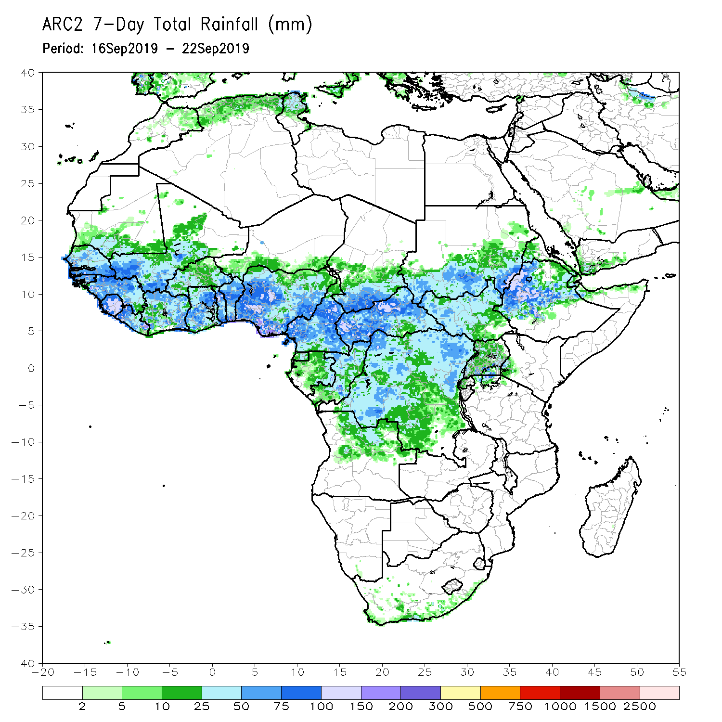
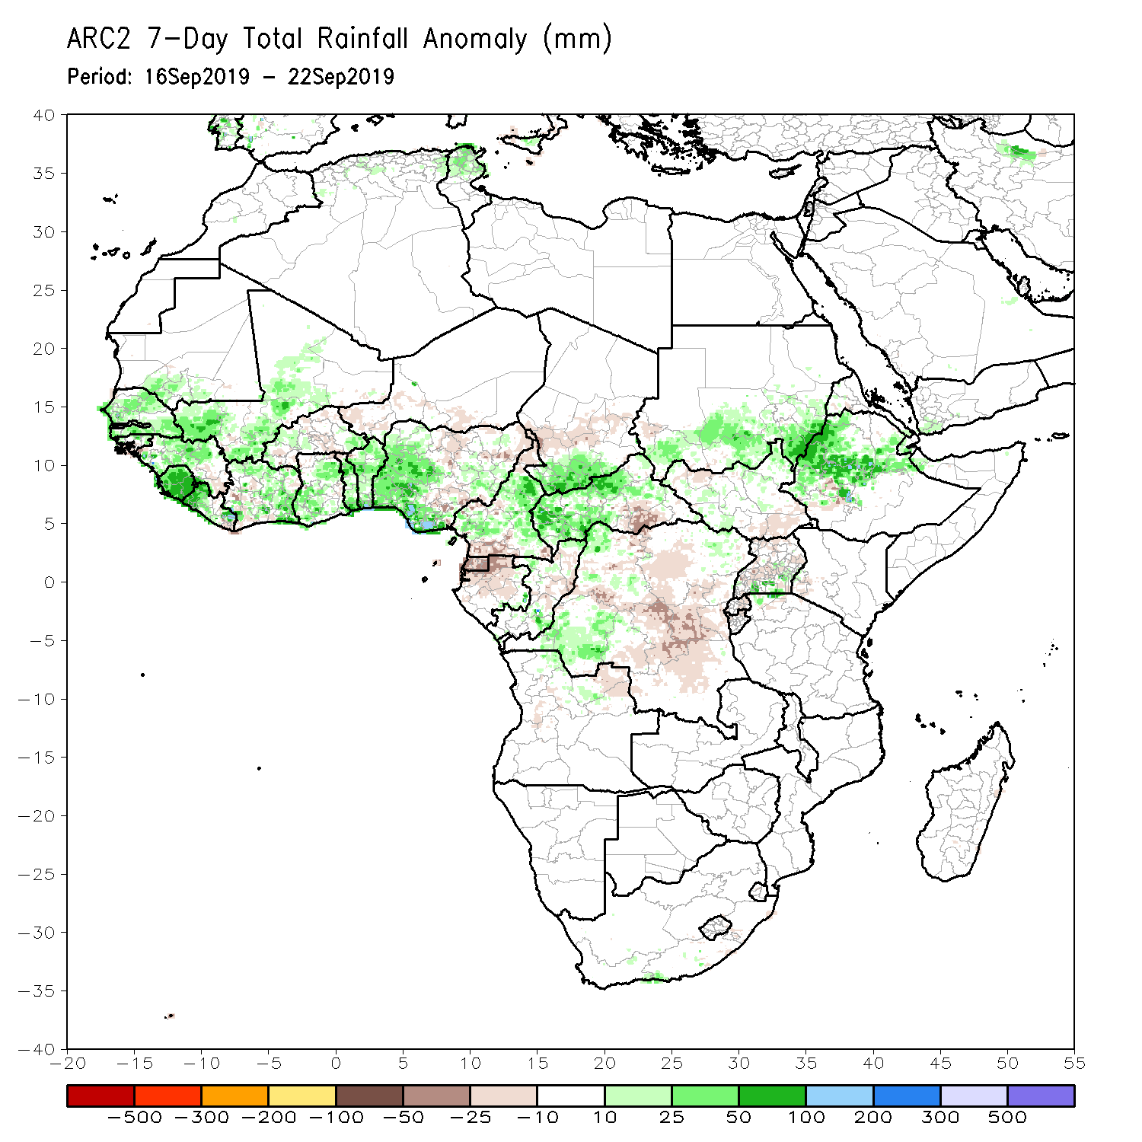
Rainfall Patterns: Last 7 Days
During the past 7 days, weekly rainfall totals exceeded 100mm over many parts of Sierra Leone, and portions of Nigeria, CAR and Ethiopia. Parts of southern Mauritania, much of Senegal, portions of Guinea-Bissau and Guinea, much of Sierra Leone, parts of Liberia and Cote d’Ivoire, portions of Mali, local areas in Ghana and Burkina Faso, many parts of Togo and Benin, portions of Nigeria, many parts of Cameroon, southern Chad, local areas in Congo, many parts of CAR, western DRC, southern and eastern Sudan, local areas in Uganda and northern Tanzania, and many parts of Ethiopia had above-average rainfall.
Rainfall was below-average over portions of Guinea and Liberia, local areas in Cote d’Ivoire, Ghana and Burkina Faso, parts of Niger and Nigeria, local areas in Cameroon, much of Equatorial Guinea, Gabon, central Chad, southeastern CAR, portions of DRC and South Sudan, northern Uganda and local areas in southwestern Ethiopia.

Slide 5
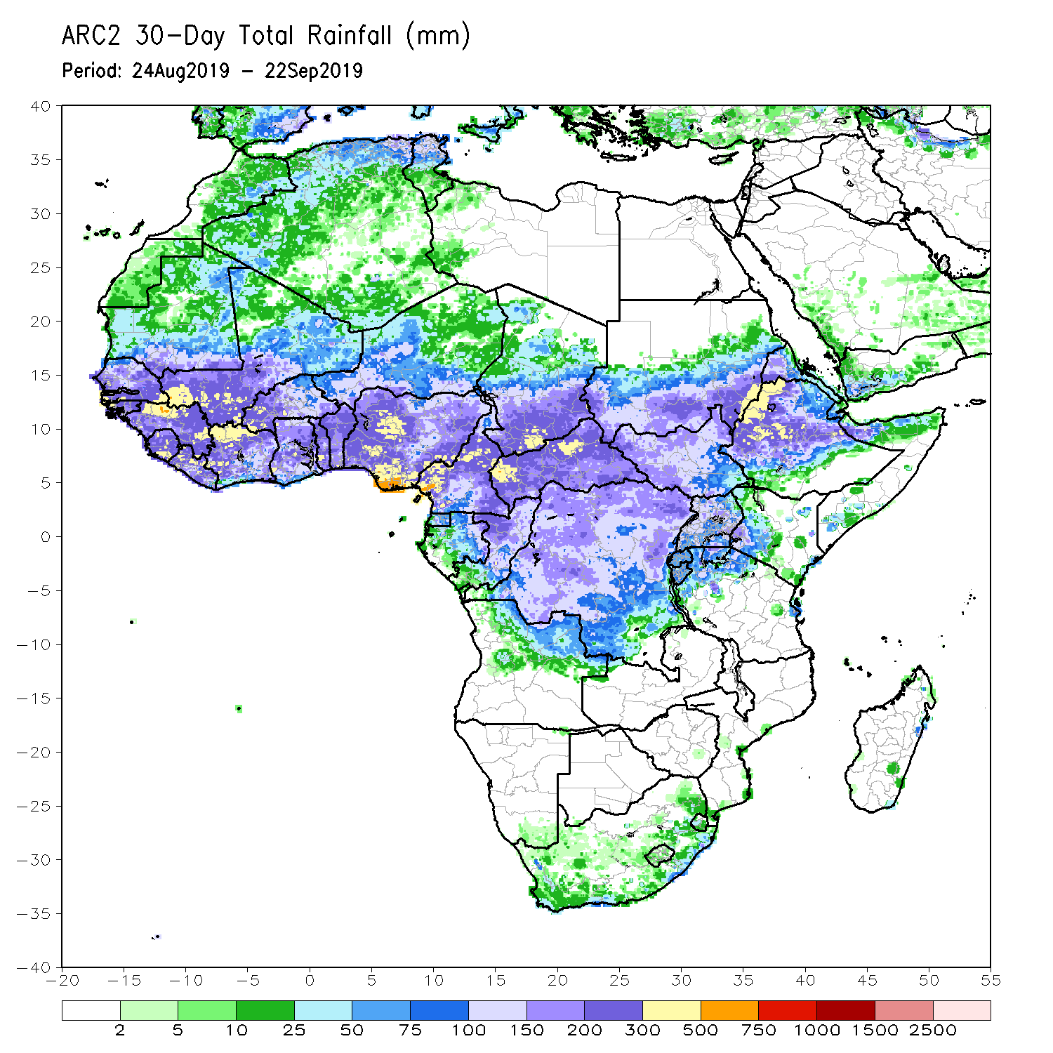
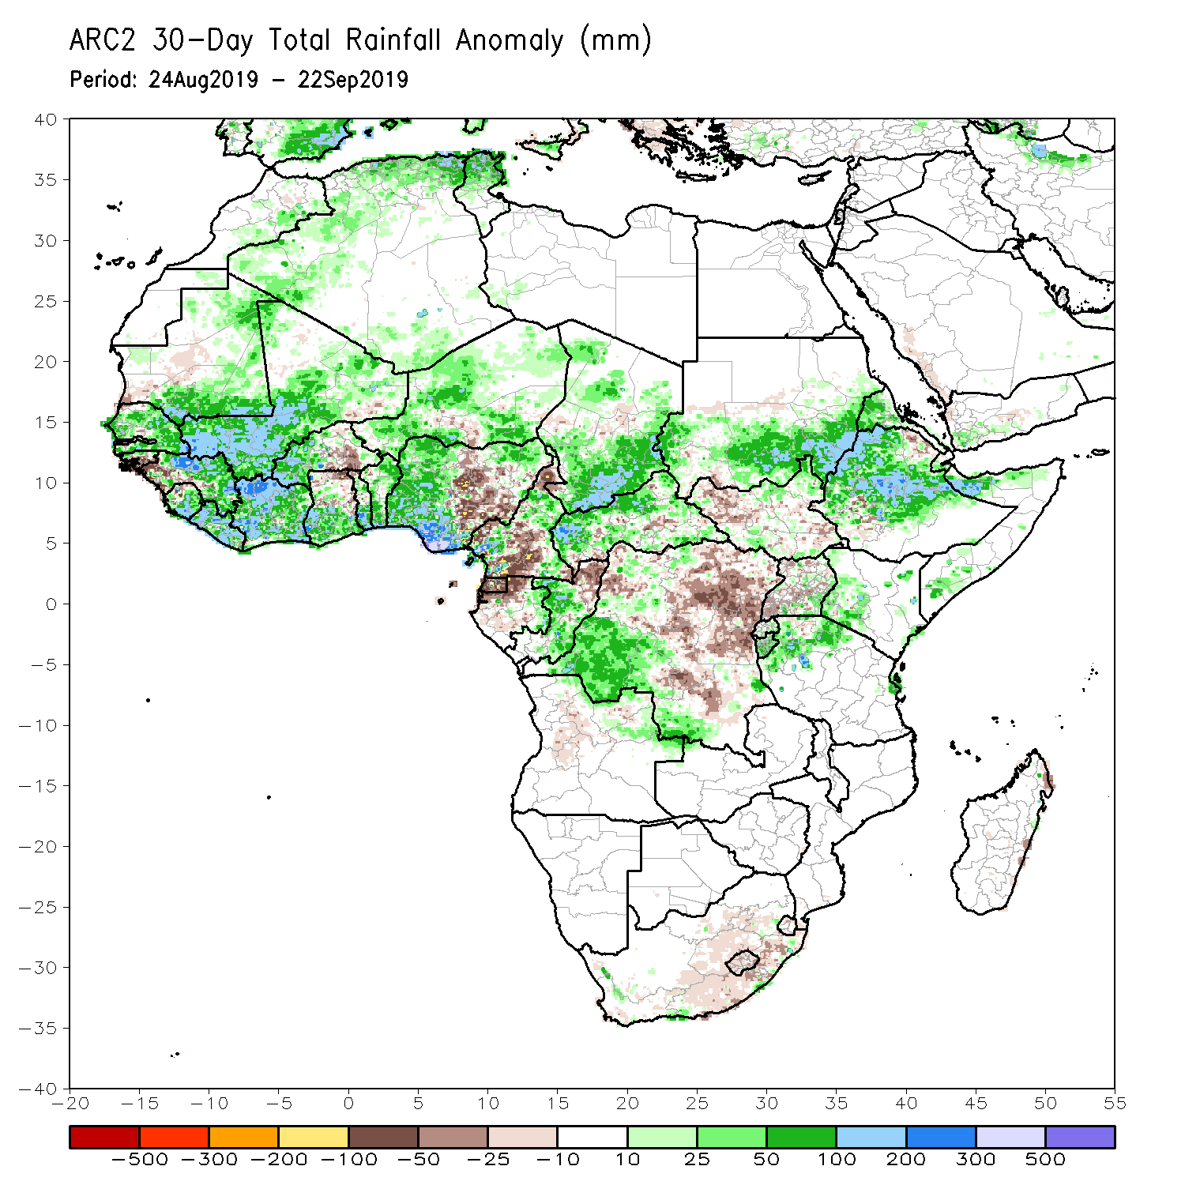
Rainfall Patterns: Last 30 Days
During the past 30 days, rainfall was above-average over southern and eastern Mauritania, much of Senegal, portions of Guinea and Sierra Leone, much of Liberia, Mali, many parts of Burkina Faso and Ghana, Cote d’Ivoire, Togo, Benin, Niger, portions of Nigeria and Cameroon, many parts of Chad and CAR, much of Congo, western DRC, parts of South Sudan, southern and eastern Sudan, many parts of Ethiopia, Eritrea, northern Tanzania, and parts of Somalia and Kenya.
Southwestern and central Mauritania, parts of Guinea-Bissau, western Guinea, western Sierra Leone, parts of northeastern Ghana and Burkina Faso, local areas in Togo and Benin, portions of Nigeria and Cameroon, central and eastern DRC, southwestern CAR, local areas in South Sudan, and portions of Uganda had below-average rainfall.
Notes:
5

Slide 6
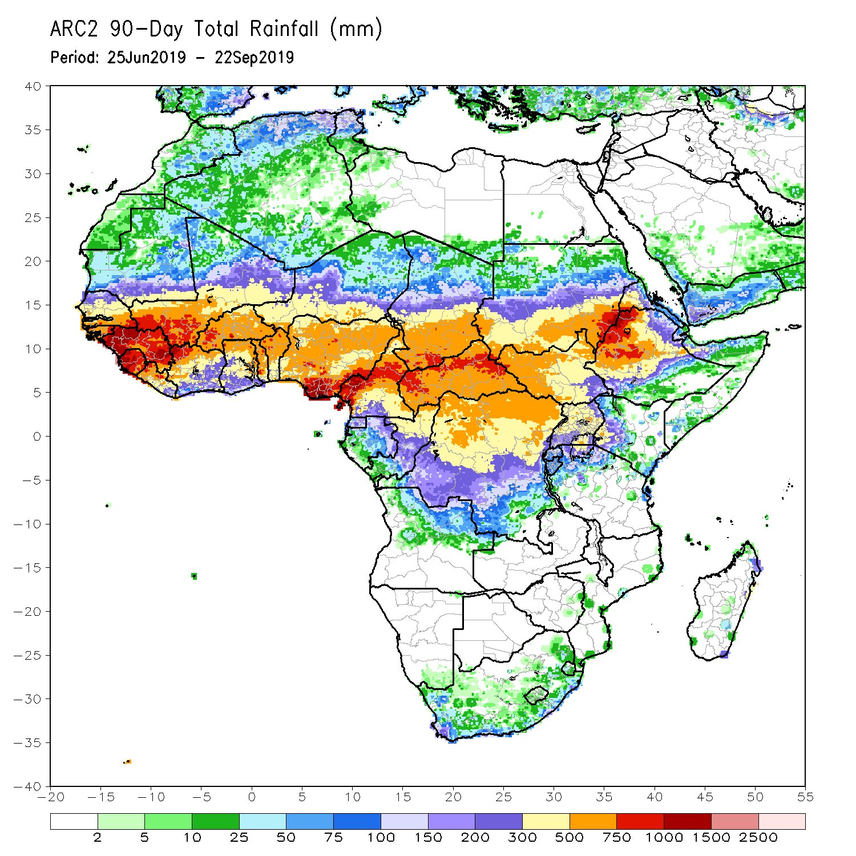
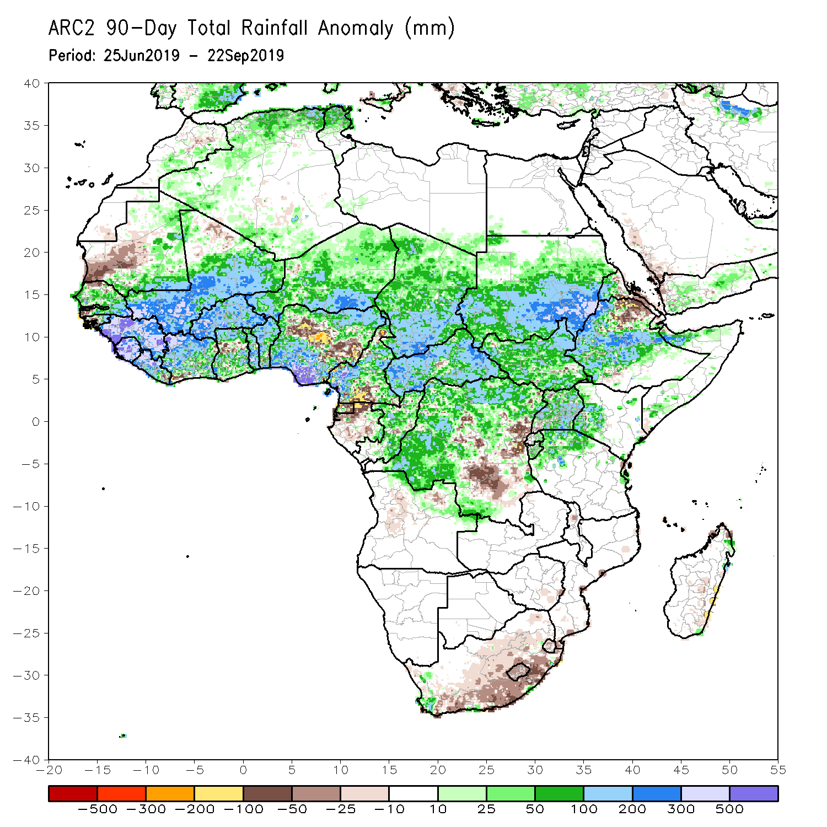
Rainfall Patterns: Last 90 Days
During the past 90 days, western and central Mauritania, local areas in Senegal, western Guinea-Bissau, local areas in Cote d’Ivoire and Ghana, portions of Nigeria and Cameroon, parts of Gabon, local areas in Congo, portions of DRC, and northeastern Ethiopia and southern South Africa had below-average rainfall.
Rainfall was above-average over many parts of Senegal, much Guinea, southern and eastern Mauritania, Sierra Leone, Liberia, Mali, much of Cote d’Ivoire, Burkina Faso, Ghana, Togo, Benin, Niger, portions of Nigeria, much of Chad, many parts of Cameroon, CAR, many parts of DRC, South Sudan, Uganda, Sudan, many parts of Ethiopia, and western Kenya, parts of Somalia and northern Tanzania.
Notes:
6

Slide 7
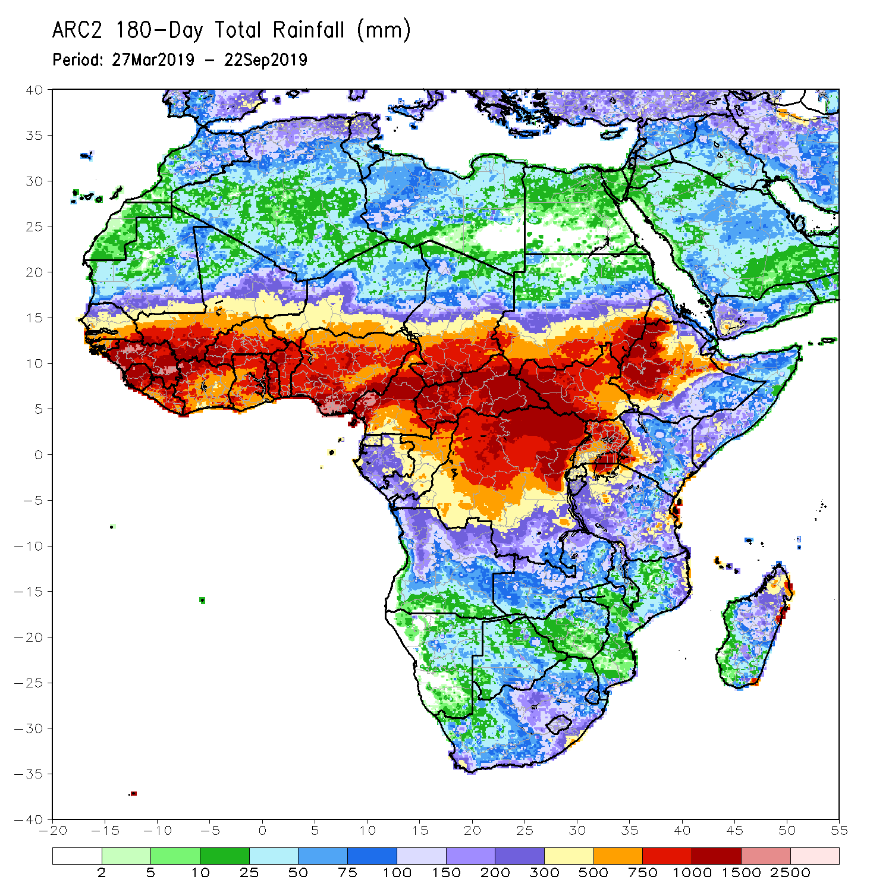
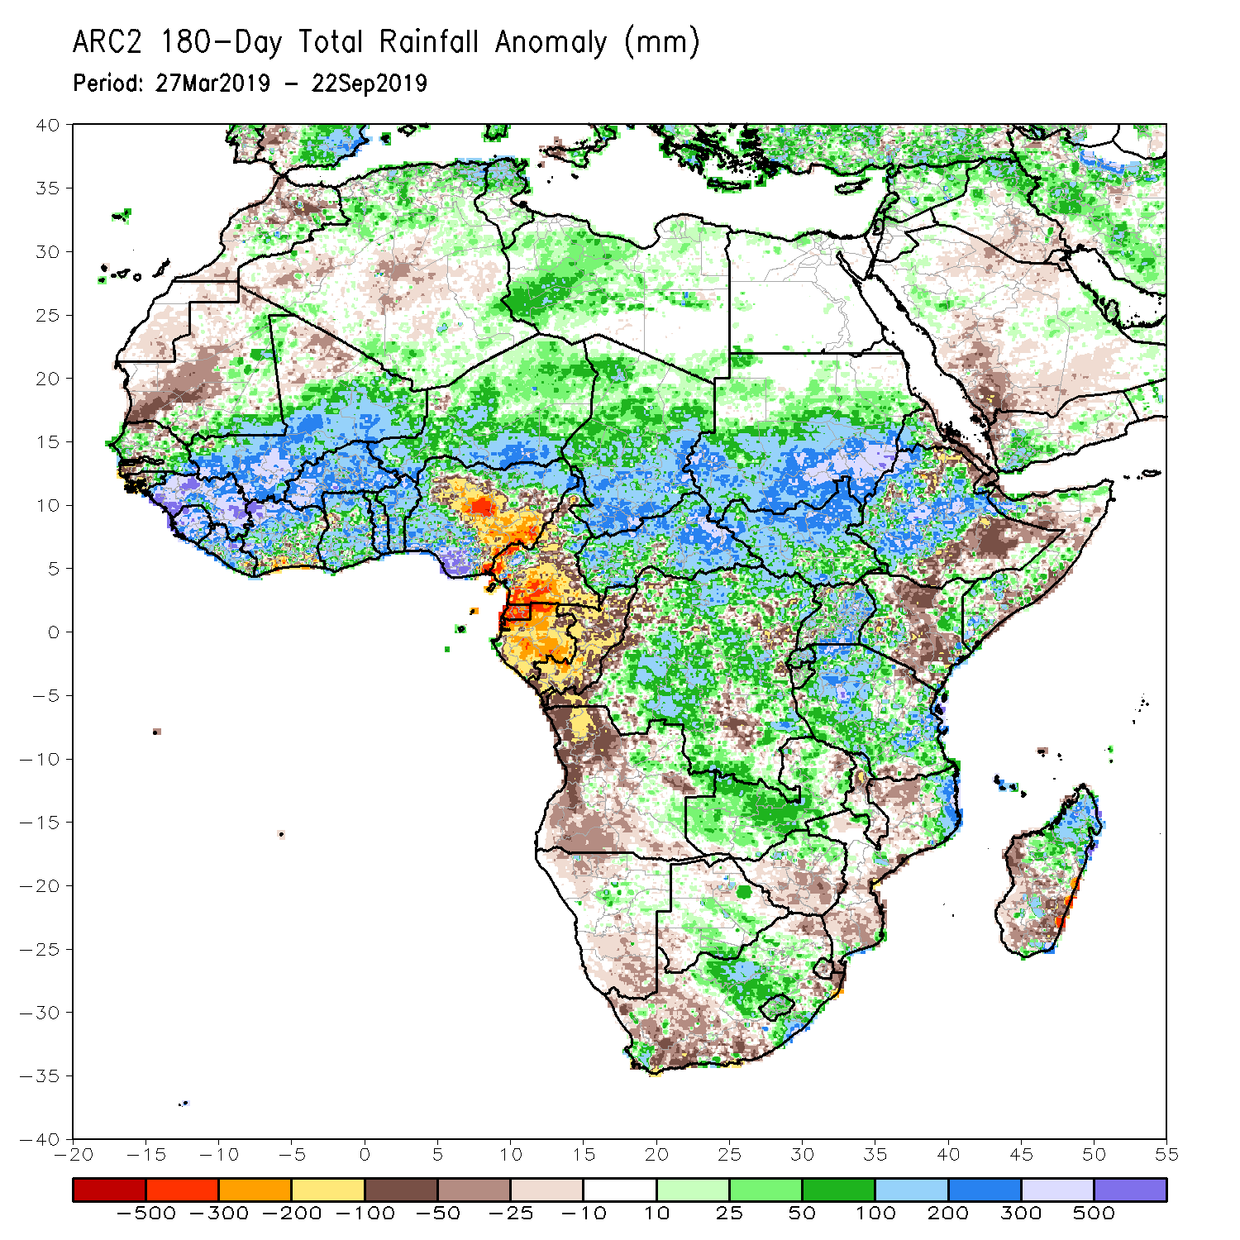
Rainfall Patterns: Last 180 Days
During the past 180 days, below-average rainfall was observed over western and central Mauritania, local areas in Senegal, western Guinea-Bissau, local areas in Liberia, Cote d’Ivoire and Ghana, portions of Nigeria, many parts of Cameroon, Equatorial Guinea, Gabon, Congo, portions of DRC, much of Angola, Namibia, western and northeastern South Africa, eastern Zambia, parts of Botswana, Zimbabwe, many parts of Mozambique, parts of Madagascar, local areas in Tanzania, many parts of Kenya, and portions of Ethiopia and Somalia.
Many parts of Senegal, eastern Guinea-Bissau, much of Guinea, Sierra Leone, Mali, much of Liberia and Cote d’Ivoire, Burkina Faso, Ghana, Togo, Benin, parts of Nigeria, Niger, Chad, CAR, many parts of DRC, South Sudan, Sudan, Uganda, many parts of Ethiopia and Tanzania, Zambia, local areas in Malawi, northern Mozambique, and portions of South Africa and Madagascar had above-average rainfall.
Notes:
7

Slide 8
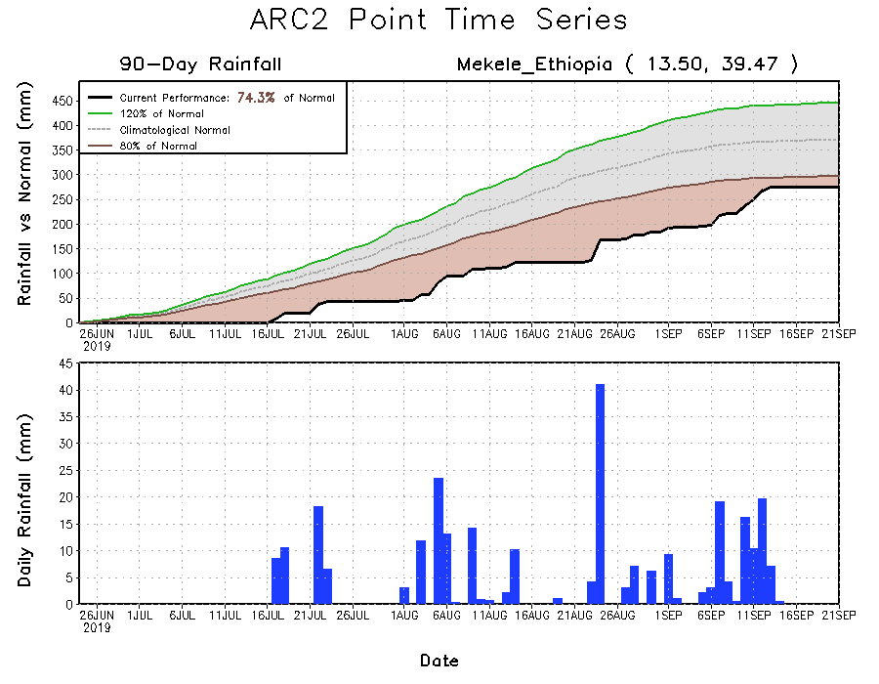
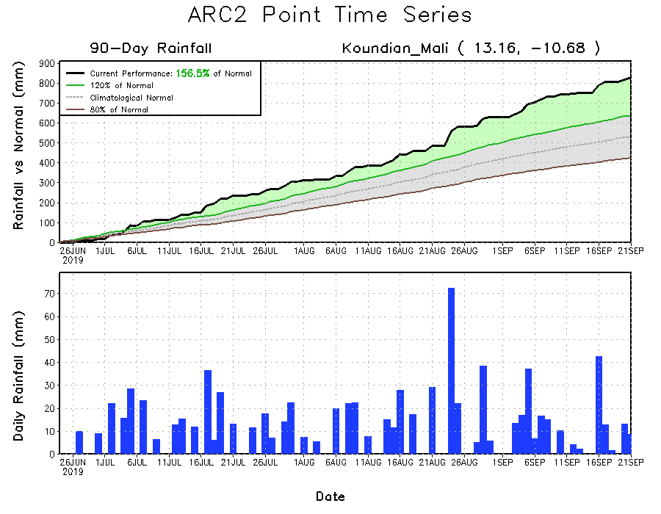
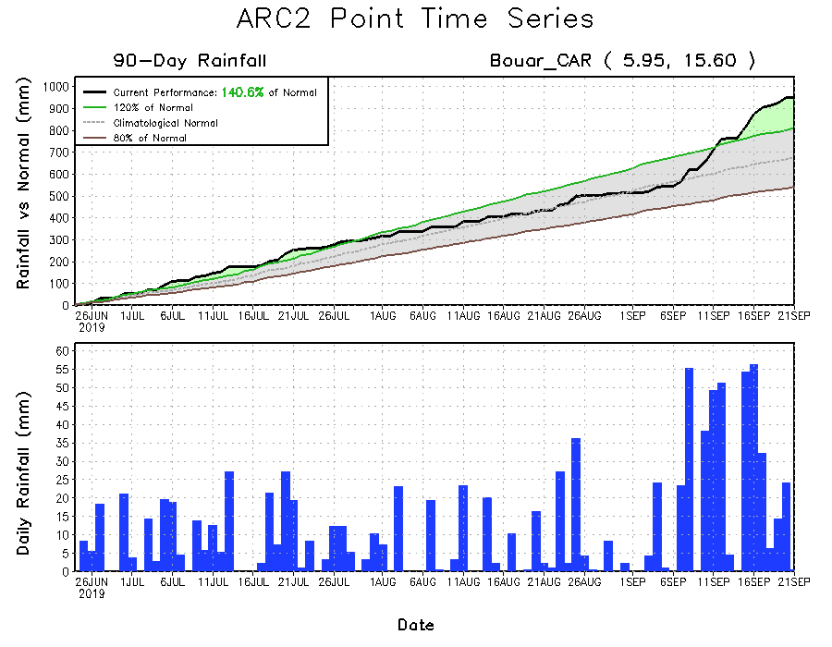
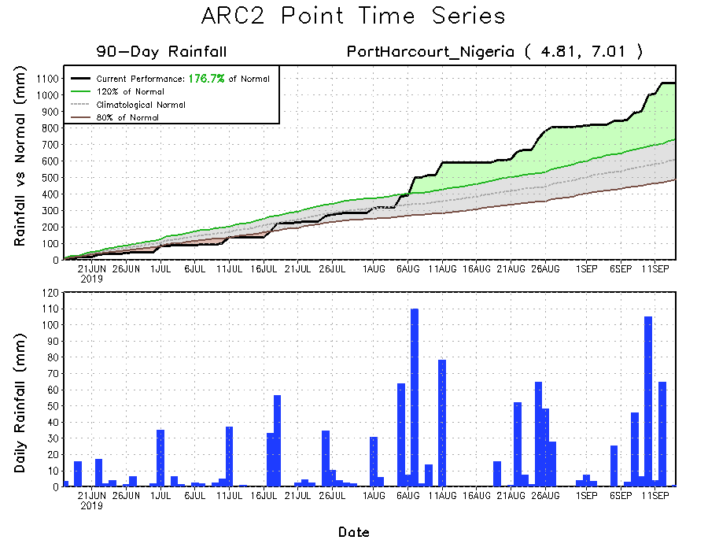
Recent Rainfall Evolution
Daily evolution of rainfall over the last 90 days at selected locations shows that moderate to locally heavy rainfall sustained moisture surpluses over parts of southwestern Mali (bottom left) and western CAR (bottom right). Seasonal total rainfall remained below-average over parts of Northeast Ethiopia (top right).

Slide 9
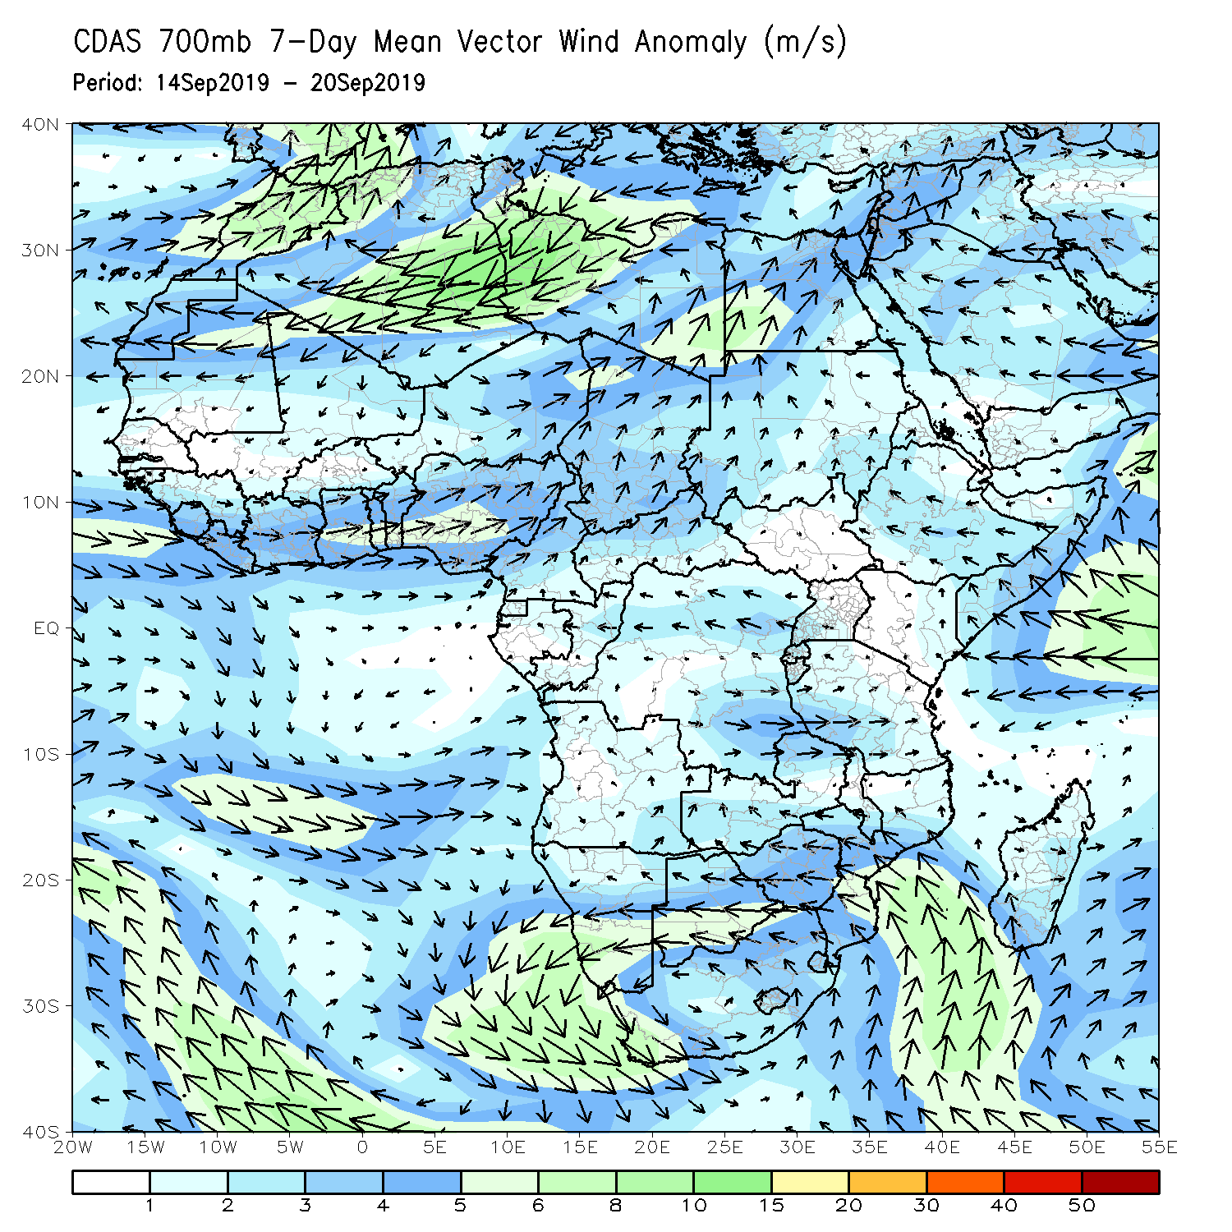
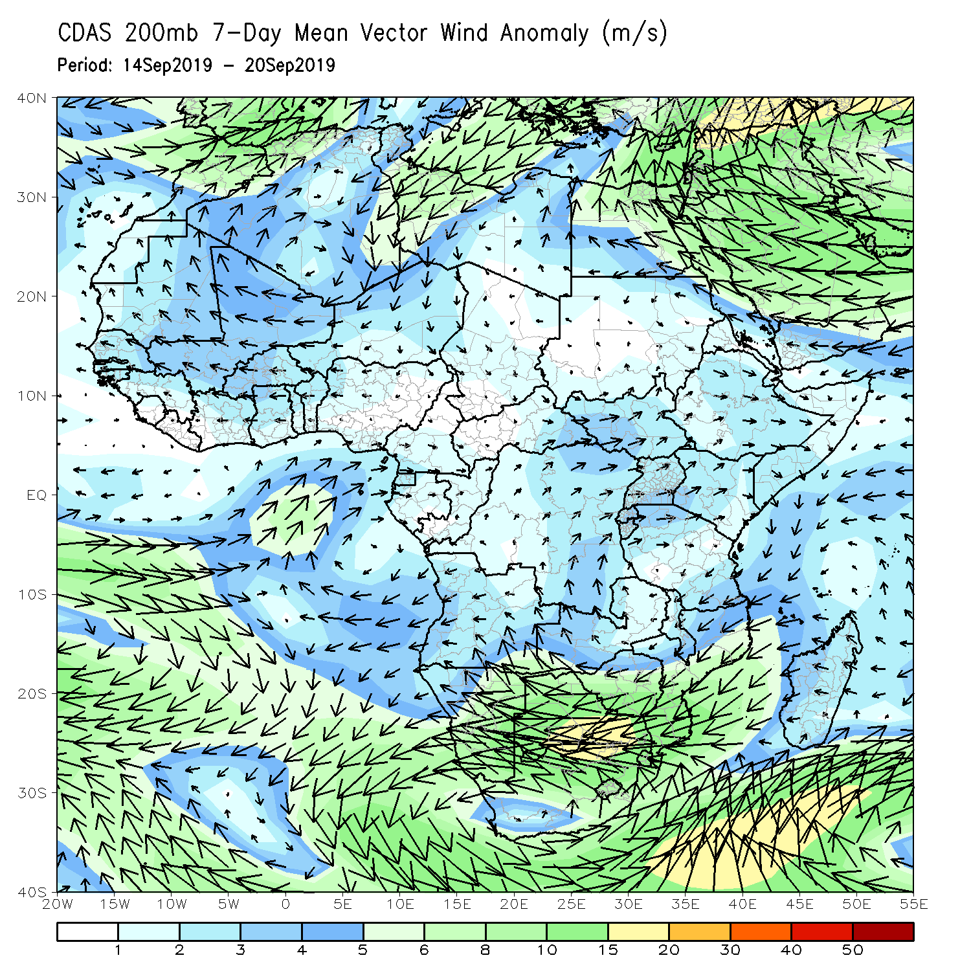
Atmospheric Circulation: Last 7 Days
Anomalous lower-level westerly to southwesterly flow was observed across the Gulf of Guinea region (left).

Slide 10
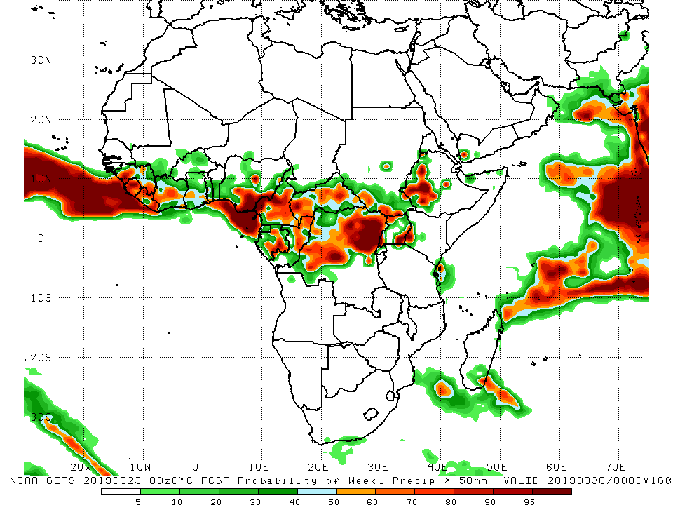
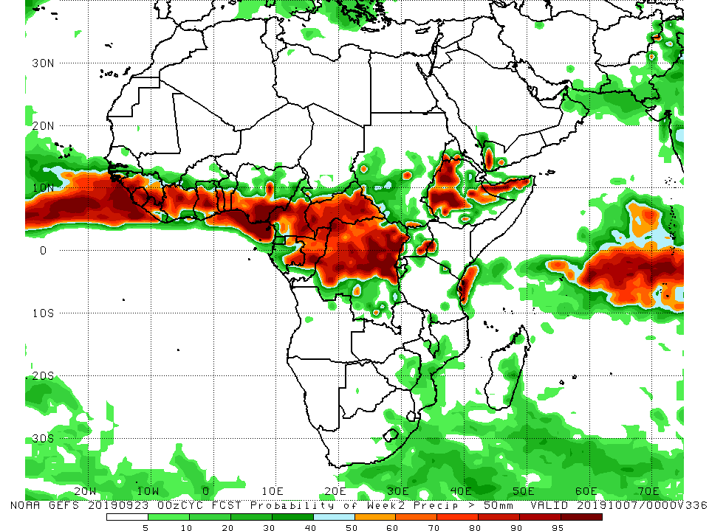
NCEP GEFS Model Forecasts Non-Bias Corrected Probability of precipitation exceedance
Week-1: Valid 24 – 30 September, 2019
Week-2: Valid 1 – 7 October, 2019
For week-1 (left panel) and week-2 (right panel), there is an increased chance for weekly rainfall totals to exceed 50mm over many places in the Gulf of Guinea and Central Africa countries, and portions of Ethiopia.
Notes:
10

Slide 11
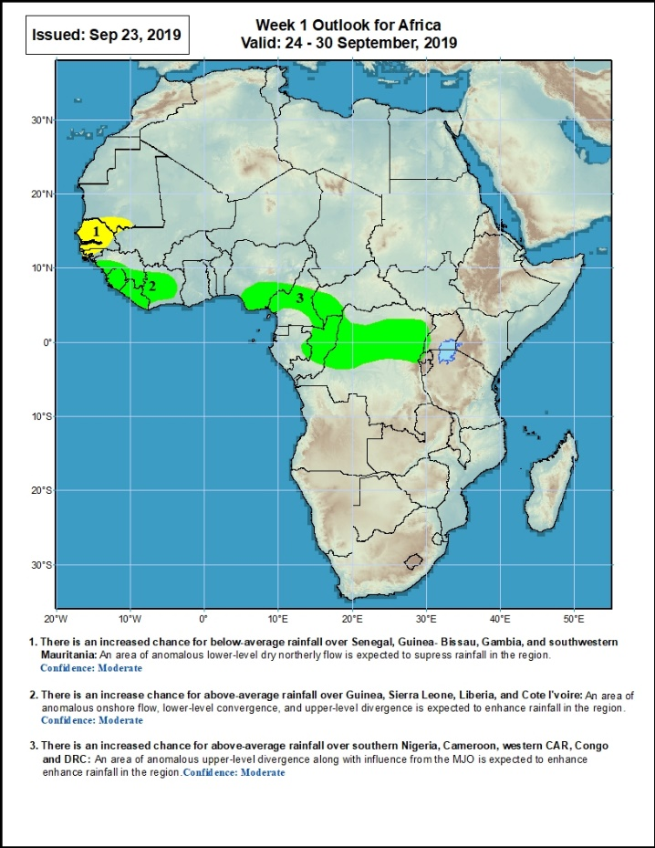
Week-1 Precipitation Outlooks
24 – 30 September, 2019
There is an increased chance for below-average rainfall over much of Senegal, Guinea- Bissau, Gambia, and southwestern Mauritania: An area of anomalous lower-level dry northerly flow is expected to suppress rainfall in the region. Confidence: Moderate
There is an increase chance for above-average rainfall over southern Guinea, Sierra Leone, Liberia, and Cote d’Ivoire: An area of anomalous onshore flow, lower-level convergence, and upper-level divergence is expected to enhance rainfall in the region. Confidence: Moderate
There is an increased chance for above-average rainfall over southern Nigeria, Cameroon, western CAR, Congo and DRC: An area of upper-level divergence along with the projected phase of the MJO is expected to enhance rainfall in the region. Confidence: Moderate
Notes:
11

Slide 12
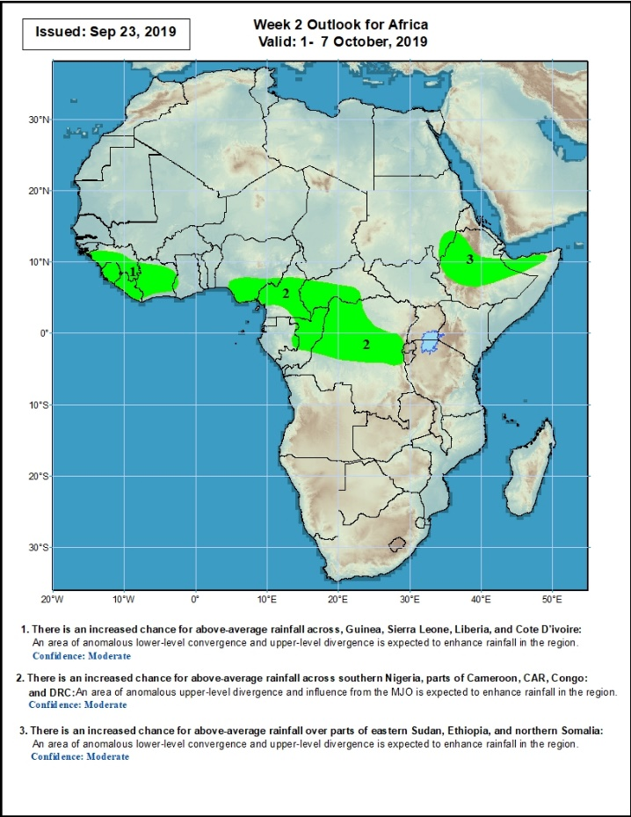
Week-2 Precipitation Outlooks
1 – 7 October, 2019
There is an increased chance for above-average rainfall across, Guinea, Sierra Leone, Liberia, and Cote d‘Ivoire: An area of anomalous lower-level convergence and upper-level divergence is expected to enhance rainfall in the region. Confidence: Moderate
There is an increased chance for above-average rainfall across southern Nigeria, parts of Cameroon, CAR, Congo and DRC: An area of upper-level divergence along with the projected phase of the MJO is expected to enhance rainfall in the region. Confidence: Moderate
There is an increased chance for above-average rainfall over parts of eastern Sudan, Ethiopia, and northern Somalia: An area of anomalous lower-level convergence and upper-level divergence is expected to enhance rainfall in the region. Confidence: Moderate
Notes:
12

Slide 13
Summary
During the past 7 days, weekly rainfall totals exceeded 100mm over many parts of Sierra Leone, and portions of Nigeria, CAR and Ethiopia. Parts of southern Mauritania, much of Senegal, portions of Guinea-Bissau and Guinea, much of Sierra Leone, parts of Liberia and Cote d’Ivoire, portions of Mali, local areas in Ghana and Burkina Faso, many parts of Togo and Benin, portions of Nigeria, many parts of Cameroon, southern Chad, local areas in Congo, many parts of CAR, western DRC, southern and eastern Sudan, local areas in Uganda and northern Tanzania, and many parts of Ethiopia had above-average rainfall. Rainfall was below-average over portions of Guinea and Liberia, local areas in Cote d’Ivoire, Ghana and Burkina Faso, parts of Niger and Nigeria, local areas in Cameroon, much of Equatorial Guinea, Gabon, central Chad, southeastern CAR, portions of DRC and South Sudan, northern Uganda and local areas in southwestern Ethiopia.
During the past 30 days, rainfall was above-average over southern and eastern Mauritania, much of Senegal, portions of Guinea and Sierra Leone, much of Liberia, Mali, many parts of Burkina Faso and Ghana, Cote d’Ivoire, Togo, Benin, Niger, portions of Nigeria and Cameroon, many parts of Chad and CAR, much of Congo, western DRC, parts of South Sudan, southern and eastern Sudan, many parts of Ethiopia, Eritrea, northern Tanzania, and parts of Somalia and Kenya. Southwestern and central Mauritania, parts of Guinea-Bissau, western Guinea, western Sierra Leone, parts of northeastern Ghana and Burkina Faso, local areas in Togo and Benin, portions of Nigeria and Cameroon, central and eastern DRC, southwestern CAR, local areas in South Sudan, and portions of Uganda had below-average rainfall.
During the past 90 days, western and central Mauritania, local areas in Senegal, western Guinea-Bissau, local areas in Cote d’Ivoire and Ghana, portions of Nigeria and Cameroon, parts of Gabon, local areas in Congo, portions of DRC, and northeastern Ethiopia and southern South Africa had below-average rainfall. Rainfall was above-average over many parts of Senegal, much Guinea, southern and eastern Mauritania, Sierra Leone, Liberia, Mali, much of Cote d’Ivoire, Burkina Faso, Ghana, Togo, Benin, Niger, portions of Nigeria, much of Chad, many parts of Cameroon, CAR, many parts of DRC, South Sudan, Uganda, Sudan, many parts of Ethiopia, and western Kenya, parts of Somalia and northern Tanzania.
Week-1 outlooks call for an increased chance for below-average rainfall over much Senegal, Gambia, Guinea-Bissau, and southwestern Mauritania. In contrast, there is an increased chance for above-average rainfall over southern Guinea, Sierra Leone, Liberia, Cote d’Ivoire, southern Nigeria, Cameroon, western CAR, Congo and DRC.
Notes:
13

