Slide 1
The African Monsoon Recent Evolution and Current Status Include Week-1 and Week-2 Outlooks
Update prepared by
Climate Prediction Center / NCEP
9 September 2019
For more information, visit:
http://www.cpc.ncep.noaa.gov/products/Global_Monsoons/African_Monsoons/precip_monitoring.shtml

Slide 2
Outline
Highlights
Recent Evolution and Current Conditions
NCEP GEFS Forecasts
Summary

Slide 3
Highlights: Last 7 Days
Weekly rainfall totals exceeded 100mm over local areas in Guinea, southern Mali, parts of Nigeria, southwestern Cameroon, and local areas in Ethiopia.
Week-1 outlooks call for an increased chance for above-average rainfall over southern Senegal, Guinea-Bissau, Guinea-Conakry, Sierra Leone, Liberia, western Cote d’Ivoire, southwestern Mali, southern Nigeria, portions of Cameroon, eastern CAR, northern DRC, and western South Sudan.

Slide 4
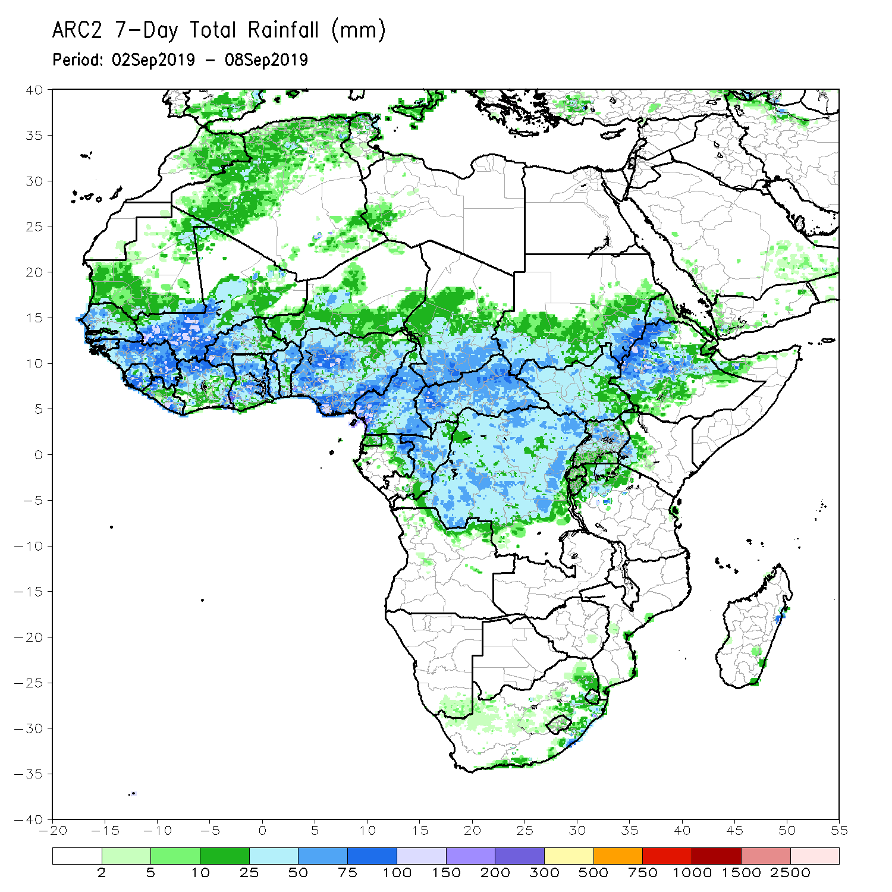
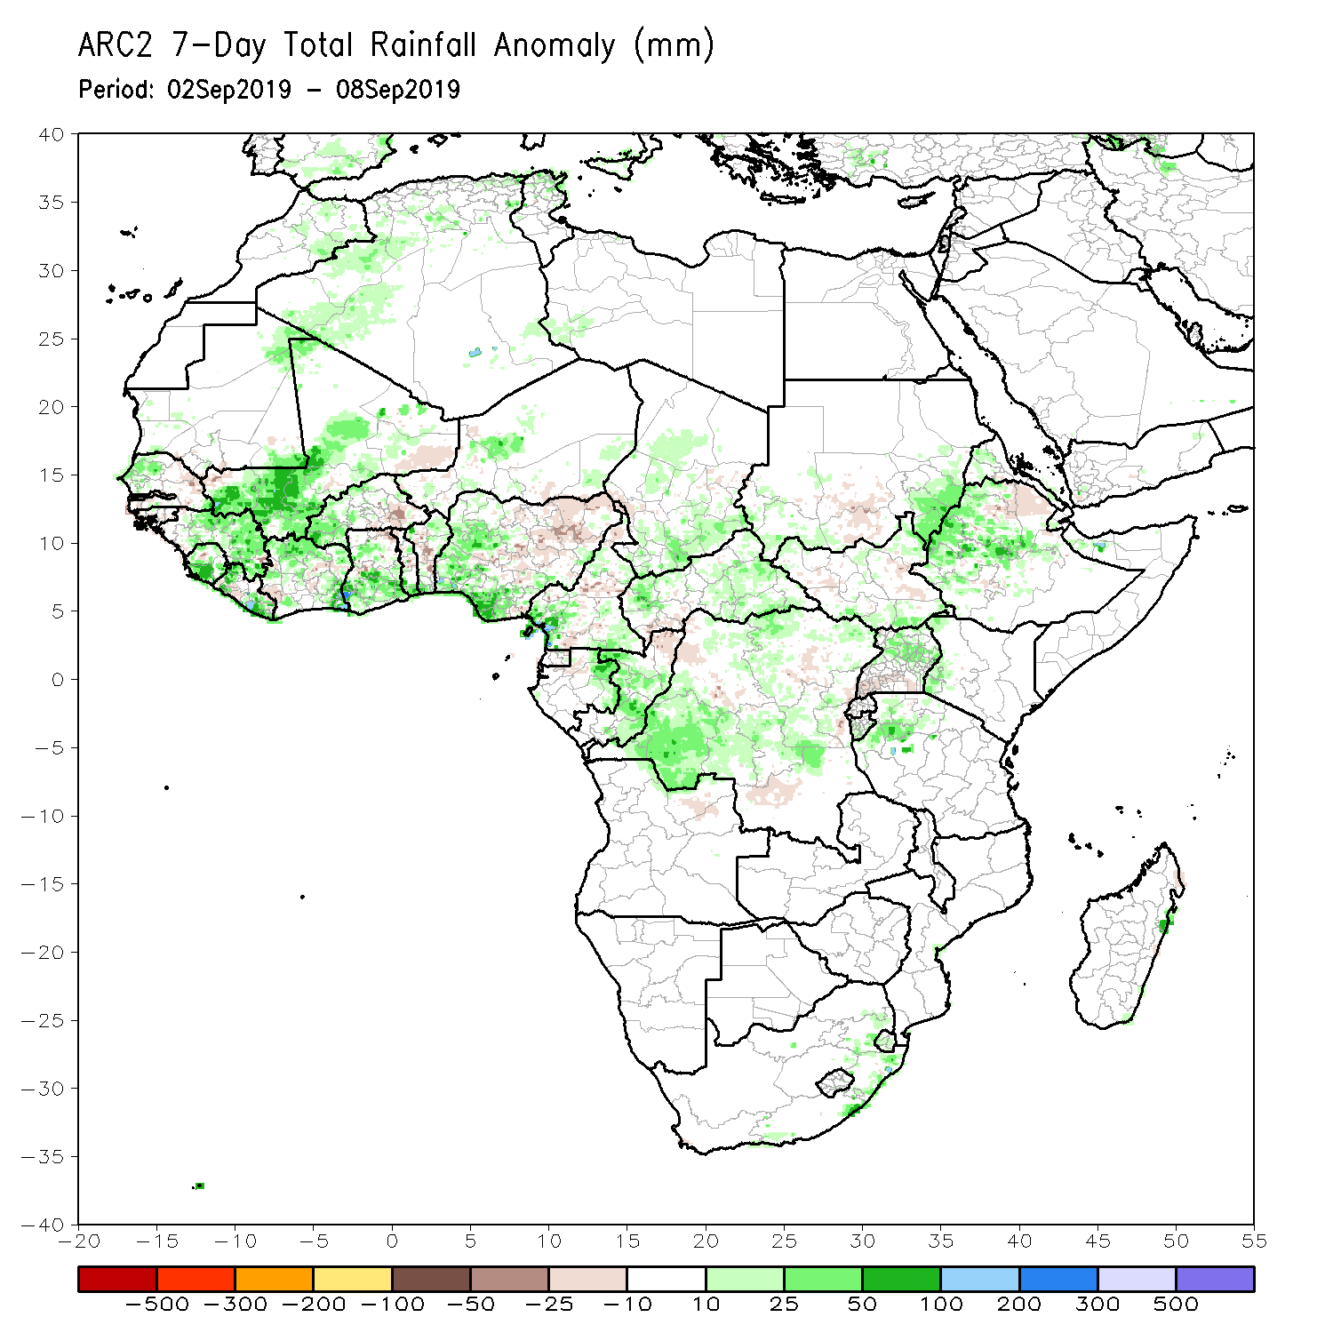
Rainfall Patterns: Last 7 Days
During the past 7 days, western Senegal, much of Guinea, Sierra Leone, Mali, many parts of Liberia, Cote d’Ivoire, western Burkina Faso, southern Ghana, portions of Togo, Benin and Niger, western and southern Nigeria, parts of Cameroon and Chad, Congo, parts of DRC, parts of eastern Sudan, northern Tanzania, western Kenya, northern Uganda and many parts of Ethiopia had above-average rainfall. Weekly rainfall totals exceeded 100mm over local areas in Guinea, southern Mali, parts of Nigeria, southwestern Cameroon, and local areas in Ethiopia.
Rainfall was below-average over parts of eastern Senegal, eastern Burkina Faso, northwestern Ghana, parts of Togo and Benin, many parts of Nigeria and Cameroon, portions of DRC, southern Sudan, and northeastern Ethiopia.

Slide 5
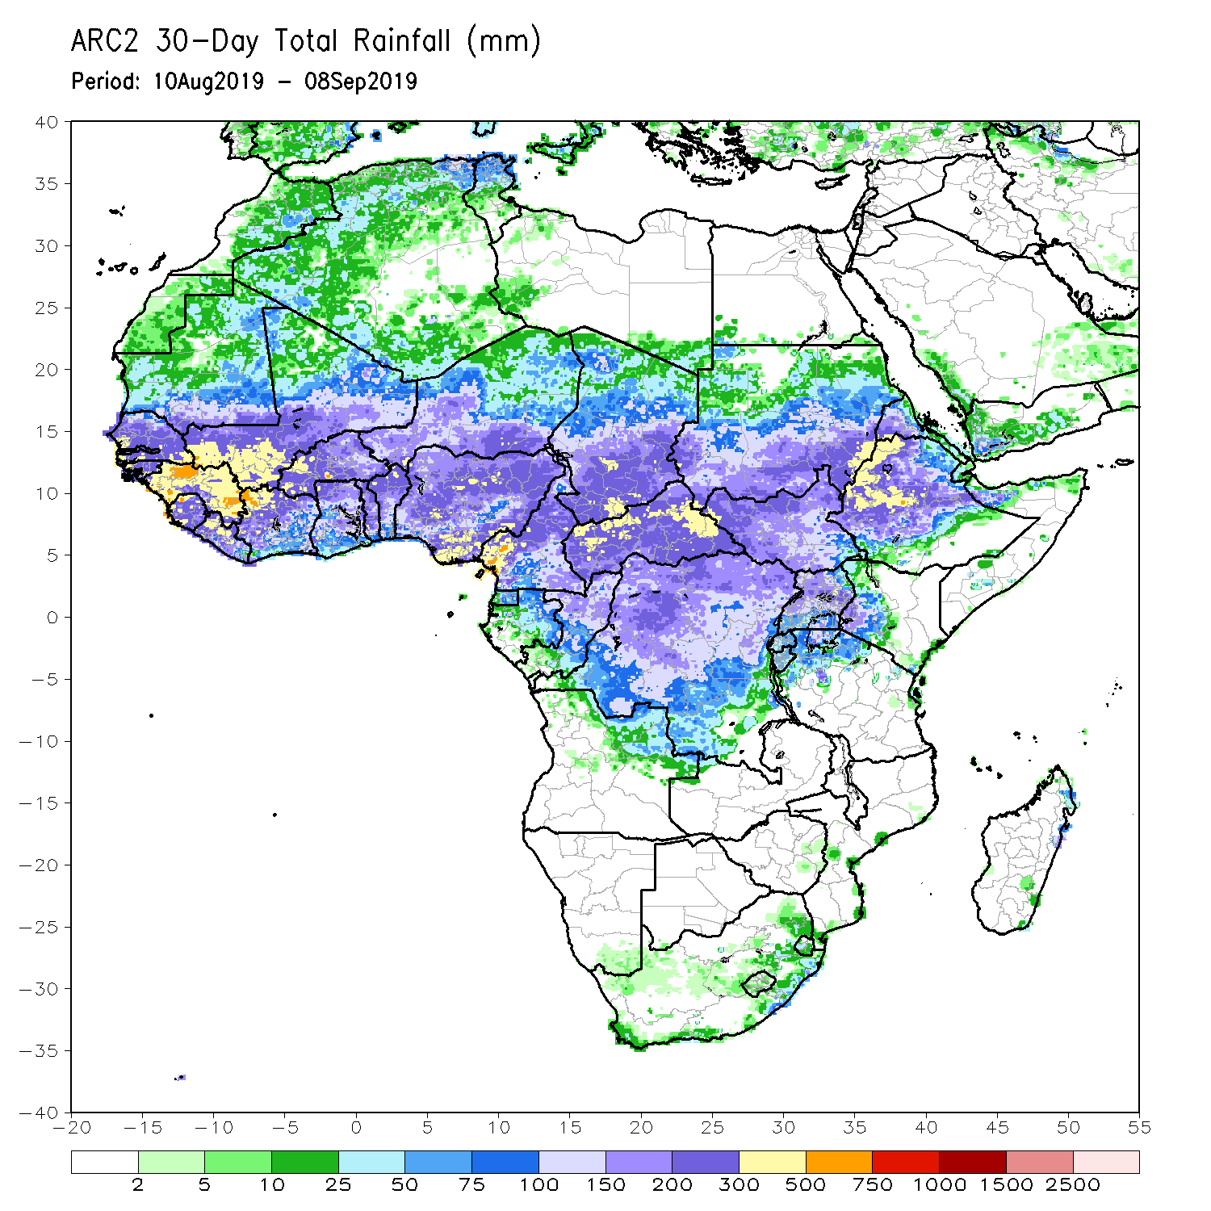
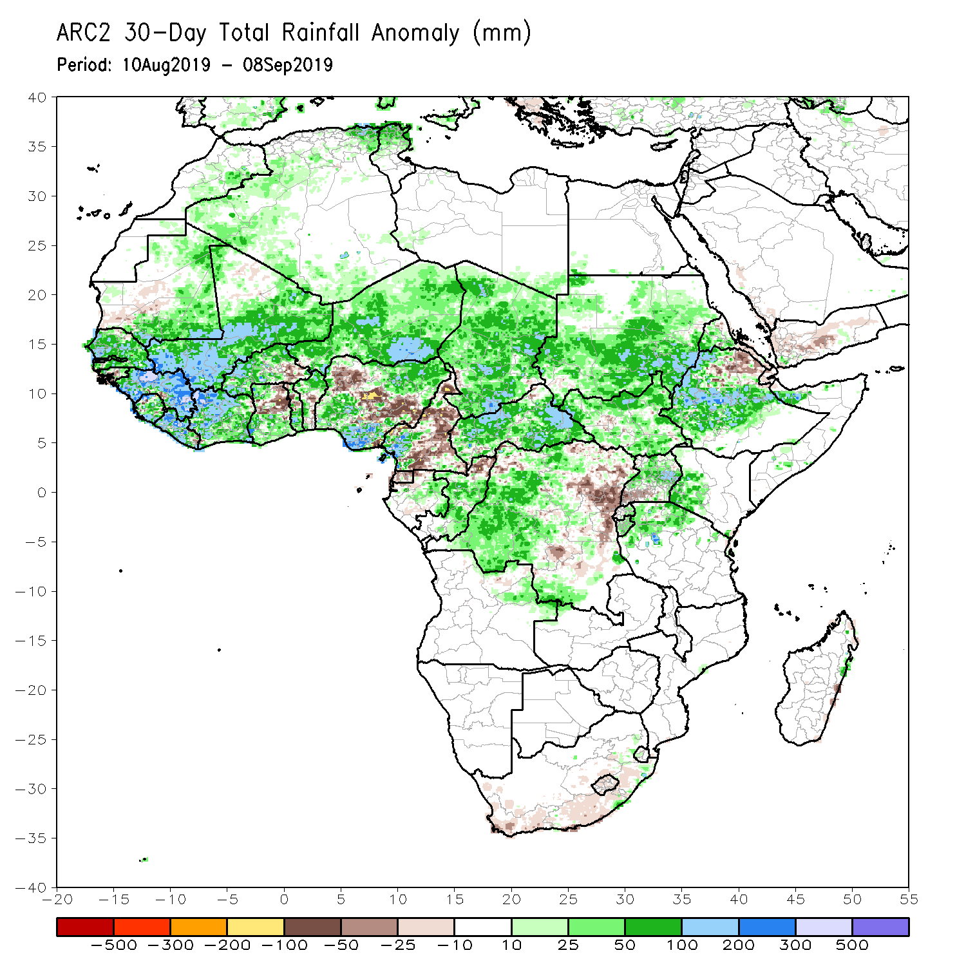
Rainfall Patterns: Last 30 Days
During the past 30 days, Rainfall was above-average over southern and eastern Mauritania, much of Senegal, Guinea, Sierra Leone, much of Liberia, Mali, many parts of Burkina Faso, Cote d’Ivoire, northwestern and southern Ghana, many parts of Togo and Benin, much of Niger, portions of Nigeria, western Cameroon, much of Chad and CAR, many parts of Congo, western and southern DRC, much of Uganda, South Sudan, Sudan, many parts of Ethiopia, Eritrea, northern Tanzania, northern Somalia and western Kenya.
Southwestern Mauritania, local areas in eastern Liberia, parts of northern Ghana, local areas in Togo and Benin, portions of Nigeria and Cameroon, central and eastern DRC, local areas in South Sudan, and northern Ethiopia had below-average rainfall.
Notes:
5

Slide 6
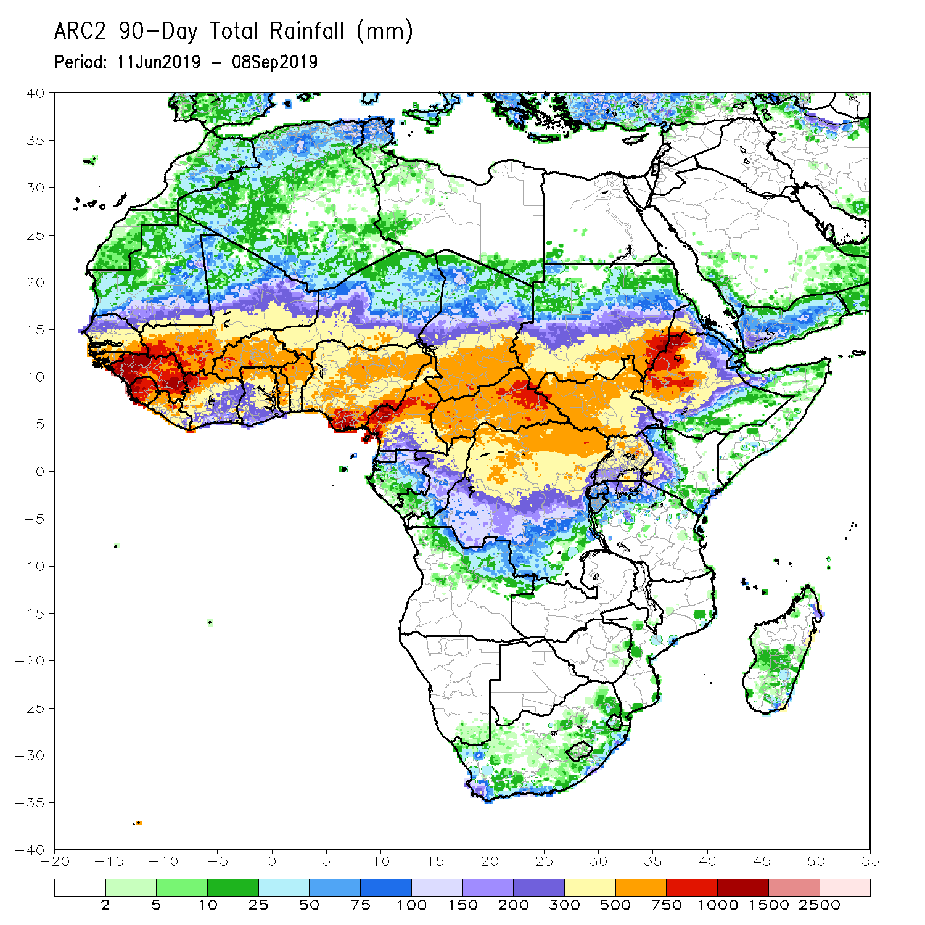
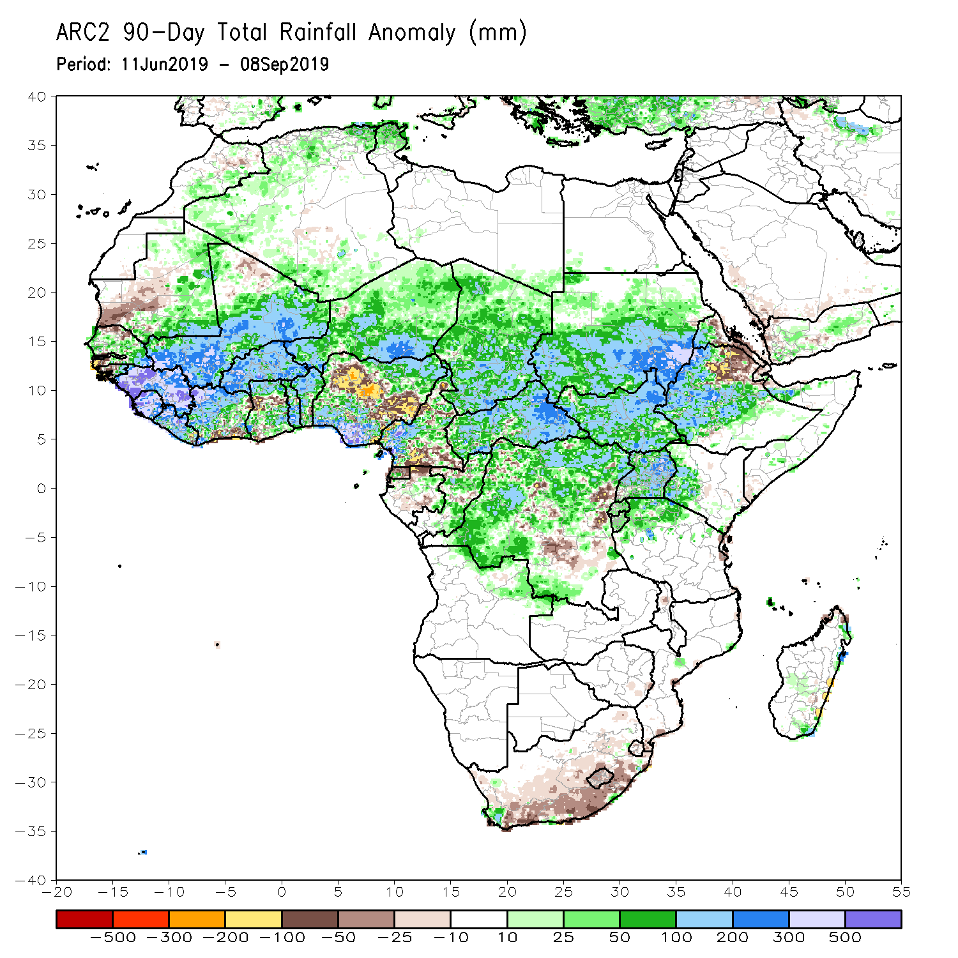
Rainfall Patterns: Last 90 Days
During the past 90 days, western and central Mauritania, parts of northern and southwestern Senegal, western Guinea-Bissau, parts of Cote d’Ivoire and Ghana, portions of Nigeria and Cameroon, parts of Gabon, local areas in Congo, portions of DRC, and northeastern Ethiopia and southern South Africa had below-average rainfall.
Rainfall was above-average over many parts of Senegal, much Guinea, southern and eastern Mauritania, Sierra Leone, Liberia, Mali, many parts of Cote d’Ivoire, Burkina Faso, Ghana, Togo, Benin, Niger, parts of Nigeria, Chad, parts of Cameroon, much of CAR, parts of DRC, South Sudan, Uganda, Sudan, many parts of Ethiopia, and western Kenya and northern Tanzania.
Notes:
6

Slide 7
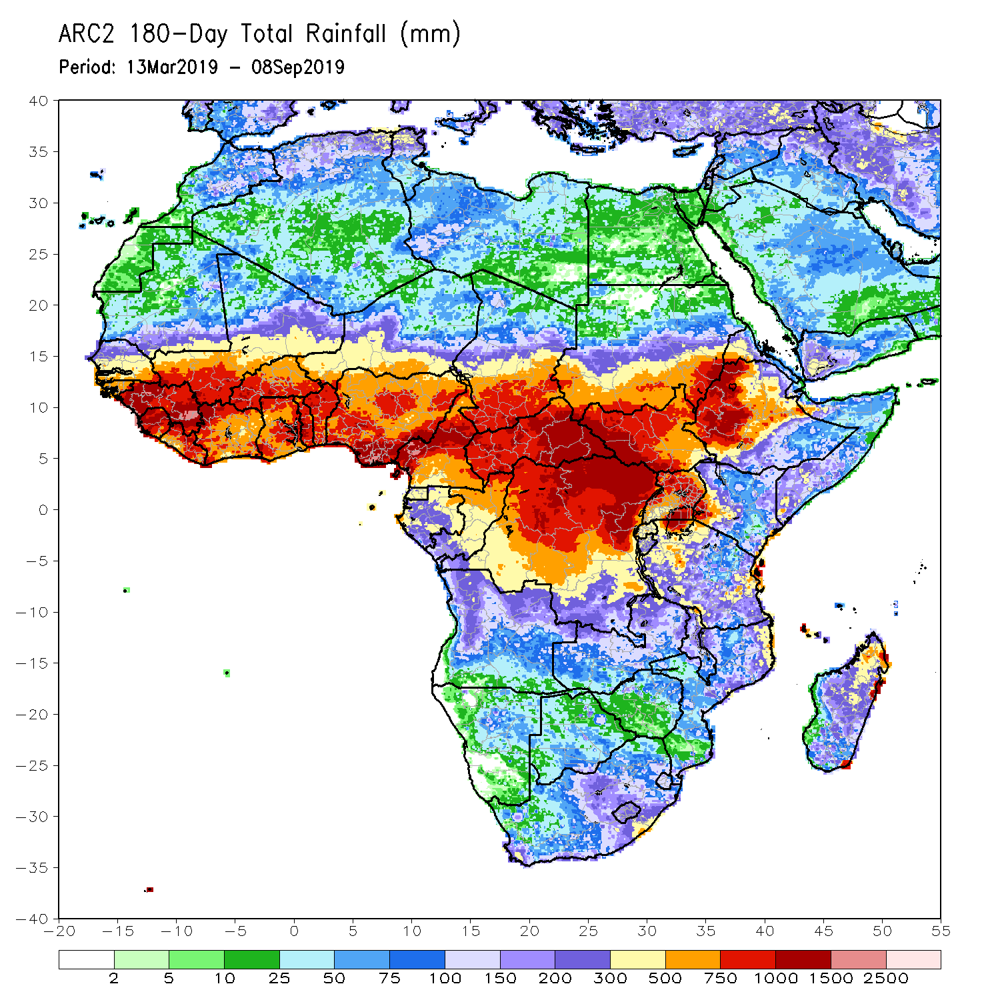
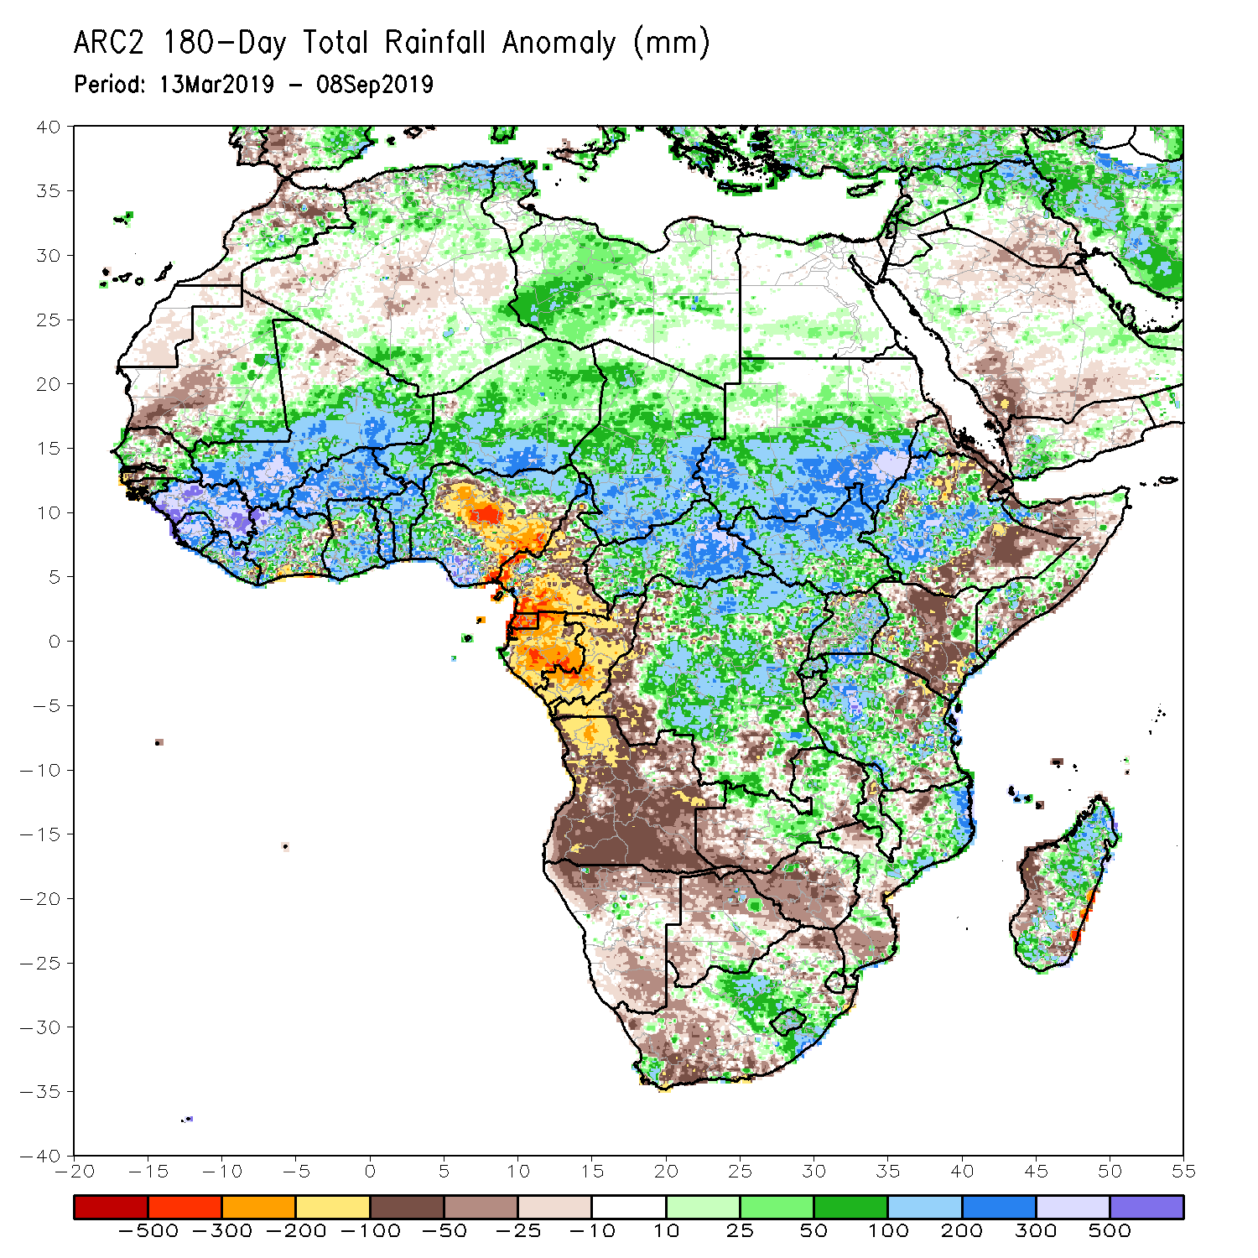
Rainfall Patterns: Last 180 Days
During the past 180 days, below-average rainfall was observed over western and central Mauritania, parts of northern Senegal, western Guinea-Bissau, local areas in Liberia, parts of Cote d’Ivoire, local areas in Ghana, portions of Nigeria, many parts of Cameroon, Equatorial Guinea, Gabon, Congo, portions of DRC, Angola, Namibia, western and northeastern South Africa, portions of Zambia, Botswana, Zimbabwe, southern Mozambique, parts of Madagascar and Tanzania, many parts of Kenya, portions of Ethiopia, and Somalia.
Many parts of Senegal, eastern Guinea-Bissau, much of Guinea, Sierra Leone, Mali, much of Liberia and Cote d’Ivoire, Burkina Faso, Ghana, Togo, Benin, parts of Nigeria, Niger, Chad, CAR, many parts of DRC, South Sudan, Sudan, Uganda, many parts of Ethiopia, many parts of Tanzania and Zambia, local areas in Malawi, northern Mozambique, and portions of South Africa and Madagascar had above-average rainfall.
Notes:
7

Slide 8
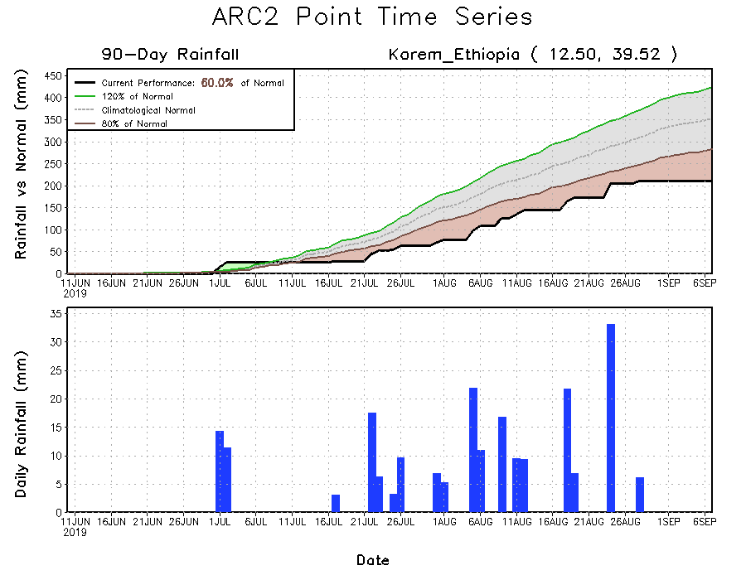
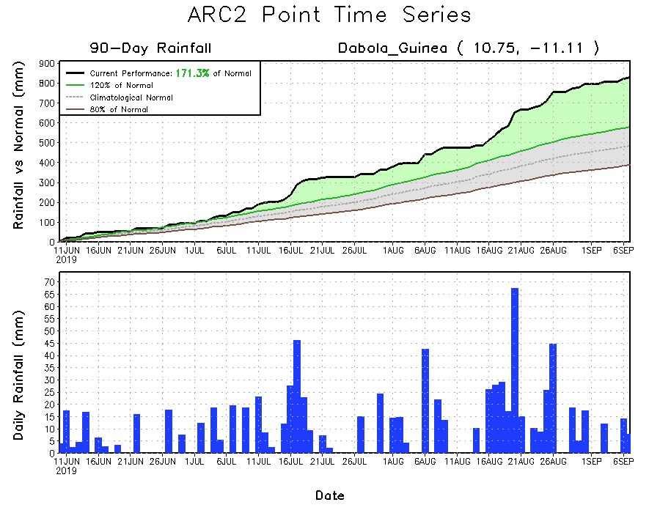
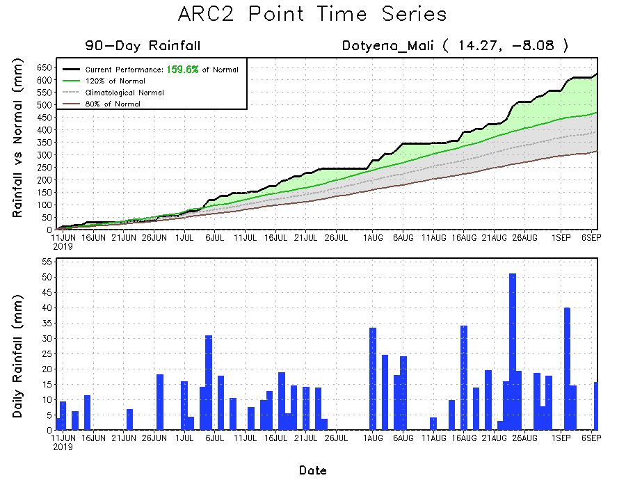
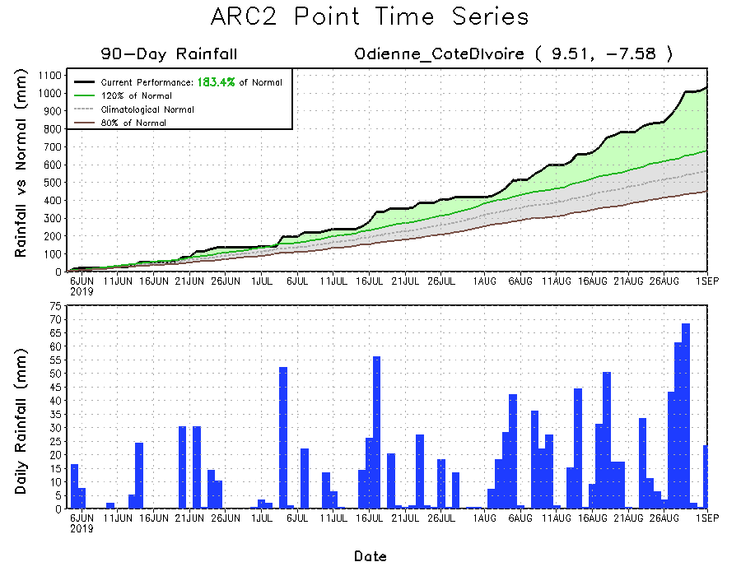
Recent Rainfall Evolution
Daily evolution of rainfall over the last 90 days at selected locations shows moderate to heavy rainfall sustained moisture surpluses over parts of Guinea (bottom left) and southwestern Mali (bottom right). Seasonal total rainfall remained below-average over parts of Northeast Ethiopia (top right).

Slide 9
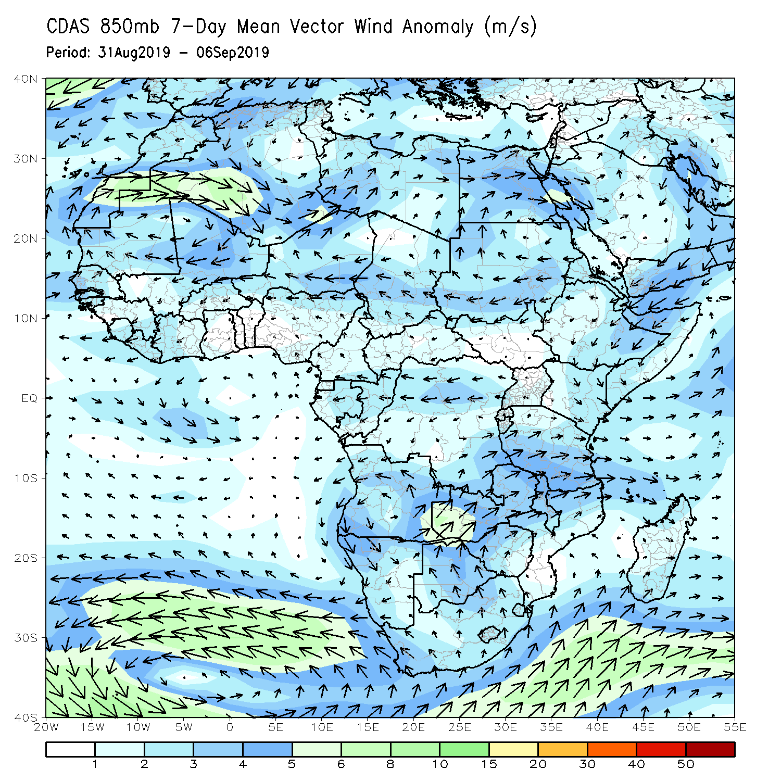
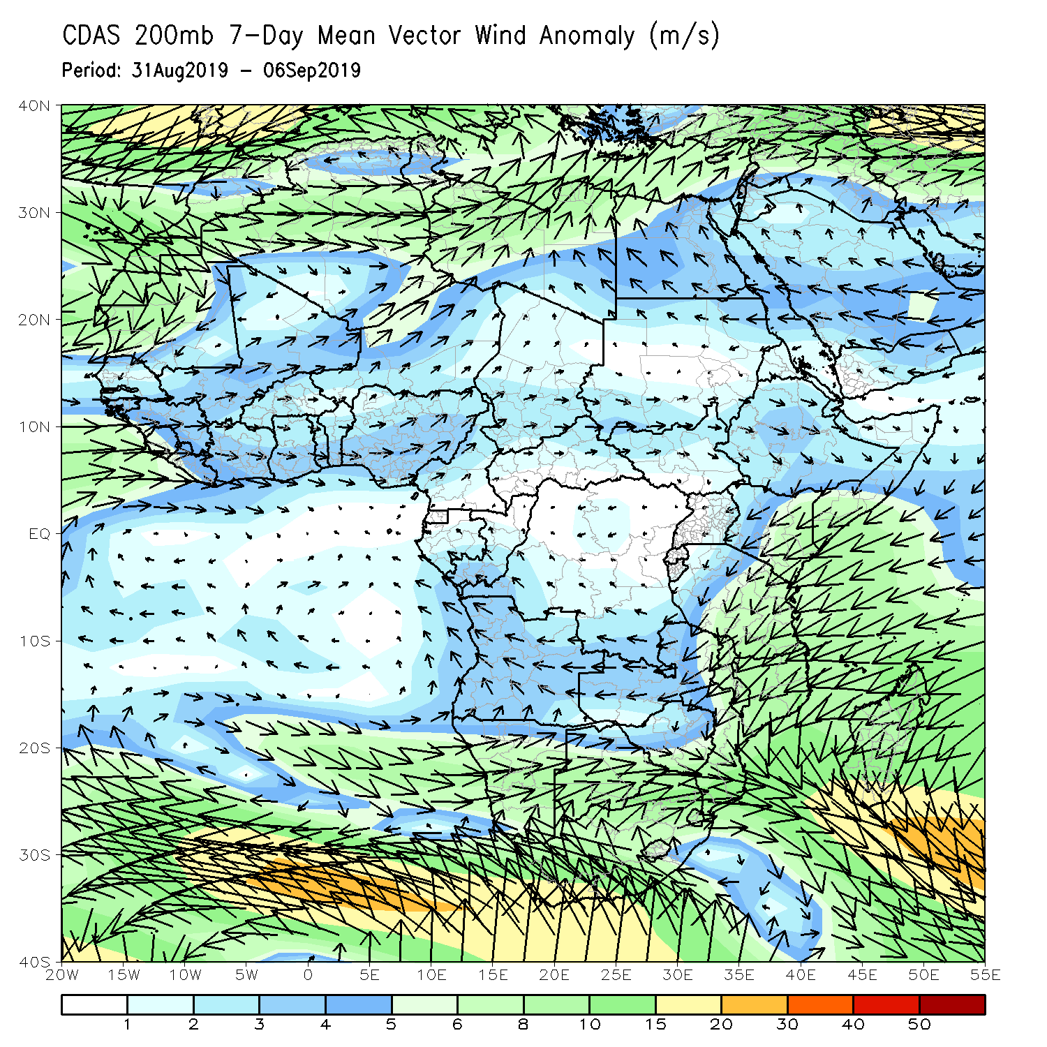
Atmospheric Circulation: Last 7 Days
Lowe-level anomalies were anti-cyclonic across much of the Sahel and the neighboring areas of North Africa (left).

Slide 10
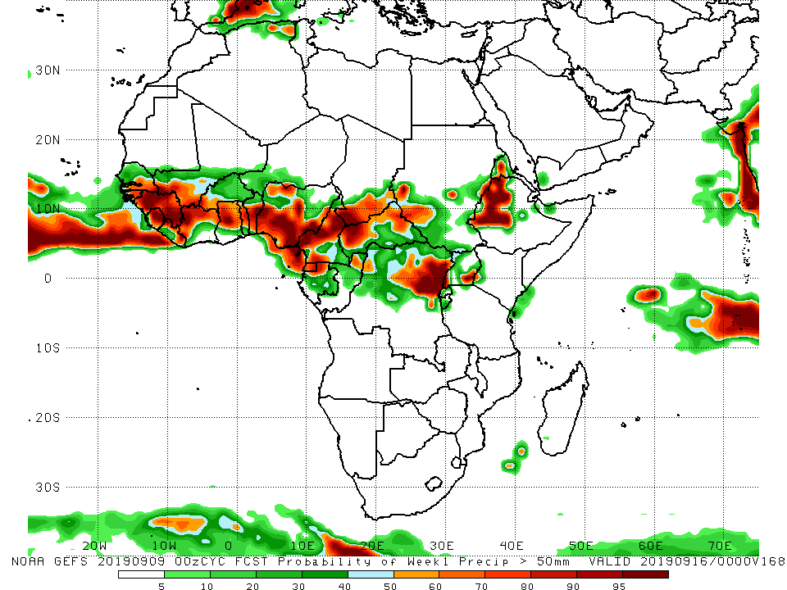
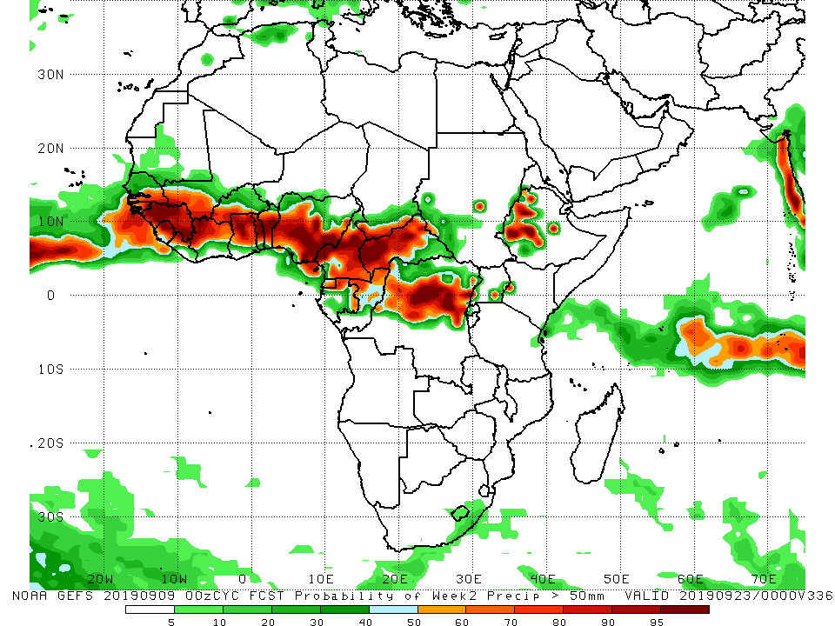
NCEP GEFS Model Forecasts Non-Bias Corrected Probability of precipitation exceedance
Week-1: Valid 10 – 16 September, 2019
Week-2: Valid 17 – 23 September, 2019
For week-1 (left panel) and week-2 (right panel), there is an increased chance for weekly rainfall totals to exceed 50mm over many places in the Gulf of Guinea and Central Africa countries, and western Ethiopia.
Notes:
10

Slide 11
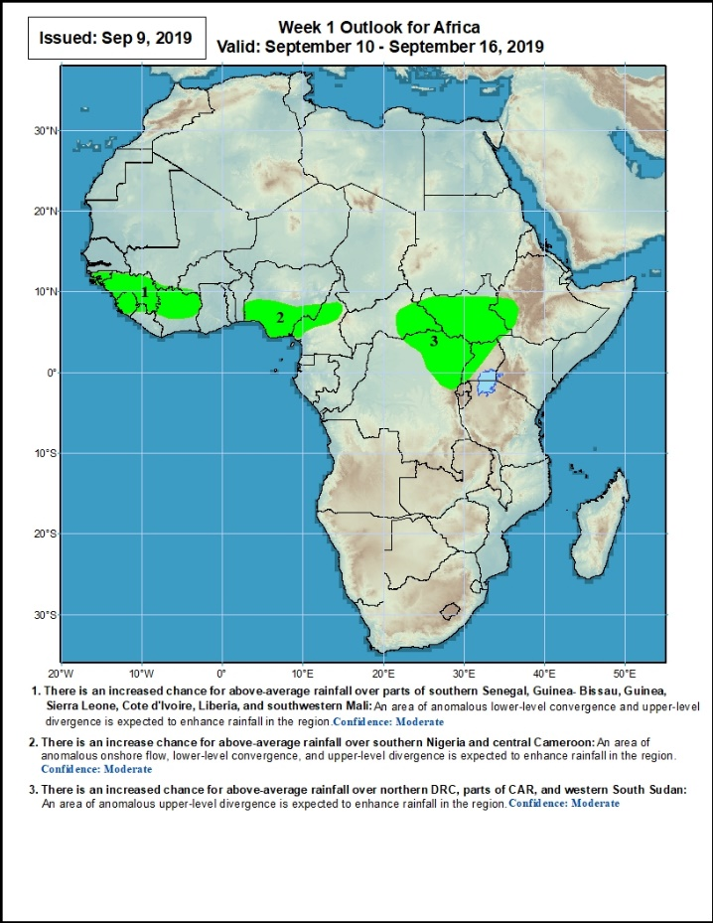
Week-1 Precipitation Outlooks
10 – 16 September, 2019
There is an increased chance for above-average rainfall over Guinea- Bissau, Guinea, Sierra Leone, Cote d'Ivoire, northern, Liberia, and parts of southwestern Mali: An area of anomalous lower-level convergence is expected to enhance rainfall in the region. Confidence: Moderate
There is an increase chance for above-average rainfall over southern Nigeria and central Cameroon: An area of anomalous onshore flow, lower-level convergence, and upper-level divergence is expected to enhance rainfall in the region.. Confidence: Moderate
There is an increased chance for above-average rainfall over northeastern DRC, eastern CAR, western Uganda, southwestern Ethiopia, and South Sudan: An area of upper-level divergence is expected to enhance rainfall in the region. Confidence: Moderate
Notes:
11

Slide 12
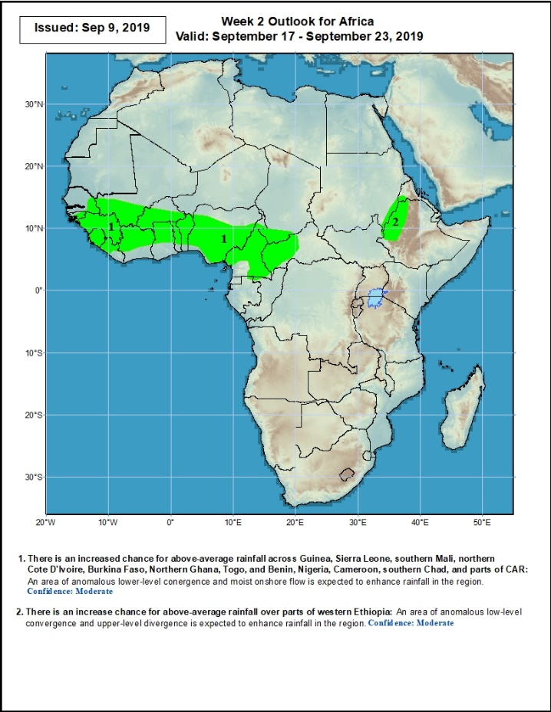
Week-2 Precipitation Outlooks
17 – 23 September, 2019
There is an increased chance for above-average rainfall across eastern Senegal, Guinea, Sierra Leone, southern Mali, northern Cote d'Ivoire, Burkina Faso, Ghana, Togo, Benin, Nigeria, Cameroon, southern Chad, and parts of CAR: An area of anomalous lower-level convergence and upper-level divergence is expected to enhance rainfall in the region. Confidence: Moderate
There is an increase chance for above-average rainfall over parts of eastern Sudan and western Ethiopia: An area of anomalous lower-level convergence and upper-level divergence is expected to enhance rainfall in the region. Confidence: Moderate
Notes:
12

Slide 13
Summary
During the past 7 days, western Senegal, much of Guinea, Sierra Leone, Mali, many parts of Liberia, Cote d’Ivoire, western Burkina Faso, southern Ghana, portions of Togo, Benin and Niger, western and southern Nigeria, parts of Cameroon and Chad, Congo, parts of DRC, parts of eastern Sudan, northern Tanzania, western Kenya, northern Uganda and many parts of Ethiopia had above-average rainfall. Weekly rainfall totals exceeded 100mm over local areas in Guinea, southern Mali, parts of Nigeria, southwestern Cameroon, and local areas in Ethiopia. Rainfall was below-average over parts of eastern Senegal, eastern Burkina Faso, northwestern Ghana, parts of Togo and Benin, many parts of Nigeria and Cameroon, portions of DRC, southern Sudan, and northeastern Ethiopia.
During the past 30 days, Rainfall was above-average over southern and eastern Mauritania, much of Senegal, Guinea, Sierra Leone, much of Liberia, Mali, many parts of Burkina Faso, Cote d’Ivoire, northwestern and southern Ghana, many parts of Togo and Benin, much of Niger, portions of Nigeria, western Cameroon, much of Chad and CAR, many parts of Congo, western and southern DRC, much of Uganda, South Sudan, Sudan, many parts of Ethiopia, Eritrea, northern Tanzania, northern Somalia and western Kenya. Southwestern Mauritania, local areas in eastern Liberia, parts of northern Ghana, local areas in Togo and Benin, portions of Nigeria and Cameroon, central and eastern DRC, local areas in South Sudan, and northern Ethiopia had below-average rainfall.
During the past 90 days, western and central Mauritania, parts of northern and southwestern Senegal, western Guinea-Bissau, parts of Cote d’Ivoire and Ghana, portions of Nigeria and Cameroon, parts of Gabon, local areas in Congo, portions of DRC, and northeastern Ethiopia and southern South Africa had below-average rainfall. Rainfall was above-average over many parts of Senegal, much Guinea, southern and eastern Mauritania, Sierra Leone, Liberia, Mali, many parts of Cote d’Ivoire, Burkina Faso, Ghana, Togo, Benin, Niger, parts of Nigeria, Chad, parts of Cameroon, much of CAR, parts of DRC, South Sudan, Uganda, Sudan, many parts of Ethiopia, and western Kenya and northern Tanzania.
Week-1 outlooks call for an increased chance for above-average rainfall over southern Senegal, Guinea-Bissau, Guinea-Conakry, Sierra Leone, Liberia, western Cote d’Ivoire, southwestern Mali, southern Nigeria, portions of Cameroon, eastern CAR, northern DRC, and western South Sudan.
Notes:
13

