Slide 1
The African Monsoon Recent Evolution and Current Status Include Week-1 and Week-2 Outlooks
Update prepared by
Climate Prediction Center / NCEP
19 August 2019
For more information, visit:
http://www.cpc.ncep.noaa.gov/products/Global_Monsoons/African_Monsoons/precip_monitoring.shtml

Slide 2
Outline
Highlights
Recent Evolution and Current Conditions
NCEP GEFS Forecasts
Summary

Slide 3
Highlights: Last 7 Days
Rainfall was below-average over many places in the Gulf of Guinea and Central Africa countries.
Week-1 outlooks call for an increased chance for above-average rainfall over southern Senegal, parts of Mali, Gambia, Guinea-Bissau, Guinea, Sierra Leone, northern Burkina Faso and southern Niger.

Slide 4
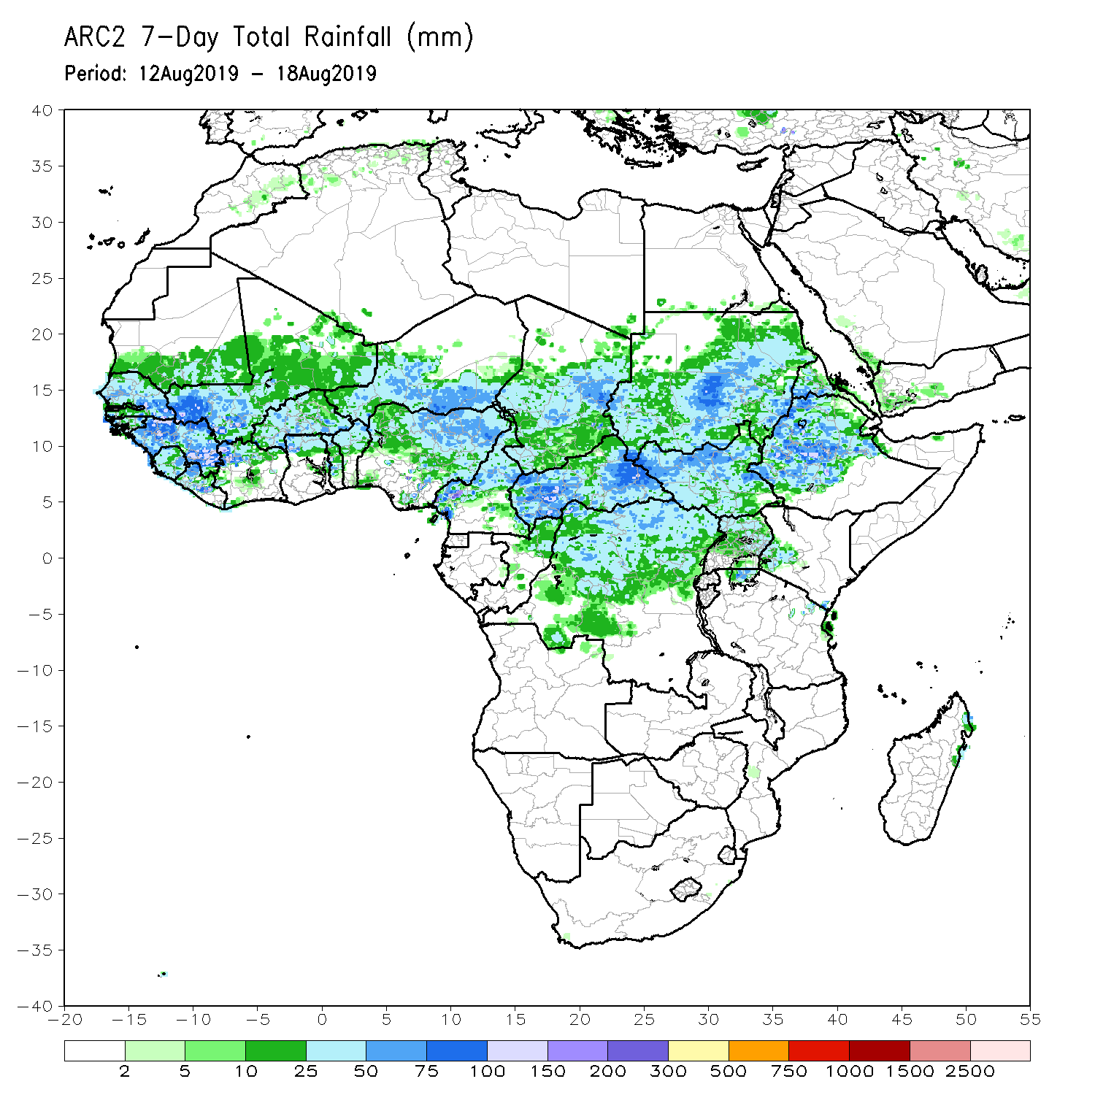
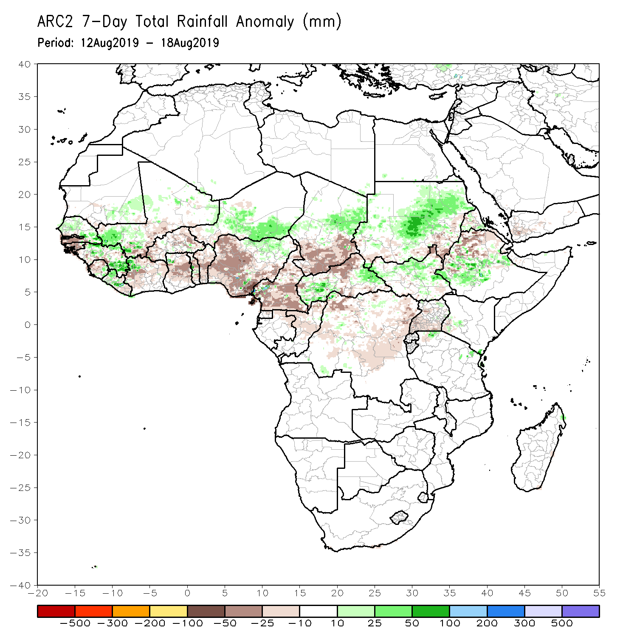
Rainfall Patterns: Last 7 Days
During the past 7 days, rainfall was below-average over southern Senegal, Gambia, Guinea-Bissau, parts of Guinea and Sierra Leone, portions of Mali, Cote d’Ivoire, Ghana, Burkina Faso, Togo, Benin, parts of Niger, many parts of Nigeria, Cameroon, southern Chad, DRC, parts of CAR, eastern Sudan and northern Ethiopia.
Northern and eastern Senegal, parts of Guinea, Liberia, northwestern Cote d’Ivoire, parts of Mali, portions of Niger and Nigeria, eastern Chad, portions of Sudan and South Sudan, and parts of Ethiopia had above-average rainfall.

Slide 5
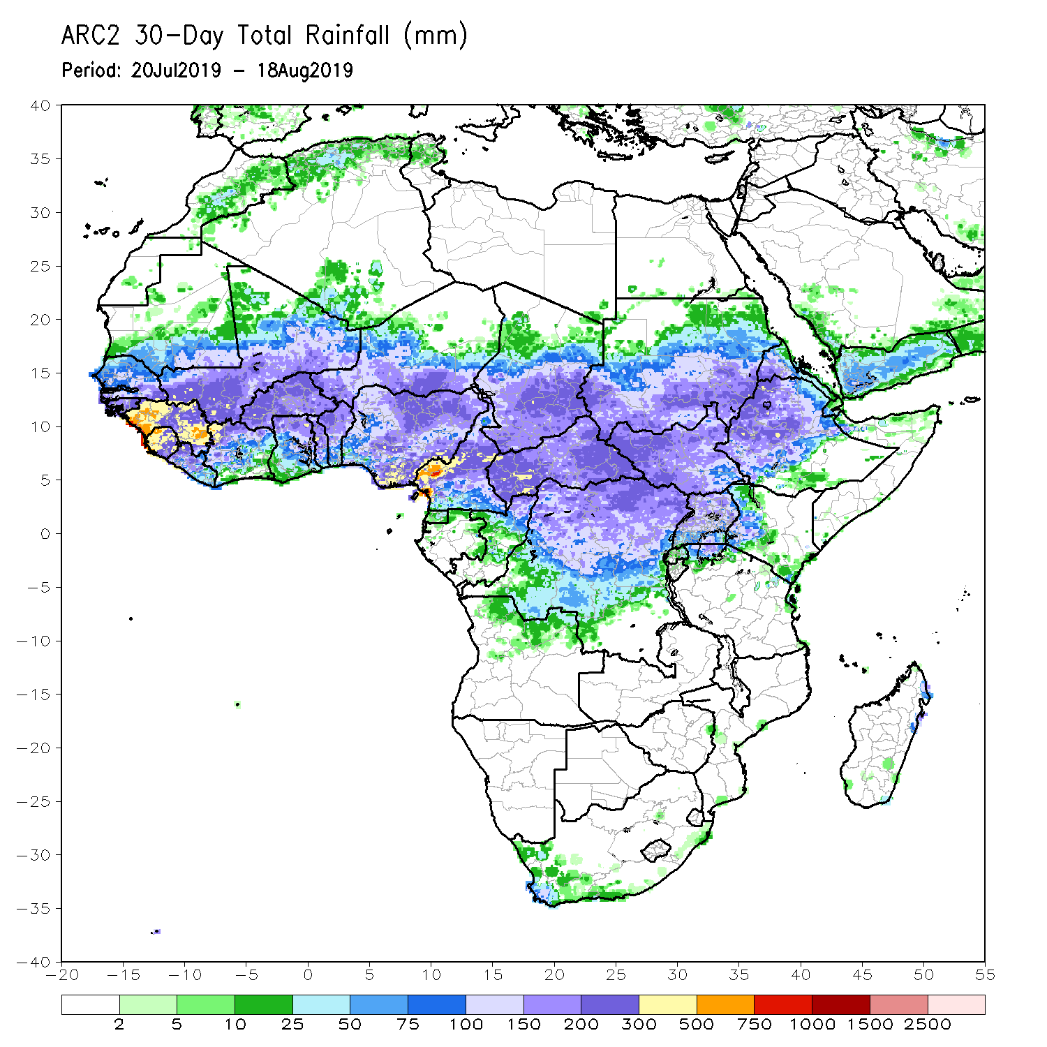
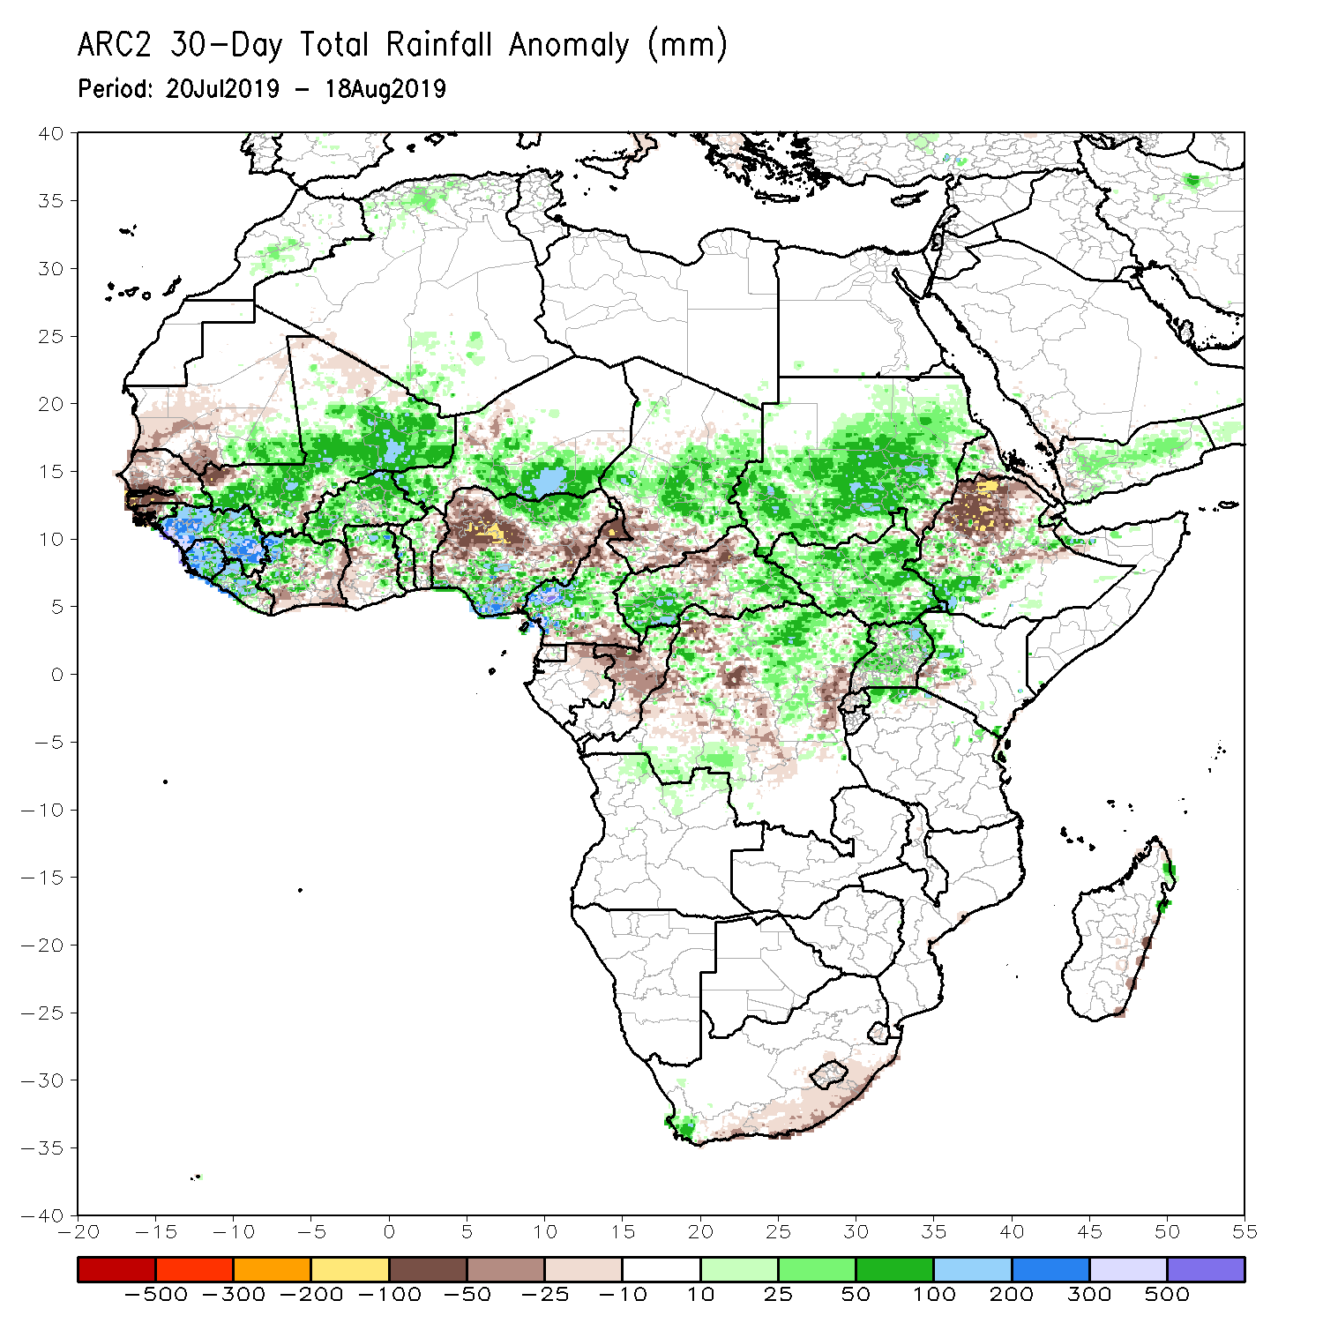
Rainfall Patterns: Last 30 Days
During the past 30 days, southern Mauritania, Senegal, Gambia, Guinea-Bissau, parts of southern Cote d’Ivoire, western Ghana, portions of Nigeria, northern Cameroon, local areas in Niger, southern Chad, parts of Congo and DRC, and portions of Ethiopia had below-average rainfall.
Rainfall was above-average over much of Guinea, Sierra Leone, Liberia, Mali, Burkina Faso, central and northern Cote d’Ivoire, many parts of Ghana, Togo, Benin, Niger, portions of Nigeria, Cameroon, parts of Chad and CAR, northern Congo, many parts of DRC, Uganda, South Sudan, Sudan, and parts of Ethiopia and western Kenya.
Notes:
5

Slide 6
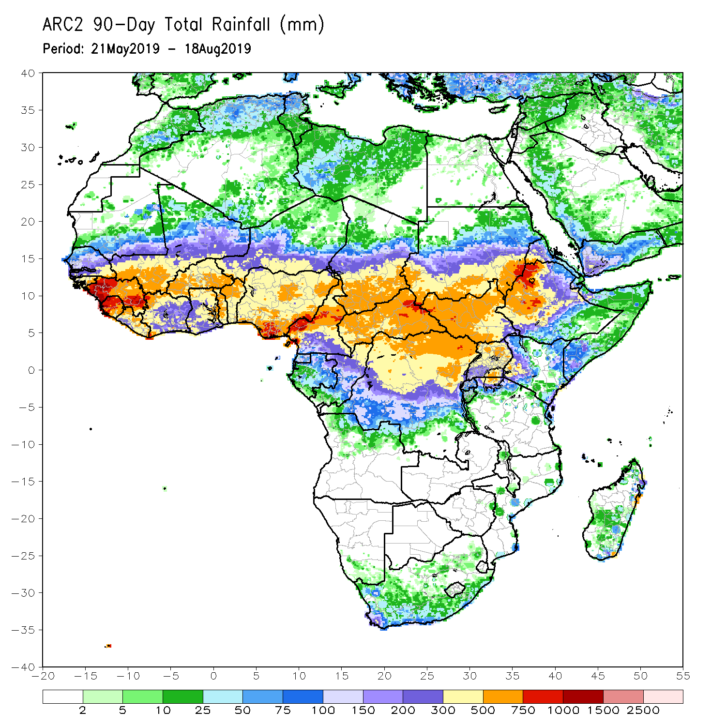
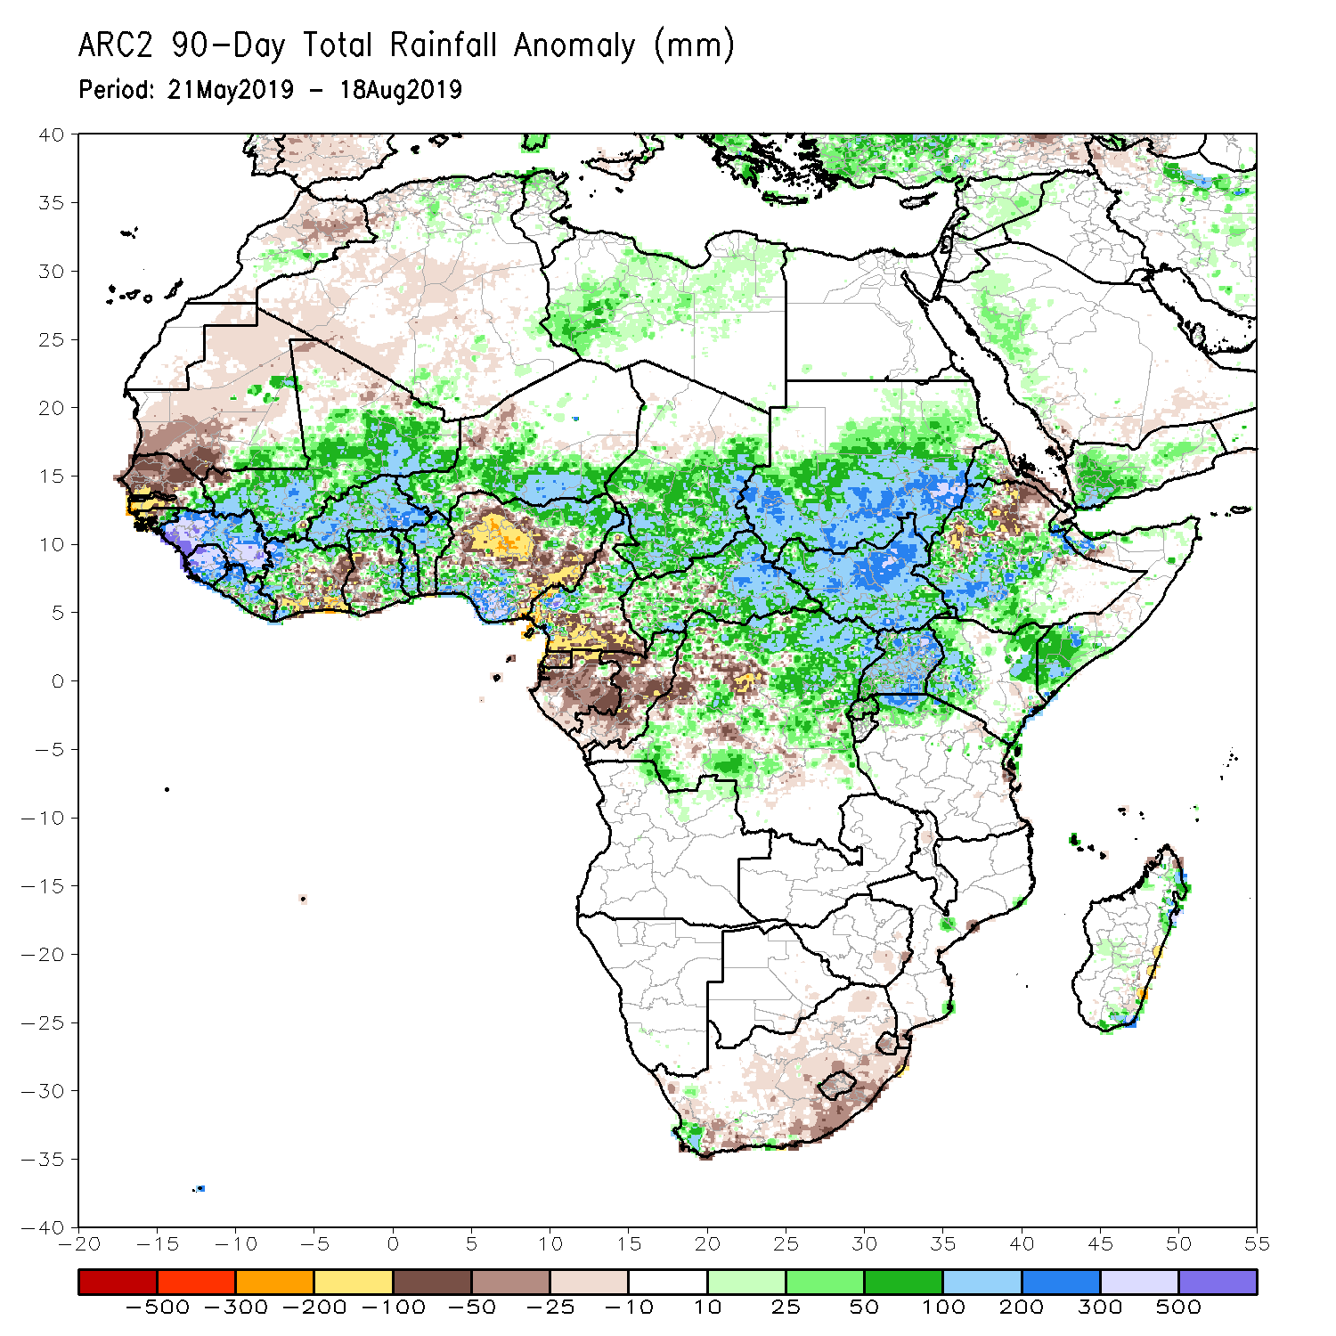
Rainfall Patterns: Last 90 Days
During the past 90 days, much of Senegal, Mauritania, parts of Cote d’Ivoire and western Ghana, portions of Nigeria, southern Cameroon, Equatorial Guinea, Gabon, much of Congo, portions of DRC, and parts of Ethiopia and South Africa had below-average rainfall.
Rainfall was above-average over much Guinea, Sierra Leone, Liberia, Mali, parts of Cote d’Ivoire, Burkina Faso, Ghana, Togo, Benin, Niger, parts of Nigeria, Chad, parts of Cameroon, much of CAR, parts of DRC, South Sudan, Uganda, Sudan, portions of Ethiopia, southern Somalia, and parts of Kenya and Tanzania.
Notes:
6

Slide 7
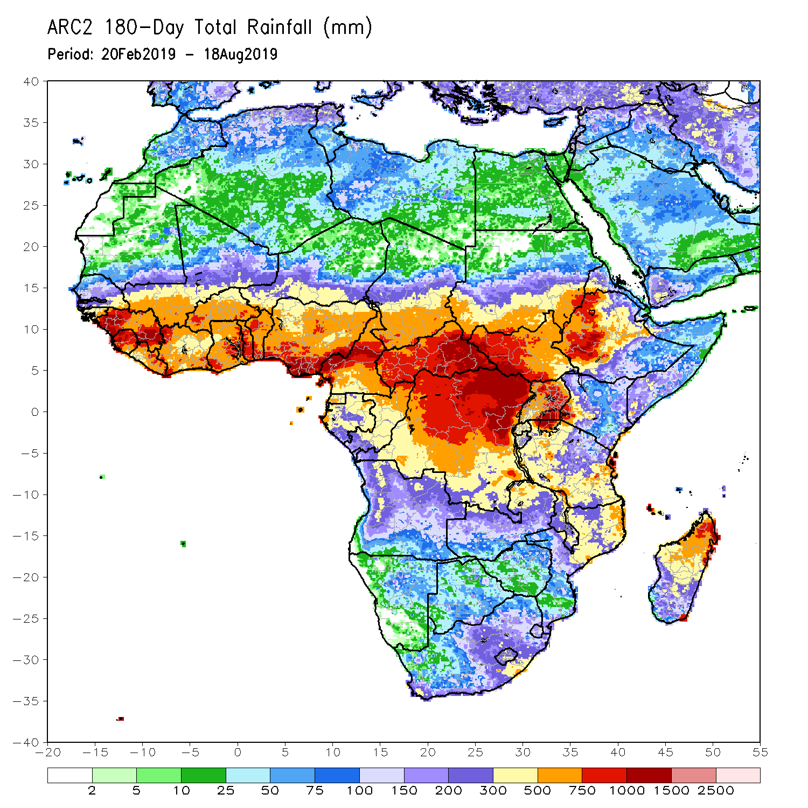
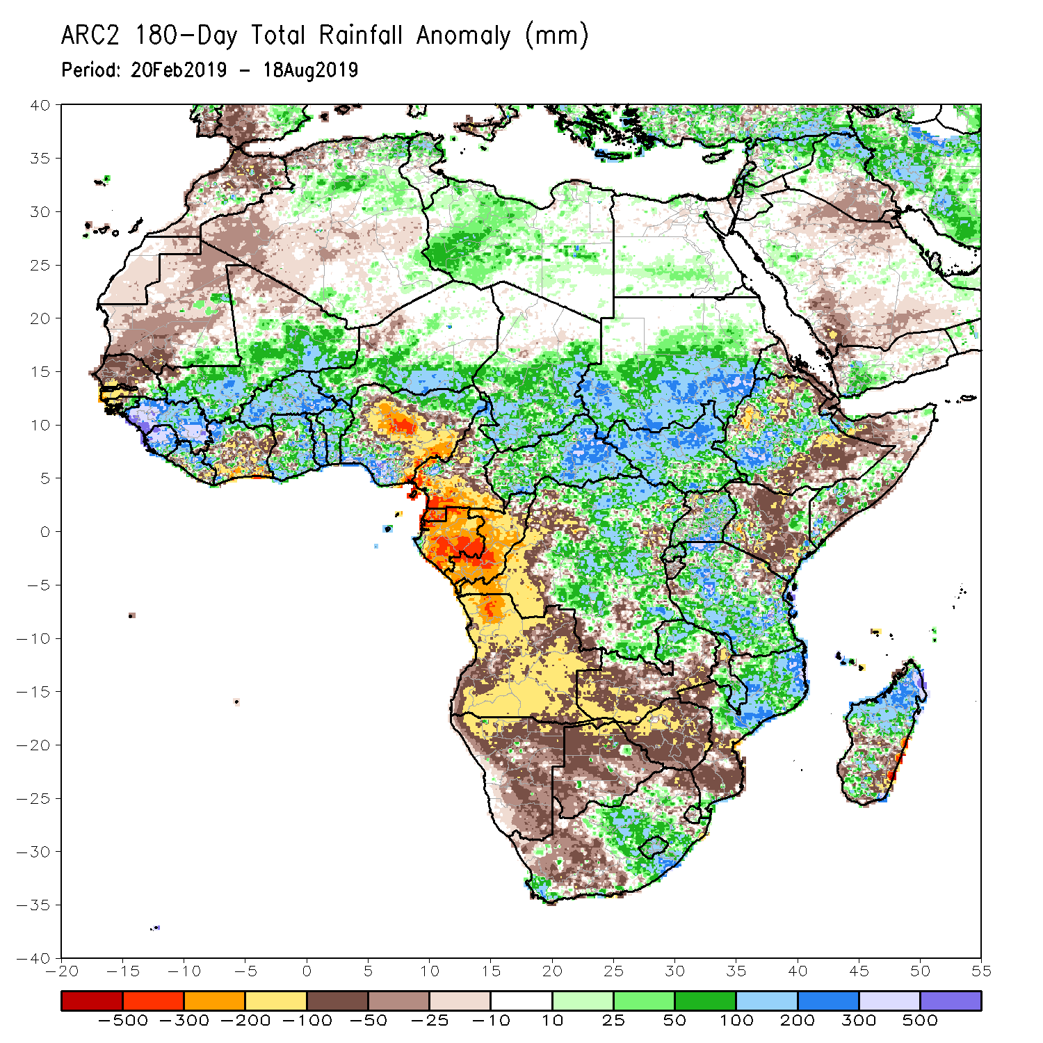
Rainfall Patterns: Last 180 Days
During the past 180 days, below-average rainfall was observed over much of Mauritania, Senegal, Guinea-Bissau, parts of Liberia and Cote d’Ivoire, western Ghana, portions of Nigeria and Cameroon, Equatorial Guinea, Gabon, Congo, portions of DRC, Angola, Namibia, western and northeastern South Africa, western and southern Zambia, Botswana, Zimbabwe, southern Mozambique, parts of Madagascar, northern Tanzania, much of Kenya, portions of Ethiopia, and Somalia.
Much of Guinea, Sierra Leone, Mali, parts of Liberia and Cote d’Ivoire, Burkina Faso, Ghana, Togo, Benin, parts of Nigeria, Niger, Chad, CAR, many parts of DRC, South Sudan, Sudan, Uganda, many parts of Ethiopia, Tanzania, eastern Zambia, Malawi, northern Mozambique, and portions of South Africa and Madagascar had above-average rainfall.
Notes:
7

Slide 8
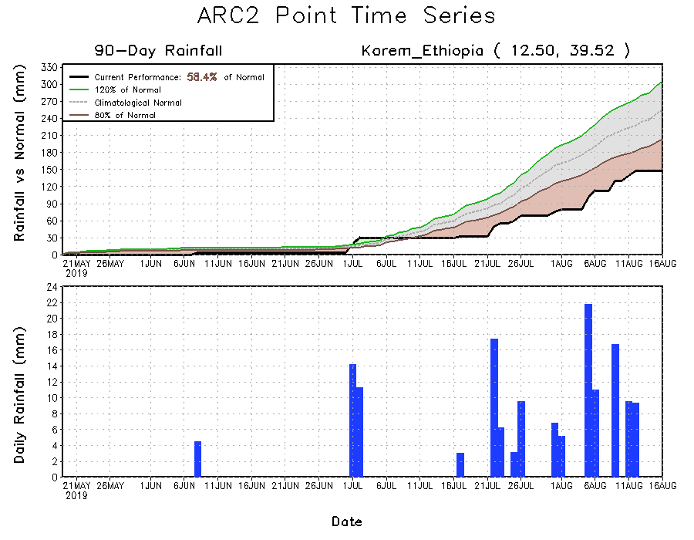
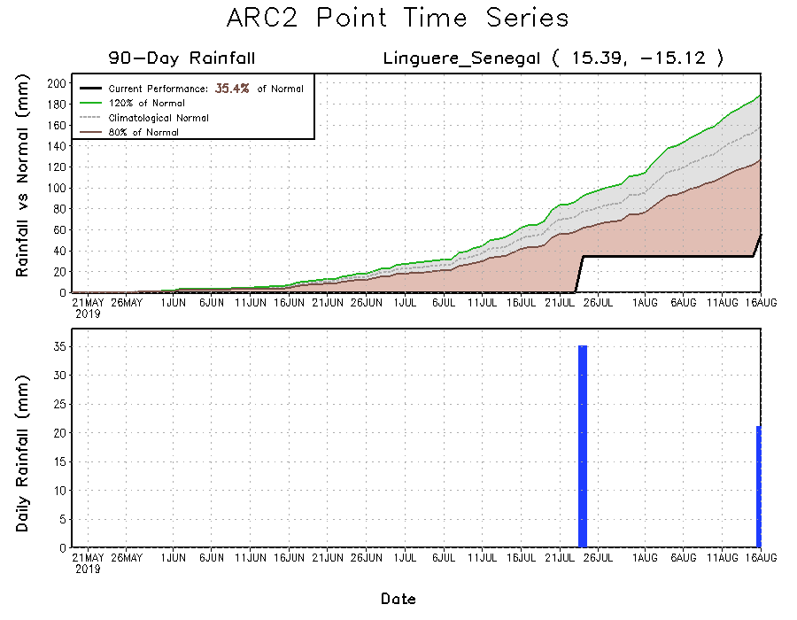
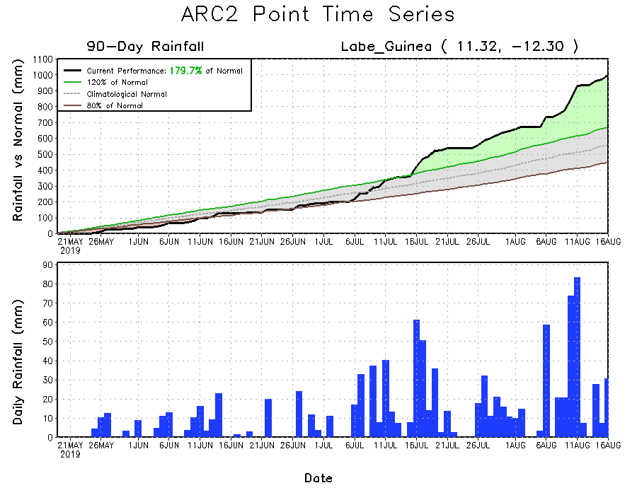
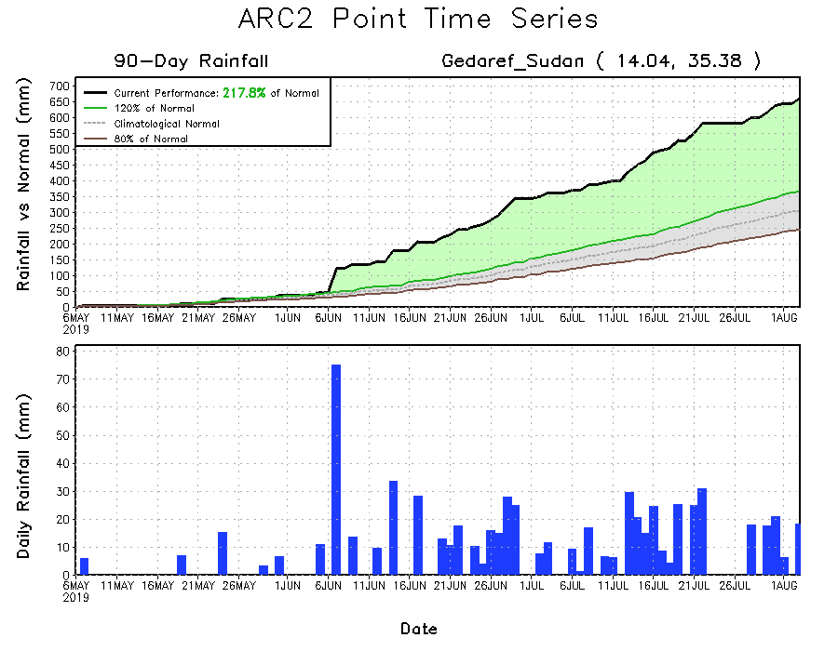
Recent Rainfall Evolution
Daily evolution of rainfall over the last 90 days at selected locations shows growing dryness over parts of Senegal (bottom left) and northeastern Ethiopia (top right). Moderate to local heavy rainfall sustained moisture surpluses over parts of Guinea (bottom right).

Slide 9
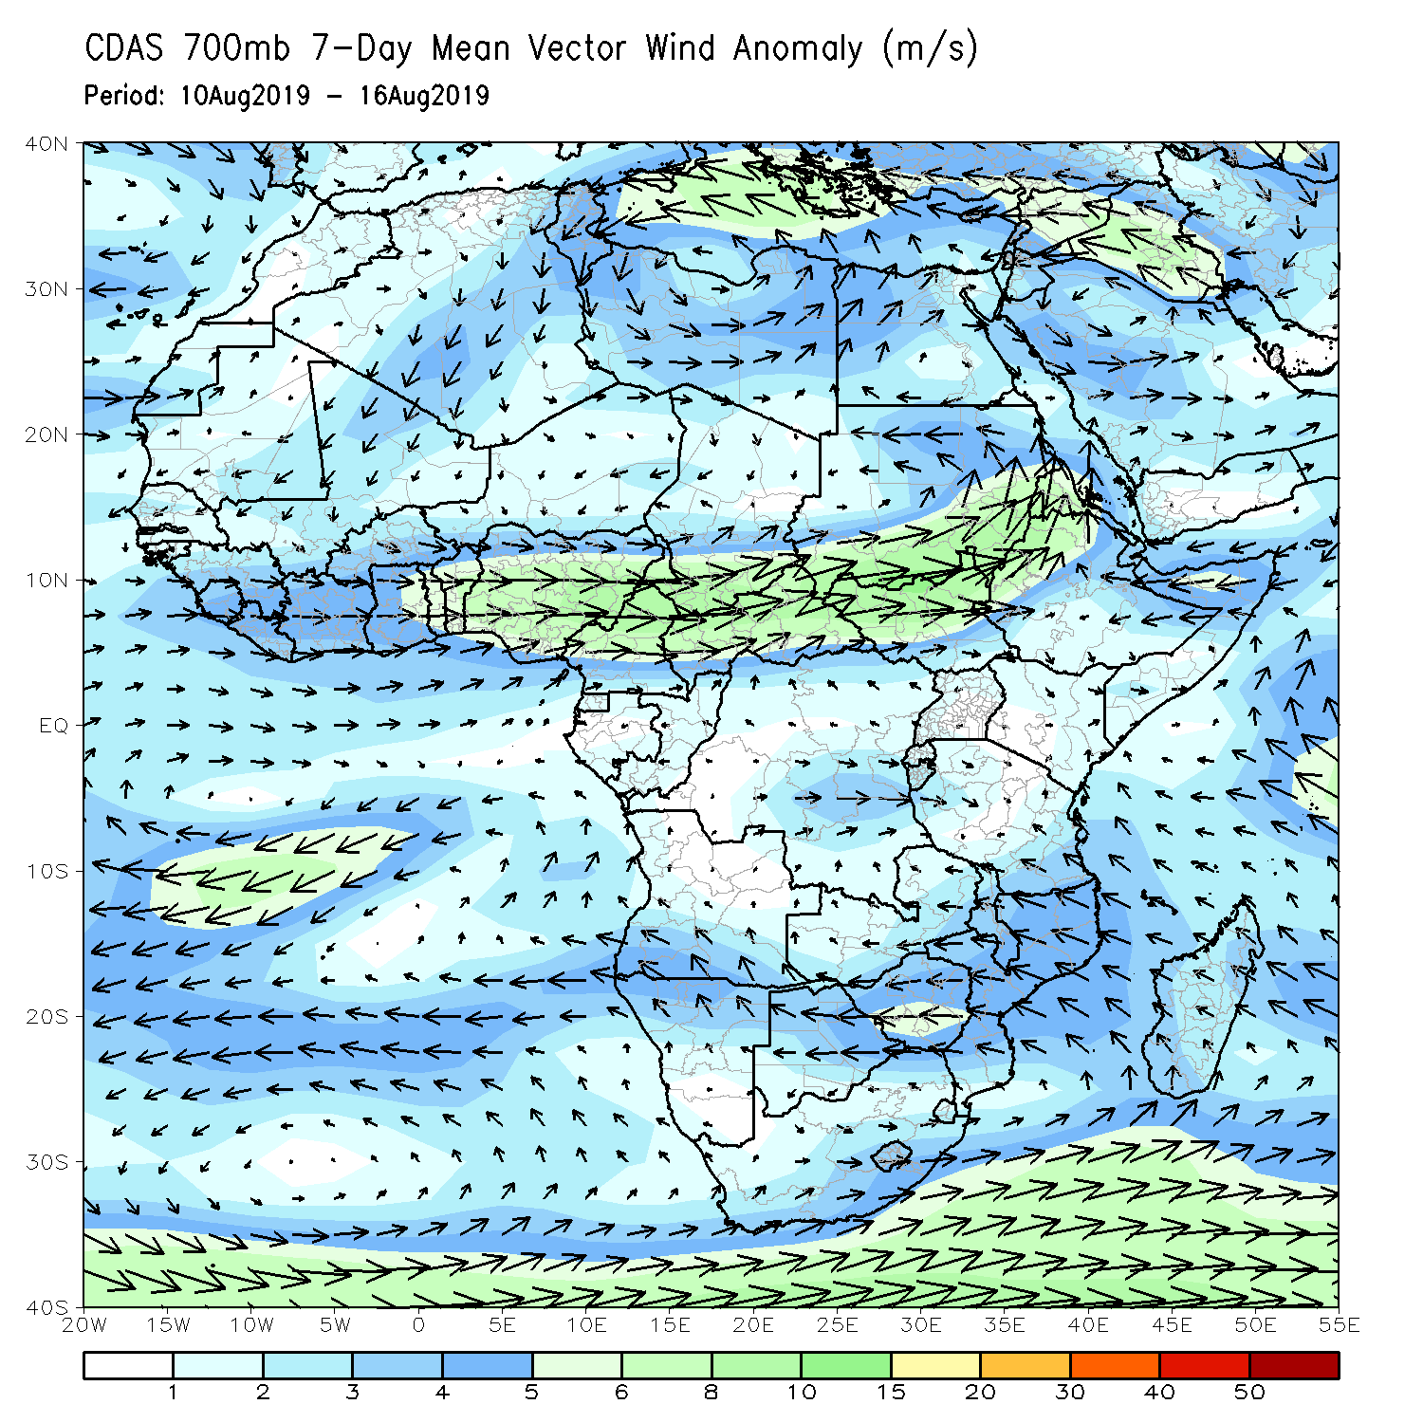
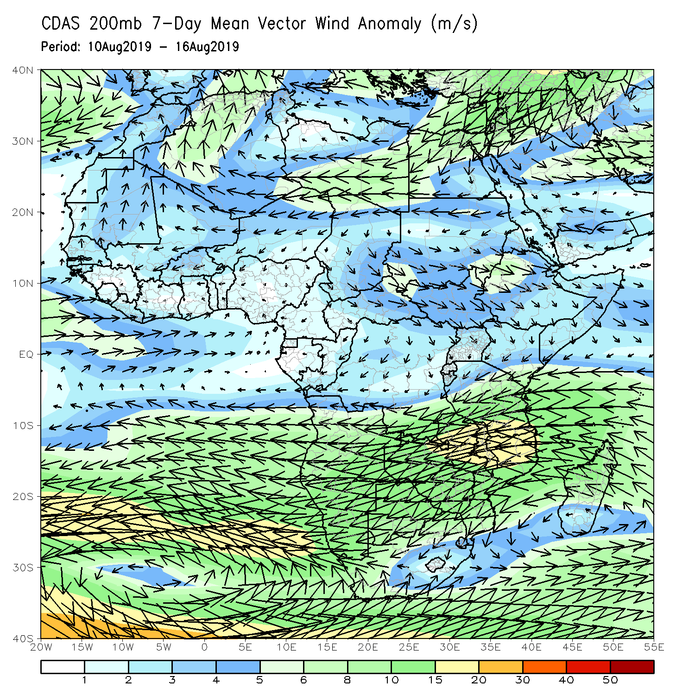
Atmospheric Circulation: Last 7 Days
Strong lower-level westerly to southwesterly anomalies prevailed across eastern Gulf of Guinea, and over portions of Central and the Greater Horn of Africa (left).

Slide 10
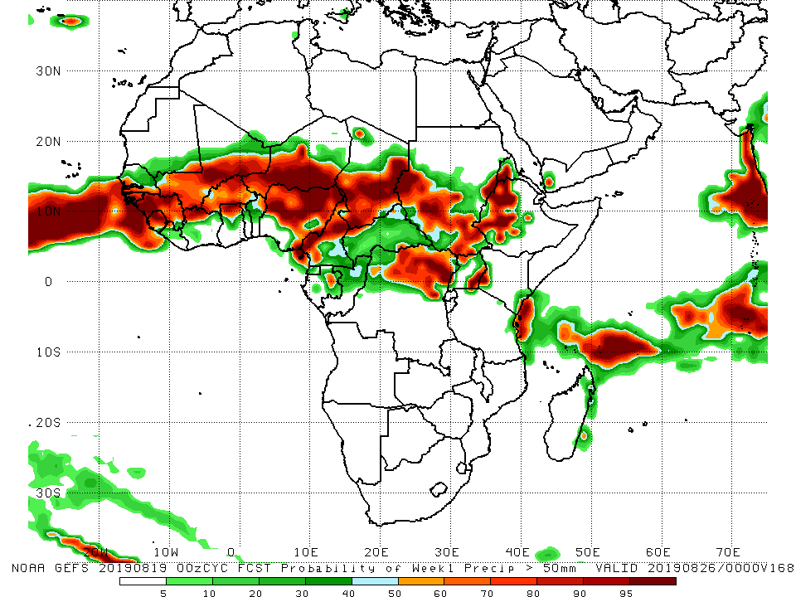
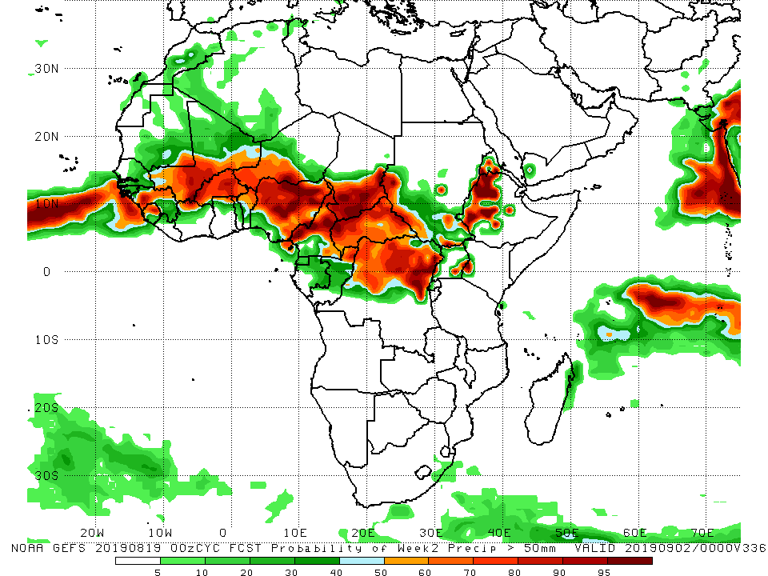
NCEP GEFS Model Forecasts Non-Bias Corrected Probability of precipitation exceedance
Week-1: Valid 20 – 26 August, 2019
Week-2: Valid August 27 – September 2, 2019
For week-1 (left panel) and week-2 (right panel), there is an increased chance for weekly rainfall totals to exceed 50mm over much of Guinea, Sierra Leone, southern Mali, northern Cote d’Ivoire, much of Burkina Faso, Nigeria, Cameroon, central and southern Chad, north DRC, portions of Sudan and South Sudan, Eritrea, western Ethiopia and western Kenya.
Notes:
10

Slide 11
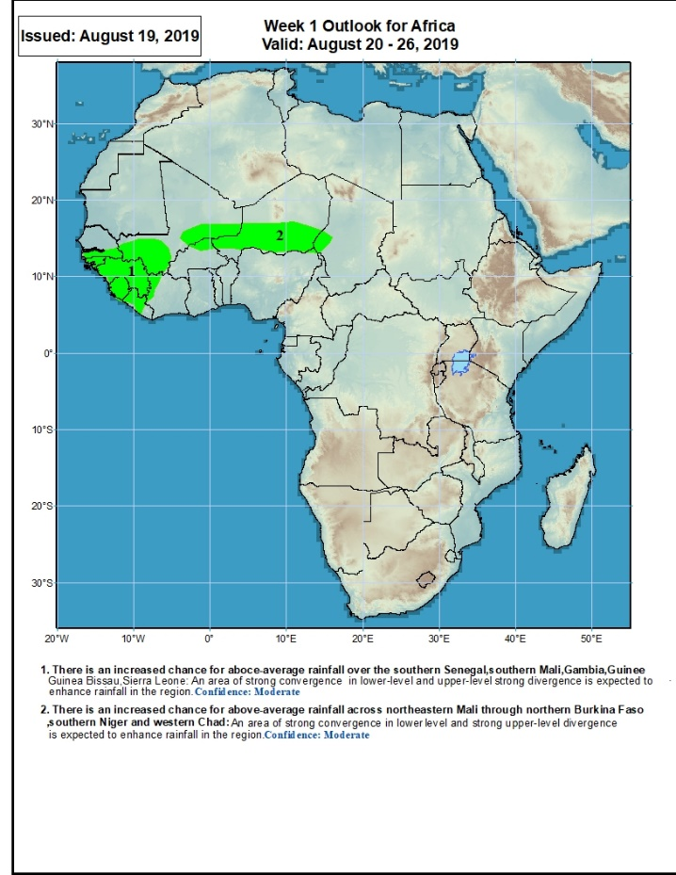
Week-1 Precipitation Outlooks
20 – 26 August, 2019
There is an increased chance for above-average rainfall over the southern Senegal, southern Mali, Gambia, Guinea, Guinea-Bissau and Sierra Leone: An area of anomalous lower-level convergence and upper-level divergence is expected to enhance rainfall in the region. Confidence: Moderate
There is an increased chance for above-average rainfall across northeastern Mali, northern Burkina Faso and southern Niger: An area of anomalous lower-level convergence and upper-level divergence is expected to enhance rainfall in the region. Confidence: Moderate
Notes:
11

Slide 12
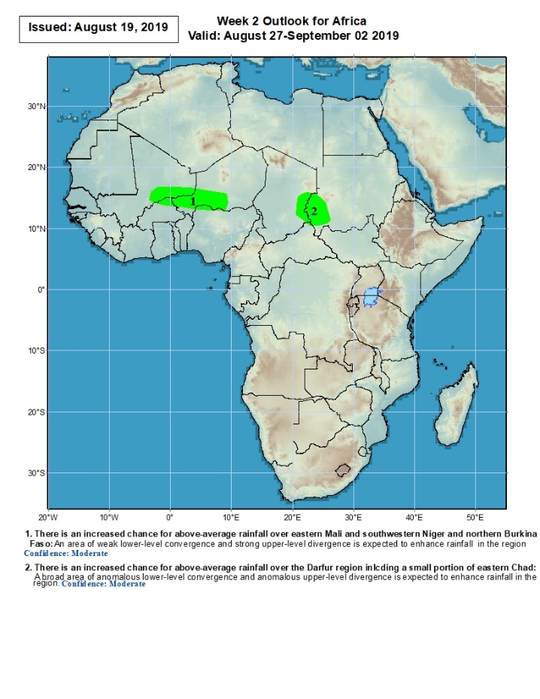
Week-2 Precipitation Outlooks
August 27 – September 2, 2019
There is an increased chance for above-average rainfall over northeastern Mali, northern Burkina Faso and southern Niger: An area of anomalous lower-level convergence and upper-level divergence is expected to enhance rainfall in the region. Confidence: Moderate
There is an increased chance for above-average rainfall across eastern Chad and western Sudan: An area of anomalous lower-level convergence and upper-level divergence is expected to enhance rainfall in the region. Confidence: Moderate
Notes:
12

Slide 13
Summary
During the past 7 days, rainfall was below-average over southern Senegal, Gambia, Guinea-Bissau, parts of Guinea and Sierra Leone, portions of Mali, Cote d’Ivoire, Ghana, Burkina Faso, Togo, Benin, parts of Niger, many parts of Nigeria, Cameroon, southern Chad, DRC, parts of CAR, eastern Sudan and northern Ethiopia. Northern and eastern Senegal, parts of Guinea, Liberia, northwestern Cote d’Ivoire, parts of Mali, portions of Niger and Nigeria, eastern Chad, portions of Sudan and South Sudan, and parts of Ethiopia had above-average rainfall.
During the past 30 days, southern Mauritania, Senegal, Gambia, Guinea-Bissau, parts of southern Cote d’Ivoire, western Ghana, portions of Nigeria, northern Cameroon, local areas in Niger, southern Chad, parts of Congo and DRC, and portions of Ethiopia had below-average rainfall. Rainfall was above-average over much of Guinea, Sierra Leone, Liberia, Mali, Burkina Faso, central and northern Cote d’Ivoire, many parts of Ghana, Togo, Benin, Niger, portions of Nigeria, Cameroon, parts of Chad and CAR, northern Congo, many parts of DRC, Uganda, South Sudan, Sudan, and parts of Ethiopia and western Kenya.
During the past 90 days, much of Senegal, Mauritania, parts of Cote d’Ivoire and western Ghana, portions of Nigeria, southern Cameroon, Equatorial Guinea, Gabon, much of Congo, portions of DRC, and parts of Ethiopia and South Africa had below-average rainfall. Rainfall was above-average over much Guinea, Sierra Leone, Liberia, Mali, parts of Cote d’Ivoire, Burkina Faso, Ghana, Togo, Benin, Niger, parts of Nigeria, Chad, parts of Cameroon, much of CAR, parts of DRC, South Sudan, Uganda, Sudan, portions of Ethiopia, southern Somalia, and parts of Kenya and Tanzania.
Week-1 outlooks call for an increased chance for above-average rainfall over southern Senegal, parts of Mali, Gambia, Guinea, Guinea-Bissau, Sierra Leone, northern Burkina Faso and southern Niger.
Notes:
13

