Slide 1
The African Monsoon Recent Evolution and Current Status Include Week-1 and Week-2 Outlooks
Update prepared by
Climate Prediction Center / NCEP
12 August 2019
For more information, visit:
http://www.cpc.ncep.noaa.gov/products/Global_Monsoons/African_Monsoons/precip_monitoring.shtml

Slide 2
Outline
Highlights
Recent Evolution and Current Conditions
NCEP GEFS Forecasts
Summary

Slide 3
Highlights: Last 7 Days
Weekly rainfall surpluses exceeded 100m over portions of Guinea, Sierra Leone, northwestern Cote d’Ivoire, southeastern Nigeria and western Cameroon.
Week-1 outlooks call for an increased chance for below-average rainfall over the far western West Africa. In contrast, there is an increased chance for above-average rainfall over many places in the Sahel region.

Slide 4
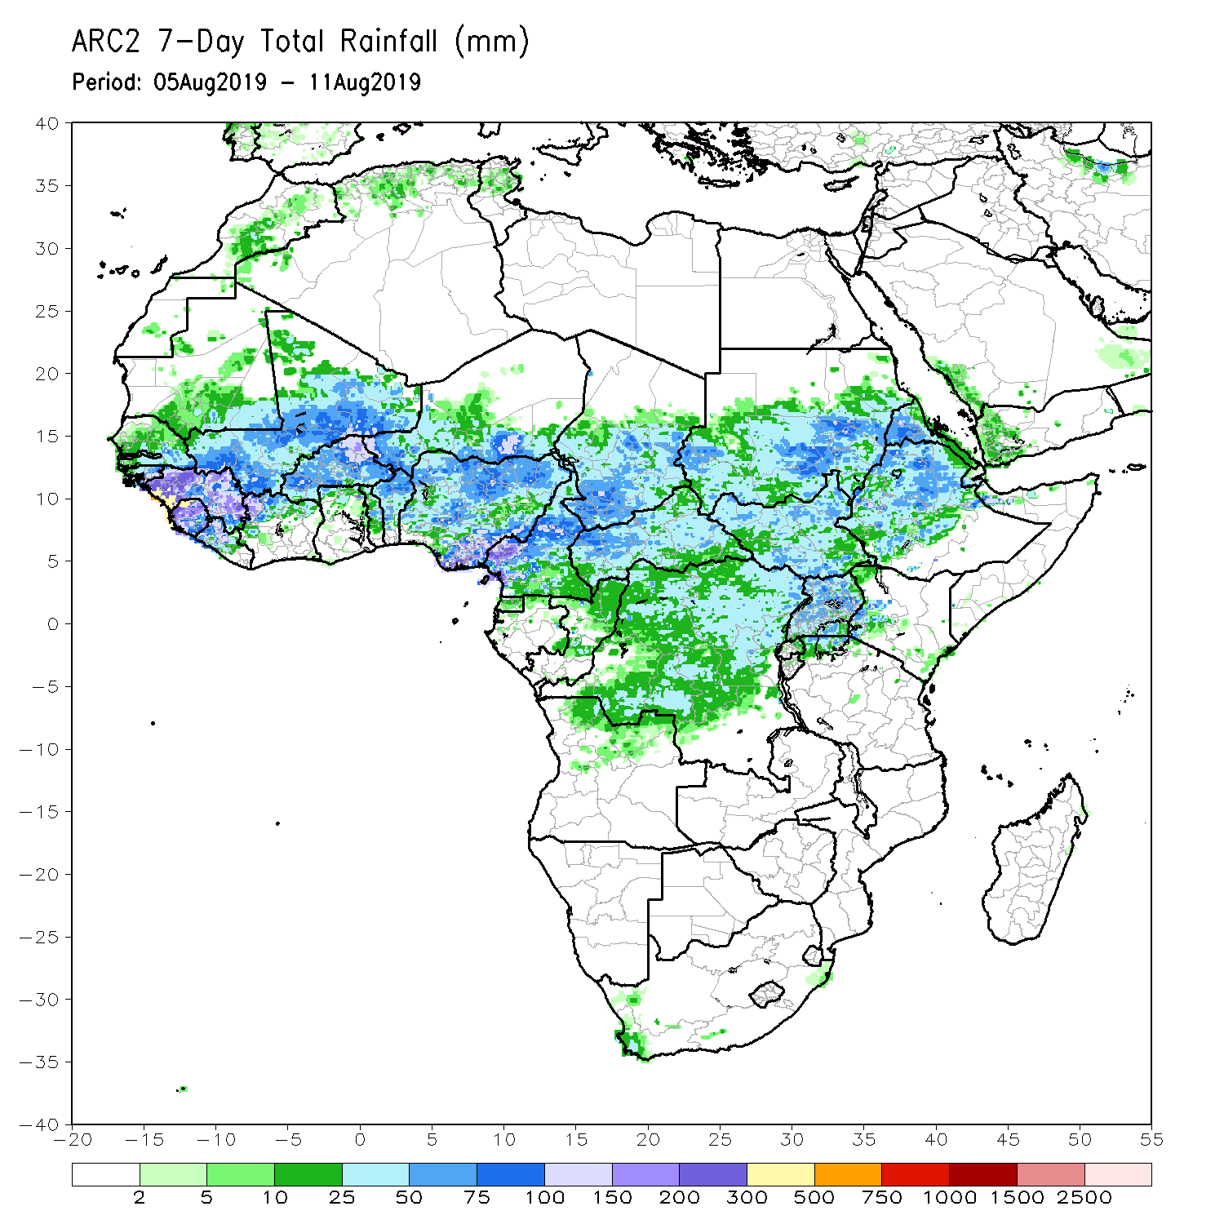
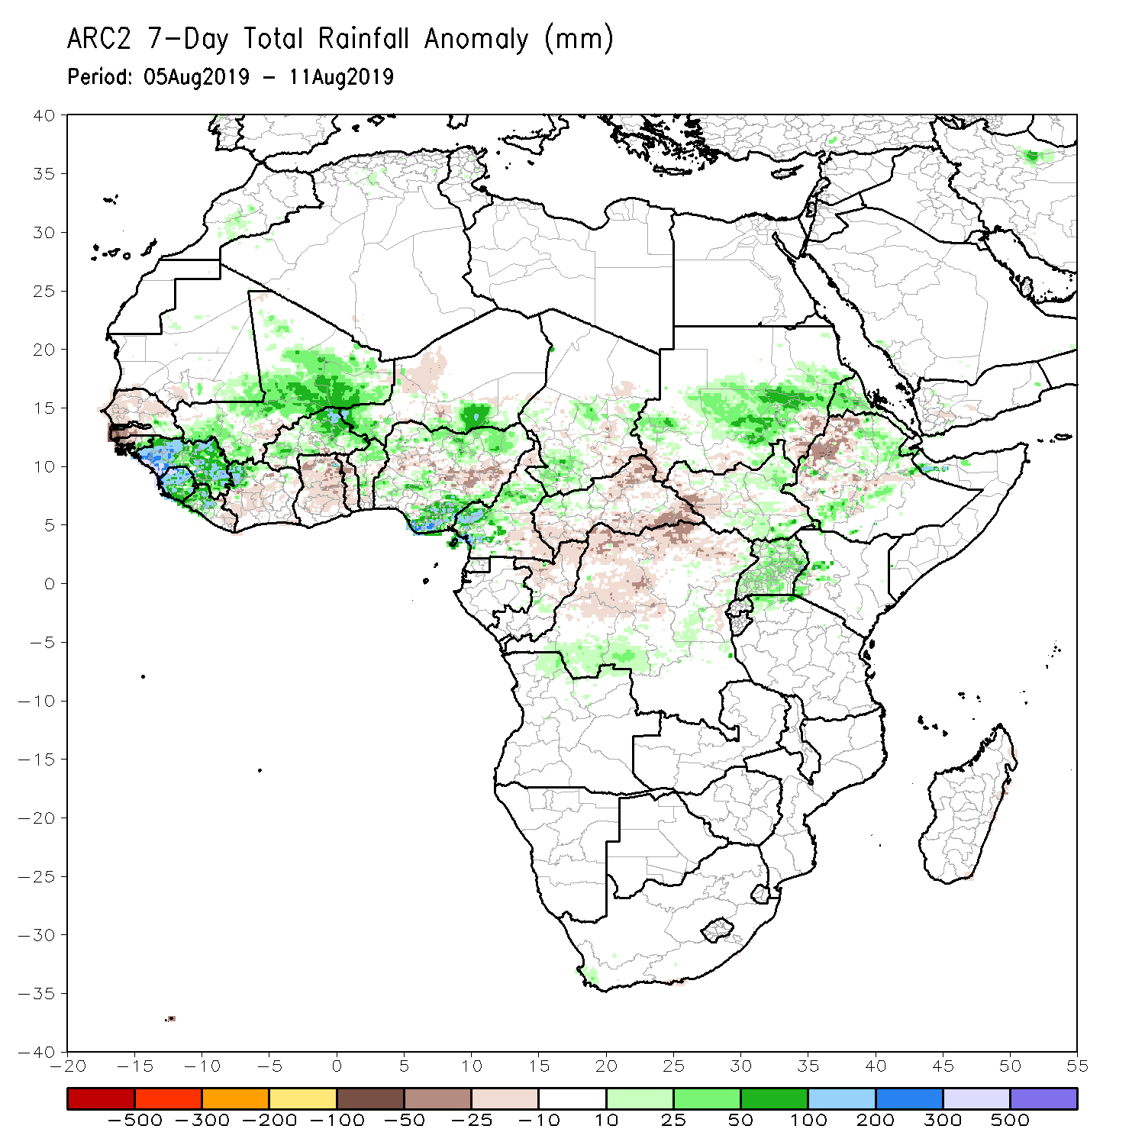
Rainfall Patterns: Last 7 Days
During the past 7 days, rainfall was below-average over much Senegal, Gambia, Guinea-Bissau, parts of western Mali, Cote d’Ivoire, Ghana Togo, Benin, western Niger, portions of eastern Nigeria, Cameroon, parts of Chad, northern DRC, CAR, South Sudan and northern Ethiopia.
Much of Guinea, Sierra Leone, Liberia, northwestern Cote d’Ivoire, many parts of Mali, Burkina Faso, portions of Nigeria, local areas in Chad, portions of Sudan local areas in DRC, Eritrea and Ethiopia had above-average rainfall. Weekly rainfall surpluses exceeded 100m over portions of Guinea, Sierra Leone, northwestern Cote d’Ivoire, southeastern Nigeria and western Cameroon.

Slide 5
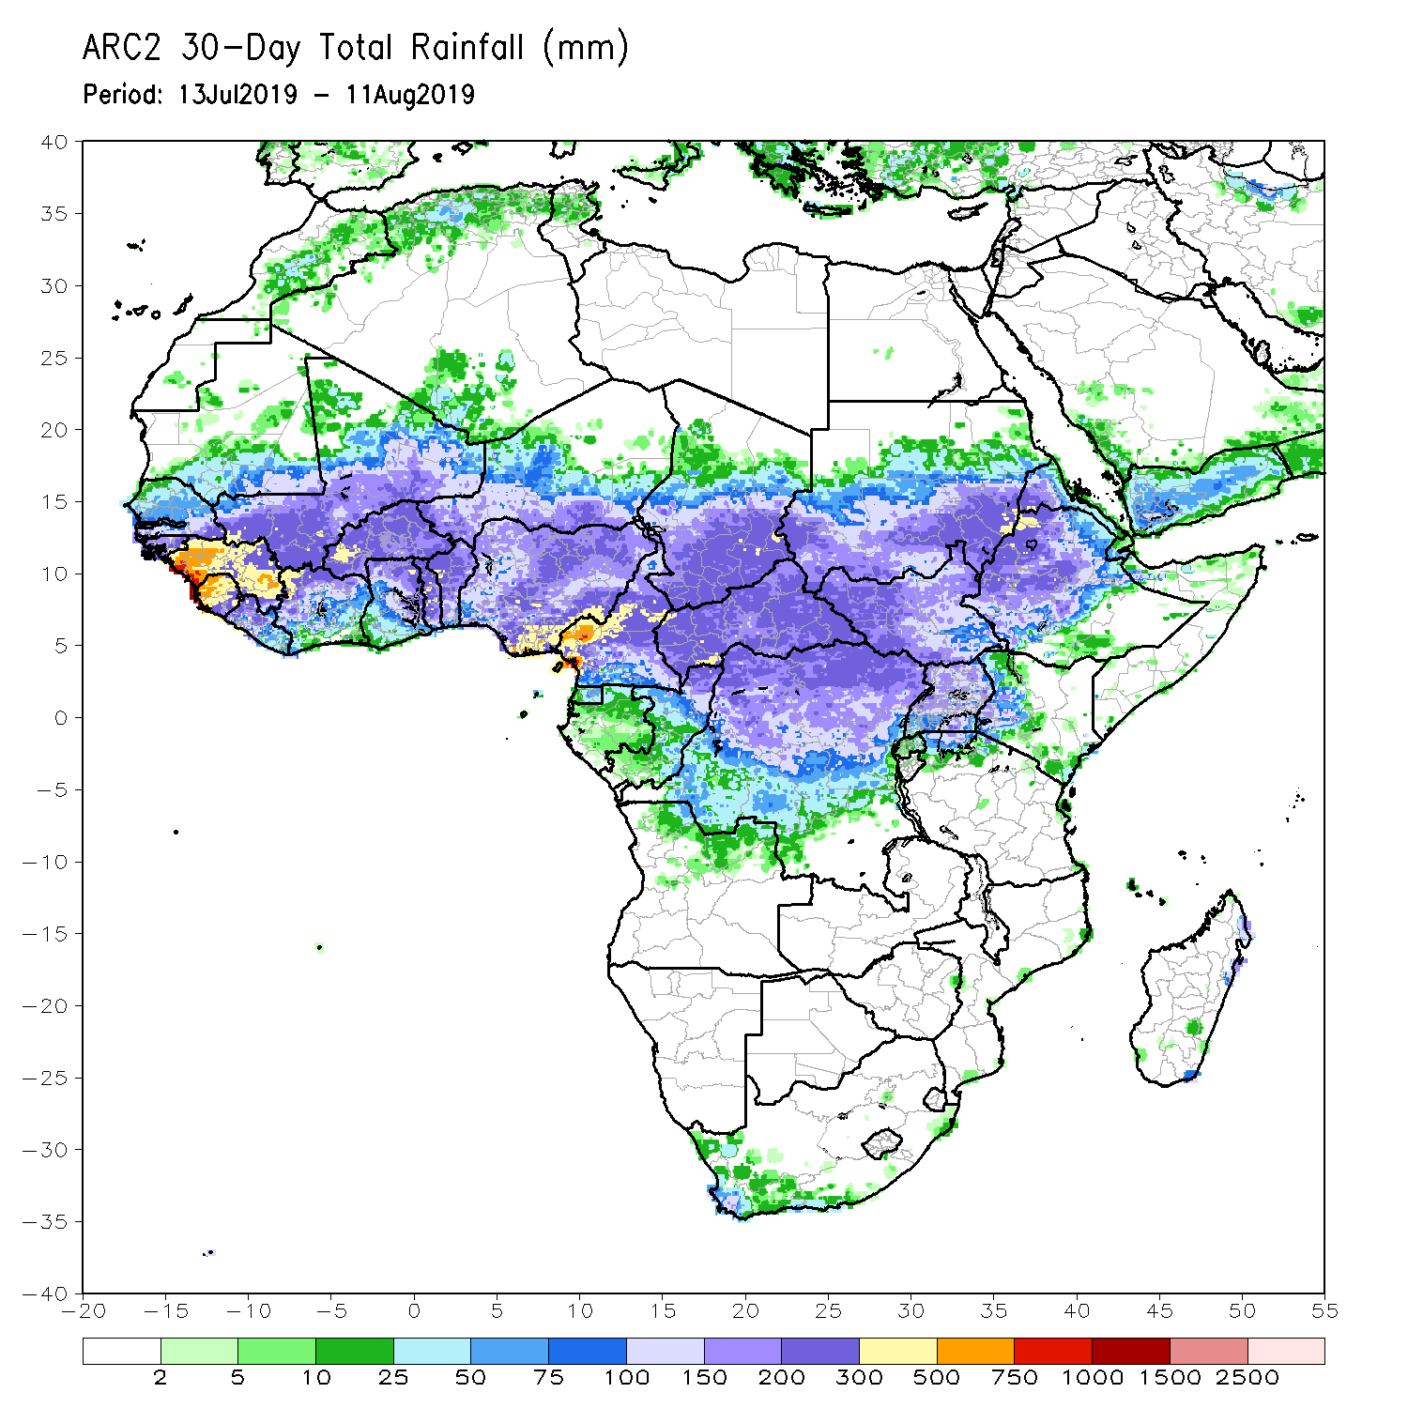
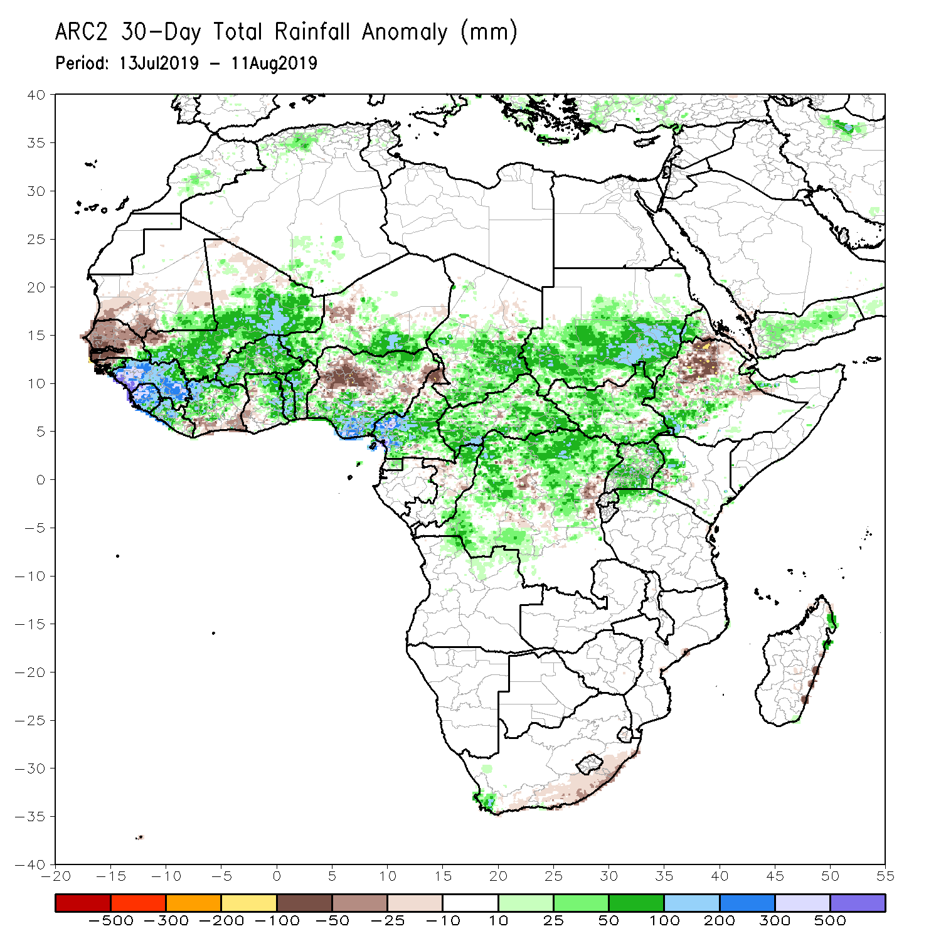
Rainfall Patterns: Last 30 Days
During the past 30 days, southern Mauritania, Senegal, Gambia, Guinea-Bissau, parts of southern Cote d’Ivoire, western Ghana, portions of Nigeria, northern Cameroon, local areas in Niger and Chad, and portions of Ethiopia had below-average rainfall.
Rainfall was above-average over much of Guinea, Sierra Leone, Liberia, Mali, Burkina Faso, central and northern Cote d’Ivoire, many parts of Ghana, Togo, Benin, local areas in Niger, portions of Nigeria, Cameroon, many parts of Chad, CAR, Congo, DRC, Uganda, South Sudan, many parts of Sudan, and local areas in Ethiopia, Kenya and Somalia.
Notes:
5

Slide 6
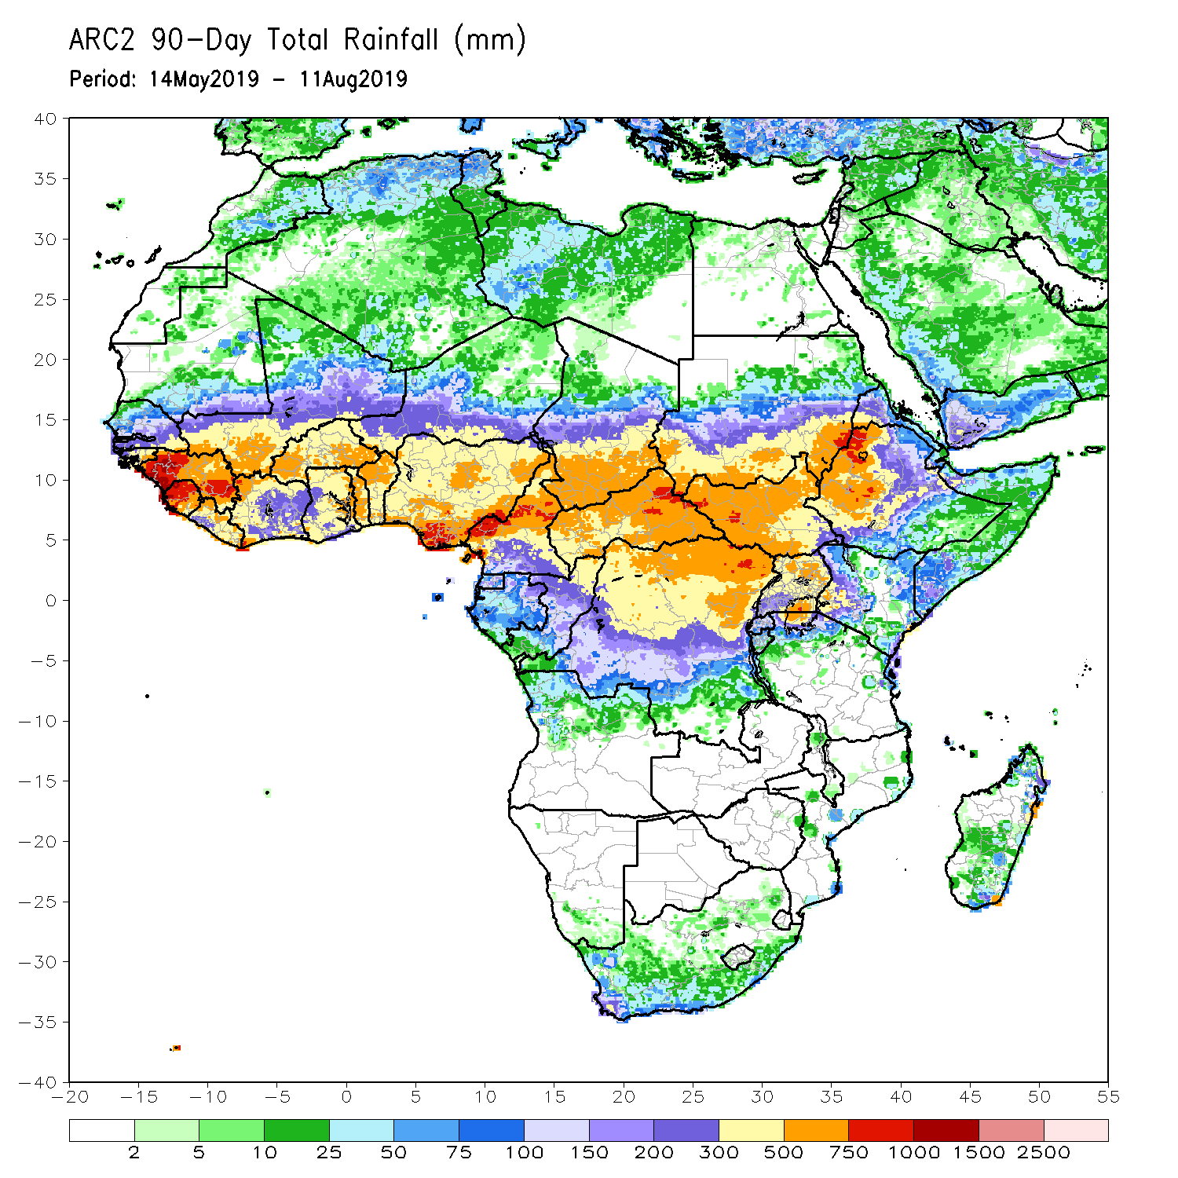
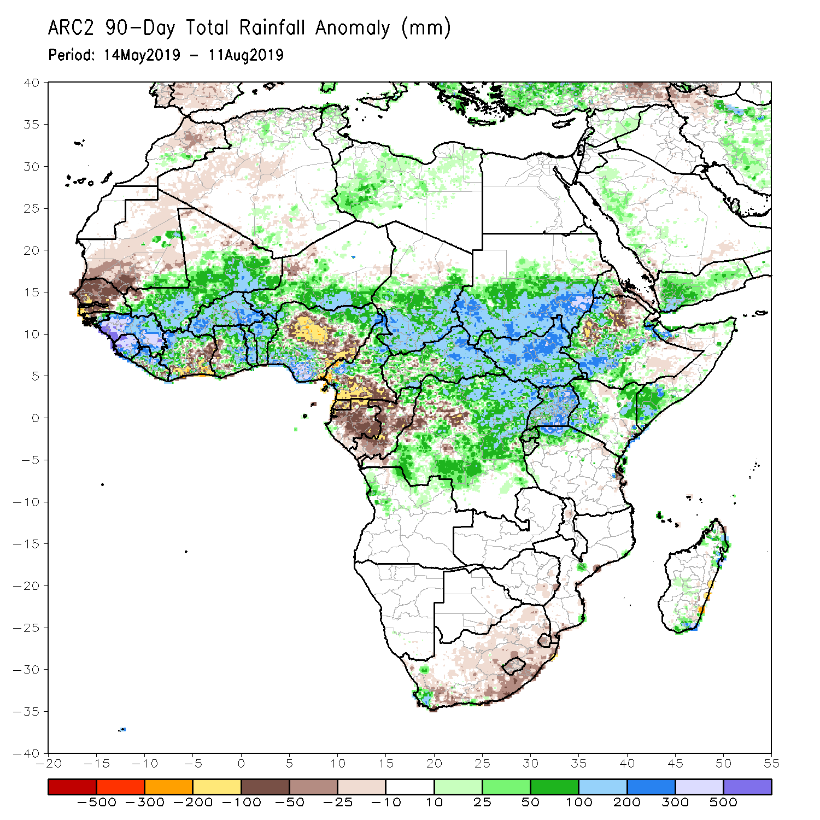
Rainfall Patterns: Last 90 Days
During the past 90 days, much of Senegal, Mauritania, parts of northern Mali, local areas in Liberia, parts of Cote d’Ivoire and western Ghana, portions of Nigeria and Cameroon, Equatorial Guinea, Gabon, much of Congo, local areas in DRC, and parts of Ethiopia had below-average rainfall.
Rainfall was above-average over much Guinea, Sierra Leone, Liberia, Mali, parts of Cote d’Ivoire, Burkina Faso, Ghana, Togo Benin, Niger, parts of Nigeria, Chad, northern Cameroon, parts of CAR and DRC, South Sudan, Uganda, southern Sudan, portions of Ethiopia, southern Somalia, and parts of Kenya and Tanzania.
Notes:
6

Slide 7
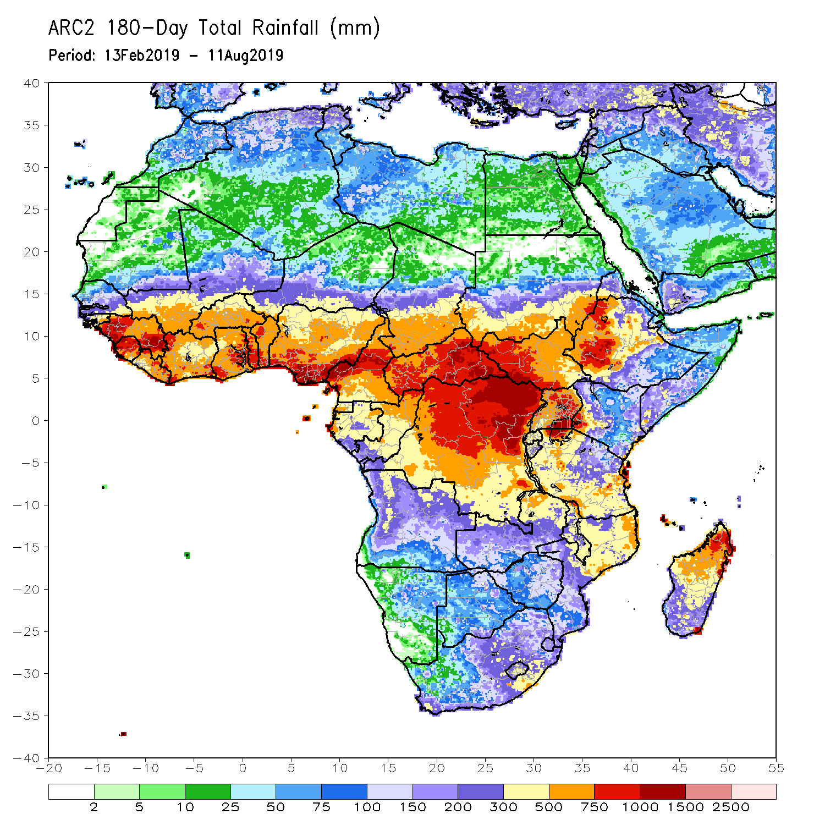
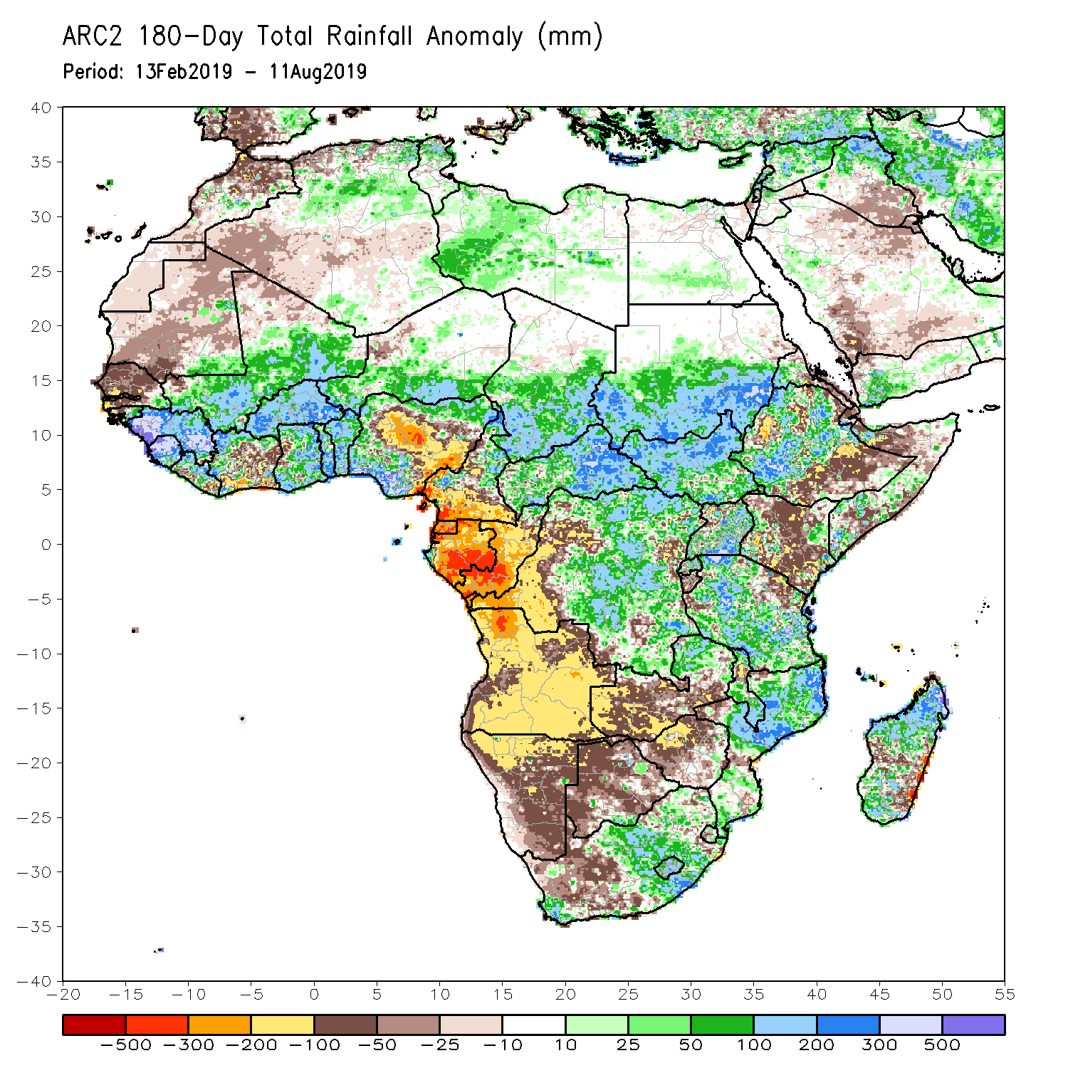
Rainfall Patterns: Last 180 Days
During the past 180 days, below-average rainfall was observed over much of Mauritania, Senegal, Guinea-Bissau, parts of Liberia and Cote d’Ivoire, western Ghana, portions of Nigeria and Cameroon, Equatorial Guinea, Gabon, Congo, portions of DRC, Angola, Namibia, western South Africa, western and southern Zambia, parts of Botswana, Zimbabwe, southern Mozambique, parts of Madagascar, northern Tanzania, much of Kenya, portions of Ethiopia, and Somalia.
Much of Guinea, Sierra Leone, Mali, parts of Liberia and Cote d’Ivoire, Burkina Faso, Ghana, Togo, Benin, parts of Nigeria, Niger, Chad, CAR, many parts of DRC, South Sudan, southern Sudan, parts of Uganda and Ethiopia, many parts of Tanzania, eastern Zambia, Malawi, northern Mozambique, and portions of South Africa and Madagascar had above-average rainfall.
Notes:
7

Slide 8
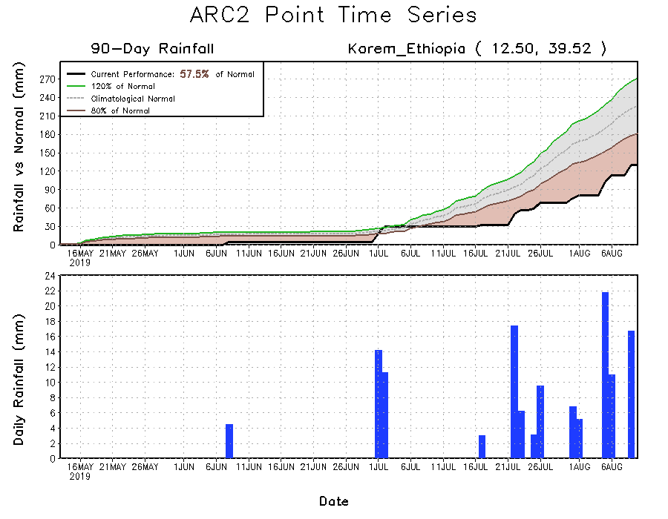
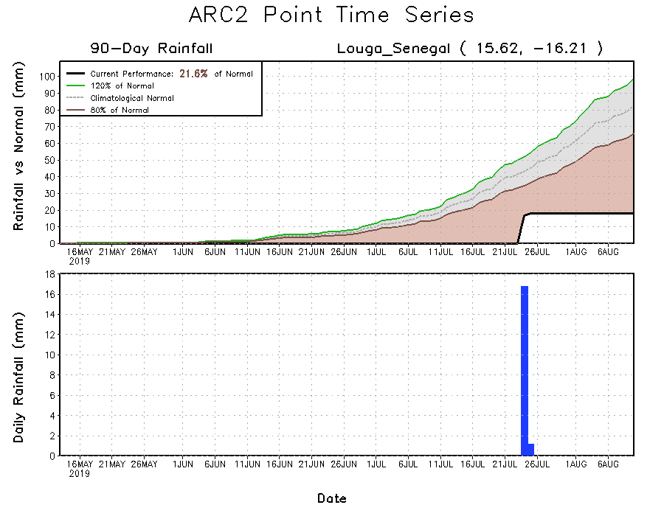
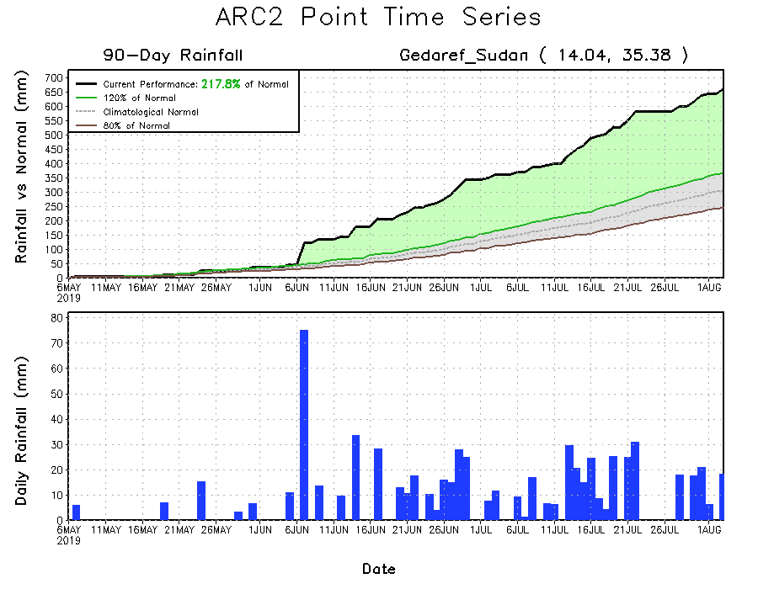
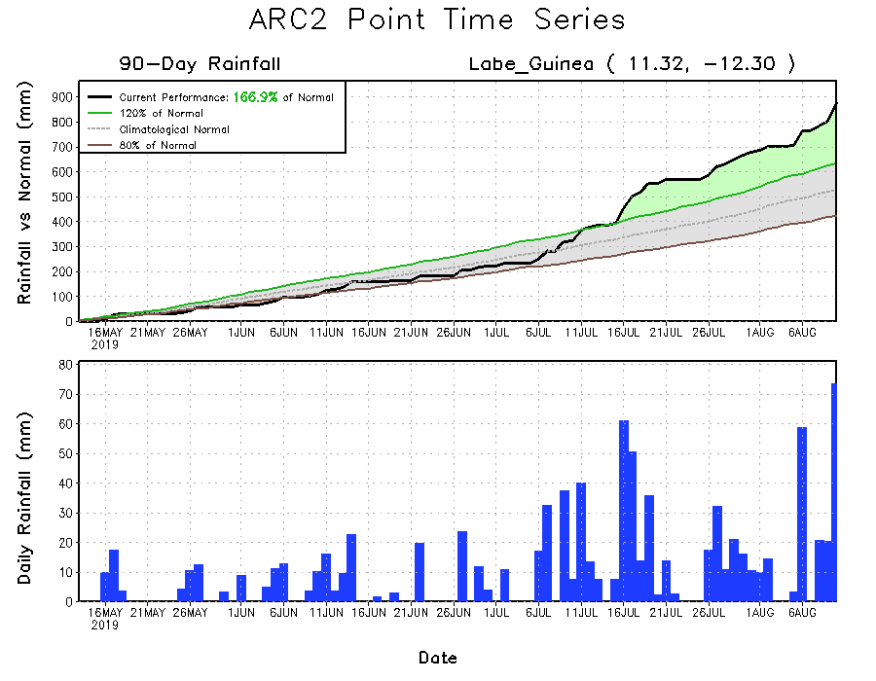
Recent Rainfall Evolution
Daily evolution of rainfall over the last 90 days at selected locations shows growing dryness over parts of Senegal (bottom left) and northeastern Ethiopia (top right). Moderate to local heavy rainfall sustained moisture surpluses over parts of Guinea (bottom right).

Slide 9
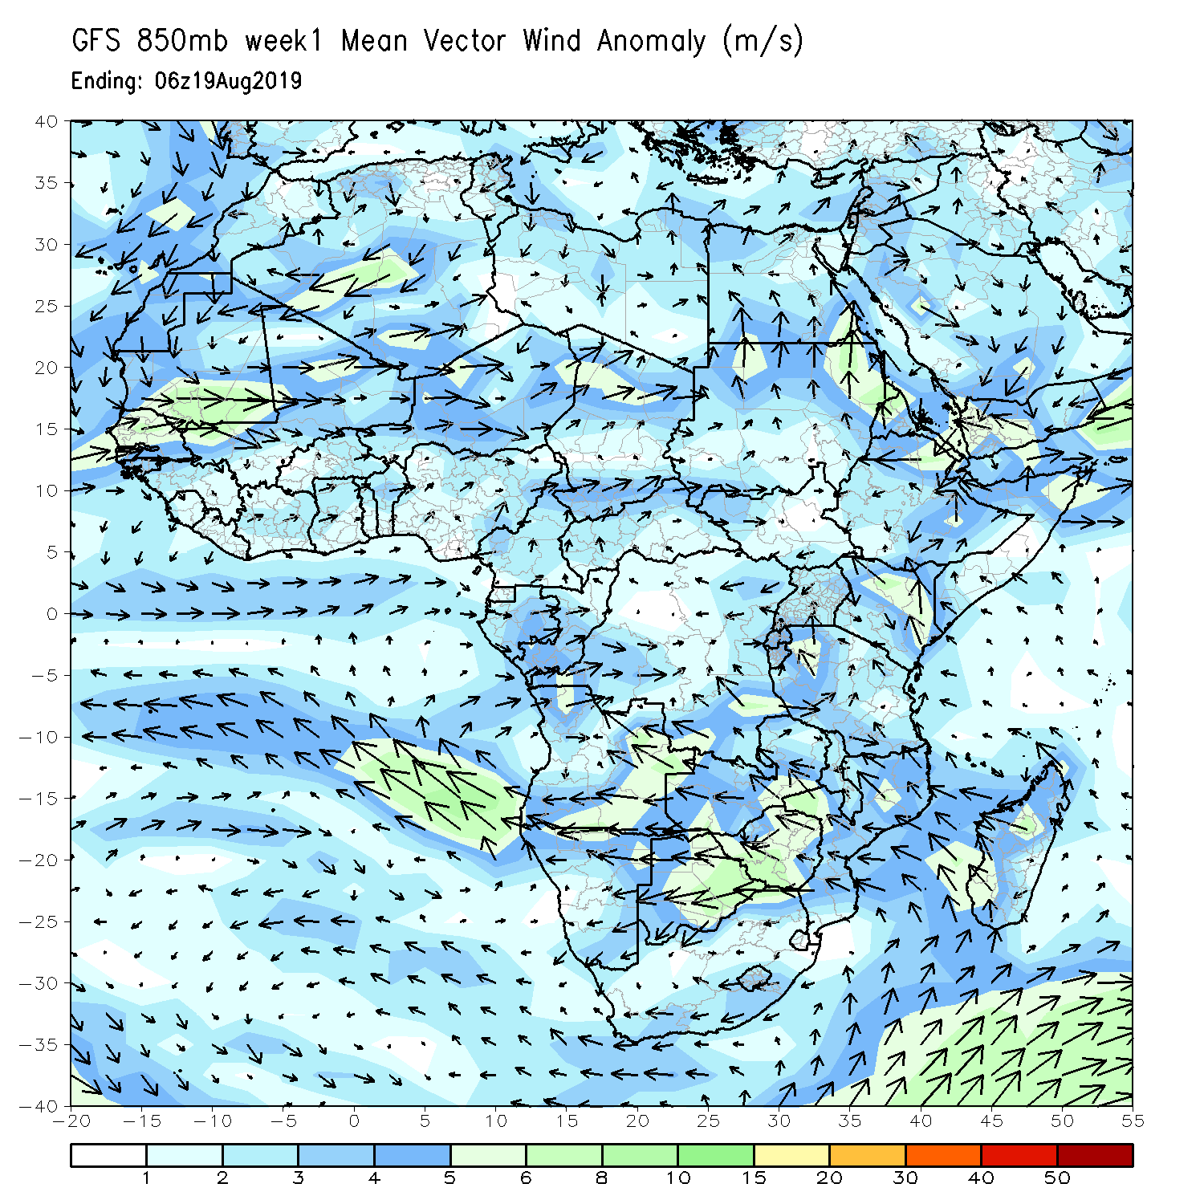
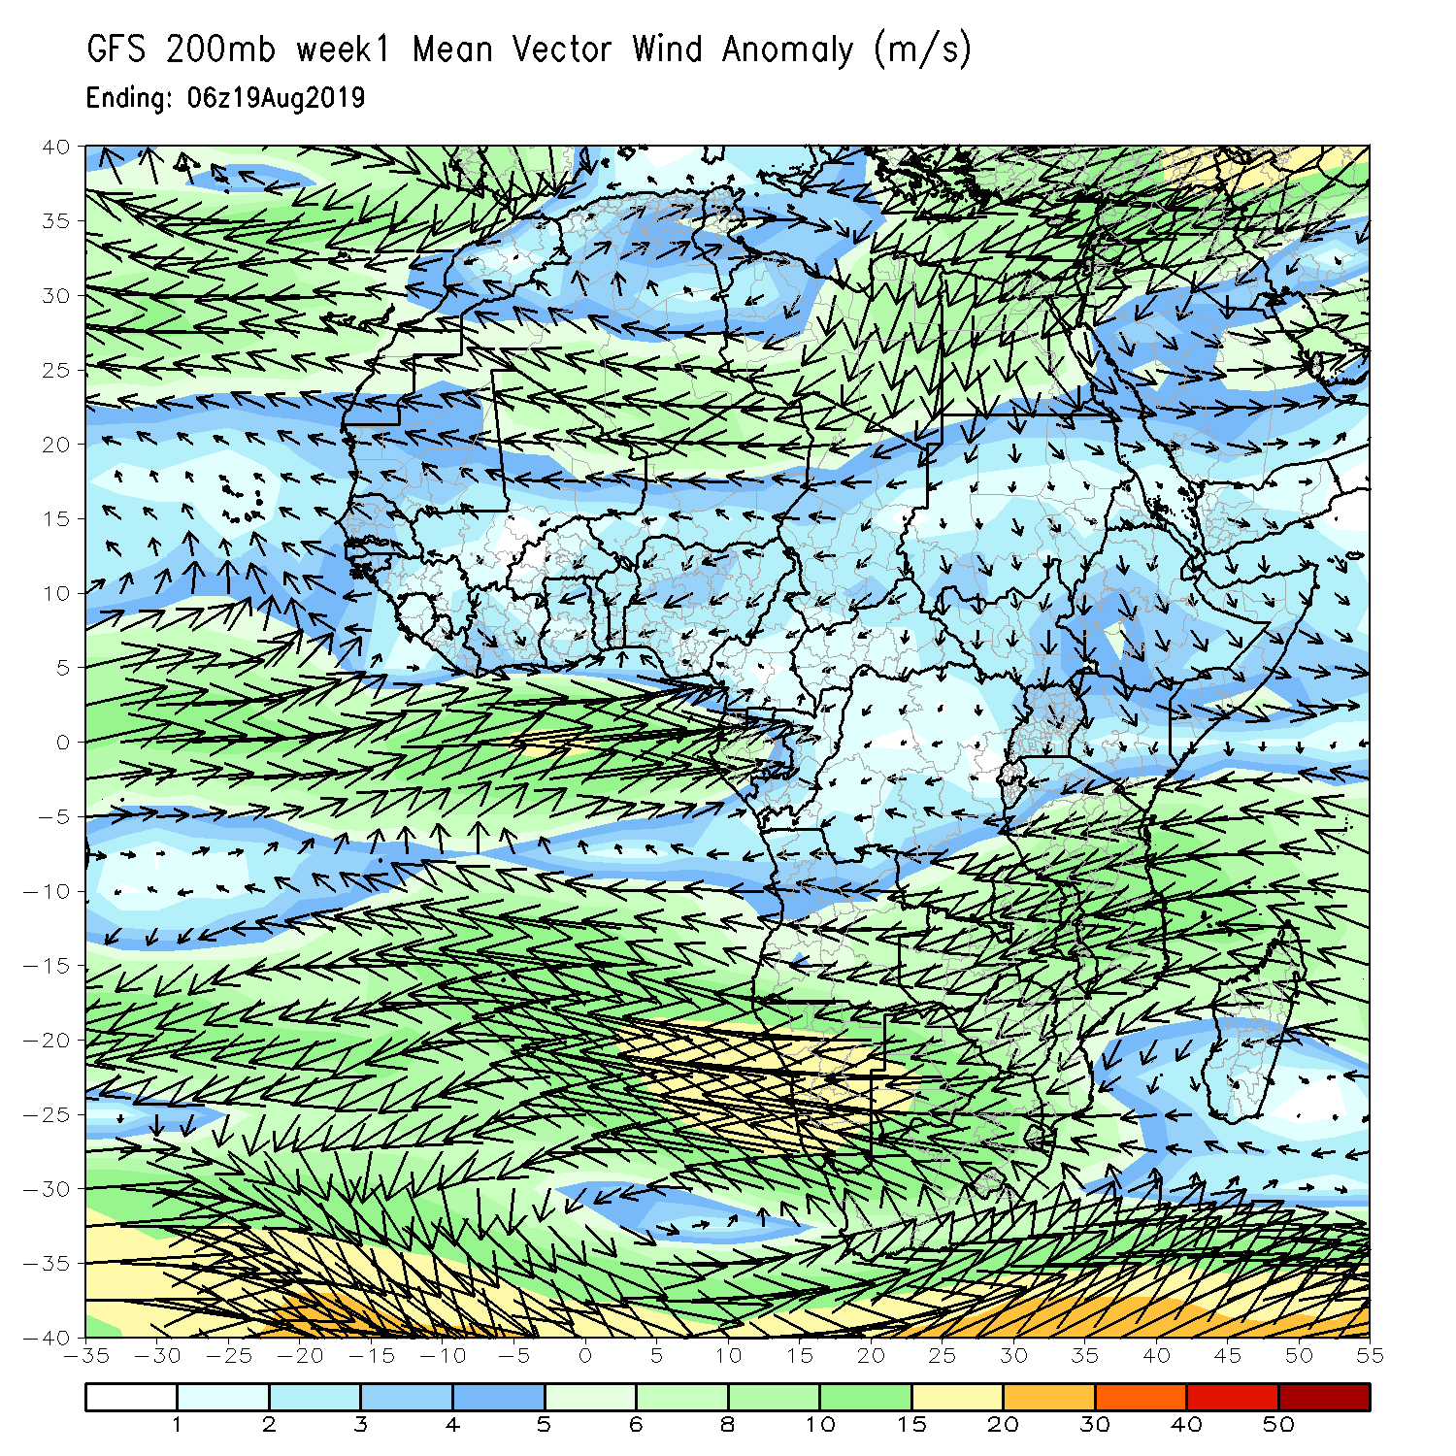
Atmospheric Circulation: Last 7 Days
An area of anomalous lower-level westerly anomaly was observed across the Sahel region (left panel).

Slide 10
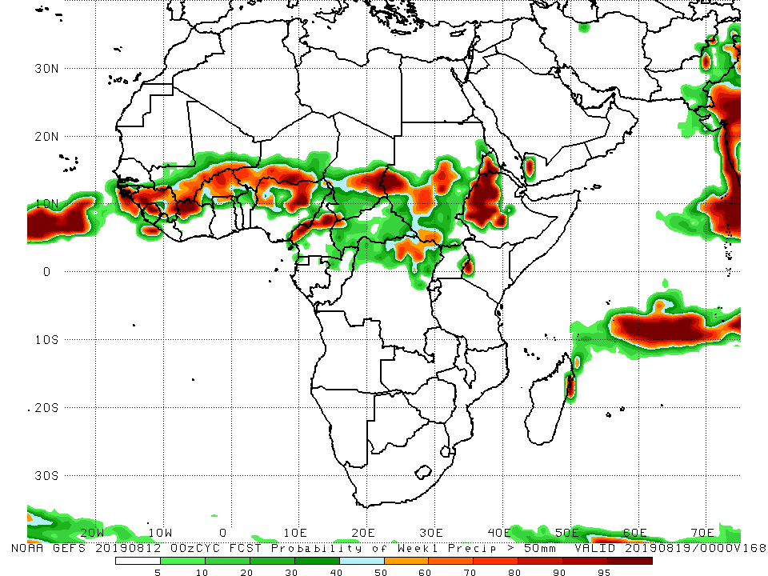
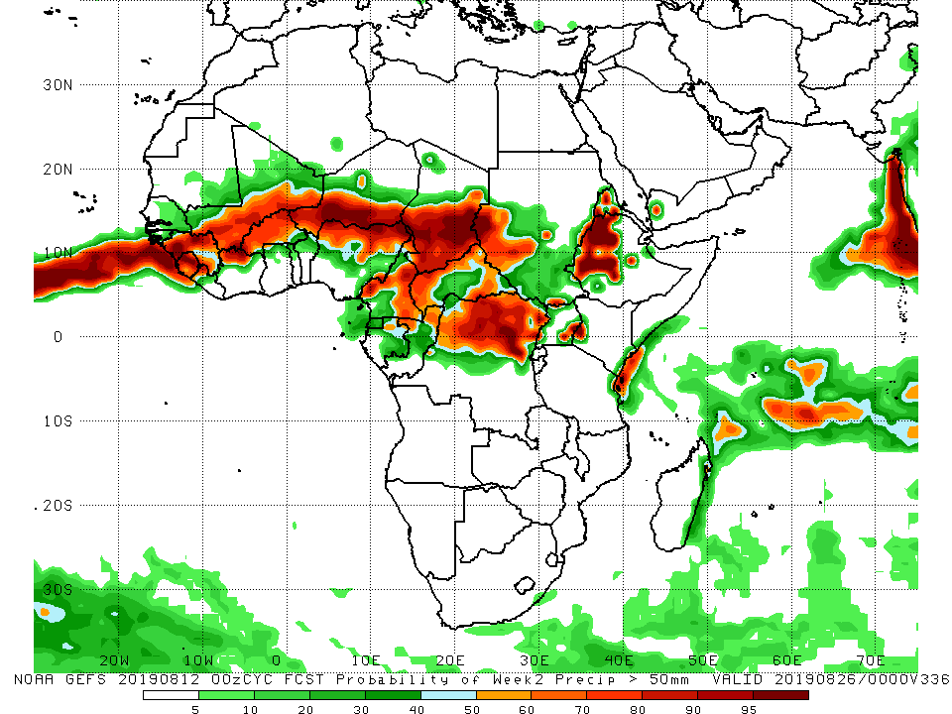
NCEP GEFS Model Forecasts Non-Bias Corrected Probability of precipitation exceedance
Week-1: Valid 13 – 19 August, 2019
Week-2: Valid 20 – 26 August, 2019
For week-1 (left panel) and week-2 (right panel), there is an increased chance for weekly rainfall totals to exceed 50mm over much of Guinea, Sierra Leone, southern Mali, northern Cote d’Ivoire, much of Burkina Faso, northern Nigeria, northern Cameroon, central and southern Chad, northeastern DRC, portions of Sudan and South Sudan, Eritrea, western Ethiopia and western Kenya.
Notes:
10

Slide 11
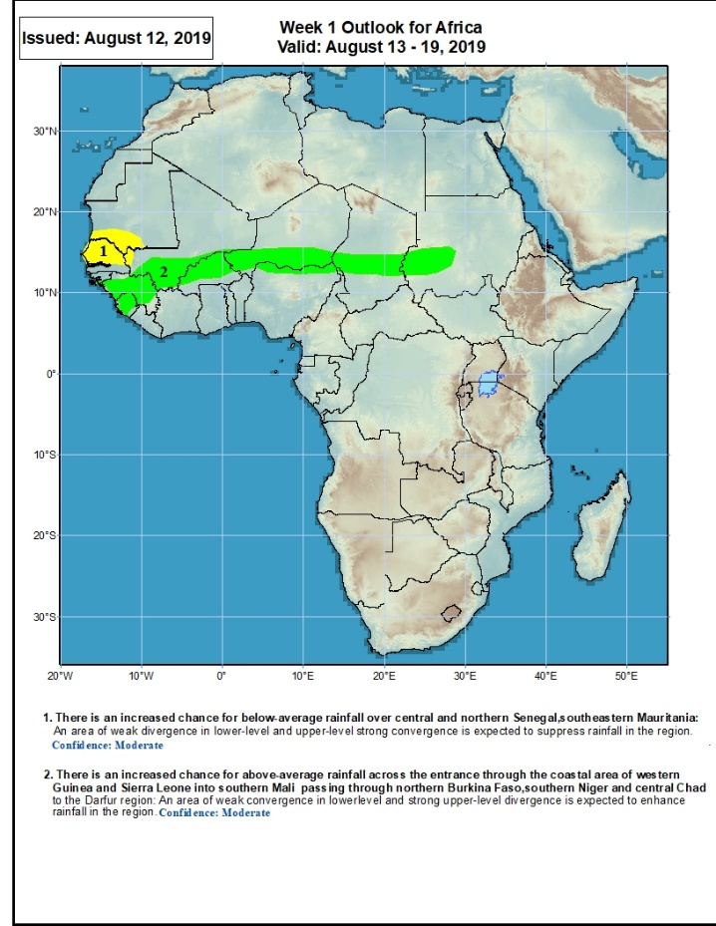
Week-1 Precipitation Outlooks
13 – 19 August, 2019
There is an increased chance for below-average rainfall over much of Senegal, Gambia, Guinea-Bissau, southern Mauritania and southwestern Mali: An area of anomalous lower-level divergence and upper-level convergence is expected to suppress rainfall in the region. Confidence: Moderate
There is an increased chance for above-average rainfall across Sierra Leone, Guinea, southern Mali, Burkina Faso, southern Niger, central Chad and western Sudan: An area of anomalous lower-level convergence and upper-level divergence is expected to enhance rainfall in the region. Confidence: Moderate
Notes:
11

Slide 12
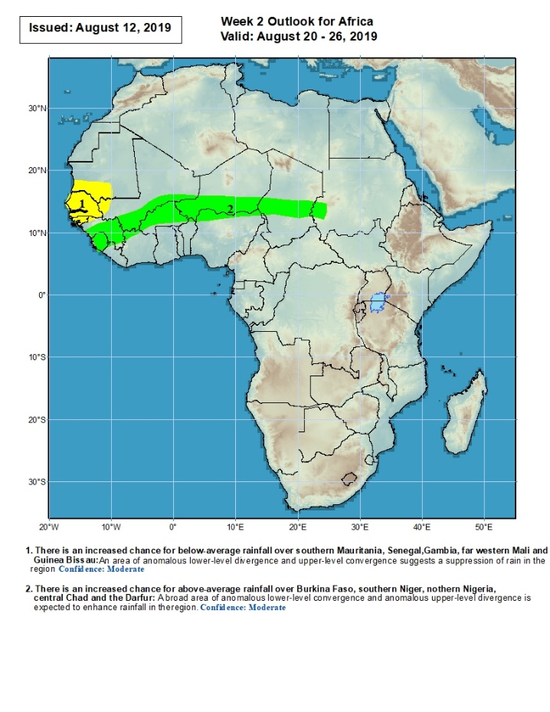
Week-2 Precipitation Outlooks
20 – 26 August, 2019
There is an increased chance for below-average rainfall over much of Senegal, Gambia, Guinea-Bissau, parts of southwestern Mali, and southern Mauritania: An area of anomalous lower-level divergence and upper-level convergence is expected to suppress rainfall in the region. Confidence: Moderate
There is an increased chance for above-average rainfall across Guinea, Sierra Leone, southern Mal, Burkina Faso, southern Niger, central Chad, and western Sudan: A broad area of anomalous lower-level convergence and upper-level divergence is expected to enhance rainfall in the region. Confidence: Moderate
Notes:
12

Slide 13
Summary
During the past 7 days, rainfall was below-average over much Senegal, Gambia, Guinea-Bissau, parts of western Mali, Cote d’Ivoire, Ghana Togo, Benin, western Niger, portions of eastern Nigeria, Cameroon, parts of Chad, northern DRC, CAR, South Sudan and northern Ethiopia. Much of Guinea, Sierra Leone, Liberia, northwestern Cote d’Ivoire, many parts of Mali, Burkina Faso, portions of Nigeria, local areas in Chad, portions of Sudan local areas in DRC, Eritrea and Ethiopia had above-average rainfall. Weekly rainfall surpluses exceeded 100m over portions of Guinea, Sierra Leone, northwestern Cote d’Ivoire, southeastern Nigeria and western Cameroon.
During the past 30 days, southern Mauritania, Senegal, Gambia, Guinea-Bissau, parts of southern Cote d’Ivoire, western Ghana, portions of Nigeria, northern Cameroon, local areas in Niger and Chad, and portions of Ethiopia had below-average rainfall. Rainfall was above-average over much of Guinea, Sierra Leone, Liberia, Mali, Burkina Faso, central and northern Cote d’Ivoire, many parts of Ghana, Togo, Benin, local areas in Niger, portions of Nigeria, Cameroon, many parts of Chad, CAR, Congo, DRC, Uganda, South Sudan, many parts of Sudan, and local areas in Ethiopia, Kenya and Somalia.
During the past 90 days, much of Senegal, Mauritania, parts of northern Mali, local areas in Liberia, parts of Cote d’Ivoire and western Ghana, portions of Nigeria and Cameroon, Equatorial Guinea, Gabon, much of Congo, local areas in DRC, and parts of Ethiopia had below-average rainfall. Rainfall was above-average over much Guinea, Sierra Leone, Liberia, Mali, parts of Cote d’Ivoire, Burkina Faso, Ghana, Togo Benin, Niger, parts of Nigeria, Chad, northern Cameroon, parts of CAR and DRC, South Sudan, Uganda, southern Sudan, portions of Ethiopia, southern Somalia, and parts of Kenya and Tanzania.
Week-1 outlooks call for an increased chance for below-average rainfall over the far western West Africa. In contrast, there is an increased chance for above-average rainfall over many places in the Sahel region.
Notes:
13

