Slide 1
The African Monsoon Recent Evolution and Current Status Include Week-1 and Week-2 Outlooks
Update prepared by
Climate Prediction Center / NCEP
05 August 2019
For more information, visit:
http://www.cpc.ncep.noaa.gov/products/Global_Monsoons/African_Monsoons/precip_monitoring.shtml

Slide 2
Outline
Highlights
Recent Evolution and Current Conditions
NCEP GEFS Forecasts
Summary

Slide 3
Highlights: Last 7 Days
Weekly rainfall totals exceeded 100mm over portions of Guinea and Sierra Leone. Heavy rainfall was also observed over local areas in Nigeria, southwestern Cameroon, Chad and CAR.
Below-average rainfall was observed over portions of the far western West Africa. Rainfall was also below-average over many parts of Eritrea and Ethiopia.
Week-1 outlooks call for an increased chance for below-average rainfall over much of Senegal, Gambia, Guinea-Bissau, southern Mauritania and southwestern Mali. In contrast, there is an increased chance for above-average rainfall over much of Guinea, Sierra Leone, western Liberia, southwestern Mali, southeastern Nigeria, Cameroon, southern Chad, northern CAR, central and southern Sudan, northern South Sudan and northeastern DRC.

Slide 4
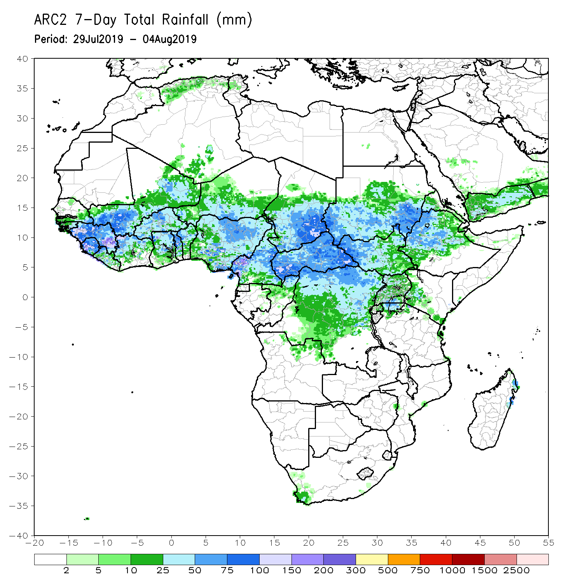
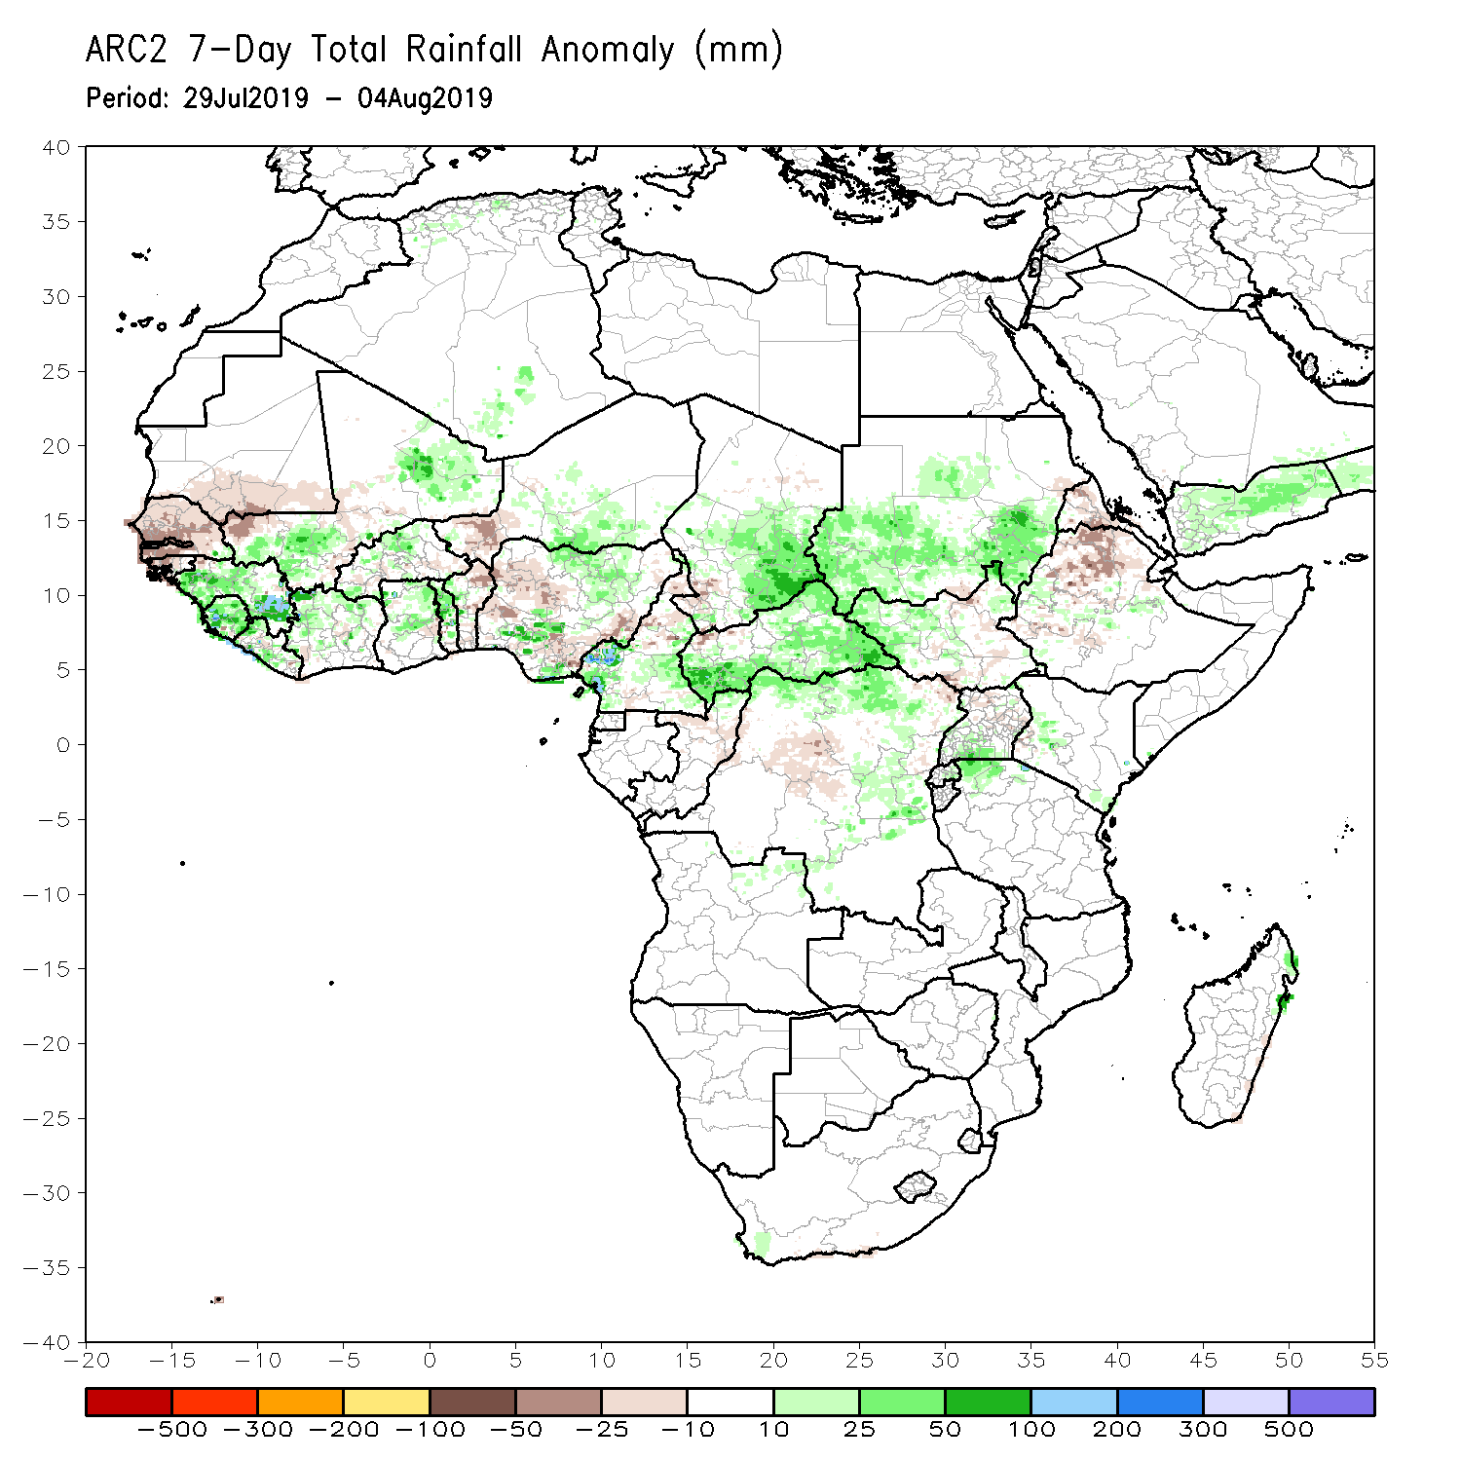
Rainfall Patterns: Last 7 Days
During the past 30 days, weekly rainfall totals exceeded 100mm over portions of Guinea and Sierra Leone. Heavy rainfall was also observed over local areas in Nigeria, southwestern Cameroon, Chad and CAR.
Rainfall was below-average over southern Mauritania, Senegal, Gambia, Guinea-Bissau, parts of Mali, western Niger, Benin, portions of Nigeria, northern Cameroon, western Chad, central DRC, local areas in South Sudan, and northern Ethiopia and parts of Eritrea.
Much of Guinea, Sierra Leone, Liberia, portions of Cote d’Ivoire and Mali, Burkina Faso, Ghana, Togo, local areas in Nigeria, portions of Cameroon, central and eastern Chad, many parts of CAR, portions of Sudan and South Sudan, northern and eastern DRC, and local areas in Tanzania and Kenya had above-average rainfall.

Slide 5
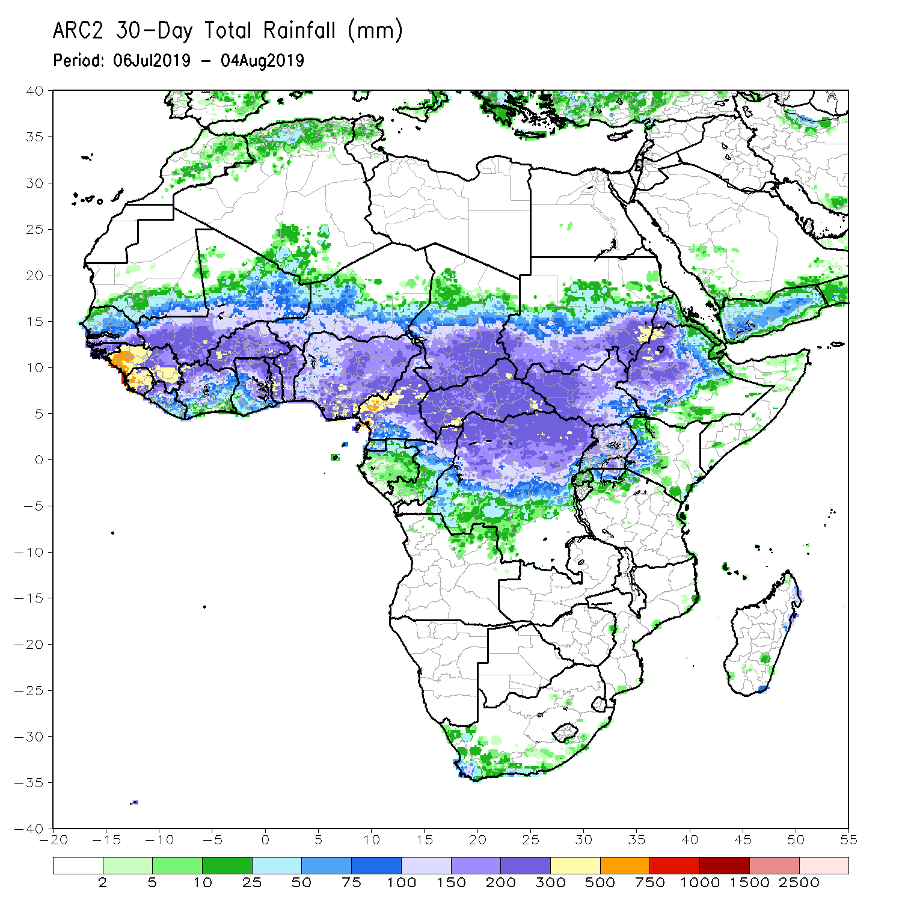
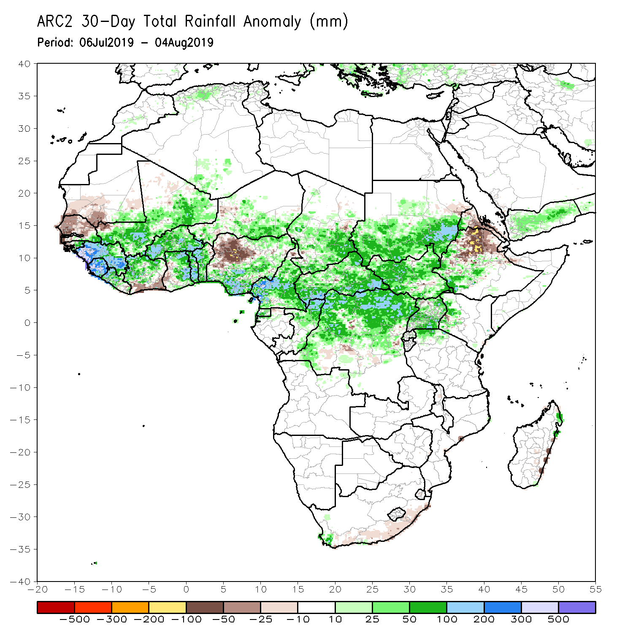
Rainfall Patterns: Last 30 Days
During the past 30 days, southern Mauritania, western and central Senegal, southern Cote d’Ivoire, parts of western and southern Ghana, portions of Nigeria, local areas in Niger and Chad, and portions of Ethiopia had below-average rainfall.
Rainfall was above-average over parts of southern Senegal, Guinea-Bissau, much of Guinea, Sierra Leone, Liberia, Mali, Burkina Faso, central and northern Cote d’Ivoire, many parts of Ghana, Togo, Benin, portions of Niger and Nigeria, Cameroon, many parts of Chad, CAR, Congo, northern DRC, Uganda, South Sudan, many parts of Sudan, and parts of western and southwestern Ethiopia.
Notes:
5

Slide 6
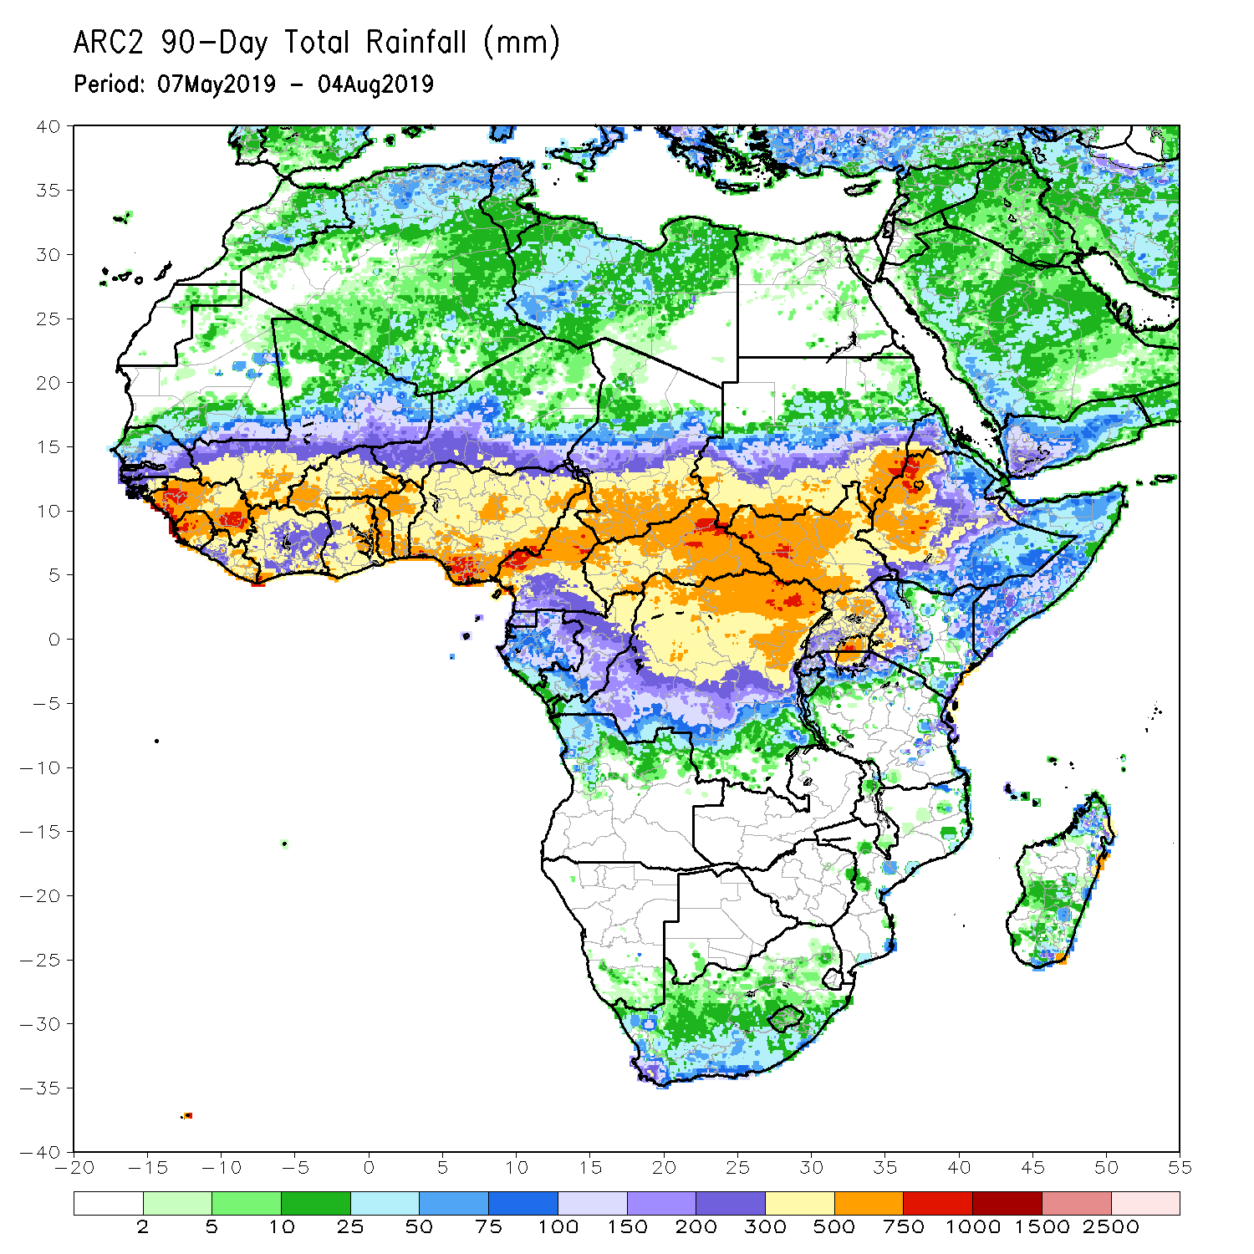
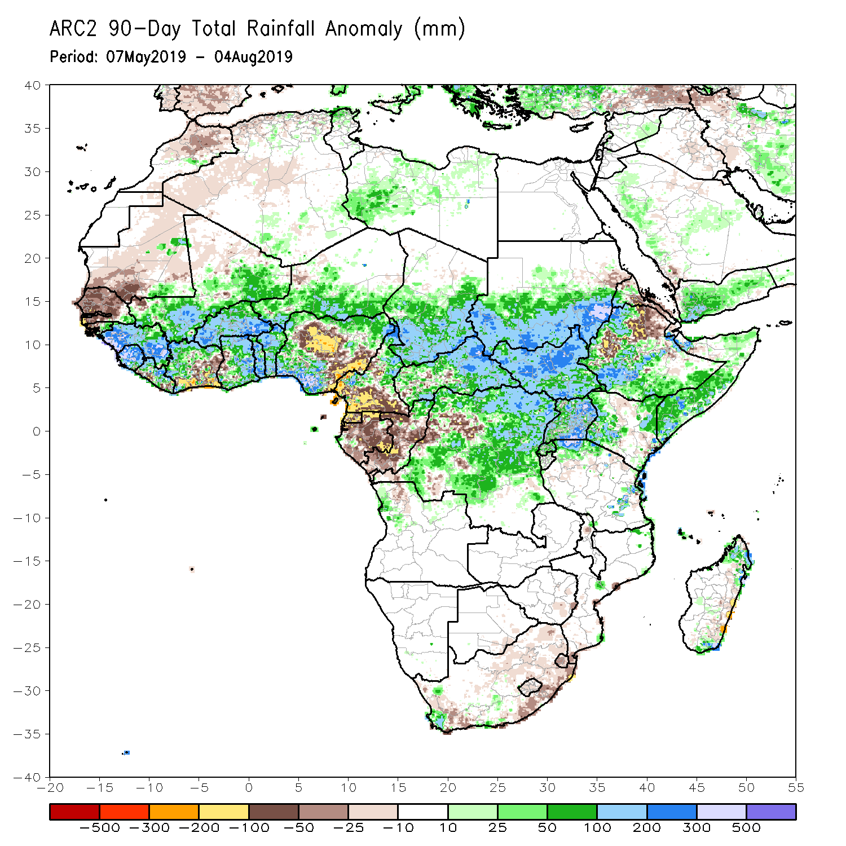
Rainfall Patterns: Last 90 Days
During the past 90 days, much of Senegal, Mauritania, northern Mali, local areas in Liberia, parts of Cote d’Ivoire and western Ghana, portions of Nigeria and Cameroon, Equatorial Guinea, Gabon, much of Congo, local areas in Angola and DRC, and parts of Ethiopia had below-average rainfall.
Rainfall was above-average over much Guinea, Sierra Leone, Liberia, Mali, parts of Cote d’Ivoire, Burkina Faso, Ghana, Togo Benin, Niger, parts of Nigeria, Chad, northern Cameroon, many parts of CAR, DRC, South Sudan, Uganda, southern Sudan, portions of Ethiopia, southern Somalia, and parts of Kenya and Tanzania.
Notes:
6

Slide 7
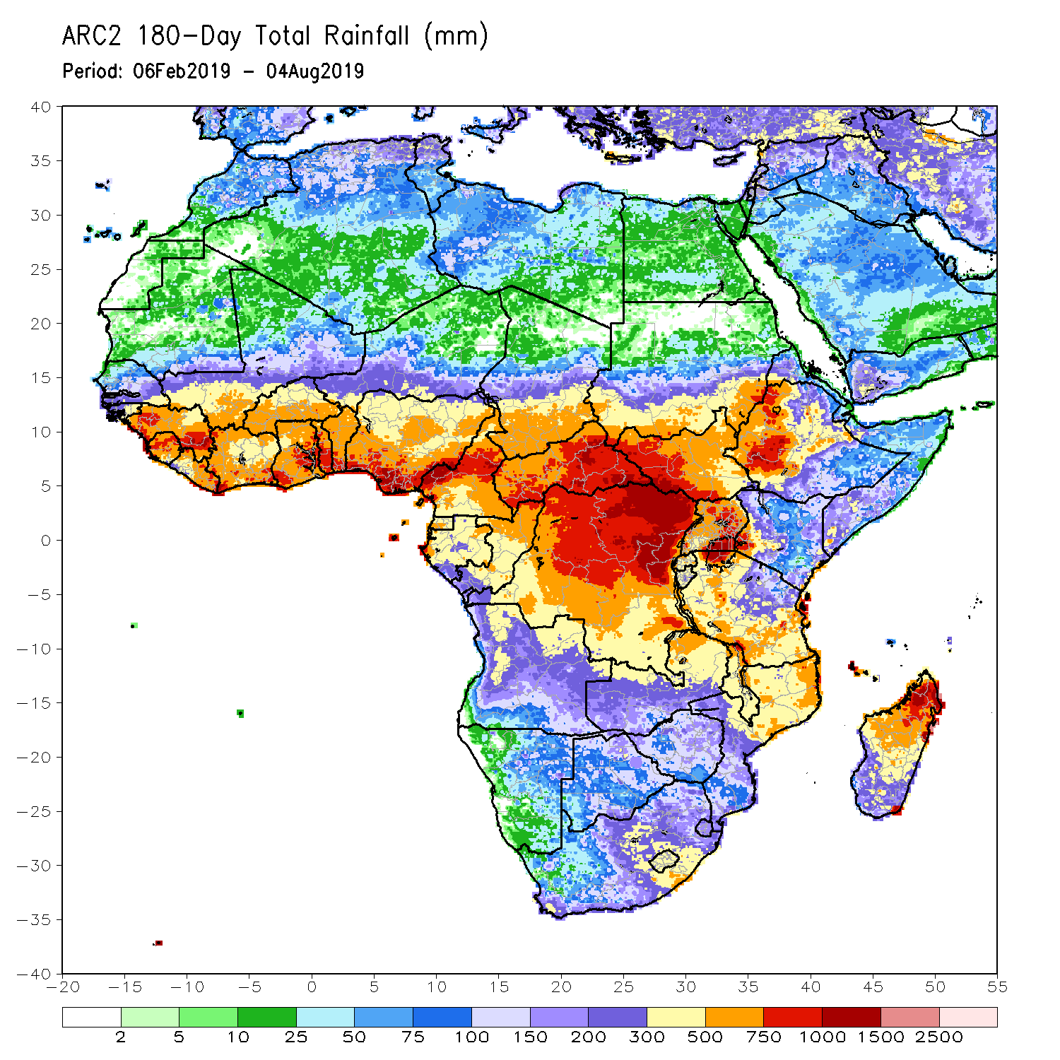
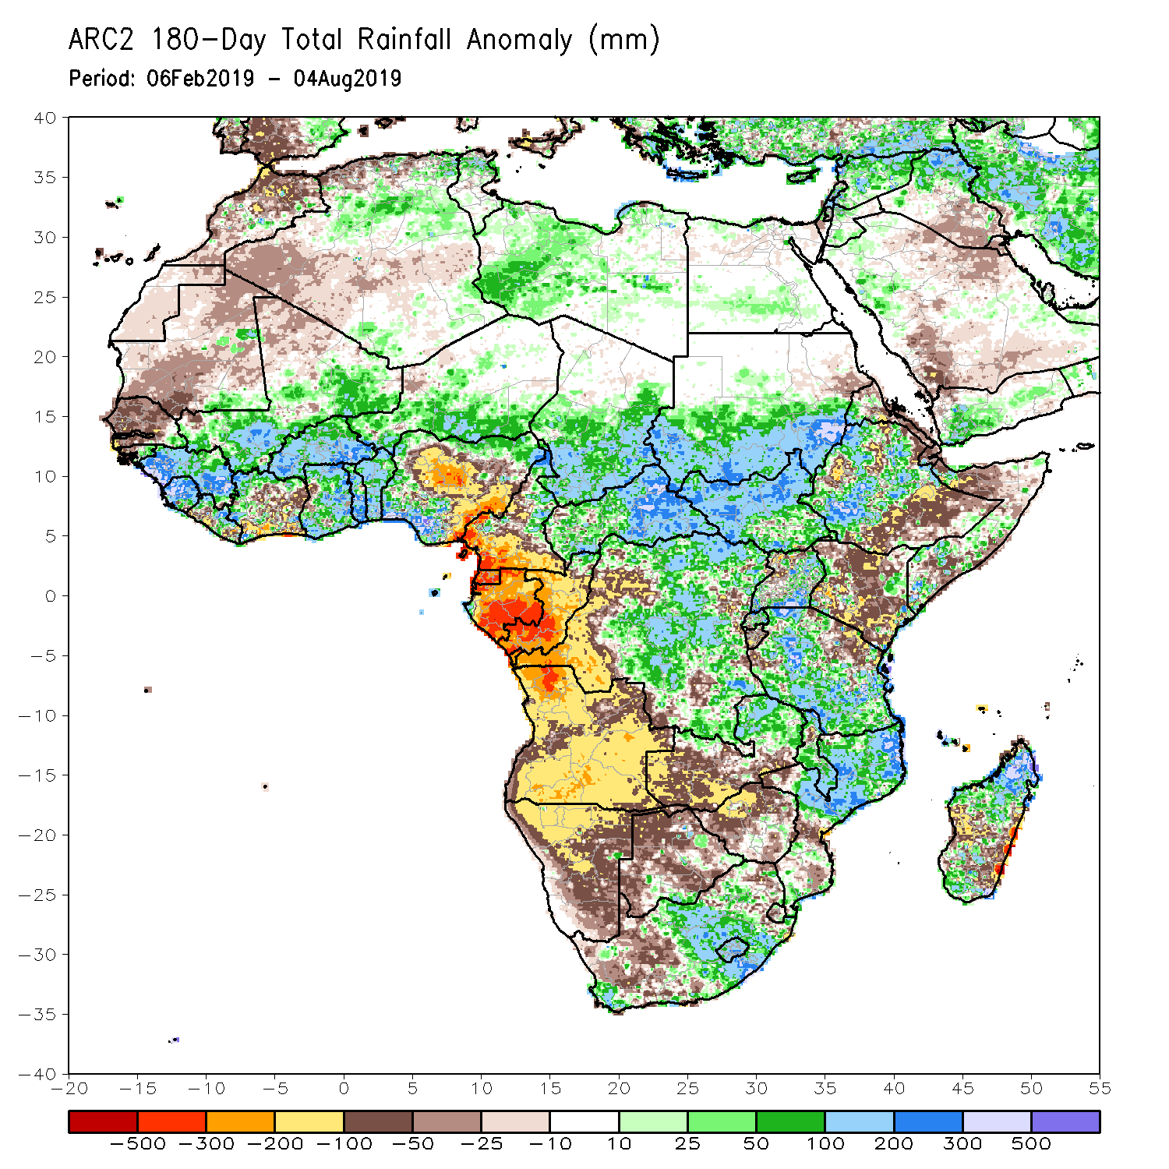
Rainfall Patterns: Last 180 Days
During the past 180 days, below-average rainfall was observed over much of Mauritania, Senegal, Guinea-Bissau, parts of Liberia and Cote d’Ivoire, western Ghana, portions of Nigeria and Cameroon, Equatorial Guinea, Gabon, Congo, portions of DRC, Angola, Namibia, western South Africa, western and southern Zambia, parts of Botswana, Zimbabwe, southern Mozambique, parts of Madagascar, northern Tanzania, much of Kenya, portions of Ethiopia, and Somalia.
Much of Guinea, Sierra Leone, Mali, parts of Liberia and Cote d’Ivoire, Burkina Faso, Ghana, Togo, Benin, parts of Nigeria, Niger, Chad, CAR, many parts of DRC, South Sudan, southern Sudan, parts of Uganda and Ethiopia, many parts of Tanzania, eastern Zambia, Malawi, northern Mozambique, and portions of South Africa and Madagascar had above-average rainfall.
Notes:
7

Slide 8
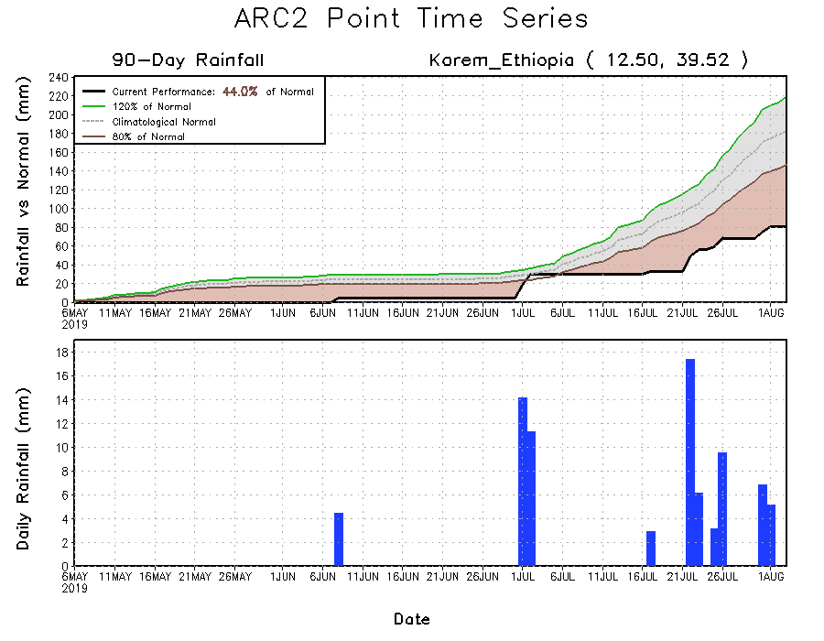
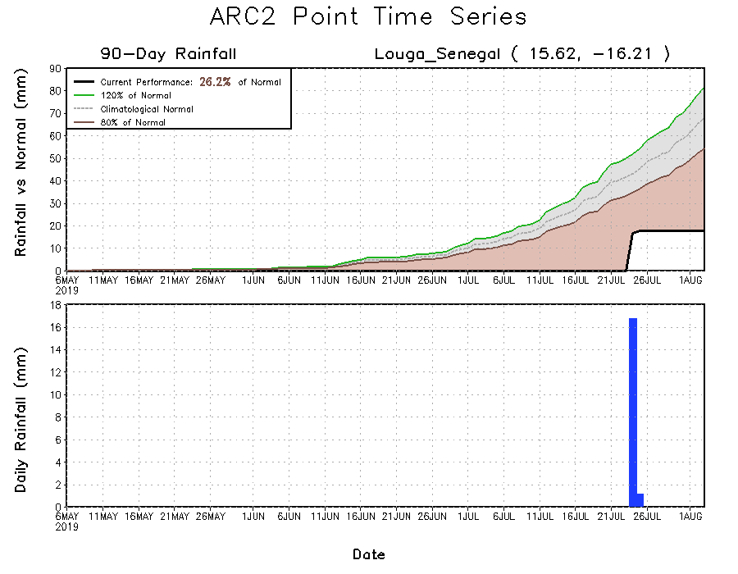
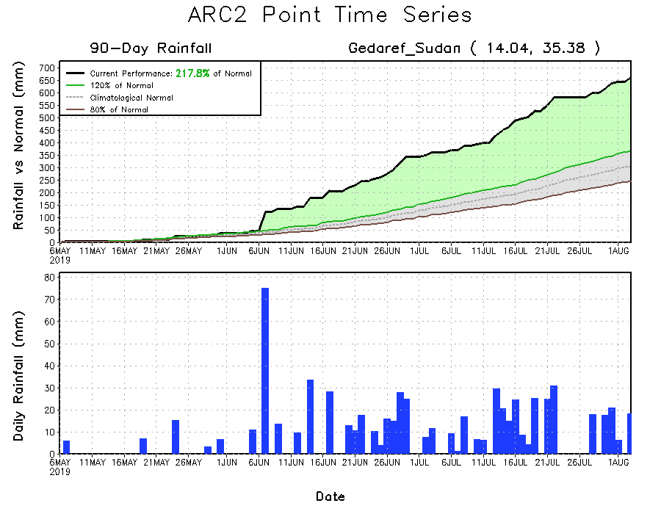
Recent Rainfall Evolution
Daily evolution of rainfall over the last 90 days at selected locations shows growing dryness over parts of Senegal (bottom left) and northeastern Ethiopia (top right). Moderate to local heavy rainfall sustained moisture surpluses over parts of eastern Sudan (bottom right).

Slide 9
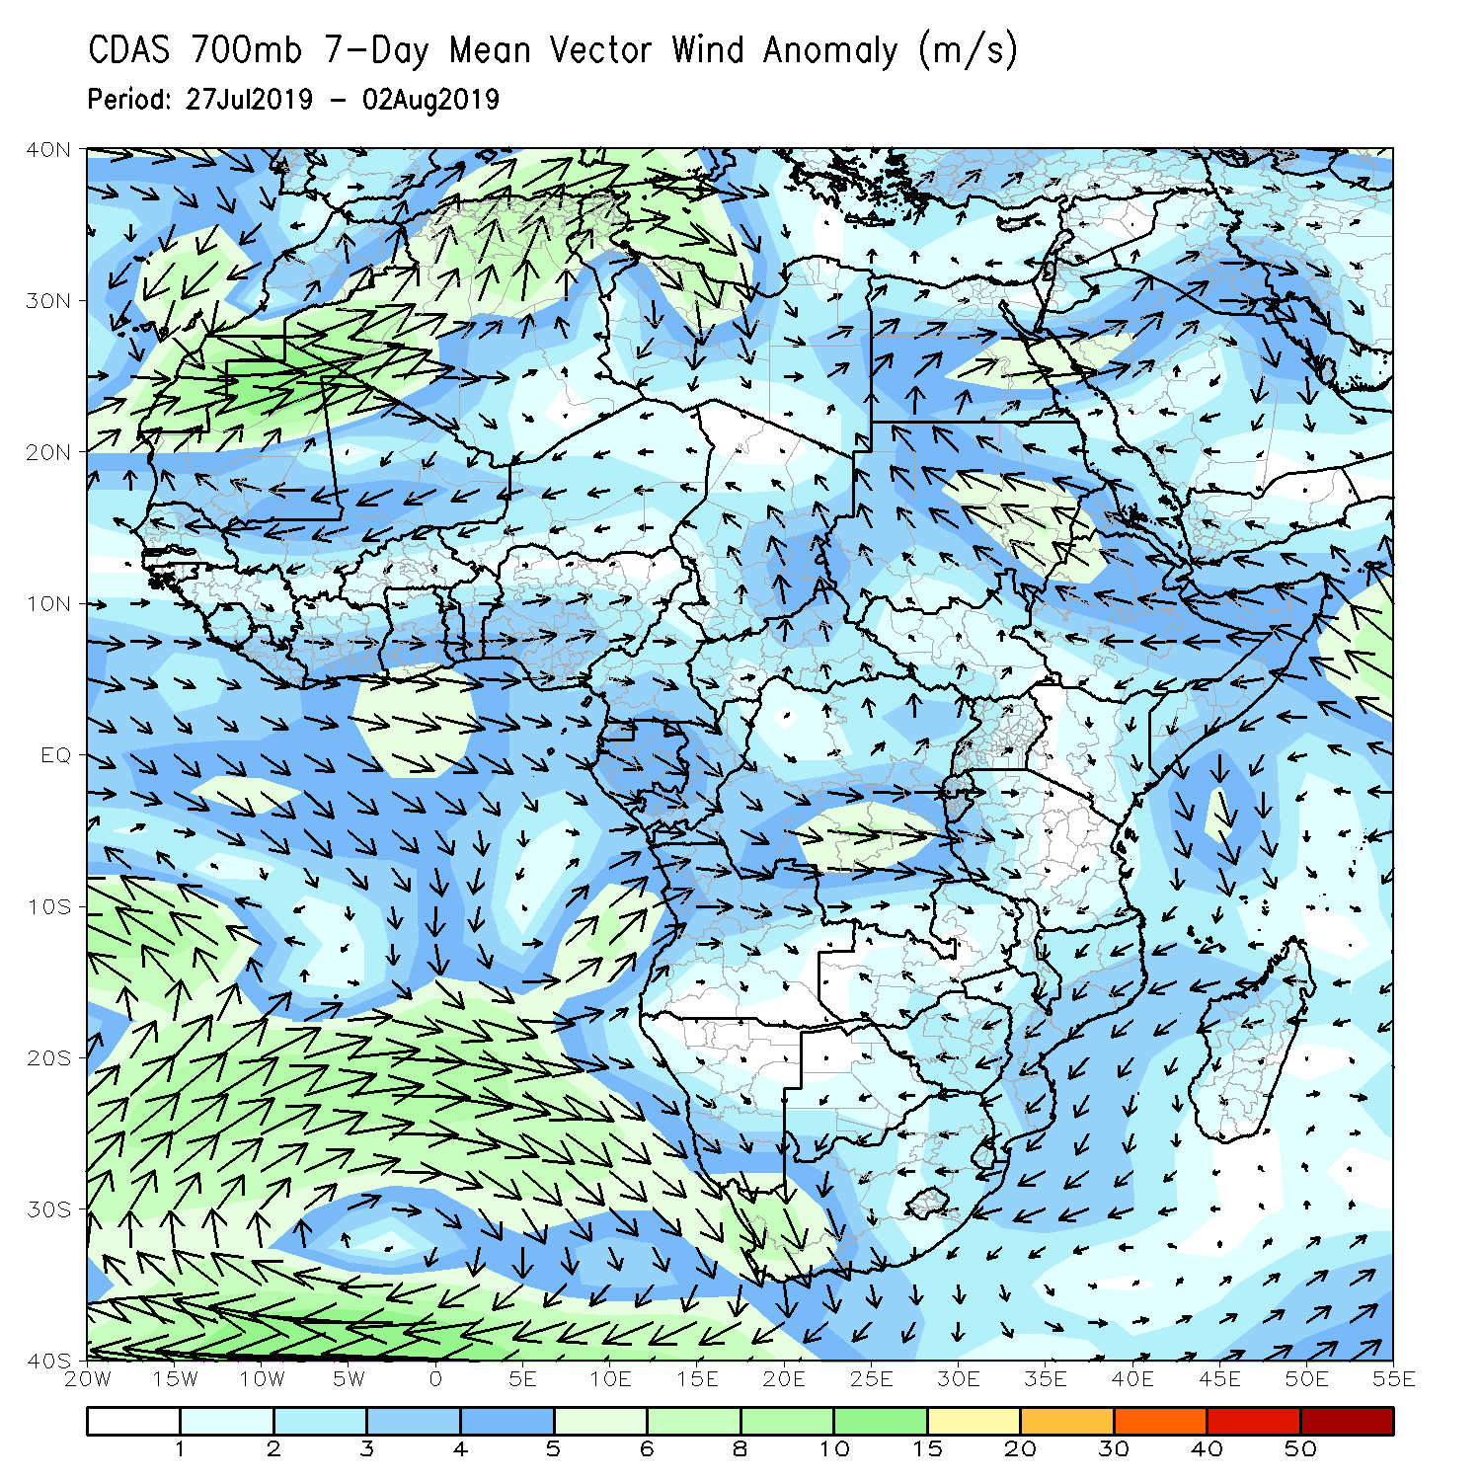
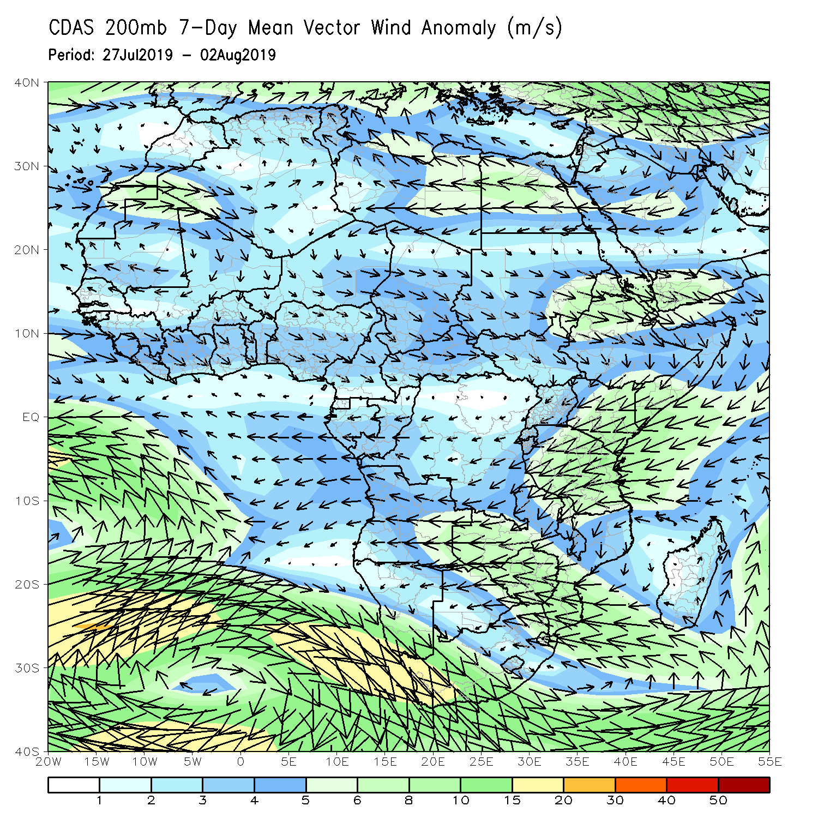
Atmospheric Circulation: Last 7 Days
An area of anomalous lower-level anti-cyclonic flow may have contributed to the observed drier than average condition over the far western West Africa. In contrast, lower-level anomalies were cyclonic across the gulf of Guinea and the neighboring areas (left panel).

Slide 10
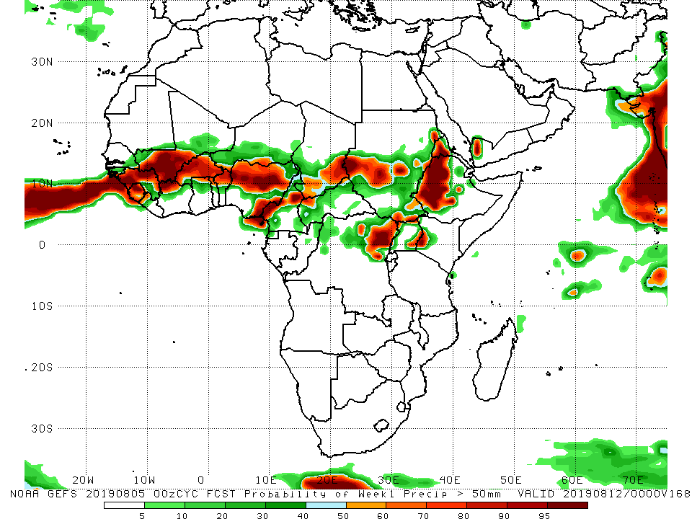
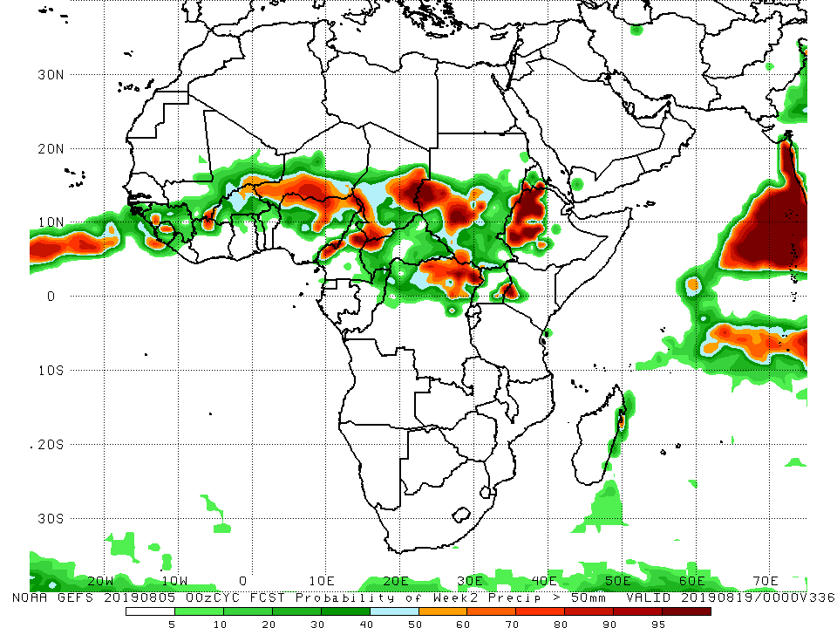
NCEP GEFS Model Forecasts Non-Bias Corrected Probability of precipitation exceedance
Week-1: Valid 6 – 12 August, 2019
Week-2: Valid 13 – 19 August, 2019
For week-1 (left panel), there is an increased chance for weekly rainfall totals to exceed 50mm over much of Guinea, Sierra Leone, southern Mali, northern Cote d’Ivoire, much of Burkina Faso, northern Benin, northern and southeastern Nigeria, northern Cameroon, southern Chad, northeastern DRC, portions of Sudan and South Sudan, Eritrea, western Ethiopia and western Kenya.
For week-2 (right panel), there is an increased chance for weekly rainfall totals to exceed 50mm over local areas in Guinea, Sierra Leone and Cote d’Ivoire, parts of southern Mali, northern Cote d’Ivoire, southern Niger, northern Nigeria, parts of Cameroon, Chad, northern DRC, portions of Sudan and South Sudan, western Ethiopia, and western Kenya.
Notes:
10

Slide 11
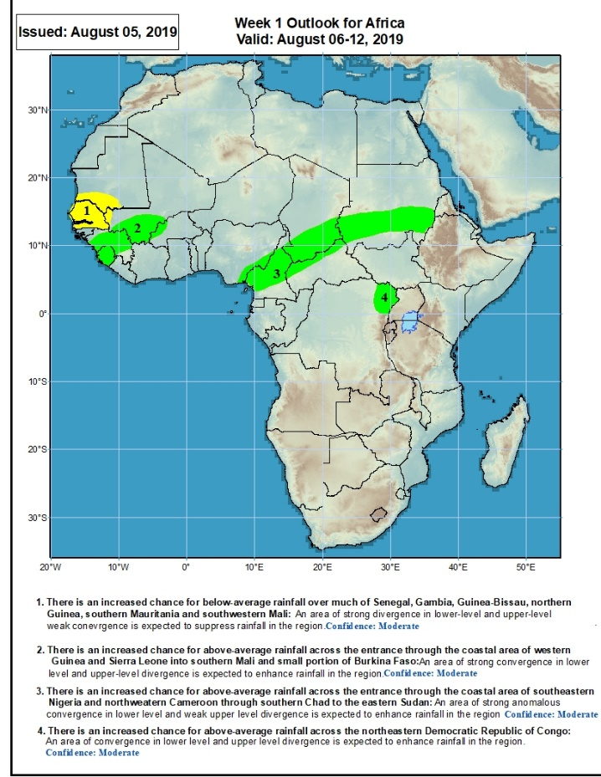
Week-1 Precipitation Outlooks
6 – 12 August, 2019
There is an increased chance for below-average rainfall over much of Senegal, Gambia, Guinea-Bissau, southern Mauritania and southwestern Mali: An area of anomalous lower-level divergence and upper-level convergence is expected to suppress rainfall in the region. Confidence: Moderate
There is an increased chance for above-average rainfall across Sierra Leone, Guinea, southern Mali, and parts of northern Burkina Faso: An area of anomalous westerly flow from the Atlantic Ocean and upper-level divergence is expected to enhance rainfall in the region. Confidence: Moderate
There is an increased chance for above-average rainfall across parts of eastern Nigeria, Cameroon, southern Chad, northern CAR and southern Sudan: An area of anomalous lower-level convergence and upper-level divergence is expected to enhance rainfall in the region. Confidence: Moderate
There is an increased chance for above-average rainfall over northeastern DRC: An area of anomalous lower-level convergence and upper-level divergence is expected to enhance rainfall in the region. Confidence: Moderate
Notes:
11

Slide 12
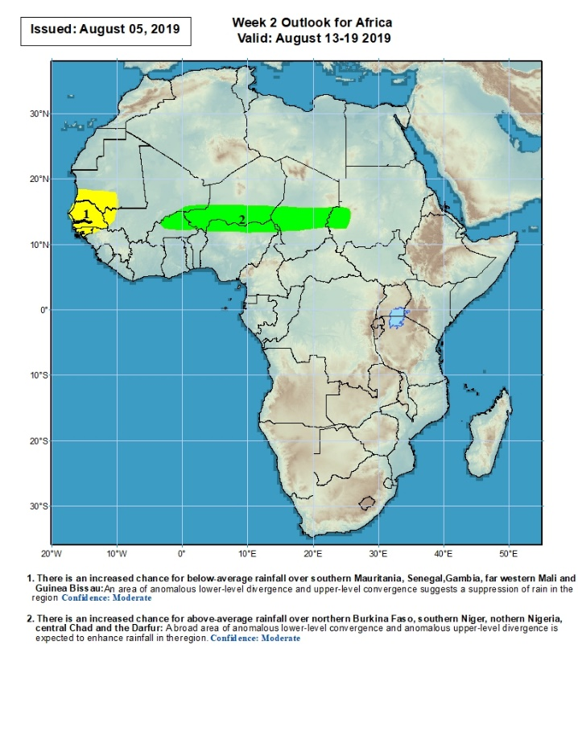
Week-2 Precipitation Outlooks
13 – 19 August, 2019
There is an increased chance for below-average rainfall over much of Senegal, Gambia, Guinea-Bissau, parts of northwestern Guinea, and southern Mauritania: An area of anomalous lower-level divergence and upper-level convergence is expected to suppress rainfall in the region. Confidence: Moderate
There is an increased chance for above-average rainfall across northern Burkina Faso, southern Niger, northern Nigeria, central Chad and western Sudan: A broad area of anomalous lower-level cyclonic circulation and upper-level divergence is expected to enhance rainfall in the region. Confidence: Moderate
Notes:
12

Slide 13
Summary
During the past 30 days, weekly rainfall totals exceeded 100mm over portions of Guinea and Sierra Leone. Heavy rainfall was also observed over local areas in Nigeria, southwestern Cameroon, Chad and CAR. Rainfall was below-average over southern Mauritania, Senegal, Gambia, Guinea-Bissau, parts of Mali, western Niger, Benin, portions of Nigeria, northern Cameroon, western Chad, central DRC, local areas in South Sudan, and northern Ethiopia and parts of Eritrea. Much of Guinea, Sierra Leone, Liberia, portions of Cote d’Ivoire and Mali, Burkina Faso, Ghana, Togo, local areas in Nigeria, portions of Cameroon, central and eastern Chad, many parts of CAR, portions of Sudan and South Sudan, northern and eastern DRC, and local areas in Tanzania and Kenya had above-average rainfall.
During the past 30 days, southern Mauritania, western and central Senegal, southern Cote d’Ivoire, parts of western and southern Ghana, portions of Nigeria, local areas in Niger and Chad, and portions of Ethiopia had below-average rainfall. Rainfall was above-average over parts of southern Senegal, Guinea-Bissau, much of Guinea, Sierra Leone, Liberia, Mali, Burkina Faso, central and northern Cote d’Ivoire, many parts of Ghana, Togo, Benin, portions of Niger and Nigeria, Cameroon, many parts of Chad, CAR, Congo, northern DRC, Uganda, South Sudan, many parts of Sudan, and parts of western and southwestern Ethiopia.
During the past 90 days, much of Senegal, Mauritania, northern Mali, local areas in Liberia, parts of Cote d’Ivoire and western Ghana, portions of Nigeria and Cameroon, Equatorial Guinea, Gabon, much of Congo, local areas in Angola and DRC, and parts of Ethiopia had below-average rainfall. Rainfall was above-average over much Guinea, Sierra Leone, Liberia, Mali, parts of Cote d’Ivoire, Burkina Faso, Ghana, Togo Benin, Niger, parts of Nigeria, Chad, northern Cameroon, many parts of CAR, DRC, South Sudan, Uganda, southern Sudan, portions of Ethiopia, southern Somalia, and parts of Kenya and Tanzania.
Week-1 outlooks call for an increased chance for below-average rainfall over much of Senegal, Gambia, Guinea-Bissau, southern Mauritania and southwestern Mali. In contrast, there is an increased chance for above-average rainfall over much of Guinea, Sierra Leone, western Liberia, southwestern Mali, southeastern Nigeria, Cameroon, southern Chad, northern CAR, central and southern Sudan, northern South Sudan and northeastern DRC.
Notes:
13

