Slide 1
The African Monsoon Recent Evolution and Current Status Include Week-1 and Week-2 Outlooks
Update prepared by
Climate Prediction Center / NCEP
29 July 2019
For more information, visit:
http://www.cpc.ncep.noaa.gov/products/Global_Monsoons/African_Monsoons/precip_monitoring.shtml

Slide 2
Outline
Highlights
Recent Evolution and Current Conditions
NCEP GEFS Forecasts
Summary

Slide 3
Highlights: Last 7 Days
Above-average rainfall was observed over many places in the Gulf of Guinea and Central Africa countries.
Week-1 outlooks call for an increased chance for below-average rainfall over much of Senegal, Gambia, Guinea-Bissau, northern Guinea, southern Mauritania and southwestern Mali. In contrast, there is an increased chance for above-average rainfall across eastern Burkina Faso, northern Togo, northern Benin, southwestern Niger, central and northern Nigeria, northern Cameroon, northern CAR, and western Sudan.

Slide 4
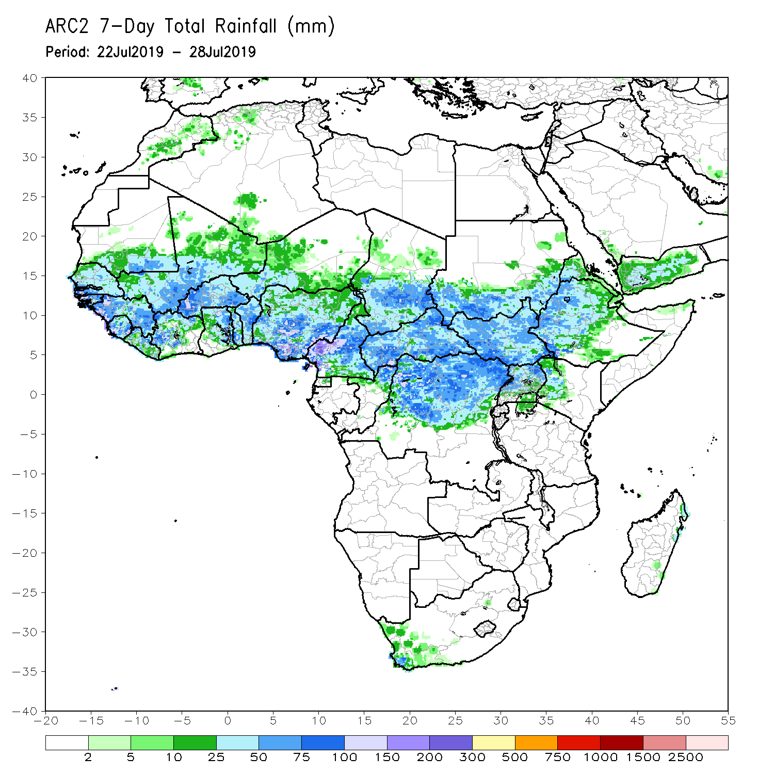
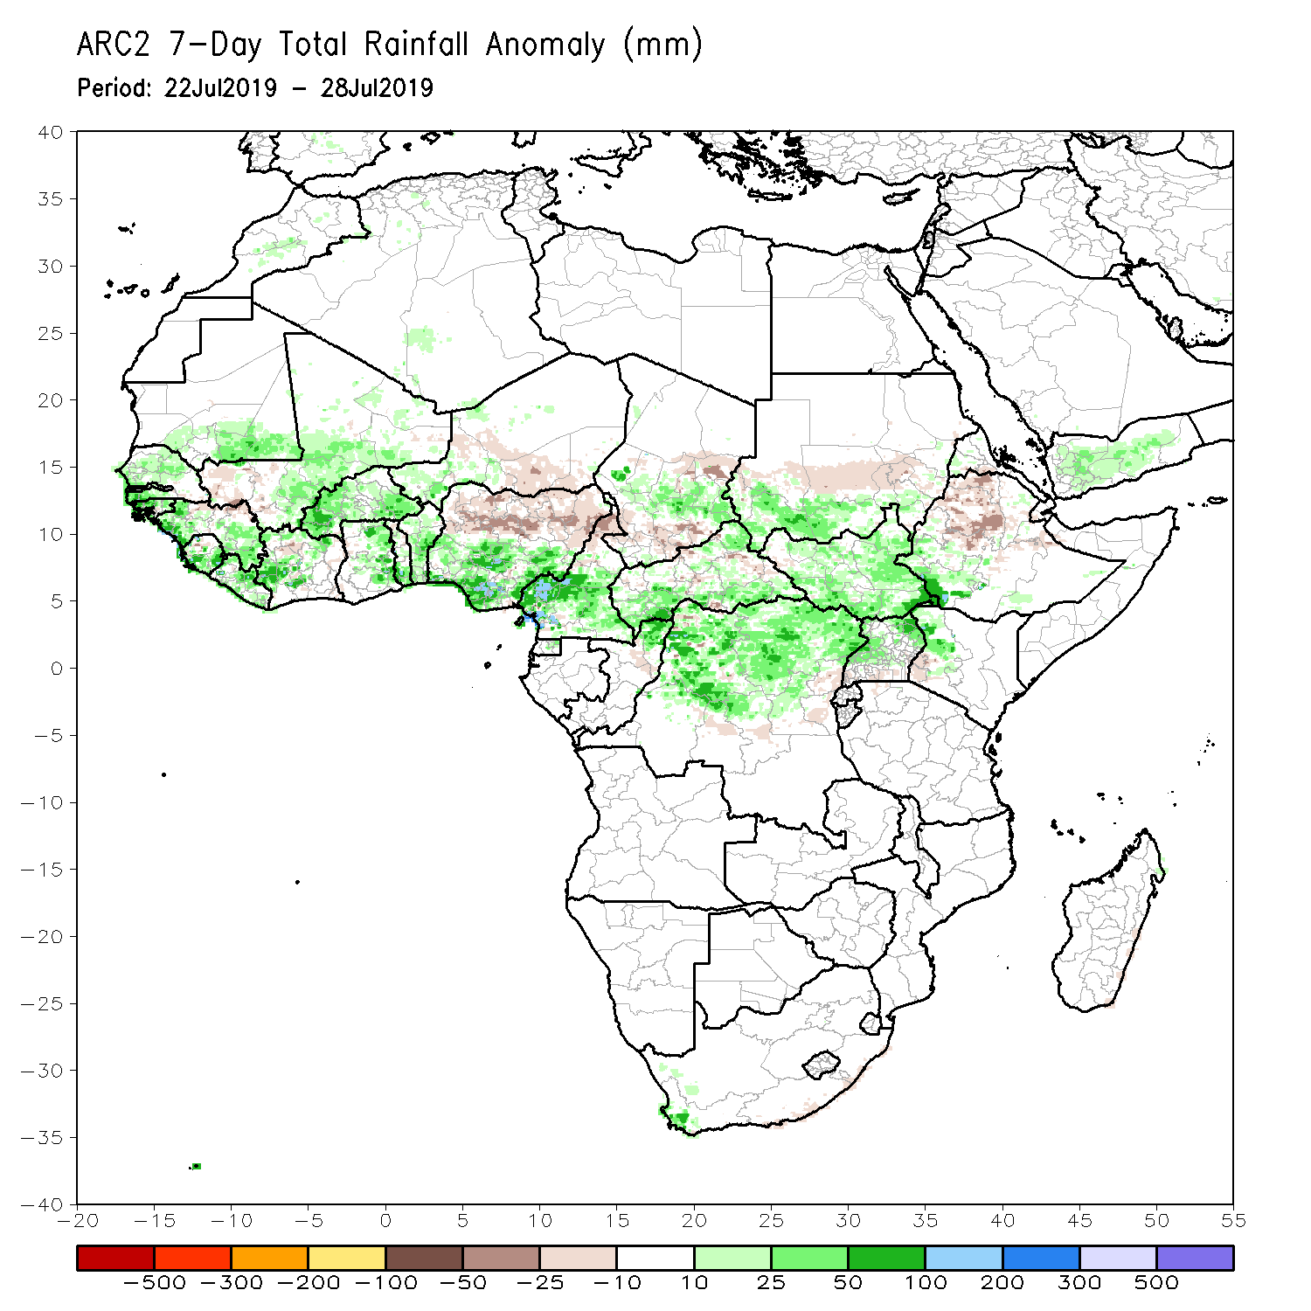
Rainfall Patterns: Last 7 Days
During the past 30 days, rainfall was above-average over southern Mauritania, Senegal, much of Guinea, parts of Mali, Sierra Leone, Liberia, parts of Cote d’Ivoire and Burkina Faso, Ghana, Togo and Benin, parts of Niger, southern Nigeria, central and southern Cameroon, portions of Chad and CAR, central and northern DRC, much of South Sudan, parts of Uganda, southern Sudan, southwestern Ethiopia, and, western Kenya.
Parts of eastern Senegal, southwestern Mali, local areas in Cote d’Ivoire and Burkina Faso, parts of Niger, northern Nigeria, northern Cameroon, southern Chad, local areas in CAR, central Sudan and many parts of Ethiopia had below-average rainfall.

Slide 5
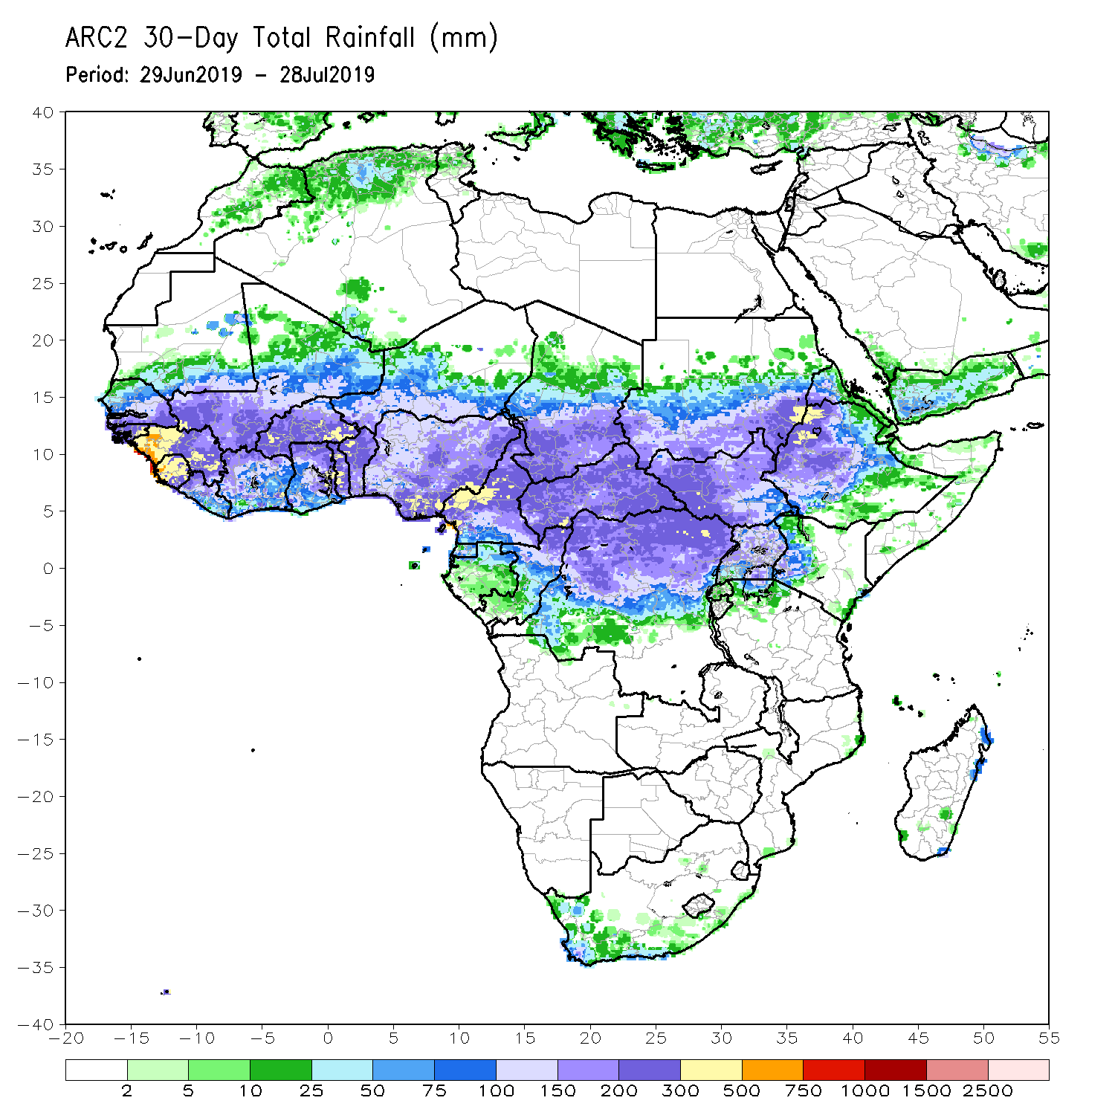
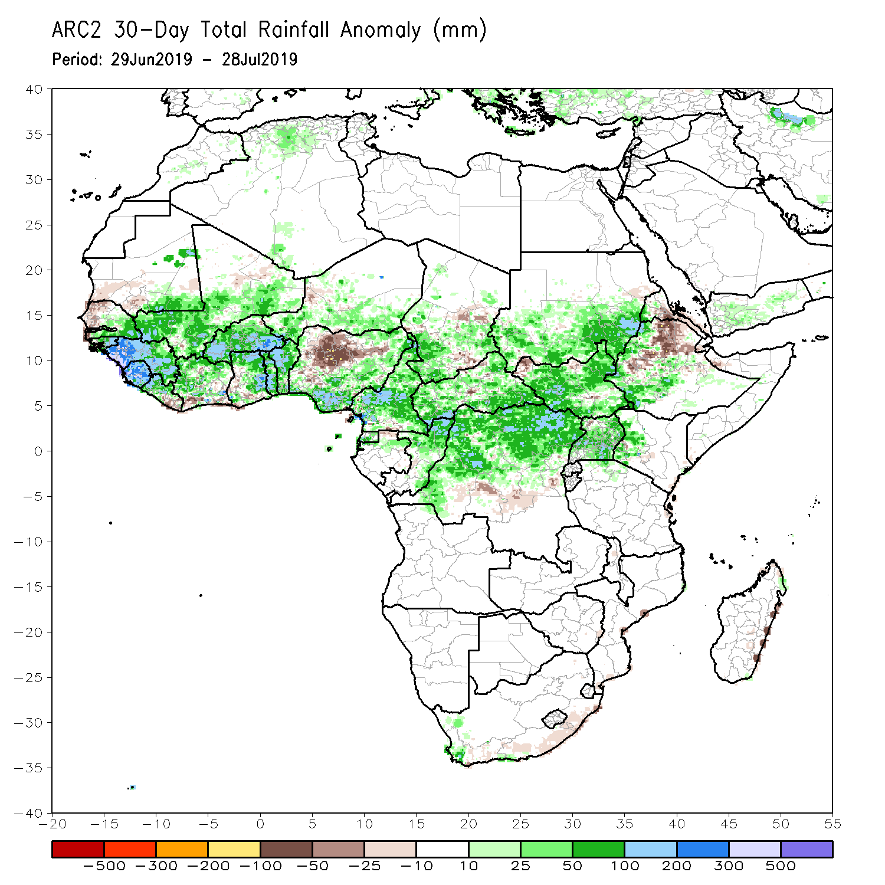
Rainfall Patterns: Last 30 Days
During the past 30 days, western Senegal, portions of Nigeria, local areas in Chad, CAR and South Sudan, parts of central DRC, and portions of Ethiopia had below-average rainfall.
Rainfall was above-average over eastern Senegal, Guinea, Sierra Leone, Liberia, Mali, Burkina Faso, Cote d’Ivoire, Ghana, Togo, Benin, portions of Niger, southern Nigeria, Cameroon, many parts of Chad, CAR, Congo, northern DRC, Uganda, South Sudan, southern Sudan, parts of Ethiopia and southwestern Ethiopia.
Notes:
5

Slide 6
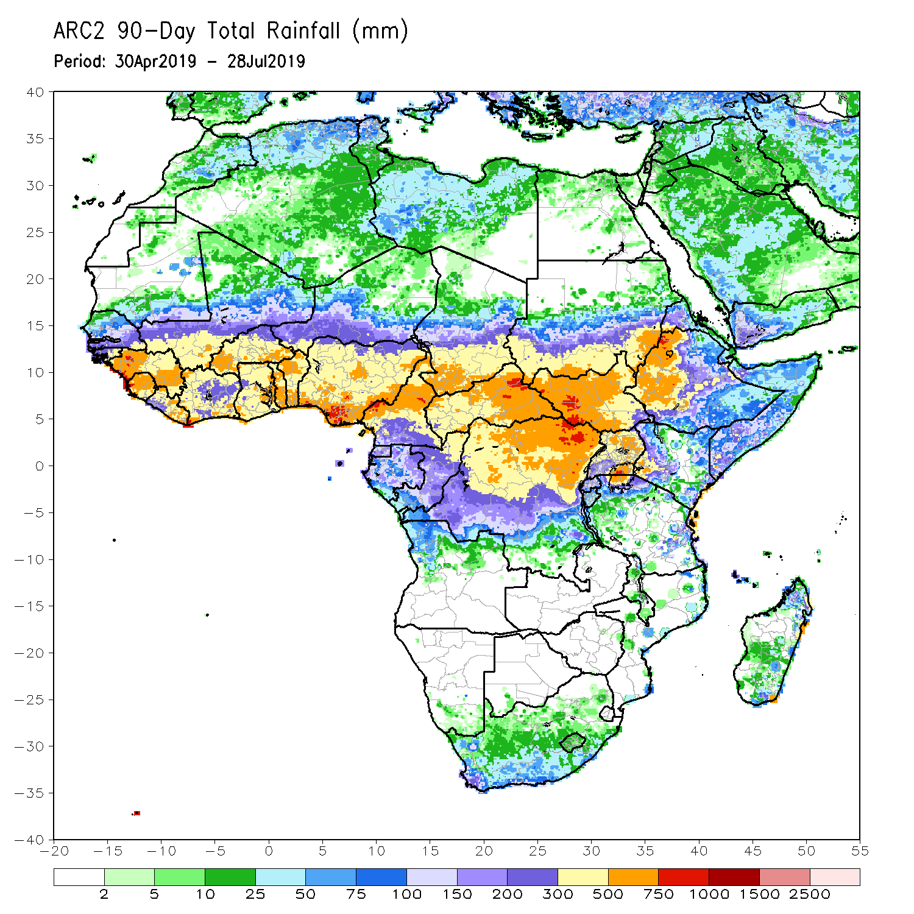
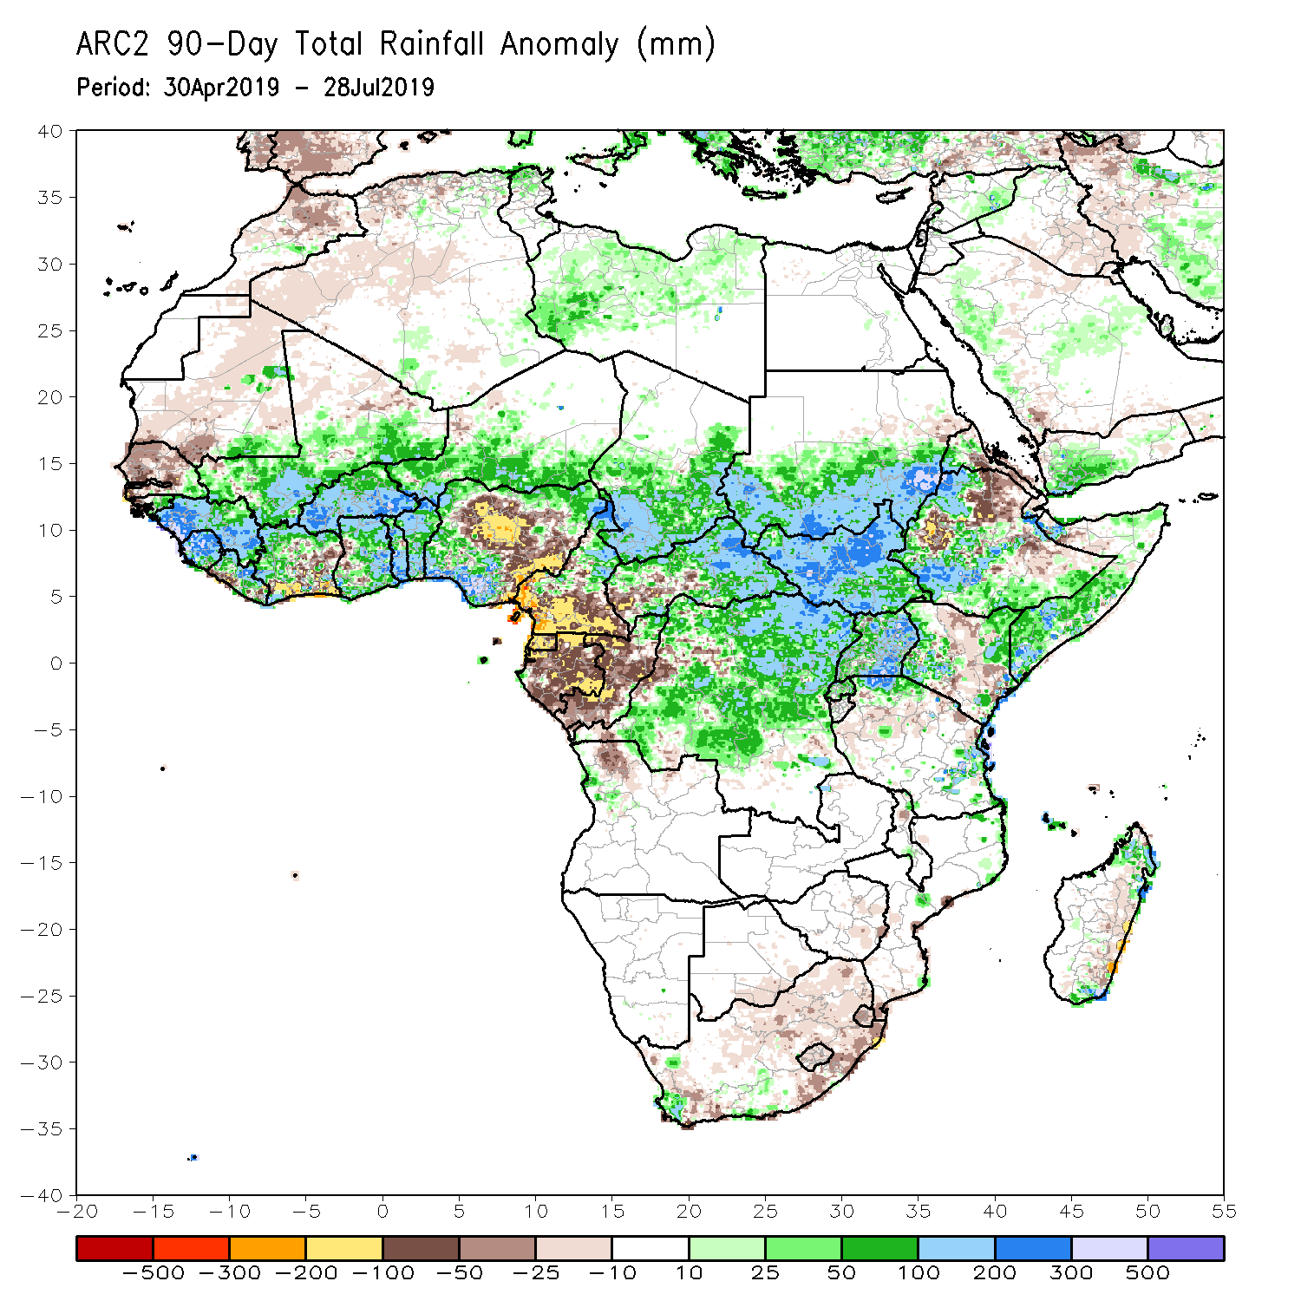
Rainfall Patterns: Last 90 Days
During the past 90 days, much of Senegal, Mauritania, parts of Cote d’Ivoire, portions of Nigeria, southern Cameroon, Equatorial Guinea, Gabon, much of Congo, local areas in Angola, and parts of Ethiopia had below-average rainfall.
Rainfall was above-average over much Guinea, Sierra Leone, Liberia, Mali, parts of Cote d’Ivoire, Burkina Faso, Ghana, Togo Benin, Niger, parts of Nigeria, Chad, northern Cameroon, many parts of CAR, DRC, South Sudan, Uganda, southern Sudan, portions of Ethiopia, southern Somalia, and parts of Kenya and Tanzania.
Notes:
6

Slide 7
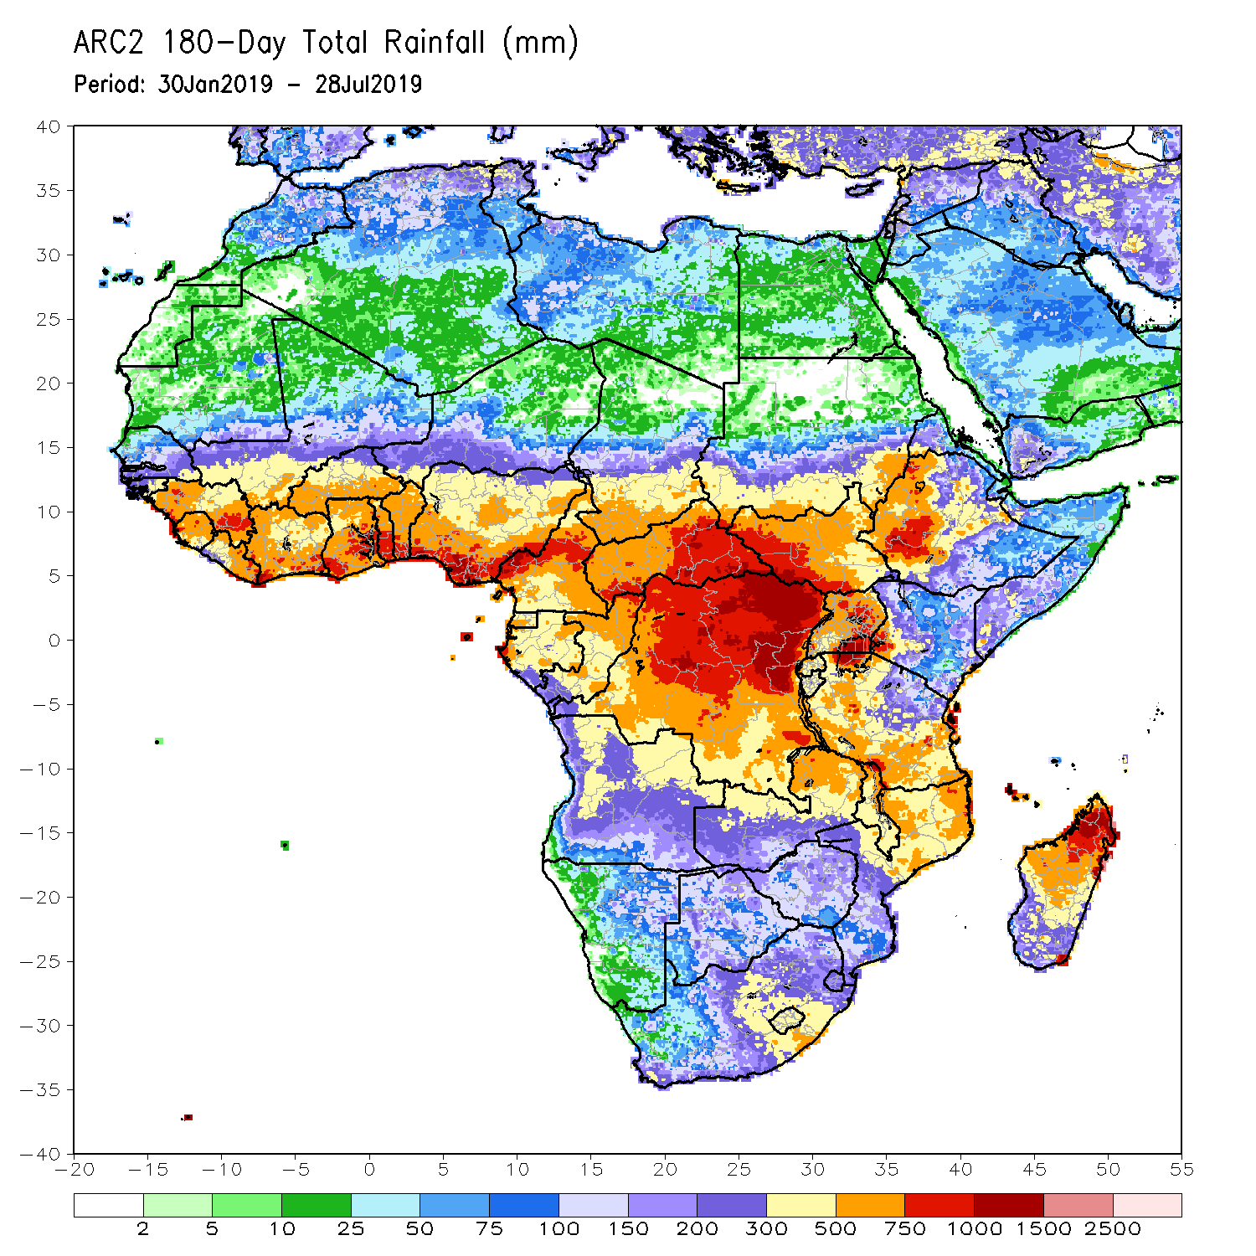
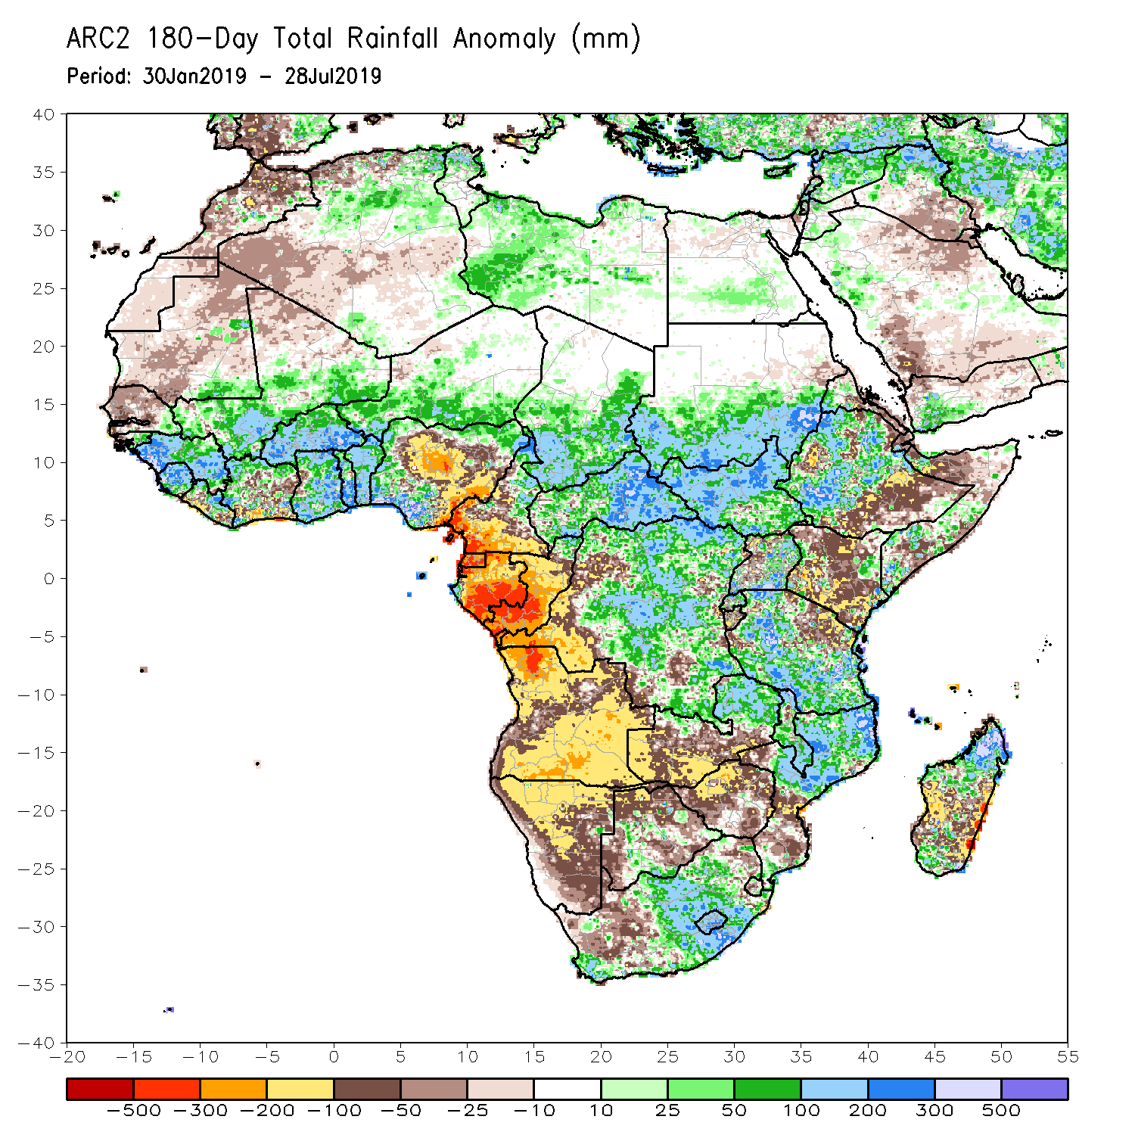
Rainfall Patterns: Last 180 Days
During the past 180 days, below-average rainfall was observed over much of Mauritania, Senegal, Guinea-Bissau, parts of Liberia and Cote d’Ivoire, portions of Nigeria and Cameroon, Equatorial Guinea, Gabon, Congo, western DRC, Angola, Namibia, western South Africa, western and southern Zambia, parts of Botswana, Zimbabwe, southern Mozambique, parts of Madagascar, northern Tanzania, much of Kenya, portions of Ethiopia, and Somalia.
Much of Guinea, Sierra Leone, Mali, parts of Liberia and Cote d’Ivoire, Burkina Faso, Ghana, Togo, Benin, parts of Nigeria, Niger, Chad, CAR, many parts of DRC, South Sudan, southern Sudan, parts of Uganda and Ethiopia, many parts of Tanzania, eastern Zambia, Malawi, northern Mozambique, and portions of South Africa and Madagascar had above-average rainfall.
Notes:
7

Slide 8
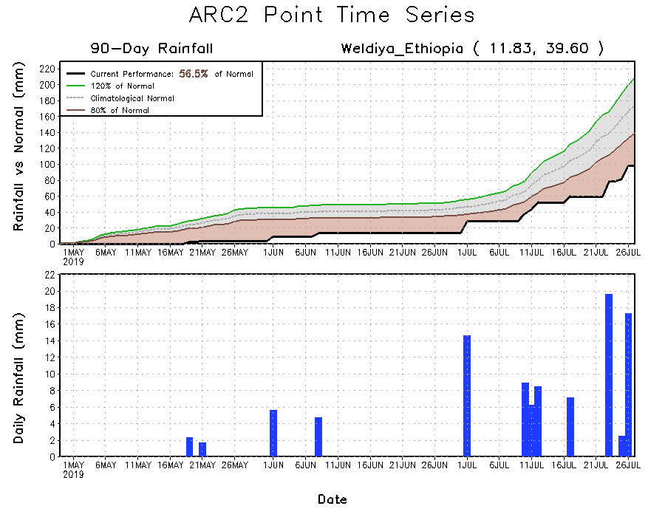
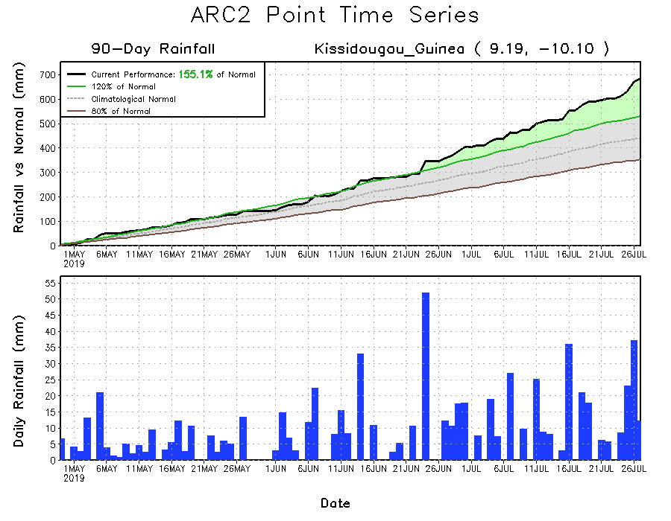
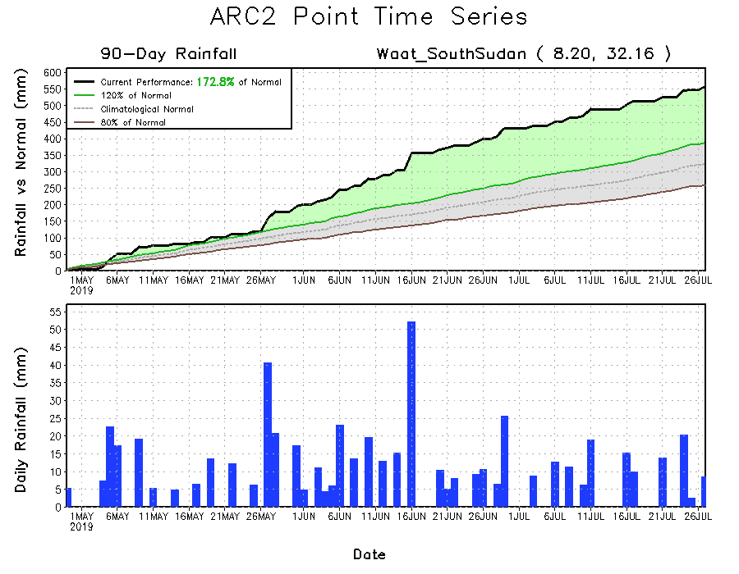
Recent Rainfall Evolution
Daily evolution of rainfall over the last 90 days at selected locations shows that seasonal total rainfall remained above-average over much of Guinea (bottom left) and South Sudan (bottom right). Seasonal total rainfall remained below-average over northeastern Ethiopia (top right).

Slide 9
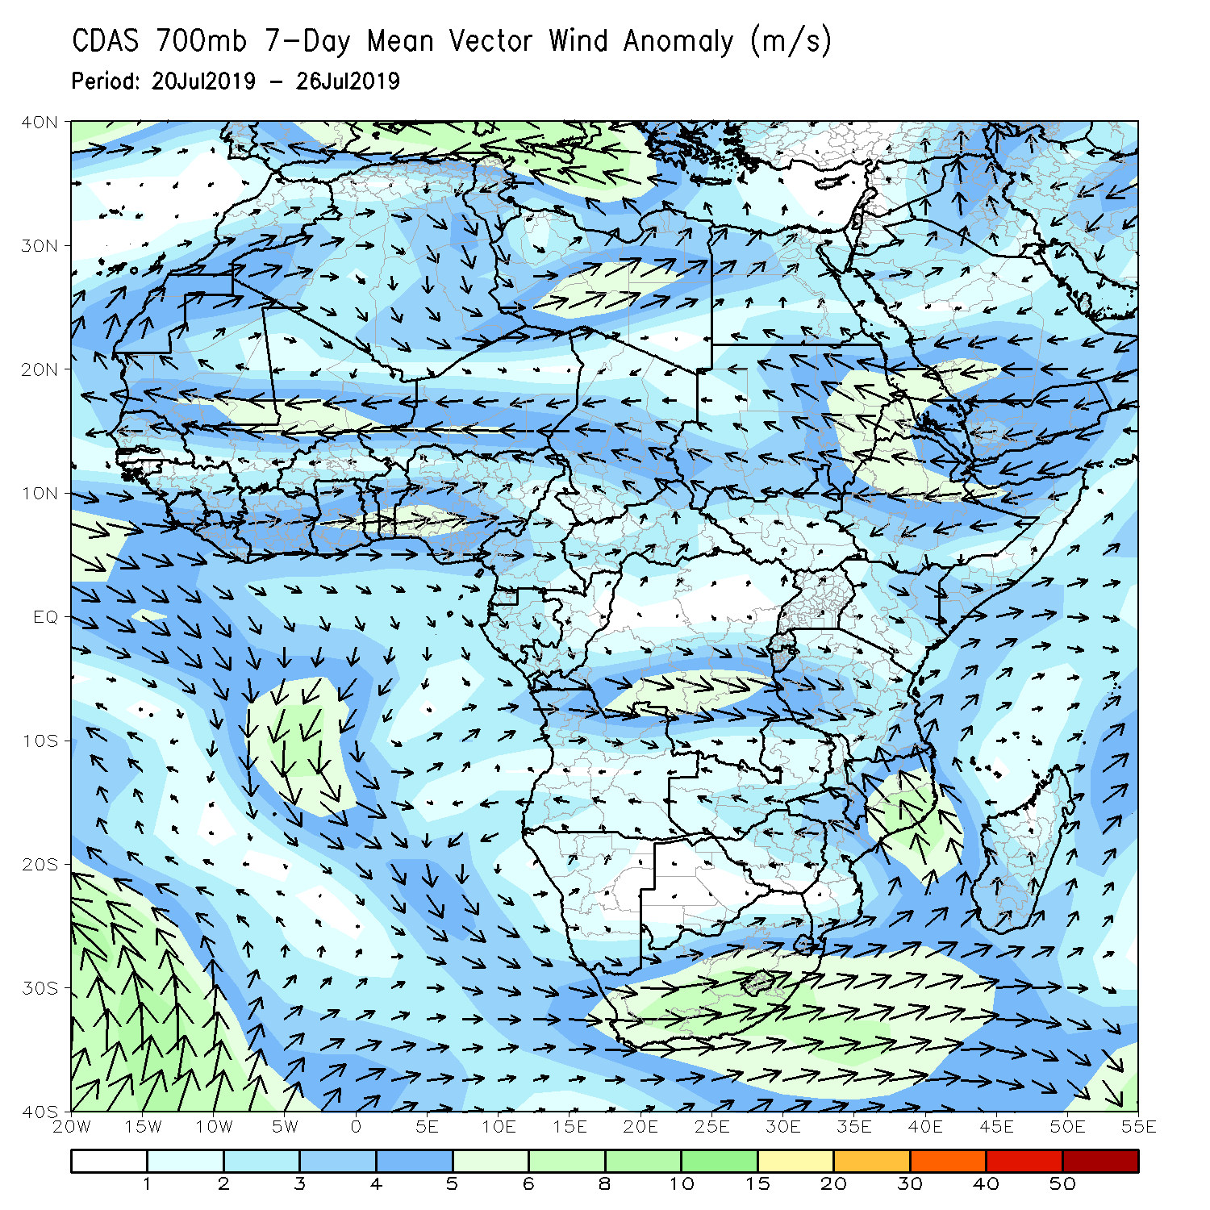
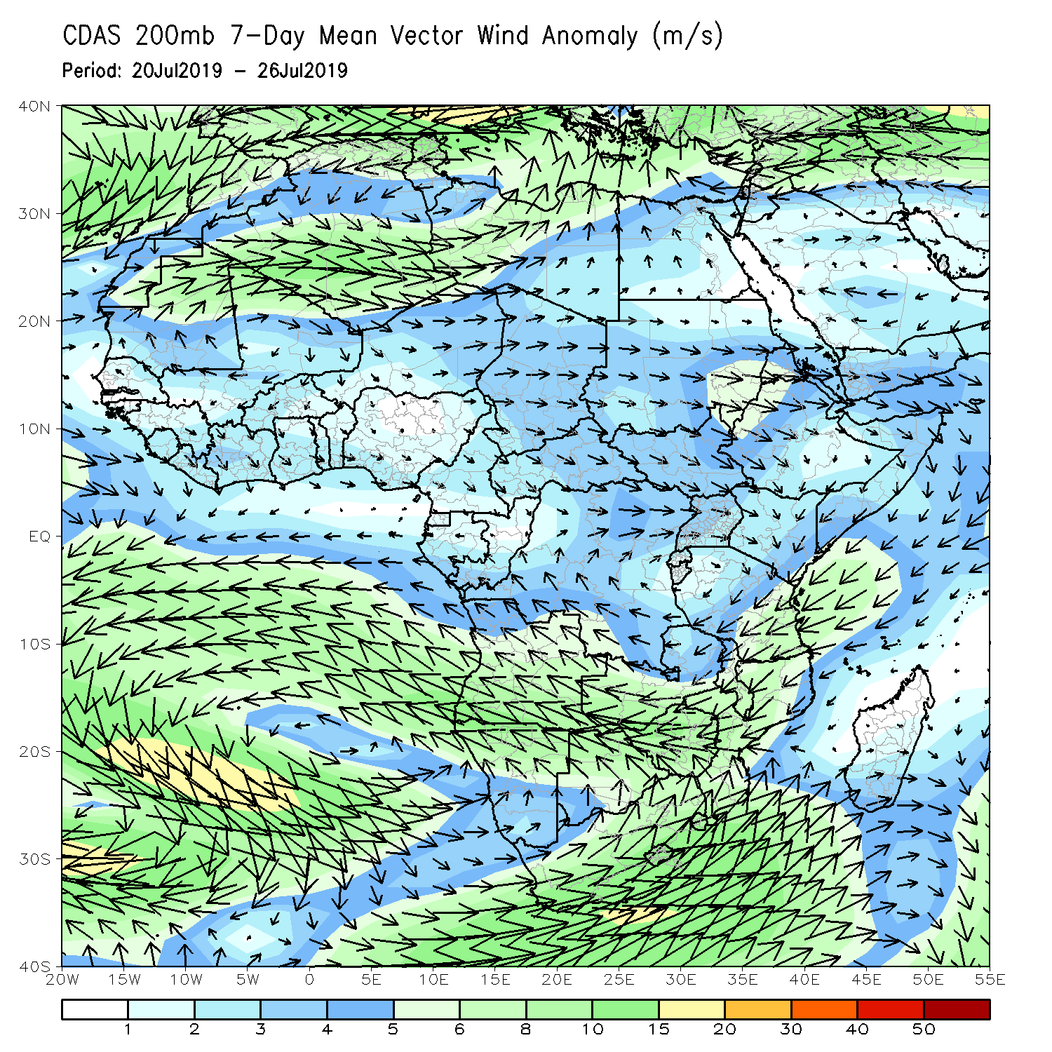
Atmospheric Circulation: Last 7 Days
An area of anomalous lower-level cyclonic shear across West Africa may have contributed to the observed above-average rainfall in the region (left).

Slide 10
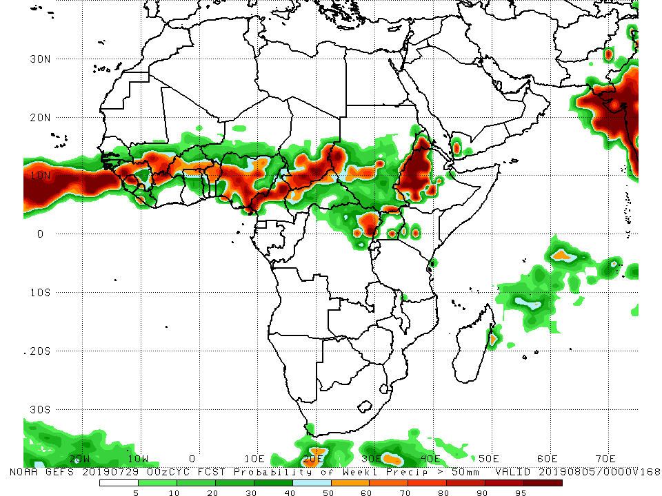
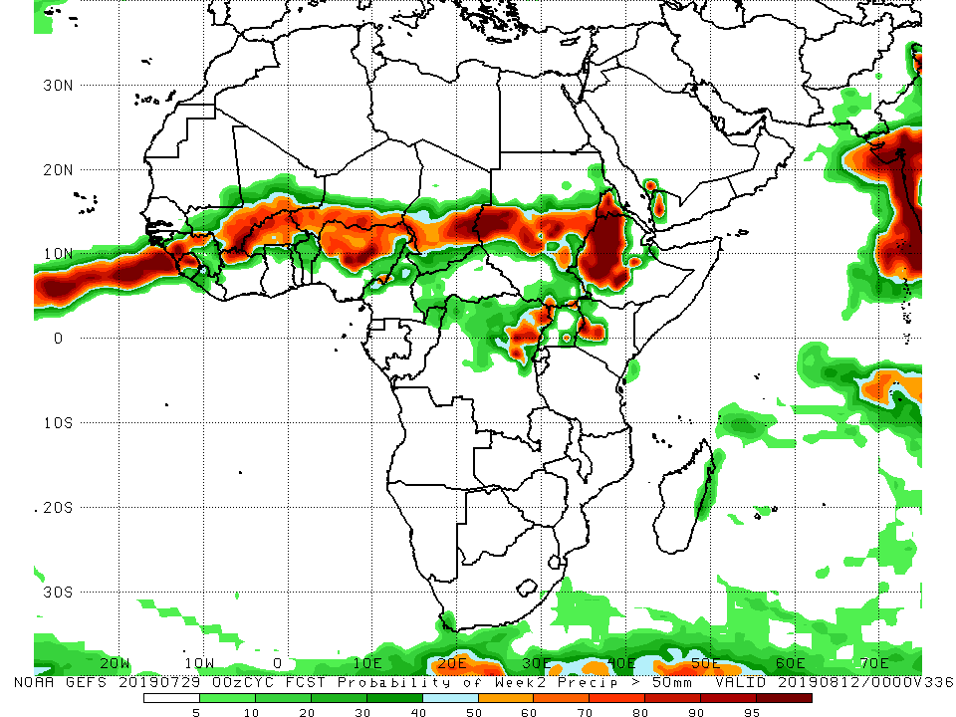
NCEP GEFS Model Forecasts Non-Bias Corrected Probability of precipitation exceedance
Week-1: Valid 30 July – 5 August, 2019
Week-2: Valid 6 – 12 August, 2019
For week-1 (left panel), there is an increased chance for weekly rainfall totals to exceed 50mm over western Guinea, Sierra Leone, southern Mali, Burkina Faso, northern Ghana, Togo, Benin, Nigeria, Cameroon, southern Chad, northern CAR, northeastern DRC, parts of Sudan and South Sudan, Eritrea, and Ethiopia.
For week-2 (right panel), there is an increased chance for weekly rainfall totals to exceed 50mm over parts of Guinea and Sierra Leone, southern Mali, Burkina Faso, southern Niger, northern Nigeria, southern Chad, southern Sudan, northeastern DRC, Eritrea, Ethiopia and western Kenya.
Notes:
10

Slide 11
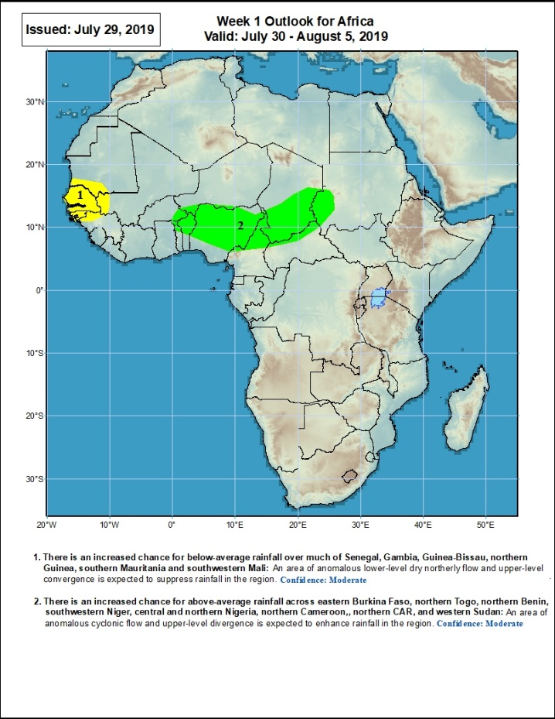
Week-1 Precipitation Outlooks
30 July – 5 August, 2019
There is an increased chance for below-average rainfall over much of Senegal, Gambia, Guinea-Bissau, northern Guinea, southern Mauritania and southwestern Mali: An area of anomalous lower-level dry northerly flow and upper-level convergence is expected to suppress rainfall in the region. Confidence: Moderate
There is an increased chance for above-average rainfall across eastern Burkina Faso, northern Togo, northern Benin, southwestern Niger, central and northern Nigeria, northern Cameroon, northern CAR, and western Sudan: An area of anomalous cyclonic flow and upper-level divergence is expected to enhance rainfall in the region. Confidence: Moderate
Notes:
11

Slide 12
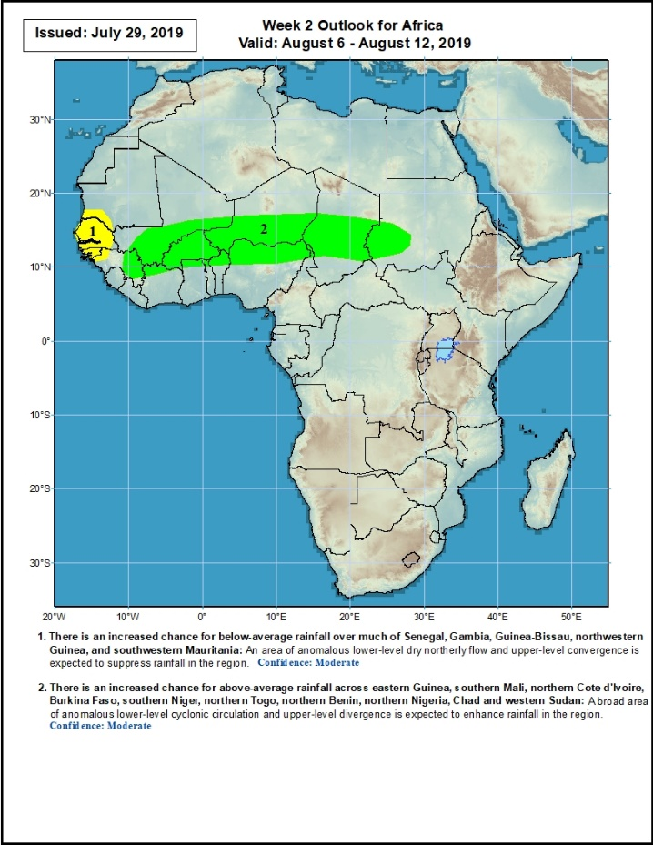
Week-2 Precipitation Outlooks
6 – 12 August, 2019
There is an increased chance for below-average rainfall over much of Senegal, Gambia, Guinea-Bissau, northwestern Guinea, and southwestern Mauritania: An area of anomalous lower-level dry northerly flow and upper-level convergence is expected to suppress rainfall in the region. Confidence: Moderate
There is an increased chance for above-average rainfall across eastern Guinea, southern Mali, northern Cote d'Ivoire, Burkina Faso, southern Niger, northern Togo, northern Benin, northern Nigeria, Chad and western Sudan: A broad area of anomalous lower-level cyclonic circulation and upper-level divergence is expected to enhance rainfall in the region. Confidence: Moderate
Notes:
12

Slide 13
Summary
During the past 30 days, rainfall was above-average over southern Mauritania, Senegal, much of Guinea, parts of Mali, Sierra Leone, Liberia, parts of Cote d’Ivoire and Burkina Faso, Ghana, Togo and Benin, parts of Niger, southern Nigeria, central and southern Cameroon, portions of Chad and CAR, central and northern DRC, much of South Sudan, parts of Uganda, southern Sudan, southwestern Ethiopia, and, western Kenya. Parts of eastern Senegal, southwestern Mali, local areas in Cote d’Ivoire and Burkina Faso, parts of Niger, northern Nigeria, northern Cameroon, southern Chad, local areas in CAR, central Sudan and many parts of Ethiopia had below-average rainfall.
During the past 30 days, western Senegal, portions of Nigeria, local areas in Chad, CAR and South Sudan, parts of central DRC, and portions of Ethiopia had below-average rainfall. Rainfall was above-average over eastern Senegal, Guinea, Sierra Leone, Liberia, Mali, Burkina Faso, Cote d’Ivoire, Ghana, Togo, Benin, portions of Niger, southern Nigeria, Cameroon, many parts of Chad, CAR, Congo, northern DRC, Uganda, South Sudan, southern Sudan, parts of Ethiopia and southwestern Ethiopia.
During the past 90 days, much of Senegal, Mauritania, parts of Cote d’Ivoire, portions of Nigeria, southern Cameroon, Equatorial Guinea, Gabon, much of Congo, local areas in Angola, and parts of Ethiopia had below-average rainfall. Rainfall was above-average over much Guinea, Sierra Leone, Liberia, Mali, parts of Cote d’Ivoire, Burkina Faso, Ghana, Togo Benin, Niger, parts of Nigeria, Chad, northern Cameroon, many parts of CAR, DRC, South Sudan, Uganda, southern Sudan, portions of Ethiopia, southern Somalia, and parts of Kenya and Tanzania.
Week-1 outlooks call for an increased chance for below-average rainfall over much of Senegal, Gambia, Guinea-Bissau, northern Guinea, southern Mauritania and southwestern Mali. In contrast, there is an increased chance for above-average rainfall across eastern Burkina Faso, northern Togo, northern Benin, southwestern Niger, central and northern Nigeria, northern Cameroon, northern CAR, and western Sudan.
Notes:
13

