Slide 1
The African Monsoon Recent Evolution and Current Status Include Week-1 and Week-2 Outlooks
Update prepared by
Climate Prediction Center / NCEP
26 November 2018
For more information, visit:
http://www.cpc.ncep.noaa.gov/products/Global_Monsoons/African_Monsoons/precip_monitoring.shtml

Slide 2
Outline
Highlights
Recent Evolution and Current Conditions
NCEP GEFS Forecasts
Summary

Slide 3
Highlights: Last 7 Days
Central Tanzania, western Mozambique and local areas in northern Madagascar, southern Nigeria and western Gabon experienced moisture surpluses of over 100 mm.
Moisture deficits of over 25 mm were observed in southern Gabon, southern Congo-Brazzaville, northern DRC, local areas in southern Uganda, central Kenya, southern Somalia, Angola, western Zambia, northern Zimbabwe, northeastern South Africa and western Madagascar.
Week-1 and week-2 forecasts call for an increased chance for weekly rainfall totals to exceed 50 mm over southern Gabon, southern Congo-Brazzaville, southern DRC, northern Angola, northern Zambia and portions of Madagascar. In addition, week-1 forecast indicates an increased chance for weekly rainfall totals to exceed 50 mm over local areas in Mozambique.

Slide 4
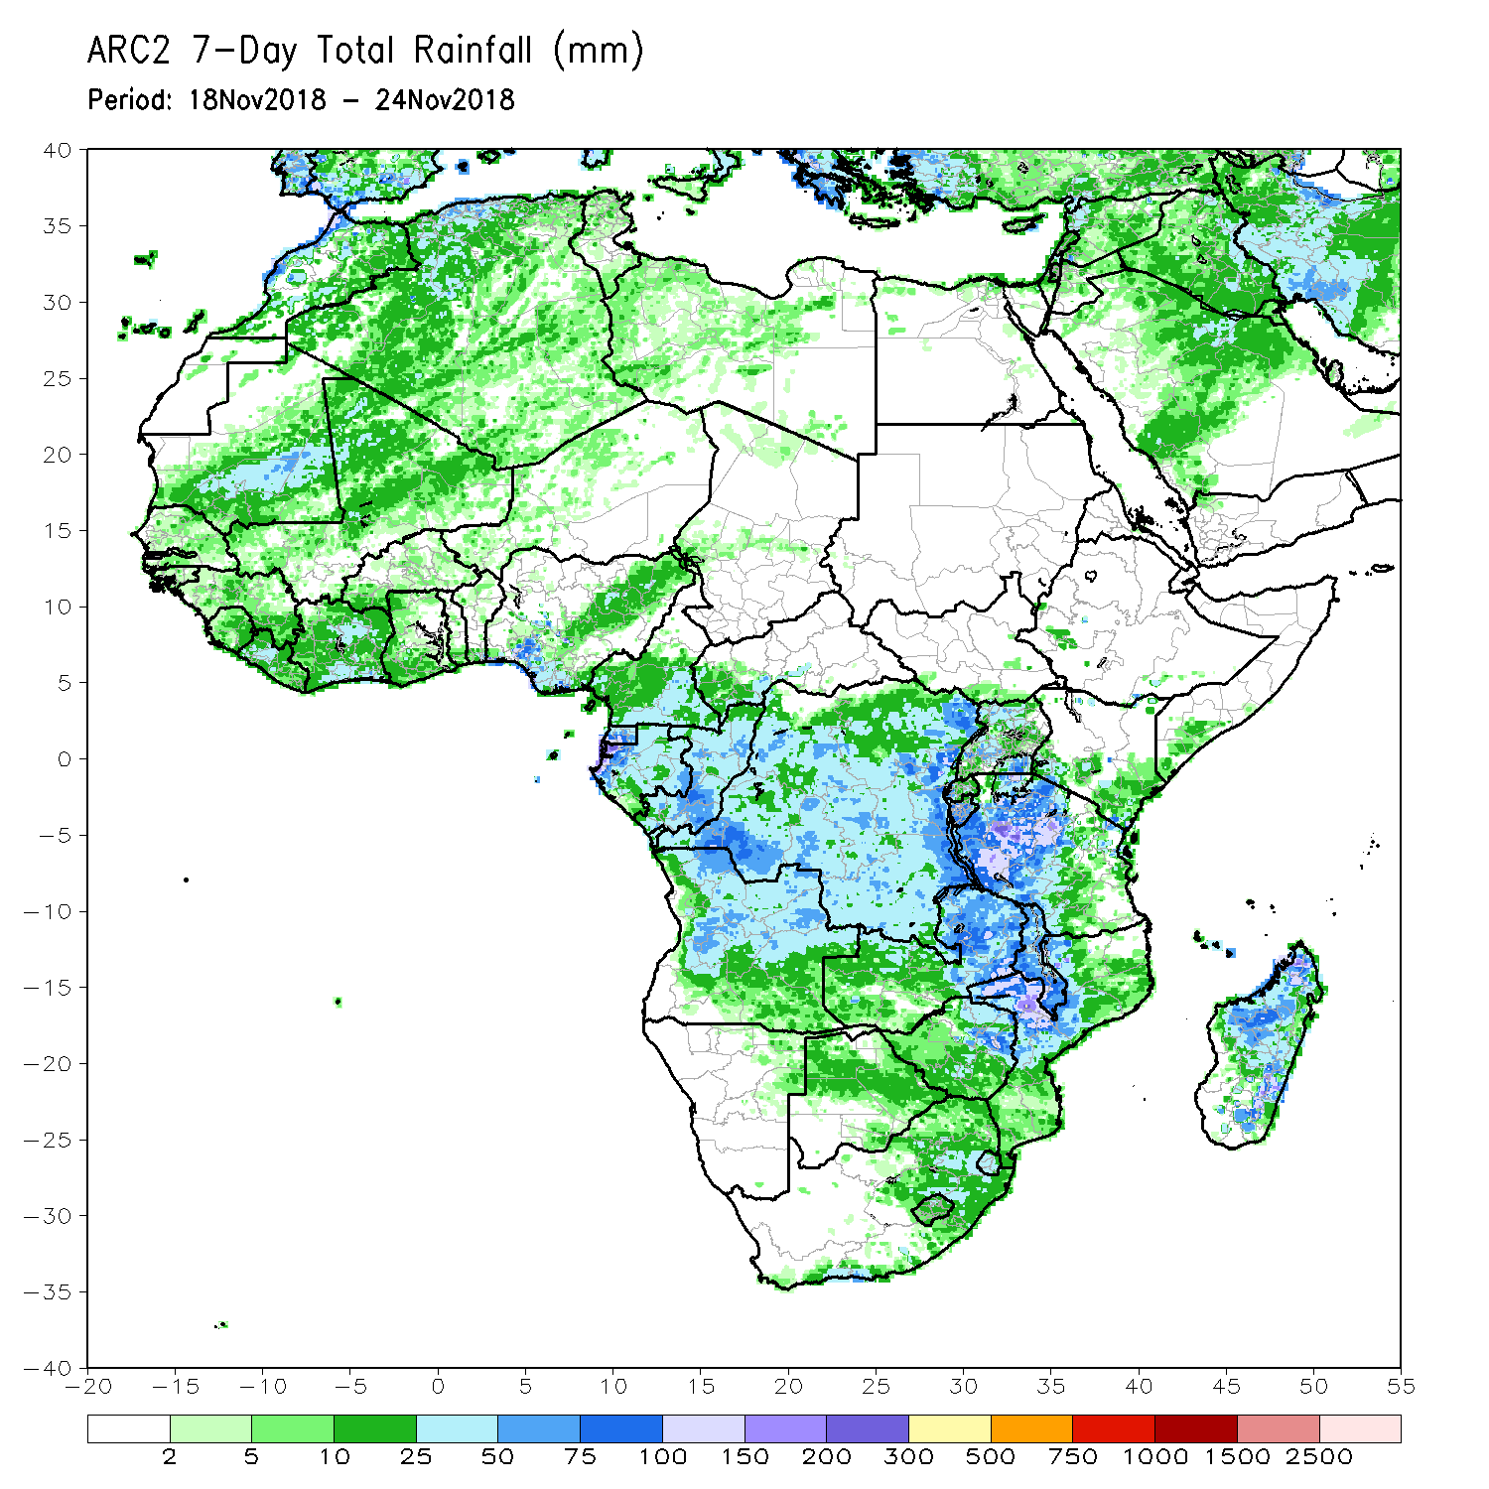
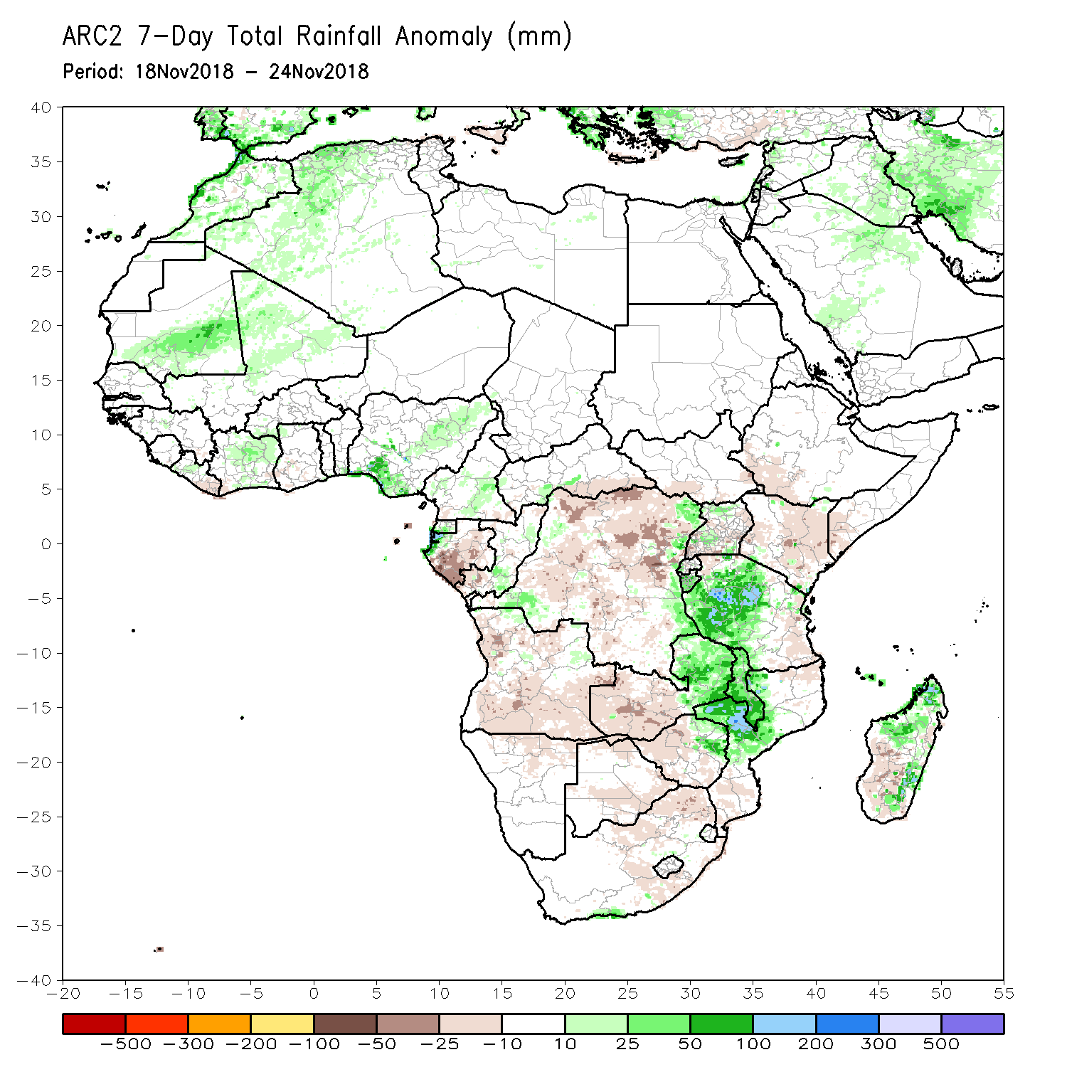
Rainfall Patterns: Last 7 Days
During the past 7 days, above-average rainfall was observed over parts of Morocco, Algeria, southern Mauritania, northern Mali, western Liberia, Côte d’Ivoire, Nigeria, Cameroon, southern Equatorial Guinea and western Gabon. Above-average rainfall was also observed over parts of Congo-Brazzaville, CAR, local areas in DRC, Uganda, much of Burundi, Tanzania, eastern Zambia, eastern Zimbabwe, Malawi, western Mozambique, Madagascar and southern South Africa.
In contrast, much of DRC, Gabon, Angola, eastern South Africa, northern and southern Mozambique, western Zimbabwe, western Zambia, Kenya, southern CAR, parts of Madagascar, southern Somalia, and southwestern Ethiopia received below-average rainfall.

Slide 5
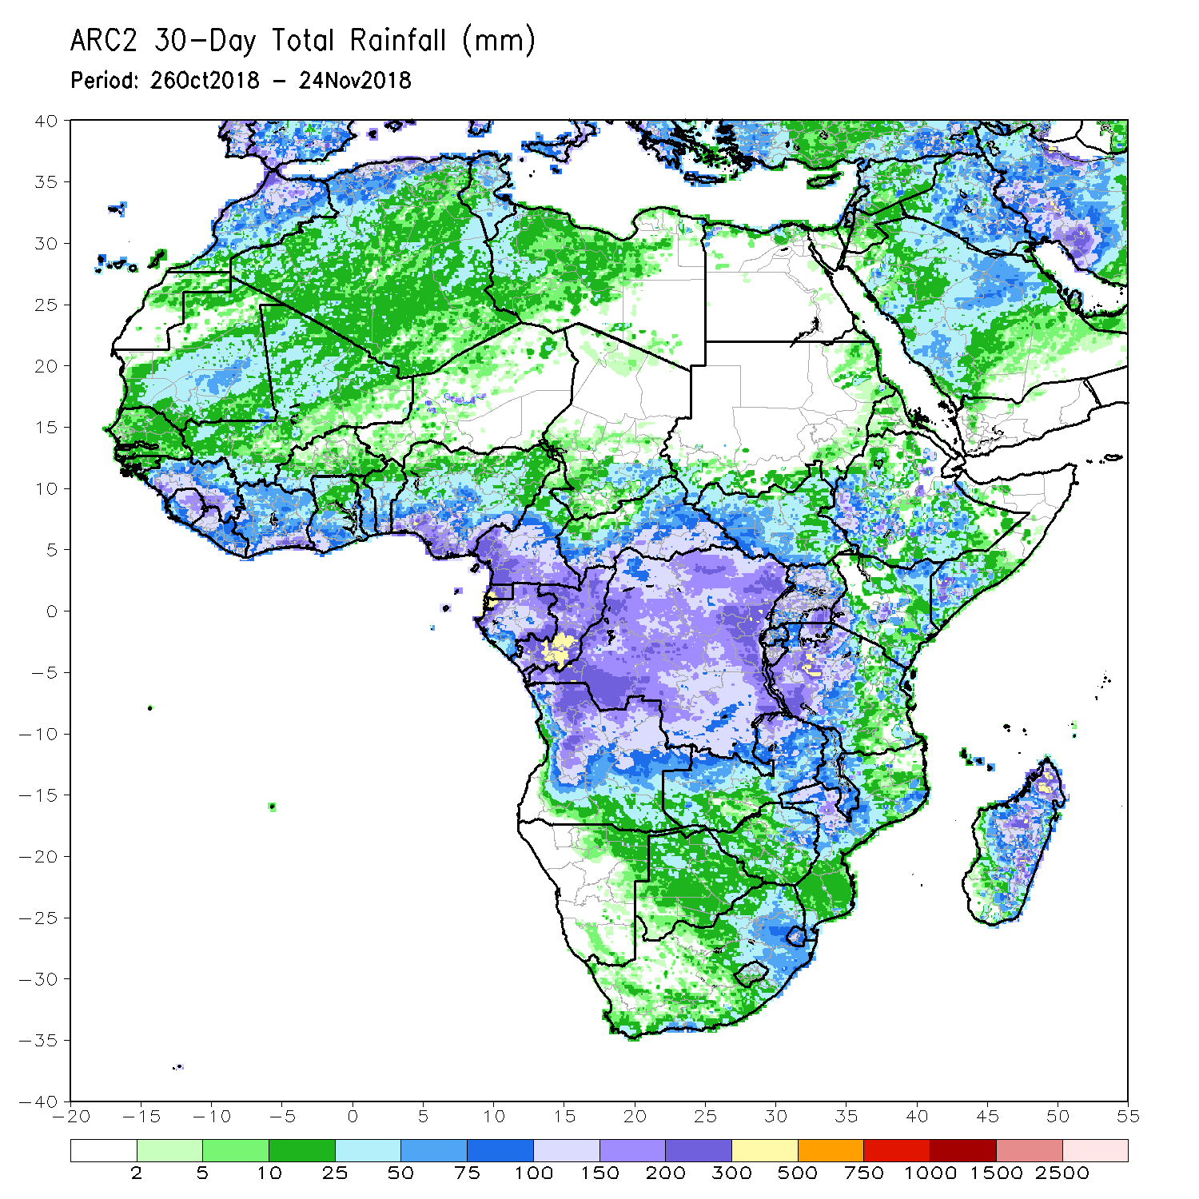
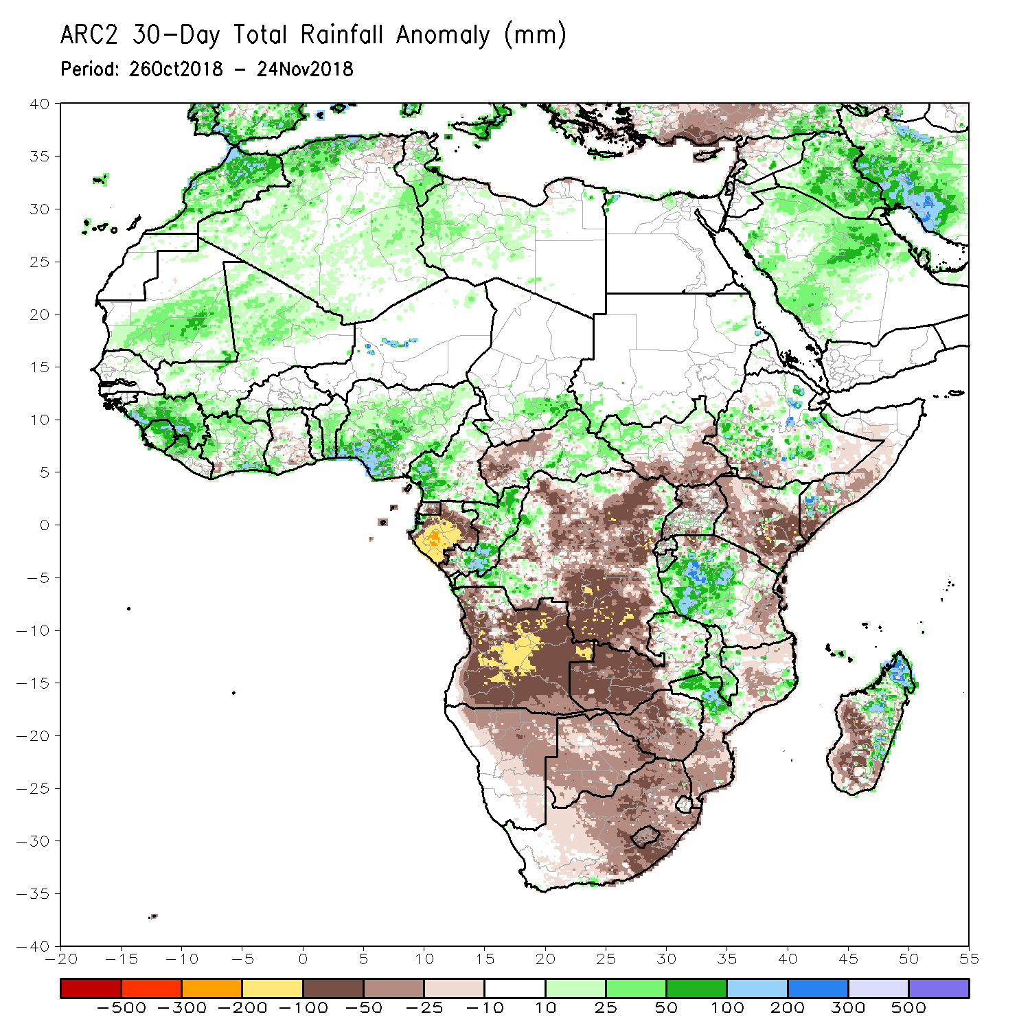
Rainfall Patterns: Last 30 Days
During the past 30 days, moisture surpluses of over 100 mm (more than 200% of normal rainfall) were observed in northern Morocco, northern Algeria, parts of Guinea, Sierra Leone, southern Côte d’Ivoire, southern Benin, southern Nigeria, western Cameroon, central Niger, southern Congo-Brazzaville, local areas in Ethiopia, southern Somalia, western Tanzania, western Mozambique and northern Madagascar.
Conversely, moisture deficit of over 100 mm (less than 80% of normal rainfall) were observed in Gabon, central and eastern Angola and local areas in DRC, northern Tanzania, Madagascar, eastern Kenya and southern Somalia.
Notes:
5

Slide 6
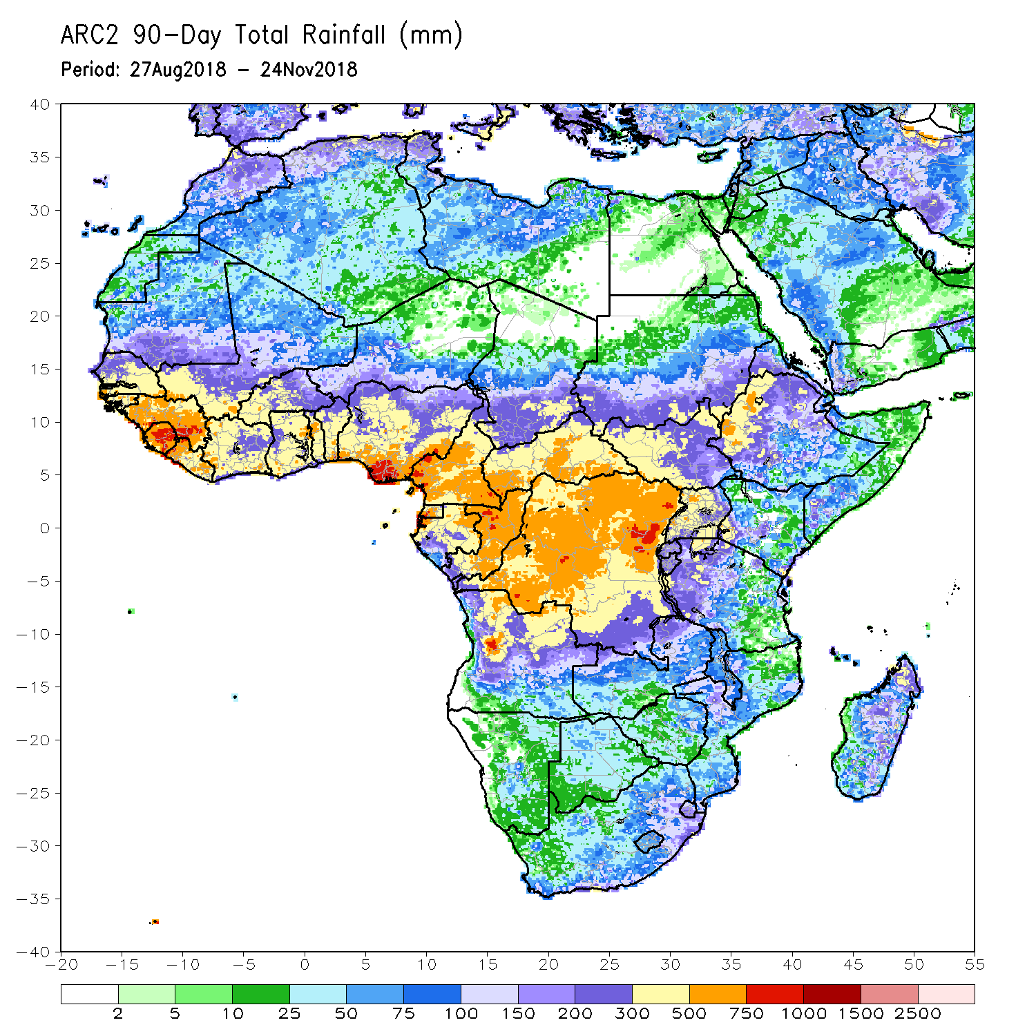
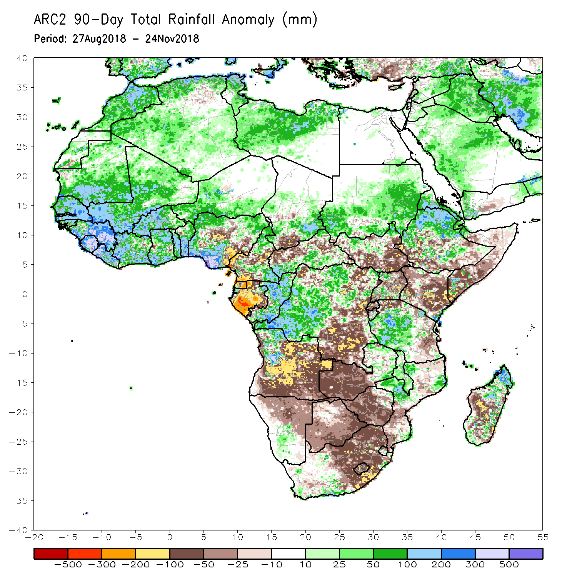
Rainfall Patterns: Last 90 Days
During the past 90 days, eastern Guinea, Sierra Leone, western Liberia, southern Benin, southern Nigeria, and local areas in the northern part of Congo-Brazzaville, western part of Angola, northern part of Ethiopia, eastern Tanzania, southern Kenya and northern part of Madagascar experienced moisture surpluses of over 300 mm.
Moisture deficits of over 100 mm were observed in parts of Nigeria, Cameroon, Equatorial Guinea, Gabon, southern Chad, northern CAR, South Sudan, southern Ethiopia, southern Somalia, central Kenya, Uganda, portions of DRC, much of Angola, northern Tanzania, southern South Africa and portions of Madagascar.
Notes:
6

Slide 7
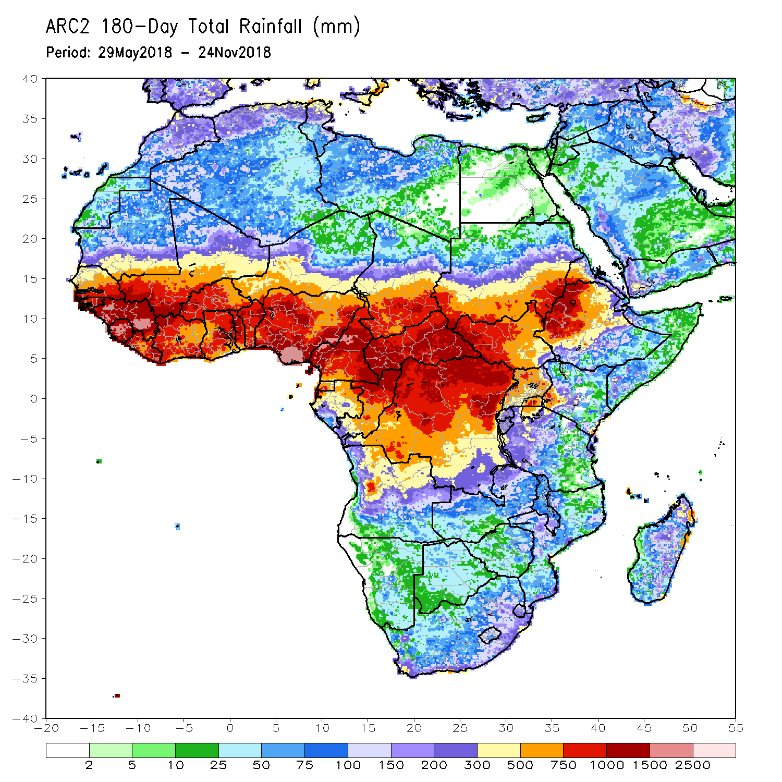
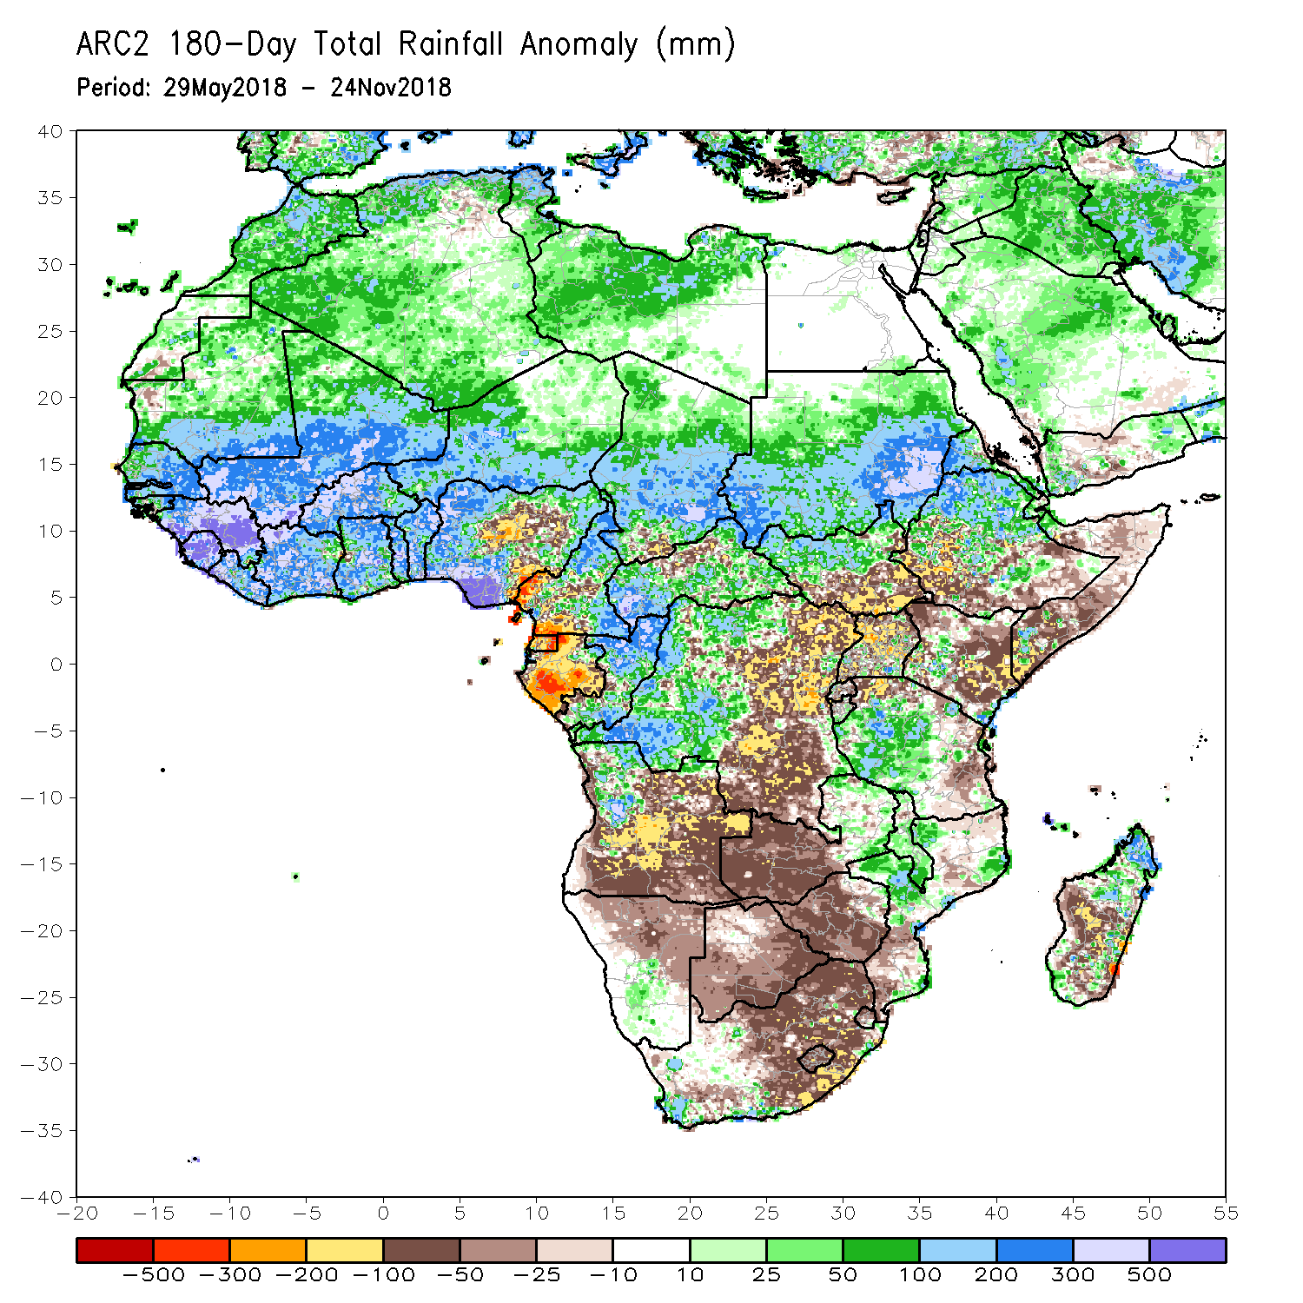
Rainfall Patterns: Last 180 Days
During the past 180 days, Guinea, Sierra Leone, southern Nigeria and portions of Cameroon registered rainfall totals of over 2500 mm (moisture surpluses of over 500 mm).
Moisture deficits of over 300 mm were observed in the eastern border of Nigeria and Cameroon, southern Cameroon, Equatorial Guinea and many parts of Gabon.
Notes:
7

Slide 8
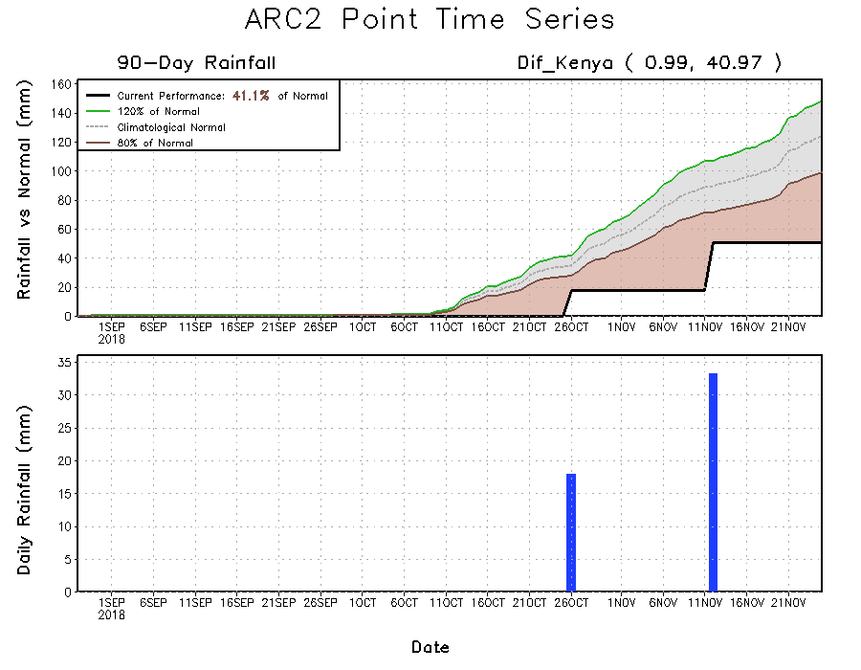
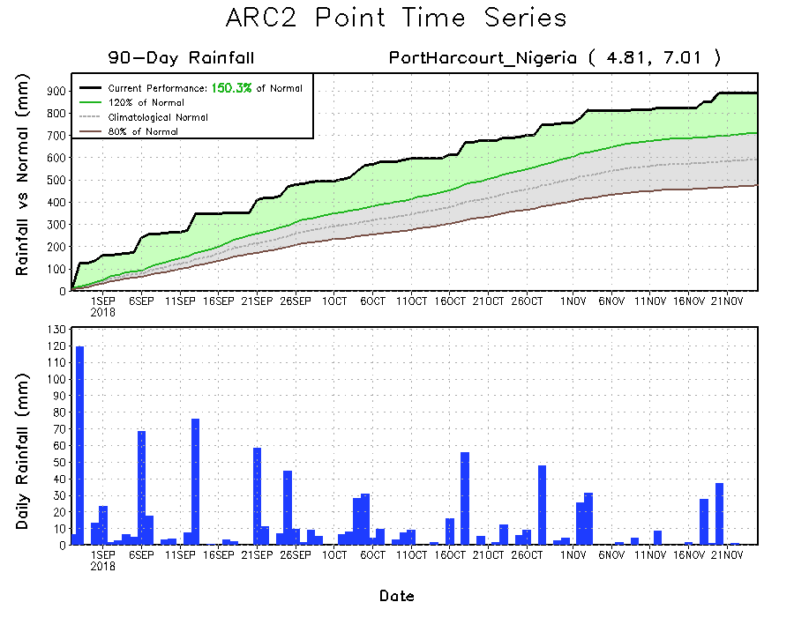
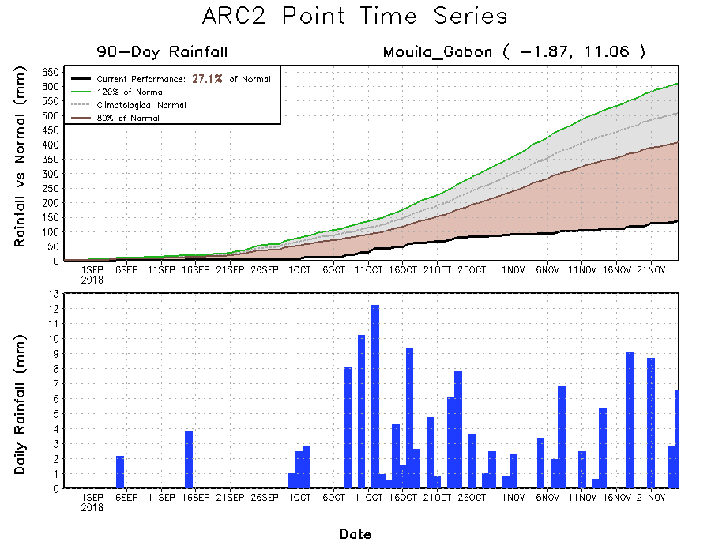
Recent Rainfall Evolution
Daily evolution of rainfall over the last 90 days at selected locations highlights moisture surpluses over the southern part of Nigeria (bottom left), while moisture deficits are evident over Kenya that continues to experience suppressed rainfall (top right). Below-average rainfall prevailed over Gabon, despite the recent precipitation (bottom right).

Slide 9
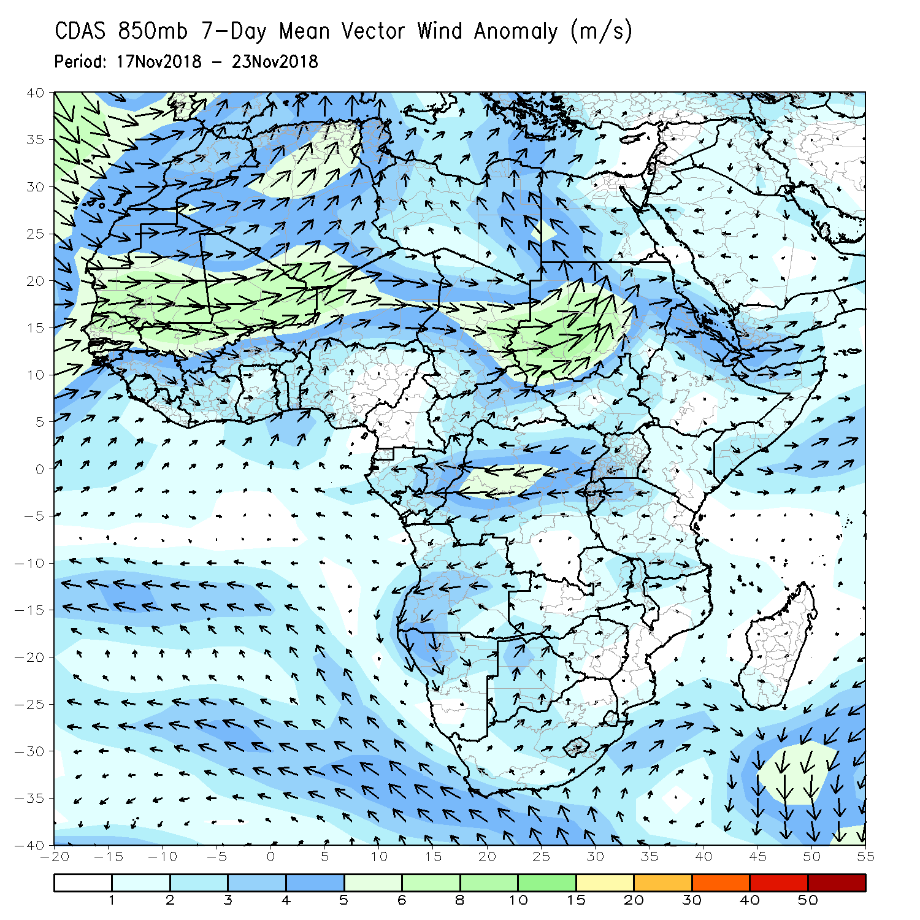
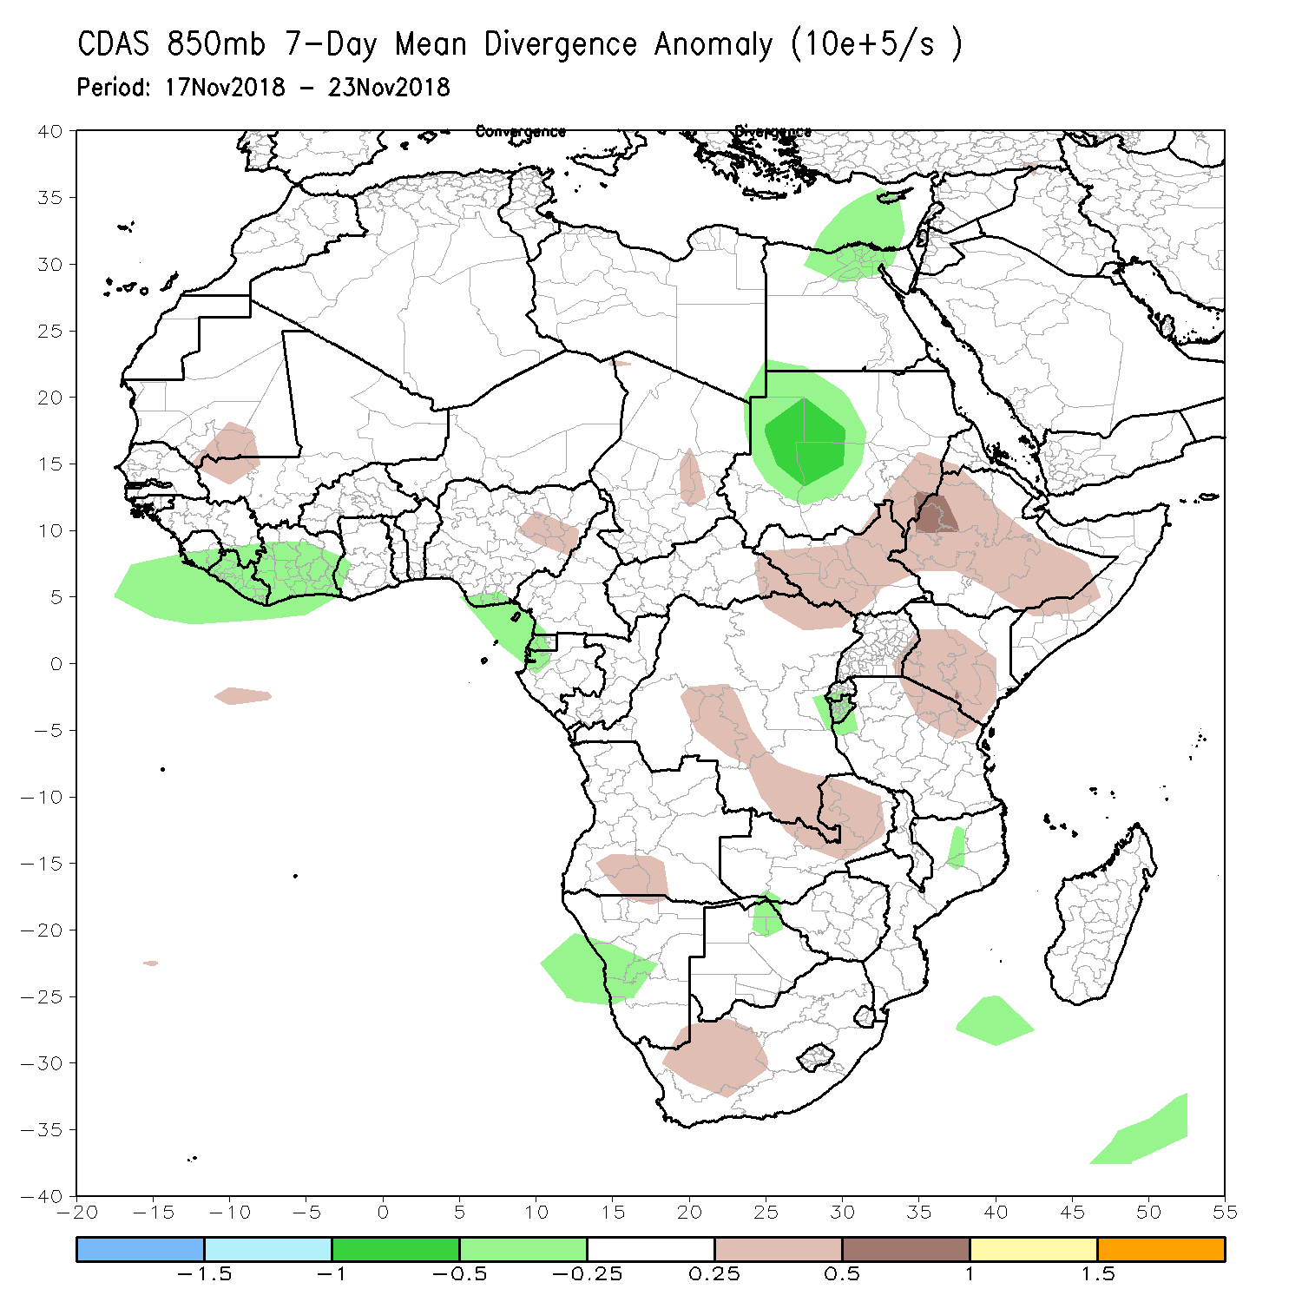
Atmospheric Circulation: Last 7 Days
At 850 mb, the flow from the cyclonic circulation over the southeastern part of the Atlantic Ocean may have contributed to wet conditions in Morocco, Algeria, northern Mali and Mauritania.

Slide 10
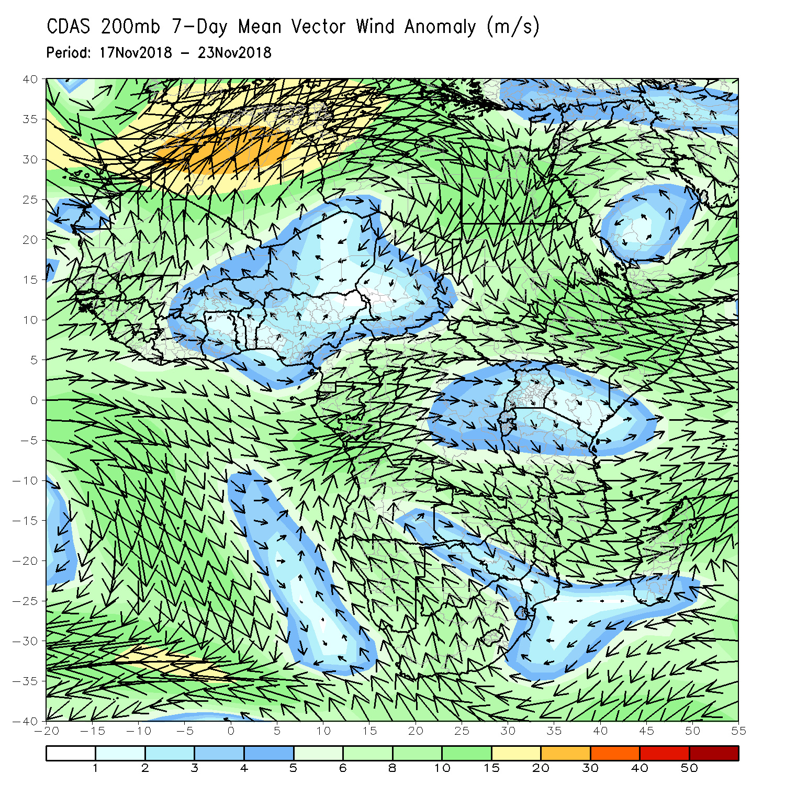
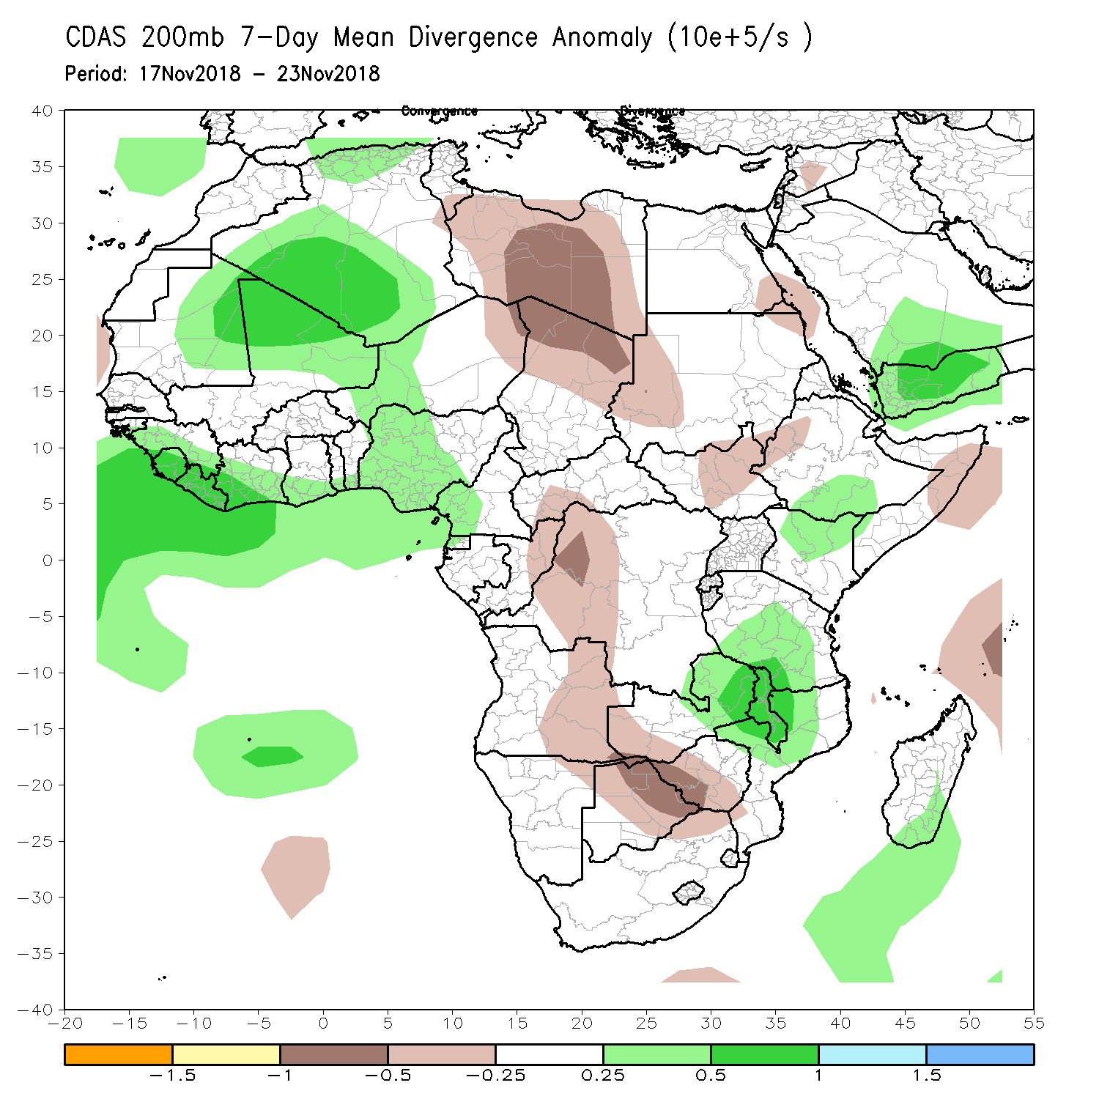
Atmospheric Circulation: Last 7 Days
The upper-level divergence zones over the northwestern and southeastern parts of Africa may have led to wet conditions in Morocco, Algeria, portions of Mauritania and Mali, as well as Tanzania, eastern Zambia, Malawi, central Mozambique and eastern Zimbabwe.
The upper-level convergence over the central and southern part of Africa may have contributed to observed suppressed rainfall in the neighboring countries.

Slide 11
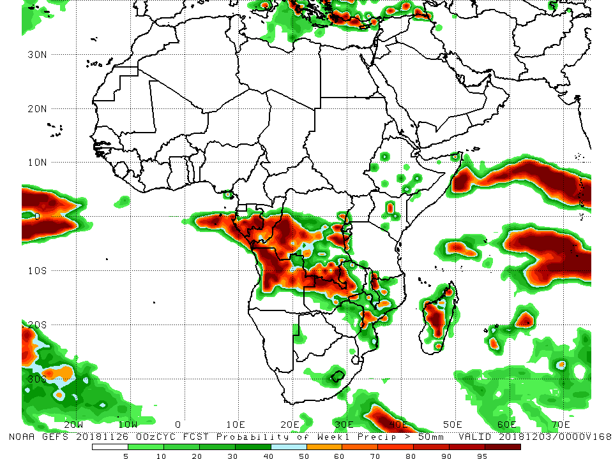
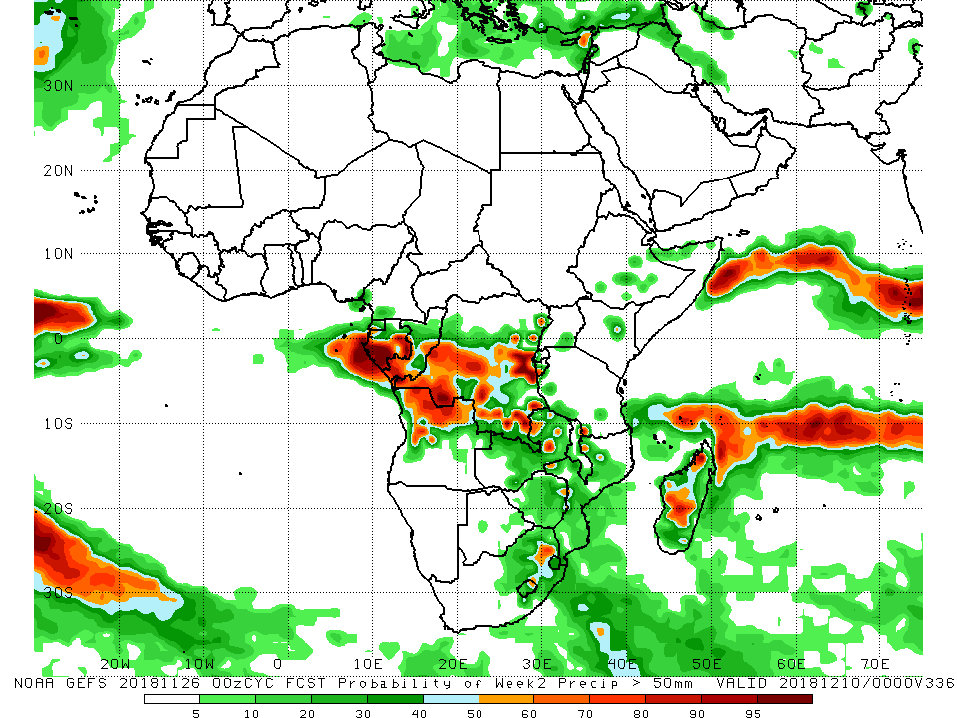
NCEP GEFS Model Forecasts Non-Bias Corrected Probability of precipitation exceedance
Week-1: Valid 27 November – 3 December, 2018
Week-2: Valid 4-10 December, 2018
Week-1 (left panel) and week-2 (right panel) forecasts call for an increased chance for weekly rainfall totals to exceed 50 mm over southern Gabon, southern Congo-Brazzaville, southern DRC, northern Angola, northern Zambia and portions of Madagascar.
In addition, week-1 forecast indicates an increased chance for weekly rainfall totals to exceed 50 mm over local areas in Mozambique.
Notes:
11

Slide 12
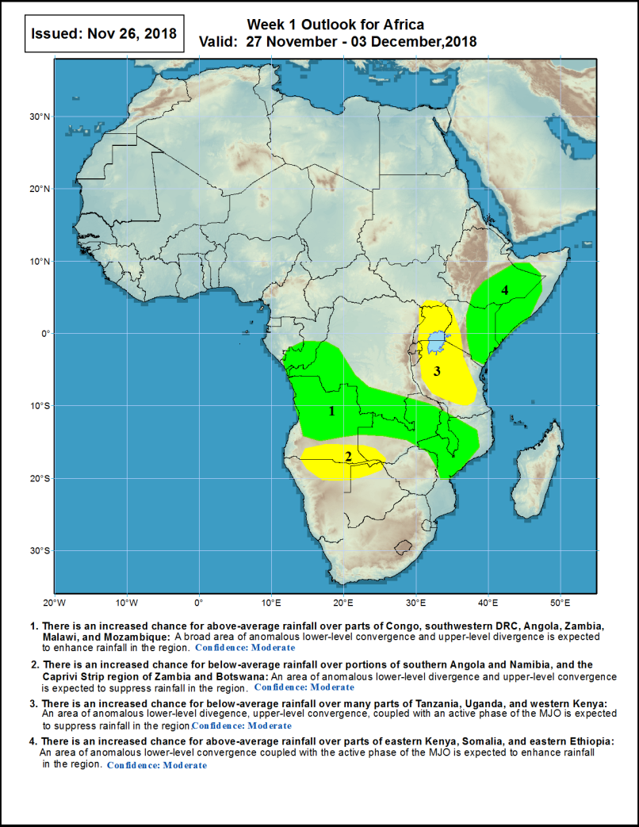
Week-1 Precipitation Outlooks
27 Nov- 3 Dec, 2018
There is an increased chance for above-average rainfall over parts of Congo, southwestern DRC, Angola, Zambia, Malawi, and Mozambique: A broad area of anomalous lower-level convergence and upper-level divergence is expected to enhance rainfall in the region. Confidence: Moderate
There is an increased chance for below-average rainfall over portions of southern Angola and Namibia, and the Caprivi Strip region of Zambia and Botswana: An area of anomalous lower-level divergence and upper-level convergence is expected to suppress rainfall in the region. Confidence: Moderate
There is an increased chance for below-average rainfall over many parts of Tanzania, Uganda, and western Kenya: An area of anomalous lower-level divergence and upper-level convergence, coupled with an active phase of the MJO is expected to suppress rainfall in the region. Confidence: Moderate
There is an increased chance for above-average rainfall over parts of eastern Kenya, Somalia, and eastern Ethiopia: An area of anomalous lower-level convergence coupled with the active phase of the MJO is expected to enhance rainfall in the region. Confidence: Moderate
Notes:
12

Slide 13
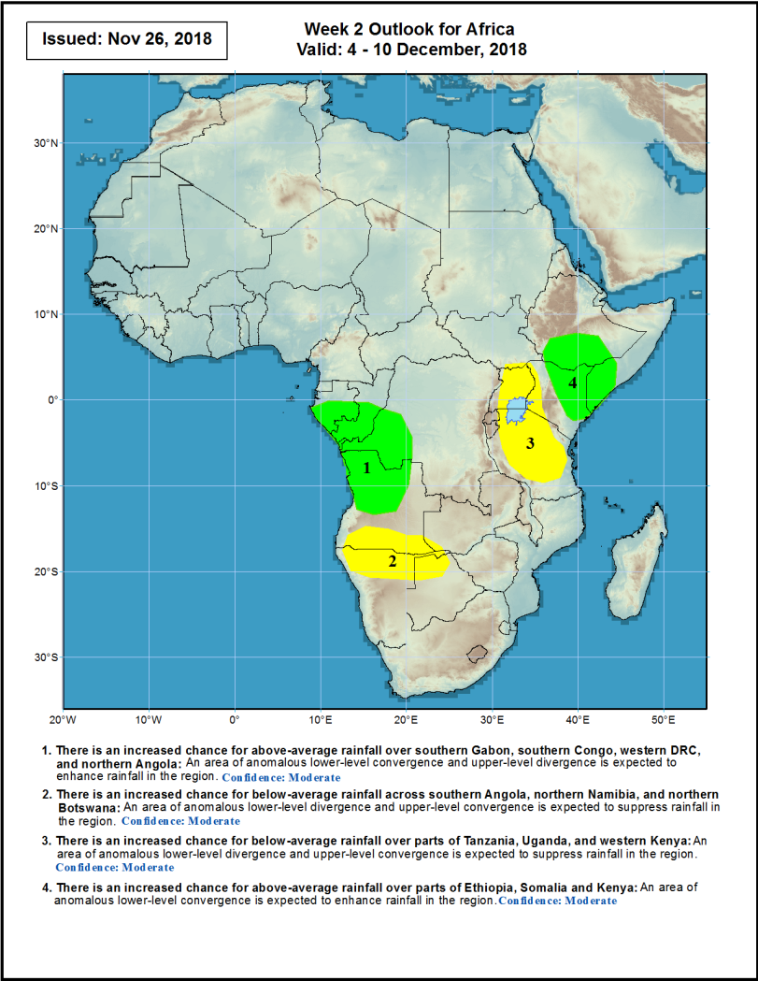
Week-2 Precipitation Outlooks
4 -10 Dec, 2018
There is an increased chance for above-average rainfall over southern Gabon, southern Congo, western DRC, and northern Angola: An area of anomalous lower-level convergence and upper-level divergence is expected to enhance rainfall in the region. Confidence: Moderate
There is an increased chance for below-average rainfall across southern Angola, northern Namibia, and northern Botswana: An area of anomalous lower-level divergence and upper-level convergence is expected to suppress rainfall in the region. Confidence: Moderate
There is an increased chance for below-average rainfall over parts of Tanzania, Uganda, and western Kenya: An area of anomalous lower-level divergence and upper-level convergence is expected to suppress rainfall in the region. Confidence: Moderate
There is an increased chance for above-average rainfall over parts of Ethiopia, Somalia and Kenya: An area of anomalous lower-level convergence is expected to enhance rainfall in the region. Confidence: Moderate
Notes:
13

Slide 14
Summary
During the past 7 days, above-average rainfall was observed over parts of Morocco, Algeria, southern Mauritania, northern Mali, western Liberia, Côte d’Ivoire, Nigeria, Cameroon, southern Equatorial Guinea and western Gabon. Above-average rainfall was also observed over parts of Congo-Brazzaville, CAR, local areas in DRC, Uganda, much of Burundi, Tanzania, eastern Zambia, eastern Zimbabwe, Malawi, western Mozambique, Madagascar and southern South Africa. In contrast, much of DRC, Gabon, Angola, eastern South Africa, northern and southern Mozambique, western Zimbabwe, western Zambia, Kenya, southern CAR, parts of Madagascar, southern Somalia, and southwestern Ethiopia received below-average rainfall.
During the past 30 days, moisture surpluses of over 100 mm (more than 200% of normal rainfall) were observed in northern Morocco, northern Algeria, parts of Guinea, Sierra Leone, southern Côte d’Ivoire, southern Benin, southern Nigeria, western Cameroon, central Niger, southern Congo-Brazzaville, local areas in Ethiopia, southern Somalia, western Tanzania, western Mozambique and northern Madagascar. Conversely, moisture deficit of over 100 mm (less than 80% of normal rainfall) were observed in Gabon, central and eastern Angola and local areas in DRC, northern Tanzania, Madagascar, eastern Kenya and southern Somalia.
During the past 90 days, eastern Guinea, Sierra Leone, western Liberia, southern Benin, southern Nigeria, and local areas in the northern part of Congo-Brazzaville, western part of Angola, northern part of Ethiopia, eastern Tanzania, southern Kenya and northern part of Madagascar experienced moisture surpluses of over 300 mm. Moisture deficits of over 100 mm were observed in parts of Nigeria, Cameroon, Equatorial Guinea, Gabon, southern Chad, northern CAR, South Sudan, southern Ethiopia, southern Somalia, central Kenya, Uganda, portions of DRC, much of Angola, northern Tanzania, southern South Africa and portions of Madagascar.
During the past 180 days, Guinea, Sierra Leone, southern Nigeria and portions of Cameroon registered rainfall totals of over 2500 mm (moisture surpluses of over 500 mm). Moisture deficits of over 300 mm were observed in the eastern border of Nigeria and Cameroon, southern Cameroon, Equatorial Guinea and many parts of Gabon.
Week-1 and week-2 forecasts call for an increased chance for weekly rainfall totals to exceed 50 mm over southern Gabon, southern Congo-Brazzaville, southern DRC, northern Angola, northern Zambia and portions of Madagascar. In addition, week-1 forecast indicates an increased chance for weekly rainfall totals to exceed 50 mm over local areas in Mozambique.
Notes:
14

