Slide 1
Drought Outlook Support Briefing August 2021
Climate Prediction Center/NCEP/NOAA
http://www.cpc.ncep.noaa.gov/products/Drought

Slide 2
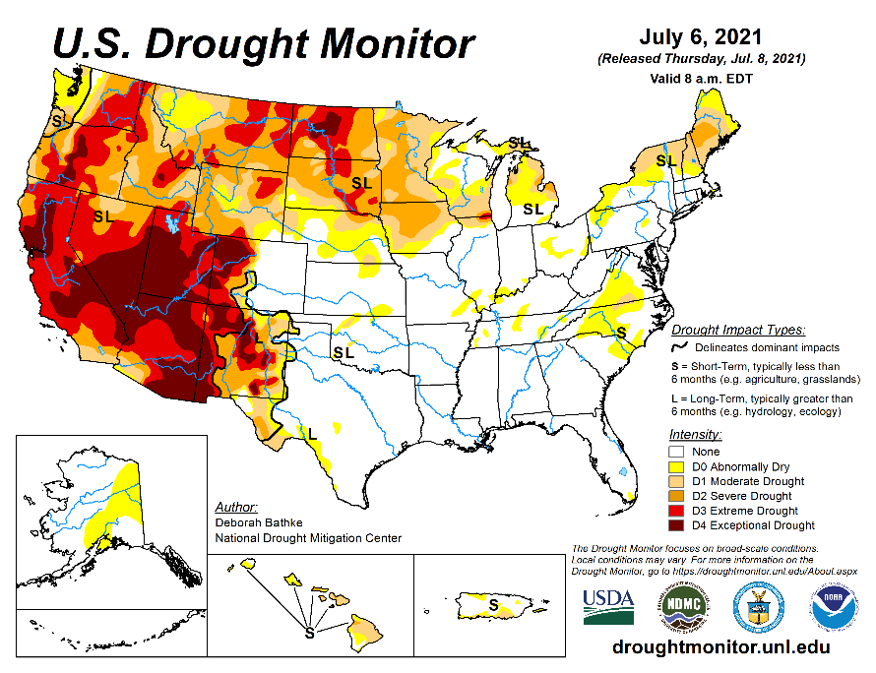
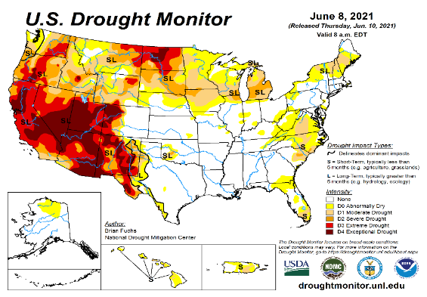
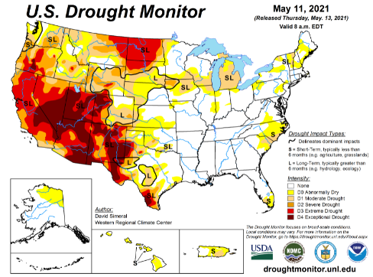
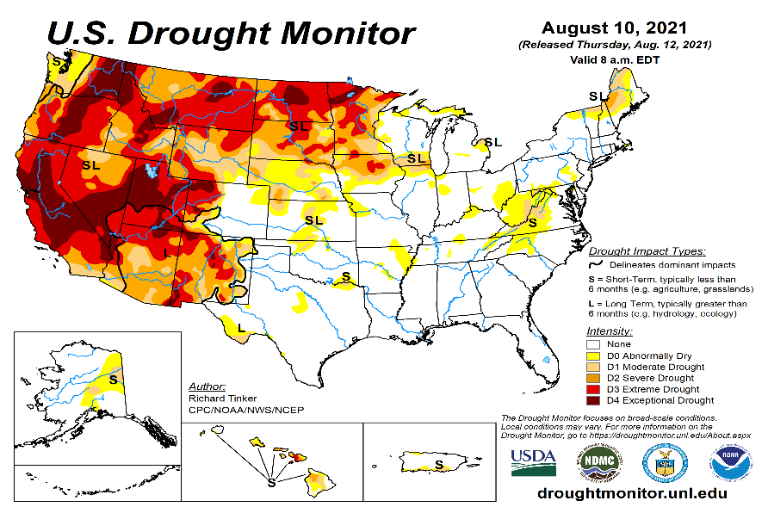
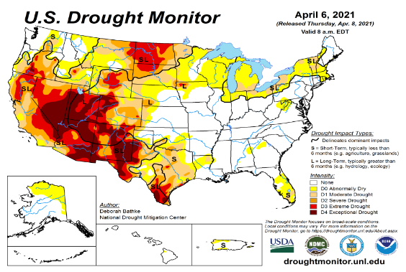
Drought Monitor
Monitoring is important because, unlike US T/P fcsts, for drought forecasts, we have to know where we are, before we can tell where we are going!! Drought forecasts are tendency forecasts.
July
June
Due to better SW monsoon rainfall this year, improvement in short term drought conditions is happening around the four corners states area and vicinity and is also forecast. But Long term drought worries prevail! Hard to distinguish/show in USDM!
Over the last 4-5 months, drought area has overall generally remained about the same, but severity has lessened somewhat in the US west. The worse drought conditions are in the border areas of southwest states CA, NV, UT, western CO, and NM. These west regions are part of the long term drought.
The somewhat improved conditions in the SW is compensated by the slightly worsened conditions in the Northern Great plains area, thus still keeping about 50 % of the to continue to experience category D1 or worse drought condition (next side!). Dry/Drought conditions over the eastern US slightly improved.
May
August
(Recent/Latest)
April
February

Slide 3
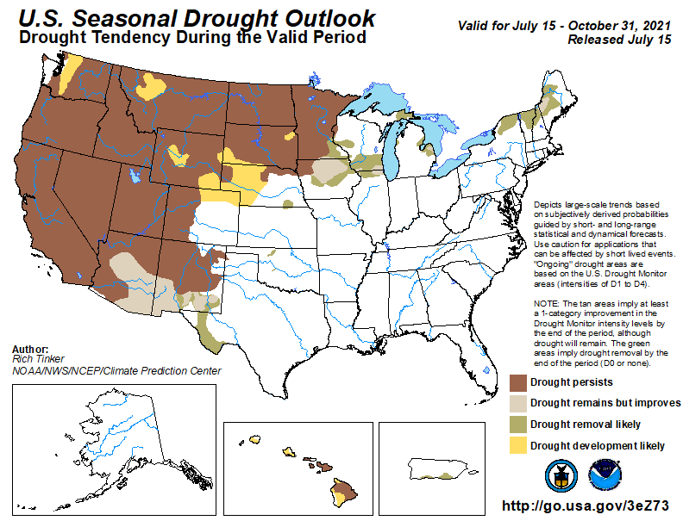
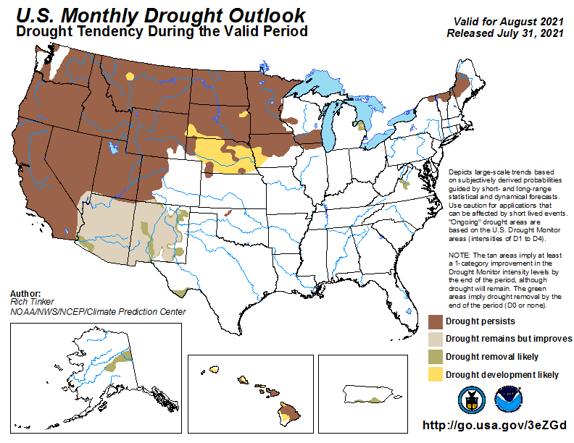
(Previous) Seasonal/Monthly Drought outlooks
New Seasonal+ Drought Outlook to be released in 2 days!
New Monthly Drought Outlook to be released end of this month)
Seasonal Outlook
(Mid July 2021- Oct 2021)
issued 07/15/21
Monthly outlook
(for August 2021)
issued 07/31/21
Similar looking Monthly and seasonal outlooks.!
Improvements forecast (short term!) in parts of southwest, due to better monsoon rains around AZ/NM & vicinity!!
Also compare West vs East.

Slide 4
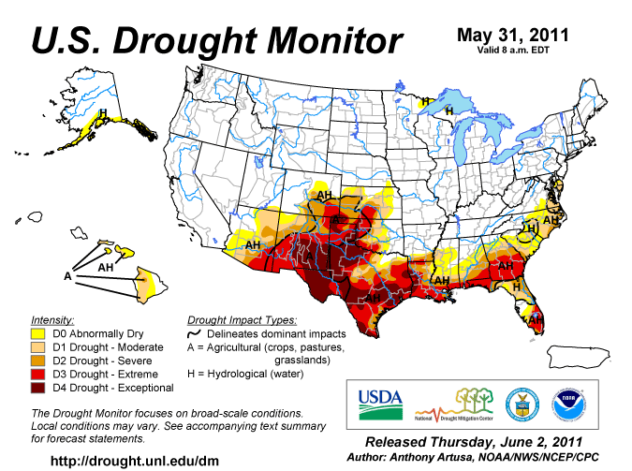
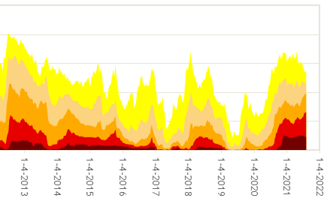
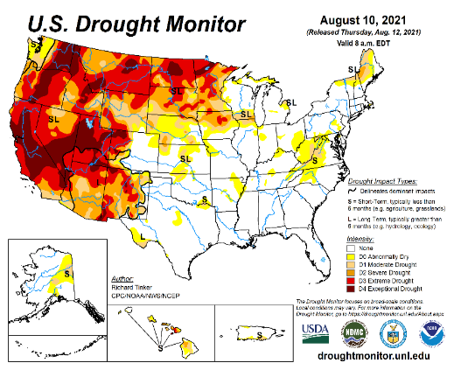
Famous 2011 TX drought
Just as no two ENSO events are the same,
no two drought events are he same!
The recent drought has somewhat stagnated ?
50%
Now!
Most area continuously under severe D4 drought for a long time since 2000?

Slide 5
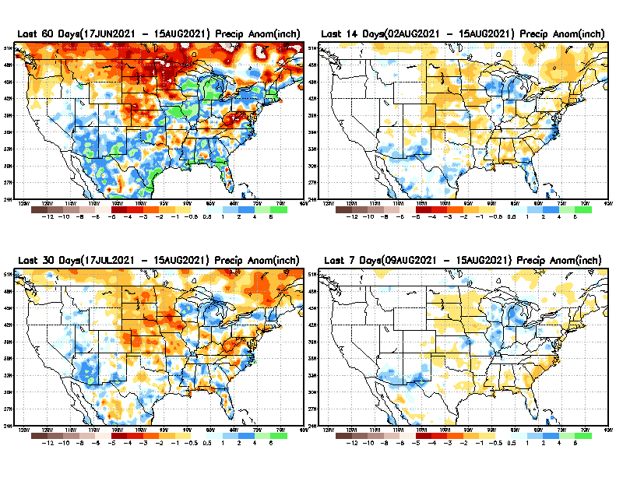
Precipitation ANOM during last 7, 14, 30, & 60 days.
This and next few slides show Precip deficit (excess).
Droughts, for the MOST part, begin and end with precip!! Lately, Temps are becoming (secondarily) important as well.
60 Days
14 Days
30 Days
7 Days
These maps in this and following slides, including a) Total,
b) Anom and
c) Percent of Normal precip. in these and other longer time ranges are now (routinely) daily updated at:
From: Recent Accumulated Precipitation https://www.cpc.ncep.noaa.gov/products/Drought/briefing_prcp.shtml

Slide 6
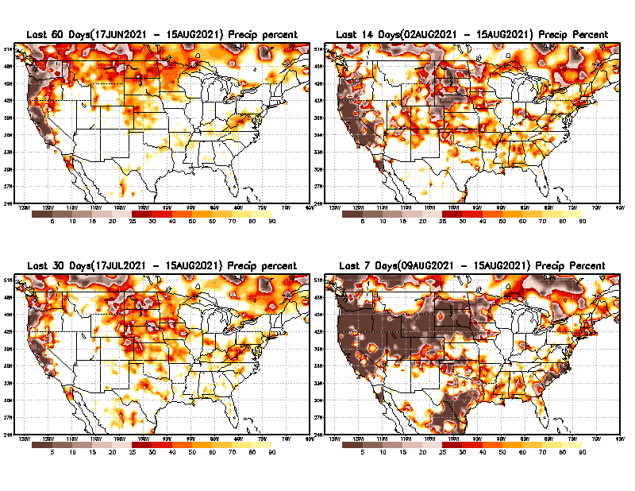
Precipitation Percent (of normal) during last 7, 14, 30, & 60 days - Only Deficit Areas <=90% shown !
60 Days
14 Days
This plot shows only the rainfall deficient regions <= 90% of normal.
-- This shows more clearly possible/likely drought developing region in the future unless there is above normal rainfall in these regions in the future, to offset these shortfalls.
30 days
7 Days
☹
☺
From: Recent Accumulated Precipitation https://www.cpc.ncep.noaa.gov/products/Drought/briefing_prcp.shtml

Slide 7
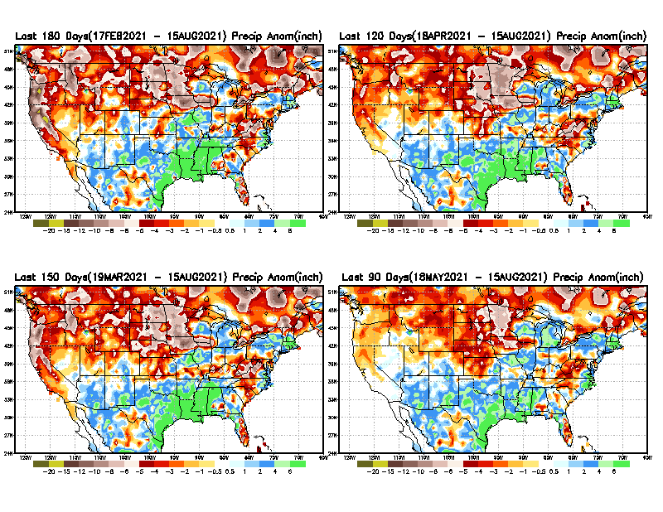
Total precipitation ANOM during last 3, 4, 5, and 6 months.
6 M
4 M
While the Precipitation anomalies deficit may seem large in some regions (compared to others), it is the % of normal precip (next slide) that matters more!!
5 M
3 M
May look bad here, but in % map (next!)
From: Recent Accumulated Precipitation https://www.cpc.ncep.noaa.gov/products/Drought/briefing_prcp.shtml

Slide 8
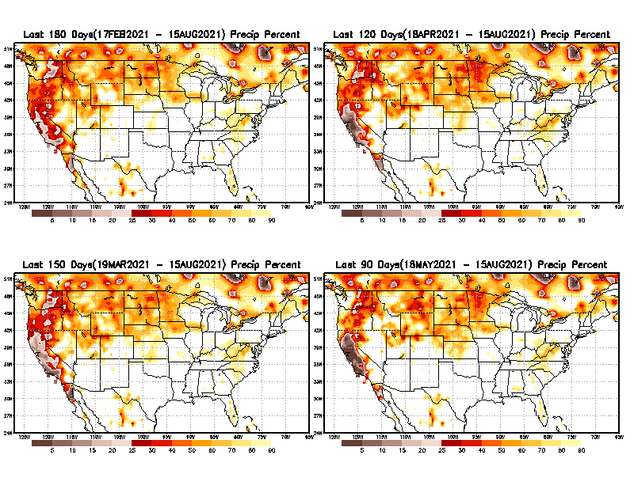
Total precipitation Percent (of normal) during last 3, 4, 5, and 6 months Only Deficit Areas <=90% shown!!
6 M
4 M
In these interim time scale 3-6 months, we need to pay attention to regions, which are dark-brown, red & dark red (<50%).
Not so bad!
in %
While accrued precipitation deficits are real & objective,
droughts are subjective declarations!!
5 M
3M
East vs West!
Broad vs Narrow
rainfall season.
In general, West suffers more from frequent and lasting droughts.
With these various rainfall deficits in diff. time ranges, where and how exactly does one declare drought? Other factors (T/SM/E, etc..) do matter, but is cumulative precip. Are deficits/percent_of_normal ultimately more important?

Slide 9
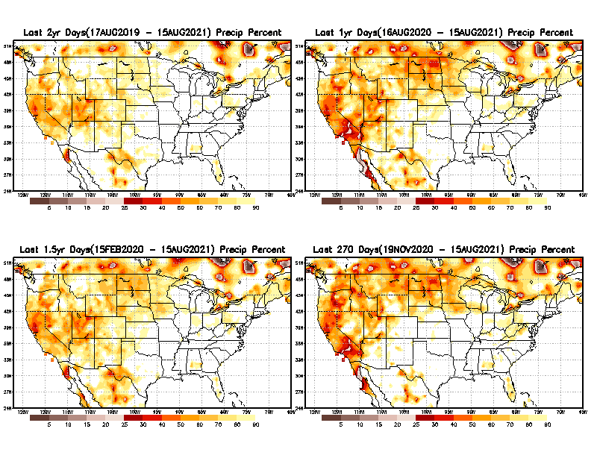
Total precipitation Percent during last 9 months, 1 yr, 1.5yrs, & 2 yrs. .–Only Deficit Areas shown!! <=90%
2 Y
1 Y
Tinderbox areas, where some form of longer term rainfall
deficiencies already, exist !!
-Almost all are in the southwest!, all part of the long term drought
-This & Next slide!!
1.5 Y
9 M
From: Recent Accumulated Precipitation https://www.cpc.ncep.noaa.gov/products/Drought/briefing_prcp.shtml

Slide 10
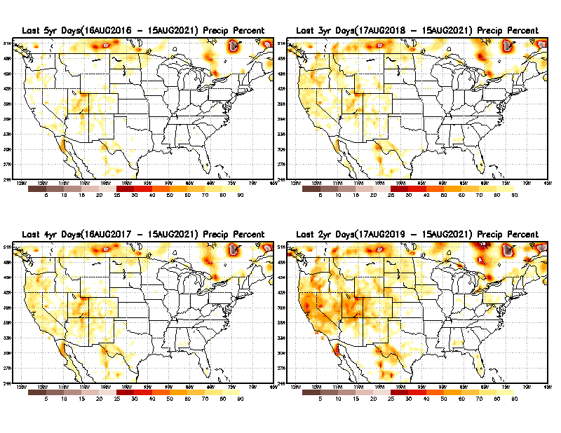
Total precipitation Percent (of normal) during last 2, 3, 4, & 5 yrs. .–Only Deficit Areas <=90% shown !!
5 Y
3 Y
In these long time ranges (2-5 yrs), there is a general dearth/lack of precipitation in the southwest US. – where the current severe drought ravages!!.
If the La Nina returns later in the year, things will get even worse!!
4 Y
2 Y
Ongoing multiyear drought in the SouthWest!! Getting Worse.
Last few years, each year is a new record for the Fire Season!!
From: Recent Accumulated Precipitation https://www.cpc.ncep.noaa.gov/products/Drought/briefing_prcp.shtml

Slide 11
Rainy (3-month)Season across the US
SON - Least rainfall season of the year for the US? – No Green??
East vs West!
More darker colors in west/central => narrow rainy season (months)
Overall, more white space in the east => distributed rainfall season (except ~FL).

Slide 12
SON season, difficult season for drought forecast? Also transition-ing ENSO?
*********
EAST vs
CTR/WEST
Drought Behavior is loosely tied to rainfall climo!! And the limited rainy season in the west
*********
Adapted from Rich Tinker.

Slide 13
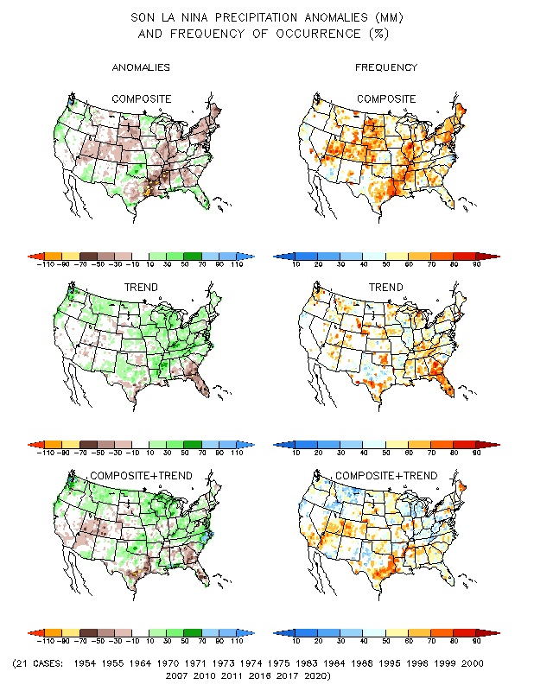
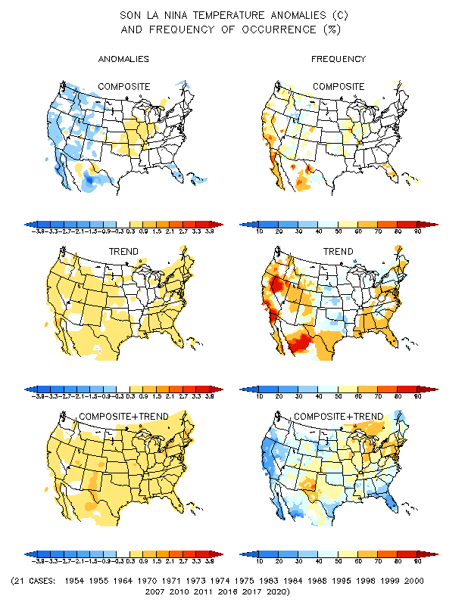
La Nina Precip/Temperature COMPOSITES & Trend map
SON
P
T
With expected ENSO-neutral conditions, this row is relevant!!

Slide 14
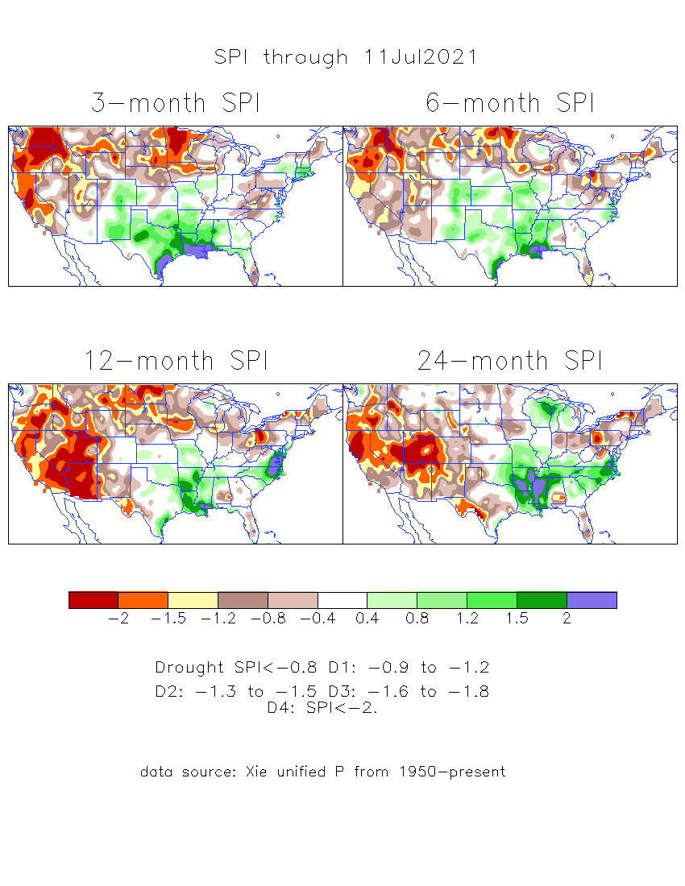
The Standardized Precipitation Index SPI (based on Observed P)
----- Last Month
Very interesting graphic & details for the drought across the US based on the more generalized precip deficit/excess, the Standardized Precipitation Index (SPI).
The dark brown and red colors, indicating standardized precipitation deficits, in the various time periods, approximately correspond to the appropriate short/long term drought monitor regions and their intensities

Slide 15
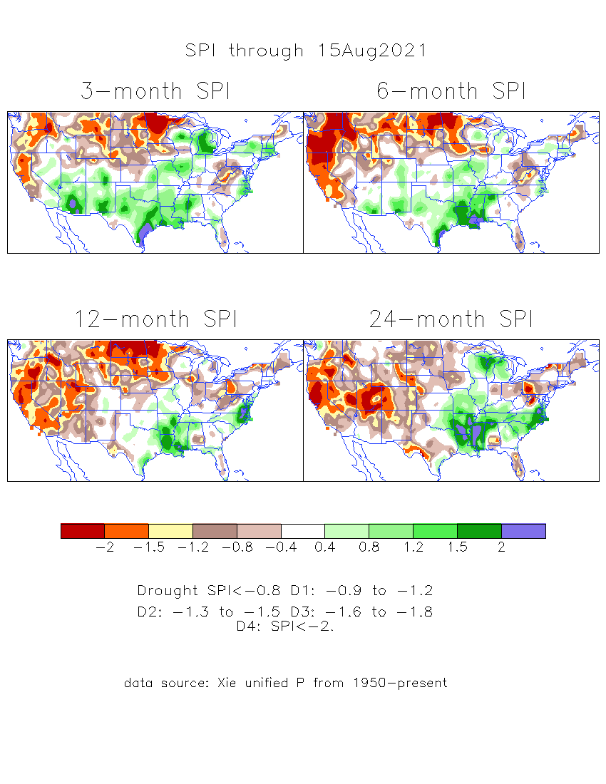
The Standardized Precipitation Index SPI (based on Observed P)
----- NOW
Very interesting graphic & details for the drought across the US based on the more generalized precip deficit/excess, the Standardized Precipitation Index (SPI).
The dark brown and red colors, indicating standardized precipitation deficits, in the various time periods, approximately correspond to the appropriate short/long term drought monitor regions and their intensities
Short
The short term drought has somewhat shifted/extended from southwest to northwest and the northern Plains. But the long term drought in the southwest remains.
----- NOW
Long
How does one negotiate and reconcile declaring short term vs long term drought when precip. deficiencies patterns differ on many different time scales locally!!
What is the cutoff delineating time between short VS long term drought!!

Slide 16
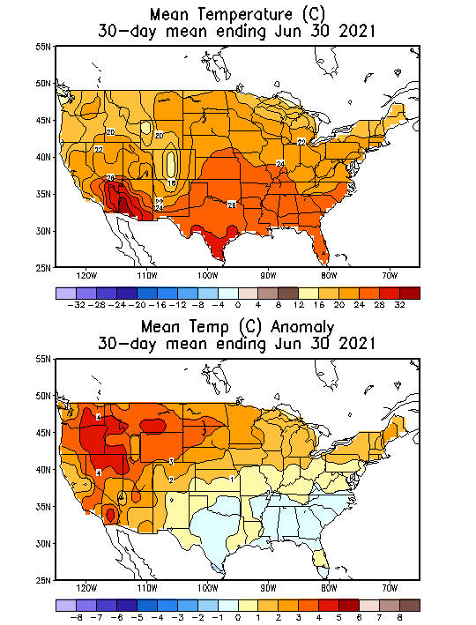
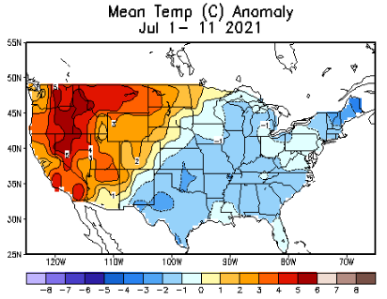
Recent US Temperatures
(Slide shown last month)
Such swings in winter Temperatures
Even in the midst of La Nina!!
From Mar->Apr –> May -> Jun
So far this month !!
Remember, the TX freeze!!

Slide 17
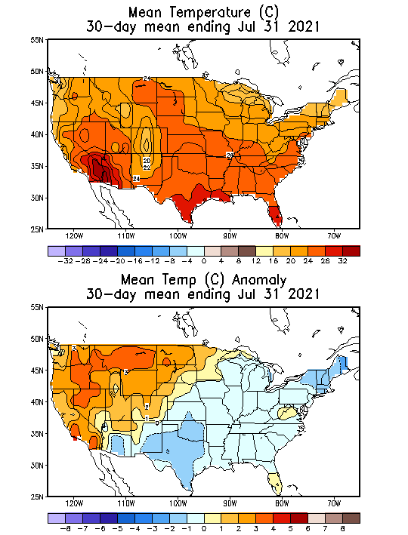
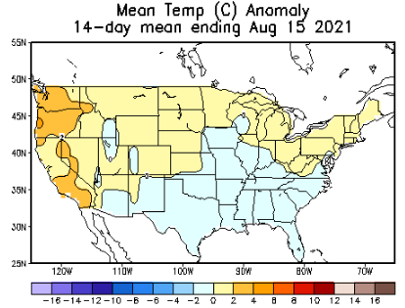
Recent US Temperatures
(NOW)
Such swings in winter Temperatures
Even in the midst of La Nina!!
From Mar->Apr –> May -> Jun
So far this month !!
Remember, the TX freeze!!

Slide 18
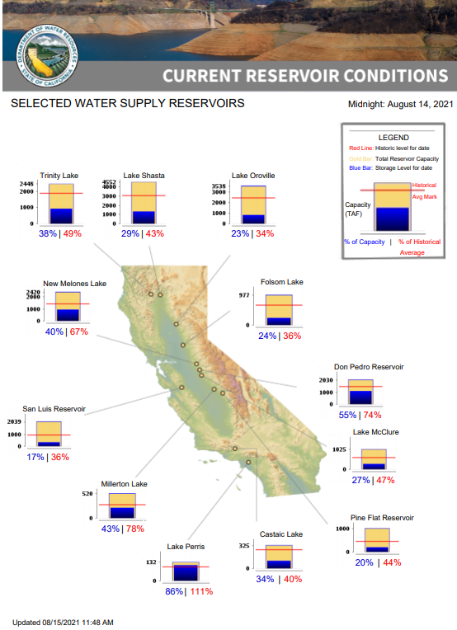
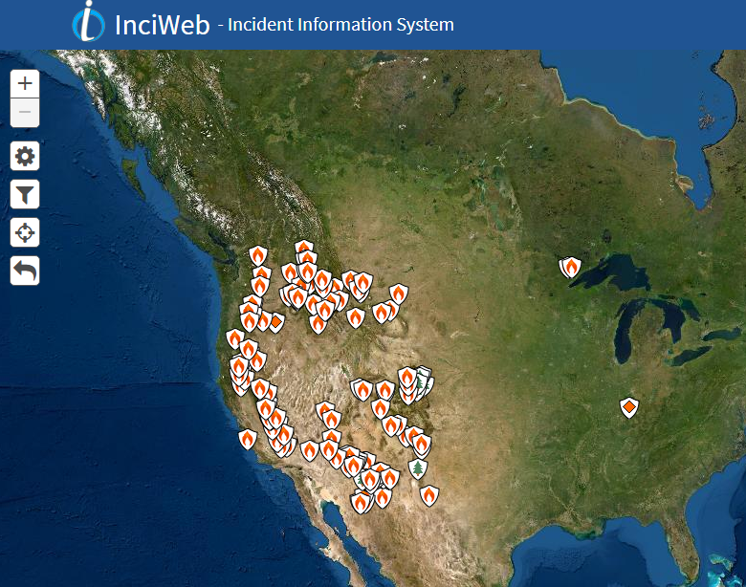
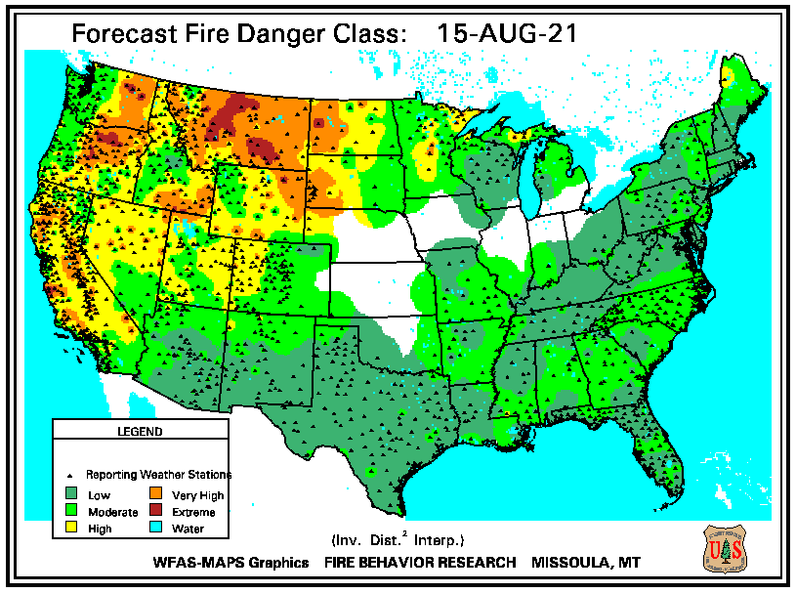
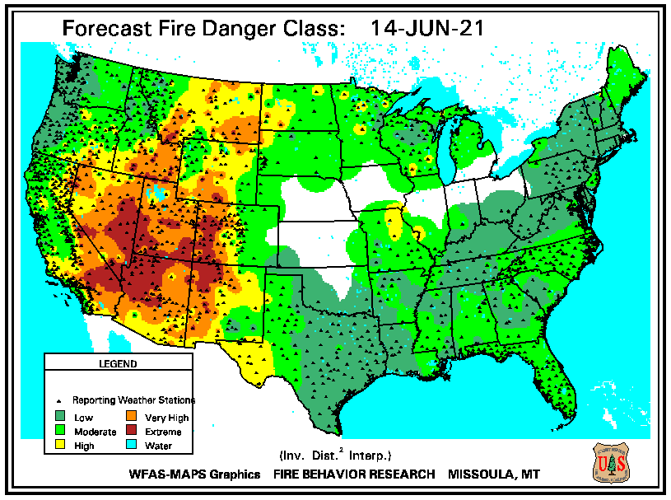
THIS MONTH
https://fsapps.nwcg.gov/
# of Fires NOW in western states, twice as that during last year, at this time!!
???
Many CA reservoirs are already low!!
Improvement to the Fire season (?) around the frour corner states and vicinity due to recent monsoon rains.
If La Nina continues reappears later this year, (which looks more and more likely) it will be a major problem for water in the western coastal states!

Slide 19
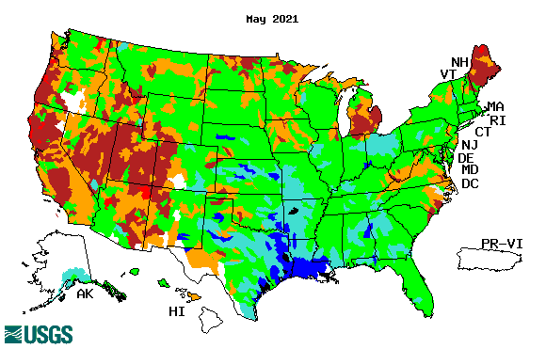
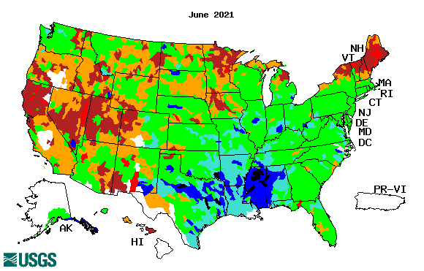
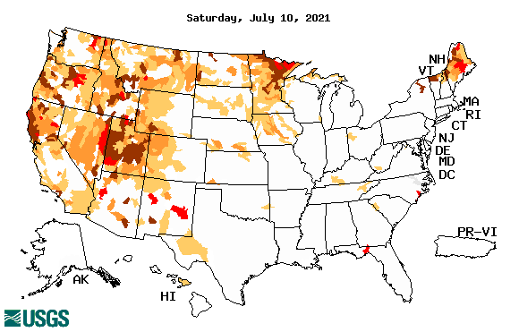
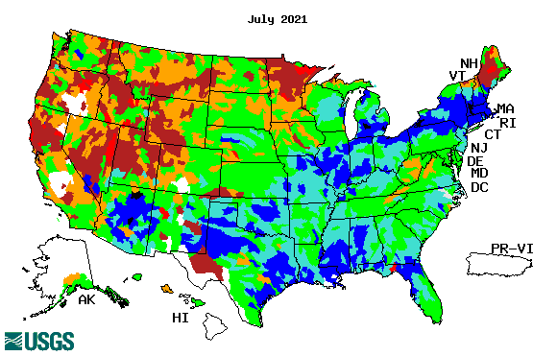
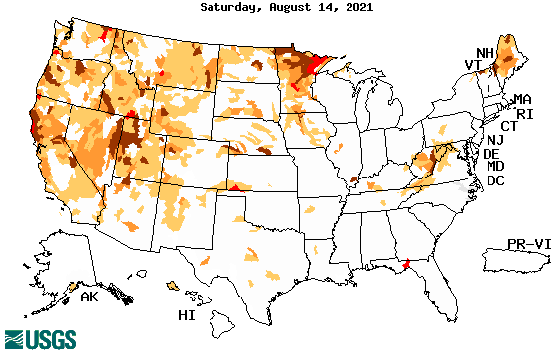
Streamflow (USGS)
Same data source USGS:
Look at the monthly maps for Northeast vs weekly maps in the bottom!!
Map shows only below normal 7-day average streamflow compared to historical streamflow for the day of year.
One month ago (left) &
Now (below)
Streamflow is only a partial indicator, as it is highly managed.
Look along the Pacific coastal states. If sometimes, the various indicators are confusing, go back to % of rainfall deficit maps – to reinforce!!
19

Slide 20
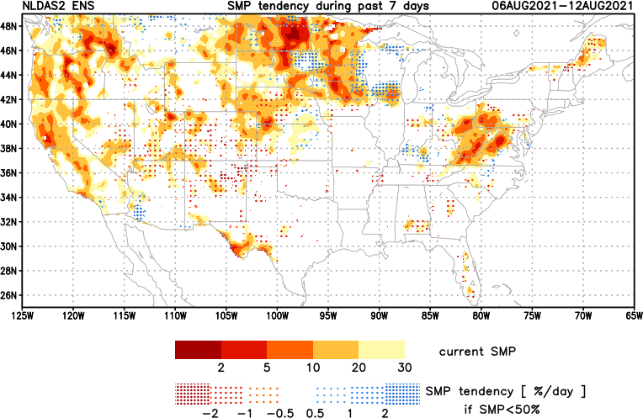
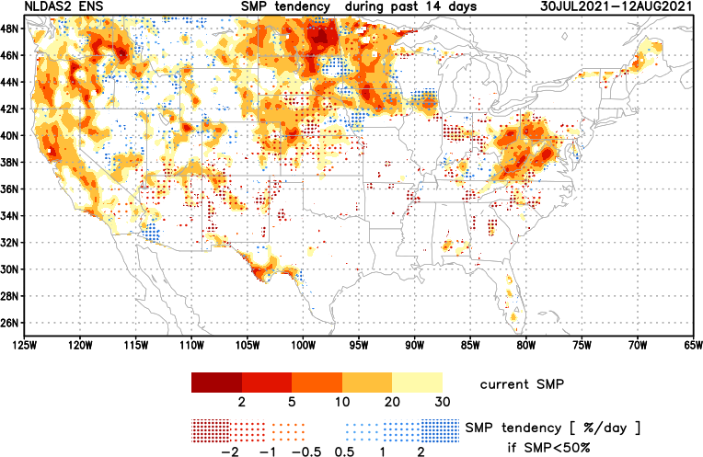
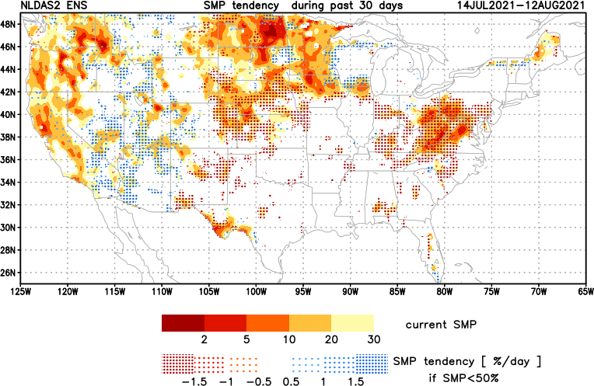
[Now]
NCEP Ensemble mean NLDAS2 models’ Soil Moisture tendency/trend
7 days
14 days
30 days
These NLDAS2 based SM tendency mas are a few days old!! But note the change in the middle part of the country!! Upper Midwest consistently dry!!
The drying in the mid-Atlantic eastern US states need to keep an eye, but with the approaching Tropical storm FRED, will likely have an impact in the area. Need to watch here. May not be a concern for the season.
+ve SMP (wetness) tendency due to monsoon rains is a temporary relief here and even further north.

Slide 21
EL NIÑO/SOUTHERN OSCILLATION (ENSO)
DIAGNOSTIC DISCUSSION
issued by CLIMATE PREDICTION CENTER/NCEP/NWS and the International Research Institute for Climate and Society
12 August 2021
ENSO Alert System Status: La Nina Watch
Synopsis: ENSO-neutral is favored for the remainder of summer (~60% chance in the July-September season), with La Niña possibly emerging during the August-October season and lasting through the 2021-22 winter (~70% chance during November-January).

Slide 22
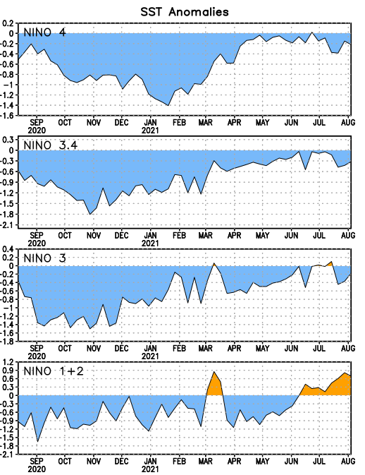
Latest values of SST indices in the various Nino Regions.

Slide 23
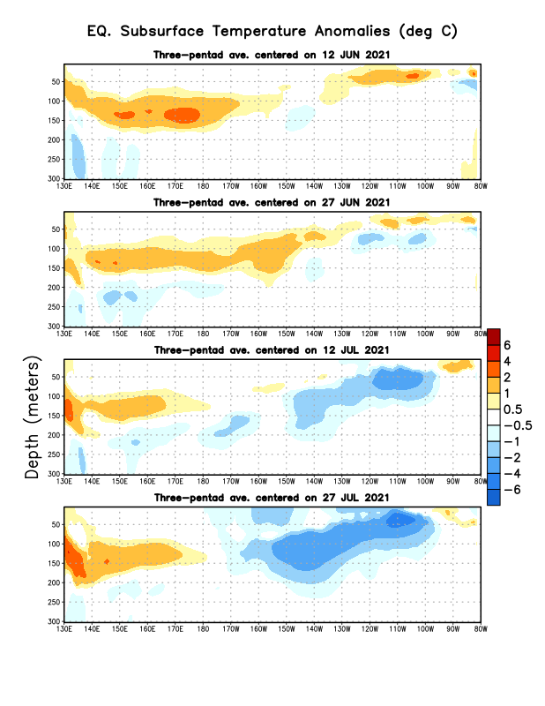
Sub-Surface Temperature Departures in the Equatorial Pacific
Do the current subsurface conditions suggest La Nina development later in the year?
Most recent pentad analysis

Slide 24
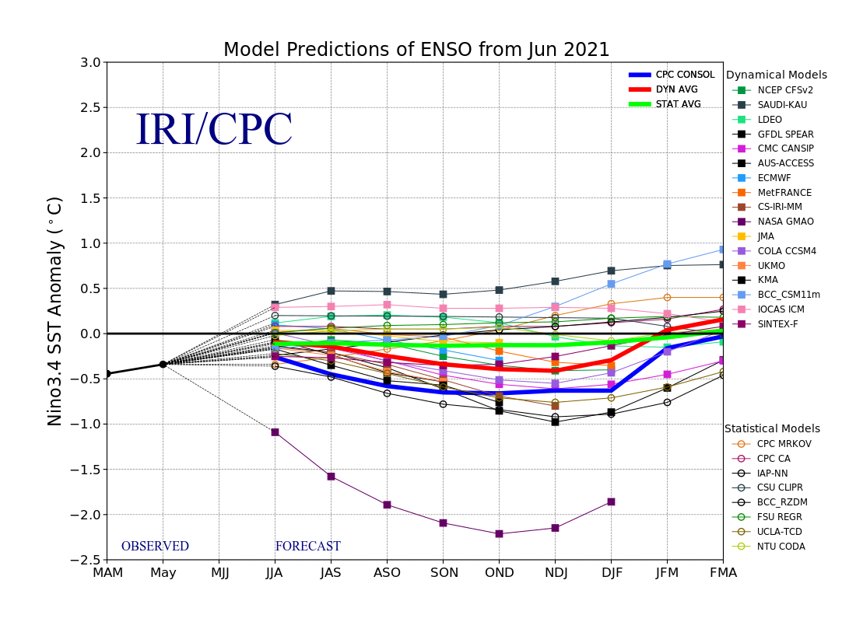
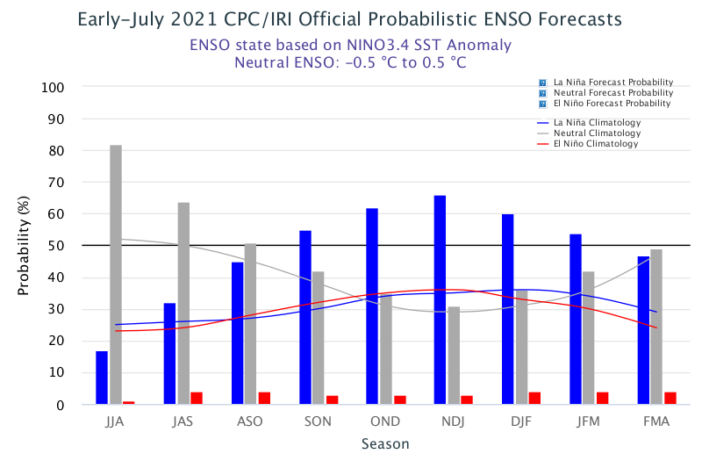
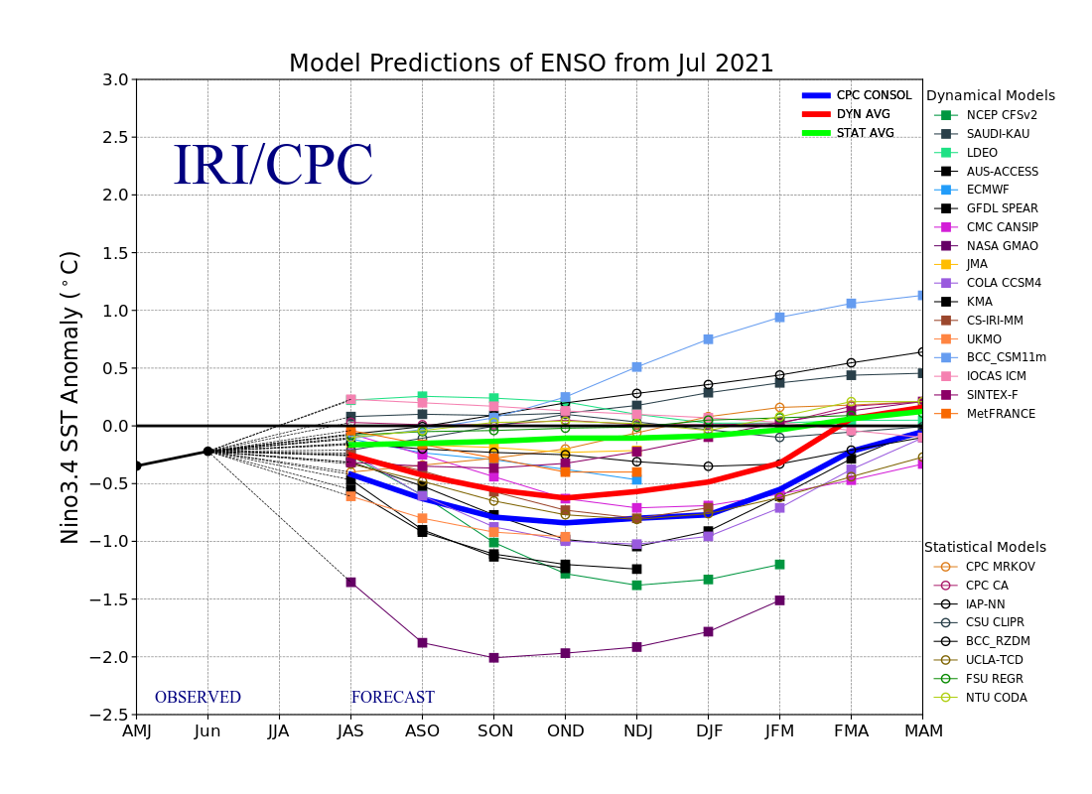
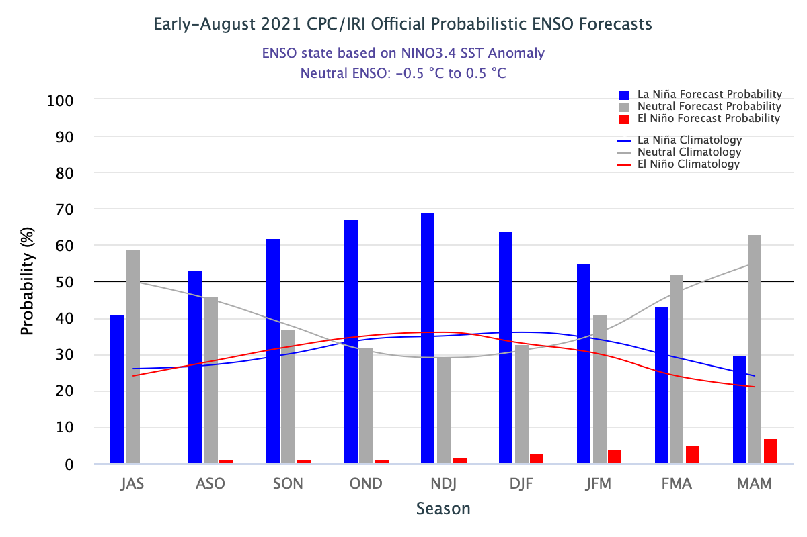
ENSO Forecasts
Early- July CPC/IRI forecast
Early- August CPC/IRI forecast
La Nina looks more and more likely, odds are slightly increasing, not good for western US drought!!

Slide 25
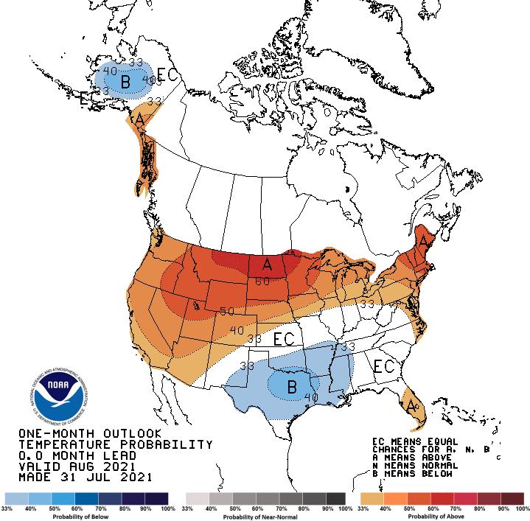
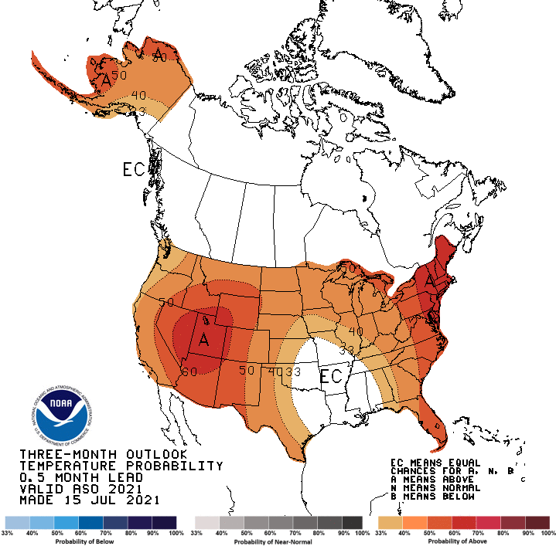
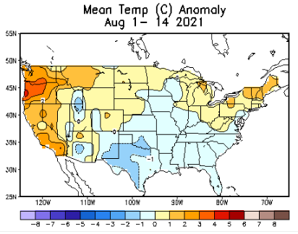
Made
Jul 31st
Previous (Last Month)
CPC’s official
Temperature OUTLOOK for Monthly (August)/Seasonal (ASO)
Made July 15th
The continued warm temperatures forecast (and observed also) in the US West and North are not going to help ease the drought there.
Observed so far this month!! ☺

Slide 26
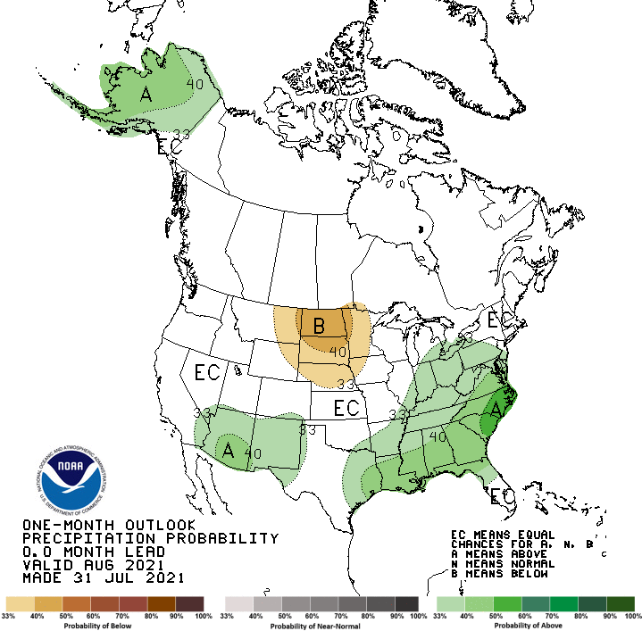
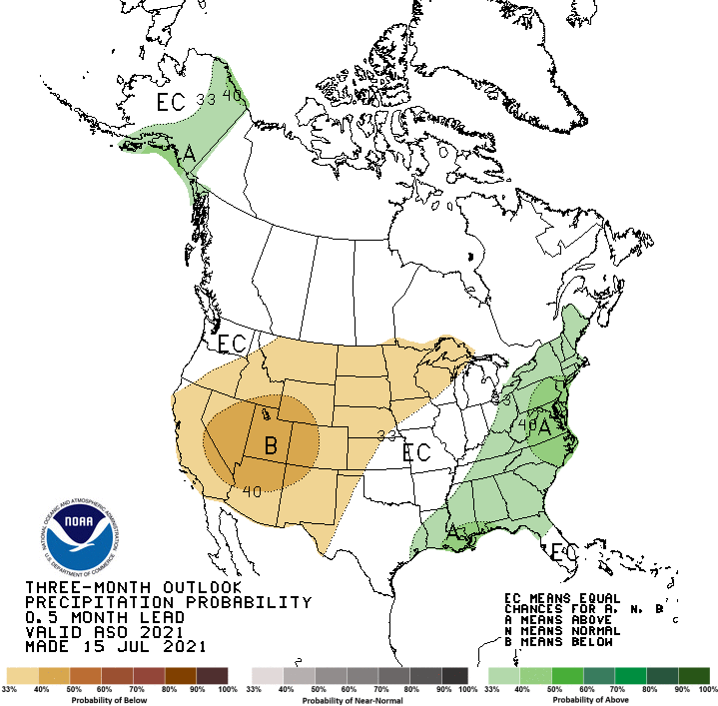
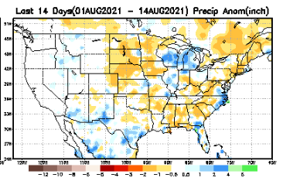
Previous(Last month)
CPC’s official
Precipitation OUTLOOK for Monthly (August)/Seasonal (ASO)
Released Jul 31th
Released July 15th
Observed so far this month!! ☹
Monthly P/T forecasts verified at mid-month are generally good! Why? ☺
(becoz they are mostly based on GFS’ 2-wk fcsts).
But so far, fcst looks ??

Slide 27
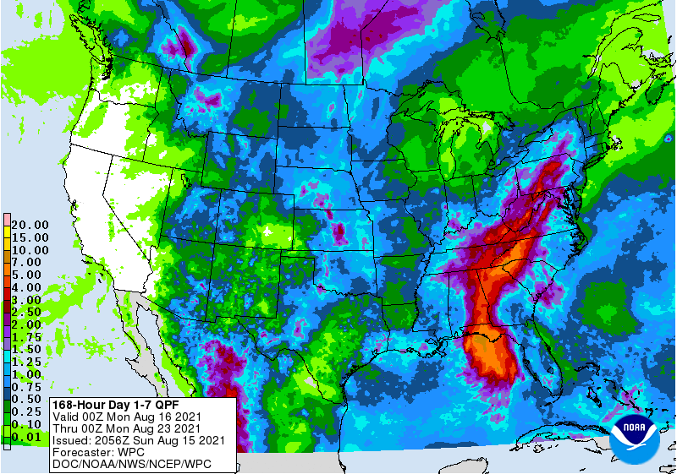
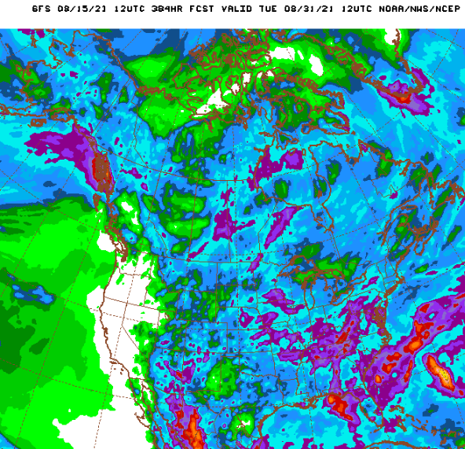
NCEP/WPC Next 7 days QPF Forecast
Impact of TC FRED! Skipped FL (rainfall impact!)
Actual Precip amounts and region generally varies highly from one model run to next!!
GFS Model Guidance for the
next 16 days.
The only good thing happening in the West is at least the Monsoon this year did not fail as it did last year. No relief in Pacific coastal states until later November/December??

Slide 28
From European Center (EC) Precip forecast (made yesterday, 16 Aug) for next 30 days.

Slide 29
From European Center (EC) Precip forecast (made yesterday, 16 Aug) for next 30 days.

Slide 30
SHOWN LAST MONTH, at the briefing!!

Slide 33
Week-4 Soil Moisture Percentile (SMP) Fcst based on VIC model forced with ECMWF-extended precipitation forecast!
??
(From Drs. Li Xu and Yun Fan) More detail at From: https://www.cpc.ncep.noaa.gov/products/people/lxu/flashd/flash_prediction.html

Slide 34
NMME T & P Ens.Mean forecasts for
Sep
Much of the country is fcst to be warm, except in eastern TX & vicinity. The west is WARM+
SON
Will the SW monsoon be good this year for next 2mos.
The drought expand/redevel-op further in the NW? and in the Northern Great Plains area. How bad can it get anyway?
Not much green anywhere over US!!

Slide 35
Agreement/Disagreement among the various NMME models’ SON seasonal Precip. Forecast.
??

Slide 36
(From NMME) compared with this month(foreground, red border)
Why is there so fewer hatched areas in SPI6 fcst from NMME models’ based fcst this month as compared to last month (left 2 columns) ? Fcsts more confident now?
Forecast uncertain in Hatched areas.
Many pieces of hatched areas in the central and mostly in the eastern half of the US – indicating the model’s inability to know the status of drought here.
SPI6 Fcst made from last month
SPI6/SPI12 Fcst made from this month

Slide 37
http://drought.geo.msu.edu/research/forecast/smi.monthly.php
Latest Initial Conditions:
08/10/2021
Predicted Monthly Soil Moisture Percentile
MSU Soil Moisture Percentile forecast NOT available, NOT updated!
CPC’s soil moisture percentile – Leaky bucket Model
The inter quartile range suggest greater uncertainty about the forecast in these shaded regions. Lots of uncertainty regions!! ☹

Slide 38
Summary
Current Drought conditions:
Due to better SW monsoon rainfall this year, improvement in short term drought conditions is happening around the four corners states area and vicinity and this was/is also forecast. But Long term drought worries still prevail! Difficult to distinguish/show clearly the short/vs long term differences in USDM and Drought outlooks.
Over the last 4-5 months, drought area has overall generally remained about the same, but the severity has lessened somewhat in the US west. The worse drought conditions are in the border areas of southwest states CA, NV, UT, western CO, and NM. These west regions are part of the long term drought. It needs more than one good monsoon!
The somewhat improved conditions in the SW is however compensated by the slightly worsened drought conditions in the Northern Great plains area, thus still keeping about 50 % of the US area to continue to experience category D1 or worse drought condition. Dry/Drought conditions over the eastern US slightly improved.
All California reservoirs levels continue to worsen to below their historical average levels. If the forecast heat/temps and the lack of (seasonal) rainfall continues, things will probably get dire.
The fire season in the US western states is already well underway, and is much worse this year, as compared to the same time last year (a record year!), but the better SW monsoon this year has somewhat helped the situation here.
Current ENSO status and forecast: ENSO-neutral is favored for the remainder of summer (~60% chance in the July-September season), with La Niña possibly emerging during the August-October season and lasting through the 2021-22 winter (~70% chance during November-January).
Prediction:
The odds of La Nina reemerging soon, within the upcoming forecast season (SON) continues to increase. Nevertheless, with the continued forecast of above normal temperatures in the US west and the continued dry season along the west coast states until winter (rainfall season), the short term drought in the Pacific coastal and adjoining states especially in CA, OR, WA is expected to broaden and get worse.
In spite of the better SW monsoon rainfall in AZ/NM/UT/CO and vicinity, the long term drought in the south and west is still entrenched. The present drought and forecast T/P conditions here are likely to contribute to unfortunately a yet another severe fire season for the western states. Water shortages could certainly develop in many of the southwest/western states. Drought conditions in the Northern Great Plains states has worsened, and with the summer rainfall season coming soon to a close, it is unlikely the current drought conditions there will likely persist,
By the end of the forecast season, east of Minnesota, there will most likely be no areas under drought including Florida, the New England states and the Mid Atlantic states.
SON is a difficult season to forecast, both in terms of rainfall climatology (relatively dry!) and drought, especially in the context of developing La Nina conditions. The mild dry conditions (% rainfall wise) in the mid Atlantic states need not be of concern, especially given the track of TS Fred, and the rest of active hurricane season. ***********

Slide 39
Miscellaneous maps

Slide 40
Miscellaneous maps

