Slide 1
Drought Outlook Support Briefing August 2020
Climate Prediction Center/NCEP/NOAA
http://www.cpc.ncep.noaa.gov/products/Drought
Phone: 1-877-680-3341
Pwd: 858747#

Slide 2
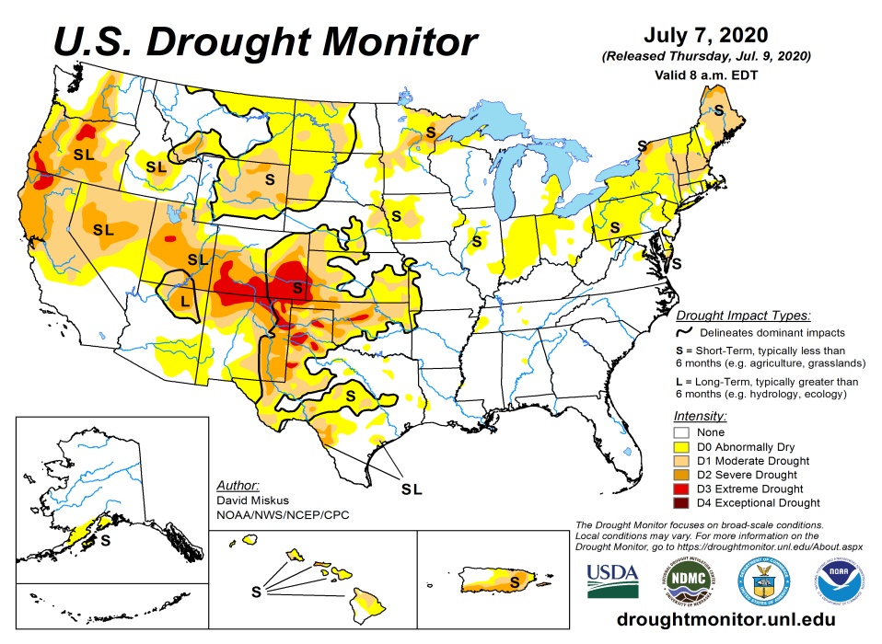
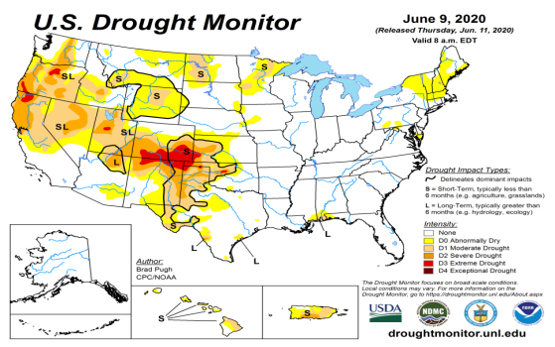
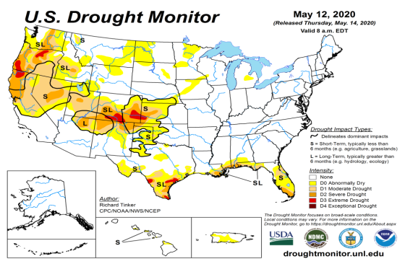
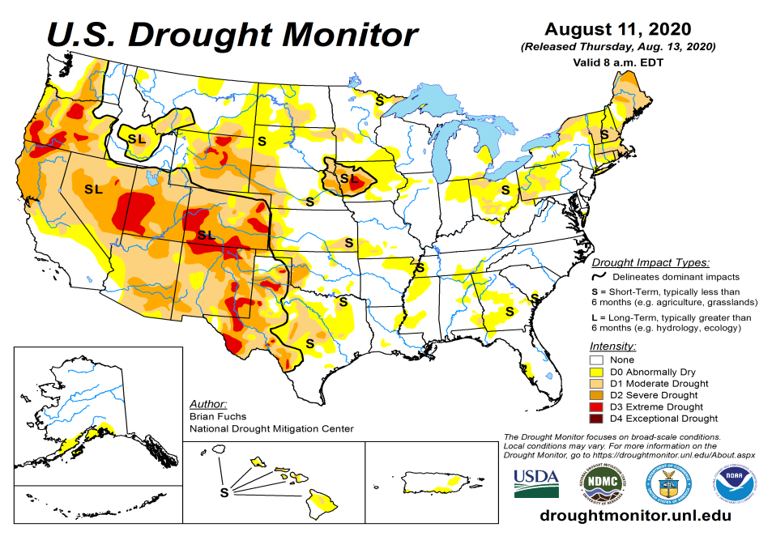
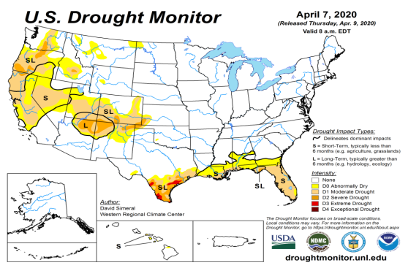
Drought Monitor
July
Monitoring is important because, unlike US T/P fcsts, for drought forecasts, we have to know where we are, before we can tell where we are going!!
Drought forecasts are tendency forecasts.
June
Over the last five months, drought area & severity has overall generally increased across the South, West & Northern Plains and NE.
The short/long term drought in the four corner states area (AZ/NM/UT/CO) has expanded and intensified southward & westward.
Dryness/Drought in Northern Great Plain states has slightly eased.
Recent short-term Drought in the Northeastern states has gotten better.
New dry/drought areas are emerging in the upper Midwest (IN, OH, PA) and southeast.
May
August
(Recent/Latest)
April
February

Slide 3
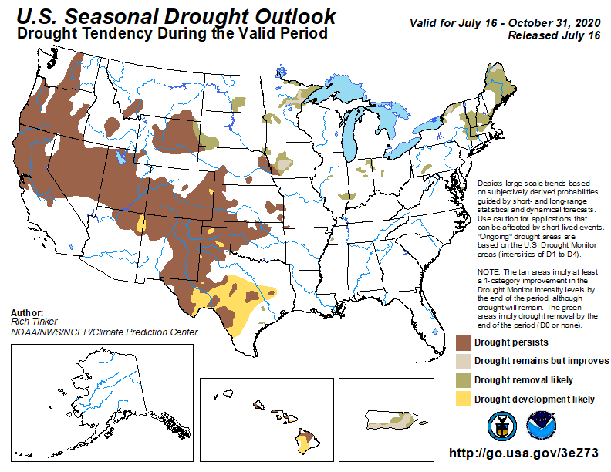
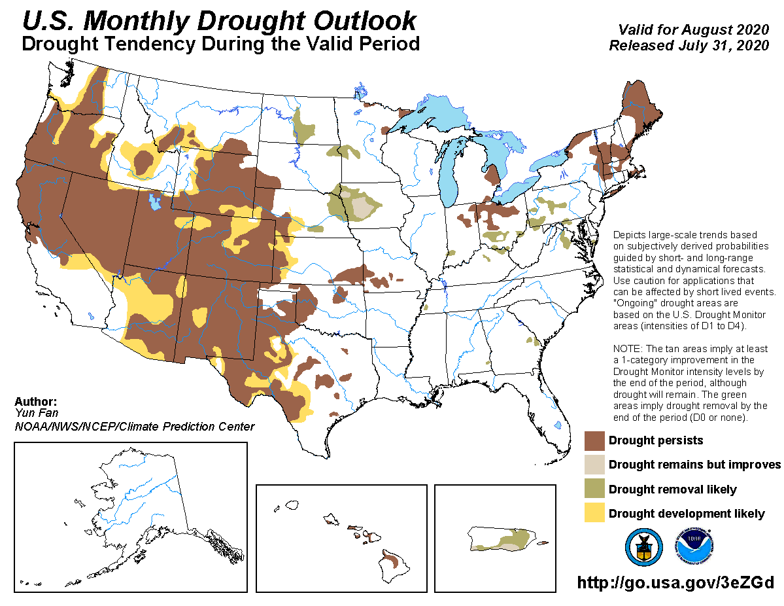
(Prev) Seasonal/Monthly Drought outlooks
(New Seasonal Drought Outlook to be released in 2 days!)
(New Monthly Drought Outlook to be released end of the month)
Seasonal Outlook
(Mid July 2020- Oct 2020)
issued 07/16/20
Monthly outlook
(for August 2020)
issued 07/31/20
It was not too long ago (~May 2019), the US had almost the lowest coverage of area covered by drought! Approx. < 4% or so.
Now much of the southwest and parts of NorthEast is under drought!
Drought is very fragile!! Have to keep a close eye!!

Slide 4
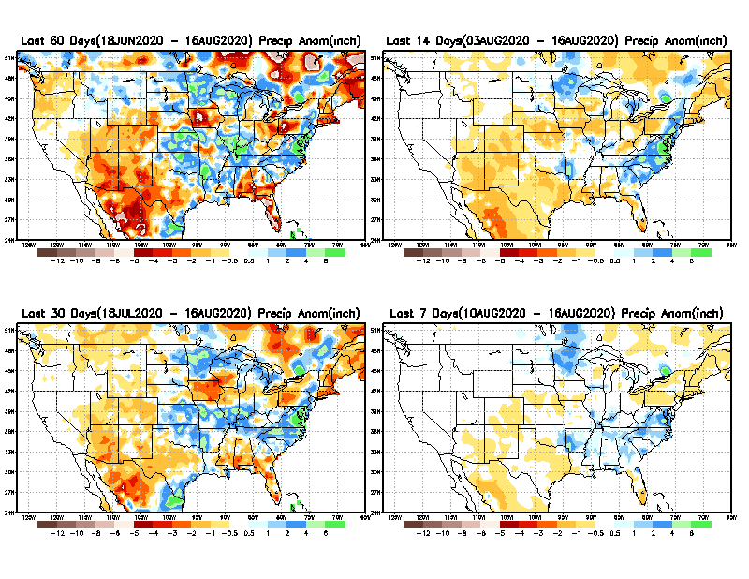
Precipitation ANOM during last 7, 14, 30, & 60 days.
60 Days
14 Days
These maps in this and following slides, including a) Total,
b) Anom and
c) Percent of Normal precip. in these and other longer time ranges are now (routinely) daily updated at:
Isaias
Watch!
30 Days
7 Days
Alaska regn. was also added here as separate maps recently.
From: Recent Accumulated Precipitation https://www.cpc.ncep.noaa.gov/products/Drought/briefing_prcp.shtml

Slide 5
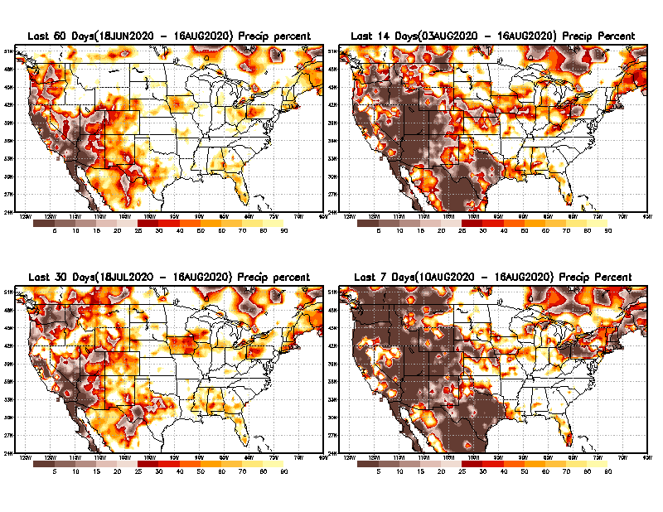
Precipitation Percent during last 7, 14, 30, & 60 days.
60 Days
14 Days
This plot shows only the rainfall deficient regions <= 90% of normal.
-- This shows more clearly possible/likely drought developing region in the future unless there is above normal rainfall in these regions to offset these shortfalls.
Pockets of short-term dryness, Watch!
Late/weak monsoon
So far!!
30 days
7 Days
From: Recent Accumulated Precipitation https://www.cpc.ncep.noaa.gov/products/Drought/briefing_prcp.shtml

Slide 6
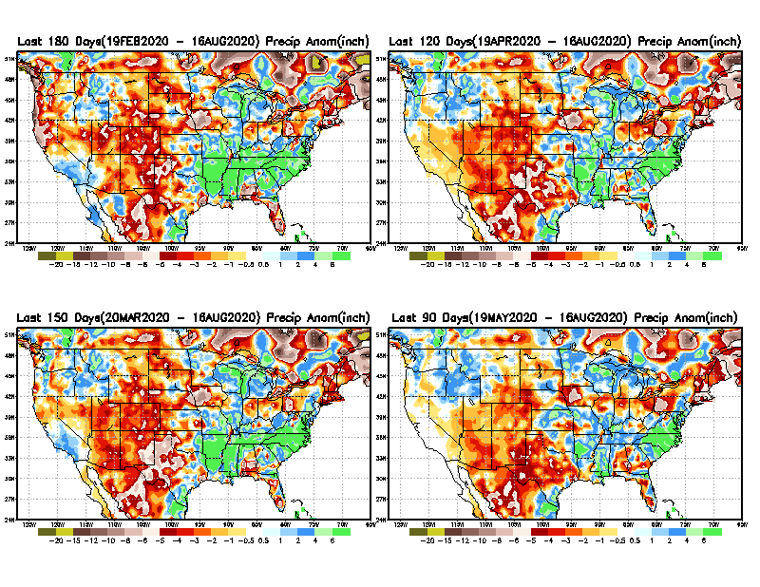
Total precipitation ANOM during last 3, 4, 5, and 6 months.
6 M
4 M
While the Precipitation anomalies deficit may seem large in some regions (compared to others), it is the % of normal precip (next slide) that matters more!!
5 M
3 M
From: Recent Accumulated Precipitation https://www.cpc.ncep.noaa.gov/products/Drought/briefing_prcp.shtml

Slide 7
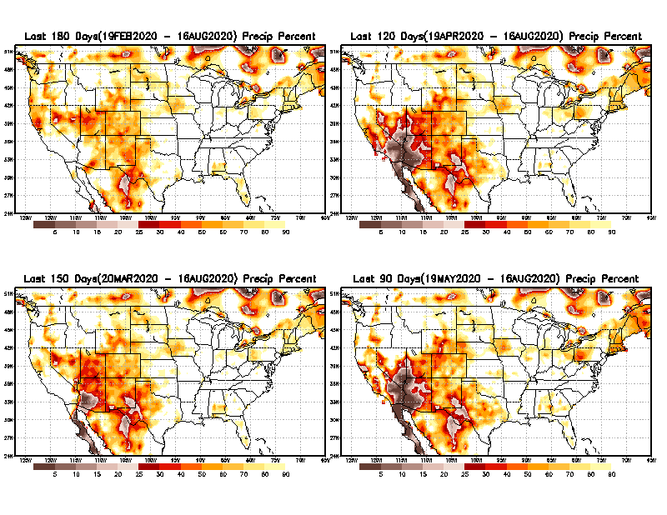
Total precipitation Percent during last 3, 4, 5, and 6 months.
6 M
4 M
In these interim time scale 3-6 months, we need to pay attention to regions, which are dark-brown, red & dark red (<50%).
5 M
3M
While accrued precipitation deficits are real & objective,
droughts are subjective declarations!!
Looks Bad! In W.PA also!
East vs West!
Broad vs Narrow
rainfall season.
With these various rainfall deficits in diff. time ranges, where and how exactly does one declare drought? Other factors (T/SM/E, etc..) do matter, but is cumulative precip. Deficits/percent_of_normal ultimately more important?

Slide 8
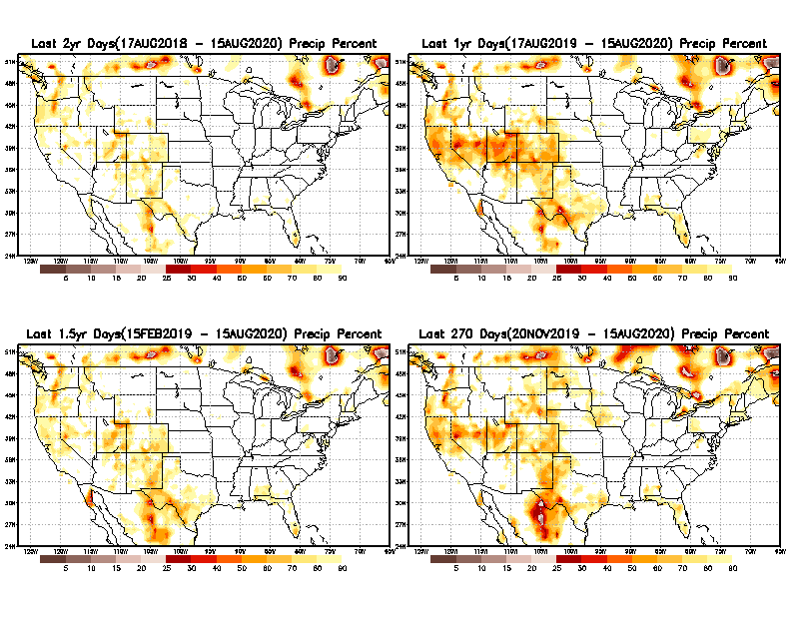
Total precipitation Percent during last 9 months, 1 yr, 1.5yrs, & 2 yrs.
2 Y
1 Y
Tinderbox areas, where some form of longer term rainfall
deficiencies already, exist !!
-Almost all are in the WEST!
1.5 Y
9 M
From: Recent Accumulated Precipitation https://www.cpc.ncep.noaa.gov/products/Drought/briefing_prcp.shtml

Slide 9
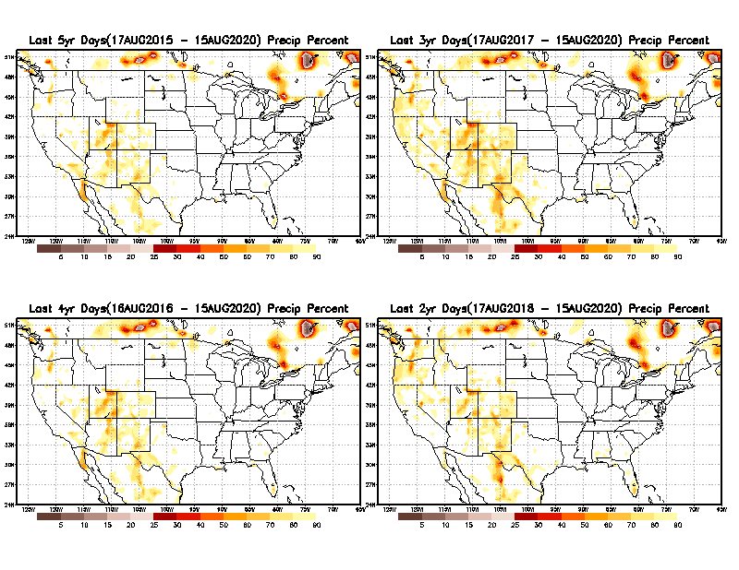
Total precipitation Percent during last 2 yrs, 3 yrs, 4 yrs, & 5 yrs.
5 Y
3 Y
Still longer term rainfall deficit variability in play? Especially in the southwest!
In new format
4 Y
2 Y
In this time range, across the country, there is not any big area where the rainfall is less than 50%.
From: Recent Accumulated Precipitation https://www.cpc.ncep.noaa.gov/products/Drought/briefing_prcp.shtml

Slide 10
Rainy (3-month)Season across the US
East vs West!
More darker colors in regn. central/west => narrow rainy season (months)
Overall, more white space in the east -> distributed rainfall season (except ~FL).

Slide 11
*********
EAST vs
CTR/WEST
Behavior in Drought is loosely tied to rainfall climo!!
*********
Adapted from Rich Tinker.

Slide 12
Adapted from
Rich Tinker

Slide 13
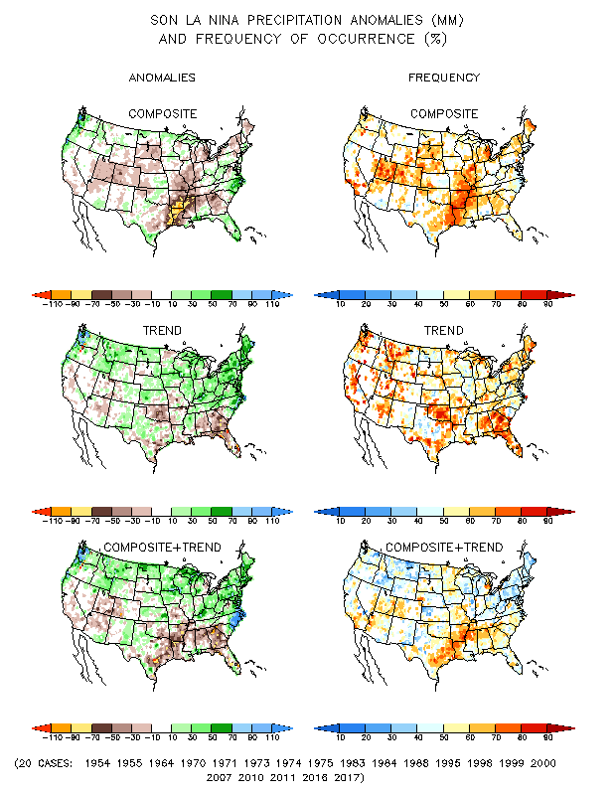
La Nina Precip COMPOSITES & Trend map
JFM
FMA
SON

Slide 14
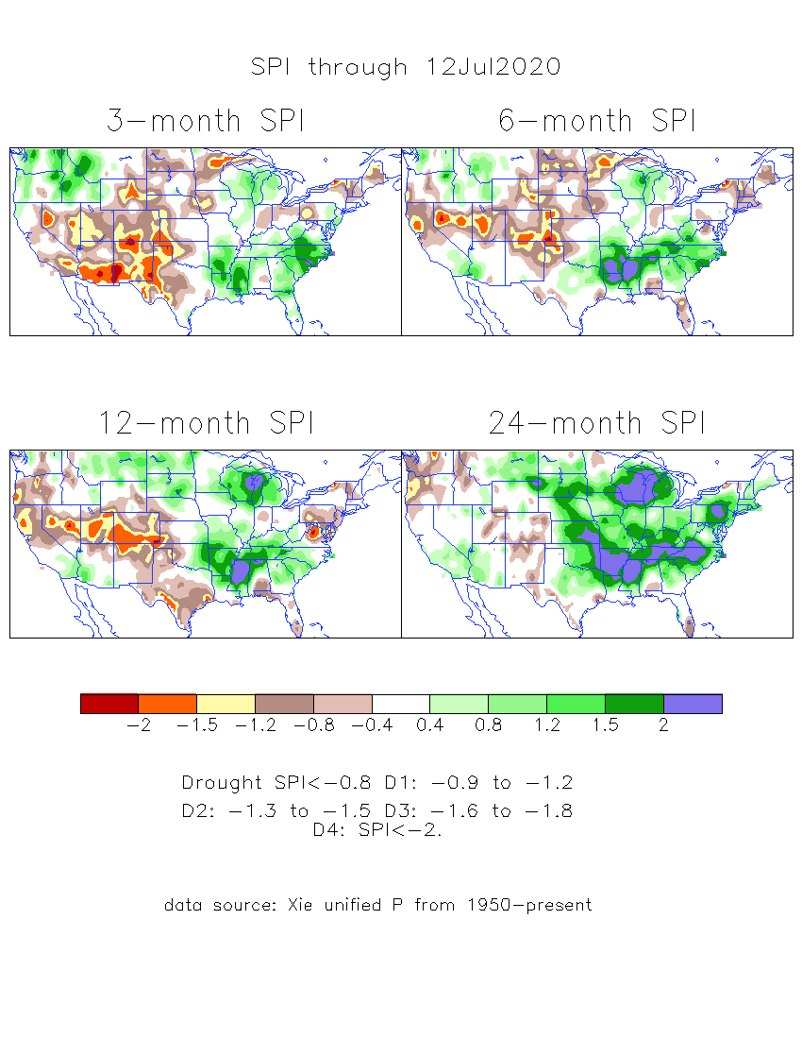
The Standardized Precipitation Index SPI (based on Observed P)
----- Last Month
Very interesting graphic & details for the drought across the US based on the more generalized precip deficit/excess, the Standardized Precipitation Index (SPI).
The dark brown and red colors, indicating standardized precipitation deficits, in the various time periods, approximately correspond to the appropriate short/long term drought monitor regions and their intensities

Slide 15
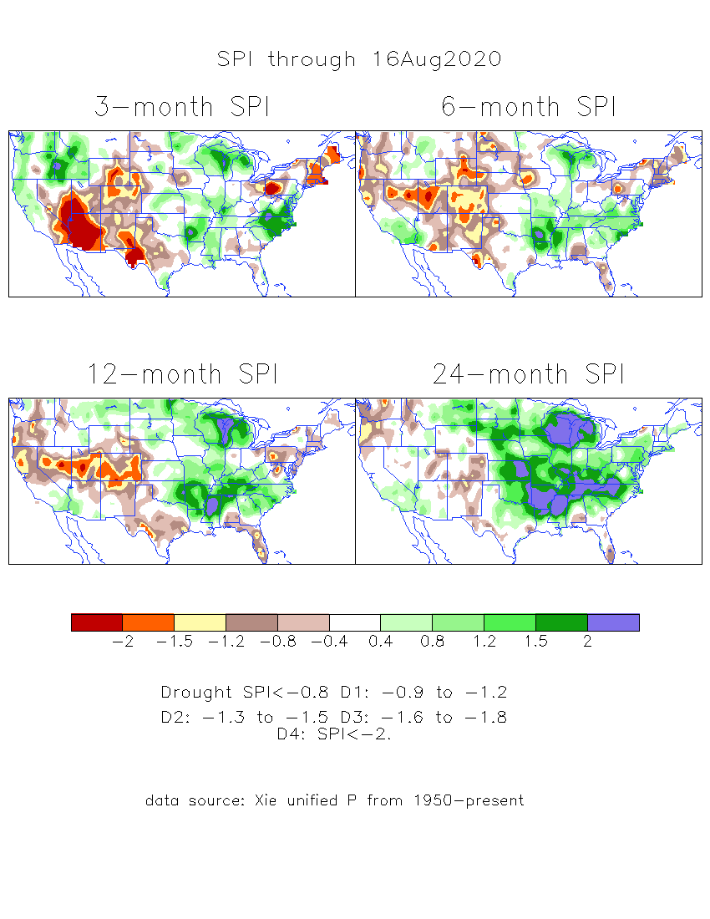
The Standardized Precipitation Index SPI (based on Observed P)
----- NOW
Very interesting graphic & details for the drought across the US based on the more generalized precip deficit/excess, the Standardized Precipitation Index (SPI).
The dark brown and red colors, indicating standardized precipitation deficits, in the various time periods, approximately correspond to the appropriate short/long term drought monitor regions and their intensities
----- NOW
How does one negotiate and reconcile declaring short term vs long term drought when precip. deficiencies patterns differ on many different time scales locally!!
What is the cutoff delineating time between short VS long term drought!!

Slide 16
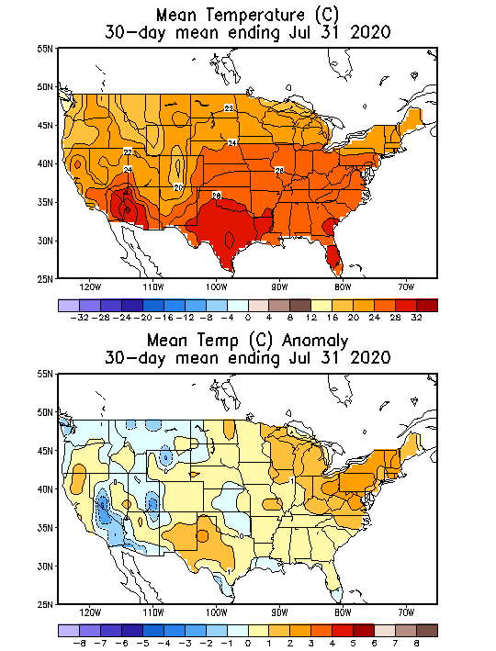
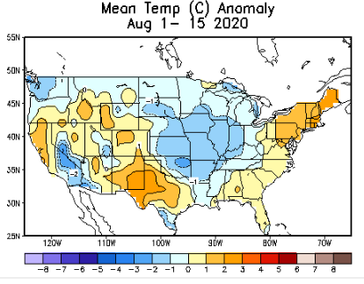
Recent US Temperatures

Slide 17
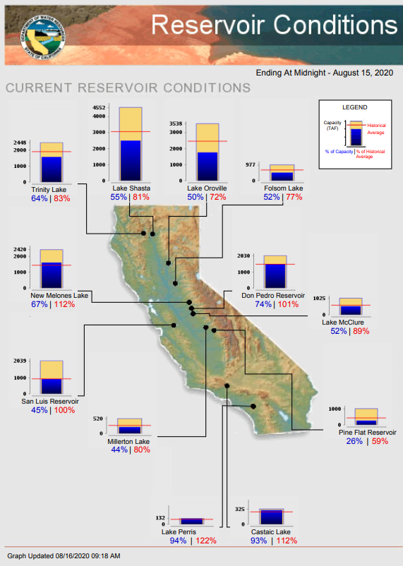
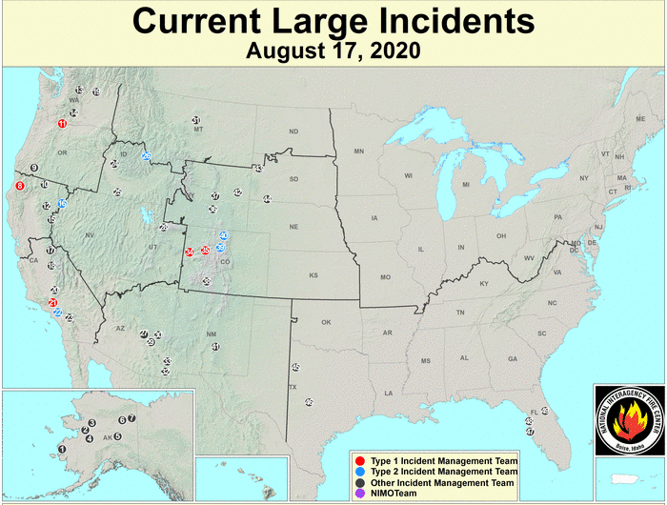
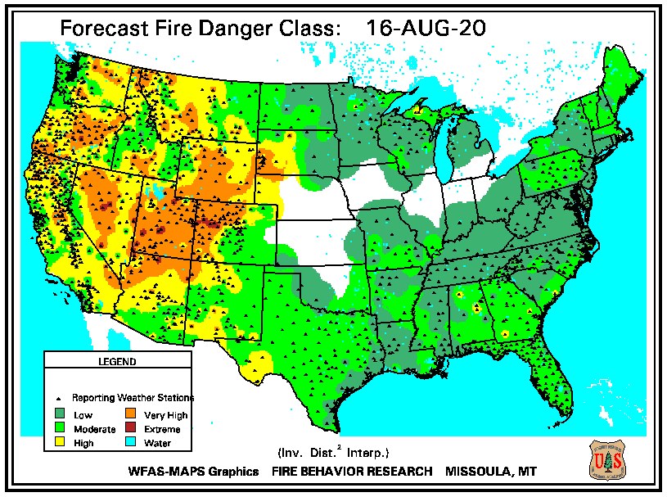
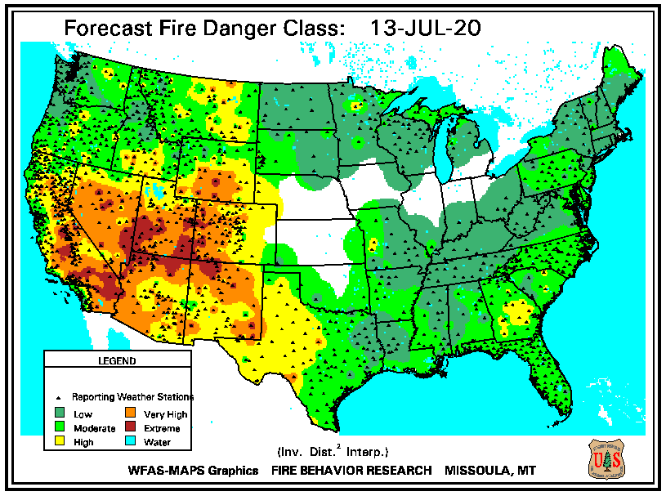
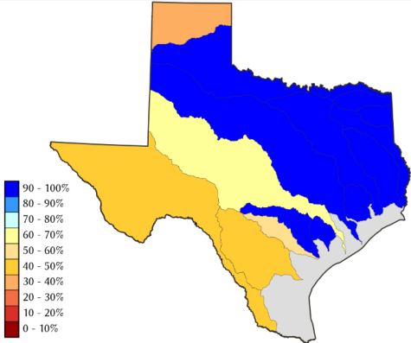
https://fsapps.nwcg.gov/
https://www.nrcs.usda.gov/wps/portal/wcc/
https://www.wfas.net/index.php/fire-danger-rating-fire-potential--danger-32
TX
Some/many of California reservoirs levels are below their historical average levels. Next rainy season is 4-months away.

Slide 18
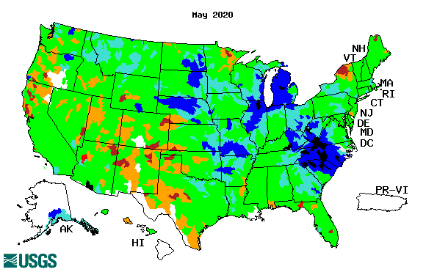
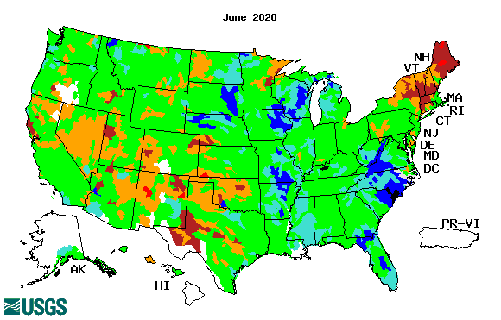
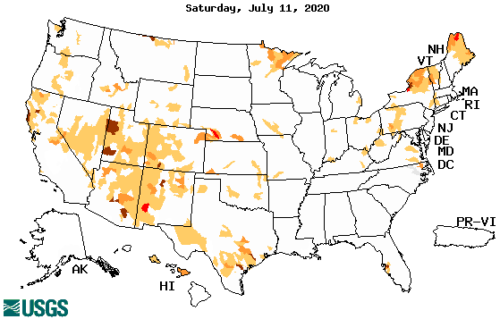
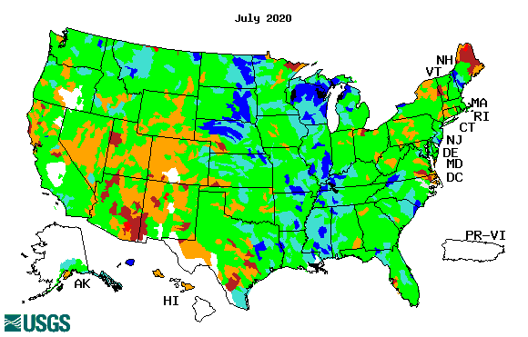
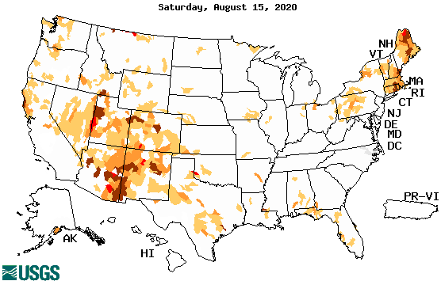
Streamflow (USGS)
Worse conditions in the southwest, in the monsoon region.
Northeast conditions slightly omproved.
Pacific NW much improved now.
Map shows only below normal 7-day average streamflow compared to historical streamflow for the day of year.
One month ago (left) &
Now (below)
The far NE drought/dryness has got better!
18

Slide 19
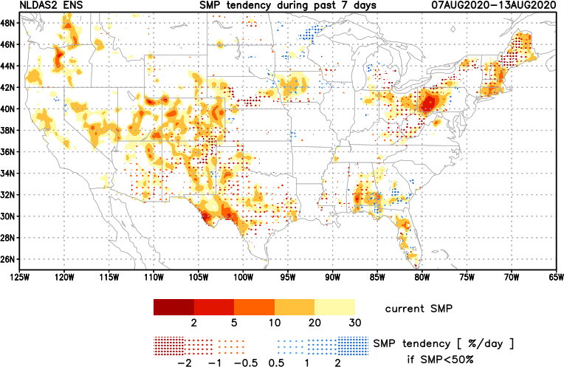
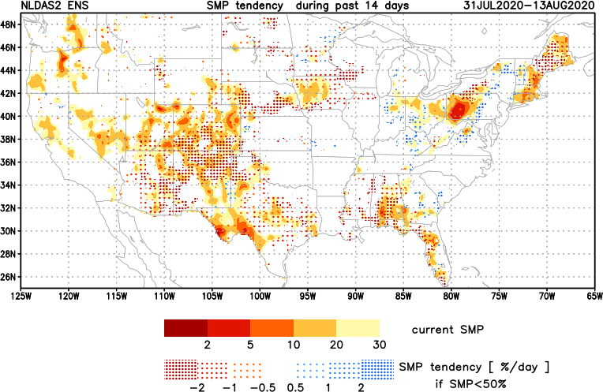
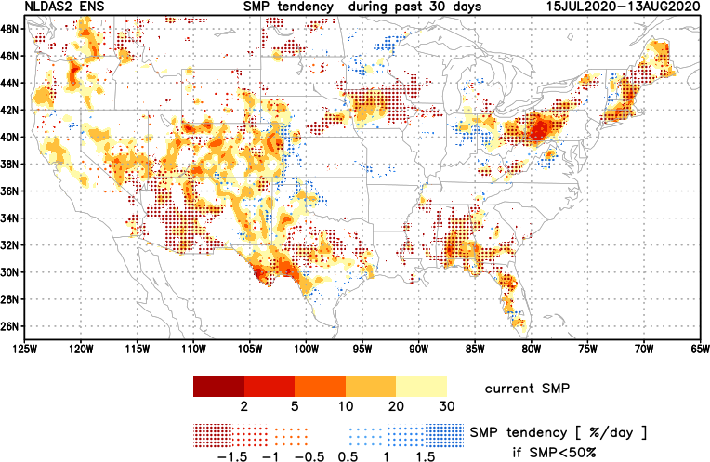
[Now]
NCEP Ensemble mean NLDAS2 models’ Soil Moisture tendency/trend
7 days
14 days
30 days
Overall, during the past month, lots of yellow/red across the country – that is -ve soil moisture tendency – that is drying!

Slide 20
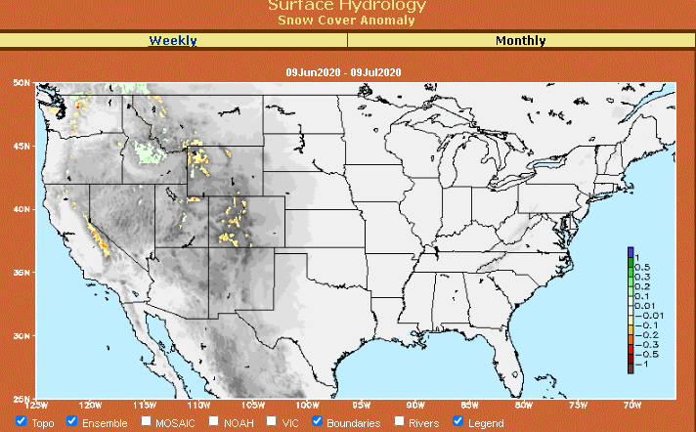
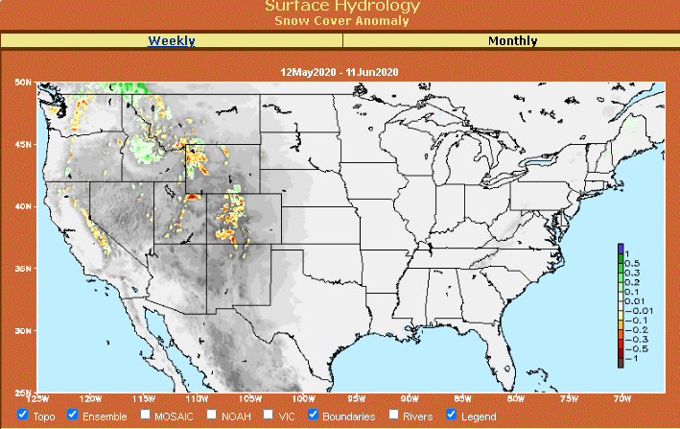
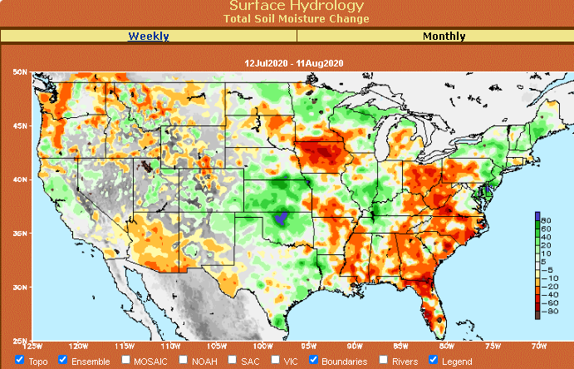
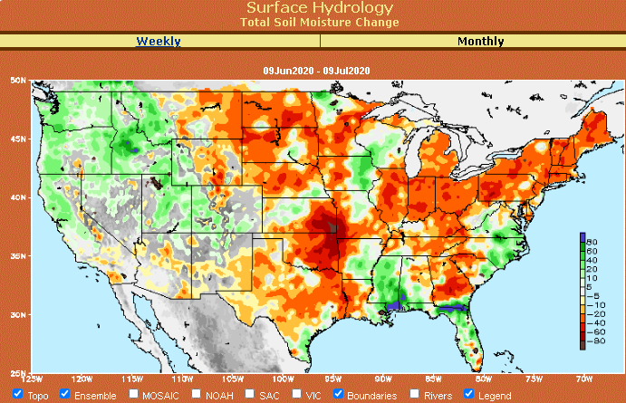
Snow cover & Soil Moisture Anomalies
Snow cover
Last month ~ this time
Now
Look further for areas of drought development

Slide 21
EL NIÑO/SOUTHERN OSCILLATION (ENSO)
DIAGNOSTIC DISCUSSION
issued by CLIMATE PREDICTION CENTER/NCEP/NWS and the International Research Institute for Climate and Society
13 August 2020
ENSO Alert System Status: La Nina Watch
Synopsis: There is a ~60% chance of La Niña development during Northern Hemisphere fall 2020 and continuing through winter 2020-21 (~55% chance).

Slide 22
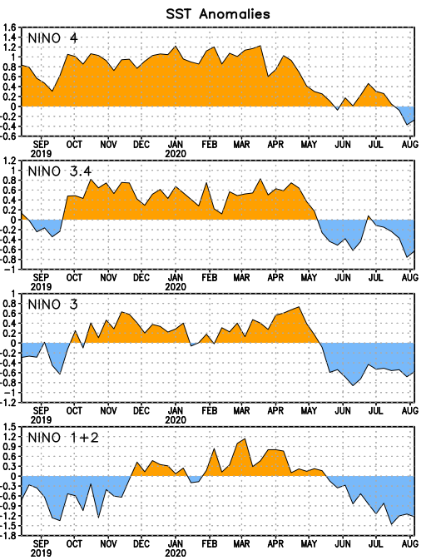
Latest values of SST indices in the various Nino Regions.
This is the most blue! (cold) in all 4 indices (see left) in a while. But subsurface ocean heat anomalies is going yo-yo!!

Slide 23
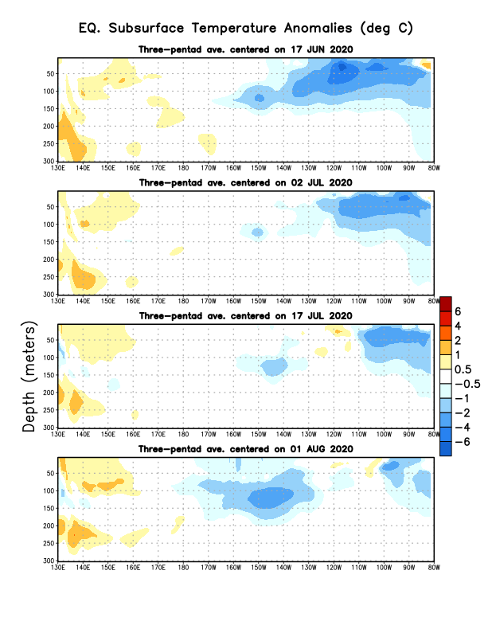
Sub-Surface Temperature Departures in the Equatorial Pacific
Tropical Pacific (Nino 3.4) surface SST in ENSO neutral status vs cool Subsurface
Most recent pentad analysis

Slide 24
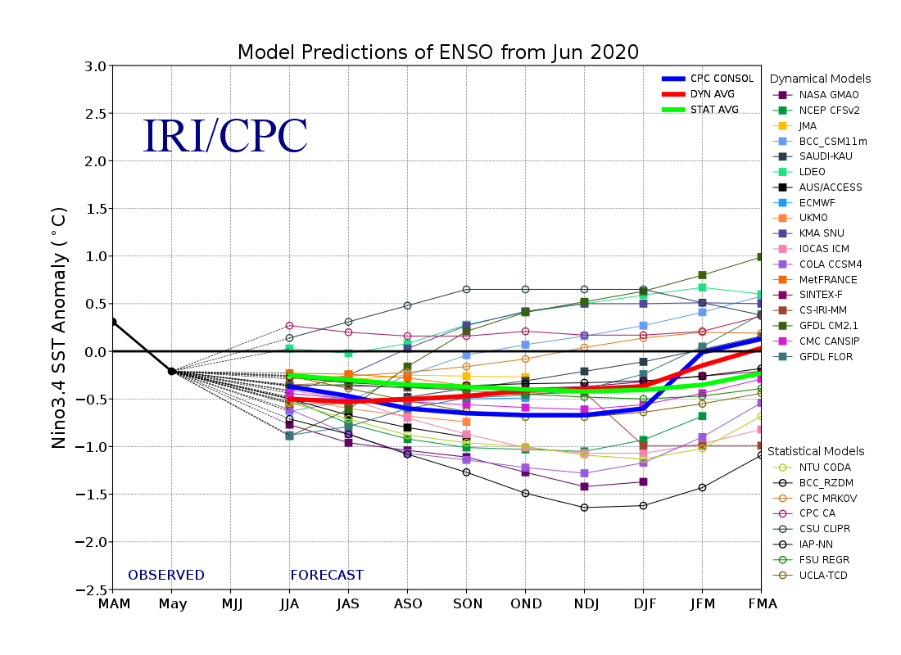
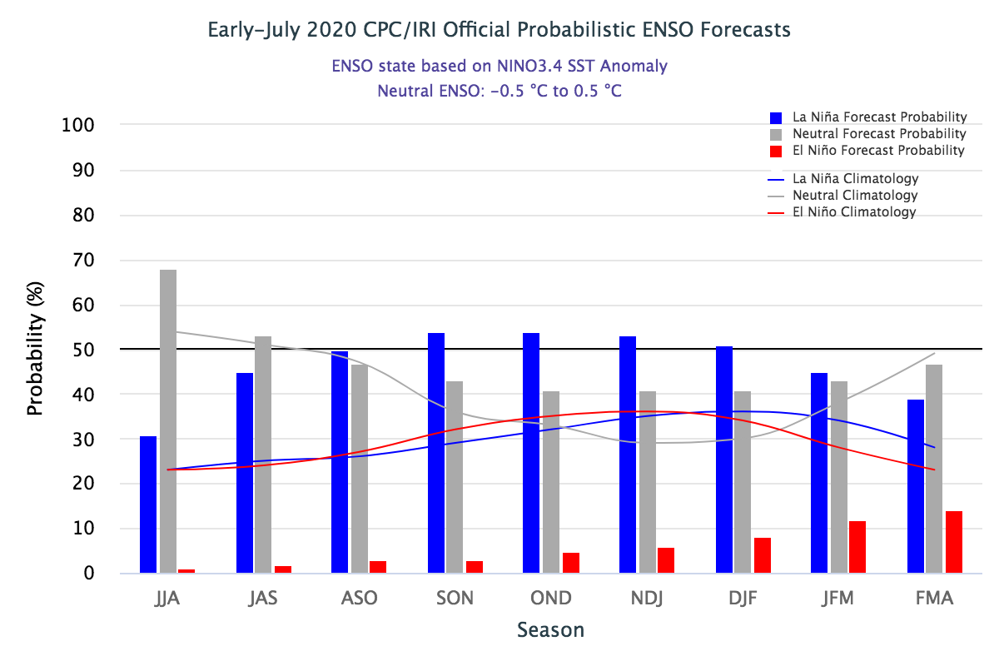
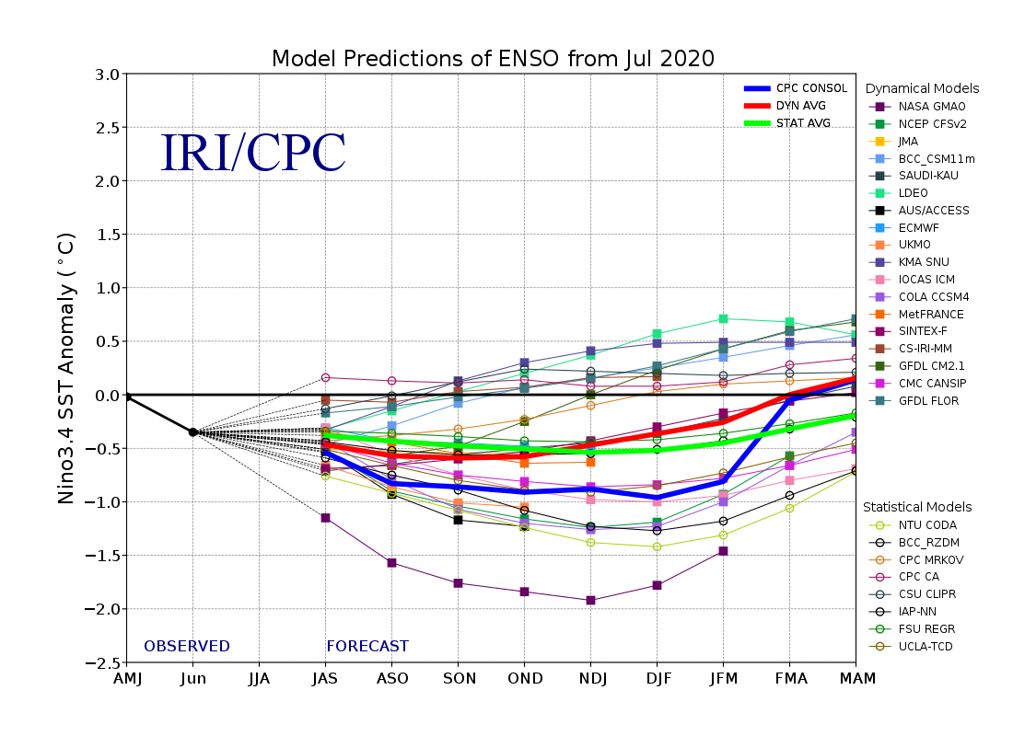
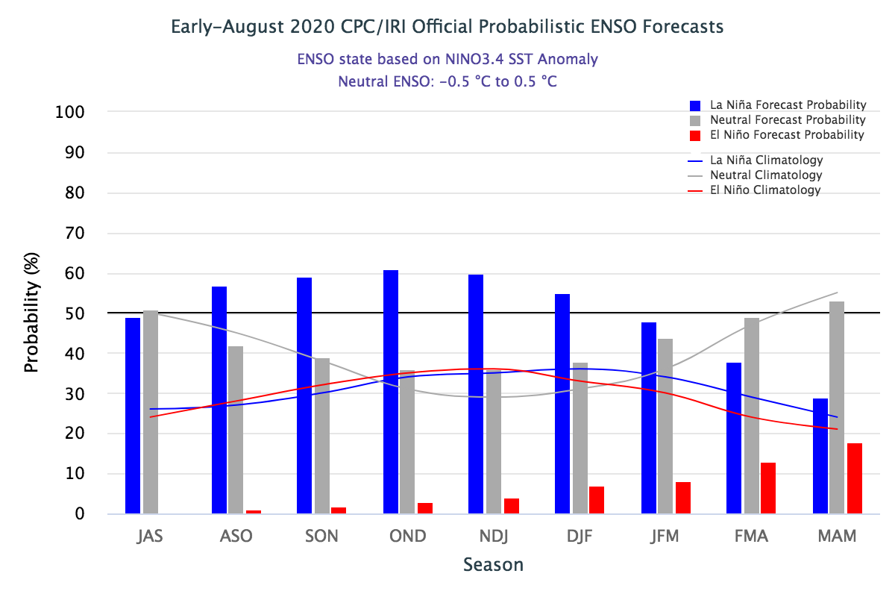
ENSO Forecasts
Early- July CPC/IRI forecast
Onwards to quick increasing (??) probability for La Nina later in the year.
Barely >50 percent.
50-50 Chance
Early- August CPC/IRI forecast
Developing La Nina during next 3 months.

Slide 25
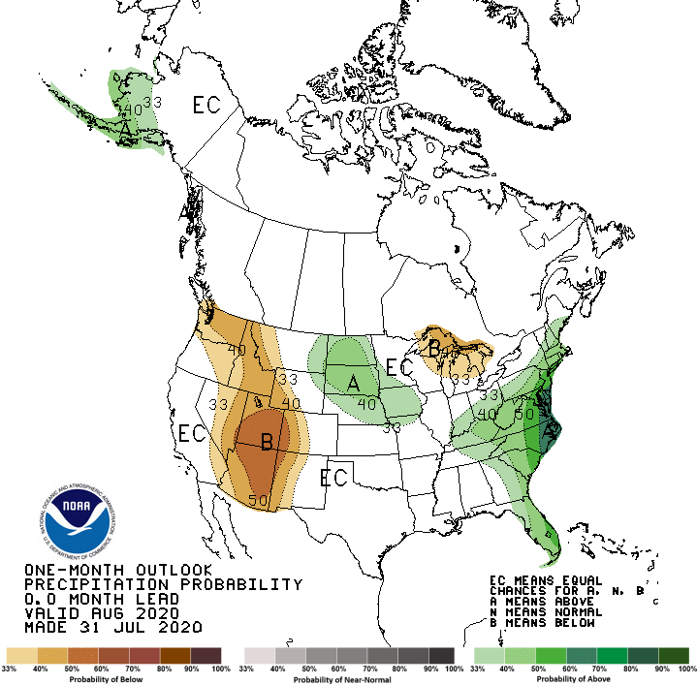
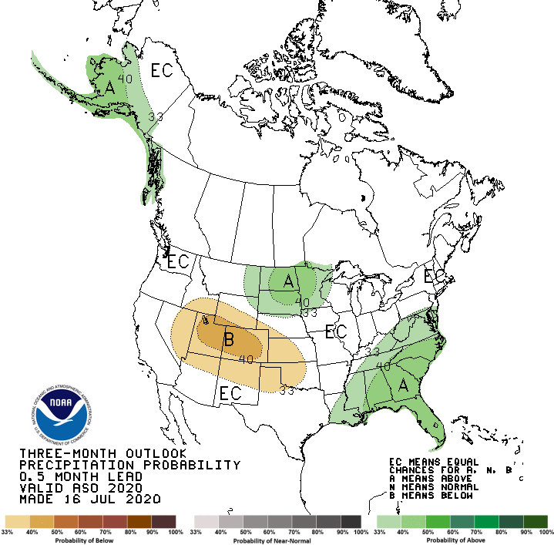
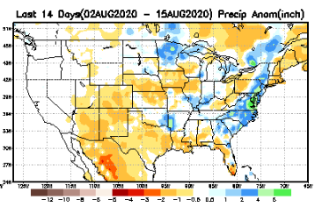
Released July 31st
Previous(Last month)
CPC’s official
Precipitation OUTLOOK for Monthly (Aug)/Seasonal (ASO)
Released July 16th
Observed so far this month!!
Monthly P/T forecasts verified at mid-month are generally good! Why? ☺ (becoz they r mostly based on GFS’ 2-wk fcsts)
But this month, so far ????

Slide 26
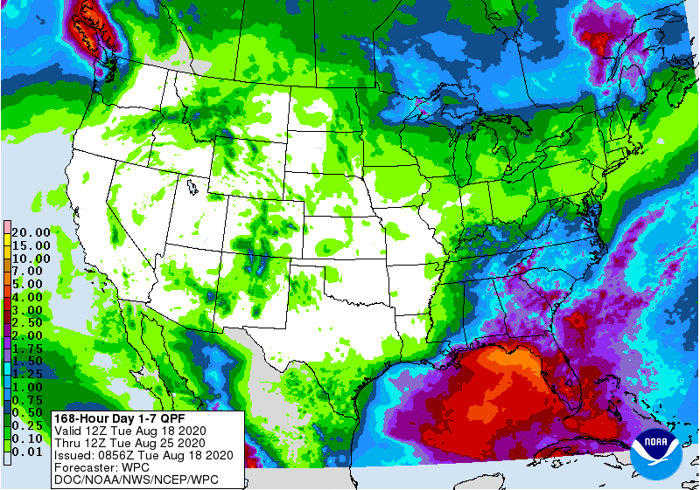
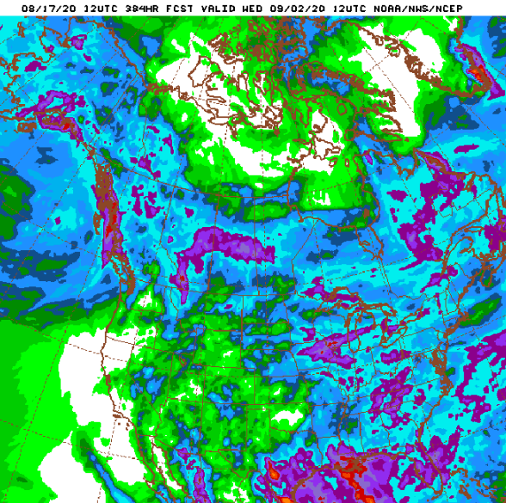
WPC Next 7 days QPF Forecast
GFS Model Guidance for next 16 days.
Much of the US drought is in the West.
In the next 1-2 weeks, much of the expected rain is in the East. (Much of green color is < ½ inch).

Slide 27
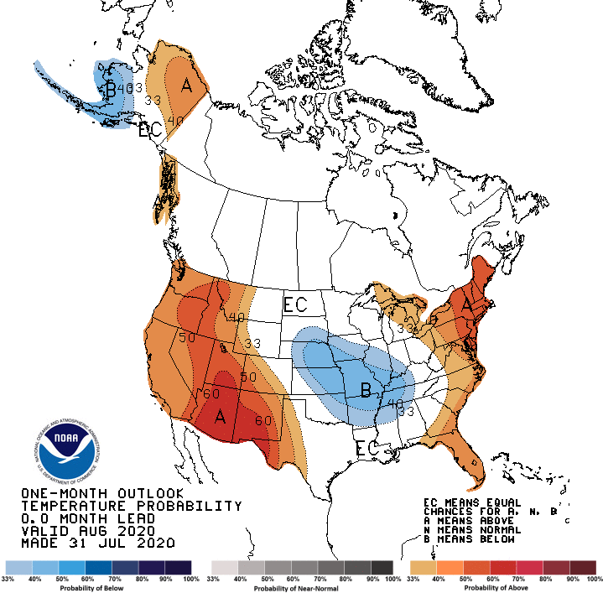
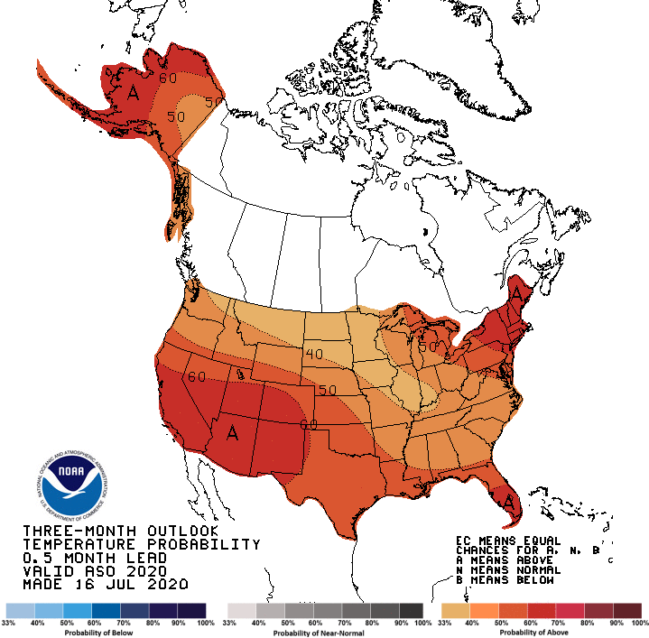
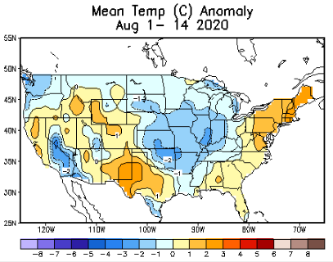
Made
July 31th
Previous (Last Month)
CPC’s official
Temperature outlook for Monthly (Aug)/Seasonal (ASO)
Made
Jul 16th
Observed so far this month!! ☺

Slide 28
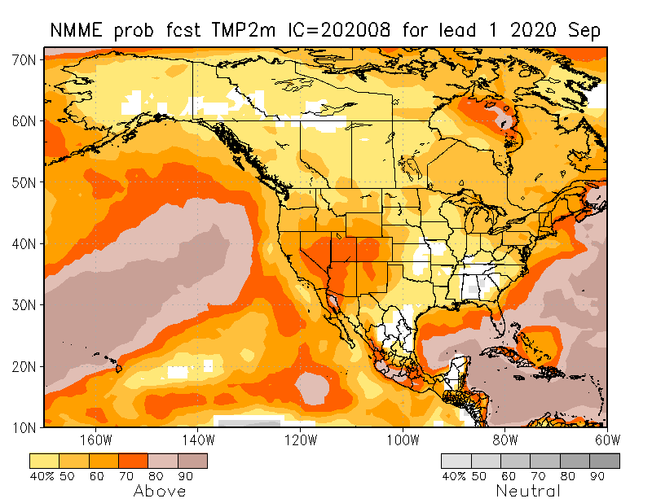
NMME T & P Ens.Mean forecasts
Sep
These NMME models always make these red (warmer T) forecasts.
SON
Models predict high Temps. and less chances of rain in drought areas of SW. ☹

Slide 29
Agreement/Disagreement in the various NMME models’ SON seasonal Precip. Forecast.
??

Slide 30
Fcst made from last month(background) compared with this month(foreground, red border)
Forecast uncertain in Hatched areas.
Fcsts generally no good!(see 4 corners area)–disconnect with the USDM. Based mainly on NMME precip fcst deficiency.

Slide 32
Latest Initial Conditions:
08/11/2020
http://drought.geo.msu.edu/research/forecast/smi.monthly.php
Predicted Monthly Soil Moisture Percentile
MSU stopped updating 06/10/20 ☹
Initial Conditions 2 months ago:
06/09/2020
The inter quartile range suggest greater uncertainty about the forecast in these shaded regions.

Slide 33
Summary
Current Drought conditions:
Over the last five months, drought area & severity has overall generally increased across the South, West & Northern Plains and Northeast.
The short/long term drought in the four corner states area (AZ/NM/UT/CO) has expanded and intensified southward & westward.
Dryness/Drought in Northern Great Plain states has slightly eased.
Recent short-term Drought in the Northeastern states has got better.
New dry/drought areas are emerging in the upper Midwest (IN, OH, PA) and southeast.
Some/many of California reservoirs levels are below their historical average levels. Next rainy season is 6-months away. It is going to be tough with the above normal Temperature forecast.
Little more than a year ago(~May 2019), the US had almost the lowest coverage of area covered by drought! approx. < 4% or so. Now much of the Southwest and parts of Northeast is under drought!
Current ENSO status and forecast:
- There is a ~60% chance of La Niña development during Northern Hemisphere fall 2020 and continuing through winter 2020-21 (~55% chance).
Prediction:
The much needed lower boundary condition forcing in the tropical equatorial Pacific is finally beginning to take hold, in the form of a developing La Nina, so, our confidence in model’s forecasts is increased.
The late and deficient North American monsoon in the southwest and its continued “less than normal” expected rainfall in this four corners states and vicinity combined with high temperatures make the drought persist and even get worse in the upcoming season. The short/long tem drought in northern CA, NV, UT and western TX will persist, may expand, and may even get worse.
The remaining dry/drought conditions in the northeastern states is likely be gone in the upcoming forecast season given the expected rainfall in the coming season and the forecast temperature and rainfall conditions.
Existing developing dry drought conditions in IN, OH and parts of PA will likely persist or get worsen in the next three months, as well as the pocket of drought in NE/IA border.
The developing dryness in in isolated regions in the Gulf states, is an area of concern, especially with the developing La Nina, and the rainfall climatology. There is a possibility of drought conditions developing in this region, even though a single tropical system from the active hurricane season will make all the difference.
*********************

Slide 34
Miscellaneous maps

Slide 35
Miscellaneous maps

