Slide 1
Drought Outlook Support Briefing August 2019
Climate Prediction Center/NCEP/NOAA
http://www.cpc.ncep.noaa.gov/products/Drought
Phone: 1-877-680-3341
Pwd: 858747#

Slide 2
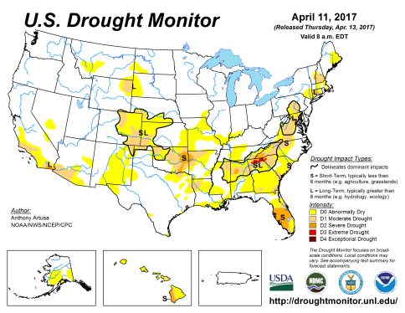
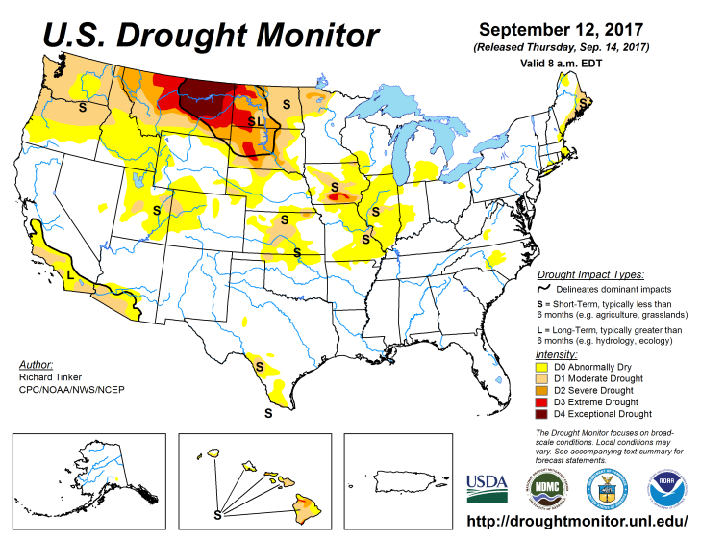
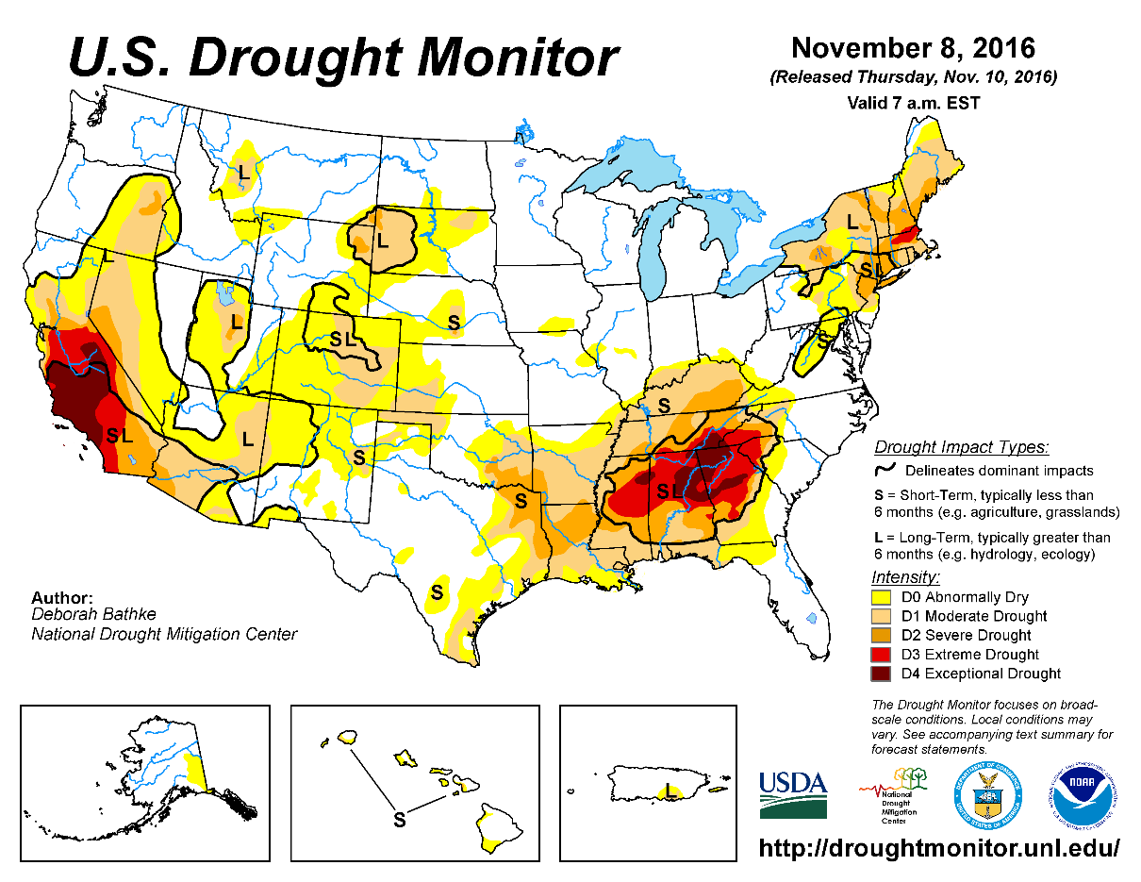
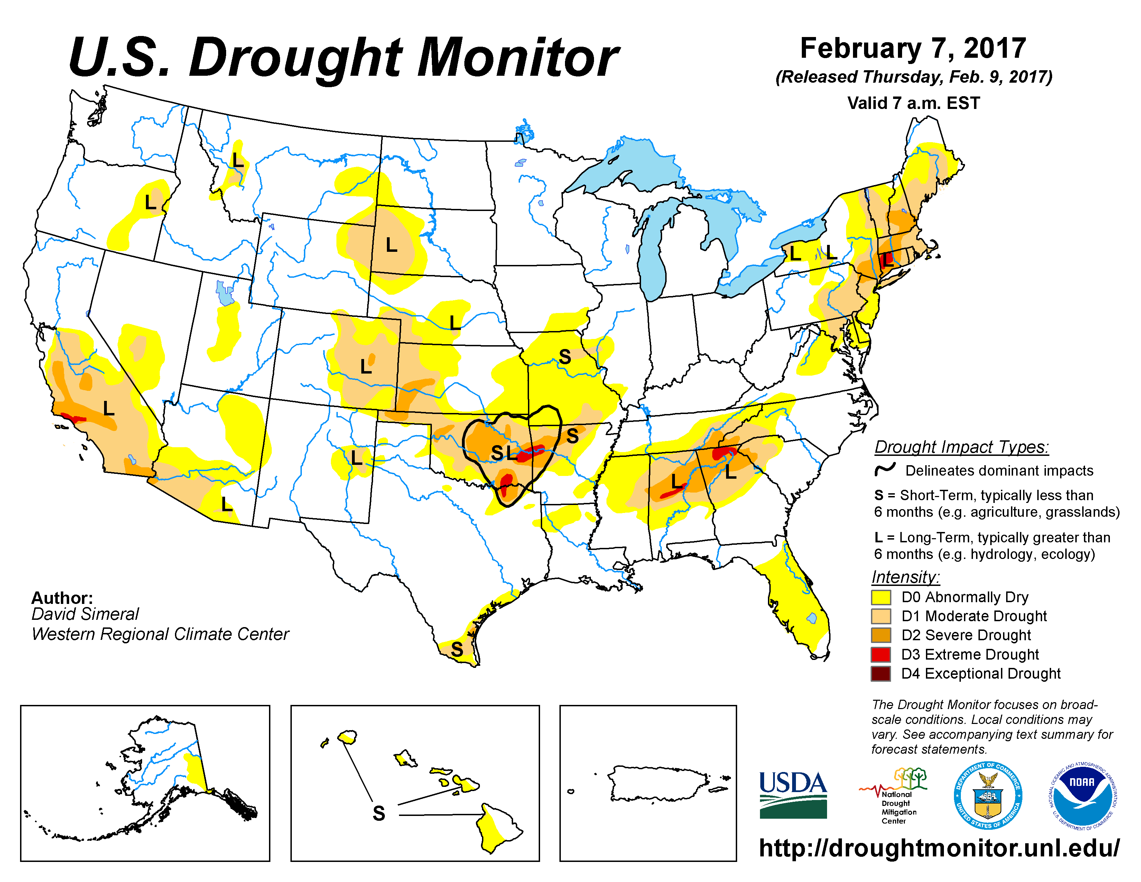
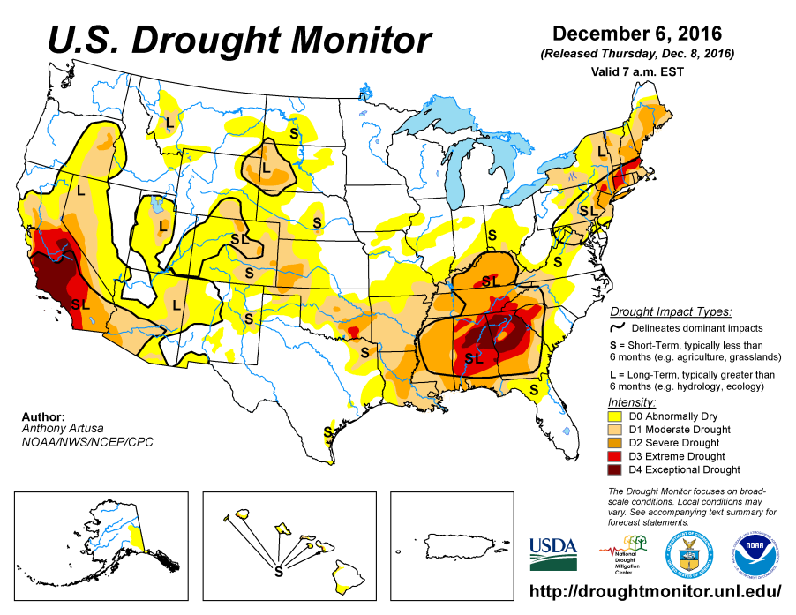
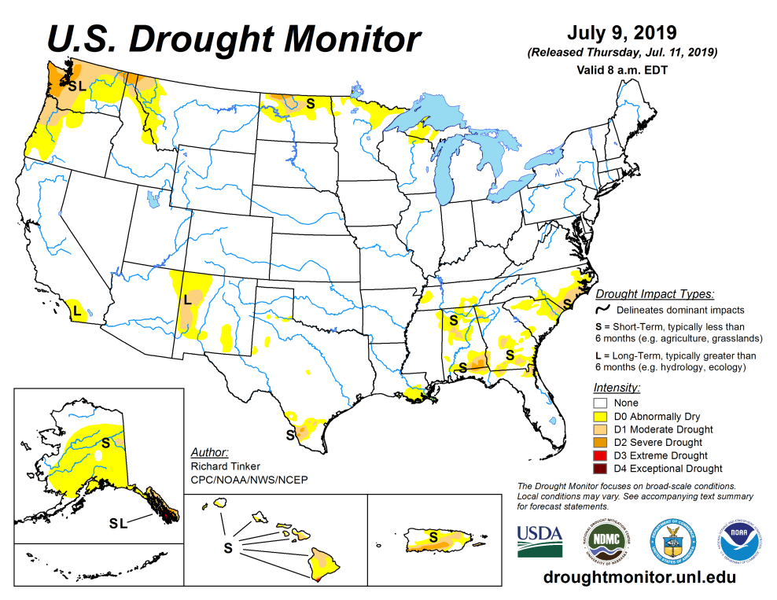
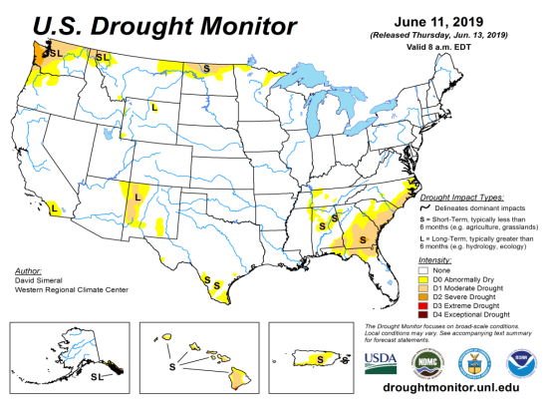
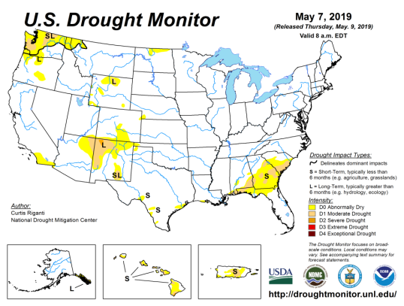
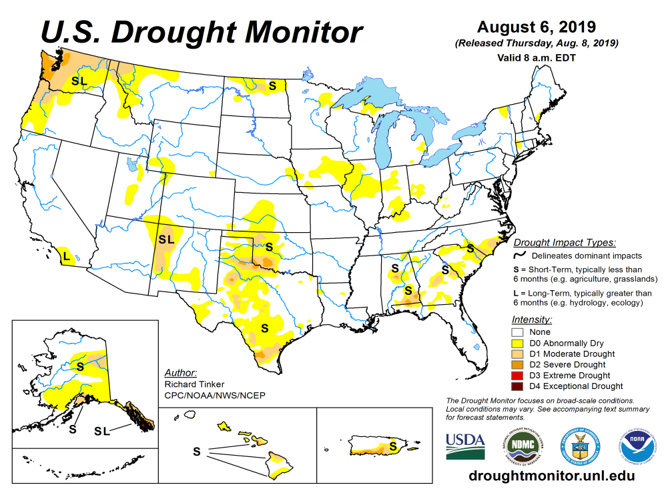
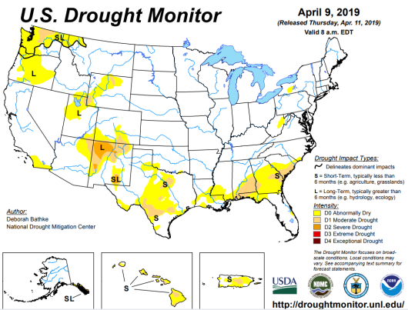
Drought Monitor
July
June
After reaching a relative minimum in the area of drought coverage across the US, it is slowly beginning to surge.
According to the DM, these regions have droughts:
Pacific NW & nearby regions
Many regions across the south including TX/OK, the southeast, and
NM & vicinity.
The upper Midwest,
The Northern Great Plains esp. ND.
May
Recent/Latest
April
February

Slide 3
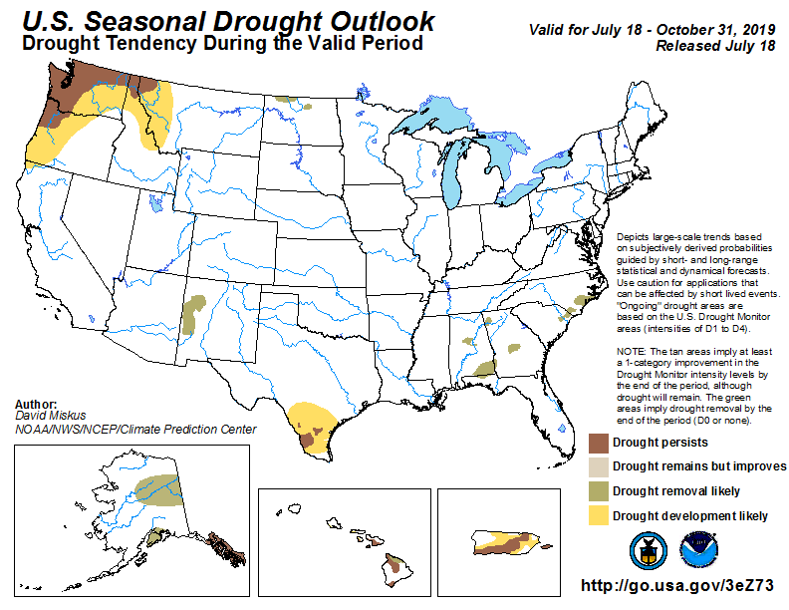
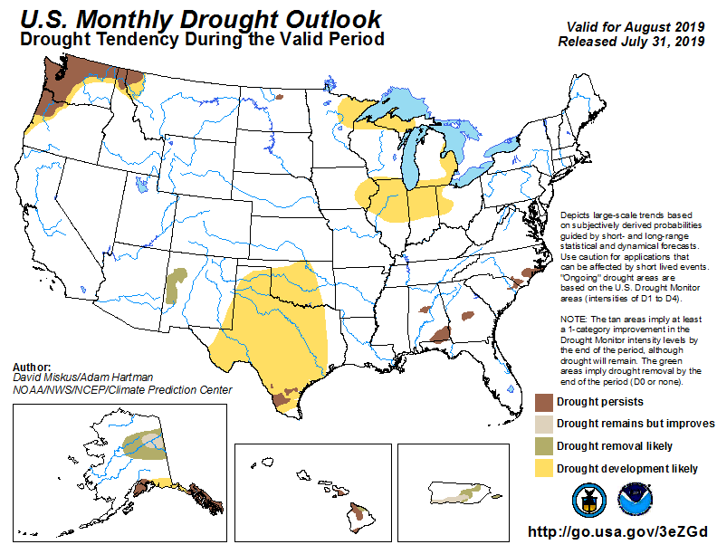
(Prev) Seasonal/Monthly Drought outlooks
(New Seasonal Drought Outlook to be released in 2 days!)
Seasonal Outlook
(Mid July 2019- Oct 2019)
issued 7/18/19
Monthly outlook
(for Aug 2019)
issued 7/31/19
The uncertainties in the monthly/seasonal rainfall/temperature outlooks directly impacts these drought outlooks!!

Slide 4
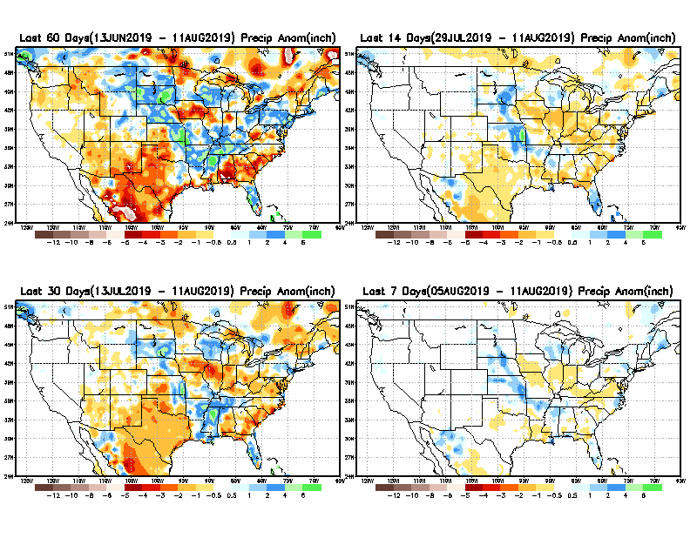
Precipitation ANOM during last 7, 14, 30, & 60 days.
60 Days
14 Days
These maps in this and following slides, including
a) Total,
b) Anom and c) Percent of precip. in these and other longer time ranges are now daily updated at:
30 Days
7 Days
From: Recent Accumulated Precipitation https://www.cpc.ncep.noaa.gov/products/Drought/briefing_prcp.shtml

Slide 5
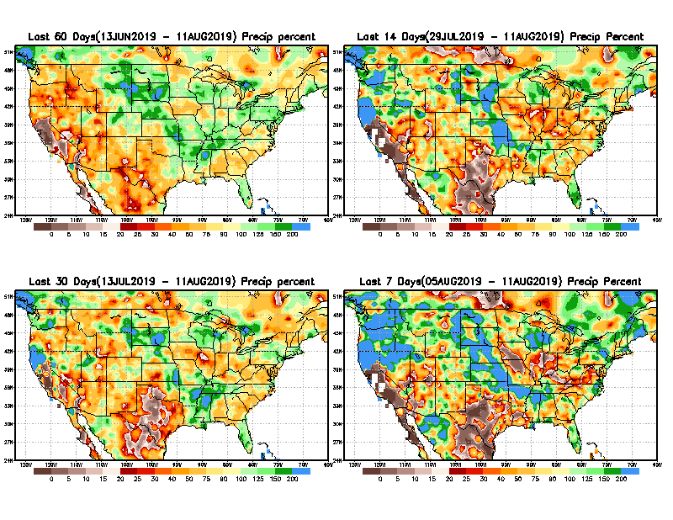
Precipitation Percent during last 7, 14, 30, & 60 days.
60 Days
14 Days
NOW !
30 days
7 Days
From: Recent Accumulated Precipitation https://www.cpc.ncep.noaa.gov/products/Drought/briefing_prcp.shtml

Slide 6
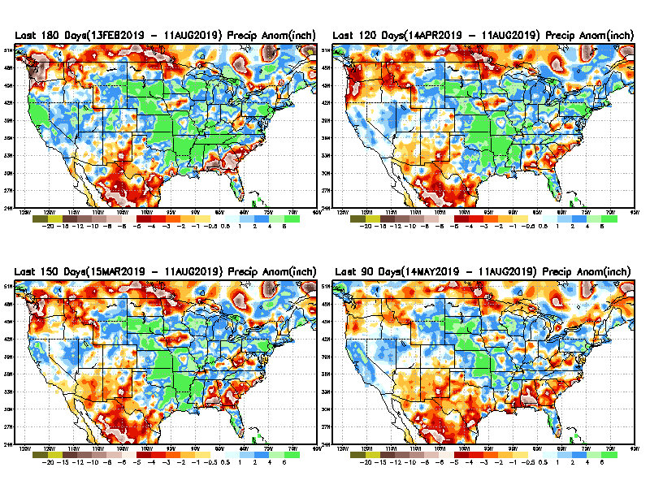
Total precipitation ANOM during last 3, 4, 5, and 6 months.
6 M
4 M
5 M
3 M
From: Recent Accumulated Precipitation https://www.cpc.ncep.noaa.gov/products/Drought/briefing_prcp.shtml

Slide 7
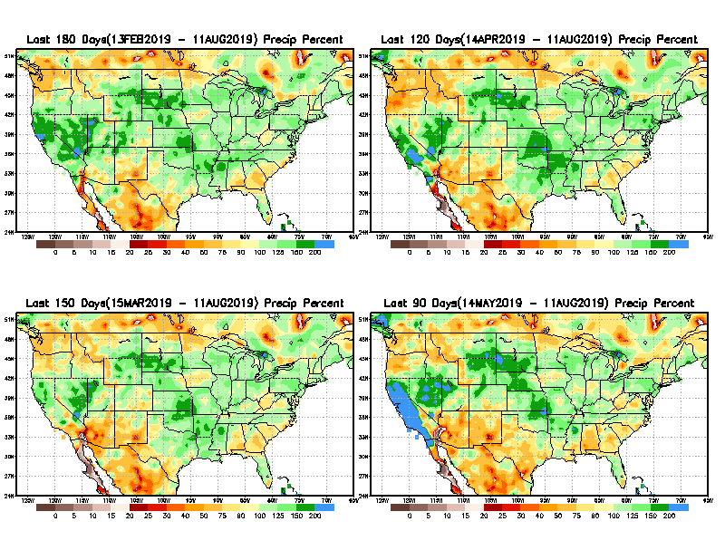
Total precipitation Percent during last 3, 4, 5, and 6 months.
6 M
4 M
CA precip – El Nino impact!!- which had max amplitude during winter.
5 M
3 M

Slide 8
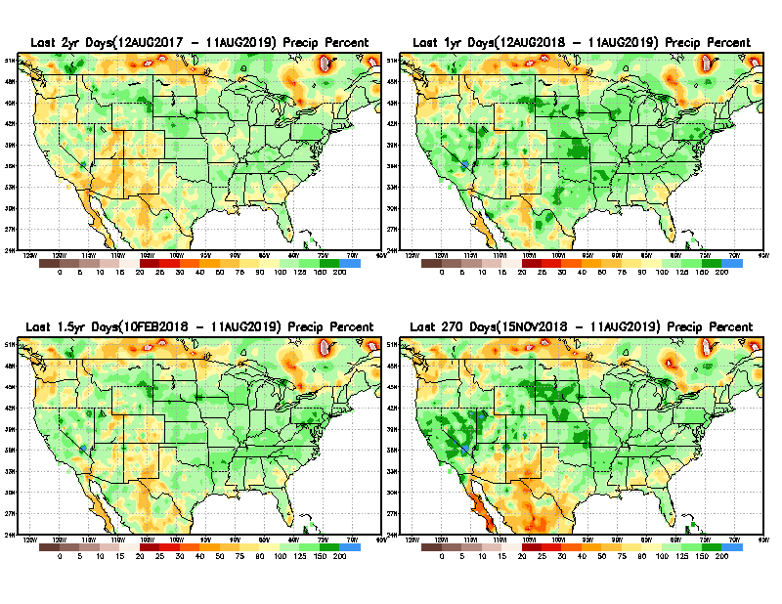
Total precipitation Percent during last 9 months, 1 yr, 1.5yrs, & 2 yrs.
2 Y
1 Y
1.5 Y
9 M
From: Recent Accumulated Precipitation https://www.cpc.ncep.noaa.gov/products/Drought/briefing_prcp.shtml

Slide 9
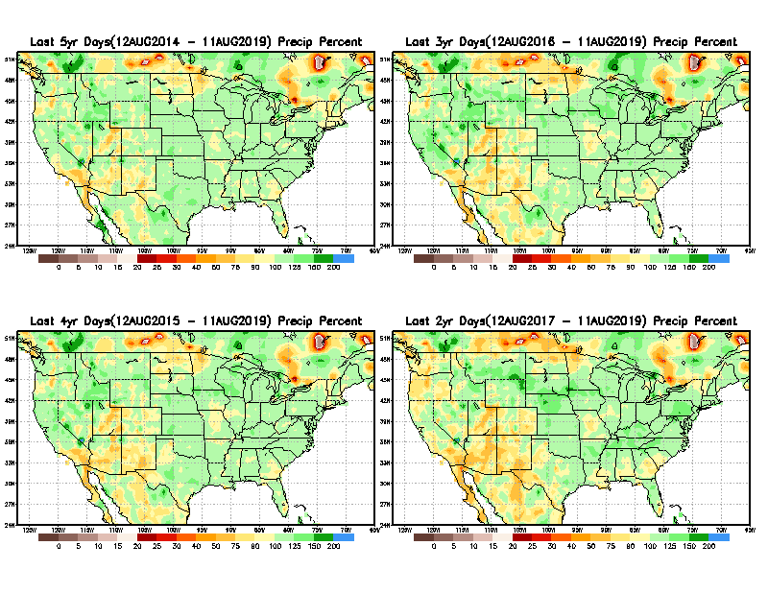
Total precipitation Percent during last 2 yrs, 3 yrs, 4 yrs, & 5 yrs.
5 Y
3 Y
Still longer term rainfall deficit variability in play? Especially in the southwest!
Will these deficits ever go away, OR is these part of the new norm??
4 Y
2 Y
From: Recent Accumulated Precipitation https://www.cpc.ncep.noaa.gov/products/Drought/briefing_prcp.shtml

Slide 10
Rainy (3-month)Season across the US

Slide 11
Adapted from Rich Tinker.

Slide 12
Adapted from
Rich Tinker

Slide 13
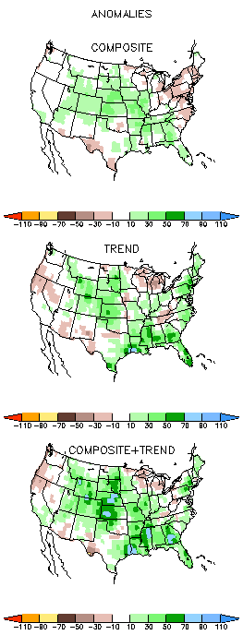
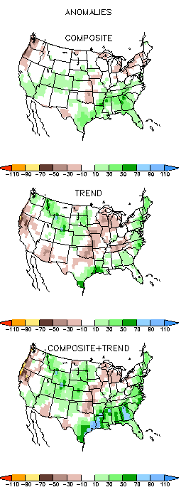
EL NINO Precip COMPOSITES
ASO
SON

Slide 14
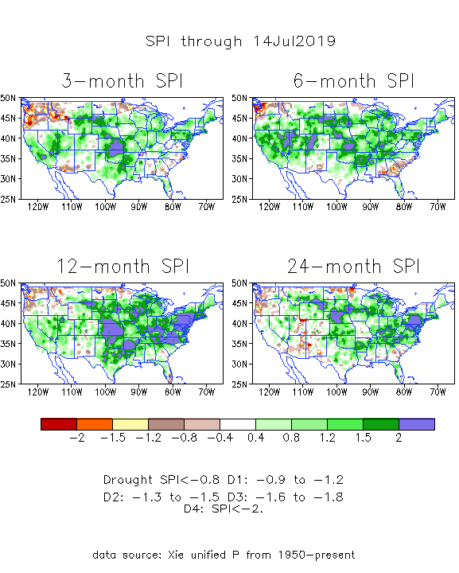
The Standardized Precipitation Index SPI (based on Observed P)
---Last month
Very interesting graphic & details for the drought across the US based on the more generalized precip deficit/excess, the Standardized Precipitation Index (SPI).
The dark brown and red colors, indicating standardized precipitation deficits, in the various time periods, approximately correspond to the appropriate short/long term drought monitor regions and their intensities
In the short term (~3-6 mo) dryness still exists in the far southeast, and in the Pacific NW, and in ND.
In the longer term ~12m-24m and longer, rainfall deficits remain in the AZ/NM/UT/CO states area and in Northwest and in the Northern Plains.

Slide 15
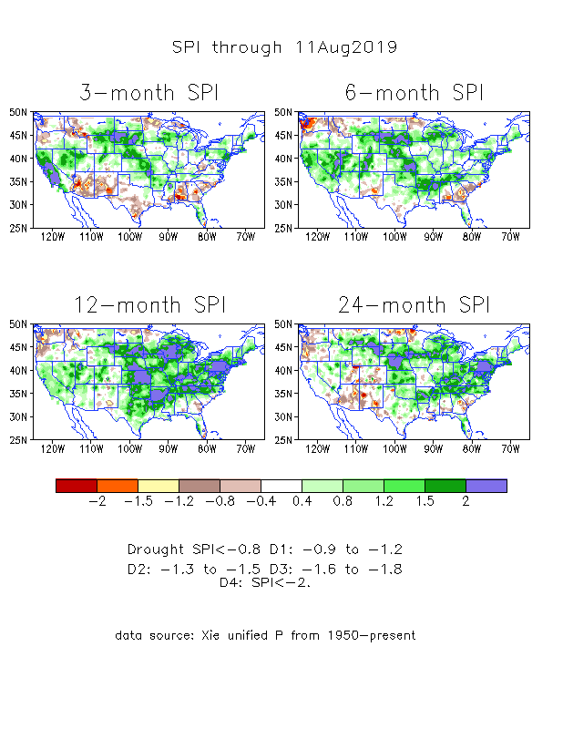
The Standardized Precipitation Index SPI (based on Observed P)
----- NOW
----- NOW
Very interesting graphic & details for the drought across the US based on the more generalized precip deficit/excess, the Standardized Precipitation Index (SPI).
The dark brown and red colors, indicating standardized precipitation deficits, in the various time periods, approximately correspond to the appropriate short/long term drought monitor regions and their intensities
A quick change around in a few places since last month in the short term (3-mo) SPI: Pacific NW, and across the whole South.
In the longer term ~12m-24m and longer, rainfall deficits remain in the AZ/NM/UT/CO states area and in Northwest and in the Northern Plains.

Slide 16
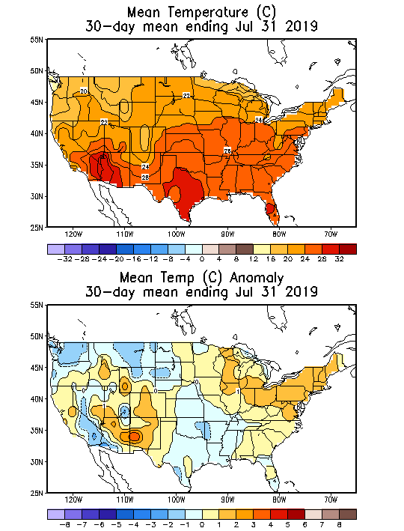
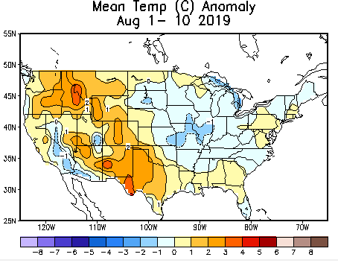
Recent US Temperatures
July US T pattern was mixed with warm in the east and somewhat mixed elsewhere
August so far is warmer than normal over much of the west, and somewhat cooler in the easr.

Slide 17
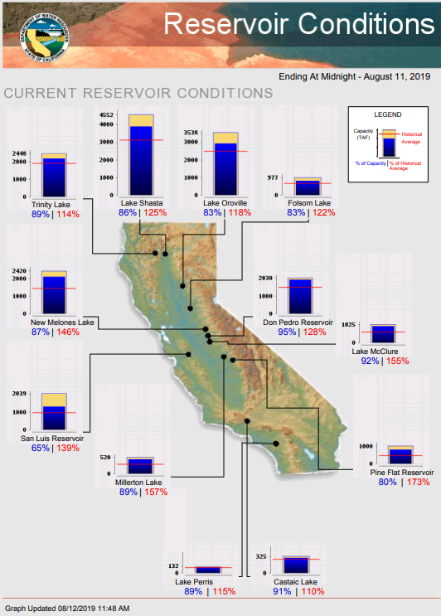
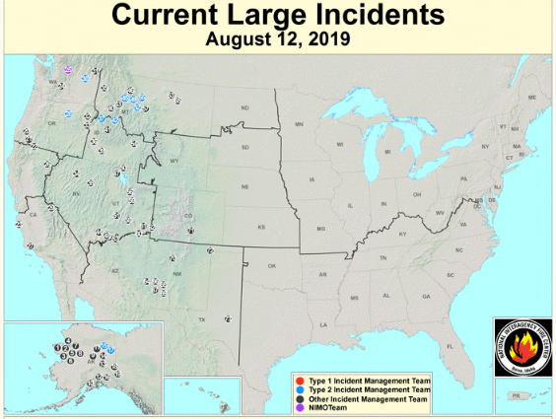
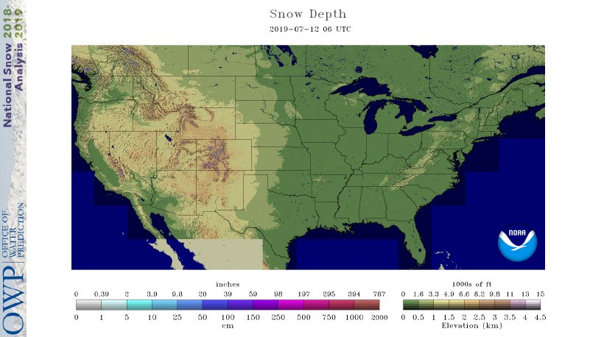
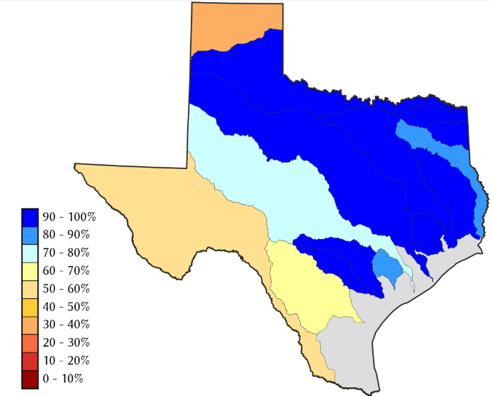
Water Reservoir Levels in some Western/Southern States! !
https://fsapps.nwcg.gov/afm/index.php
No reported major fire incidents so far. (cf. last year!)
Except in few high elevations, all snow has melted.
Northern CA reservoirs beginning to show
Weakness, but rainy season coming up!
TX
California reservoirs are well above historic average levels.
https://fsapps.nwcg.gov/afm/index.php

Slide 18
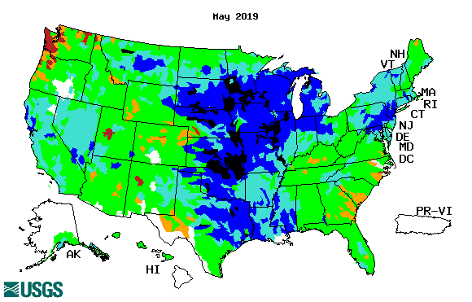
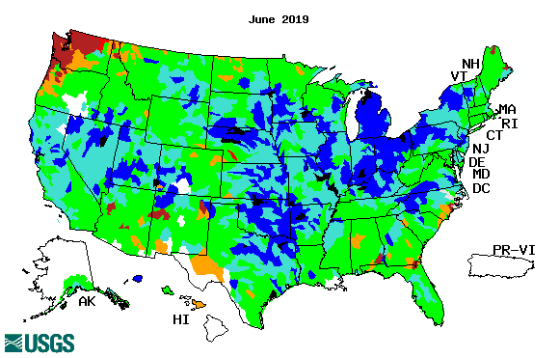
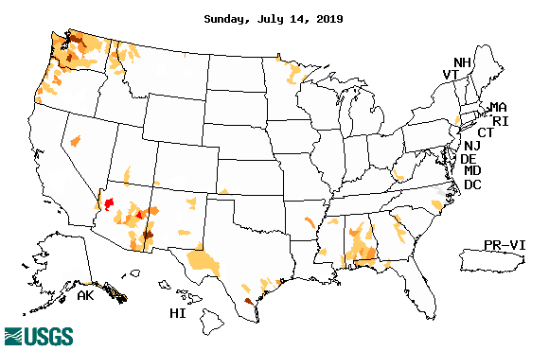
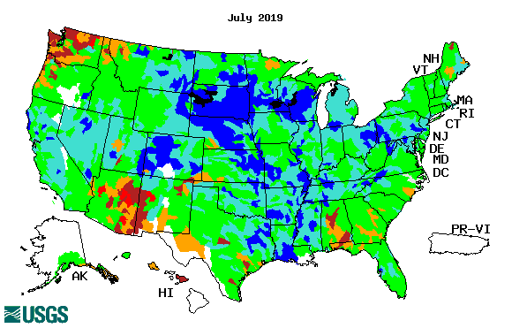
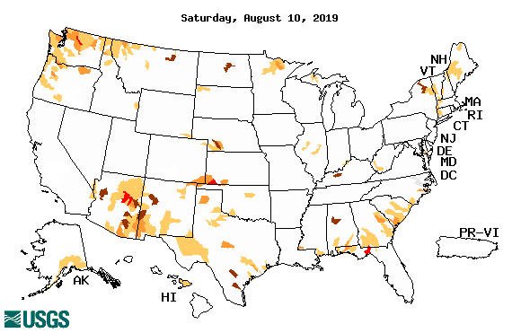
Streamflow (USGS)
Overall, worsened stream flow conditions in the south.
The weak southwest monsoon so far is not helping in AZ/NM and western TX.
Pacific NW is about same as prev. month or may be slightly better.
Map shows only below normal 7-day average streamflow compared to historical streamflow for the day of year.
One month ago (left) &
Now (below)
18

Slide 19
EL NIÑO/SOUTHERN OSCILLATION (ENSO)
DIAGNOSTIC DISCUSSION
issued by CLIMATE PREDICTION CENTER/NCEP/NWS and the International Research Institute for Climate and Society
8 August 2019
ENSO Alert System Status: Final El Nino Advisory
Synopsis: ENSO-neutral conditions are present. Equatorial sea surface temperatures (SSTs) are above average across the western and central Pacific Ocean and are below average in the eastern Pacific. The pattern of anomalous convection and winds are generally consistent with ENSO-neutral. ENSO-neutral is most likely to continue through Northern Hemisphere winter 2019-20 (50-55% chance).

Slide 20
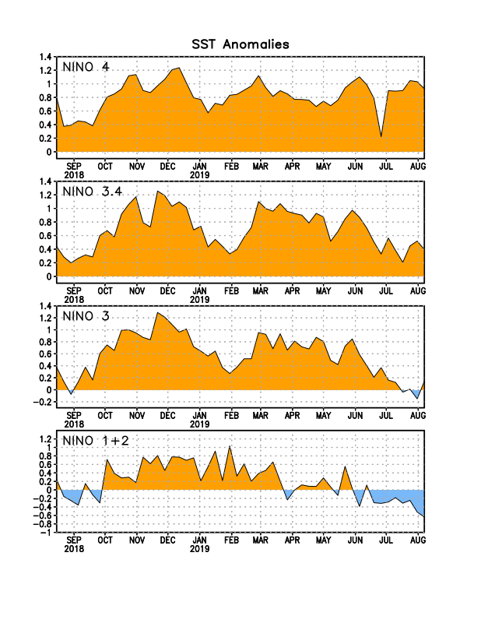
Latest values of SST indices in the various Nino Regions.
The sub surface heat anom has been falling for the past few months.
Decreasing!
?
Relatively short lived!

Slide 21
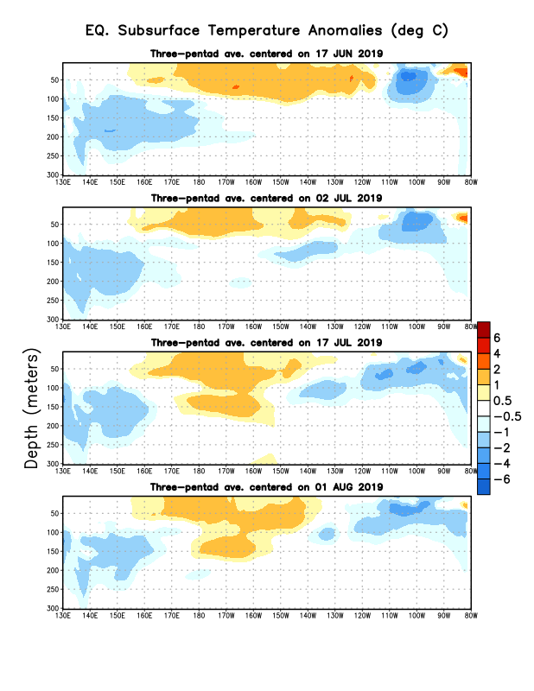
Sub-Surface Temperature Departures in the Equatorial Pacific
Most recent pentad analysis

Slide 22
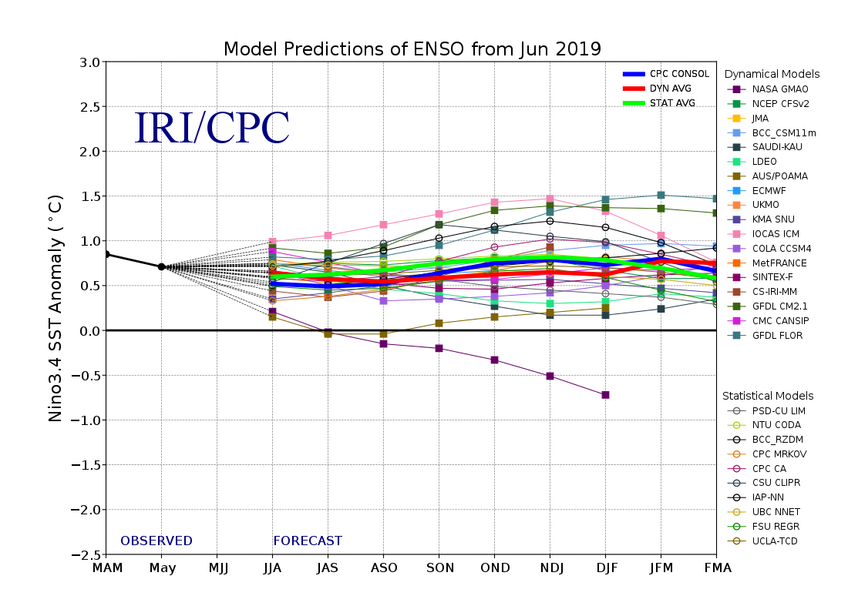
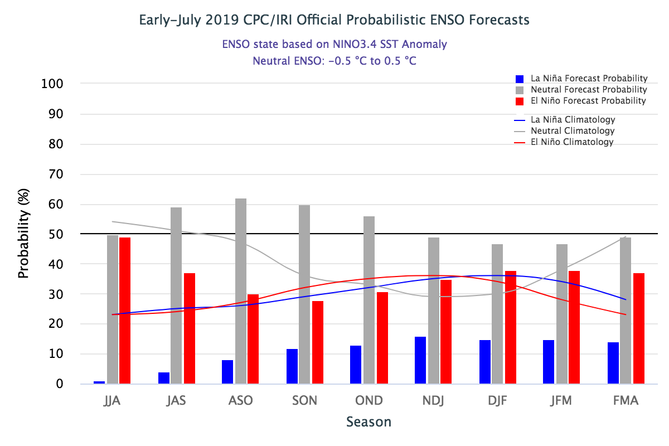
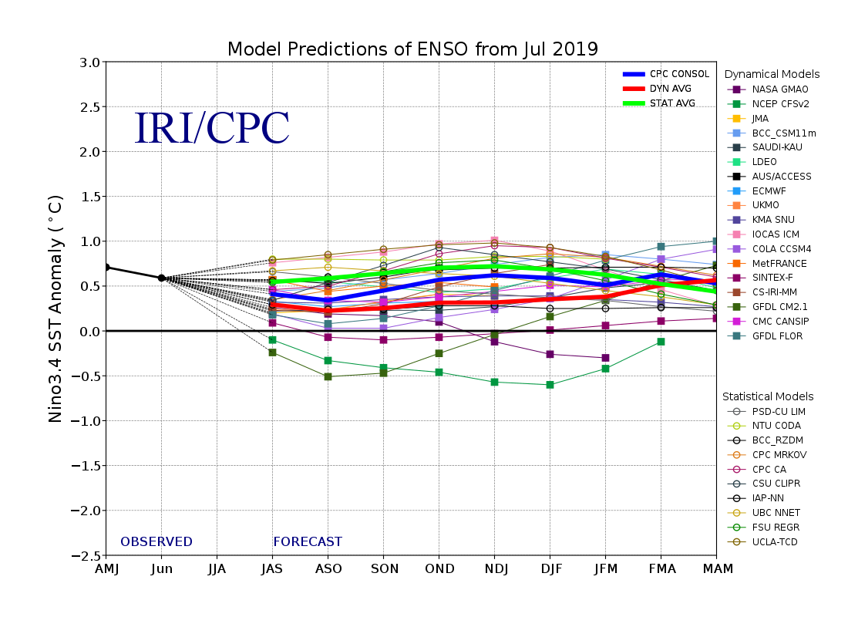
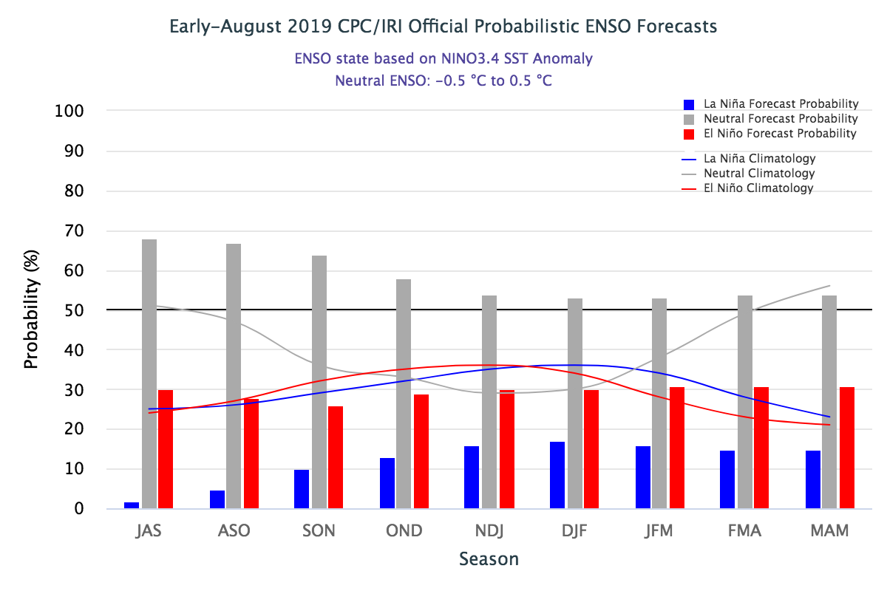
ENSO Forecasts
Early- July CPC/IRI forecast
Early- August CPC/IRI forecast

Slide 23
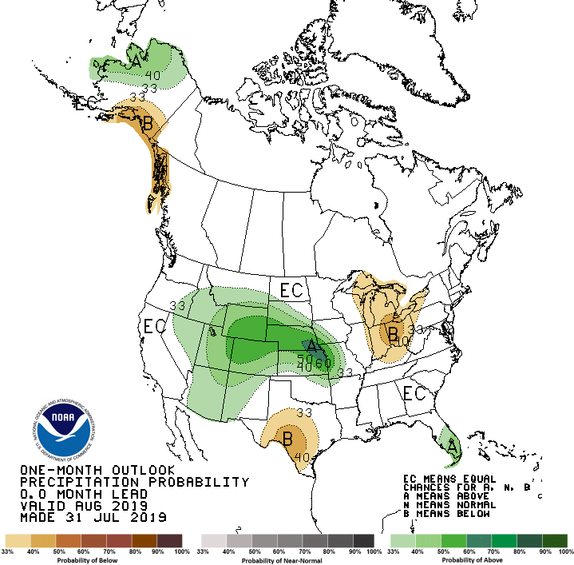
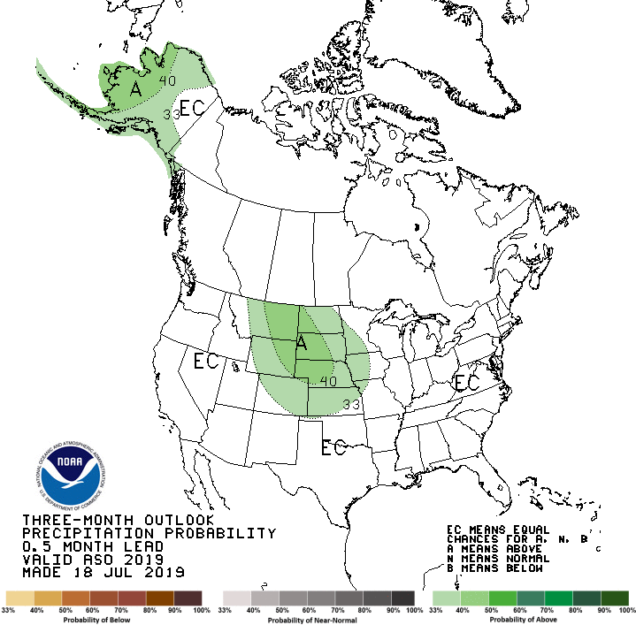
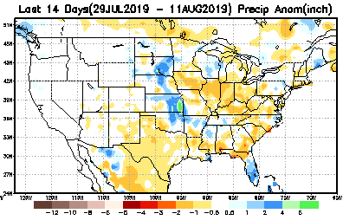
Released July 31st
Previous(Last month)
CPC’s official
Precipitation outlook for Monthly (August)/Seasonal (ASO)
Released July 18th
Observed so far this month!!
?

Slide 24
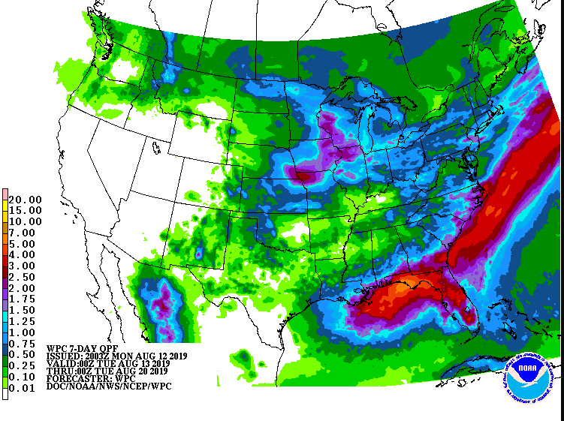
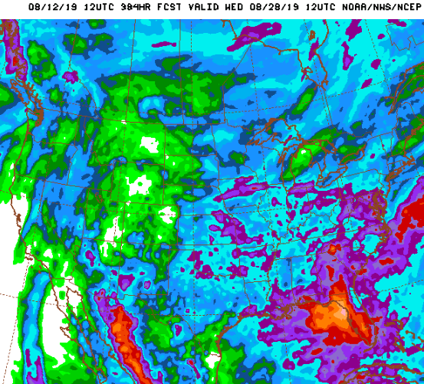
WPC Next 7 days QPF Forecast
GFS Model Guidance for next 16 days.

Slide 25
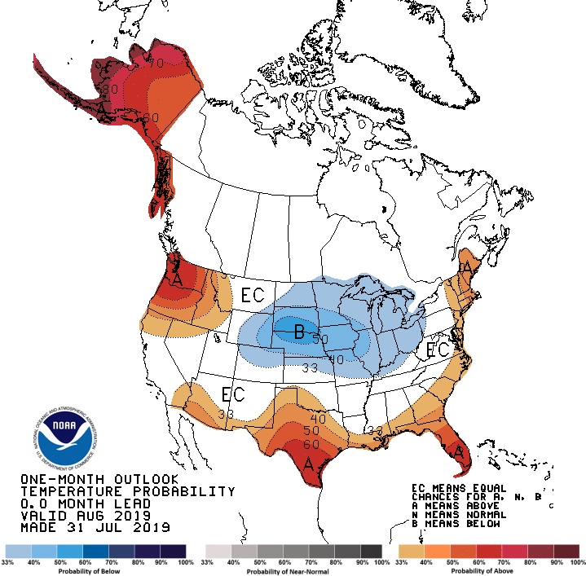
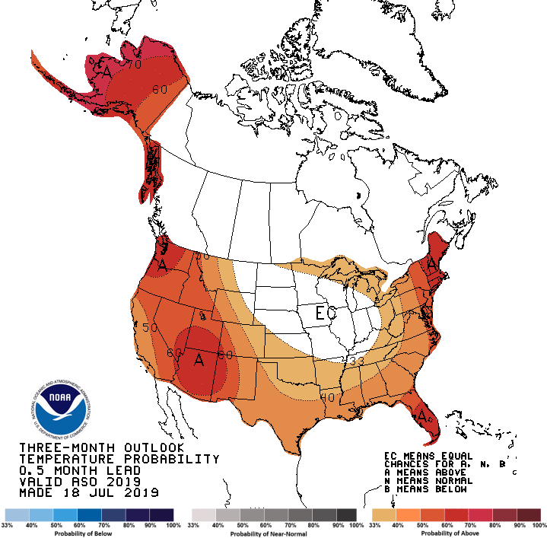
Previous (Last Month)
CPC’s official
Temperature outlook for Monthly (Aug)/Seasonal (ASO)
Made
July 31st
Made July 18th
Observed so far this month!! ☺

Slide 26
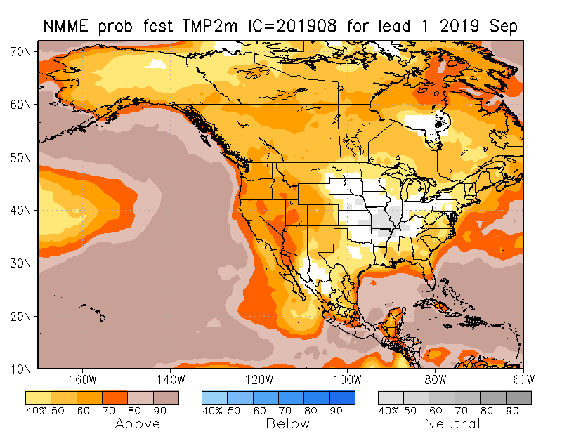
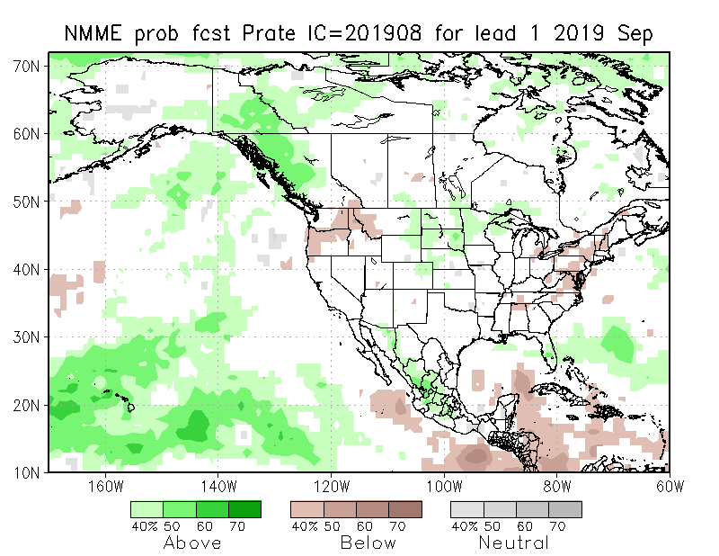
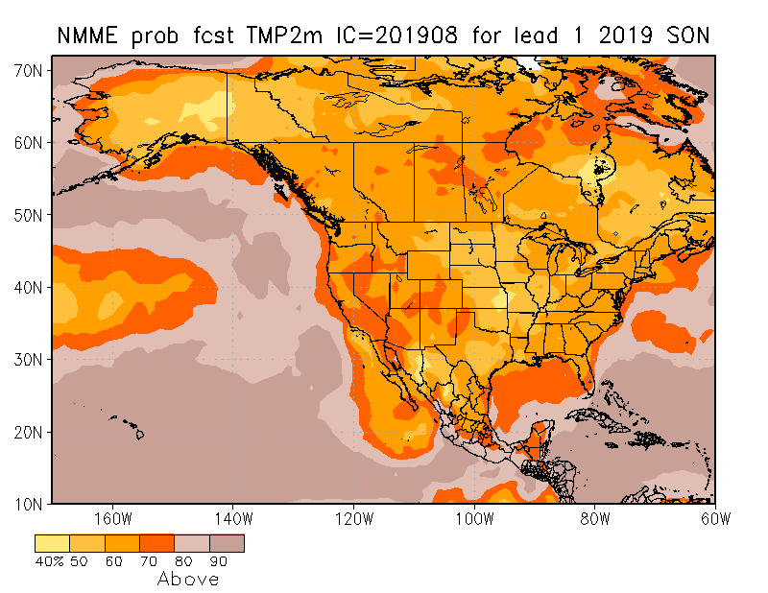
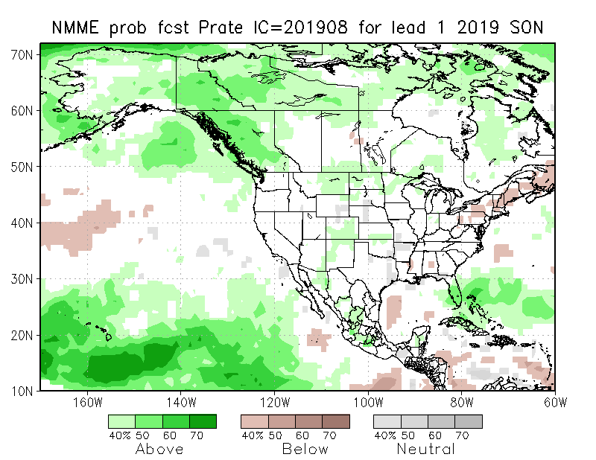
NMME T & P EnsMean forecasts
Sep
SON
Both monthly and seasonal forecasts call for above normal temperatures except in the middle of the centered near KS.
Forecast seasonal precip map is very similar to the ENSO impact+trend map seen earlier.

Slide 27
The agreement/uncertainty among the diff. NMME models’ forecasts (middle and bottom panels) for Sep-Oct-Nov Precipitation!!!
27

Slide 28
SPI3, SPI6
& SPI12
Forecasts from 6 NMME Models
(uses obs. P up to past month, and forecast months’ P from NMME models)
The goodness and skill of these SPI’s forecasts depend directly on the NMME models’ skill in predicting precipitation!!!

Slide 29
Initial Conditions: 5/7/2019
http://drought.geo.msu.edu/research/forecast/smi.monthly.php
Predicted Monthly Soil Moisture Percentile
NOT AVAILABLE
THIS
MONTH
Initial Conditions: 6/11/2019
Latest
Initial Conditions:
7/09/2019
The inter quartile range suggest greater uncertainty about the forecast in these shaded regions.

Slide 30
NCEP Ensemble mean NLDAS2 models’ Soil Moisture tendency/trend
7 days
14 days
30 days

Slide 32
Precipitation
NASA GEOS 5 Model
Precipitation & Soil Moisture Forecast
Aug 2019
Soil Moisture
Sep 2019
Oct 2019
10/1

Slide 33
Summary
Current ENSO status and forecast. Weak ENSO-neutral conditions are present. Equatorial sea surface temperatures (SSTs) are above average across the western and central Pacific Ocean and are below average in the eastern Pacific. The pattern of anomalous convection and winds are generally consistent with ENSO-neutral. ENSO-neutral is most likely to continue through Northern Hemisphere winter 2019-20 (50-55% chance).
Current Drought conditions:
After having been near record low in terms of areal coverage for drought affected regions across the US over the past few months, the extent of abnormally dryness/drought area coverage appears to creep up slightly during last month.
The apparent ending of El Nino conditions did not help the recent emerging dry conditions in the south. Consequently, the stream flow conditions across the south are weaker this past month than before. The moderate to severe drought in the Pacific Northwest & vicinity has gotten slightly better.
The weak performance of the southwest monsoon so far in the southwestern states AZ/NM and western Texas has contributed to the dryness in the region. California reservoirs, at present, are at better than historically average levels (The El Nino excess rainfall during winter and spring helped!). Compared to this time last year, the major fire incidents in the state are nearly absent this year.
Long-term (>1 year) deficits still remain over large areas in the Southwest and West - which is not completely reflected in the drought monitor.
Prediction:
The return to normal conditions, with the apparent ending of El Nino, is not providing any boundary forcing, and it is reflected in the weak precipitation model (NMME) forecast signal over the US for the upcoming season.
The small pockets of short term dryness/drought in the southeast is unlikely to get any worse, and may even disappear, since the medium and extended range forecast (along with a possible storm/hurricane from above normal hurricane season forecast) is likely to bring some wetness here.
The drought along the Pacific Northwest is likely to persist in the monthly time scale, but may considerably improve before the forecast season is over, once the rainy season starts here.
The dryness & short term drought in NM is likely to persist, as the models do not show any +ve signal here.
Overall, the upcoming season will continue to be likely a season with very low percent area coverage for drought across the contiguous US; however, drought in Alaska, Hawaii, and Puerto Rico needs to be monitored.

Slide 34
Miscellaneous maps

Slide 35
Miscellaneous maps

