Slide 1
Seasonal Rainfall and Temperature Guidance Issued 11 April, 2024 NOAA/Climate Prediction Center
Forecast Background
ENSO update
Current State of the global climate
SST Forecasts
Regional Rainfall Forecast maps
Summary

Slide 2
CPC ENSO Update
CPC ENSO Alert System Status El Niño Advisory / La Niña Watch
Synopsis: A transition from El Niño to ENSO-neutral is likely by April-June 2024 (85% chance), with the odds of La Niña developing by June-August 2024 (60% chance). (Updated 11 April 2024).
http://www.cpc.ncep.noaa.gov/products/analysis_monitoring/enso_advisory/ensodisc.shtml

Slide 3
Summary of State of the Global Climate in March 2024
During March 2024, sea surface temperature (SST) anomalies continued to weaken across most of the equatorial Pacific Ocean.
SST anomalies were coolest in the far eastern Pacific Ocean.
The weekly Niño-1+2 value at -0.1°C. Weekly SST index values in the other Niño regions were between +0.9°C and +1.2°C.
Area-average below-average subsurface temperatures strengthened.
Collectively, the coupled ocean-atmosphere system reflected the continued weakening of El Niño.
The Indian Ocean Dipole Index returned to the neutral range in early April 2024.
Suppressed precipitation was observed over the northern portion of Southern Africa, around Philippines Malaysia, and near the Date.
Enhanced precipitation was evident across southern Indonesia and northern Australia..

Slide 4
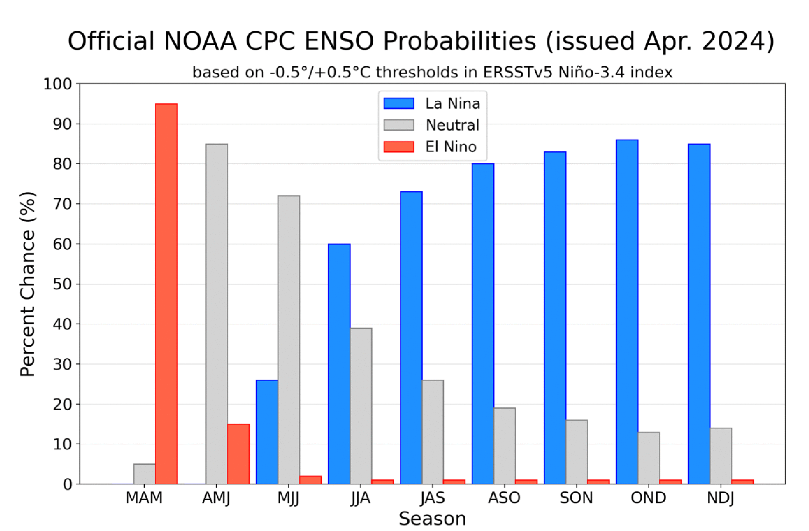
CPC OFFICIAL NIŇO3.4 Forecast
Season | La Niña | Neutral | El Niño
MAM | 0 | 5 | 95
AMJ | 0 | 85 | 15
MJJ | 26 | 72 | 2
JJA | 60 | 39 | 1
JAS | 73 | 26 | 1
ASO | 80 | 19 | 1
SON | 83 | 16 | 1
OND | 86 | 13 | 1
NDJ | 85 | 14 | 1
A transition from El Niño to ENSO-neutral is likely by April-June 2024 (85% chance), with the odds of La Niña developing by June-August 2024 (60% chance).

Slide 5
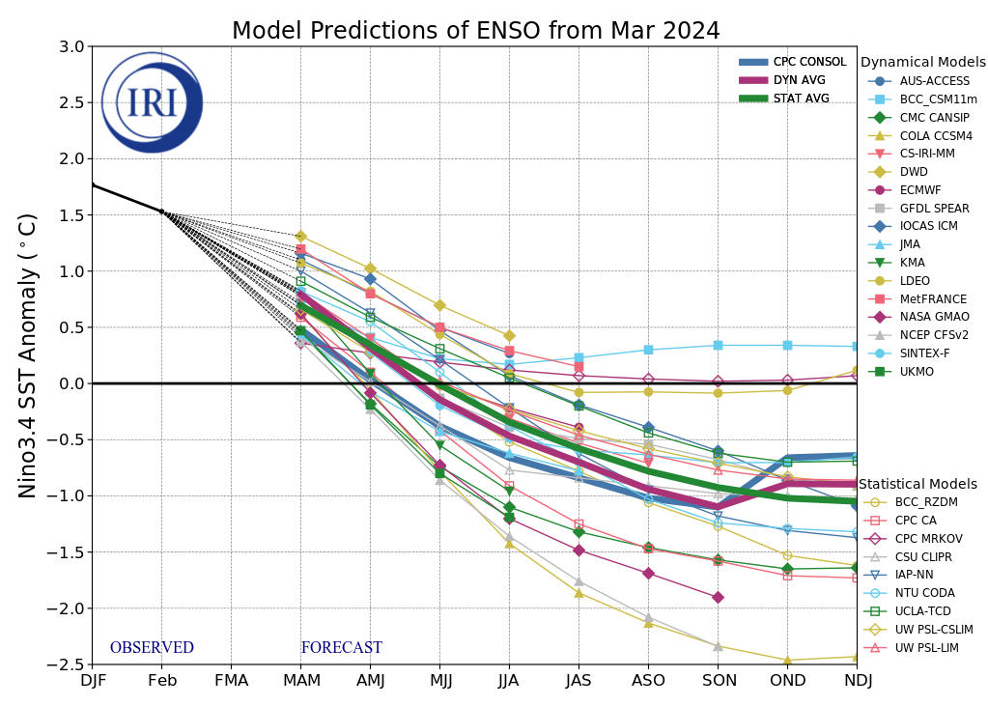
NINO3.4 Model Forecasts
Figure provided by the International Research Institute (IRI) for Climate and Society (updated 19 March 2024).
The majority of models indicate El Niño will persist through March-May 2024 and then transition to ENSO-neutral during April-June 2024.
After a brief period of ENSO-neutral conditions, most models indicate a transition to La Niña around July-September 2024.

Slide 6
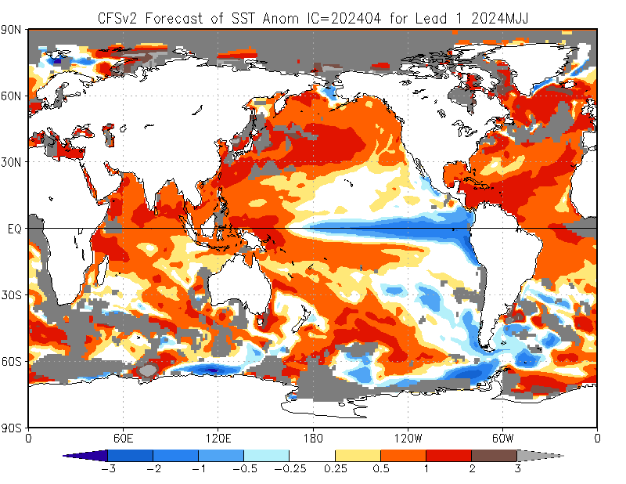
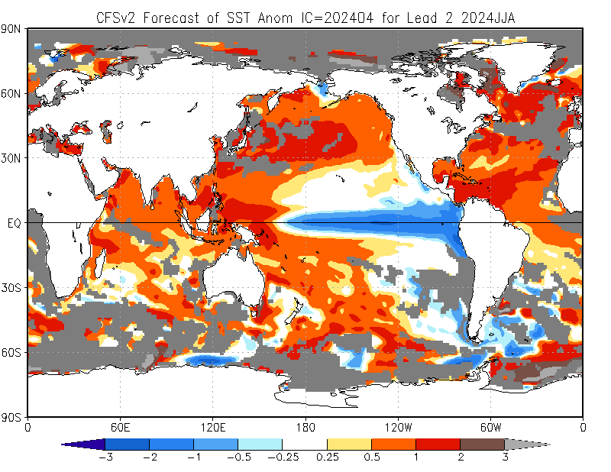
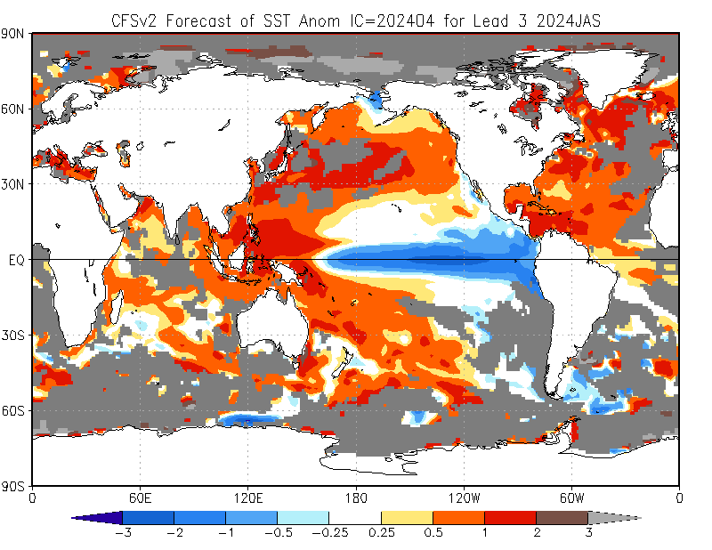
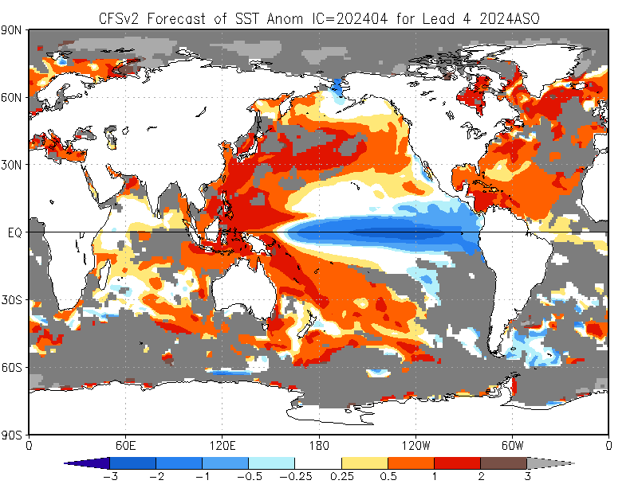
NCEP Climate Forecast System version 2 (CFSv2) SST Outlooks (skill masked)
(01 – 08 Apr 2024 IC)
The NCEP CFSv2 favors above-average SSTs over the equatorial western Pacific, and across the tropical Indian Ocean.
In contrast, the forecast favors below-average SSTs across the equatorial central and eastern Pacific.
May - Jul 2024
Jun - Aug 2024
Jul - Sep 2024
Aug - Oct 2024

Slide 7
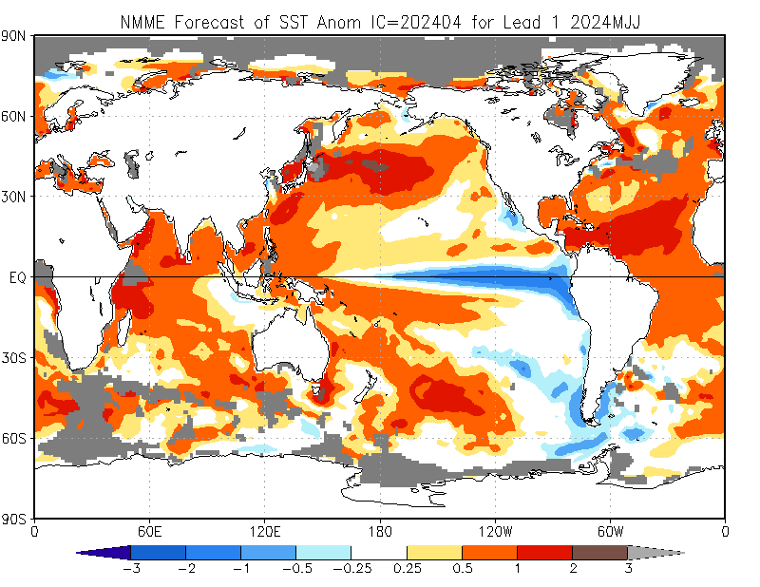
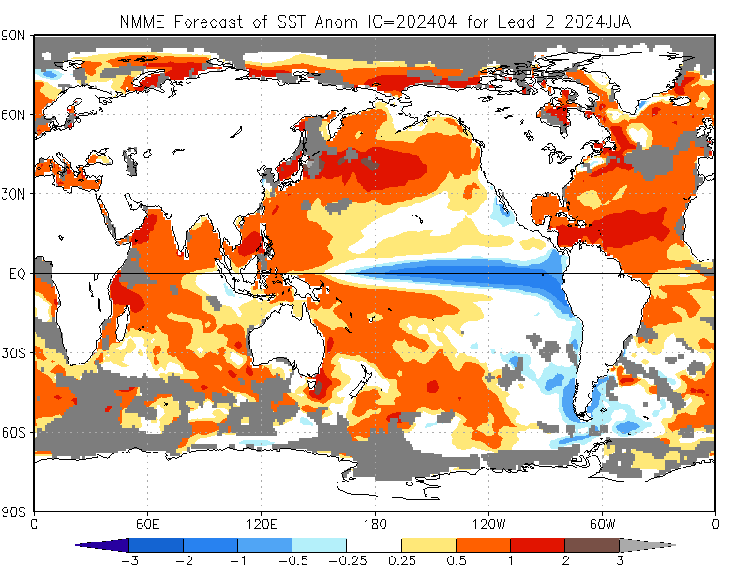
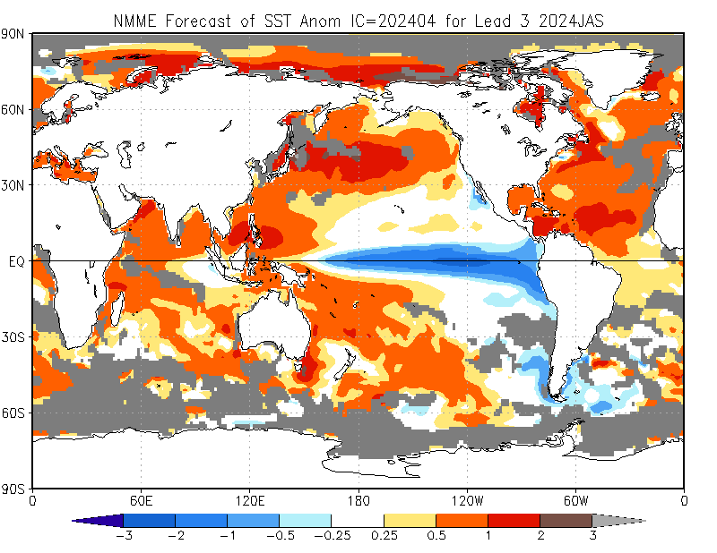
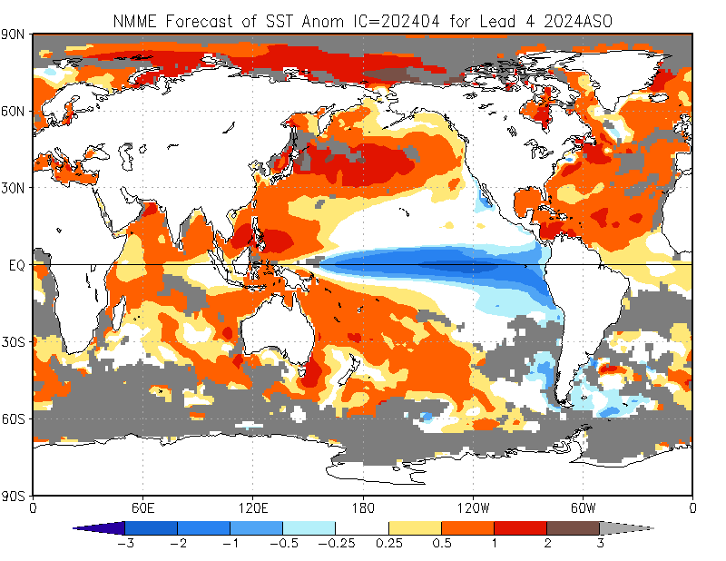
North American Multi-Model Ensemble (NMME) Global SST Outlook (skill masked)
(01 – 08 Apr 2024 IC)
May - Jul 2024
Jun - Aug 2024
The NMME forecasts are consistent with those of the CFSv2.
Jul - Sep 2024
Aug - Oct 2024

Slide 8
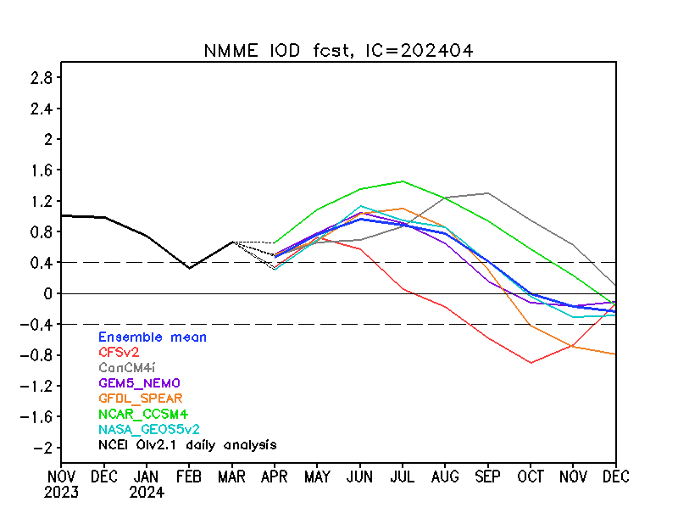
Indian Ocean Dipole (IOD) Outlook
NMME forecasts indicate an increased chance for positive IOD through the northern hemisphere summer 2024.

Slide 9
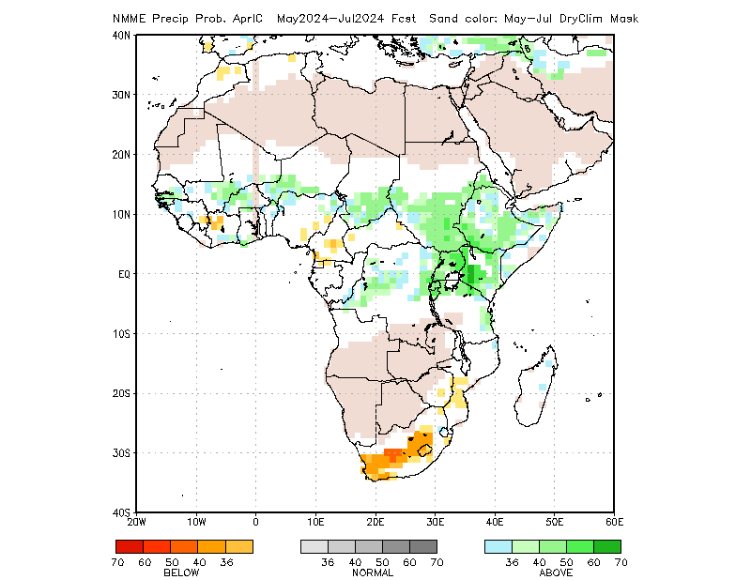
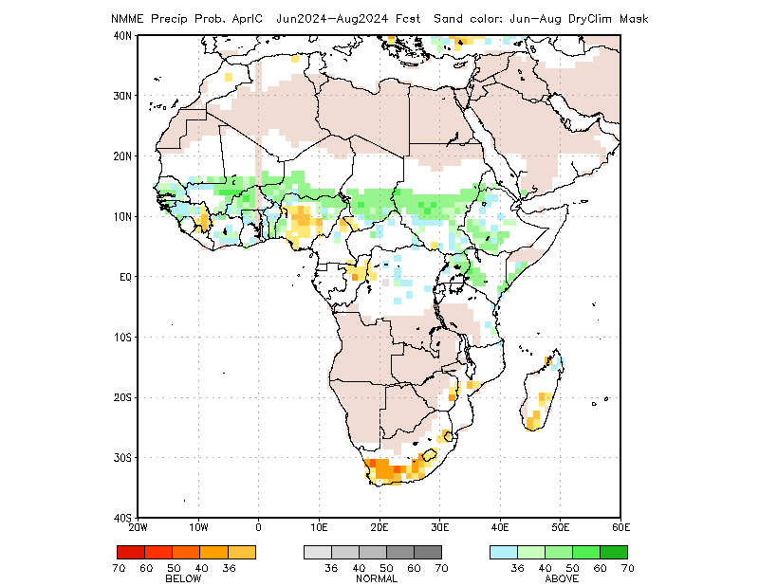
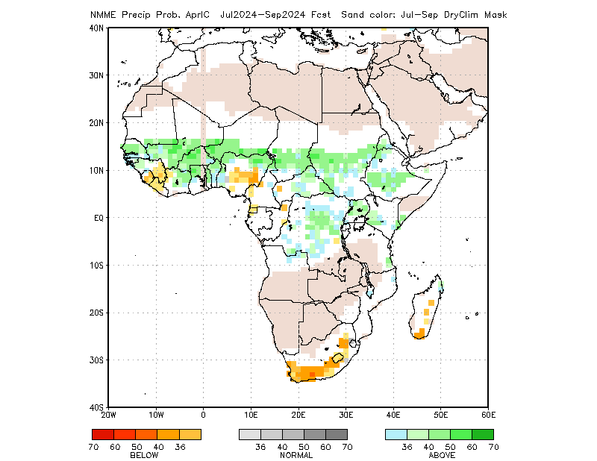
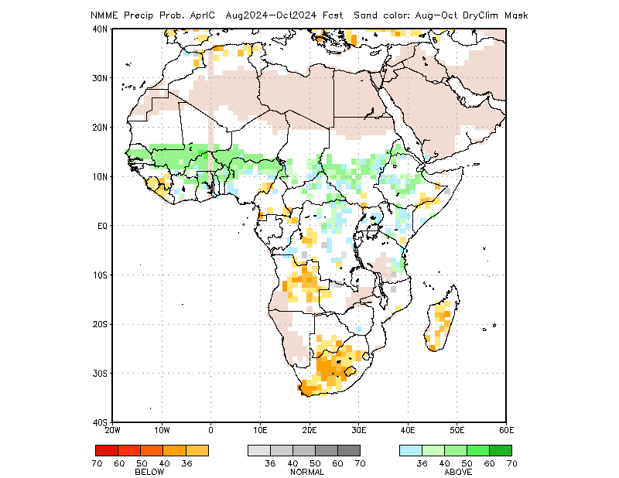
Rainfall Guidance, Africa: North American Multi-Model Ensemble (NMME)
(01 – 08 Apr 2024 IC)
Sand shade indicates indicate dry climatological mask. White areas show where no one class is dominant: either all terciles are under 36%, or both A and B are over 36% (http://www.cpc.ncep.noaa.gov/products/NMME/NMME_PROB_descr.html).
May - Jul 2024
Jun - Aug 2024
The forecasts call for a slight to moderate tilt in the odds to favor above-average rainfall over many places in the Sahel region, and Sudan, South Sudan, Eritrea, Ethiopia, Uganda, Kenya, northern Tanzania, Rwanda, Burundi, and parts of DRC.
There is a slight to moderate tilt in the odds to favor below-average rainfall over portions of the Gulf of Guinea region, and South Africa, Lesotho and Eswatini.
Jul - Sep 2024
Aug - Oct 2024
Individual model forecasts can be found here:
http://www.cpc.ncep.noaa.gov/products/international/nmme/nmme.shtml

Slide 10
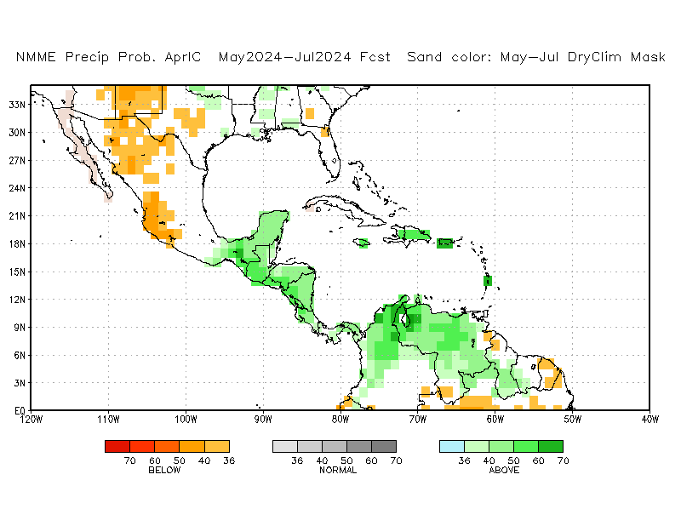
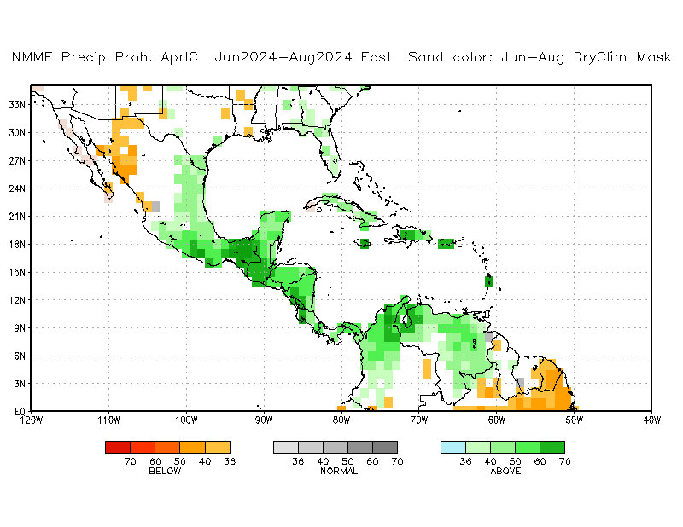
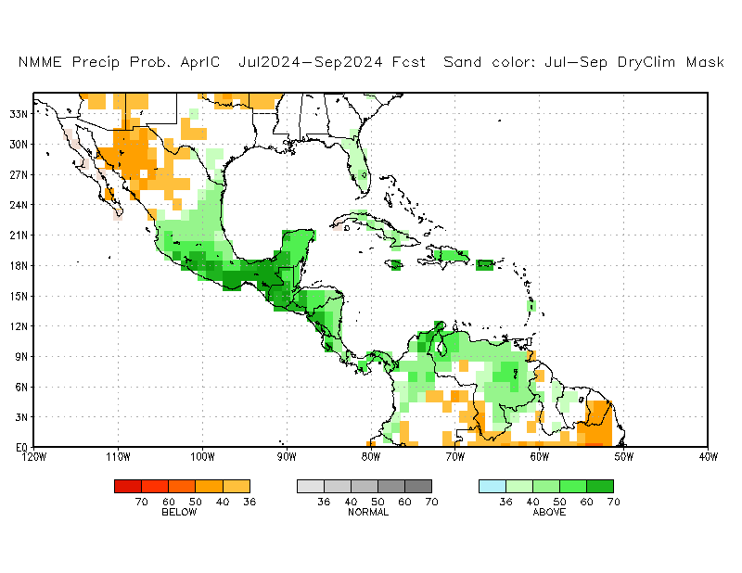
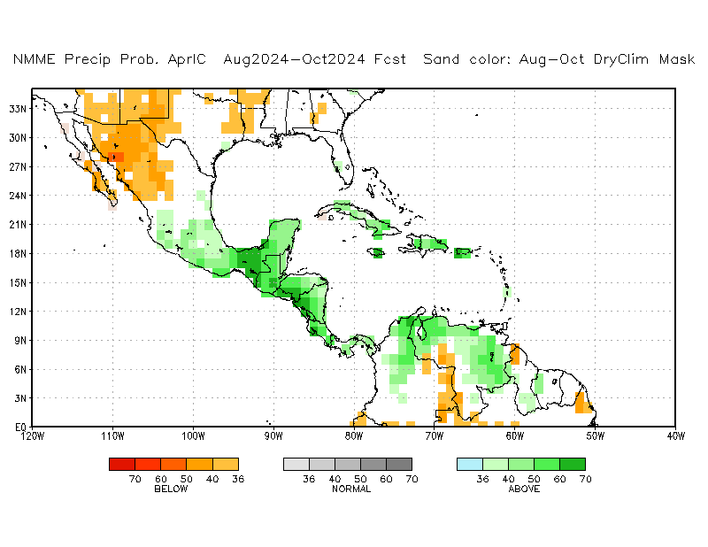
Rainfall Guidance, CAM and Caribbean: North American Multi-Model Ensemble (NMME)
(01 – 08 Apr 2024 IC)
Sand shade indicates indicate dry climatological mask. White areas show where no one class is dominant: either all terciles are under 36%, or both A and B are over 36% (http://www.cpc.ncep.noaa.gov/products/NMME/NMME_PROB_descr.html).
May - Jul 2024
Jun - Aug 2024
There is a slight to moderate tilt in the odds to favor below-average rainfall over the northern portion of Mexico.
There is a moderate to high tilt in the odds to favor above-average rainfall over much of Central America and the Caribbean.
Jul - Sep 2024
Aug - Oct 2024
Individual model forecasts can be found here:
http://www.cpc.ncep.noaa.gov/products/international/nmme/nmme.shtml

Slide 11
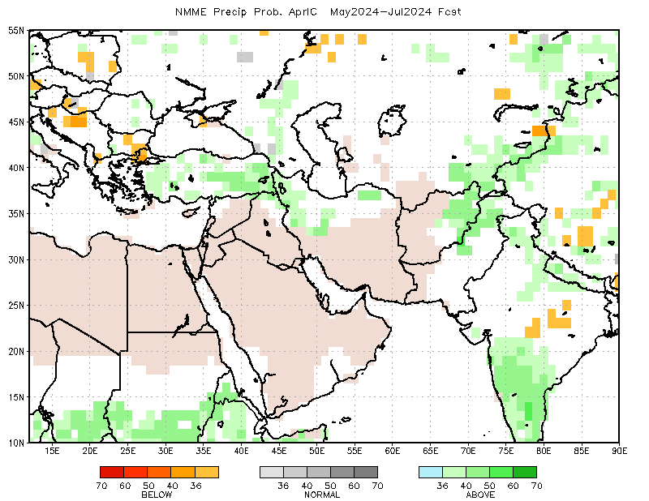
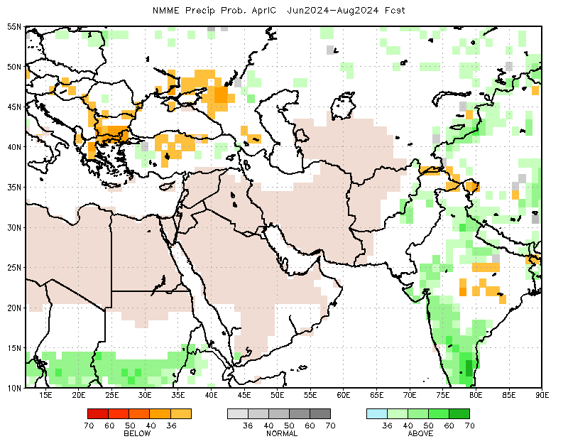
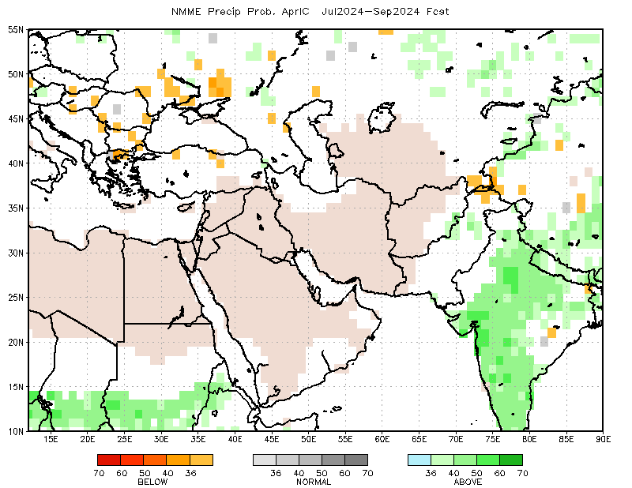
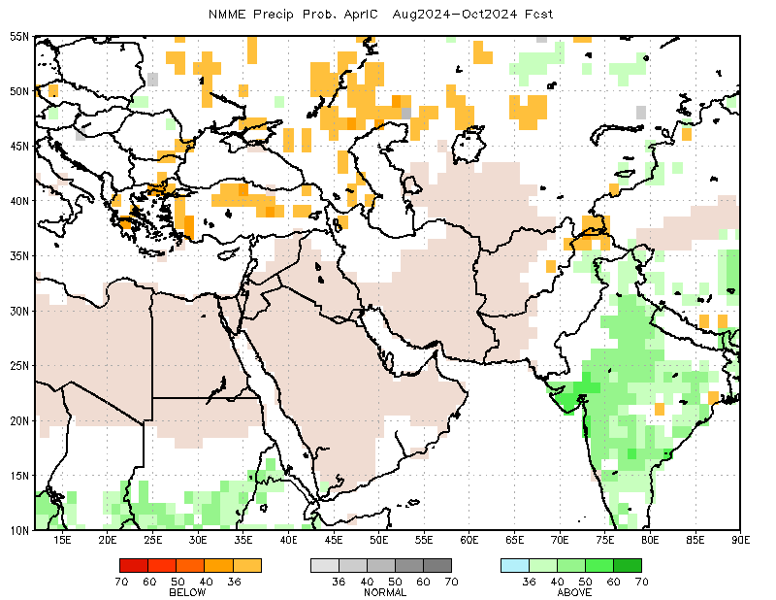
Rainfall Guidance, Central Asia: North American Multi-Model Ensemble (NMME)
(01 – 08 Apr 2024 IC)
Sand shade indicates indicate dry climatological mask. White areas show where no one class is dominant: either all terciles are under 36%, or both A and B are over 36% (http://www.cpc.ncep.noaa.gov/products/NMME/NMME_PROB_descr.html).
May - Jul 2024
Jun - Aug 2024
There is a slight to moderate tilt in the odds to favor above-average rainfall across eastern Afghanistan and Pakistan through the northern hemisphere early summer 2024.
There is a slight tilt in the odds to favor below-average rainfall over he northern portion of Central Asia during the northern hemisphere summer 2024.
Jul - Sep 2024
Aug - Oct 2024
Individual model and forecasts can be found here:
http://www.cpc.ncep.noaa.gov/products/international/nmme/nmme.shtml

Slide 12
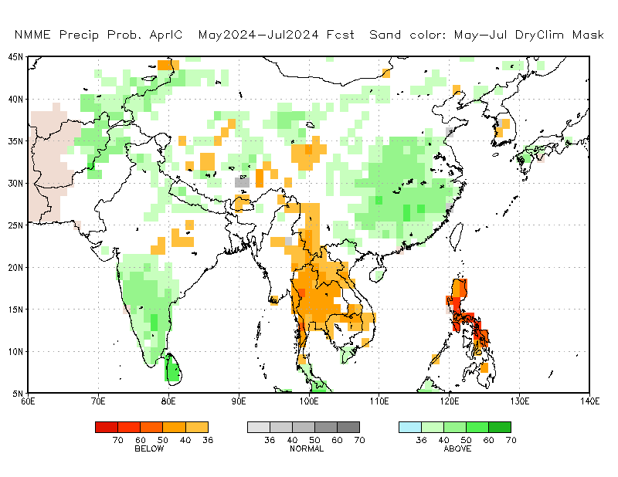
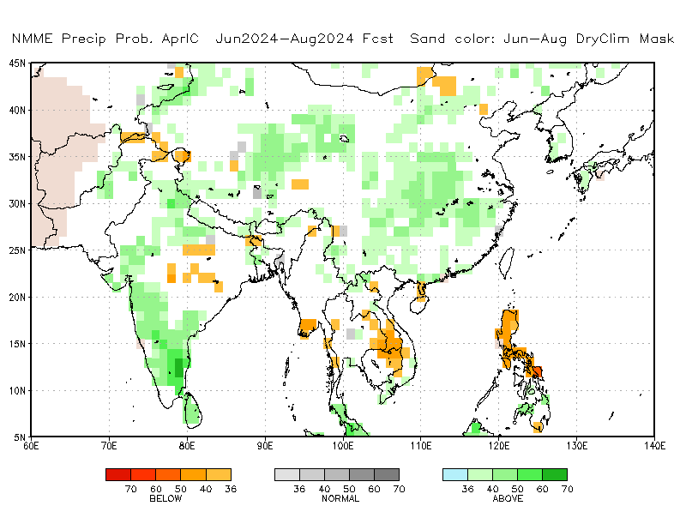
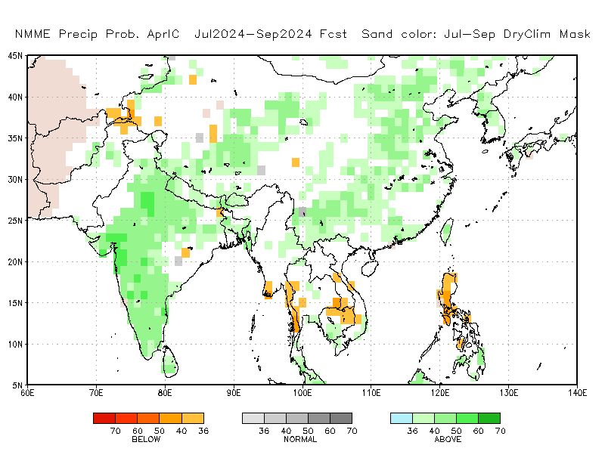
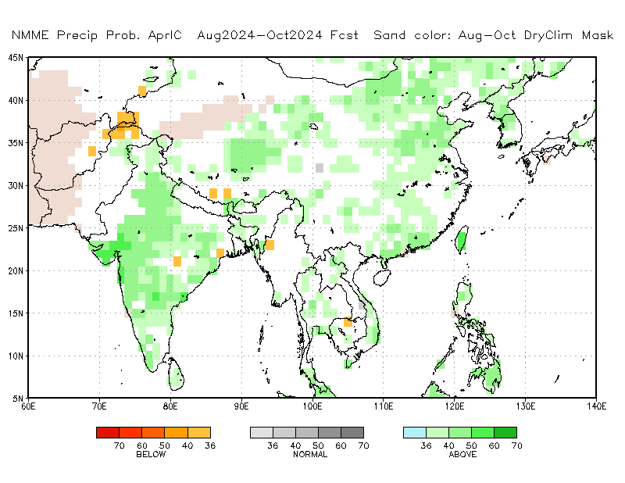
Rainfall Guidance, South Asia: North American Multi-Model Ensemble (NMME)
(01 – 08 Apr 2024 IC)
Sand shade indicates indicate dry climatological mask. White areas show where no one class is dominant: either all terciles are under 36%, or both A and B are over 36% (http://www.cpc.ncep.noaa.gov/products/NMME/NMME_PROB_descr.html).
May - Jul 2024
Jun - Aug 2024
There is a slight to moderate tilt in the odds to favor above-average rainfall over many parts of India and China.
There is a slight to moderate tilt in the odds to favor below-average rainfall over parts of Southeast Asia.
Feb – Mar 2024
Aug - Oct 2024
Individual model forecasts can be found here:
http://www.cpc.ncep.noaa.gov/products/international/nmme/nmme.shtml

Slide 13
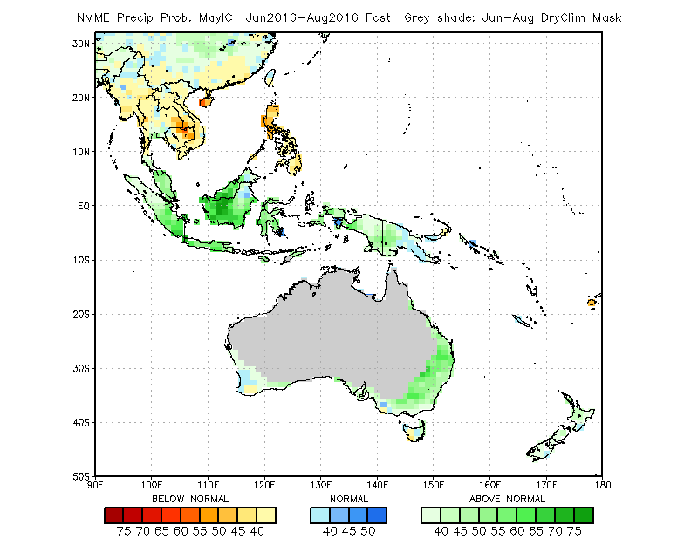
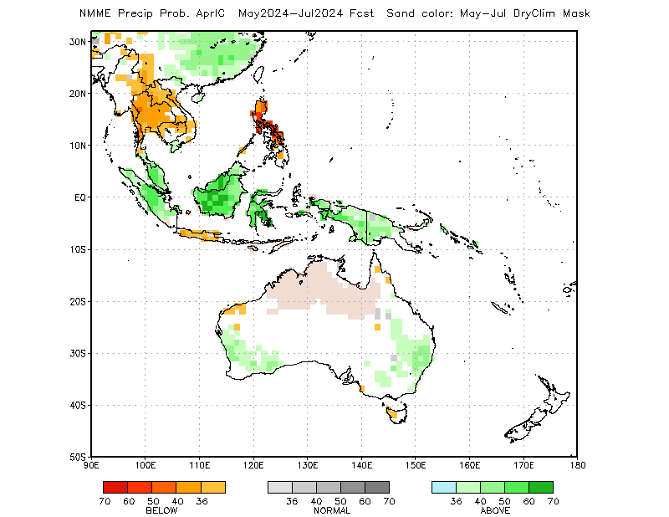
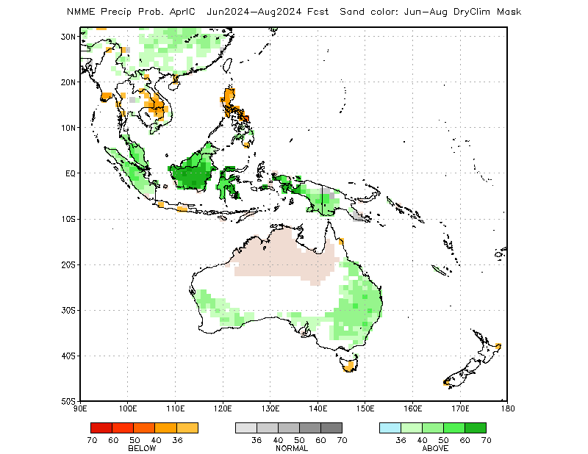
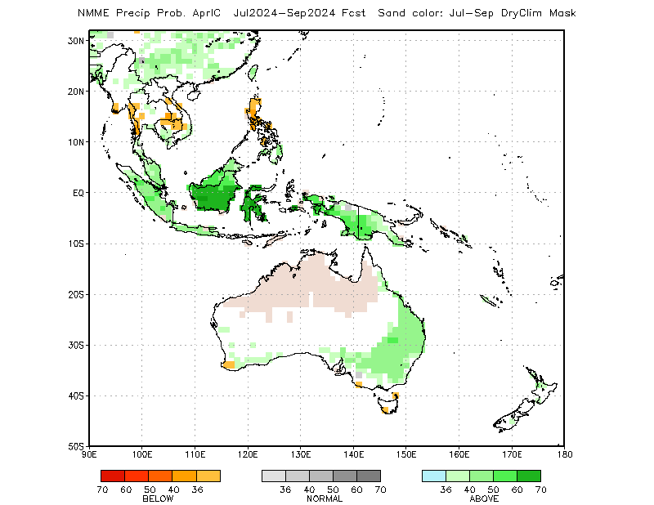
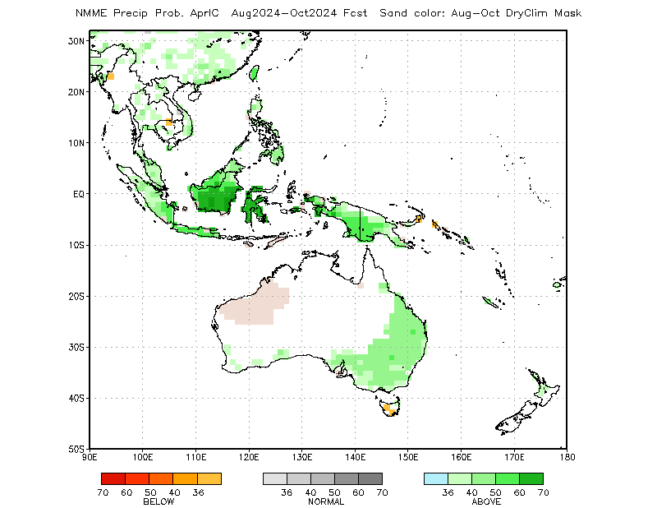
Rainfall Guidance, Maritime Continent: North American Multi-Model Ensemble (NMME)
(01 – 08 Apr 2024 IC)
Sand shade indicates indicate dry climatological mask. White areas show where no one class is dominant: either all terciles are under 36%, or both A and B are over 36% (http://www.cpc.ncep.noaa.gov/products/NMME/NMME_PROB_descr.html).
May - Jul 2024
Jun - Aug 2024
The forecasts call for a slight to moderate tilt in the odds to favor below-average rainfall over the Philippines through the northern hemisphere early summer 2024.
The forecasts call for a slight to moderate tilt in the odds to favor above-average rainfall over many places in the Maritime Continent region, including Australia.
Jul - Sep 2024
Aug - Oct 2024
Individual model forecasts can be found here:
http://www.cpc.ncep.noaa.gov/products/international/nmme/nmme.shtml

Slide 14
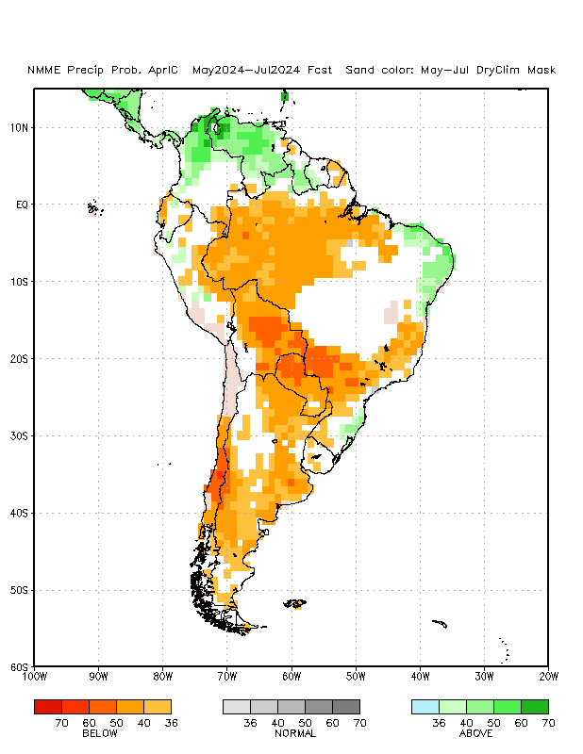
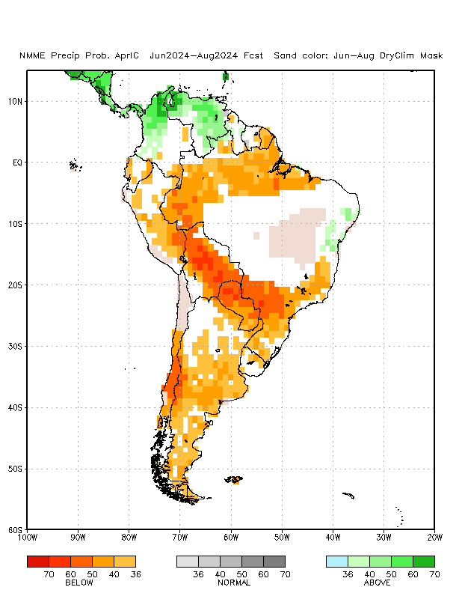
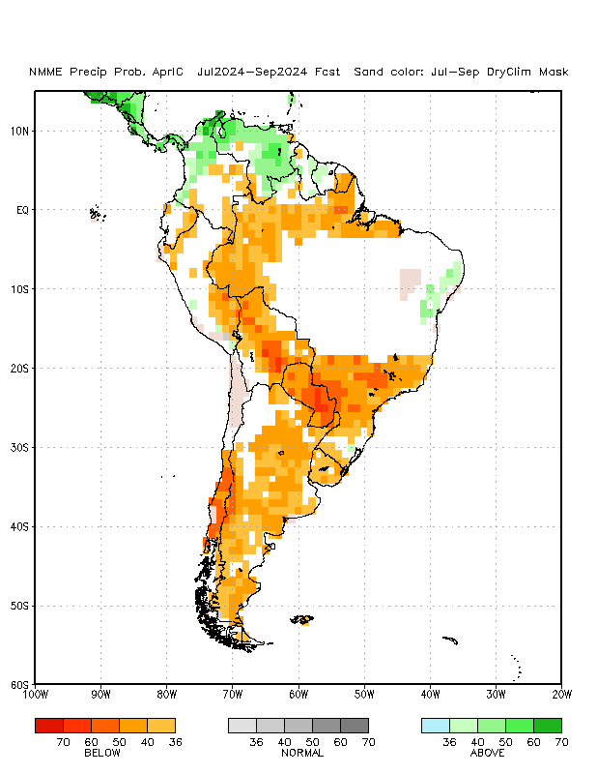
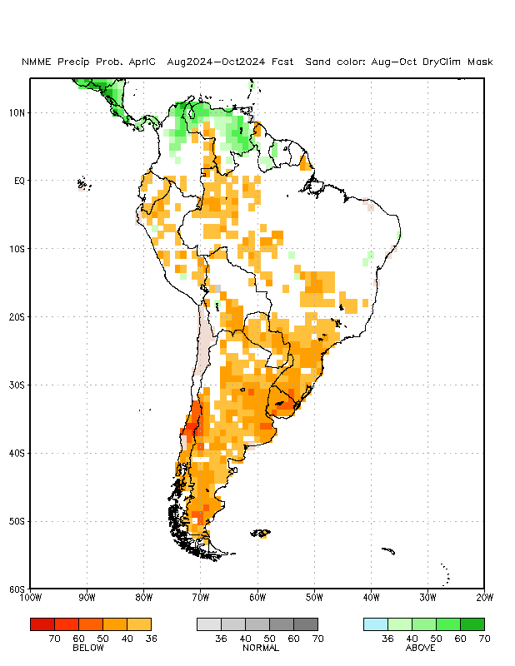
Rainfall Guidance, South America: North American Multi-Model Ensemble (NMME)
(01 – 08 Apr 2024 IC)
Sand shade indicates indicate dry climatological mask. White areas show where no one class is dominant: either all terciles are under 36%, or both A and B are over 36% (http://www.cpc.ncep.noaa.gov/products/NMME/NMME_PROB_descr.html).
May - Jul 2024
Jun - Aug 2024
There is a slight tilt in the odds to favor above-average rainfall over the far northern parts of South America.
The forecasts call for a moderate to high tilt in the odds to favor below-average rainfall over parts of northern, central and southern South America.
Jul - Sep 2024
Aug - Oct 2024
Individual model forecasts can be found here:
http://www.cpc.ncep.noaa.gov/products/international/nmme/nmme.shtml

Slide 15
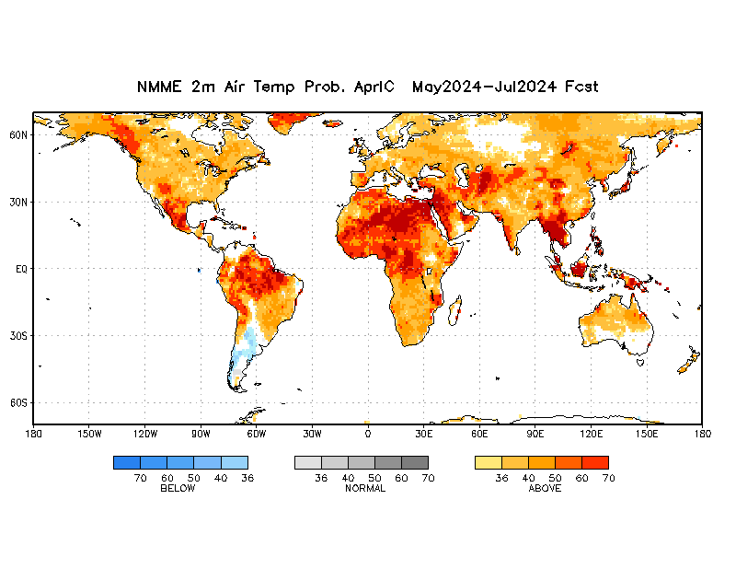
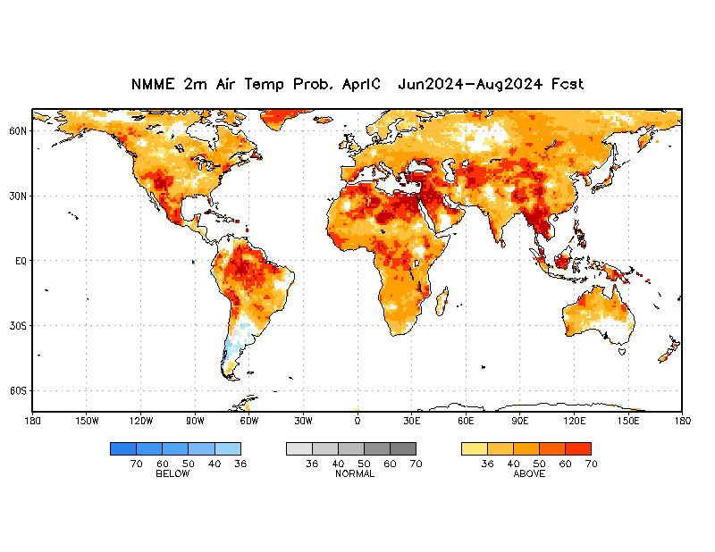
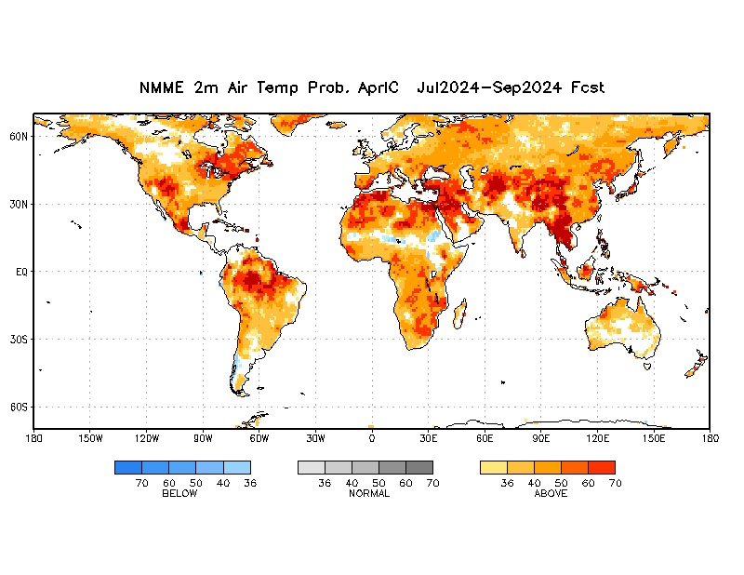
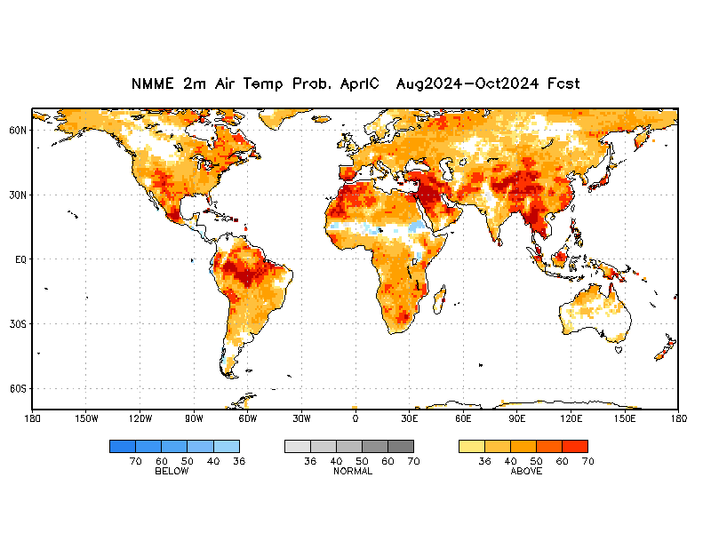
Air Temperature Guidance: North American Multi-Model Ensemble (NMME)
(01 – 08 Apr 2024 IC)
May - Jul 2024
Jun - Aug 2024
Jul - Sep 2024
Aug - Oct 2024
The forecasts call for a moderate to high tilt in the odds to favor above-average temperatures over much of the Globe. There is a tilt in the odds to favor below-average temperature in the Sahel region of Africa during the NH summer.
Individual model forecasts can be found here: http://www.cpc.ncep.noaa.gov/products/international/nmme/nmme.shtml

Slide 16
Summary
A transition from El Niño to ENSO-neutral is likely by April-June 2024 (85% chance), with the odds of La Niña developing by June-August 2024 (60% chance).
Model forecasts indicate an increased chance for positive IOD through the northern hemisphere summer 2024.
The NMME forecasts favor a slight to moderate chance for above-average rainfall the Sahel region and Eastern Africa, Central Asia, Central America and parts of the Maritime Continent region.
The forecasts call for an increased chance for below-average rainfall over parts of South Africa, and much of South America.
There is a moderate to high chance for temperatures to trend upward across much of the Globe.
Additional forecast resources can be found here:
http://www.cpc.ncep.noaa.gov/products/international/index.shtml
http://www.cpc.ncep.noaa.gov/products/international/nmme/nmme.shtml
http://origin.cpc.ncep.noaa.gov/products/people/wwang/cfsv2fcst/

Slide 17
CPC ENSO Update
CPC ENSO Alert System Status El Niño Advisory / La Niña Watch
Synopsis: A transition from El Niño to ENSO-neutral is likely by April-June 2024 (83% chance), with the odds of La Niña developing by June-August 2024 (62% chance). (Updated 14 March 2024).
http://www.cpc.ncep.noaa.gov/products/analysis_monitoring/enso_advisory/ensodisc.shtml

Slide 18
Summary of State of the Global Climate in February 2024
During February 2024, sea surface temperature (SST) anomalies continued to weaken across most of the equatorial Pacific Ocean.
In the last week, below-average SSTs emerged in a small region of the eastern equatorial Pacific Ocean.
The weekly Niño indices weakened but remained positive, with the latest value in Niño-3.4 standing at 1.4°C.
Area-averaged subsurface temperature anomalies were slightly negative.
Collectively, the coupled ocean-atmosphere system reflected a weakening El Niño.
The Indian Ocean Dipole Index remained in the neutral range in late February and early March 2024.
Suppressed precipitation was observed over much of Southern Africa and the Maritime Continent region, and parts of northern South America.
Enhanced precipitation was evident near the Date Line.

Slide 19
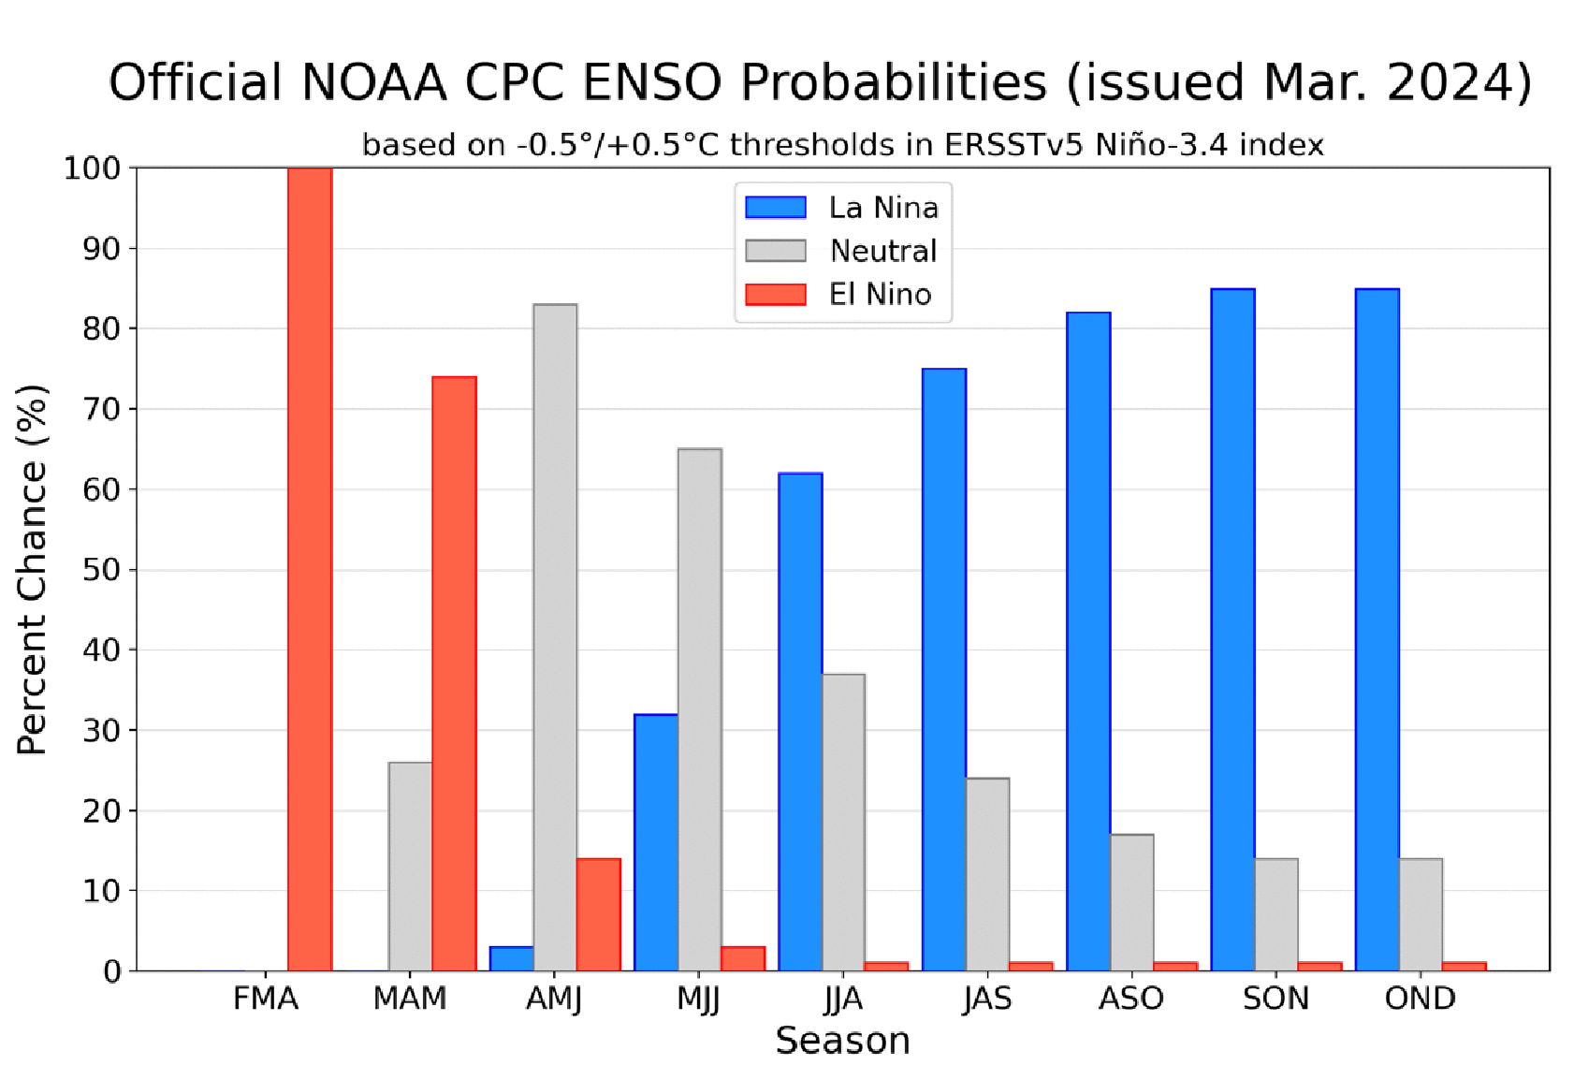
CPC/IRI OFFICIAL NIŇO3.4 Forecast
Season | La Niña | Neutral | El Niño
FMA | 0 | 0 | 100
MAM | 0 | 26 | 74
AMJ | 3 | 83 | 14
MJJ | 32 | 65 | 3
JJA | 62 | 37 | 1
JAS | 75 | 24 | 1
ASO | 82 | 17 | 1
SON | 85 | 14 | 1
OND | 85 | 14 | 1
A transition from El Niño to ENSO-neutral is likely by April-June 2024 (83% chance), with the odds of La Niña developing by June-August 2024 (62% chance).

Slide 20
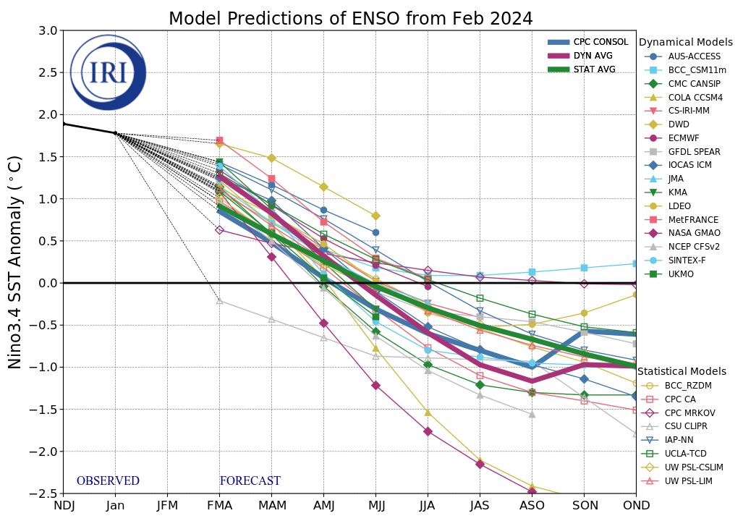
NINO3.4 Model Forecasts
Figure provided by the International Research Institute (IRI) for Climate and Society (updated 19 February 2024).
The majority of models indicate El Niño will persist through March-May 2024 and then transition to ENSO-neutral during April-June 2024.
After a brief period of ENSO-neutral conditions, most models indicate a transition to La Niña around June-August 2024.

Slide 21
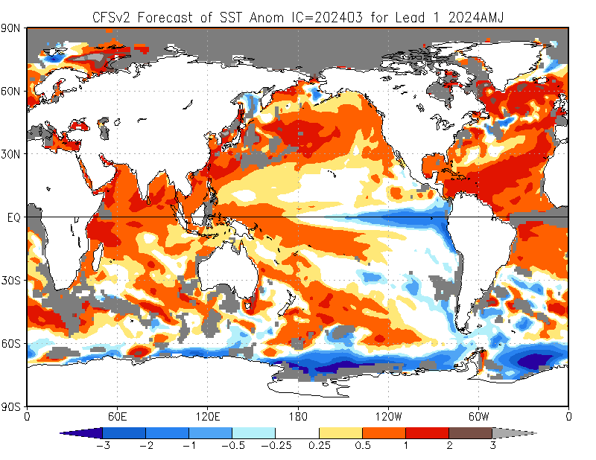
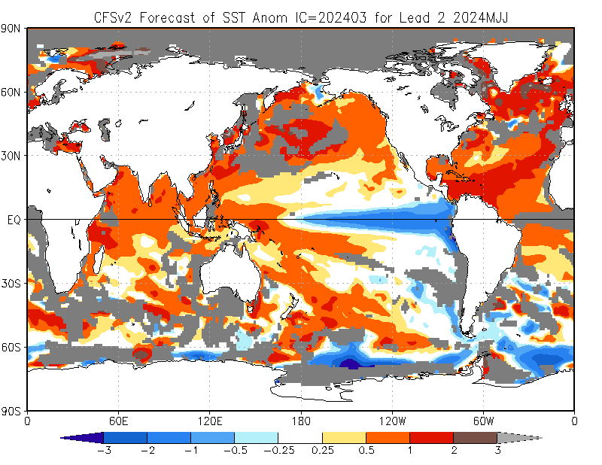
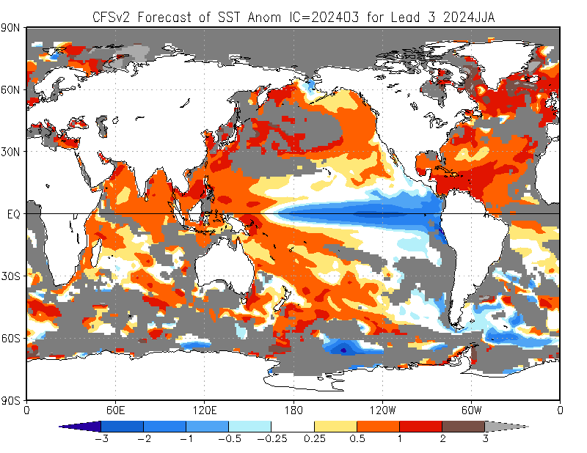
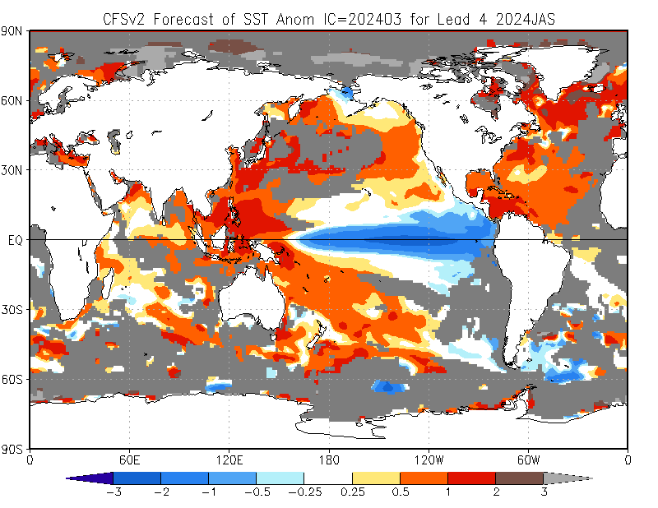
NCEP Climate Forecast System version 2 (CFSv2) SST Outlooks (skill masked)
(01 – 08 Mar 2024 IC)
The NCEP CFSv2 favors above-average SSTs across the equatorial western Pacific, and across the tropical Indian Ocean.
In contrast, the forecast favors below-average SSTs across the equatorial central and eastern Pacific through the northern hemisphere summer 2024.
Apr - Jun 2024
May - Jul 2024
Jun - Aug 2024
Jul - Sep 2024

Slide 22
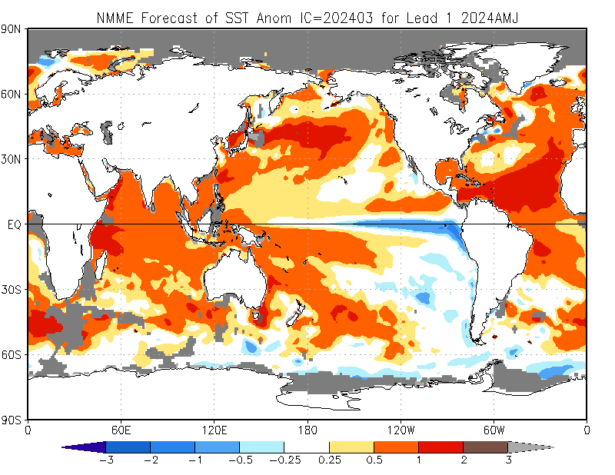
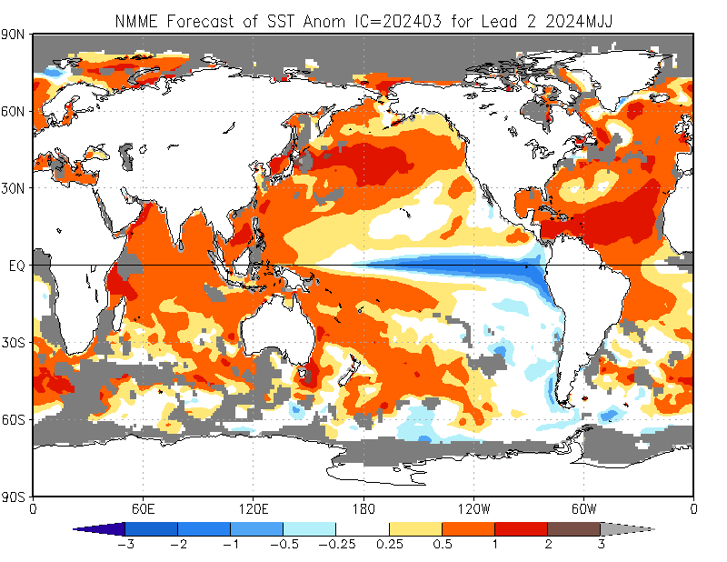
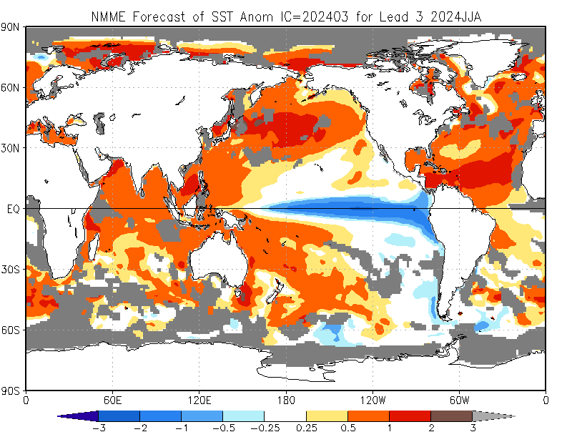
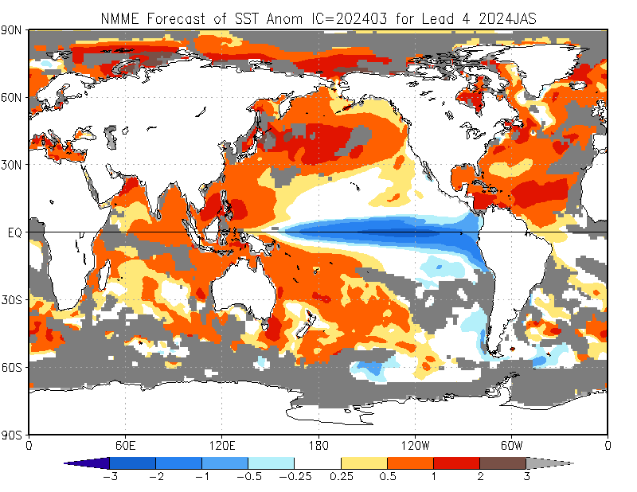
North American Multi-Model Ensemble (NMME) Global SST Outlook (skill masked)
(01 – 08 Mar 2024 IC)
Apr - Jun 2024
May - Jul 2024
The NMME forecasts are consistent with those of the CFSv2.
Jun - Aug 2024
Jul - Sep 2024

Slide 23
Indian Ocean Dipole (IOD) Outlook
NMME forecasts indicate the IOD index to remain in the neutral range through the northern hemisphere spring, and a slightly increased chance for negative IOD in late summer and autumn 2024.

Slide 24
Rainfall Guidance, Africa: North American Multi-Model Ensemble (NMME)
(01 – 08 Mar 2024 IC)
Sand shade indicates indicate dry climatological mask. White areas show where no one class is dominant: either all terciles are under 36%, or both A and B are over 36% (http://www.cpc.ncep.noaa.gov/products/NMME/NMME_PROB_descr.html).
Apr - Jun 2024
May - Jul 2024
The forecasts call for a slight to moderate tilt in the odds to favor above-average rainfall across much of the Greater Horn of Africa through the Northern Hemisphere spring 2024. There is also a slight to moderate tilt in the odds to favor above-average rainfall over many places in the Sahel region, including Sudan and western Ethiopia during the NH summer 2024.
There is a slight to moderate tilt in the odds to favor below-average rainfall over portions of Southern Africa through the northern hemisphere spring 2024. There is also a tilt in the odds to favor below-average rainfall over parts of the Gulf of Guinea region.
Jun - Aug 2024
Jul - Sep 2024
Individual model forecasts can be found here:
http://www.cpc.ncep.noaa.gov/products/international/nmme/nmme.shtml

Slide 25
Rainfall Guidance, CAM and Caribbean: North American Multi-Model Ensemble (NMME)
(01 – 08 Mar 2024 IC)
Sand shade indicates indicate dry climatological mask. White areas show where no one class is dominant: either all terciles are under 36%, or both A and B are over 36% (http://www.cpc.ncep.noaa.gov/products/NMME/NMME_PROB_descr.html).
Apr - Jun 2024
May - Jul 2024
There is a slight to moderate tilt in the odds to favor below-average rainfall over parts of Mexico during the NH spring 2024.
There is a slight to moderate tilt in the odds to favor above-average rainfall over much of Central America and the Caribbean.
Jun - Aug 2024
Jul - Sep 2024
Individual model forecasts can be found here:
http://www.cpc.ncep.noaa.gov/products/international/nmme/nmme.shtml

Slide 26
Rainfall Guidance, Central Asia: North American Multi-Model Ensemble (NMME)
(01 – 08 Mar 2024 IC)
Sand shade indicates indicate dry climatological mask. White areas show where no one class is dominant: either all terciles are under 36%, or both A and B are over 36% (http://www.cpc.ncep.noaa.gov/products/NMME/NMME_PROB_descr.html).
Apr - Jun 2024
May - Jul 2024
There is a slight to moderate tilt in the odds to favor above-average rainfall over many places in Central Asia during the northern hemisphere spring 2024.
Jun - Aug 2024
Jul - Sep 2024
Individual model and forecasts can be found here:
http://www.cpc.ncep.noaa.gov/products/international/nmme/nmme.shtml

Slide 27
Rainfall Guidance, South Asia: North American Multi-Model Ensemble (NMME)
(01 – 08 Mar 2024 IC)
Sand shade indicates indicate dry climatological mask. White areas show where no one class is dominant: either all terciles are under 36%, or both A and B are over 36% (http://www.cpc.ncep.noaa.gov/products/NMME/NMME_PROB_descr.html).
Apr - Jun 2024
May - Jul 2024
There is a slight to moderate tilt in the odds to favor above-average rainfall over many parts of China.
There is a slight to moderate tilt in the odds to favor below-average rainfall over parts of Southeast Asia.
Feb – Mar 2024
Jul - Sep 2024
Individual model forecasts can be found here:
http://www.cpc.ncep.noaa.gov/products/international/nmme/nmme.shtml

Slide 28
Rainfall Guidance, Maritime Continent: North American Multi-Model Ensemble (NMME)
(01 – 08 Mar 2024 IC)
Sand shade indicates indicate dry climatological mask. White areas show where no one class is dominant: either all terciles are under 36%, or both A and B are over 36% (http://www.cpc.ncep.noaa.gov/products/NMME/NMME_PROB_descr.html).
Apr - Jun 2024
May - Jul 2024
The forecasts call for a slight to moderate tilt in the odds to favor below-average rainfall over the Philippines through the northern hemisphere spring 2024.
The forecasts call for a slight to moderate tilt in the odds to favor above-average rainfall over many places in the Maritime Continent region during the northern hemisphere late spring and early summer 2024.
Jun - Aug 2024
Jul - Sep 2024
Individual model forecasts can be found here:
http://www.cpc.ncep.noaa.gov/products/international/nmme/nmme.shtml

Slide 29
Rainfall Guidance, South America: North American Multi-Model Ensemble (NMME)
(01 – 08 Mar 2024 IC)
Sand shade indicates indicate dry climatological mask. White areas show where no one class is dominant: either all terciles are under 36%, or both A and B are over 36% (http://www.cpc.ncep.noaa.gov/products/NMME/NMME_PROB_descr.html).
Apr - Jun 2024
May - Jul 2024
There is a slight tilt in the odds to favor above-average rainfall over the far northern parts of South America.
The forecasts call for a moderate to high tilt in the odds to favor below-average rainfall over parts of northern, central and southern South America.
Jun - Aug 2024
Jul - Sep 2024
Individual model forecasts can be found here:
http://www.cpc.ncep.noaa.gov/products/international/nmme/nmme.shtml

Slide 30
Air Temperature Guidance: North American Multi-Model Ensemble (NMME)
(01 – 08 Mar 2024 IC)
Apr - Jun 2024
May - Jul 2024
Jun - Aug 2024
Jul - Sep 2024
The forecasts call for a moderate to high tilt in the odds to favor above-average temperatures over much of the Globe. There is a tilt in the odds to favor below-average temperature in the Sahel region of Africa during the NH summer.
Individual model forecasts can be found here: http://www.cpc.ncep.noaa.gov/products/international/nmme/nmme.shtml

Slide 31
Summary
A transition from El Niño to ENSO-neutral is likely by April-June 2024 (83% chance), with the odds of La Niña developing by June-August 2024 (62% chance).
IOD index is expected to remain in the neutral range through the northern hemisphere spring.
The NMME forecasts favor a slight to moderate chance for above-average rainfall across the Greater Horn of Africa, the Sahel region, Central Asia, Central America and parts of the Maritime Continent region.
The forecasts call for an increased chance for below-average rainfall over parts of Southern Africa, and much of South America.
There is a moderate to high chance for temperatures to trend upward across much of the Globe.
Additional forecast resources can be found here:
http://www.cpc.ncep.noaa.gov/products/international/index.shtml
http://www.cpc.ncep.noaa.gov/products/international/nmme/nmme.shtml
http://origin.cpc.ncep.noaa.gov/products/people/wwang/cfsv2fcst/

